Slide 1
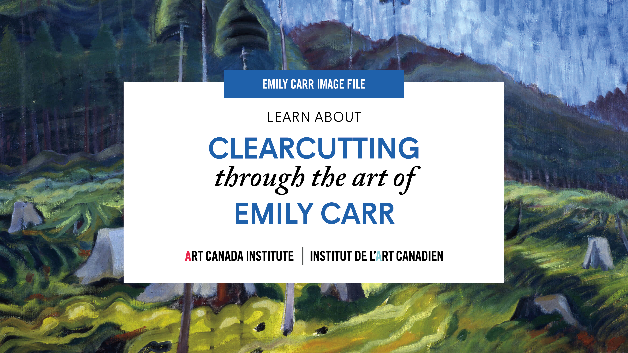

Slide 2
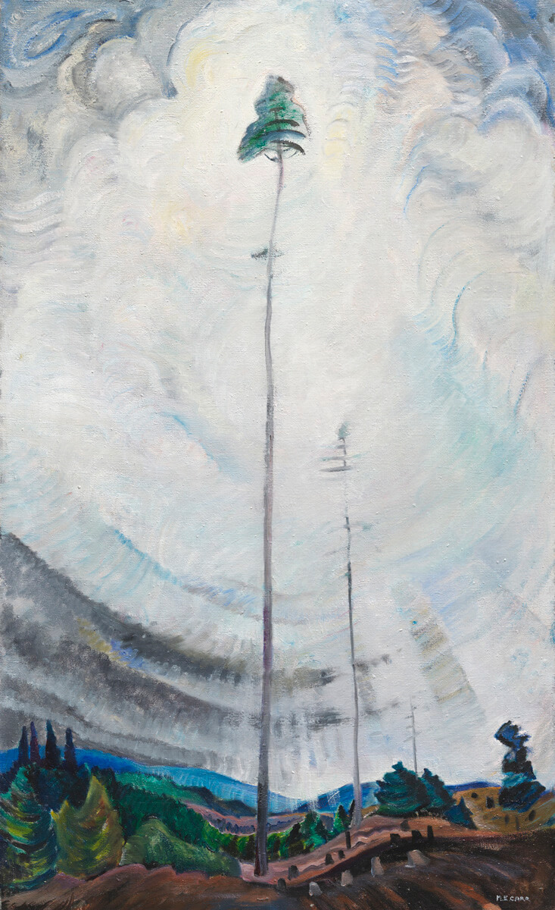
Emily Carr, Scorned as Timber, Beloved of the Sky, 1935. The few remaining trees in this work reach upwards to the sympathetic embrace of the sky.

Slide 3
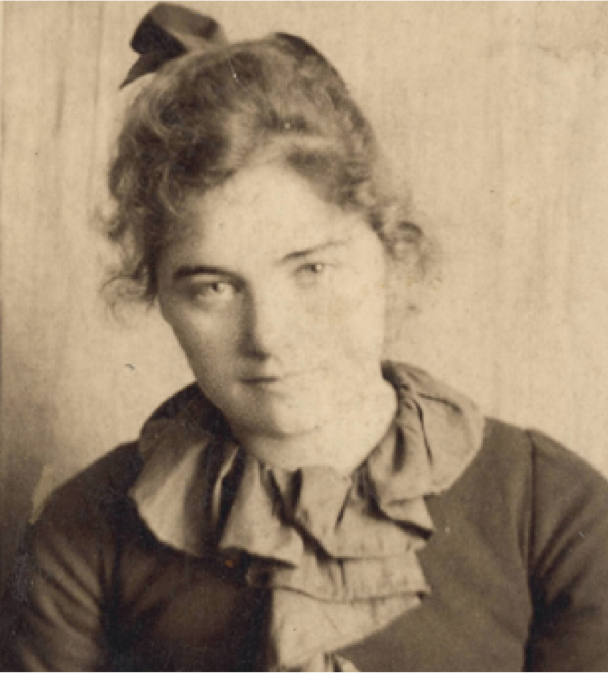
Emily Carr in San Francisco at age twenty-two, c.1893.

Slide 4
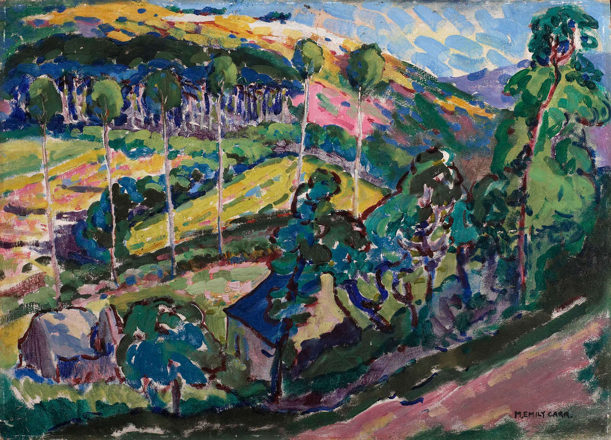
Emily Carr, Brittany Landscape, 1911. Carr’s travels in Europe informed her early, brightly coloured paintings of the landscape.

Slide 5
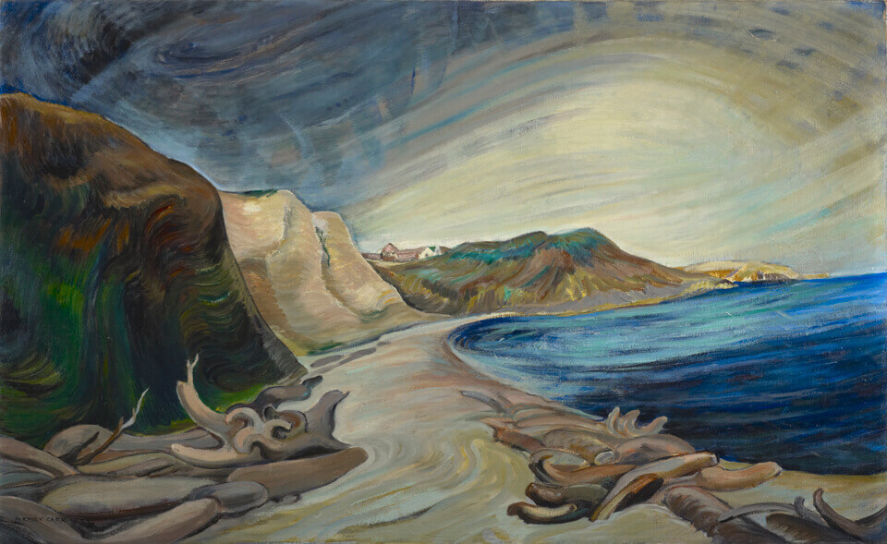
Emily Carr, Shoreline, 1936. During her life, Carr developed an important emotional and spiritual relationship with the landscape.

Slide 6
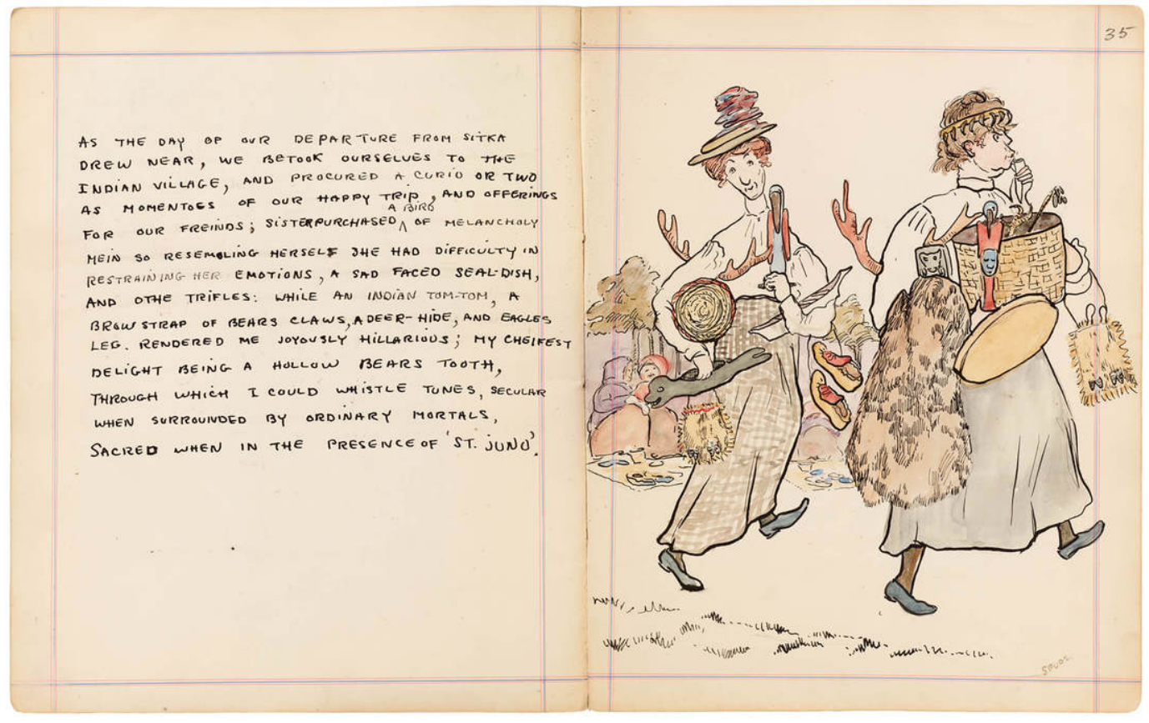
Emily Carr, Alaska Journal, page 35, 1907. In her journals Carr documented everything she experienced, through both words and detailed, often humorous, sketches.

Slide 7
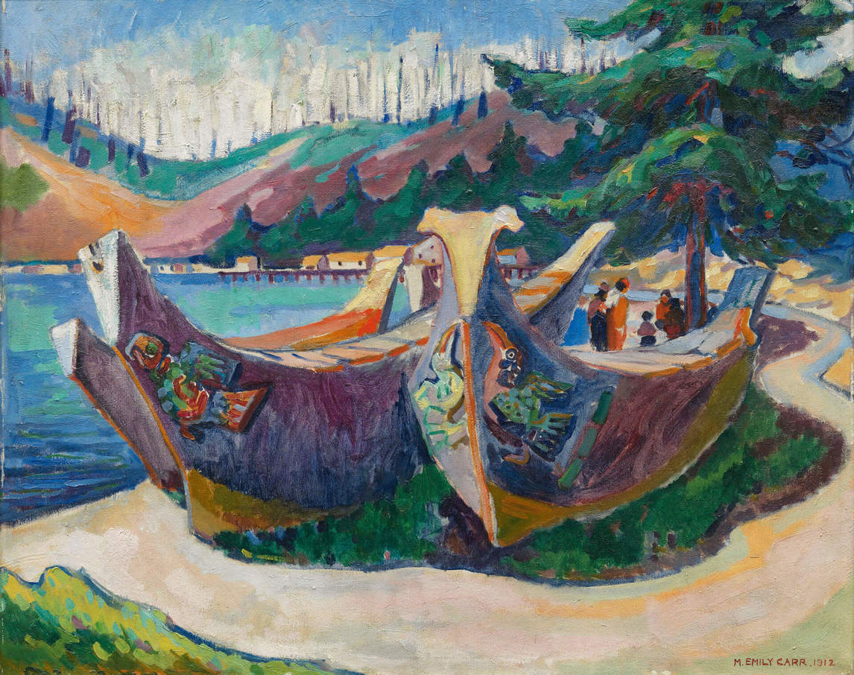
Emily Carr, War Canoes, Alert Bay, 1912. Carr spent many years in Indigenous communities, learning about their connection to the land.

Slide 8
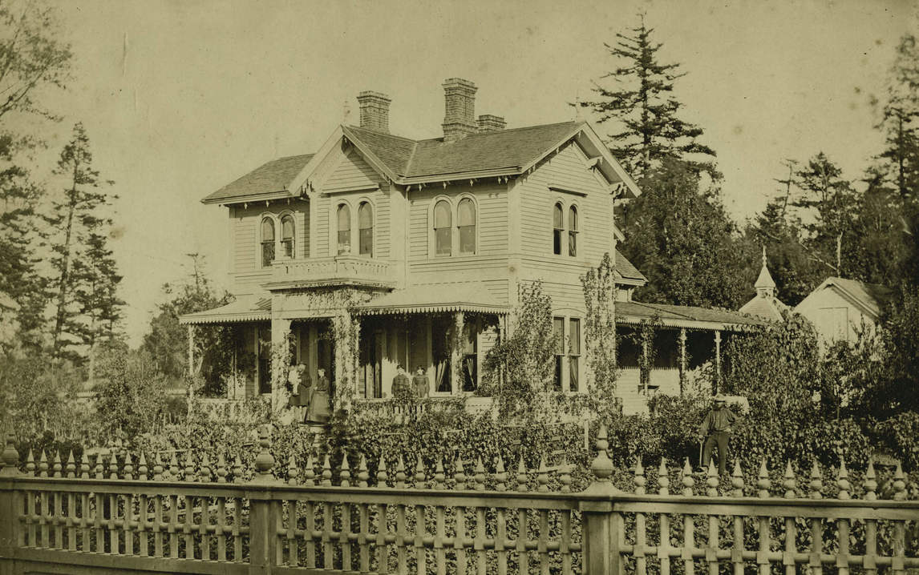
The Carr family home in Victoria.

Slide 9
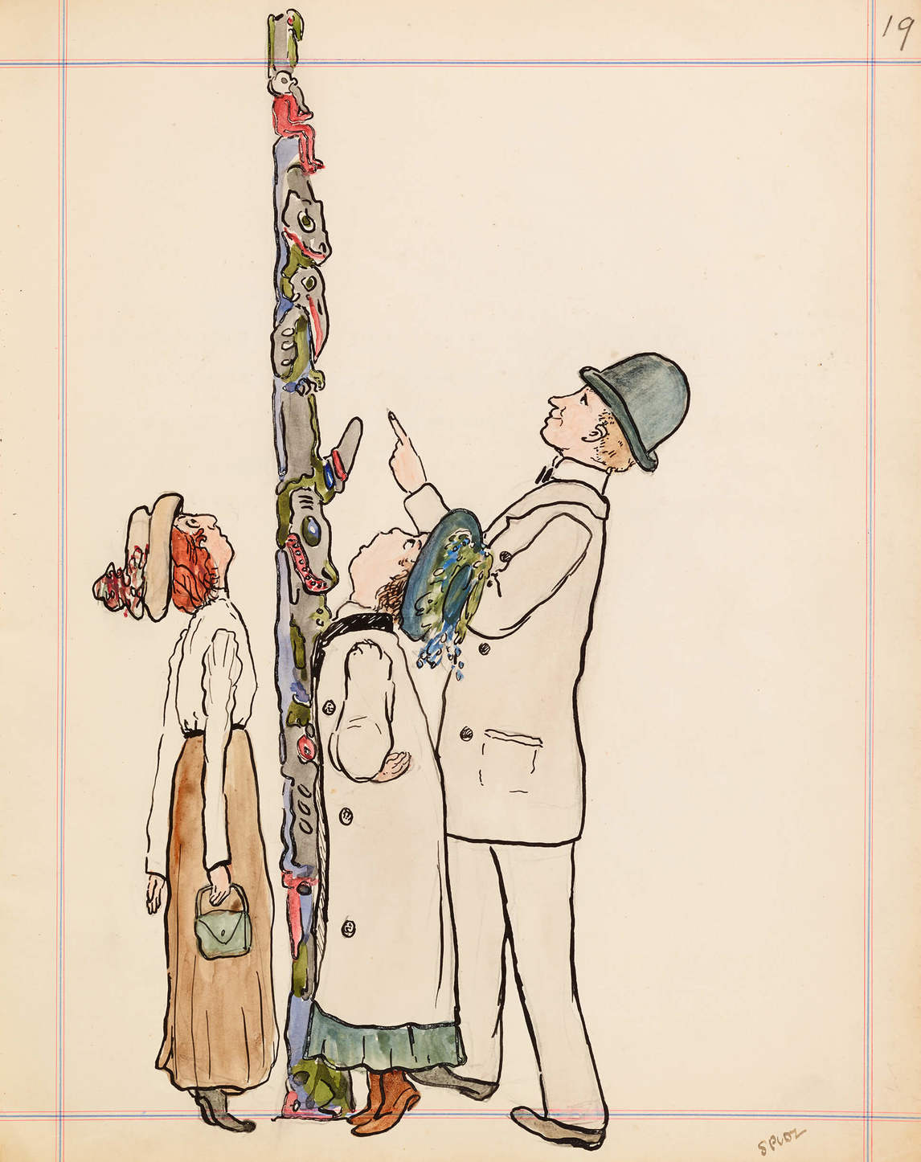
Emily Carr, Alaska Journal, 1907. This illustration shows the artist and her sister Alice, looking at a totem pole.

Slide 10
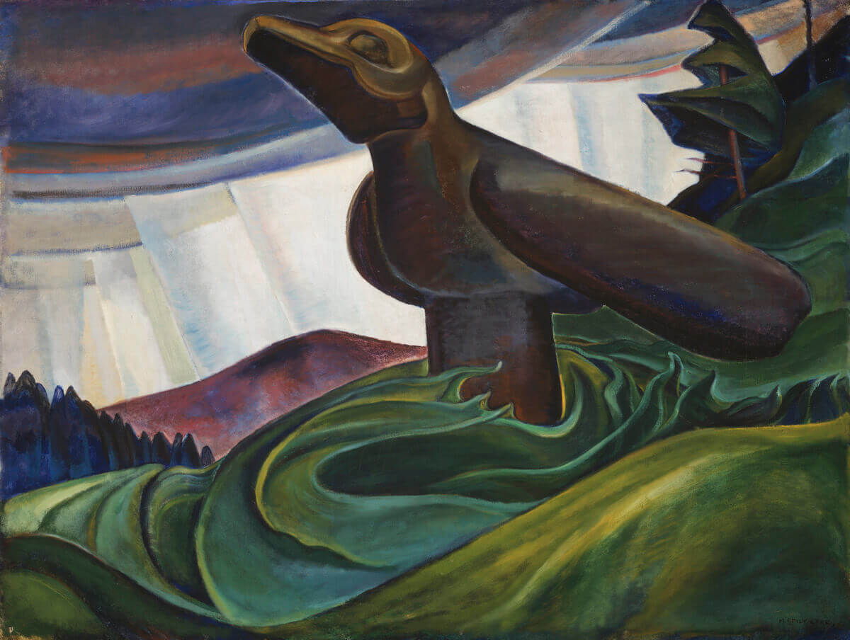
Emily Carr, Big Raven, 1931. A fine example of Carr’s sculptural modelling of her landscapes.

Slide 11
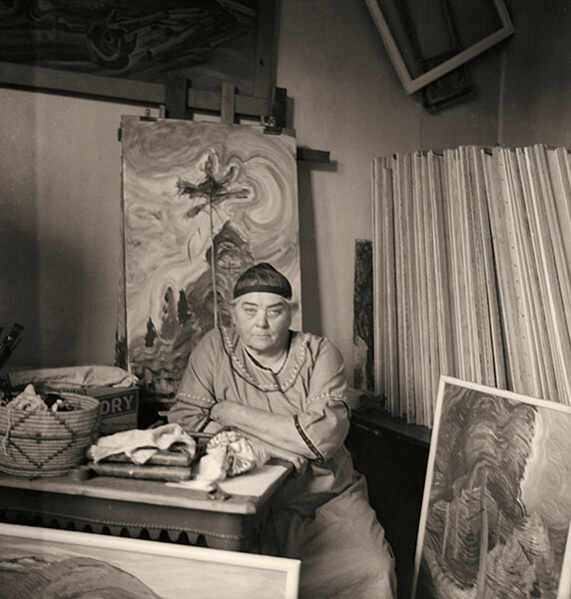
Harold Mortimer-Lamb, Emily Carr in Her Studio, 1939. This is the most iconic photo of the artist.

Slide 12
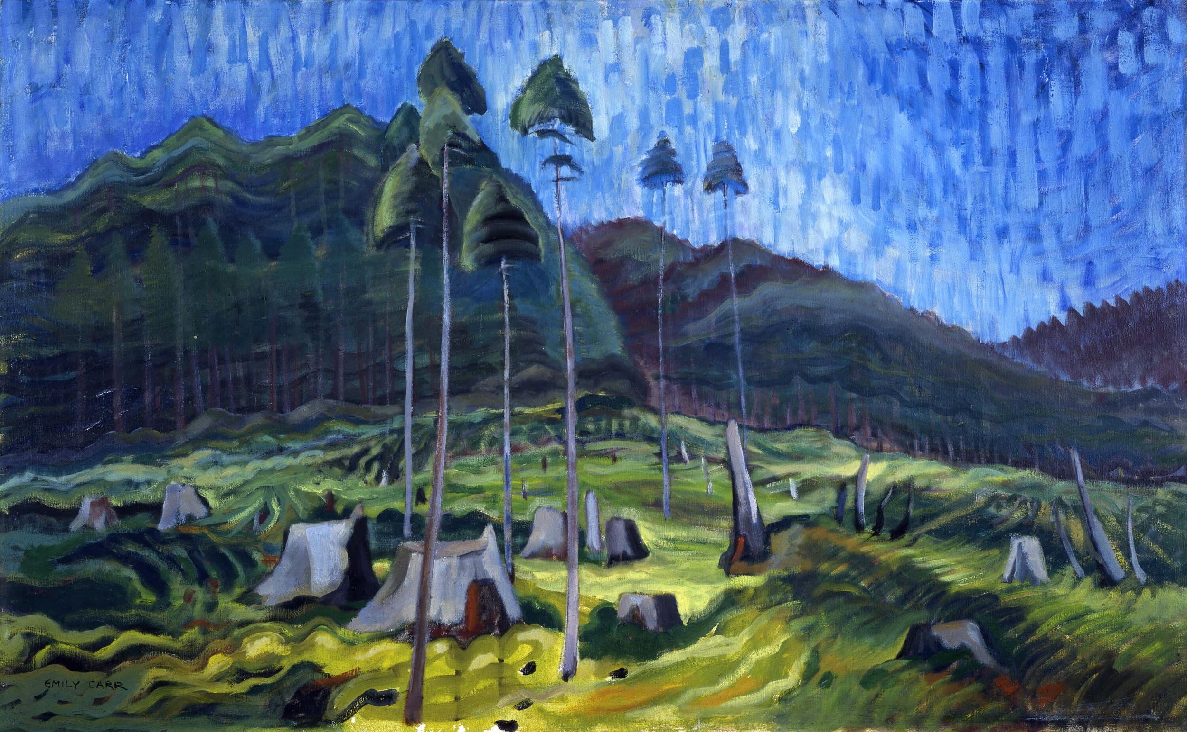
Learning Activity #1
Emily Carr, Odds and Ends, 1939. In this work, only a few trees remain, surrounded by the stumps of felled trees.

Slide 13
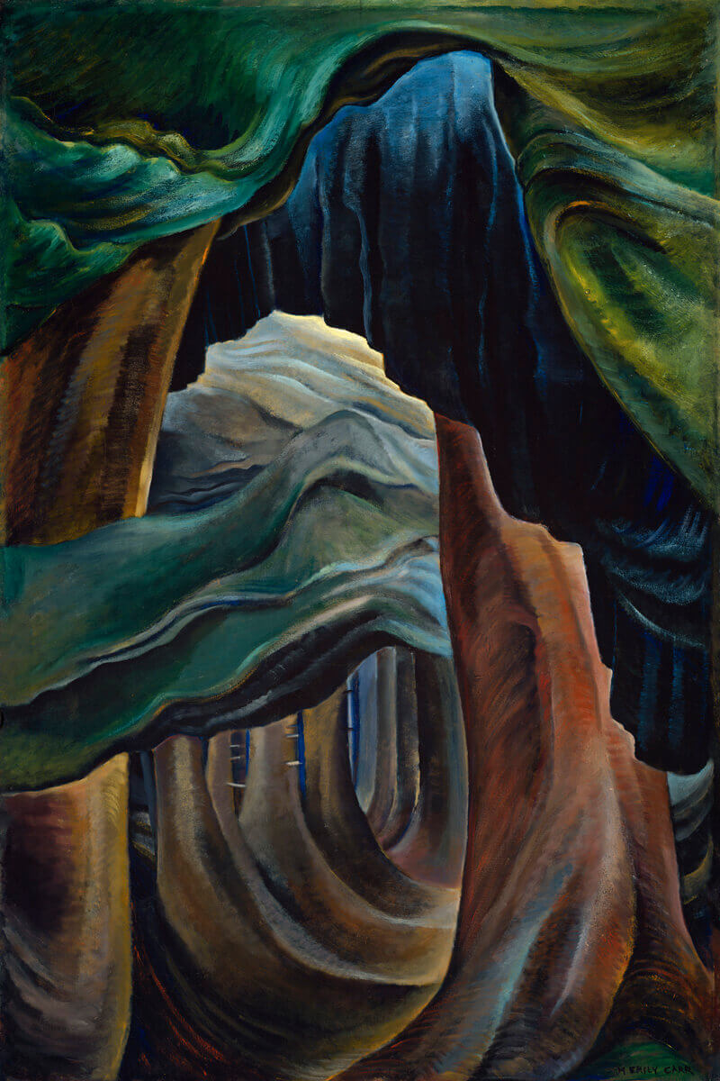
Emily Carr, Forest, British Columbia, 1931–32. In this almost abstracted painting, Carr captures the beauty of a full, dark, and dense forest interior.

Slide 14
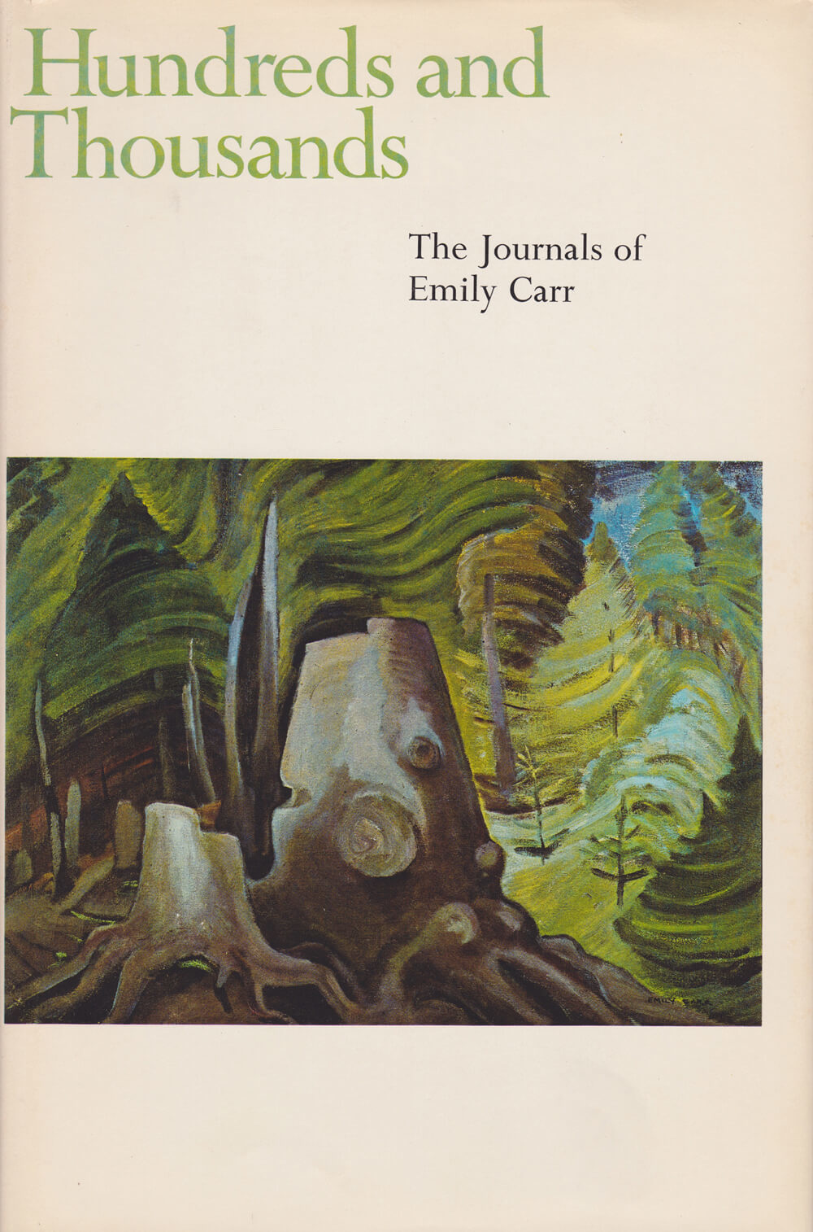
The first edition of Hundreds and Thousands, published posthumously in 1966, features Carr’s Stumps, 1936.

Slide 15
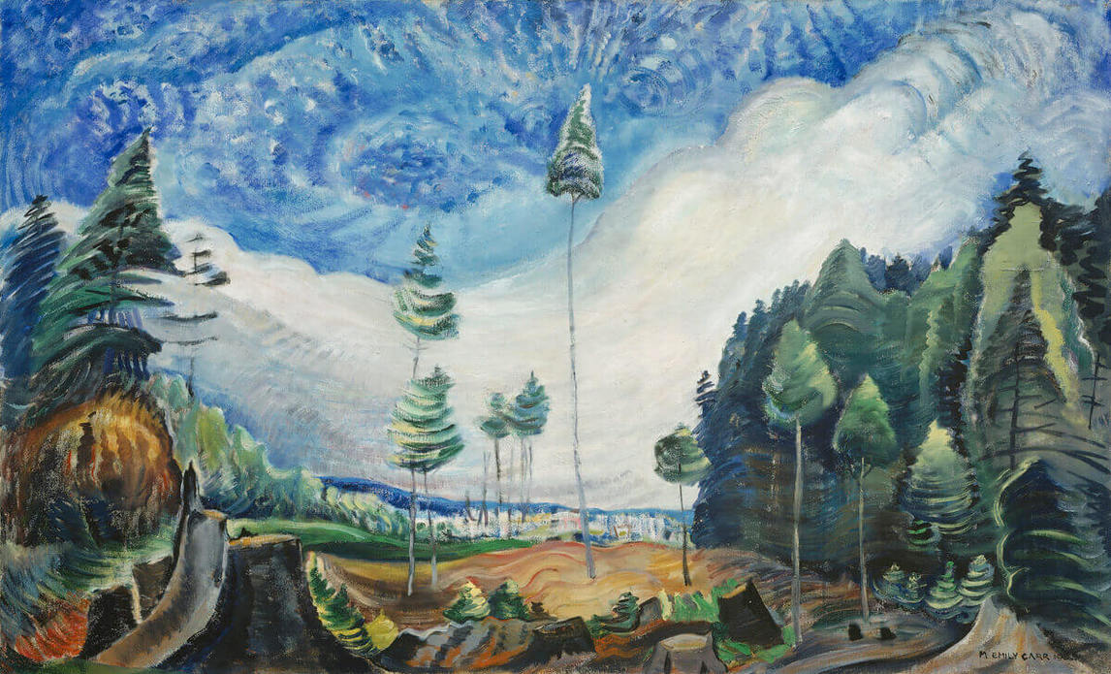
Learning Activity #2
Emily Carr, Loggers’ Culls, 1935. The trees left behind by the loggers in this painting are not young saplings, they have grown tall and skinny in order to surpass the surrounding trees and reach the sunlight above.

Slide 16
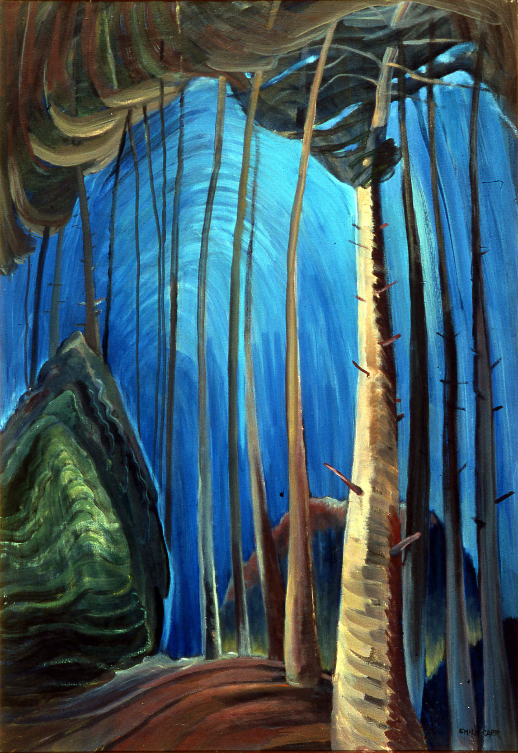
Emily Carr, Blue Sky, 1936. The colours in this painting give each element a glow that makes them leap from the canvas.

Slide 17
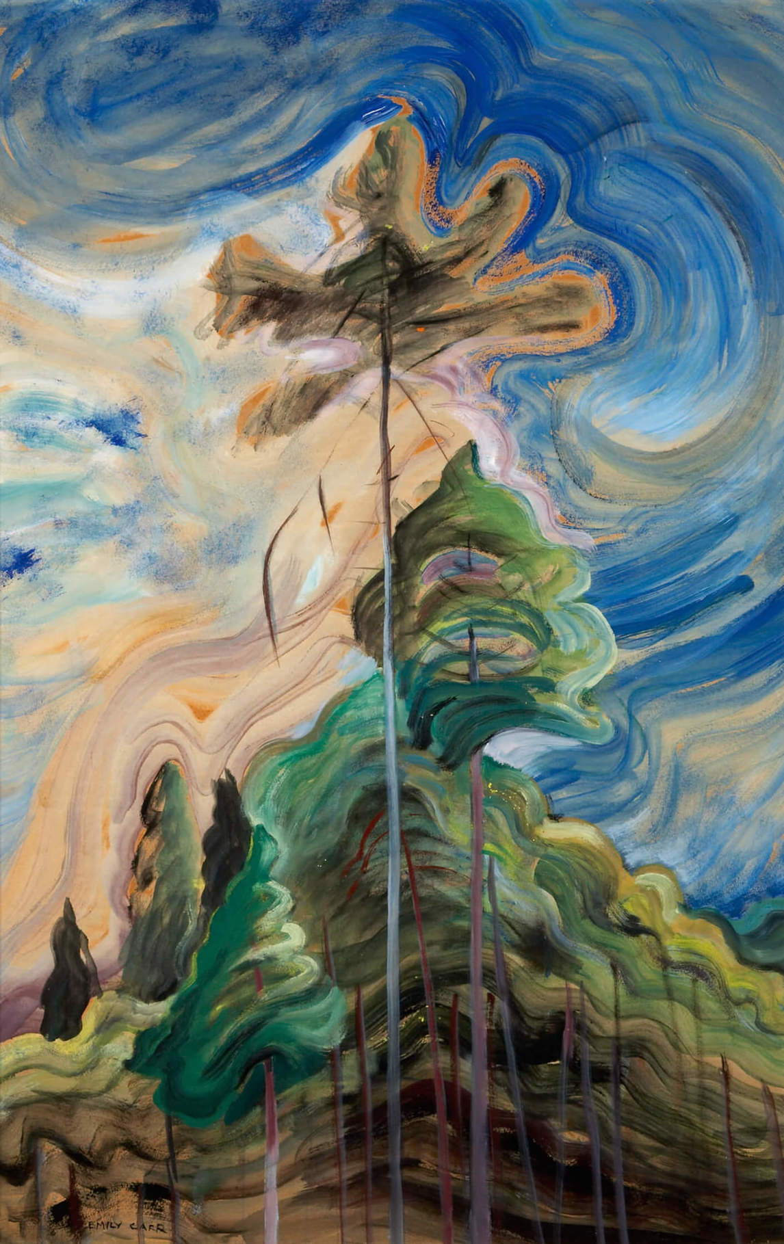
Emily Carr, Sunshine and Tumult, 1938–39. Later in her career, Carr experimented with thinning her oil paints with gasoline.

Slide 18
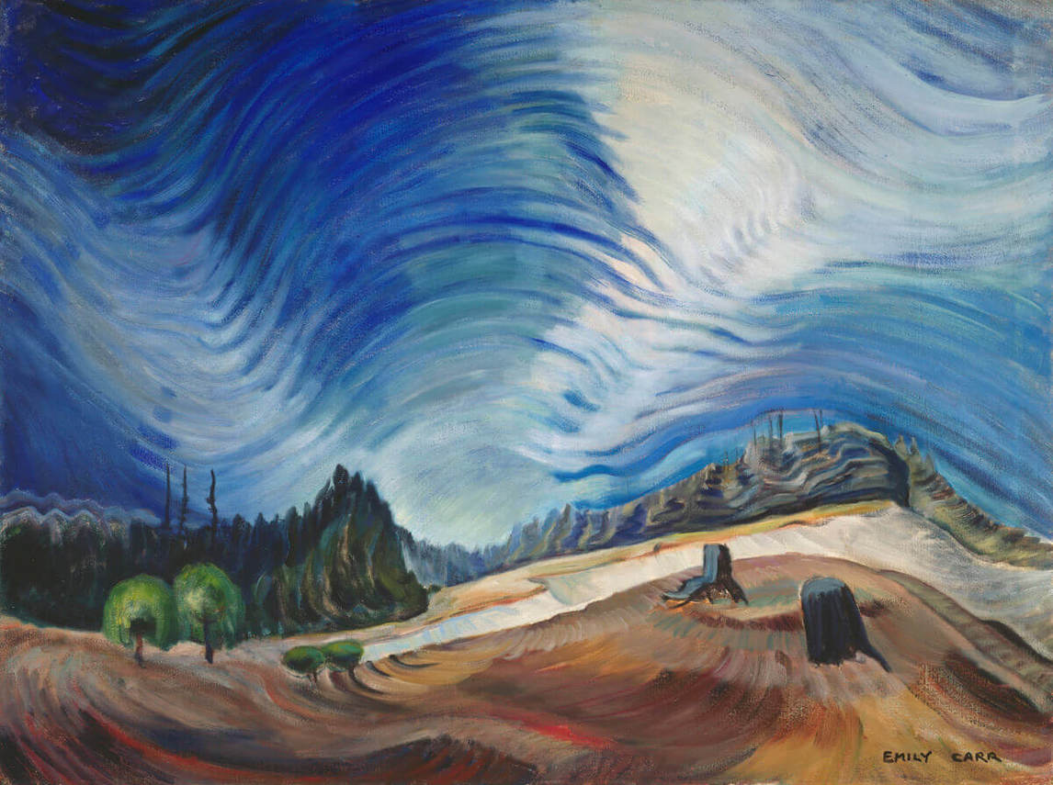
Emily Carr, Above the Gravel Pit, 1937. Carr’s brilliant handling of colour and her expressive brushstrokes give movement to the blue sky above the barren ground below.

Slide 19
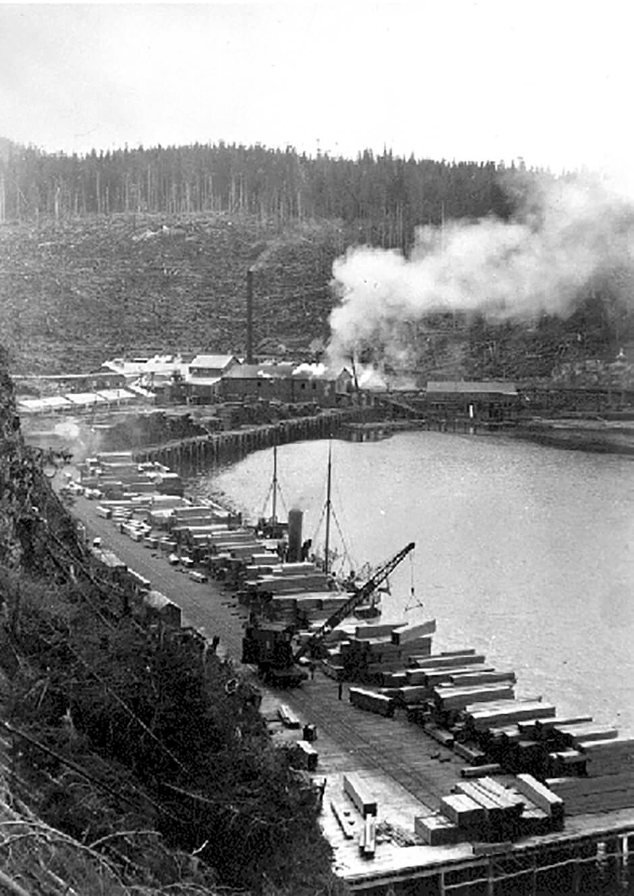
Large-scale logging has resulted in deforestation, pollution, and the degradation of traditional First Nations lands.

Slide 20
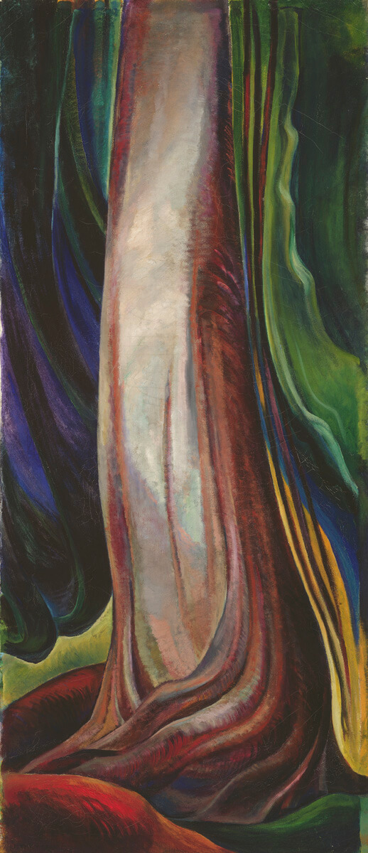
Emily Carr, Tree Trunk, 1931. The winding vertical lines make it appear as though the trunk is alive
and shooting upwards.

Slide 21
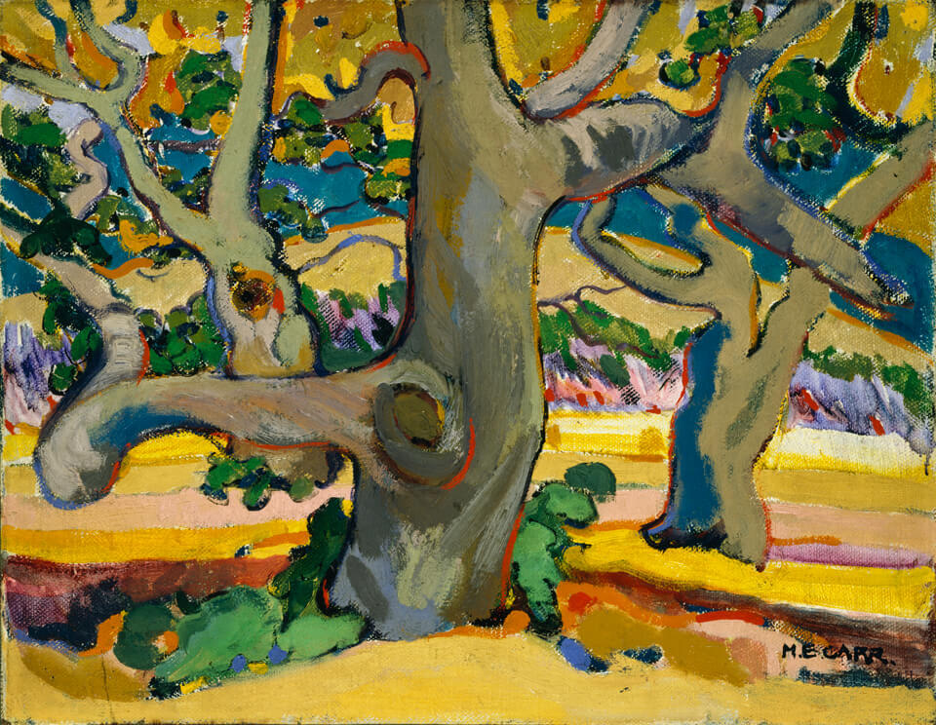
Emily Carr, Trees in France, c.1911. Carr likely painted this outside and the bold colours show influence from French modernists like the Fauves.

Slide 22
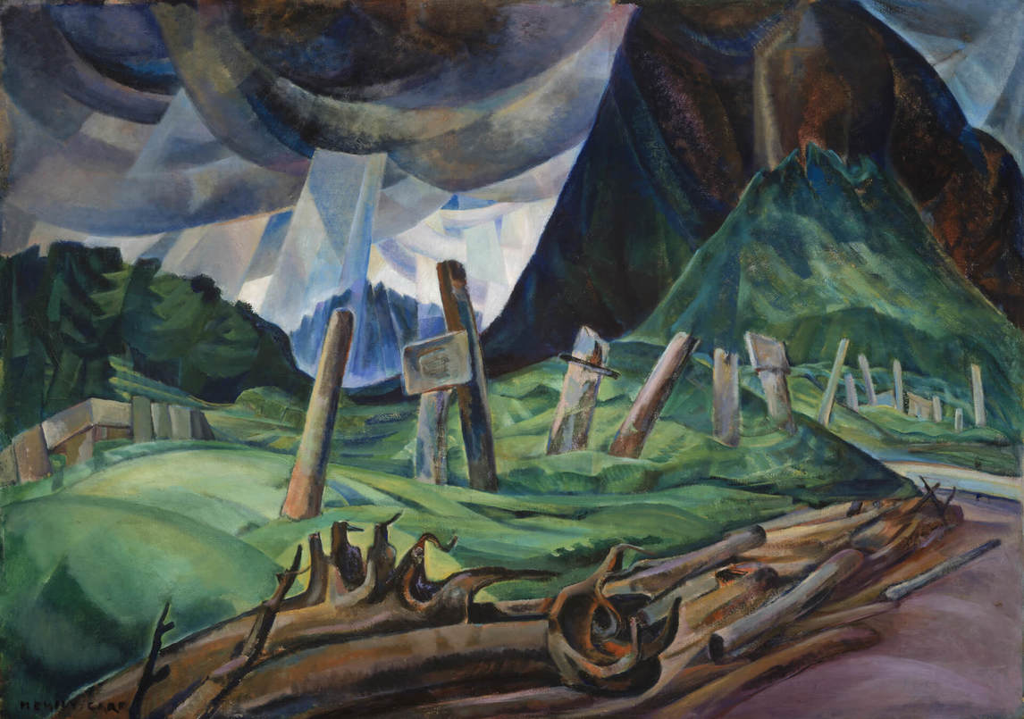
Emily Carr, Vanquished, 1930. In this painting Carr has begun to explore a heavily modelled sculptural painting style.

Slide 23
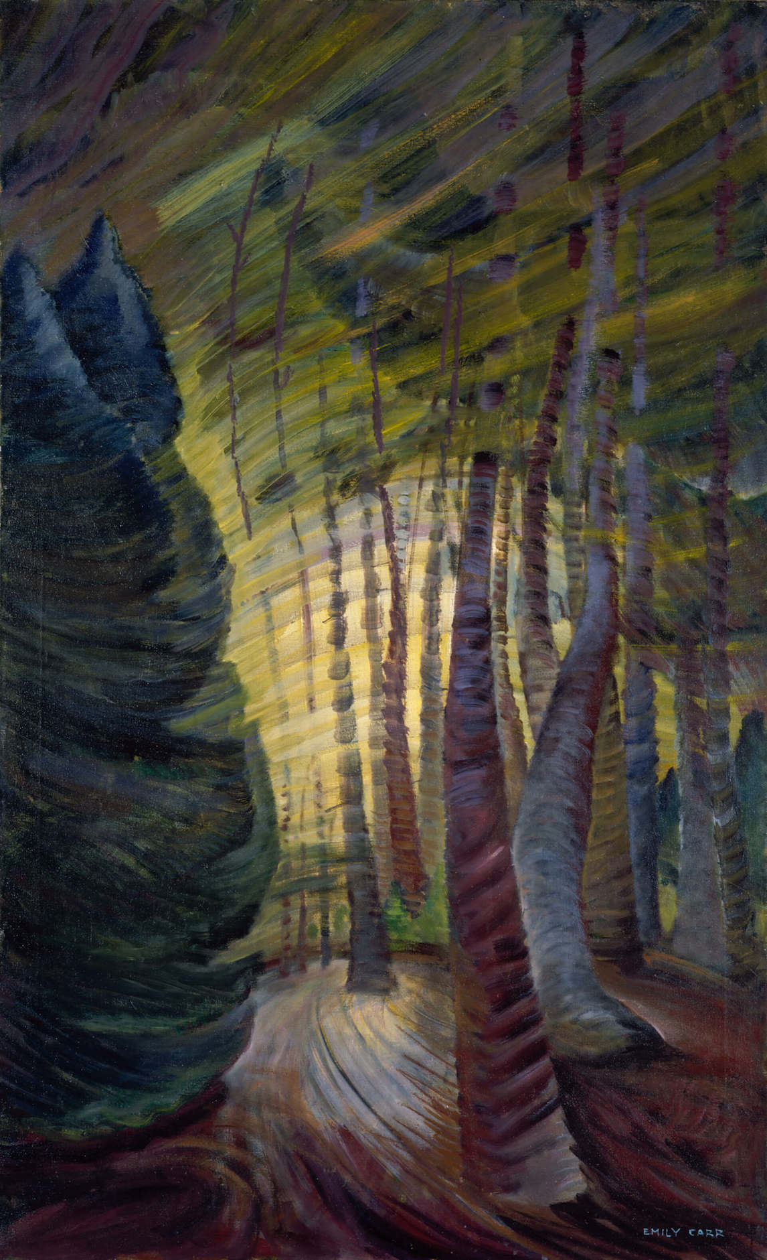
Emily Carr, Sombreness Sunlit, c.1938–40. In her final paintings, Carr focused on loose brushwork to convey with emotion the beauty of the land.

Slide 24
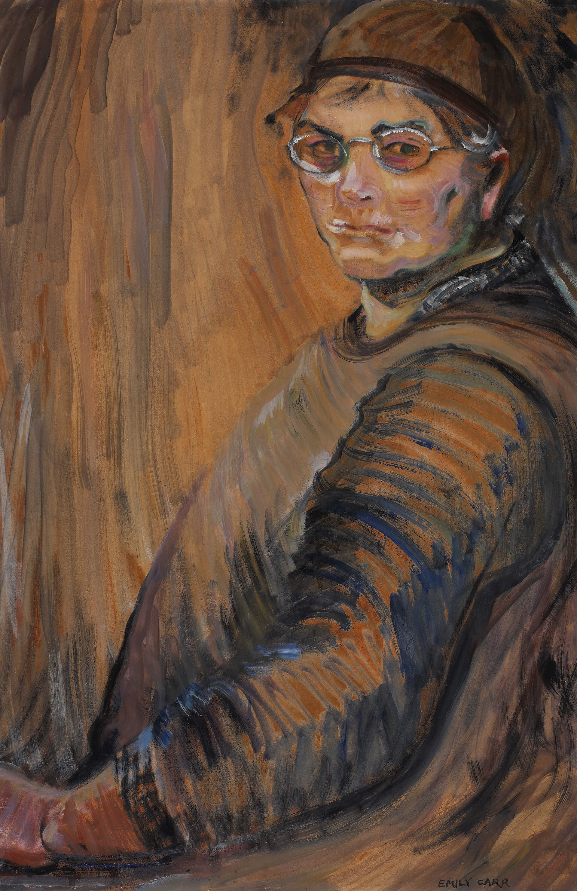
Emily Carr, Self-Portrait, 1938–39. In this, one of her few self-portraits, Carr uses a vibrant palette and expressive brushstrokes.

Slide 25
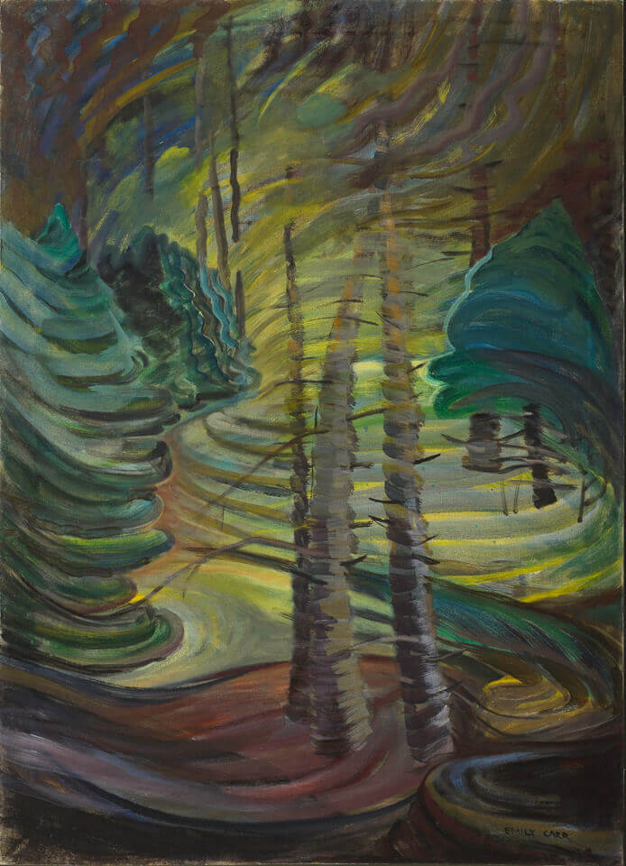
Emily Carr, Dancing Sunlight, c.1937. Carr takes her expressive brushwork even further here, almost completely fragmenting the image.

Slide 26
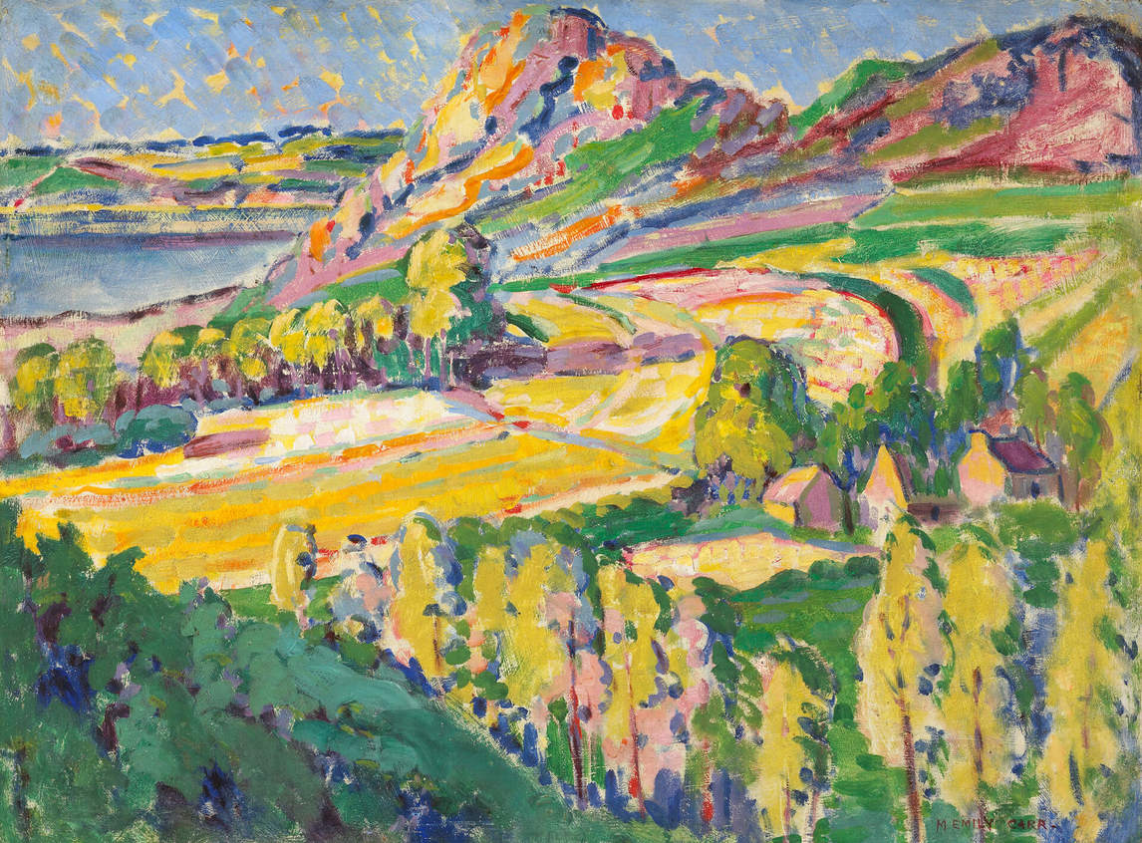
Emily Carr, Autumn in France, 1911. While studying abroad in Paris, Carr quickly tired of the big city. She retreated to rural towns in Brittany, where her artistic talents flourished. During this period she created vibrant and colourful paintings like this one.

