Slide 2
Gershon Iskowitz, Through Life, c.1947. This sketch was inspired by Iskowitz’s memories.

Slide 3
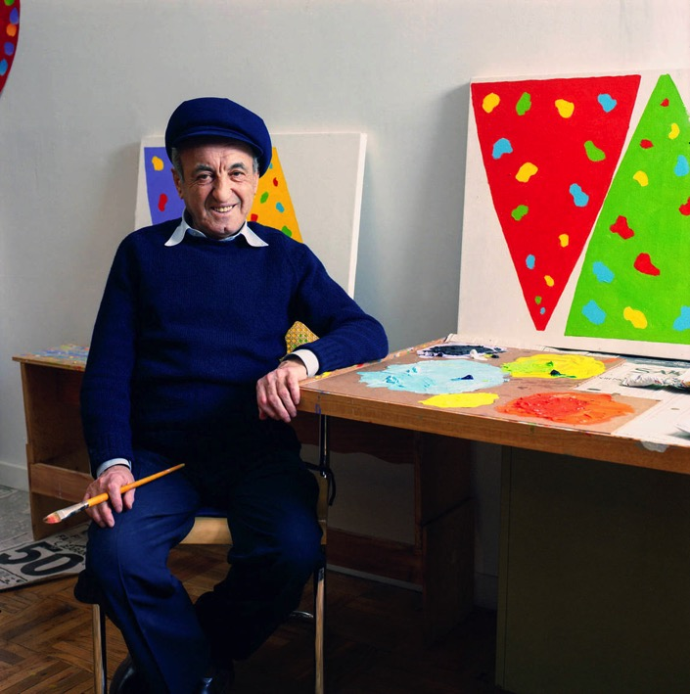
Gershon Iskowitz in his studio, 1986.

Slide 4
Gershon Iskowitz, Ghetto, c.1947. Vicious barbed wire criss-crosses this image of a mother and child in the ghetto.

Slide 5
Gershon Iskowitz, The Wall, 1952. The figure in this work reaches out as if imploring the viewer.

Slide 6
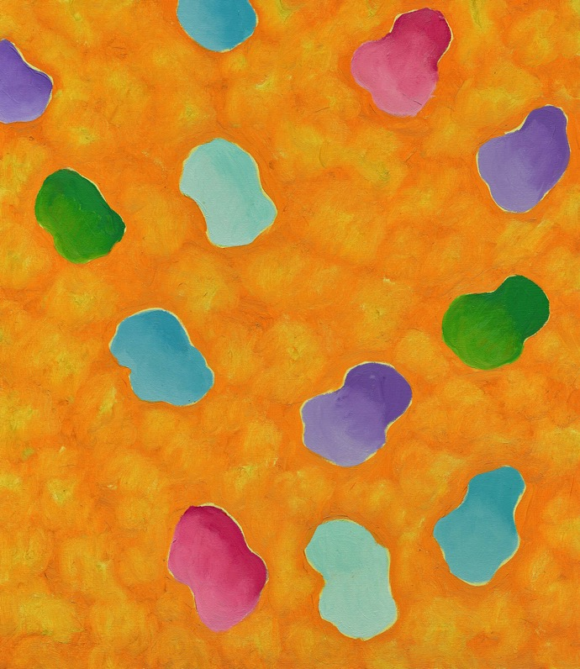
Gershon Iskowitz, Not Titled, c.1987. The ovoid forms in this painting are a hallmark of Iskowitz’s later abstract style.

Slide 7
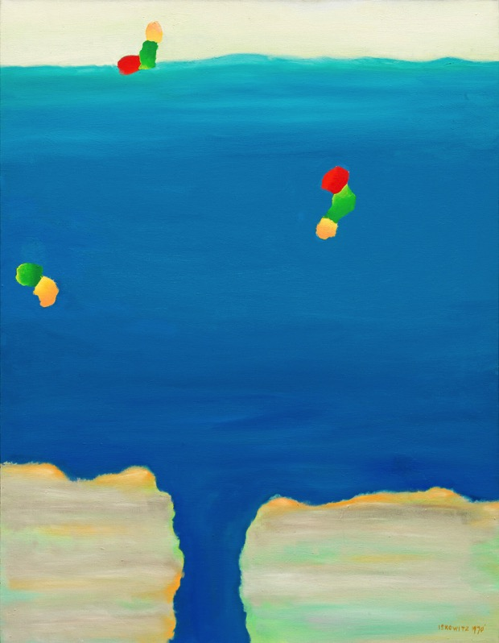
Gershon Iskowitz, Lowlands No. 9, 1970. This work depicts what Iskowitz saw from his plane as it dipped downwards over the northern landscape.

Slide 8
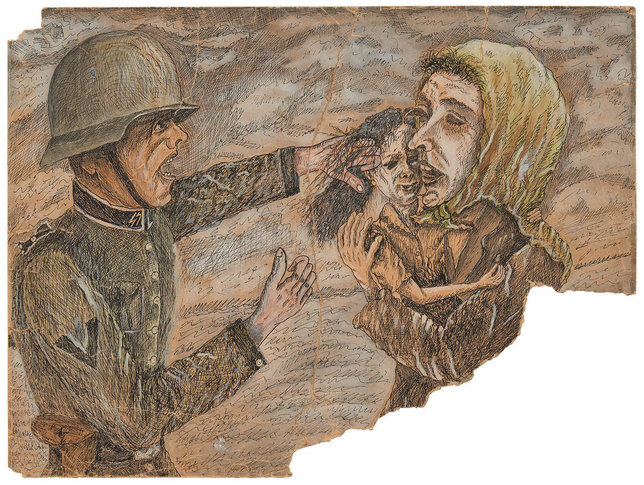
Gershon Iskowitz,
Action, 1941. A German soldier tries to forcibly remove a girl from a woman’s arms.

Slide 9
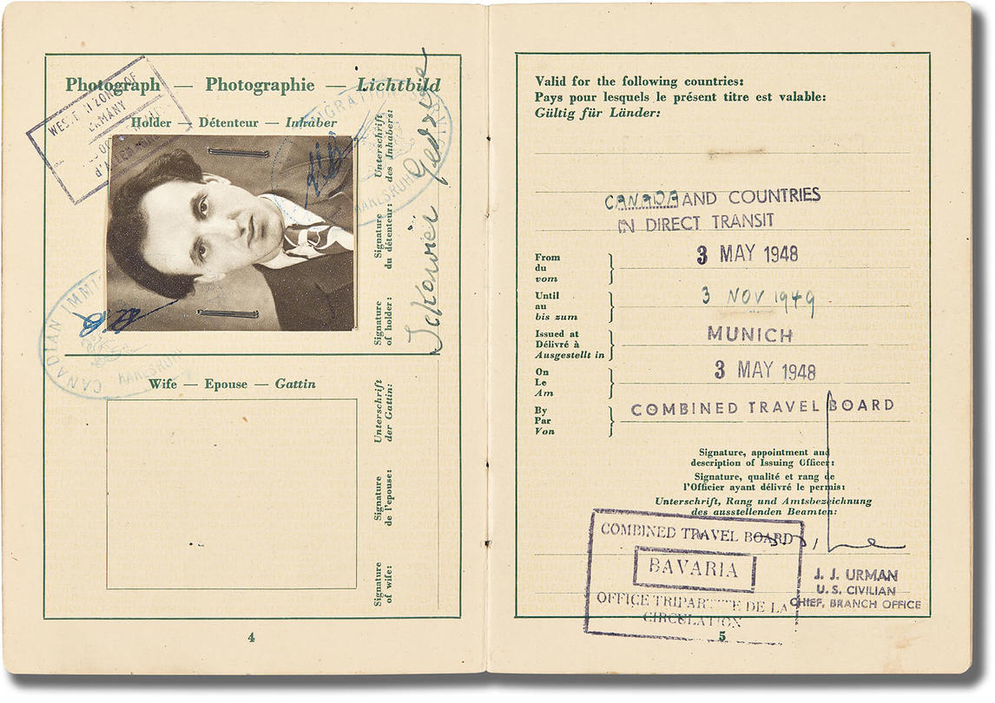
Iskowitz’s temporary travel document, Military Government for Germany, Munich, May 3, 1948.

Slide 10
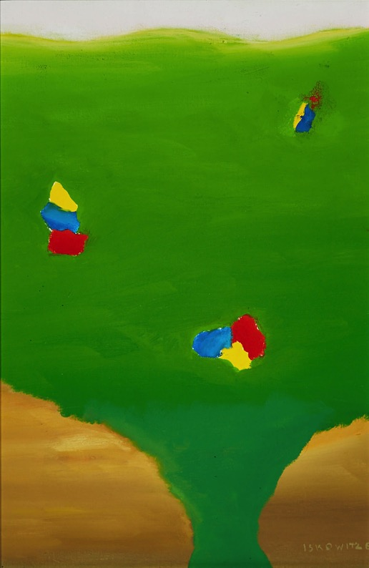
Gershon Iskowitz, Lowlands 1, 1969. A typical example of Iskowitz’s abstraction of the landscape.

Slide 11
Gershon Iskowitz, Selection, Auschwitz, 1947. A horrific scene of a guard determining who will be killed and who will remain a prisoner.

Slide 12
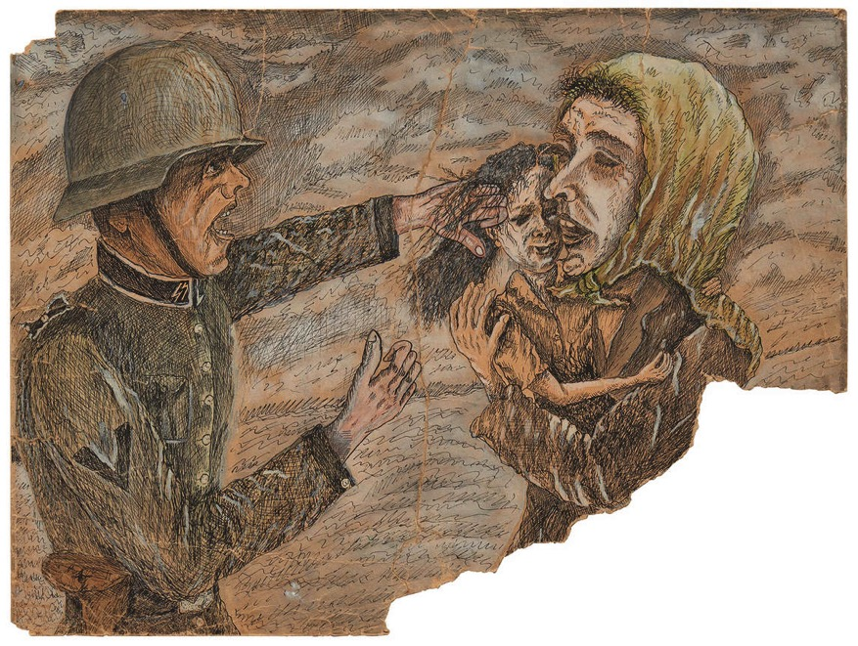
Learning Activity #1
Gershon Iskowitz, Action, 1941. This drawing records an incident in the Kielce Ghetto.

Slide 13
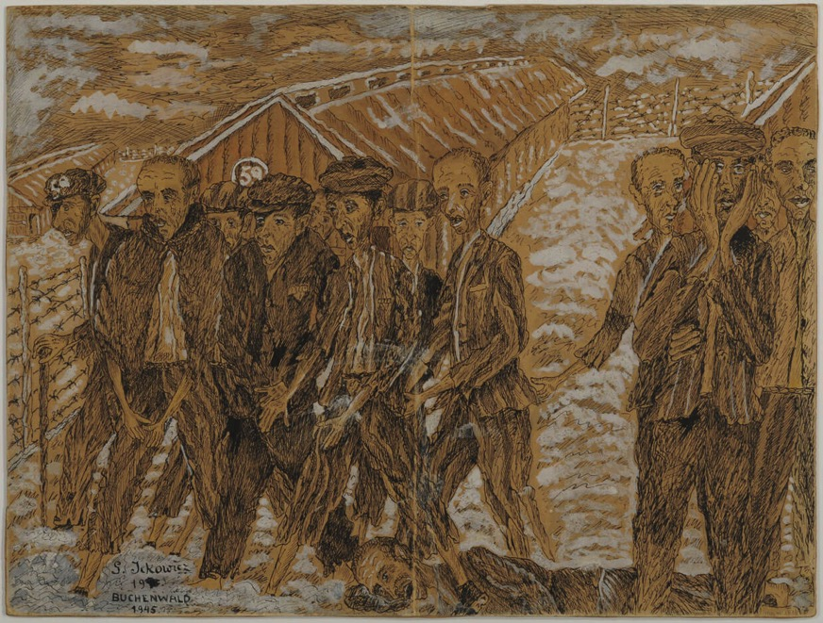
Learning Activity #1
Gershon Iskowitz, Buchenwald, 1944–45. One of Iskowitz’s few surviving drawings from inside Buchenwald.

Slide 14
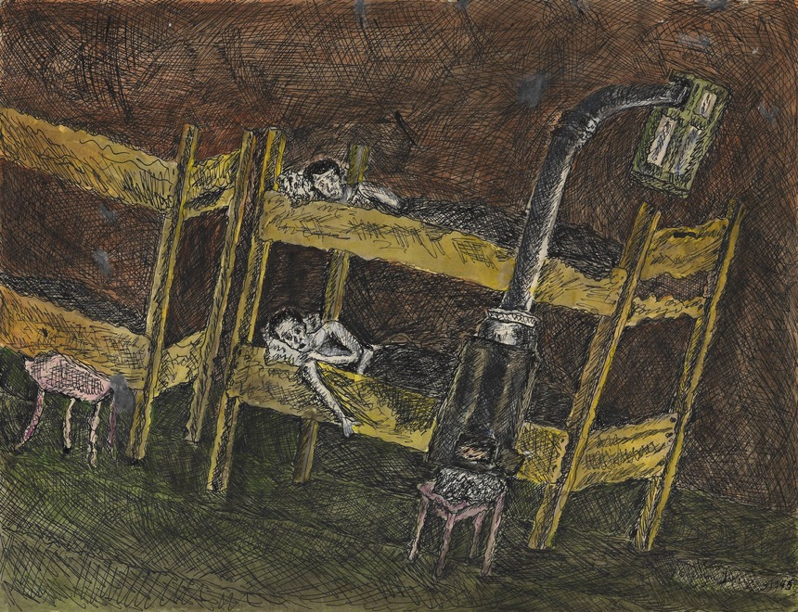
Learning Activity #1
Gershon Iskowitz, Barracks, 1949. In this painting Iskowitz portrays the barren and close living quarters of the concentration camps.

Slide 15
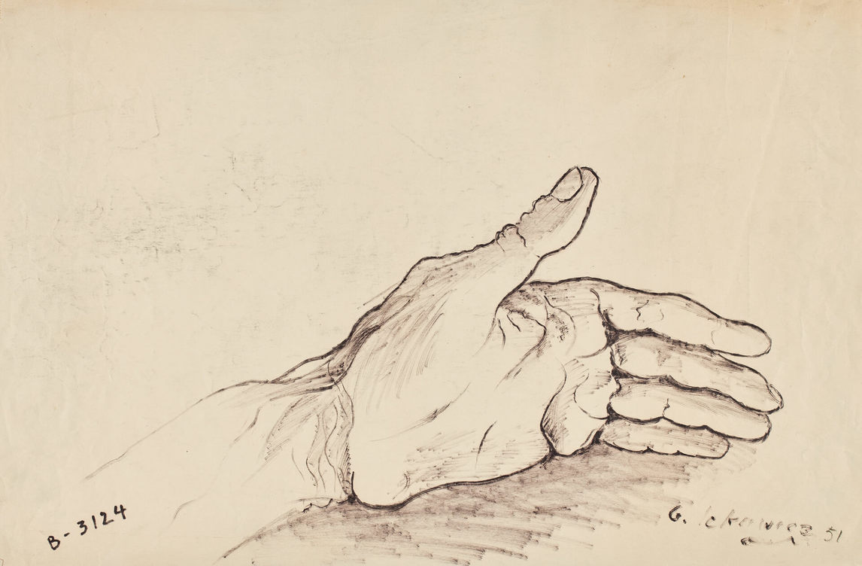
Learning Activity #1
Gershon Iskowitz, Untitled (“B-3124”), 1951. At Auschwitz, Iskowitz’s left arm was tattooed with the prisoner number B-3124.

Slide 16
Learning Activity #2
Gershon Iskowitz, Side Street, c.1952–54. A couple embraces on a quiet, deserted street in Kielce, Poland.

Slide 17
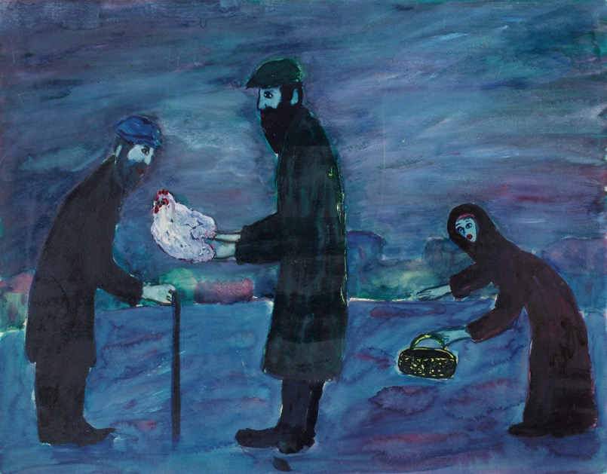
Learning Activity #2
Gershon Iskowitz, Korban, c.1952. The title of this painting refers to the Korban Pesach, the Hebrew sacrifice of a lamb at Passover, practised since the Israelites’ exodus from Egypt in biblical times.

Slide 18
Gershon Iskowitz, Market, c.1952–54. This bright painting shows a happier time in Kielce, Poland, as citizens take their purchases home from the market.

Slide 19
Gershon Iskowitz, Miriam, c.1951–52. This work depicts Iskowitz’s neighbour in Poland.

Slide 20
Culminating Task
Infographic showing the history of genocide by the numbers.

Slide 21
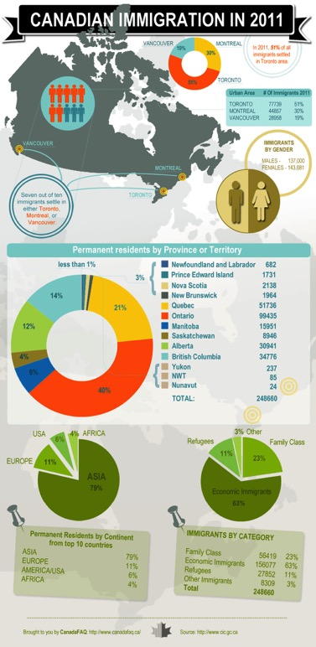
Culminating Task
Infographic showing Canadian immigration numbers in 2011.

Slide 22
Culminating Task
Infographic describing climate change through key facts.

Slide 23
Gershon Iskowitz, It Burns, c.1950–52. People run from the flames as a fire rages through the Kielce Ghetto.

Slide 24
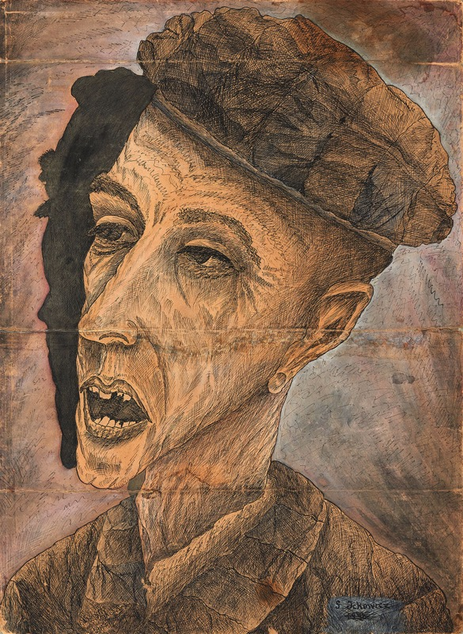
Gershon Iskowitz, Condemned, c.1944–46. This memory work is a harrowing portrait of a prisoner in Buchenwald concentration camp.

Slide 25
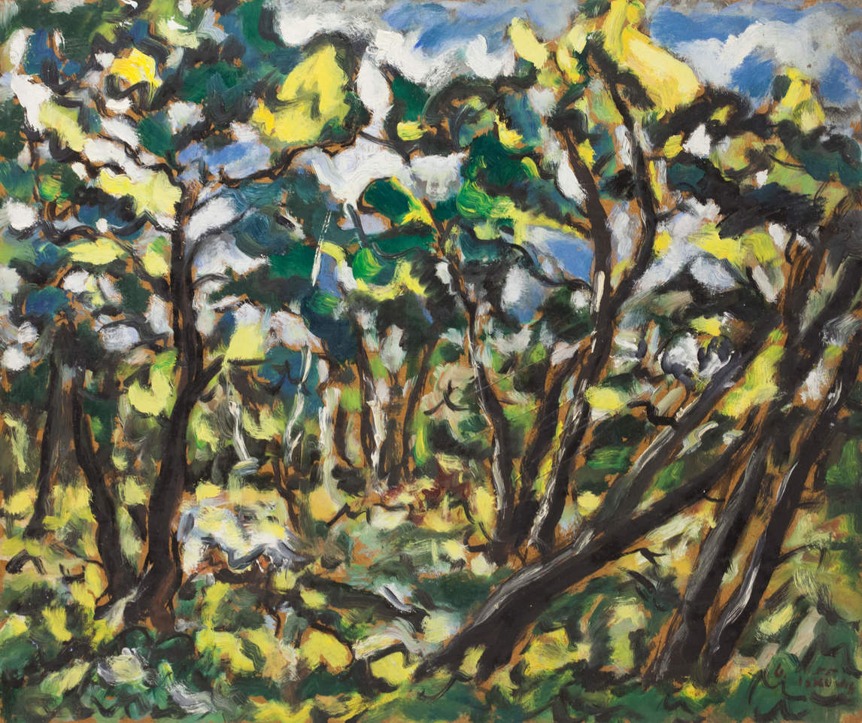
Gershon Iskowitz, Sunshine, 1955. This is one of Iskowitz’s early representational landscapes that he painted upon arriving in Canada.

Slide 26
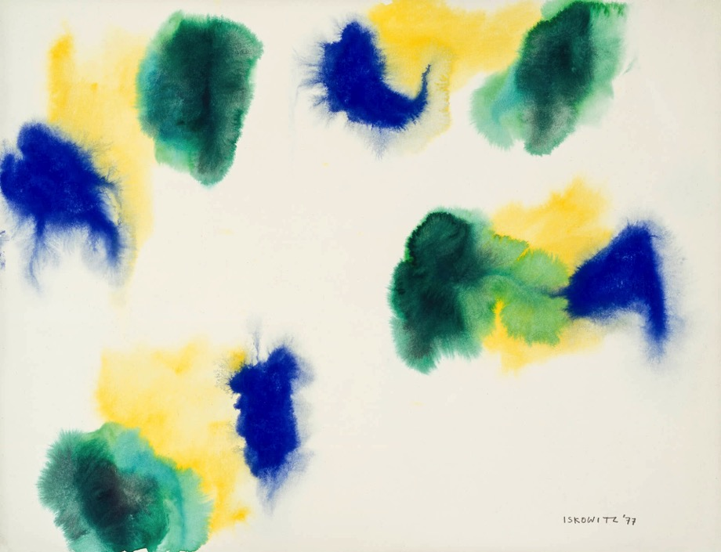
Gershon Iskowitz, Untitled, 1977. Iskowitz’s watercolours are delicate and jewel-like.

Slide 27
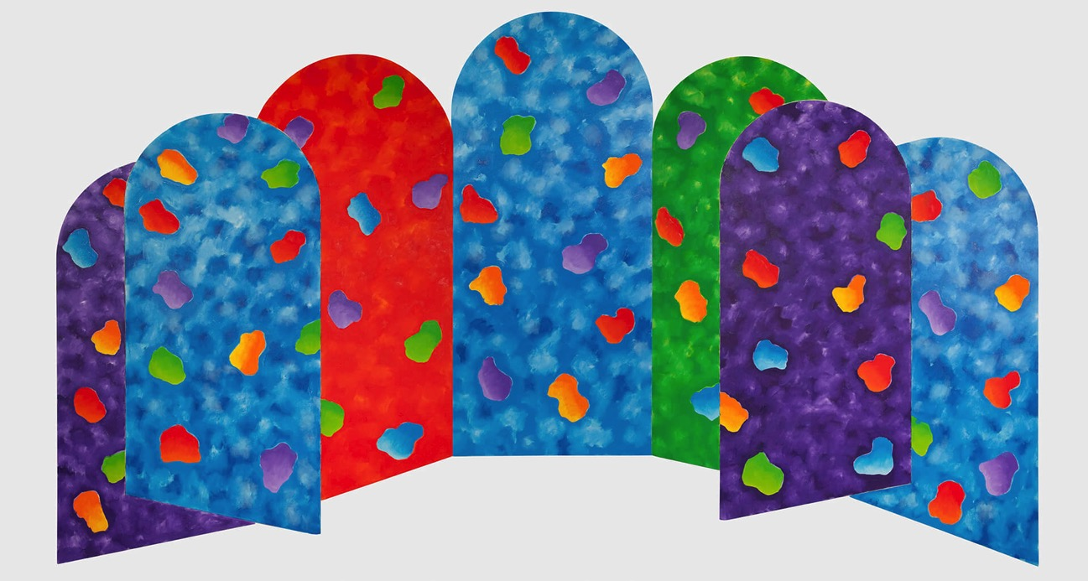
Gershon Iskowitz, Northern Lights Septet No. 3, 1985. This large work is made up of seven individual panels.

Slide 28
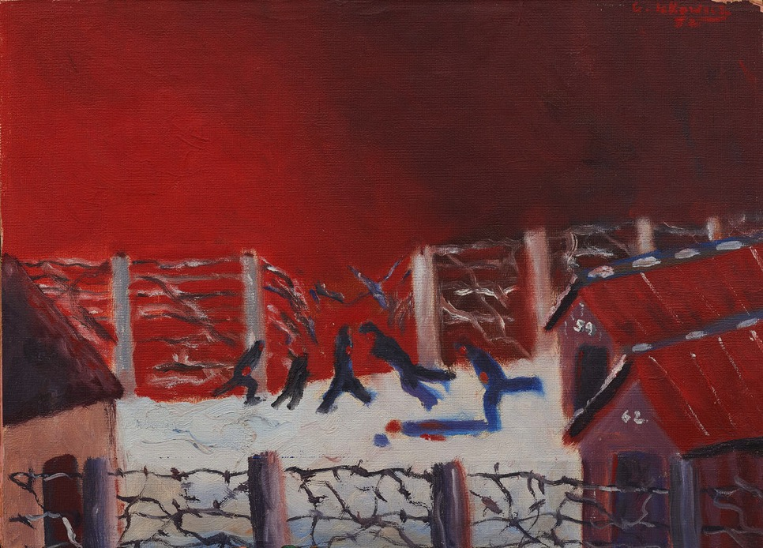
Gershon Iskowitz, Escape, 1948. Before his liberation in 1945, Iskowitz made a desperate attempt to escape. As he scrambled over the fence, he was shot in the leg and fell, breaking his hip.

Slide 29
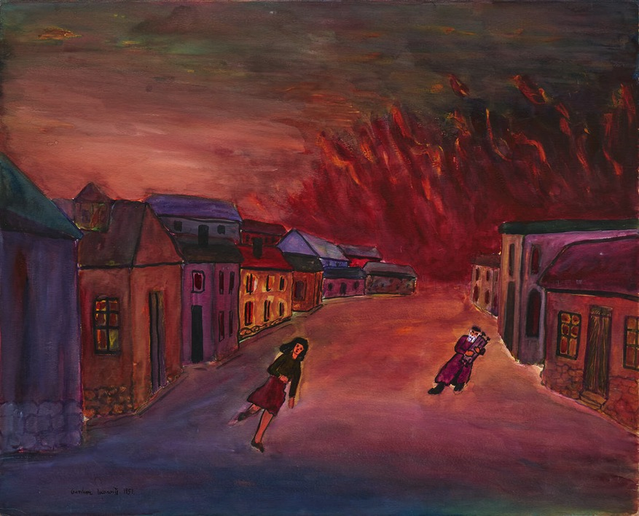
Gershon Iskowitz, Torah, 1951. Here Iskowitz depicts the pogrom in Kielce. One person carries Torah scrolls as he runs to safety.

