Slide 1
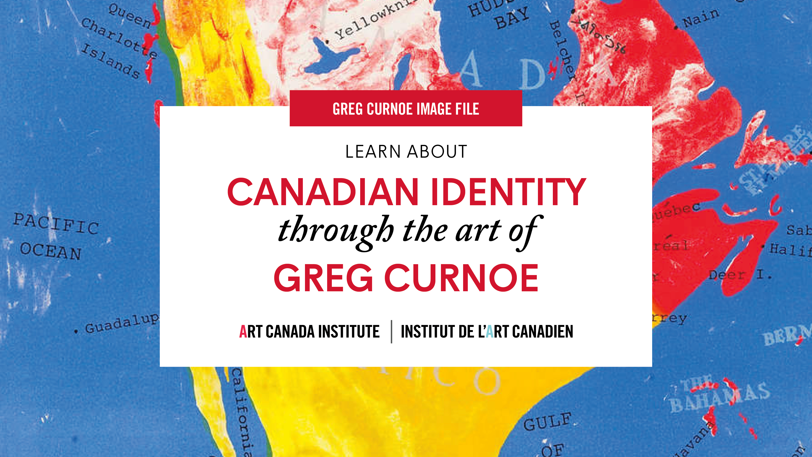

Slide 2
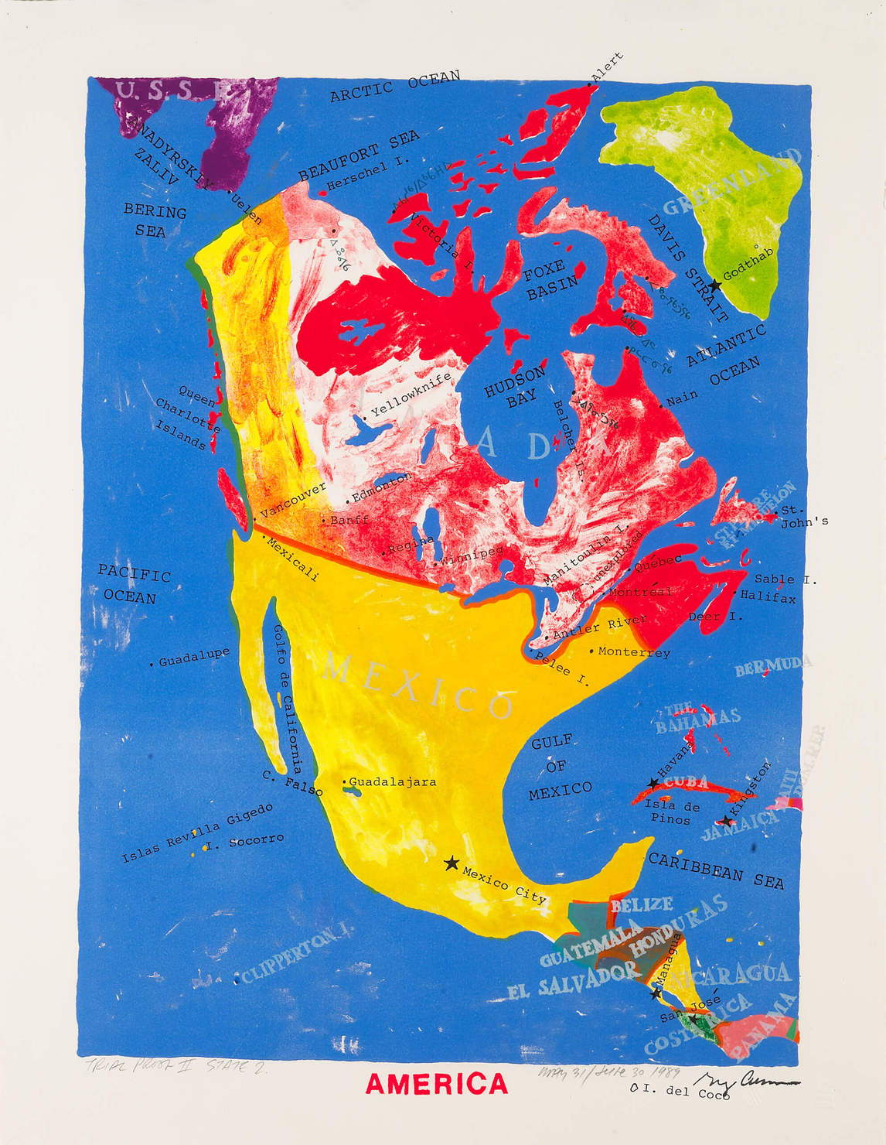
Greg Curnoe, America, July 1989. Eliminating the United States entirely, Curnoe’s maps express what has been described as a strong anti-Americanism.

Slide 3
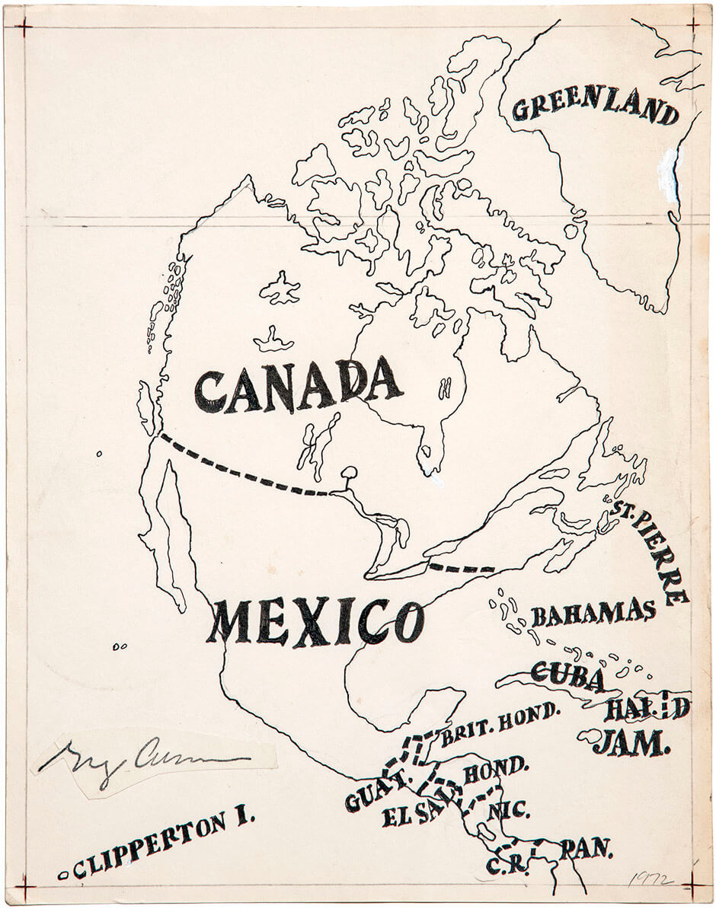
Greg Curnoe, Map of North America, 1972. This ink drawing is the first of several reimagined maps of North America that Curnoe created.

Slide 4
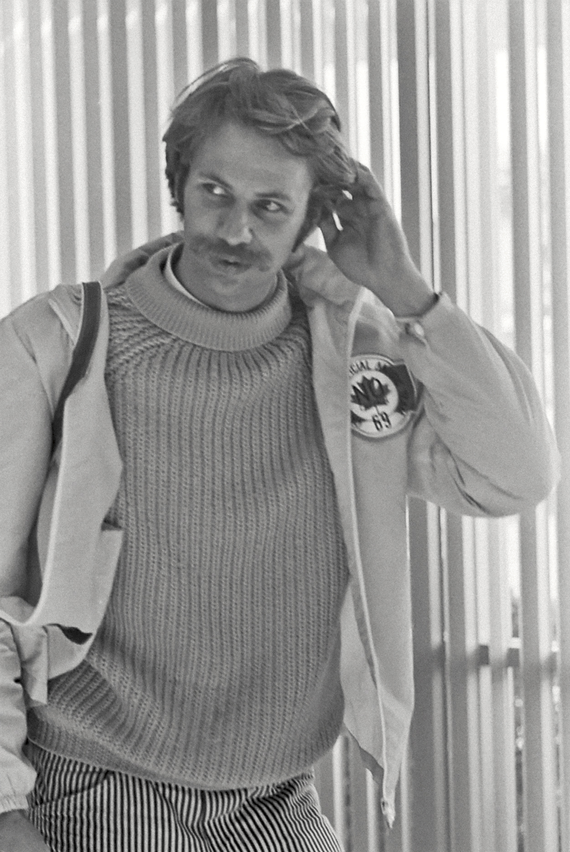
Photograph of Greg Curnoe in 1969.

Slide 5
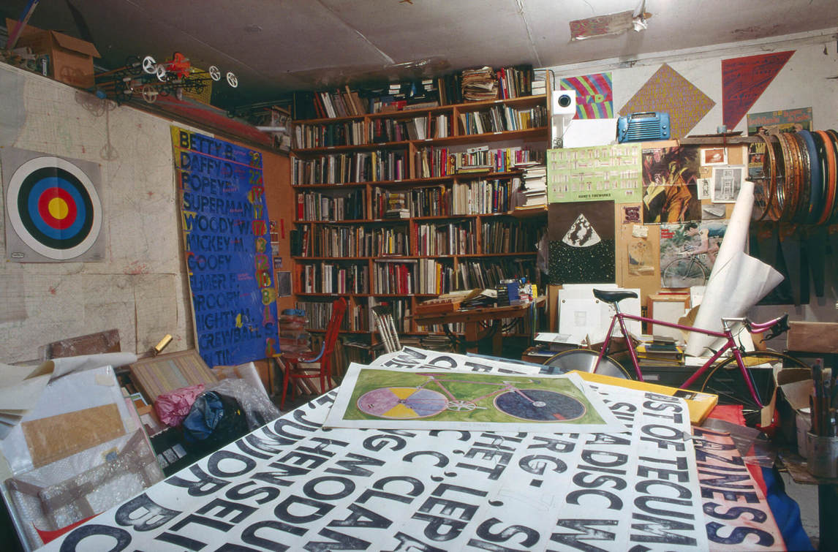
Curnoe’s studio in 1988. You can see tests and studies for numerous works and, of course,
a bicycle resting in the corner.

Slide 6
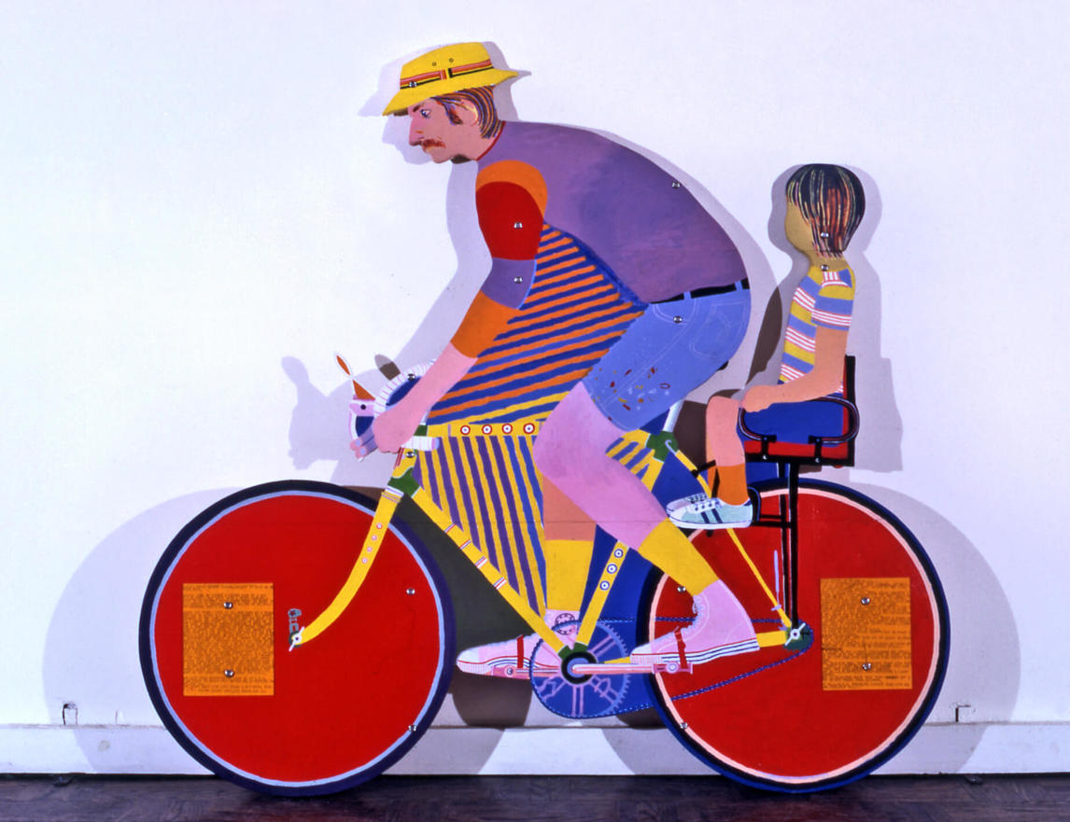
Greg Curnoe, Self-Portrait with Galen on 1951 CCM, 1971. This work shows
the connection between Curnoe’s art and his everyday life.

Slide 7
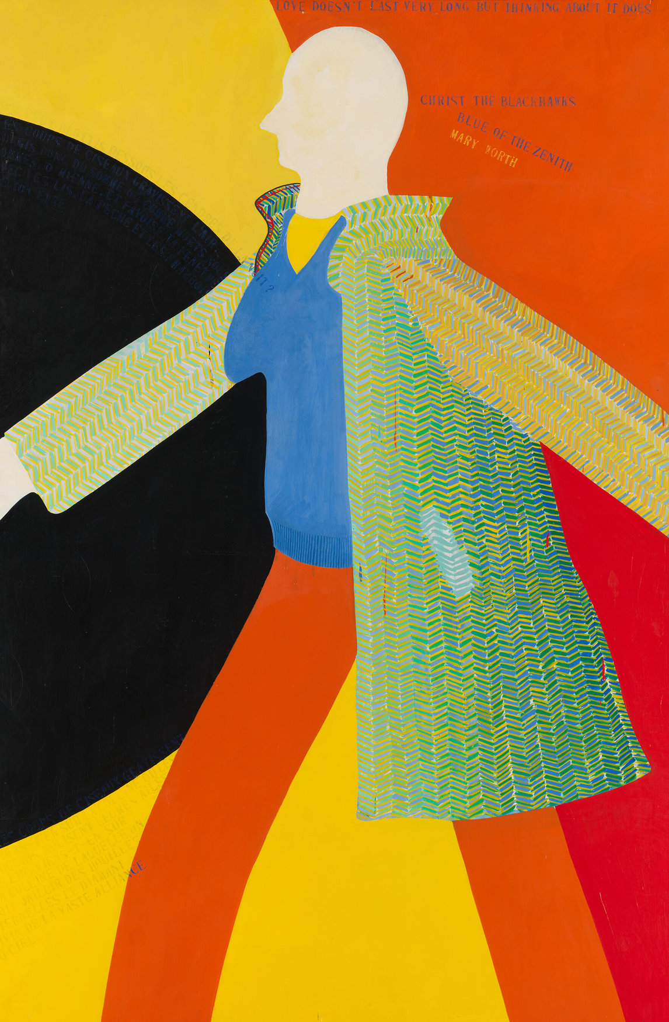
Greg Curnoe, Myself Walking North in the Tweed Coat, 1963. This life-sized, full-length self-portrait is an example of the artist’s signature style.

Slide 8
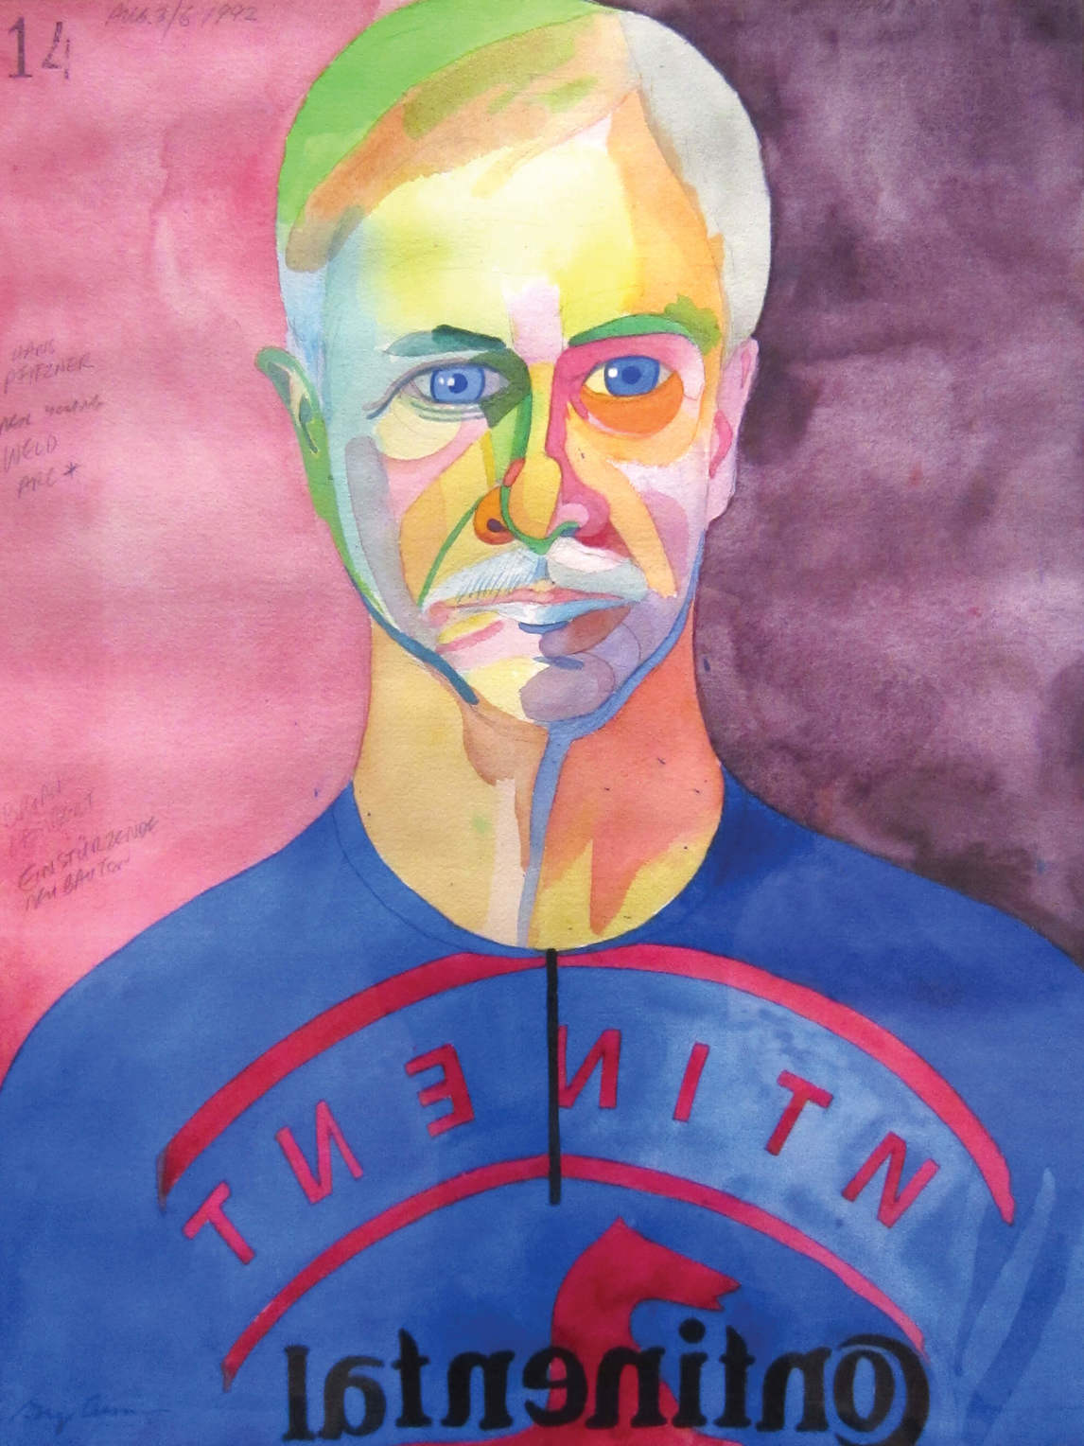
Greg Curnoe, Self-Portrait #14, 1992. Curnoe painted this self-portrait while looking at his reflection in a mirror.

Slide 9
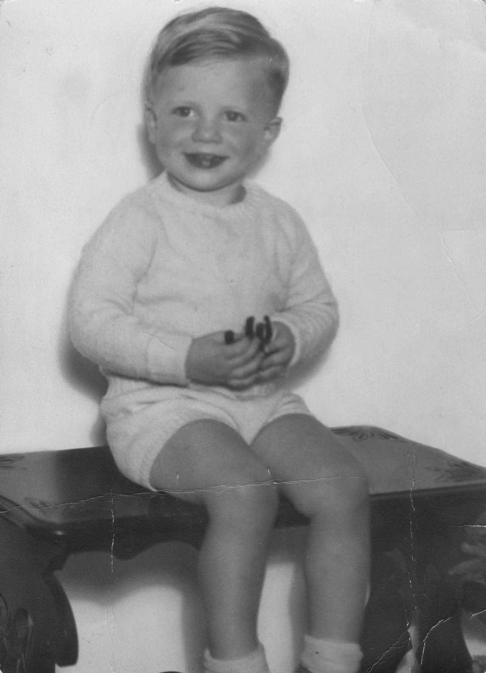
Greg Curnoe, c.1938. As a child Curnoe loved maps, journaling, and making collections.

Slide 10
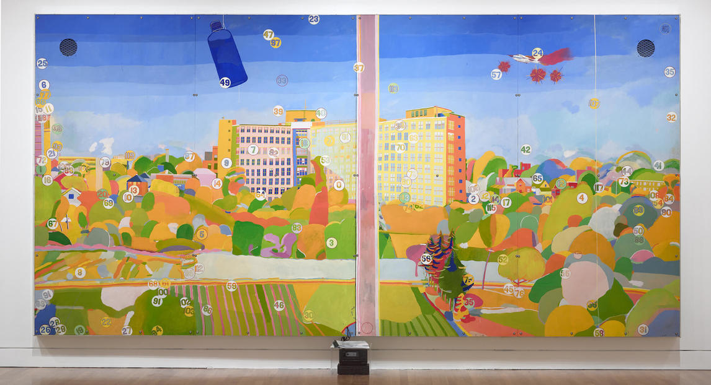
Greg Curnoe, View of Victoria Hospital, Second Series, February 10, 1969–March 10, 1971. Victoria Hospital was important to Curnoe as the place where he and so many of his family and friends had been born or had died.

Slide 11
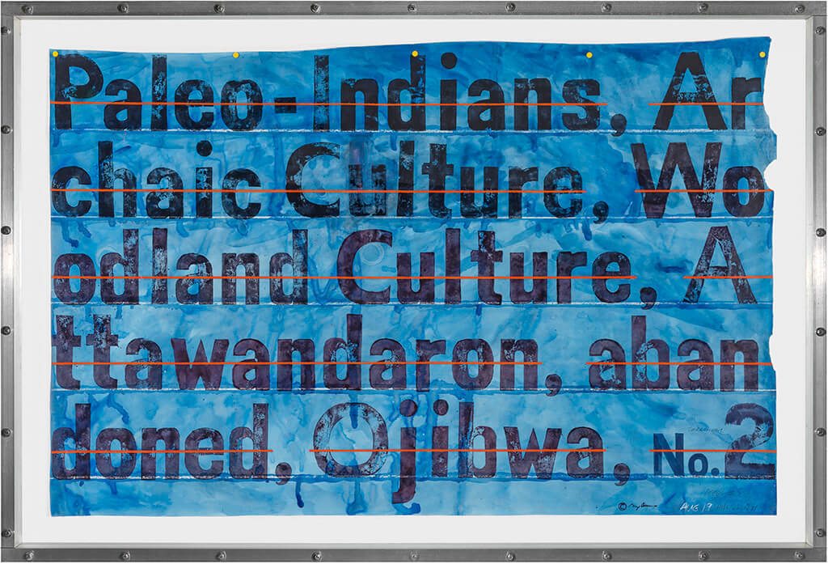
Greg Curnoe, Deeds #5, August 19–22, 1991. This work traces Curnoe’s painstaking research into the history of the land he now owned.

Slide 12
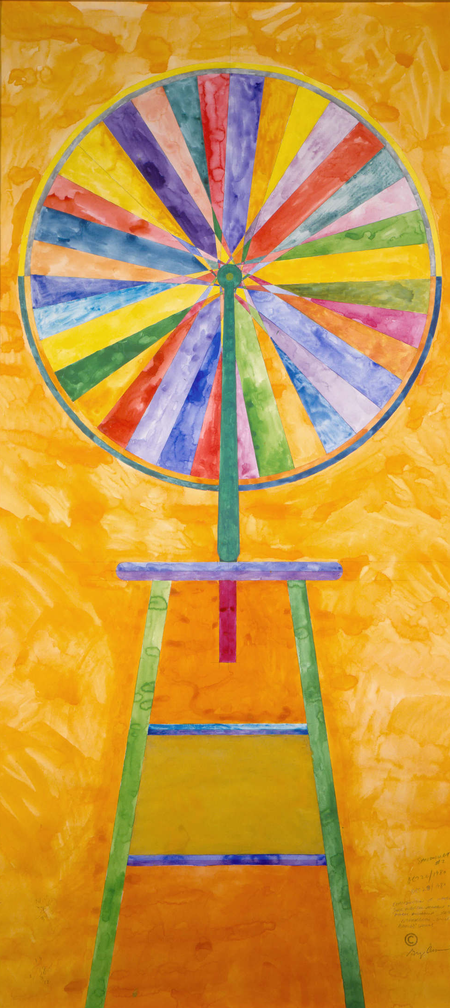
Greg Curnoe, Sanouillet #2, 1980. This work integrated the colour wheel with a bicycle wheel–truing stand. As French Dada scholar Michel Sanouillet noted, “Greg’s fascination with the wheel kept recurring.”

Slide 13
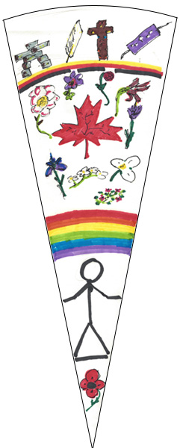
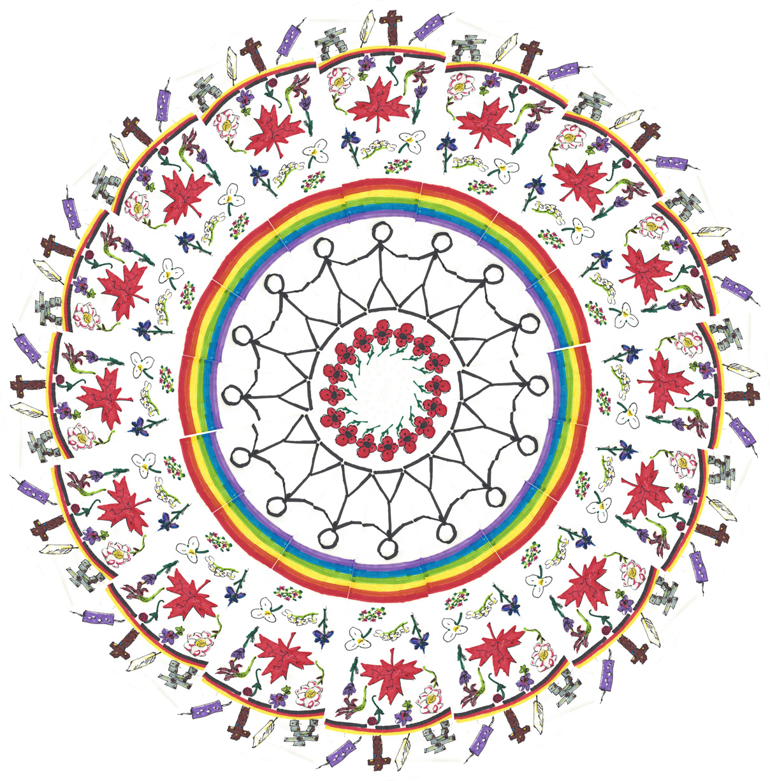
Learning Activity #1: Example 1

Slide 14
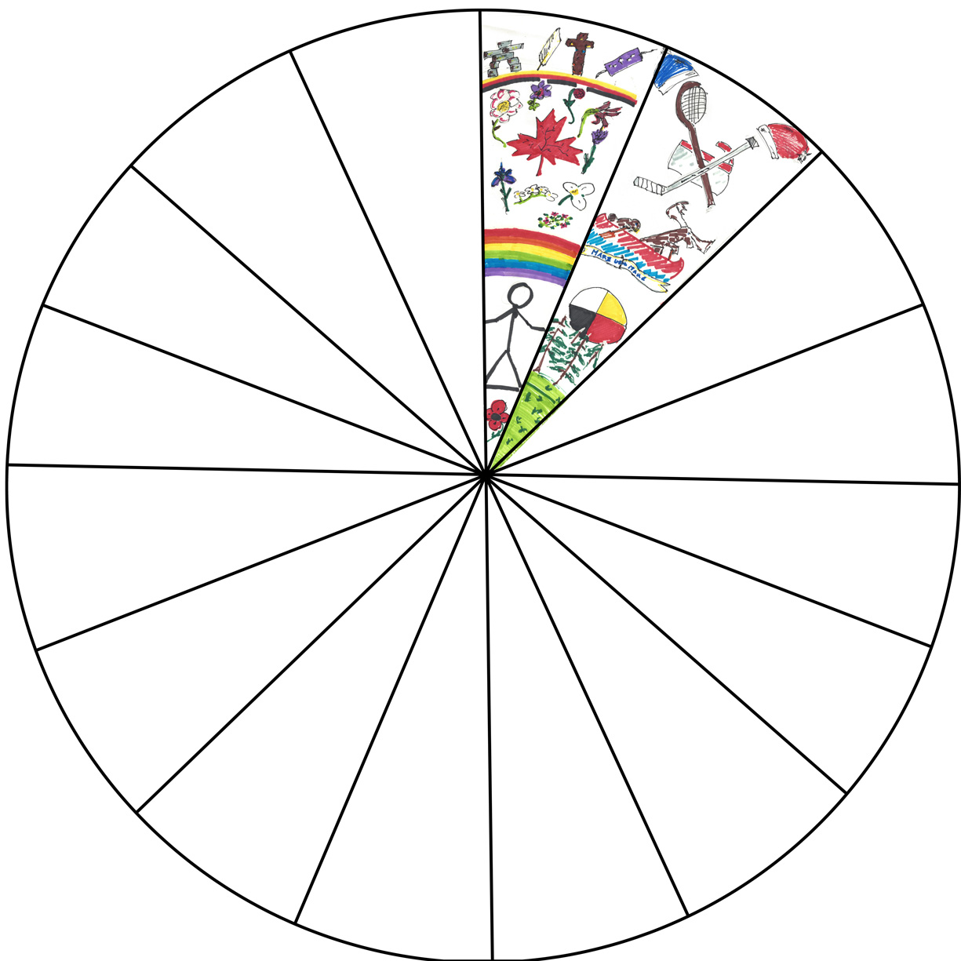
Learning Activity #1: Example 2

Slide 15
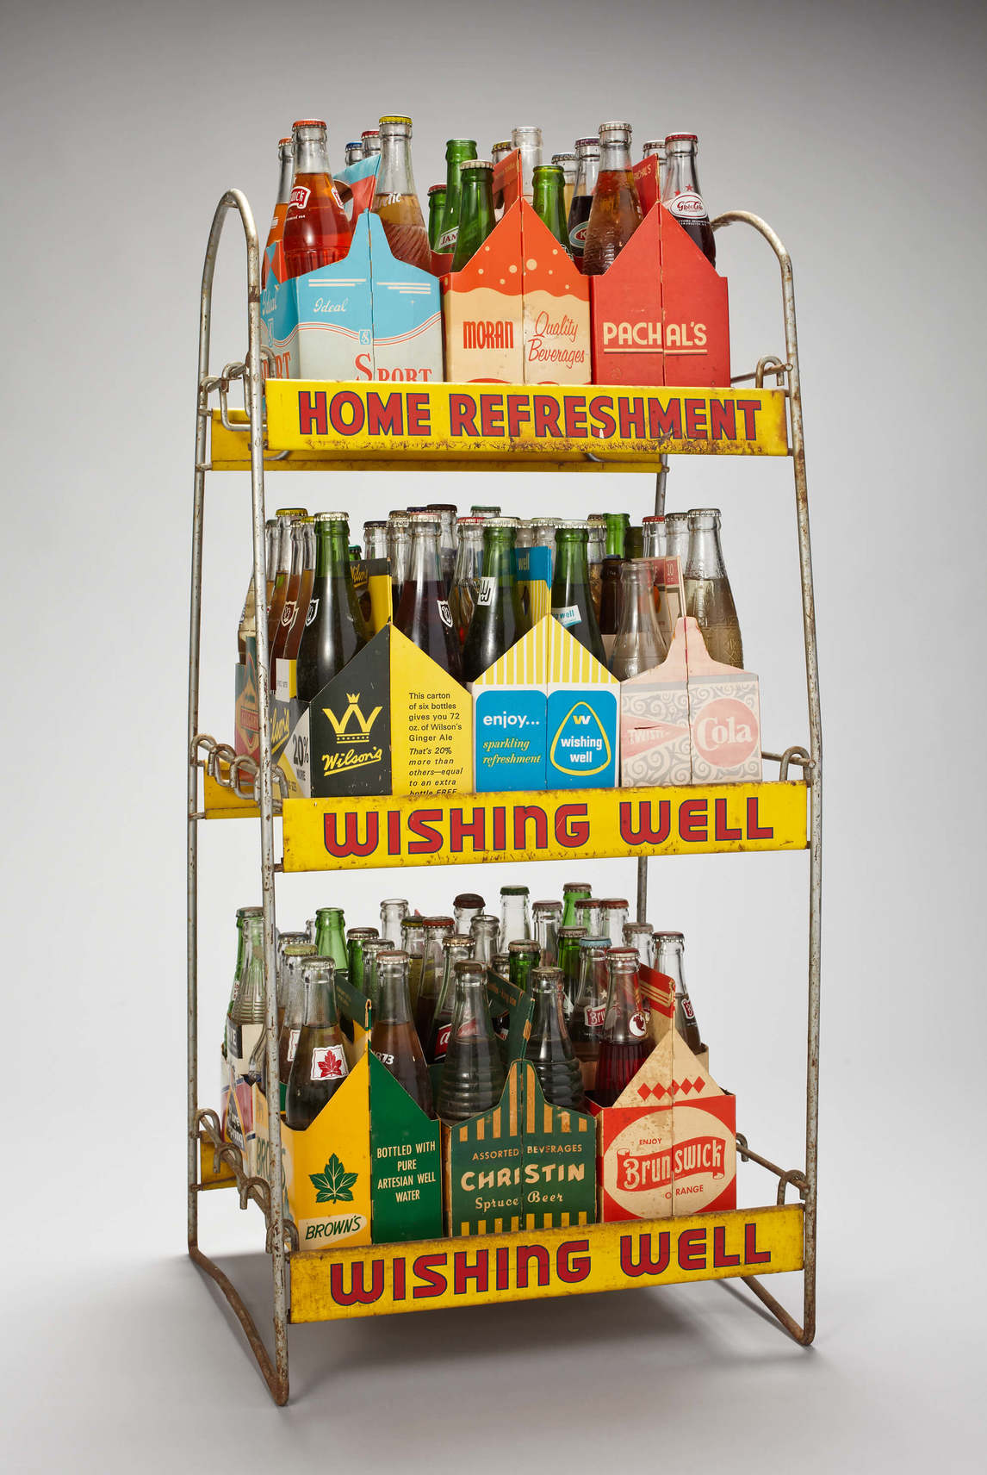
Learning Activity #2
Greg Curnoe, Pop bottle collection, 1900s–1980s, collection consists of
86 pop bottles, 15 cardboard carry trays and 1 wire rack, Art Gallery of Ontario, Toronto, Gift of Sheila Curnoe, 2003, LA.GCF.S19. © Estate of Greg Curnoe / SOCAN (2020).
For this work, Curnoe used regional pop bottles he collected during his travels across Canada from 1968 to 1989. Together they offer an unconventional, eclectic representation of Canada.

Slide 16
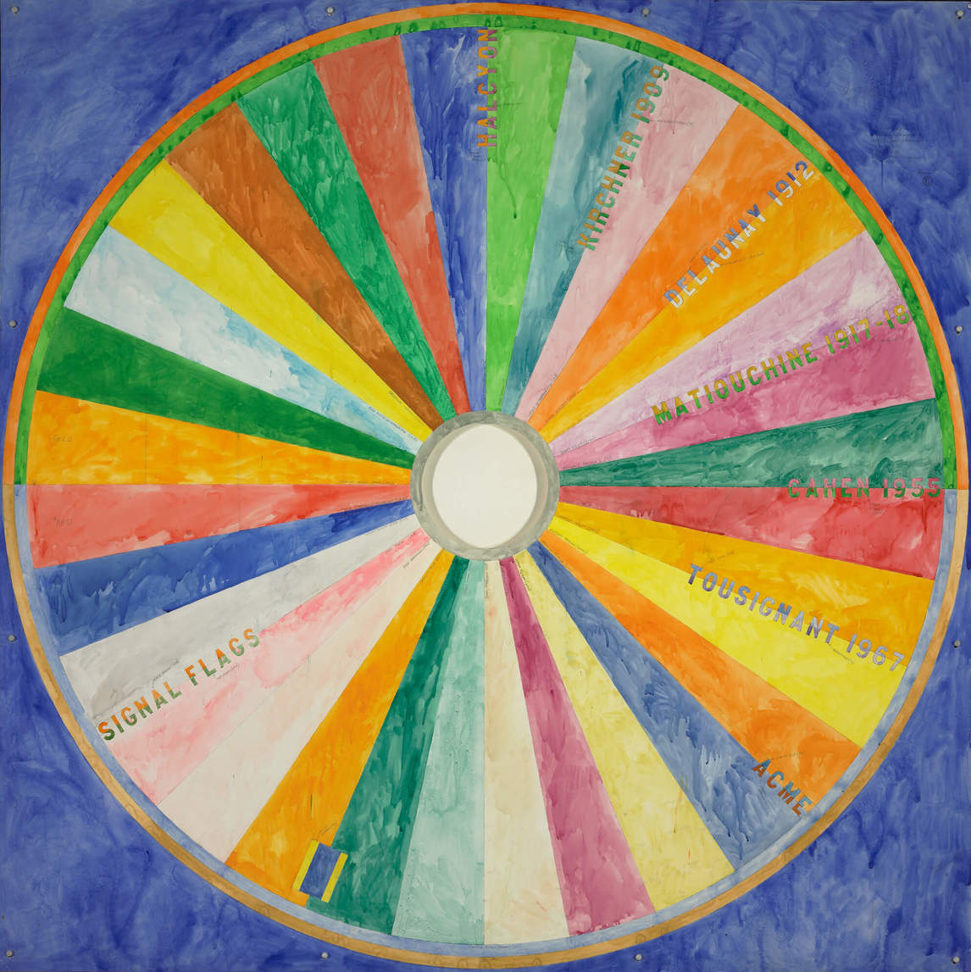
Learning Activity #2
Greg Curnoe, Large Colour Wheel, 1980. Here Curnoe
pays homage to artists who
have come before him. It is another example of Curnoe
using many different elements
to create a whole.

Slide 17
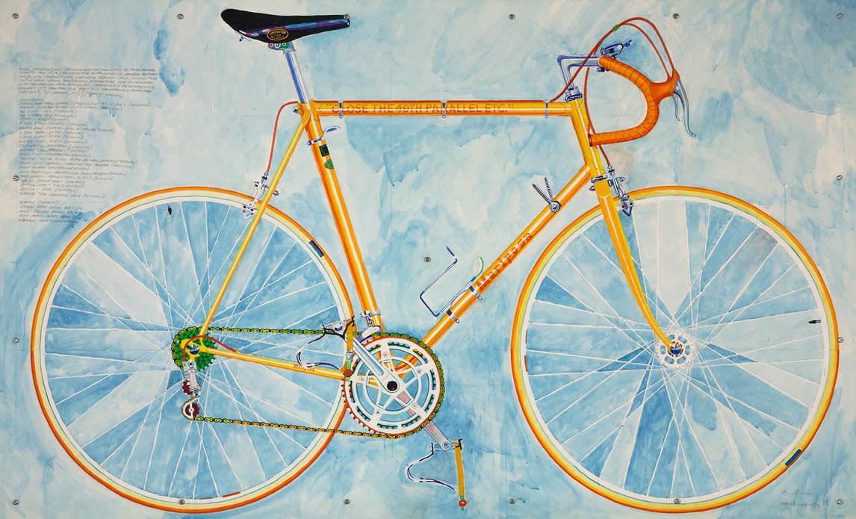
Learning Activity #2
Greg Curnoe, Mariposa 10 Speed No. 2, 1973. Curnoe’s Mariposa bicycle was a recurring symbol for the artist, elevating a personal symbol to a regional and national symbol. The phrase on the bicycle “Close the 49th Parallel” refers to Curnoe’s desire to separate Canada from American influence.

Slide 18
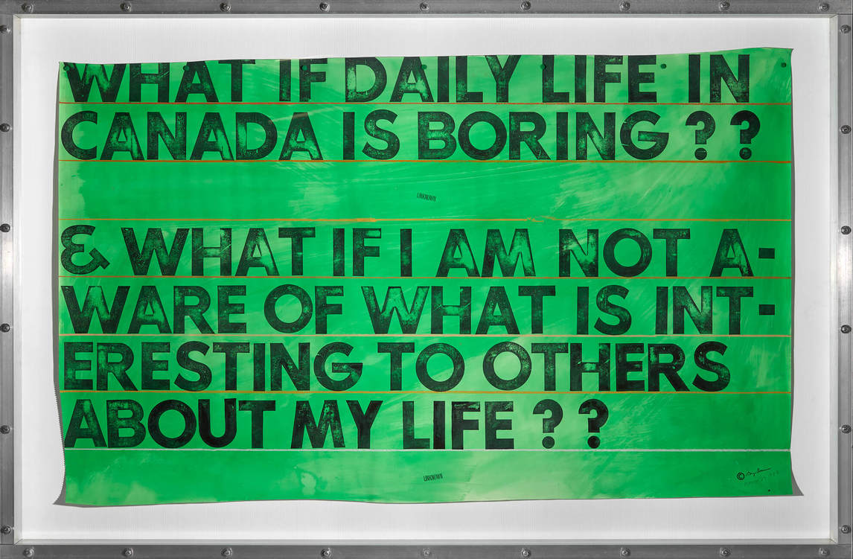
Learning Activity #2
Greg Curnoe, What if Daily Life in Canada Is Boring?, March 23, 1987, gouache, watercolour, stamp-pad ink and pastel on paper, overall: 145 × 221.1 cm, Art Gallery of Ontario, Toronto, Gift of Sheila Curnoe, London, Ontario, 1997, 97/132. © Estate of Greg Curnoe / SOCAN (2020).
The phrase on this artwork “What if daily life in Canada is boring?? & what if I am not aware of what is interesting to others about my life??” represents Curnoe’s questioning
of what is important to Canadians and identity. It questions how important one’s regional or personal interests are to Canadian identity as whole.

Slide 19
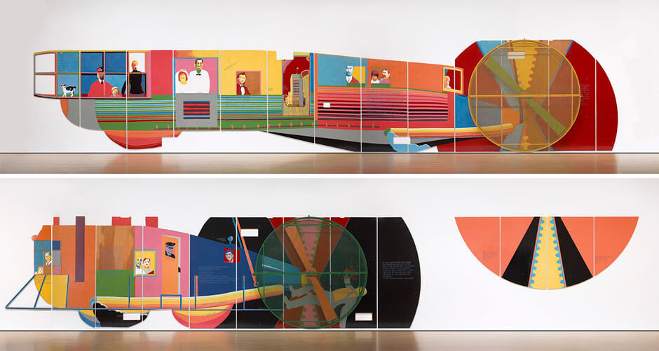
Greg Curnoe, Details of Homage to the R 34 [the Dorval mural], October 1967–March 1968. This is the largest work Greg Curnoe produced, commissioned for the international arrivals tunnel at Montreal International Airport in Dorval, Quebec.

Slide 20
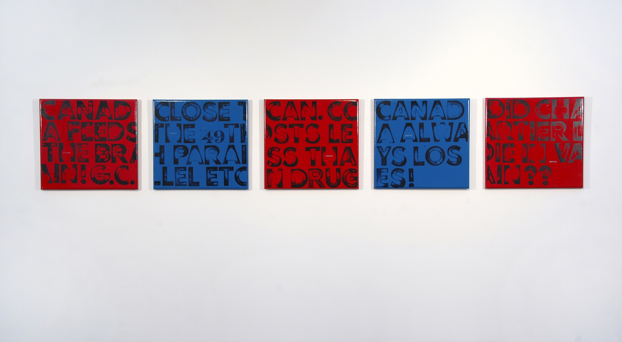
Culminating Task
Greg Curnoe, The True North Strong and Free, #1–5, 1968. Using large-scale rubber stamps for the first time, Curnoe expresses his reaction to the criticism of his anti-American sentiments and the censorship of his major work.

Slide 21
Culminating Task
CANADA FEEDS THE BRAIN! G.C.
Curnoe was passionate about Canadian arts and culture. He saw Canada, and more specifically London, Ontario, as a driving force in his art and intellectual development. He collected pop bottles from across the country for one artwork, and many other works reference Canadian figures, places, and historical events.
Notes:
*insert Ruth’s captions*

Slide 22
Culminating Task
CLOSE THE 49th PARALLEL ETC.
The 49th parallel is the line of latitude that divides Canada and the United States from British Columbia to Manitoba. With this phrase, Curnoe is alluding to the entire U.S.–Canada border. The idea of closing the border is about limiting U.S. influence, especially when it comes to Americans holding positions of power in Canadian universities, cultural institutions, and businesses.
Notes:
*insert Ruth’s captions*

Slide 23
Culminating Task
CAN. COSTS LESS THAN DRUG
Curnoe was one of the first members of Canadian Artists’ Representation, an organization set up by a group of London, Ontario, artists to ensure that Canadian artists would be paid when their work was displayed in galleries and museums. It was founded in 1968, the same year this piece was made, and the words on this panel could be a reference to Curnoe’s support for his peers.
Notes:
*insert Ruth’s captions*

Slide 24
Culminating Task
CANADA ALWAYS LOSES!
The series The True North Strong and Free, #1–5 was painted immediately after Greg Curnoe’s mural Homage to the R 34, October 1967–March 1968, was removed from Montreal International Airport in Dorval, Quebec, for being “anti-American.” With the phrase “Canada always loses!” Curnoe expresses his frustration and disappointment in being censored.
Notes:
*insert Ruth’s captions*

Slide 25
Culminating Task
DID CHARTIER DIE IN VAIN?
On May 18, 1966, Paul Joseph Chartier attempted to place a bomb in the Canadian House of Commons, but the device went off early, killing him alone. Chartier felt the government was greedy and corrupt and had no interest in helping impoverished and working-class citizens like himself. Curnoe references the attempted act of terrorism with a dark question. By asking if Chartier “died in vain,” he suggests that there was some truth to Chartier’s cause (though he does not condone his means) and that the government still fails to support the needs of many Canadians.
Notes:
*insert Ruth’s captions*

Slide 26
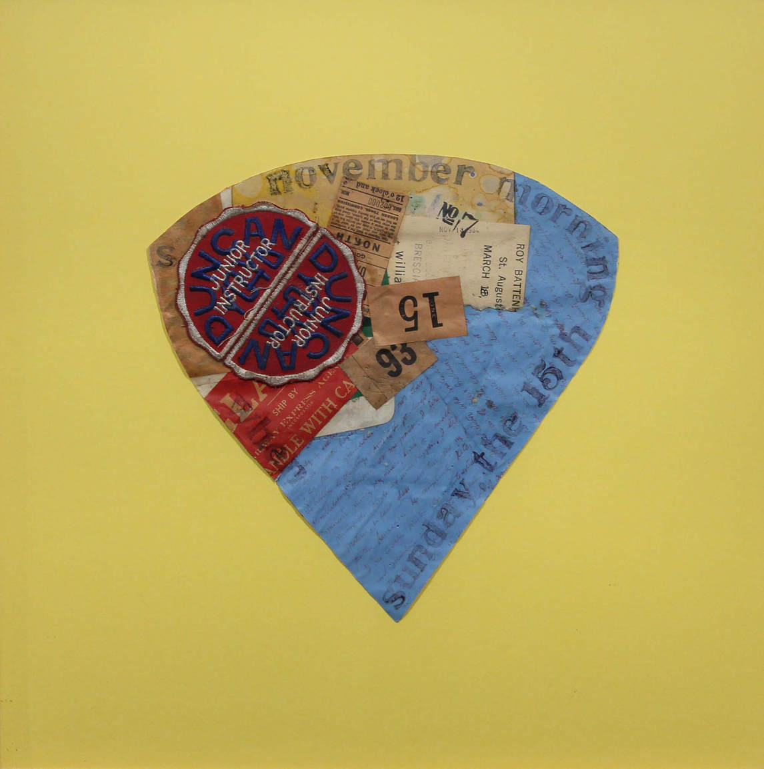
Greg Curnoe, Cherry Pop #7, November 18, 1964. Curnoe was attracted to the Dadaists’ use of found objects, assemblage, text, and collage.

Slide 27
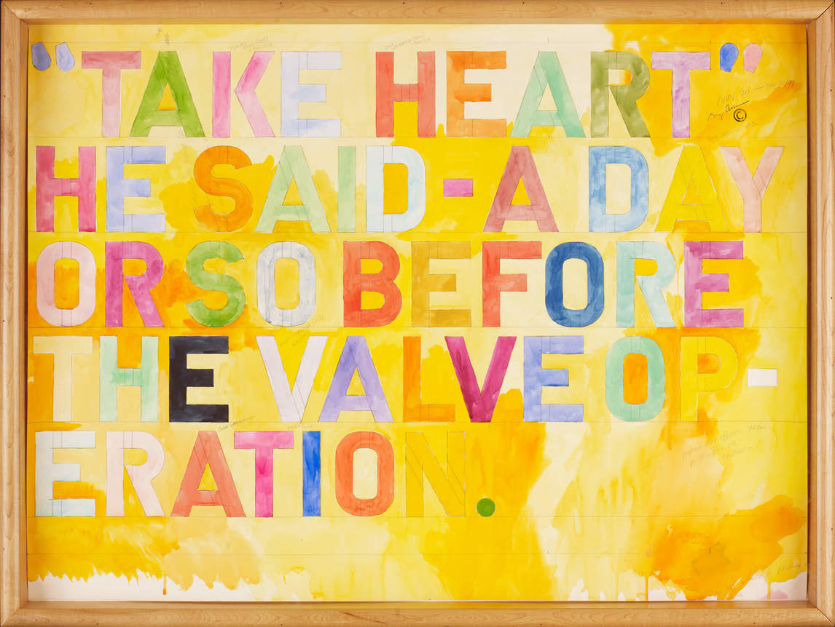
Greg Curnoe, For Selwyn #2, November 20–26, 1979, watercolour and graphite, overall: 84.5 x 114 cm, Art Gallery of Ontario, Toronto, Gift of Sheila Curnoe, London, Ontario, 1997, 97/120. © Estate of Greg Curnoe / SOCAN (2020).
Curnoe painted “obituary” text works for a number of artists close to him.

Slide 28
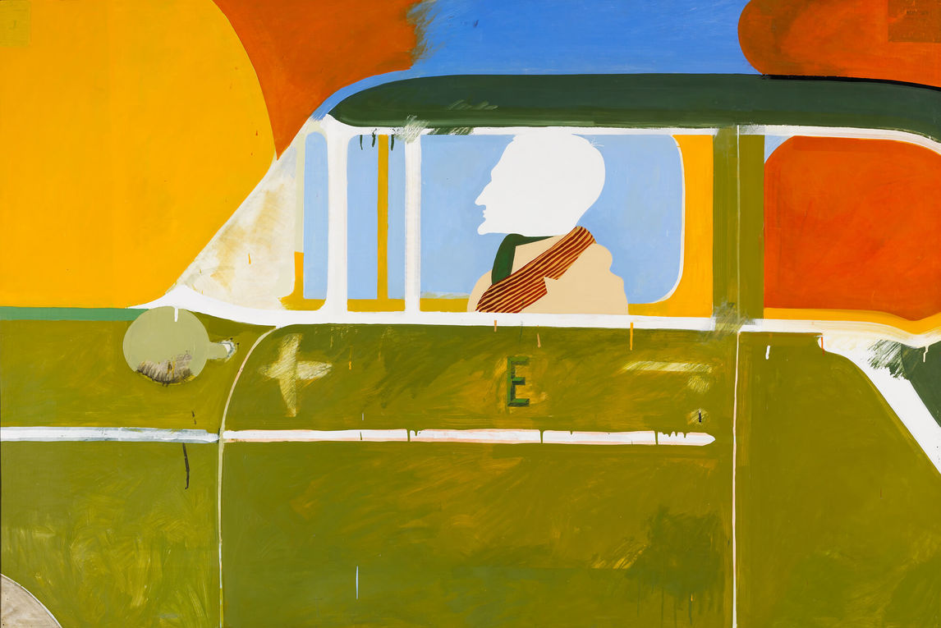
Greg Curnoe, The Best Profile in the World, 1963. Curnoe became a master of the application of pigments, usually very bright.

Slide 29
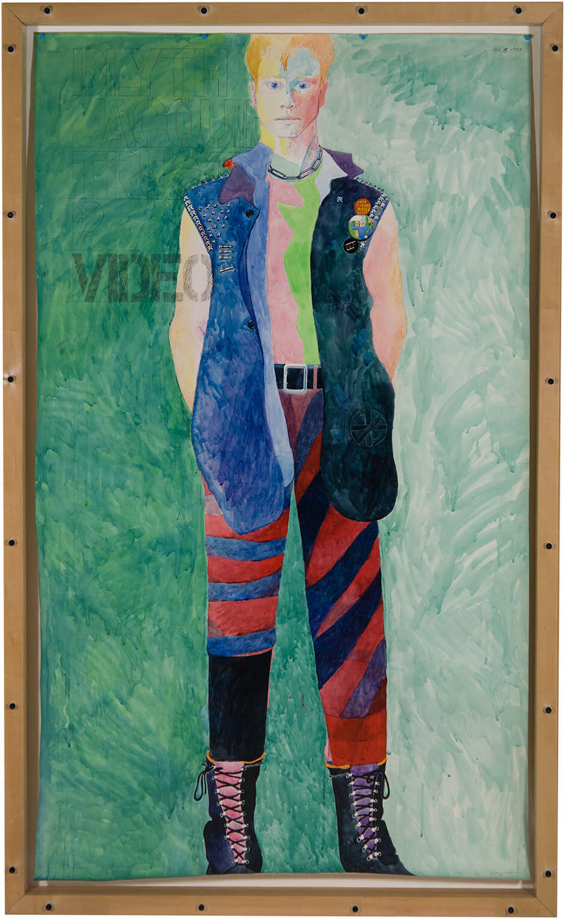
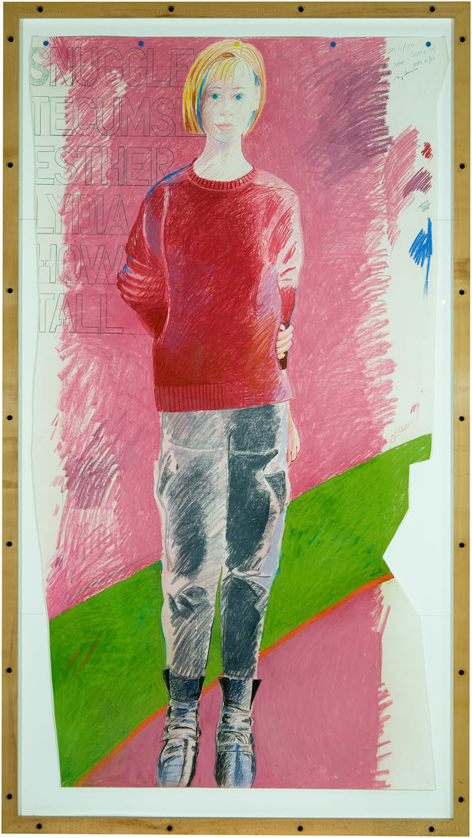
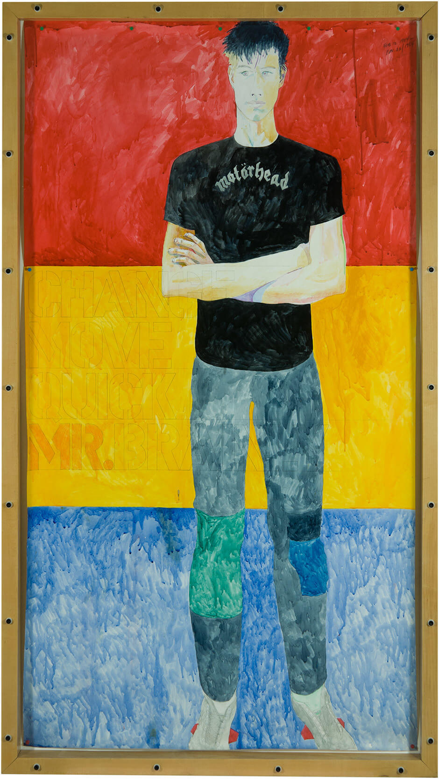
Over the years Curnoe completed many portraits of his wife and children, as seen here.
From left to right: Owen, Zoë, and Galen.

Slide 30
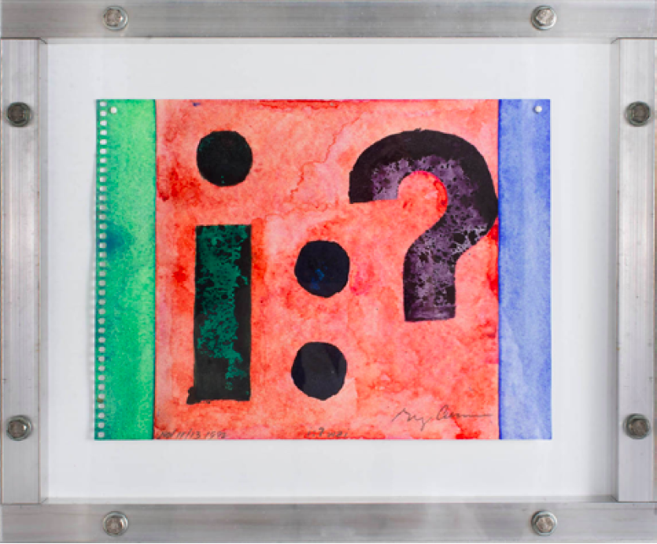
Greg Curnoe, I Wai, November 11–13, 1992. This was the work Curnoe stamped the night before he was killed; he was still searching for his identity at the end.

