Slide 2
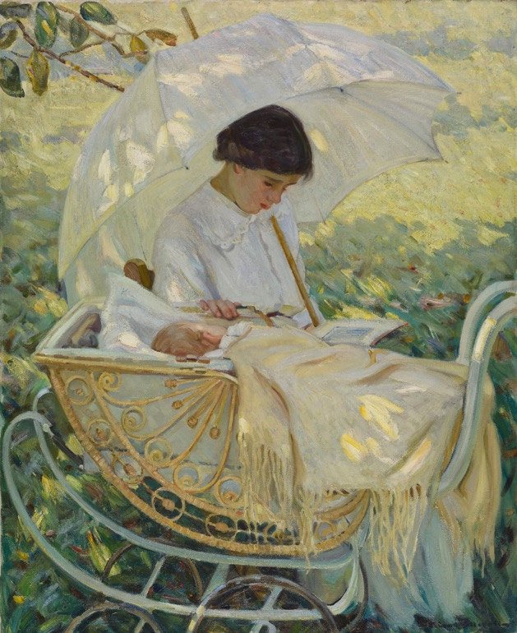
Helen McNicoll, In the Shadow of the Tree, c.1914. Today McNicoll is best known as a painter of women and children.

Slide 3
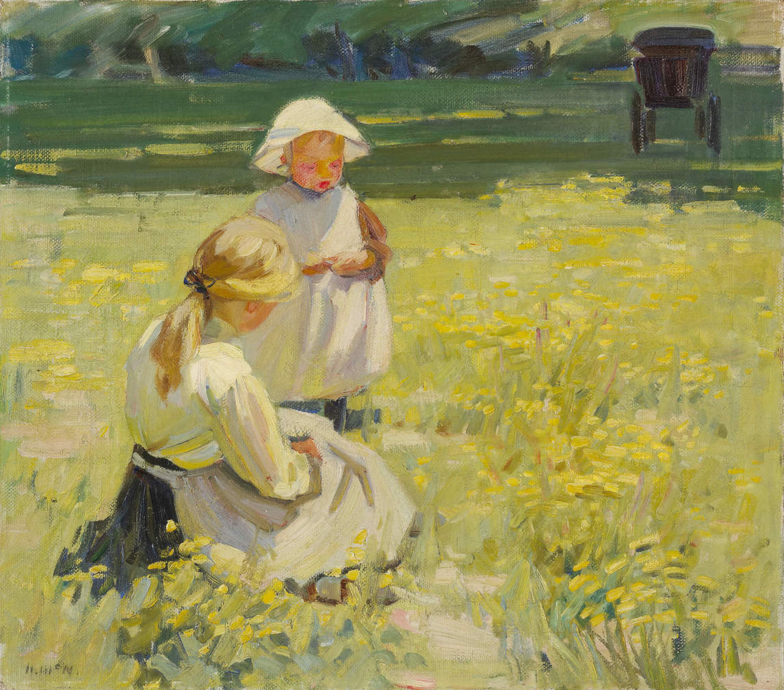
Helen McNicoll, Buttercups, c.1910. McNicoll developed her own fresh, bright style based on the principles of Impressionism.

Slide 4
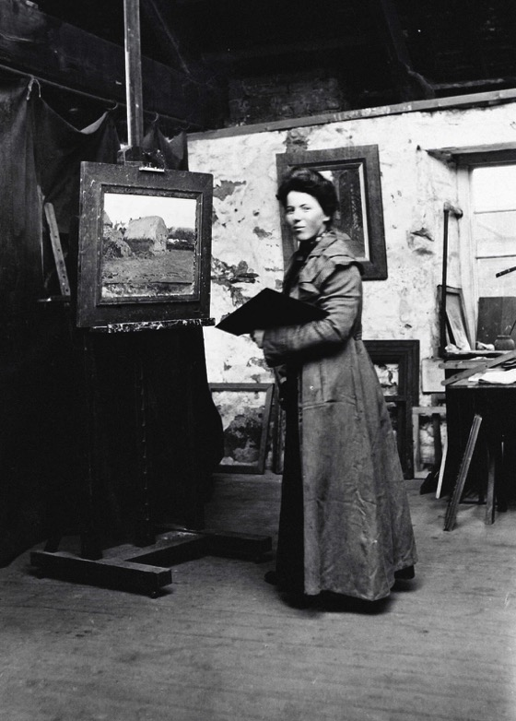
Photograph of Helen McNicoll in her studio at St. Ives, c.1906.

Slide 5
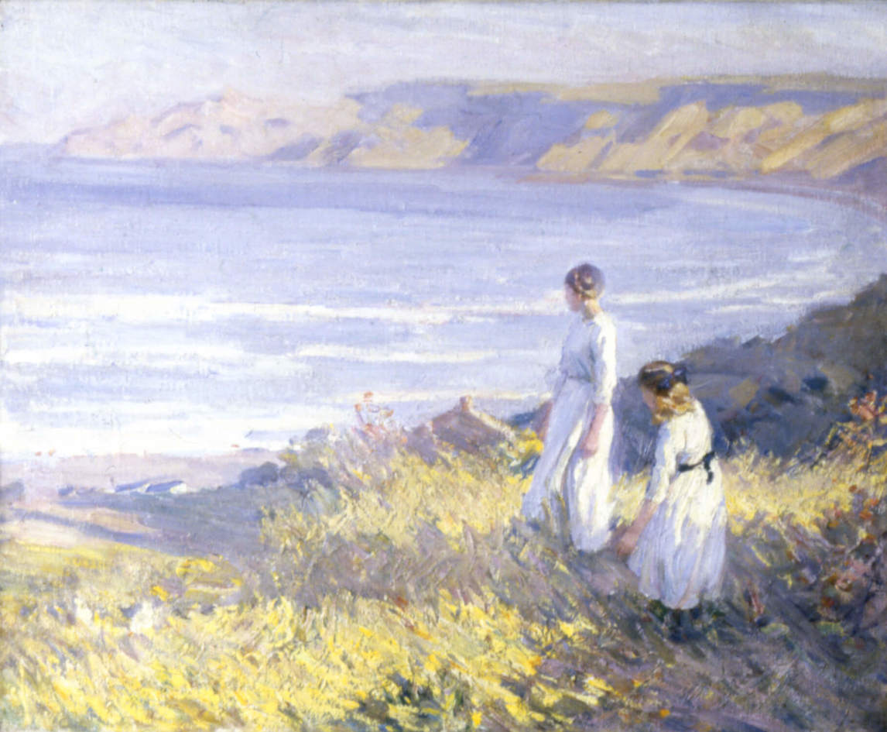
Helen McNicoll, On the Cliffs, 1913. Absorbed in their thoughts, these figures do not seem to acknowledge one another.

Slide 6
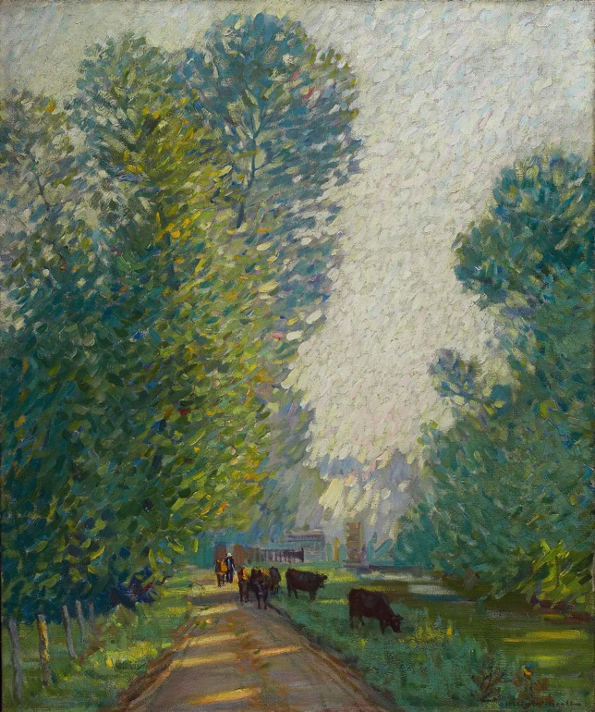
Helen McNicoll, Landscape with Cows, c.1907, oil on canvas, overall: 90.5 x 71.1 cm, Art Gallery of Ontario, Toronto, Gift of Mrs. R. Fraser Elliott, 1977, 77/7. © Art Gallery of Ontario.
This painting is one of McNicoll’s earliest efforts to take up the Impressionist style.

Slide 7
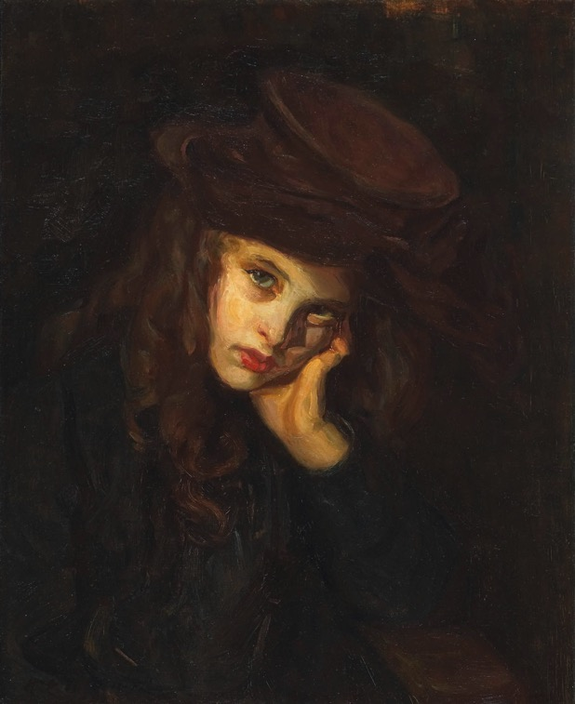
Helen McNicoll, The Brown Hat, c.1906, oil on canvas, framed: 75.5 x 65.5 cm, Art Gallery of Ontario, Toronto, Gift from the Estate of R. Fraser Elliott, 2006, 2006/88. © Art Gallery of Ontario.
With its dark palette and the direct gaze of its sitter, this portrait is unusual for McNicoll.

Slide 8
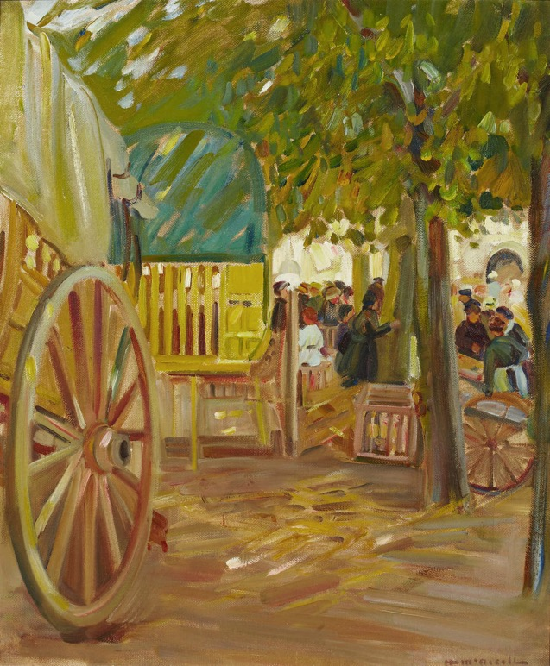
Helen McNicoll, Market Cart in Brittany, c.1910. McNicoll worked frequently in Brittany, where she painted warm-toned market scenes.

Slide 9
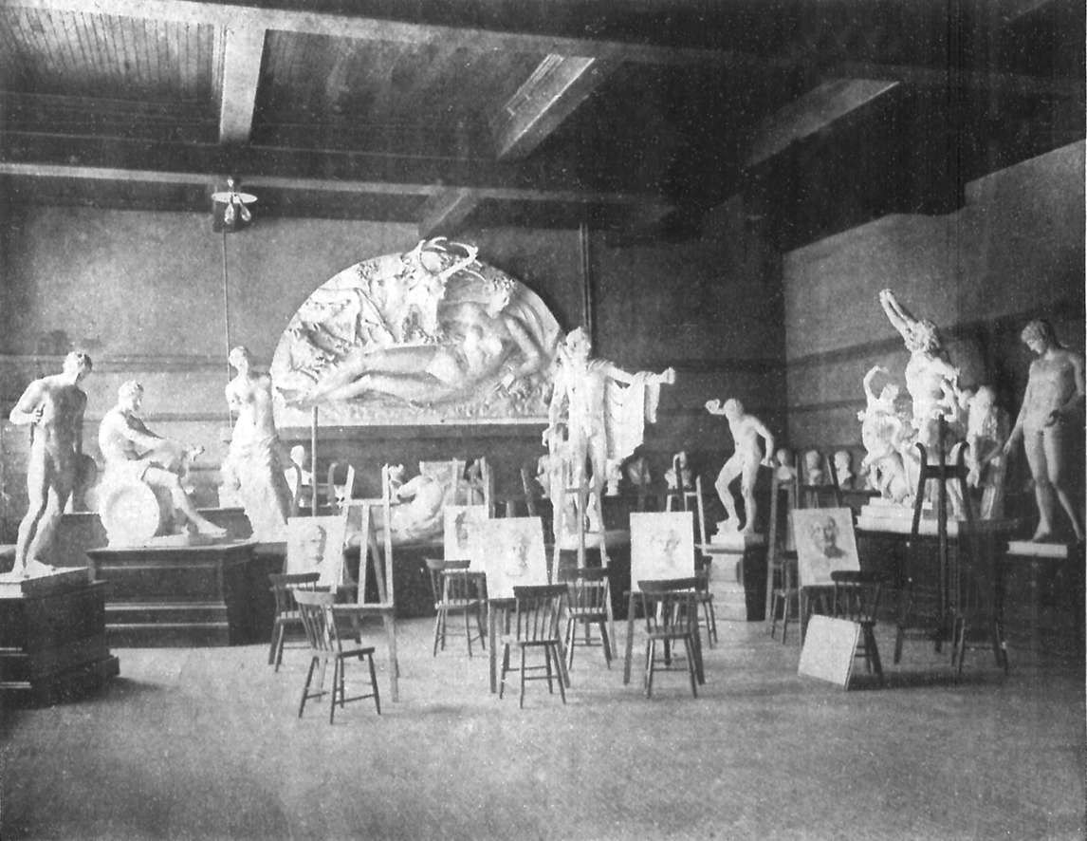
Photograph of the Art Association of Montreal sculpture room, published in The Standard, November 18, 1905.

Slide 10
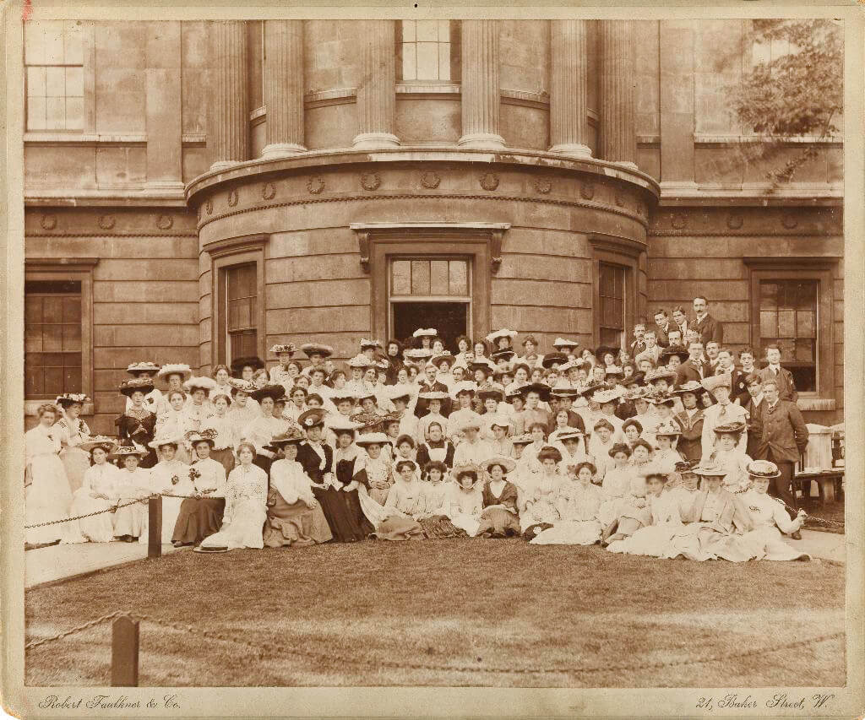
Photograph of students at the Slade School, June 23, 1905.

Slide 11
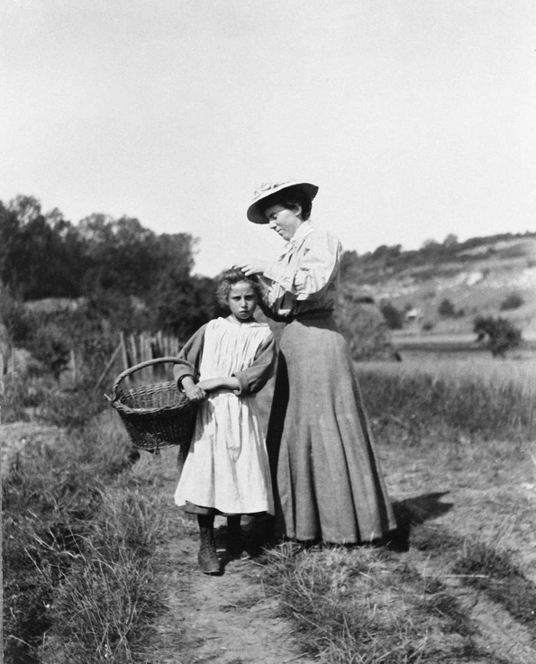
Photograph of Helen McNicoll adjusting model’s hair, n.d. The back of this photograph reads: “It’s so hot that I’ve put a handkerchief round my neck. It’s about 90 in the shade.”

Slide 12
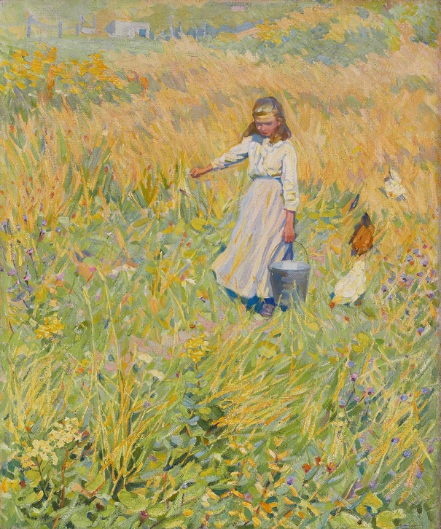
Learning Activity #1

Slide 13
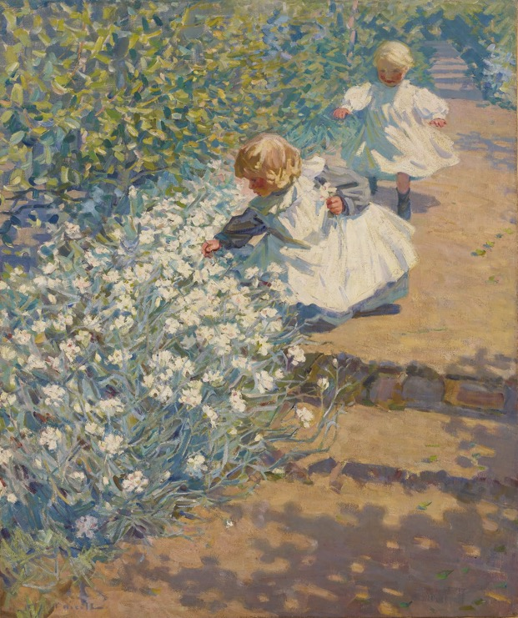
Learning Activity #1

Slide 14
Learning Activity #1

Slide 15
Learning Activity #1

Slide 16
Helen McNicoll, The Little Worker, c.1907, oil on canvas, overall: 61 x 51.3 cm, Art Gallery of Ontario, purchase, 1983, 83/238. © Art Gallery of Ontario.
The subject of this painting is shown looking after chickens, in a warm pastoral field.

Slide 17
Helen McNicoll, Picking Flowers, c.1912, oil on canvas, framed: 115.5 x 107 cm, Art Gallery of Ontario, Toronto, Gift of R. Fraser Elliott, Toronto, in memory of Betty Ann Elliott, 1992, 92/102. © Art Gallery of Ontario.
In this work we see two children picking flowers in a garden.

Slide 18
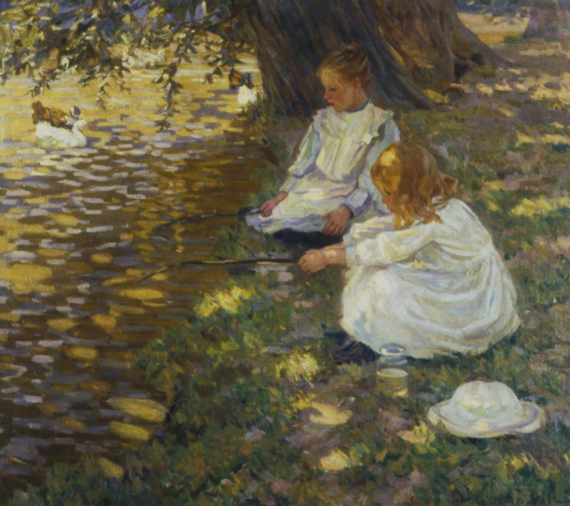
Helen McNicoll, Fishing, c.1907. These children appear to have created improvised fishing rods out of sticks for a spontaneous game.

Slide 19
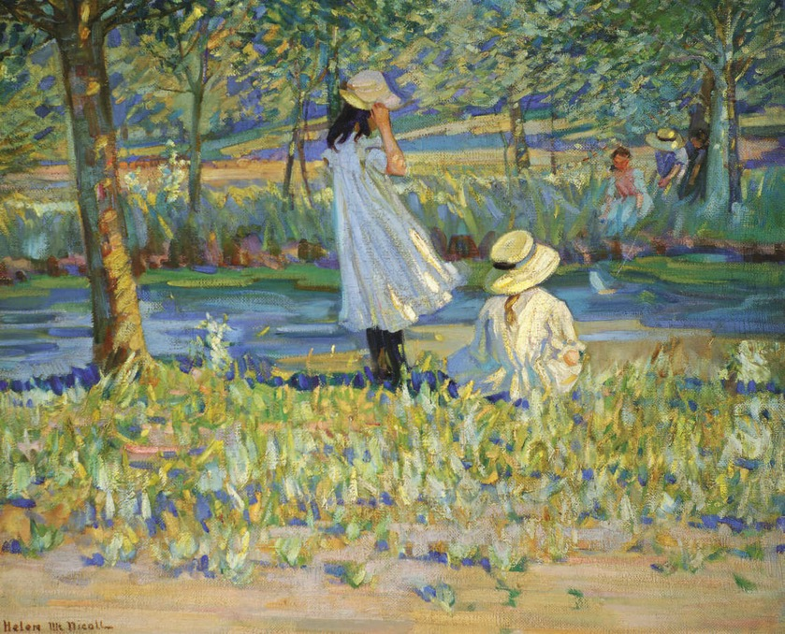
Helen McNicoll, Watching the Boat, c.1912. This scene depicts children watching a toy boat that is represented through small dabs of paint.

Slide 20
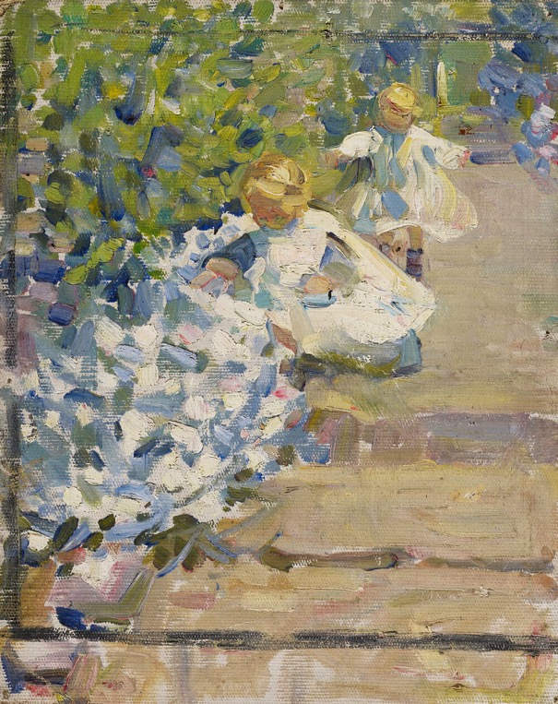
Helen McNicoll, Sketch for “Picking Flowers,” c.1912, oil on canvas on laminated paperboard, overall: 25.5 x 20.3 cm, Art Gallery of Ontario, Toronto, Gift of Helen McNicoll Dubeau, Acton, Ontario, 1994, 94/796. © Art Gallery of Ontario.
This sketch illustrates McNicoll’s plan for the finished painting.

Slide 21
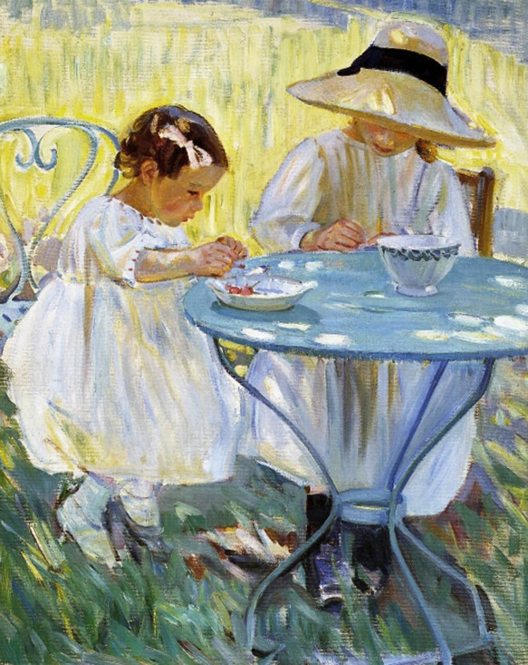
Learning Activity #2
Helen McNicoll, Cherry Time, c.1912. This painting shows two girls completely absorbed in a summer snack, fruit that they may have picked themselves.

Slide 22
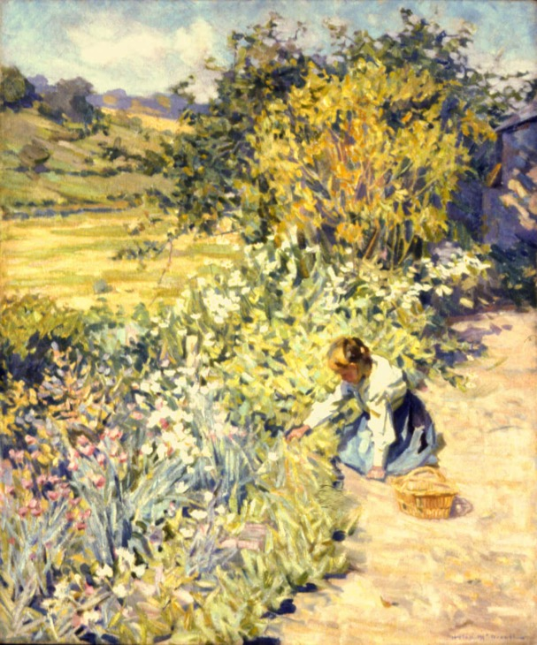
Learning Activity #2
Helen McNicoll, Gathering Flowers, c.1911.

Slide 23
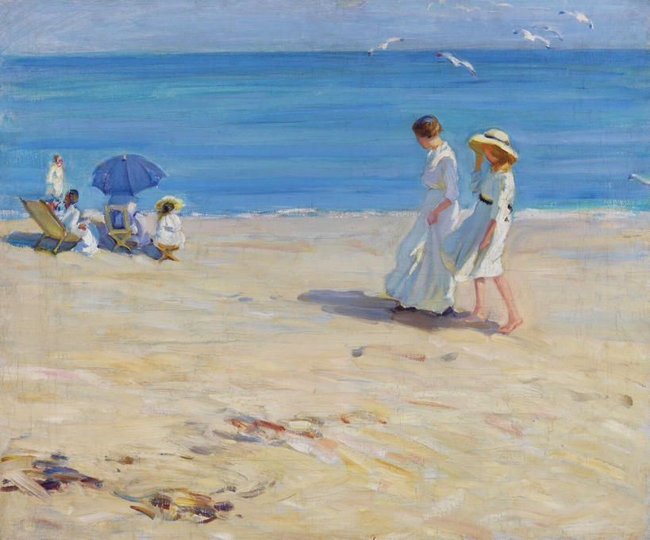
Learning Activity #2
Helen McNicoll, The Blue Sea (On the Beach at St. Malo), c.1914.

Slide 24
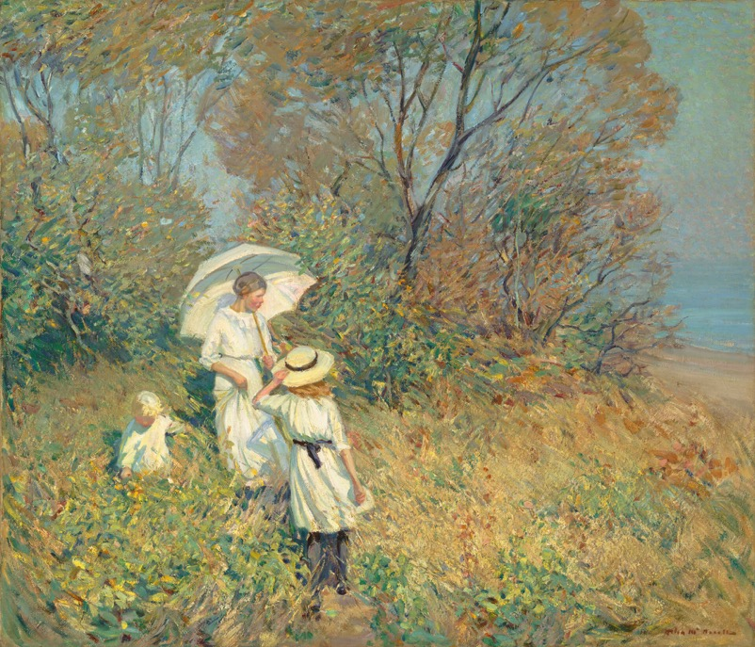
Learning Activity #2
Helen McNicoll, Sunny September, 1913.

Slide 25
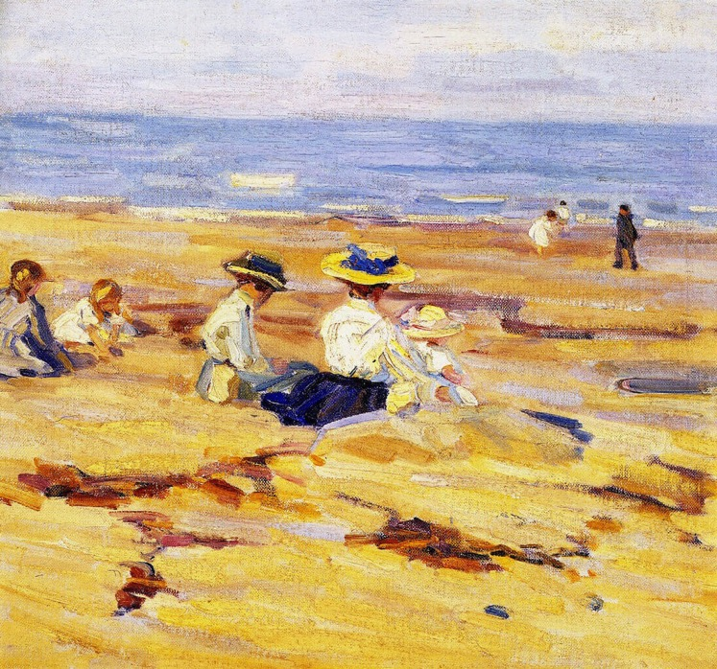
Learning Activity #2
Helen McNicoll, On the Beach, c.1910.

Slide 26
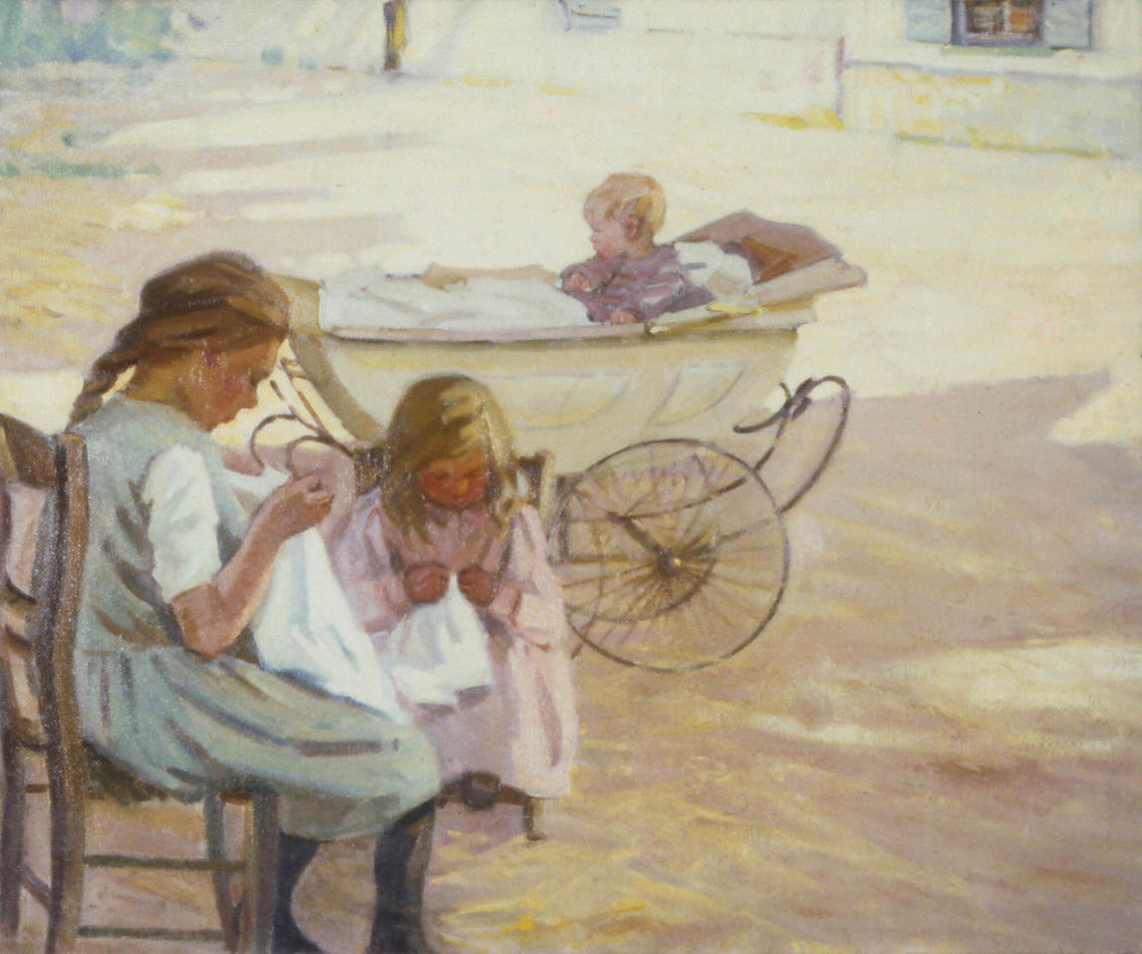
Learning Activity #2
Helen McNicoll, Minding Baby, c.1911.

Slide 27
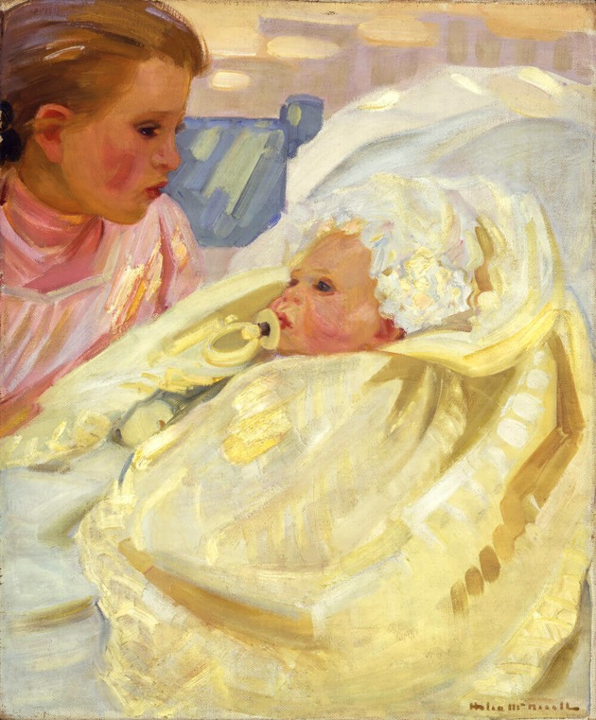
Helen McNicoll, Study of a Child, c.1900. In this painting the close-up view of the child and the baby offers us an intimate glimpse of a family’s life.

Slide 28
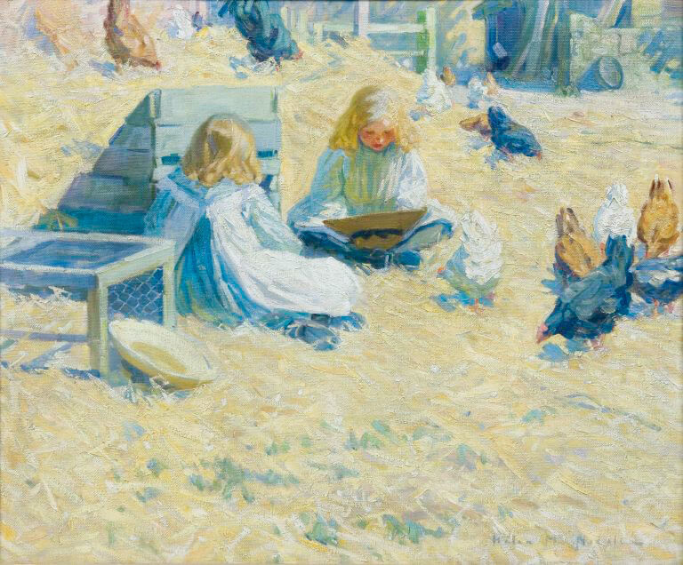
Helen McNicoll, The Farmyard, c.1908. This painting represents rural children in a farmyard with several resident chickens.

Slide 29
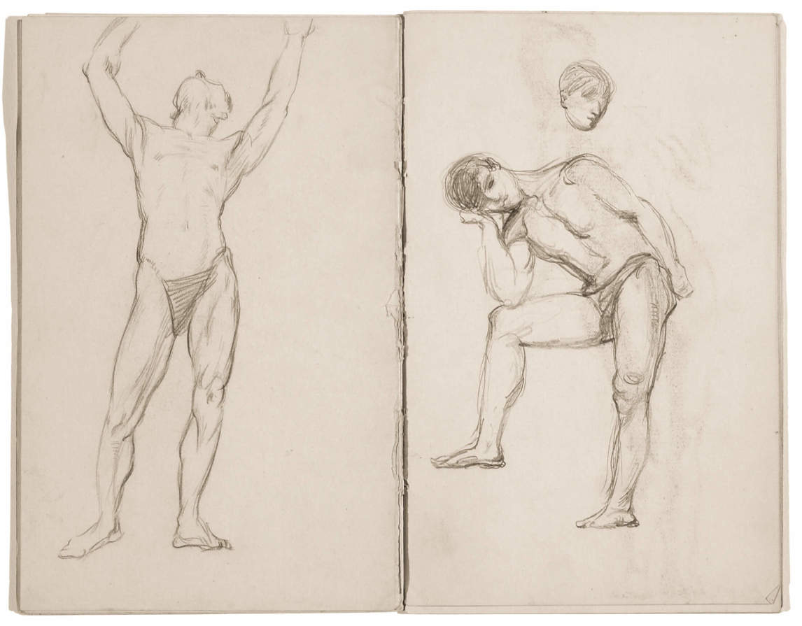
Helen McNicoll, Large Sketchbook, c.1902, 23 loose folios from bound sketchbook, with graphite, conte drawings on laid paper, overall: 20.3 x 13 cm, Art Gallery of Ontario, Toronto, Gift of Jane and John McNicoll, 2002, 2002/9440, © Art Gallery of Ontario.
The men in these drawings are not entirely nude because women artists drew male models who were draped.

Slide 30
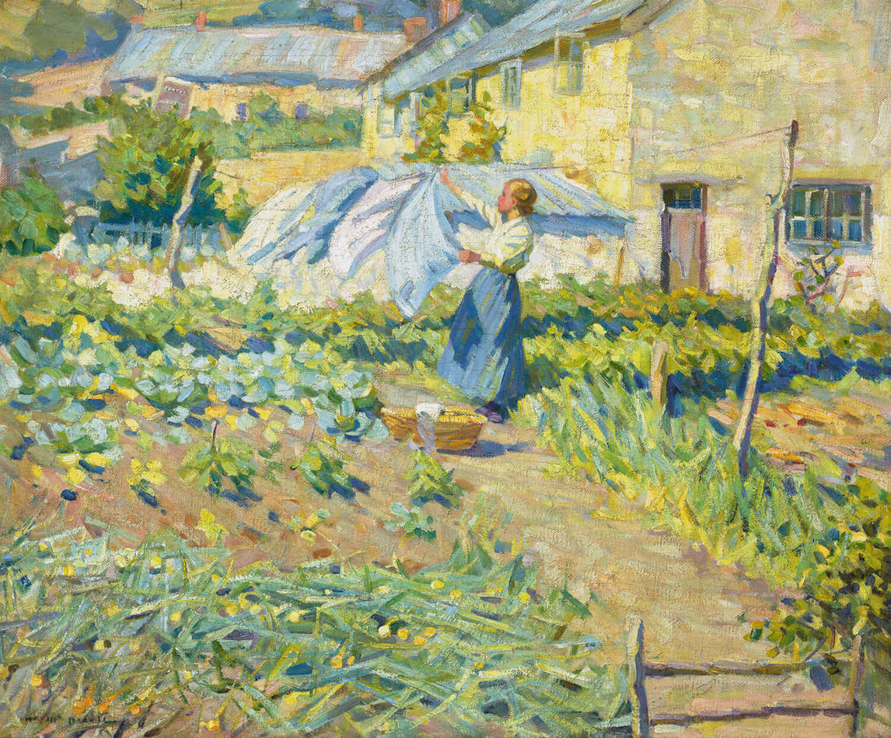
Helen McNicoll, A Welcome Breeze, c.1909. This painting was praised for capturing the quality of sunshine.

Slide 31
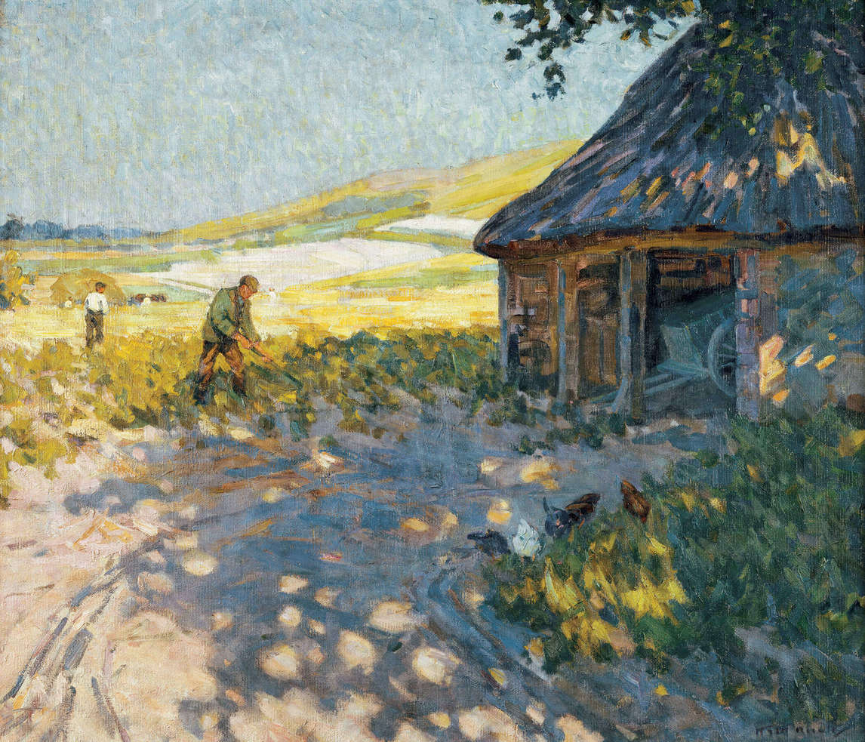
Helen McNicoll, Midsummer, c.1909. McNicoll embraced the Impressionist style for paintings of rural genre scenes and landscapes.

Slide 32
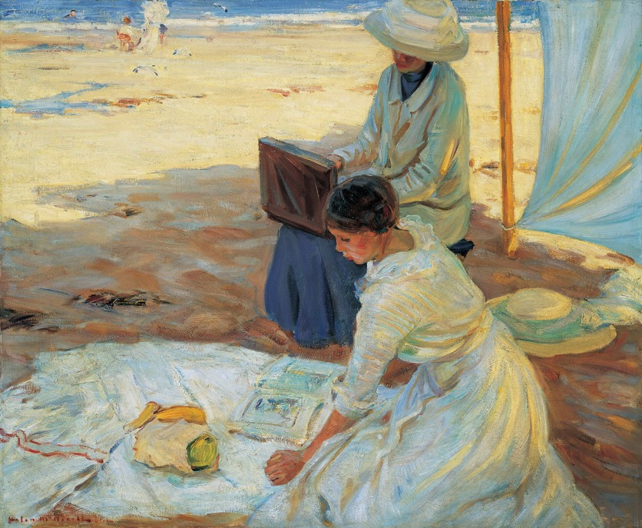
Helen McNicoll, Under the Shadow of the Tent, 1914. This painting’s relatively large size supports the idea that women’s artistic activity is important.

Slide 33
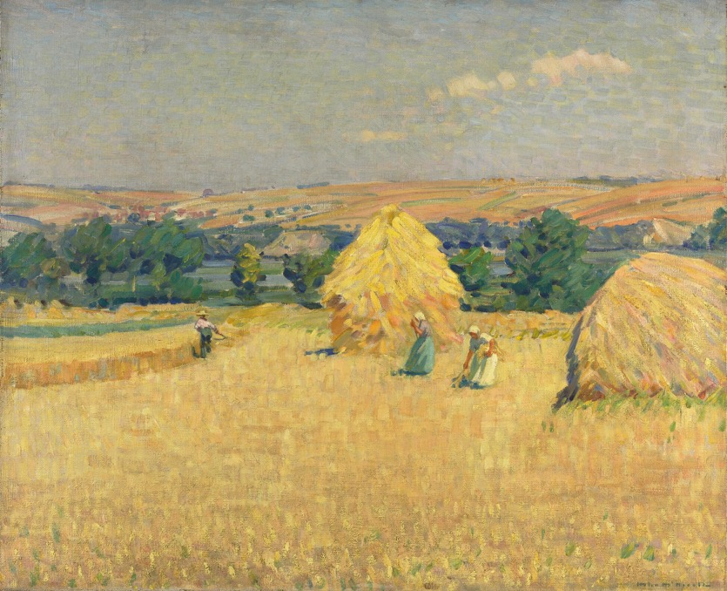
Helen McNicoll, Stubble Fields, c.1912. The brilliant yellow and purple tones show an awareness of late nineteenth-century colour theory popular in Impressionist and Post-Impressionist circles.

Slide 34
Helen McNicoll, Sunny September, 1913. In this pleasant scene a woman and two children appear to be sightseeing, tourists enjoying a day in the countryside.

Slide 35
Helen McNicoll, Minding Baby, c.1911. Here two young girls are engaged in sewing , while still keeping an eye on their younger sibling.

