Slide 1
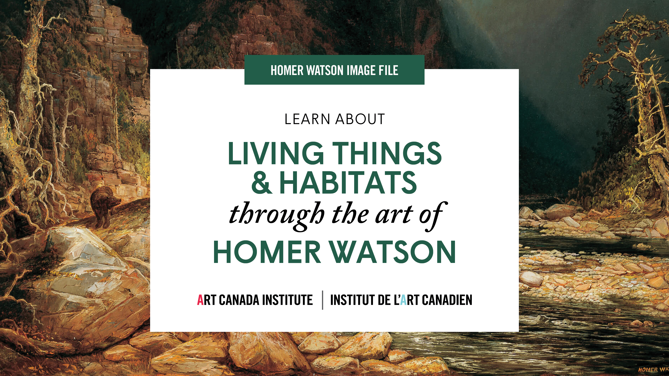

Slide 2
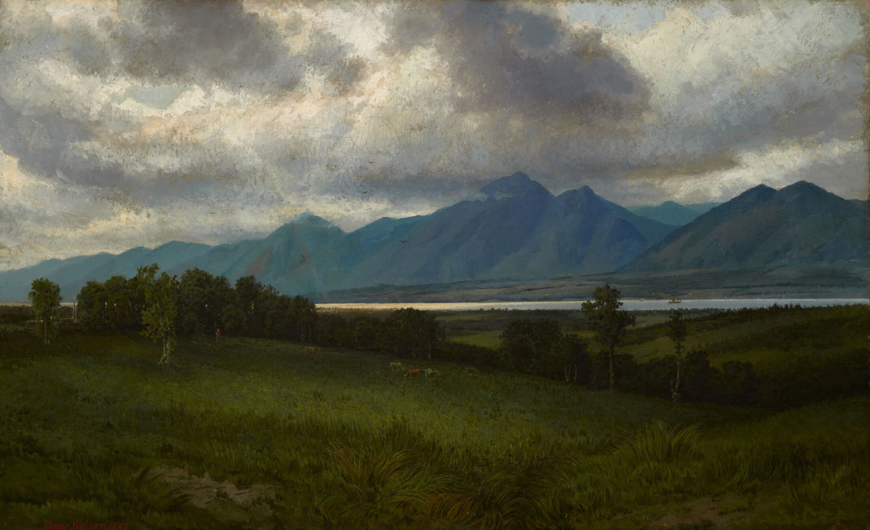
Homer Watson, Down in the Laurentides, 1882. This work was begun when Watson visited Île d’Orléans in Quebec.

Slide 3
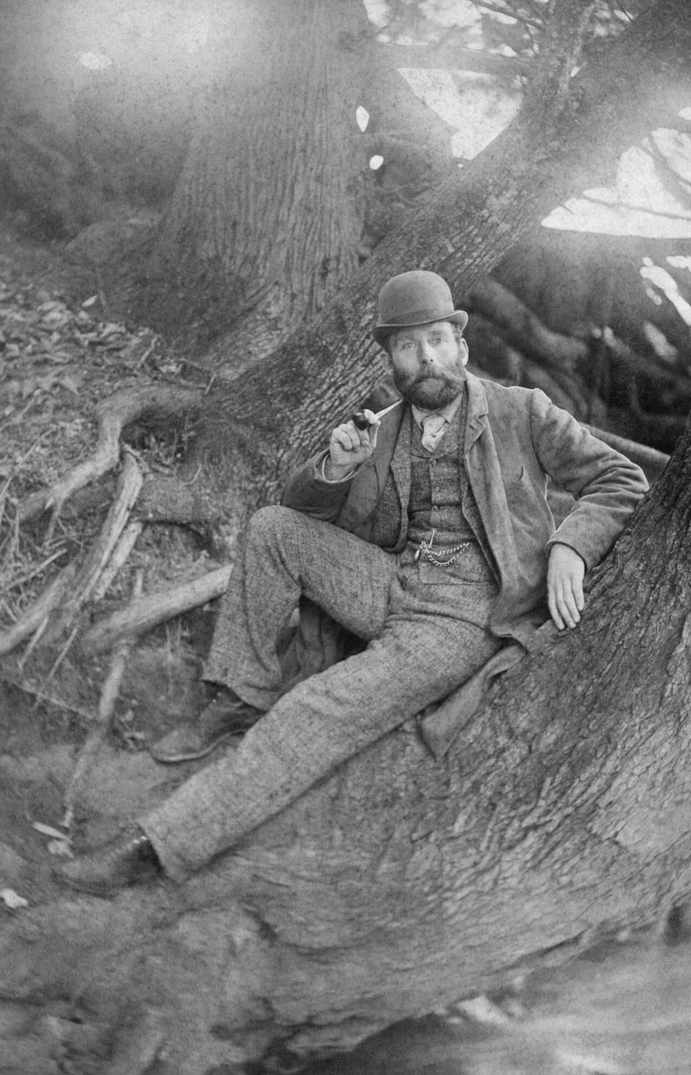
One of the earliest known photographs of Homer Watson, c.1880.

Slide 4
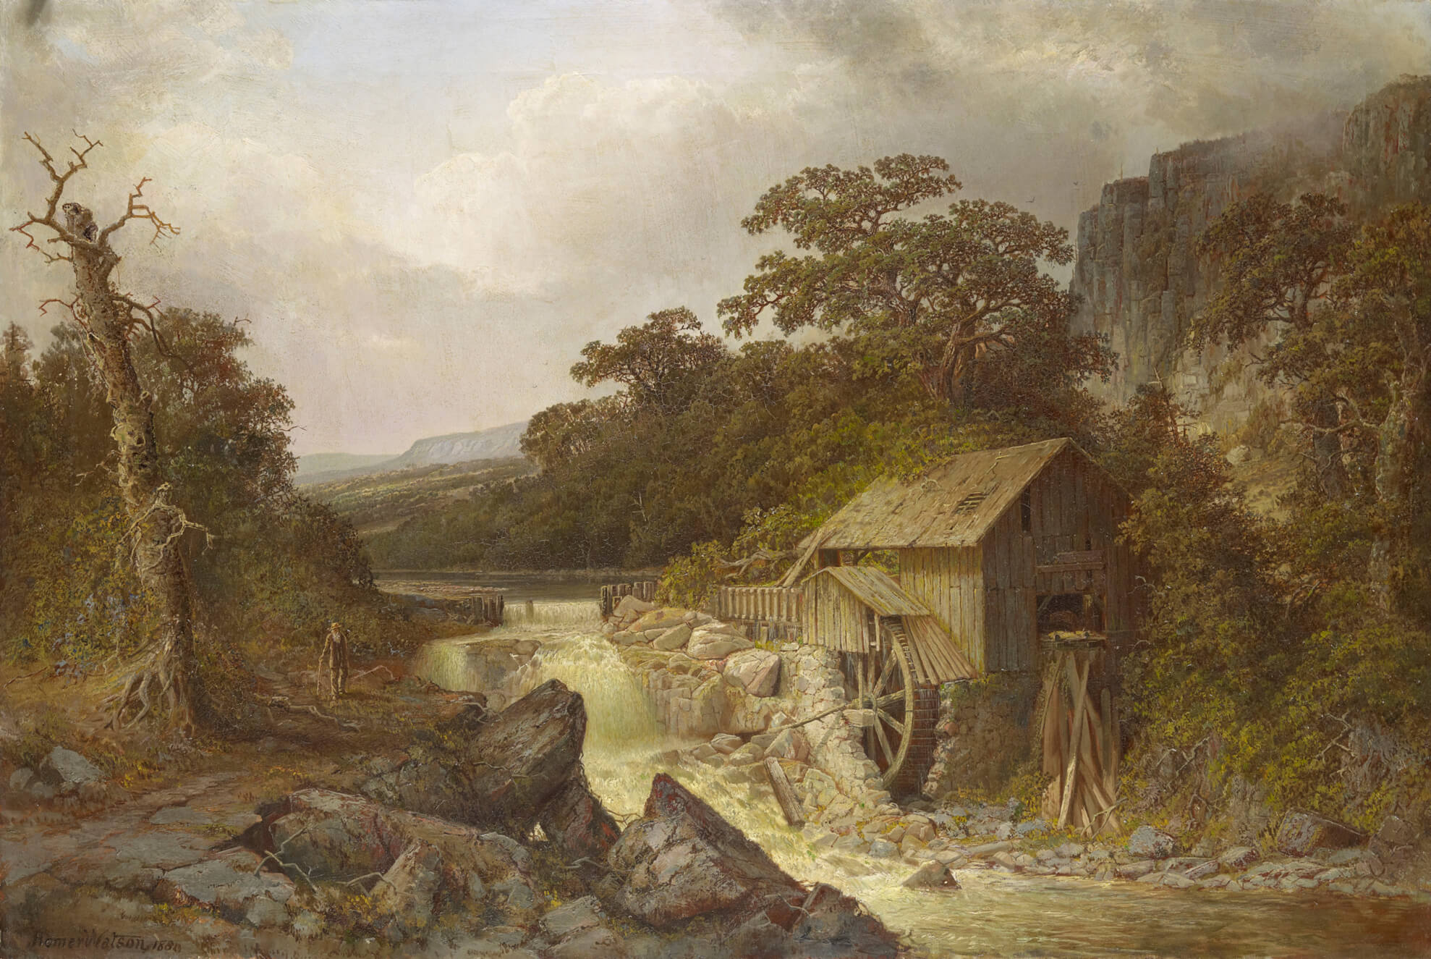
Homer Watson,
The Pioneer Mill, 1880.
No painting was more important for Watson’s career than this artwork.

Slide 5
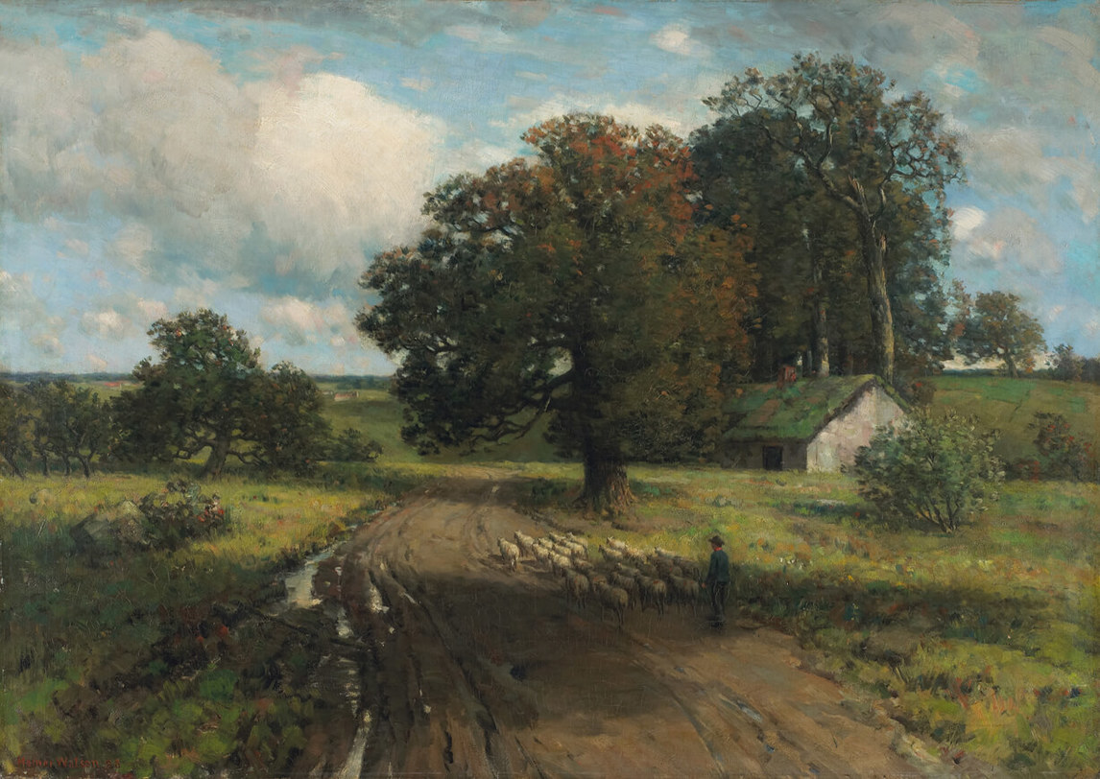
Homer Watson, Landscape, Scotland, 1888. While visiting Britain, Watson spent time on the southeast coast of Scotland.

Slide 6
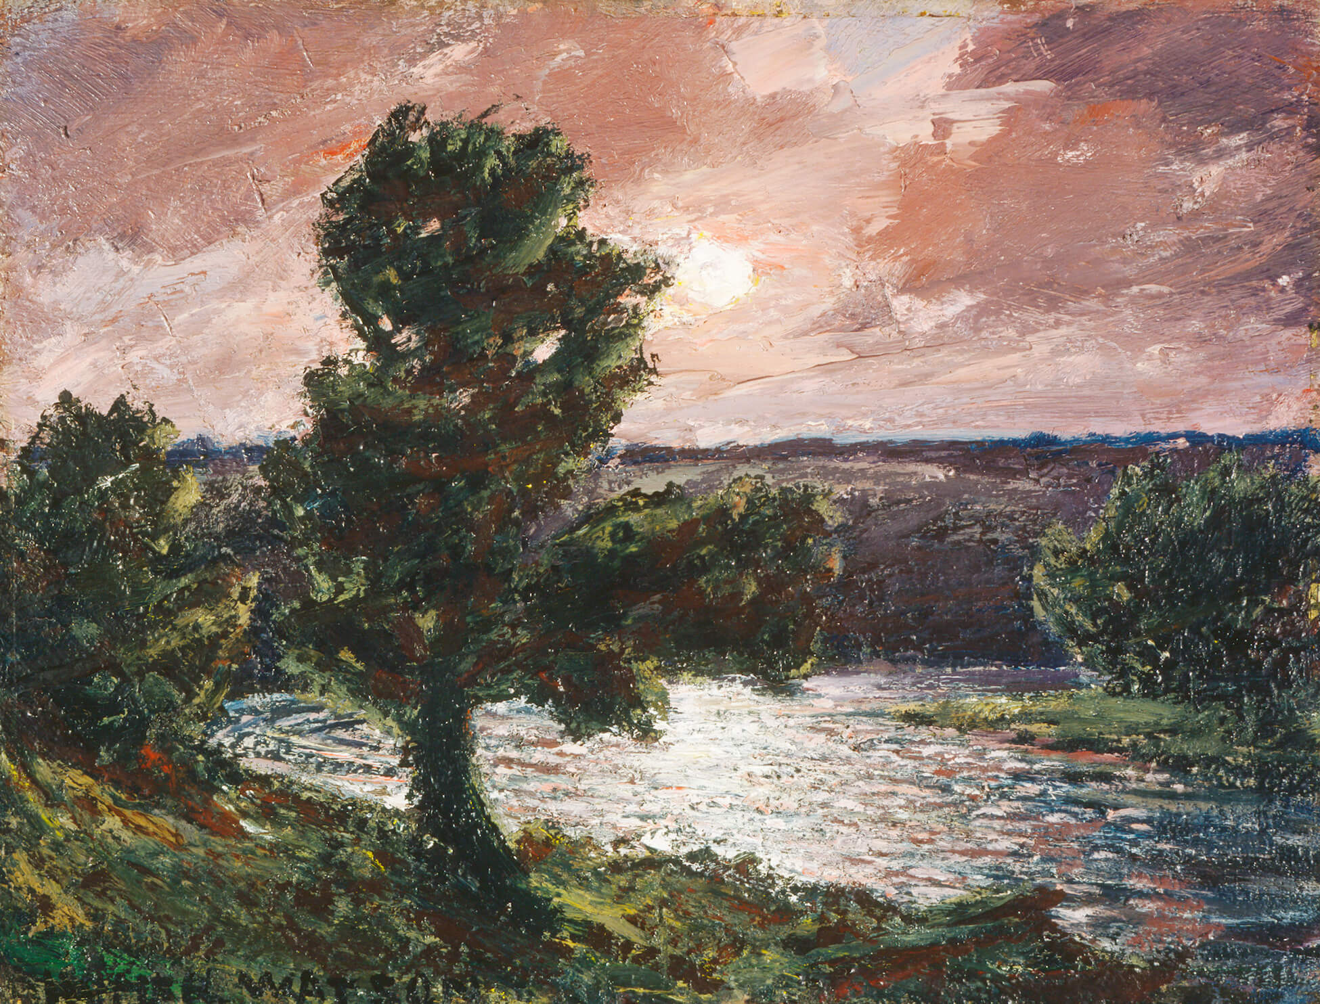
Homer Watson, Moonlit Stream, 1933. In his later years Watson often painted scenes of evening landscapes.

Slide 7
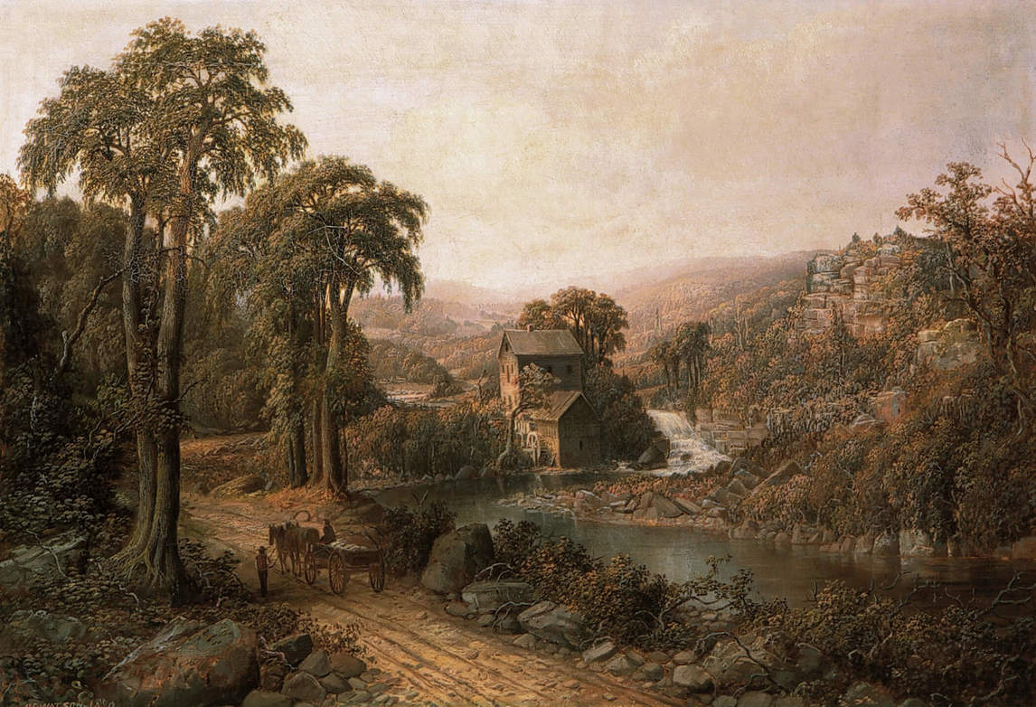
Homer Watson, The Old Mill and Stream, 1879. The mill in this painting is in ruins; its state may refer to the consequences of upsetting a balance between logging for human needs and allowing the land time to regenerate.

Slide 8
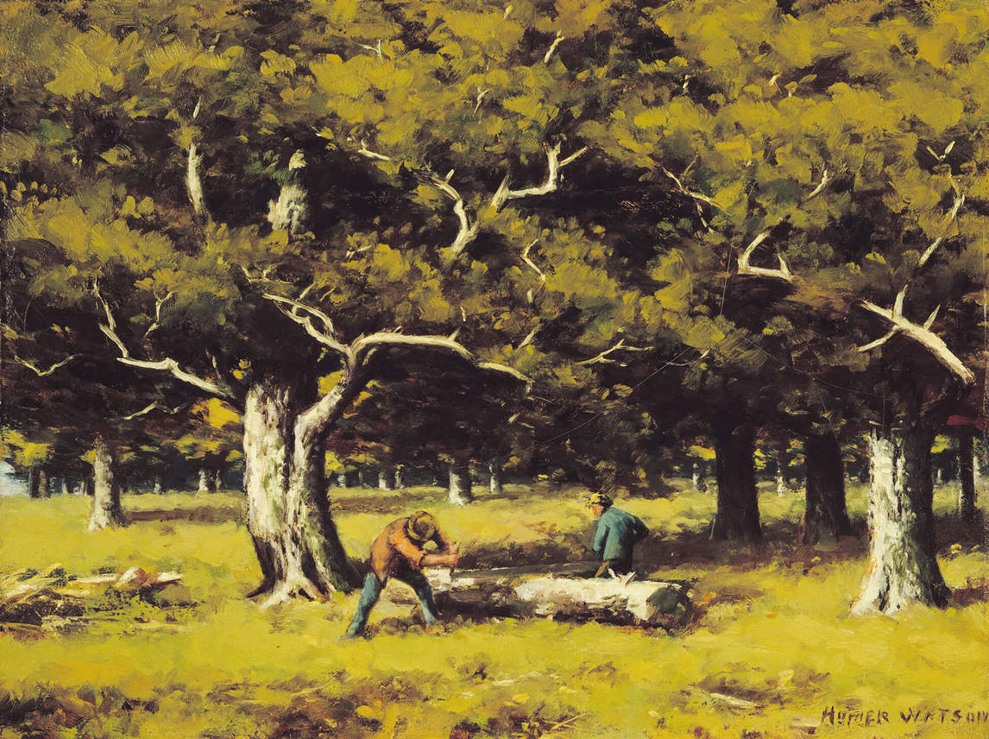
Homer Watson, Log-cutting in the Woods, 1894. In this painting two men harvest timber, but the forest beyond remains vibrant and healthy.

Slide 9
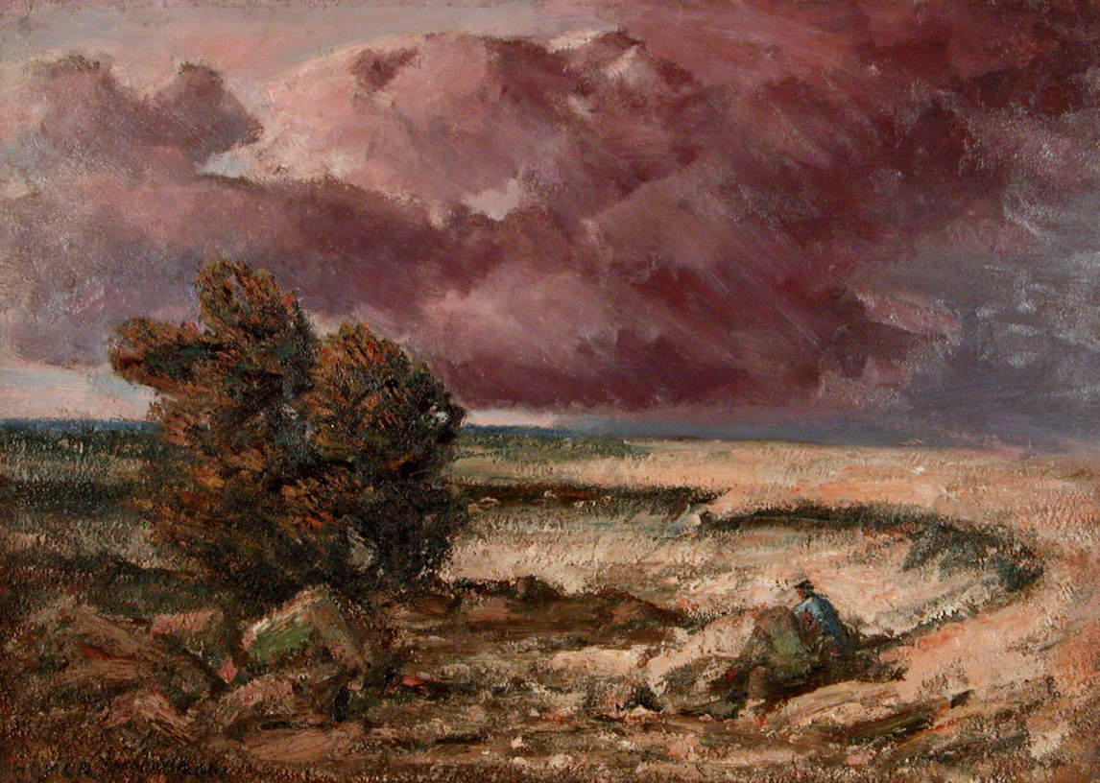
Homer Watson, Storm Drift, 1934. Watson created this work outdoors, painting directly onto a panel.

Slide 10
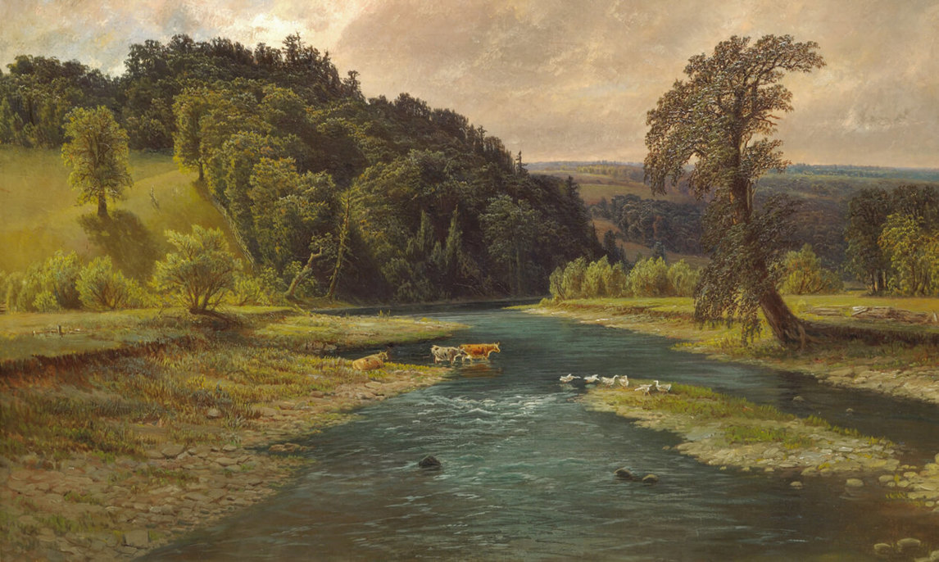
Learning Activity #1
Homer Watson, Grand River Landscape at Doon, c.1881. Although this painting is alive
with detail, it is a composite image rather than a geographically precise record.

Slide 11
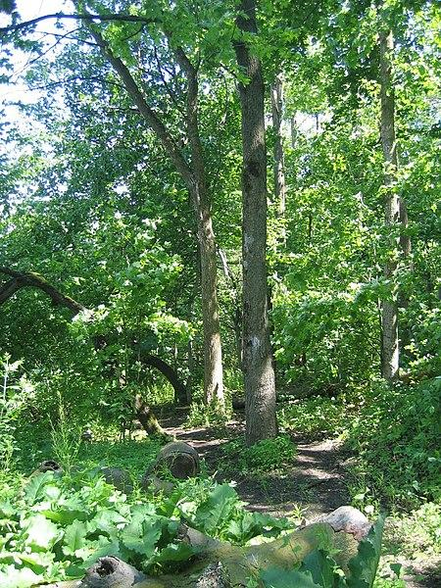
Learning Activity #1
A tree in Homer Watson Park. (Wikimedia Commons)

Slide 12
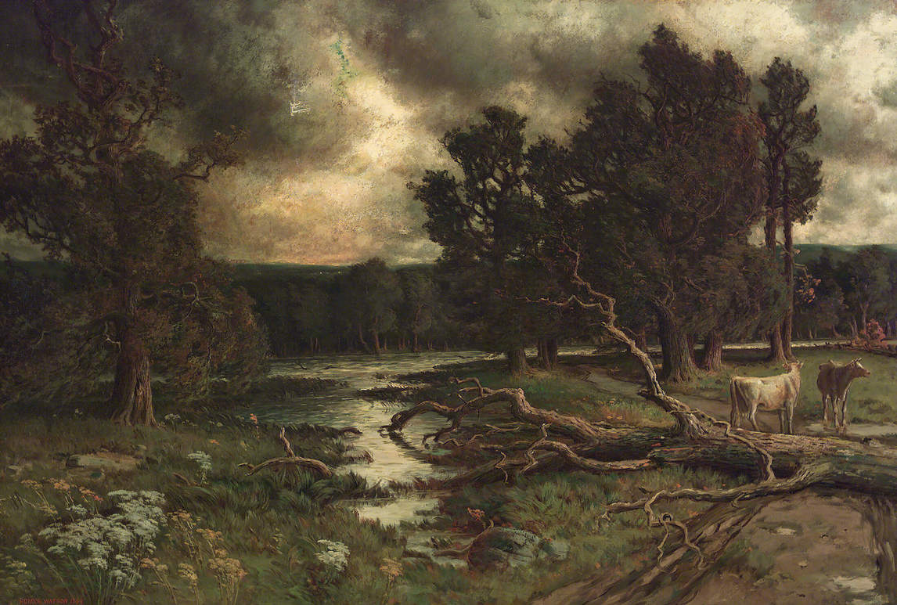
Learning Activity #1
Homer Watson, Near the
Close of a Stormy Day, 1884.
This work juxtaposes a cloudy, dramatic sky with a peaceful, calm landscape.

Slide 13
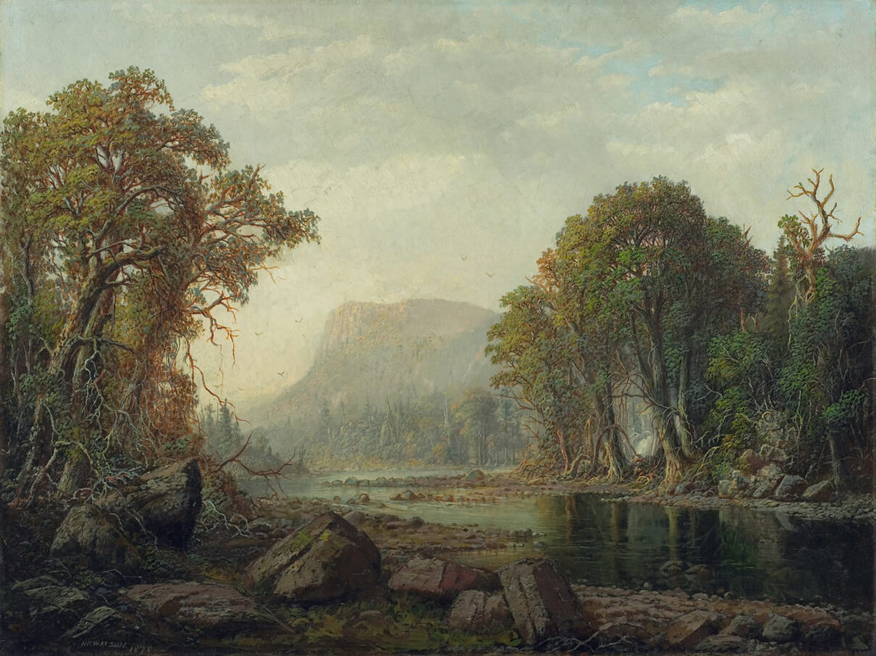
Learning Activity #1
Homer Watson, On the Mohawk River, 1878, oil on canvas, overall: 64.8 x 86.4 cm, Art Gallery of Ontario, Toronto, Gift of Colonel D.H.C. Mason, Toronto, 1949, 48/34.
© Art Gallery of Ontario.
As a young man Watson travelled in New York State; this painting depicts a major river there.

Slide 14
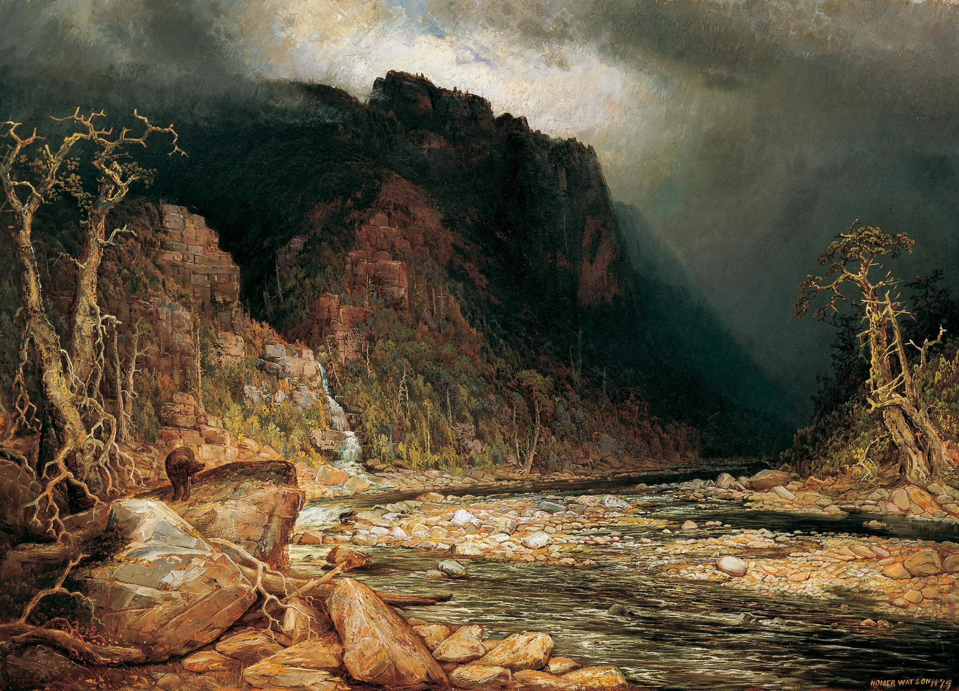
Learning Activity #1
  »
Homer Watson, A Coming Storm in the Adirondacks, 1879. This painting exemplifies Watson’s lifelong commitment to portraying nature’s power and drama.

Slide 15
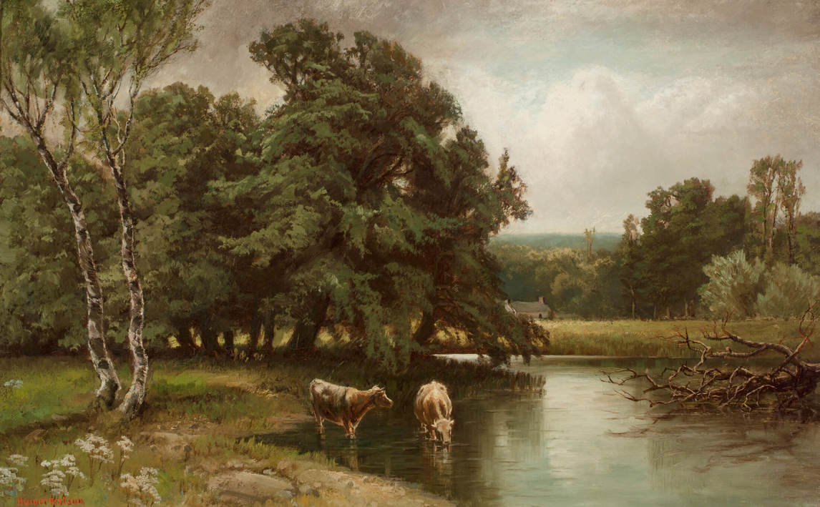
Learning Activity #1
Homer Watson, Two Cows in a Stream, c.1885. Watson felt strongly that a landscape painter should paint places he knew well—in his case, the lands near Doon.

Slide 16
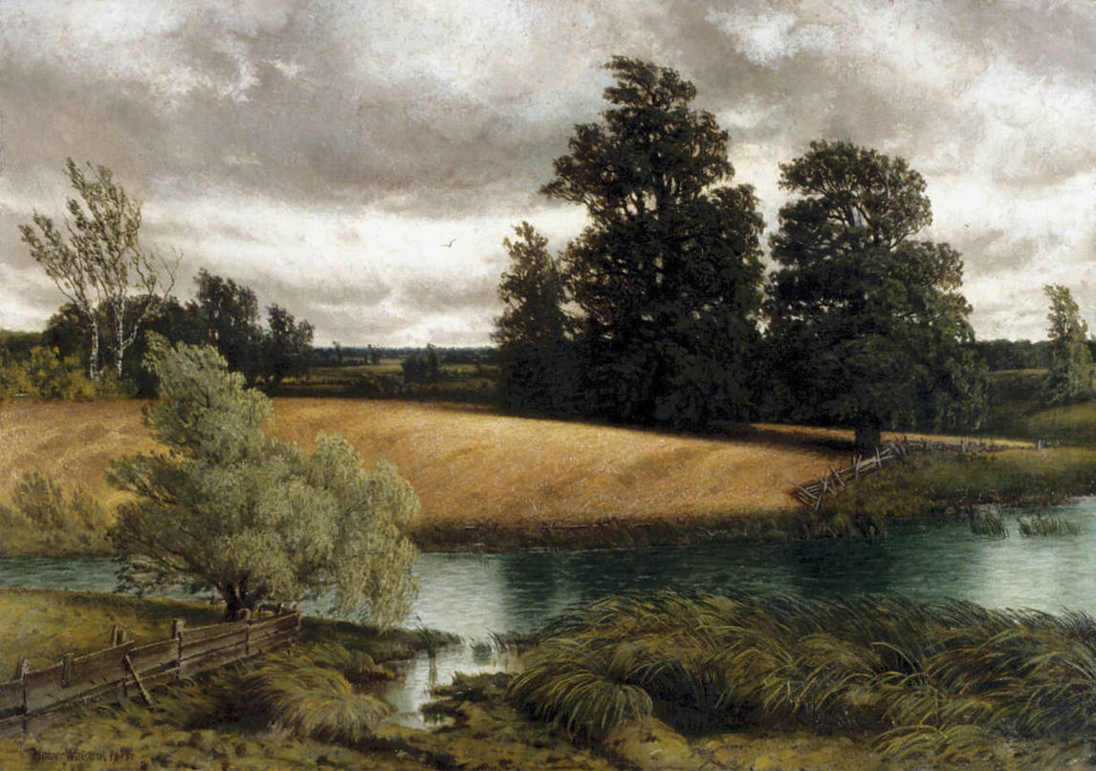
Learning Activity #1
Homer Watson, A Cornfield, 1883. This scene shows the rolling hills in the landscape around Doon.

Slide 17
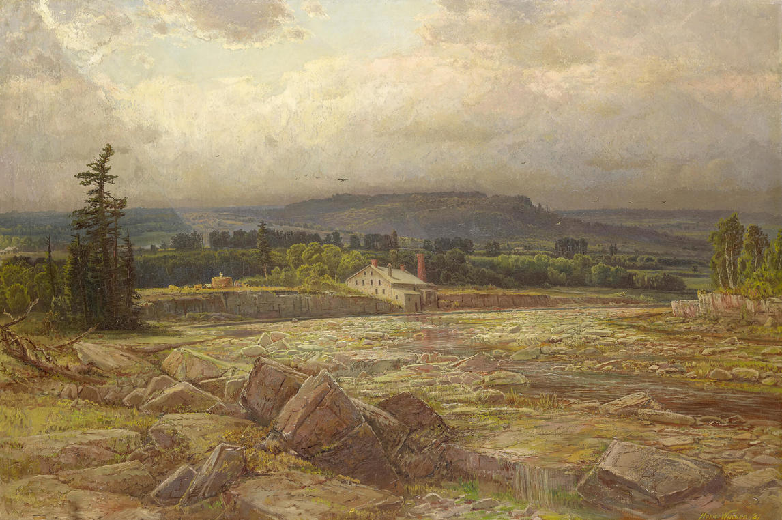
Learning Activity #2
Homer Watson, The Last of the Drouth (The Last Day of the Drought), 1881. This painting was presented to Queen Victoria as a gift.

Slide 18
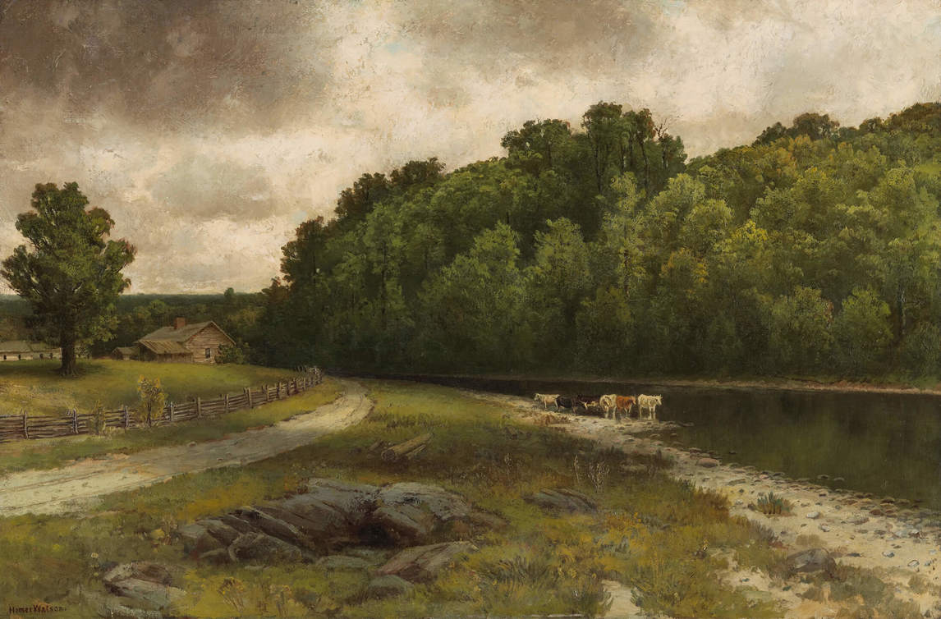
Learning Activity #2
Homer Watson, On the River at Doon, 1885.
The pale grey sky in this landscape suggests it may have rained recently or it might be about to rain.

Slide 19
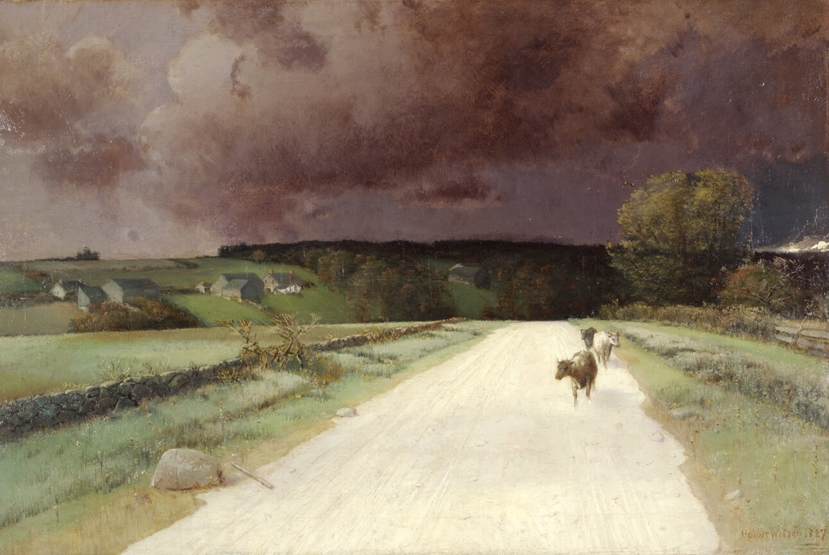
Homer Watson, Before
the Storm, 1887. Intense
storm clouds dominate
this landscape.

Slide 20
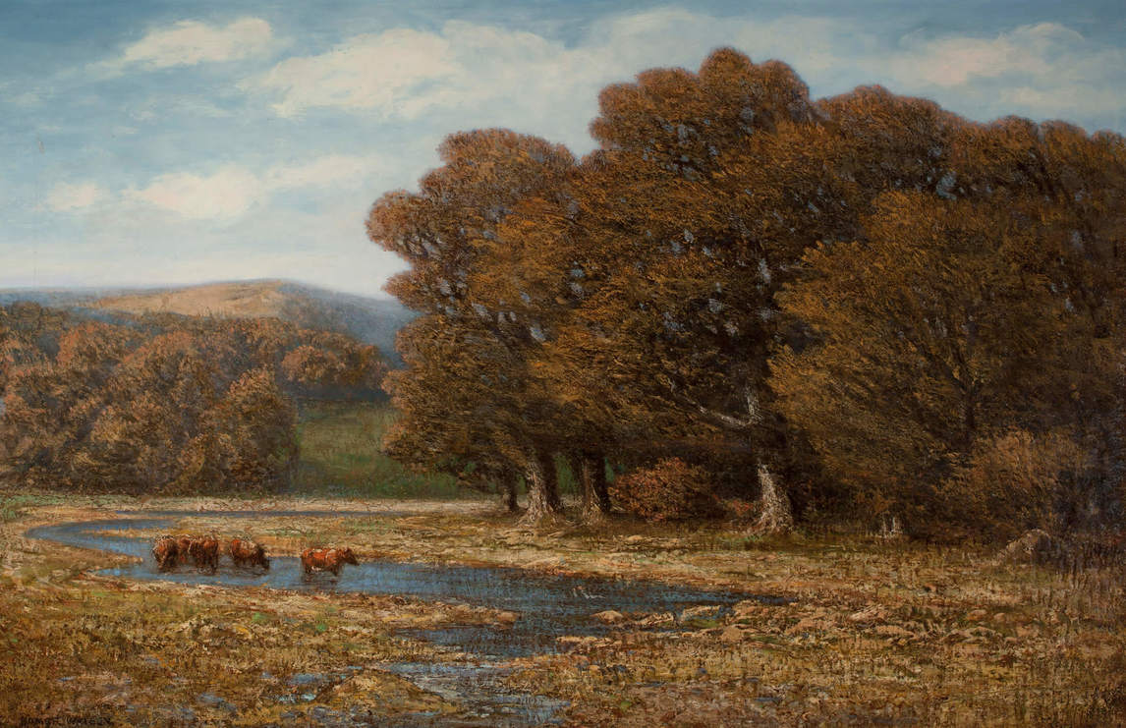
Homer Watson,
In Valley Flats Near Doon,
c.1910. The cattle in this scene represent the needs of farm animals.

Slide 21
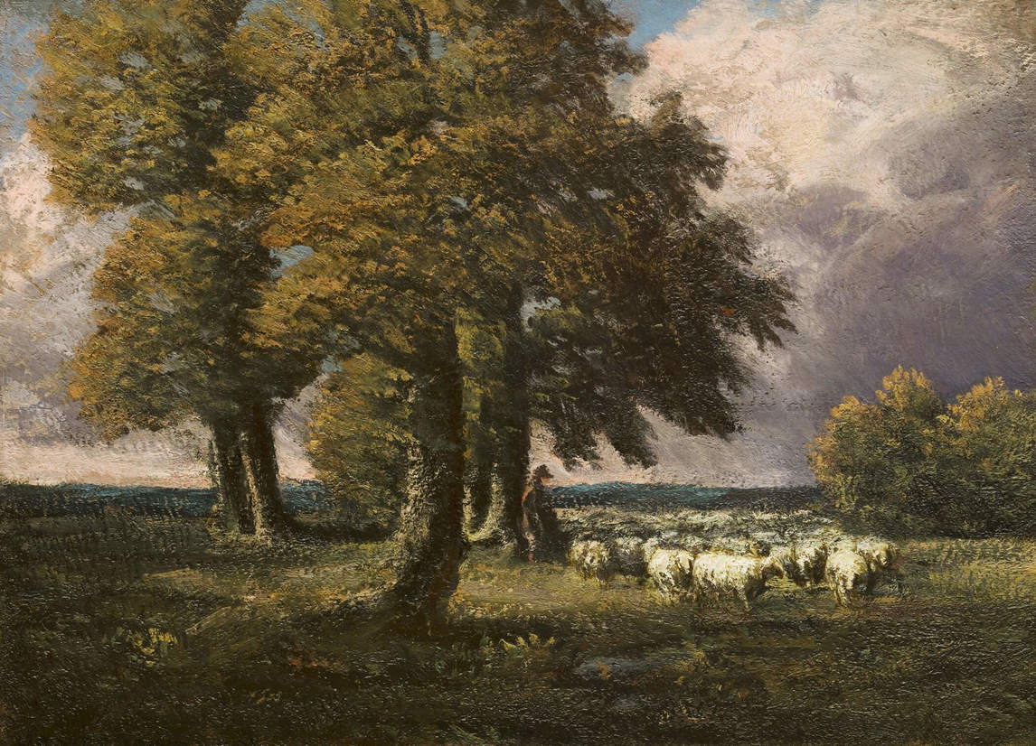
Homer Watson, November among the Oaks, c.1920. In this scene a shepherd is shown in harmony with nature, watching sheep graze under trees.

Slide 22
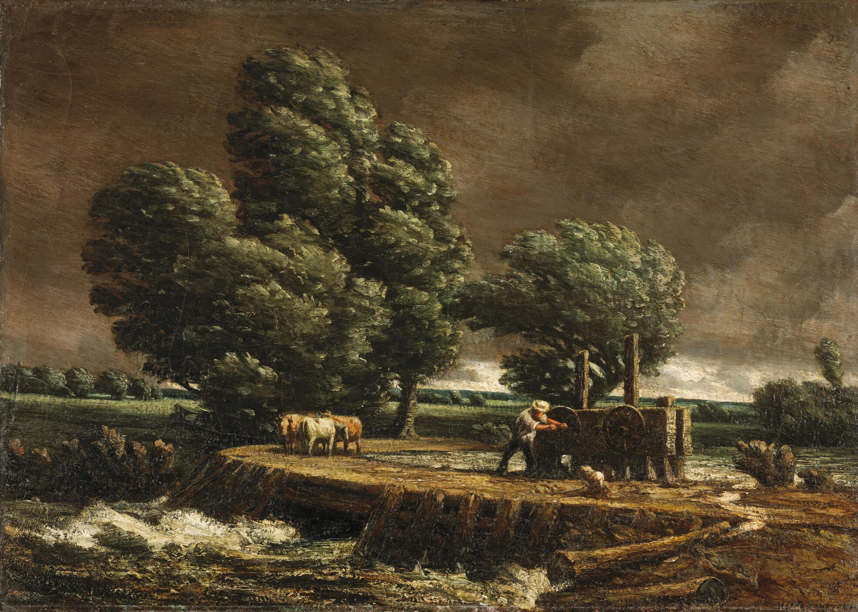
Homer Watson, The Flood Gate, c.1900–1. This painting has exceptionally thick brushwork.

Slide 23
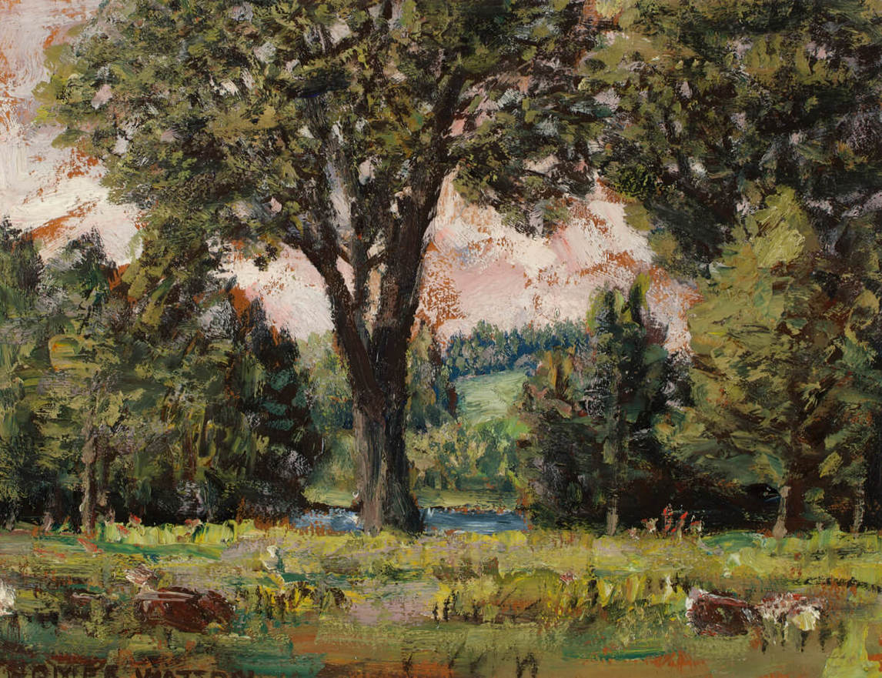
Homer Watson, Speed River
Flats Near Preston, c.1930.
Here the brushwork is so
vigorous it might be considered rough or even violent.

Slide 24
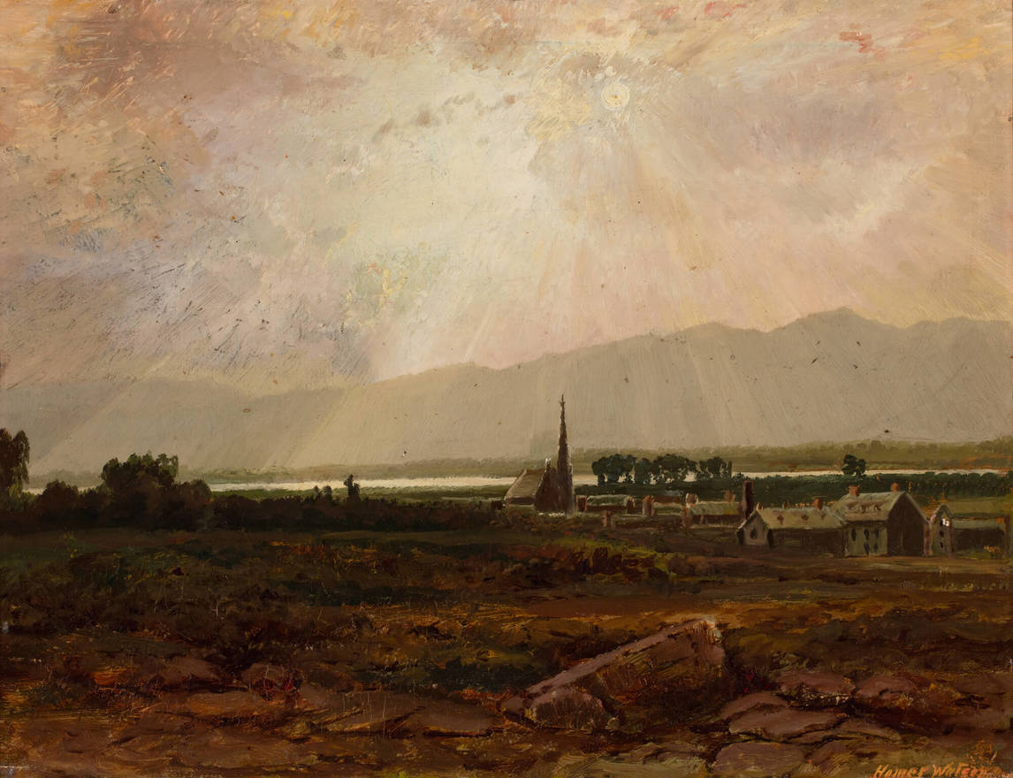
Homer Watson, Sunlit Village, 1884. Watson is famous for his landscapes depicting southern Ontario, but he did paint other places in Canada: this work shows a village in Quebec.

Slide 25
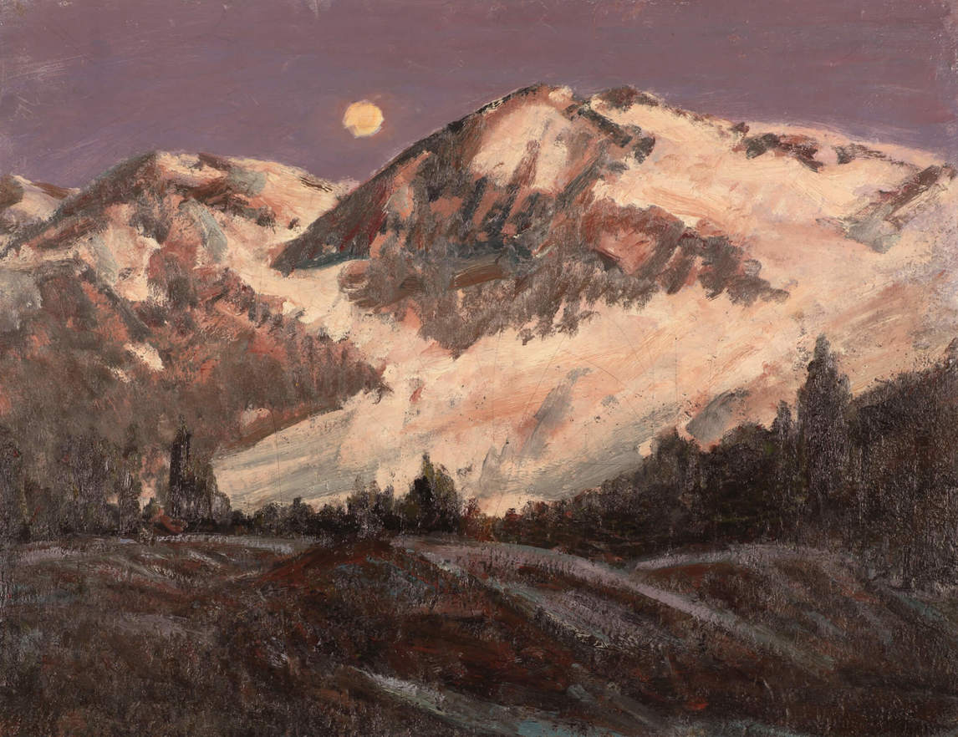
Homer Watson, Near Twilight, B.C., c.1934. Watson visited the Rocky Mountains on three separate trips.

