Slide 2
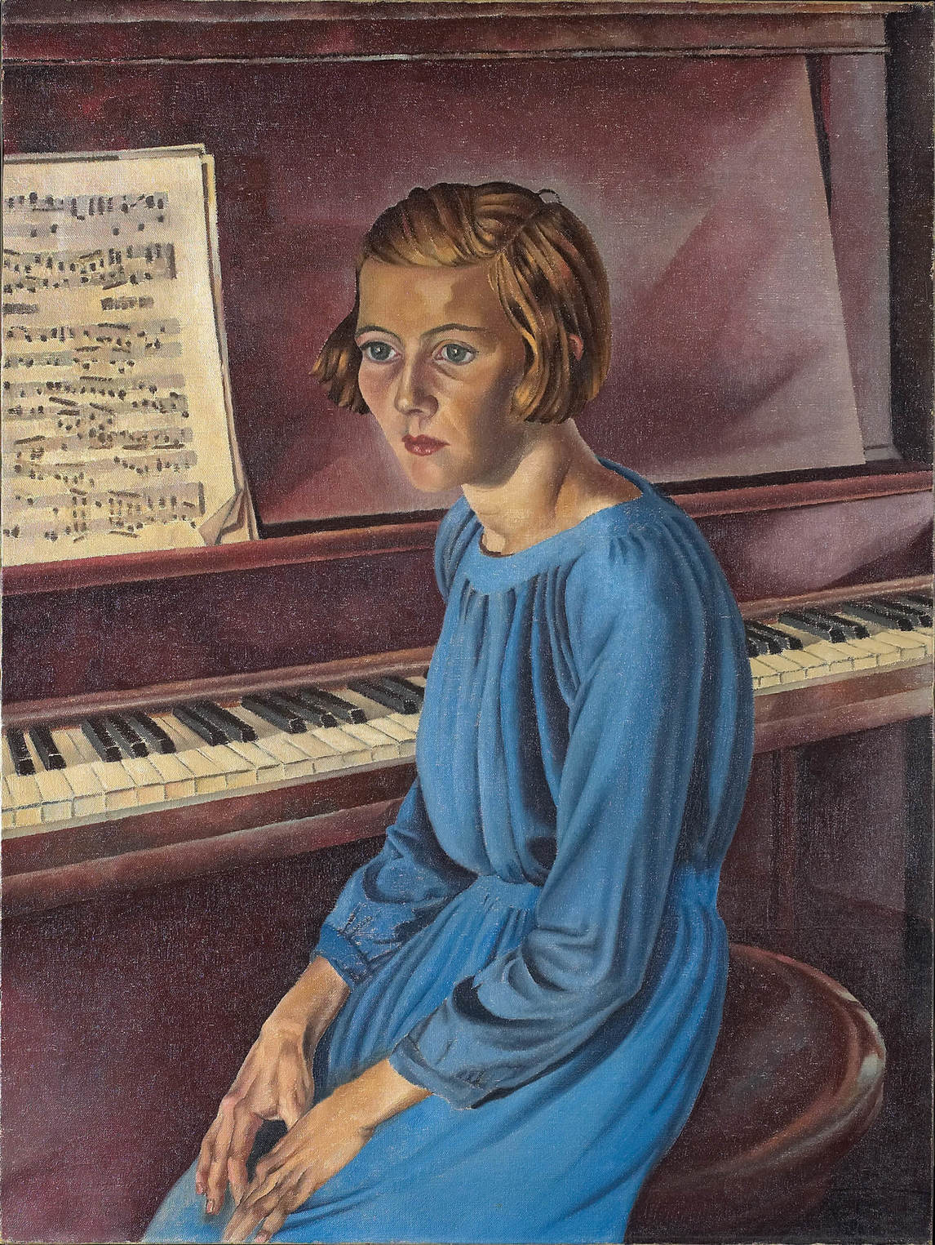
Bertram Brooker, Phyllis (Piano! Piano!), 1934, oil on canvas, 101.9 x 76.5 cm,
Art Gallery of Ontario, Toronto, purchase with assistance from Wintario, 1979, 79/59. © Art Gallery of Ontario.
Here Brooker poses his daughter seated sideways to the piano. She is lost in thought, perhaps pondering the power of the music she has just played—or is about to play.

Slide 3
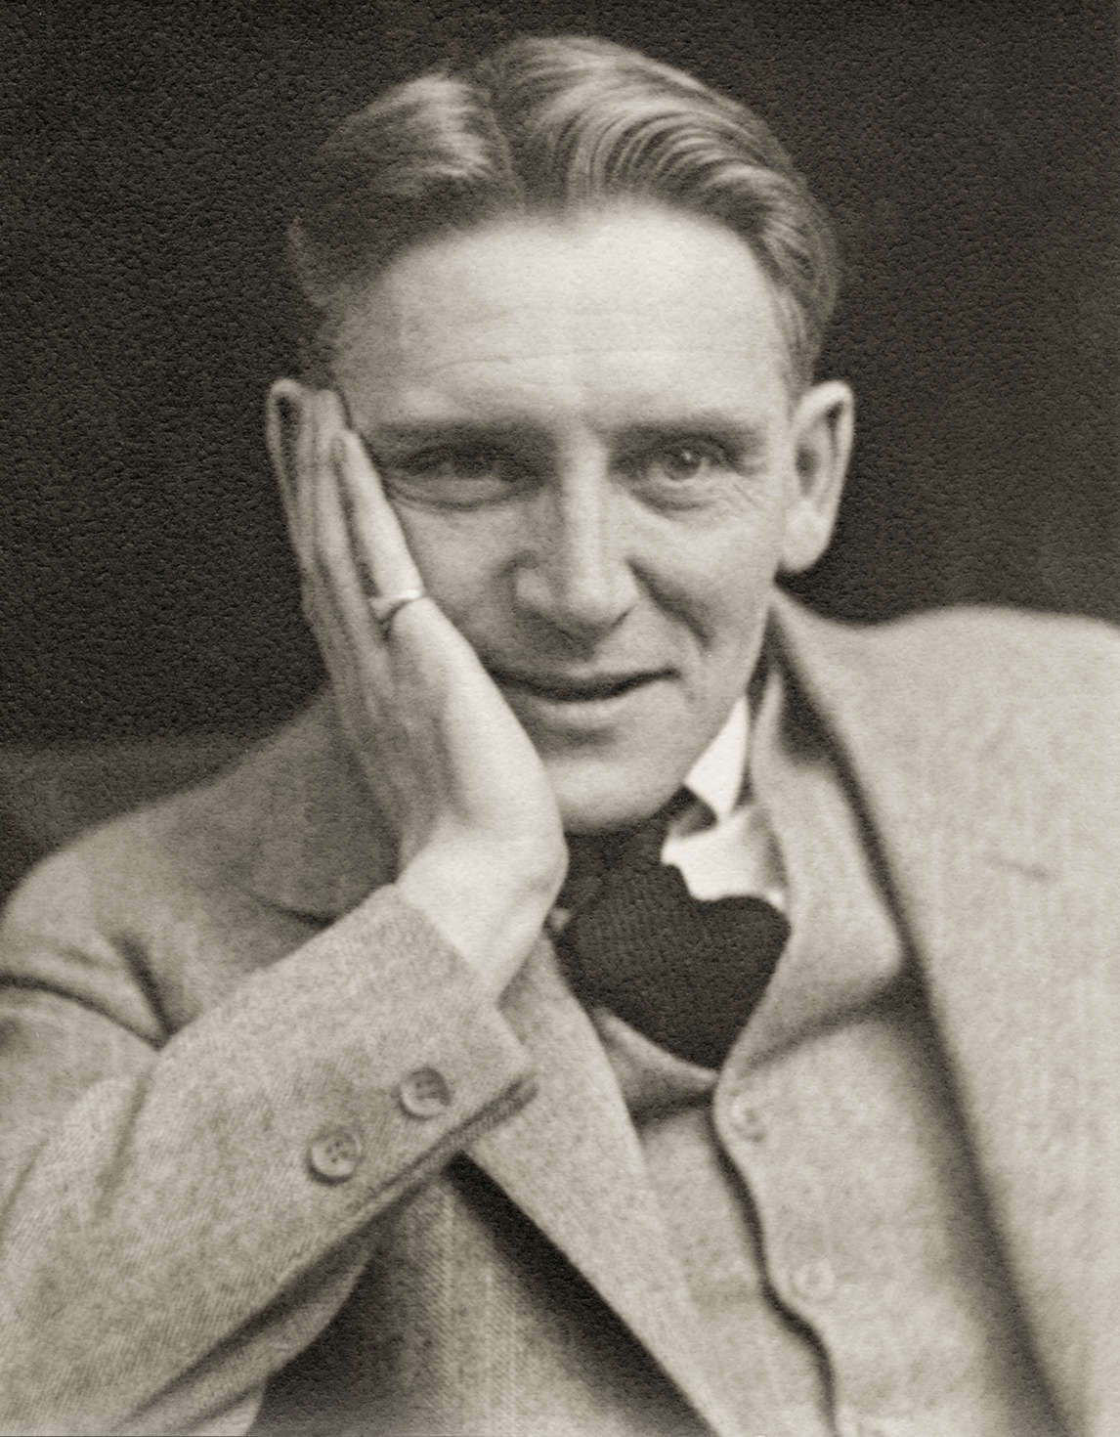
Portrait of Bertram Brooker, c.1928.

Slide 4
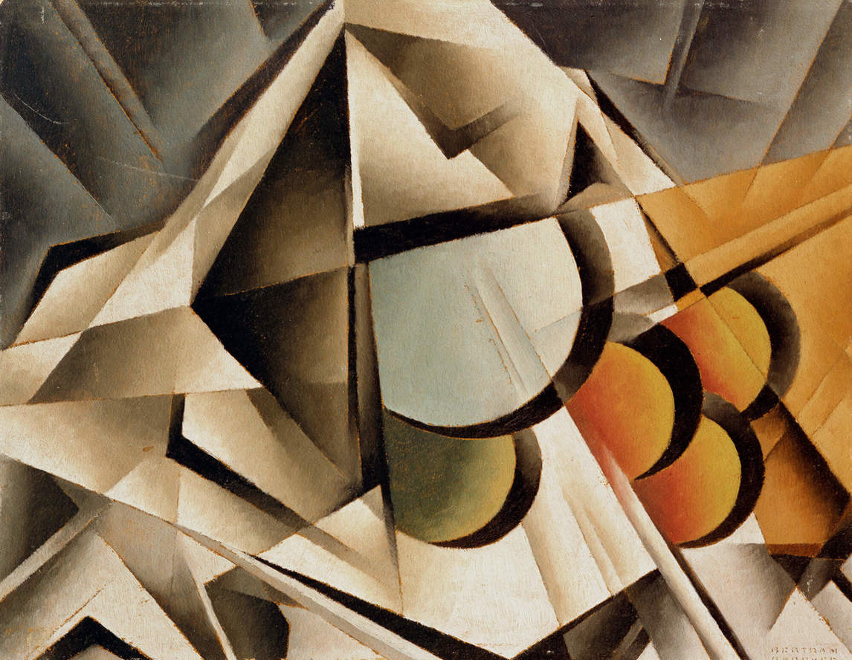
Bertram Brooker, Still Life Variation IV, c.1929. This painting has some similarities with works by Wassily Kandinsky, whose writings were of great interest to Brooker.

Slide 5
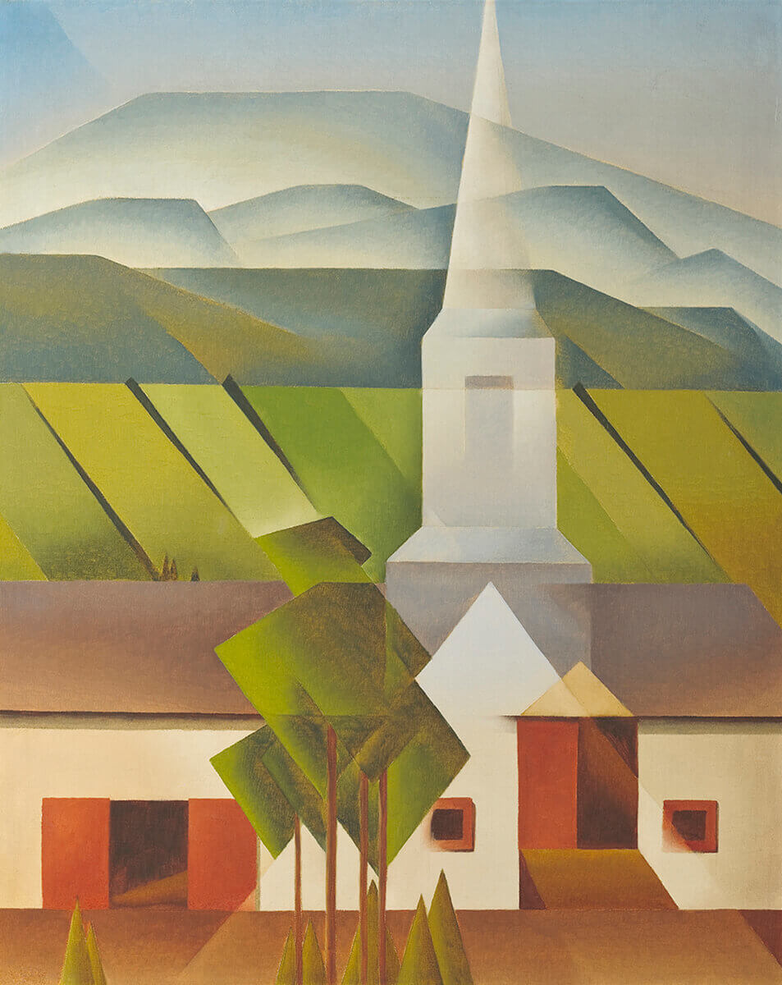
Bertram Brooker, Quebec Impression, 1942. Brooker’s experience with abstraction influenced this representational landscape painting.

Slide 6
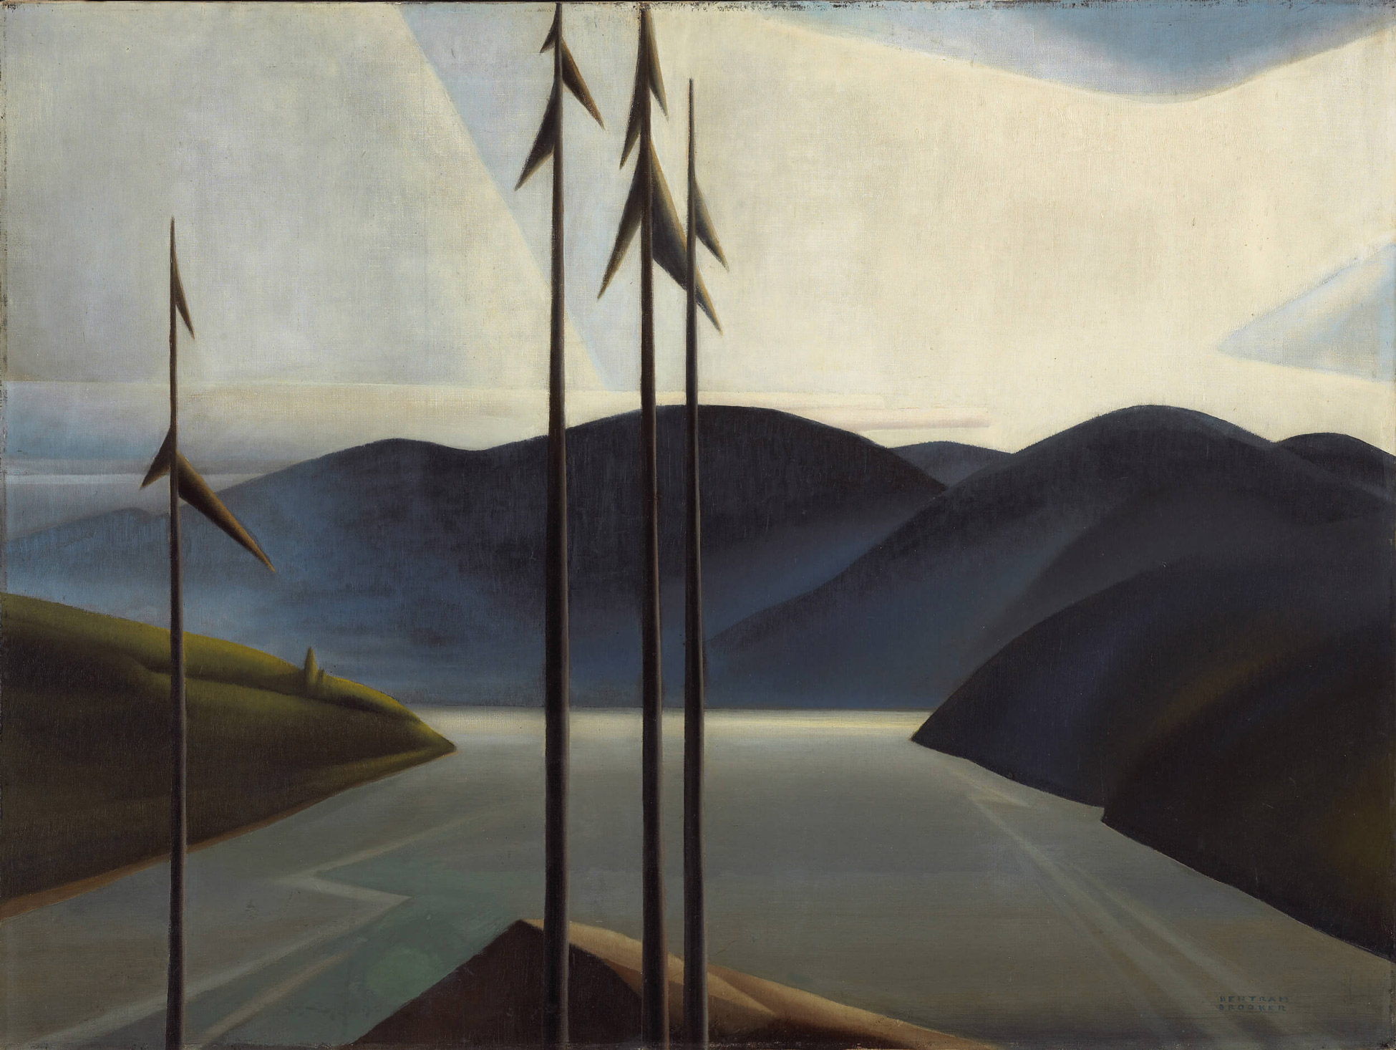
Bertram Brooker, The St. Lawrence, 1931. The geometric lines in this landscape are meant to evoke a sense of harmony between man and nature.

Slide 7
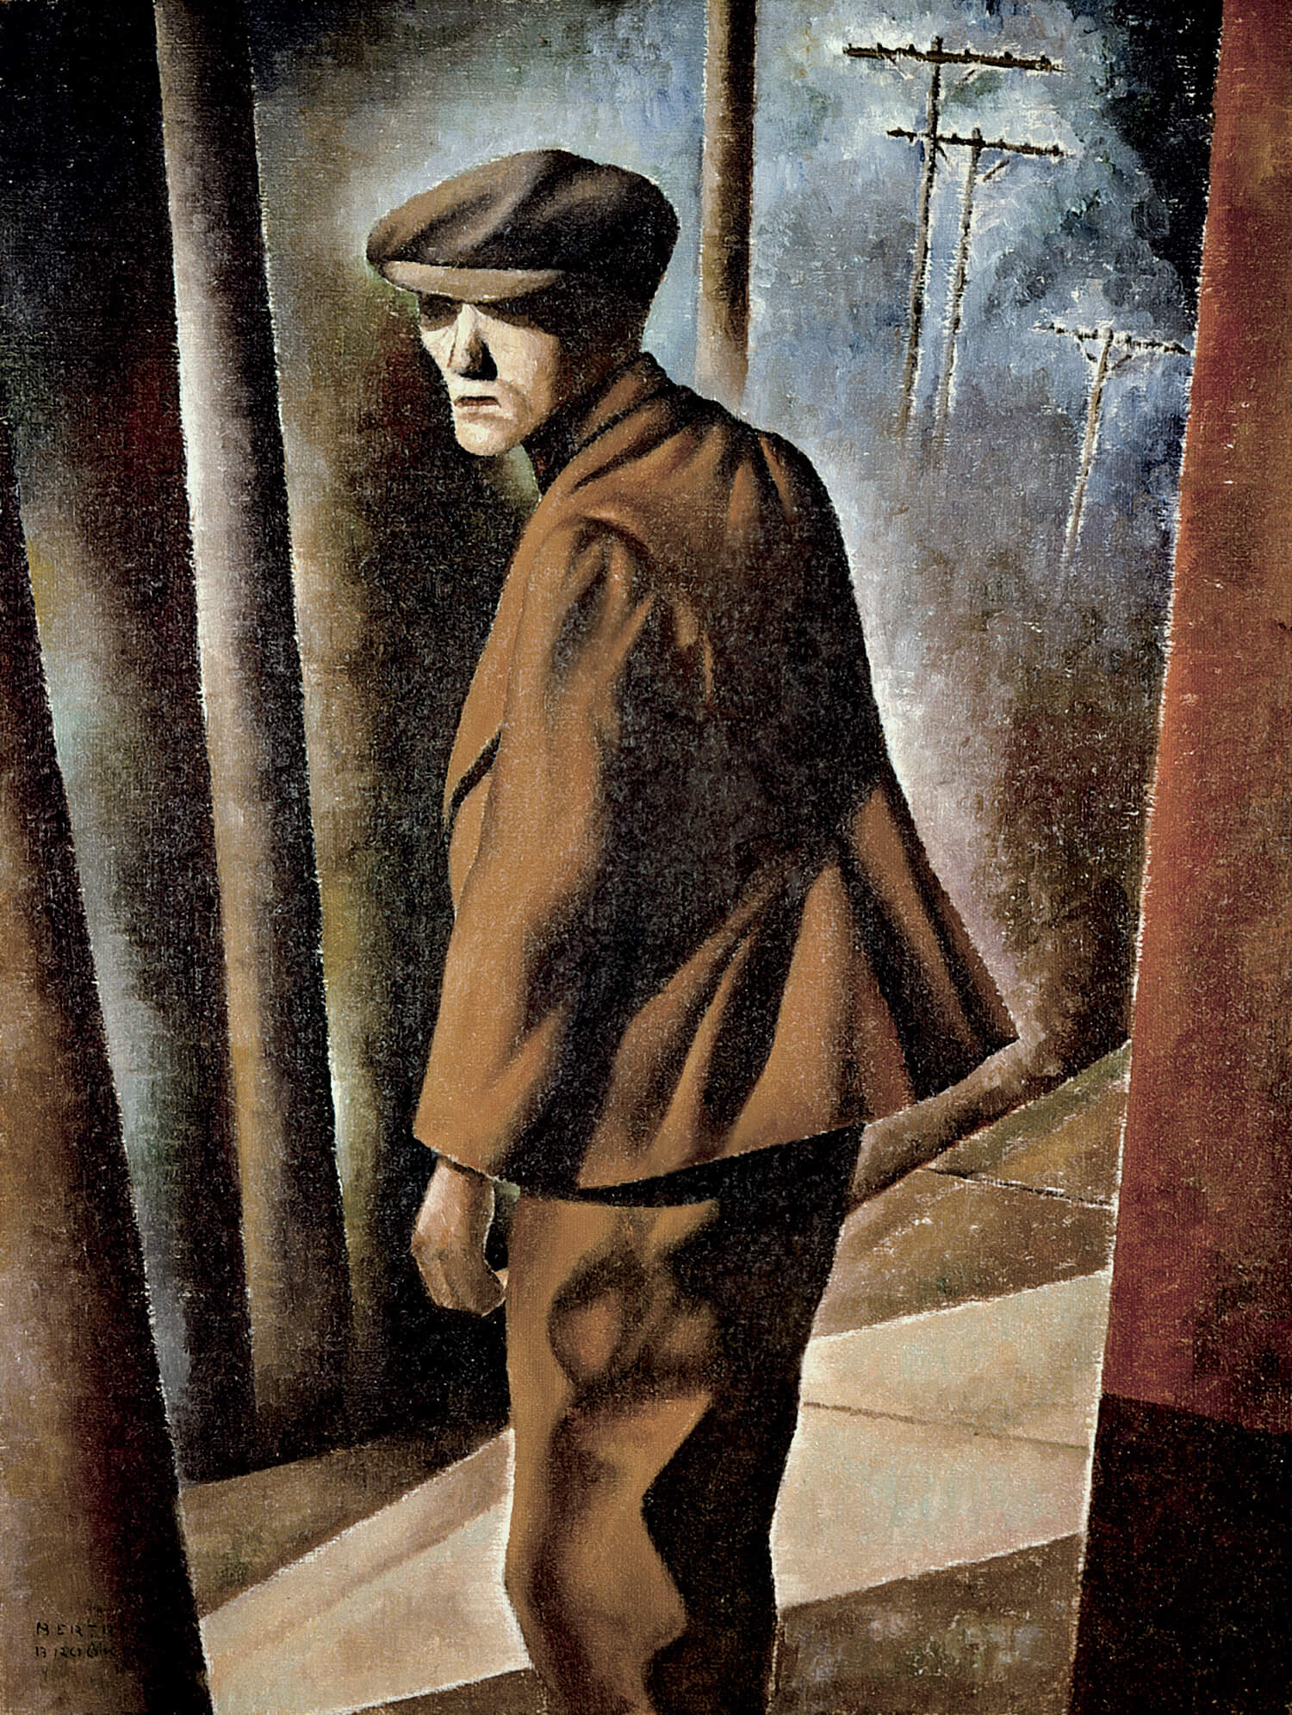
Bertram Brooker, The Recluse, 1939. Brooker was also aware of current social concerns and painted portraits of marginalized individuals.

Slide 8
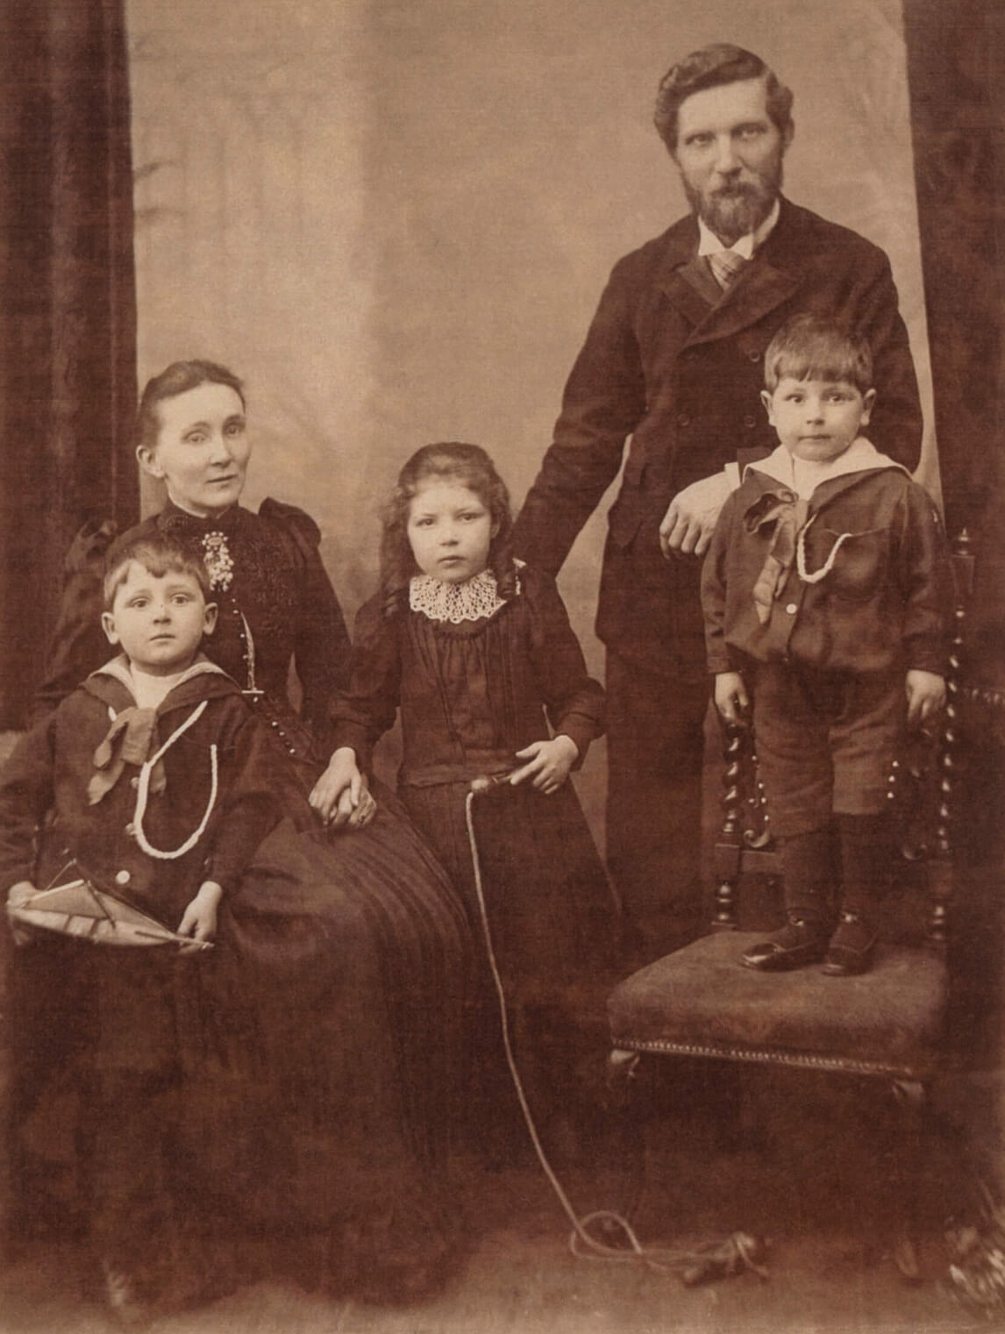
Bertram Brooker with his parents and siblings in England, 1890s.

Slide 9
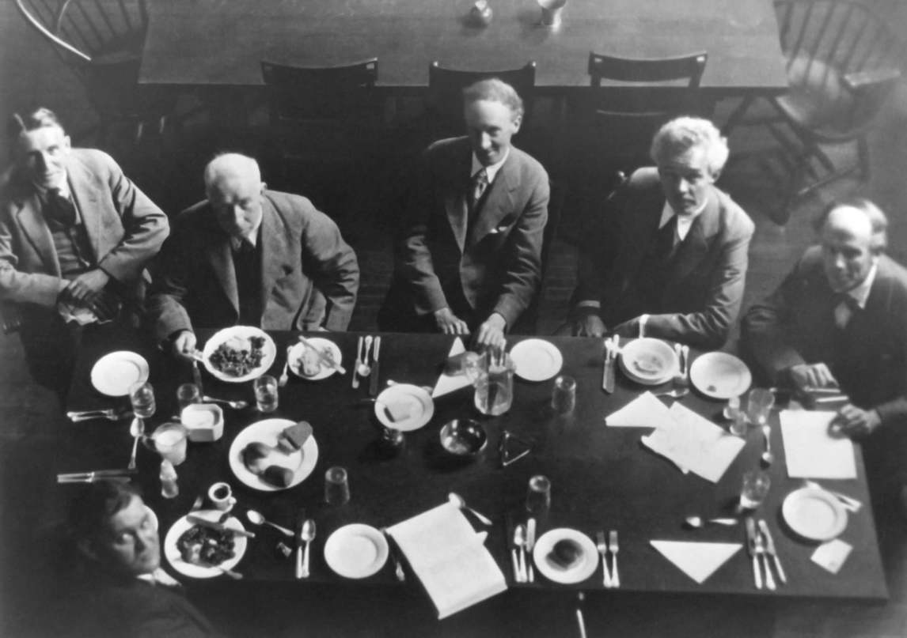
Bertram Brooker and members of the Group of Seven at the Arts and Letters Club in Toronto, 1929. Brooker is seated on the far left.

Slide 10
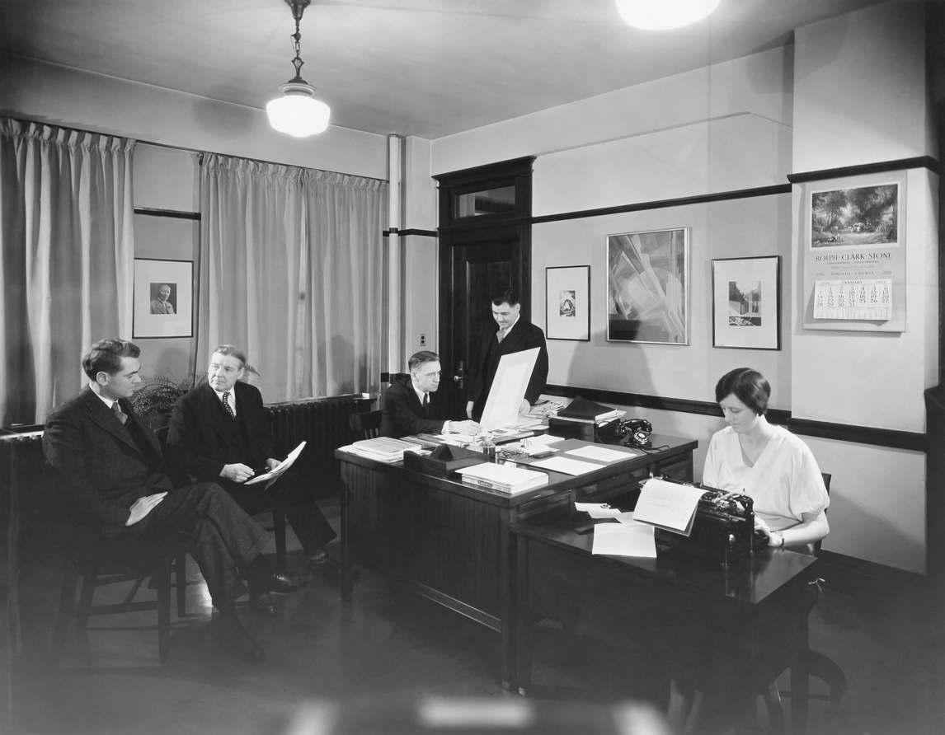
Bertram Brooker and colleagues in his office at J.J. Gibbons advertising agency in Toronto, January 1934.

Slide 11
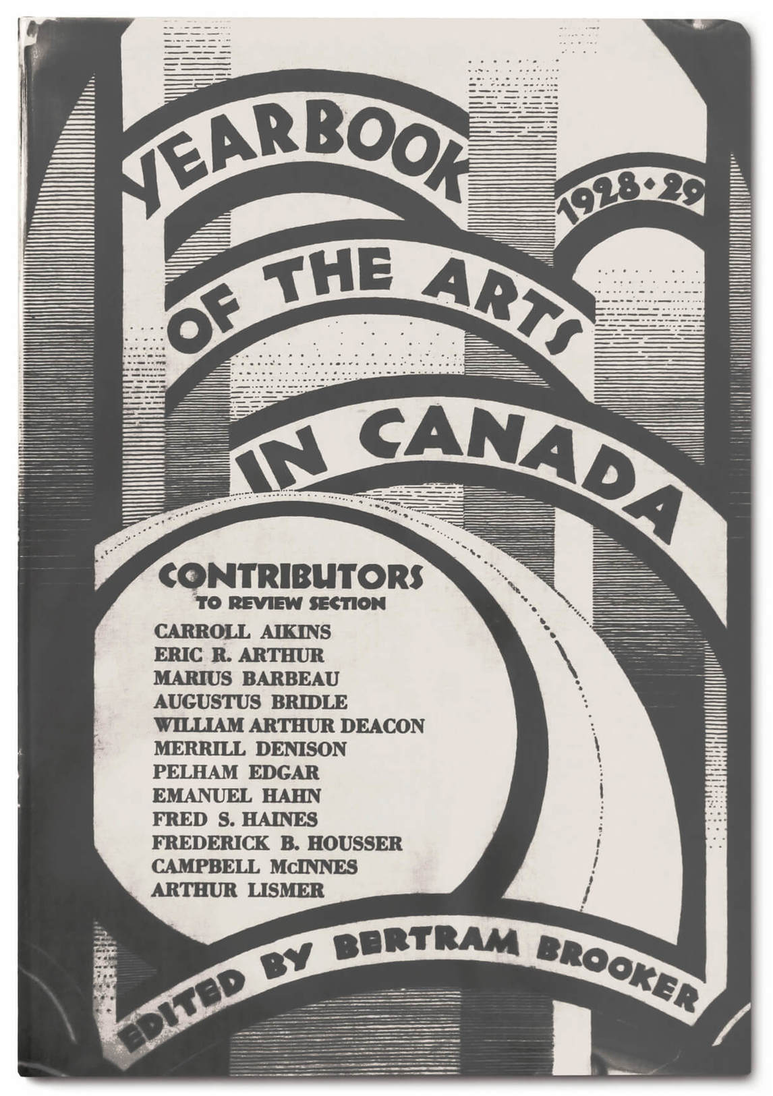
Cover of Yearbook of the Arts in Canada 1928–1929, edited by Bertram Brooker.

Slide 12
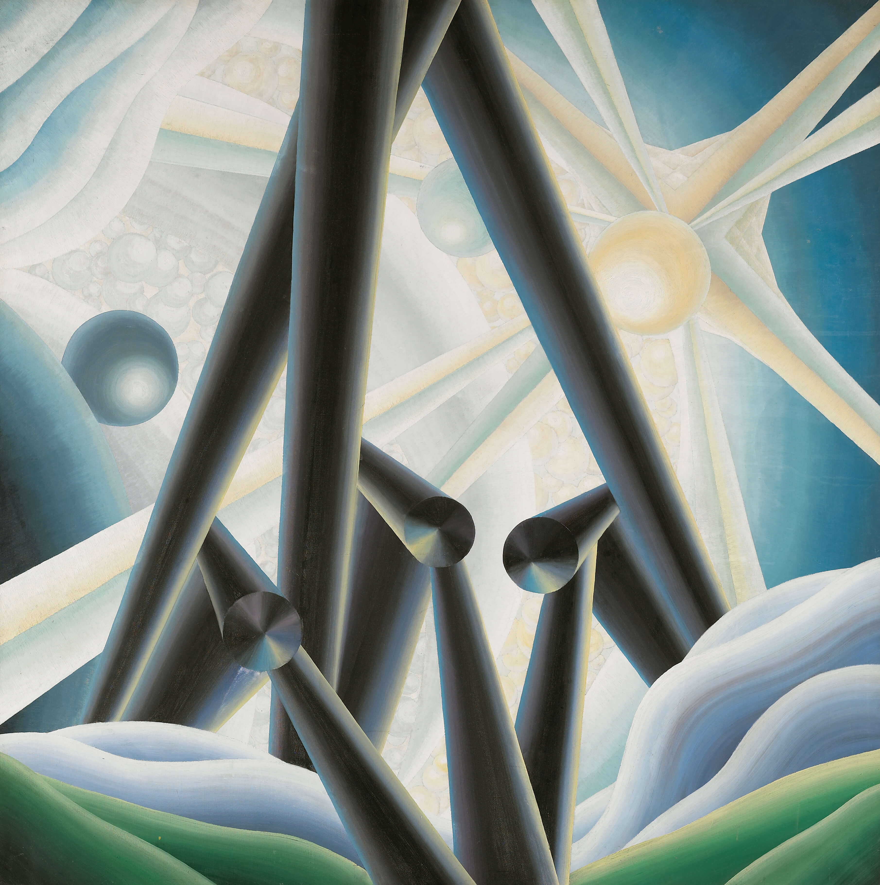
Learning Activity #1
Bertram Brooker, Alleluiah, 1929. In responding to Handel’s music, Brooker has created a composition that places abstract forms in a space that evokes a landscape.

Slide 13
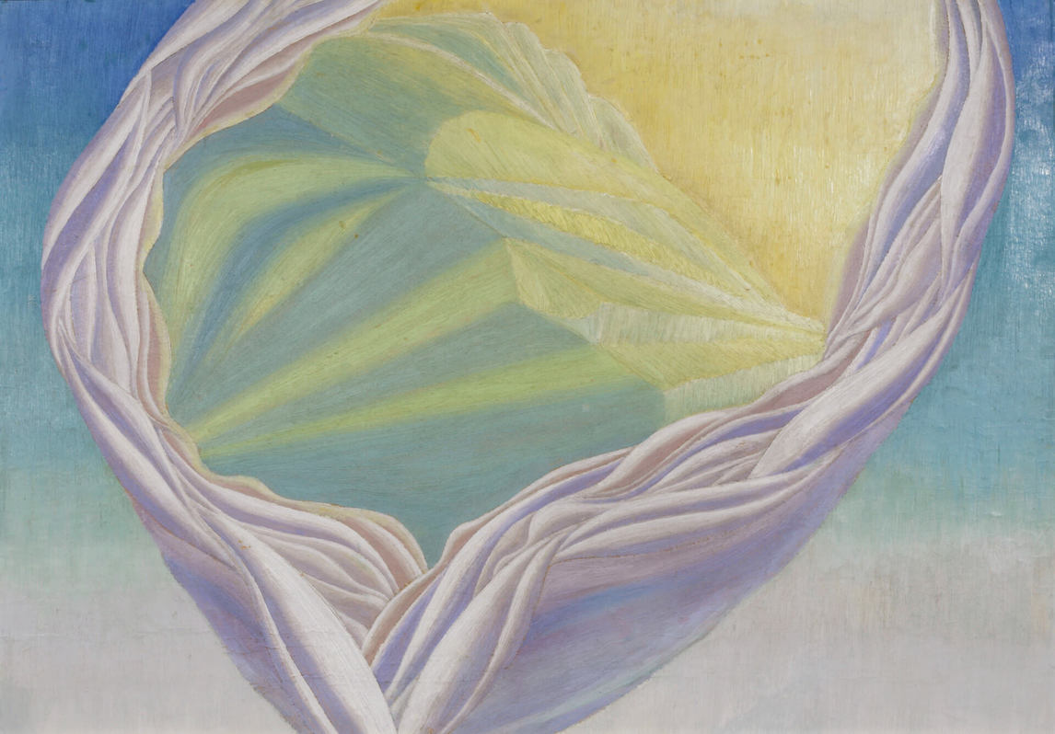
Bertram Brooker, Abstraction, Music, 1927. Brooker felt that music could transport listeners away from everyday concerns—here he attempts to capture that feeling.

Slide 14
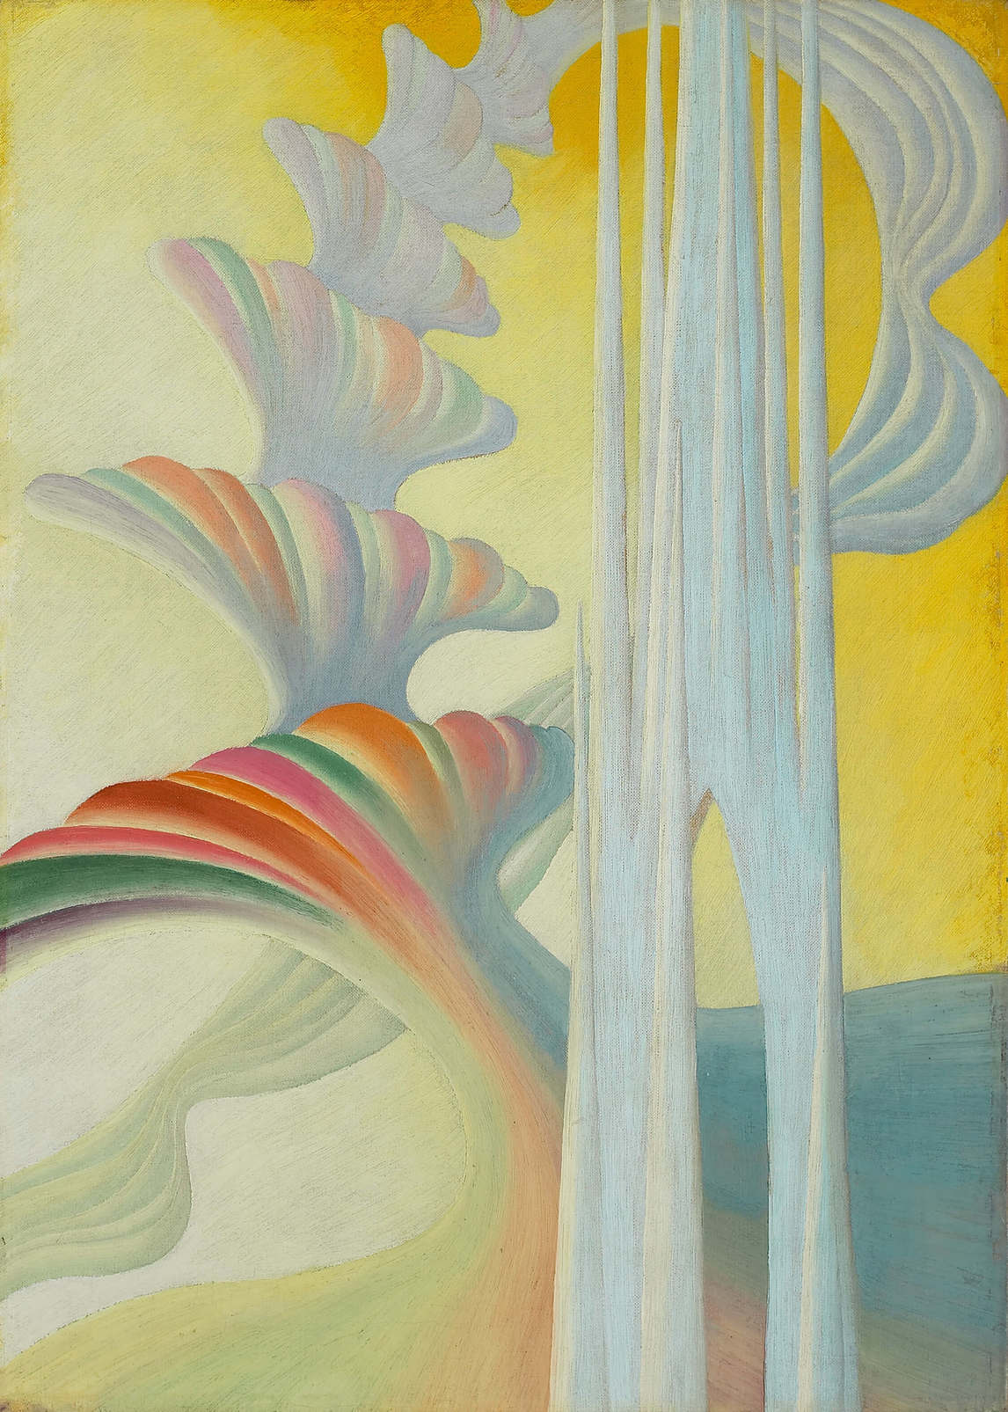
Learning Activity #2
Bertram Brooker, “Chorale” (Bach),
c.1927, oil on canvas, 61 x 43.7 cm,
Art Gallery of Ontario, Toronto, purchase, 1987, 87/175. © Art Gallery of Ontario.
Brooker believed that enjoying music could empower an artist to greater creative expression.

Slide 15
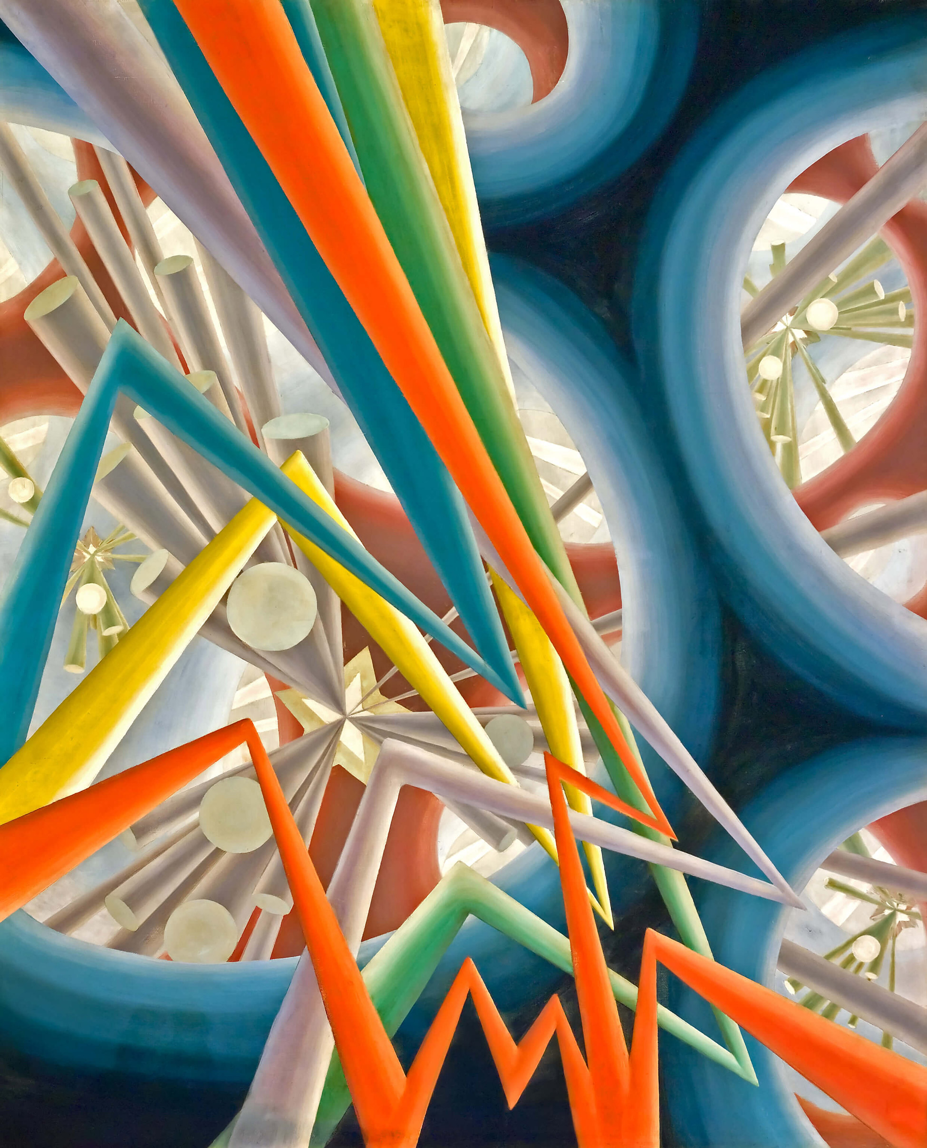
Learning Activity #2
Bertram Brooker, Sounds Assembling, 1928. In works like this one, Brooker attempted to capture the rhythm, volume, and energy of music.

Slide 16
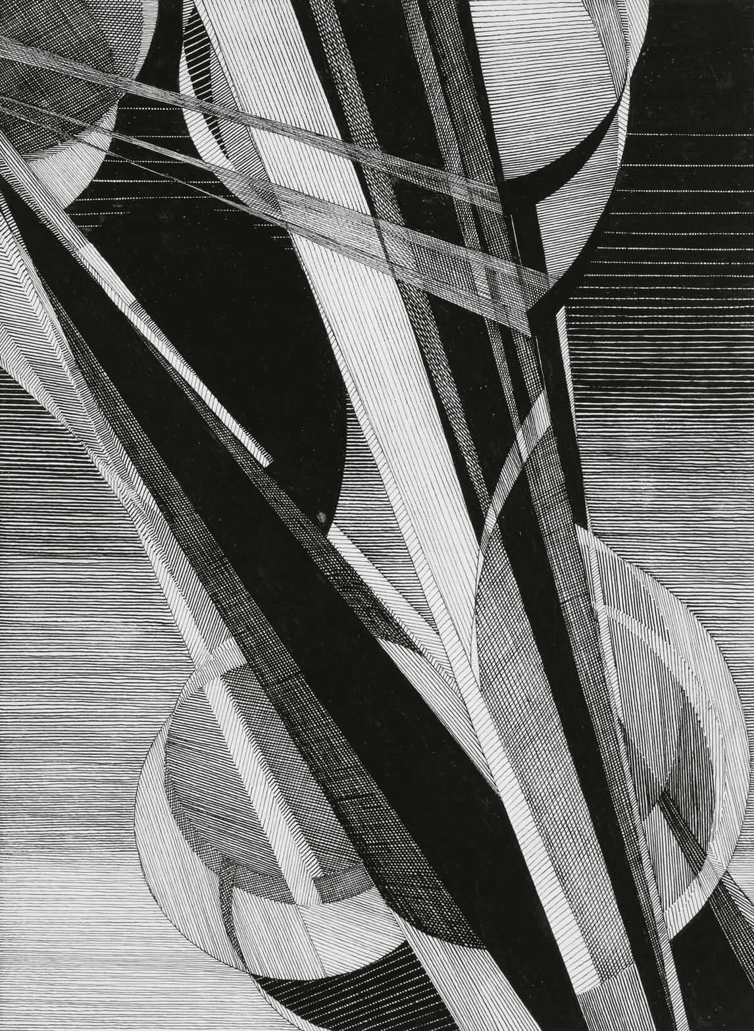
Learning Activity #2
Bertram Brooker, Symphonic Movement No. 1, c.1928–29. This drawing incorporates both delicate gradations and dramatic contrasts in order to represent musical forms.

Slide 17
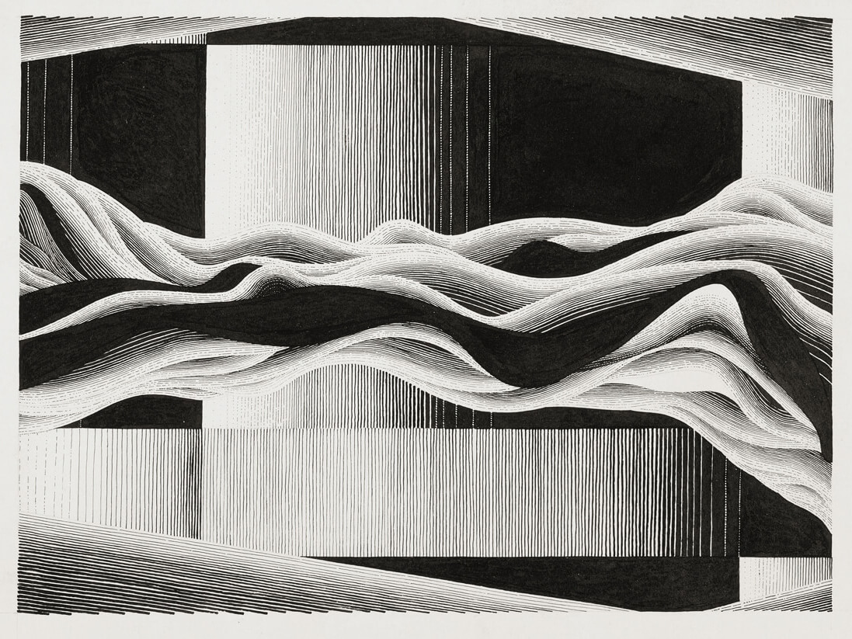
Learning Activity #2
Bertram Brooker, Fugue, c.1930, pen and ink on wove paper, 28.8 x 33.1 cm, Art Gallery of Ontario, Toronto, Gift of Dr. Walter M. Tovell, Toronto, 1983, 83/288.
© Art Gallery of Ontario.
Although the title does not refer to any one symphony, this work may have been inspired by a specific performance.

Slide 18
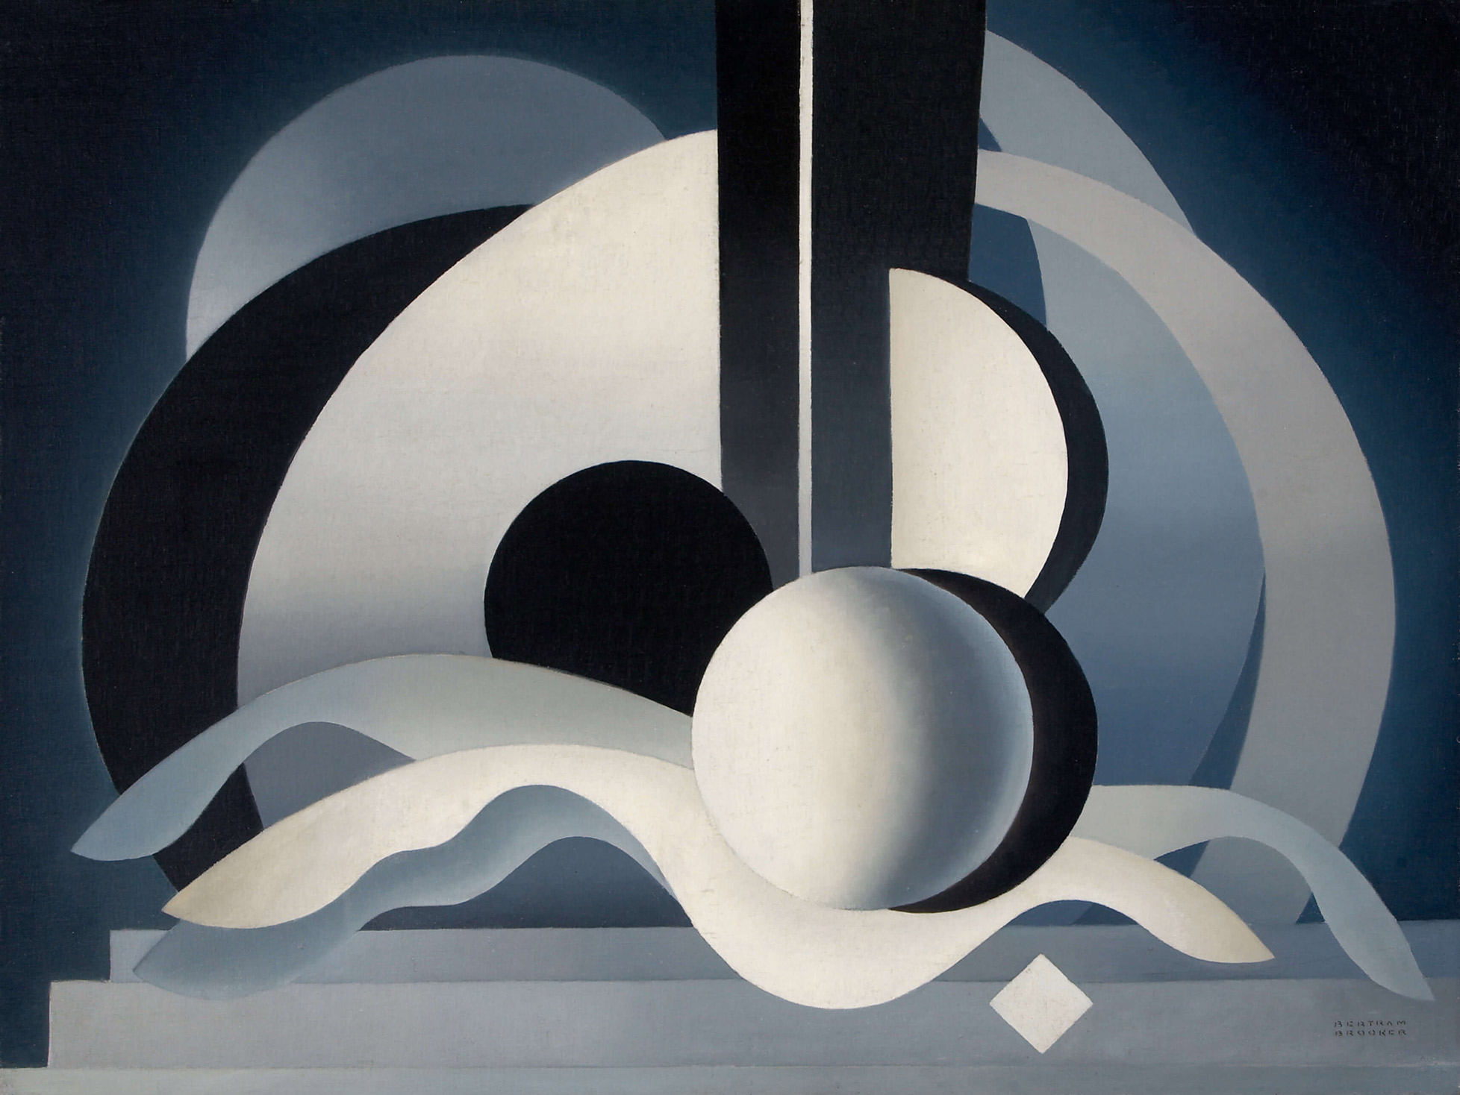
Bertram Brooker, Symphonic Forms, 1947. Like a symphony, this painting seems to be arranged in different parts with discrete forms.

Slide 19
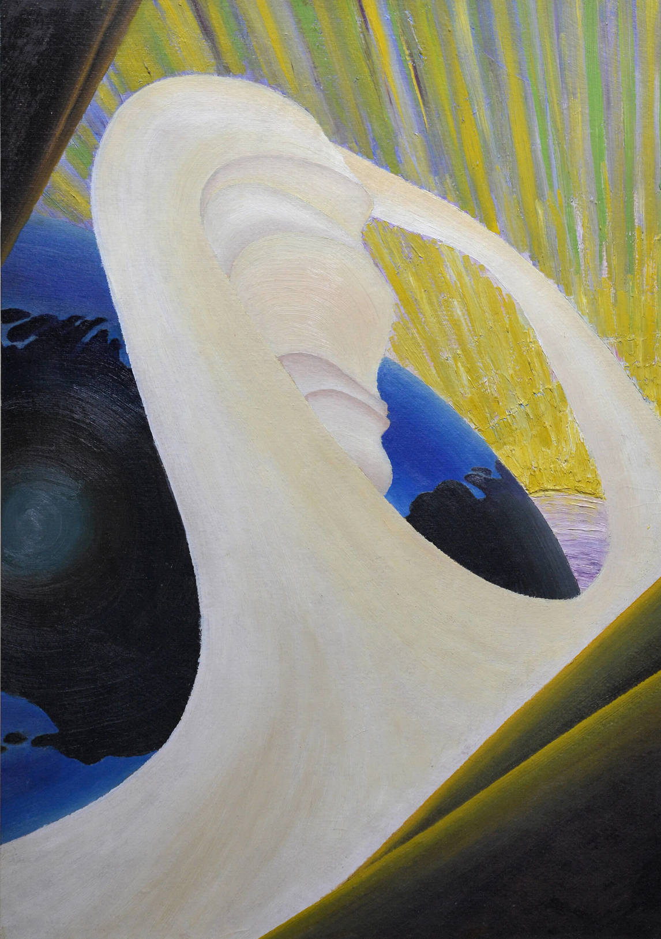
Bertram Brooker, Creation, 1925. This painting is one of Brooker’s early abstract works.

Slide 20
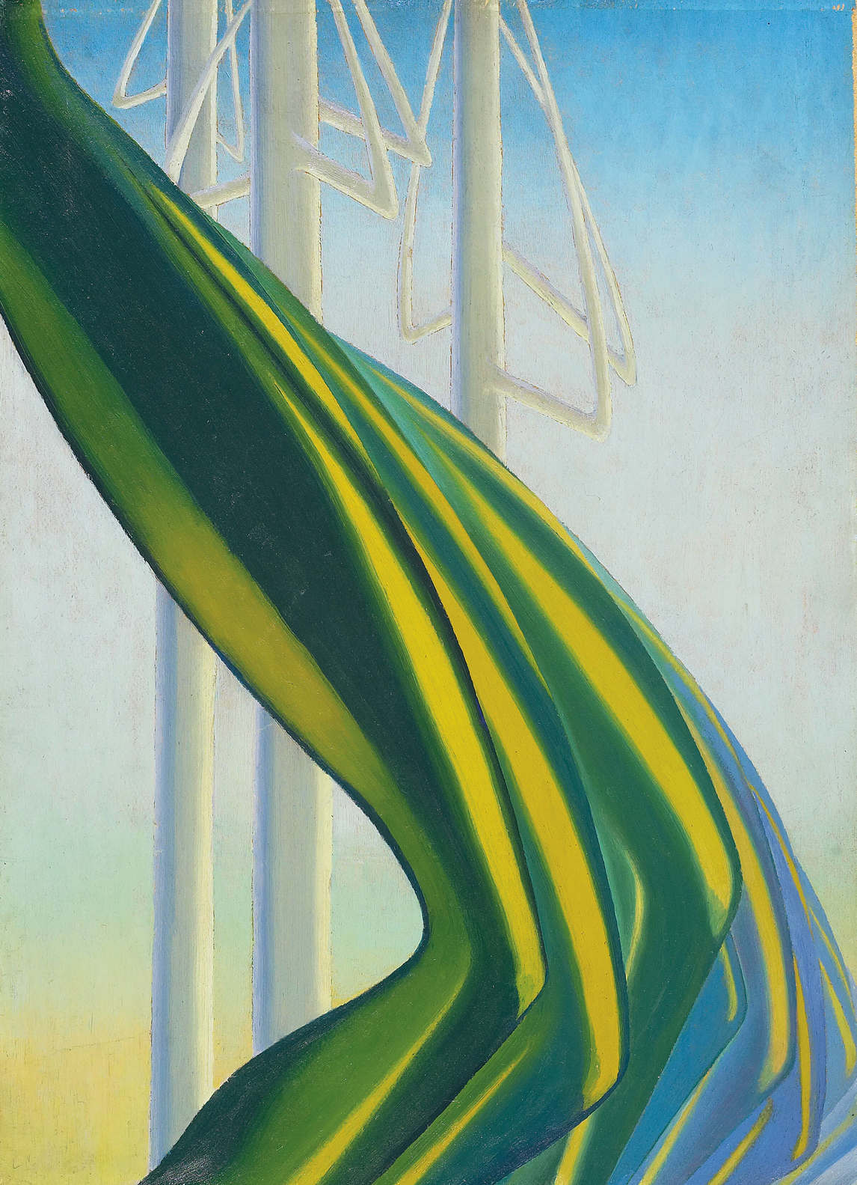
Bertram Brooker, Green Movement, c.1927, oil on paperboard, 58.8 x 43.2 cm, Art Gallery of Ontario, Toronto, purchase with assistance from Wintario, 1978, 78/14. © Art Gallery of Ontario.
In this work the green form is so distinct that it is almost as if Brooker has painted a sculpture.

Slide 21
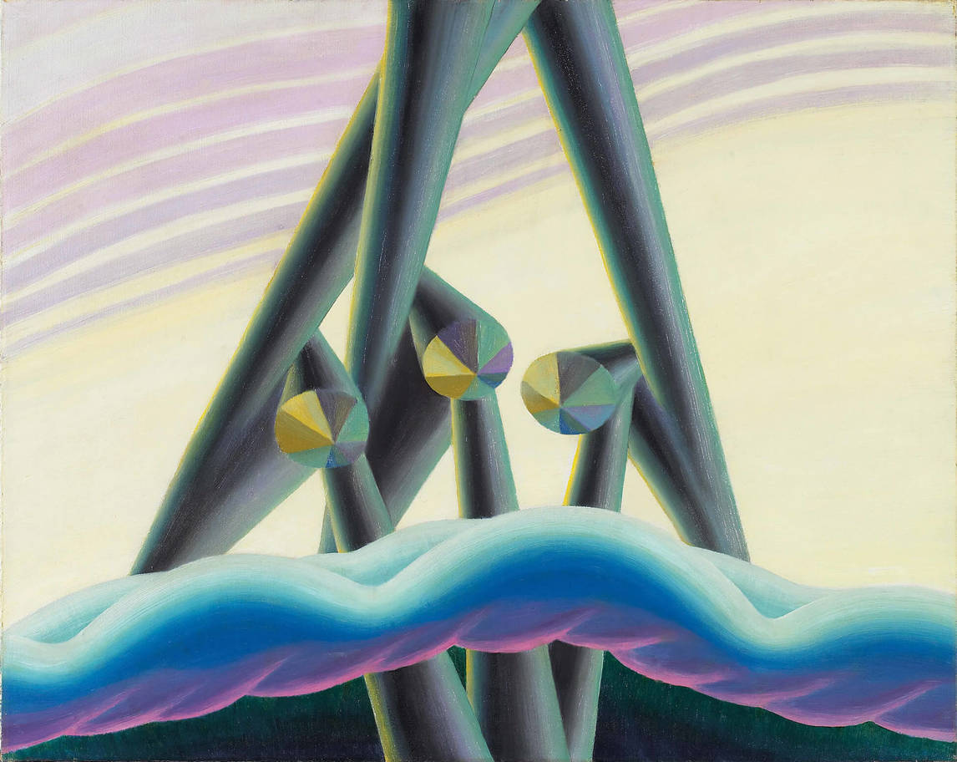
Bertram Brooker, The Three Powers, 1929, oil on canvas, 61 x 76.3 cm, Art Gallery of Ontario, Toronto, purchase, 1982, 82/33. © Art Gallery of Ontario.
This painting is abstract, but it is not just an image of form and colour: Brooker was attempting to represent a spiritual world.

Slide 22
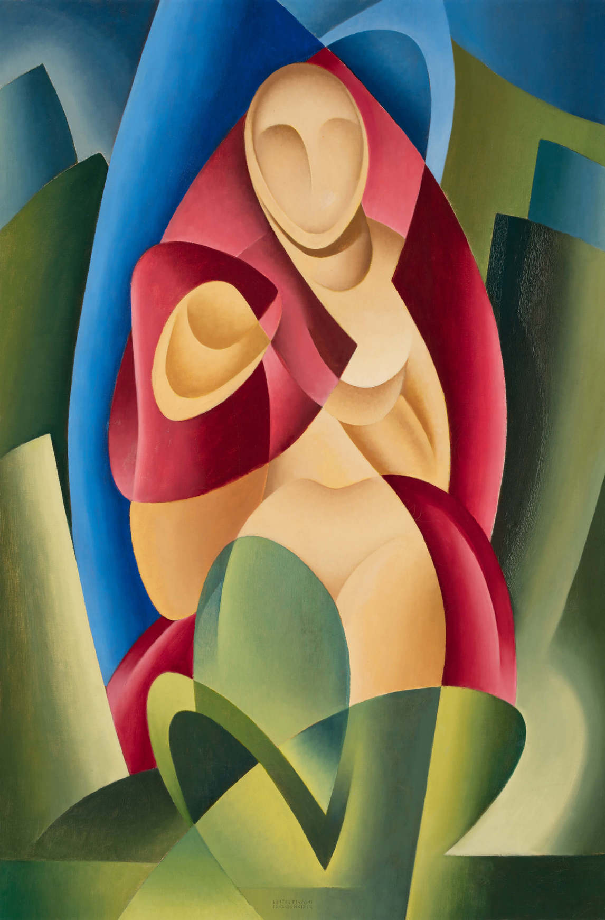
Bertram Brooker, Pharaoh’s Daughter, 1950. In this painting, the form of the woman’s body is suggested through abstract shapes.

Slide 23
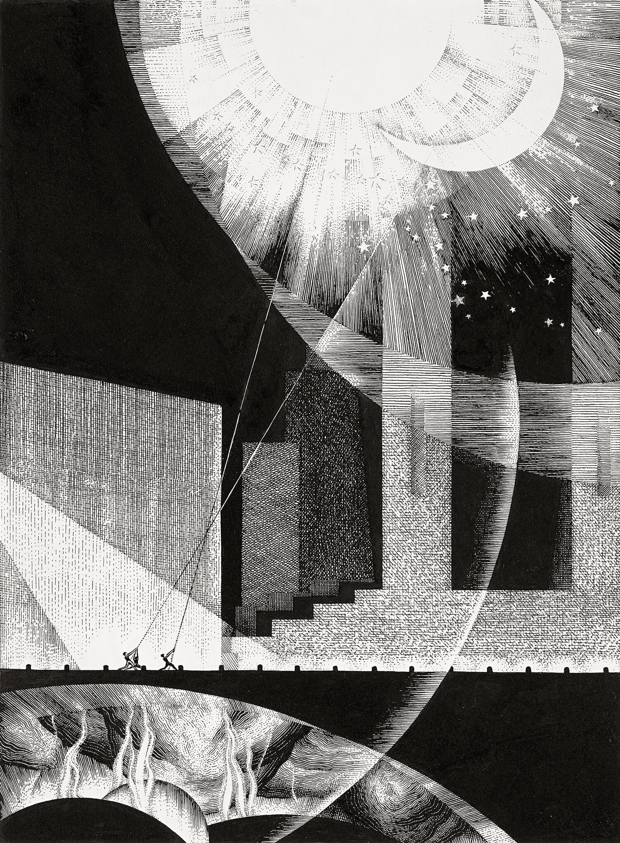
Bertram Brooker, All the World’s a Stage, 1929. Inspired by Brooker’s interest in theatre, this drawing shows several different ways of using black and white ink.

Slide 24
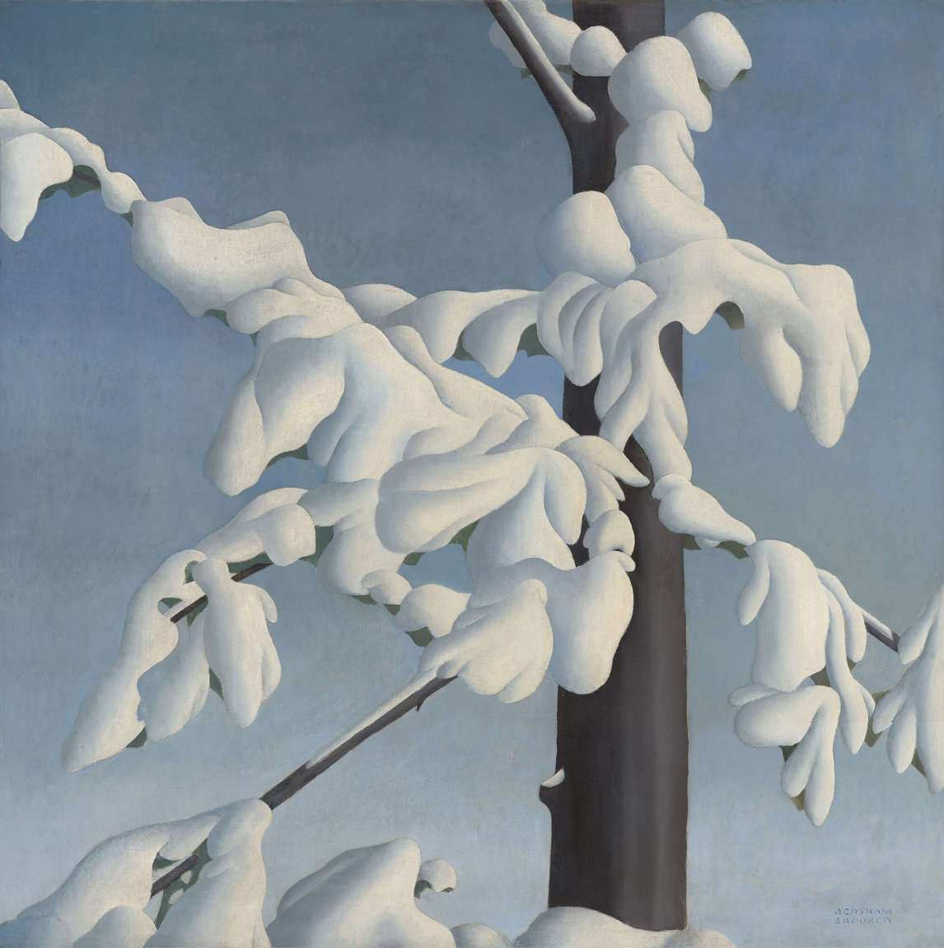
Bertram Brooker, Snow Fugue, 1930. The term “fugue” refers to a specific form of music, and it suggests that Brooker wanted viewers to think about musical rhythms in relation to this work.

Slide 25
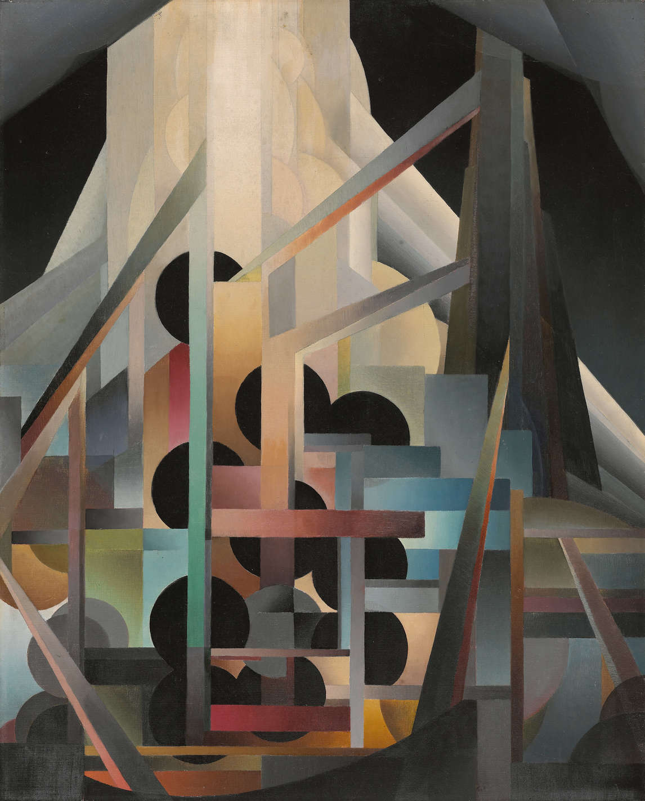
Bertram Brooker, Ascending Forms, c.1929. This painting may have been inspired by the work of the Vorticist group – the first abstract modern artists in Britain.

