Slide 1
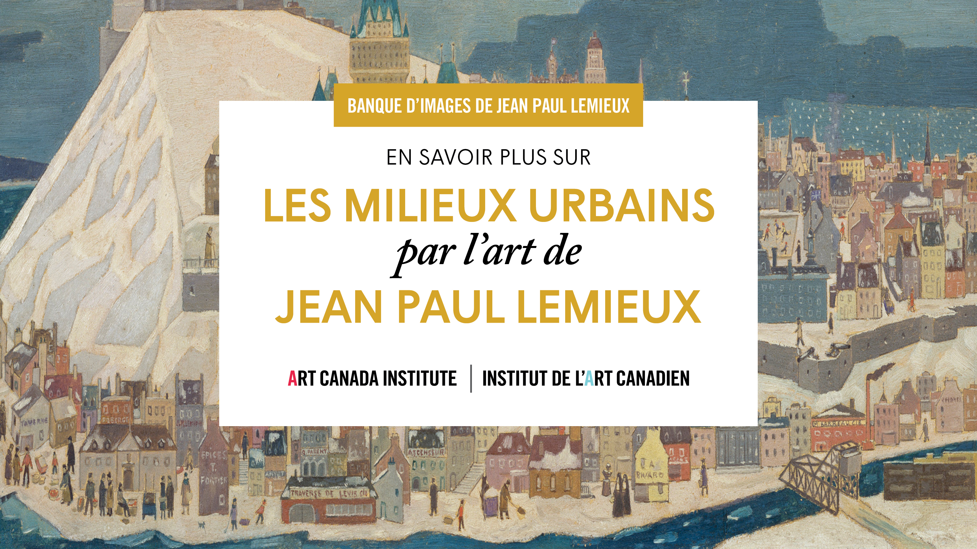

Slide 2
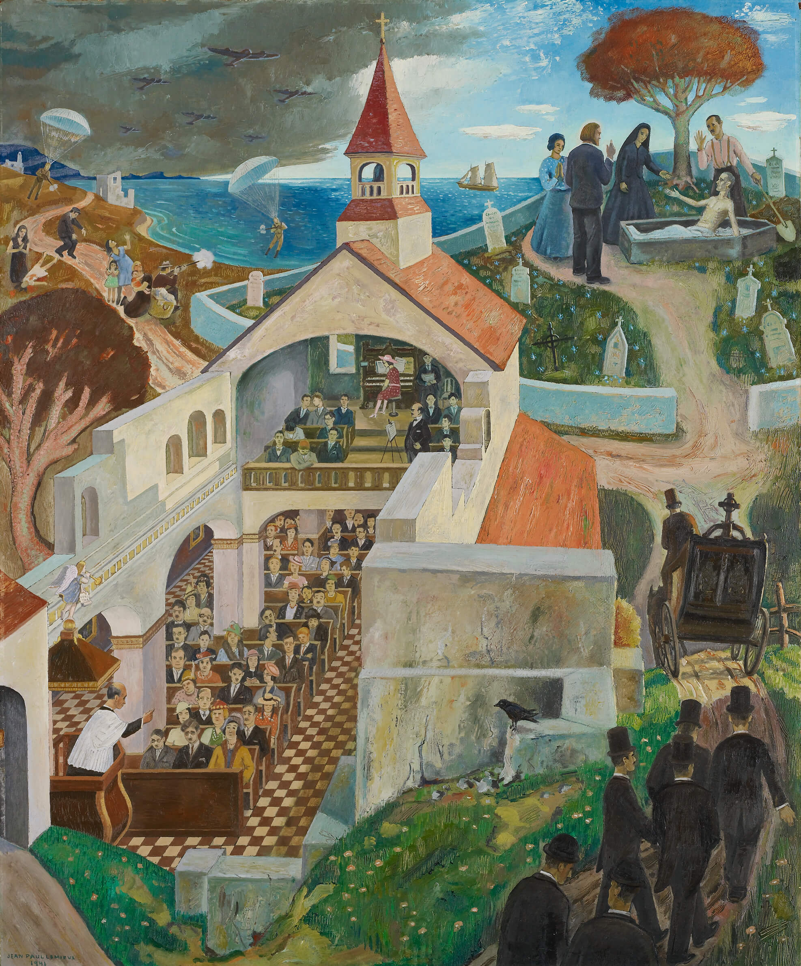
Jean Paul Lemieux, Lazarus, 1941.
A view of a church dominates this painting; Lazarus is visible in the upper right corner.

Slide 3
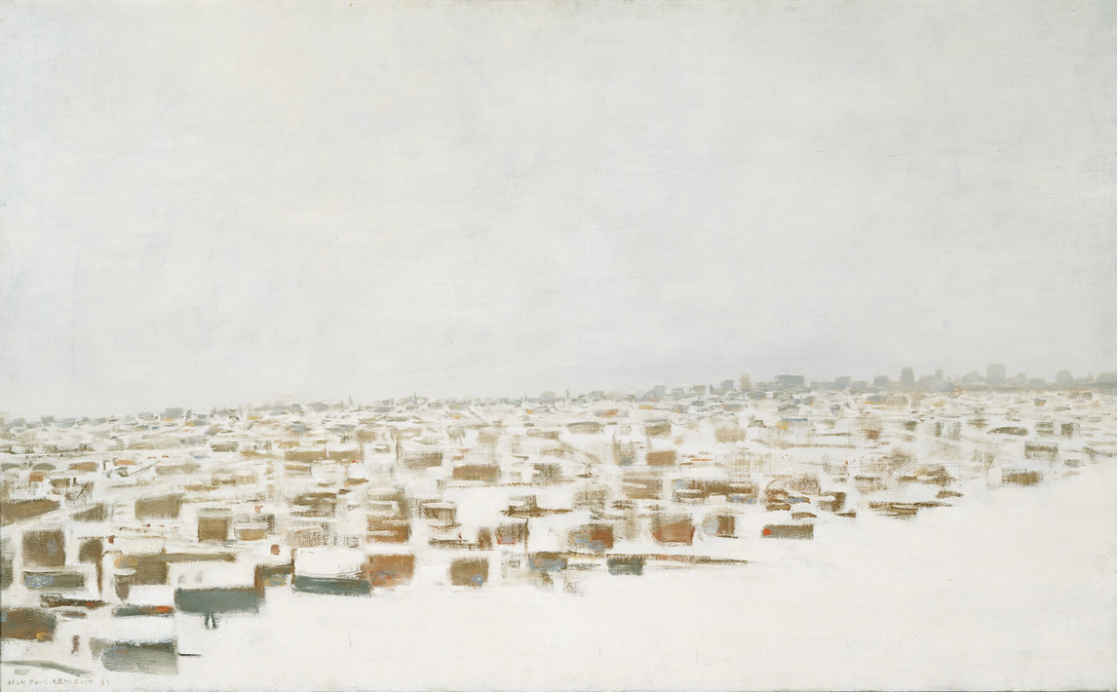
Jean Paul Lemieux, Snow-covered City, 1963. Blanketed with snow, this city still appears crowded and dense.

Slide 4
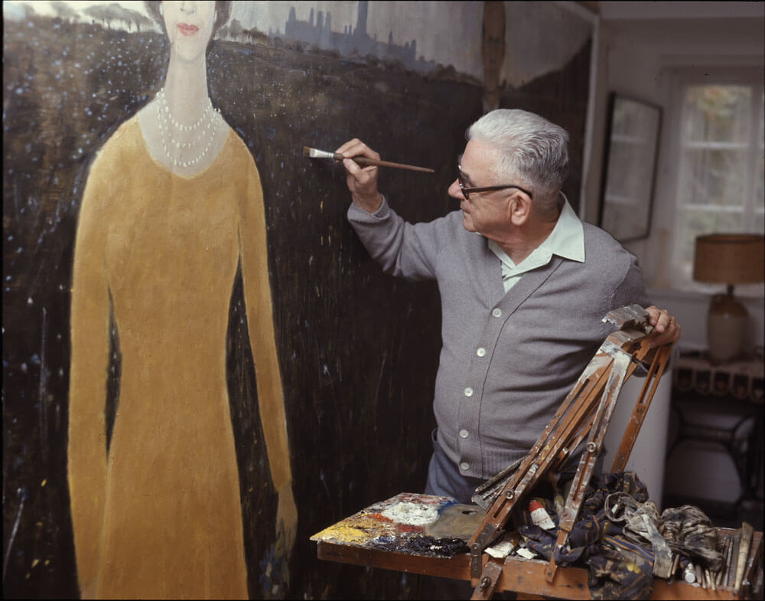
Jean Paul Lemieux painting a
portrait of Queen Elizabeth II, c.1977.

Slide 5
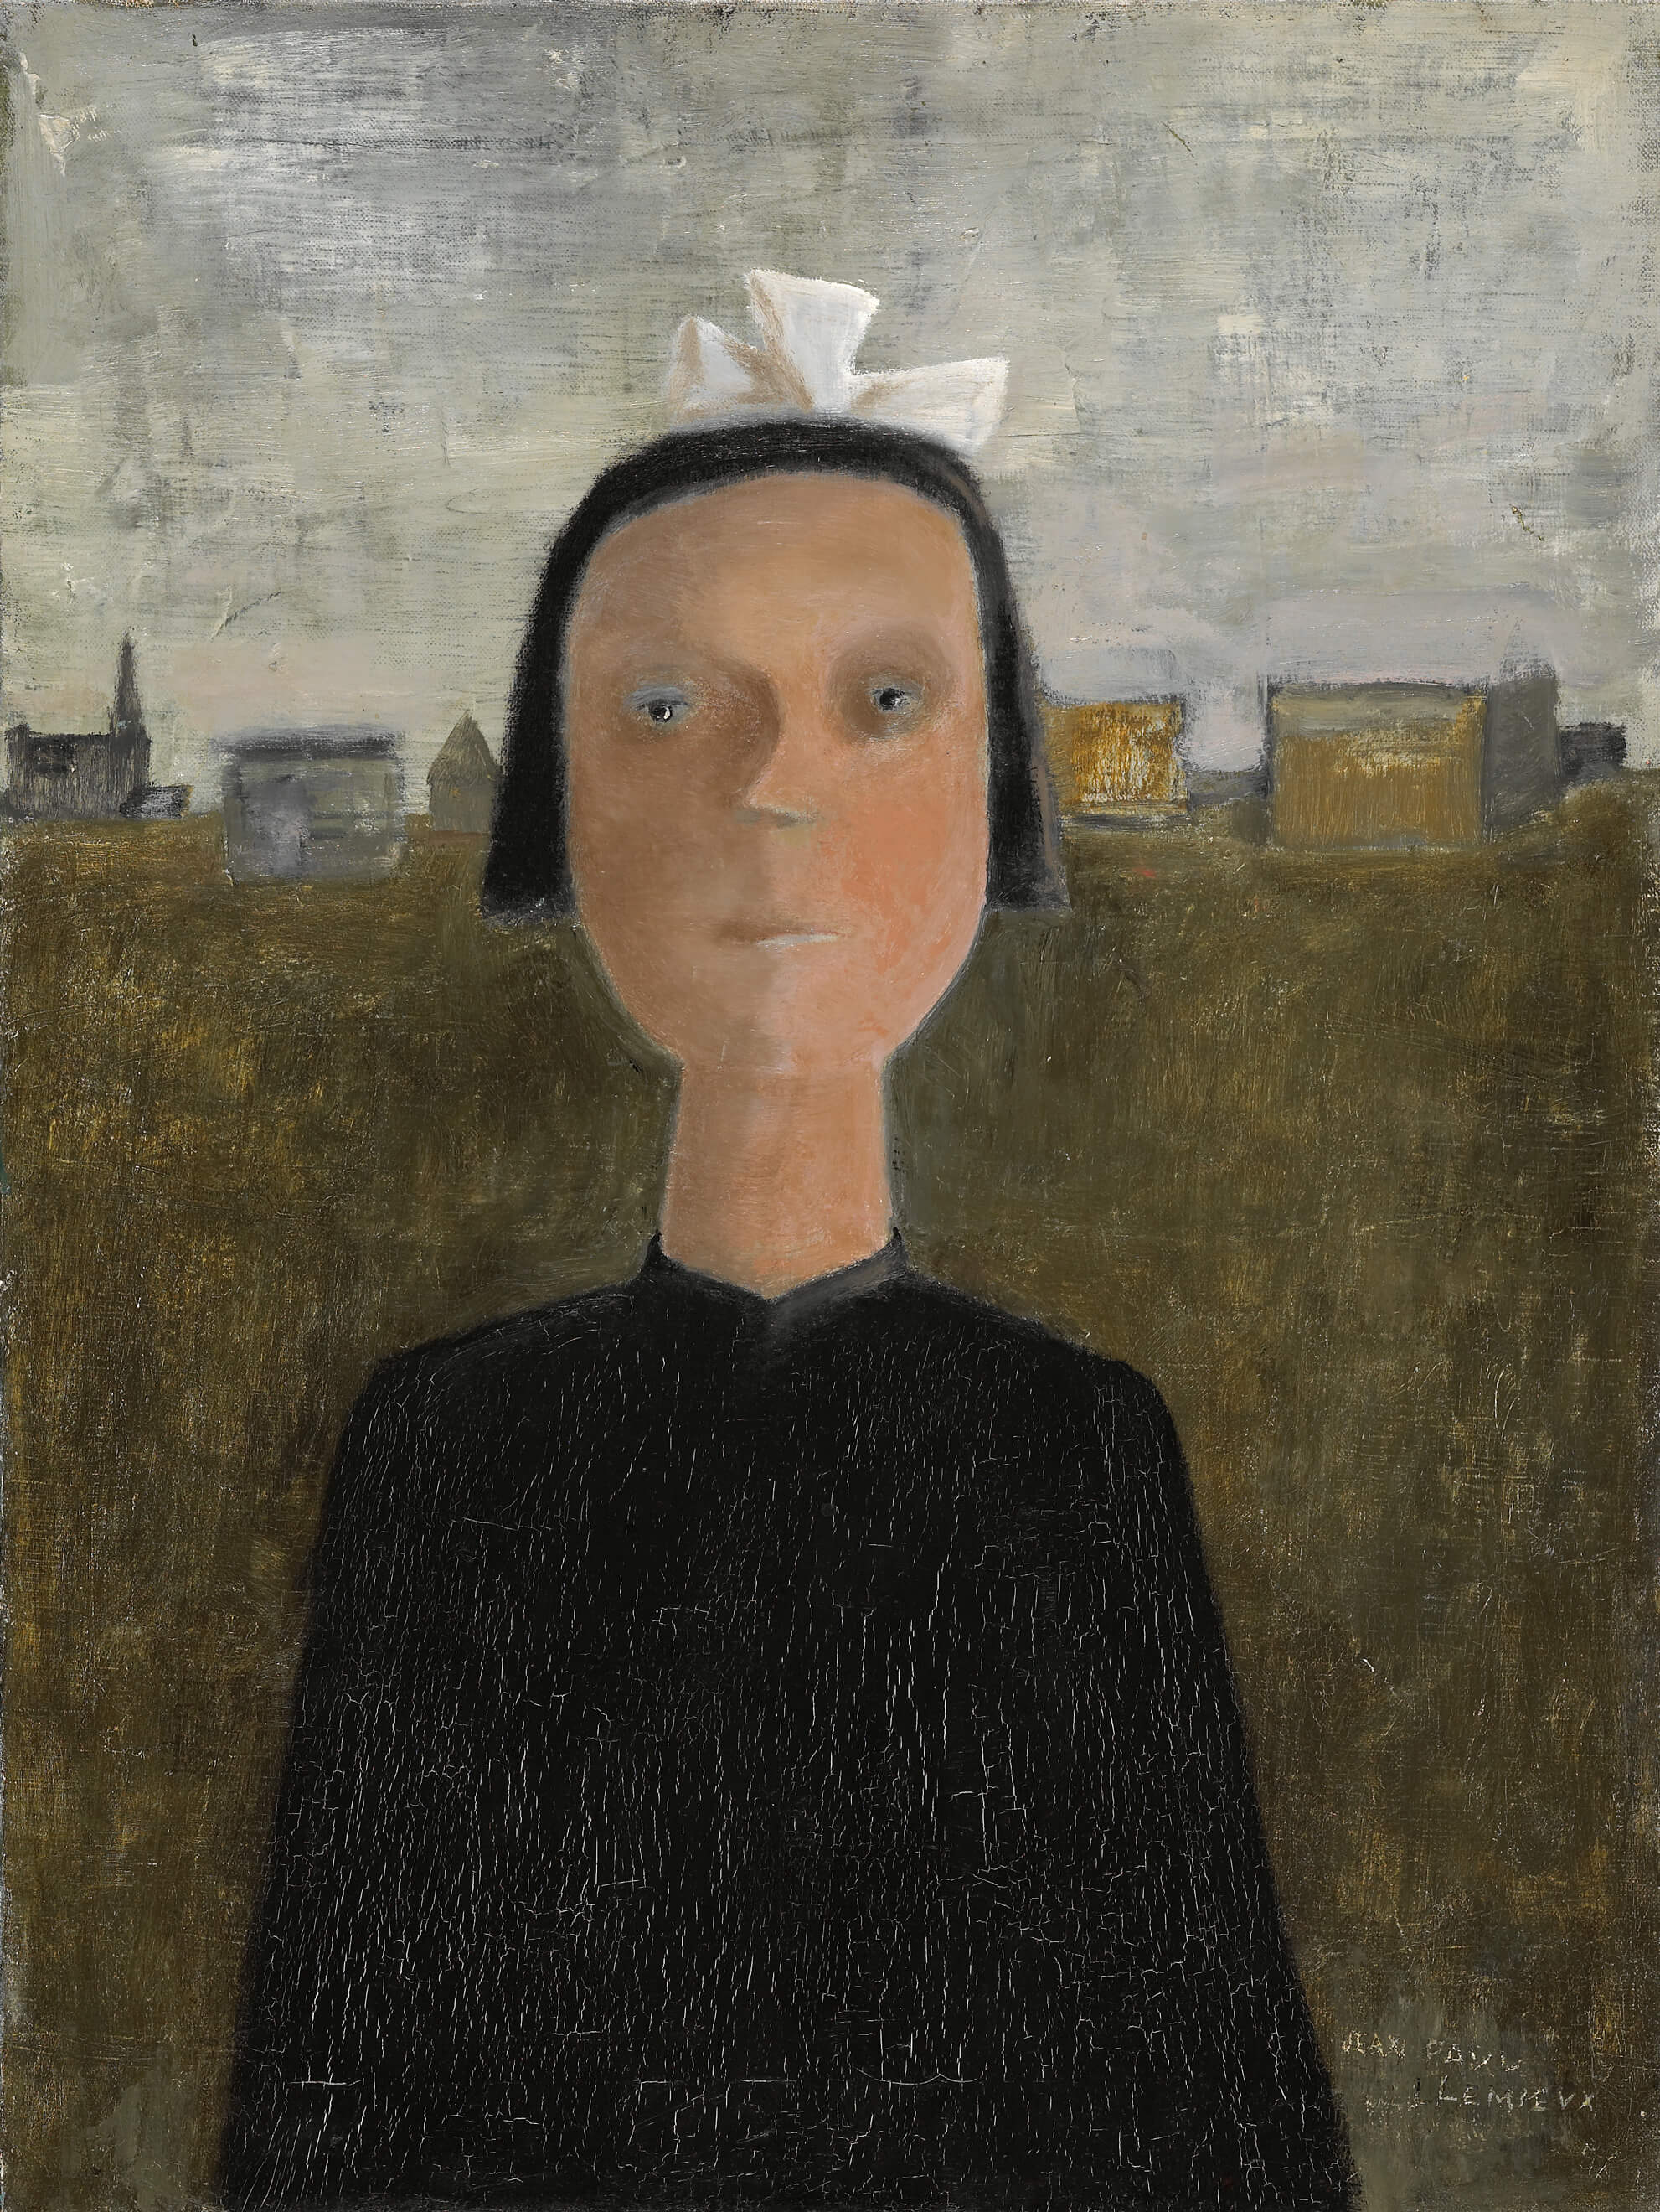
Jean Paul Lemieux, The Orphan, 1956. The darkness in this work represents the child’s unhappiness.

Slide 6
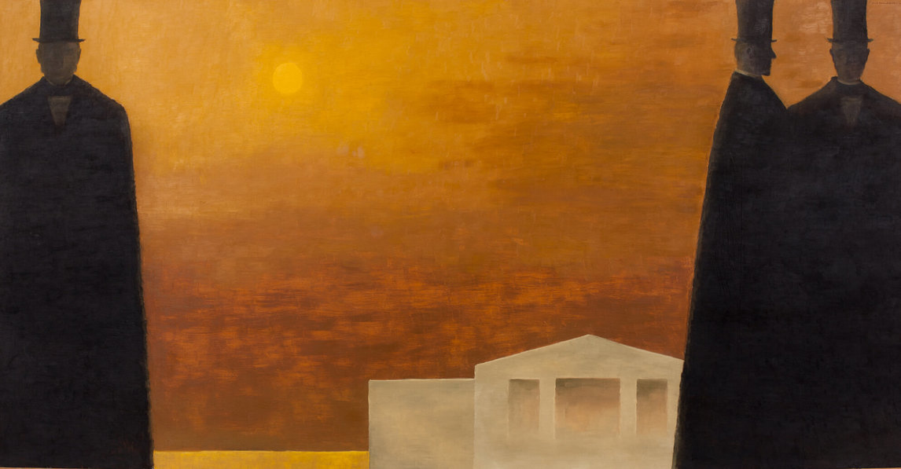
Jean Paul Lemieux, Charlottetown Revisited, 1964. This painting shows three of the Fathers of Confederation in front of Province House.

Slide 7
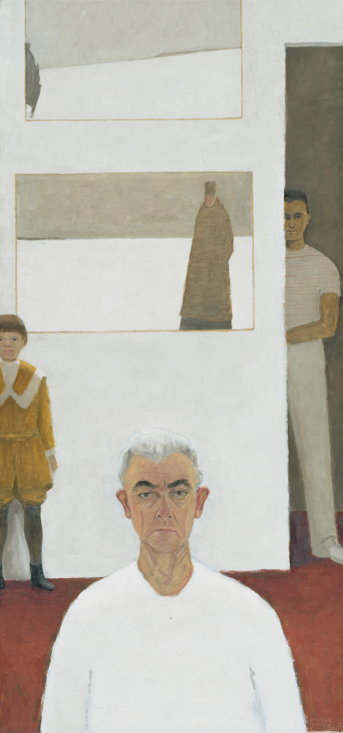
Jean Paul Lemieux, Self-portrait, 1974. This self-portrait shows Lemieux in childhood, adolescence, and old age.

Slide 8
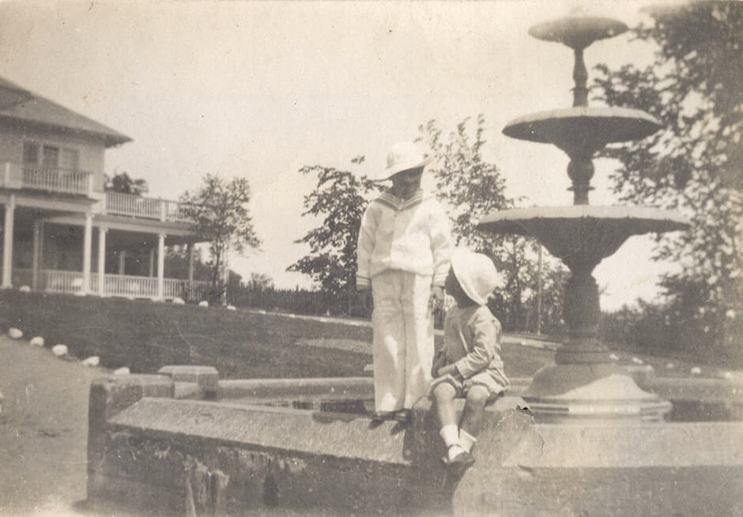
Jean Paul Lemieux (left) with his brother, Henri, at the Kent House hotel, c.1910.

Slide 9
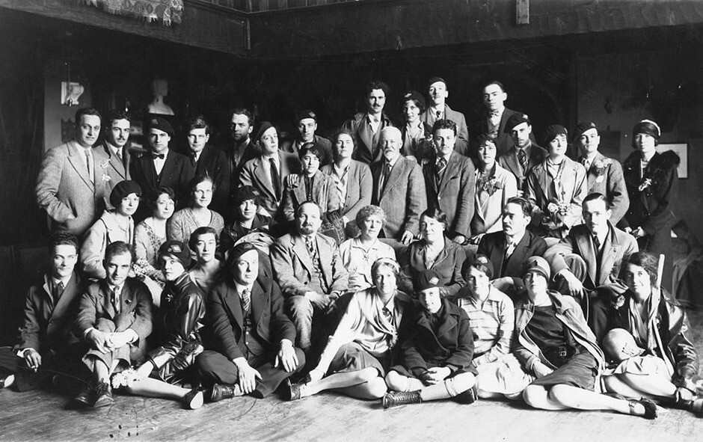
Students of the École des beaux-arts de Montréal, c.1927. Lemieux is seated at the bottom left corner of the photograph.

Slide 10
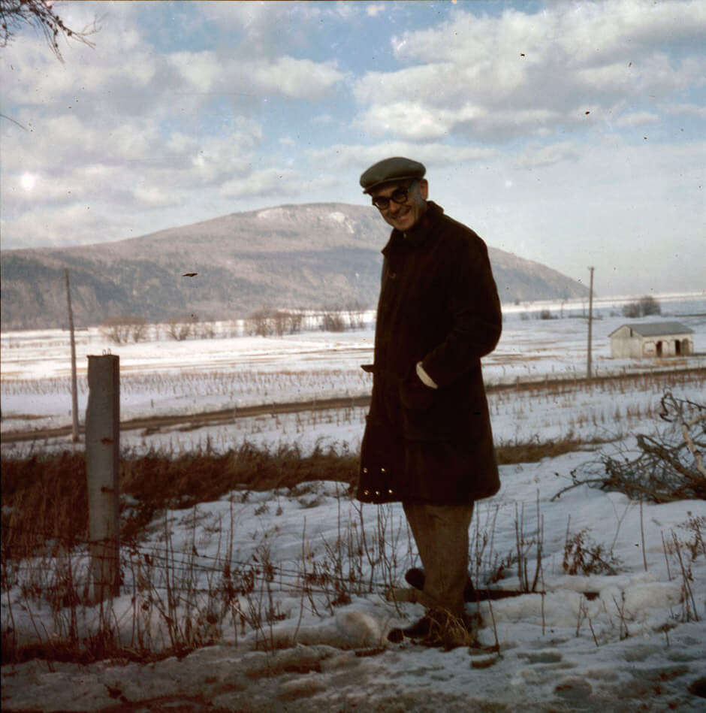
Jean Paul Lemieux in winter, Quebec, c.1955–63.

Slide 11
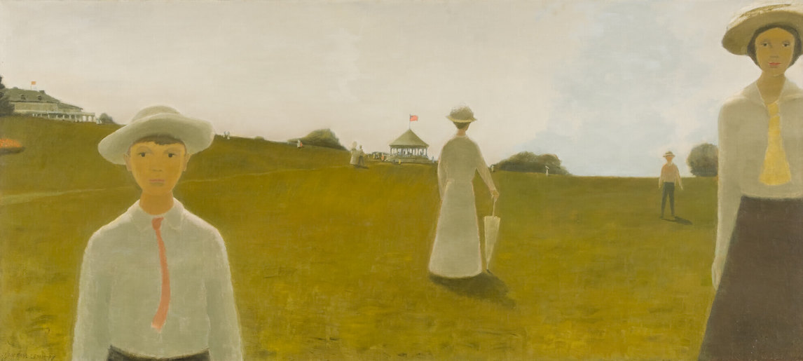
Jean Paul Lemieux, Summer of 1914, 1965. This painting reflects Lemieux’s nostalgia for childhood.

Slide 12
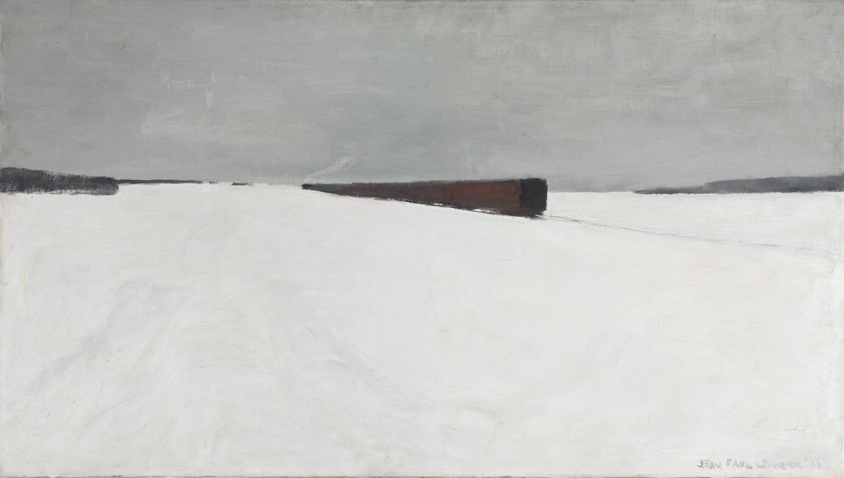
Jean Paul Lemieux, The Noon Train, 1956. The space in this work relates to how Lemieux felt on the train between Quebec City and Montreal.

Slide 13
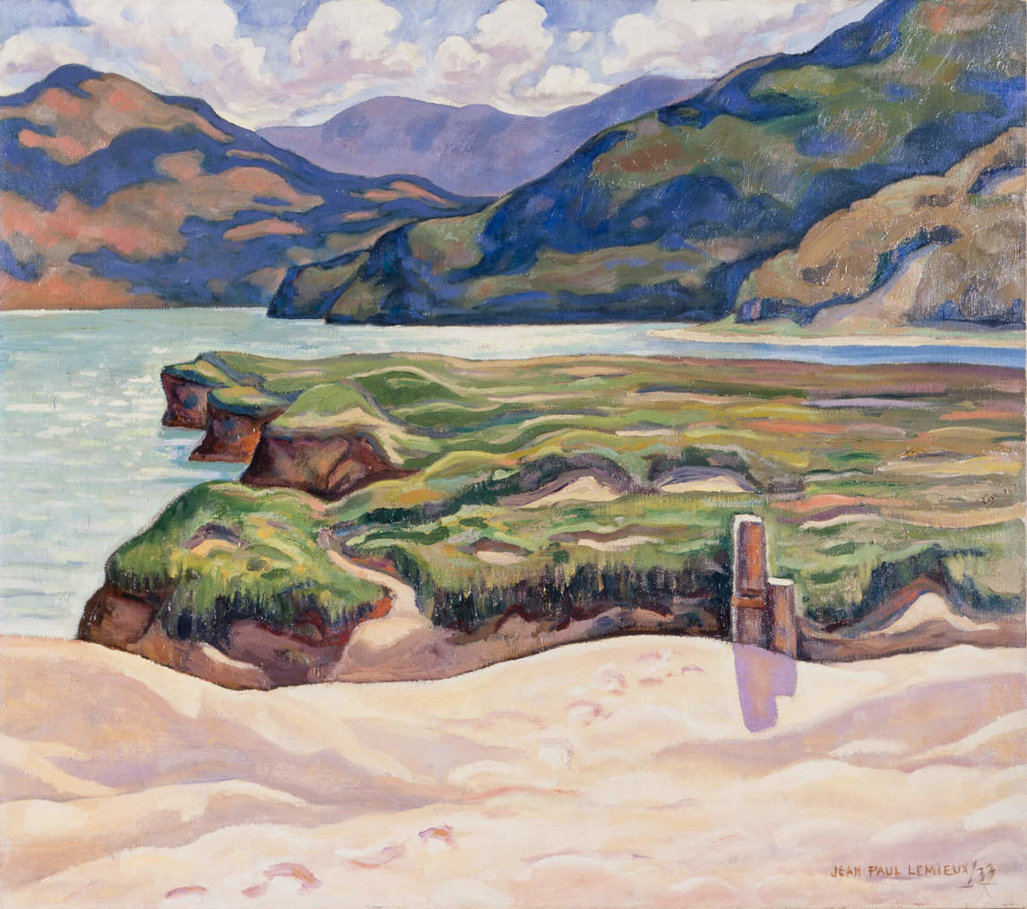
Learning Activity #1
Jean Paul Lemieux, Afternoon Sunlight, 1933. This painting shows the influence of the Group of Seven.

Slide 14
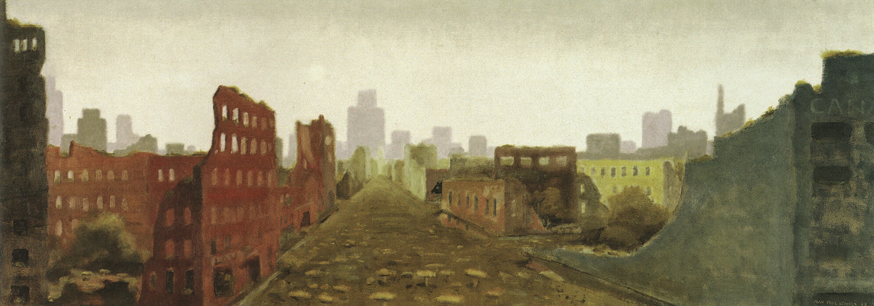
Learning Activity #1
Jean Paul Lemieux, The Aftermath/La ville détruite, 1968. Here we see a city ruined and abandoned.

Slide 15
Learning Activity #1
Jean Paul Lemieux, Afternoon Sunlight, 1933. This painting shows the influence of the Group of Seven.
Jean Paul Lemieux, The Aftermath/La ville détruite, 1968. Here we see a city ruined and abandoned.

Slide 16
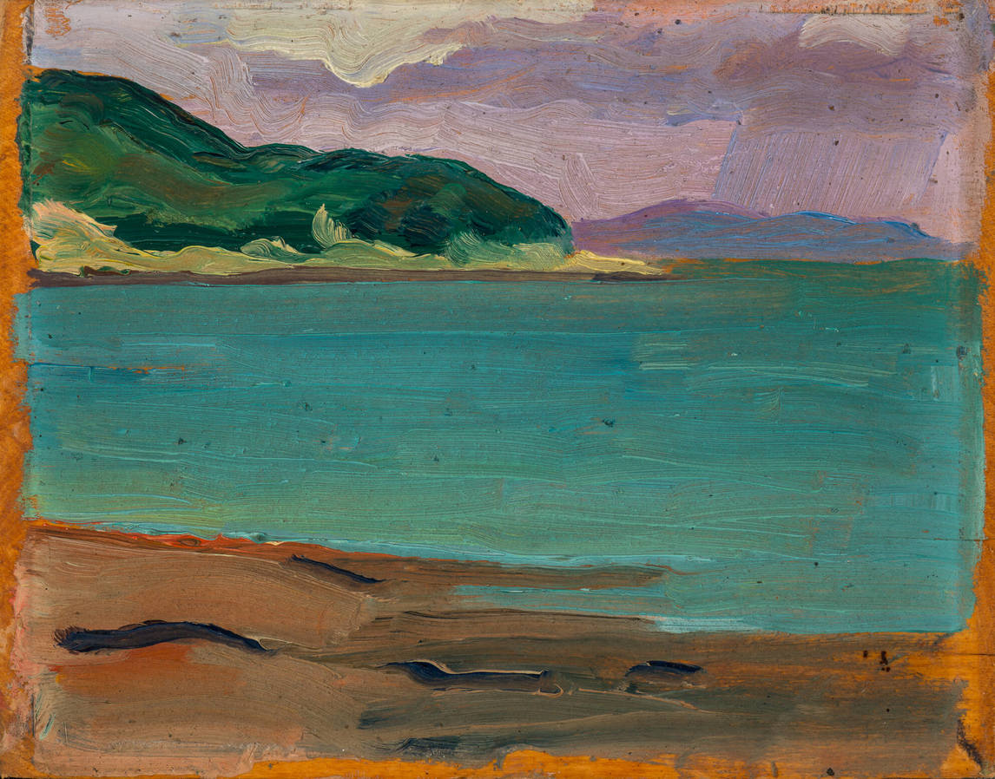
Learning Activity #1
Jean Paul Lemieux, Seascape, Bay St. Paul, 1935. In this work Lemieux used fluid brushwork and vibrant colours.

Slide 17
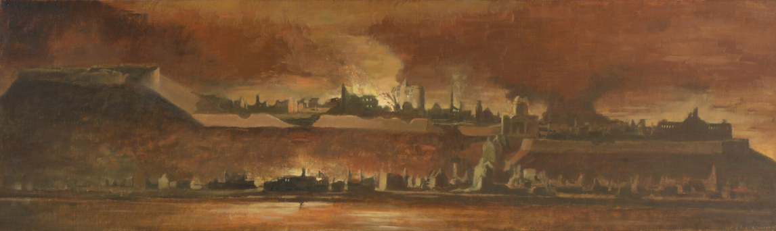
Learning Activity #1
Jean Paul Lemieux, Quebec City Is Burning, 1967. Lemieux’s decision to paint the city in flames is a reflection of his anxiety about modern cities and the machine age.

Slide 18
Learning Activity #1
Jean Paul Lemieux, Seascape, Bay St. Paul, 1935. In this work Lemieux used fluid brushwork and vibrant colours.
Jean Paul Lemieux, Quebec City Is Burning, 1967. Lemieux’s decision to paint the city in flames is a reflection of his anxiety about modern cities and the machine age.

Slide 19
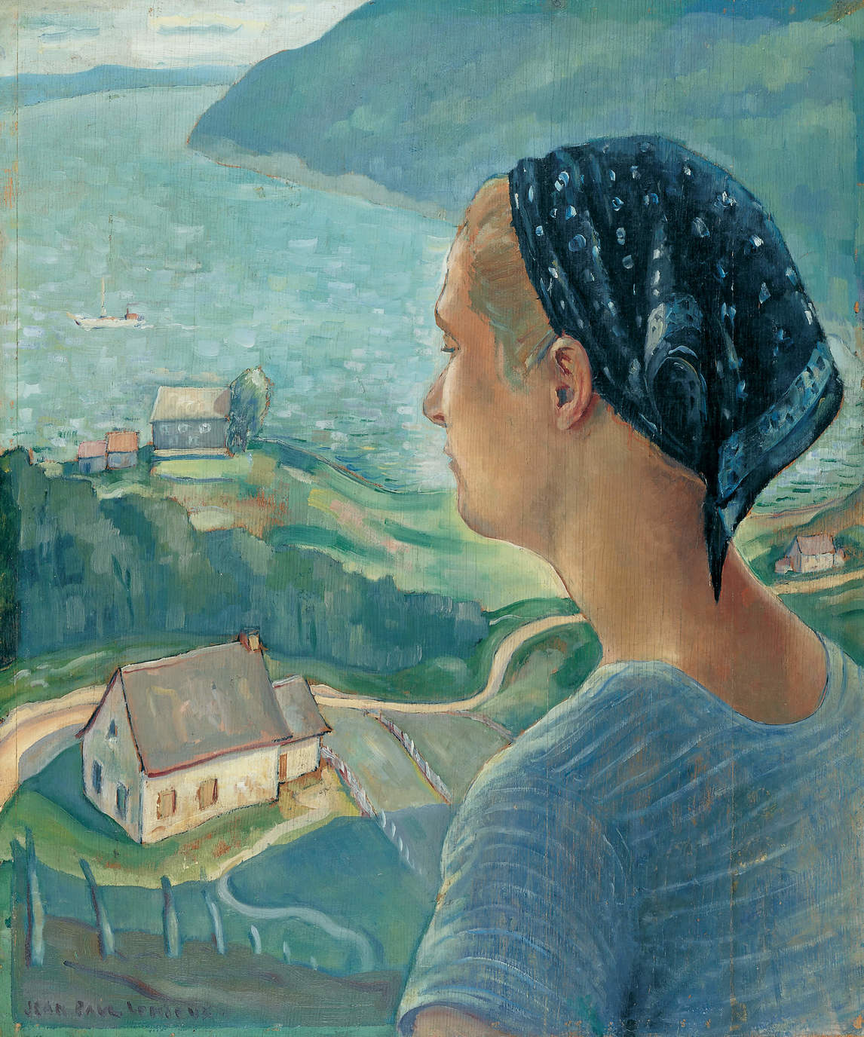
Learning Activity #1
Jean Paul Lemieux, Those Beautiful Days, 1937. This composition combines a landscape with a portrait of Lemieux’s wife, whom he had married that summer.

Slide 20
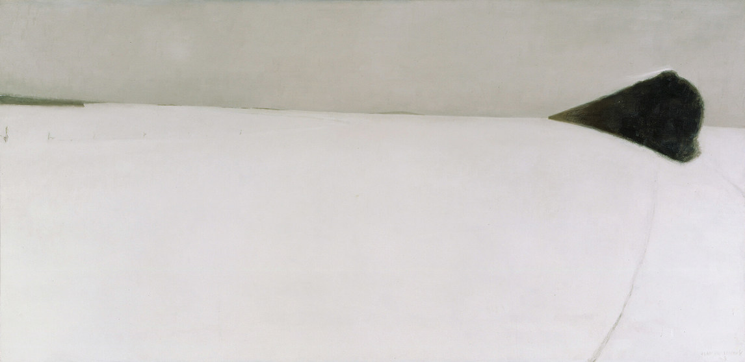
Learning Activity #1
Jean Paul Lemieux, The Express, 1968. Although Lemieux was anxious about urban transformation, he loved travelling by train.

Slide 21
Learning Activity #1
Jean Paul Lemieux, Those Beautiful Days, 1937. This composition combines a landscape with a portrait of Lemieux’s wife, whom he had married that summer.
Jean Paul Lemieux, The Express, 1968. Although Lemieux was anxious about urban transformation, he loved travelling by train.

Slide 22
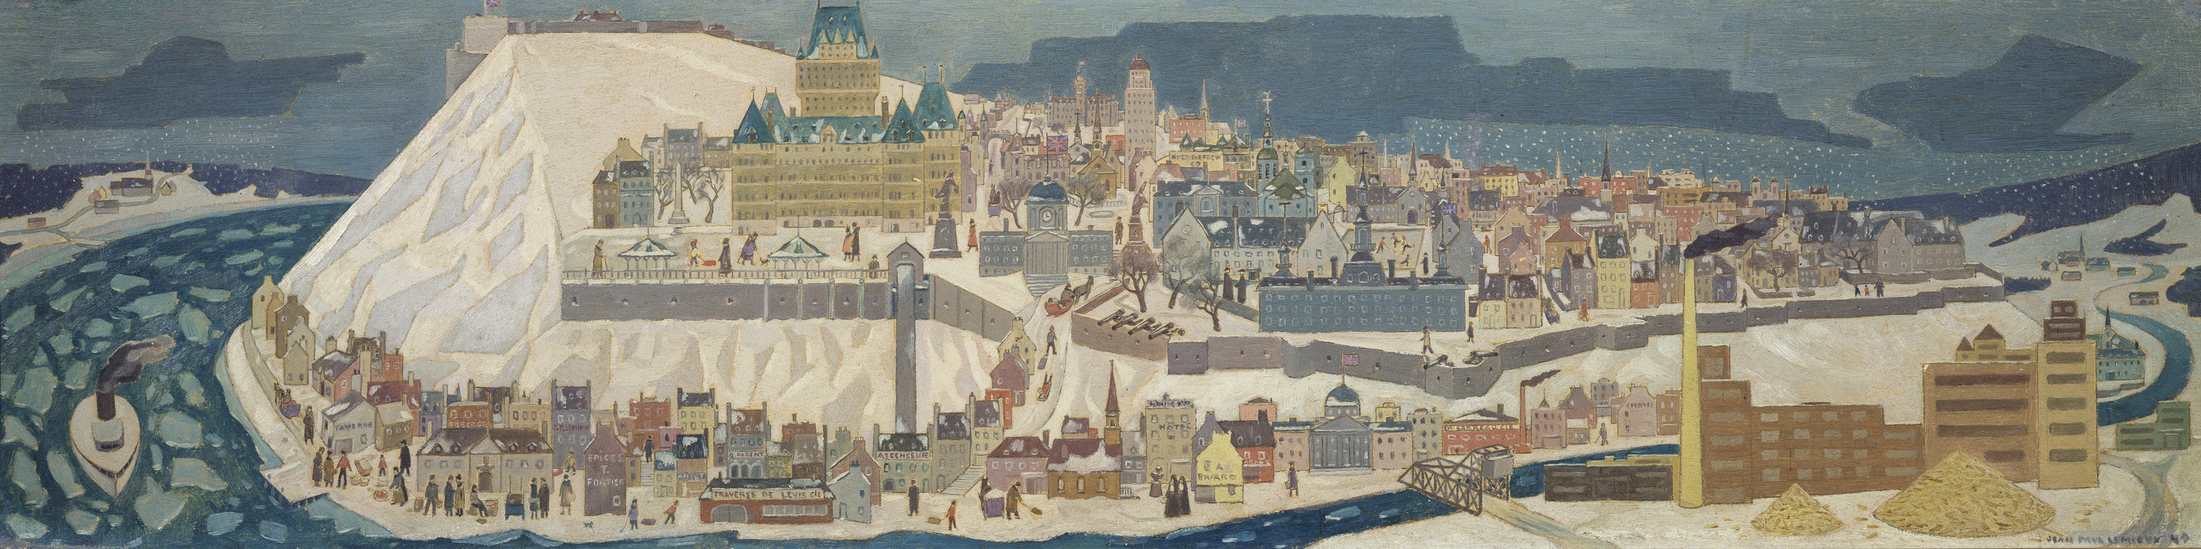
Learning Activity #2
Jean Paul Lemieux, preparatory sketch for “Québec (projet de peinture murale)”. This mural was never created, but in the sketch we see the exceptional level of detail that Lemieux intended for his depiction of the city.

Slide 23
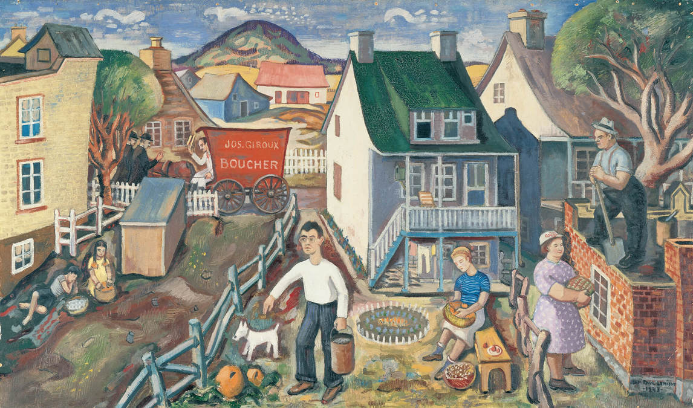
Learning Activity #2
Jean Paul Lemieux, Portrait of the Artist at Beauport-Est, 1943. This painting shows Lemieux’s house and neighbourhood.

Slide 24
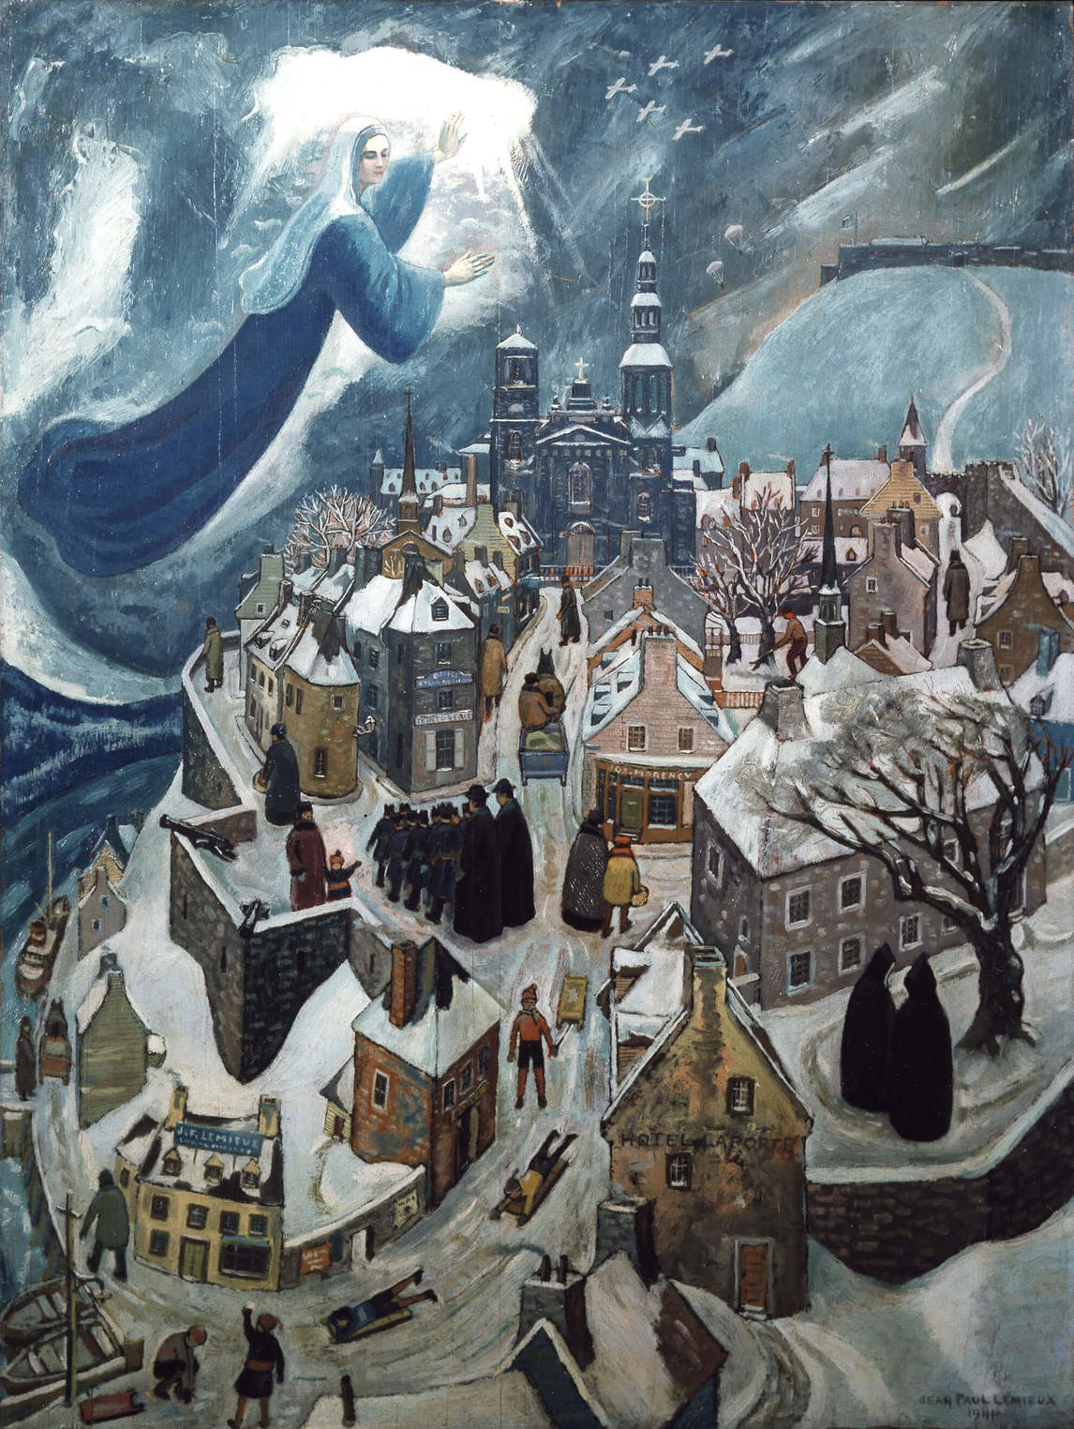
Learning Activity #2
Jean Paul Lemieux, Our Lady Protecting Quebec City, 1941. In this work Lemieux depicts an elevated view of the city; its residents are unaware that the Virgin Mary is watching over them.

Slide 25
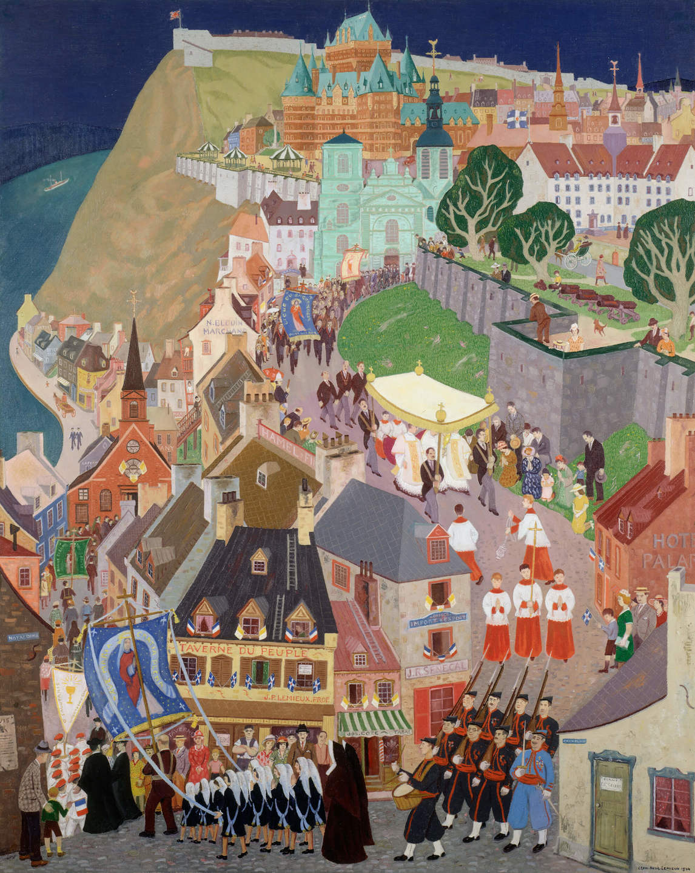
Culminating Task
Jean Paul Lemieux, Corpus Christi, Quebec City, 1944. Here Lemieux captured many details of the city’s buildings as well as the people participating in and watching the procession.

Slide 26
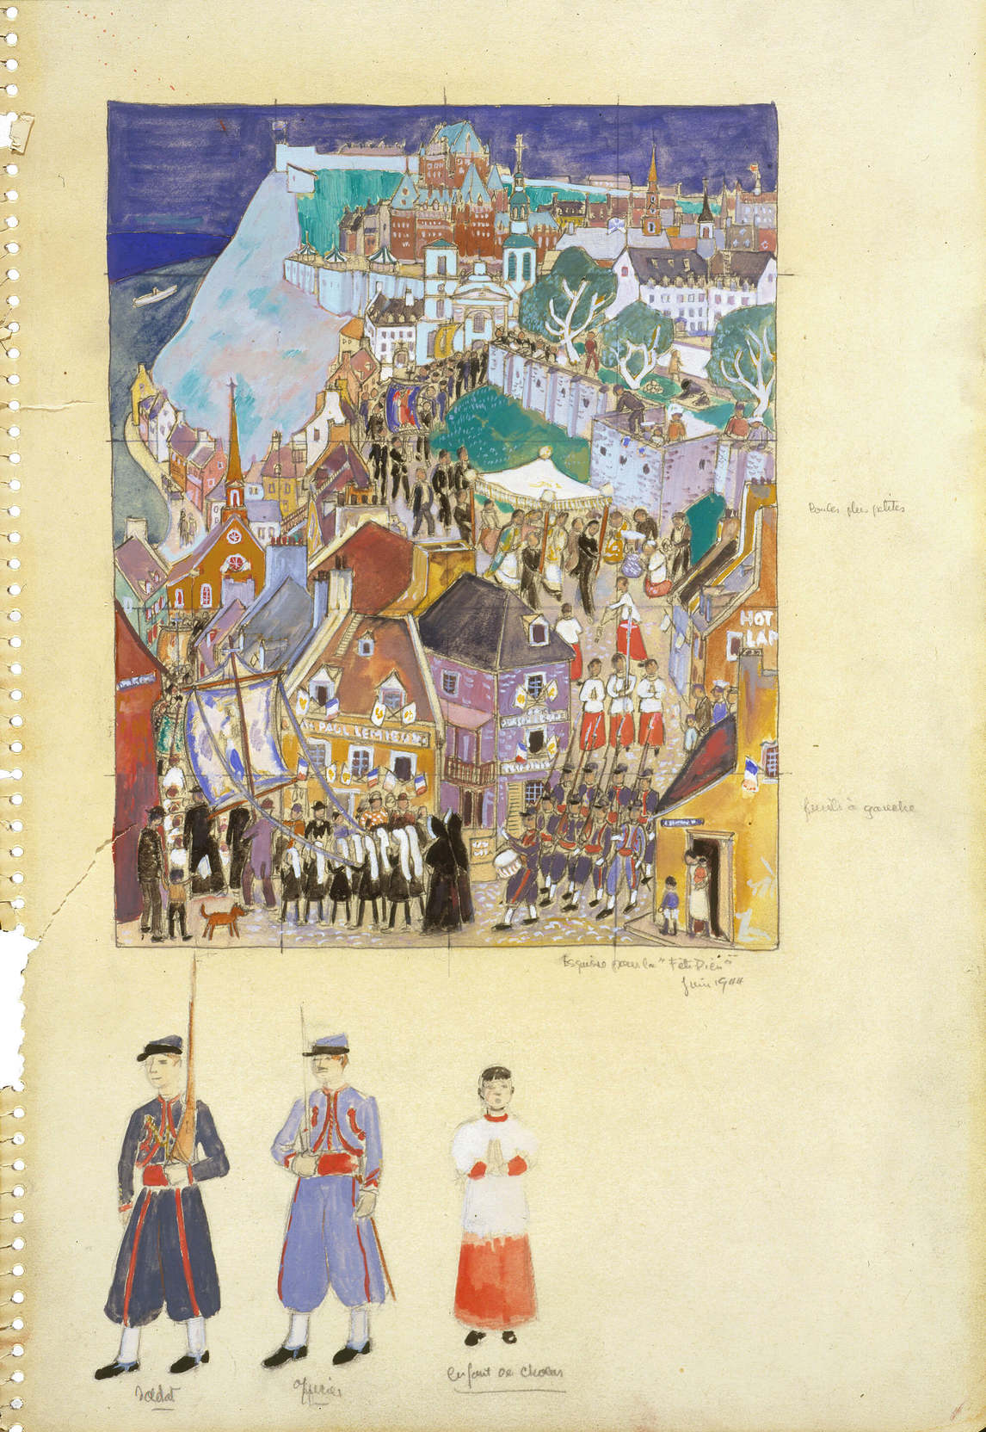
Jean Paul Lemieux, Study for “Corpus Christi, Quebec City”,
c.1944. This work shows some of Lemieux’s preparatory studies for the larger painting.

Slide 27
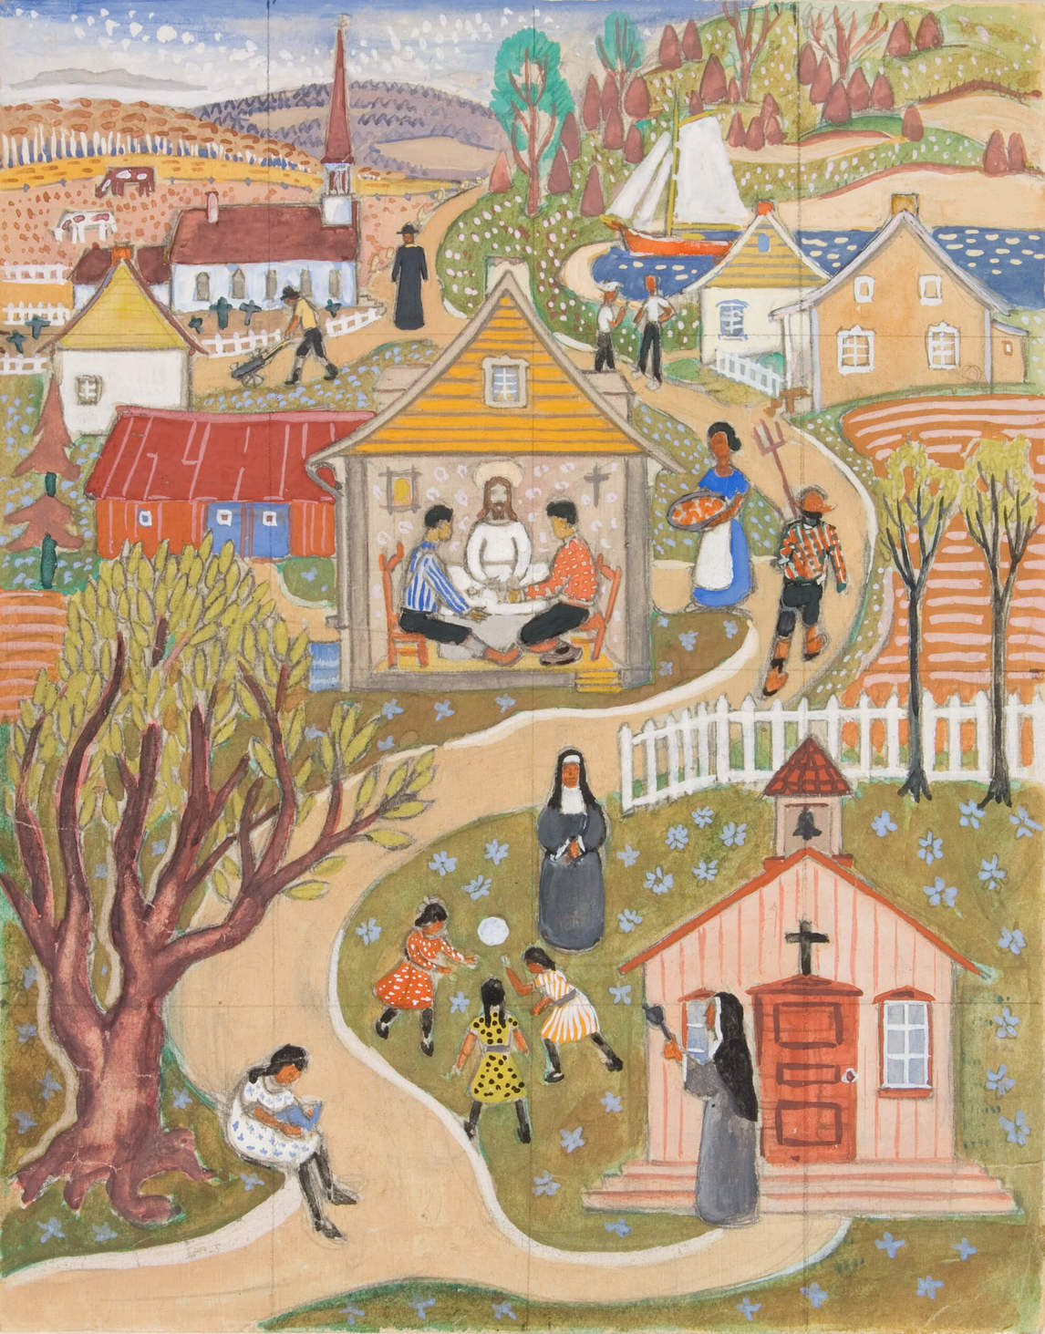
Jean Paul Lemieux, Study for “The Disciples of Emmaus”, 1940. This work depicts a scene from the Gospel of Luke in which, following his resurrection, Christ appeared to two disciples on the road to Emmaus and then ate supper with them.

Slide 28
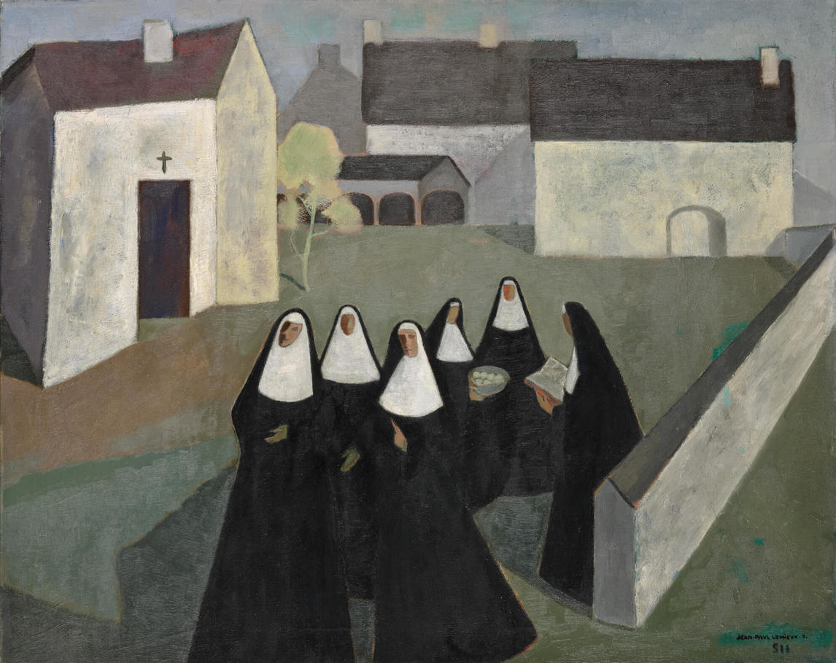
Jean Paul Lemieux, The Ursuline Nuns, 1951. As a mature artist, Lemieux began to simplify his compositions, a practice evident in this painting.

Slide 29
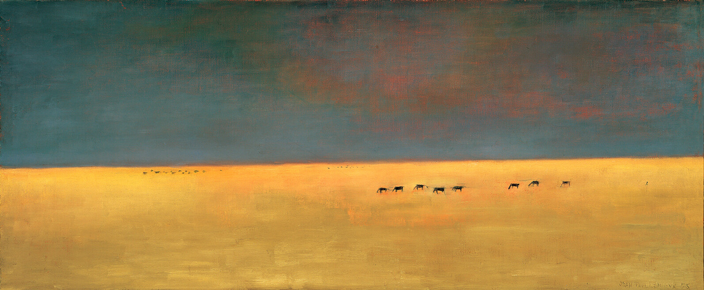
Jean Paul Lemieux, The Far West, 1955. Here we see Lemieux experimenting with a horizontal format.

Slide 30
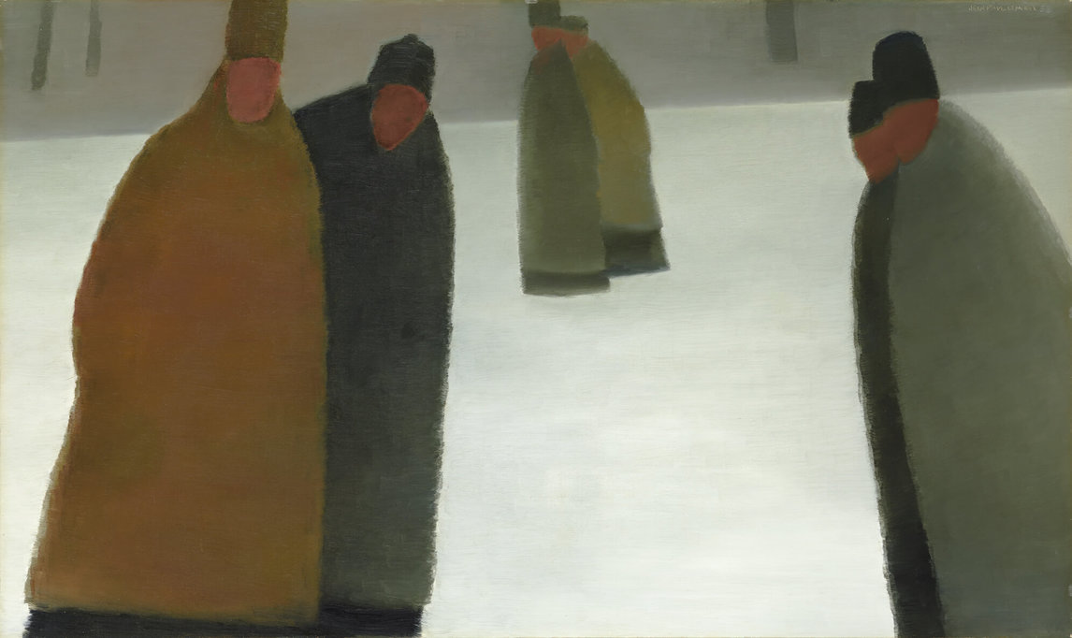
Jean Paul Lemieux, The Priests’ Promenade, 1958. Lemieux painted several sombre winter scenes.

Slide 31
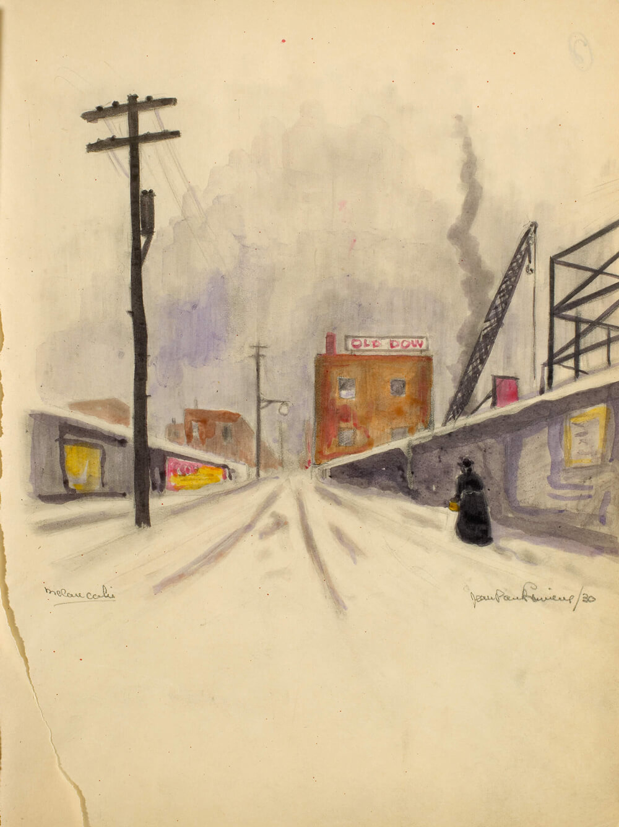
Jean Paul Lemieux, Melancholy,
c.1932. This drawing represents a lonely city street.

Slide 32
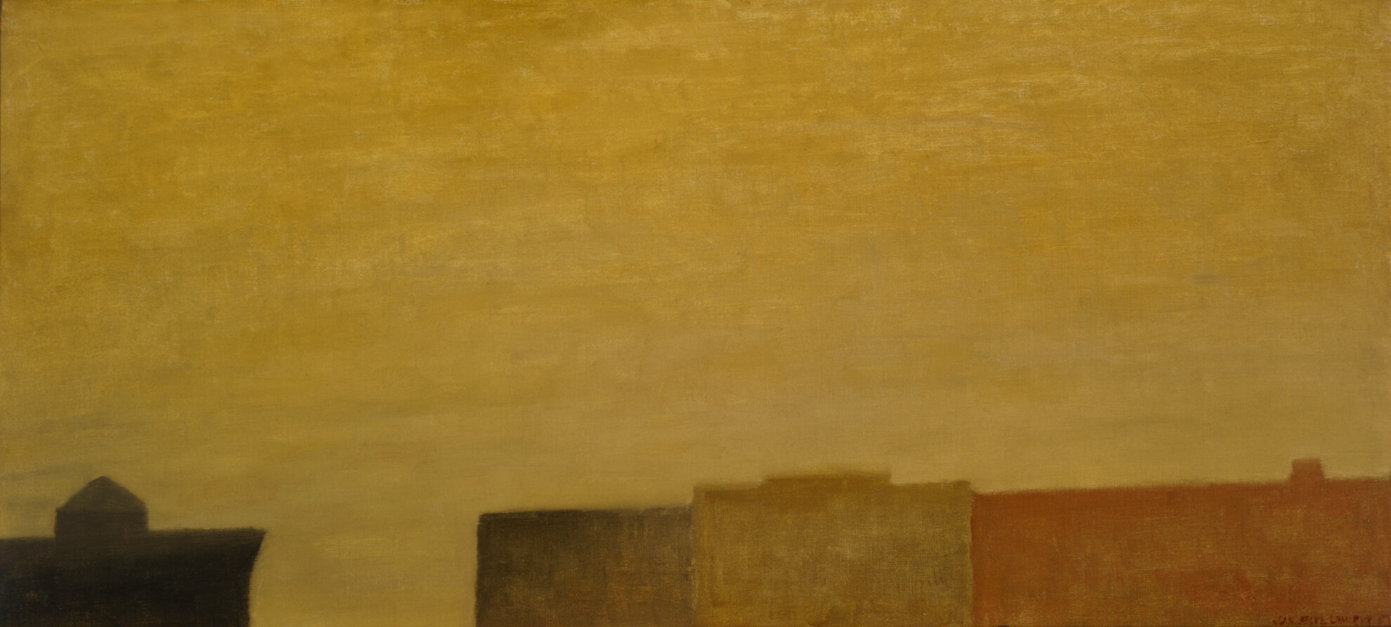
Jean Paul Lemieux, Summer in Montreal, 1959. This painting was inspired by Lemieux’s memories of sweltering summer days.

