Slide 1
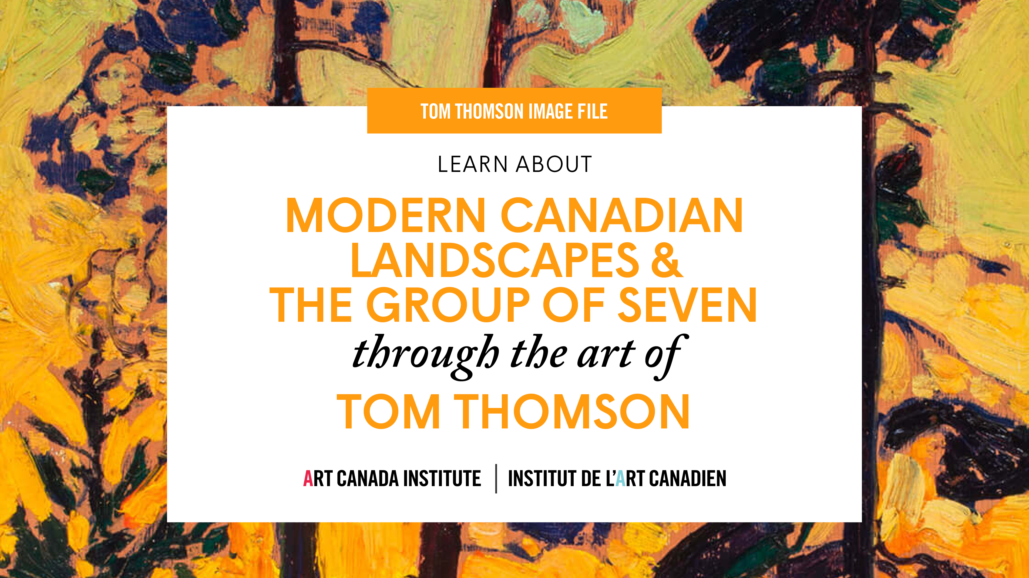

Slide 2
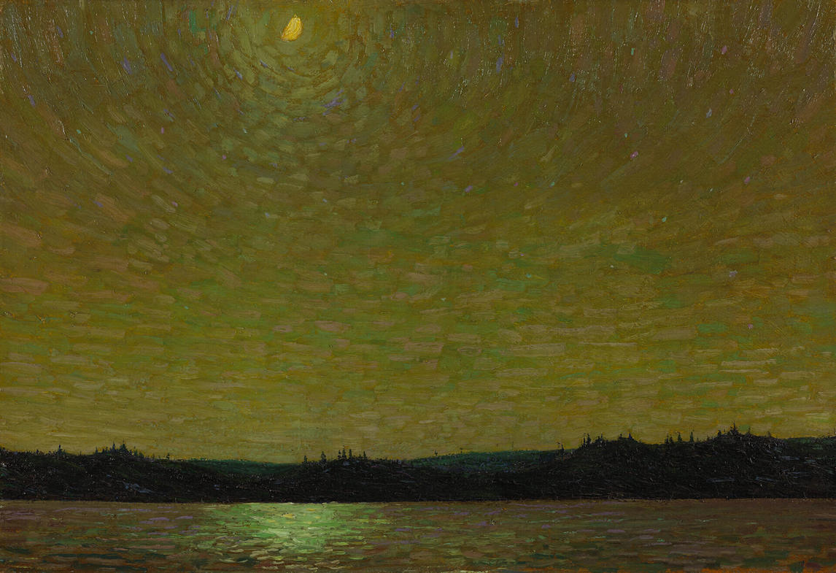
Tom Thomson, Moonlight, 1913–14. In 1914, when the National Gallery of Canada purchased this painting (their first work by Thomson), Thomson’s friend Lawren Harris was a board member and adviser to the Gallery.

Slide 3
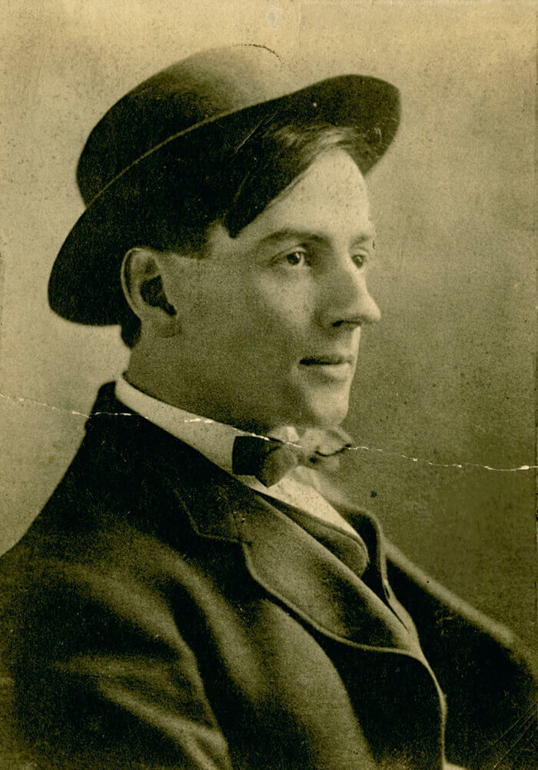
Studio portrait of Tom Thomson as a successful young commercial artist, c.1910.

Slide 4
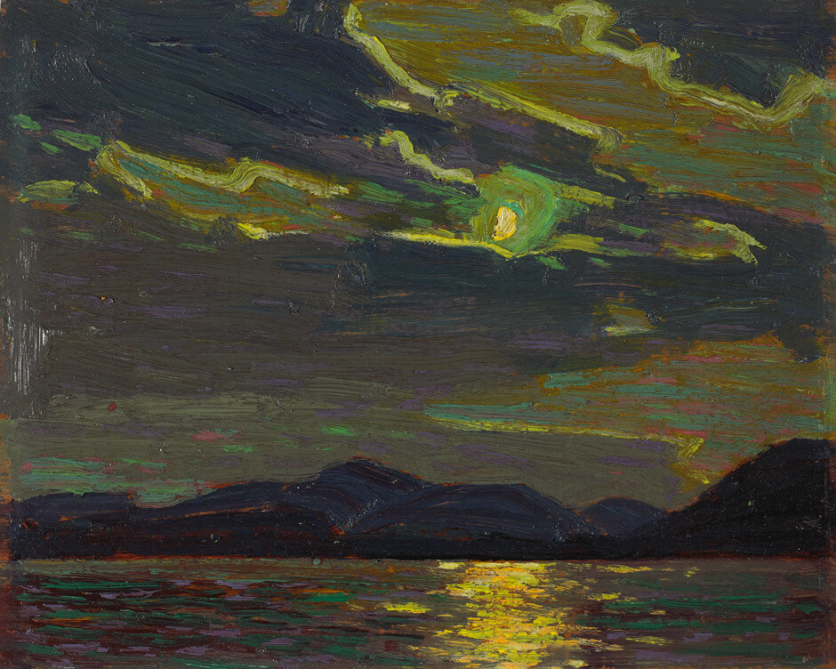
Tom Thomson, Hot Summer Moonlight, 1915. Thomson painted this work while in Algonquin Park, most likely while sitting in his canoe.

Slide 5
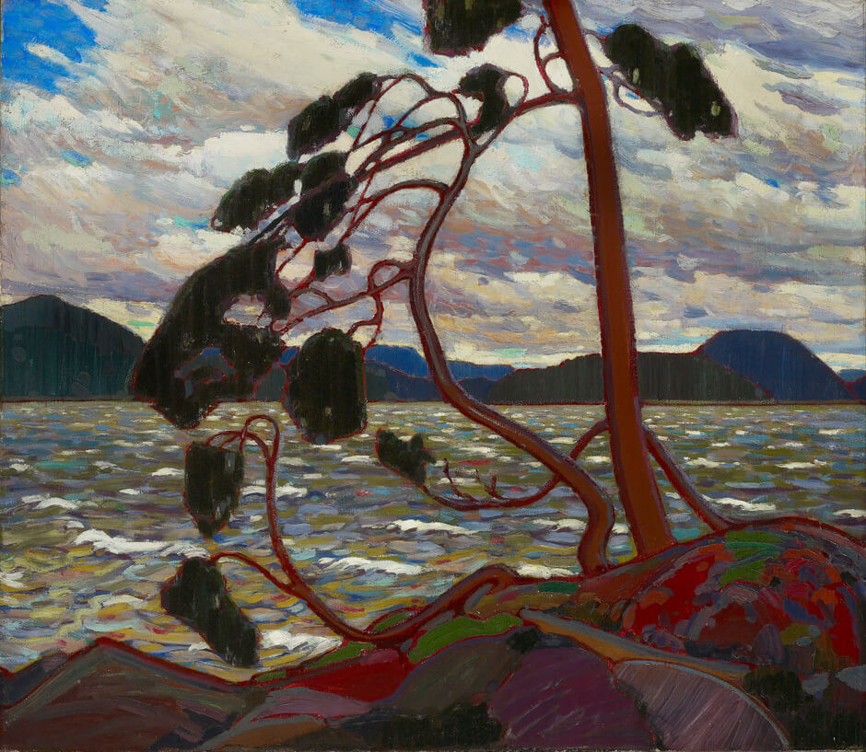
Tom Thomson, The West Wind, 1916–17. Isolated and twisted, this pine tree has clearly struggled to grow; it can be seen as a symbol of strength and perseverance.

Slide 6
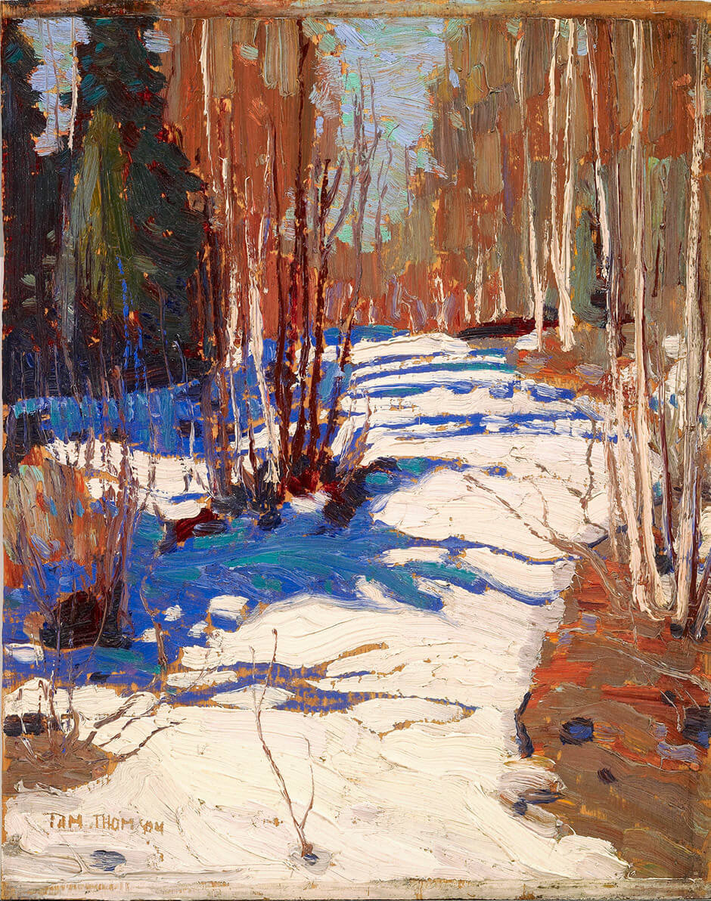
Tom Thomson, Path behind Mowat Lodge, 1917. This work is a painting on
a wooden panel, a type of support that Thomson used many times.

Slide 7
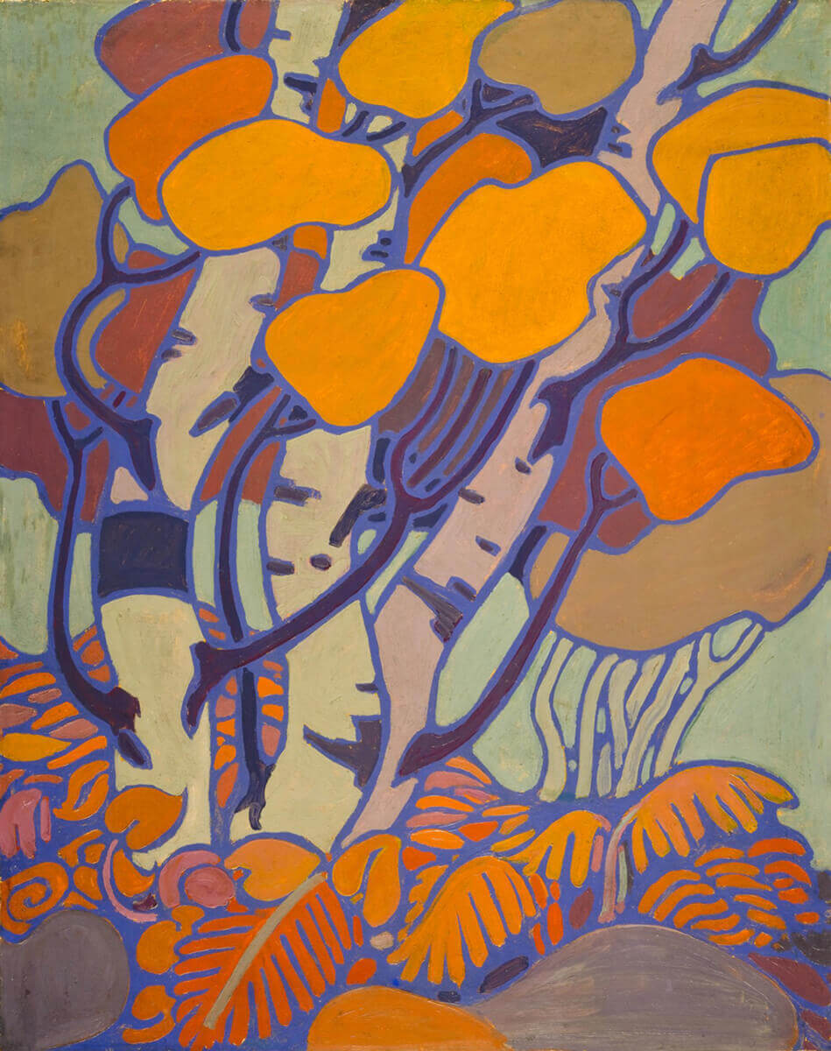
Tom Thomson, Decorative Panel (IV), 1915–16. In 1915 Thomson began working on a set of decorative panels for the cottage of his patron, Dr. James MacCallum. The first set he created included this painting; because the set did not quite fit, it was not installed at the cottage.

Slide 8
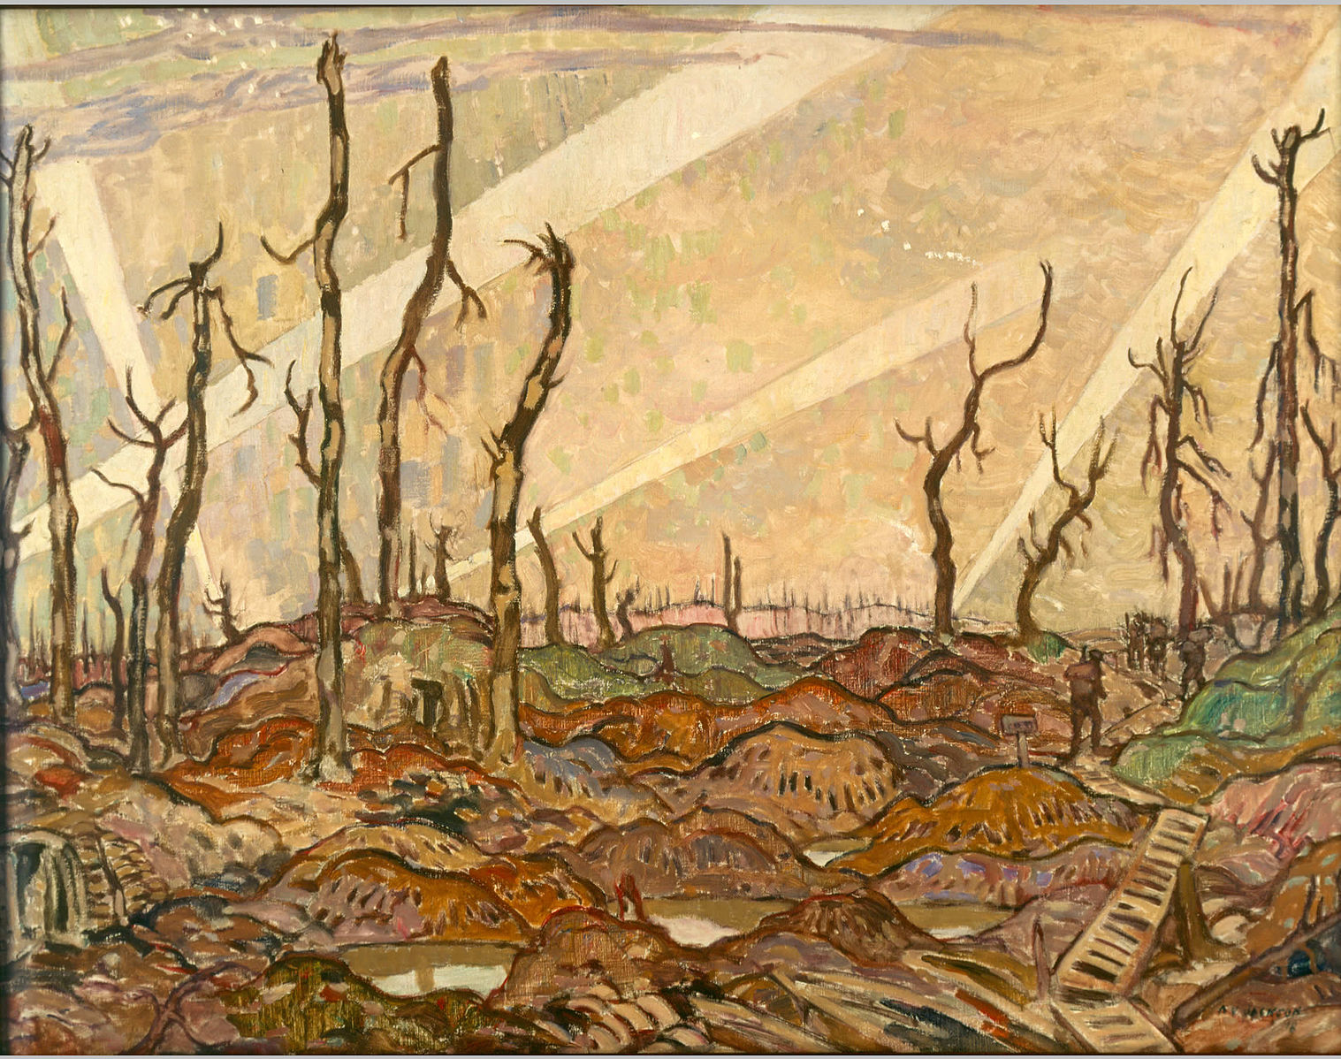
A.Y. Jackson, A Copse, Evening, 1918. During the war, Jackson served as a war artist; this work depicts a battlefield.

Slide 9
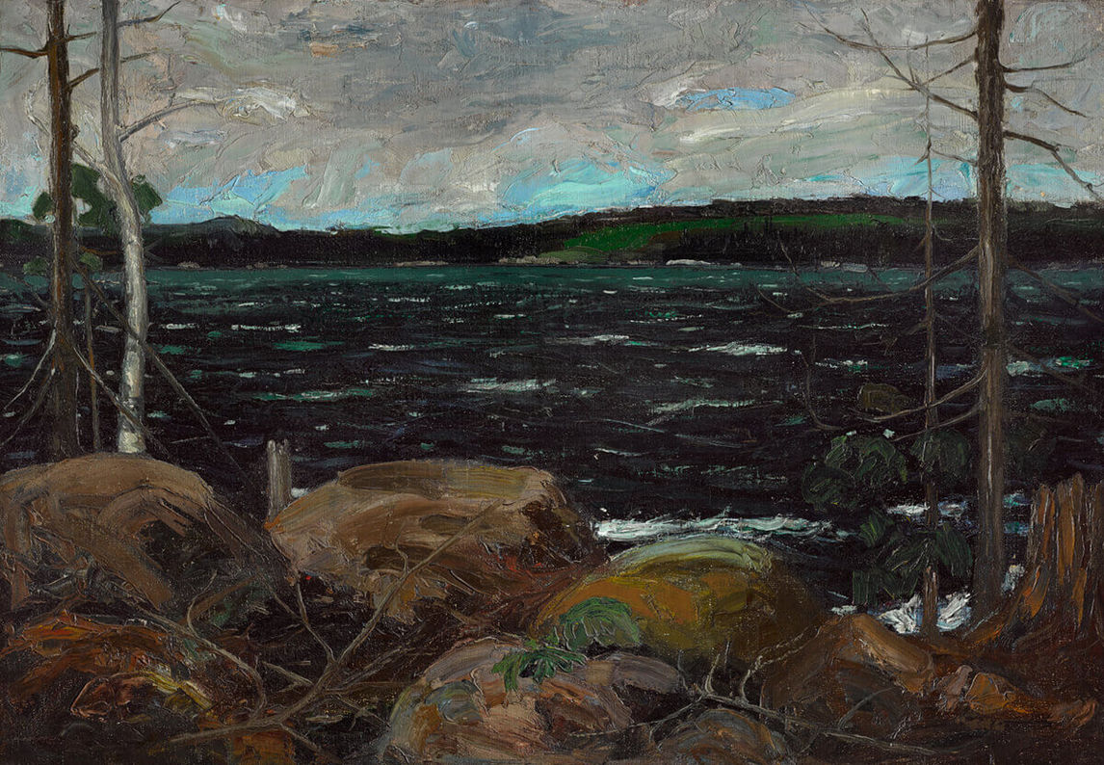
Tom Thomson, Northern Lake, 1912–13. The sale of this painting encouraged Thomson to focus on his art.

Slide 10
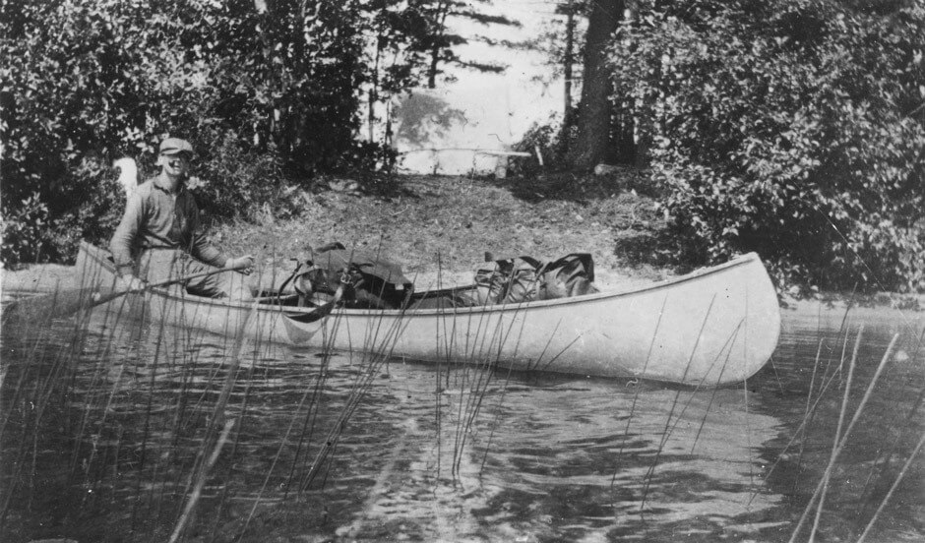
Tom Thomson in a canoe he painted dove grey, 1912.

Slide 11
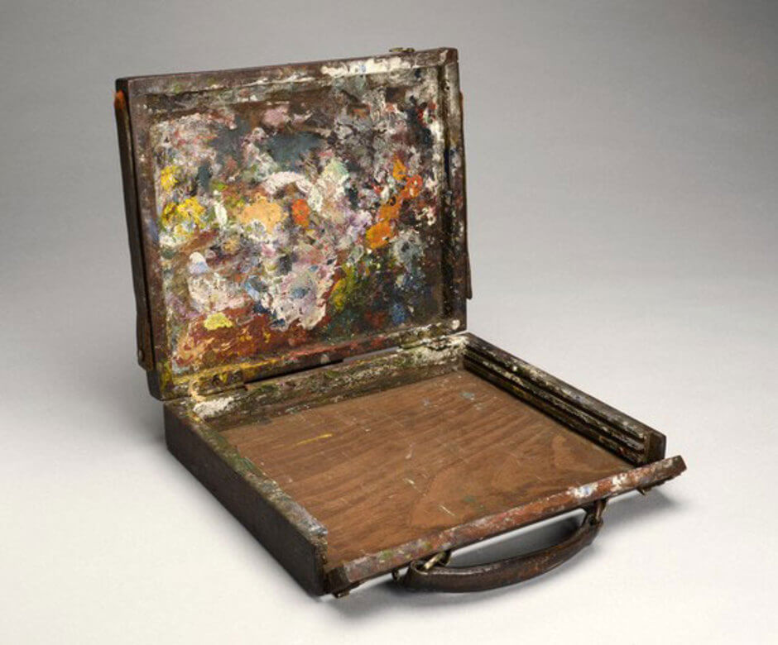
Tom Thomson’s sketch box was designed to be easy to use outdoors: he could set it up on his lap and paint anywhere he wished; the box also kept paintings safe while he was travelling.

Slide 12
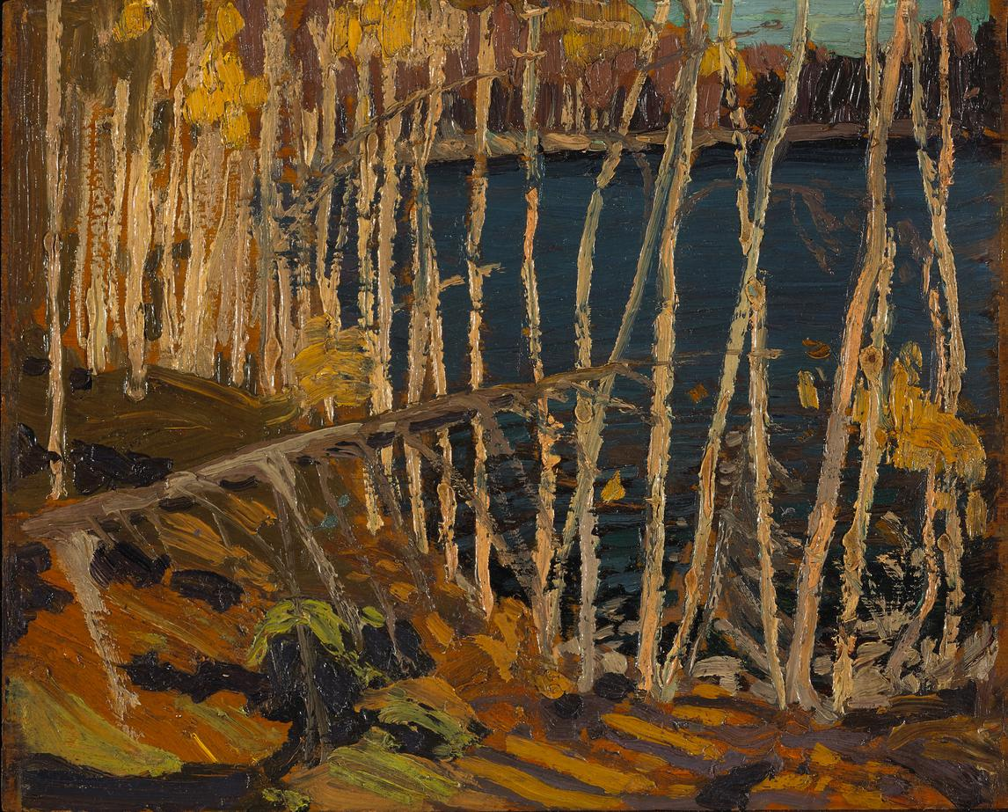
Learning Activity #1
Tom Thomson, Blue Lake: Sketch for “In the Northland,” 1915. In the sketch for In the Northland, we can see rough brushstrokes and a limited colour palette.

Slide 13
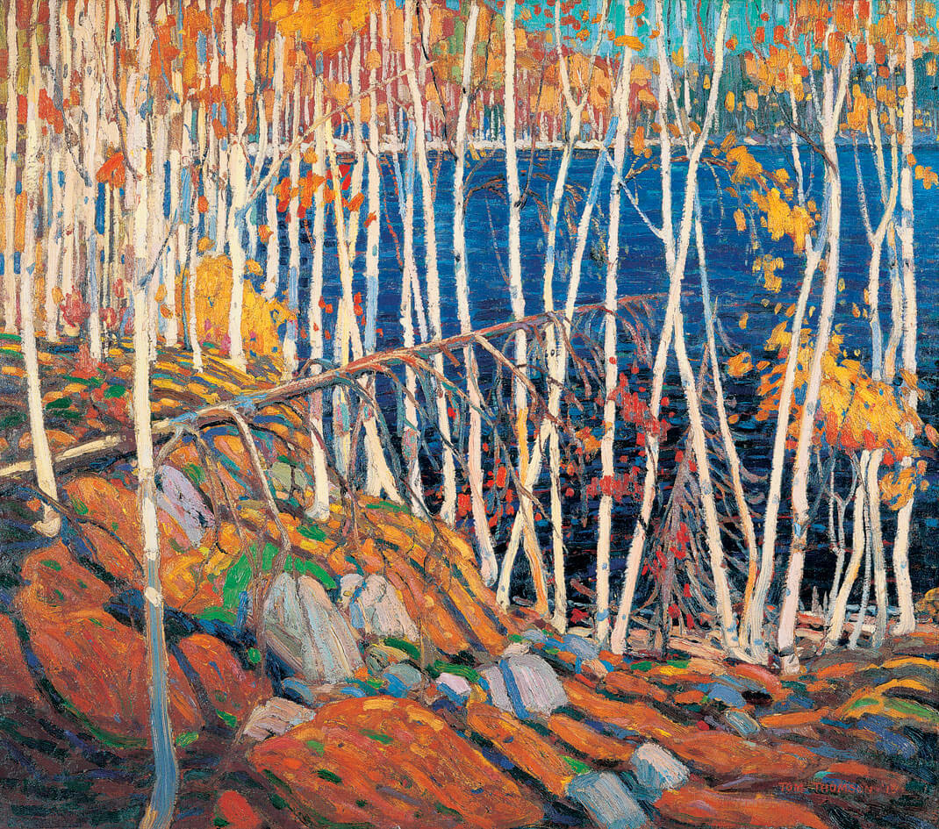
Learning Activity #1
Tom Thomson, In the Northland, 1915–16. This work is a large painting based on one of Thomson’s oil sketches.

Slide 14
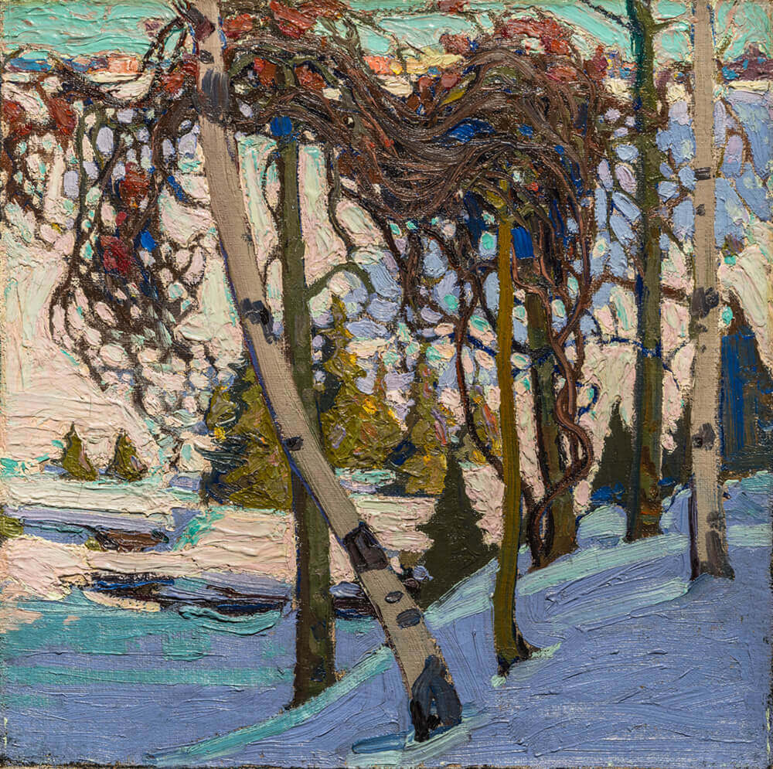
Learning Activity #2
Tom Thomson, Early Snow, 1916–17. This work is a striking wintry landscape.

Slide 15
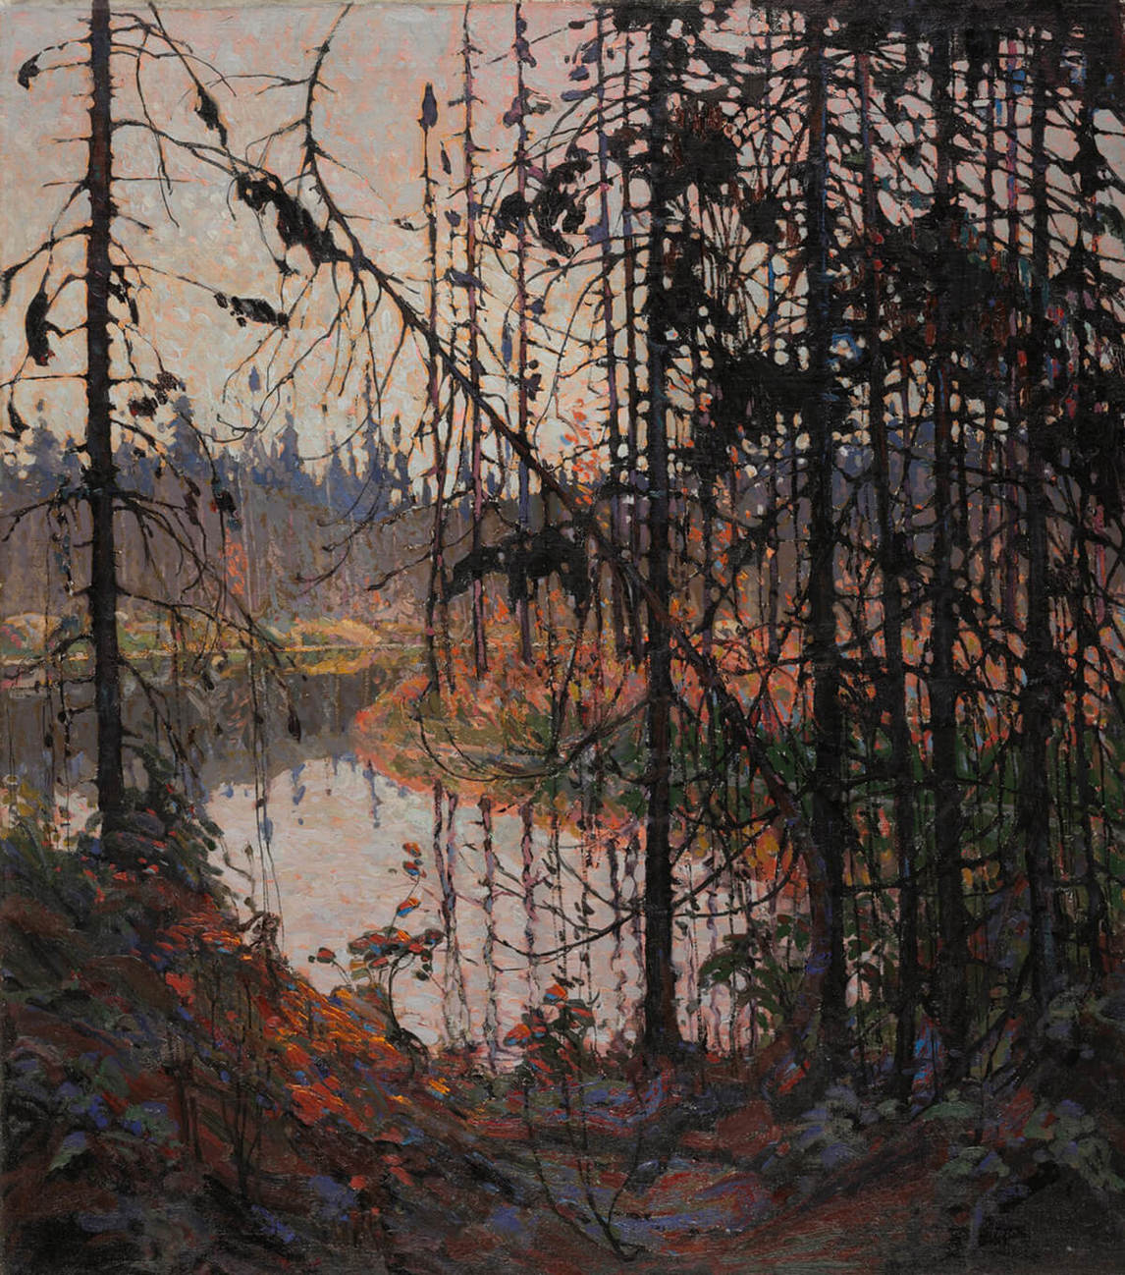
Learning Activity #2
Tom Thomson, Northern River, 1914–15. A scene in Algonquin Park, this painting does not represent a particularly special location–it is distinctive because of Thomson’s viewpoint and composition.

Slide 16
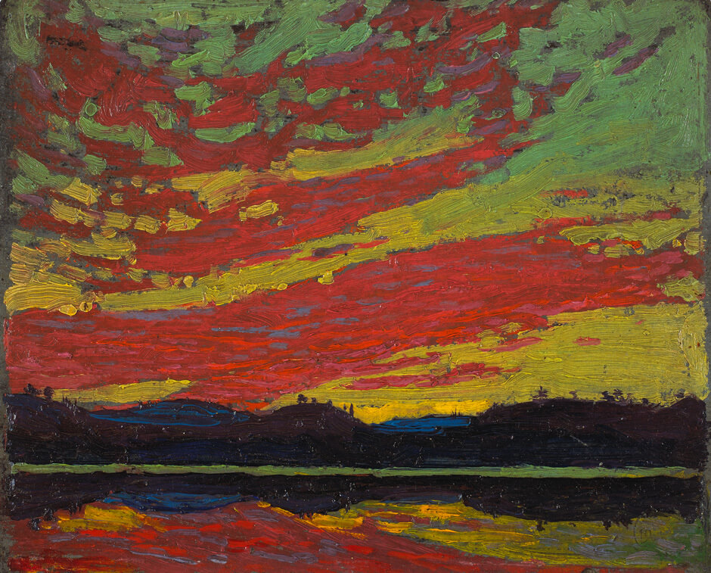
Learning Activity #2
Tom Thomson, Sunset, 1915.
In many of his sketches, Thomson chose to focus on the sky.

Slide 17
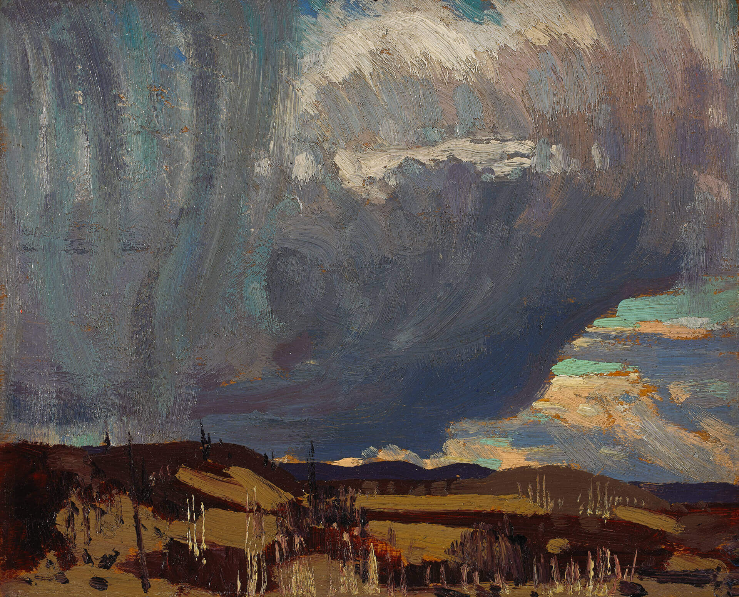
Learning Activity #2
Tom Thomson, Approaching Snowstorm, 1915. The overwhelming, dark cloud in this sketch suggests the power of the coming storm.

Slide 18
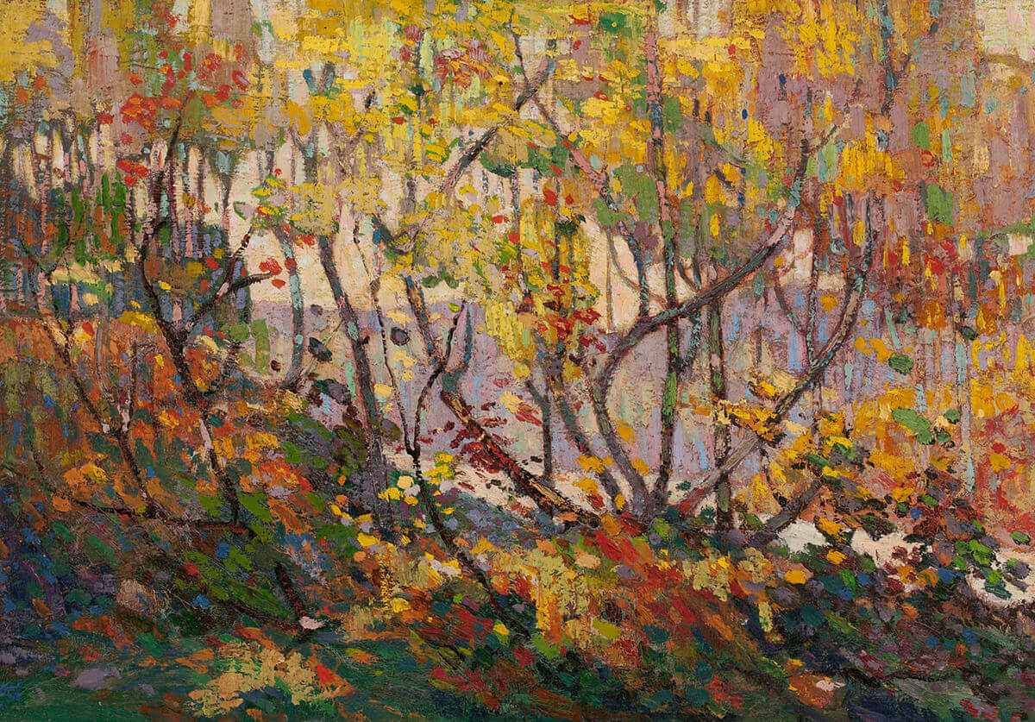
Learning Activity #2
Tom Thomson, Opulent October, 1915–16. Thomson was very inspired by autumn, as were many of his friends.

Slide 19
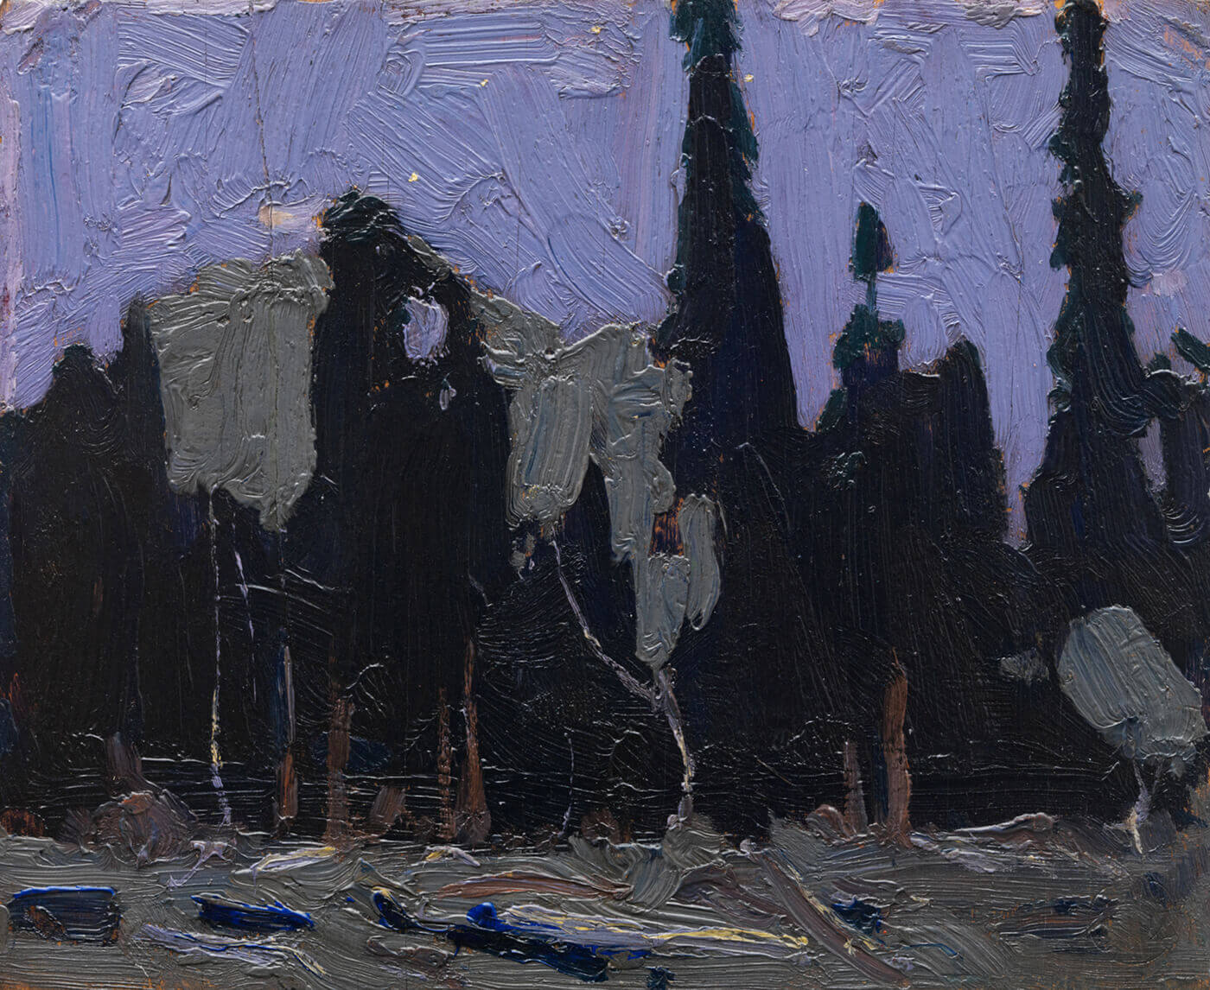
Learning Activity #2
Tom Thomson, Nocturne: Forest Spires, 1916. Thomson painted several night scenes in Algonquin Park.

Slide 20
Learning Activity #2
Tom Thomson, The West Wind, 1916–17. The white foam on the waves indicates the energy of the wind.

Slide 21
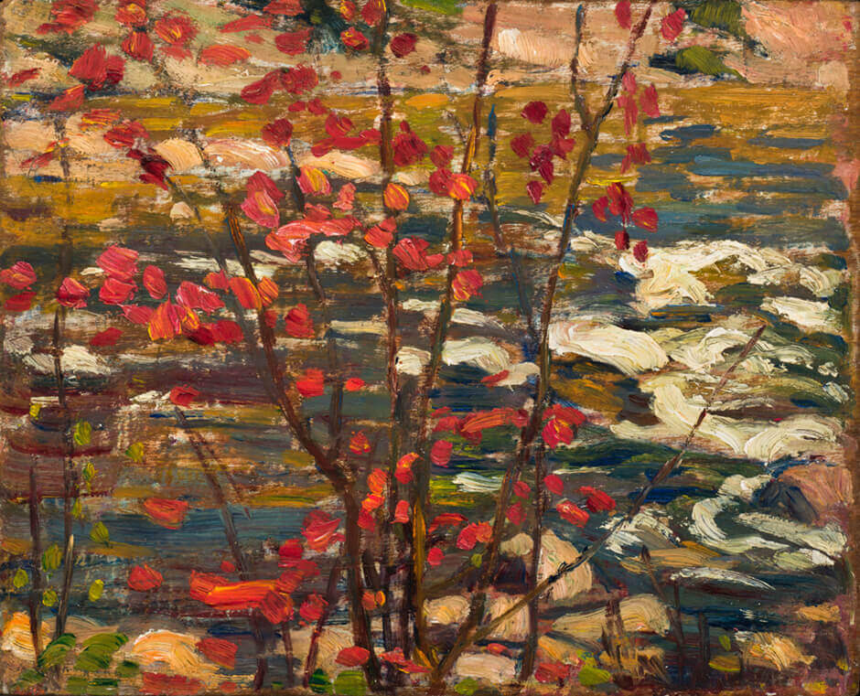
Learning Activity #2
A.Y. Jackson, The Red Maple, 1914. Jackson and Thomson were friends, and in the fall of 1914, the two men went on a canoe trip in Algonquin Park.

Slide 22
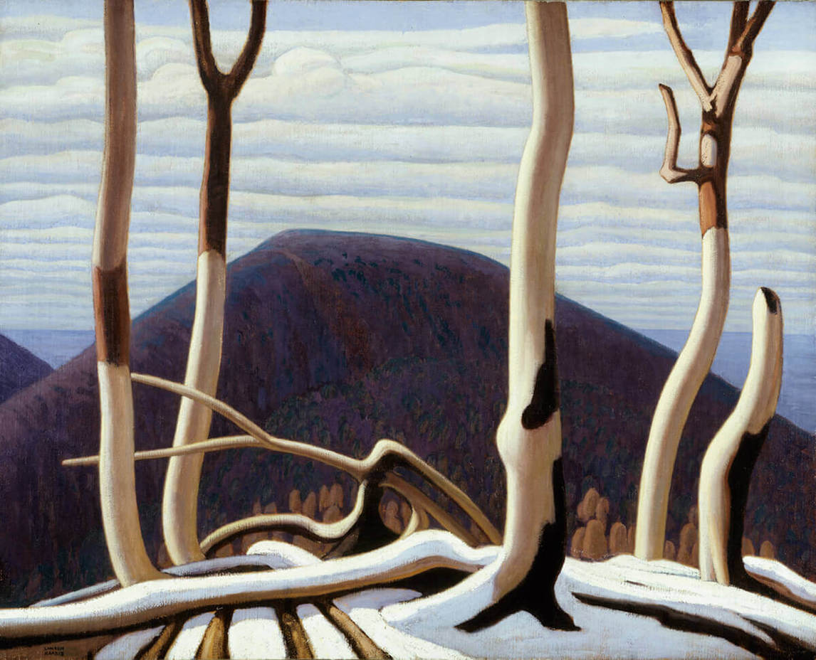
Learning Activity #2
Lawren Harris, Above Lake Superior,
c.1922. Harris painted this work a few years after Thomson’s death.

Slide 23
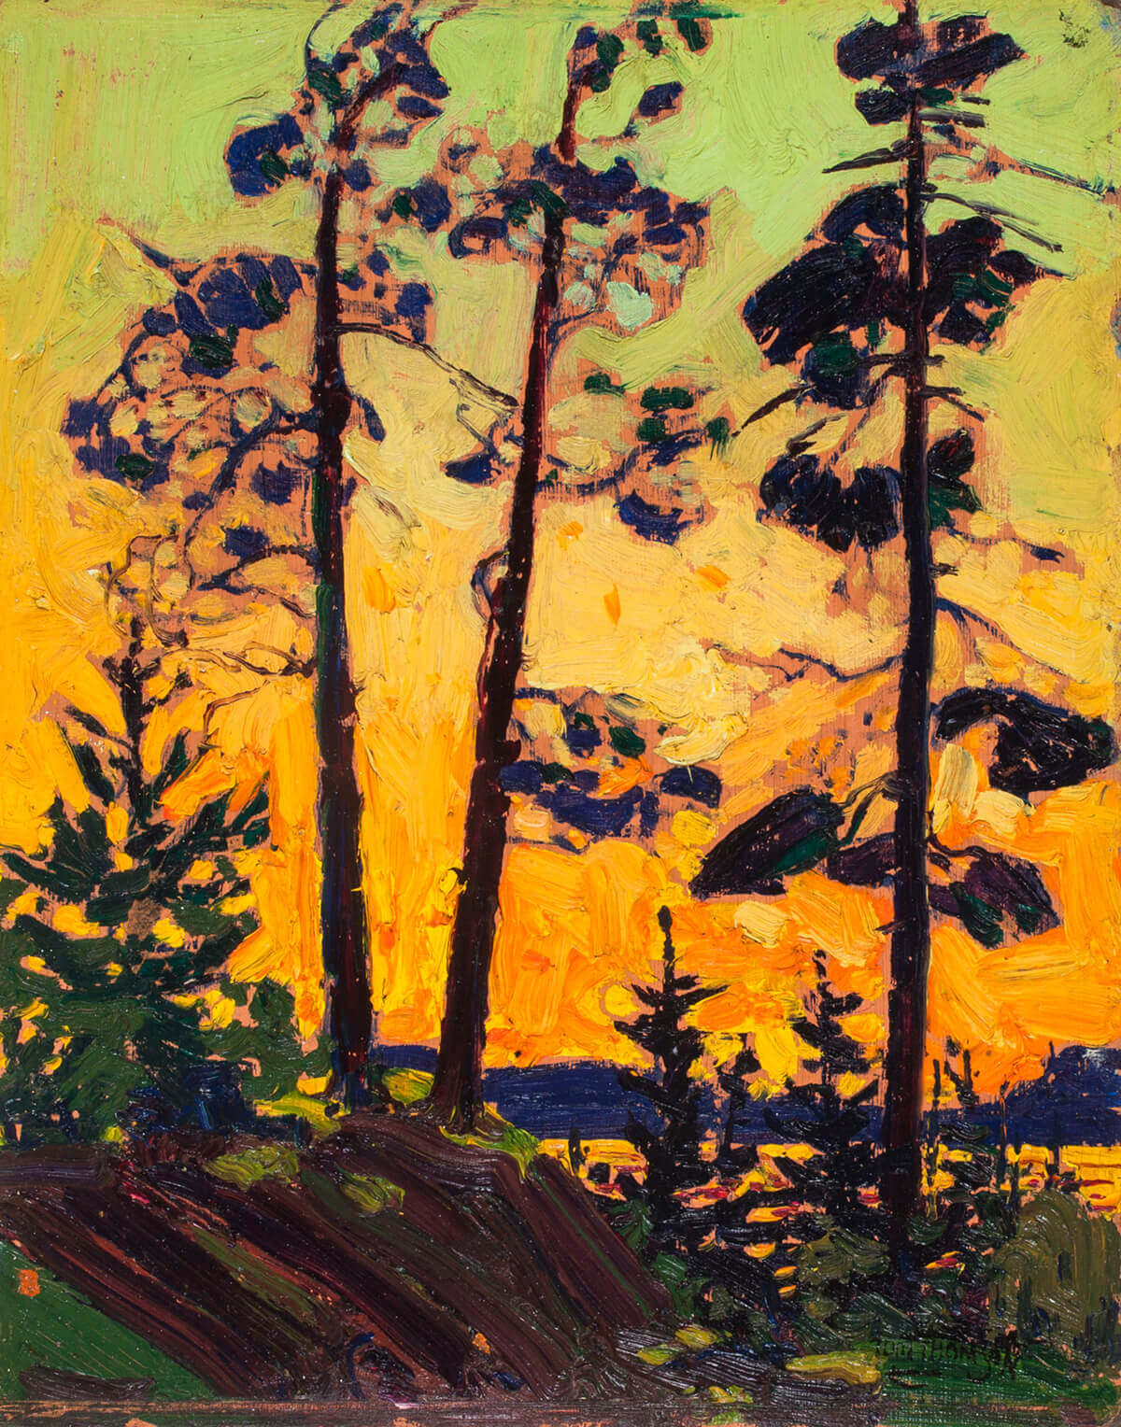
Tom Thomson, Pine Trees at Sunset, 1915. In this sketch Thomson used a combination of orange, yellow, and acid green in the sky, a combination of colours that he returned to when he painted The Jack Pine, 1916–17.

Slide 24
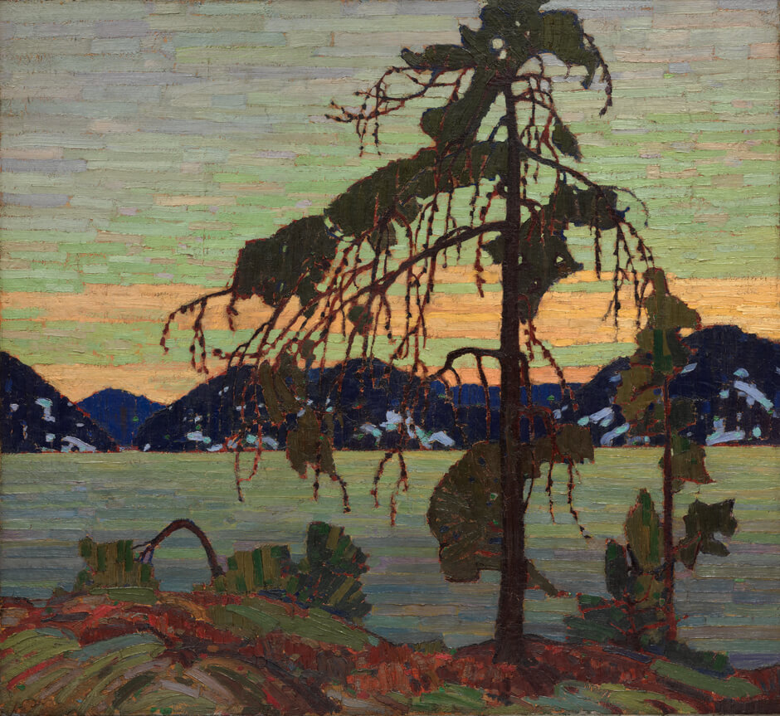
Culminating Task
Tom Thomson, The Jack Pine, 1916–17. This painting was based on a sketch that Thomson made in Algonquin Park in the spring of 1916.

Slide 25
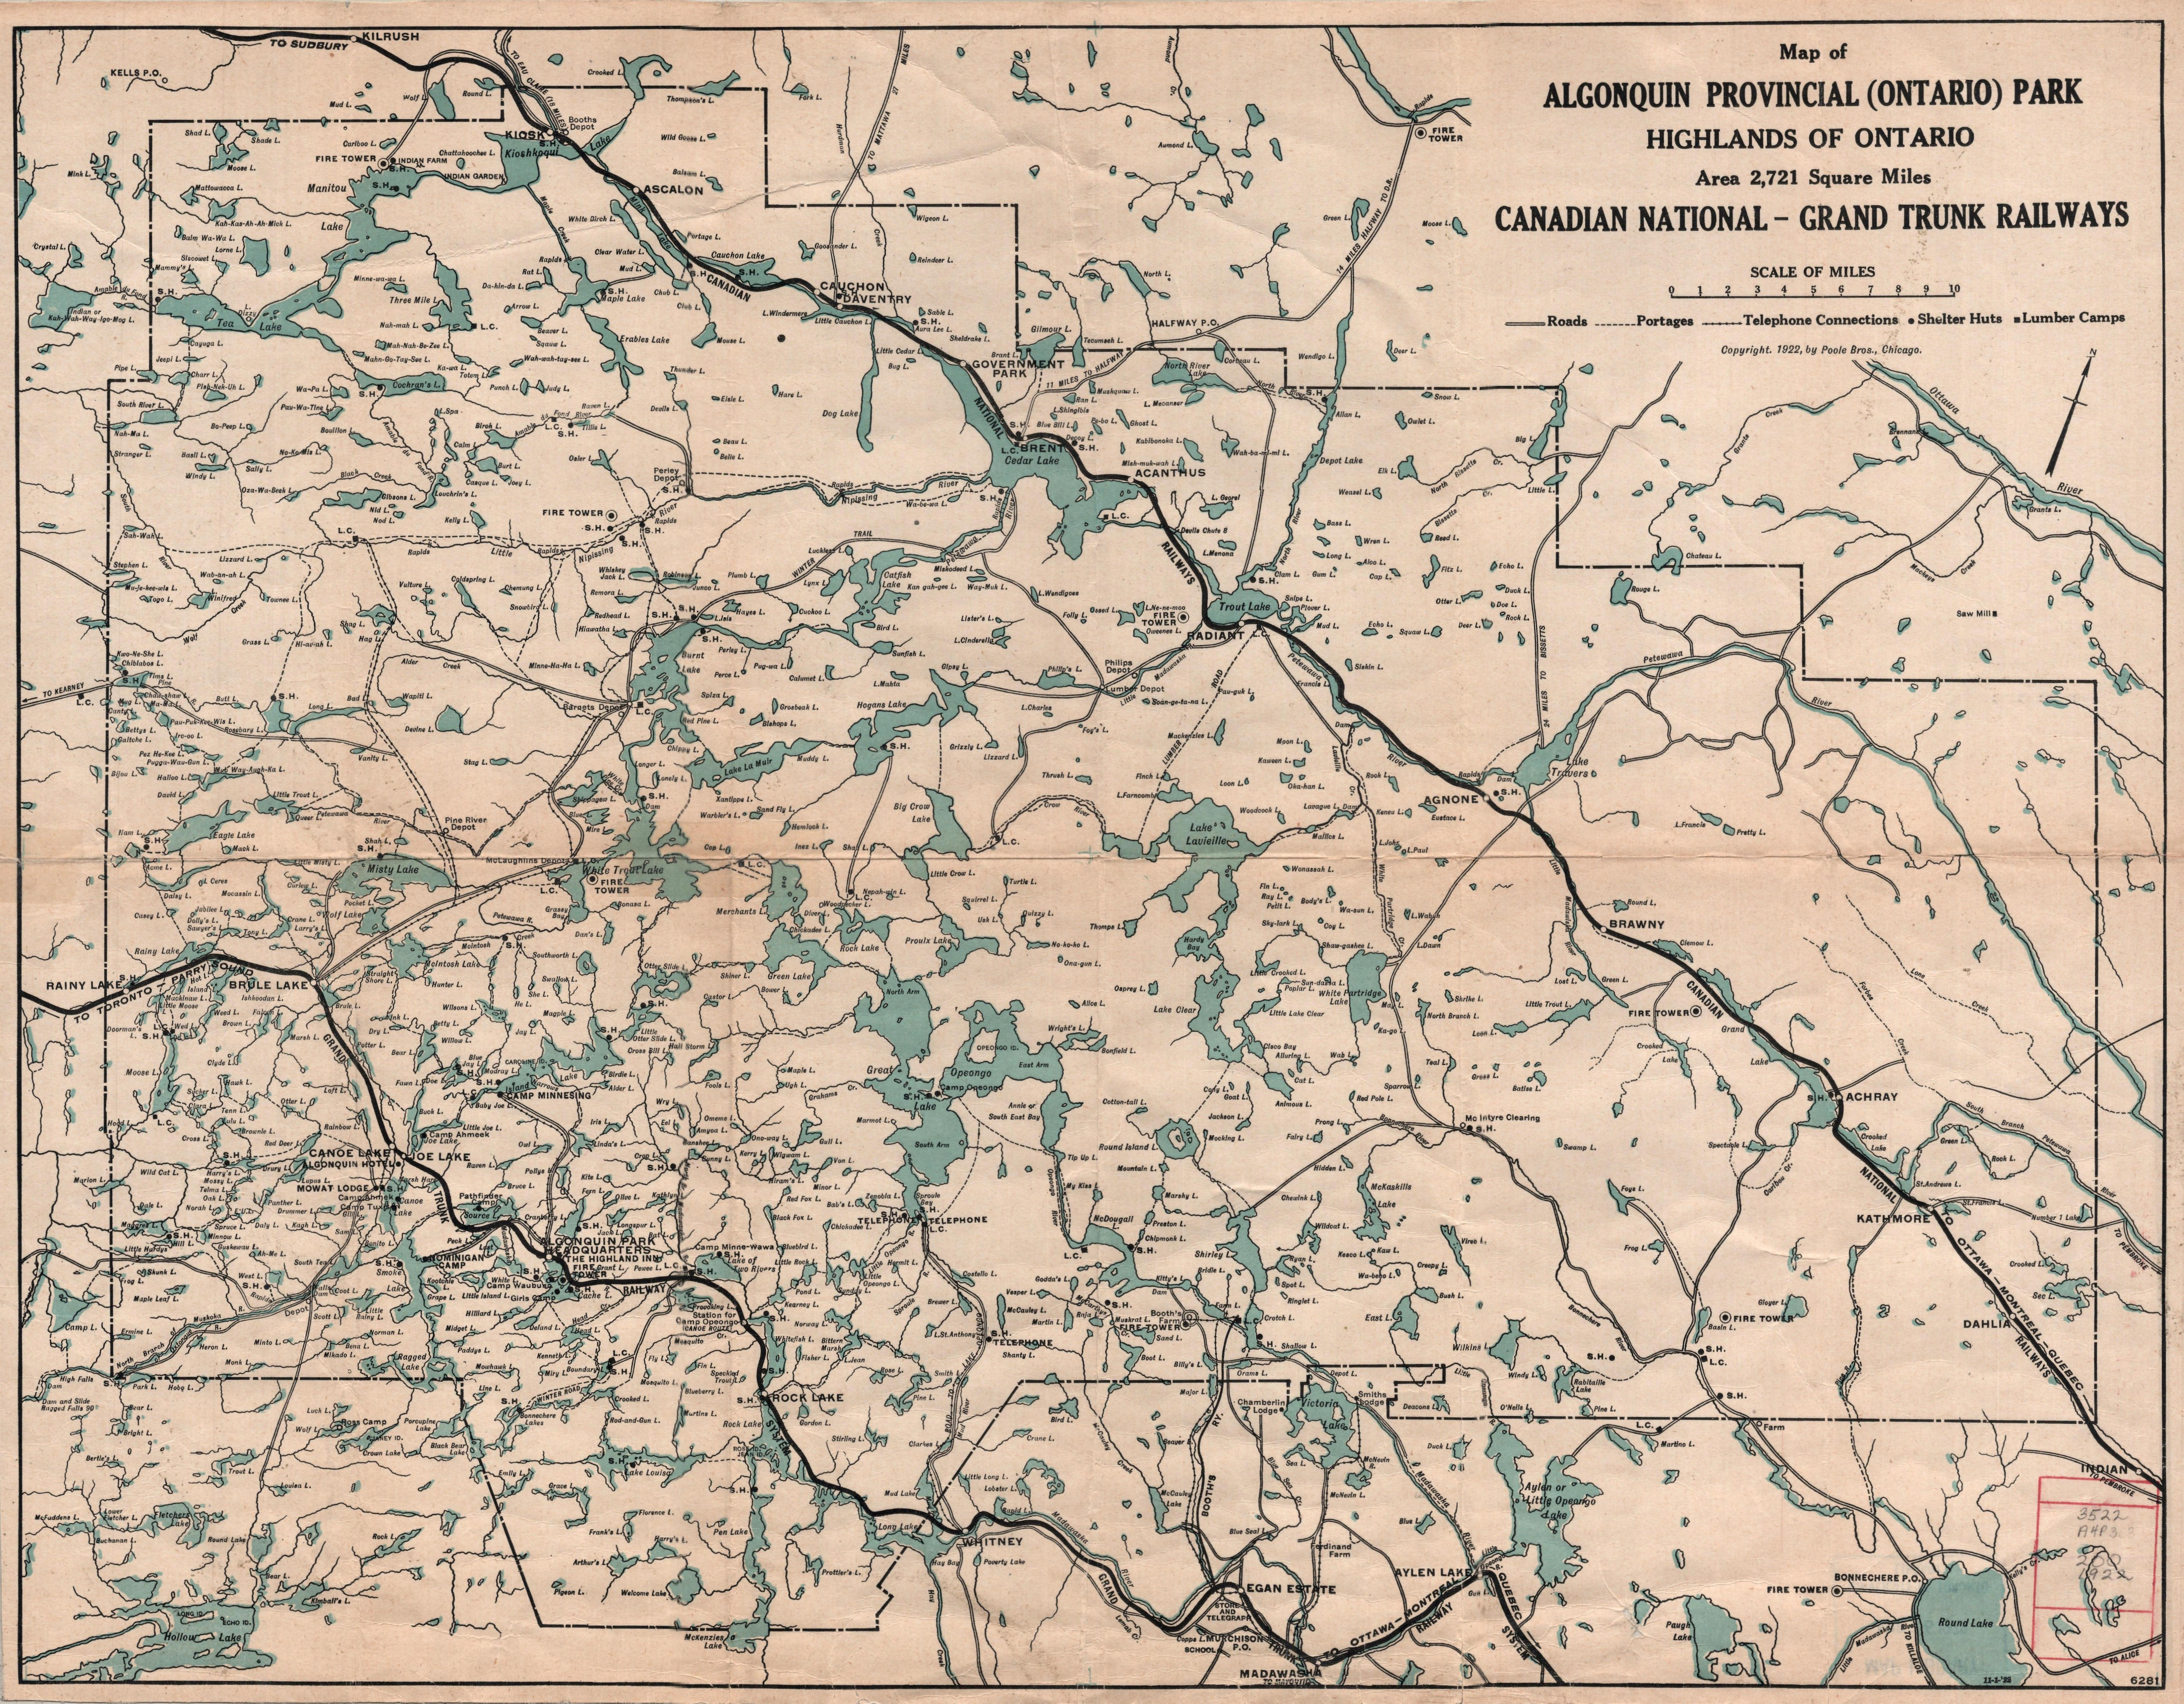
Culminating Task
Poole Brothers, Map of Algonquin Provincial (Ontario) Park, Highlands of Ontario: Canadian National–Grand Trunk Railways, 1922. This map records the presence of many different types of activities and people in Algonquin Park.

Slide 26
Detail.

Slide 27
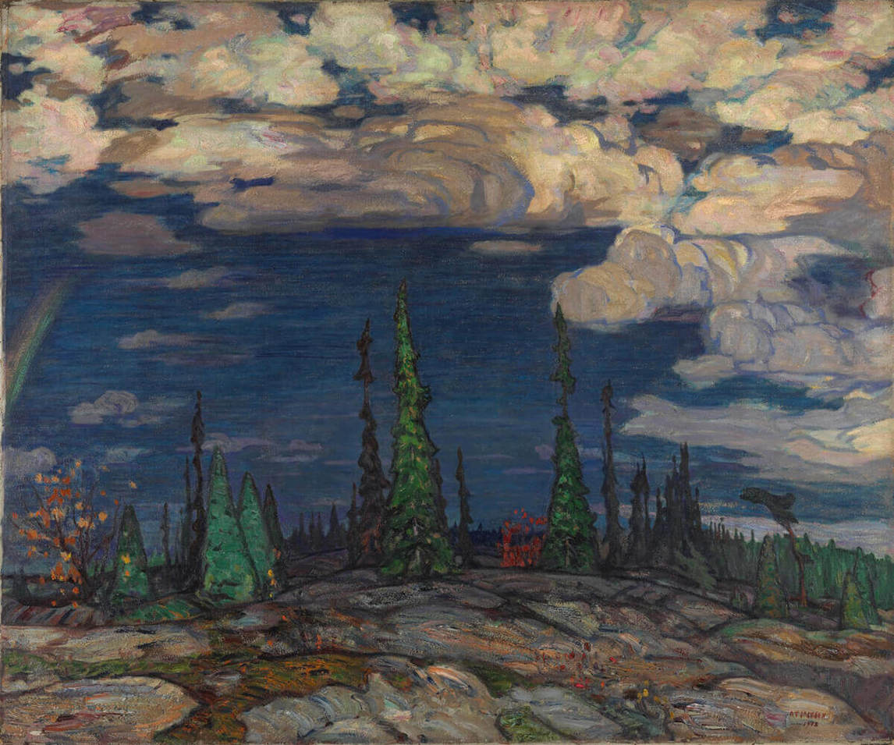
Culminating Task
A.Y. Jackson, Terre Sauvage, 1913. Jackson made sketches for this painting in Georgian Bay before working on the painting itself in a studio in Toronto.

Slide 28
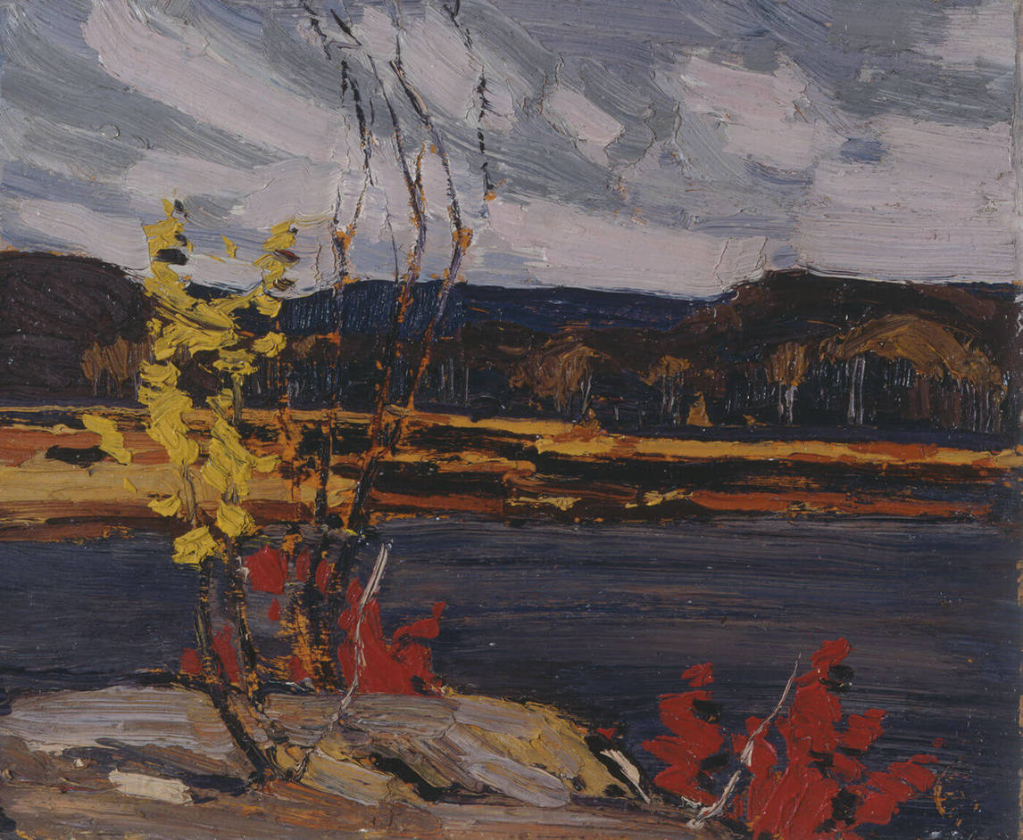
Tom Thomson, Autumn, Algonquin Park, 1916. After Thomson died, this sketch was given to J.E.H. MacDonald (1873–1932), one of Thomson’s great friends and mentors and a member of the Group of Seven.

Slide 29
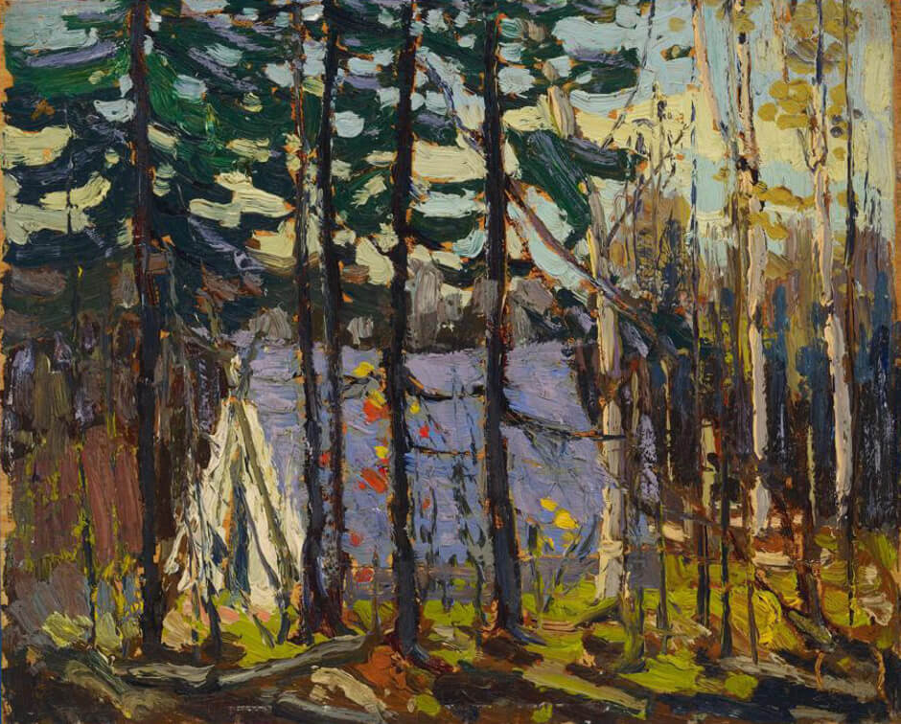
Tom Thomson, Artist’s Camp, Canoe Lake, Algonquin Park, 1915. Thomson made long trips in Algonquin Park, travelling with a silk tent! He painted his tent at least four times.

Slide 30
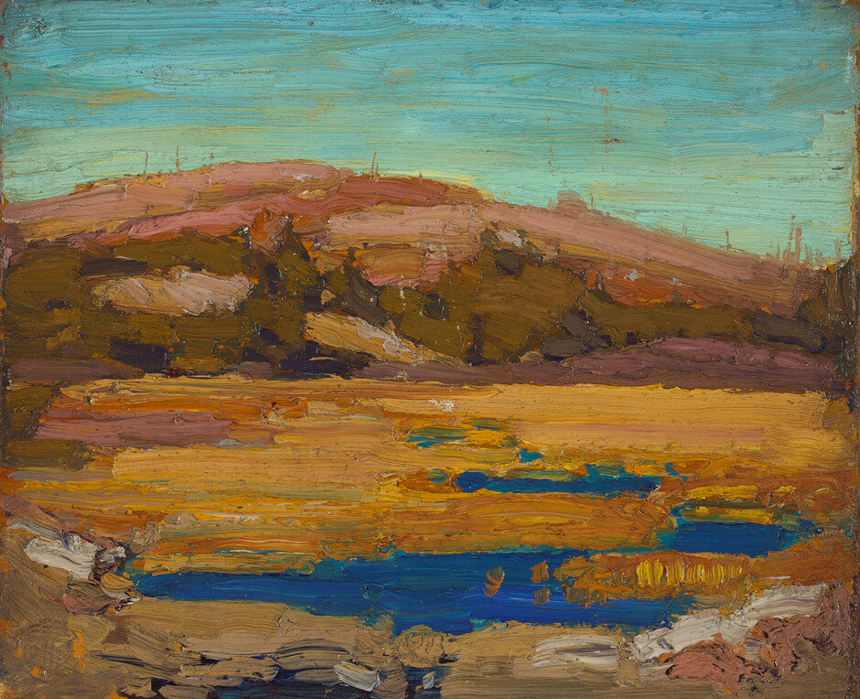
Tom Thomson, Cranberry Marsh, 1916. This sketch is notable because of its bold colours and the suggestion of strong light.

Slide 31
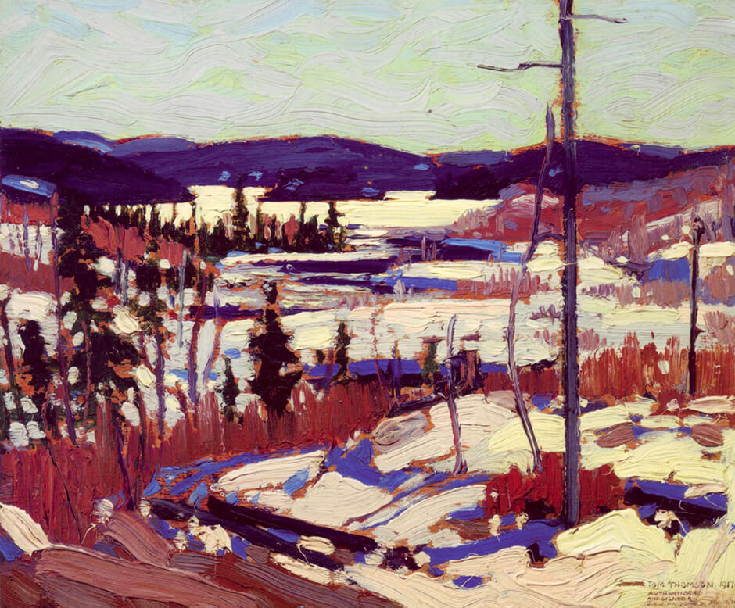
Tom Thomson, Early Spring, Canoe Lake, 1917. Thomson painted this sketch
only a few months before his death.

Slide 32
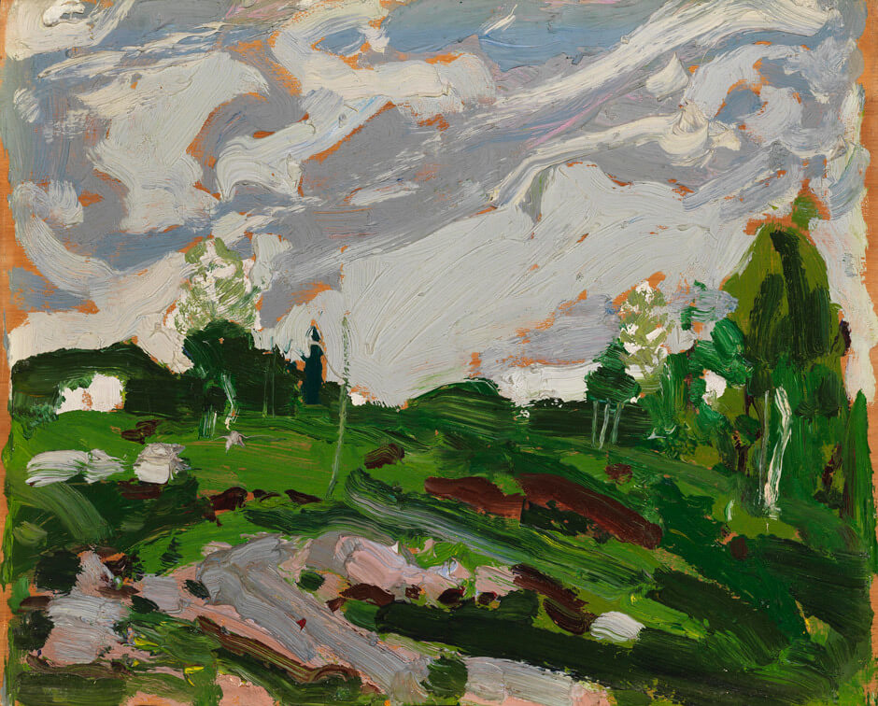
Tom Thomson, After the Storm, 1917. One of Thomson’s final paintings, this work is full of rough, loose brushstrokes, to the point that parts of the painting almost seem abstract.

