Slide 2
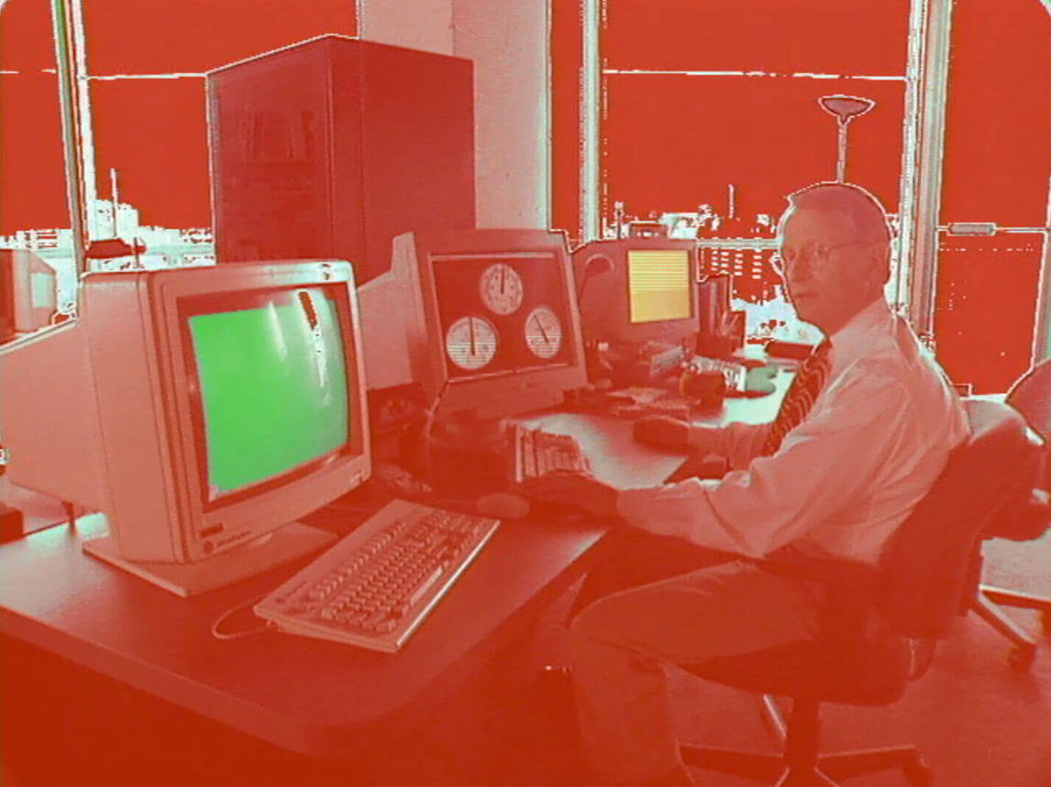
Still image from Michael Snow, *Corpus Callosum, 2002. Snow created this video using a combination of live-action film and digital animation (he worked with an animation consultant to make his vision reality).

Slide 3
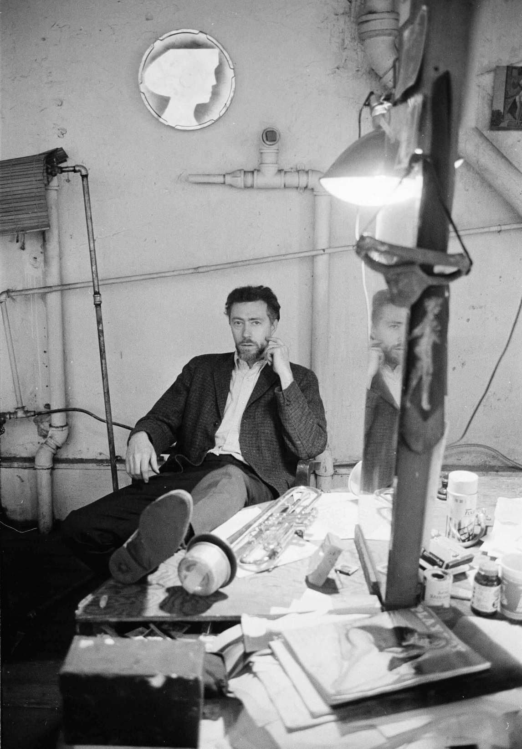
Michael Snow in New York in 1964.

Slide 4
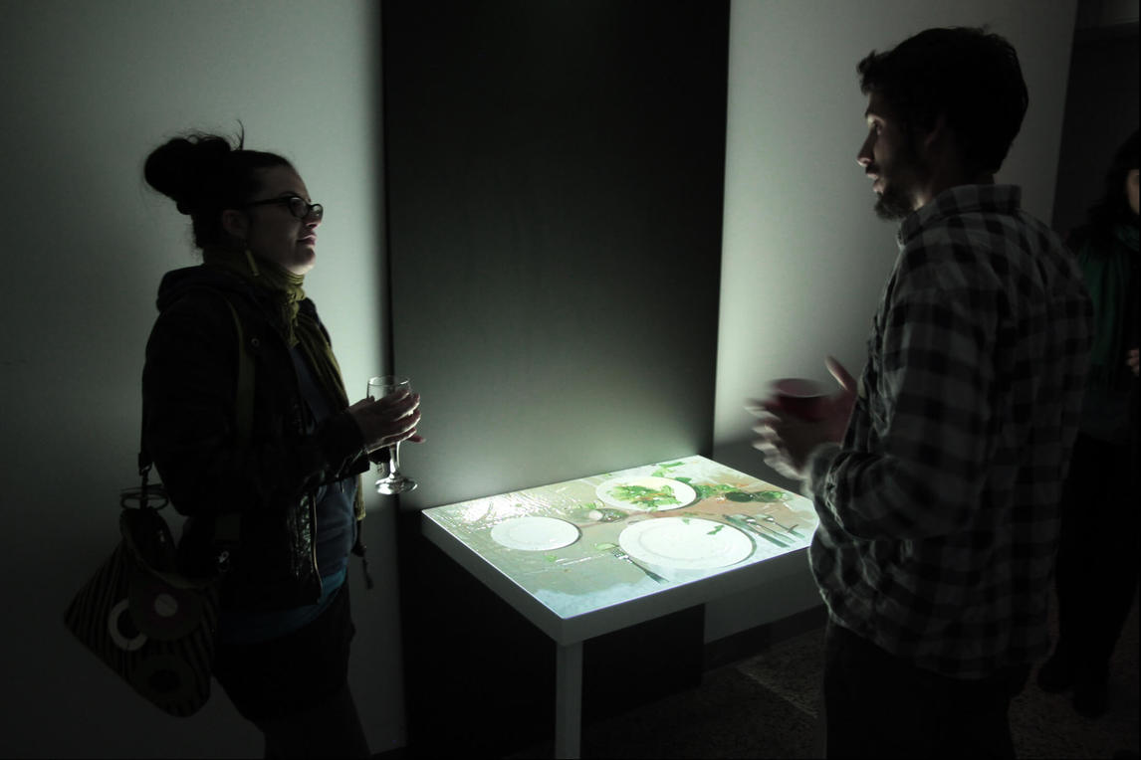
Michael Snow, Serve, Deserve,
2009. In this video installation an image is projected onto a tabletop: as the viewer watches, a meal appears to be served—but then it disappears.

Slide 5
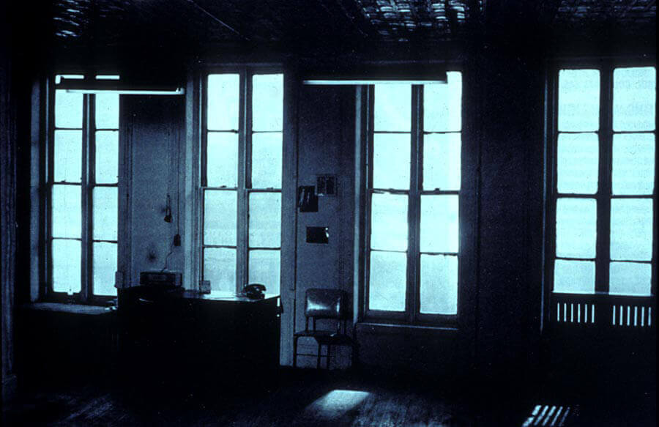
Still image from Michael Snow, Wavelength, 1966–67. A critical work in the history of contemporary art and film, Wavelength is one of Snow’s most famous projects.

Slide 6
Michael Snow, Lac Clair, 1960. This work is an abstract painting, although its title refers to a lake.

Slide 7
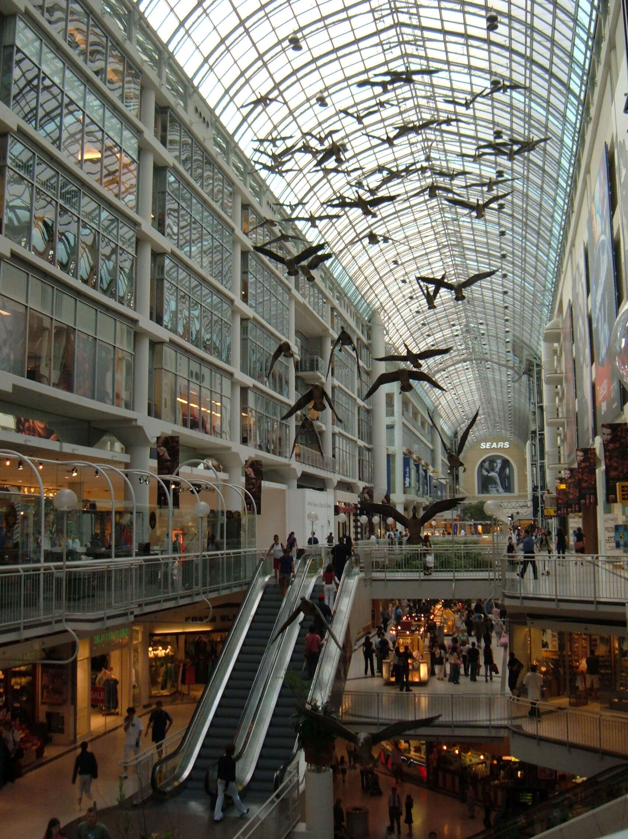
Michael Snow, Flight Stop, 1979.
Flight Stop is an installation that hangs in
the Eaton Centre in Toronto; to create it,
Snow used photographs of a Toronto
Island goose.

Slide 8
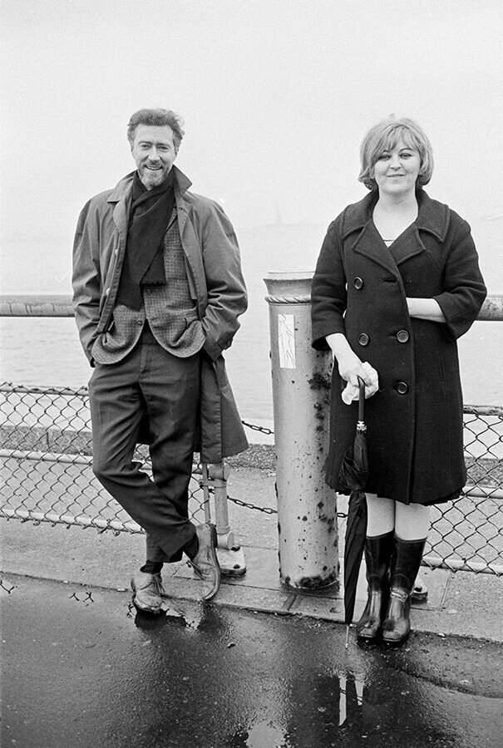
Michael Snow and Joyce Wieland in 1964.

Slide 9
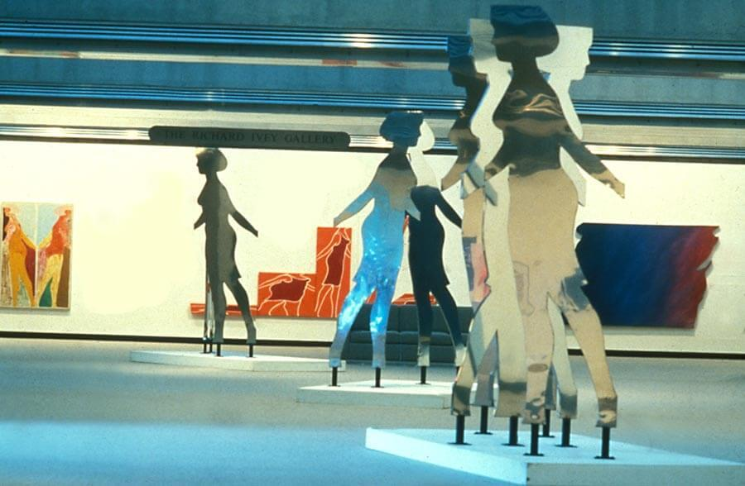
Installation view of Michael Snow’s Walking Woman Works exhibition in 1984.

Slide 10
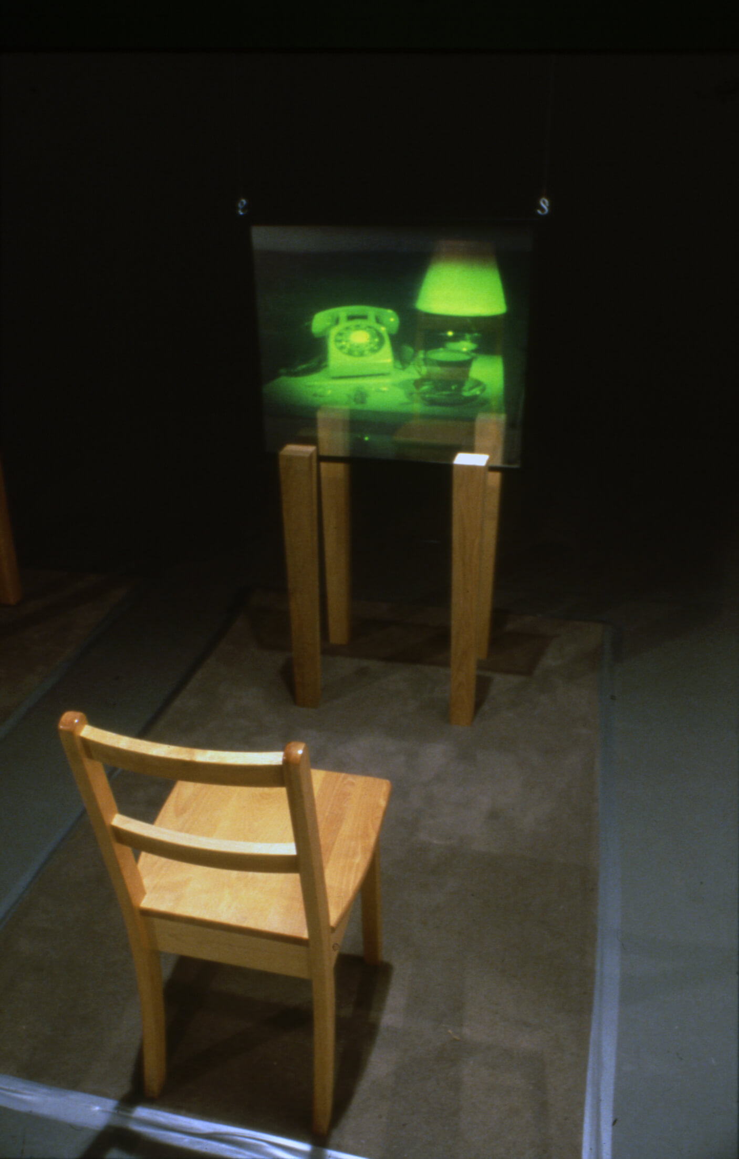
Michael Snow, Still Life in 8 Calls (detail), 1985. This work was part of The Spectral Image, Snow’s
exhibition at Expo 86 in Vancouver.

Slide 11
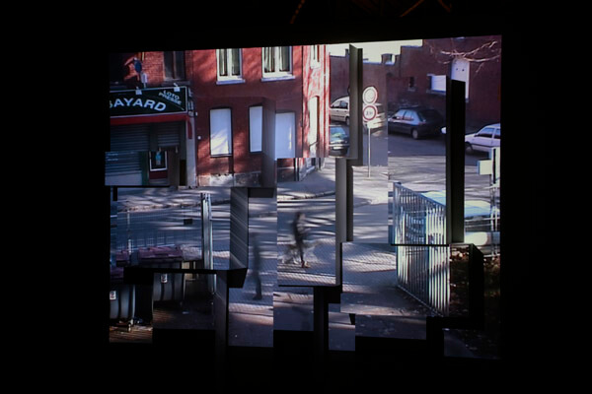
Installation view of Michael Snow, The Corner of Braque and Picasso Streets, 2009. The title of this work does not refer to specific streets, it refers to the artists Georges Braque and Pablo Picasso, artists whose experiments with Cubism transformed western art. Snow’s installation projects a live video feed onto plinths whose arrangement alludes to Cubism.

Slide 12
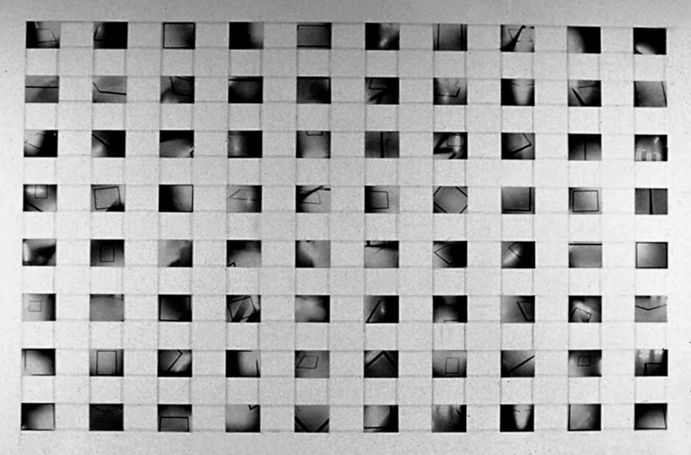
Learning Activity #1
Michael Snow, 8 x 10, 1969. In 8 x 10 framing is critical to how we view the eighty individual photographs that are the key constituent parts of the work.

Slide 13
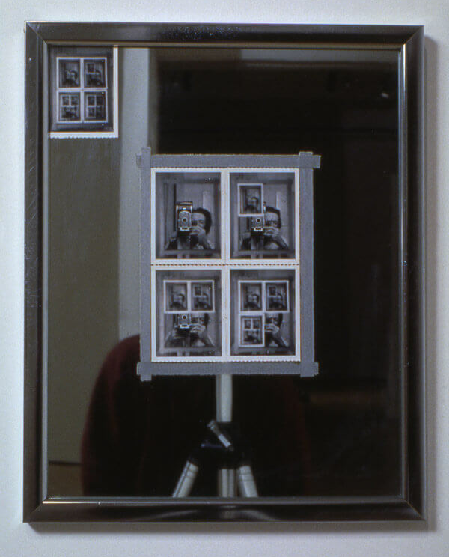
Learning Activity #1
Michael Snow, Authorization, 1969. For this work Snow took a series of polaroid photographs, placing each one onto the mirror before taking the next one.

Slide 14
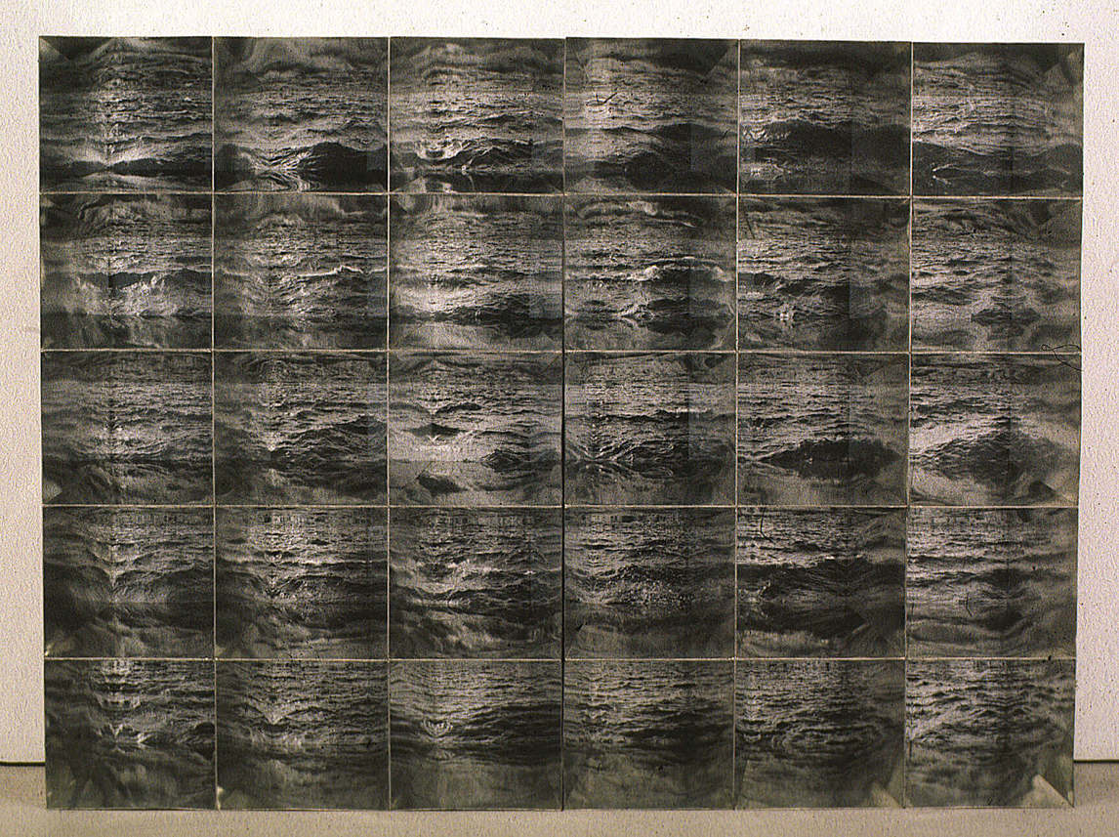
Michael Snow, Atlantic, 1967. In Atlantic, Snow brought together
thirty photographs to create a single artwork; although all the images represent the sea, each one is slightly different. The camera angle was changed as the photographs were taken, and the waves themselves were always changing (as waves do)—so repetition and variety are both built into the system.

Slide 15
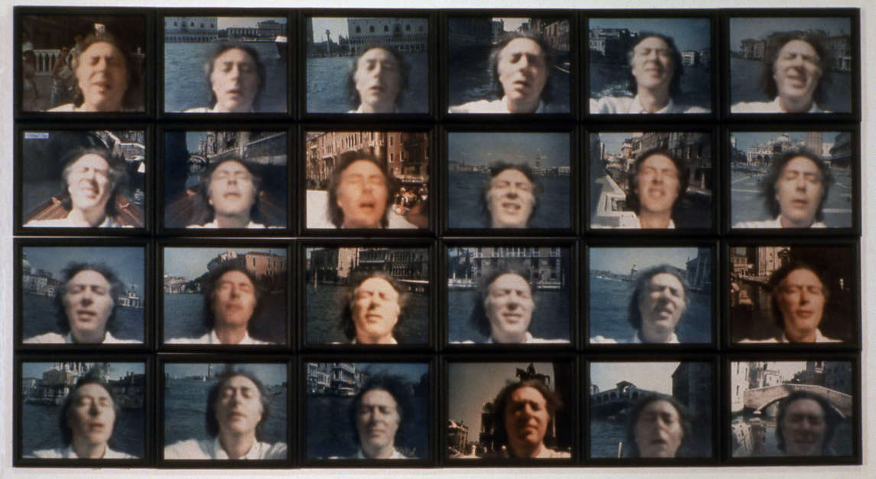
Learning Activity #2
Michael Snow, Venetian Blind, 1970. Snow created this work by using a polaroid camera to take photographs of himself.

Slide 16
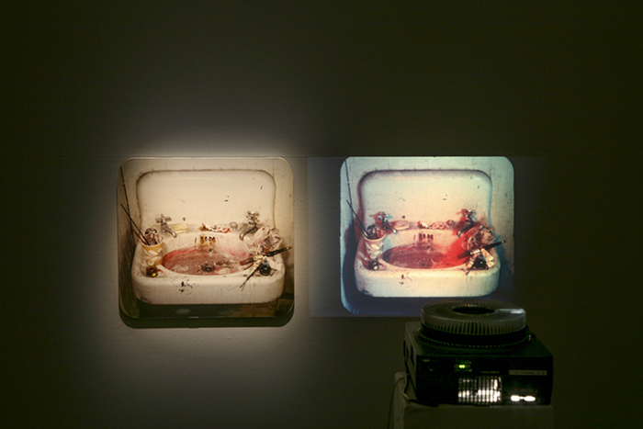
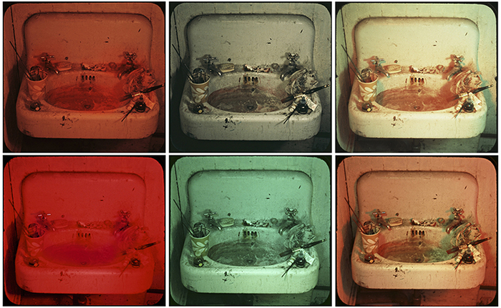
Learning Activity #2
Michael Snow, Sink (details), 1970. Here we see an image of Sink that shows you the relationship between the photograph and the slide projector, and a series of details of some of the coloured slides that are projected.

Slide 17
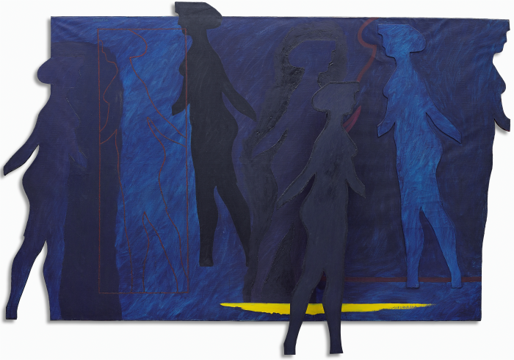
Culminating Task
Michael Snow, Venus Simultaneous, 1962, oil on canvas and wood construction, 200.7 x 299.7 x 15.2 cm. Collection of the Art Gallery of Ontario, Toronto, purchase, 1964 (63/47). © Michael Snow, Photo © Art Gallery of Ontario.
Here we can see both the cut-out form of the Walking Woman and its outline.

Slide 18
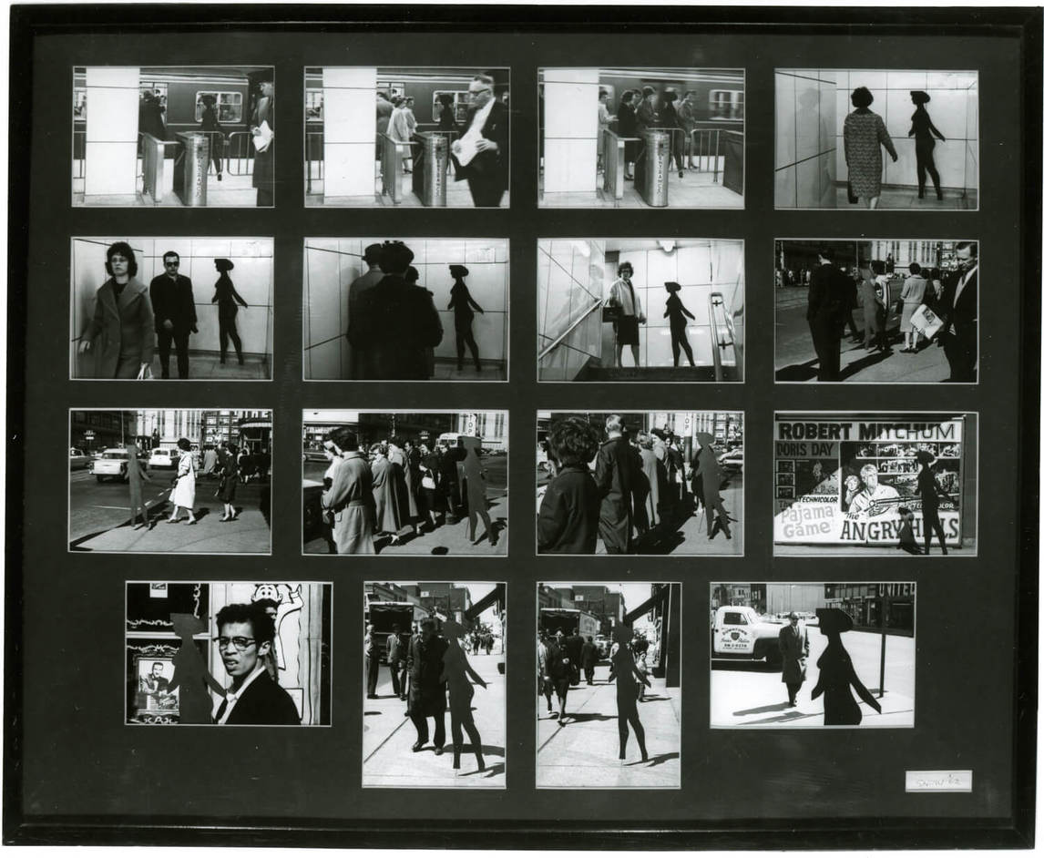
Culminating Task
Michael Snow, Four to Five, 1962, printed 1991, 16 gelatin silver prints, 68 x 83.3 cm, Collection of the Art Gallery of Ontario, Toronto, purchased with funds donated by AGO Members, 1991 (91/53). © Michael Snow, Photo © Art Gallery of Ontario.
For Four to Five, Snow photographed the Walking Woman in the streets of Toronto.

Slide 19
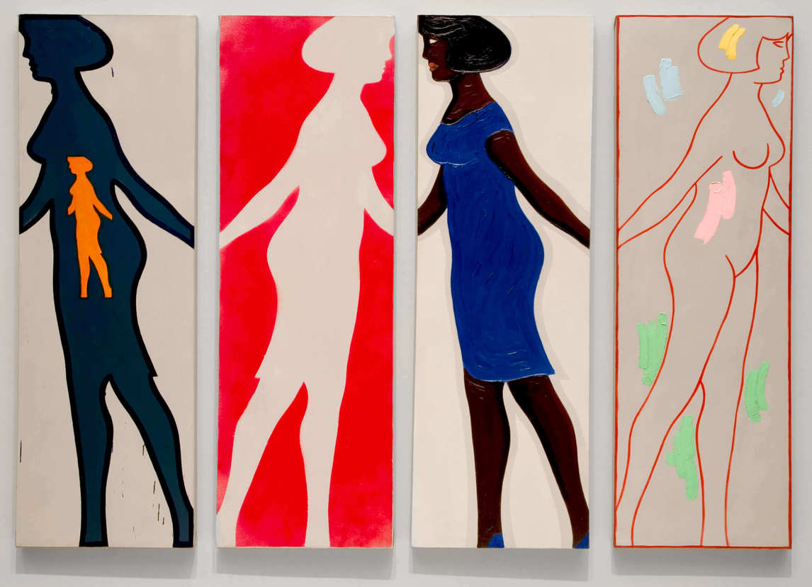
Culminating Task
Michael Snow, Four Grey Panels and Four Figures, 1963. Snow created over two hundred individual works that use the Walking Woman form.

Slide 20
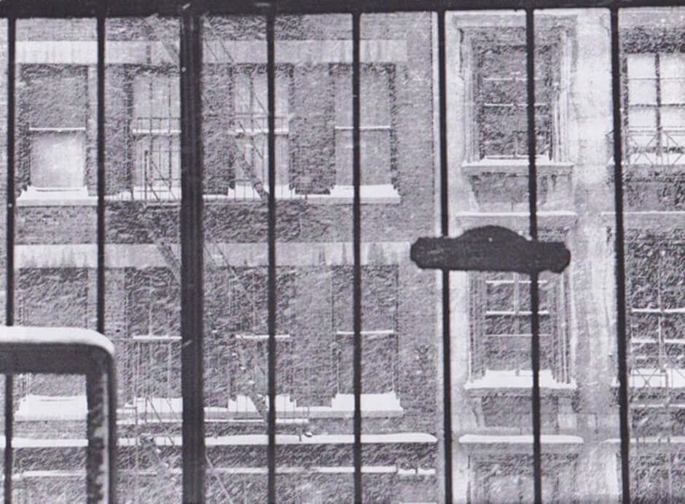
Michael Snow, Snow Storm (detail), 1967.
Although a quick glance might suggest this is a single photograph, the work was created using multiple photographs.

Slide 21
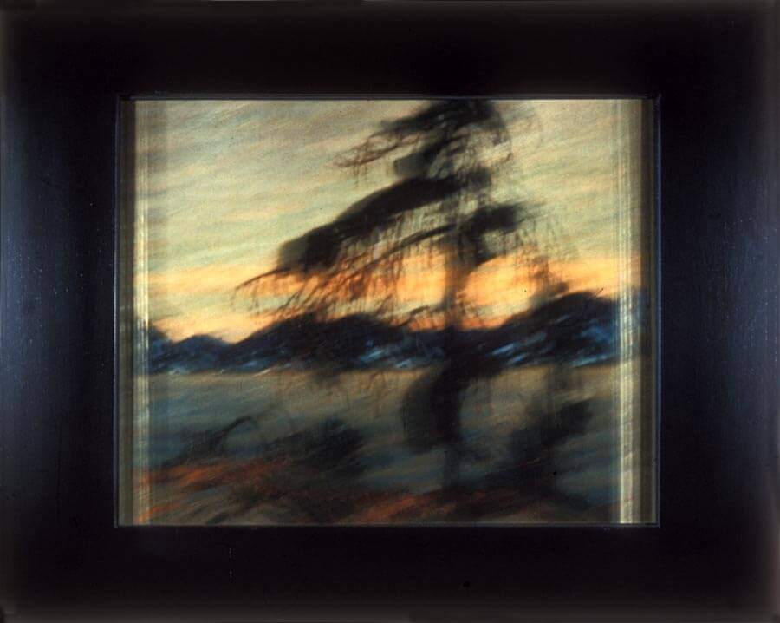
Michael Snow, Plus Tard #20 (detail), 1977. To create Plus Tard, Snow photographed a display of paintings by Tom Thomson (1877–1917) and members of the Group of Seven at the National Gallery of Canada.

Slide 22
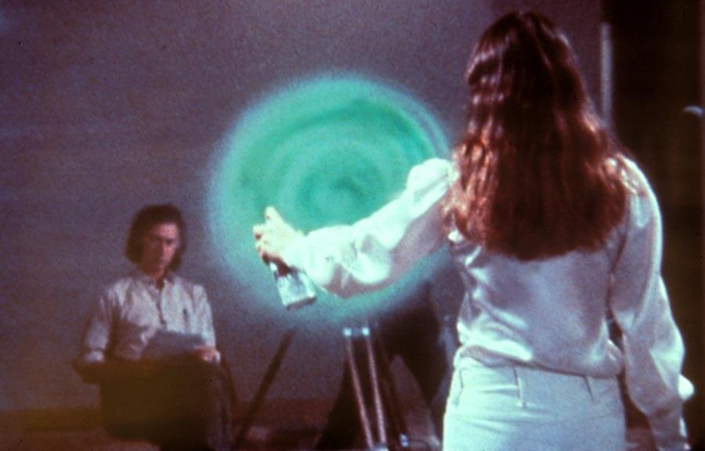
Still image from Michael Snow, Two Sides to Every Story, 1974. This work challenges viewers to try and watch films on two sides of a single screen.

Slide 23
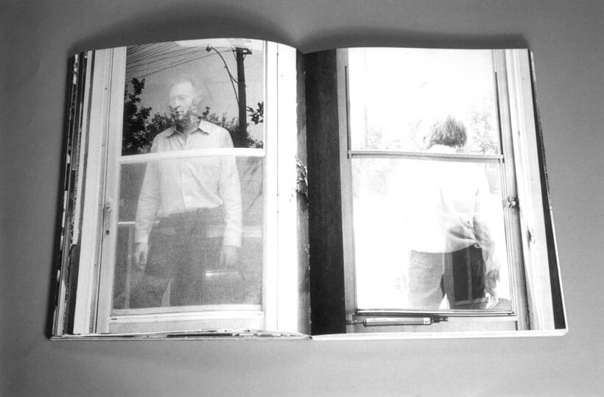
Michael Snow, Cover to Cover, 1975. This book does not include text; instead, it presents a series of images, with alternate views on facing pages.

Slide 24
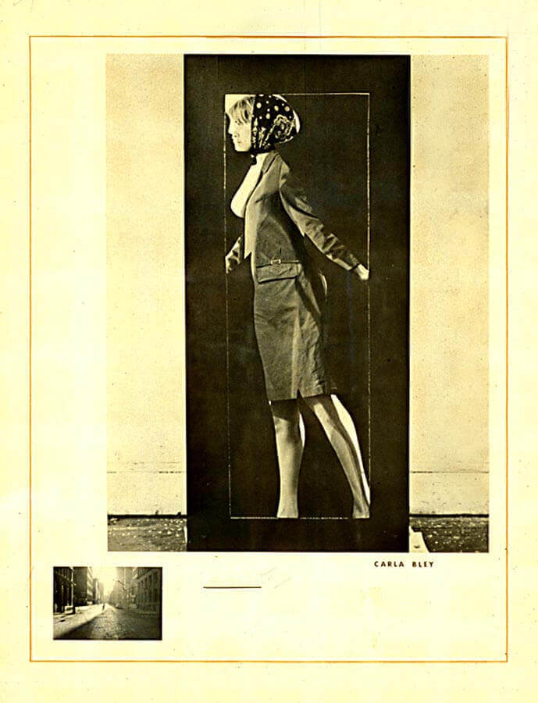
Michael Snow, Carla Bley, 1965. This work is part of Snow’s Walking Woman series, but here we see a specific person, namely Carla Bley, a jazz musician and composer and friend of the artist.

Slide 25
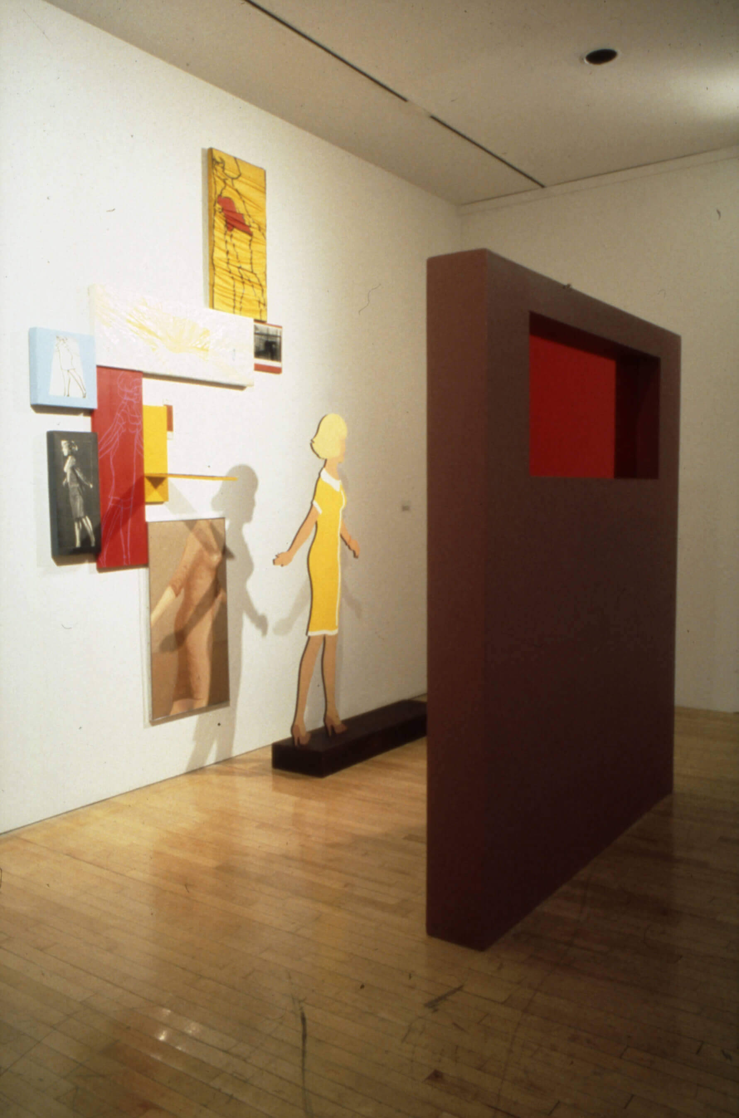
Michael Snow, Sleeve, 1965. Sleeve brings together many different forms of the Walking Woman in a single installation.

