Slide 2
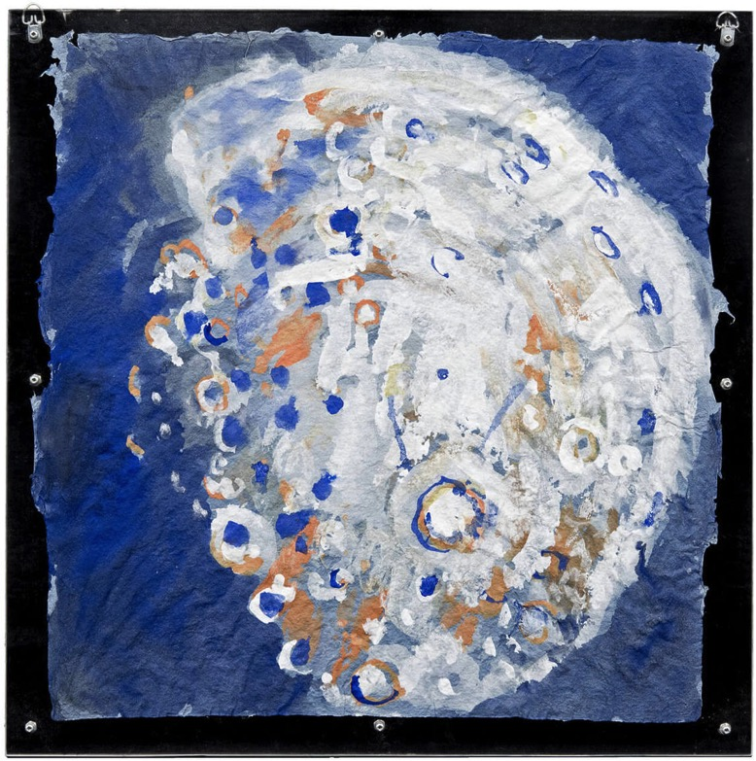
Paterson Ewen, Moon, 1975. Ewen’s brush, like a knife stabbing the image, mimics the violent forces by which the moon was created.

Slide 3
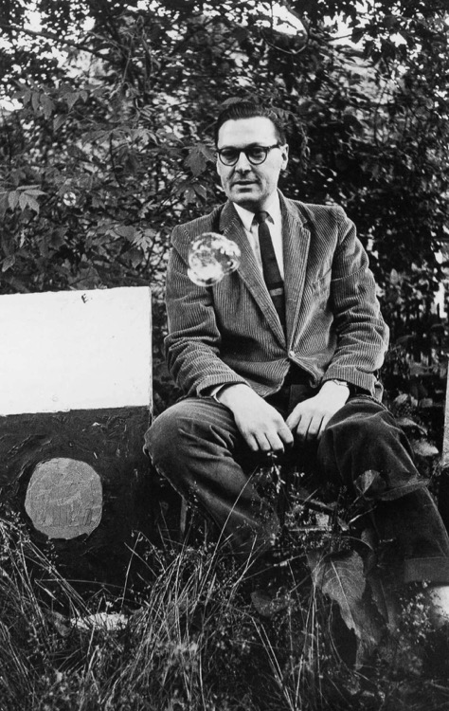
Paterson Ewen in 1962.

Slide 4
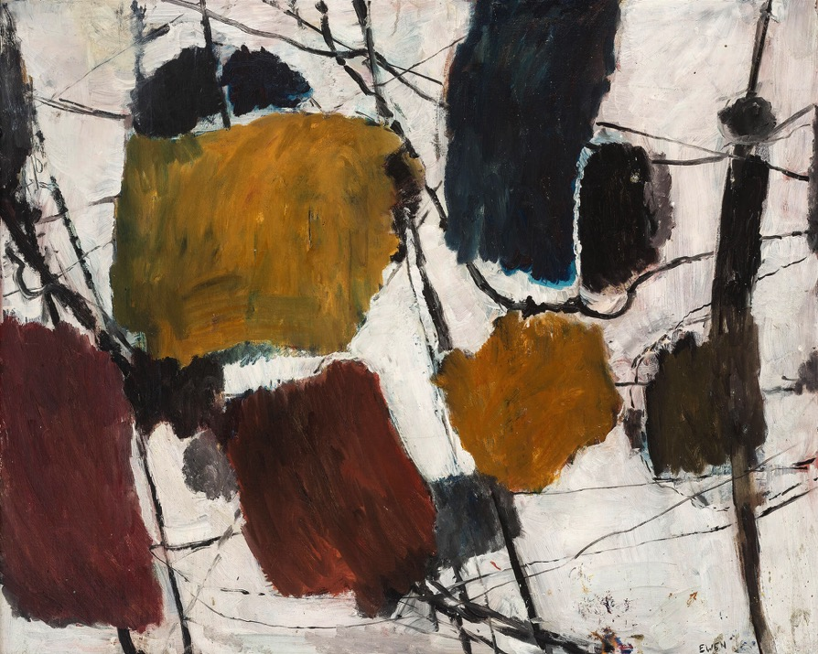
Paterson Ewen, Untitled, 1954. This is Ewen’s first abstract painting, created during his time in Montreal.

Slide 5
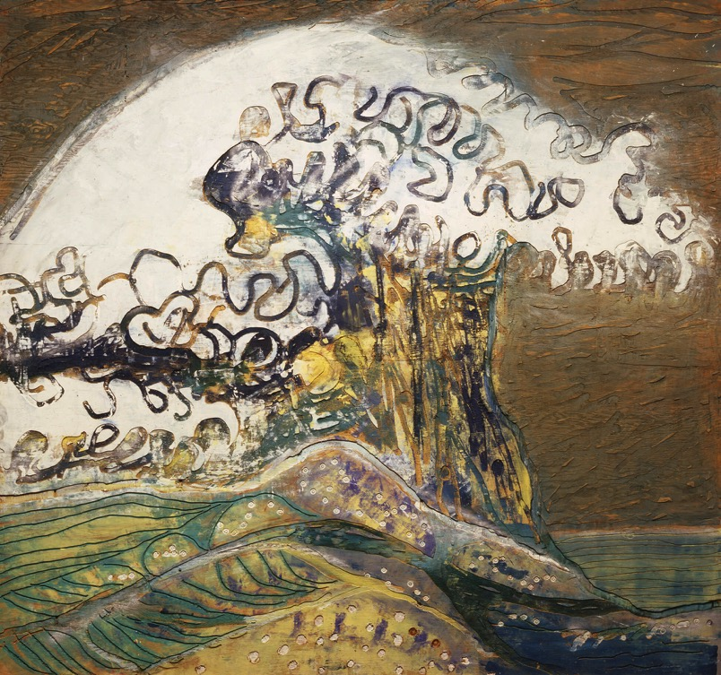
Paterson Ewen, The Great Wave—Homage to Hokusai, 1974. This work shows Ewen’s inspiration from Japanese woodblock prints.

Slide 6
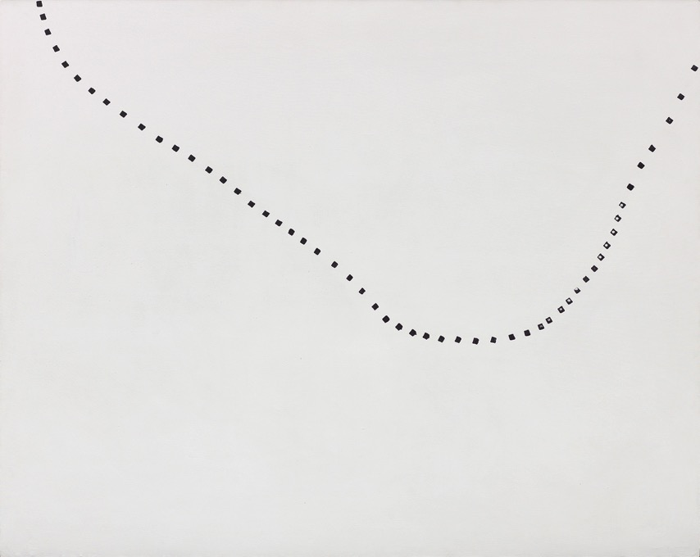
Paterson Ewen, Traces through Space, 1970. During the 1970s, Ewen was interested in trying to capture “the idea of a life stream that goes through everyone’s life and universal life.”

Slide 7
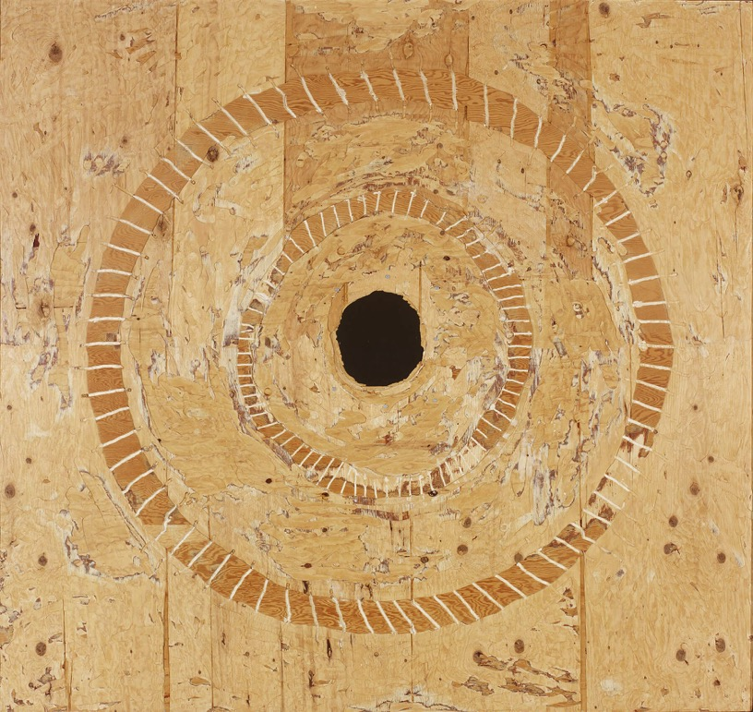
Paterson Ewen, Satan’s Pit, 1991. One time, Ewen accidentally dug too deeply with his router and made a hole through the plywood. Rather than start again, he simply started to work this feature into his artworks.

Slide 8
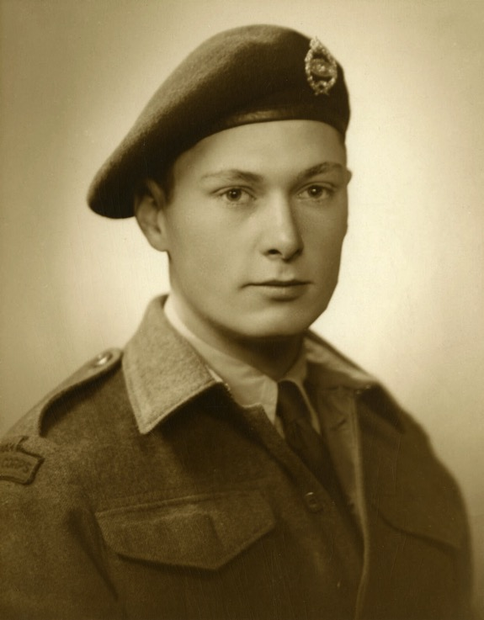
Paterson Ewen in his army uniform, c.1944.

Slide 9
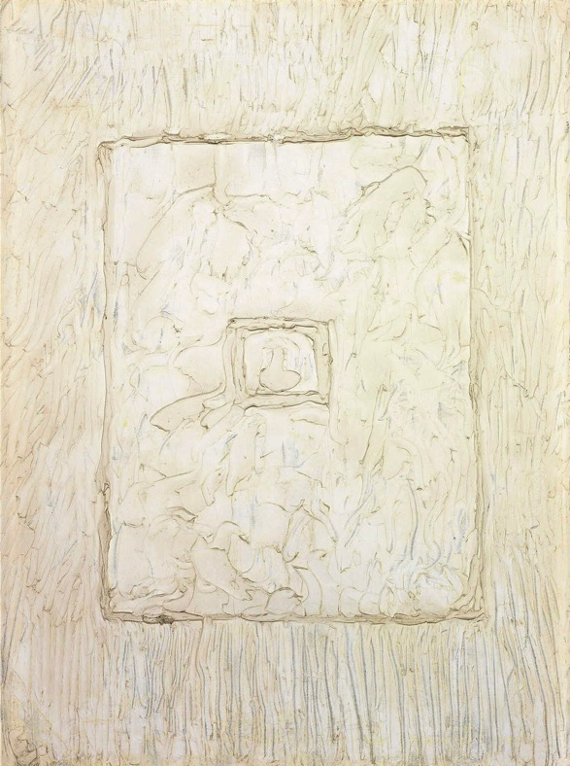
Paterson Ewen, White Abstraction No. 1, c.1963. In the 1960s Ewen produced a series of white on white abstract works.

Slide 10
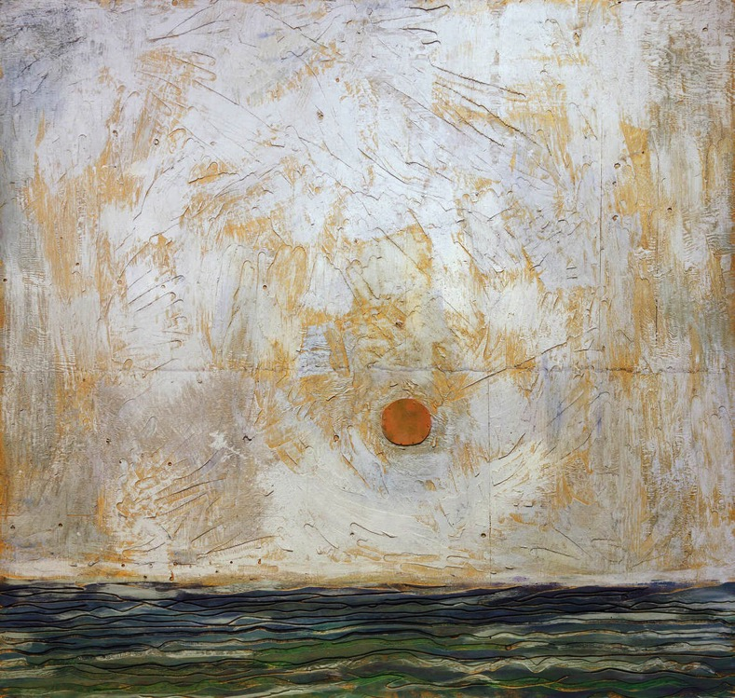
Paterson Ewen, Sunset over the Mediterranean, 1980. An example of Ewen’s best-recognized gouged plywood technique.

Slide 11
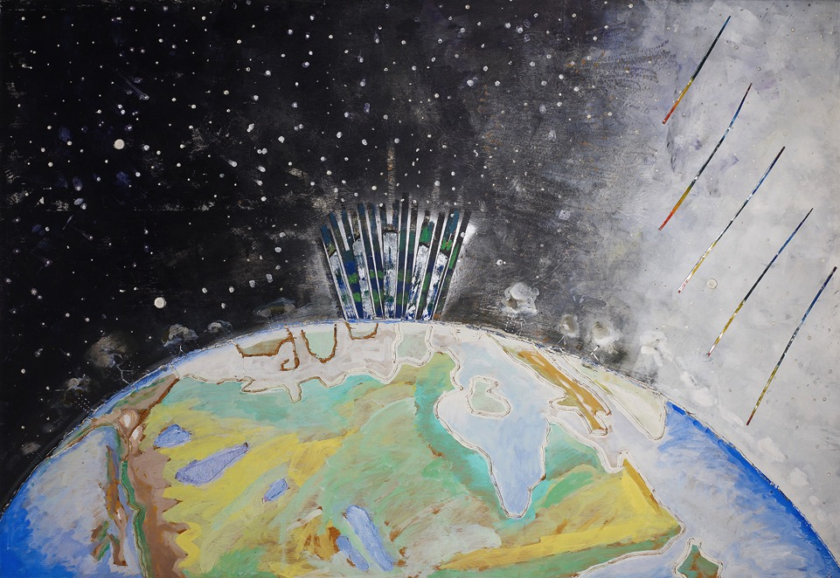
Learning Activity #1
Paterson Ewen, Northern Lights, 1973. Here Ewen depicts the natural phenomenon from space, a very unusual vantage point.

Slide 12
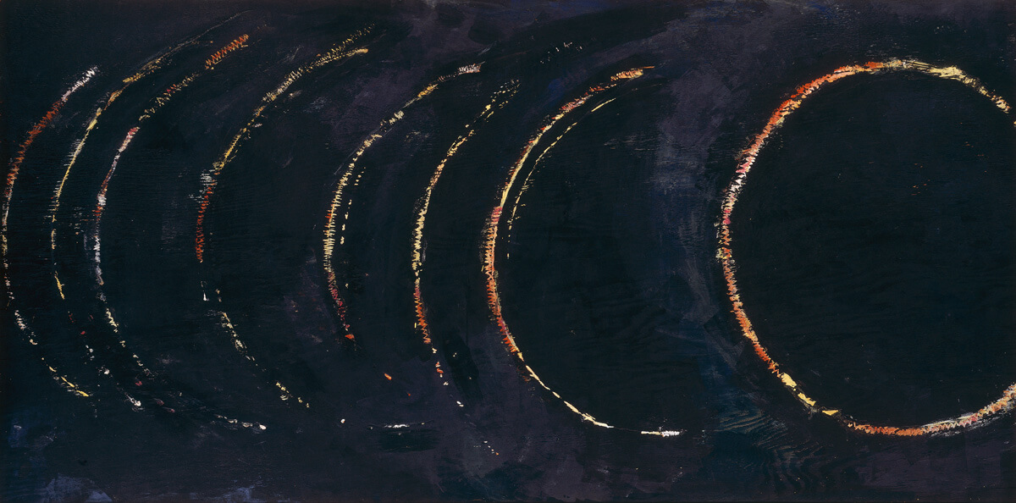
Learning Activity #1
Paterson Ewen, Solar Eclipse, 1971. This work is one of the first explicitly celestial pieces Ewen produced.

Slide 13
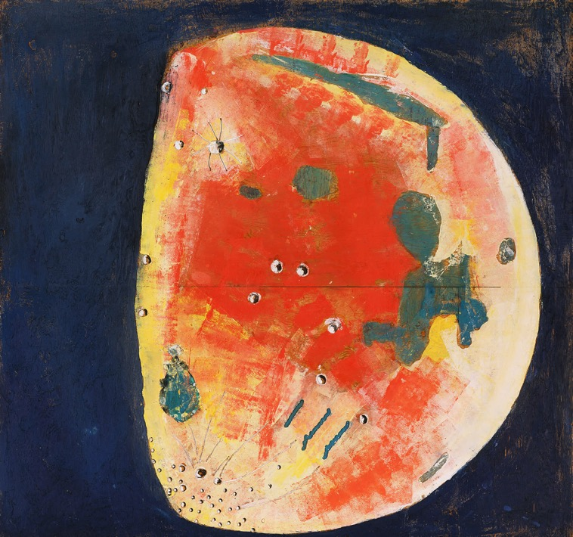
Learning Activity #1
Paterson Ewen, Gibbous Moon, 1980. Of all the celestial objects, Ewen identified most closely with the moon.

Slide 14
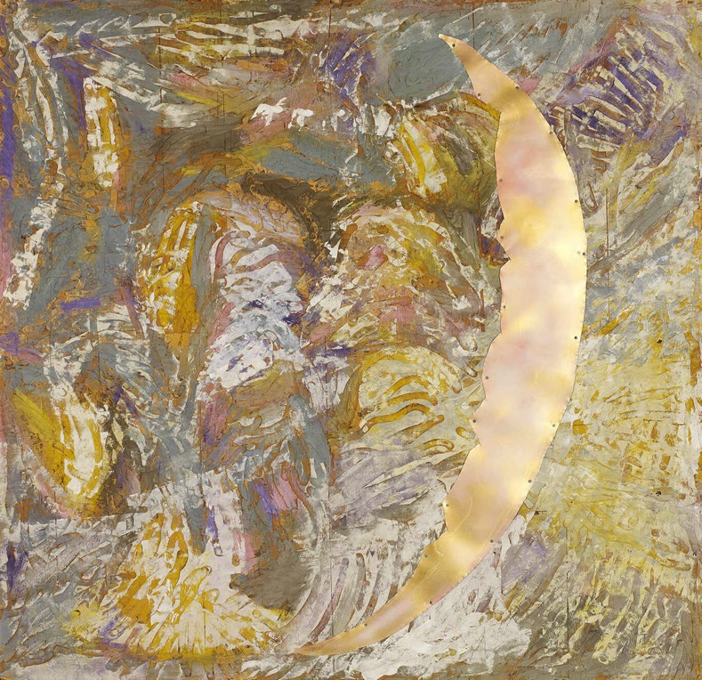
Paterson Ewen, Decadent Crescent Moon, 1990. Throughout Ewen’s works, we see a fluctuation between lines that are calm and measured and lines that are erratic. Lines set the mood in Ewen’s work.

Slide 15
Learning Activity #2
Paterson Ewen, Blackout, 1960. Here Ewen references the air raid procedures that were practised at the end of the 1950s and in the 1960s, during the height of the Cold War. This work is significant as it is one of only a few that are directly related to historical events.

Slide 16
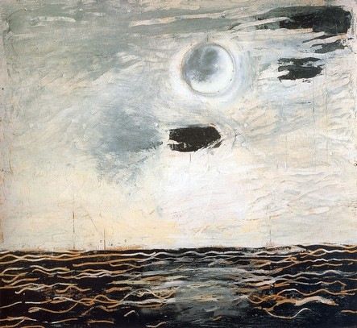
Paterson Ewen, Moon over Water, 1977. Ewen explored moons in every phase, and returned to them again and again in every period of his life and in every medium in which he worked.

Slide 17
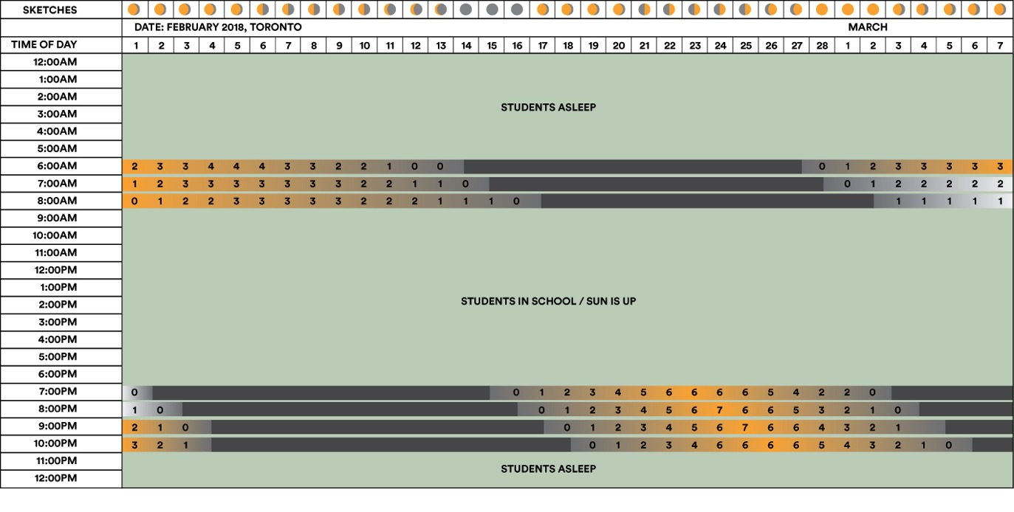
Learning Activity #2
Moon observation chart, February 1 to March 7, 2018, in Toronto, ON. (Source: www.mooncalc.org)

Slide 18
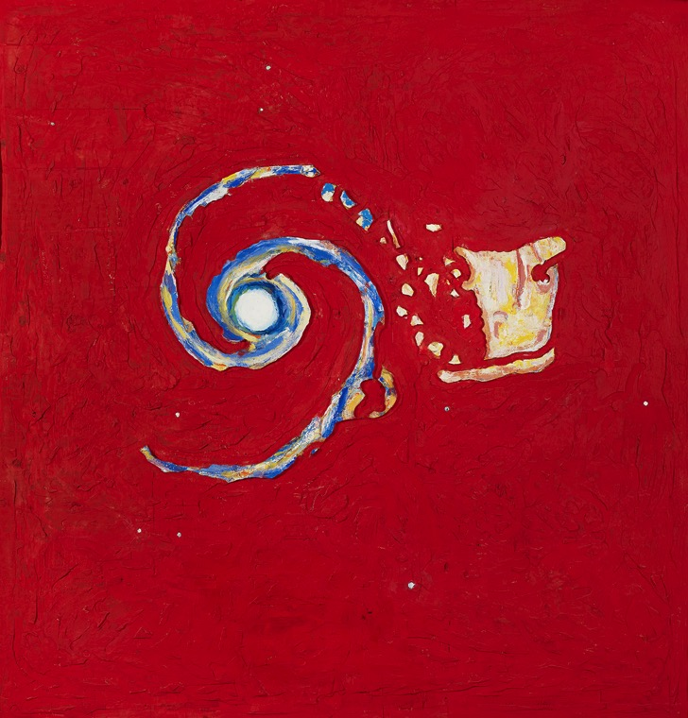
Paterson Ewen, Cosmic Cannibalism, 1994. Here Ewen depicts galactic cannibalism, where two galaxies collide and one becomes absorbed into the other. Ewen was interested in representing motion throughout his works. The breaking apart of the yellow galaxy as it is absorbed into the giant swirling mass of the blue galaxy plays out against a gouged red background that itself seems to be in motion, churning with the rotation of the blue blades.

Slide 19
Culminating Task
Paterson Ewen, Gibbous Moon, 1980. This striking work was featured on the cover of the catalogue produced when Ewen represented Canada at the 1982 Venice Biennale. A fitting representation of the artist’s work.

Slide 20
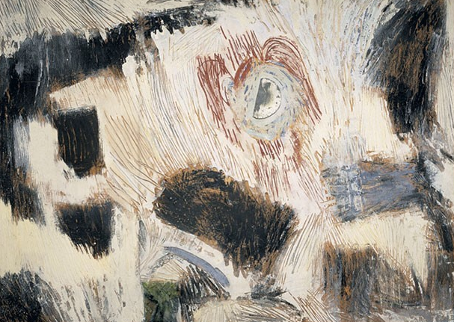
Paterson Ewen, Moon over Tobermory, 1981. This painting is likely a tribute to British landscape painter J.M.W. Turner. Whereas Turner came to be associated with the sun, Ewen is associated with the moon.

Slide 21
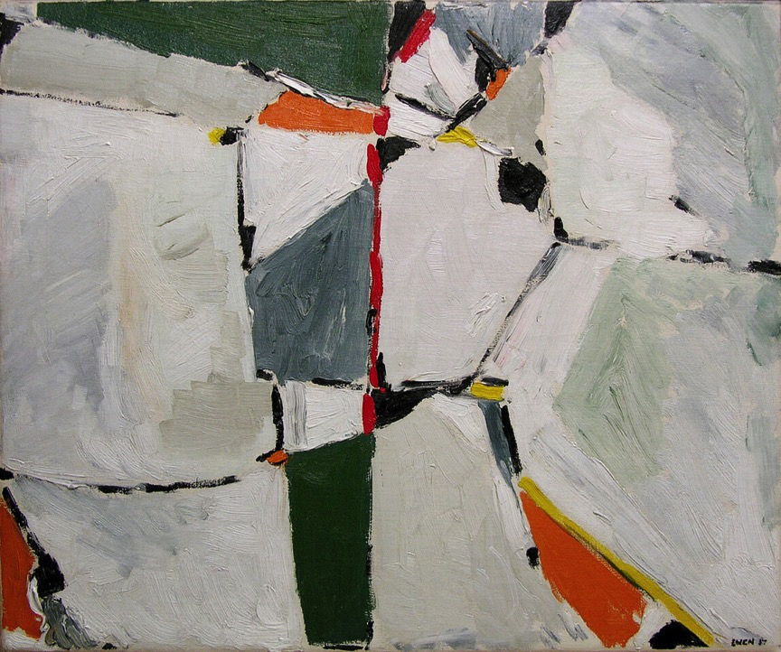
Paterson Ewen, La Pointe Sensible, 1957. Spending time in Montreal with the Automatistes, Ewen experimented with different forms of abstraction.

Slide 22
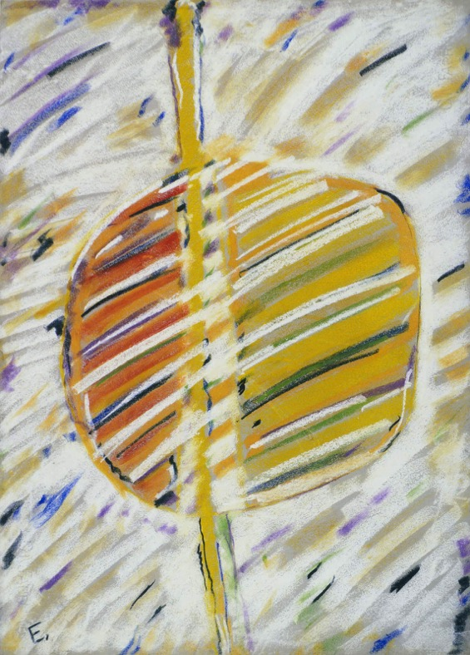
Paterson Ewen, Untitled, 1962. Ewen also created a number of abstract works in pastel on paper.

Slide 23
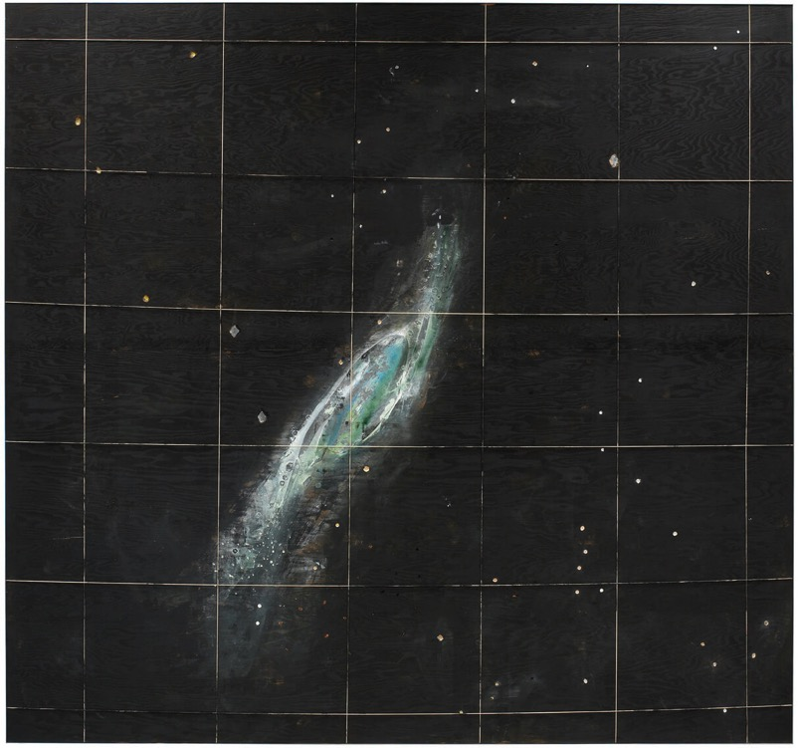
Paterson Ewen, Galaxy NGC-253, 1973. The swirling galaxy and twinkling stars in this painting are typical of Ewen’s interest in the cosmos.

Slide 24
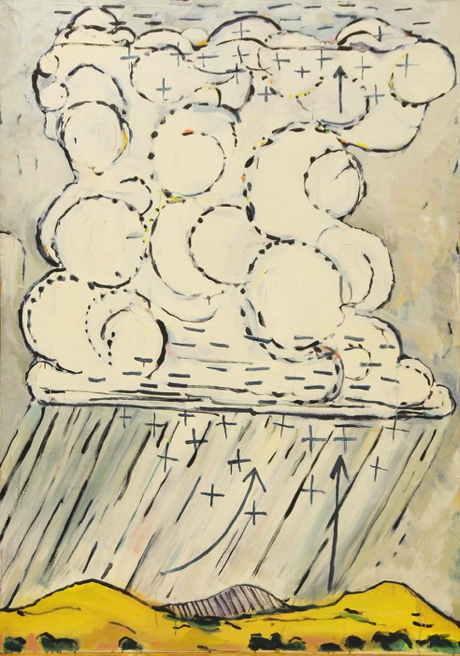
Paterson Ewen, Thunder Cloud as Generator #1, 1971. This work shows the cycle of rain falling and rising back up into the air.

Slide 25
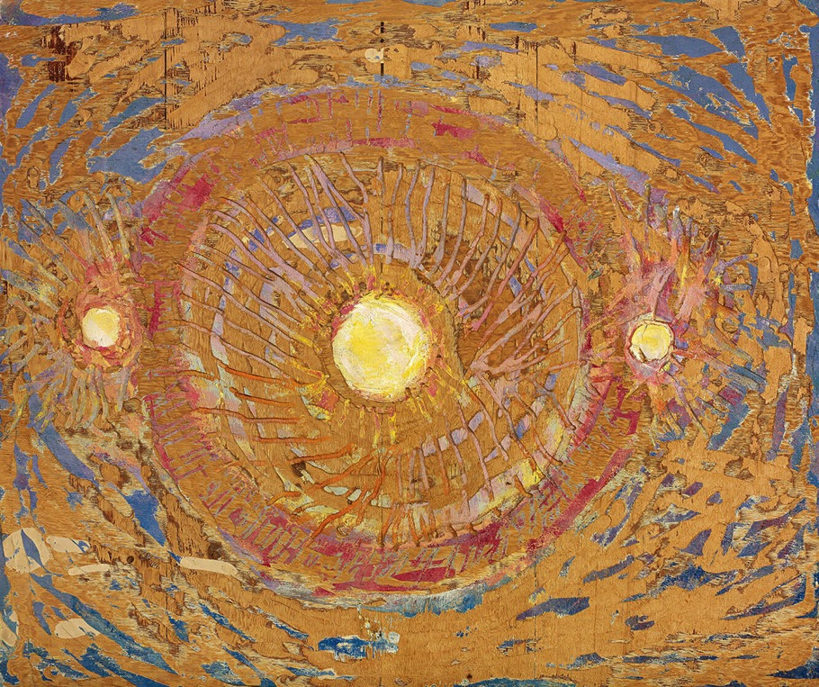
Paterson Ewen, Sun Dogs #4, 1989. Initially Ewen stood the plywood against a wall to use the router. After a near accident, he began to lay the plywood on sawhorses, often climbing onto the surface and working on all fours.

Slide 26
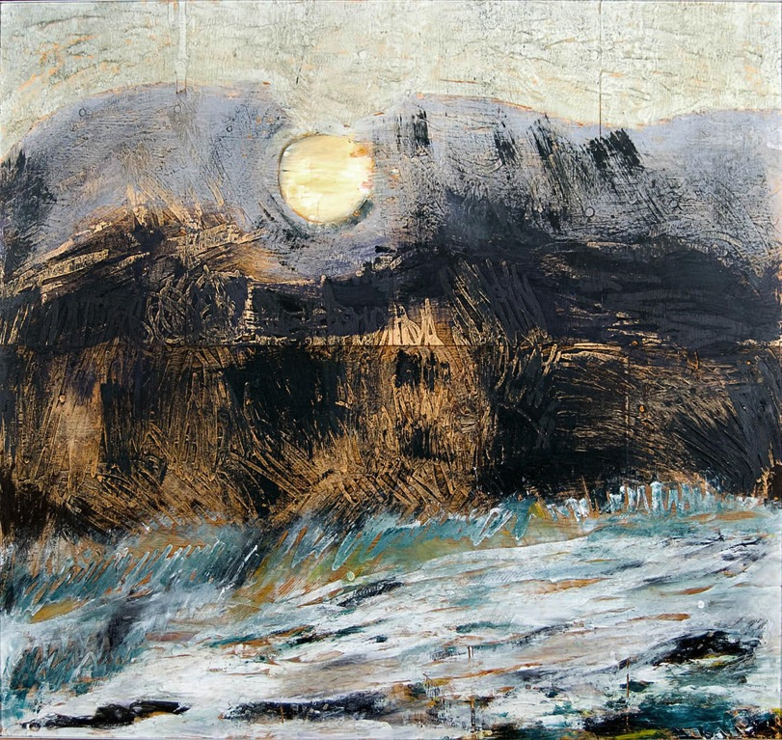
Paterson Ewen, Typhoon, 1979. In the painting Ewen combines his two interests: the moon and natural phenomena.

Slide 27
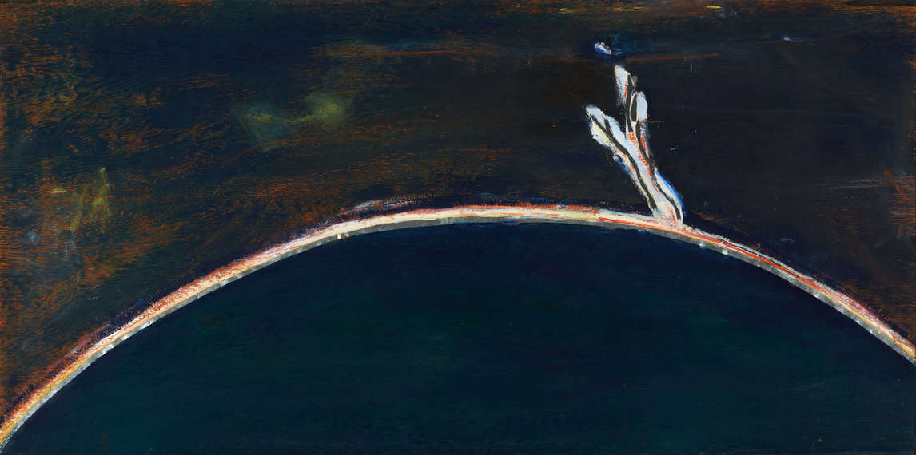
Paterson Ewen, Eruptive Prominence, 1971. One of Ewen’s earliest gouged plywood works, perhaps depicting a solar flare off the surface of the sun.

