Slide 1
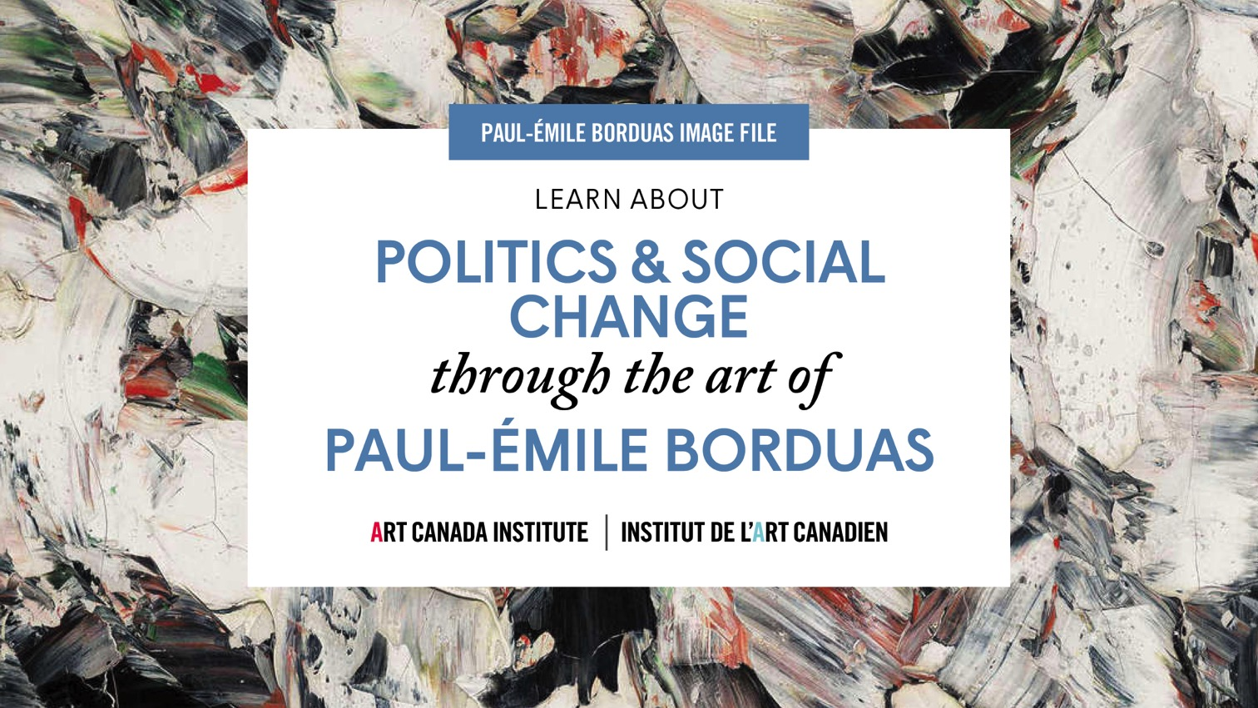

Slide 2
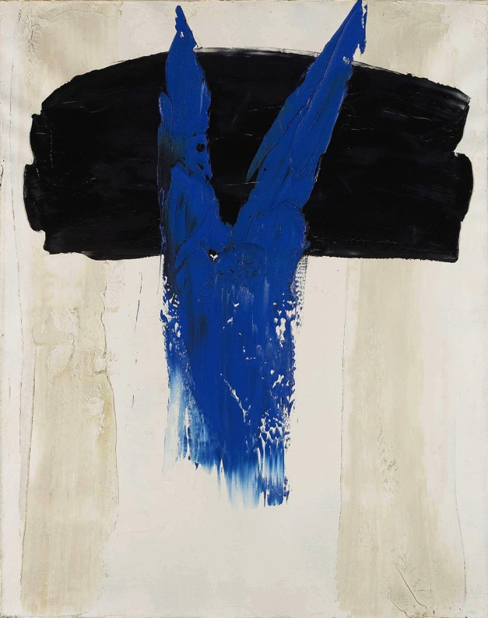
Paul-Émile Borduas, Abstract in Blue, 1959. This painting was reproduced on the invitation to Borduas’s first solo exhibition in Paris, in 1959.

Slide 3
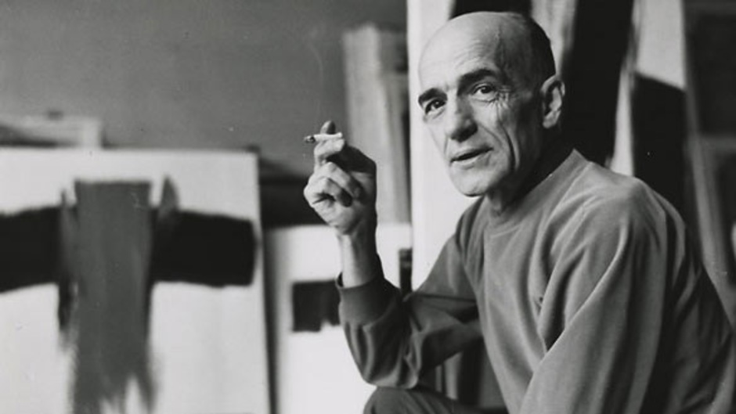
Paul-Émile Borduas in Paris, c.1955.

Slide 4
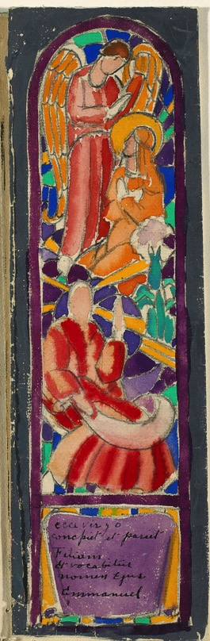
Paul-Émile Borduas, Decorative Project for the Chapel of a Château, No. 4: Study for Stained Glass Window, 1927. As an apprentice Borduas restored church decorations.

Slide 5
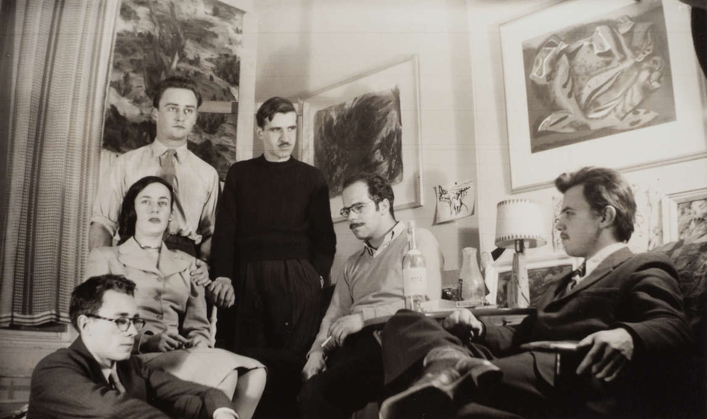
In the early 1940s the Automatistes would meet to discuss politics and art in Quebec.
They wrote the Refus global manifesto, a revolt against the narrow-mindedness of Quebec’s conservative government.

Slide 6
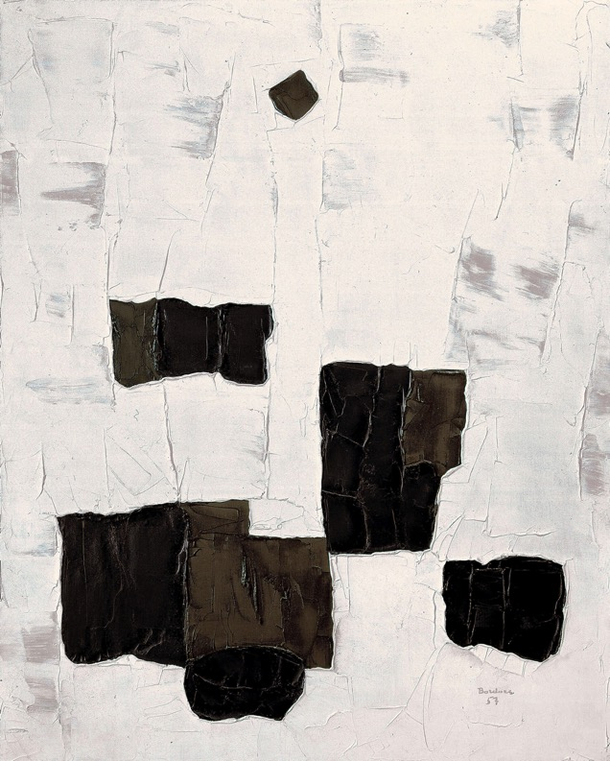
Paul-Émile Borduas, The Black Star (L’étoile noire), 1957. One of Borduas’s masterpieces, created during his final years in Paris.

Slide 7
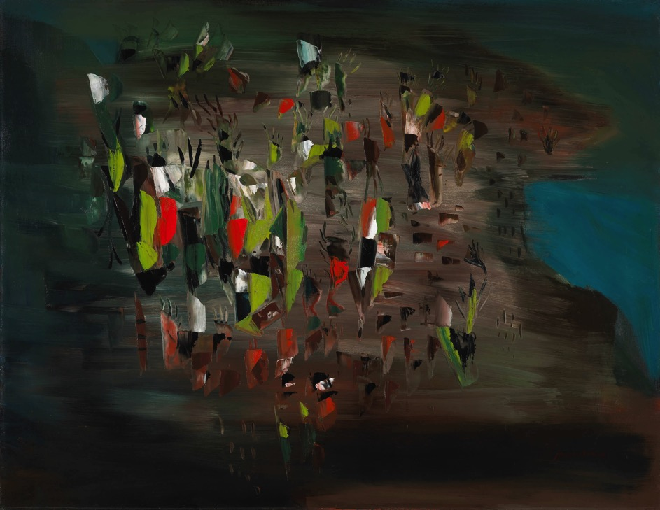
Paul-Émile Borduas, Leeward of the Island or 1.47 (Sous le vent
de l’île ou 1.47), 1947. This painting is considered the Automatistes’ iconic painting,
and it made Borduas a household name in Canada.

Slide 8
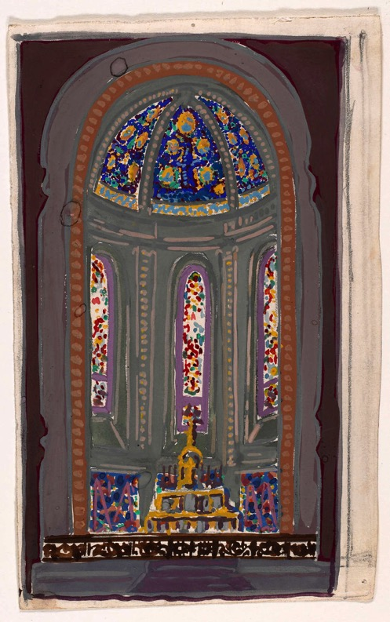
Paul-Émile Borduas, Decorative Project for
the Chapel of a Château, No. 1: Study for Choir Elevation, 1927.

Slide 9
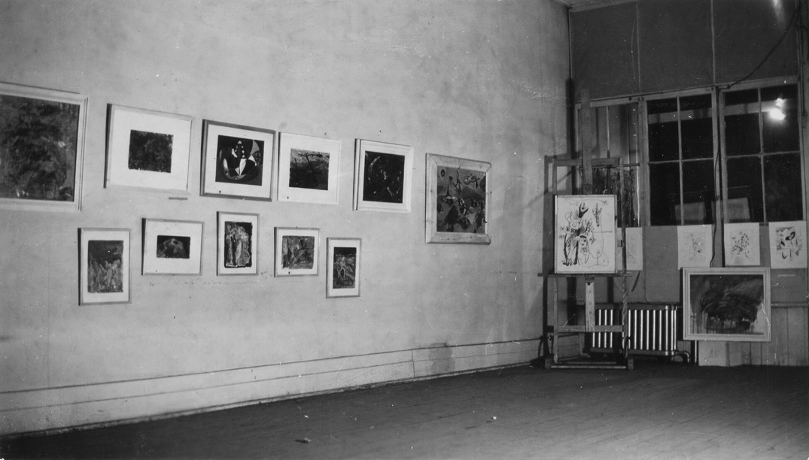
The first Automatiste exhibition, in a makeshift gallery at 1257 Amherst Street in Montreal,
ran April 20–29, 1946.

Slide 10
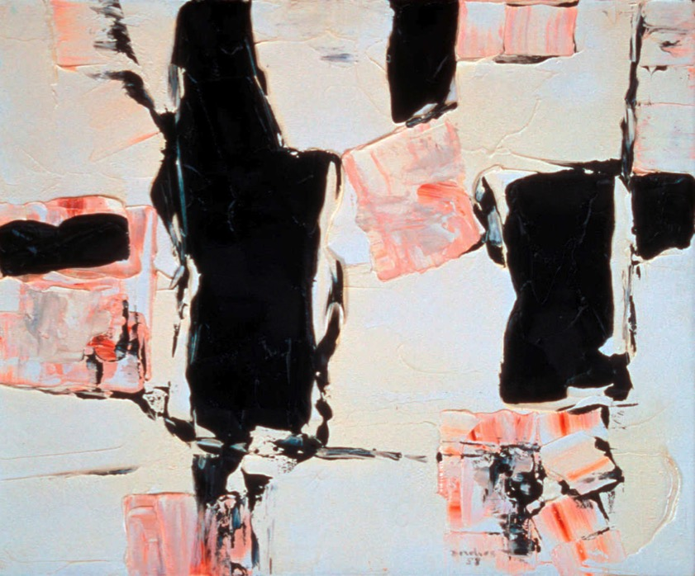
Paul-Émile Borduas, Forgotten Forms (Formes oubliées), 1958. This work was painted when Borduas lived in Paris.

Slide 11
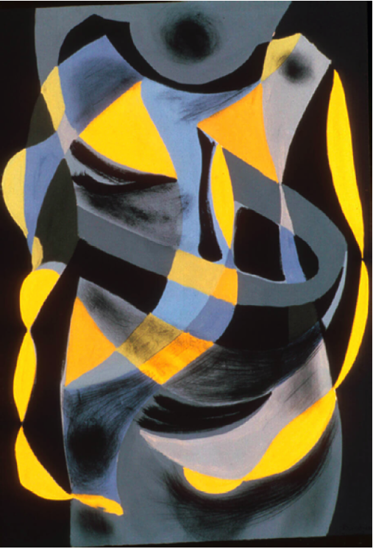
Learning Activity #1
Paul-Émile Borduas, Study for Torso or No. 14 (Étude de torse ou Nº14), 1942. Borduas’s early works, like this one, executed without any preconceived ideas were not well received by most critics, who found them difficult to understand. They were shown for the first time at the Ermitage at the Collège de Montréal as nowhere else would agree to exhibit them.

Slide 12
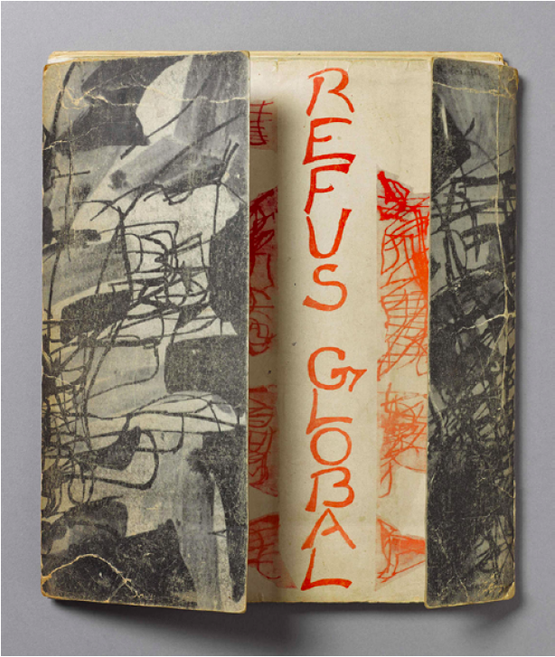
Refus global, first published in an edition of four hundred copies, went on sale at Montreal’s Librairie Tranquille on August 9, 1948.

Slide 13
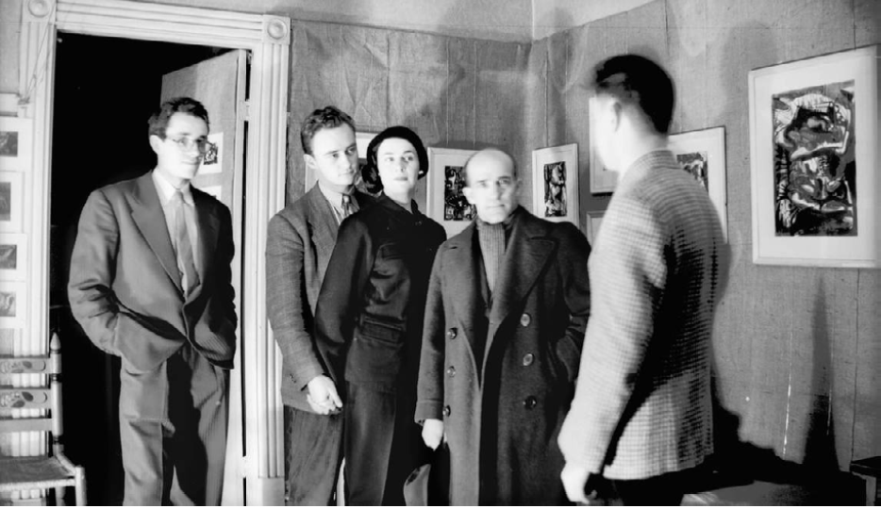
The second exhibition of the Automatistes, 1947, at 75 Sherbrooke Street West. Left to right: Marcel Barbeau, Pierre Gauvreau, Madeleine Arbour, Paul-Émile Borduas, and Claude Gauvreau.

Slide 14
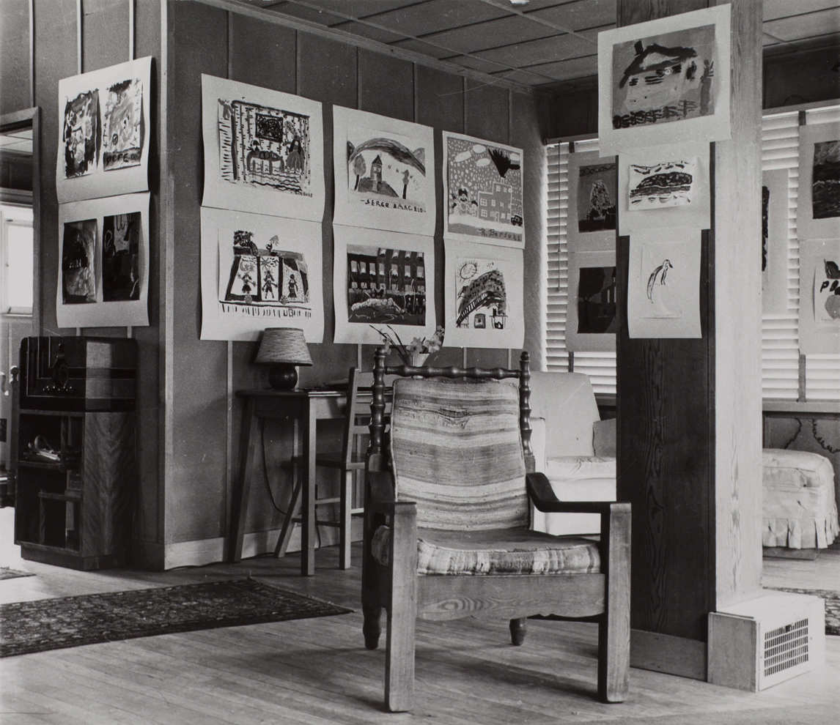
The interior of Borduas’s home. After losing his position at the École du meuble in Montreal, Borduas taught drawing to children in Saint-Hilaire.

Slide 15
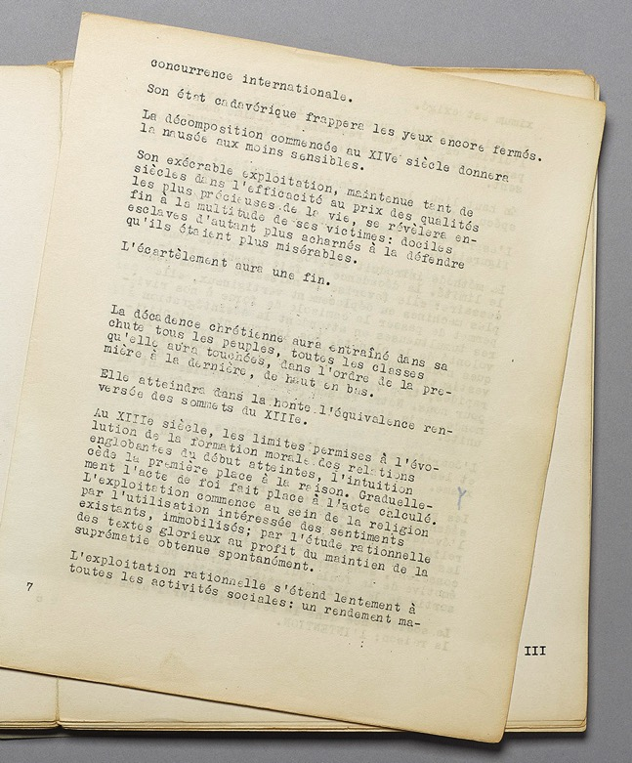
An interior page of Refus global, 1948. The work was hand-printed on a Gestetner duplicating machine.

Slide 16
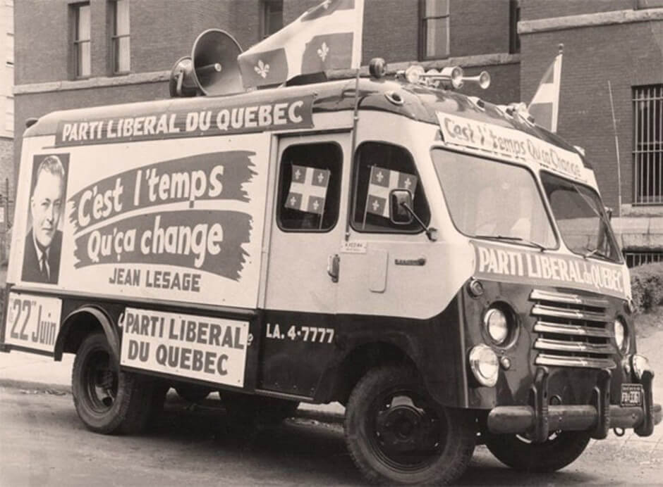
The Liberal Party slogan “C’est l’temps qu’ça change” (It’s time things changed) was a hallmark of Quebec’s Quiet Revolution, to which Refus global was an important precursor.

Slide 17
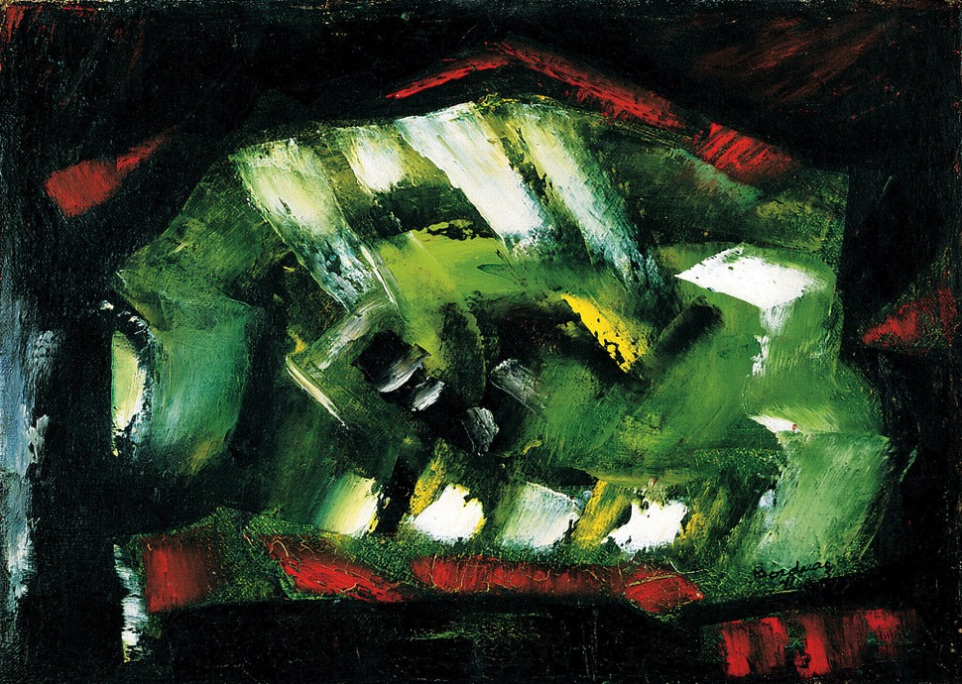
Paul-Émile Borduas,
Green Abstraction (Abstraction verte), 1941. Borduas’s first completely non-preconceived painting.

Slide 18
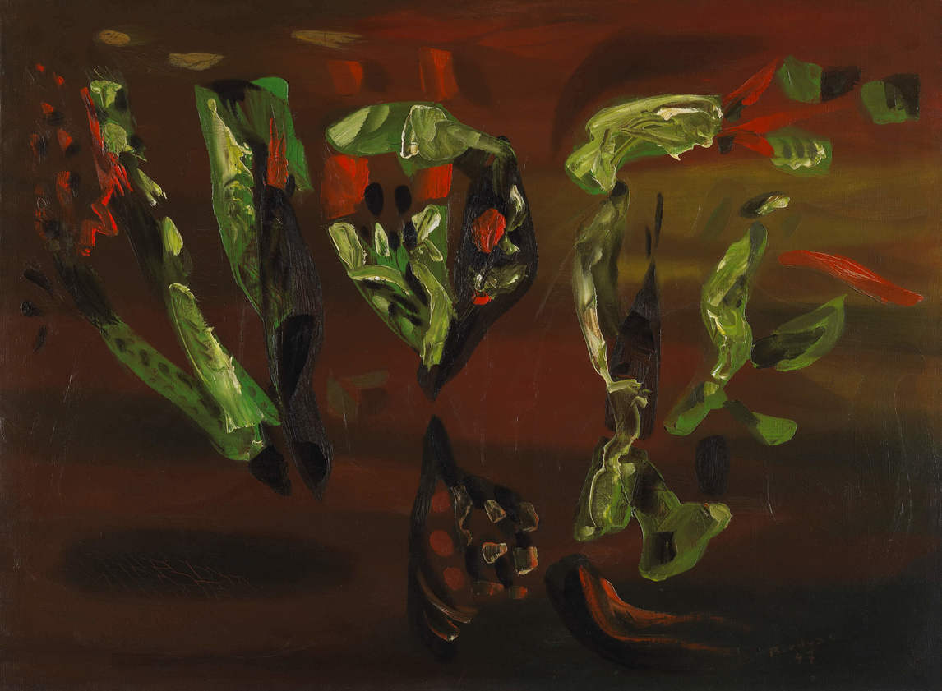
Paul-Émile Borduas, Nature’s Parachutes or 19.47 (Parachutes végétaux ou 19.47), 1947. Working in oil Borduas would have painted the background first, then, when
it was dry, the abstract shapes
on top.

Slide 19
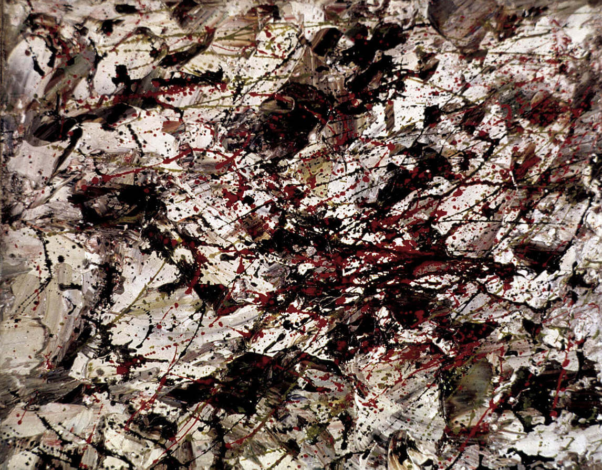
Paul-Émile Borduas, Graffiti, 1954. Similar to American artist Jackson Pollock, Borduas created abstract paintings of seemingly random splattered and dripped paint.

Slide 20
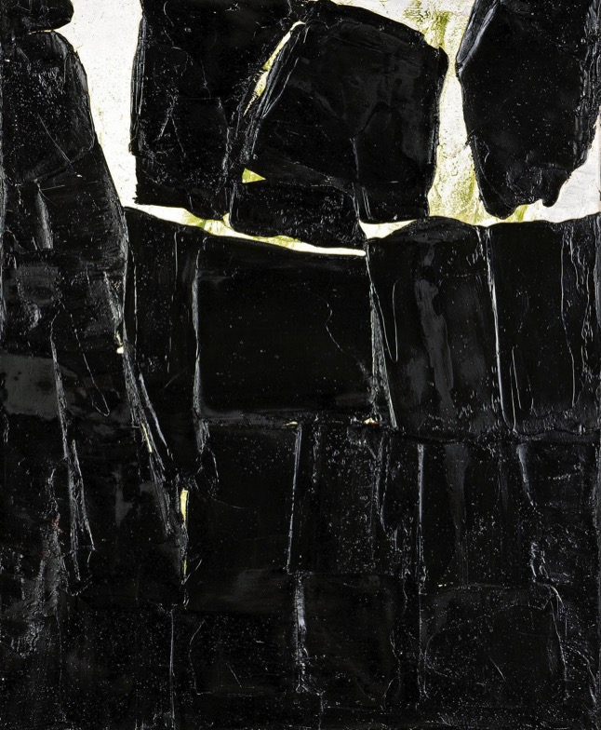
Paul-Émile Borduas, Composition 69, 1960. This painting shows Borduas’s thickly applied black paint by use of a palette knife.

Slide 21
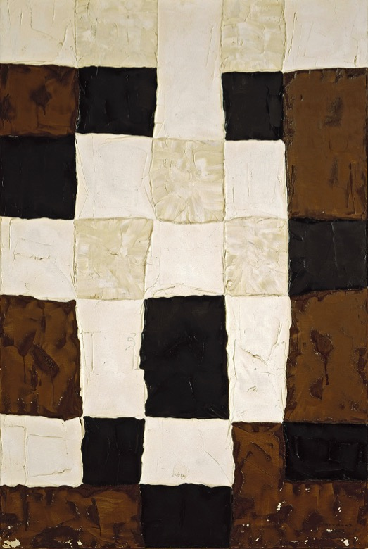
Paul-Émile Borduas, Symphony on a White Checkerboard or Symphony 2 (Symphonie en damier blanc ou Symphonie 2), 1957. Here Borduas uses a geometric grid design to emphasize equilibrium within his painting.

Slide 22
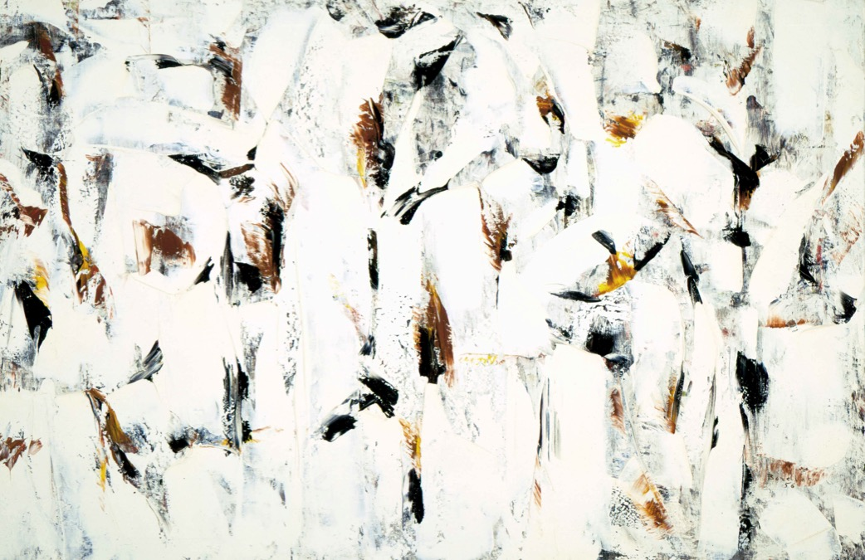
Paul-Émile Borduas, Blossoming (Épanouissement), 1956. This painting is closely aligned with Borduas’s time in New York learning from American Abstract Expressionism. There is no focal point, and the painting seems as though it continues right off the edges.

