Slide 2
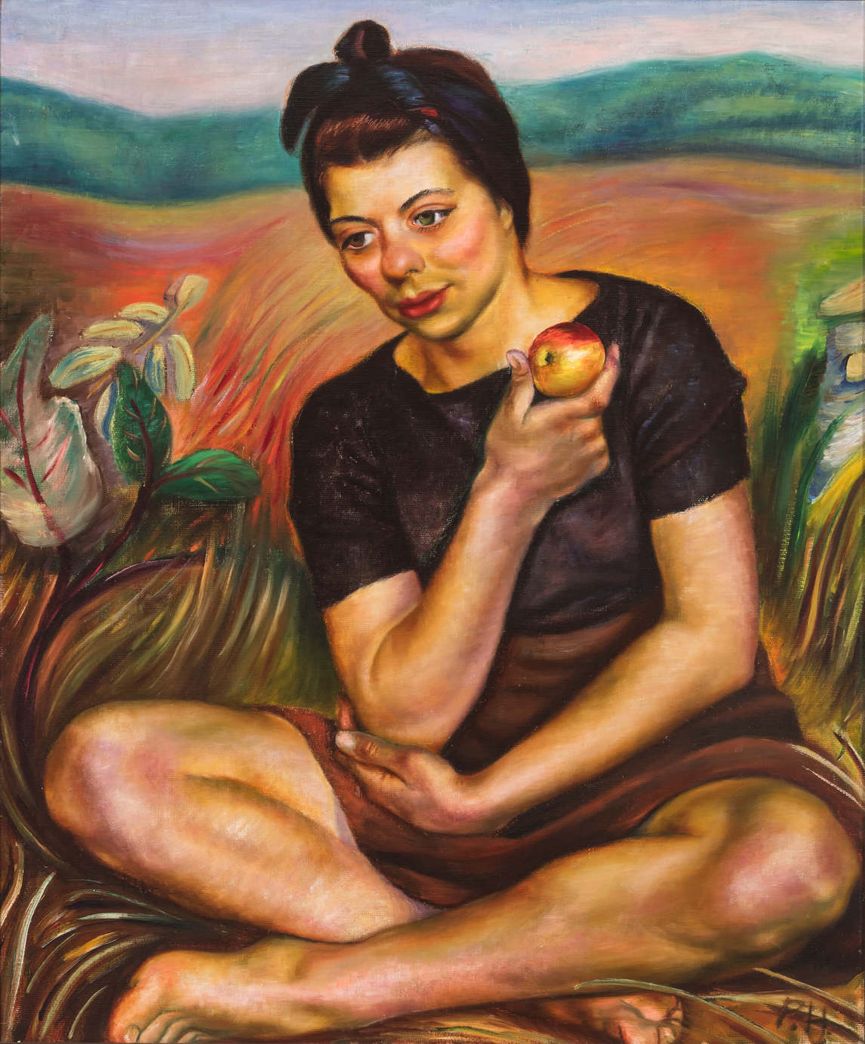
Prudence Heward, Autumn (Girl with an Apple), 1942. The woman in this painting is perhaps taking a break from apple picking. She sits cross-legged, her skirt hiked up, in a comfortable though not typically feminine pose for the time.

Slide 3
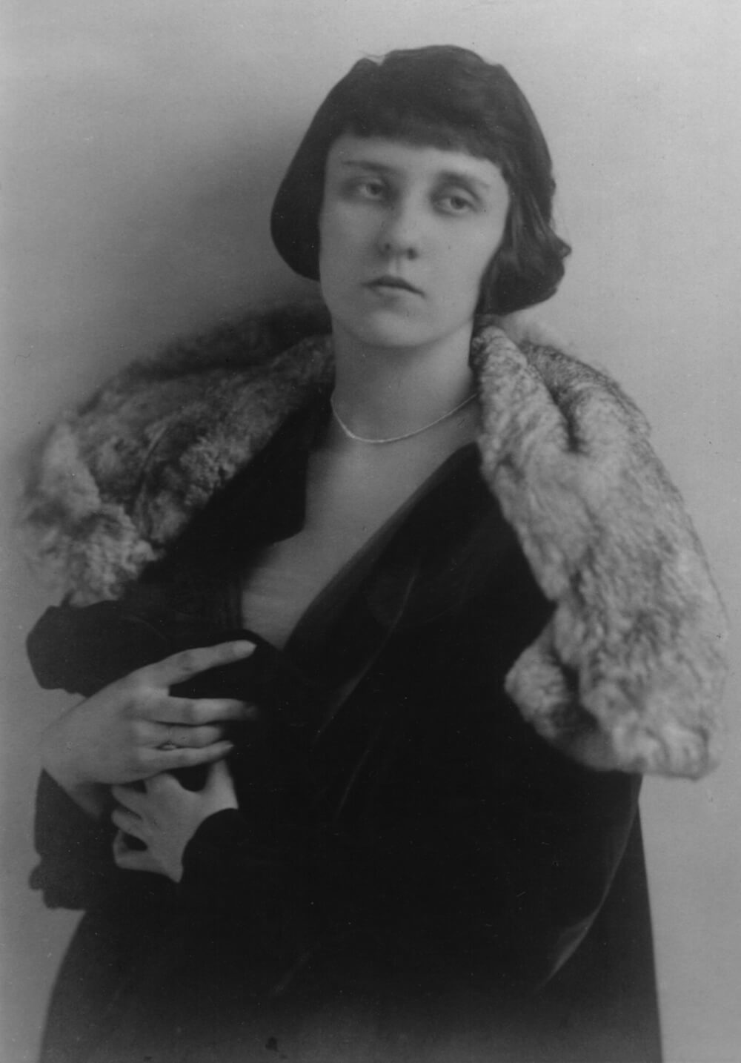
Studio portrait of Prudence Heward, c.1927.

Slide 4
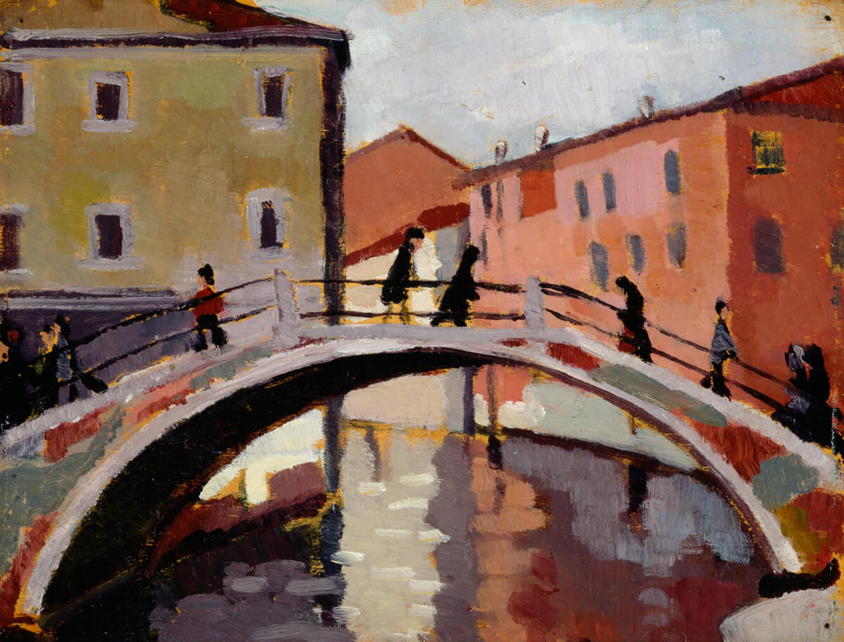
Prudence Heward, Scene of Venice, c.1928. Heward spent time in Europe learning modern art styles.

Slide 5
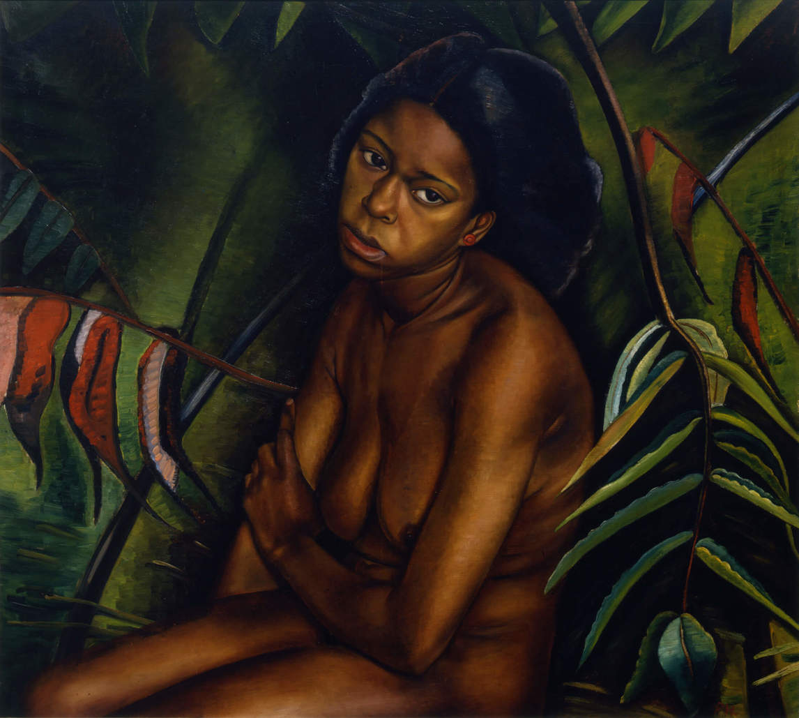
Prudence Heward, Dark Girl, 1935. This is an example of Heward’s tendency to paint black models nude and in exoticized settings.

Slide 6
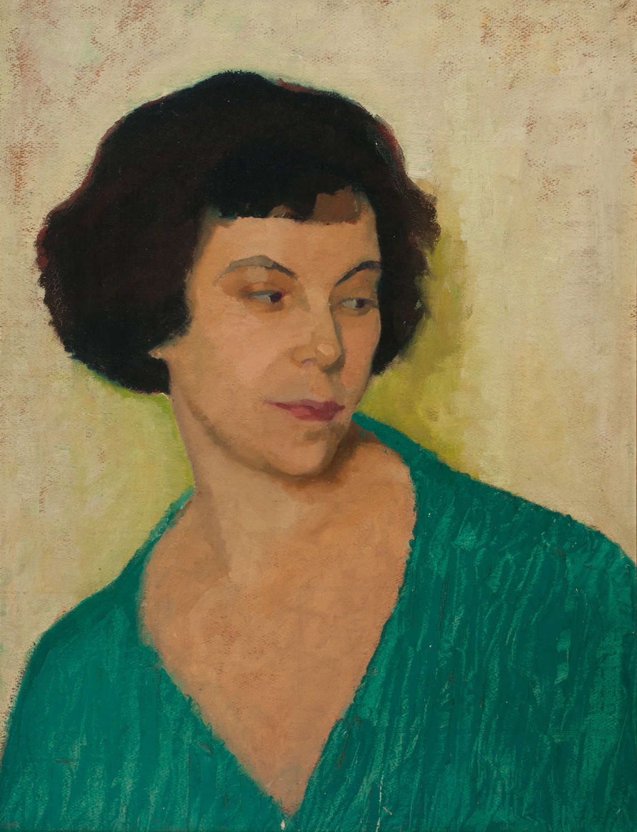
Prudence Heward, Miss Lockerby, c.1924. Heward often painted portraits of fellow professional women artists.

Slide 7
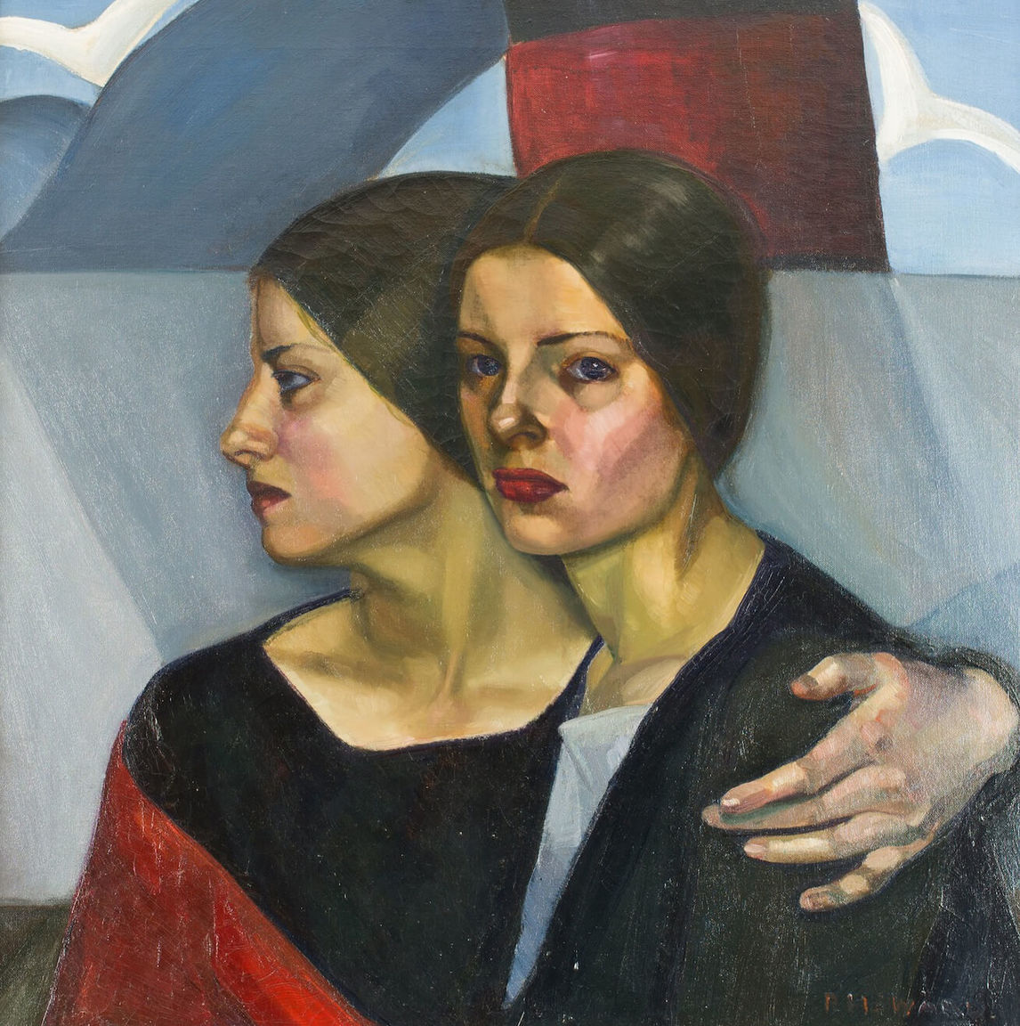
Prudence Heward, The Emigrants, c.1928. This painting was included in the Group of Seven’s exhibition at the Art Gallery of Ontario in 1930.

Slide 8
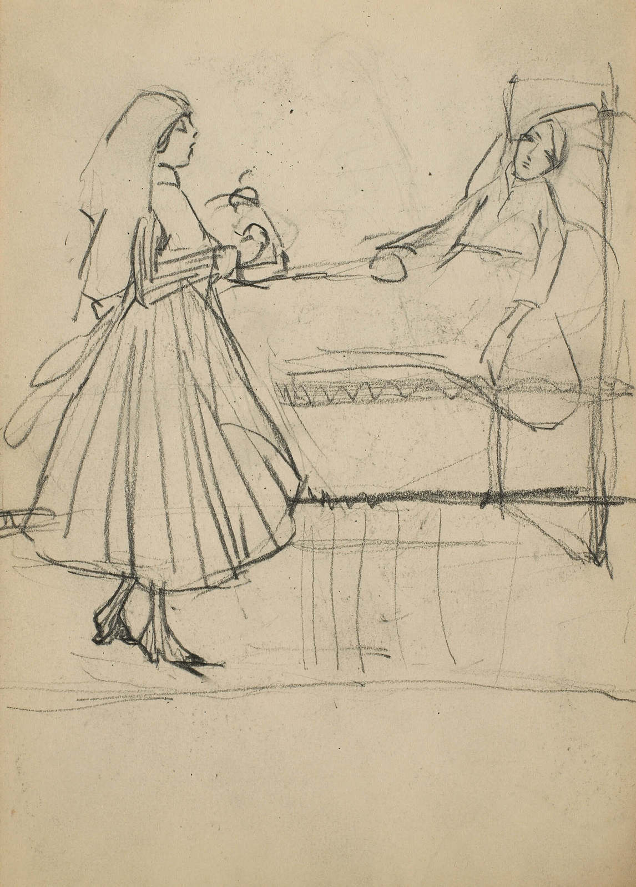
Prudence Heward, Untitled (Figural sketch of a nurse and a patient), c.1916. This sketch is likely of a Red Cross Nurse in London, U.K.

Slide 9
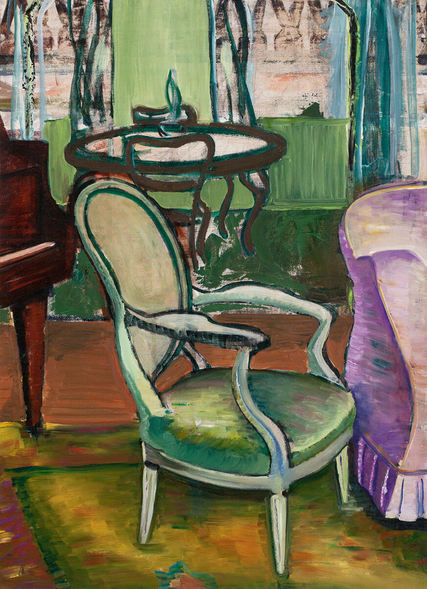
Prudence Heward, Study of the Drawing Room of the Artist, c.1940. Here Heward depicts her furnished upstairs studio in Montreal.

Slide 10
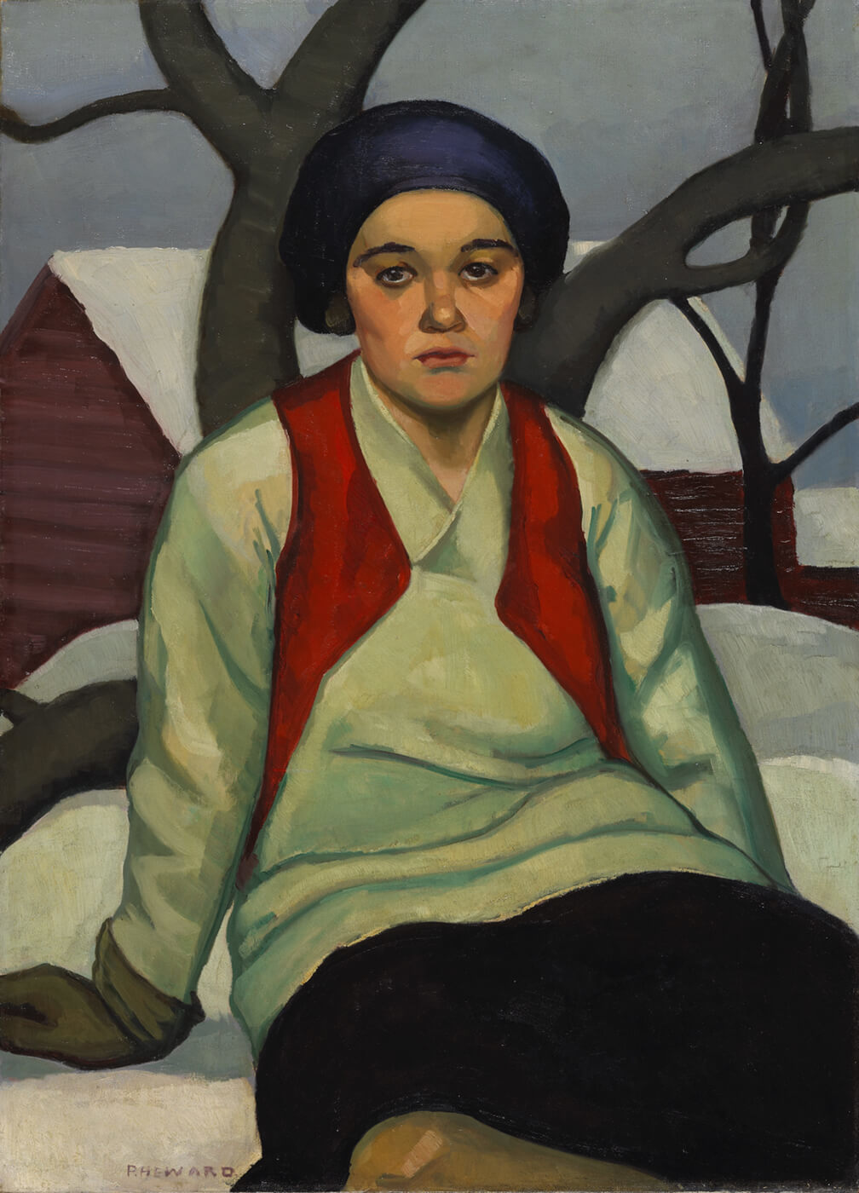
Prudence Heward, Anna, c.1927. This was the first work by Heward
purchased by the National Gallery of Canada.

Slide 11
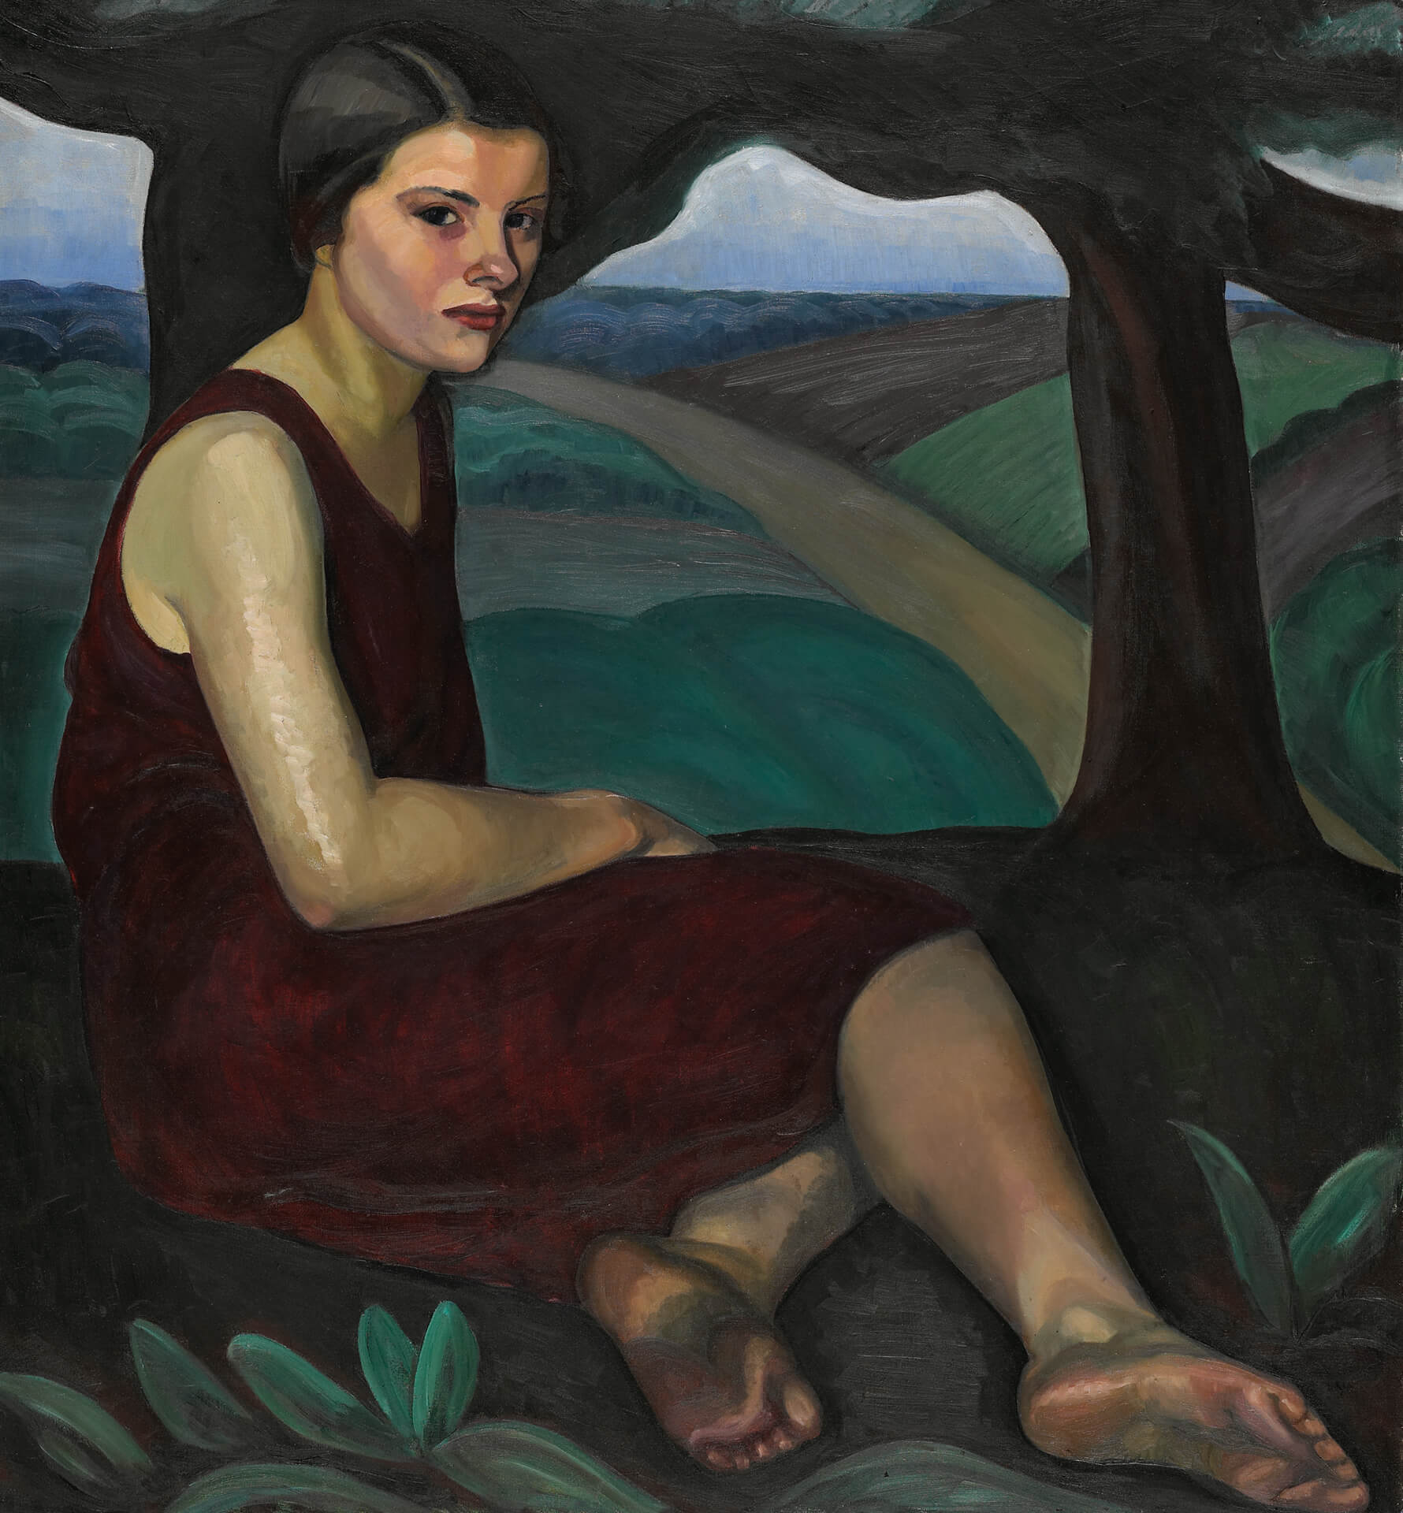
Prudence Heward, Girl on a Hill, 1928. Montreal dancer Louise McLea posed for this painting; she is barefoot, as was common for modern dancers.

Slide 12
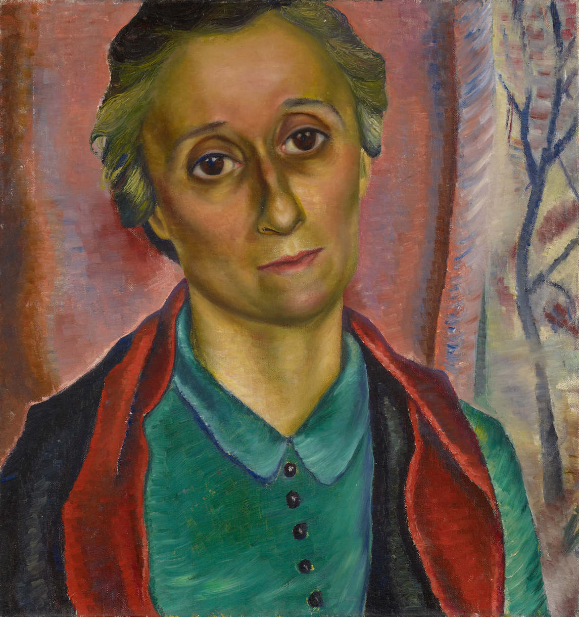
Prudence Heward, Portrait Study, 1938. The subject of this portrait is Heward’s sister Rooney.

Slide 13
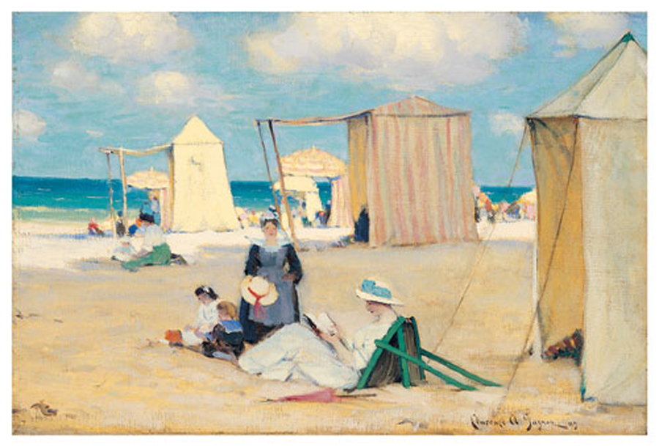
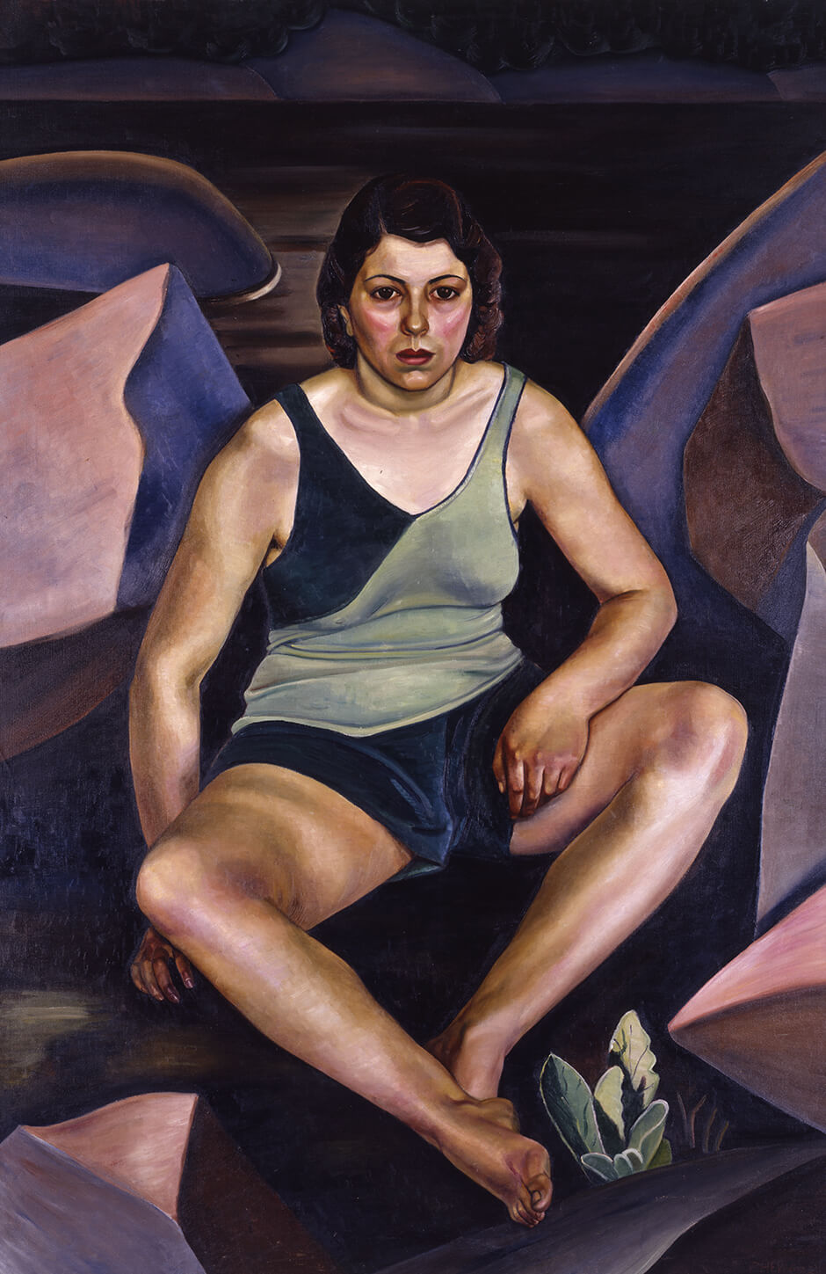
Learning Activity #1
Prudence Heward, The Bather, 1930.
Clarence Gagnon, The Beach at Dinard, 1909.

Slide 14
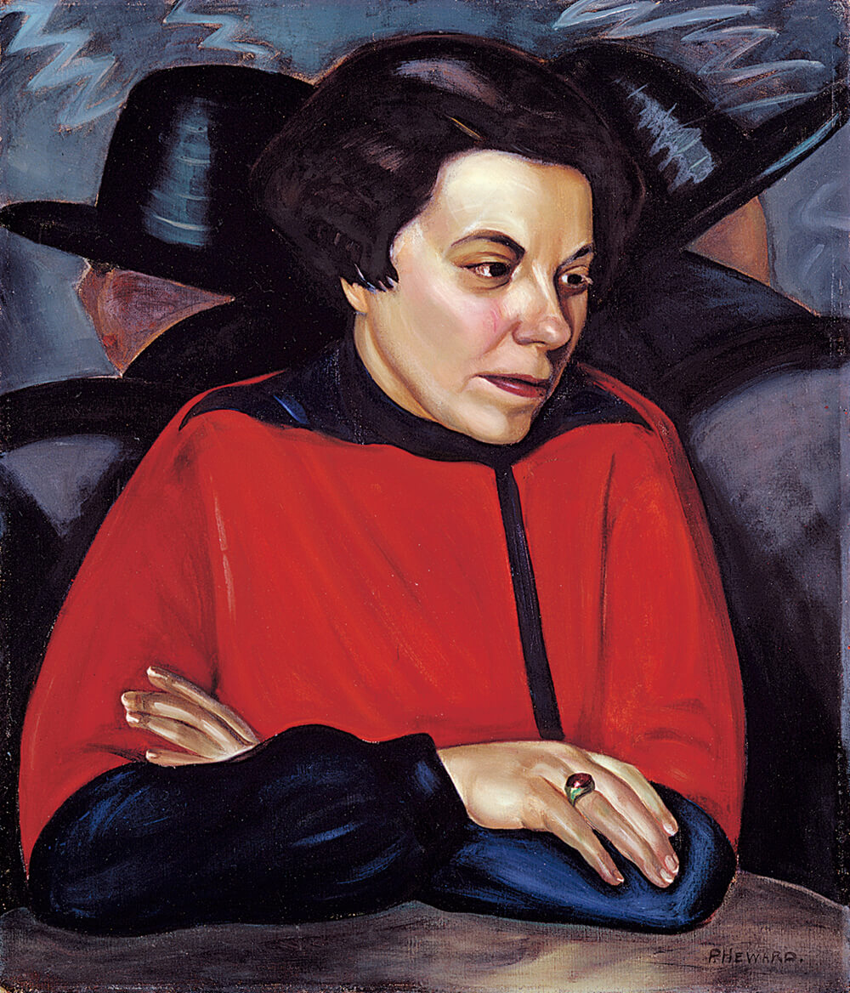
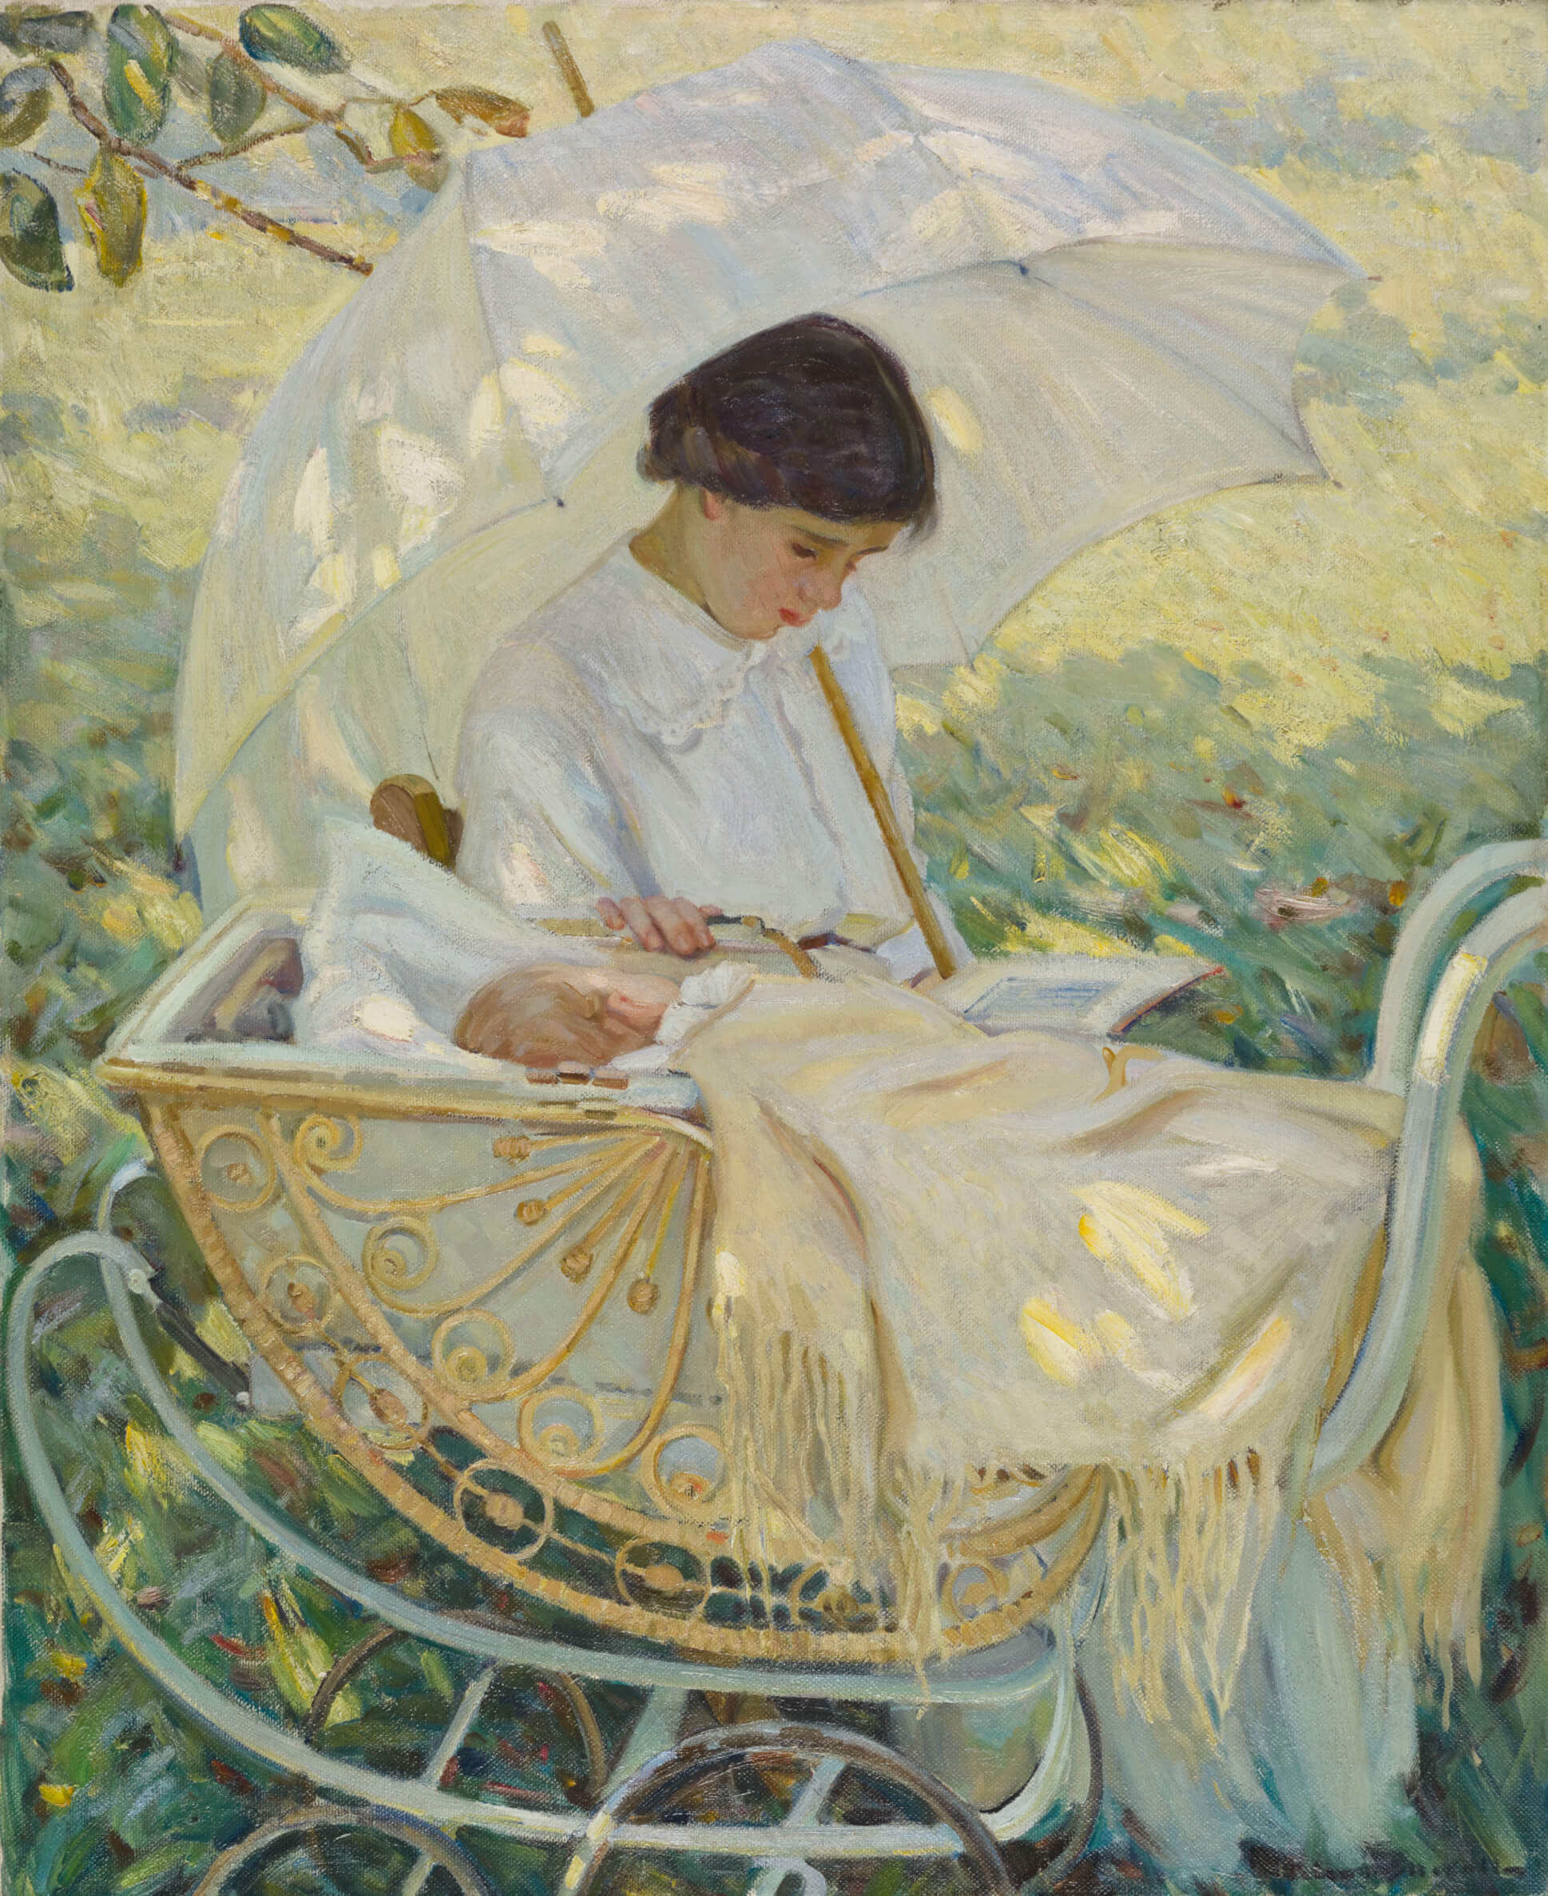
Learning Activity #1
Prudence Heward, At the Café (Miss Mabel Lockerby), c.1929.
Helen McNicoll, In the Shadow of the Tree, c.1914.

Slide 15
Prudence Heward, The Bather, 1930. The woman in this painting is not idealized. She wears a modern bathing costume, her cheeks are flushed or maybe sunburned from a day outside, and she stares challengingly at the viewer.

Slide 16
Prudence Heward, At the Café (Miss Mabel Lockerby), c.1929. Here Heward depicts her friend Mabel Lockerby out in the male-dominated public space of a lively café.

Slide 17
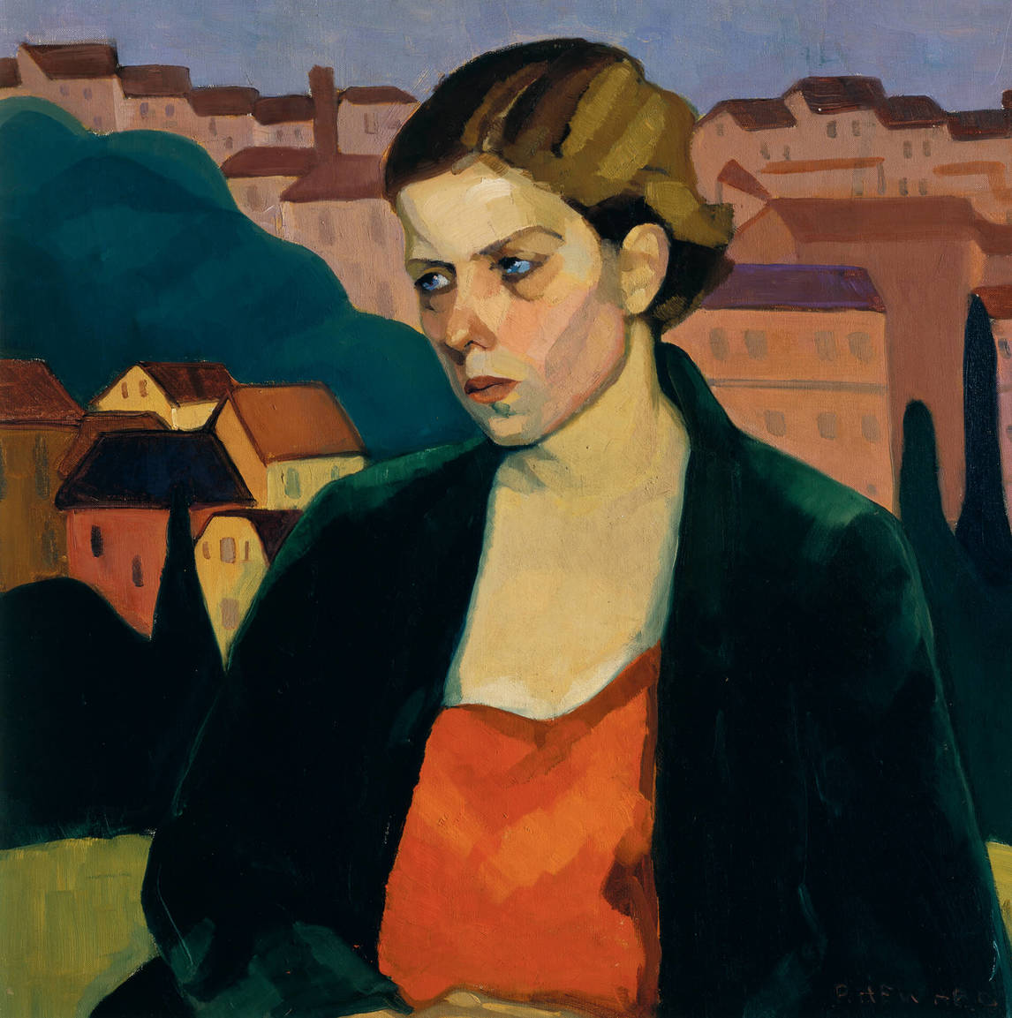
Prudence Heward, Tonina, 1928. The background of the painting closely resembles Heward’s Italian Town, c.1925, indicating that the subject, Tonina, may be an Italian woman.

Slide 18
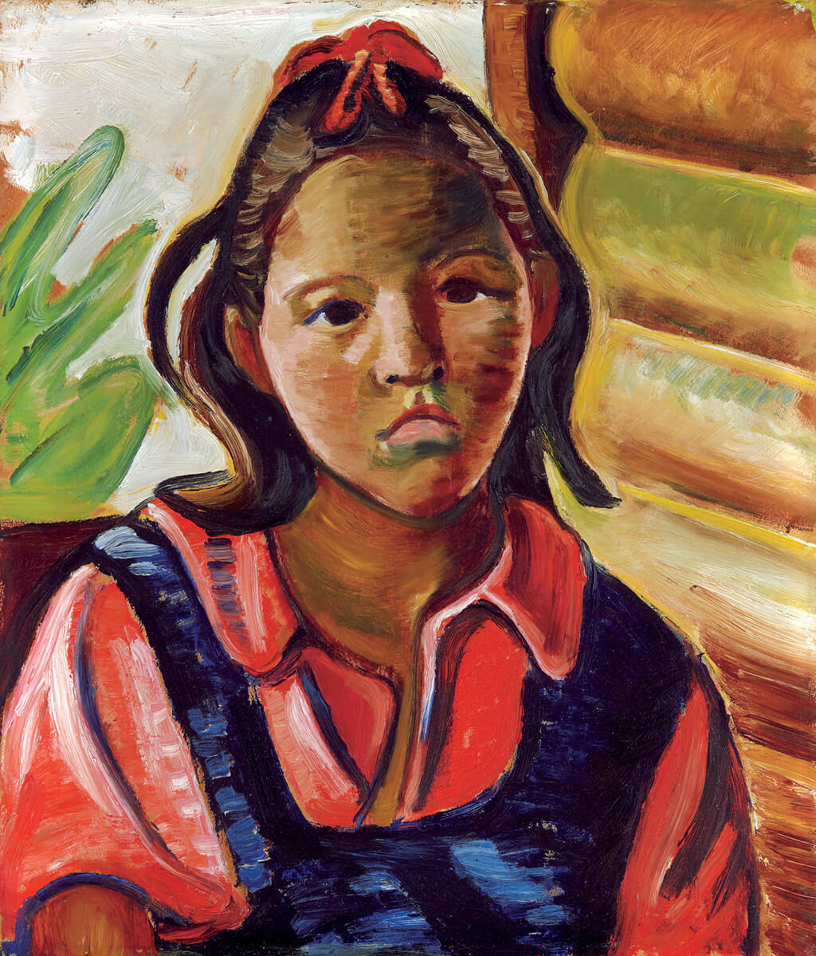
Learning Activity #2
Prudence Heward, Indian
Child, 1936. The child in the
painting is unidentified, and
little is known about Heward’s
relationship with her.

Slide 19
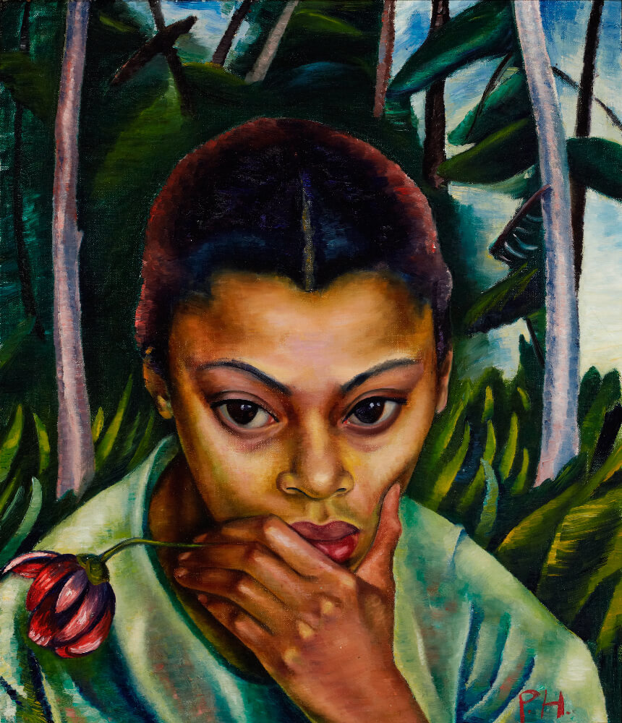
Learning Activity #2
Prudence Heward, Negress
with Flower, n.d. The black woman
in this painting pensively holds her
chin. She is set against a natural,
forested background.

Slide 20
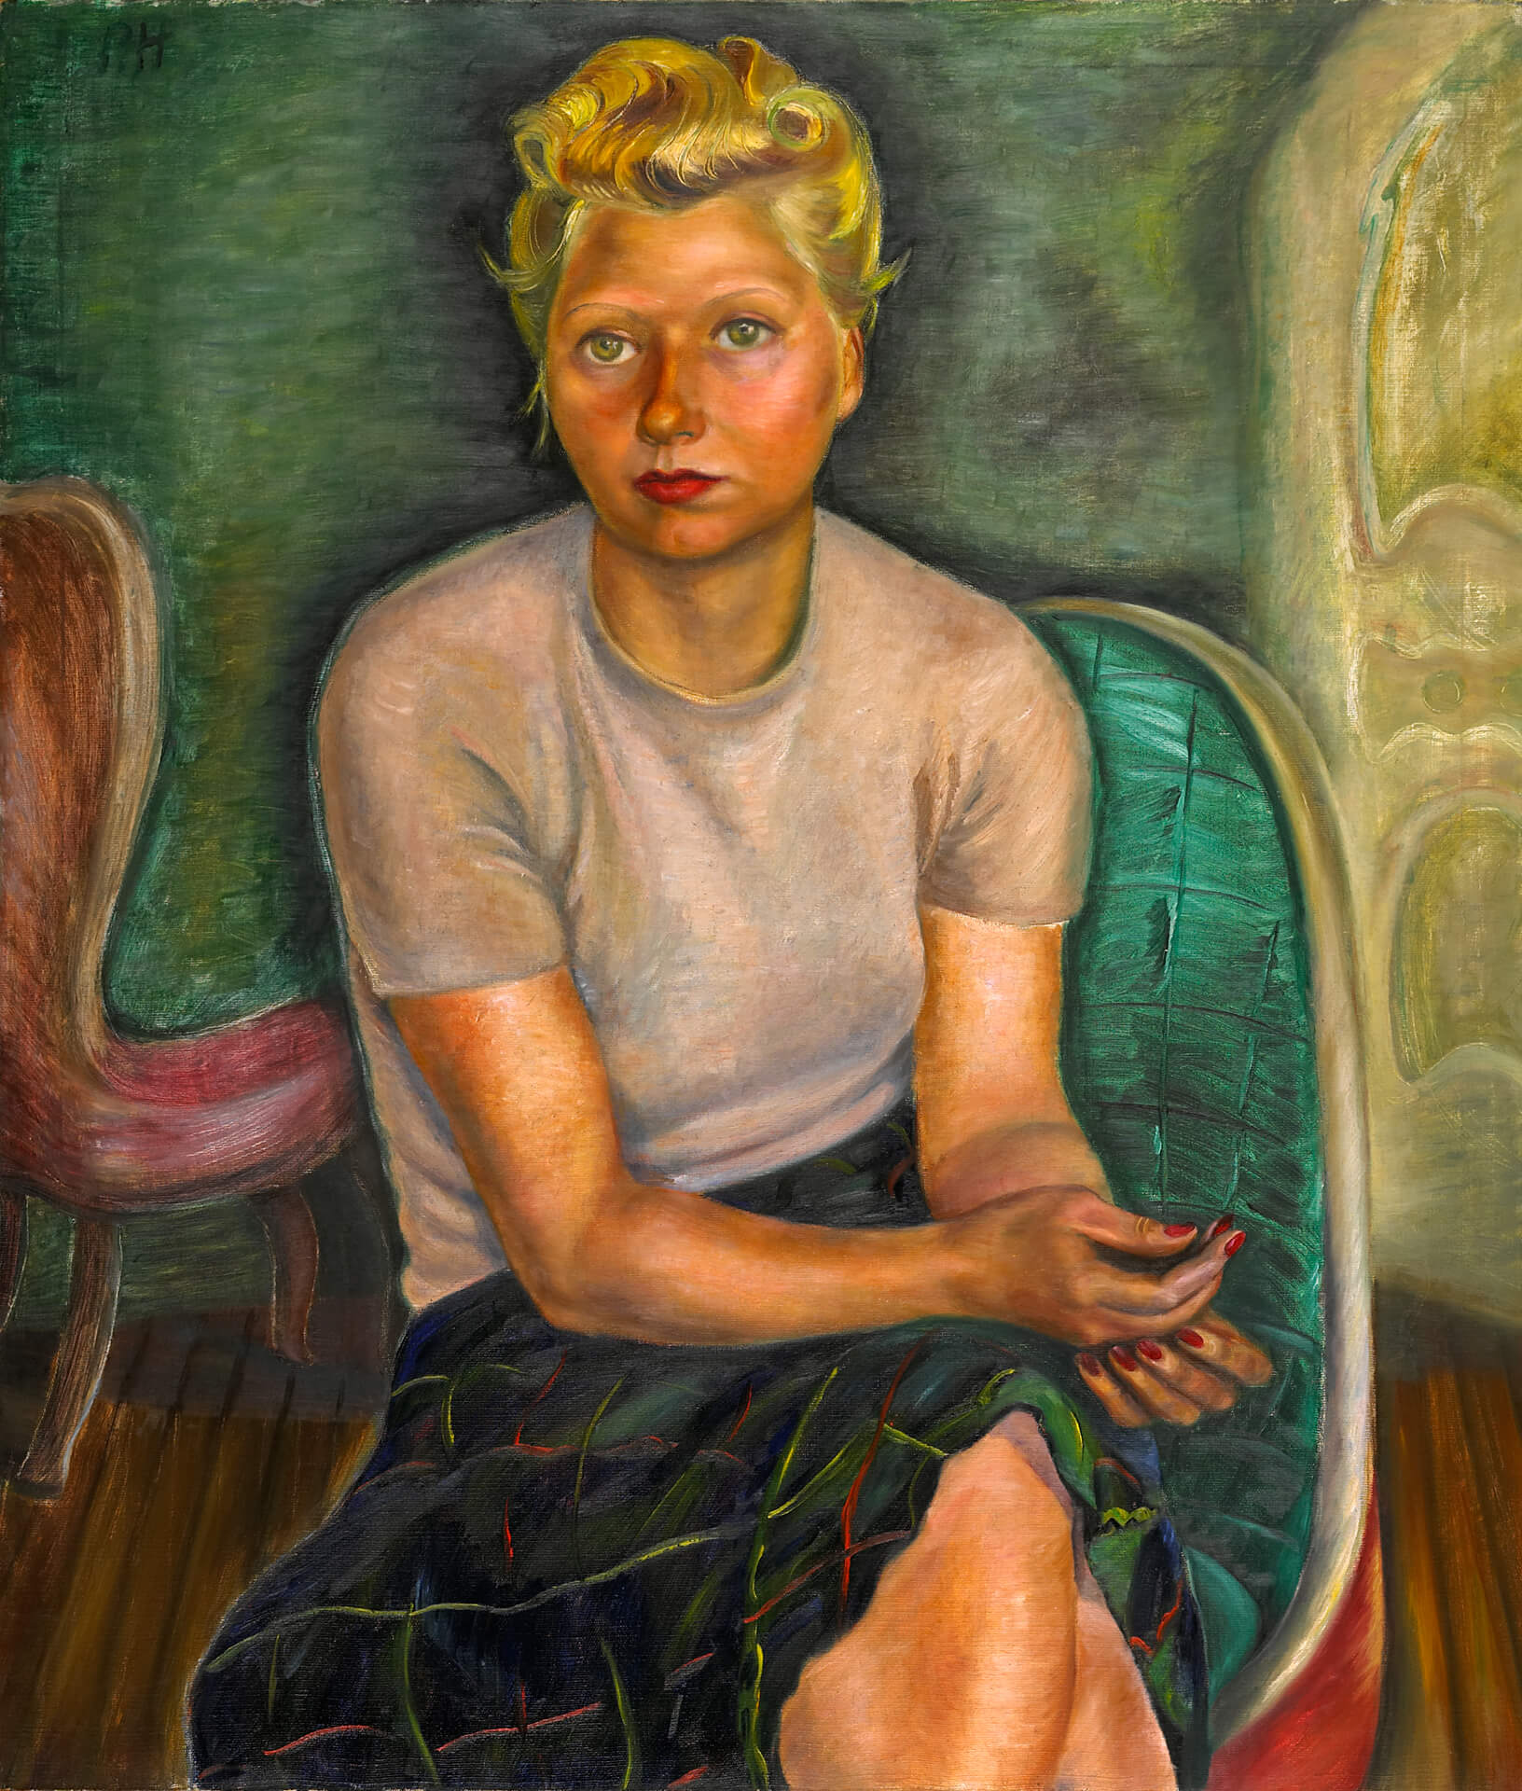
Learning Activity #2
Prudence Heward, Portrait
(Mrs. Zimmerman), 1943. The sitter’s red lipstick and nail polish identify her as a modern woman in a modern interior space.

Slide 21
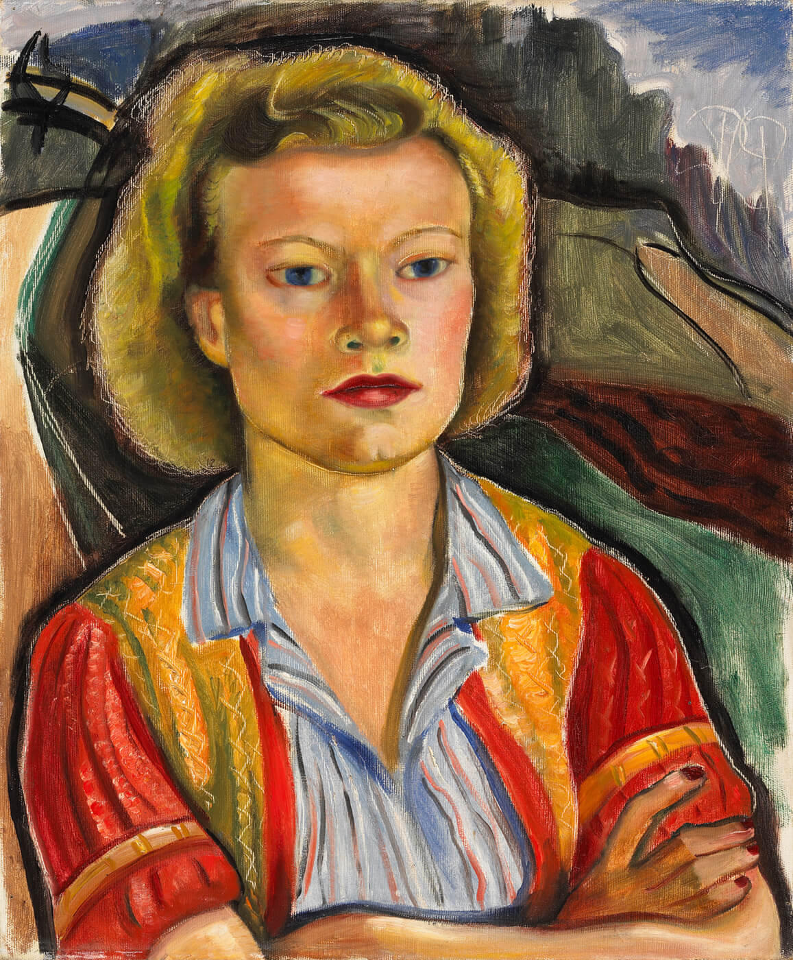
Learning Activity #2
Prudence Heward, Farmer’s
Daughter, 1945. Heward uses body language to convey defiance and strength.

Slide 22
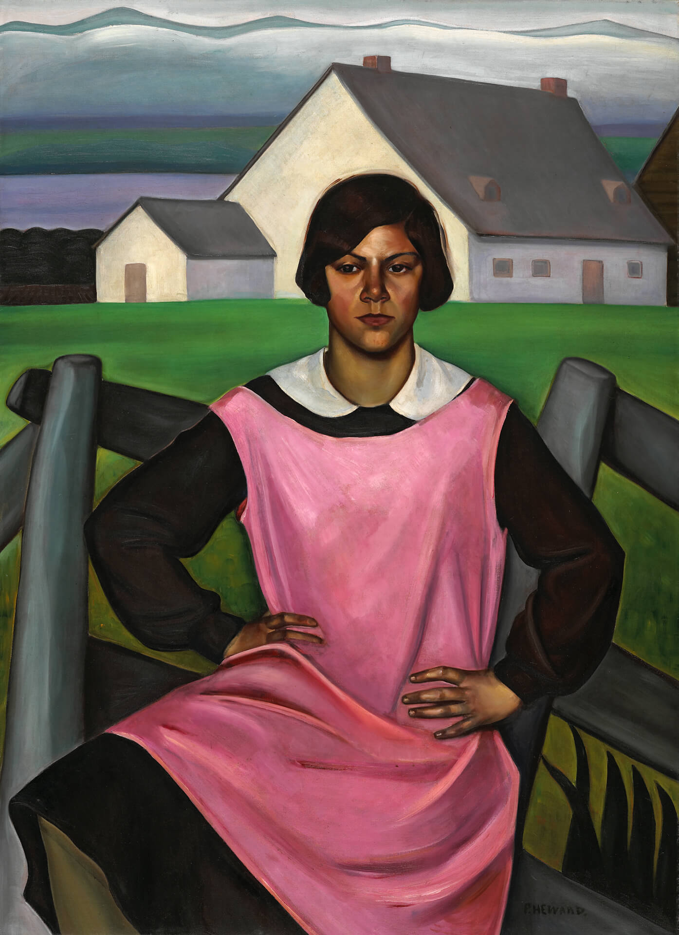
Prudence Heward, Rollande, 1929. This young woman stands with her hands placed firmly on her hips. The fence separating her from the house behind symbolically suggests she is turning her back on the past.

Slide 23
Culminating Task
Prudence Heward, At the Café (Miss Mabel Lockerby), c.1929. Here Heward depicts her friend Mabel Lockerby out in the male-dominated public space of a lively café.

Slide 24
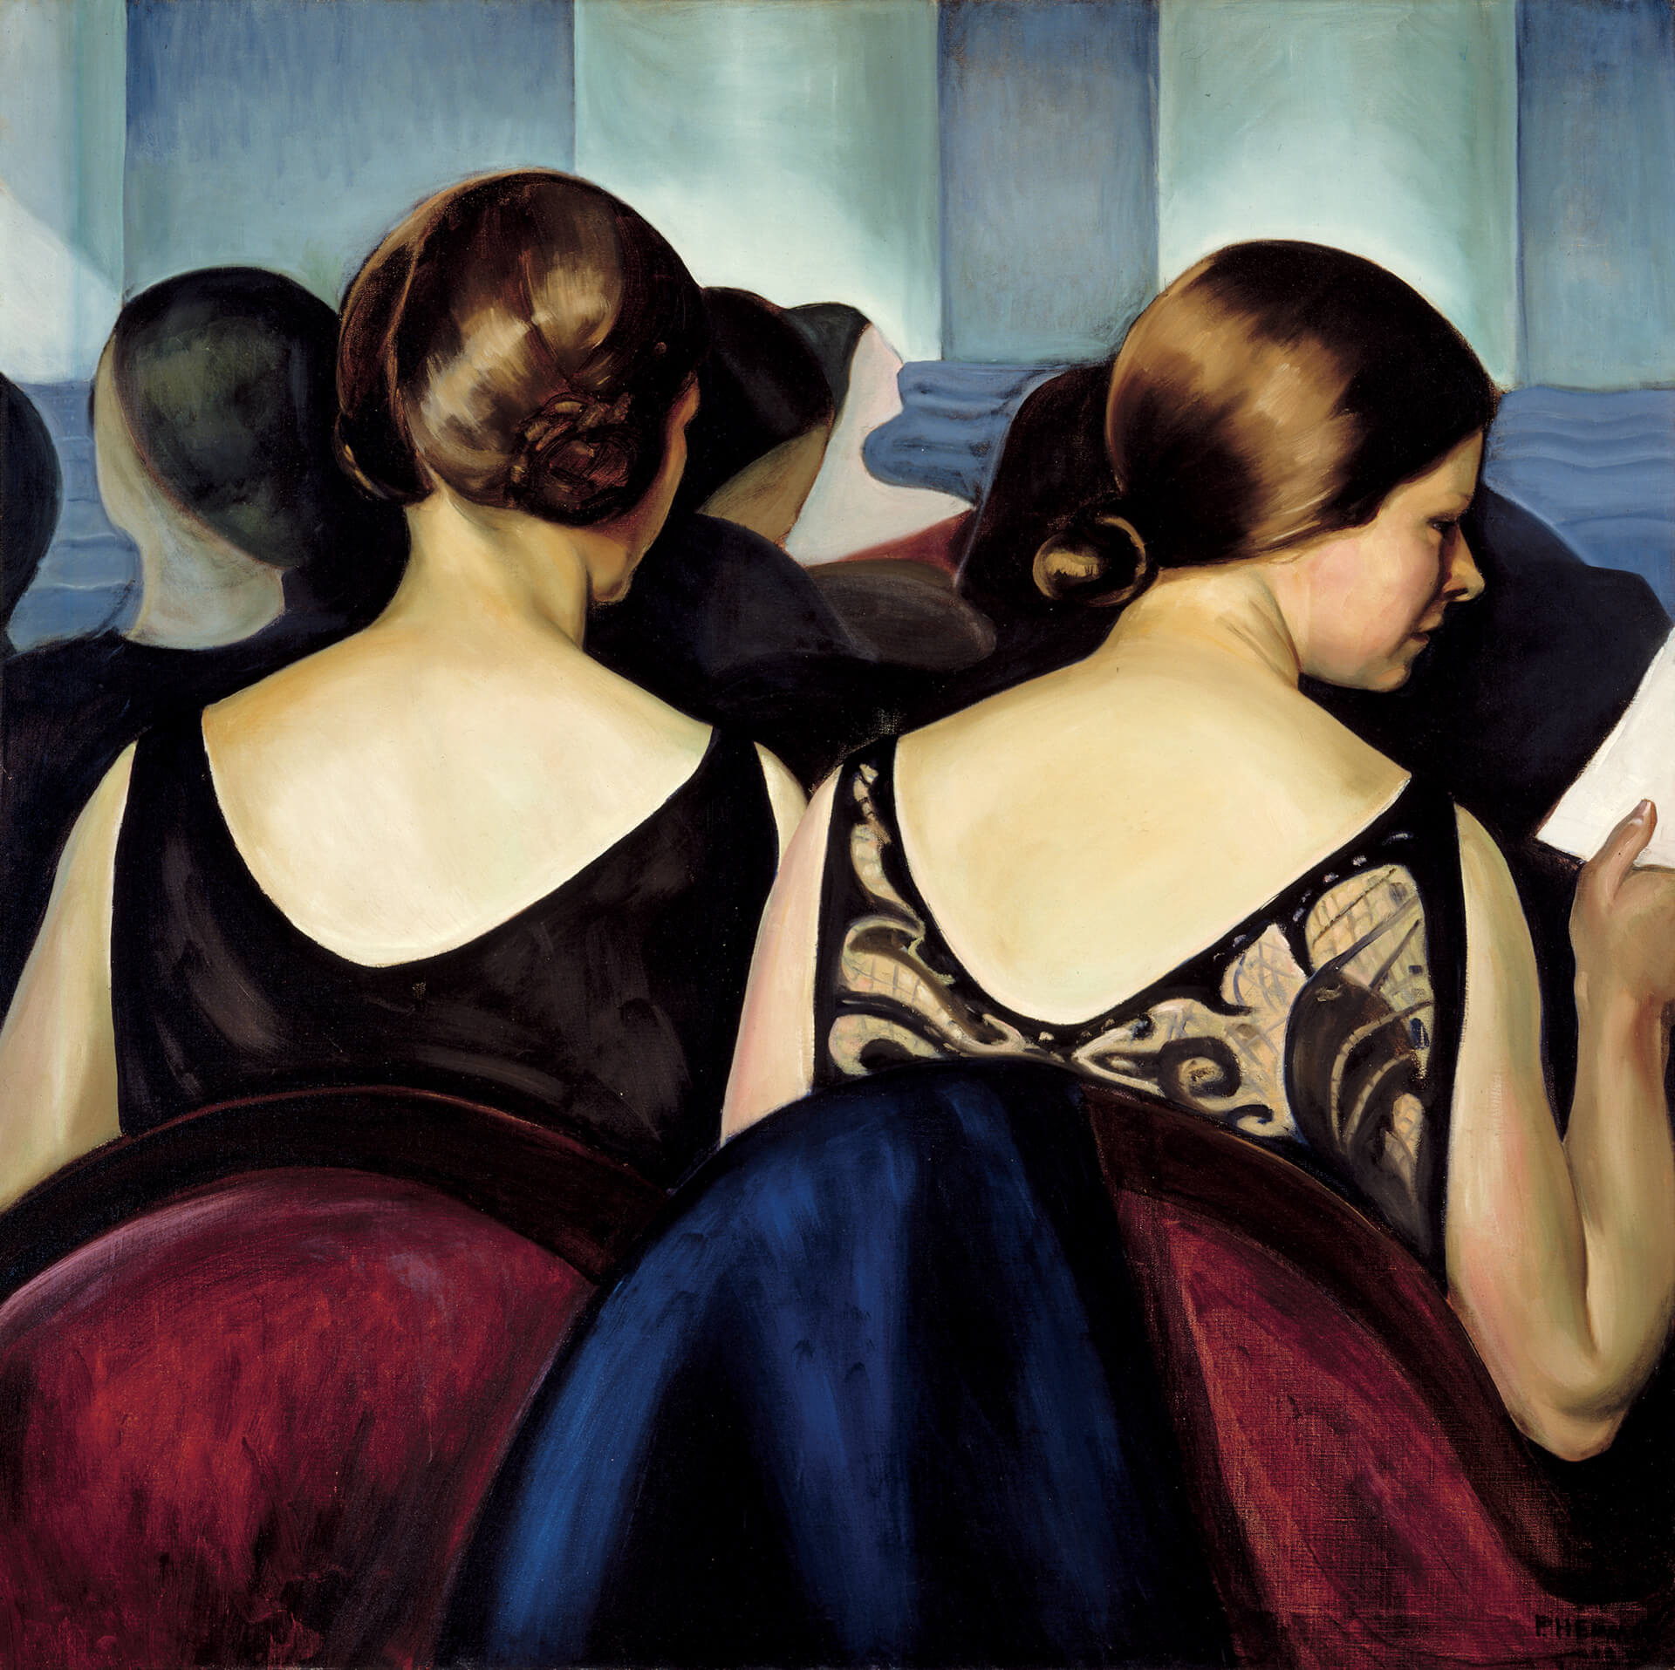
Culminating Task
Prudence Heward, At the Theatre, 1928. The women in this painting are dressed for an elegant night out at the theatre.

Slide 25
Culminating Task: Examples

Slide 26
Culminating Task: Examples

Slide 27
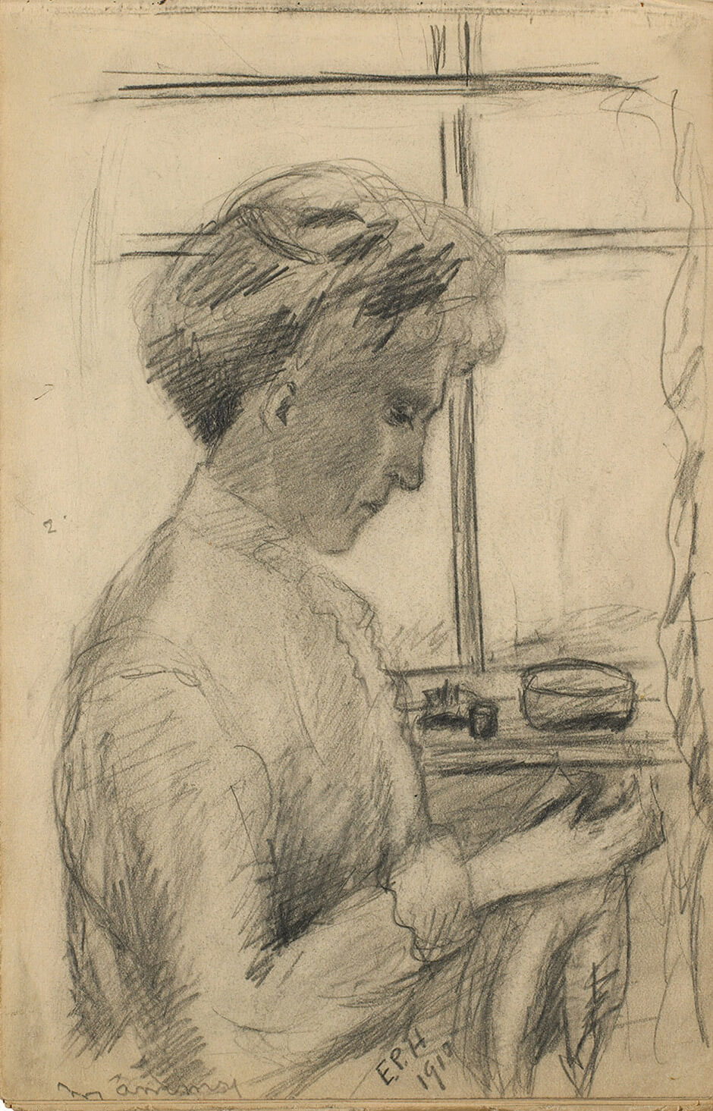
Prudence Heward, Mommsy, 1910. An early sketch by the artist of her mother.

Slide 28
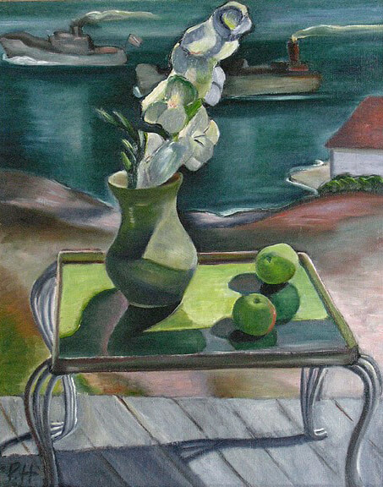
Prudence Heward, A Summer Day, 1944. In this painting Heward displays the apples and flowers against an outdoor background, which was unusual for still lifes.

Slide 29
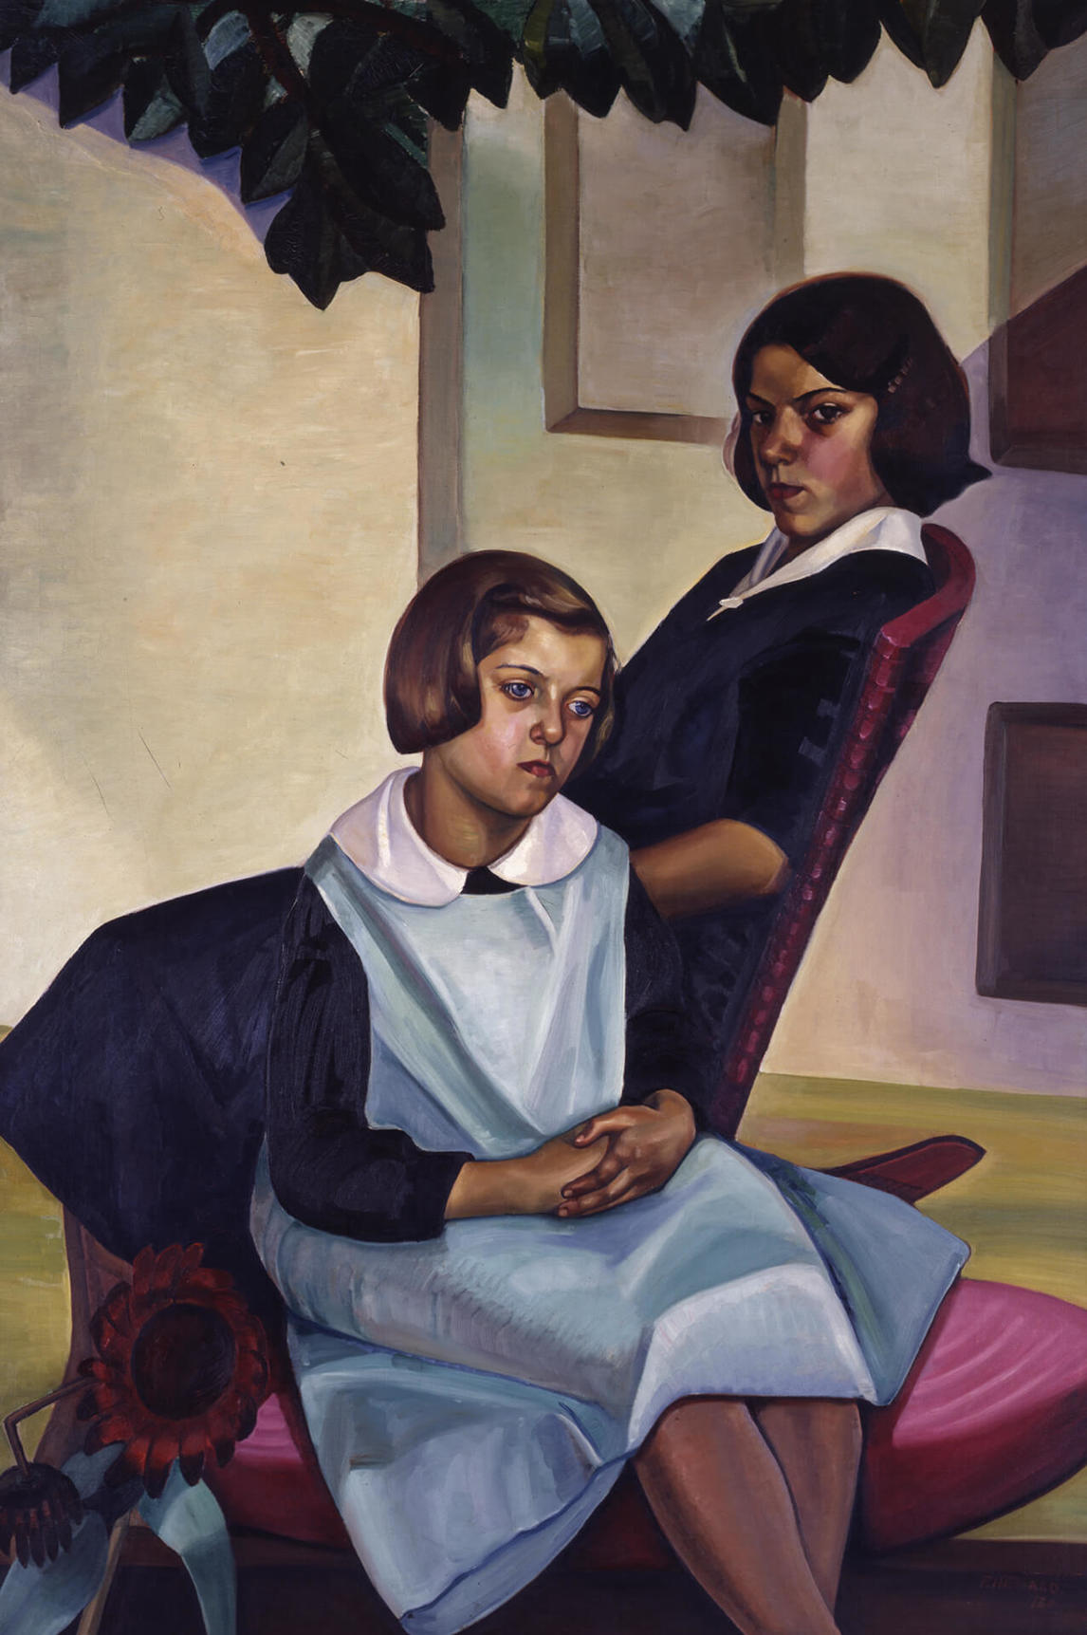
Prudence Heward, Sisters of Rural Quebec, 1930. The sharp angles in this painting show influence from Art Deco.

Slide 30
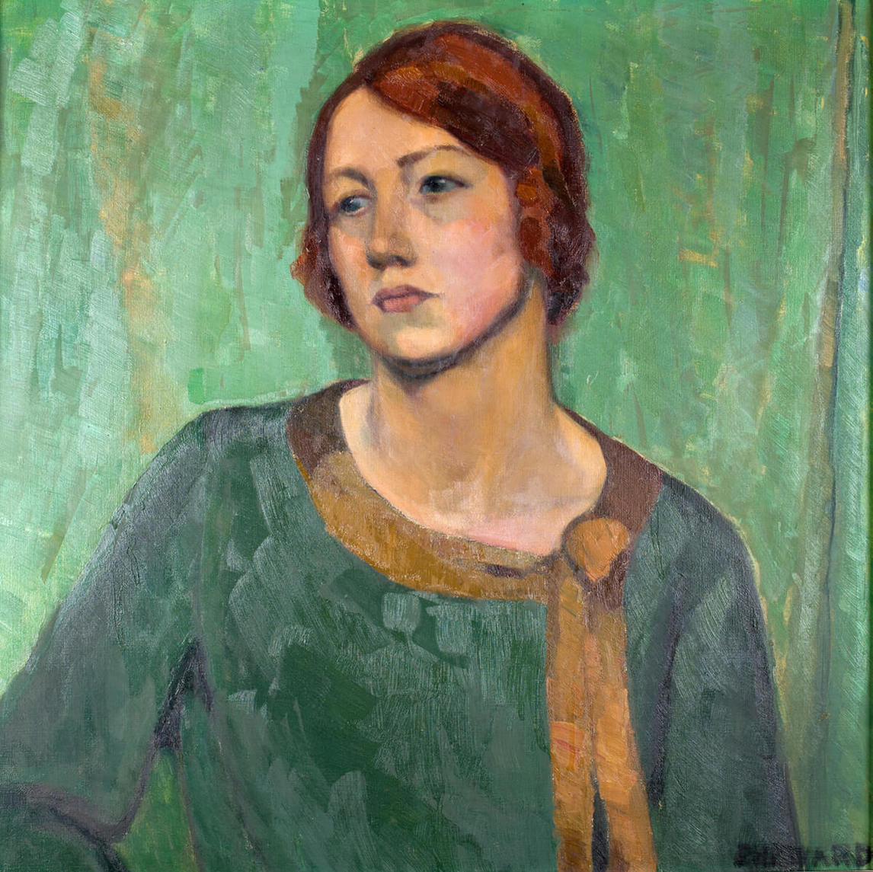
Prudence Heward, Eleanor, 1924. In this painting Heward’s friend is depicted as a solitary figure outside of the traditional domestic setting for women. She defines herself.

Slide 31
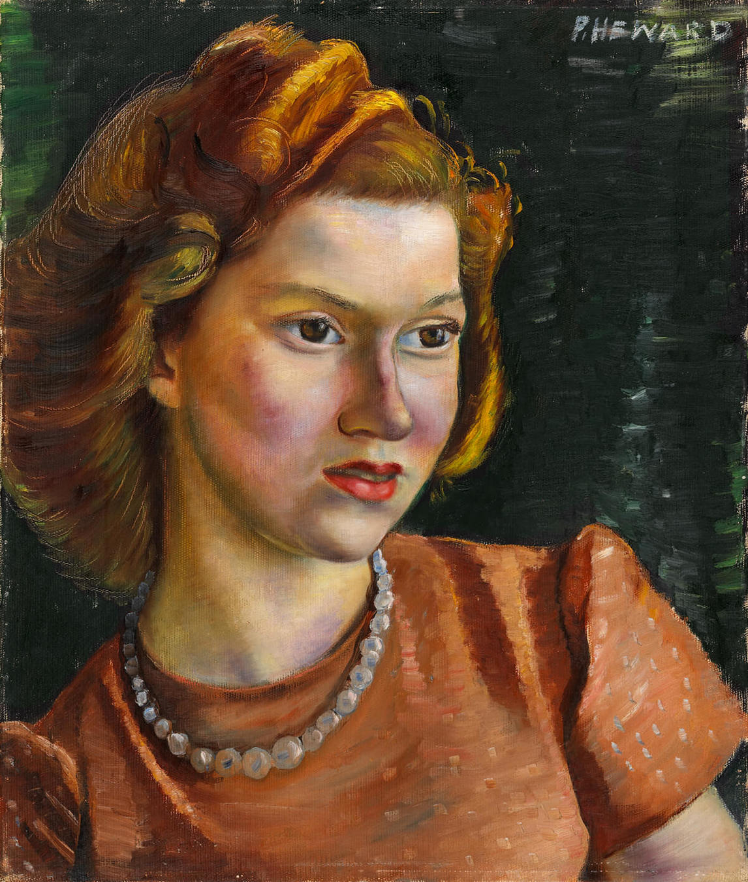
Prudence Heward, Ann, 1942. Heward often painted bust portraits of solitary, serious women.

Slide 32
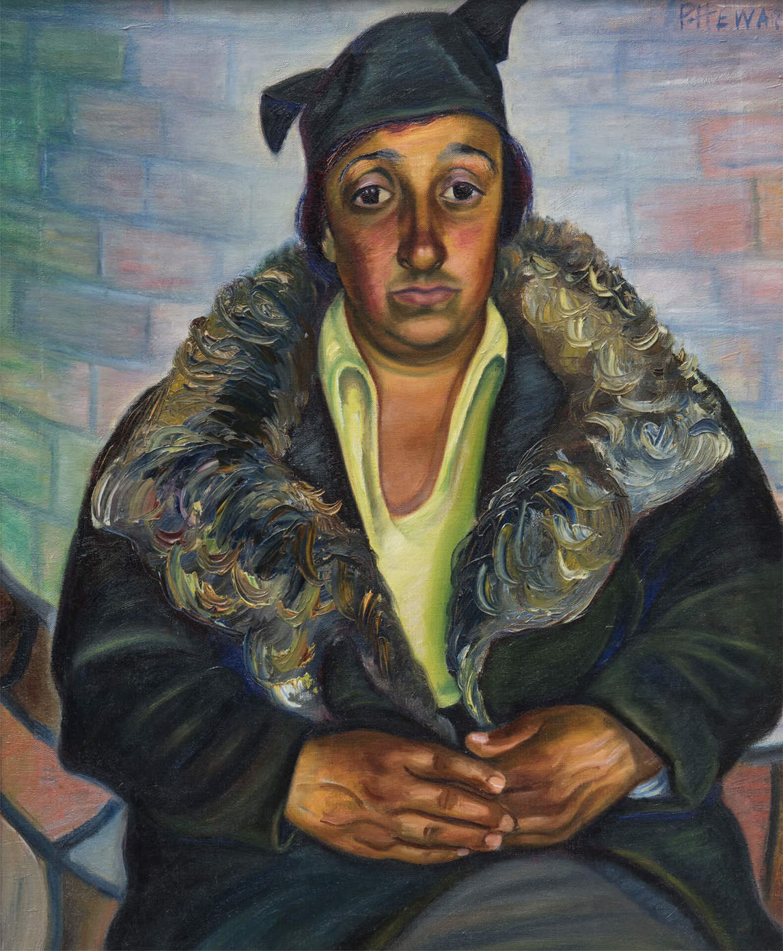
Prudence Heward, Italian Woman, c.1930. Heward’s women do not aim to please the viewer with passive smiles or soft glances.

