Slide 2
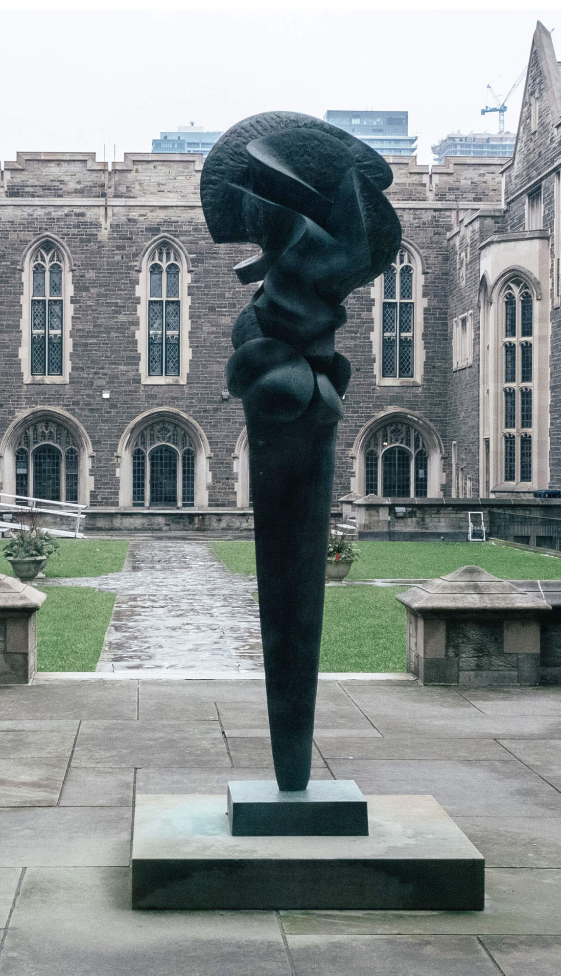
Sorel Etrog, Complexes of a Young Lady, 1962. A perfect example of one of Etrog’s biomorphic sculptures, this work was inspired by organic forms.

Slide 3
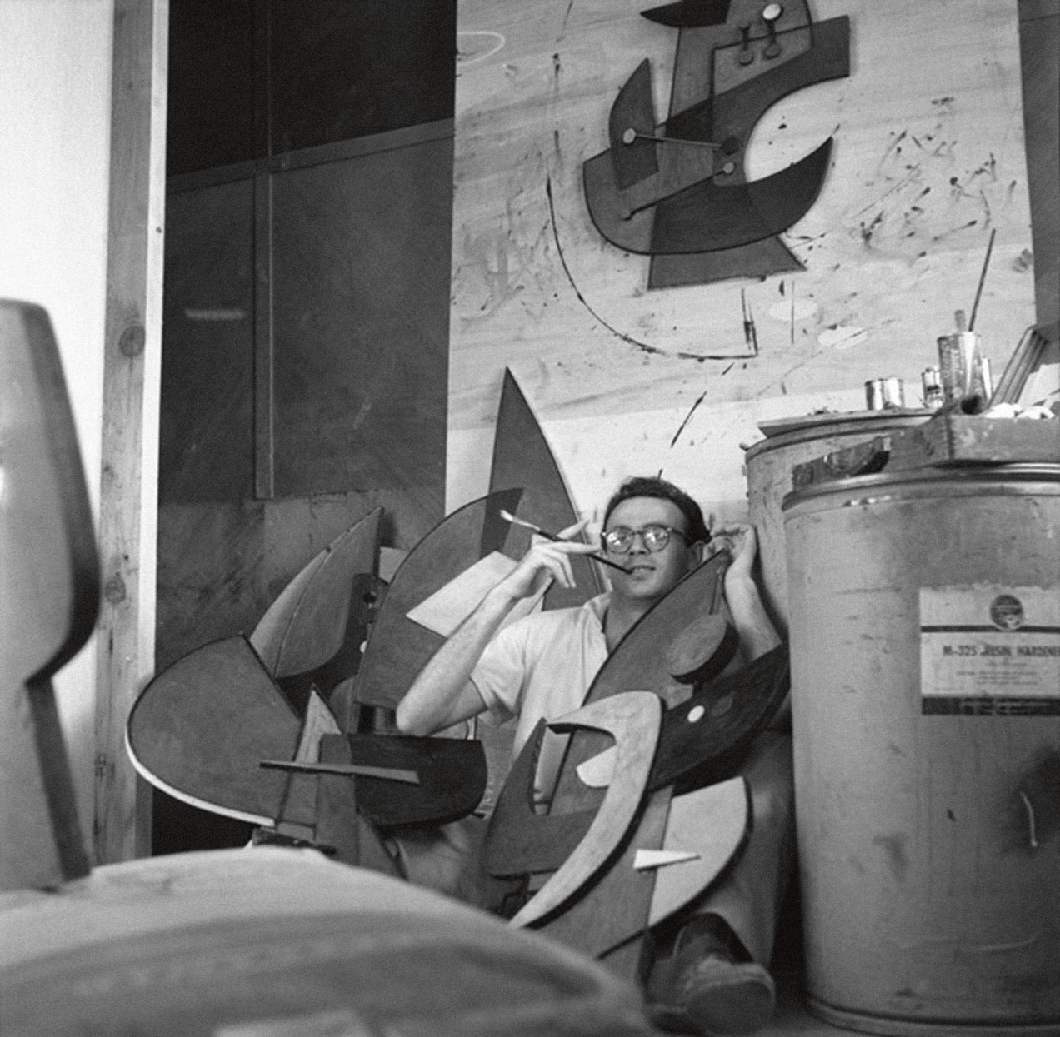
Sorel Etrog at the Zacks’ Southampton Wood Workshop, 1959.

Slide 4
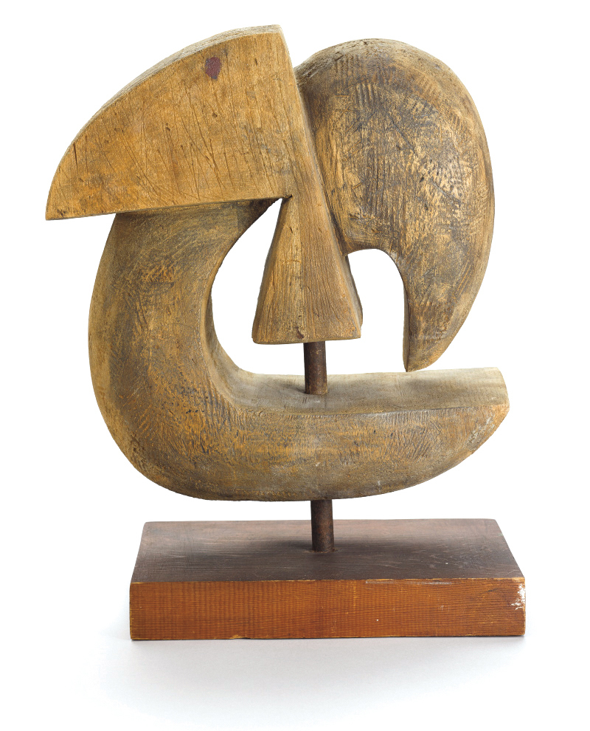
Sorel Etrog, The Golem, 1959. This wood carving is one of Etrog’s earliest sculptures.

Slide 5
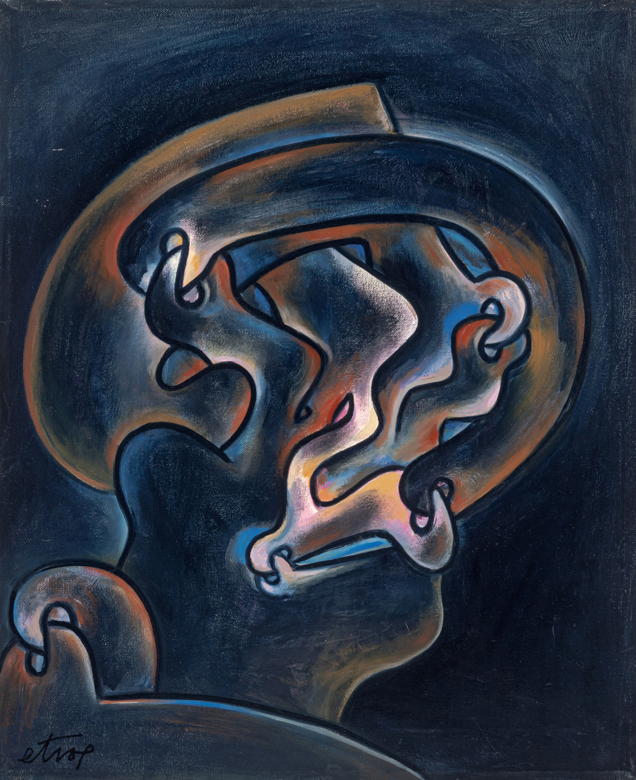
Sorel Etrog, Night Spirit, 1969–70. Like several of Etrog’s sculptures, this painting uses a link motif.

Slide 6
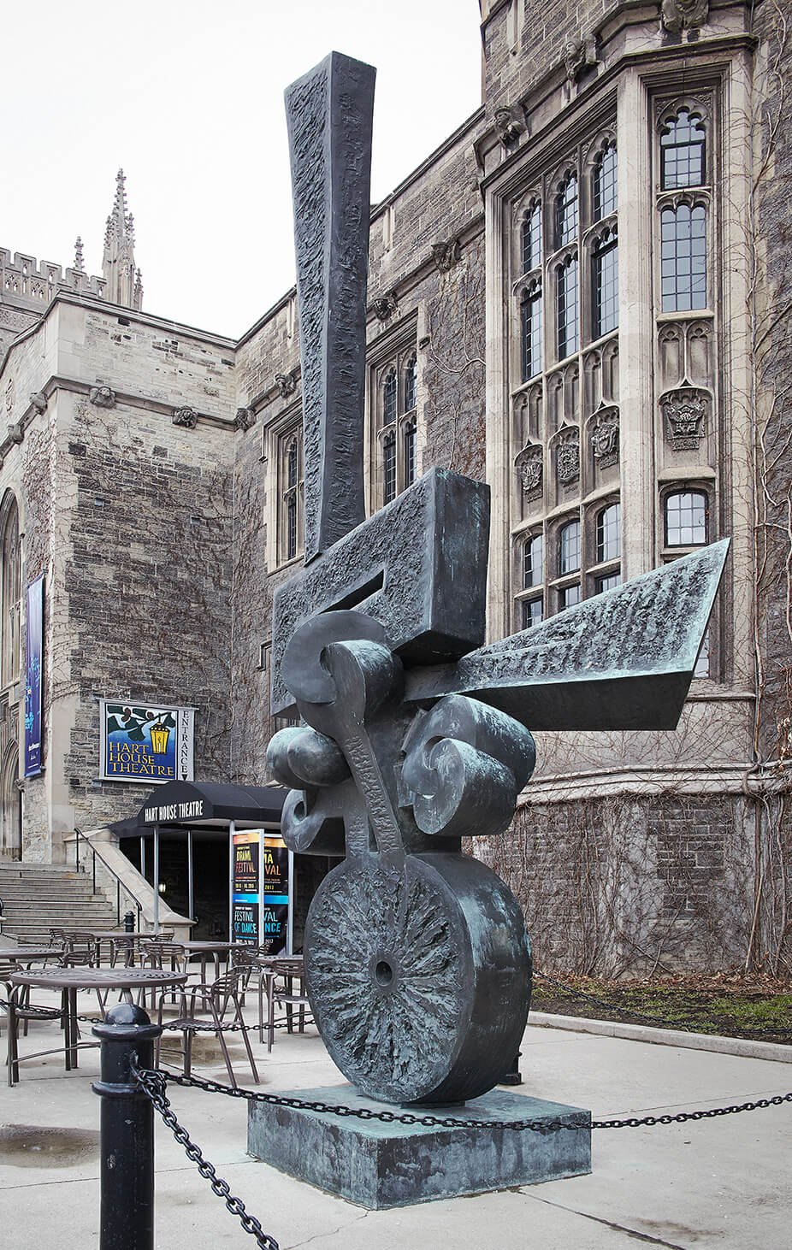
Sorel Etrog, Survivors Are Not Heroes, 1967. Here Etrog has created a visual metaphor for the emotions that stem from traumatic experiences of war.

Slide 7
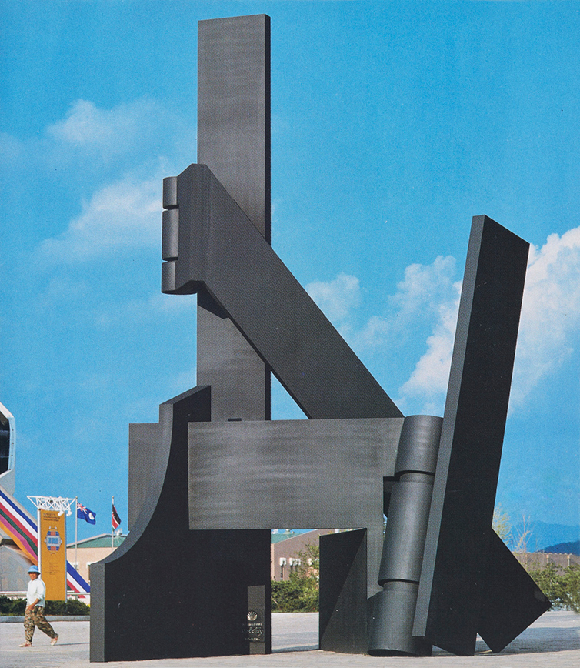
Sorel Etrog, Powersoul, 1988. Etrog created this enormous steel sculpture for the 1988 summer Olympics in Seoul, South Korea.

Slide 8
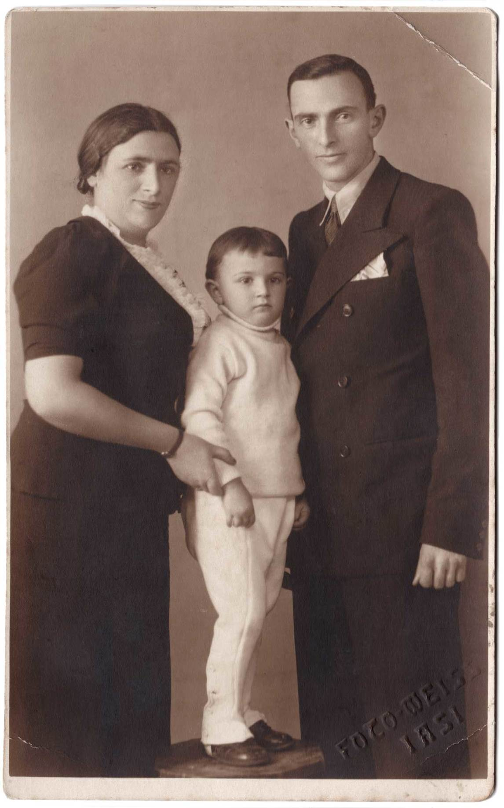
Sorel with parents Tony and Moriţ, c.1936.

Slide 9
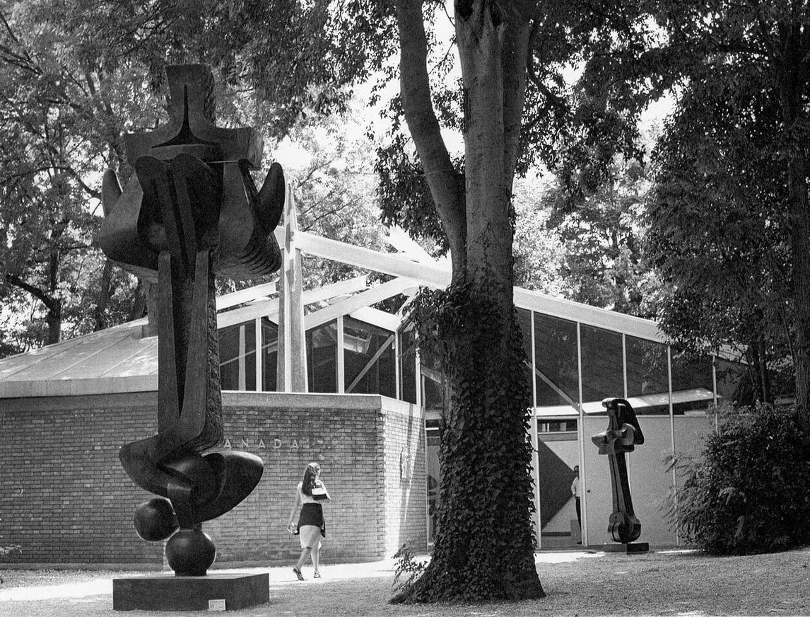
Canadian Pavilion in Venice with Moses, 1963–65 (foreground), and Mother and Child, 1960–62 (background), 1966.

Slide 10
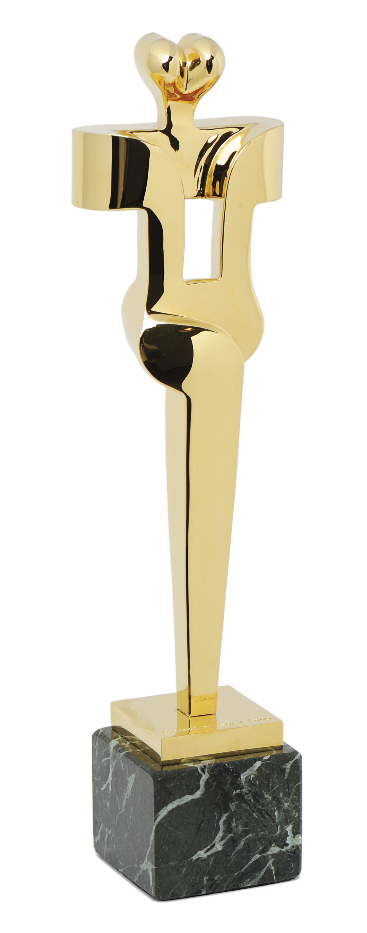
The Canadian Film Award, renamed the “Genie” in 1980.

Slide 11
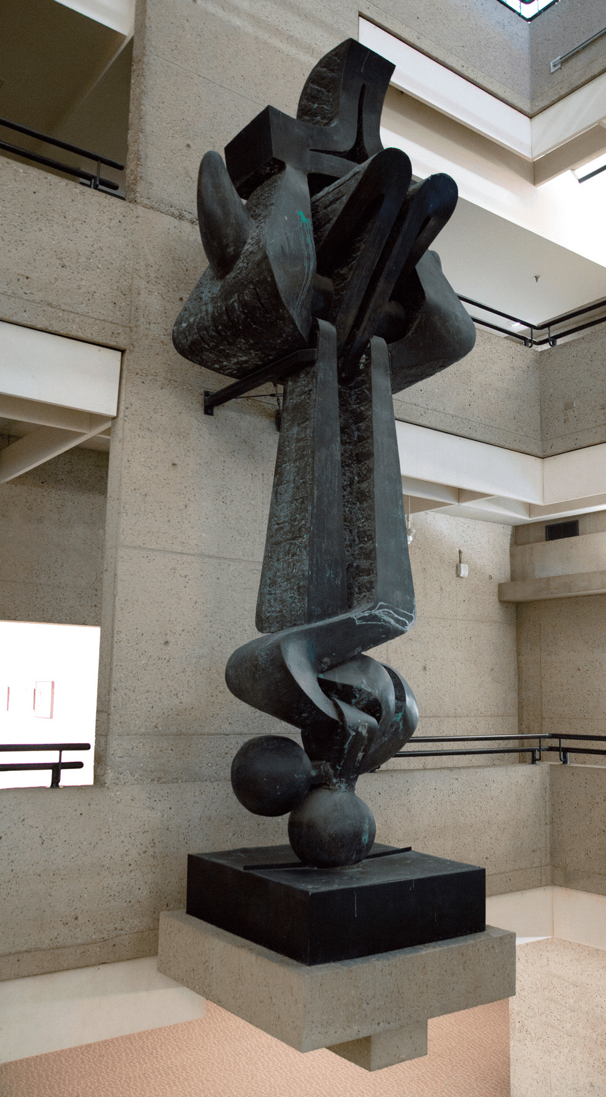
Learning Activity #1
Sorel Etrog, Moses, 1963–65. This sculpture is abstract, but its title refers to the Jewish prophet.

Slide 12
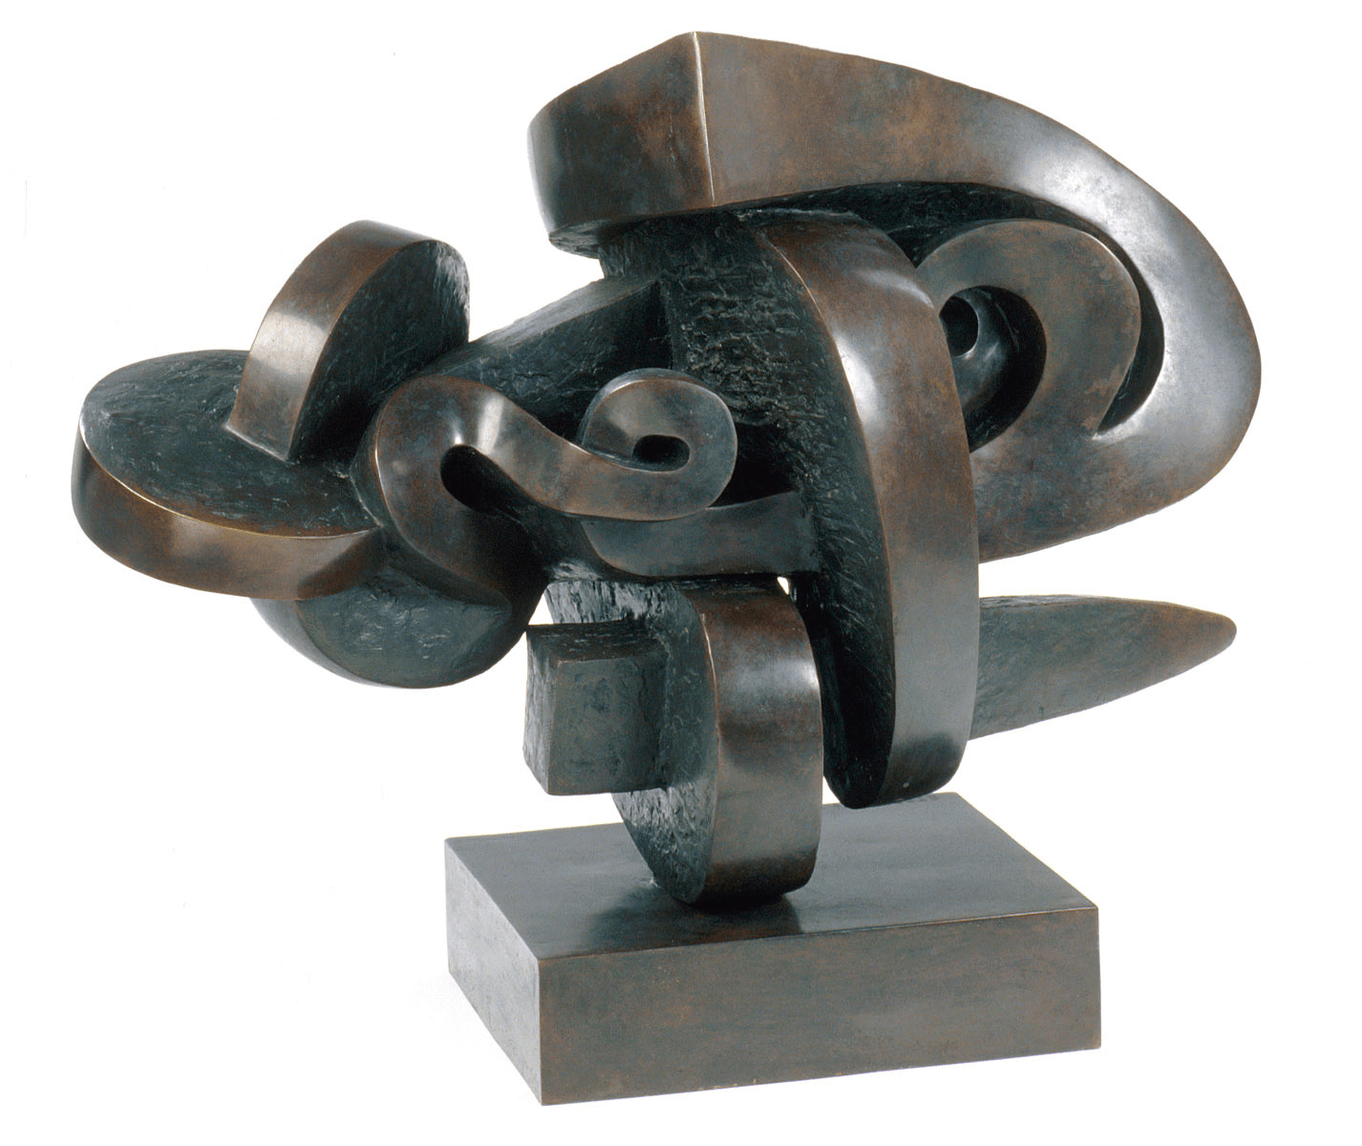
Learning Activity #1
Sorel Etrog, War Remembrance II, 1960–61. In this work, Etrog experimented with circular motifs and rounded spirals.

Slide 13
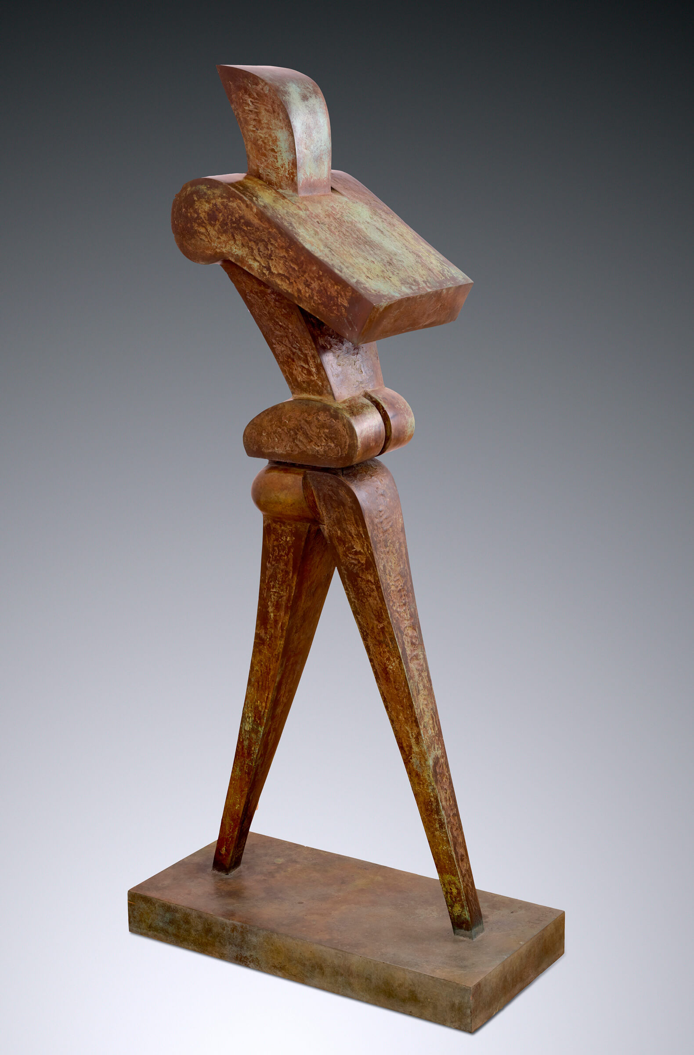
Learning Activity #2
Sorel Etrog, Rushman, 1974–76. The structure of this work gives the impression of a rushed walking pace.

Slide 14
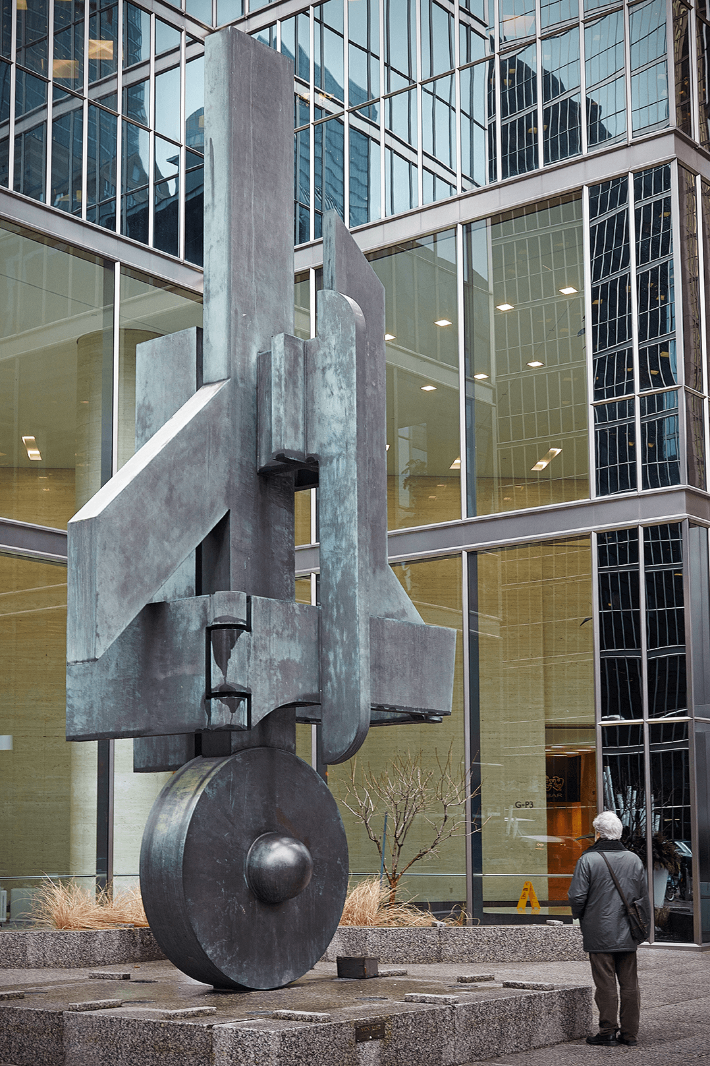
Learning Activity #2
Sorel Etrog, Sun Life, 1984. Sun Life is an enormous sculpture installed at the northeast corner of the busy Toronto intersection of King Street and University Avenue.

Slide 15
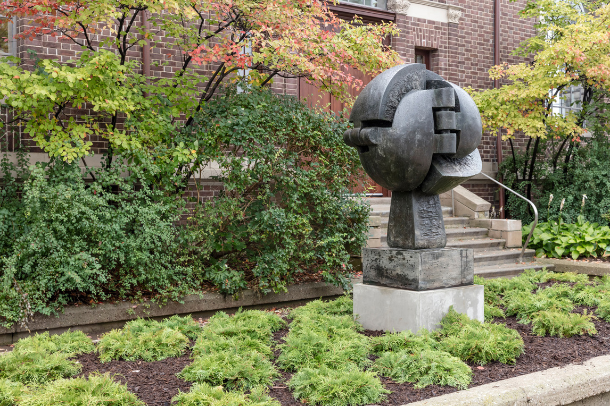
Learning Activity #2
Sorel Etrog, Dream Chamber, 1976. This sculpture is a globe whose surface is composed of several hinged doors.

Slide 16
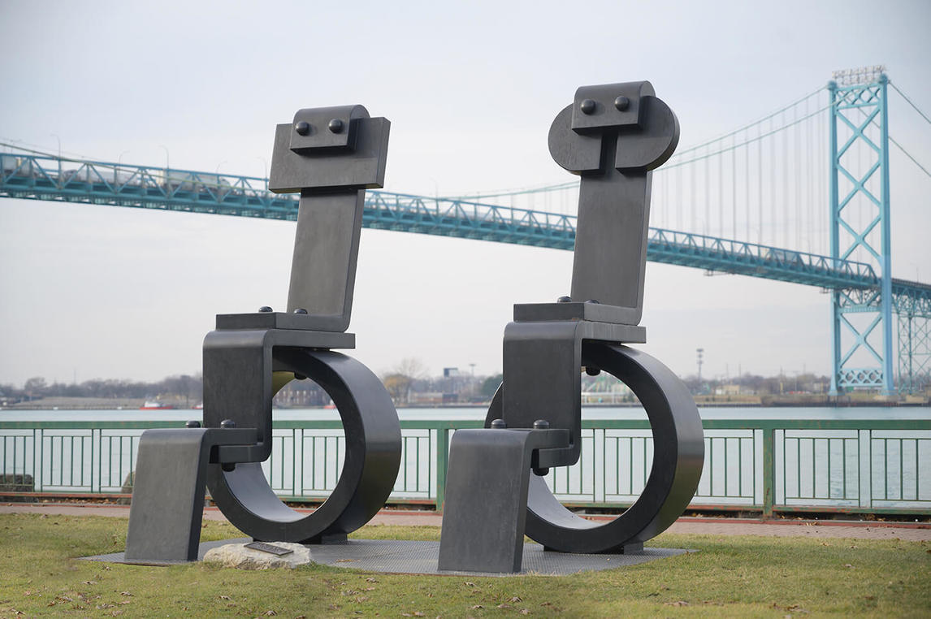
Sorel Etrog, King and Queen, 1990. This sculpture was displayed in Harbour Green Park, Coal Harbour, Vancouver, as part of the 2005 Biennale.

Slide 17
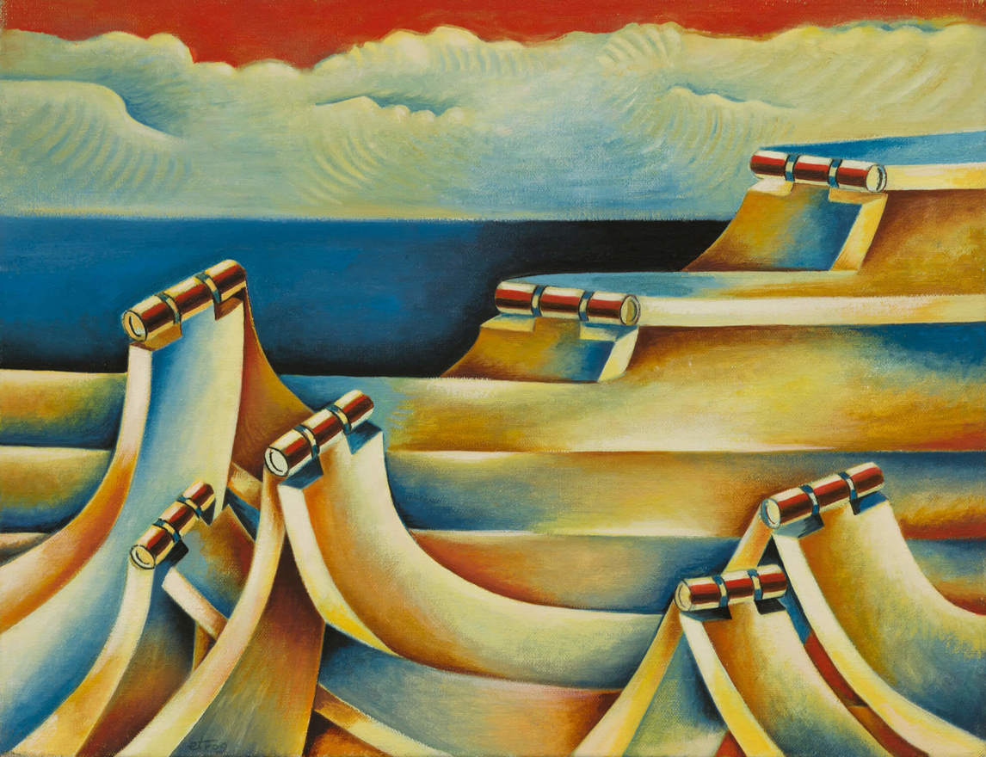
Sorel Etrog, Macrowaves, 1974–75. This seascape features meticulous depictions of hinges.

Slide 18
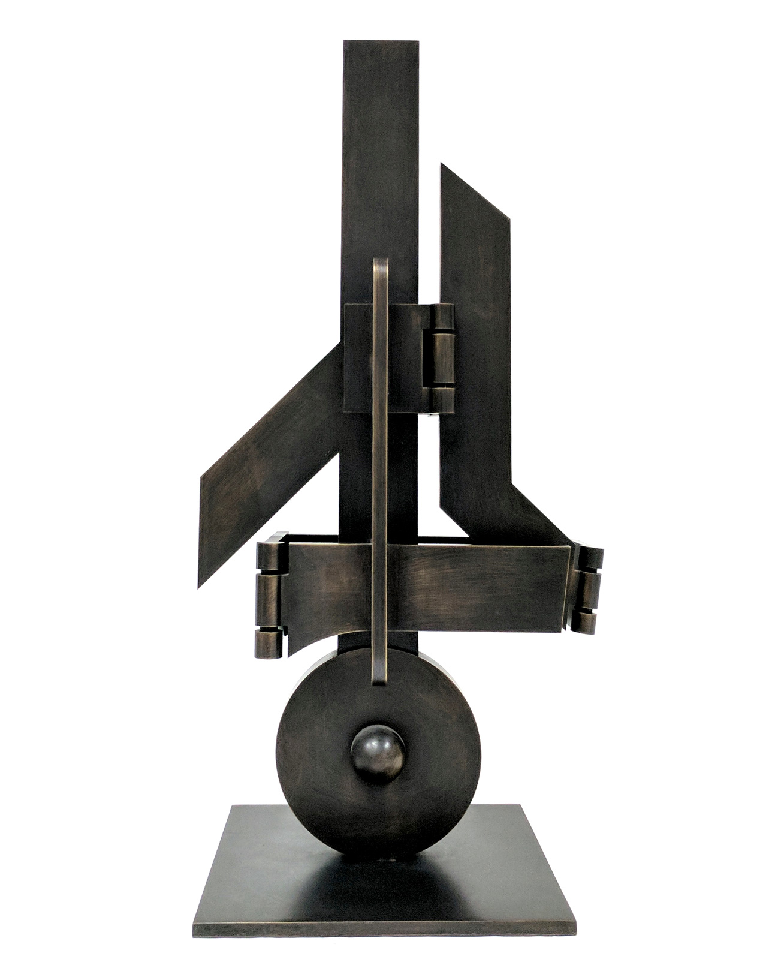
Sorel Etrog, Sun Life Study, 1984. This study is only 38.1 cm high—the final sculpture is over twenty times taller.

Slide 19
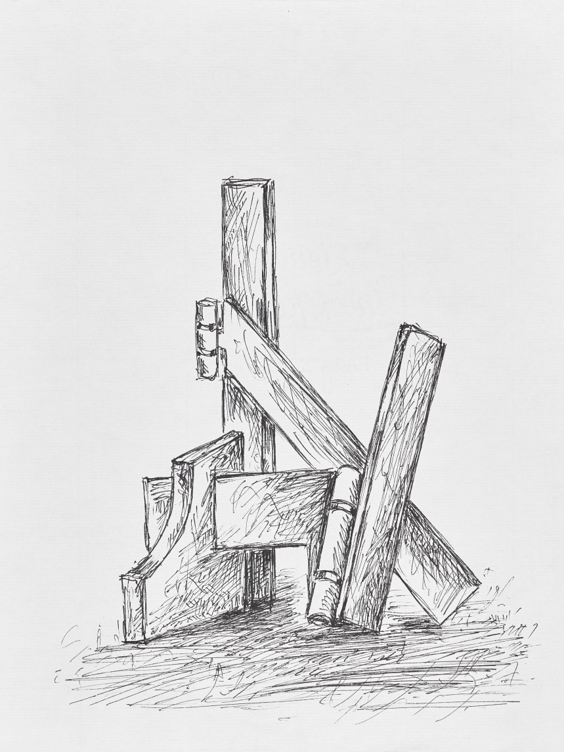
Sorel Etrog, sketch for Powersoul, c.1988. Through drawing, Etrog worked out his ideas for sculptures.

Slide 20
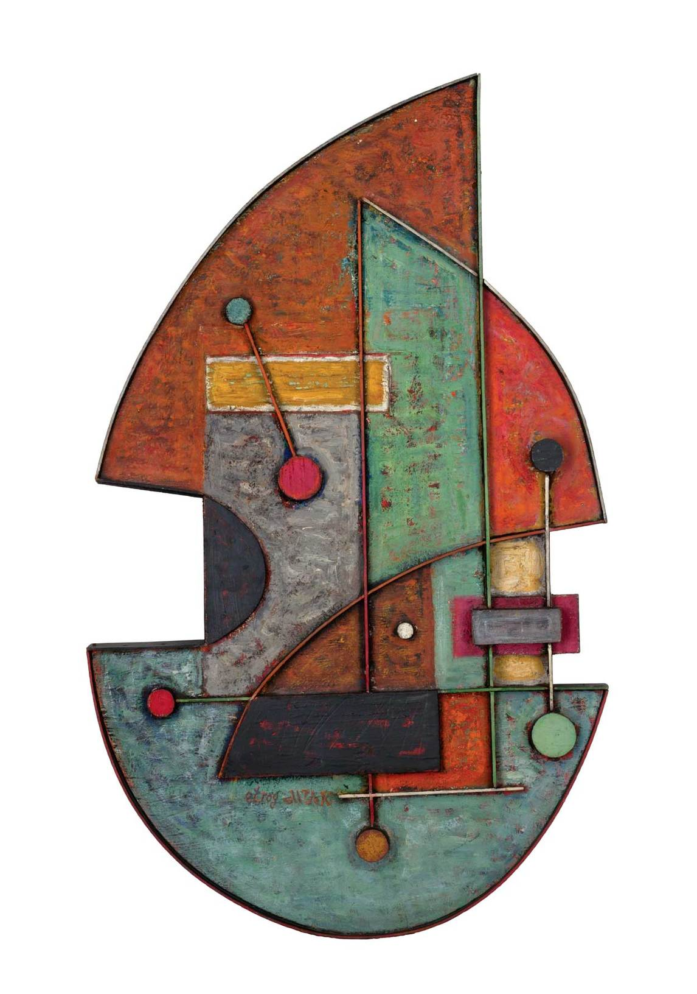
Sorel Etrog, Musical Impression, 1956. Etrog’s painted constructions are in between paintings and sculptures: they are largely flat, but they have three-dimensional elements.

Slide 21
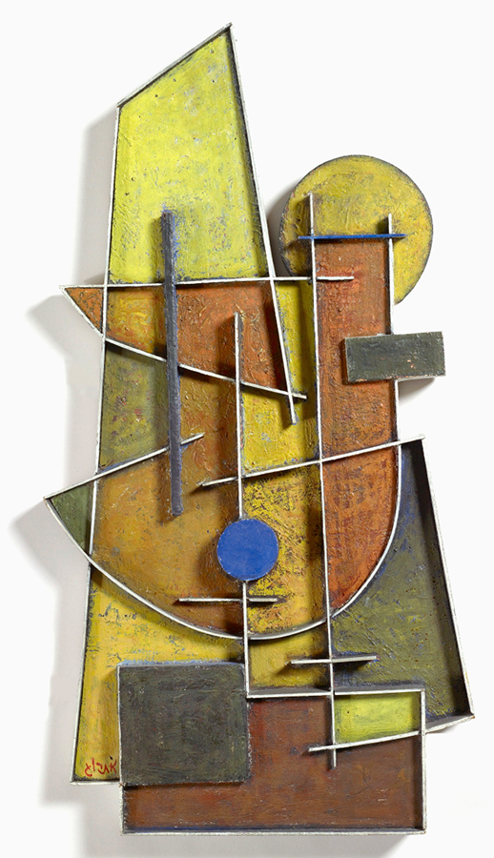
Sorel Etrog, White Scaffolding, 1958. In this work Etrog assembled several geometric forms, including rectangles, triangles, and circles.

Slide 22
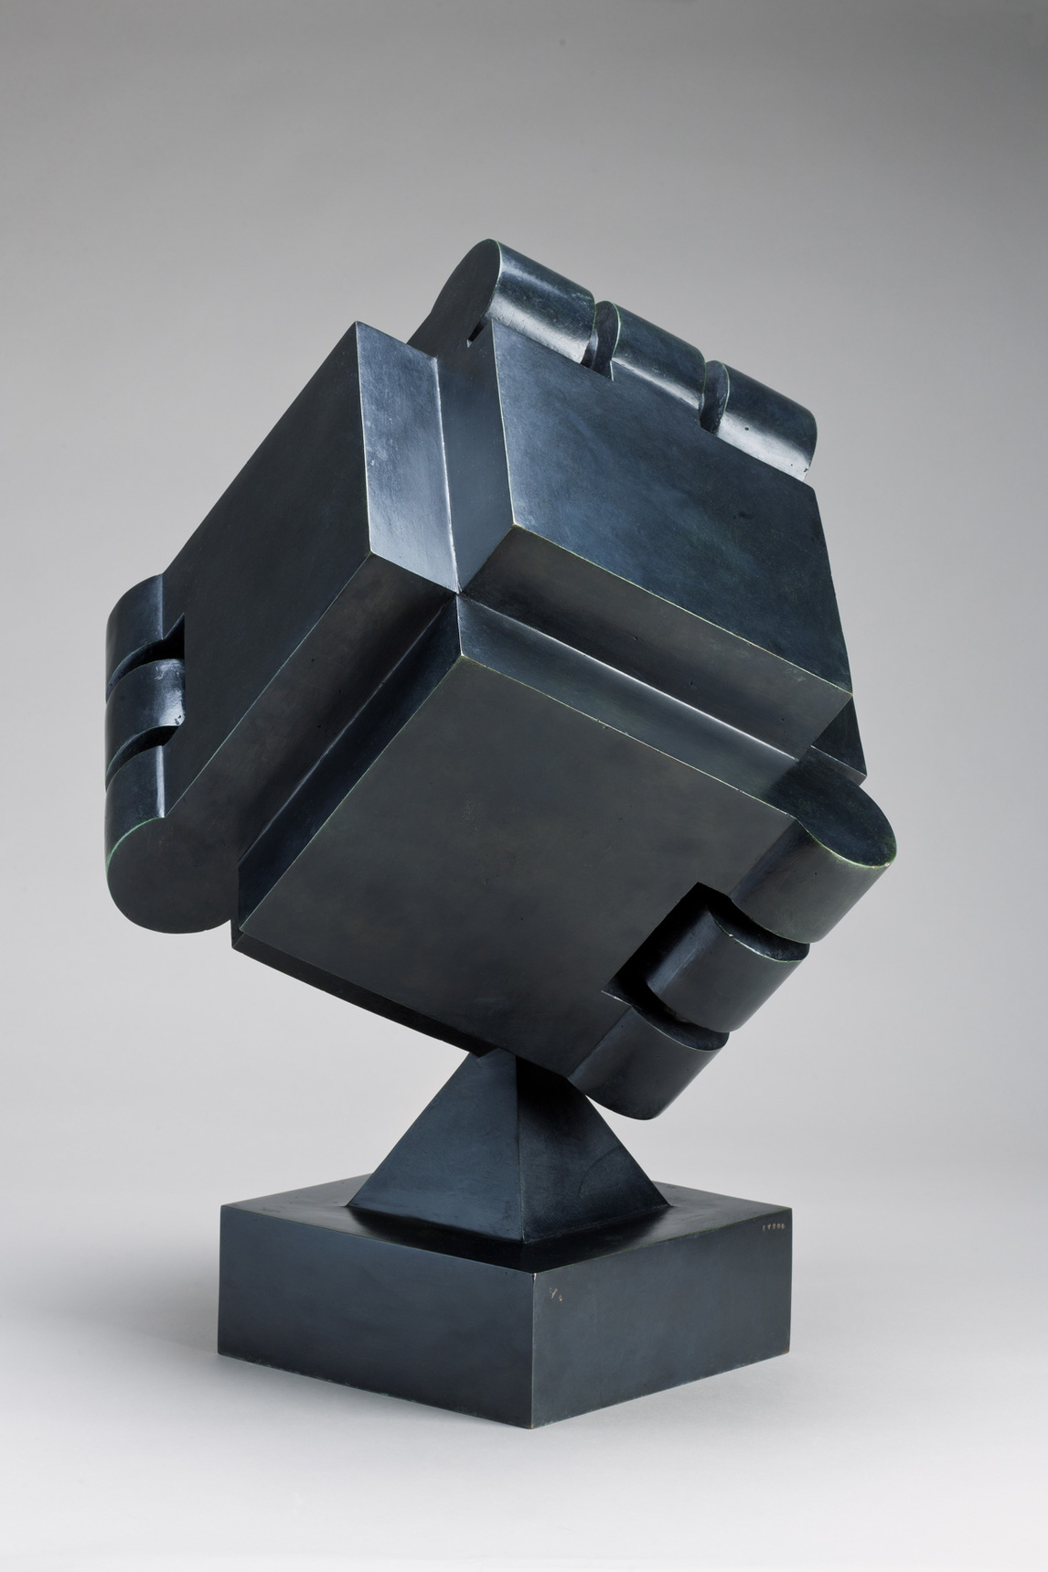
Sorel Etrog, Shelter, 1976. This sculpture is a cube whose surfaces are connected by hinges.

Slide 23
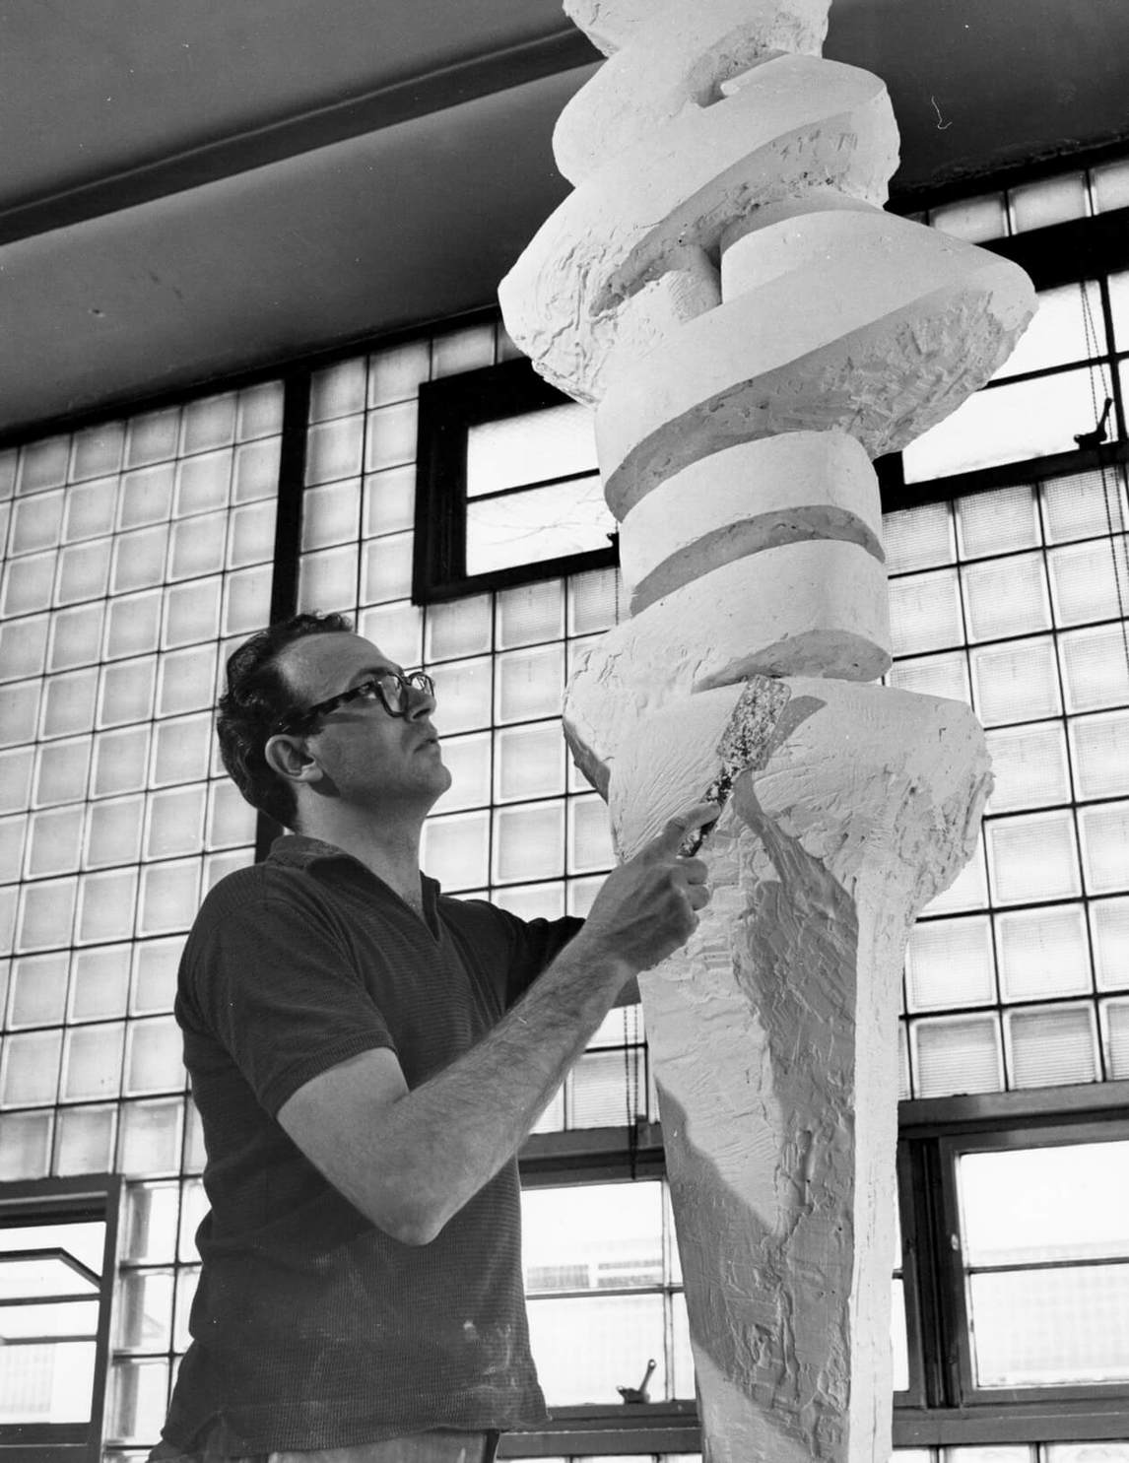
Sorel Etrog working on plaster of Embrace, 1961–64.

Slide 24
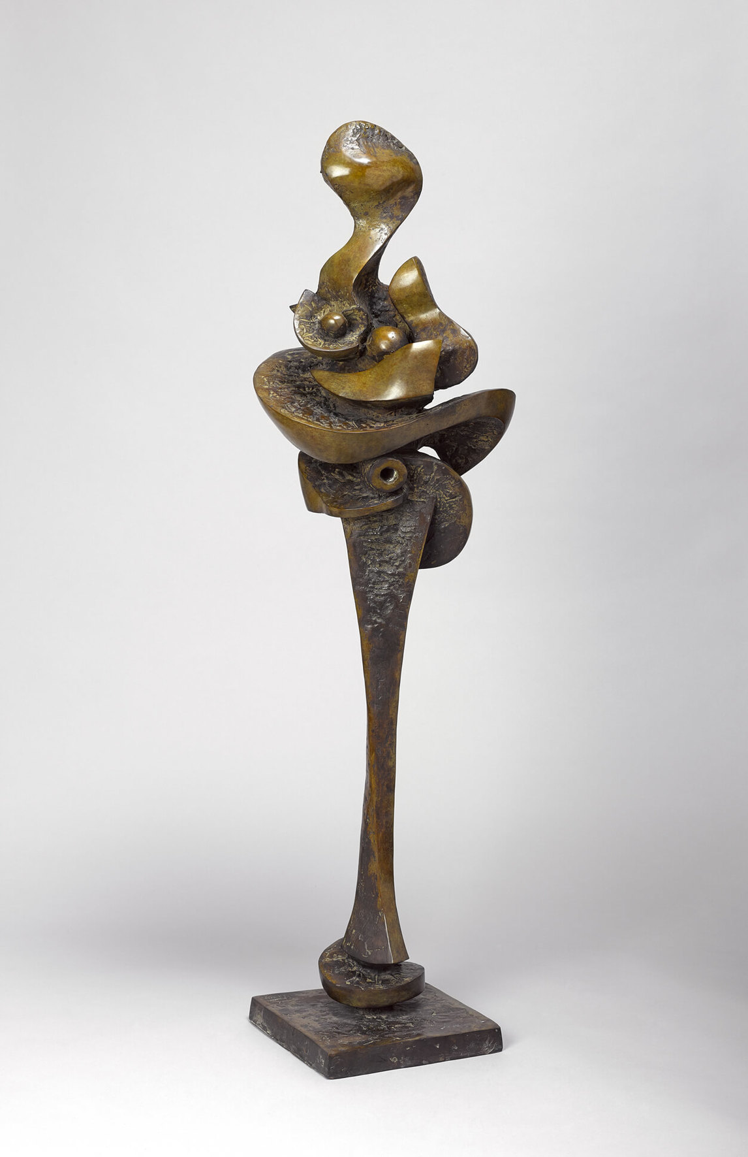
Sorel Etrog, Blossom, 1960–61. This sculpture was created at a time when Etrog was especially interested in natural forms.

