Slide 1
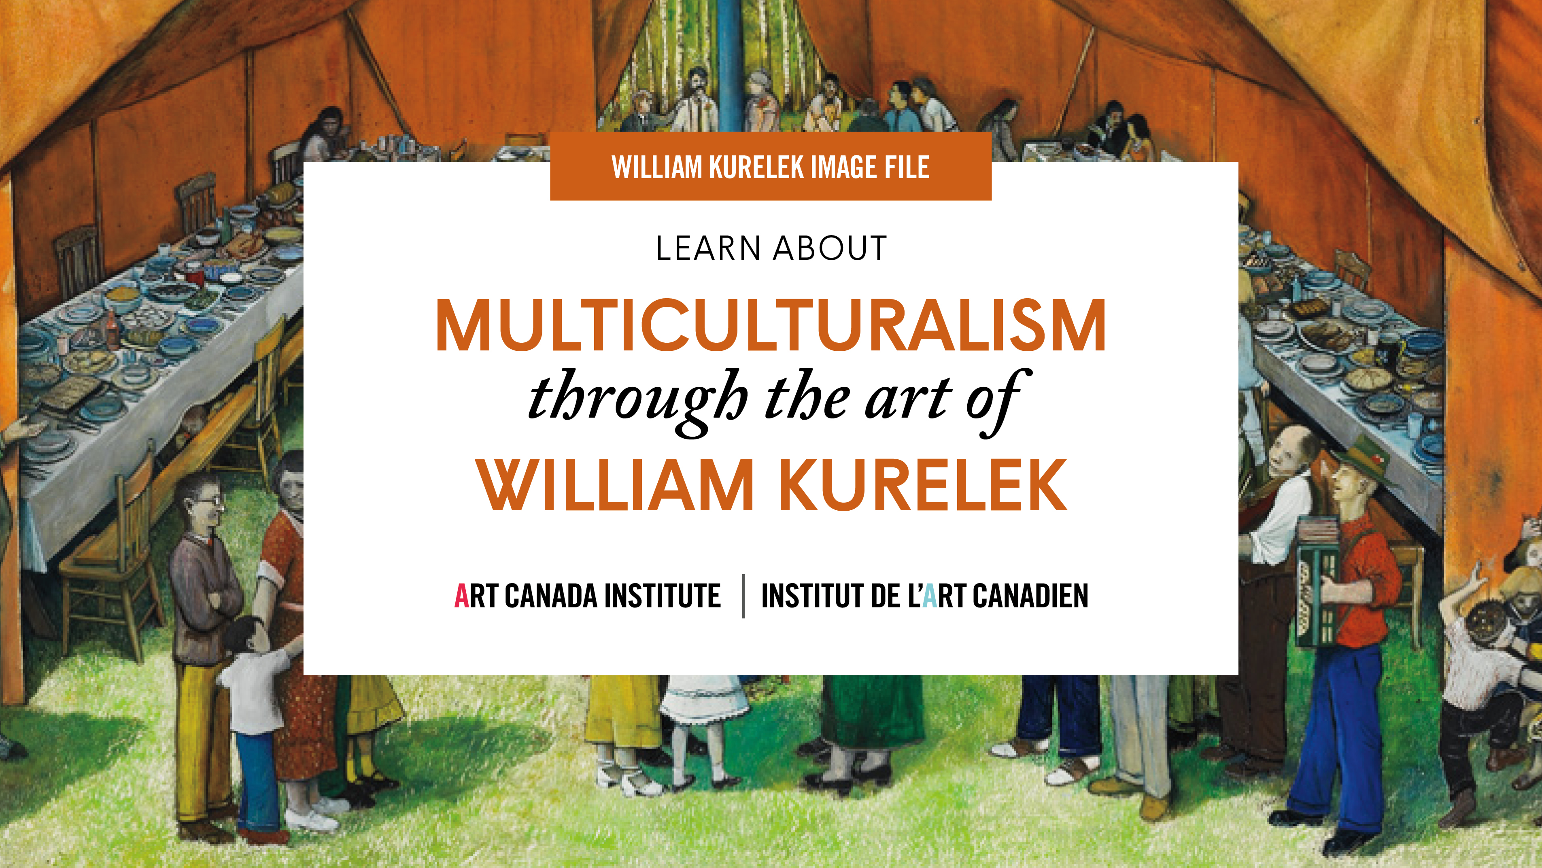

Slide 2
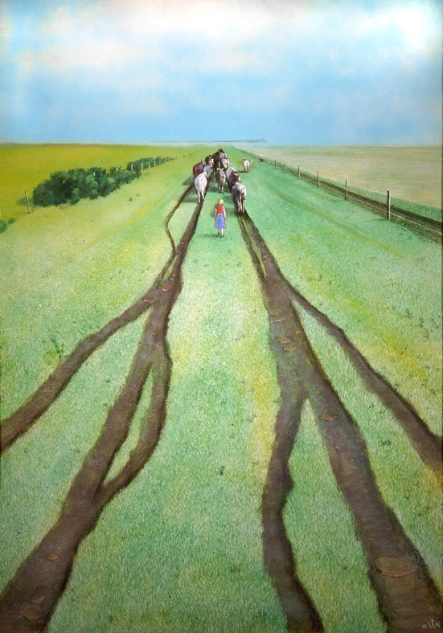
William Kurelek, No Grass Grows on the Beaten Path, 1975. This work shows Kurelek’s interest in the prairie landscape.

Slide 3
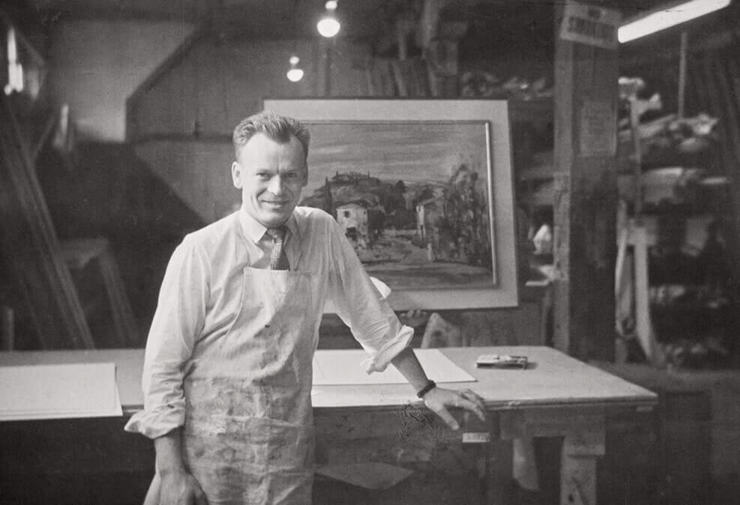
William Kurelek with a painting in the Isaacs Gallery framing workshop, date unknown.

Slide 4
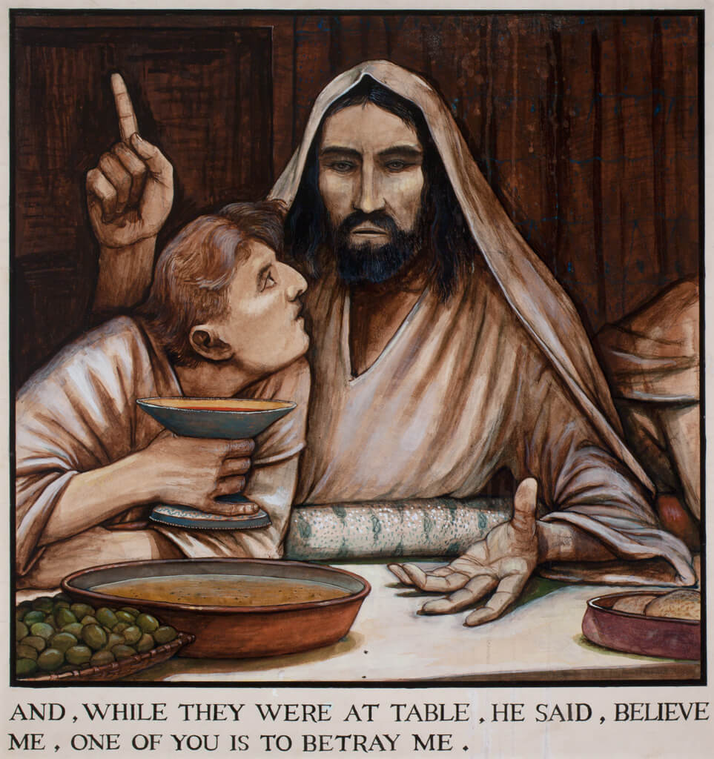
William Kurelek, The Passion of Christ (And, While They Were at Table, He Said, Believe Me, One of You Is to Betray Me), 1960–63. This is one of the 160 works Kurelek created to illustrate the Passion narrative.

Slide 5
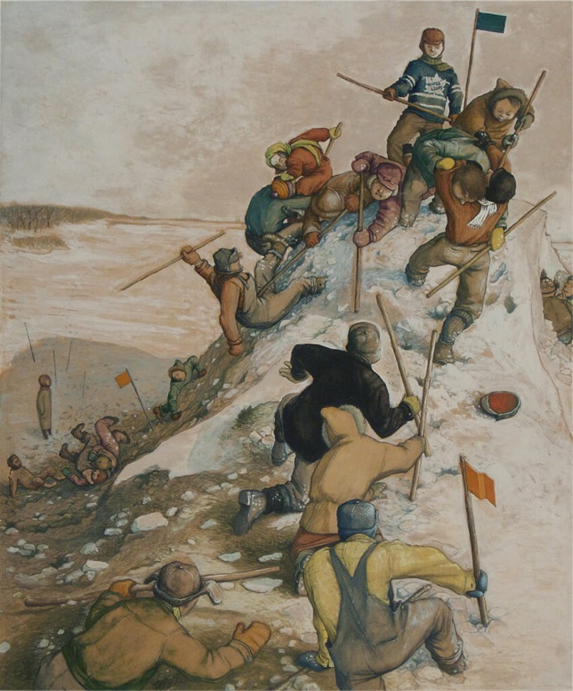
William Kurelek, King of the Castle, 1958–59. Kurelek’s formative years were deeply affected by the contests of the schoolyard.

Slide 6
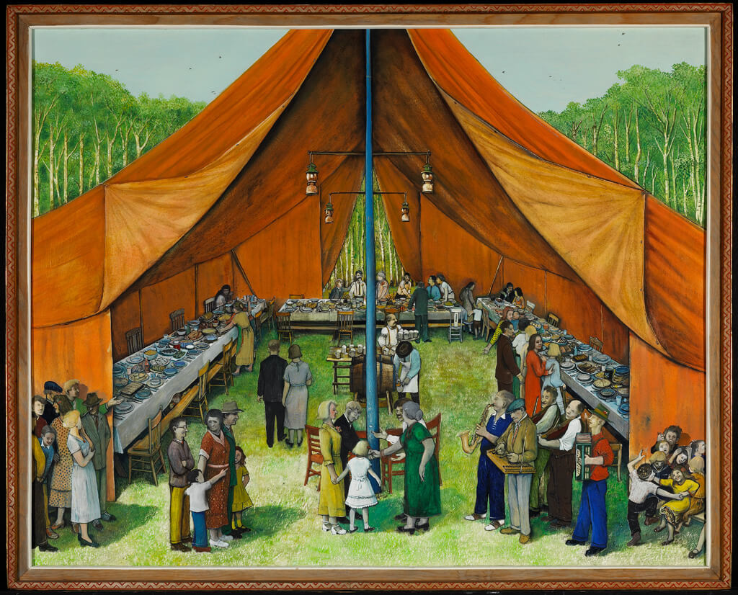
William Kurelek, Manitoba Party, 1964. Kurelek painted this work for the series An Immigrant Farms in Canada.

Slide 7
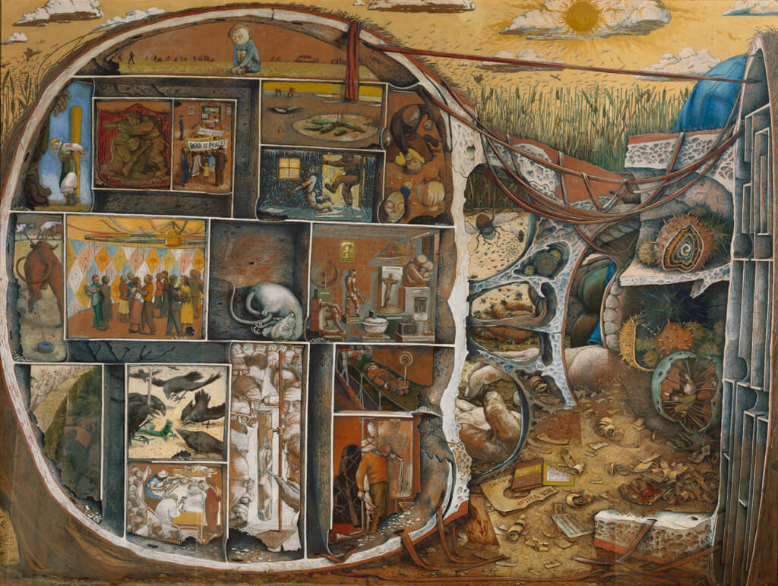
William Kurelek, The Maze, 1953. This painting shows us the inside of Kurelek’s skull in order to represent his state of mind.

Slide 8
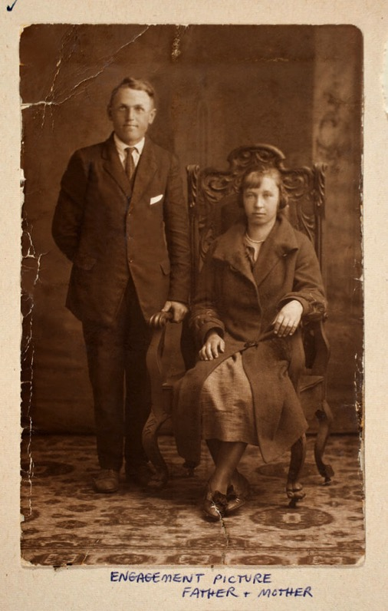
William Kurelek’s father and mother, Dmytro and Mary Kurelek (née Huculak), c.1925.

Slide 9
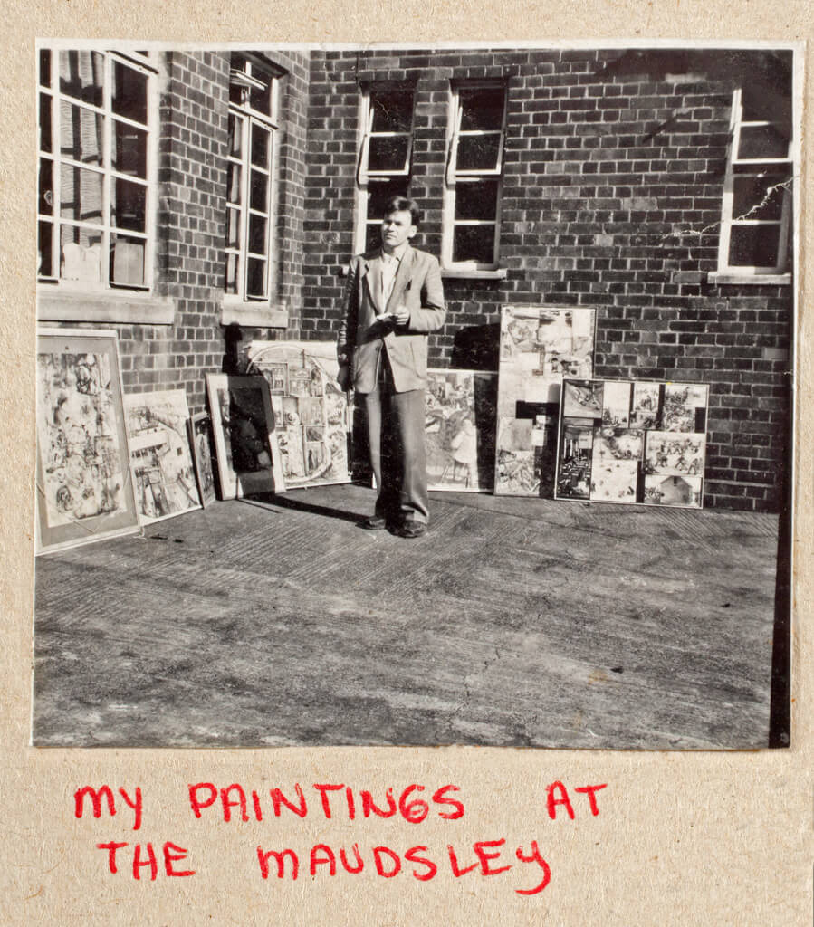
William Kurelek and his paintings at Maudsley Hospital, London, c.1953.

Slide 10
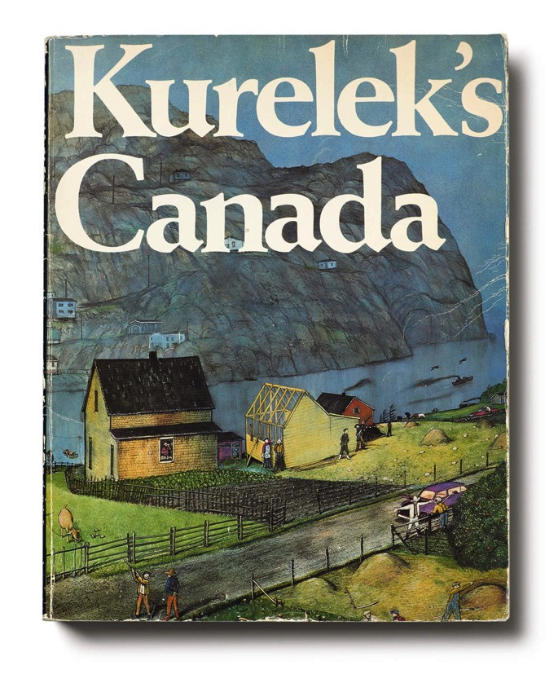
In 1975 Kurelek’s Happy Canada series of paintings was published as a book entitled Kurelek’s Canada.

Slide 11
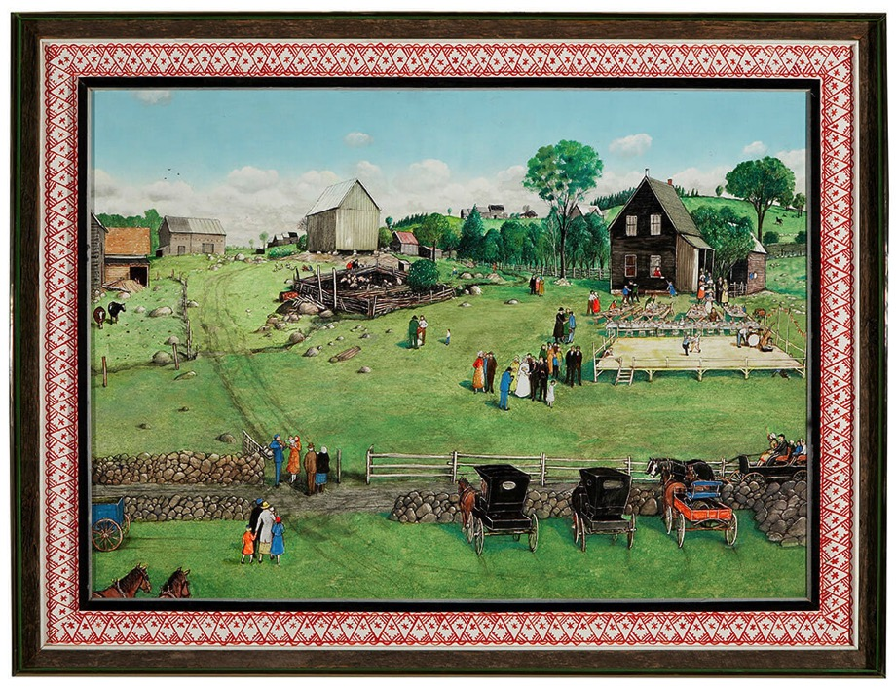
William Kurelek, Polish Wedding at Kaszuby, 1977. This work was inspired by Kurelek’s interest in Polish communities in Canada.

Slide 12
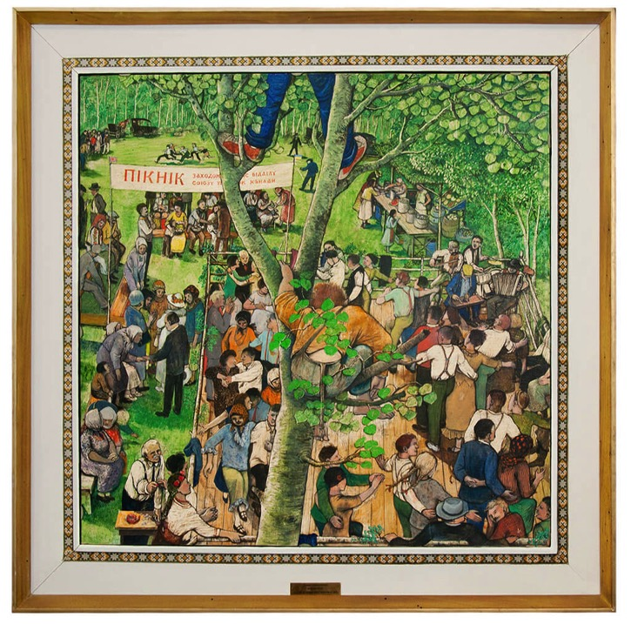
Learning Activity #1
William Kurelek, Ukrainian Canadian Farm Picnic, 1966. This painting was displayed at the Ukrainian Pavilion at Expo 67 in Montreal.
Notes:
*insert Ruth’s captions*

Slide 13
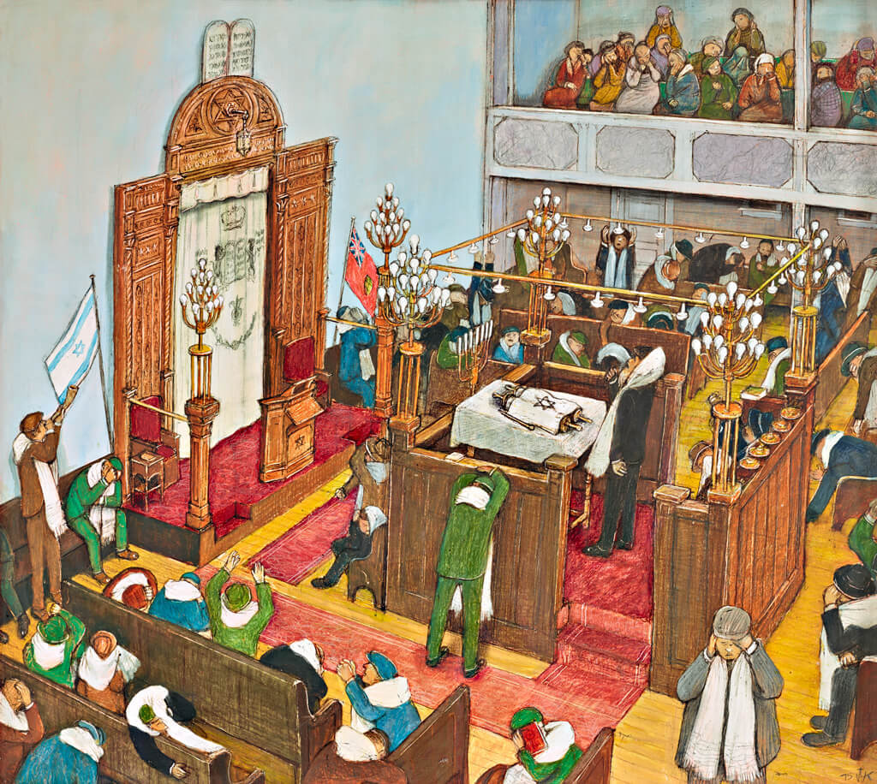
Learning Activity #1
William Kurelek, Yom Kippur, 1975. Kurelek portrayed Canada as a mosaic of diverse but harmonious cultures.
Notes:
*insert Ruth’s captions*

Slide 14
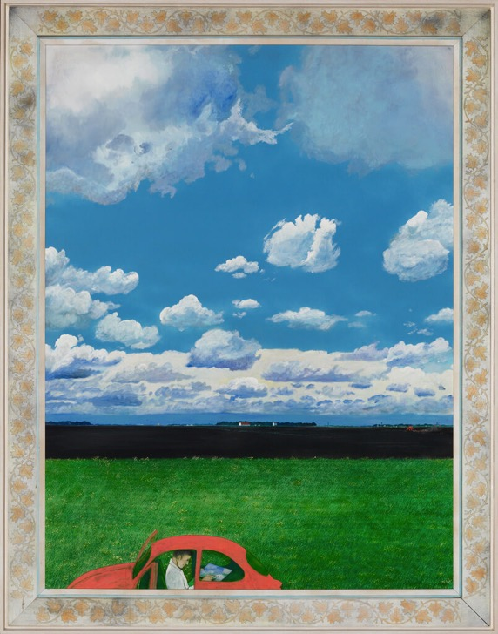
Learning Activity #2
William Kurelek, The Painter, 1974. In this scene, Kurelek is caught unaware and immersed in his work.
Notes:
*insert Ruth’s captions*

Slide 15
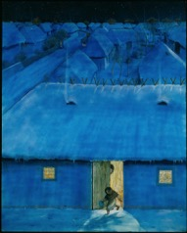
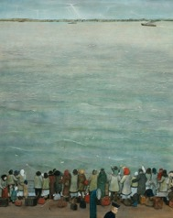
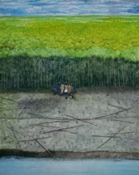
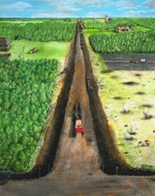
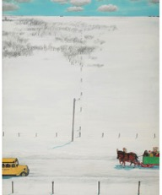
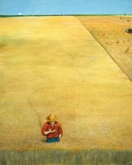
Learning Activity #2
William Kurelek, The Ukrainian Pioneer, 1971, 1976. The episodic six-panelled composition retells the story of Ukrainian immigration to Canada in the early twentieth century.
Notes:
*insert Ruth’s captions*

Slide 16
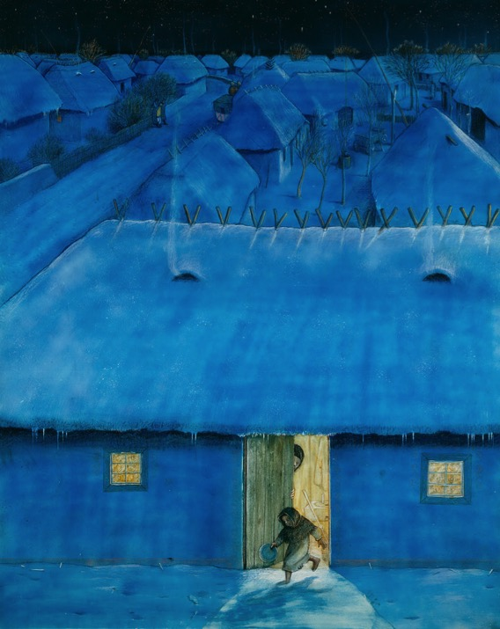
Learning Activity #2
William Kurelek, The Ukrainian Pioneer (detail), 1971, 1976.
Notes:
*insert Ruth’s captions*

Slide 17
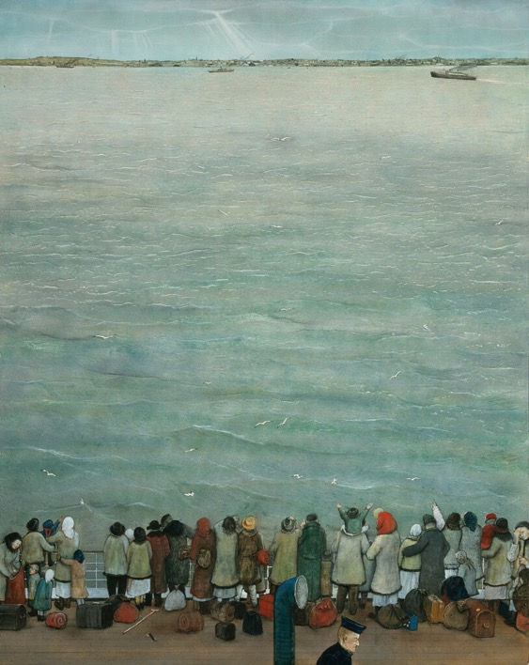
Learning Activity #2
William Kurelek, The Ukrainian Pioneer (detail), 1971, 1976.
Notes:
*insert Ruth’s captions*

Slide 18
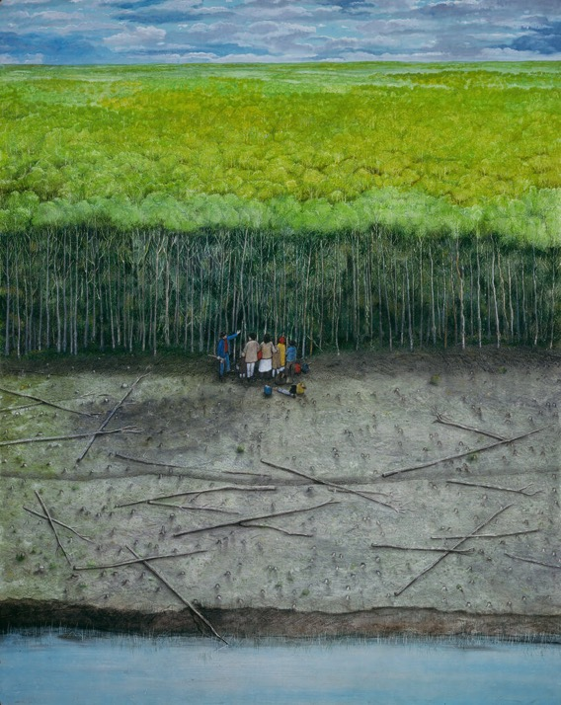
Learning Activity #2
William Kurelek, The Ukrainian Pioneer (detail), 1971, 1976.
Notes:
*insert Ruth’s captions*

Slide 19
Learning Activity #2
William Kurelek, The Ukrainian Pioneer (detail), 1971, 1976.
Notes:
*insert Ruth’s captions*

Slide 20
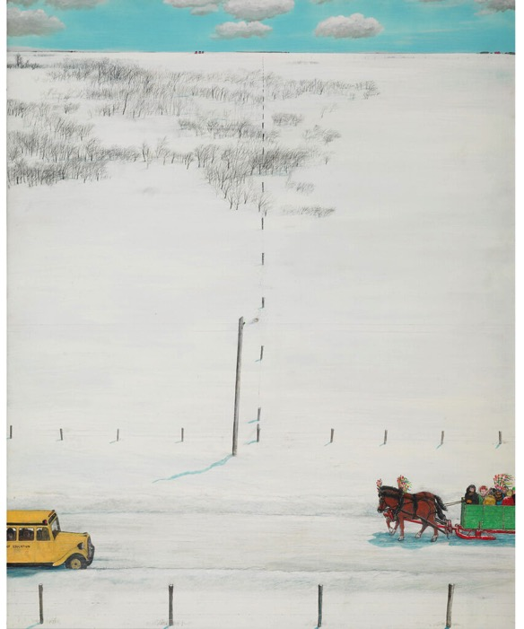
Learning Activity #2
William Kurelek, The Ukrainian Pioneer (detail), 1971, 1976.
Notes:
*insert Ruth’s captions*

Slide 21
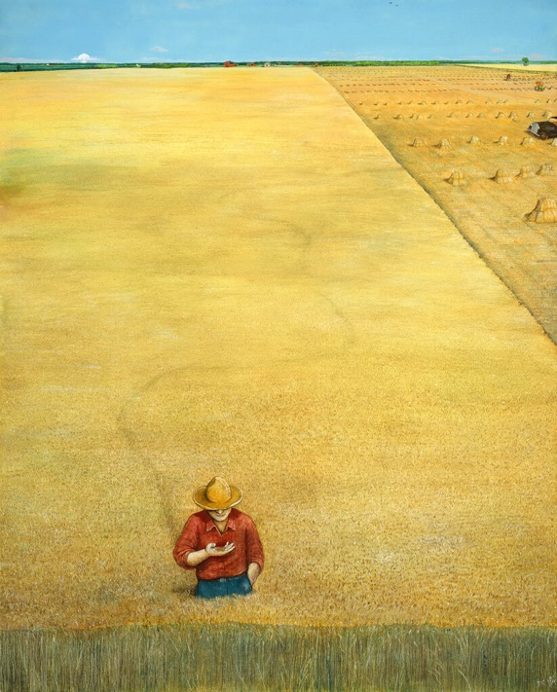
Learning Activity #2
William Kurelek, The Ukrainian Pioneer (detail), 1971, 1976.
Notes:
*insert Ruth’s captions*

Slide 22
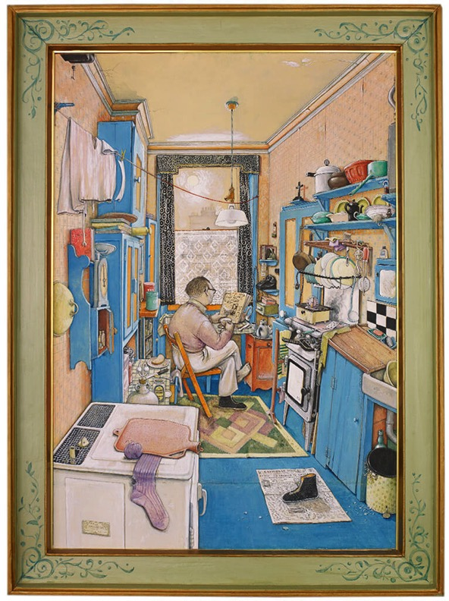
William Kurelek, The Bachelor, 1955. In this work, Kurelek created a claustrophobic interior setting.
Notes:
*insert Ruth’s captions*

Slide 23
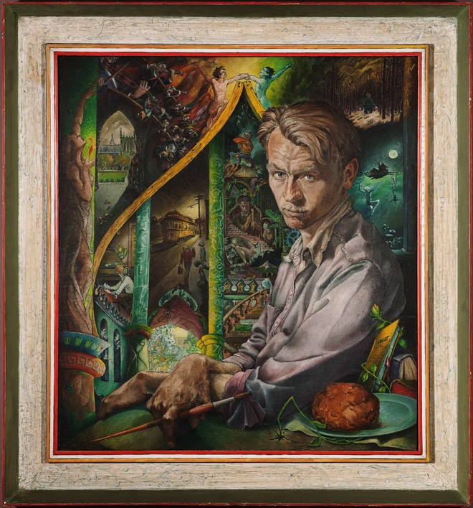
Culminating Task
William Kurelek, Portrait of the Artist as a Young Man, 1950. This portrait marks Kurelek’s decision to become a professional artist.

Slide 24
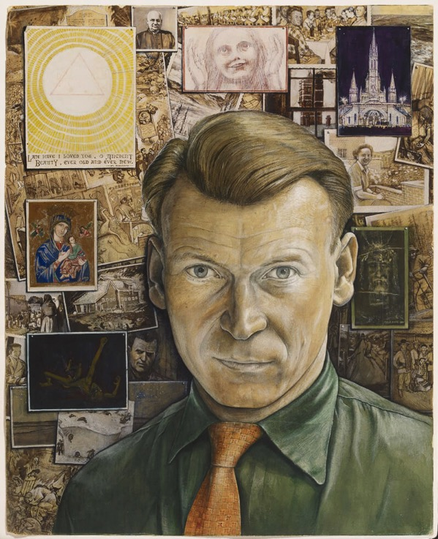
Culminating Task
William Kurelek, Self-Portrait, 1957. This is the first significant work Kurelek painted after formally converting to Roman Catholicism.
Notes:
*insert caption*

Slide 25
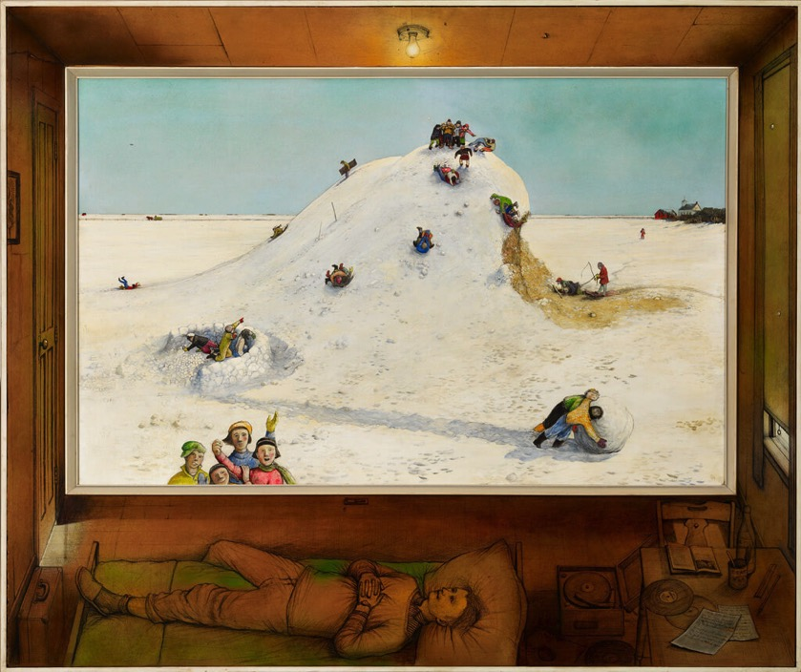
William Kurelek, Reminiscences of Youth, 1968. In this painting we see Kurelek visualizing childhood memories.

Slide 26
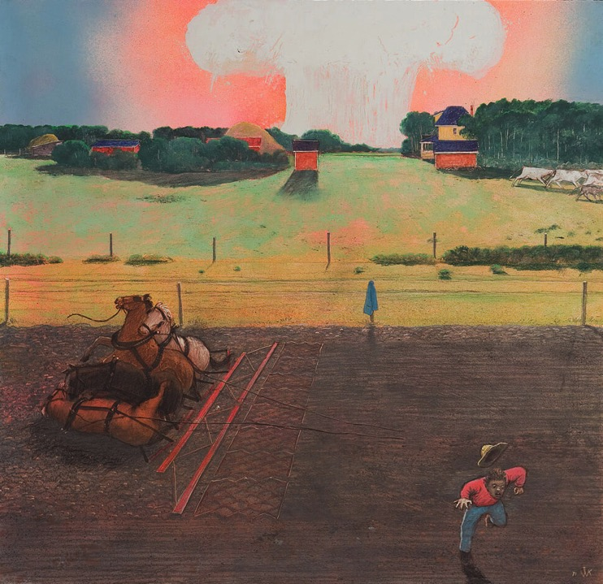
William Kurelek, Not Going Back to Pick Up a Cloak; If They Are in the Fields after the Bomb Has Dropped, 1971. This scene was inspired by Kurelek’s anxieties about nuclear war.

Slide 27
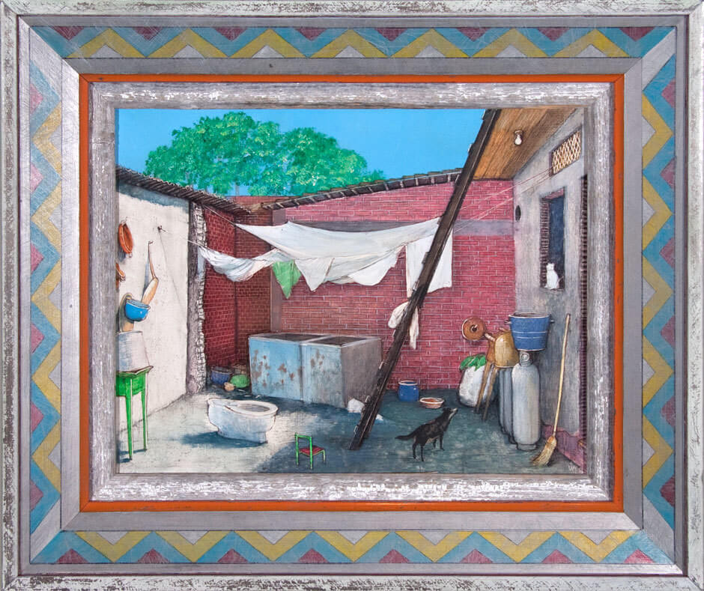
William Kurelek, A Poor Mexican Courtyard, 1976. Kurelek completed this work with a richly coloured frame.

Slide 28
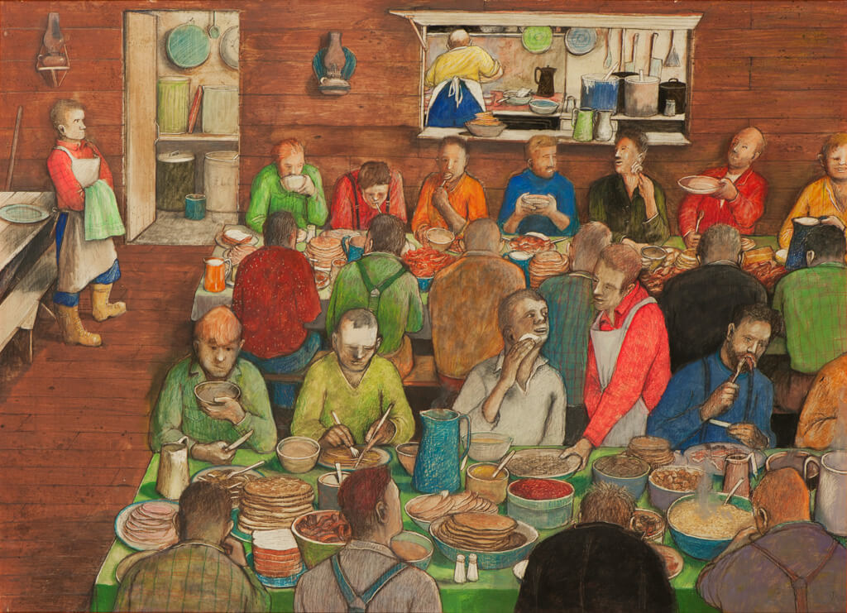
William Kurelek, Lumberjack’s Breakfast, 1973. As a young man, Kurelek worked in a Northern Ontario lumber camp.

