Slide 1
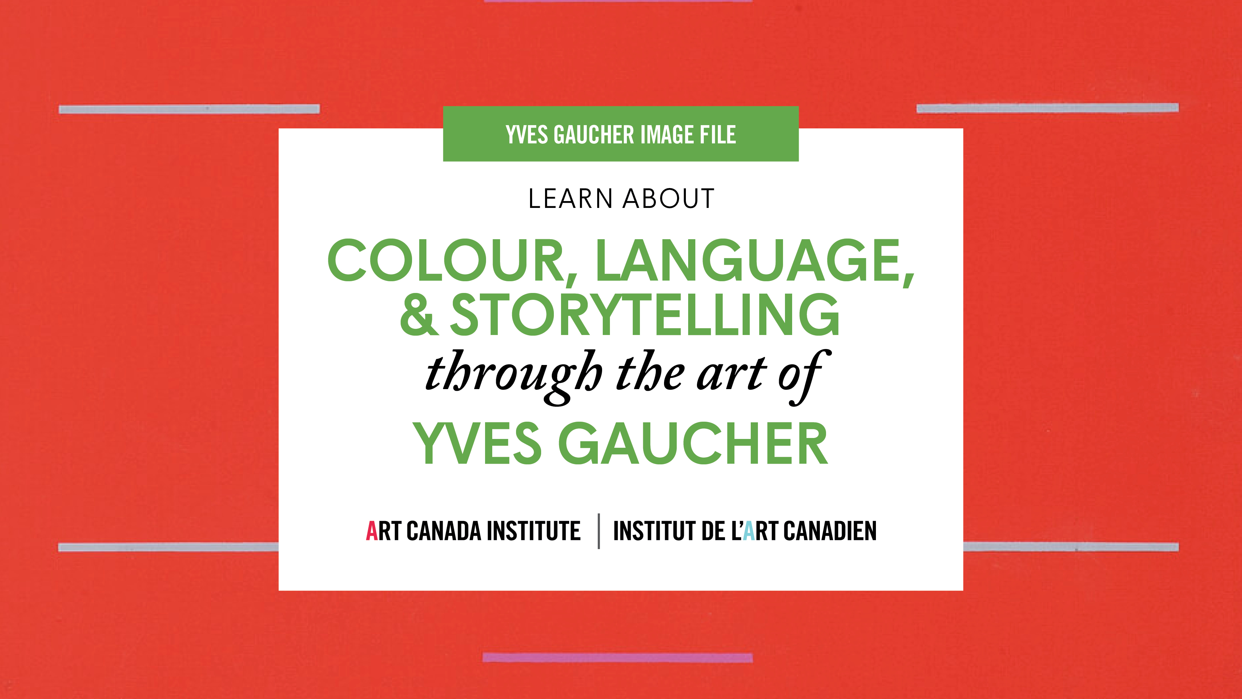

Slide 2
Yves Gaucher, Triptych (from left to right: Signals, Another Summer; Signals, Very Softly; Silences / Silence), 1966. In this triptych, Gaucher painted fine lines on top of strong primary colours to enhance the intensity of the primary colours’ appearance.

Slide 3
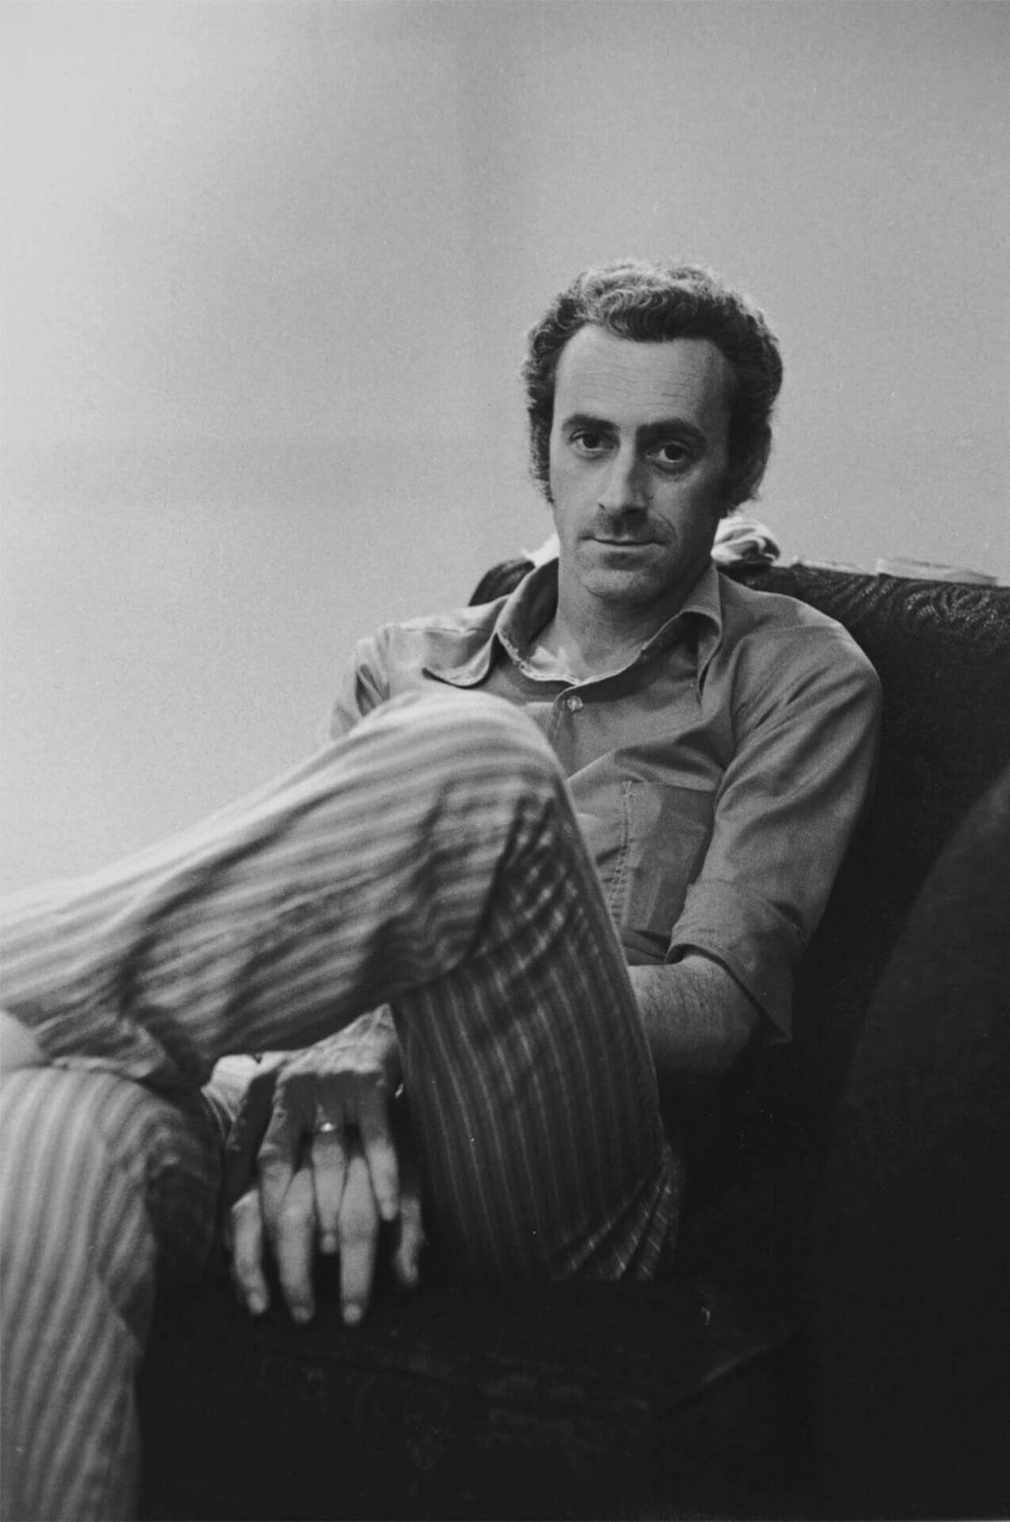
Yves Gaucher in 1971, photographed by Gabor Szilasi.

Slide 4
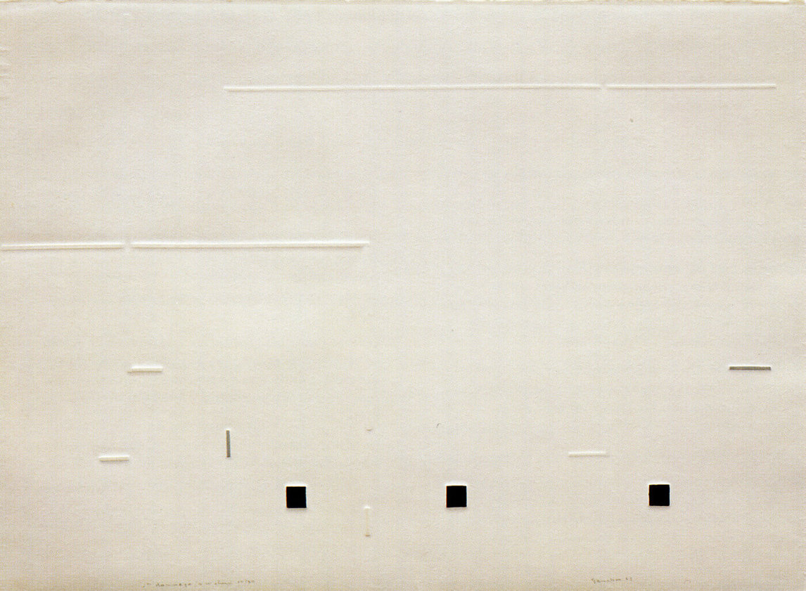
Yves Gaucher, In Homage to Webern No. 1, 1963. This print is one of a set of prints that marks an important development in Gaucher’s work: here he embraces geometry to make compositions with graphic power.

Slide 5
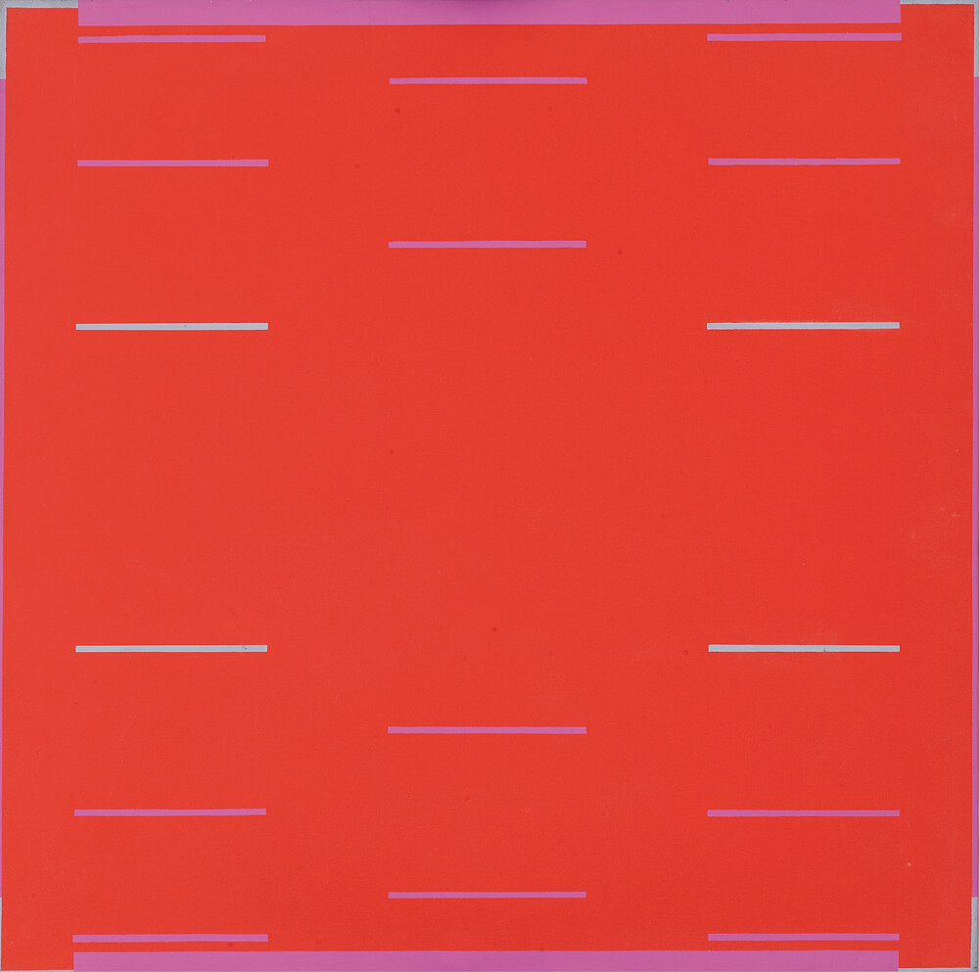
Yves Gaucher, Study for “Six Squares,” 1966. This painting has an orderly, symmetrical structure, such that our attention is drawn to the interactions between colours.

Slide 6
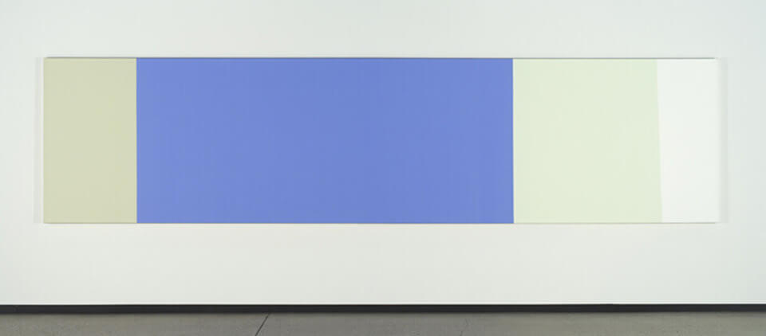
Yves Gaucher, B2 + w Ps (installation view), 1989–90. Here we see one of Gaucher’s Pale Paintings, a work with comparatively subtle variations in colours: from left to right, greenish cream, pale purplish blue, an icy pistachio, and, finally, white.

Slide 7
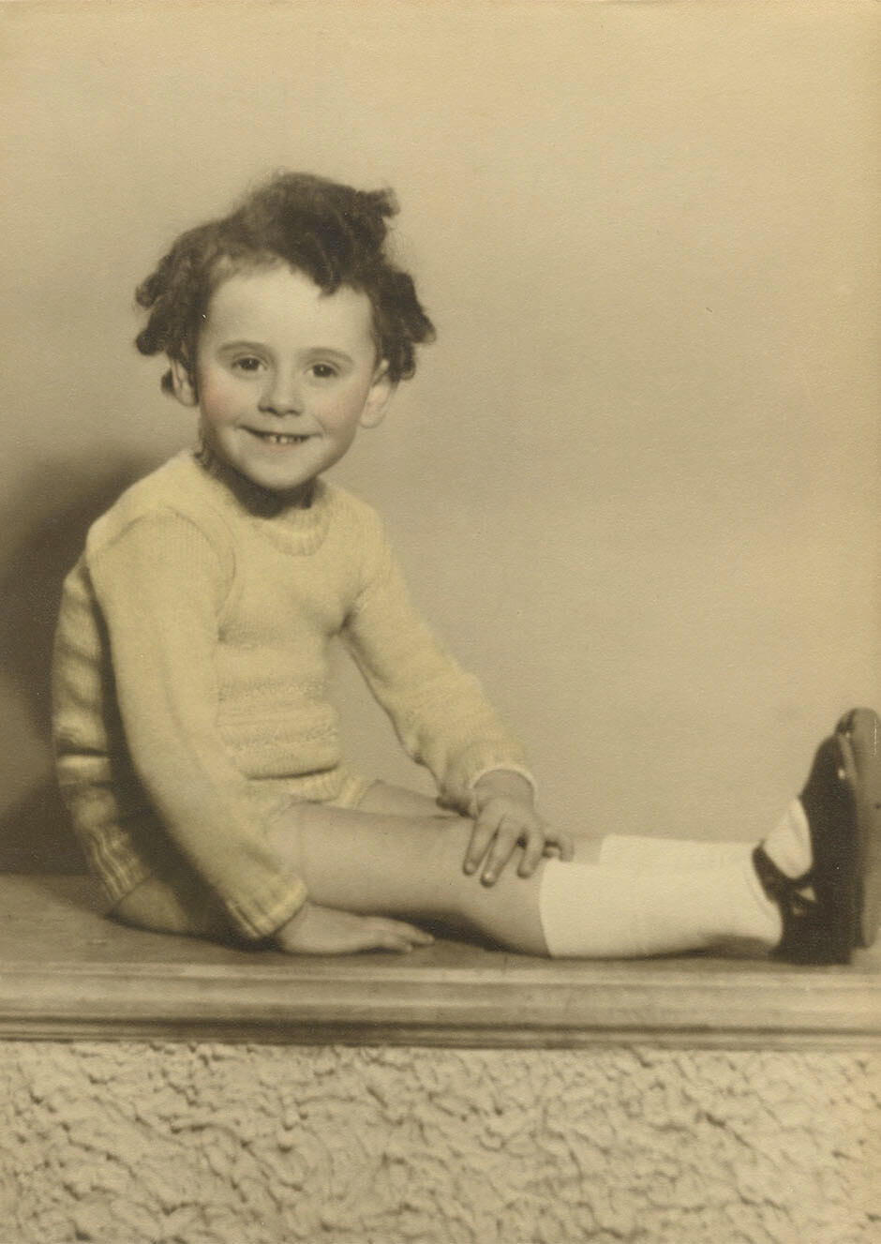
Three-year-old Yves Gaucher in 1937.

Slide 8
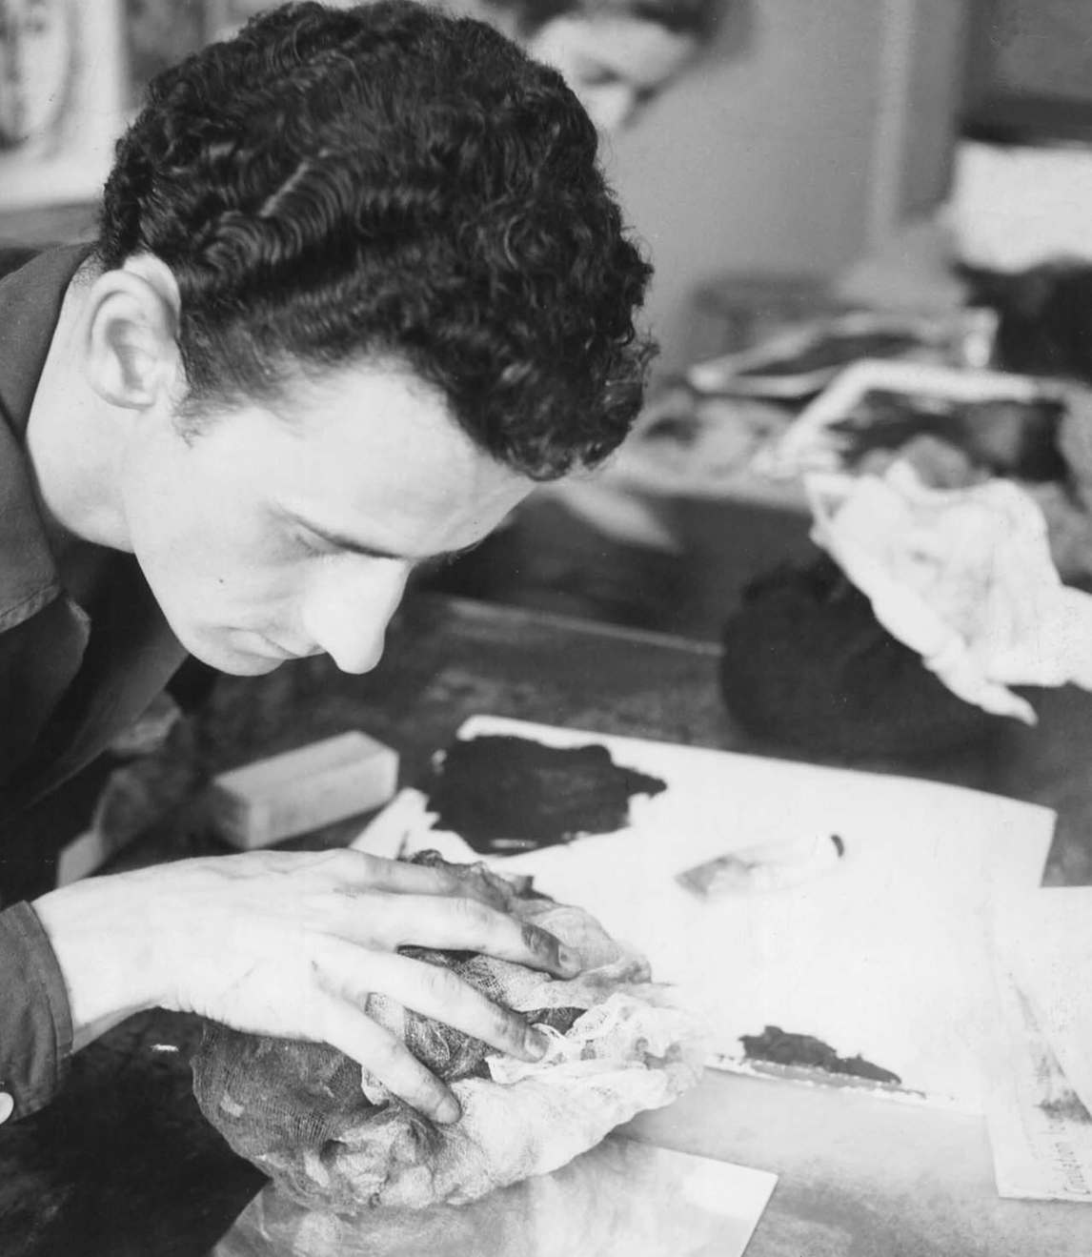
Gaucher at the École des beaux-arts in Montreal, c.1954–55.

Slide 9

Yves Gaucher, Two Blues, Two Greys, 1976. This work represents Gaucher’s interest in placing colours in dialogue with each other.

Slide 10
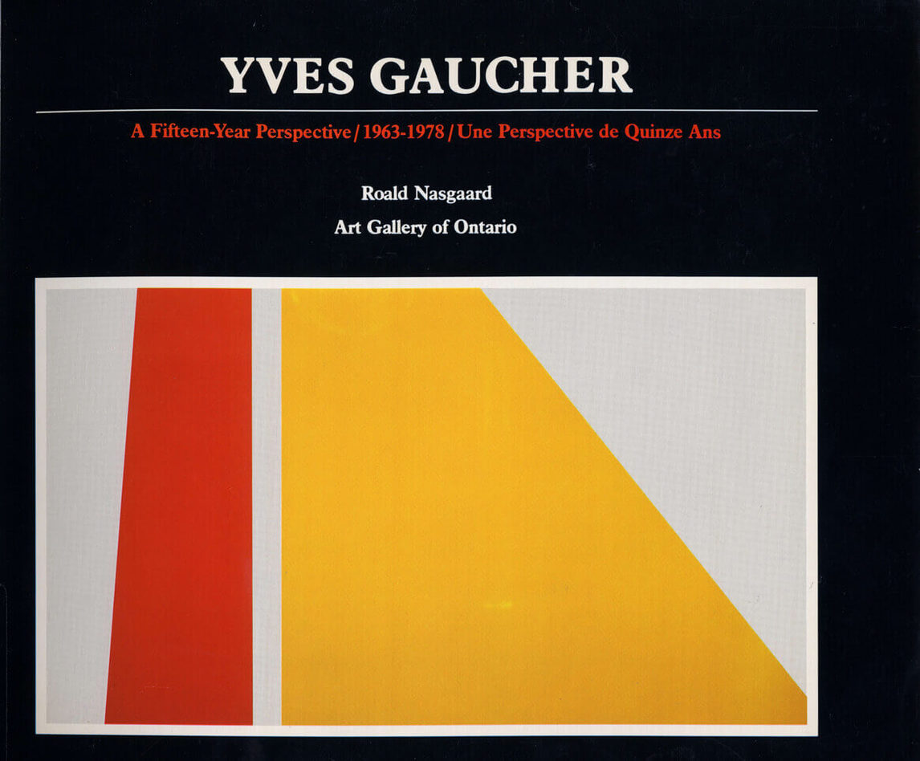
Catalogue for the 1979 exhibition Yves Gaucher: A Fifteen-Year Perspective, 1963–1978, at the Art Gallery of Ontario, Toronto.

Slide 11
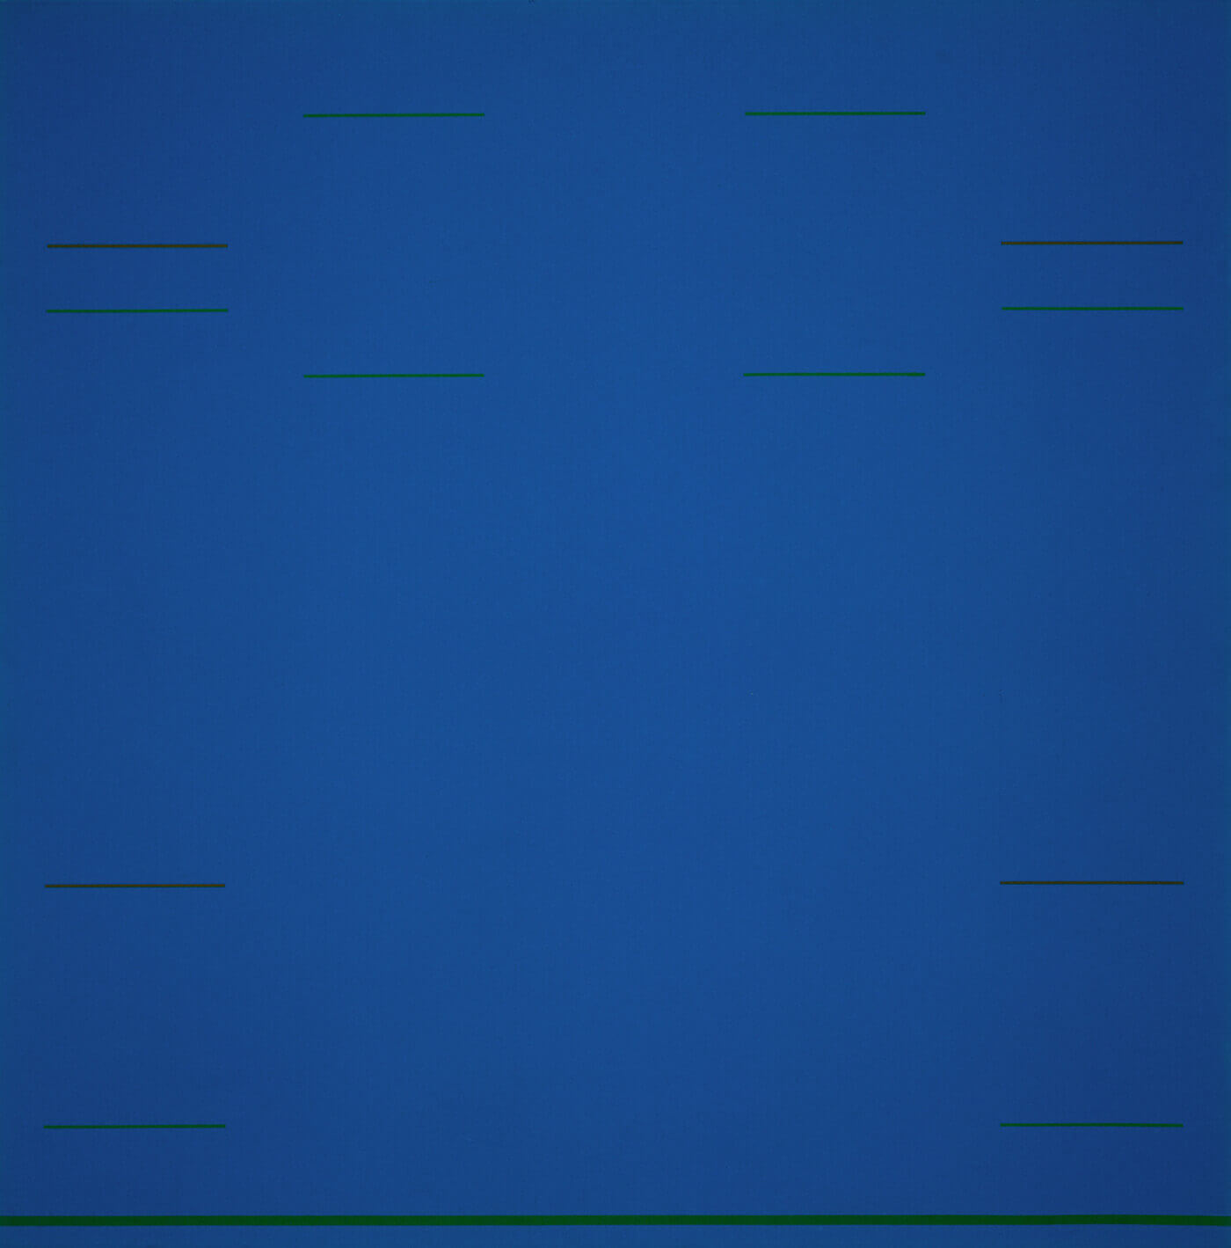
Learning Activity #1
Yves Gaucher, Blue Raga, 1967. The title of this work refers to Gaucher’s interest in Indian music; he found listening to Indian raga music was a very powerful experience.

Slide 12
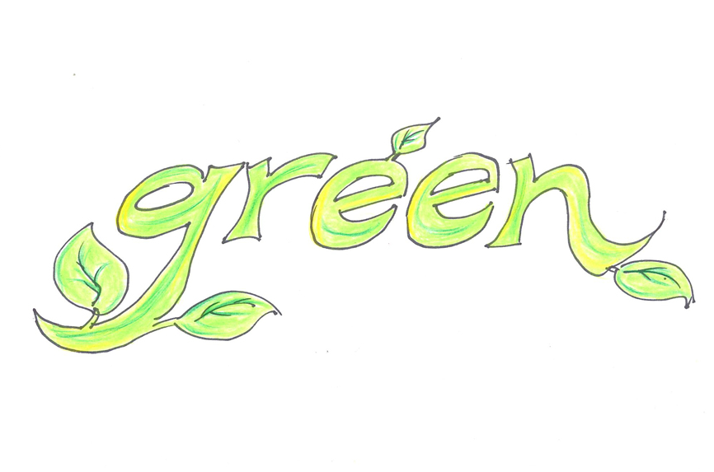
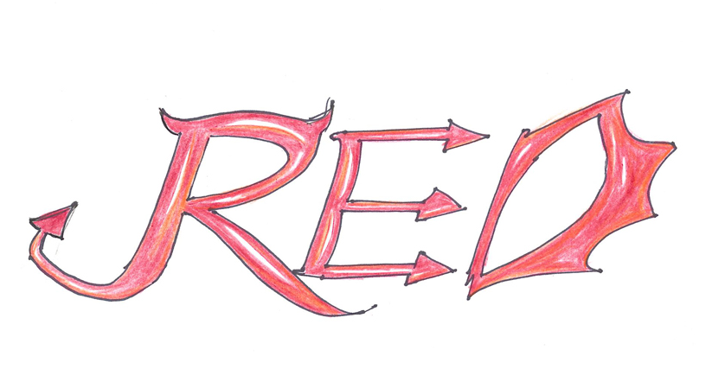
Learning Activity #1

Slide 13
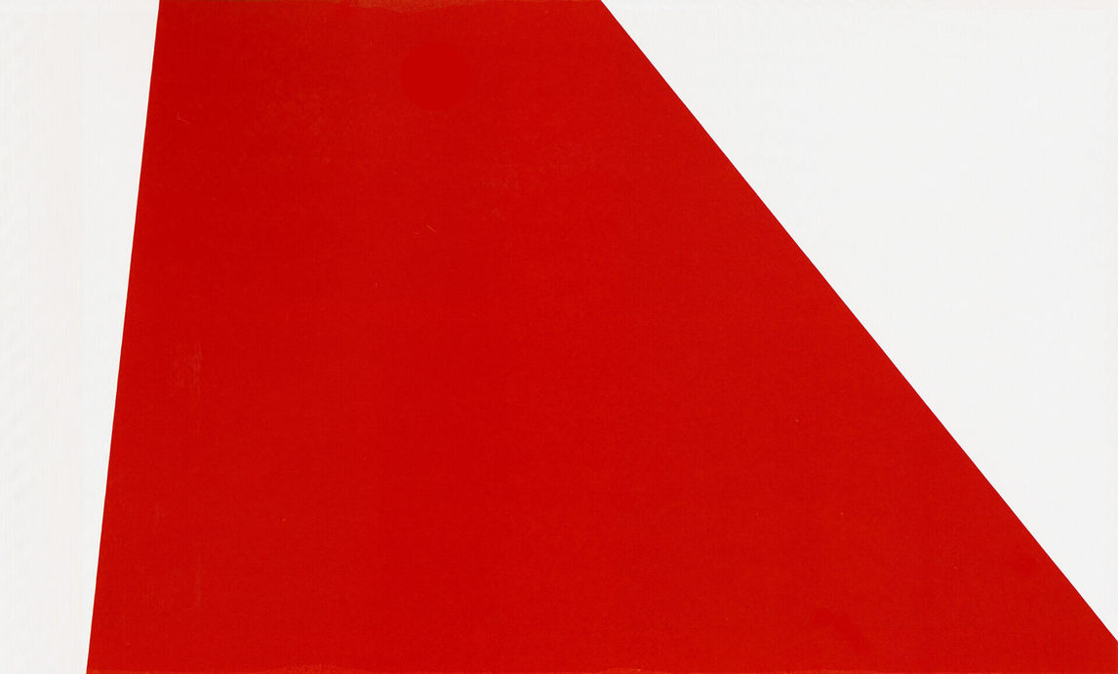
Yves Gaucher, Er-Rcha, 1978. Er-Rcha is the last work in Gaucher’s Jericho series (Er-Rcha is the Arabic name for Jericho), a series of paintings in which the shapes are based on divided triangles.

Slide 14
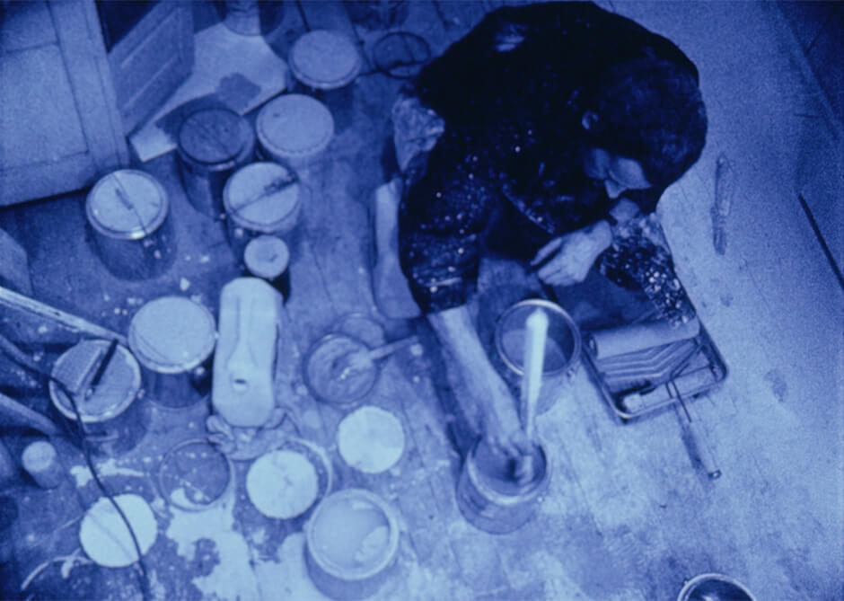
Charles Gagnon, R69, 1969– (unfinished). While Gaucher was working on his painting R69, Gagnon, another artist in Montreal, filmed the process; in this film still, we see Gaucher surrounded by numerous paint cans, reminders that Gaucher repeatedly experimented with mixing paint.

Slide 15
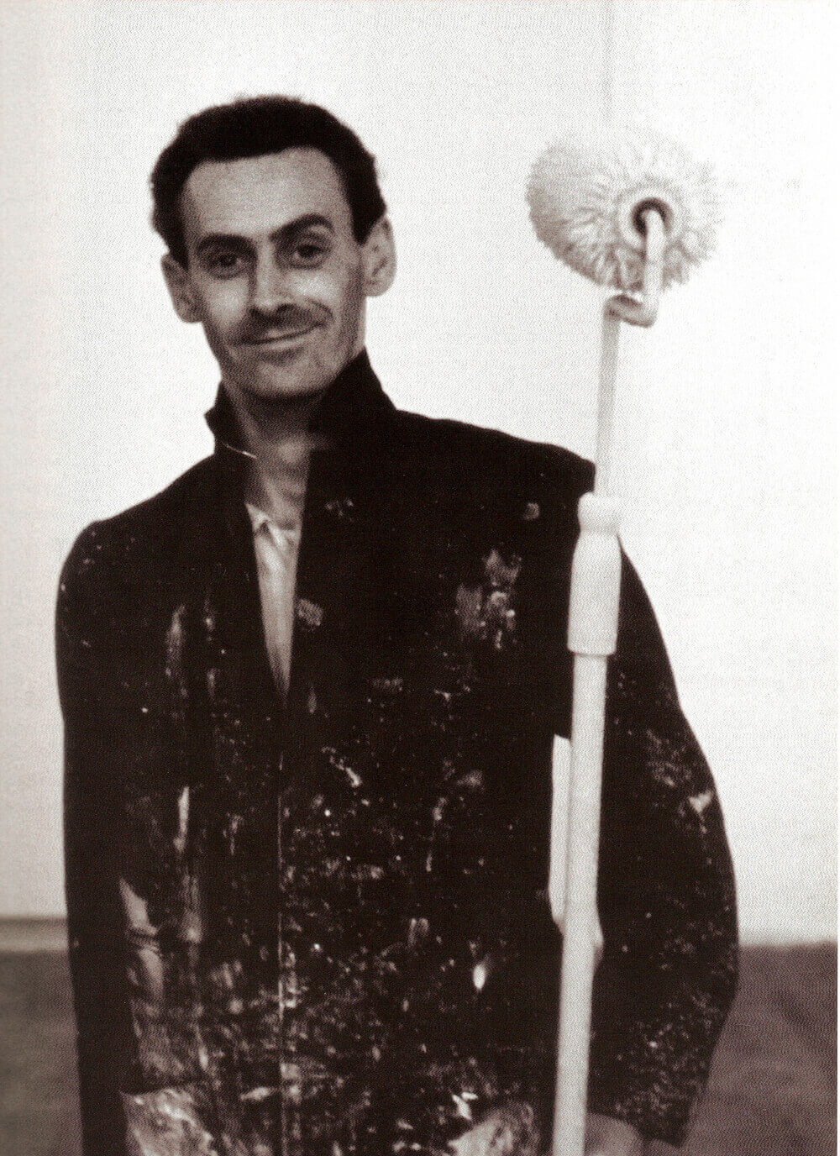
Gaucher holding a paint roller in his
studio on Saint-Paul Street East, Montreal, c.1968–69. Using a roller instead of a brush helped Gaucher apply paint evenly; he used masking tape to keep edges straight and crisp.

Slide 16
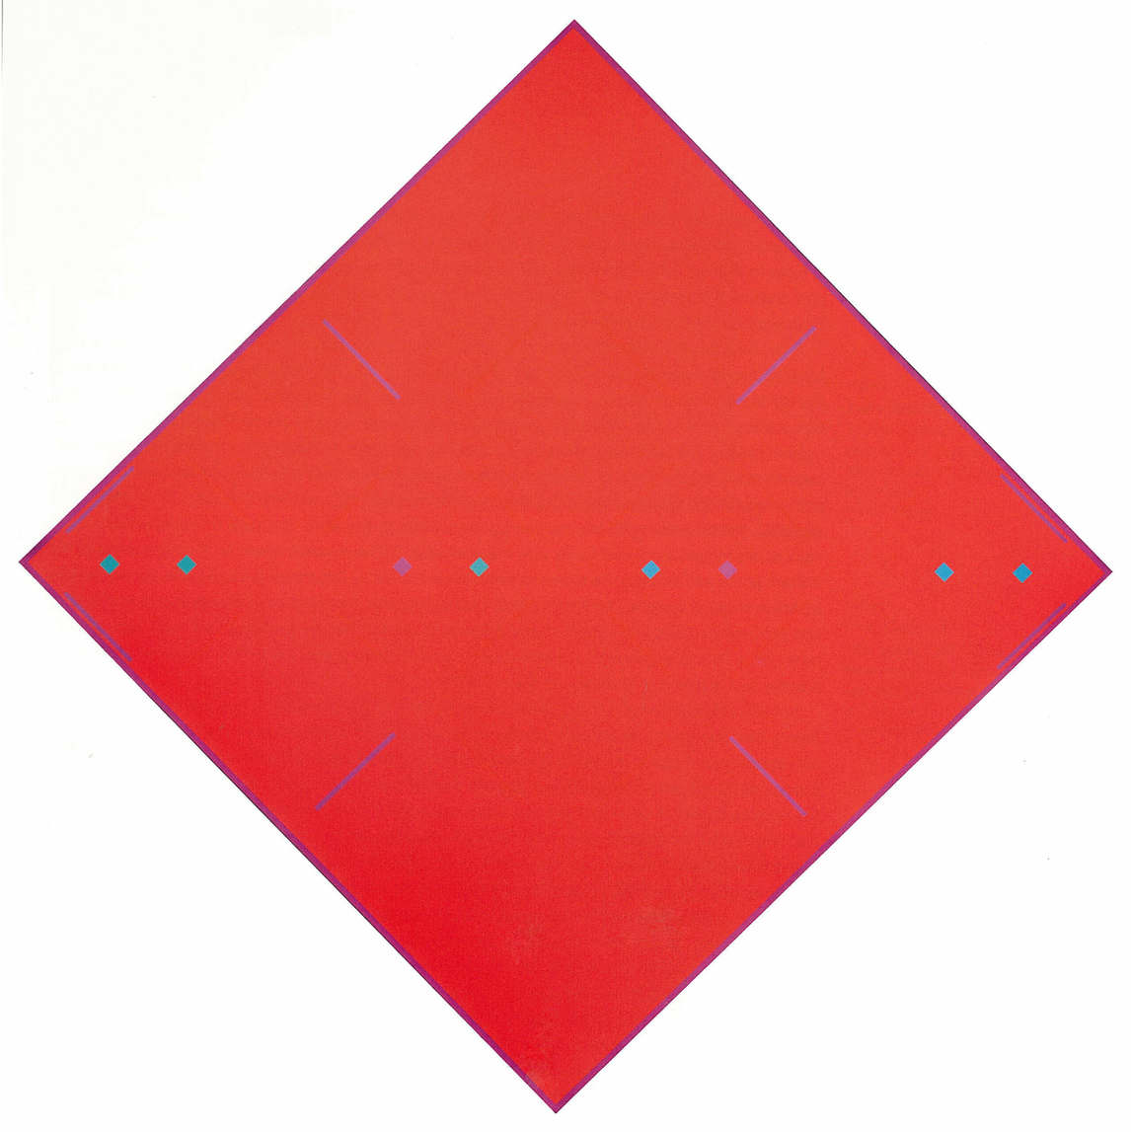
Learning Activity #2
Yves Gaucher, Square Dance, Red Modulations, 1965. The paintings in Gaucher’s Square Dances series sometimes use colours to produce effects of afterimage.

Slide 17
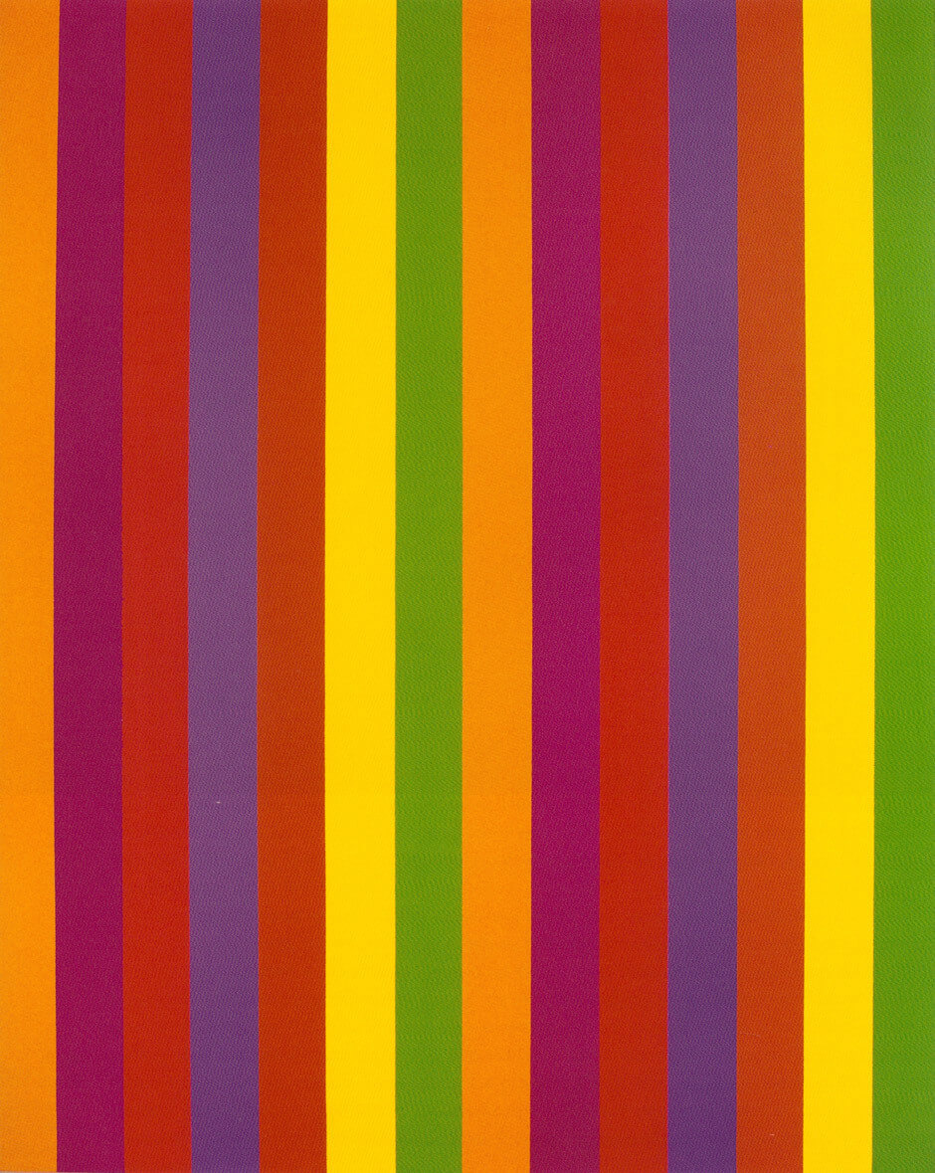
Learning Activity #2
Guido Molinari, Untitled, 1967. Molinari made colour-stripe painting his trademark in the early 1960s, creating works with vertical bands of equal width.

Slide 18
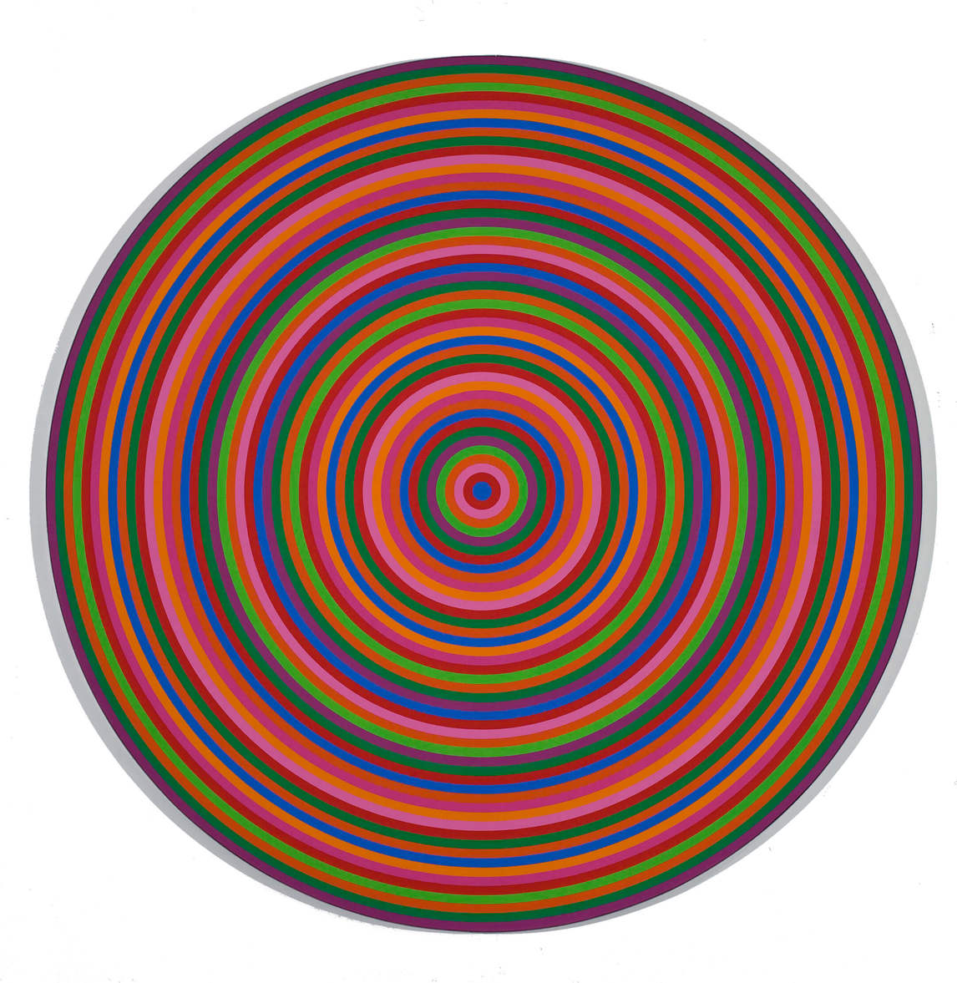
Learning Activity #2
Claude Tousignant, Chromatic Accelerator, 1968. Tousignant created a series of paintings with rings of colours.

Slide 19
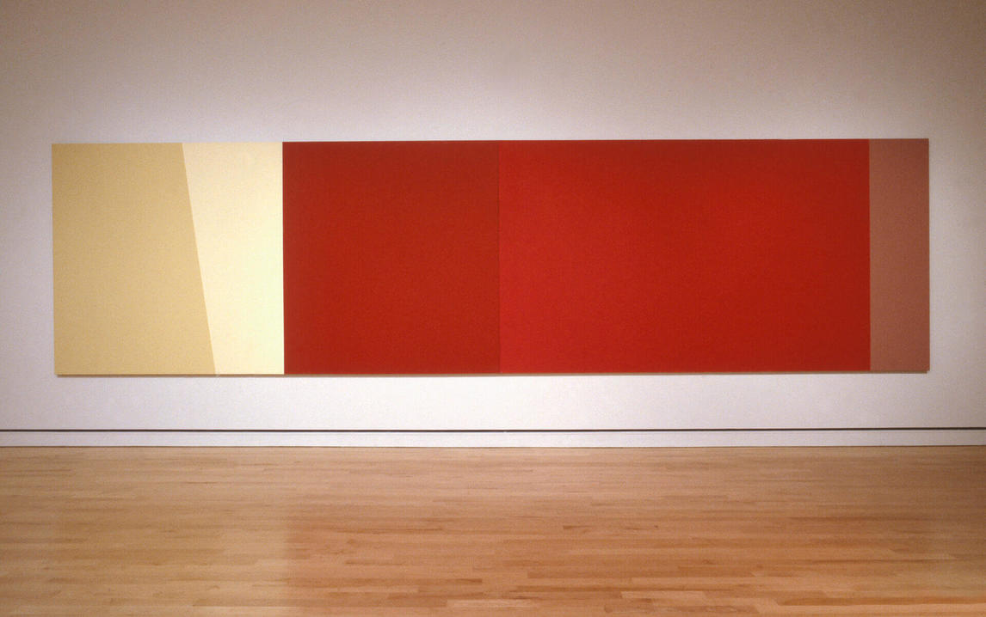
Yves Gaucher, Reds & Ps, 1992. In this painting Gaucher experimented with different shades of red, beige, and cream.

Slide 20
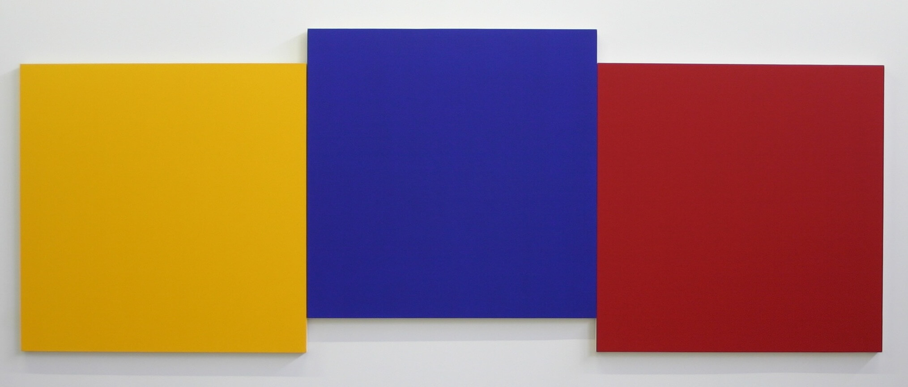
Culminating Task
Yves Gaucher, Yellow, Blue & Red IV, 1999. In two other variations of this work, Gaucher hung the panels in a straight line and in an upward progression (such that the red panel was placed slightly above the blue, and the blue slightly above the yellow).

Slide 21
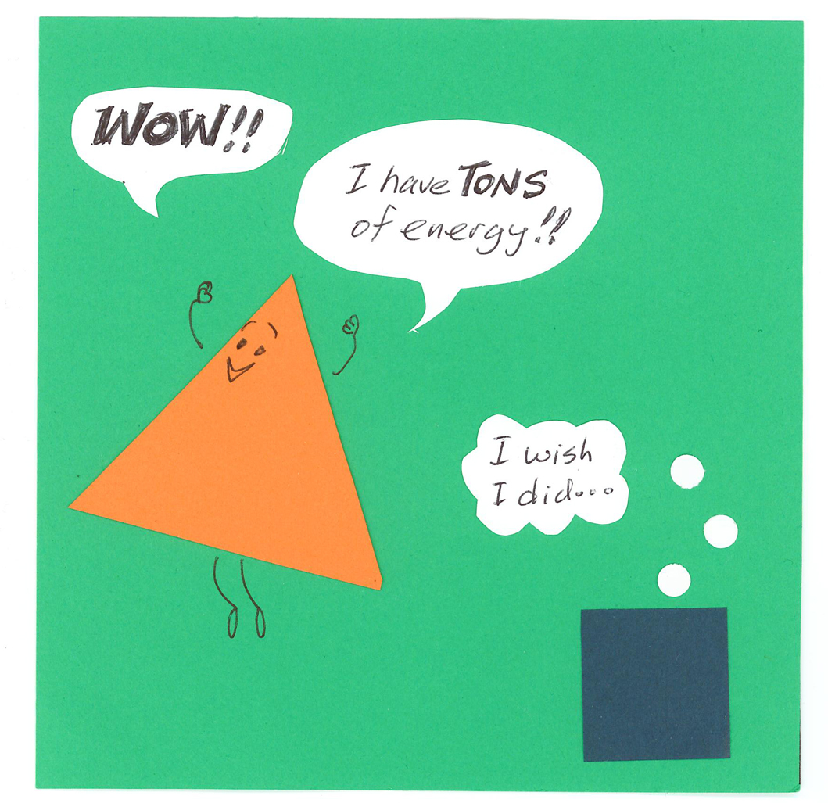
Culminating Task

Slide 22
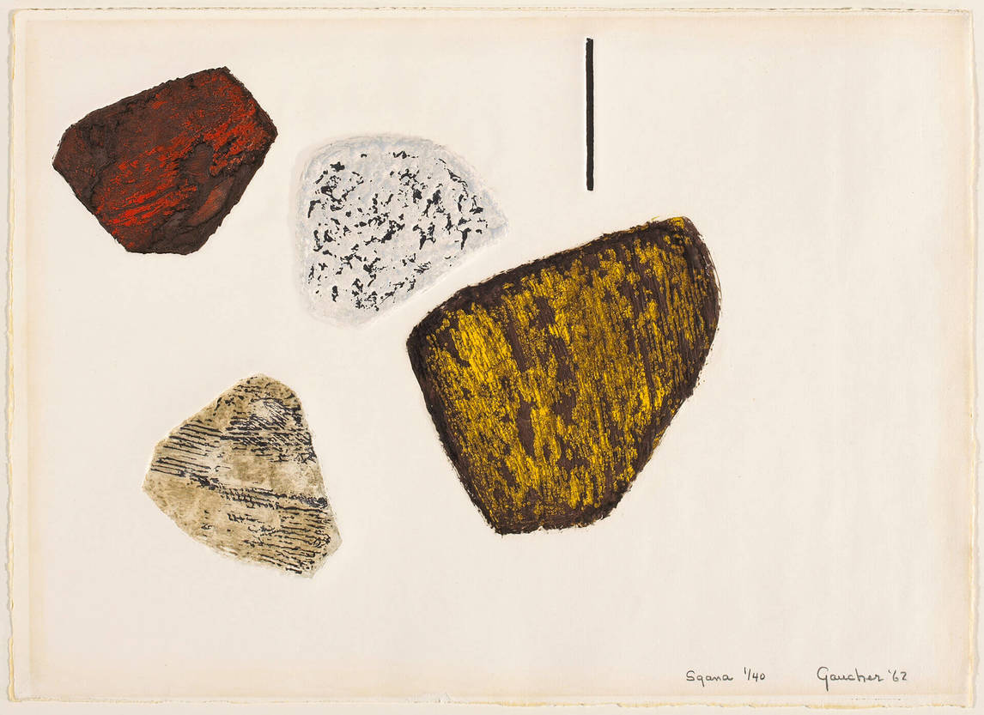
Yves Gaucher, Sgana, 1962. As a young artist, Gaucher acquired his own printing press and began to experiment; he set up the press in his parents’ garage before acquiring his own studio space.

Slide 23
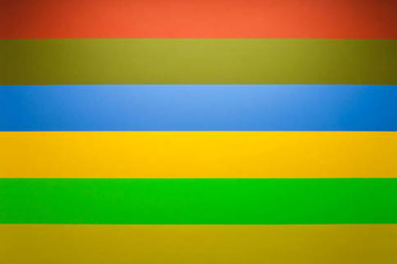
Yves Gaucher, Red, Brown, Blue, Yellow, Green, Ochre No. 11, 1974. Although Gaucher’s compositions can appear simple, he often found he needed to create several versions of a work to capture the precise balance of colours that he envisioned; he often adjusted colours by creating small versions of a painting to test tones and shades.

Slide 24
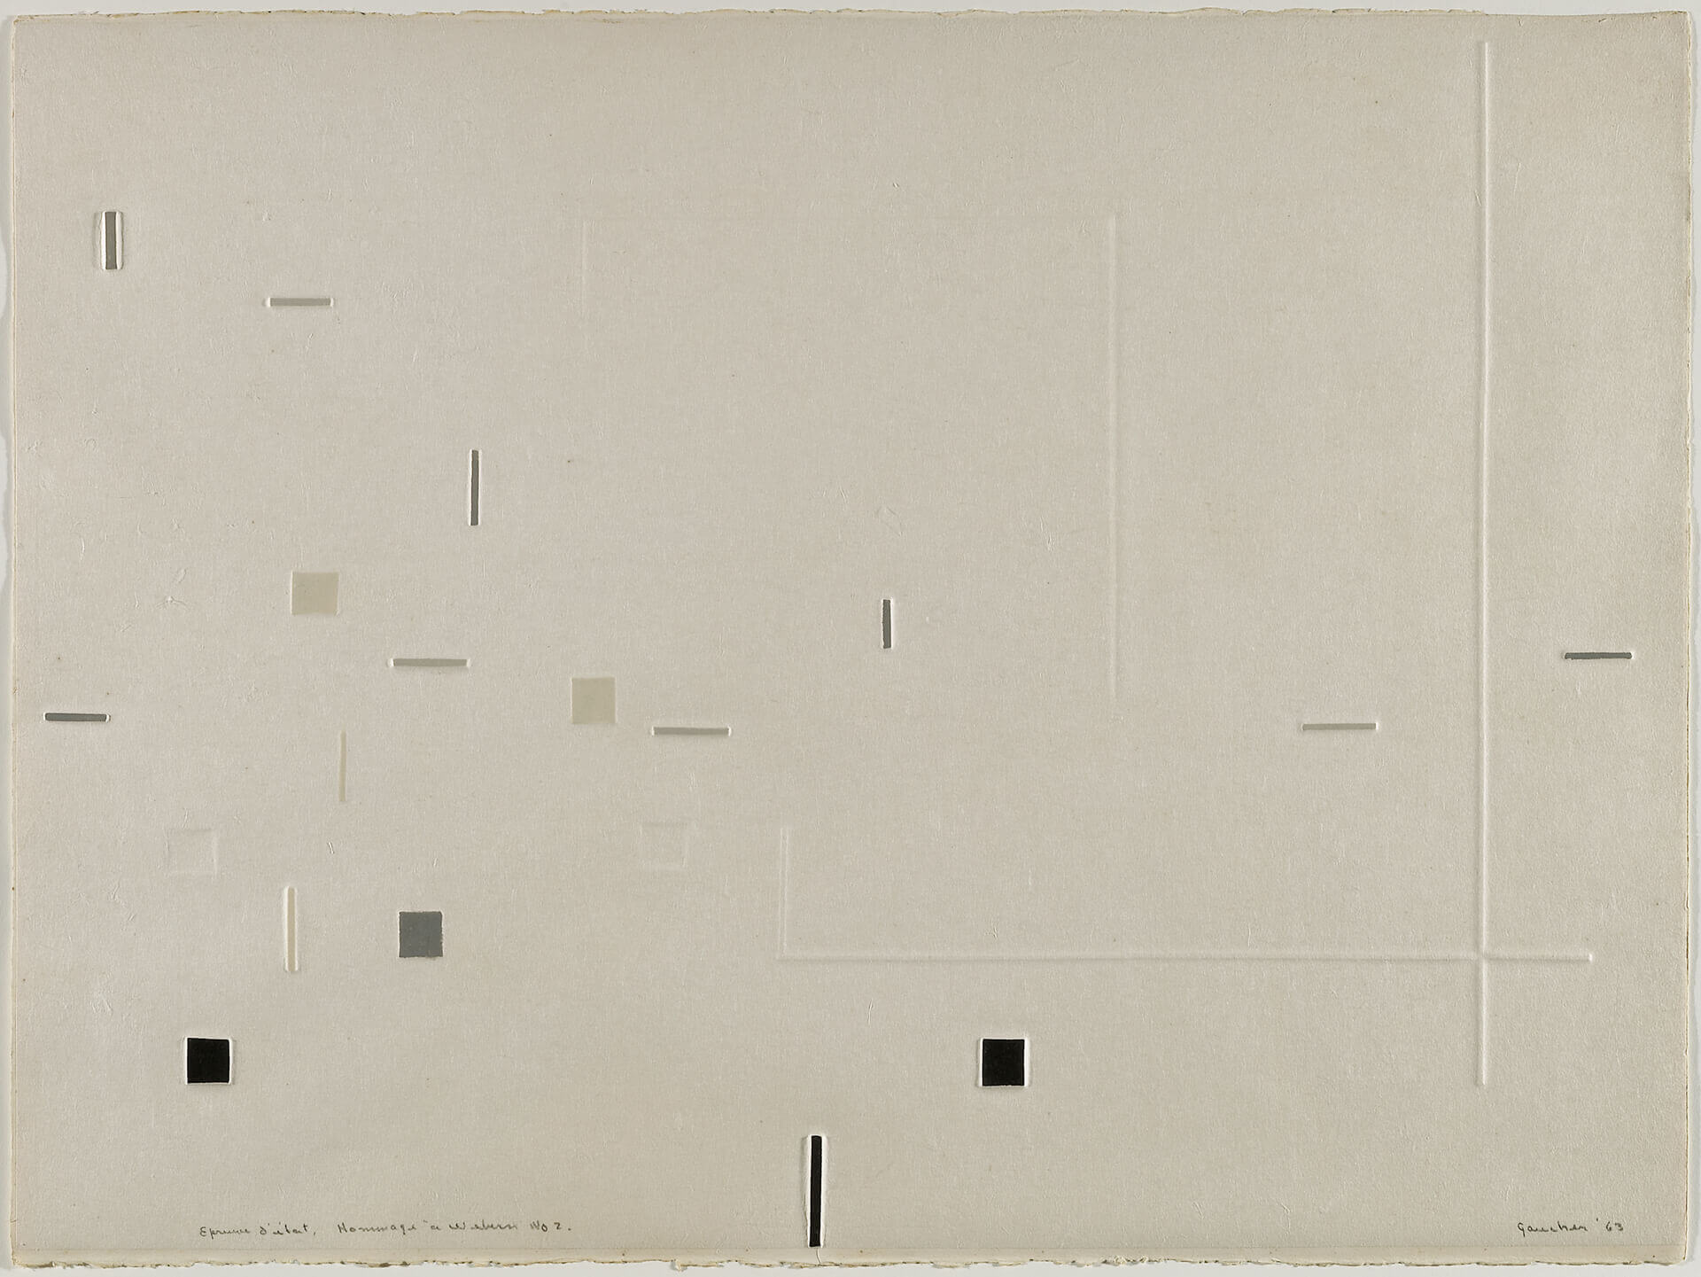
Yves Gaucher, In Homage to Webern No. 2, 1963. In this series of prints Gaucher used lines, squares, and dashes, forms he soon began using in paintings.

Slide 25
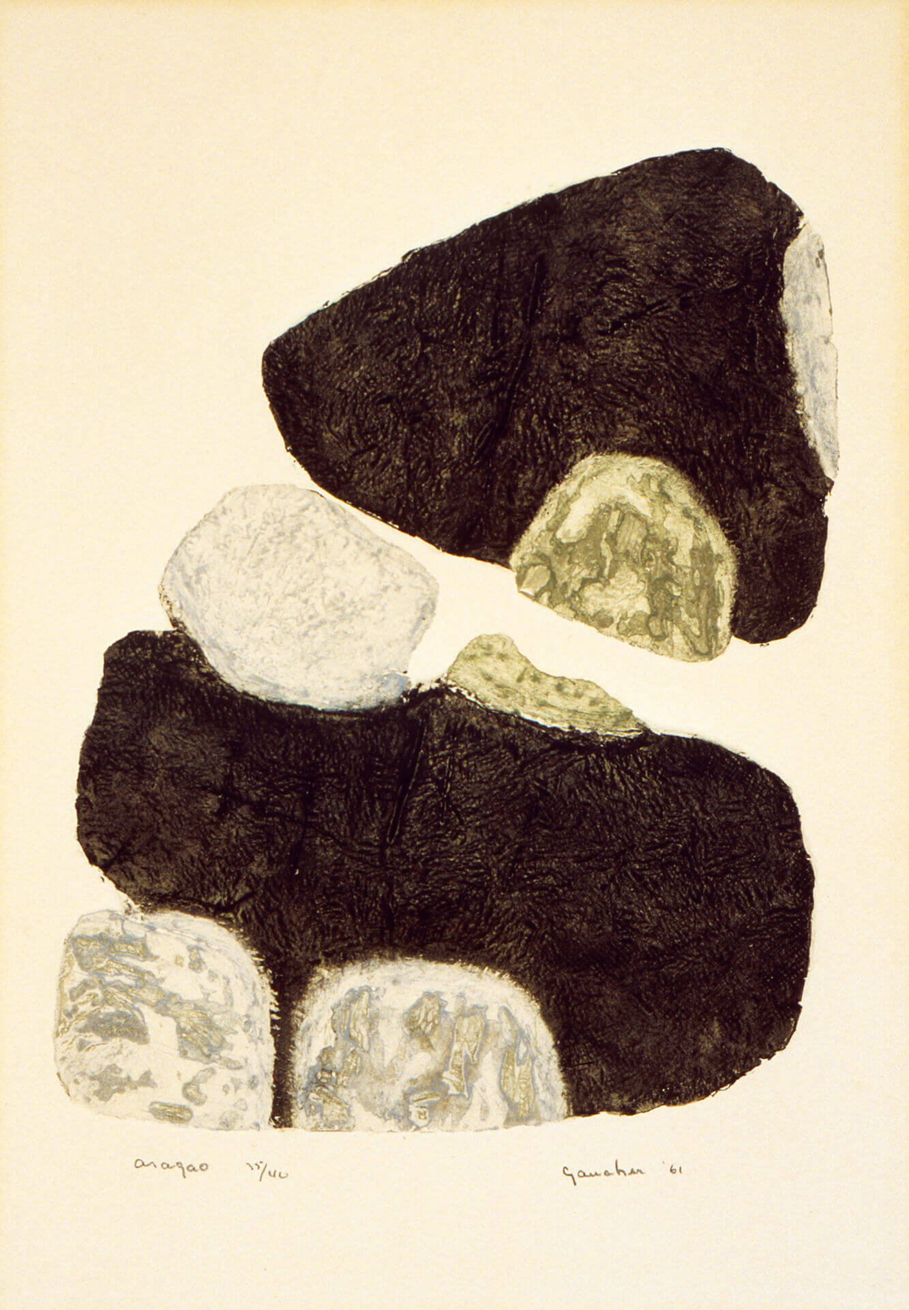
Yves Gaucher, Asagao, 1961. This work is one of Gaucher’s early prints. As a young man, Gaucher was uneasy about the spontaneity in the Automatiste approach to painting; he was drawn to printmaking in part because it required working through a series of steps.

Slide 26
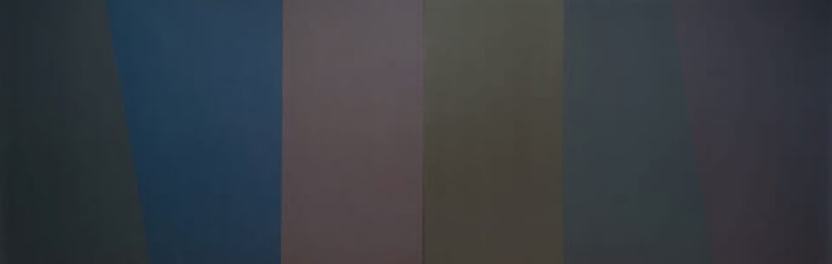
Yves Gaucher, T.D.S., 1988. T.D.S. is part of a series of works known as Gaucher’s Dark Paintings.

