Slide 1
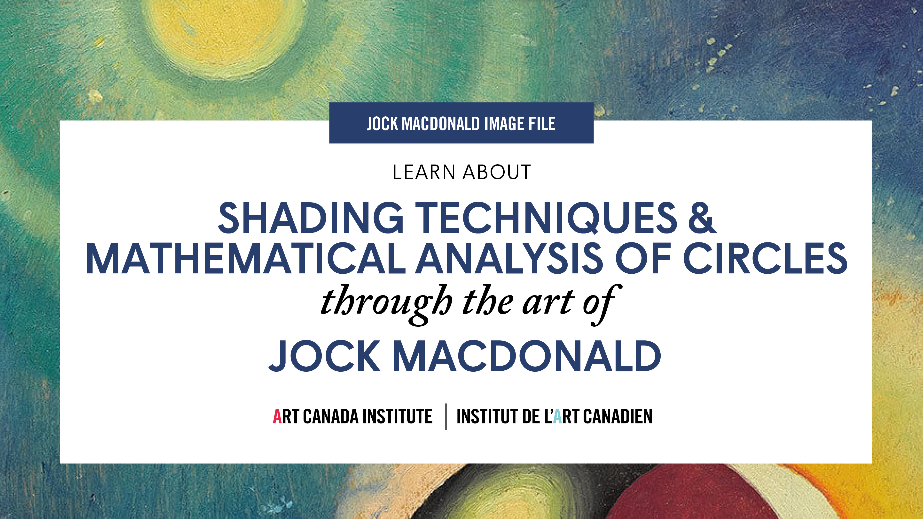

Slide 2
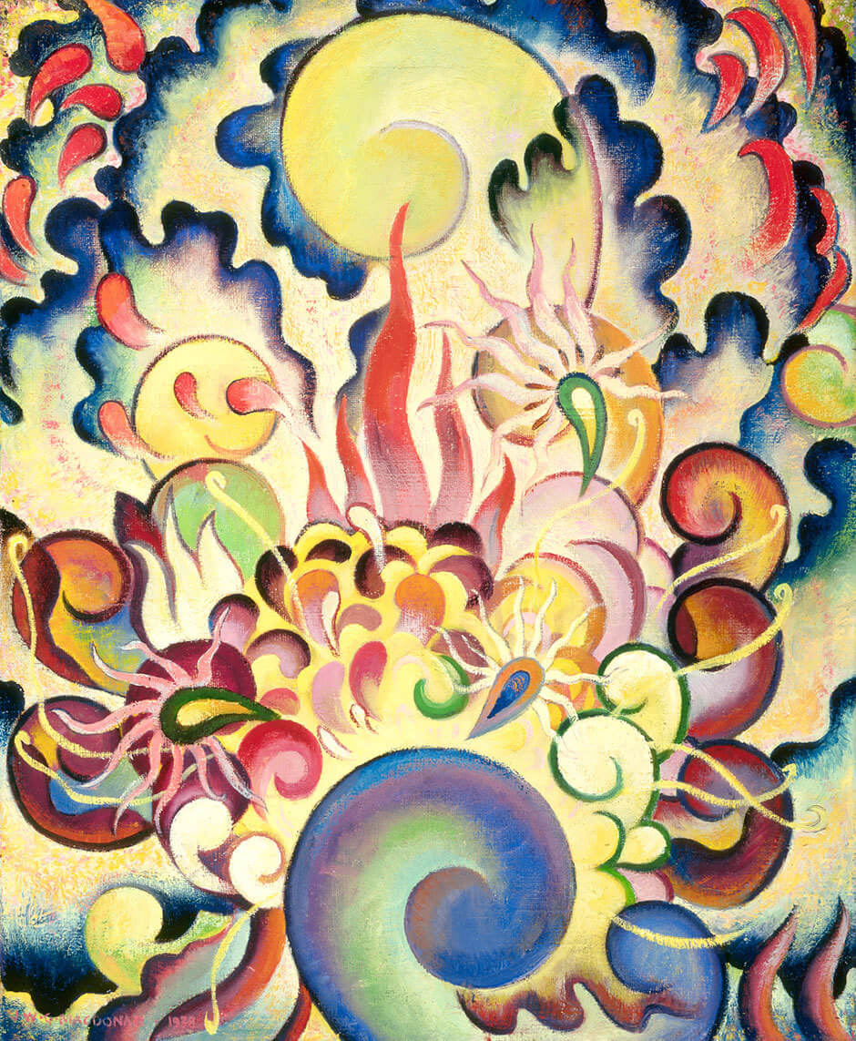
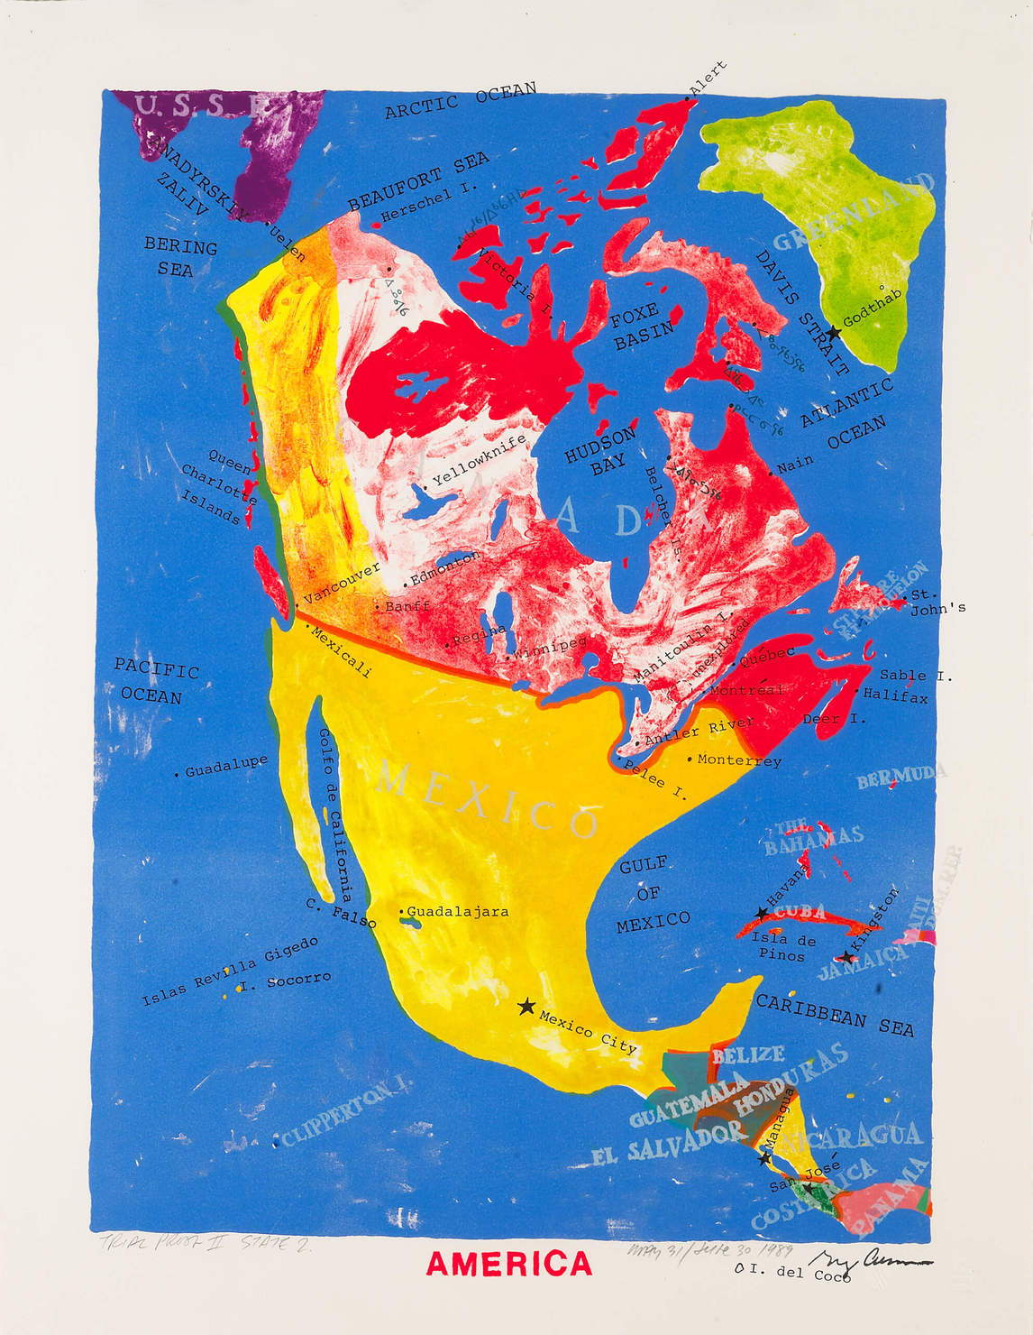
Jock Macdonald, Chrysanthemum, 1938. This work was shown at the Vancouver Art Gallery in 1938—Macdonald was the first B.C. artist to exhibit abstract painting.

Slide 3
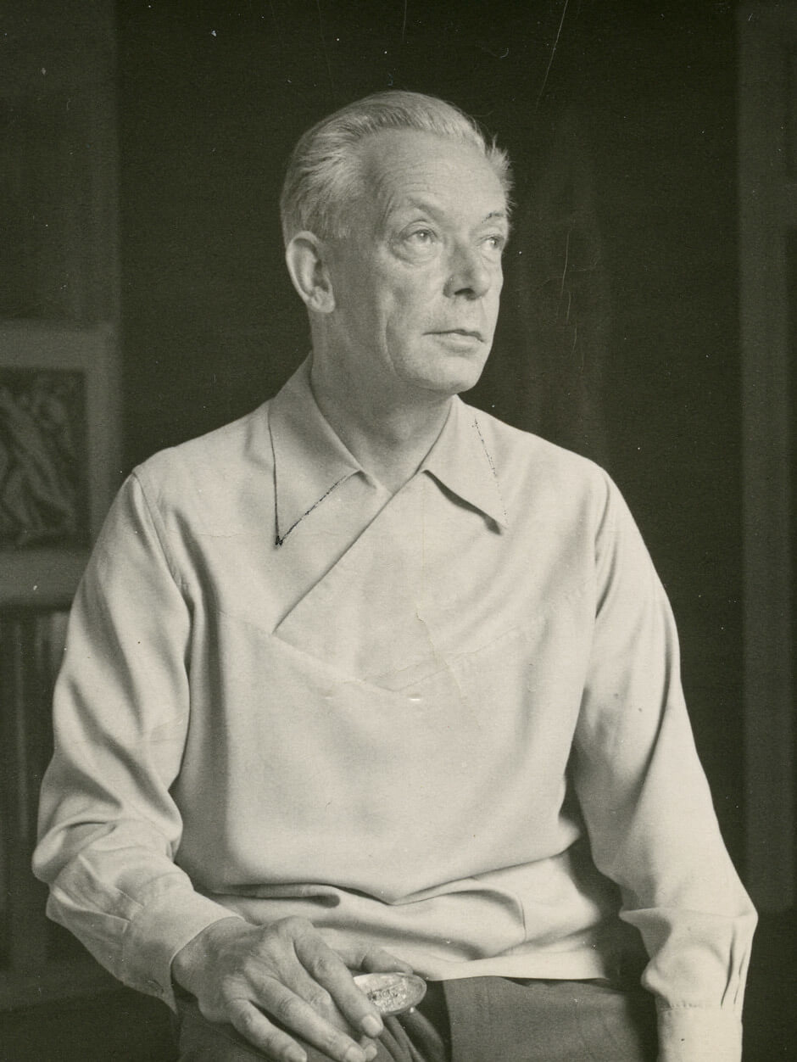
Jock Macdonald, date unknown.

Slide 4
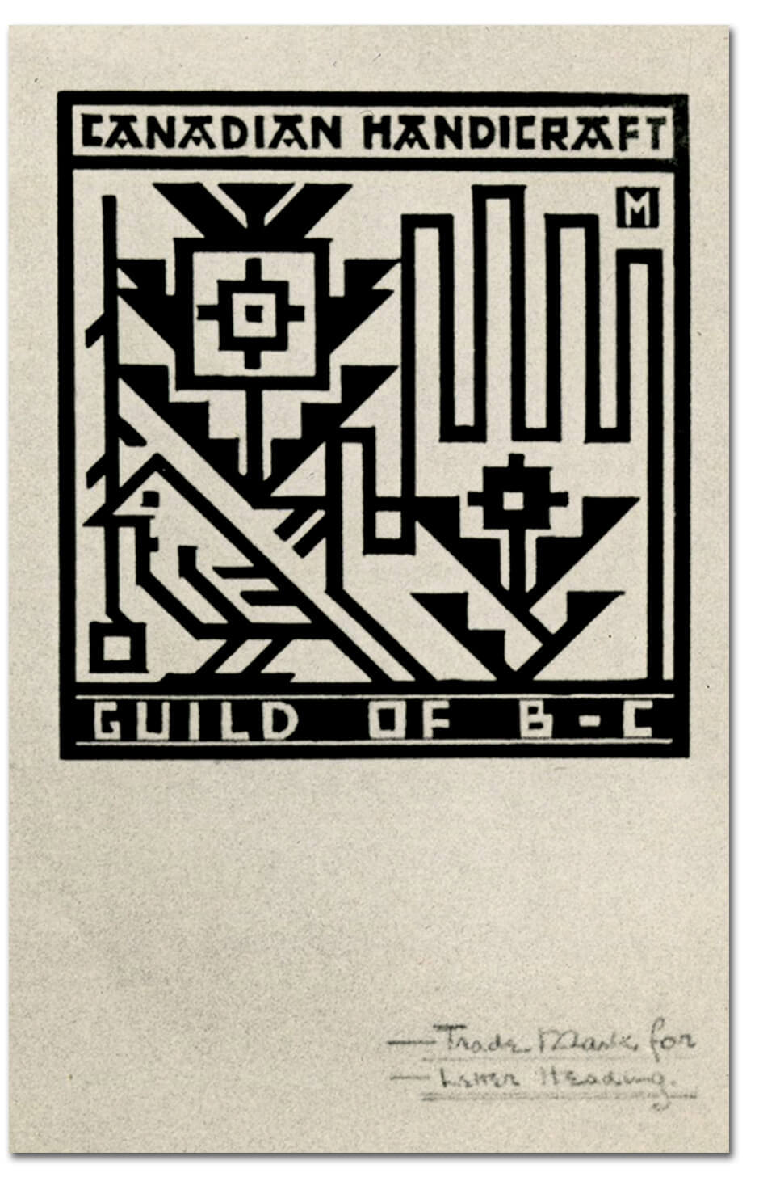
Jock Macdonald’s trademark for the Canadian Handicraft Guild of British Columbia. After moving to B.C., Macdonald occasionally took on design work in addition to teaching.

Slide 5
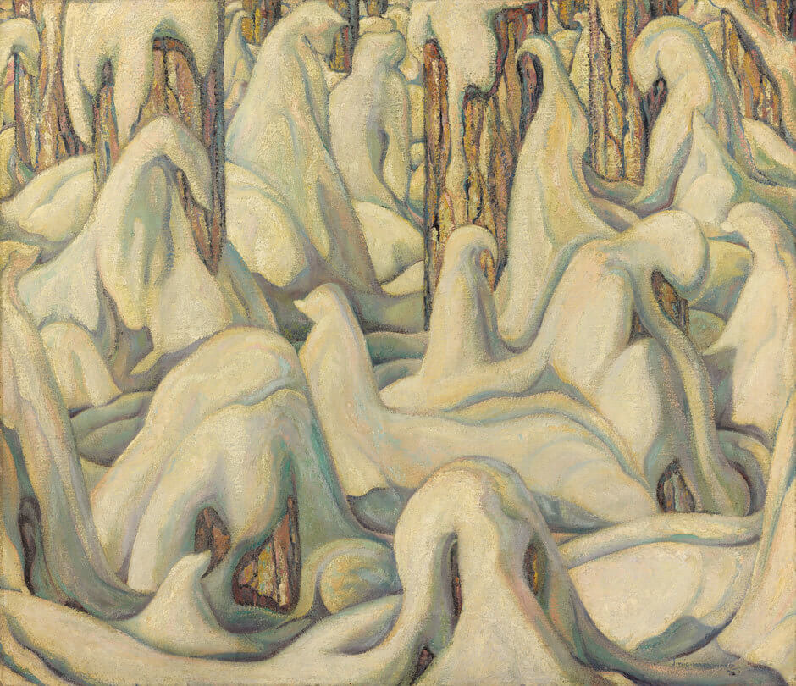
Jock Macdonald, In the White Forest, 1932, oil on canvas,
66 x 76 cm, Art Gallery of Ontario, Toronto, purchase, 1975, 75/38.
© Art Gallery of Ontario.
In the early 1930s Macdonald painted numerous modern landscapes.

Slide 6
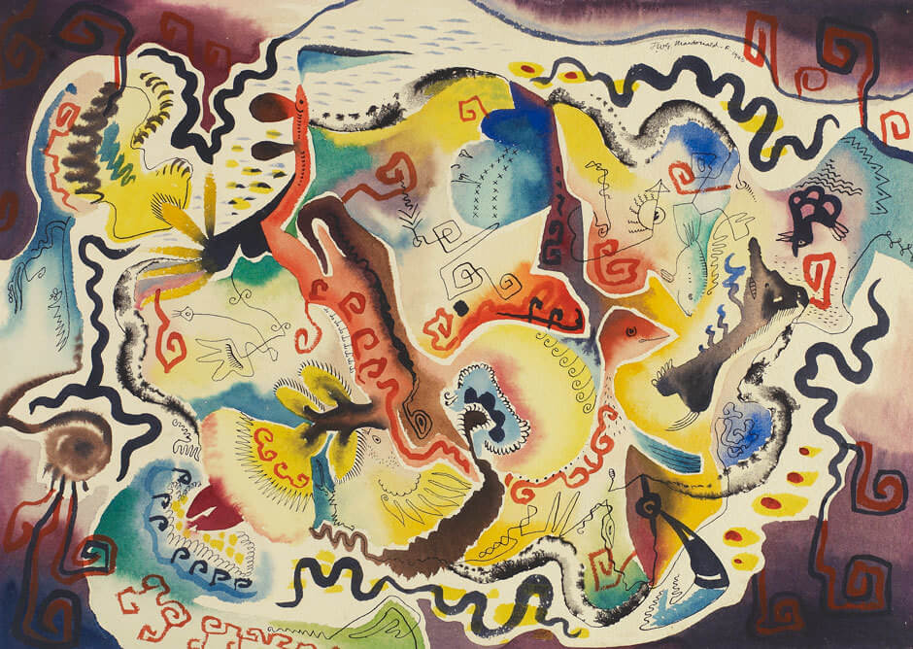
Jock Macdonald, Russian Fantasy, 1946, watercolour and ink on paper, 25.1 × 35.3 cm, Art Gallery of Ontario, Toronto, purchase, Peter Larkin Foundation, 1962 61/45.
© Art Gallery of Ontario.
This work is typical of the automatic watercolour paintings that Macdonald created between 1945
and 1952.

Slide 7
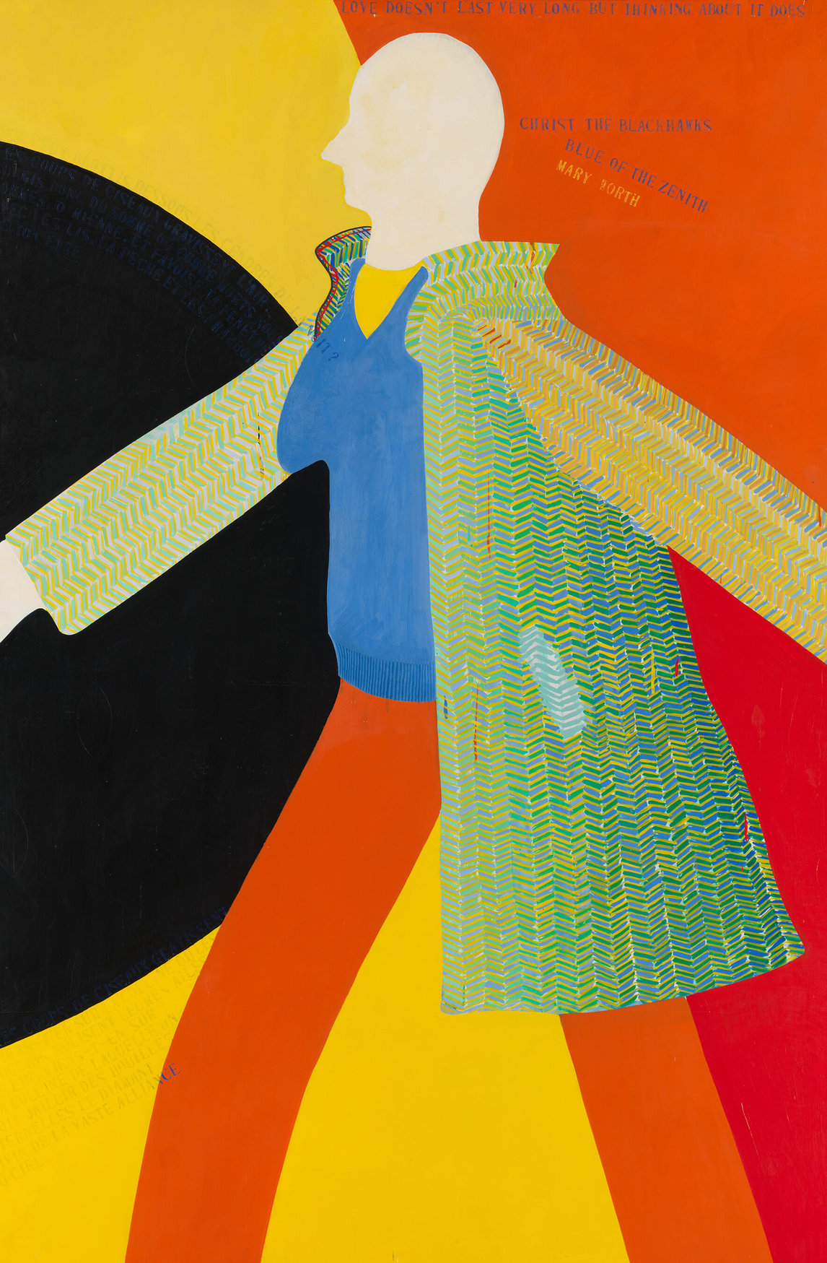
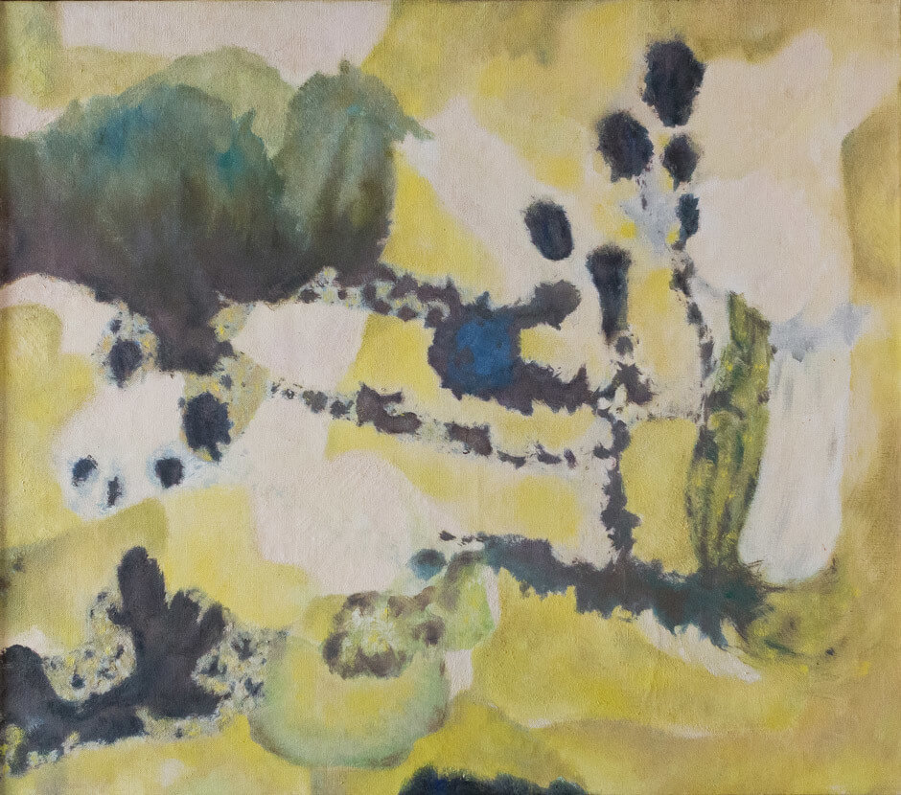
Jock Macdonald, Young Summer, 1959. Macdonald’s final paintings are remarkably delicate.

Slide 8
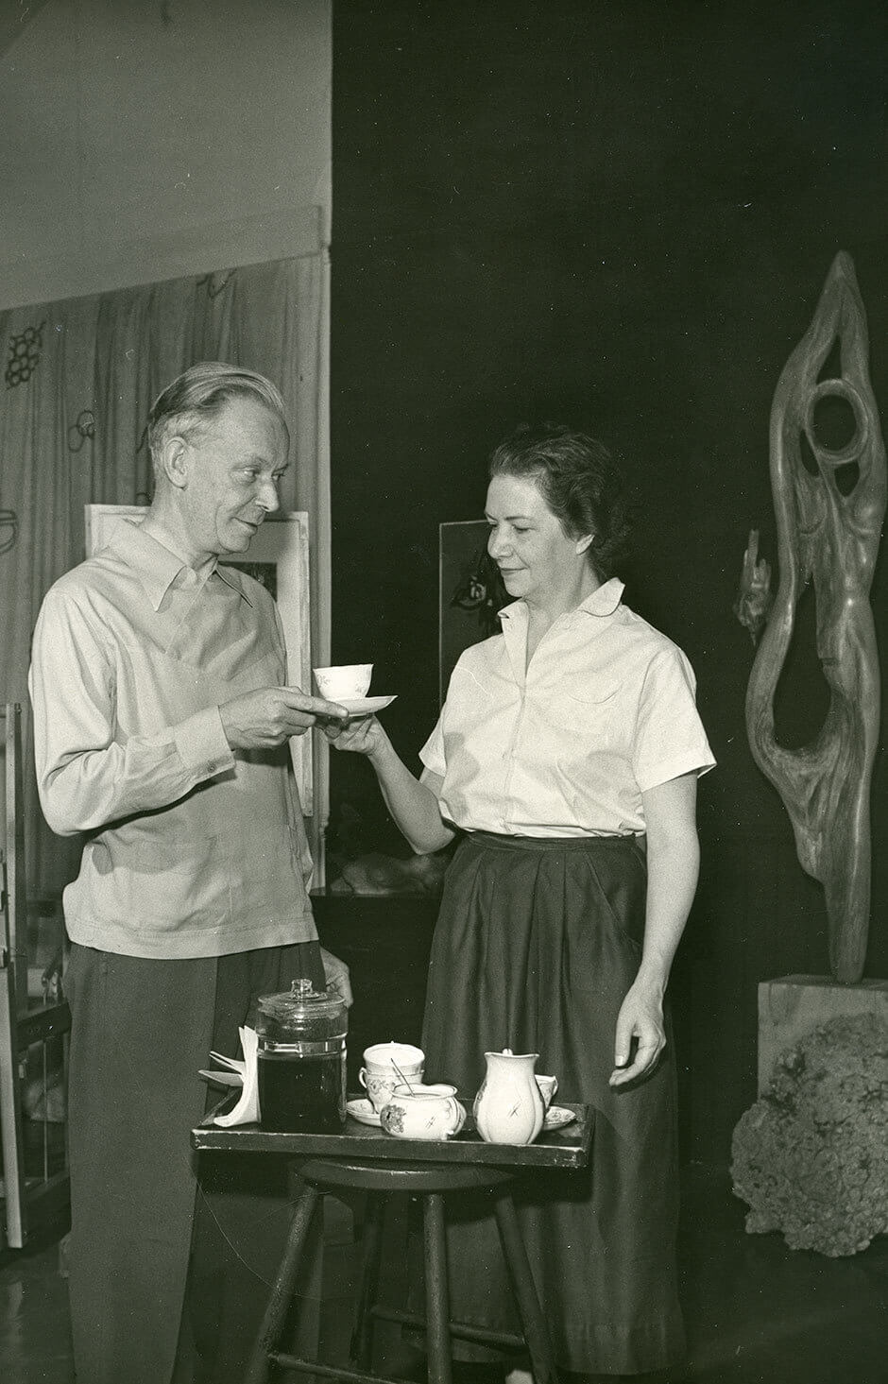
Jock and Barbara Macdonald,
date and photographer unknown.

Slide 9
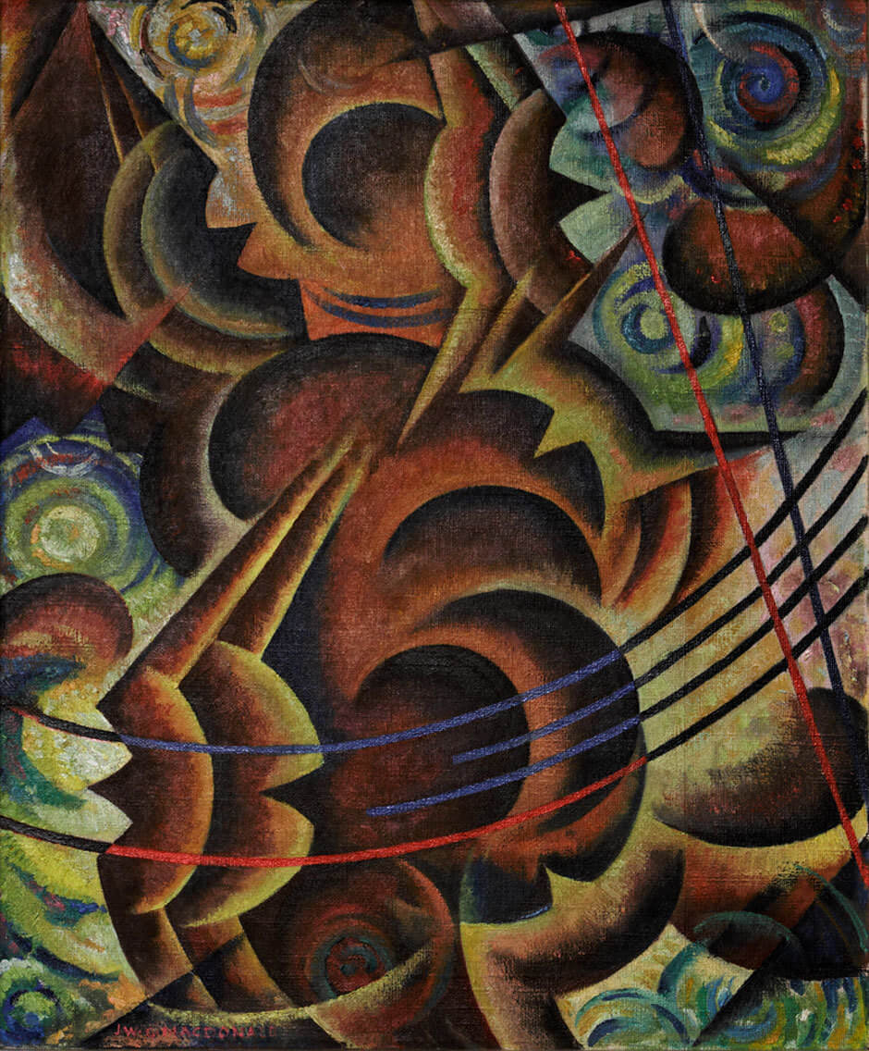
Jock Macdonald, Flight, 1939.
This painting was included in the Canadian Group of Painters exhibition at the Art Gallery of Toronto (now the Art Gallery of Ontario) in 1939.

Slide 10
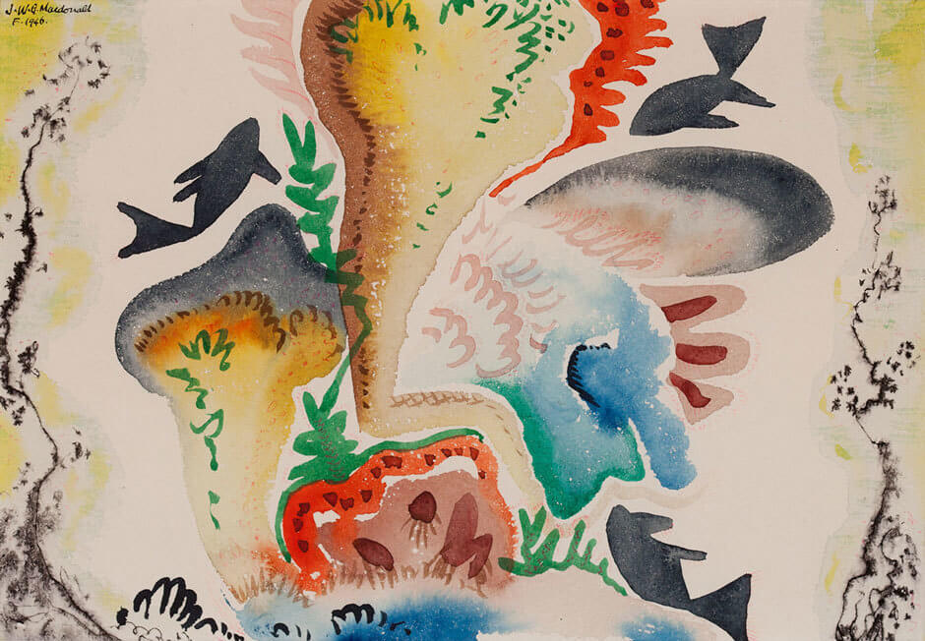
Jock Macdonald, Fish Playground, 1946. Macdonald experienced great joy in painting his automatic watercolours.

Slide 11
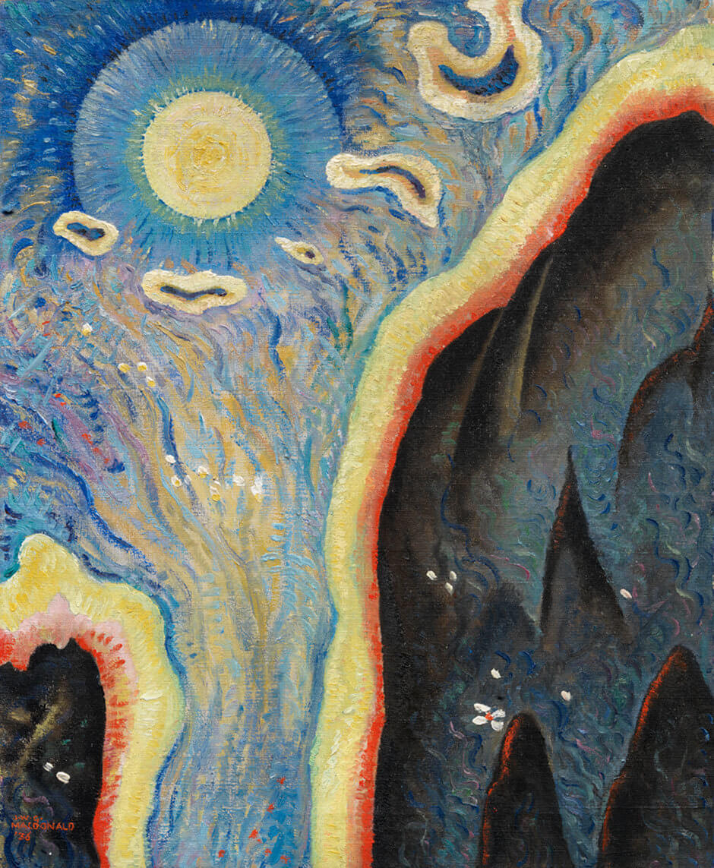
Jock Macdonald, Day Break
(May Morning), c.1937. Beginning in 1936, Macdonald created a series of abstract paintings inspired by nature that he called modalities.

Slide 12
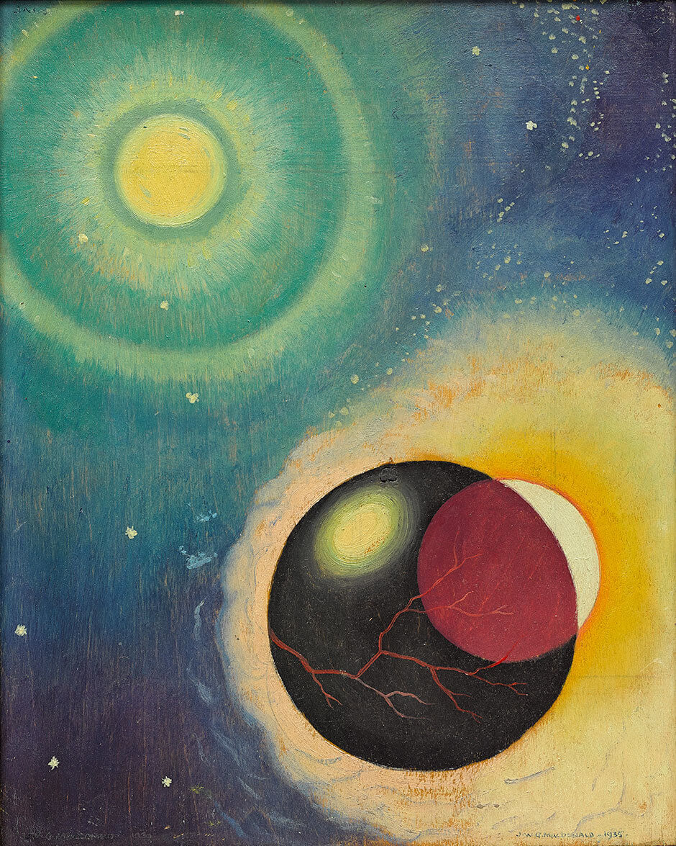
Learning Activity #1
Jock Macdonald, Departing Day, 1935, oil on wood panel, 37.9 x 30.5 cm, Art Gallery of Ontario, Toronto, purchase with assistance from Wintario, 1979, 79/60.1-.2. © Art Gallery of Ontario.
This painting represents an abstracted evening sky—Macdonald was interested in discoveries about the solar system.

Slide 13
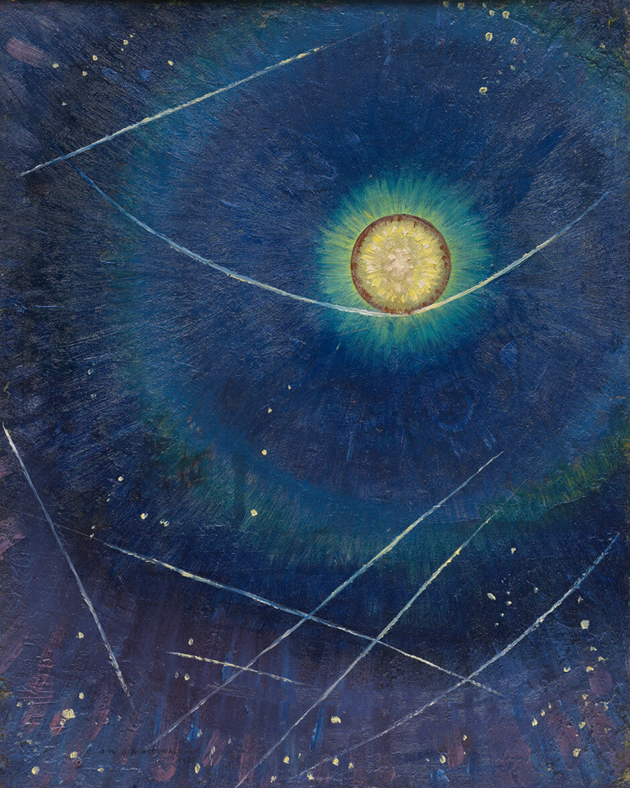
Learning Activity #1
Jock Macdonald, Etheric Form, 1936
(dated 1934). In this work Macdonald uses fine lines and a glowing circle to represent
a symbolic image of balance in the universe.

Slide 14
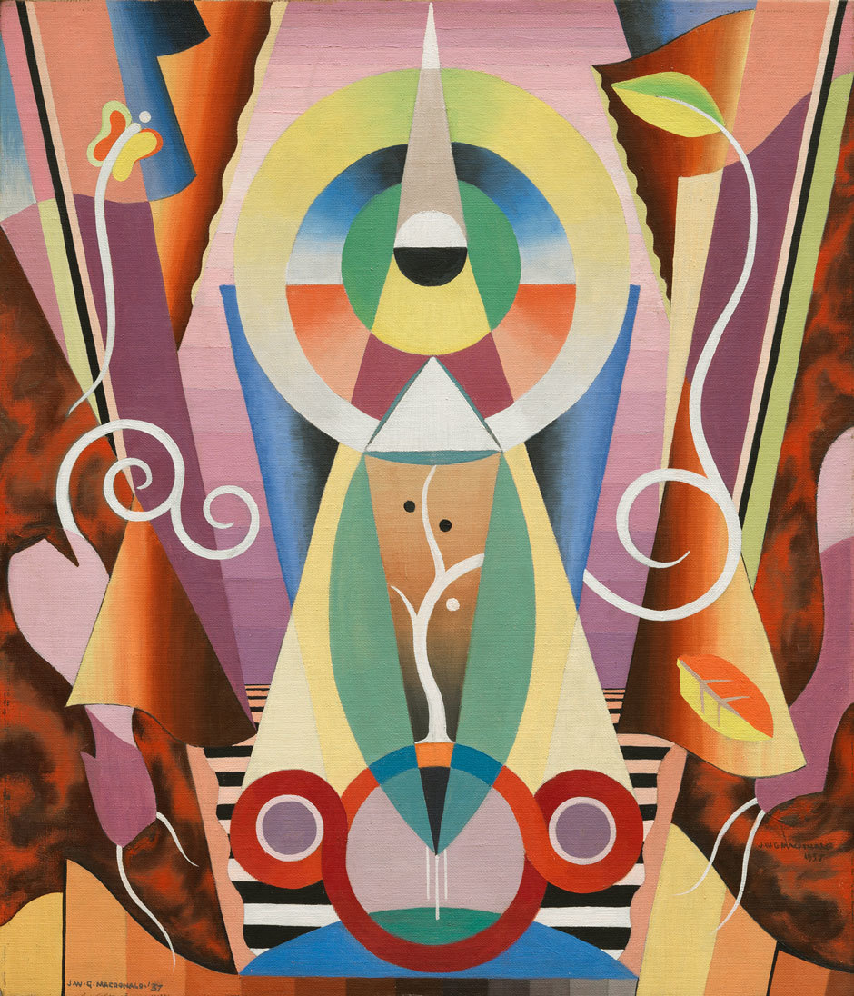
Learning Activity #2
Jock Macdonald, Fall (Modality 16), 1937.
This painting is dominated by abstract
forms, but close looking reveals a tree, leaf, and butterfly.

Slide 15
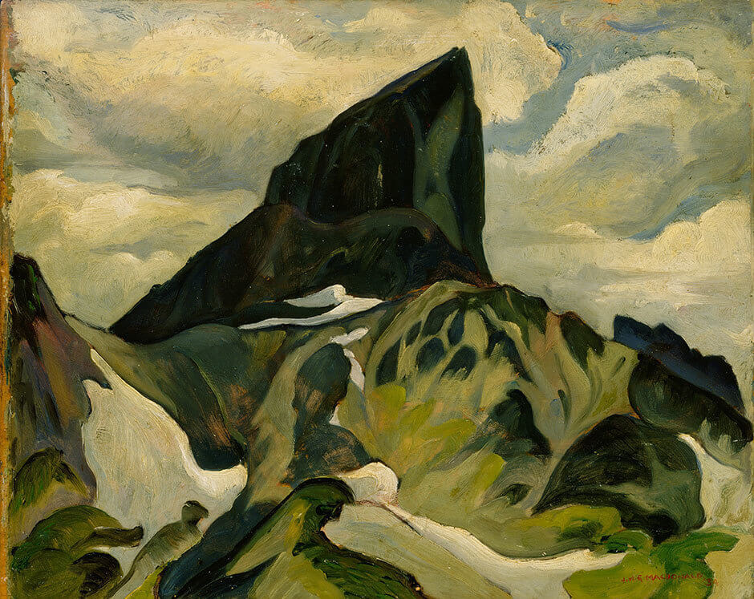
Learning Activity #2
Jock Macdonald, The Black Tusk, Garibaldi Park, 1934. Macdonald began painting in oil because he wanted a new medium to work with when capturing the dramatic landscape in B.C.

Slide 16
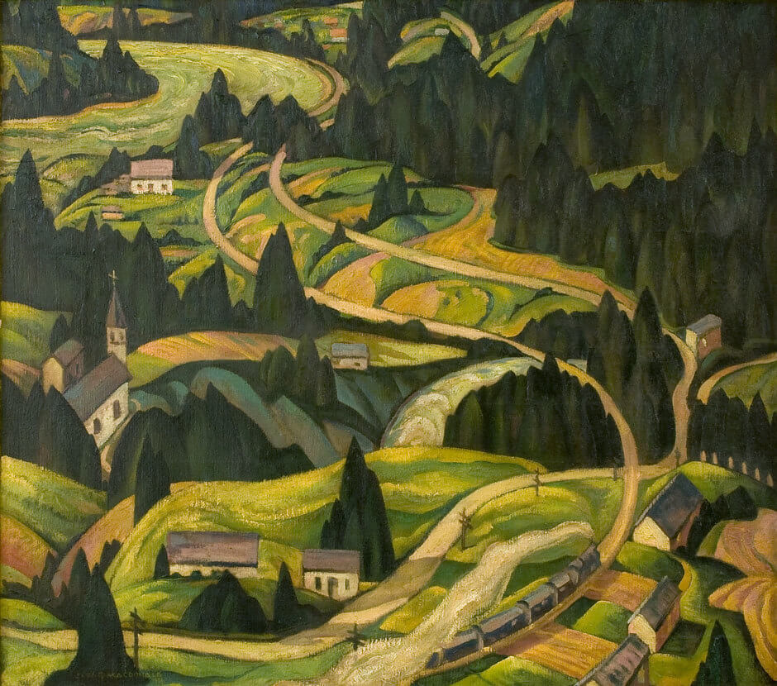
Learning Activity #2
Jock Macdonald, Yale Valley, B.C., c.1932. In the early 1930s Macdonald was interested in making his landscapes more powerful and energetic.

Slide 17
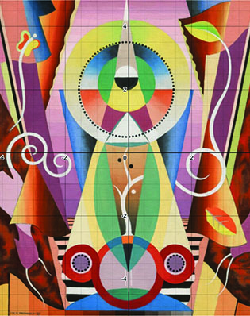
Learning Activity #2
Jock Macdonald’s Fall (Modality 16),
1937, shown with a coordinate grid demonstrating how to analyze the equation of a circle using Desmos.

Slide 18
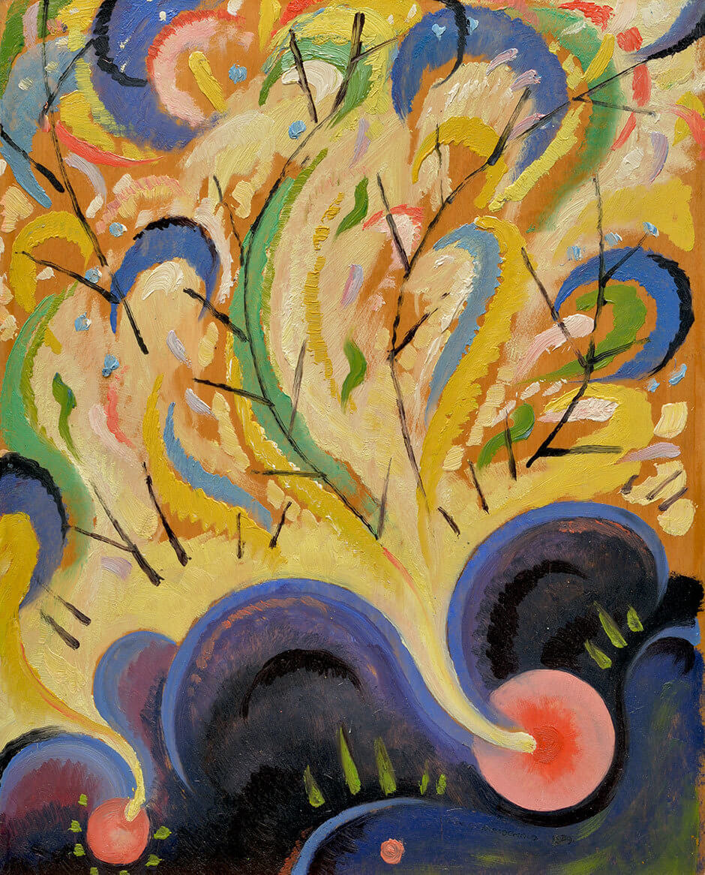
Jock Macdonald, Birth of Spring, 1939.
In this painting Macdonald tried to break away from using structured, straight lines in his work.

Slide 19
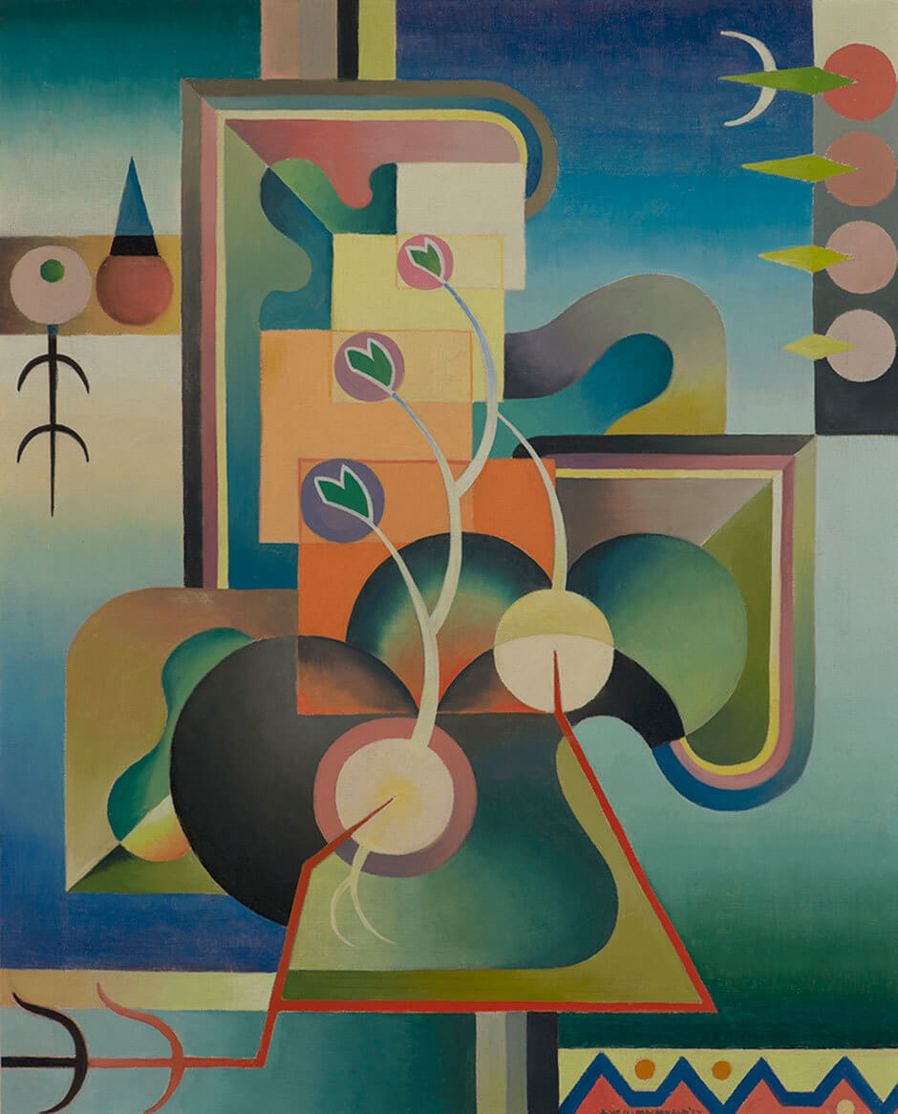
Culminating Task
Jock Macdonald, Spring Awakening,
c.1938. One of a series of paintings representing the seasons, this work is strongly geometric in style.

Slide 20
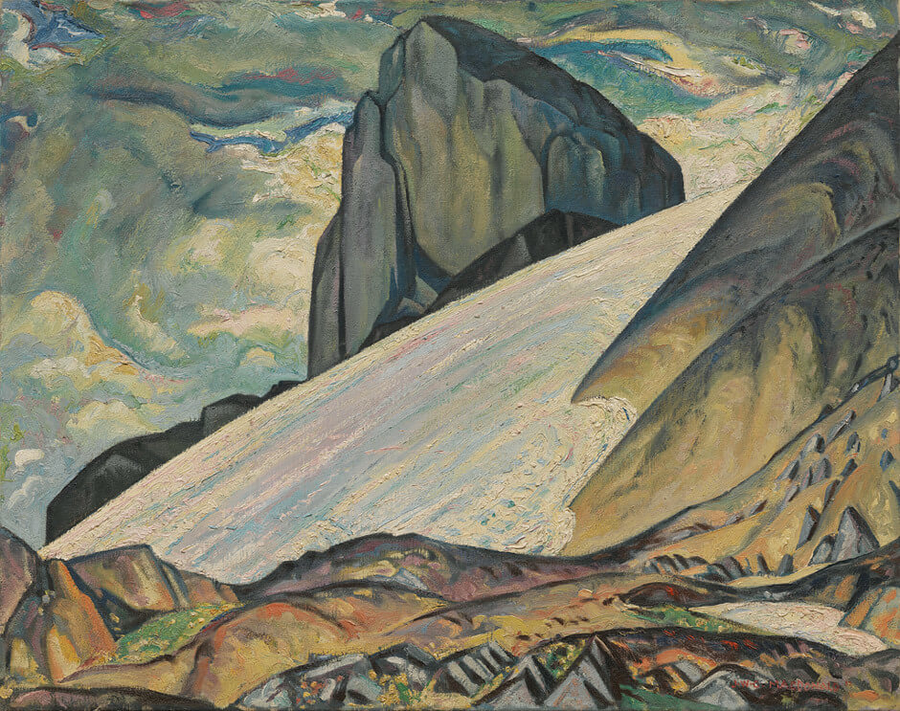
Jock Macdonald, The Black Tusk, Garibaldi Park, B.C.,
1932. Macdonald and Varley often painted in Garibaldi
Park together.

Slide 21
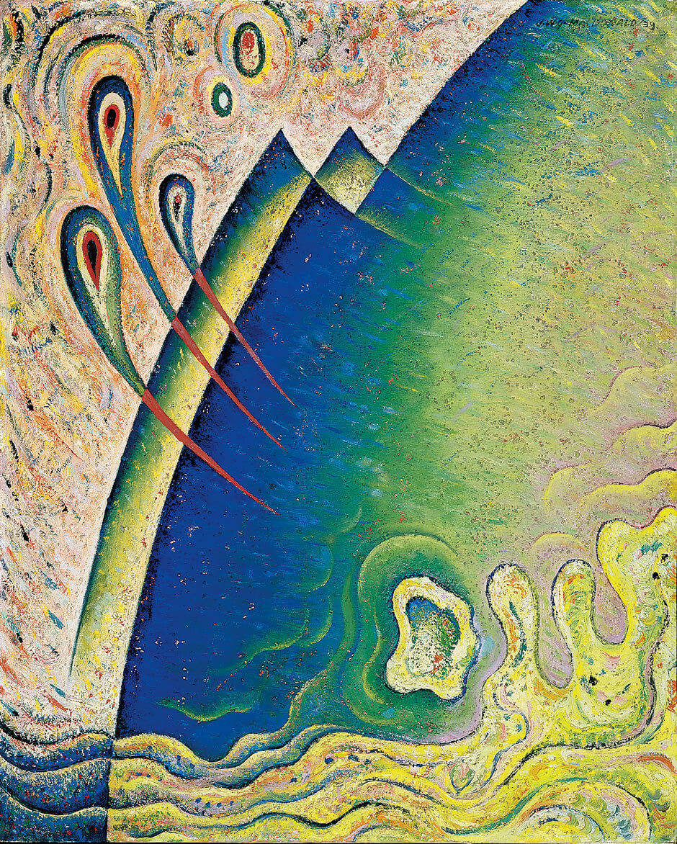
Jock Macdonald, The Wave,
1939. For this modality, Macdonald mixed sand into his paint.

Slide 22
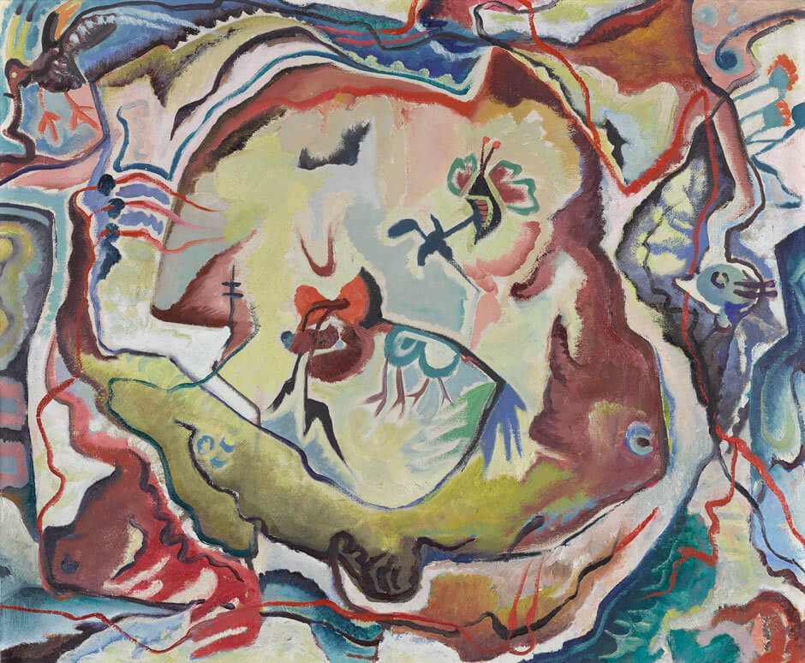
Jock Macdonald, Untitled, 1948, oil on canvas, 69.8 x 83.8 cm,
Art Gallery of Ontario, Toronto, purchase with assistance from Wintario, 1977, 77/61.
© Art Gallery of Ontario.
Macdonald’s automatic paintings were widely admired by other artists.

Slide 23
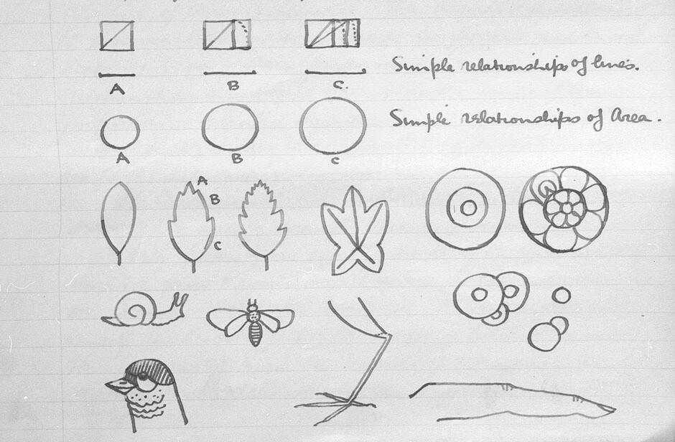
Jock Macdonald, notes
for “Art in Relation to Nature,” 1940. Macdonald’s lecture notes include geometric diagrams.

