Slide 1
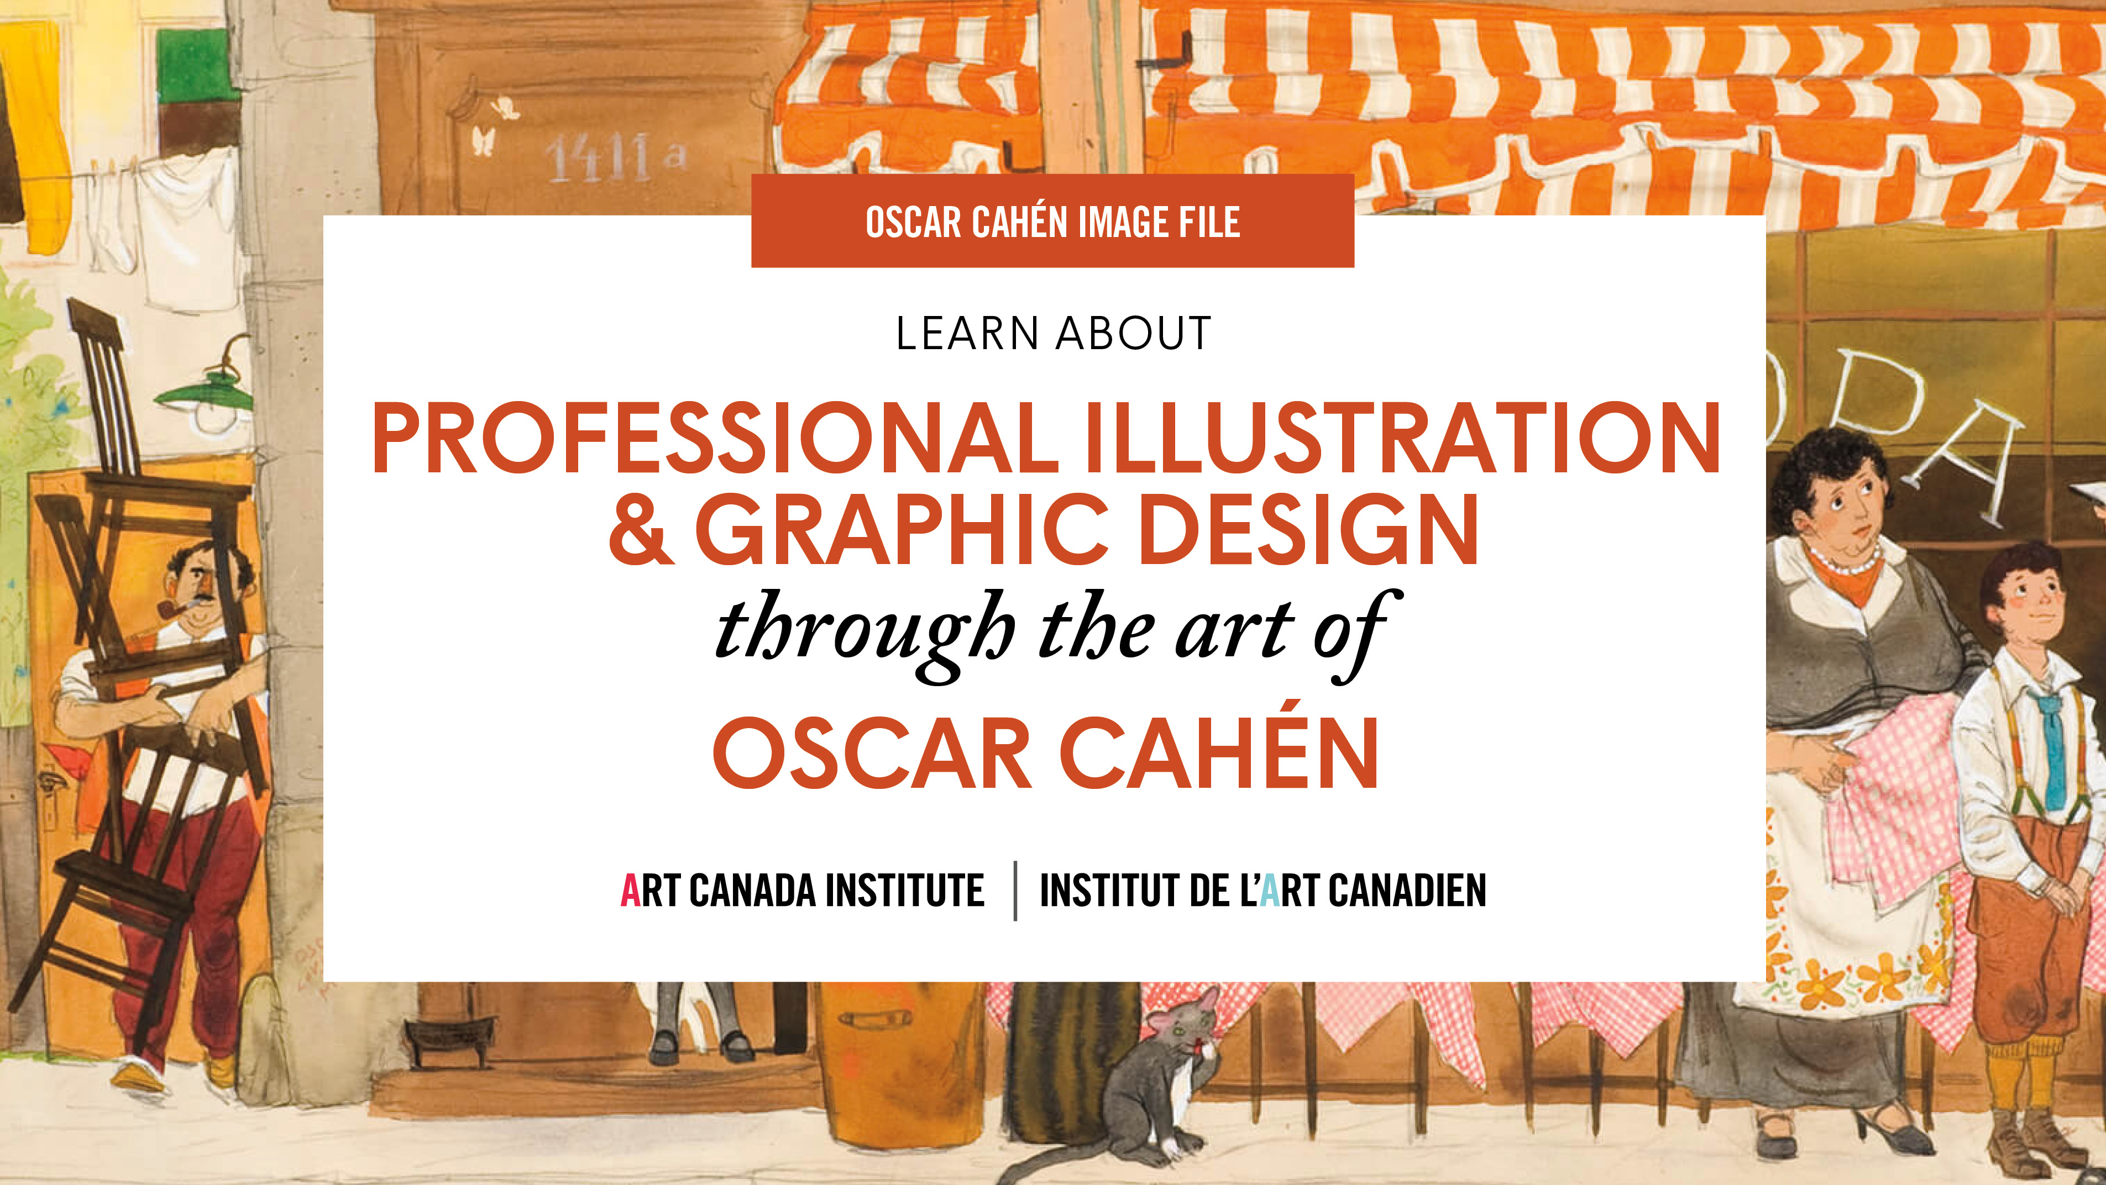

Slide 2
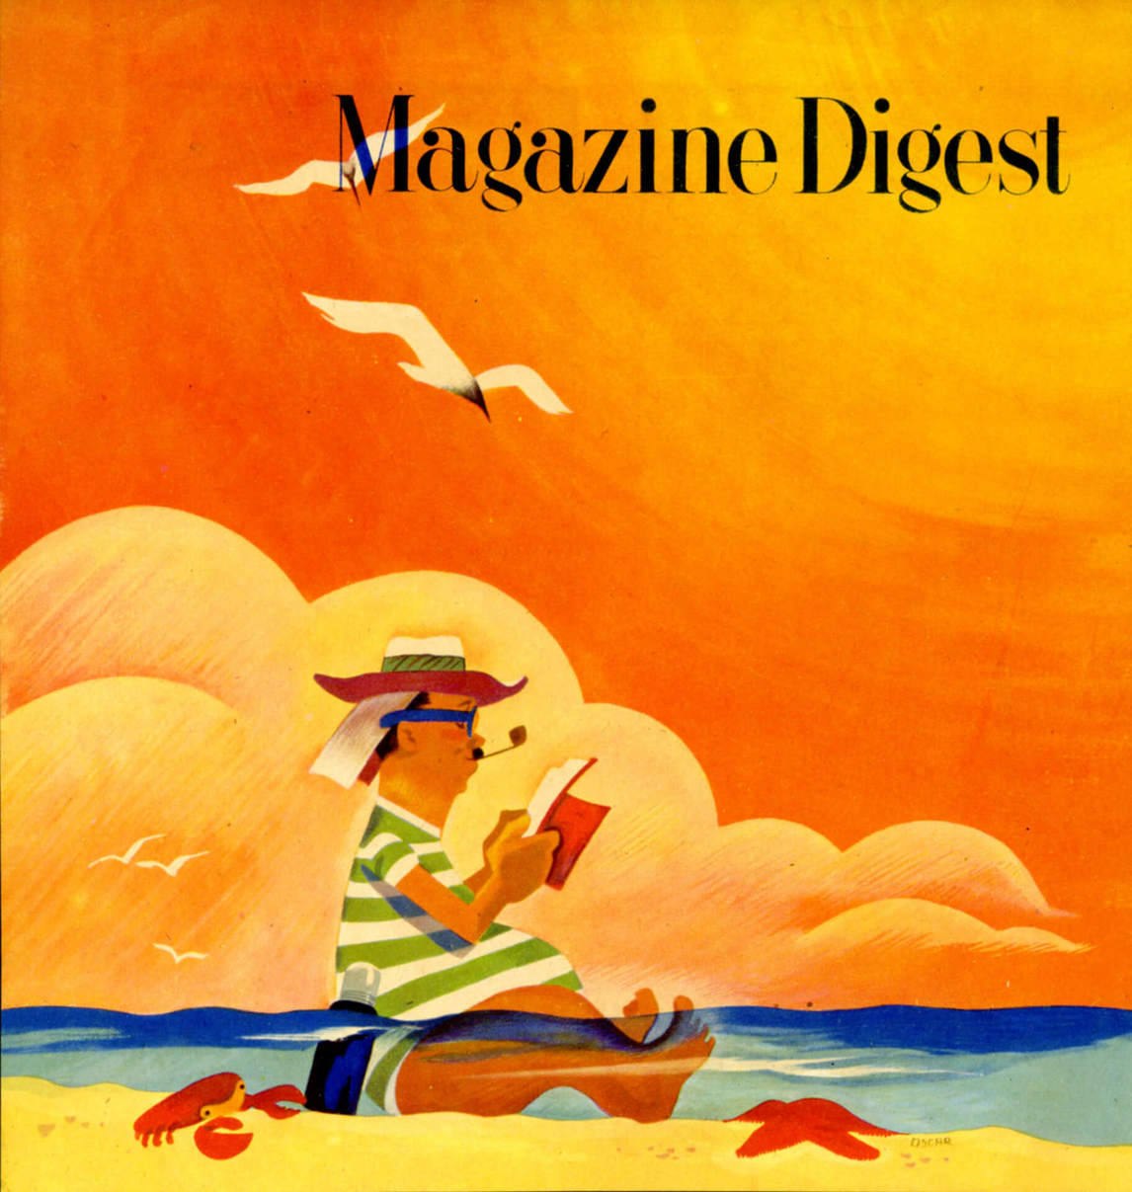
Printer’s proof for Oscar Cahén’s Magazine Digest cover design, c.1946. Cahén became the art director for Magazine Digest in late 1944.

Slide 3
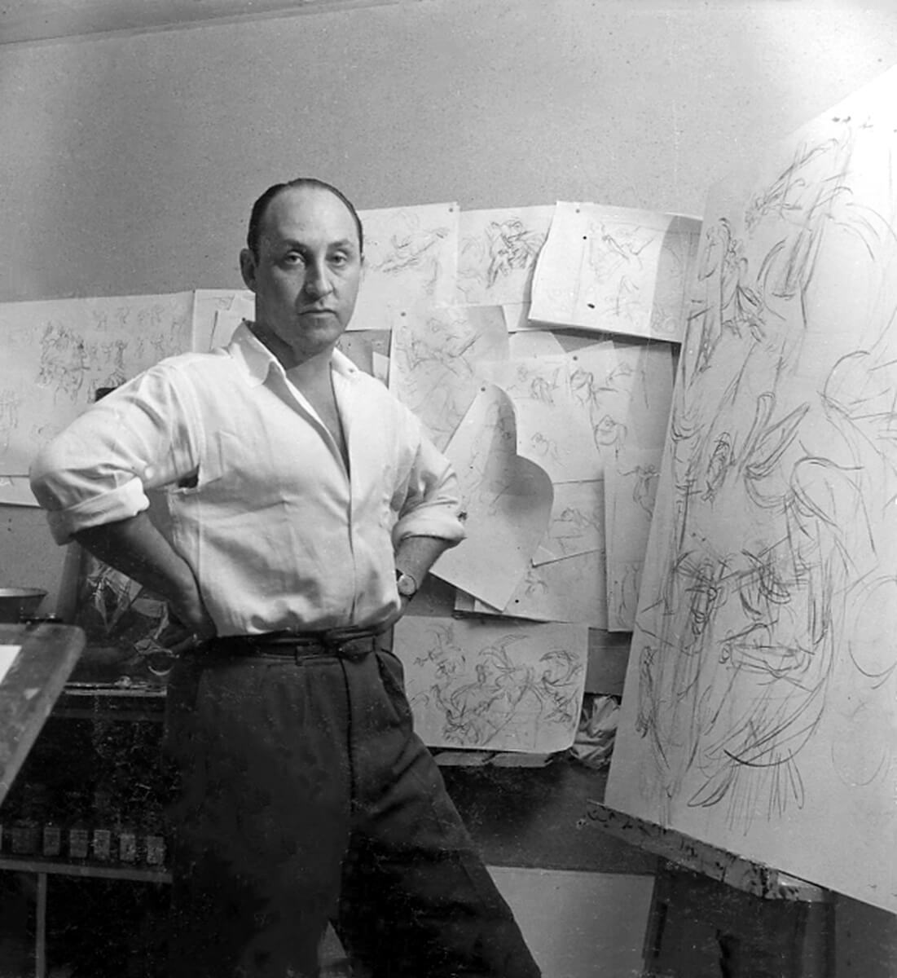
Portrait of Oscar Cahén in his studio in 1951.

Slide 4
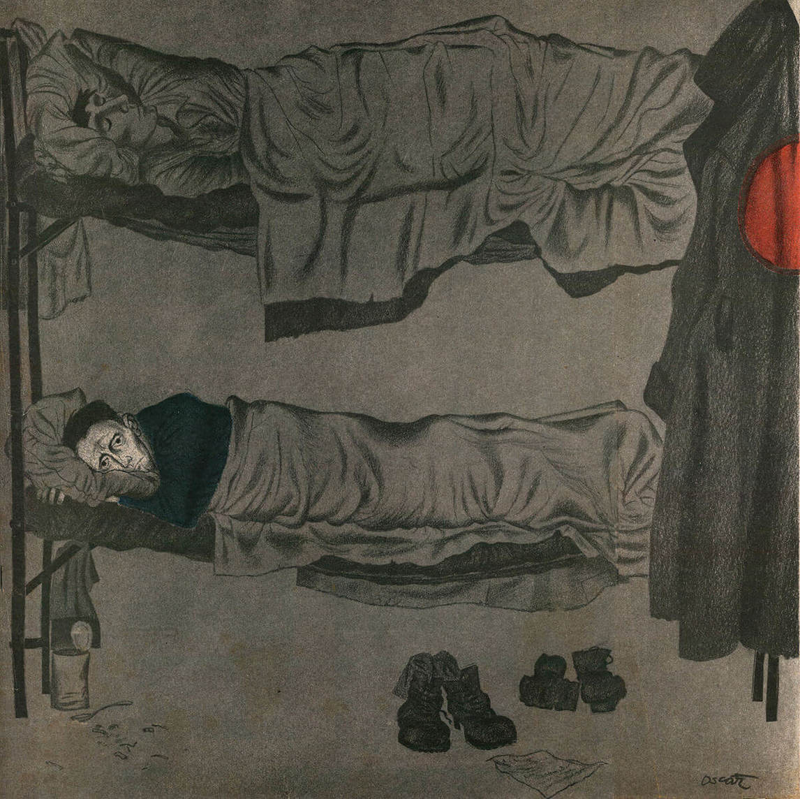
Oscar Cahén’s illustration for the short story, “Mail,” by John Norman Harris, Maclean’s, 1950. This story is set in a Nazi prison camp during the Second World War.

Slide 5
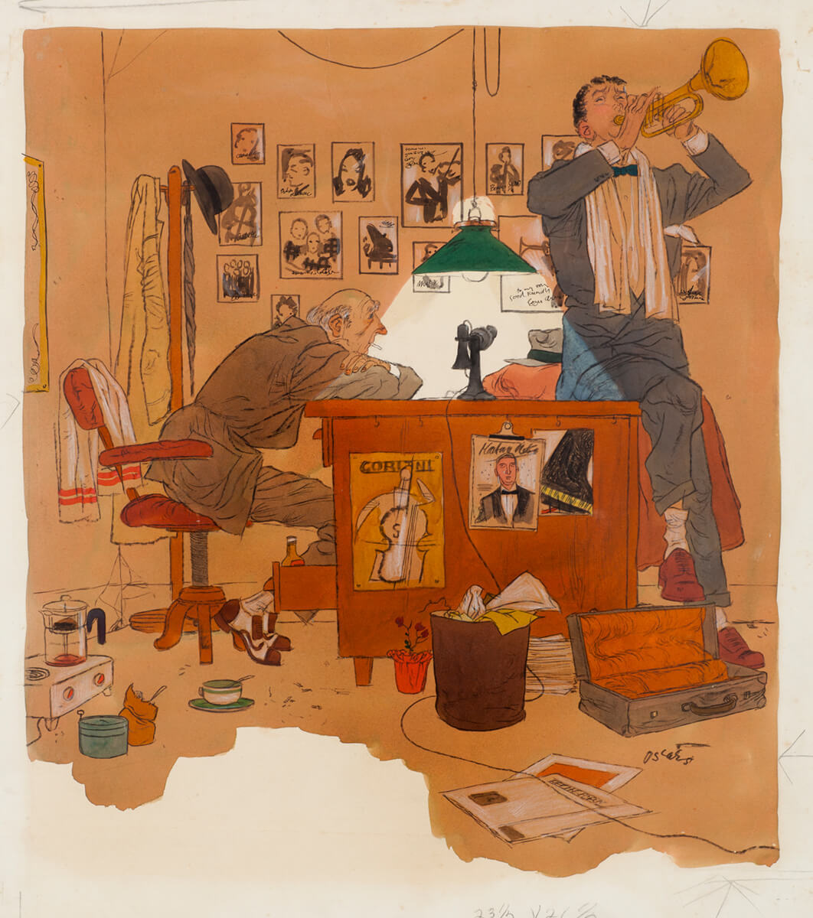
Oscar Cahén, illustration for “When Johnny Lifted the Horn,” Weekend Picture Magazine, 1951. For this work Cahén used gouache, watercolour, India ink, and graphite.

Slide 6
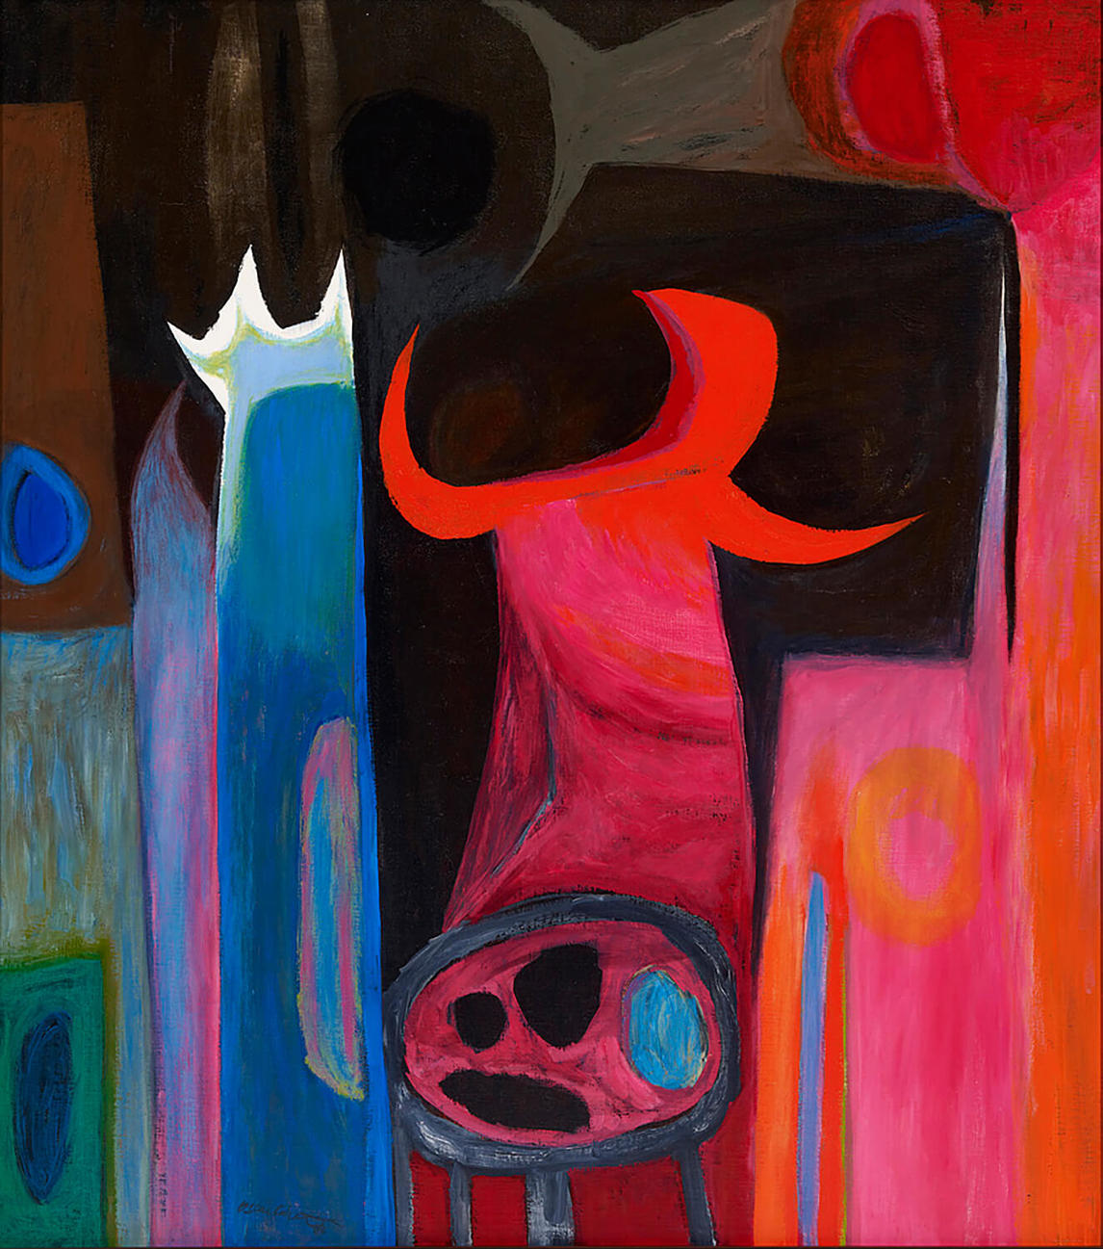
Oscar Cahén, Subjective Image, c.1954. This painting reflects Cahén’s interest in dramatic colours, especially pink and orange.

Slide 7
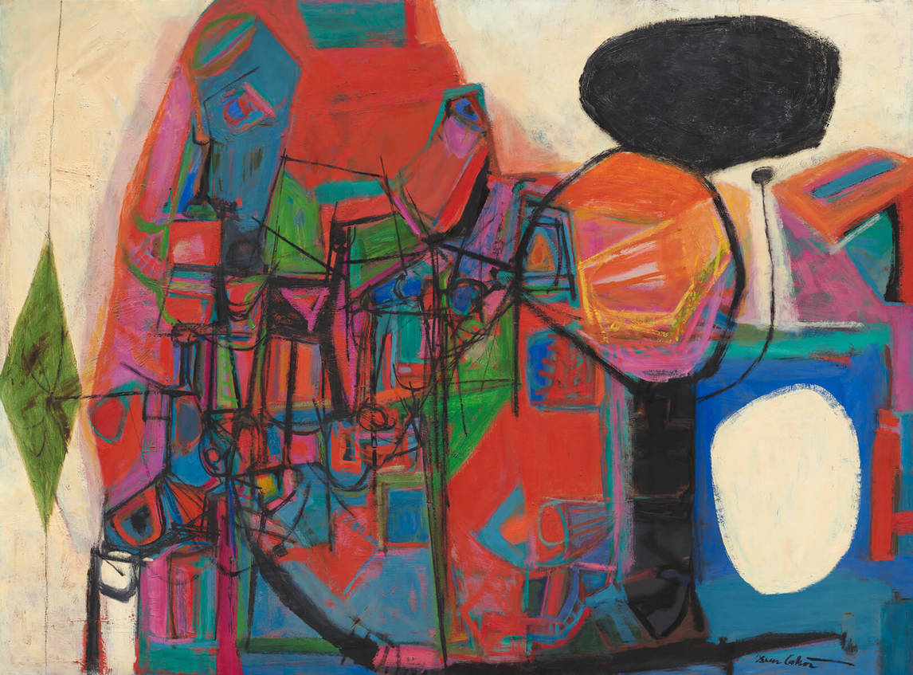
Oscar Cahén, Austin Healey 100 Engine, 1954. Inspired by a beloved sportscar, this image represents the forms and roar of a powerful engine.

Slide 8
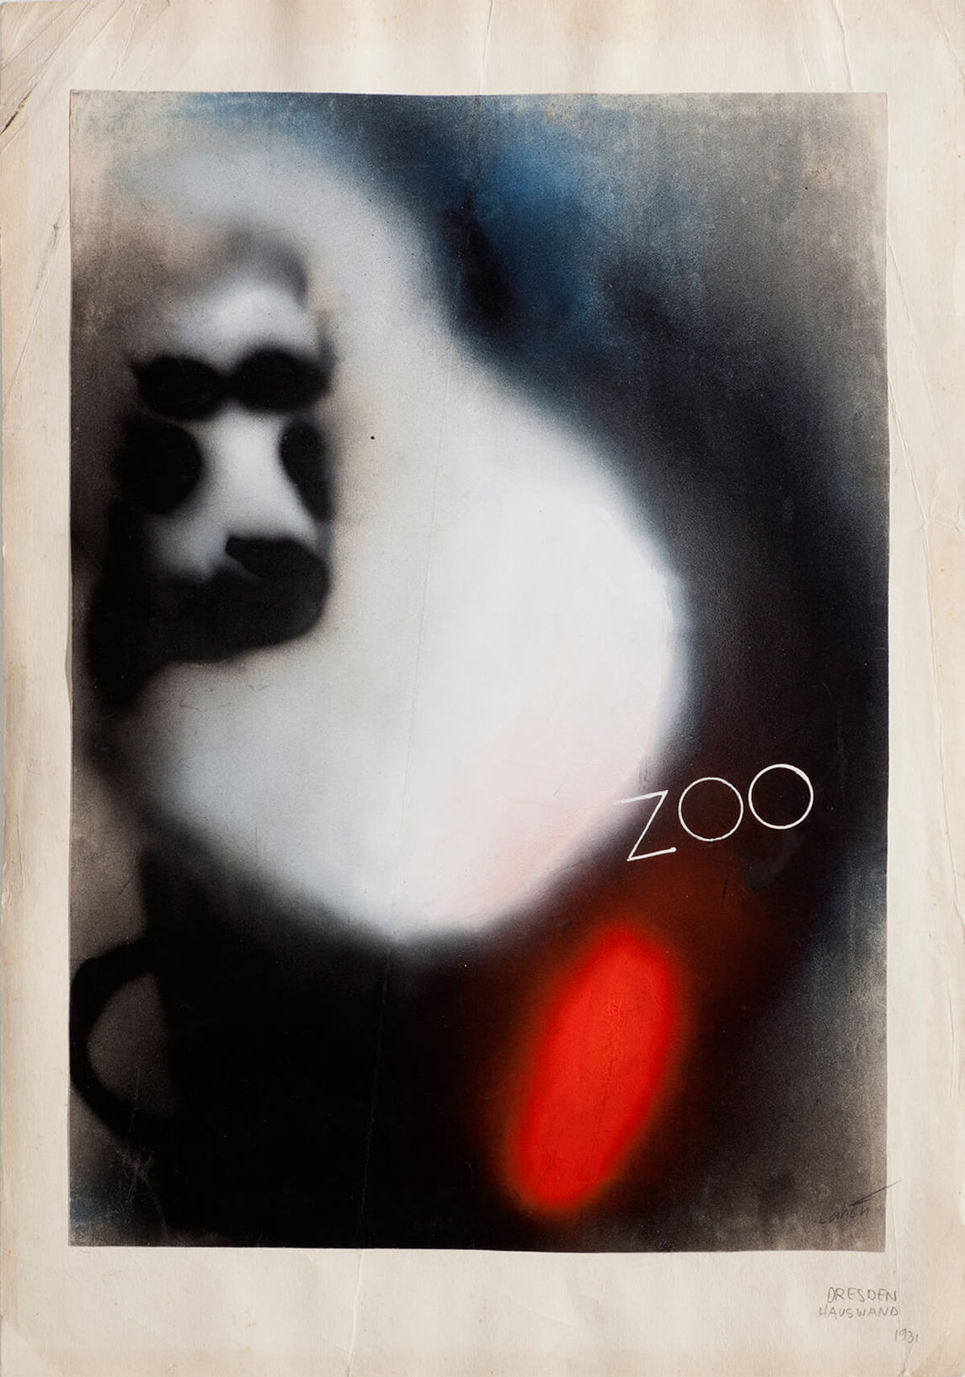
Oscar Cahén, Untitled (559), 1931. This is a poster design Cahén made as a student.

Slide 9
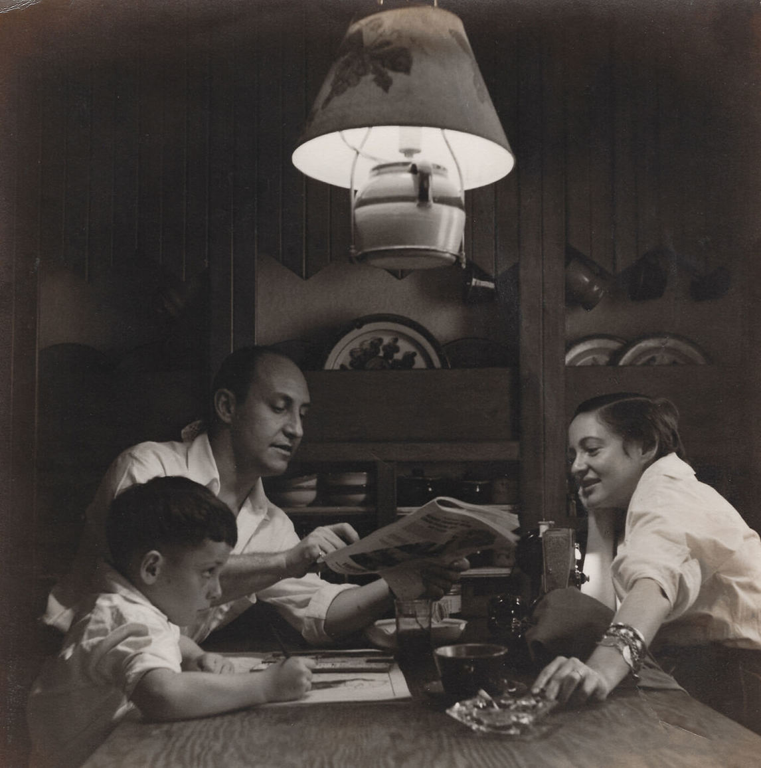
Son Michael, Oscar, and Mimi at their home in King Township, 1951.

Slide 10
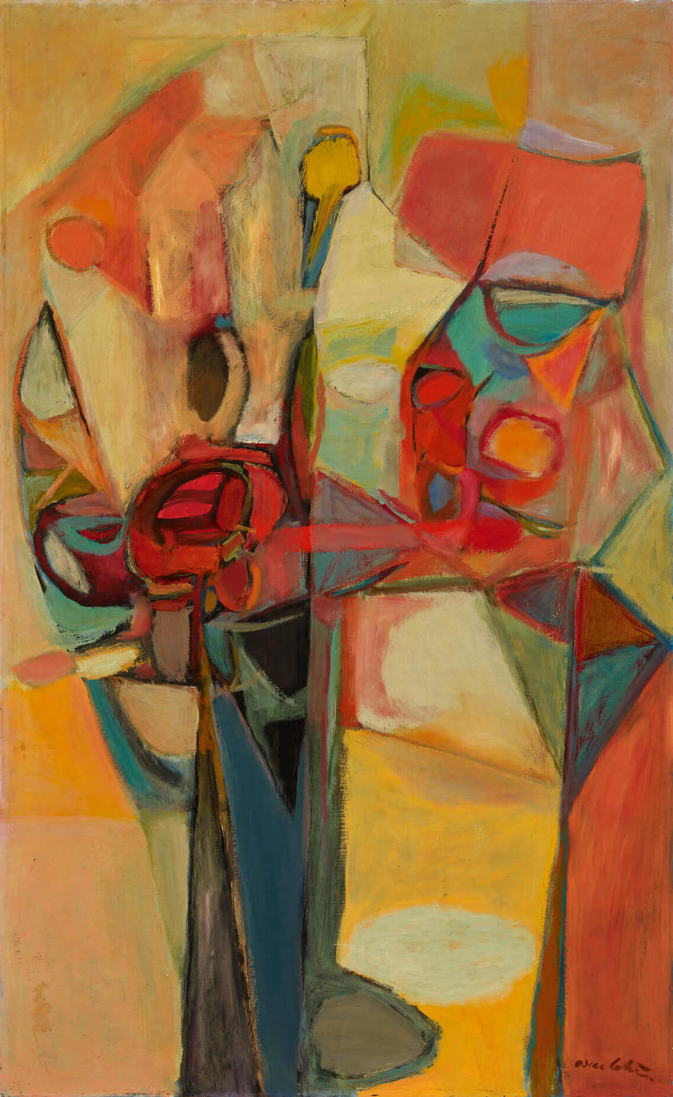
Oscar Cahén, Candy Tree, 1952–53. Cahén exhibited this work in 1953
in the show that became the beginning of the Painters Eleven group.

Slide 11
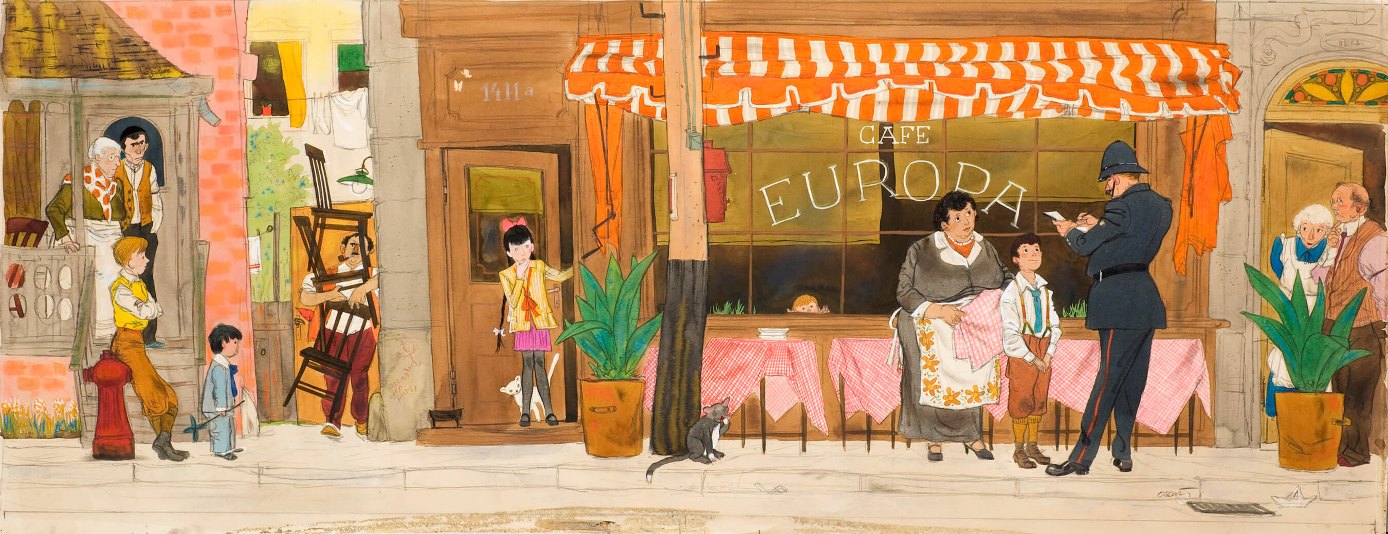
Learning Activity #1
Oscar Cahén, Illustration for “The First (and Last) Ottawa Street Café” by Ben Lappin, published in Maclean’s, July 9, 1955. This elaborate street scene depicts a critical moment in the story: the narrator’s mother, who does not speak English, has found herself in trouble with the law over her innocent attempt to open a European-style sidewalk café.

Slide 12
Oscar Cahén, detail of illustration for “The First (and Last) Ottawa Street Café” by Ben Lappin, published in Maclean’s, July 9, 1955. Here the narrator’s younger sister peeks through the window to watch the scene.

Slide 13
Oscar Cahén, detail of illustration for “The First (and Last) Ottawa Street Café” by Ben Lappin, published in Maclean’s, July 9, 1955. Neighbours watch the scene with anxiety and curiosity.

Slide 14
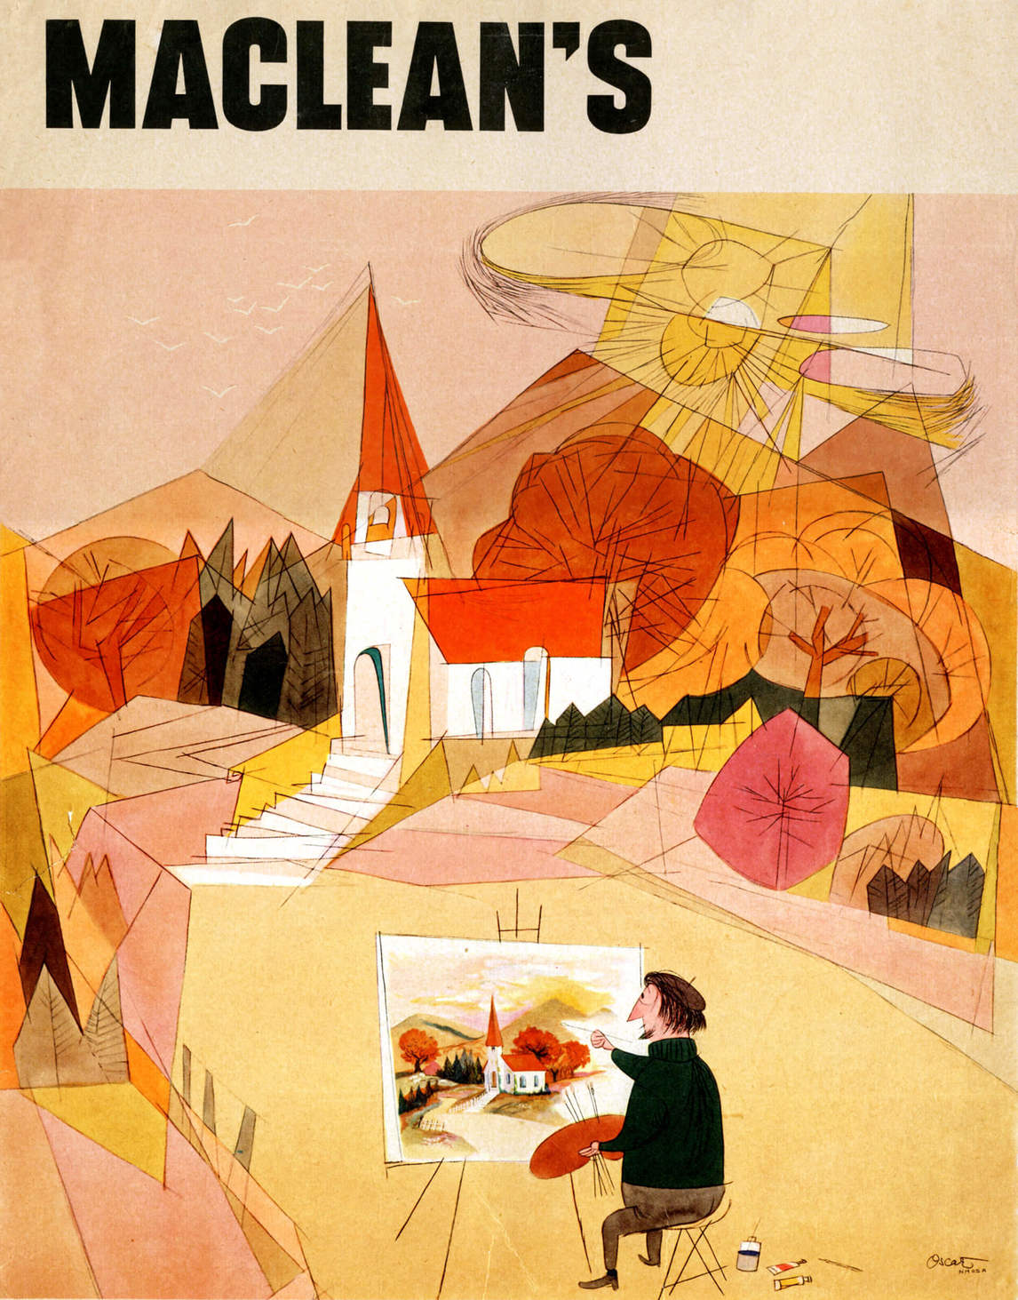
Learning Activity #2
Printer’s proof of Oscar Cahén’s cover illustration for Maclean’s, October 15, 1951. Many of Cahén’s covers took the form of playful cartoons. In this scene, an artist tries to paint a seemingly Cubist scene in a more traditional style; through this juxtaposition, Cahén encouraged his readers to question conventional views.

Slide 15
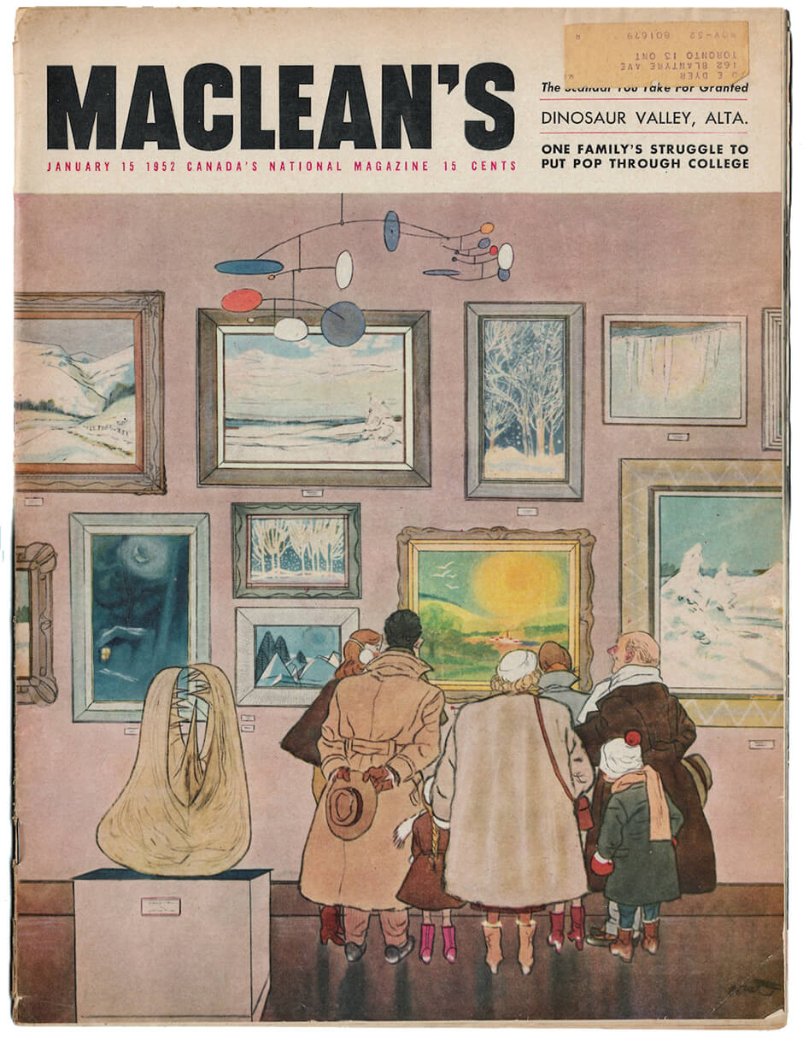
Learning Activity #2
Oscar Cahén, Cover illustration for Maclean’s, January 15, 1952. According to the magazine, “Oscar found this grouping of heavily clad art lovers gathered around a summer scene amusing enough to make him laugh out loud. He fled home to slap it on paper.”

Slide 16
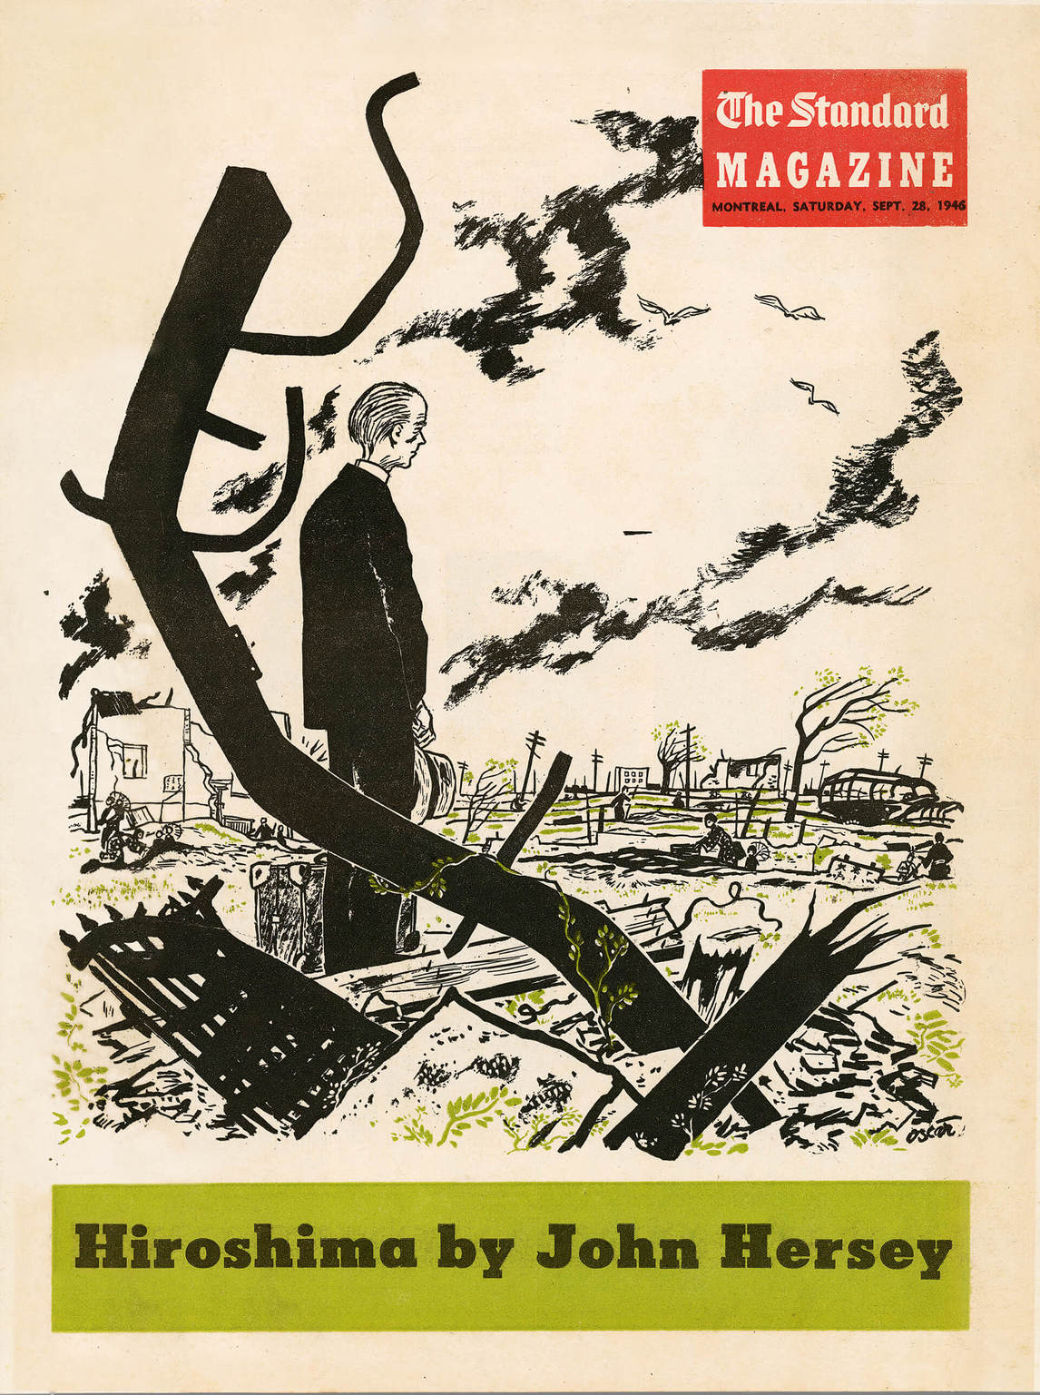
Oscar Cahén, Cover illustration for Hiroshima by John Hersey, The Standard magazine, September 28, 1946. Because of his experience as a refugee, Cahén was often asked to illustrate war-related stories.

Slide 17
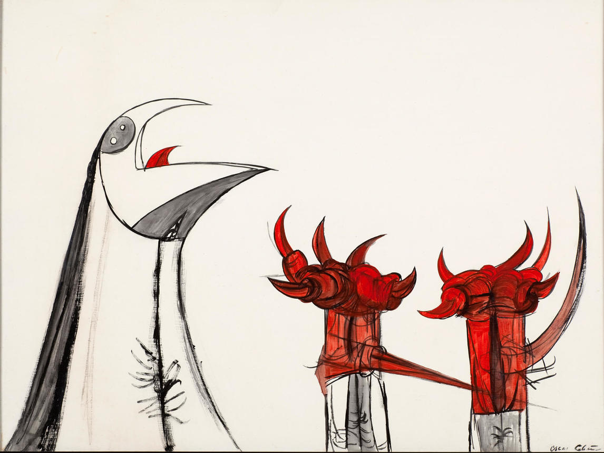
Culminating Task
Oscar Cahén, Untitled (230), 1950–51. Cahén created several works with thorny motifs reminiscent of claws and beaks.

Slide 18
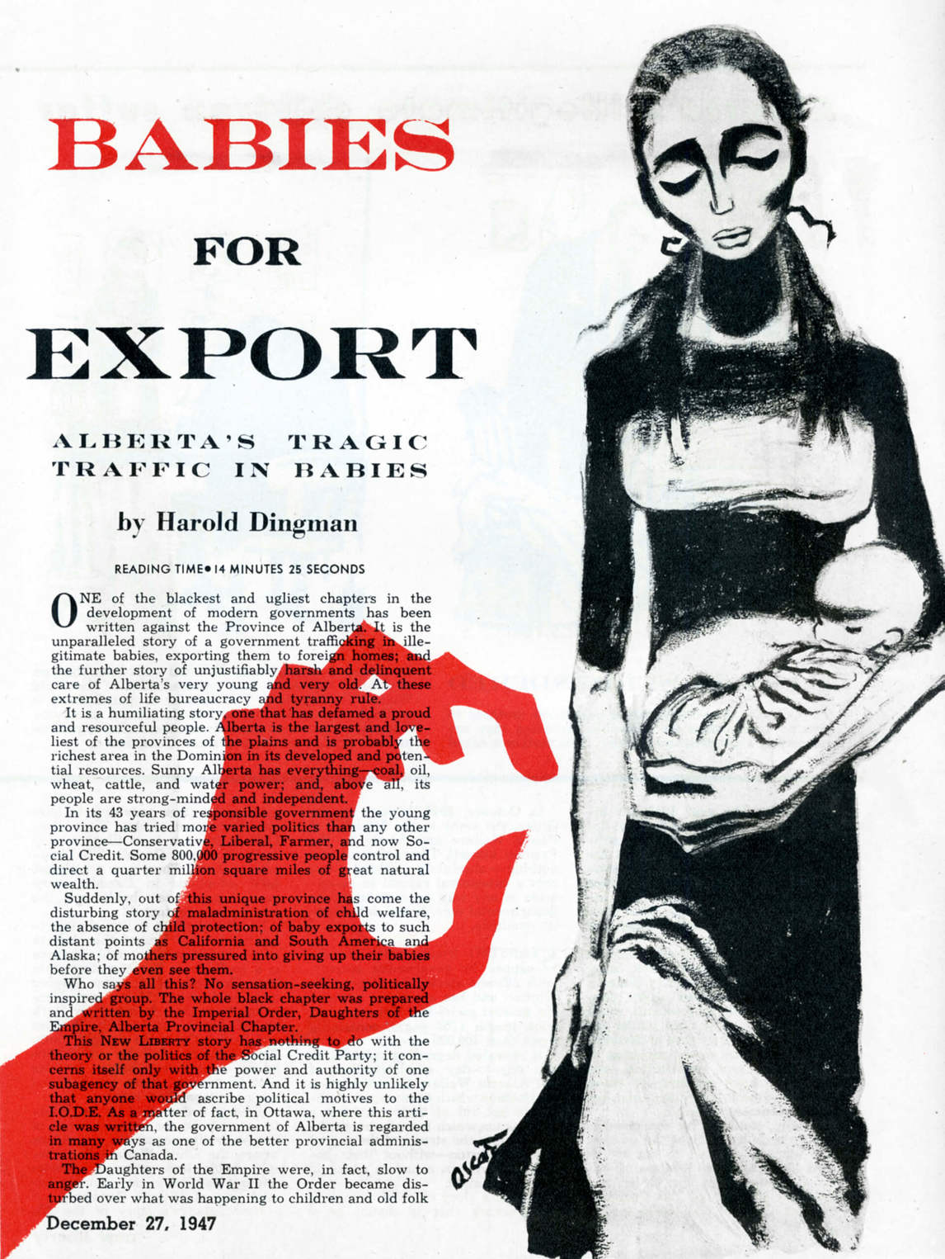
Oscar Cahén, illustration for “Babies For Export,” by Harold Dingman, New Liberty, December 27, 1947. This terrifying image accompanied an investigative journalism article on the alleged trafficking of babies of unwed mothers in Alberta.

Slide 19
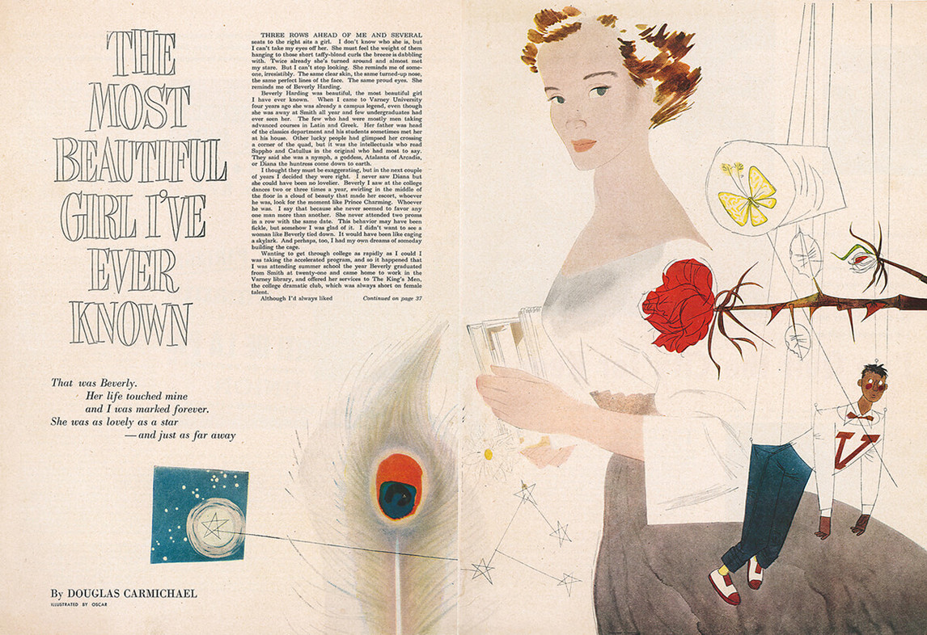
Oscar Cahén, illustration for “The Most Beautiful Girl I’ve Ever Known,” by Douglas Carmichael, Maclean’s, September 15, 1951. This image was created to accompany a chilling university love story in which the heroine keeps her admirers controlled and at a distance, and it won the 1952 medal for Editorial Illustration from the Art Directors Club of Toronto.

Slide 20
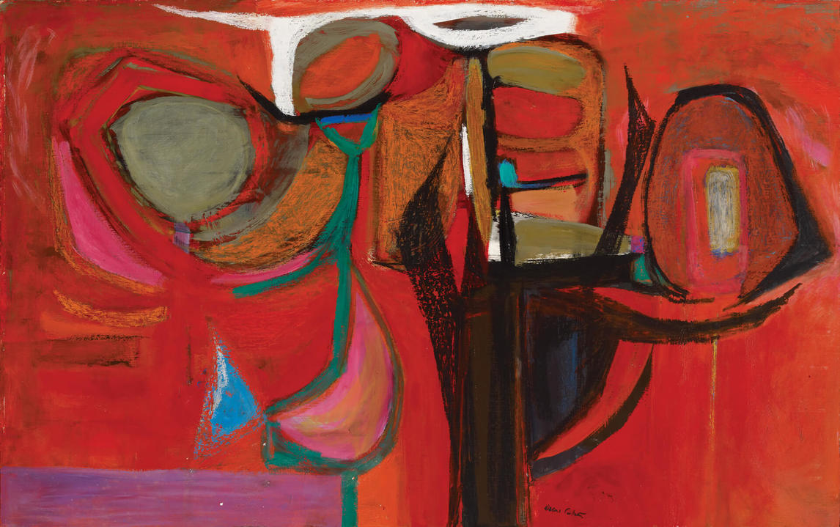
Oscar Cahén, Growing Form, 1953. An intense abstract oil painting, Growing Form was included in Cahén’s first solo show, held at Hart House in Toronto in October 1954.

Slide 21
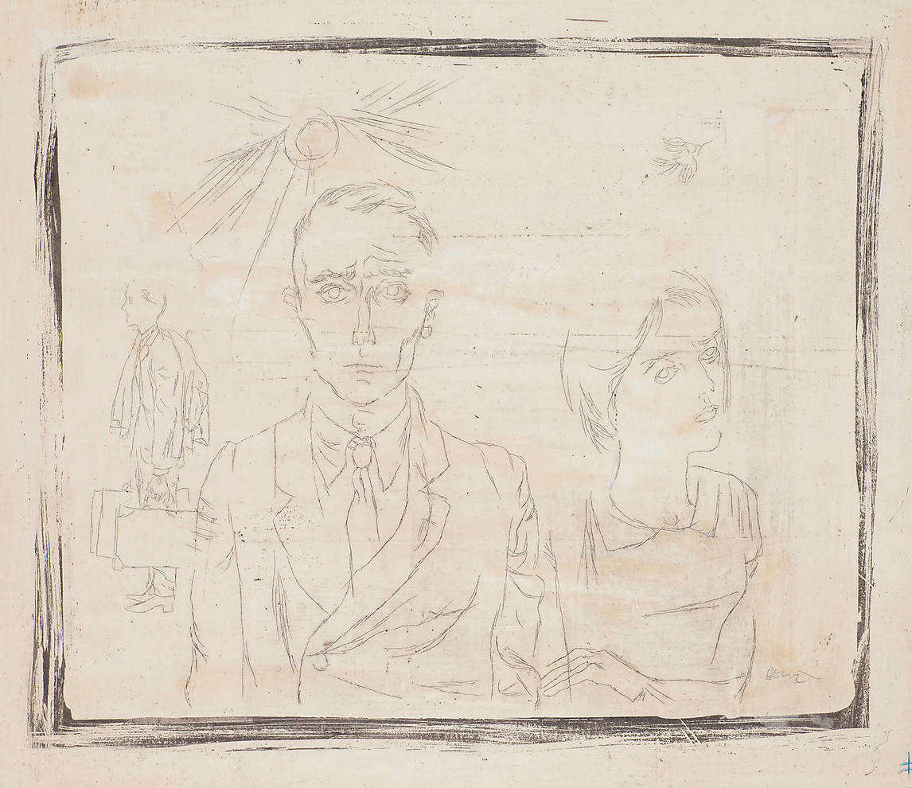
Oscar Cahén, illustration for “We Don’t Understand Our DPs,” The Standard, 1951. A delicate monoetching, this work depicts refugees.

Slide 22
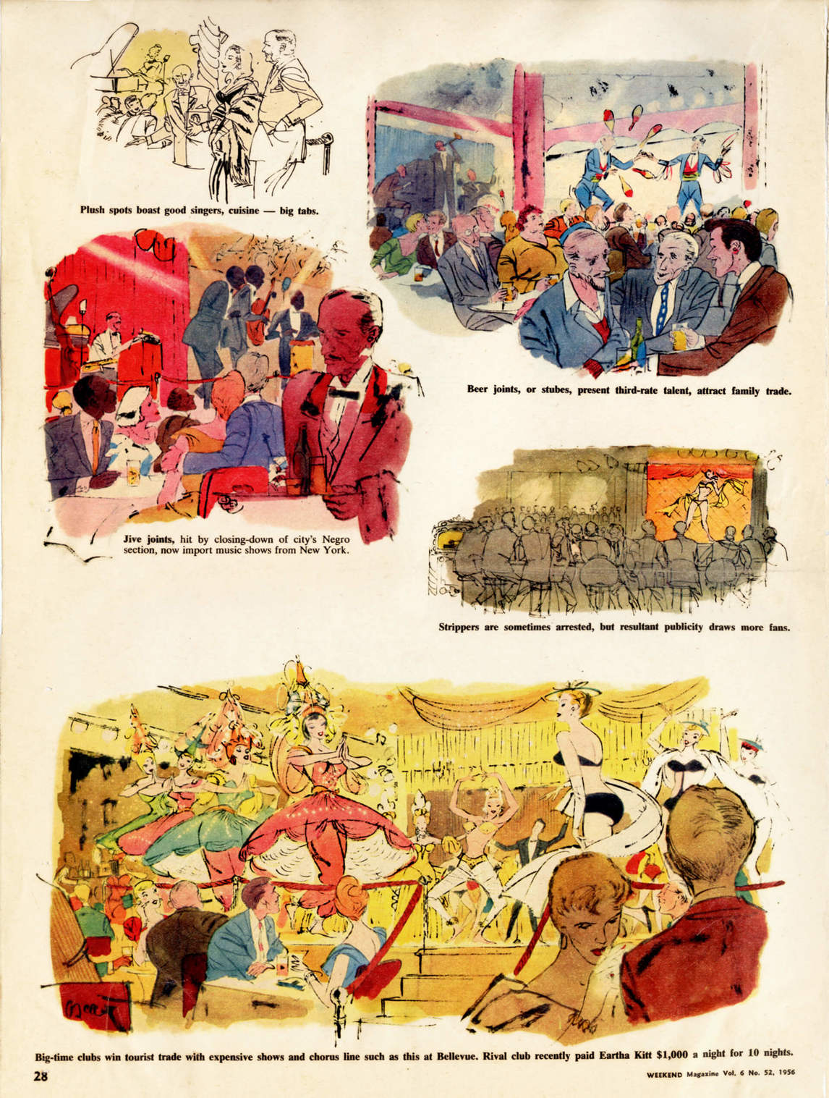
Oscar Cahén, illustration for “A Night Out in Montreal,” Weekend, 1956. In 1956 Cahén visited Montreal as an illustrator-reporter to depict its club scene.

Slide 23
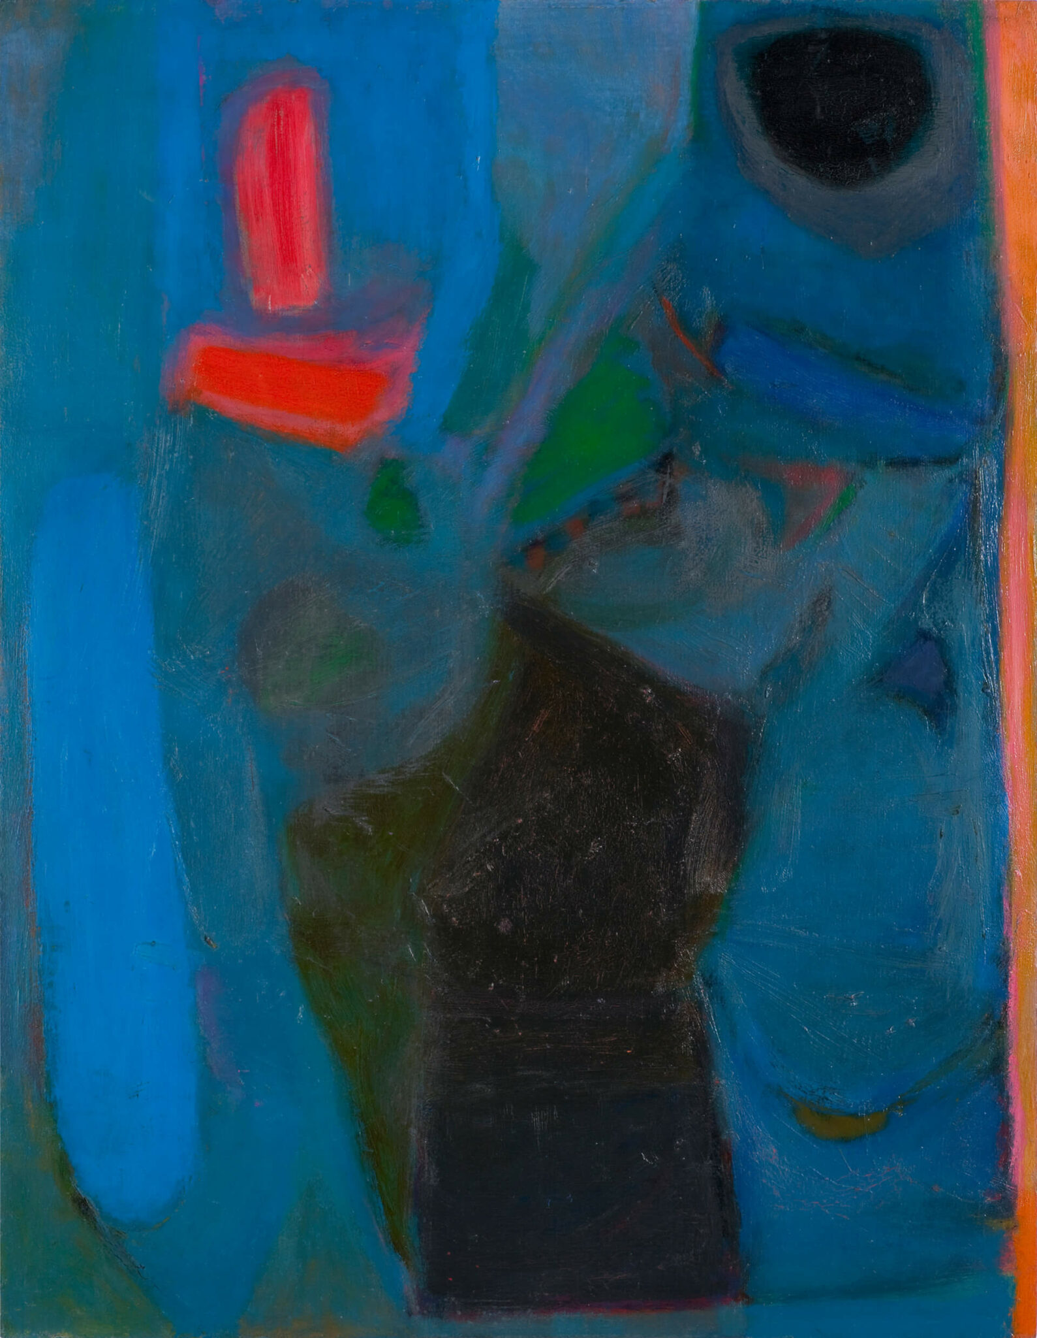
Oscar Cahén, Small Combo, c.1954.

