Slide 2
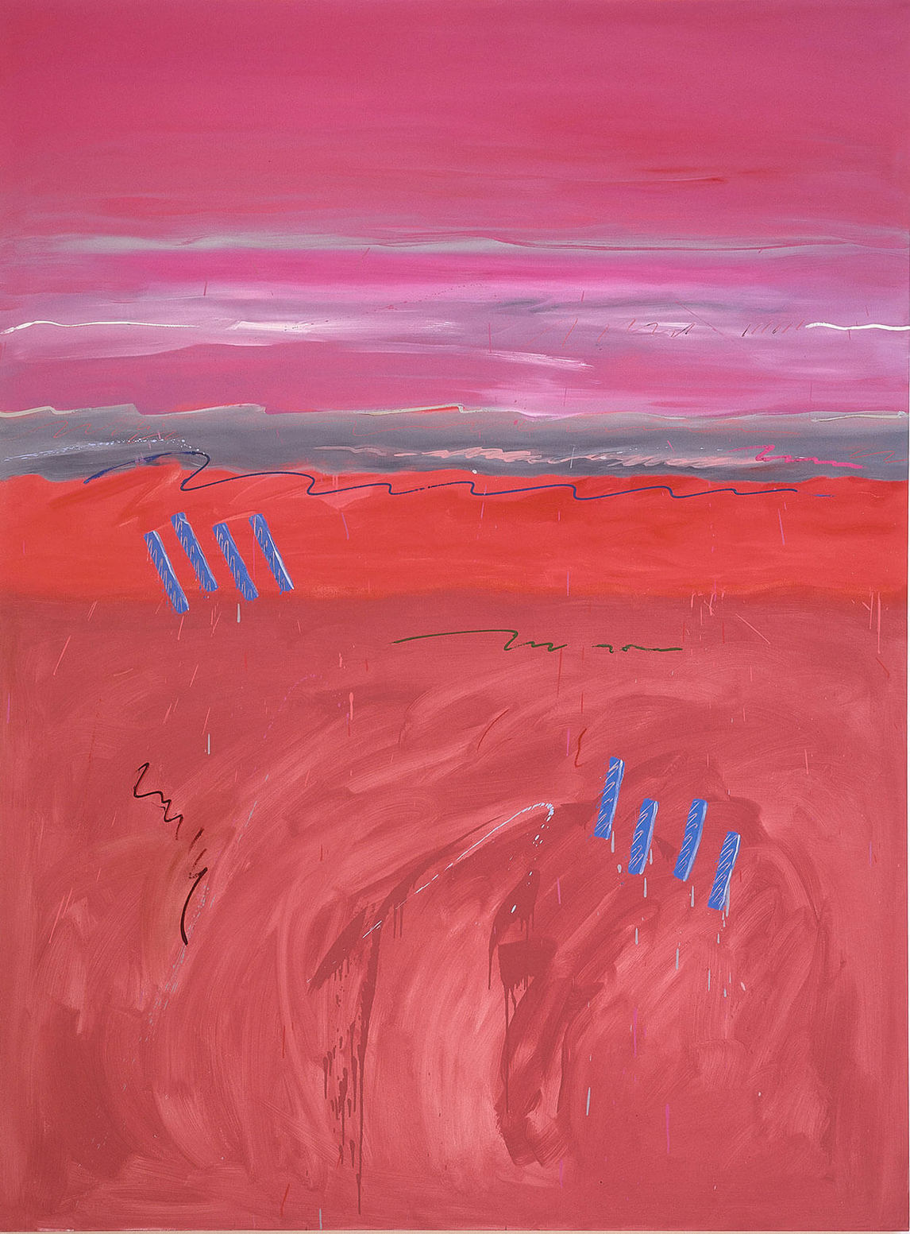
Robert Houle, Muhnedobe uhyahyuk
(Where the gods are present) (Matthew), 1989. This work was created during Houle’s artist residency at the Winnipeg Art Gallery. It is composed of four large panels (the other panels are titled Philip, Bartholomew, and Thomas); its title celebrates the origins of the name “Manitoba.”

Slide 3
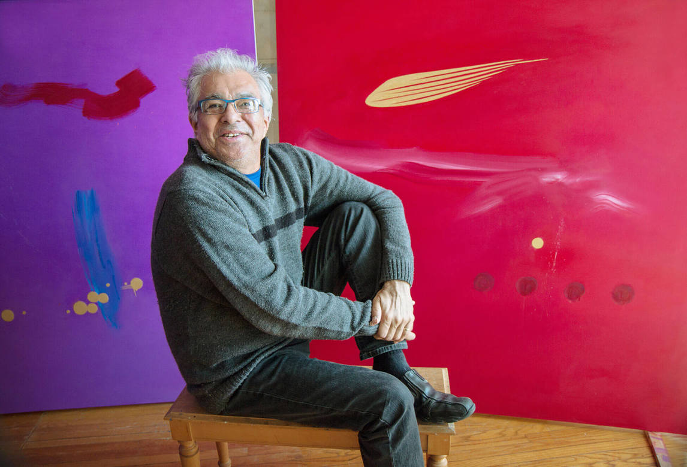
Robert Houle in 2015 with his triptych Colours of Love, 2015.

Slide 4
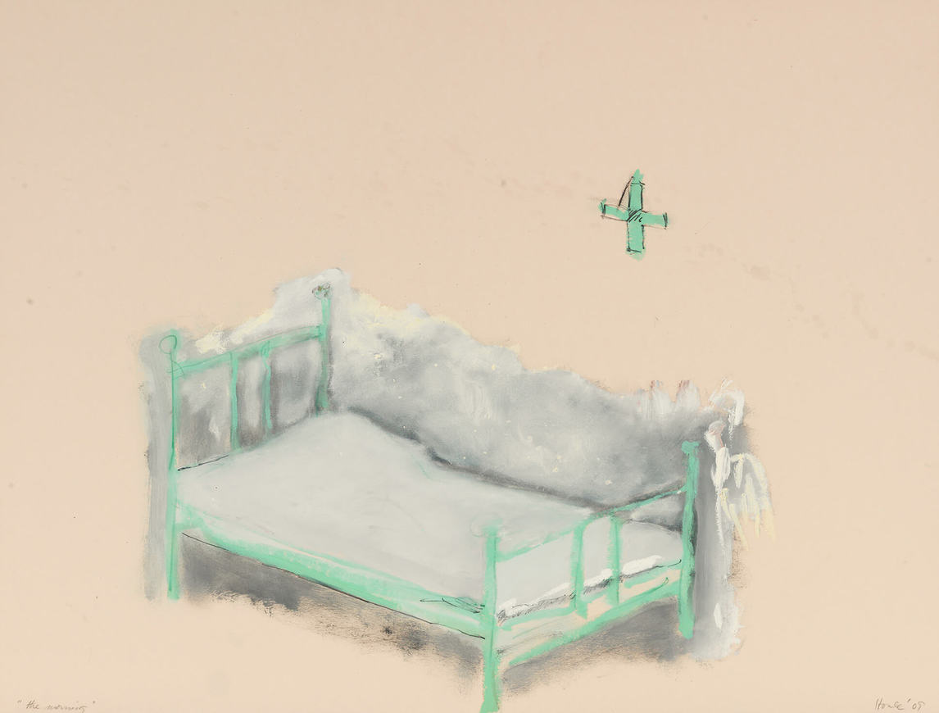
Robert Houle, Sandy Bay
Residential School Series (The
Morning), 2009. Houle created a
series of works that explored the
difficult experiences he endured in
residential schools.

Slide 5
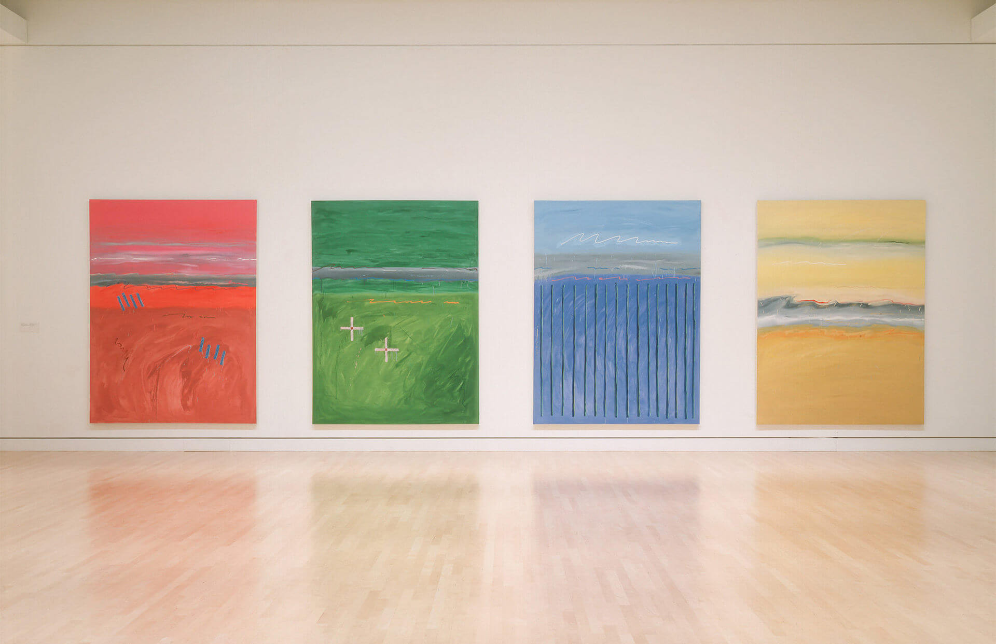
Robert Houle, Muhnedobe uhyahyuk (Where the gods are present), 1989. These large abstract works were inspired by the Manitoba landscape.

Slide 6
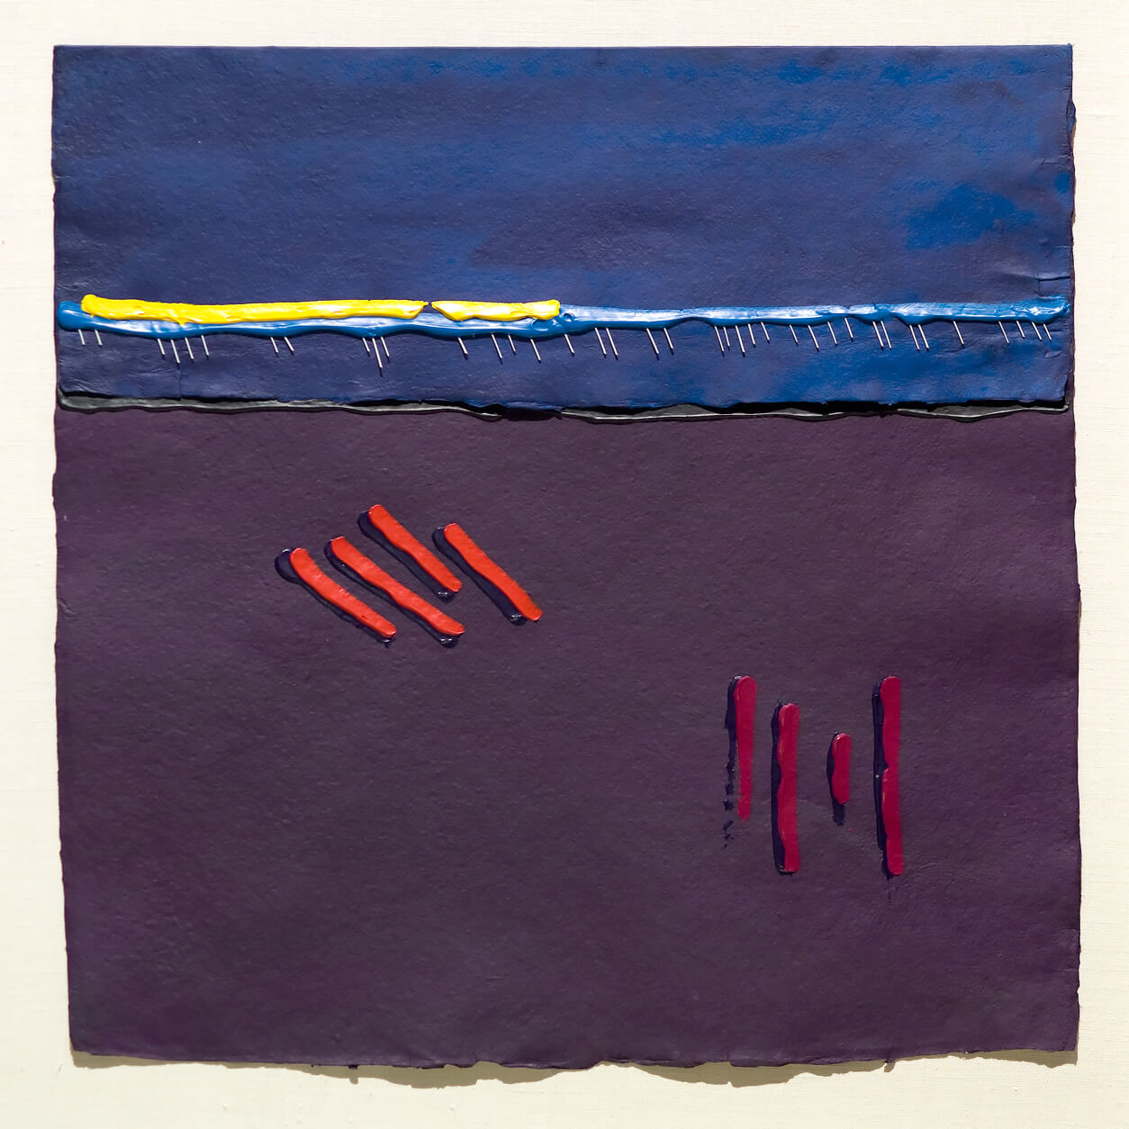
Robert Houle, Parfleches for the Last Supper (Matthew), 1983. Each parfleche in this work (which contains thirteen in total, one of
which you see here) is named for an apostle, with one for Jesus Christ. It is a bicultural work bringing together two spiritual traditions: Saulteaux and Christianity.

Slide 7
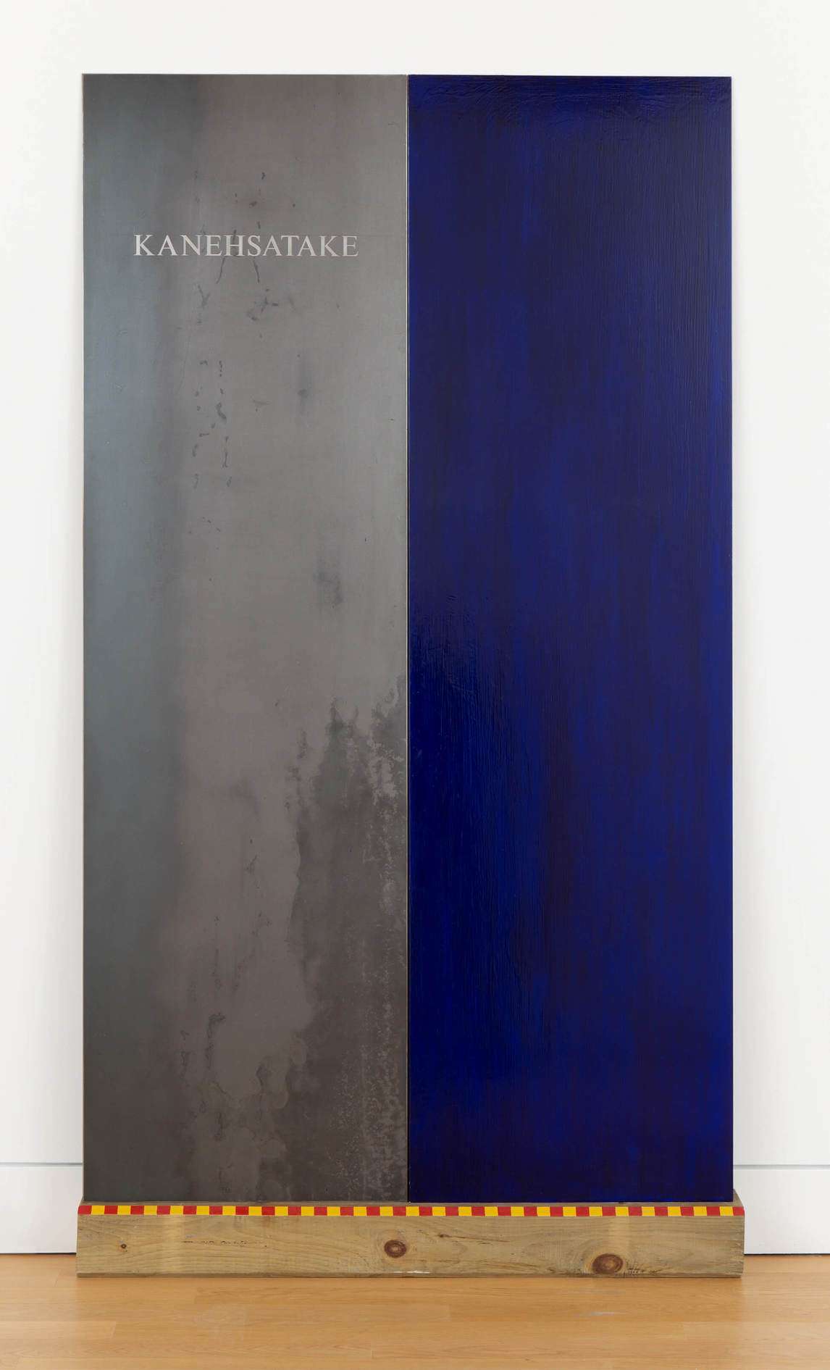
Robert Houle, Kanehsatake, 1990–93. This work was inspired by Houle’s response to the Oka Crisis, when Mohawks protested the encroachment of a golf course into their traditional territory and burial ground in Quebec.

Slide 8
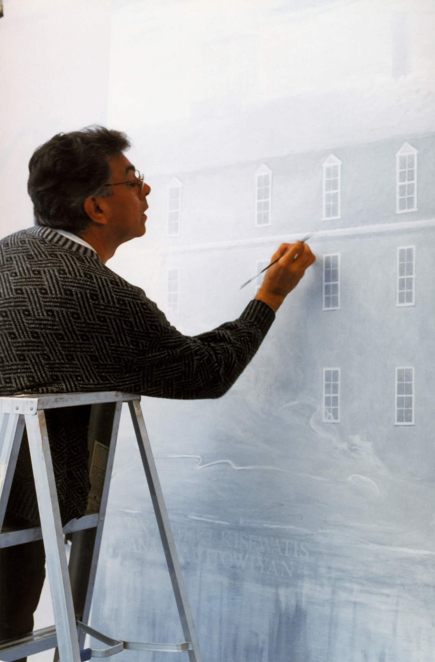
Robert Houle painting Sandy Bay in 1999. Houle often revisited his residential school experiences in his art.

Slide 9
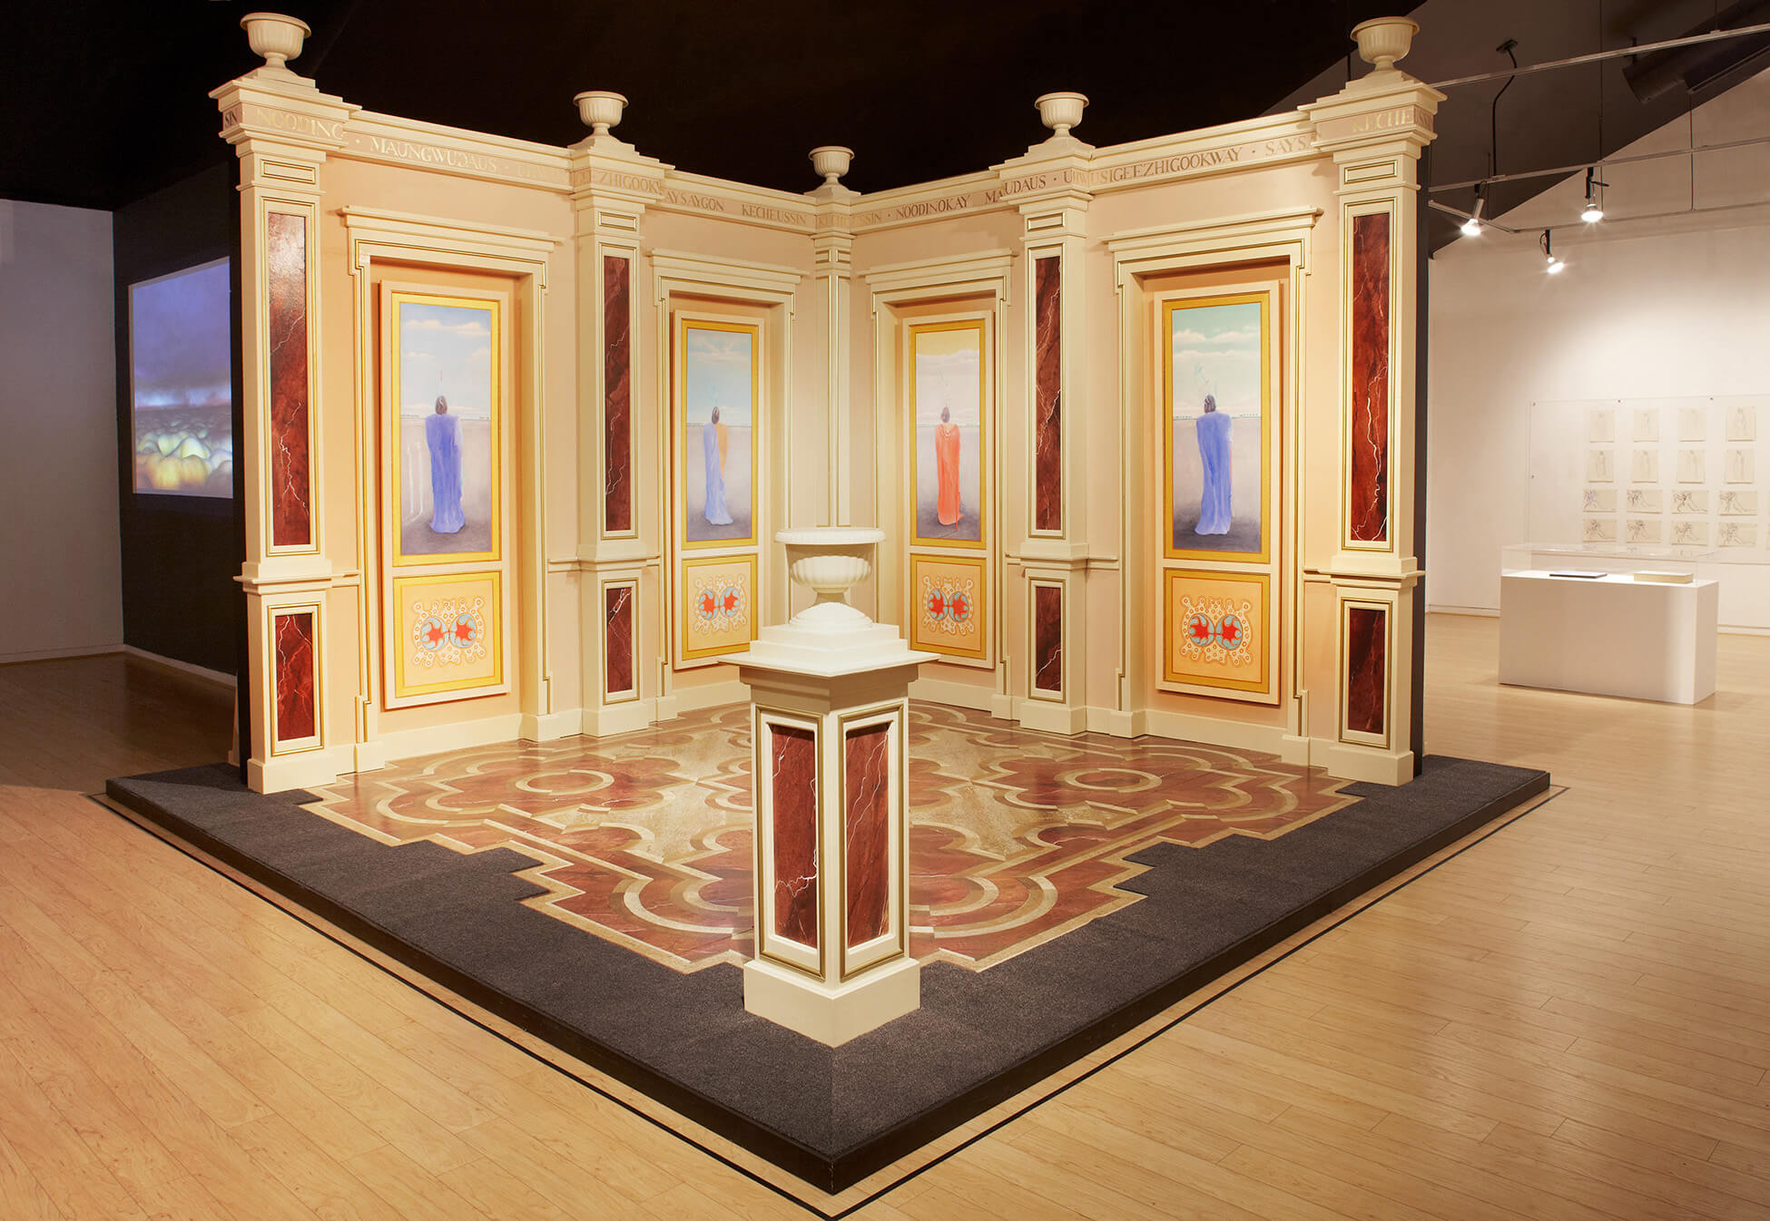
Robert Houle, Paris/Ojibwa, 2009–2010, multi-media installation: painted plywood, 4 panels oil on canvas, USB key containing video projection and sound component, installed: 358 × 488 × 488 cm. Collection of the Art Gallery of Ontario, Toronto, Gift of Robert Houle, 2020, 2020/3. © Robert Houle. Photo credit: Michael Cullen.
An installation work that represents four Ojibwa dancers who travelled from Canada to Paris in 1845.

Slide 10
Robert Houle, Everything You Wanted to Know about Indians from A to Z (detail), 1985. For this work, Houle stencilled the letters of the alphabet onto twenty-six rawhide parfleches.

Slide 11
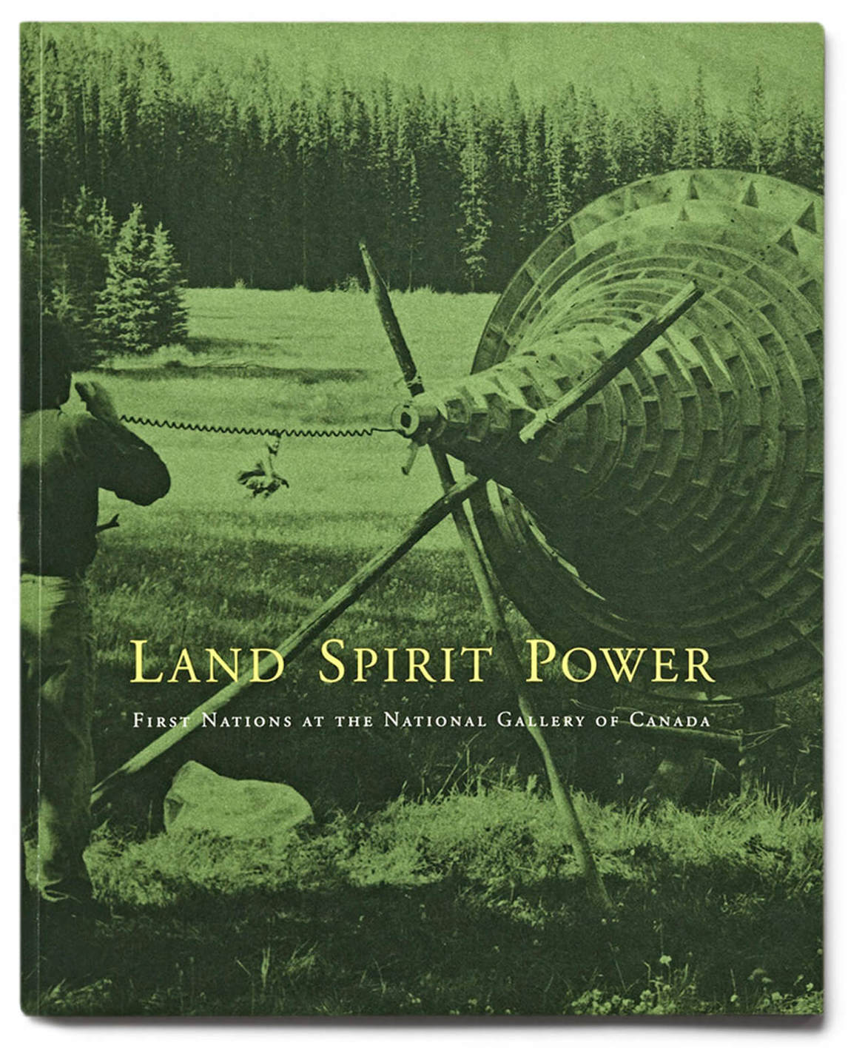
Cover of exhibition catalogue for Land, Spirit, Power, co-curated by
Robert Houle, at the National Gallery of Canada in 1992.

Slide 12
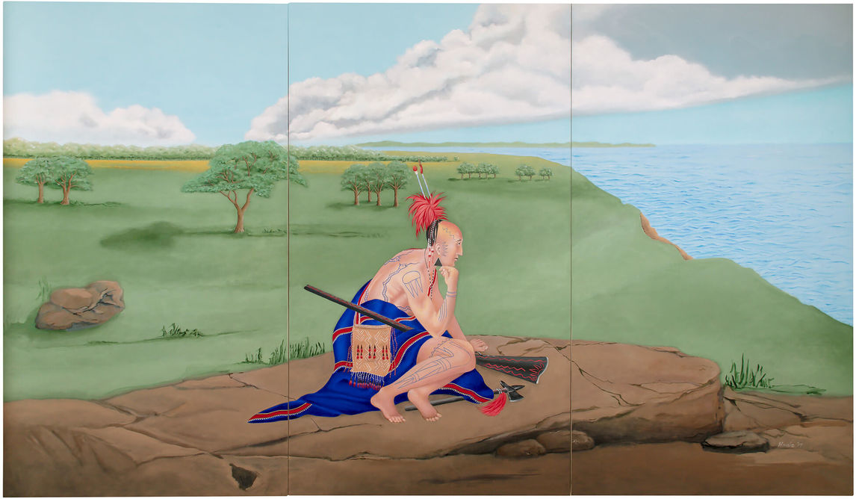
Robert Houle, O-ween du muh waun (We Were Told), 2017. This painting was commissioned by the Confederation Art Centre in Charlottetown for Canada’s 150th celebrations. It centres the Indigenous presence in Canada, effectively erasing colonial histories and making the audience question by and for whom history is written and whose voices are left out.

Slide 13
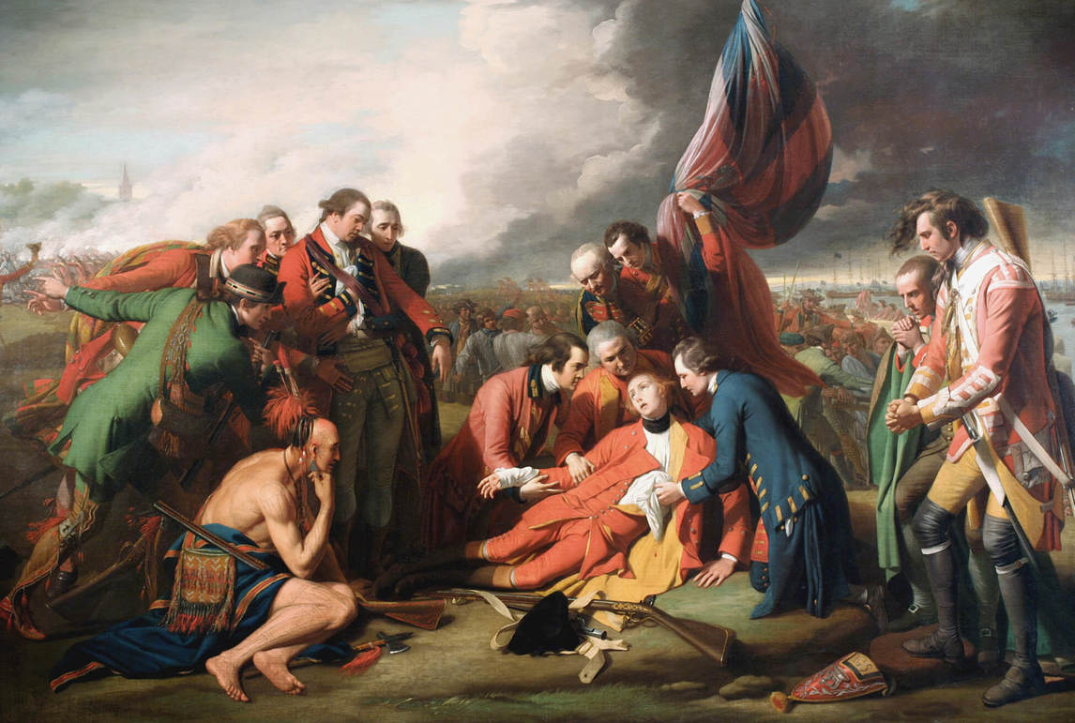
Benjamin West, The Death of General Wolfe, 1770. This painting depicts the death of the British general (September 13, 1759) on the Plains of Abraham—just outside the walls of Quebec City—during the Seven Years’ War (1756–1763). The battle ultimately led to the British conquest of Quebec and victory in the war.

Slide 14
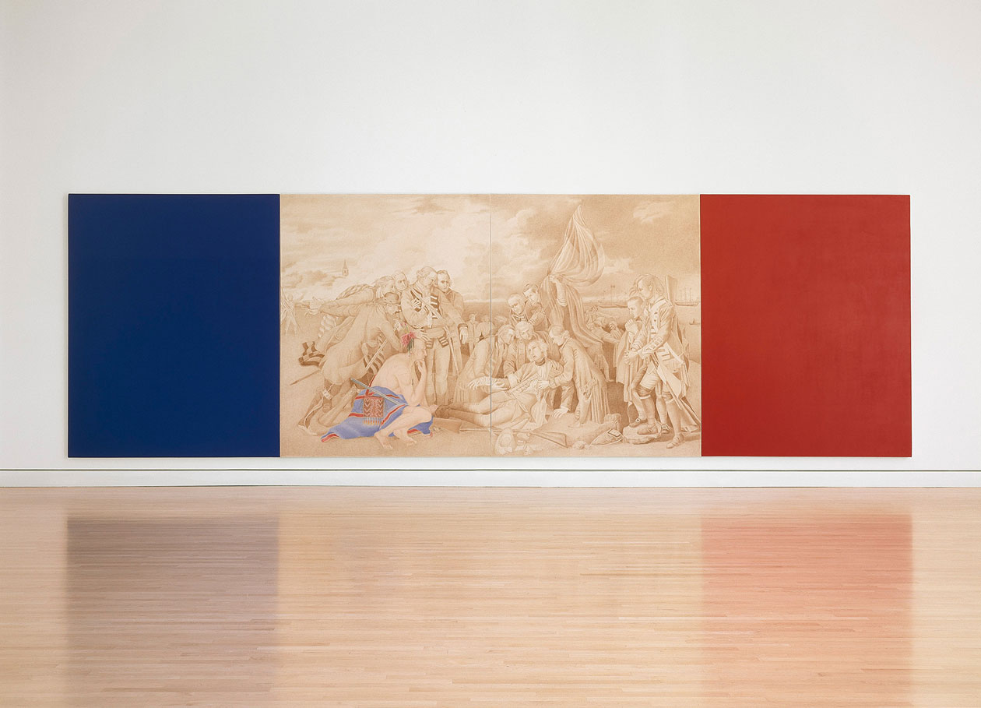
Robert Houle, Kanata, 1992. By focusing the viewer’s attention on the Delaware warrior from West’s painting, Houle emphasizes the place of First Nations in history and challenges representations of Indigenous peoples by non-Indigenous artists.

Slide 15
Learning Activity #1
Robert Houle, Kanata, 1992.
Benjamin West, The Death of General Wolfe, 1770.

Slide 16
Learning Activity #1
Robert Houle, Kanata, 1992.
Robert Houle, O-ween du muh waun (We Were Told), 2017.

Slide 17
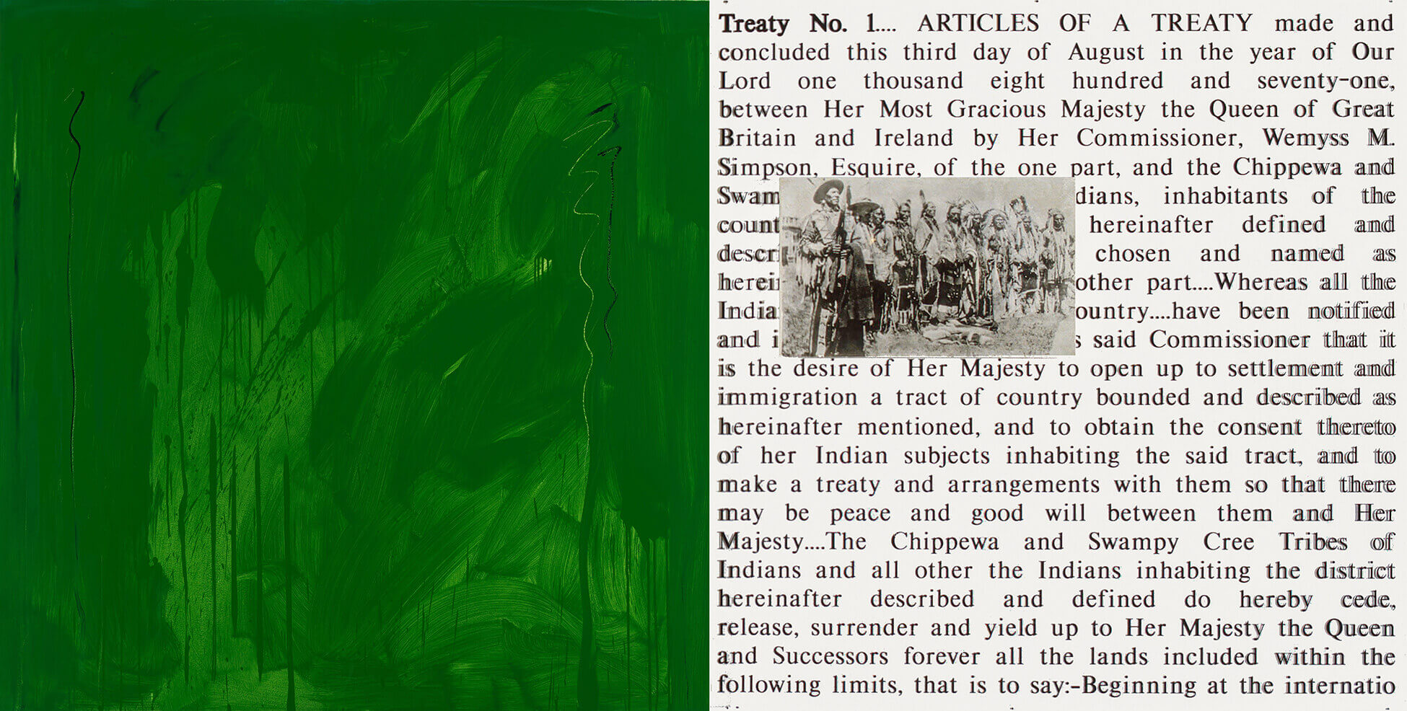
Learning Activity #2
Robert Houle, Premises for Self-Rule: Treaty No. 1, 1994. Placing an archival image of warriors looking at a medicine bundle over the text of Treaty No. 1, Houle emphasizes the rights and histories of Indigenous peoples and subverts the legislation that was used to force Indigenous peoples to cede their territory and rights.

Slide 18
Learning Activity #2
Barnett Newman, Tundra, 1950. Newman painted this bold field of colour after witnessing the great expanse of Canada’s tundra. Houle’s abstract paintings draw inspiration from Newman and similar colour-field painters.

Slide 19
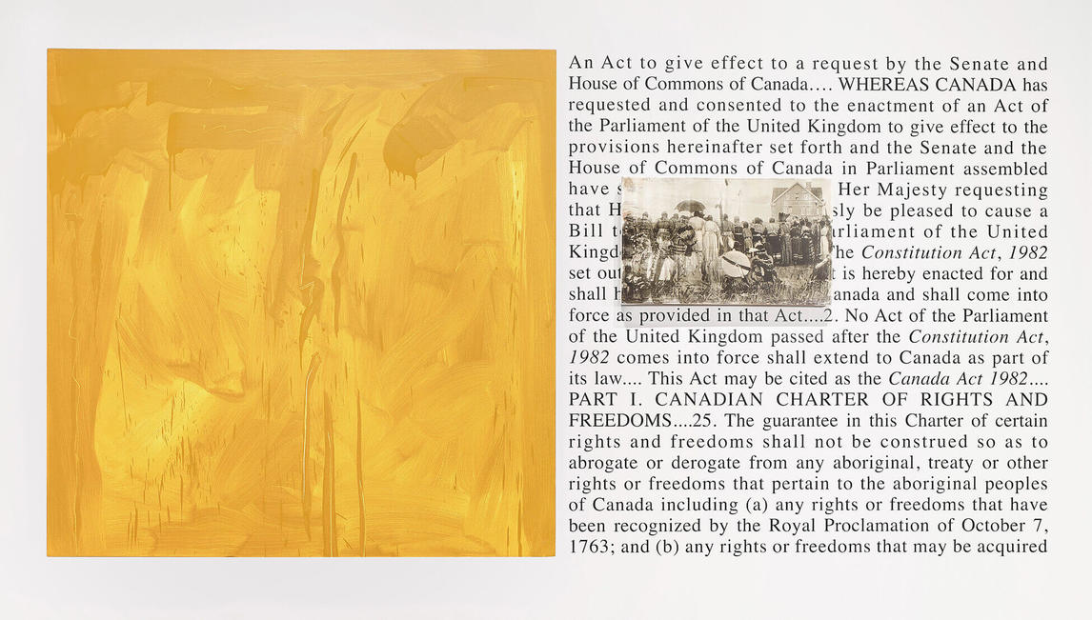
Robert Houle, Premises for Self-Rule: Constitution Act, 1982, 1994, oil on canvas, photo emulsion on canvas, and laser cut vinyl Painting: 152.4 × 152.4 cm, Art Gallery of Ontario, Toronto, purchased with funds from the Estate of Mary Eileen Ash, 2014, 2014/1. © Robert Houle. This is another work in the series Premises for Self-Rule; it confronts the Constitution Act, another piece of legislation that is critical to Indigenous land rights.

Slide 20
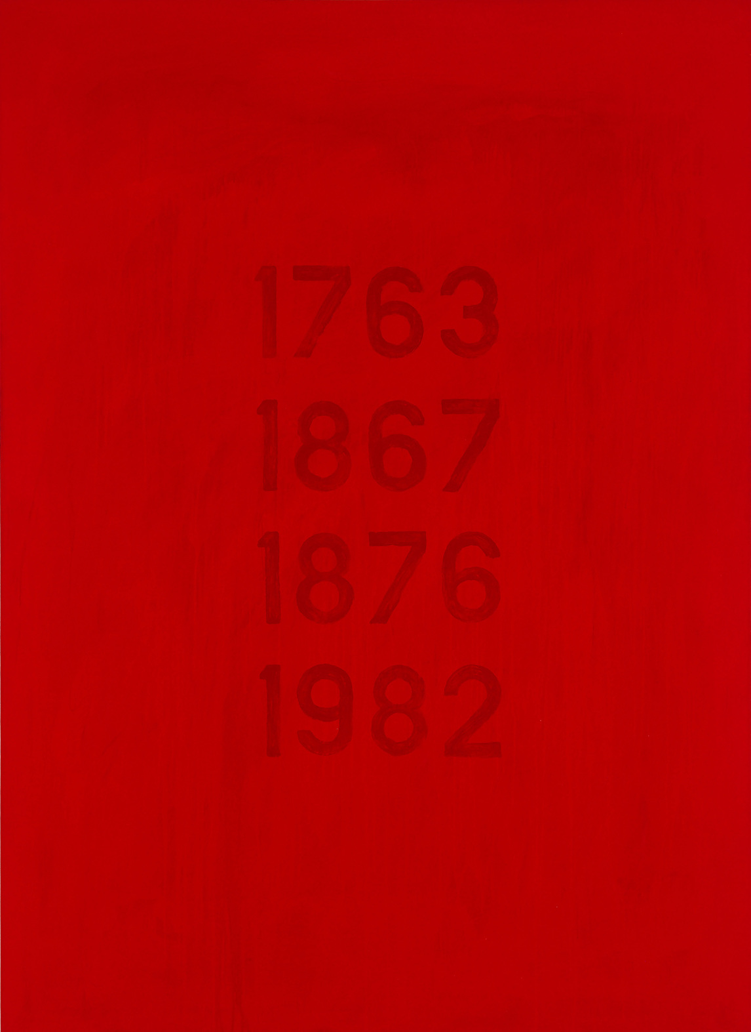
Robert Houle, Aboriginal Title, 1989–90. This work highlights four critical dates in Canadian and Indigenous history.

Slide 21
Robert Houle, Coming Home, 1995. This work was included in an important exhibition of Houle’s work titled Sovereignty over Subjectivity, organized by the Winnipeg Art Gallery in 1999.

Slide 22
Robert Houle, Love Games, 1972. This is one of twelve paintings by
Houle based on love poems written by his friend Brenda Gureshko.

Slide 23
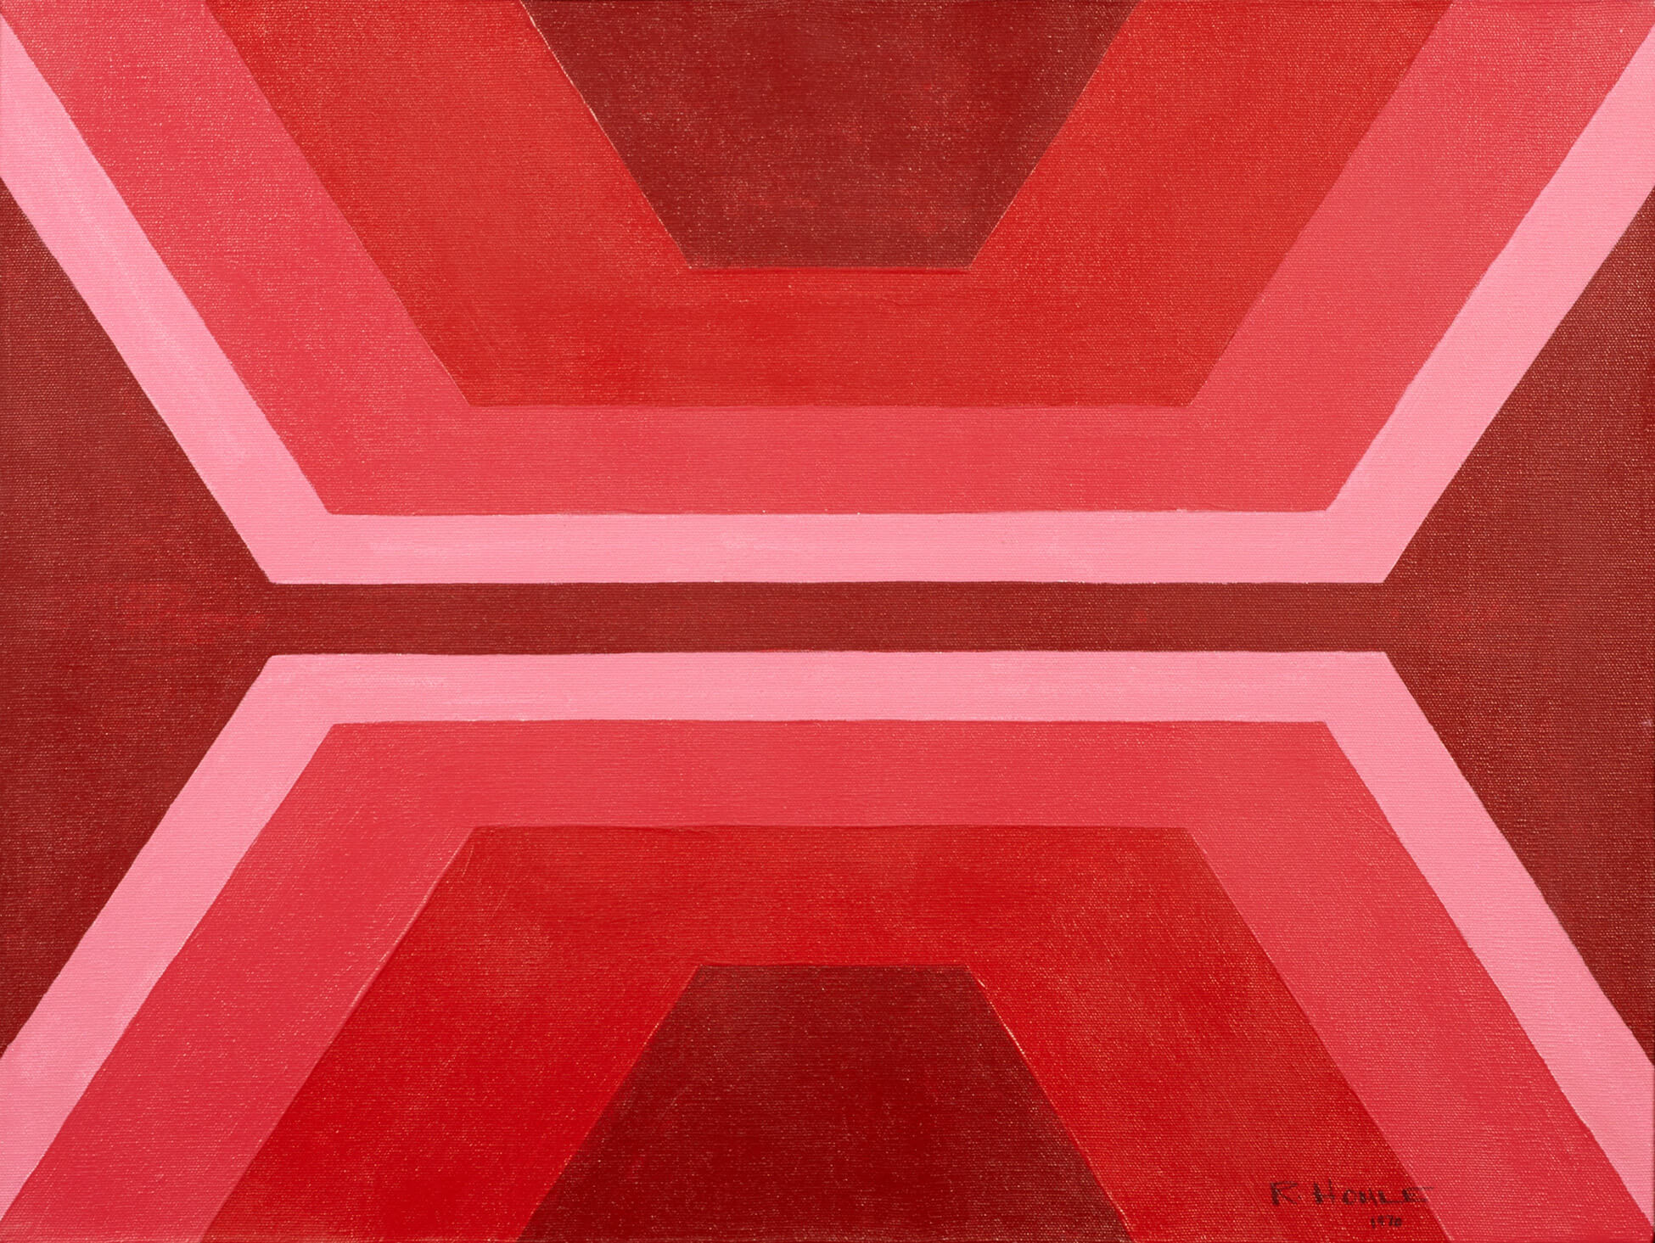
Robert Houle, Red Is Beautiful,
1970. The geometric patterns in this painting were inspired by designs used in traditional Ojibwa woven bags.

Slide 24
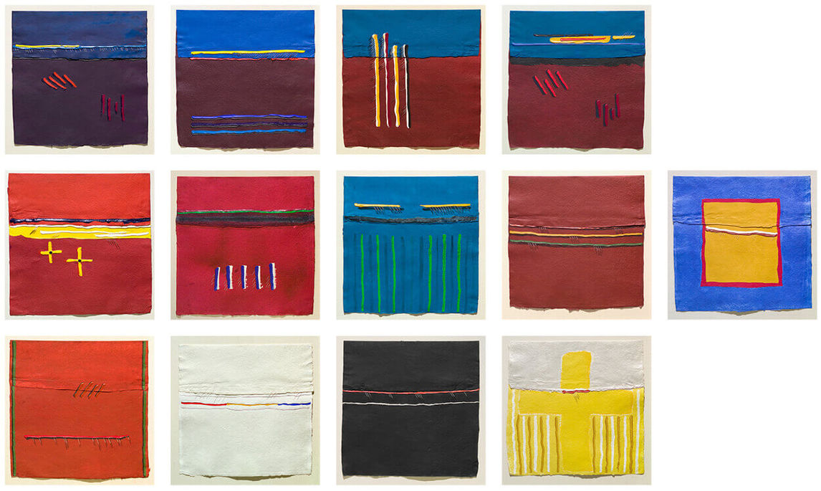
Robert Houle, Parfleches for the Last Supper, 1983. This work was inspired by Houle’s devotion to the appropriate representation of Indigenous cultural objects, art, and artists in Canadian museums and galleries. It also attempts to reconcile Houle’s Saulteaux traditions, like the Sun Dance ceremony, with Christian beliefs.

Slide 25
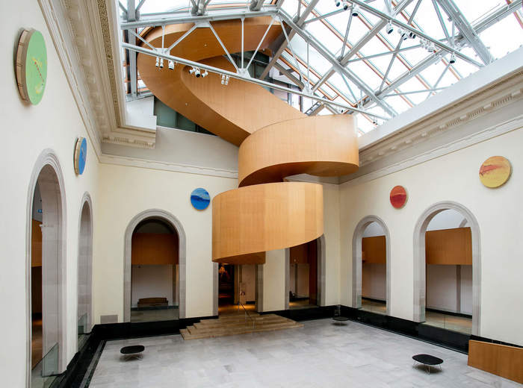
Robert Houle, Seven Grandfathers, 2013, oil on canvas, digital prints, mylar, watercolour on paper, outside: 20.3 cm. Collection of the Art Gallery of Ontario, Toronto, purchased with the assistance of the Martinsell Fund, 2016, 2015/38.1-14.
© Robert Houle.
Here, each drum painting corresponds to an animal spirit and imparts one of the seven sacred teachings in Anishnabe culture.

Slide 26
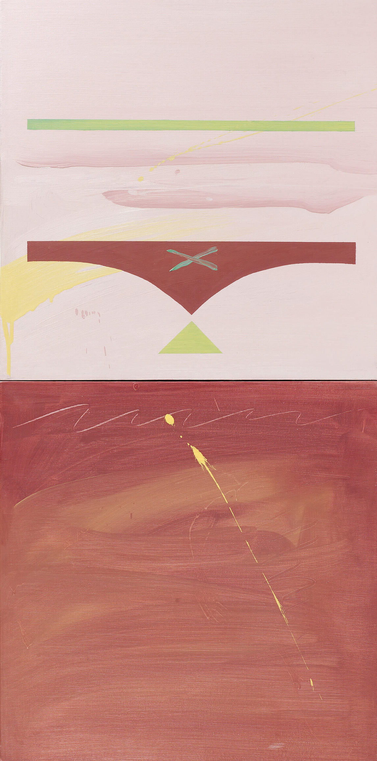
Robert Houle, Parfleche for Edna Manitowabi, 1999. In this painting Houle pays homage to the important Indigenous artist Edna Manitowabi through the spiritual object of the parfleche.

Slide 27
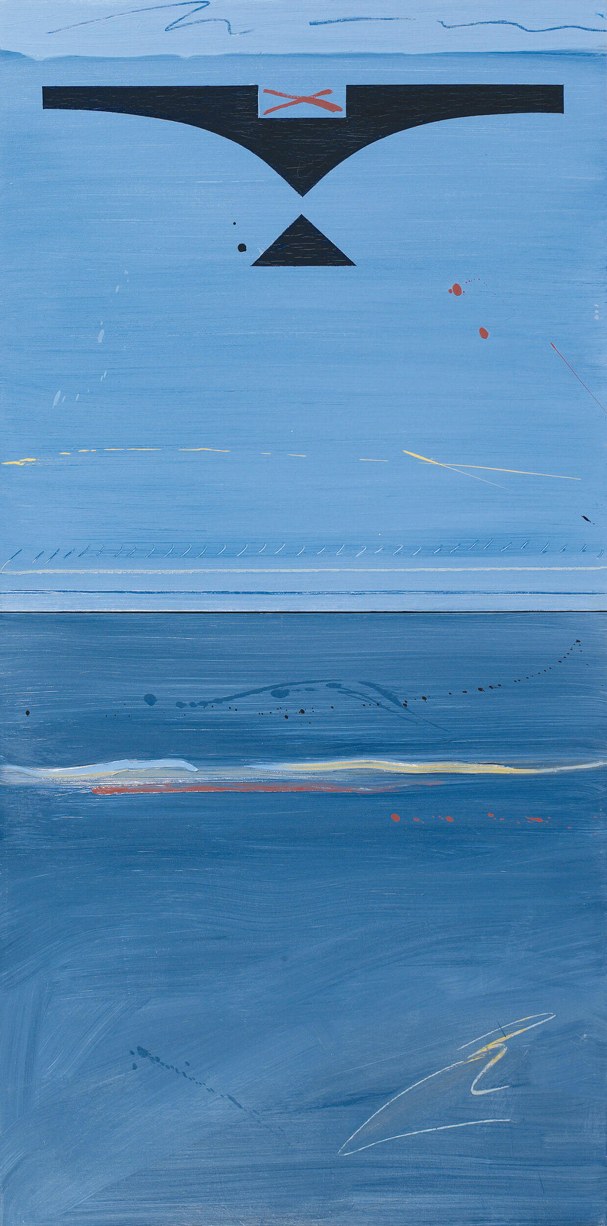
Robert Houle, Parfleche for Norval Morrisseau, 1999. For this painting, Houle carefully chose the colour to represent the influential artist Norval Morrisseau. In Houle’s own words, “What better way to recognize people who have played a significant role in my life?”

