Slide 1
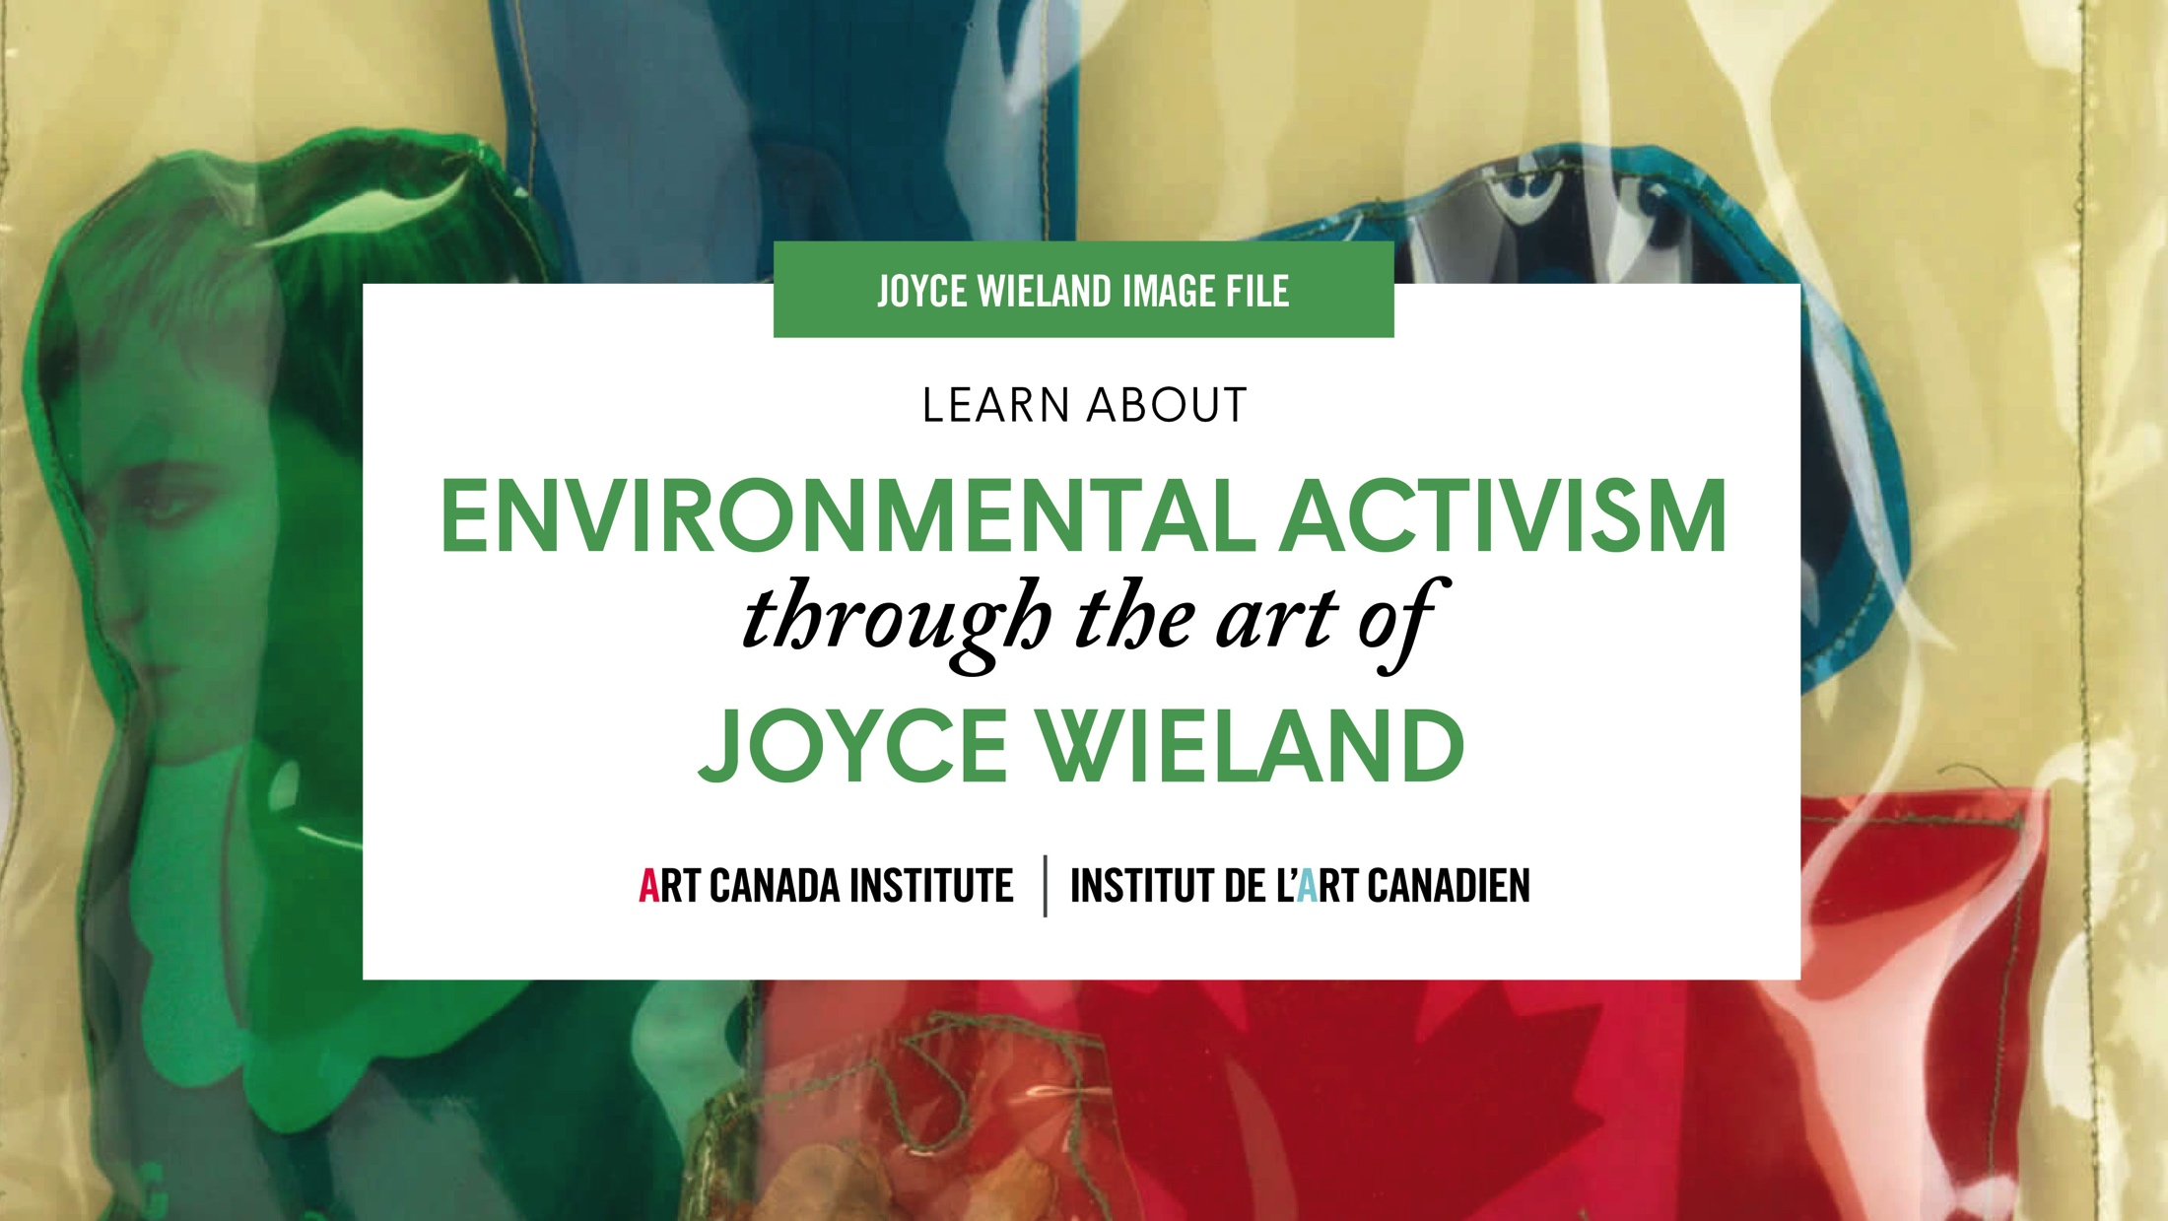

Slide 2
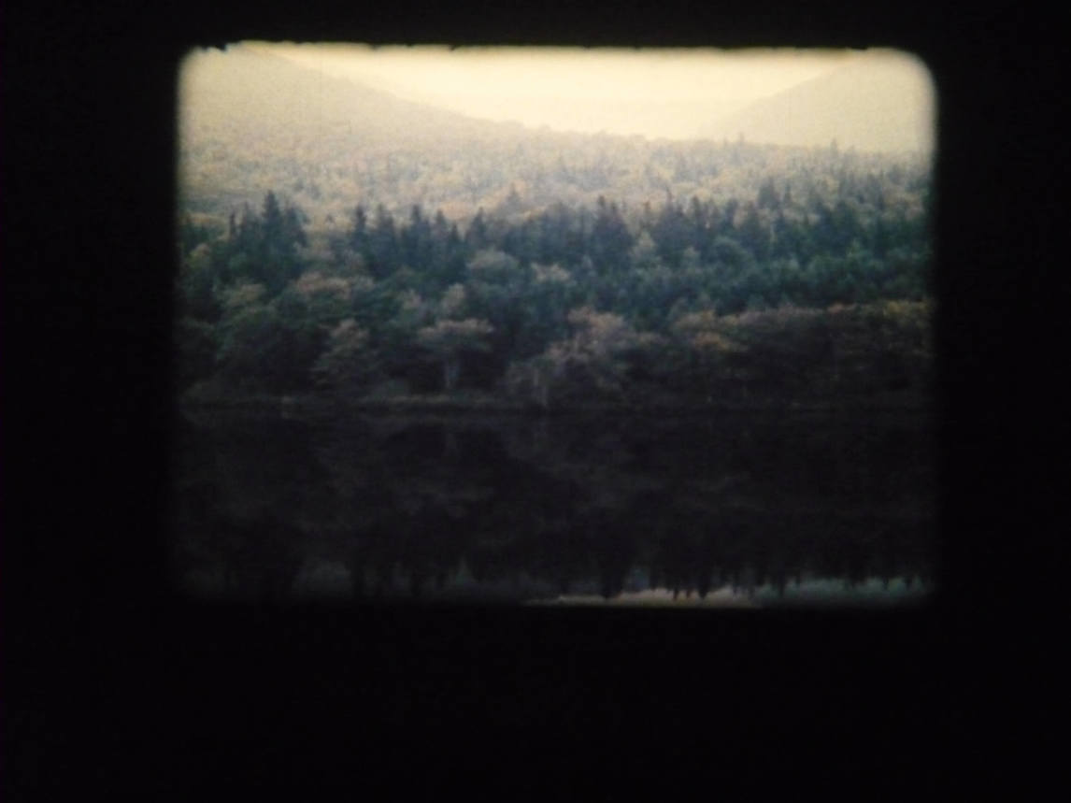
Joyce Wieland, The Far Shore, 1976. This film is both a melodrama and a film about landscape in Canada—it questions what we want from the land and how we understand it.

Slide 3
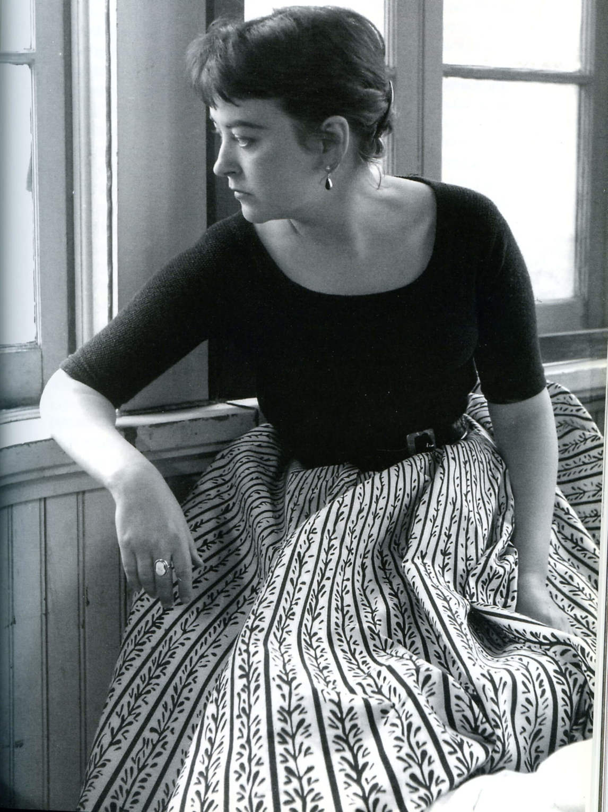
Joyce Wieland in 1955, photographed by Warren Collins.

Slide 4
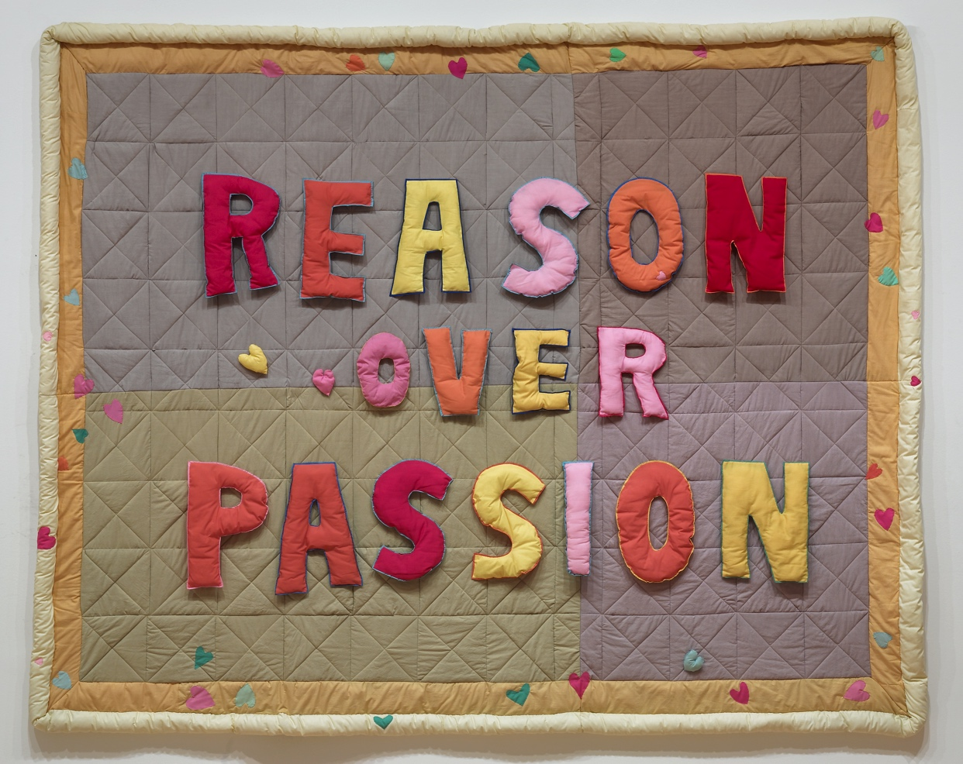
Joyce Wieland, Reason over Passion, 1968. The phrase in this work is a quotation from Pierre Elliott Trudeau, who was then prime minister.

Slide 5
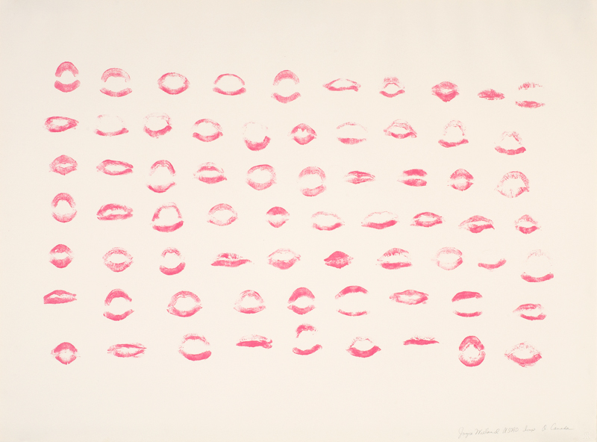
Joyce Wieland, O Canada, 4–16 December 1970. To create this print, Wieland sang the national anthem, pressing her lips to the printing stone with each new syllable.

Slide 6
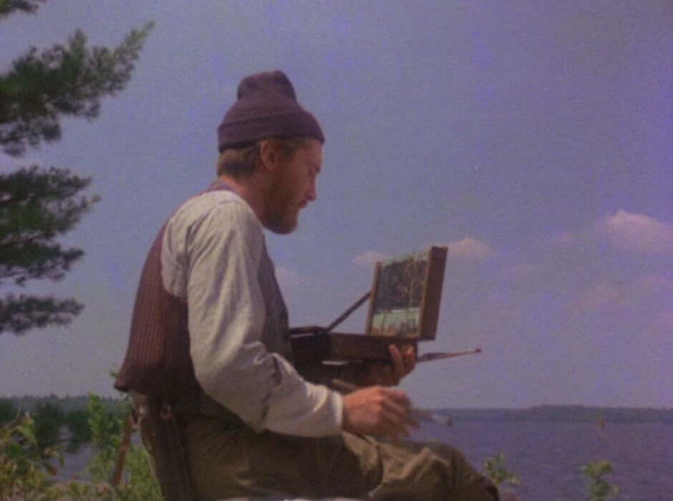
Joyce Wieland, The Far Shore, 1976. In The Far Shore, one of the main characters is an artist named Tom McLeod; like the real artist Tom Thomson (1877–1917), McLeod paints in northern Ontario.

Slide 7
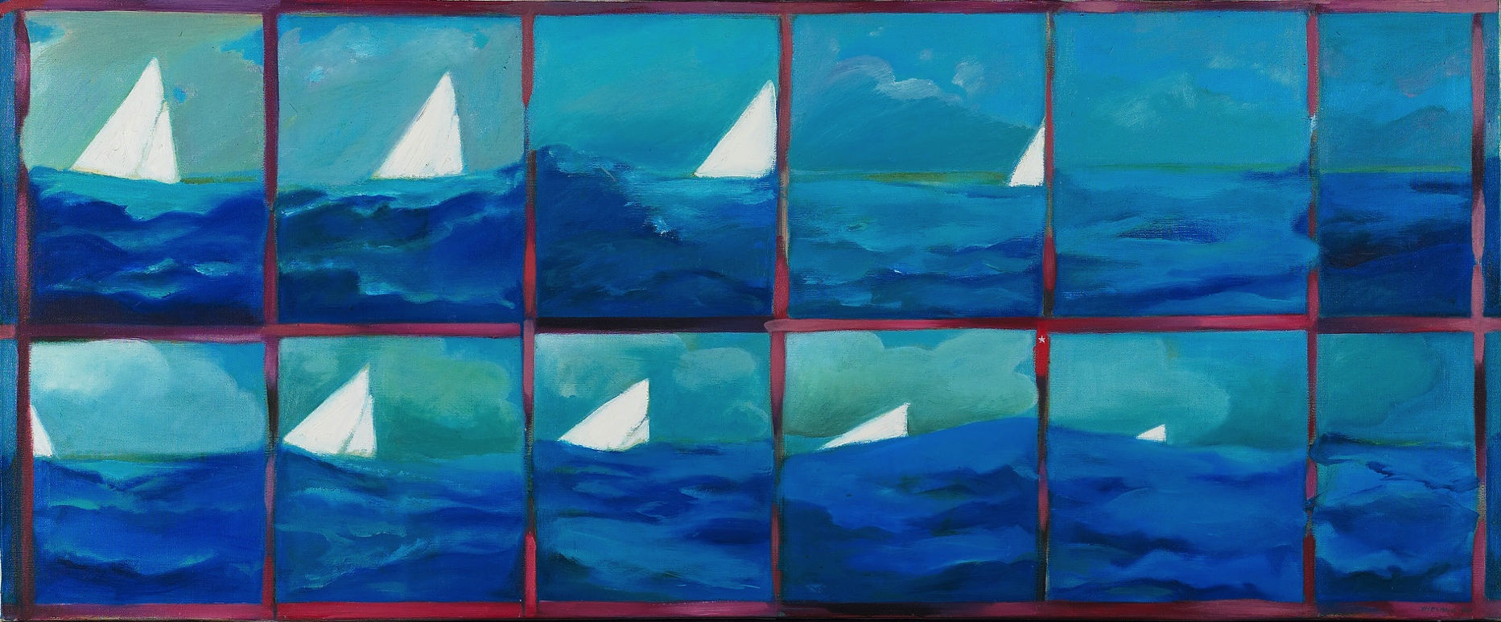
Joyce Wieland, Boat Tragedy, 1964. This painting is one of a series of works in which Wieland explored disasters.

Slide 8
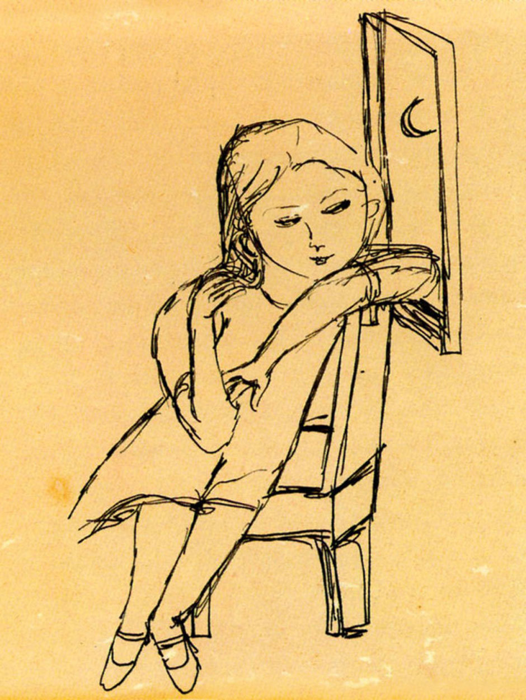
Joyce Wieland, Untitled
(Myself as a Young Girl), n.d.

Slide 9
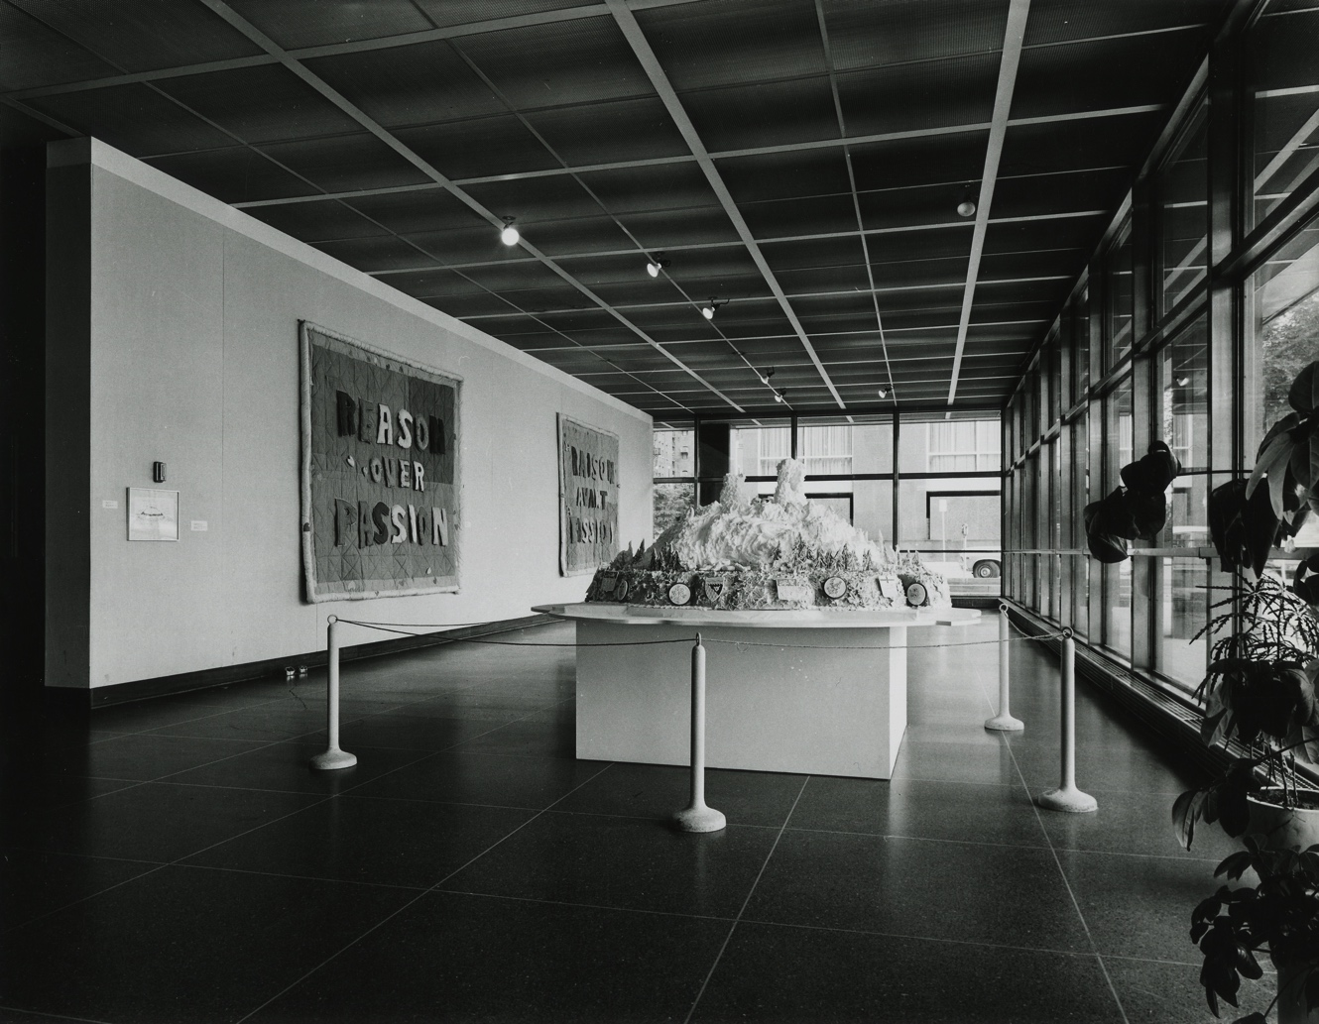
Installation view of True Patriot Love exhibition at the National Gallery of Canada, 1971.

Slide 10
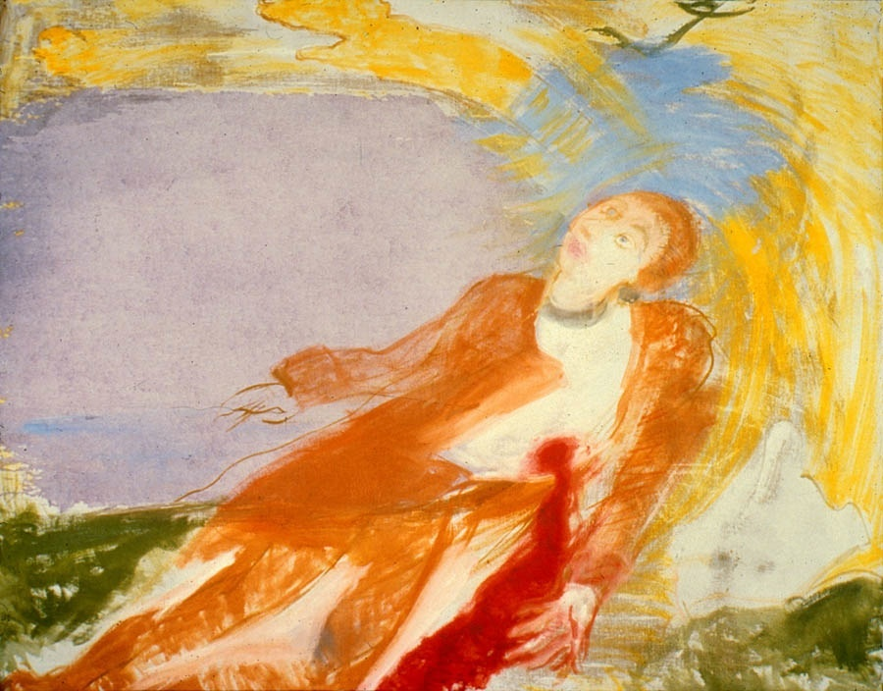
Joyce Wieland, The Death of Wolfe, 1987. This painting refers to the famous general James Wolfe, who died conquering Quebec for the British.

Slide 11
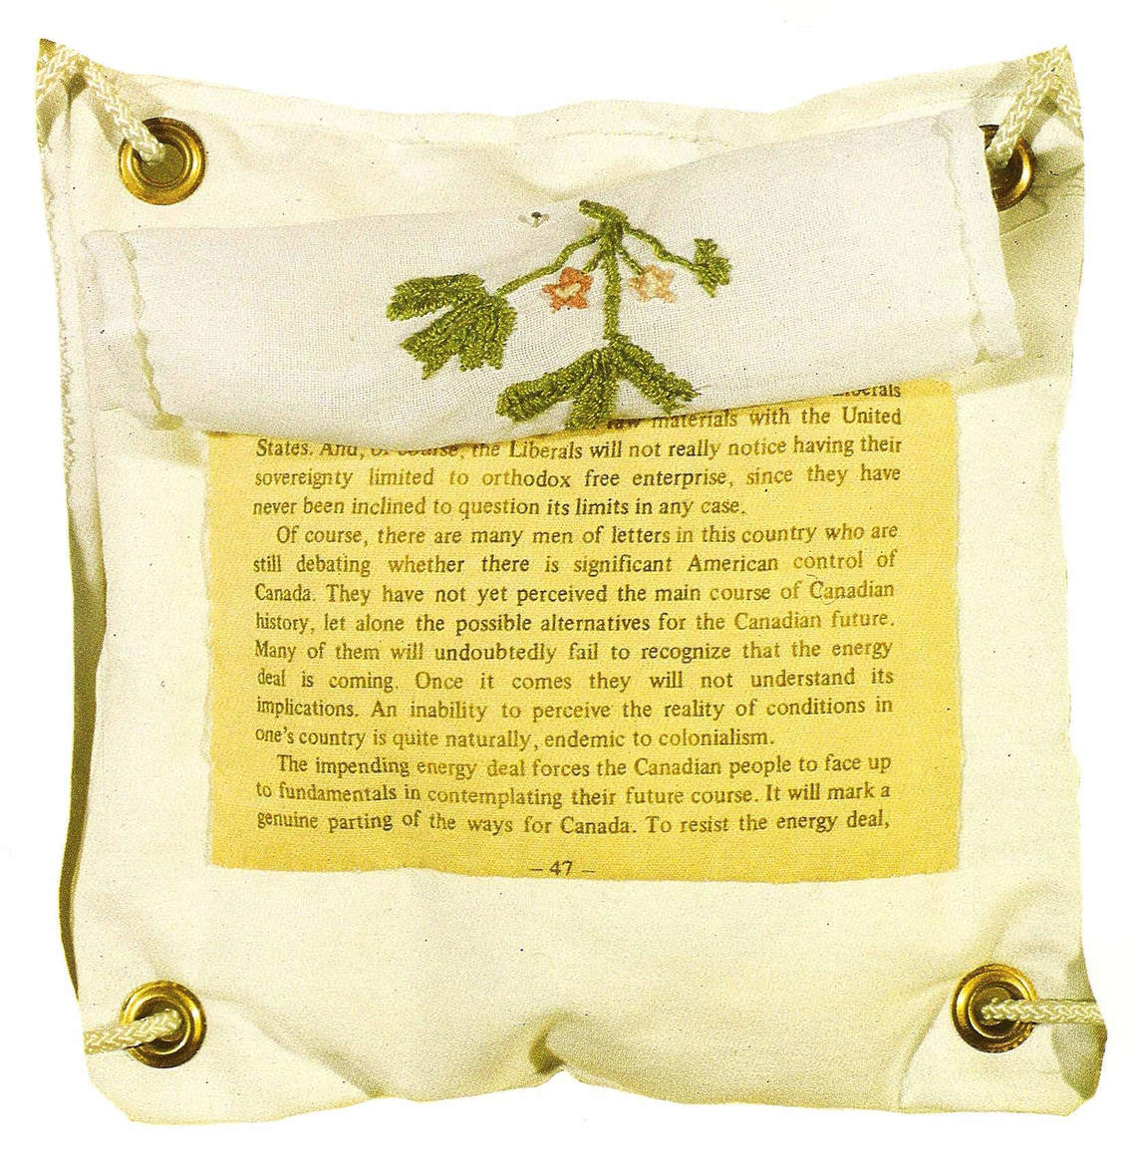
Learning Activity #1
Joyce Wieland, The Water Quilt (detail), 1970–71. In this work the pages from Laxer’s book are only revealed when the embroidered squares are lifted.

Slide 12
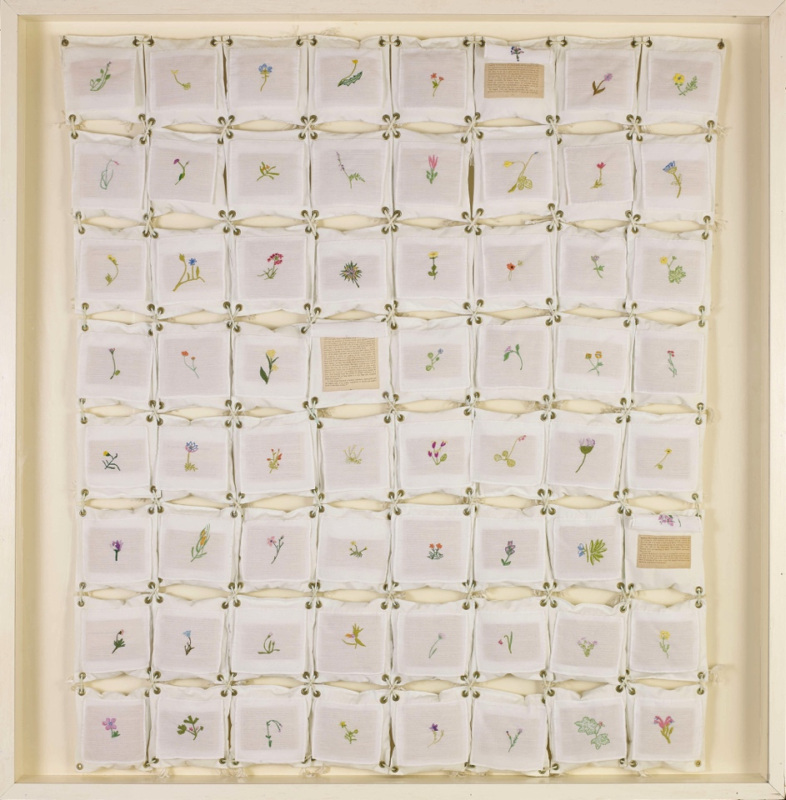
Learning Activity #1
Joyce Wieland, The Water Quilt, 1970–71. Sixty-four individual squares are assembled in this work, which Wieland described as a quilt.

Slide 13
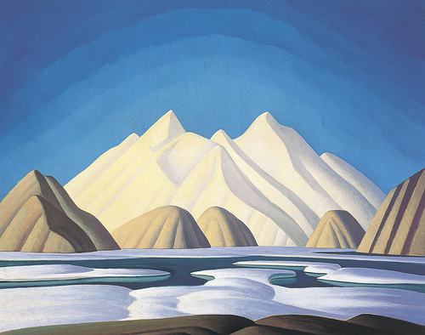
Learning Activity #2
Lawren S. Harris, Baffin Island Mountains,
c.1931. Harris, one of the leaders of the Group of Seven, is still famous for his paintings of snowy mountains and icebergs.

Slide 14
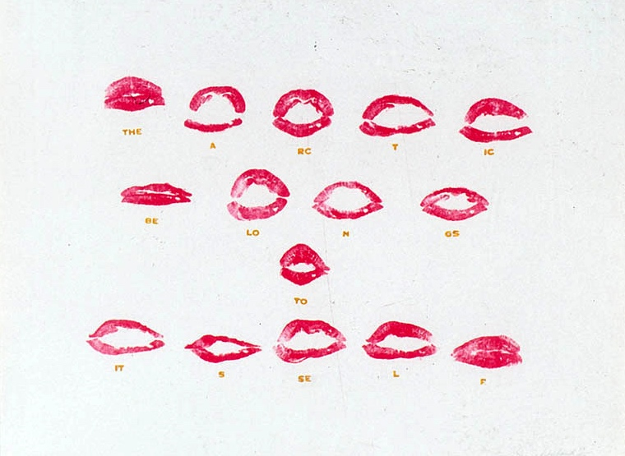
Learning Activity #2
Joyce Wieland, The Arctic Belongs to Itself, 1973. Wieland made several works with distinctive images of lips: here the lips share an environmental message.

Slide 15
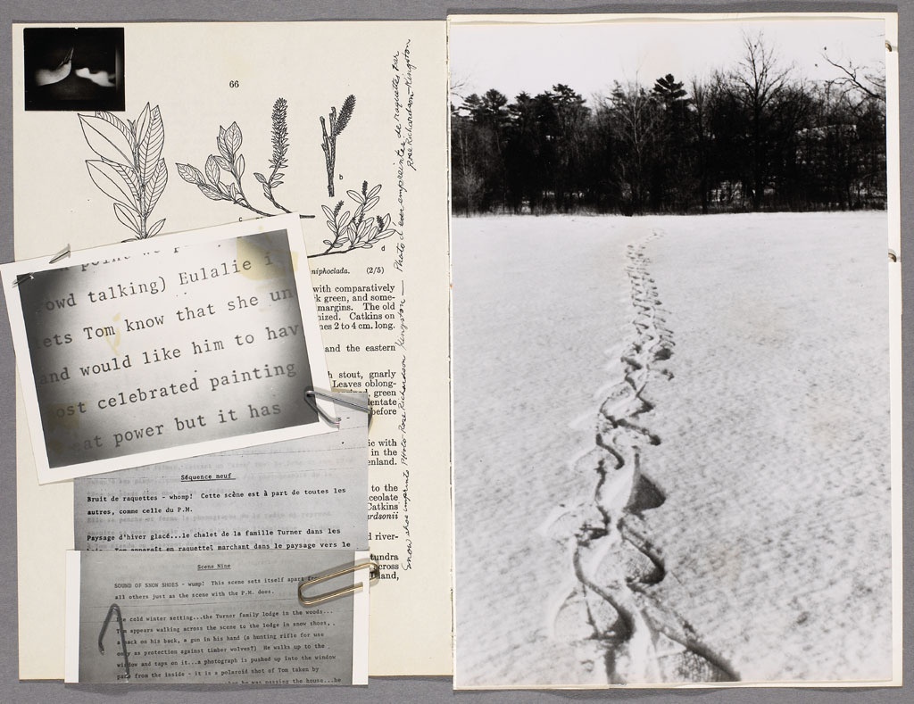
Joyce Wieland, True Patriot Love, 1971. In this image of the book we can see how Wieland inserted photographs and textual material on top of the original images of plants.

Slide 16
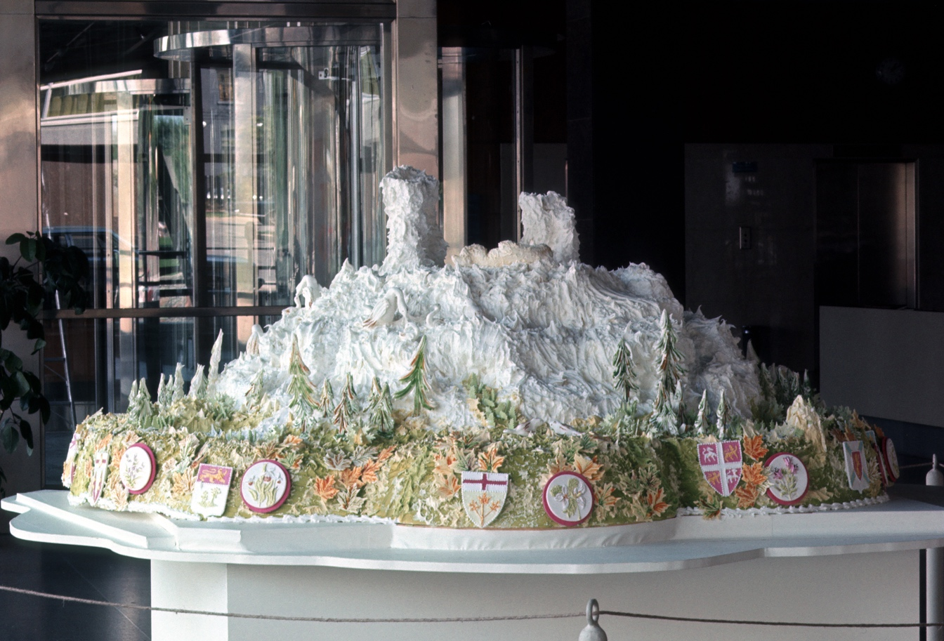
Culminating Task
Installation view of Wieland’s Arctic Passion Cake, 1971. To create this extraordinary cake, Wieland collaborated with the chef Jan Van Dierendonck.

Slide 17
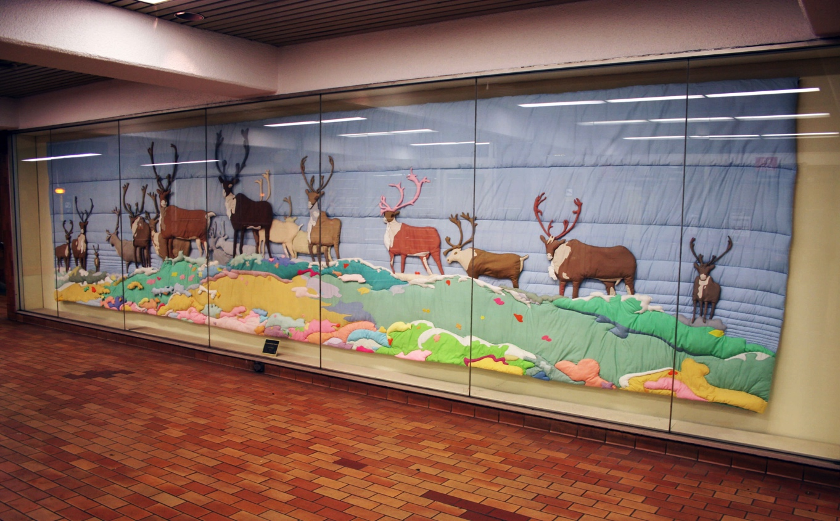
Culminating Task
Joyce Wieland, Barren Ground Caribou, 1977–78. With this work, Wieland wanted to draw attention to the tundra landscape.

Slide 18
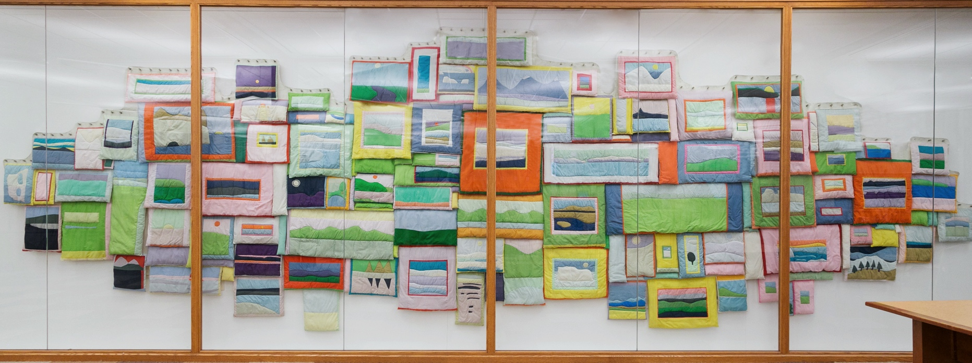
Joyce Wieland, 109 Views, 1970–71. In this fabric work, Wieland has stitched together a multitude of landscape “paintings,” each with its own frame.

Slide 19
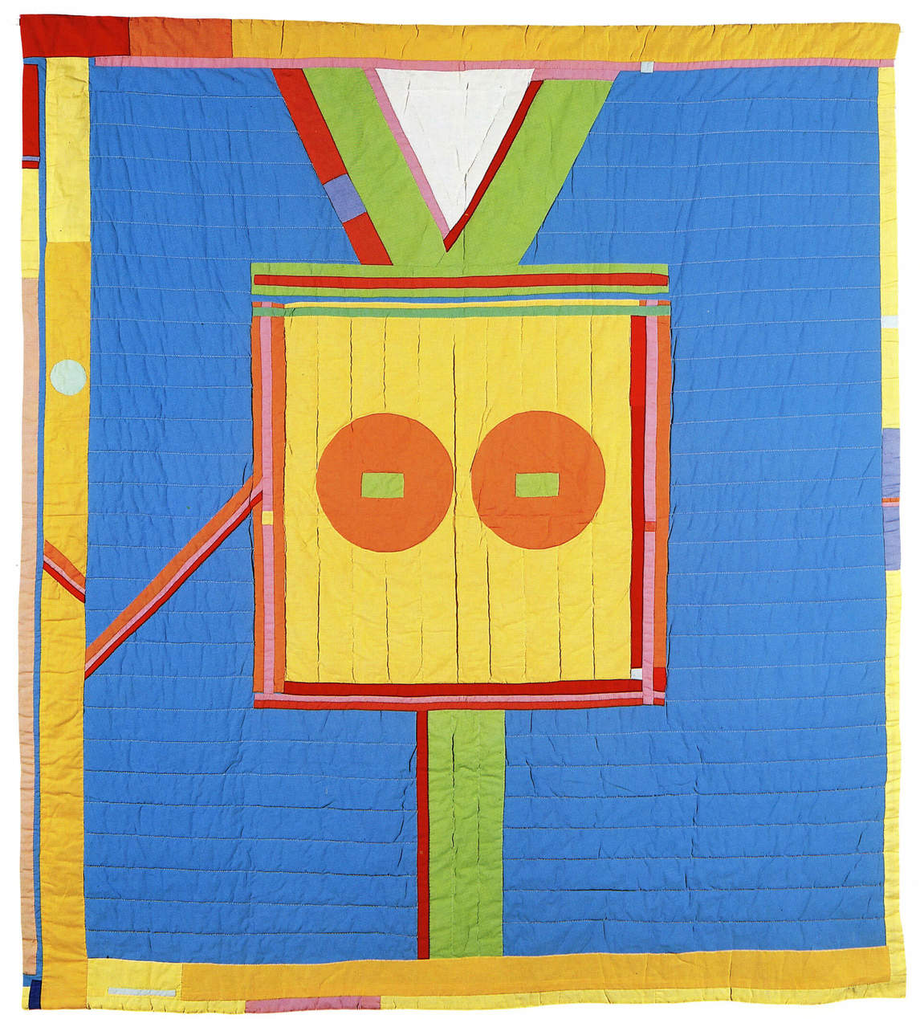
Joyce Wieland, The Camera’s Eyes, 1966. With her textile works, Wieland was reclaiming work traditionally done by women and acknowledging its artistic importance.

Slide 20
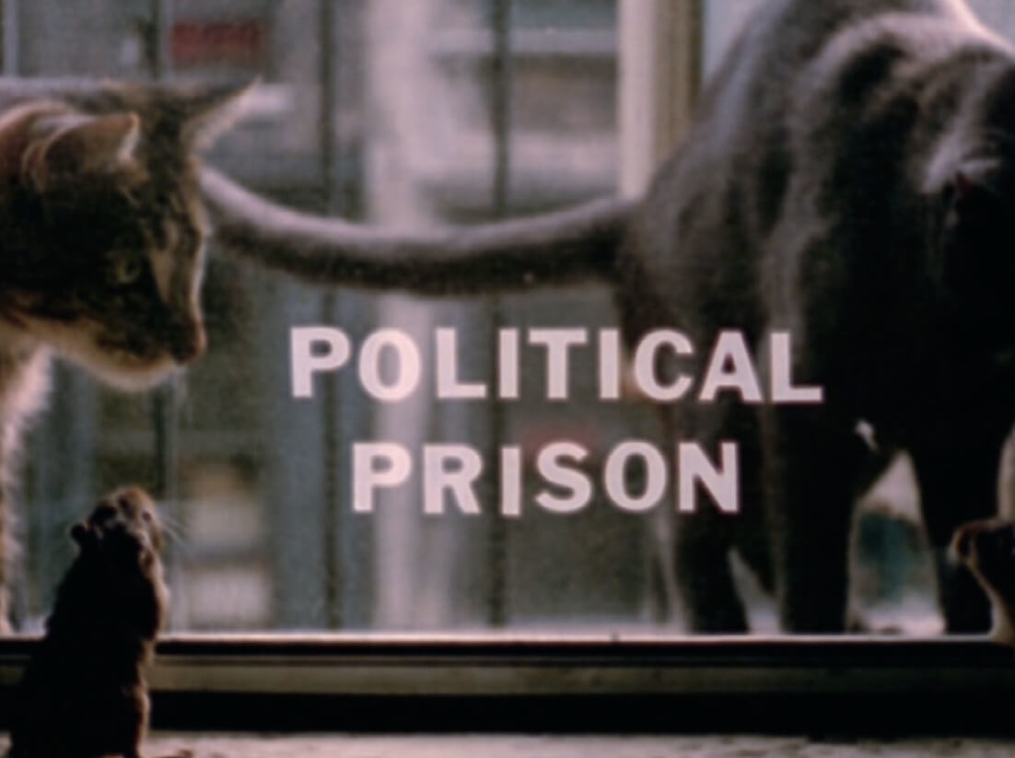
Rats seeking freedom in Canada are held captive by a cat in the United States in Wieland’s Rat Life and Diet in North America, 1968.

Slide 21
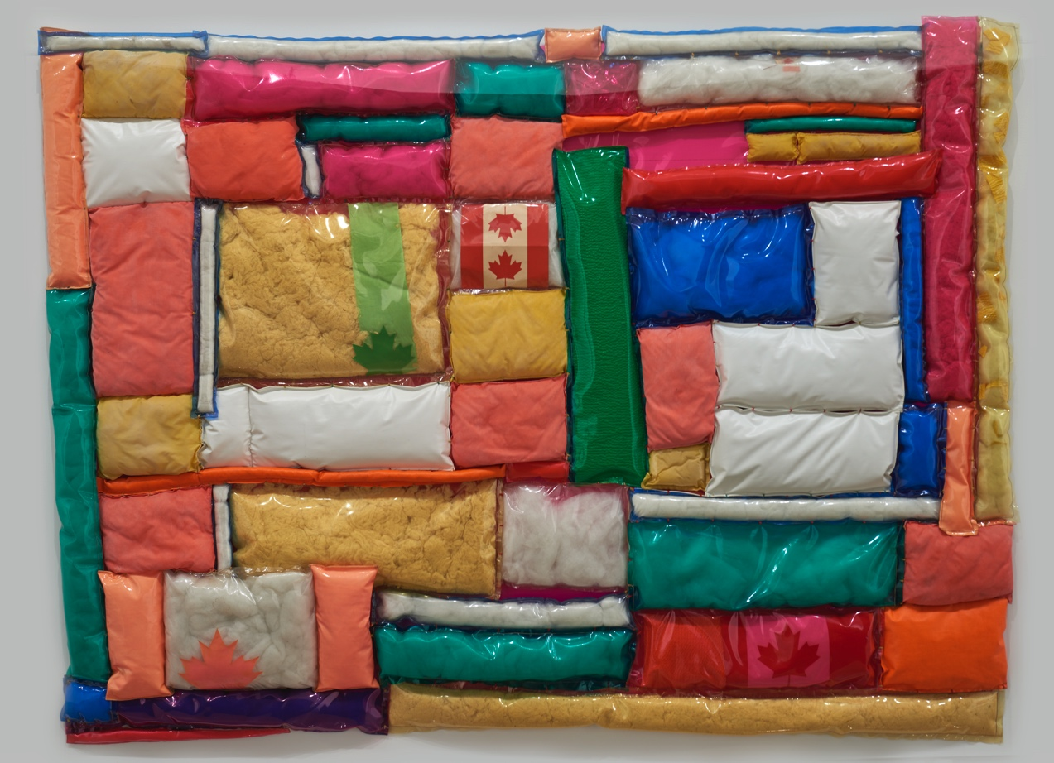
Joyce Wieland, Confedspread, 1967. Wieland created this work the same year that Canada celebrated its centennial.

Slide 22
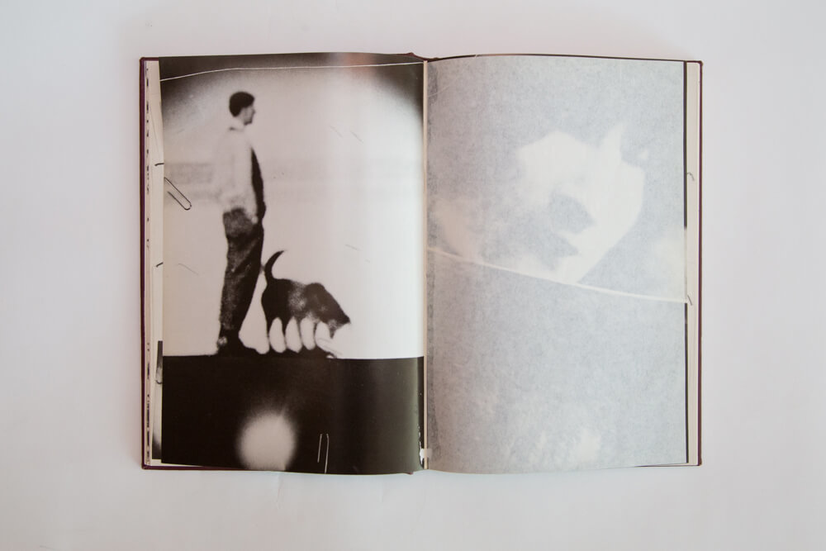
Joyce Wieland, True Patriot Love, 1971. With Wieland’s bookwork True Patriot Love, no singular picture of the Canadian landscape dominates, which allows for various voices, images, and texts to make up a diverse representation of the country.

Slide 23
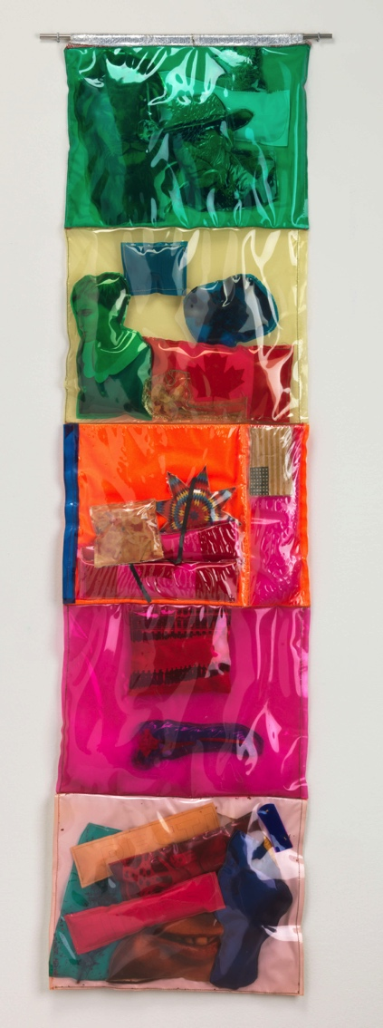
Joyce Wieland, Stuffed Movie, 1966. In the late 1960s Wieland experimented with using shiny plastic and other brightly coloured synthetic materials.

