Slide 1
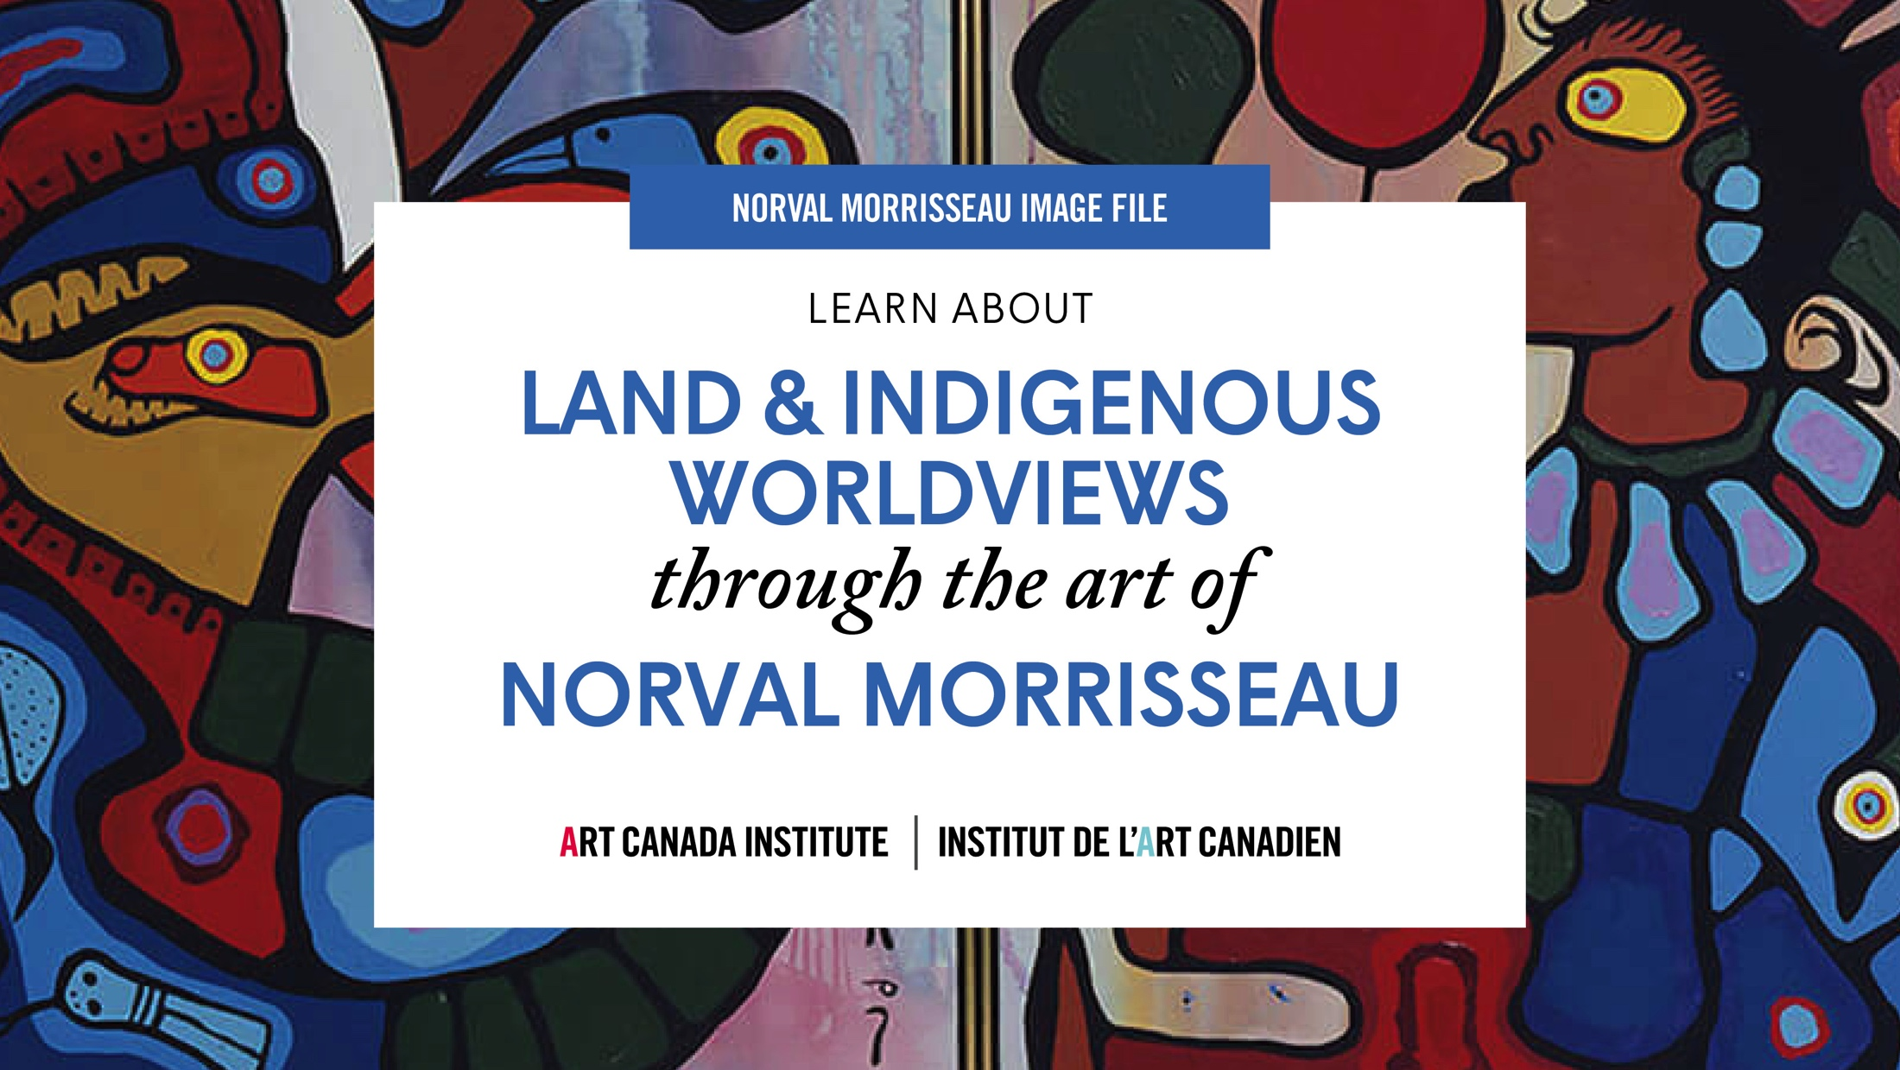

Slide 2
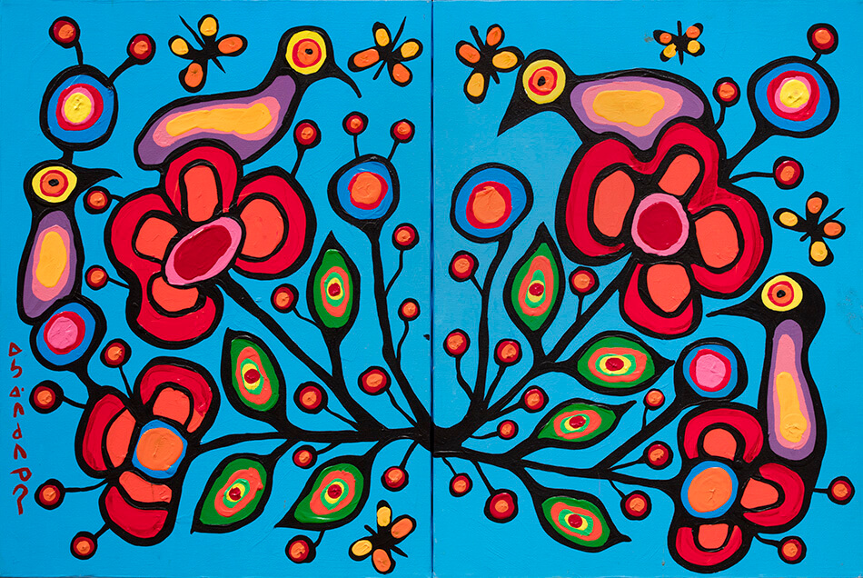
Norval Morrisseau, Floral Theme in Two Parts, c.1980–85.The symmetry in this painting of birds, butterflies, flowers, and berries represents balance in nature.

Slide 3
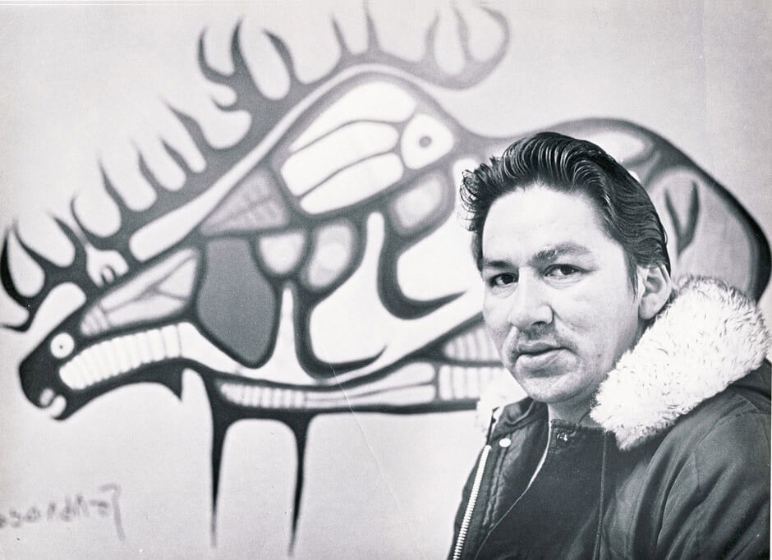
Norval Morrisseau in Red Lake.

Slide 4
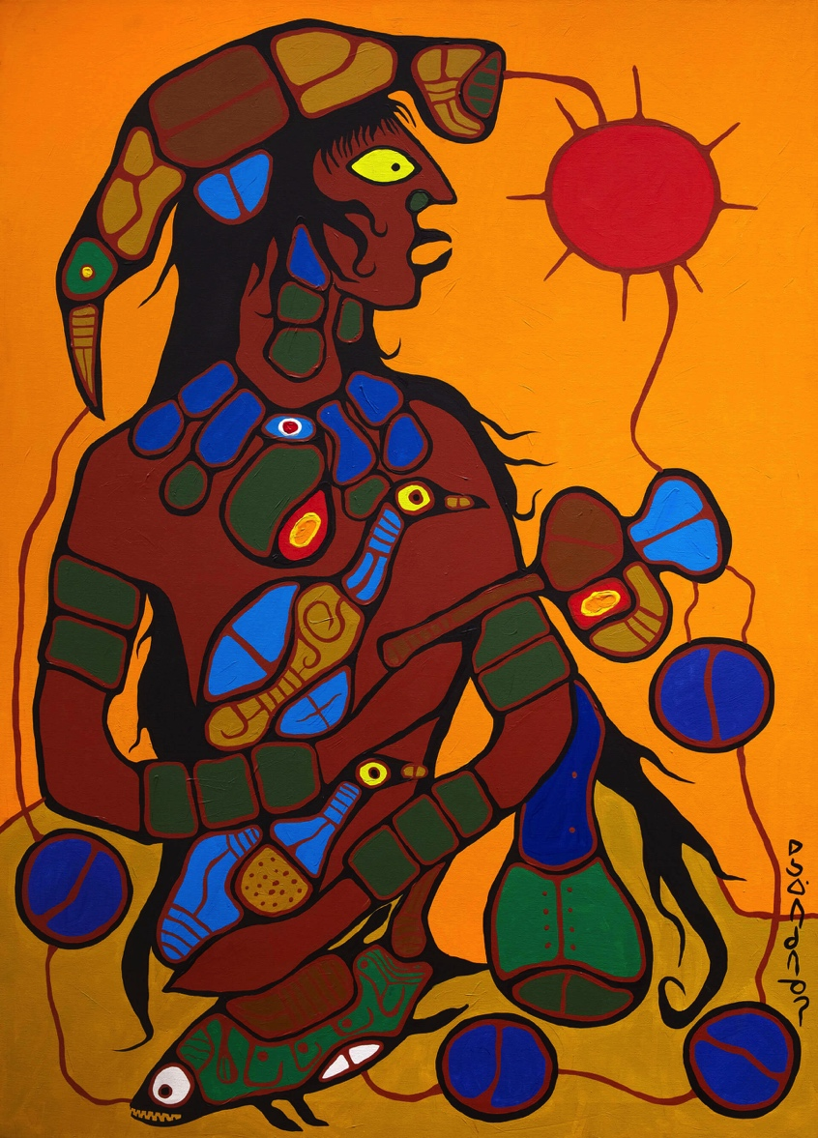
Norval Morrisseau, Man Changing into Thunderbird (detail), 1977. This work charts Morrisseau’s personal transformation into Copper Thunderbird.

Slide 5
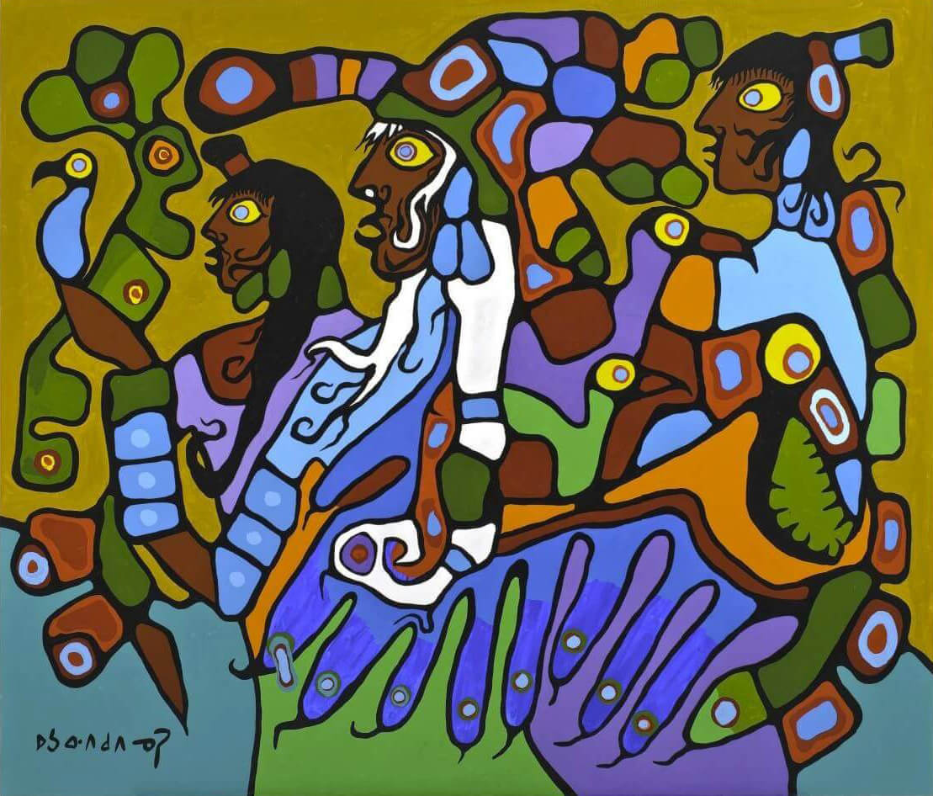
Norval Morrisseau, Shaman and Disciples, 1979. Morrisseau identified the central figure in this painting—completed while he was an artist in residence at the McMichael—as a self-portrait.

Slide 6
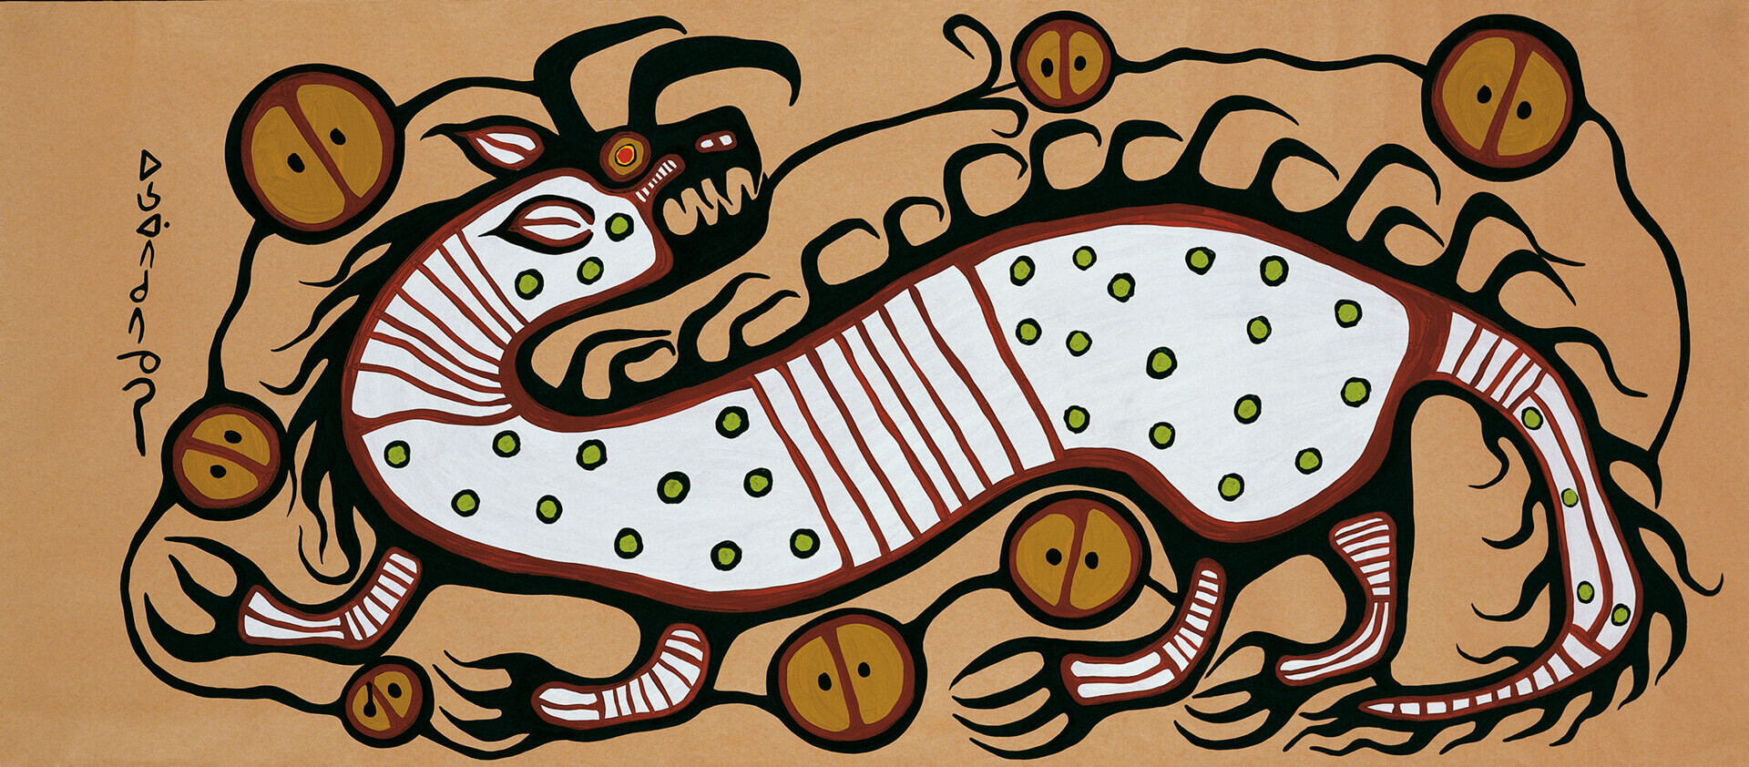
Norval Morrisseau, Water Spirit, 1972. This manitou, or spirit-being, is known as Micipijiu and expresses the duality of good and evil.

Slide 7
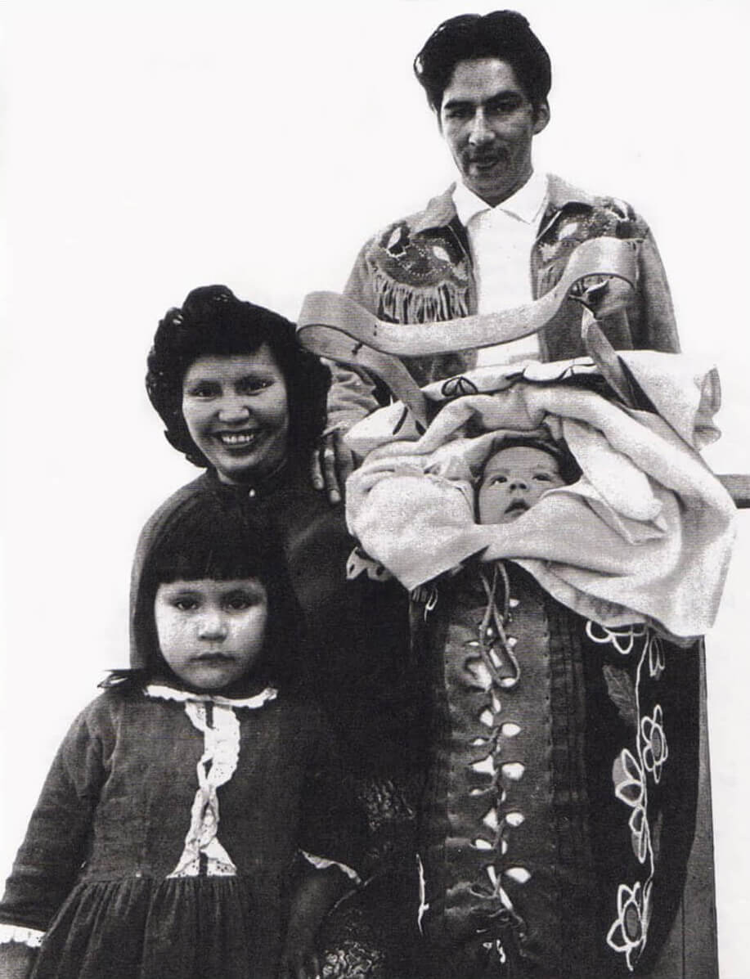
Harriet, Norval, Pierre, and Victoria Morrisseau, photographed in Toronto in March 1964.

Slide 8
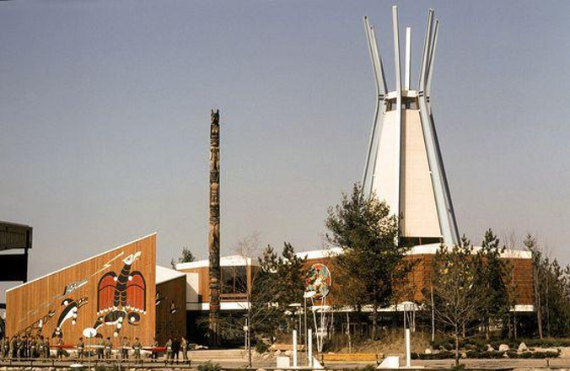
A view of the Indians of Canada Pavilion at Montreal’s Expo 67, 1967.

Slide 9
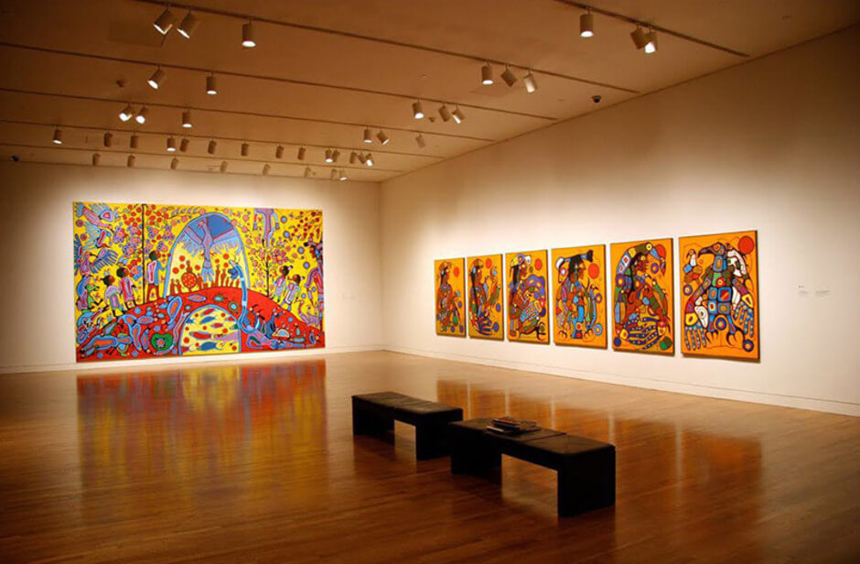
Installation of Morrisseau’s works in the exhibition Norval Morrisseau: Shaman Artist at the National Gallery of Canada, Ottawa, 2006.

Slide 10
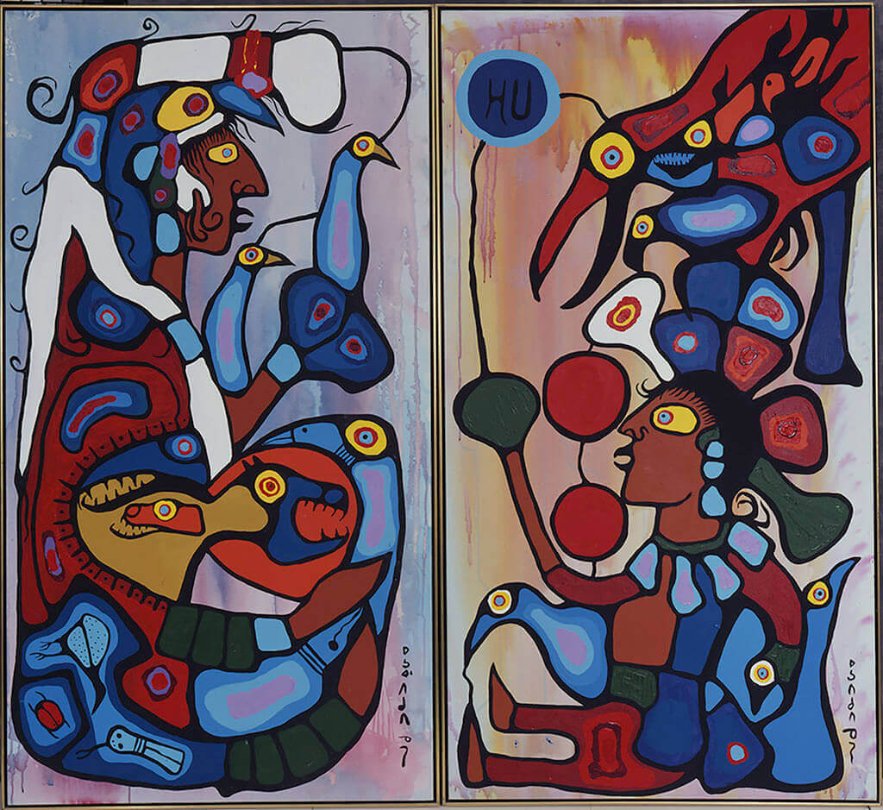
Learning Activity #1
Norval Morrisseau, The Storyteller: The Artist and His Grandfather, 1978. In this work Morrisseau presents himself as a young boy, respectfully acknowledging his debt to his Anishinaabek Mishomis—his maternal grandfather, Moses Potan Nanakonagos.

Slide 11
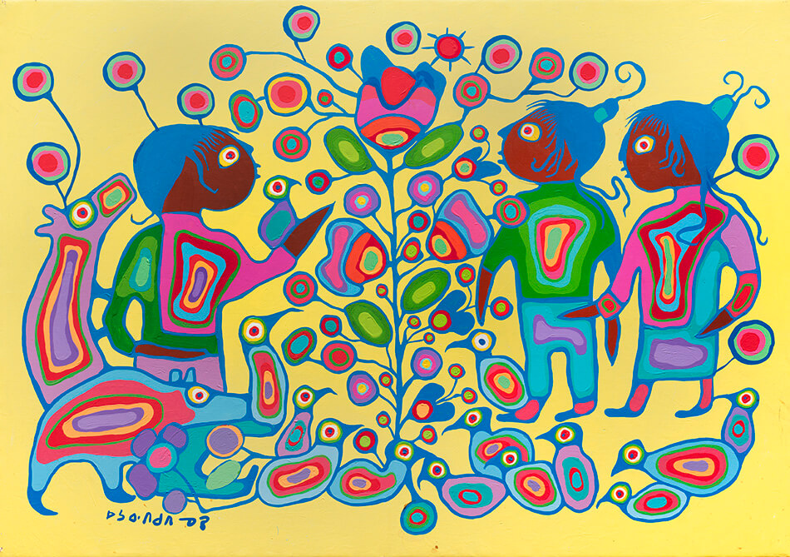
Learning Activity #1
Norval Morrisseau, Children with Tree of Life, c.1980–85. In this painting children and animals have come together to look at a vibrant, colourful plant.

Slide 12
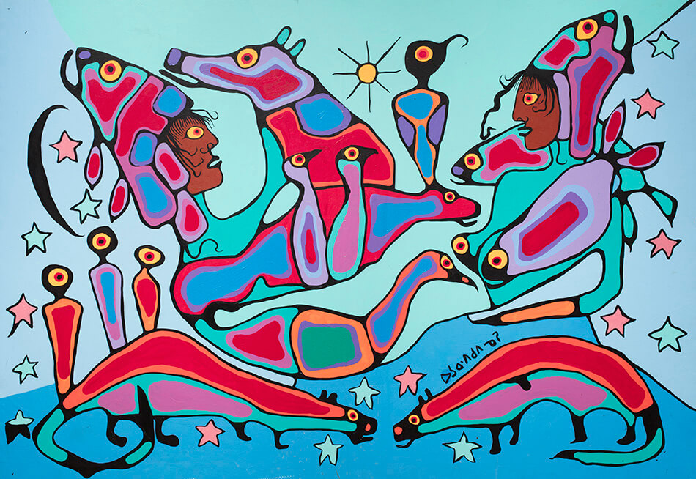
Learning Activity #1
Norval Morrisseau, Shaman and Apprentice, c.1980–85. This work represents learning: the shaman on the left is sharing his spiritual knowledge with the figure on the right.

Slide 13
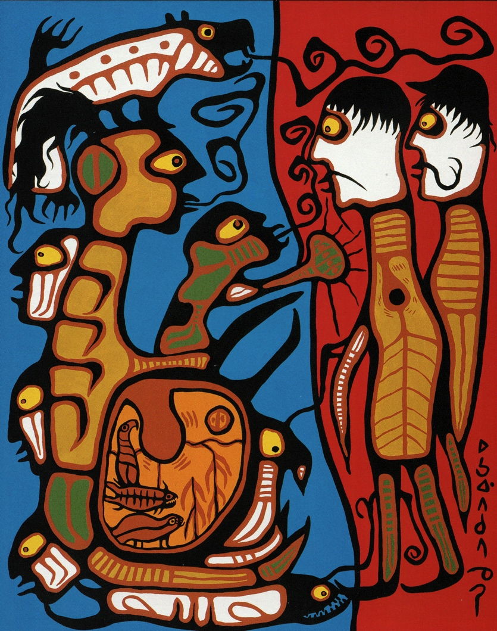
Learning Activity #2
Norval Morrisseau, The Land (Land Rights), 1976. Morrisseau’s dramatic painting speaks to historic and ongoing conflicts over land rights.

Slide 14
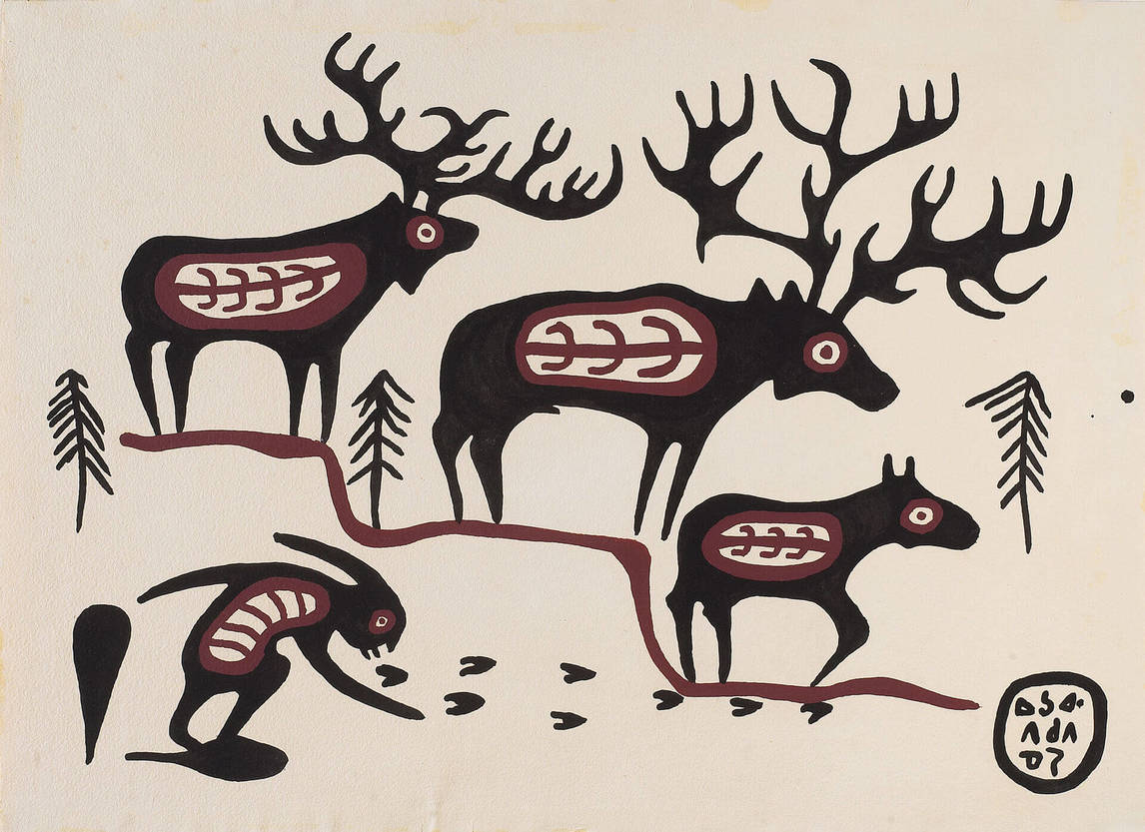
Learning Activity #2
Norval Morrisseau, Moose Dream Legend, 1962. One of Morrisseau’s early paintings, Moose Dream Legend is an example of the artist’s powerful use of lines.

Slide 15
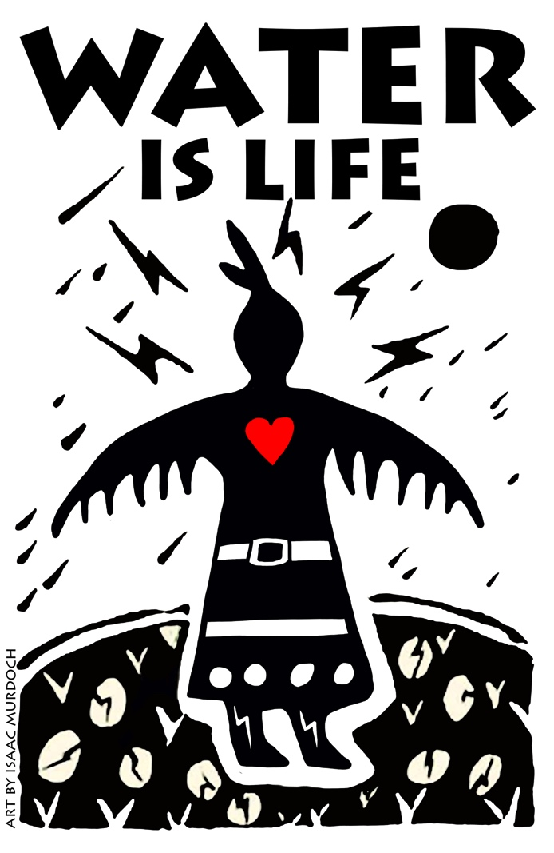
Learning Activity #2
Isaac Murdoch, Thunderbird Woman, 2016–18. This work has been adapted for banners and posters at protests and activist gatherings.

Slide 16

Learning Activity #2
Christi Belcourt, Water is Life, 2016–18. The Water Is Life project asks viewers to reflect on connections between the earth and all living beings.

Slide 17
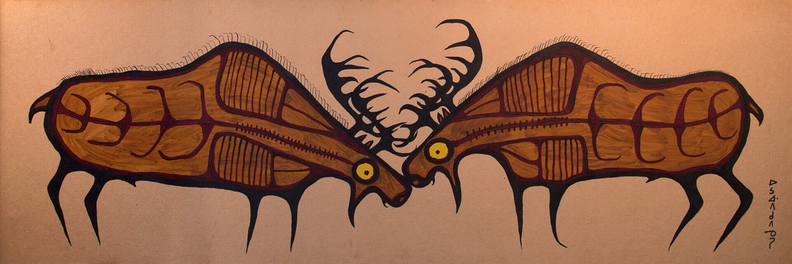
Norval Morrisseau, Untitled (Two Bull Moose), 1965. Morrisseau’s compositions often emphasize balance and symmetry.

Slide 18
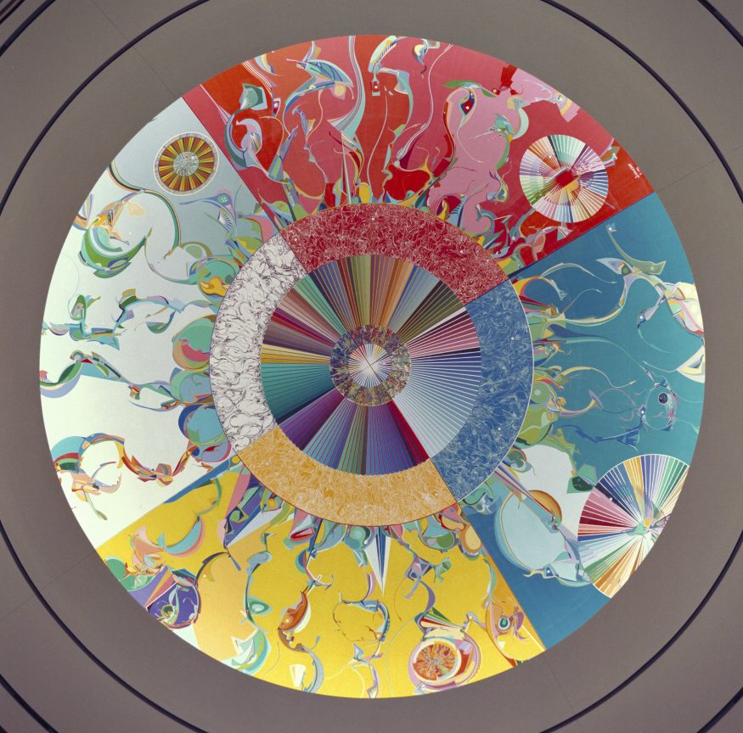
Culminating Task
Alex Janvier, Morning Star—Gambeh Then’, 1993. The title of this enormous mural (418 square metres in size) refers to the morning star because Janvier’s people used that star as a guiding light and the artist hoped this work might become one as well.

Slide 19
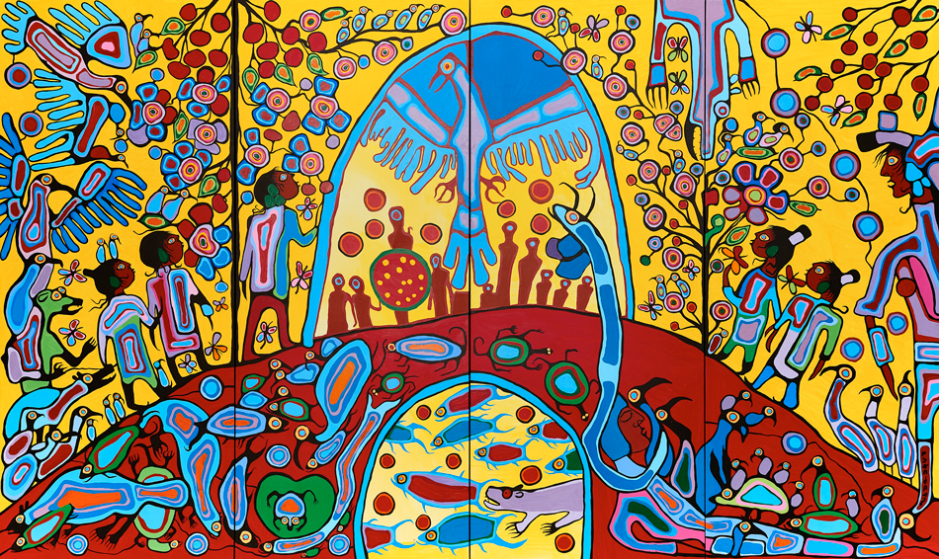
Culminating Task
Norval Morrisseau, Androgyny, 1983. Morrisseau offered this work to the people of Canada as a decolonizing gesture of reconciliation.

Slide 20
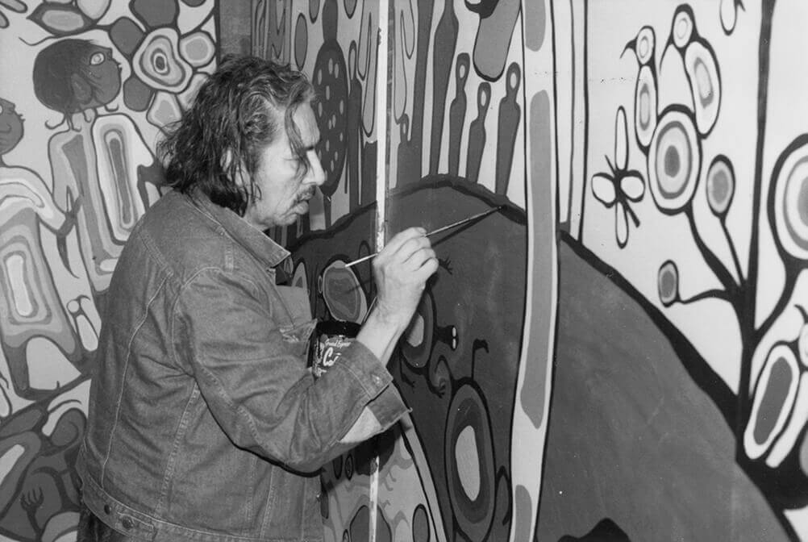
Culminating Task
Norval Morrisseau painting Androgyny, 1983. This photograph shows the artist working on the defining black outlines.

Slide 21
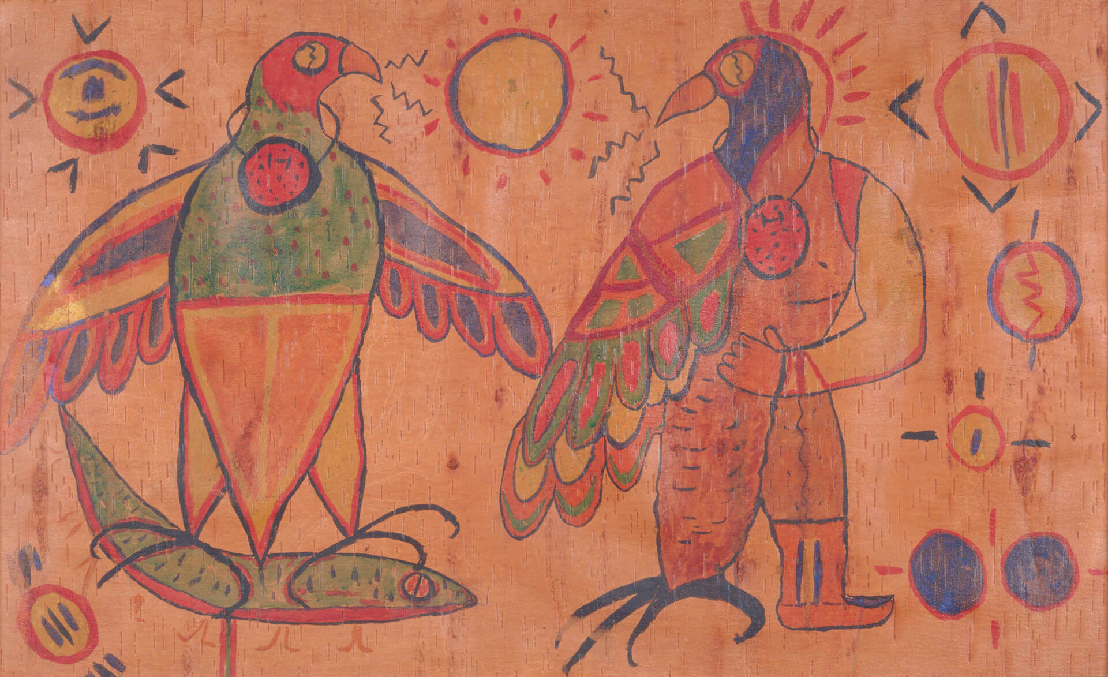
Norval Morrisseau, Untitled (Thunderbird Transformation), c.1958–60. Thunderbird, the powerful spirit-being that often signifies spiritual transformation, appears repeatedly in the artist’s paintings.

Slide 22
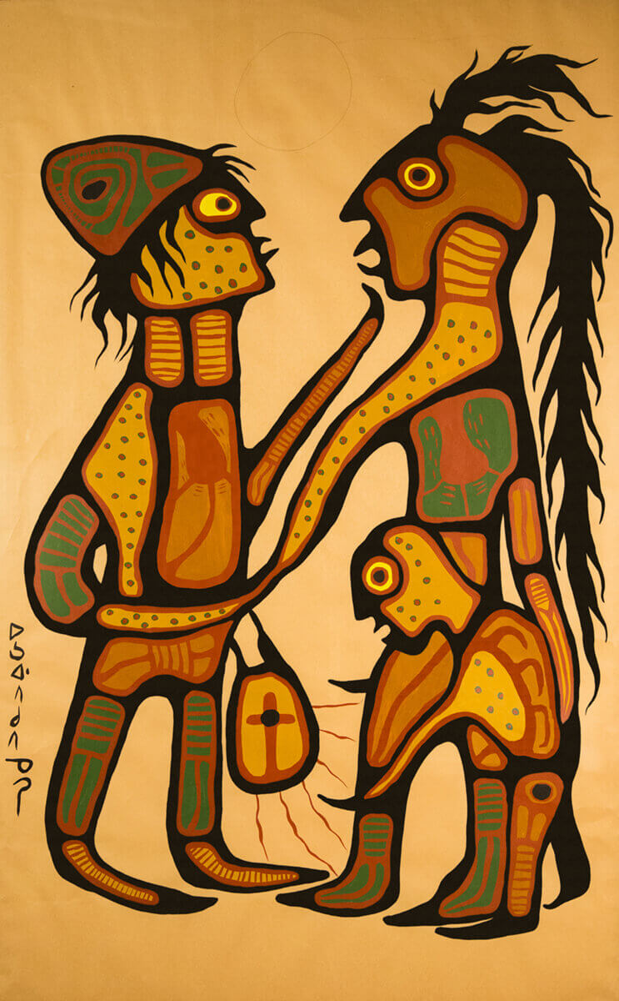
Norval Morrisseau, The Gift, 1975.
In this work Morrisseau represents
a missionary and a shaman and uses the contrast of red and green to represent their different ways of knowing the world.

Slide 23
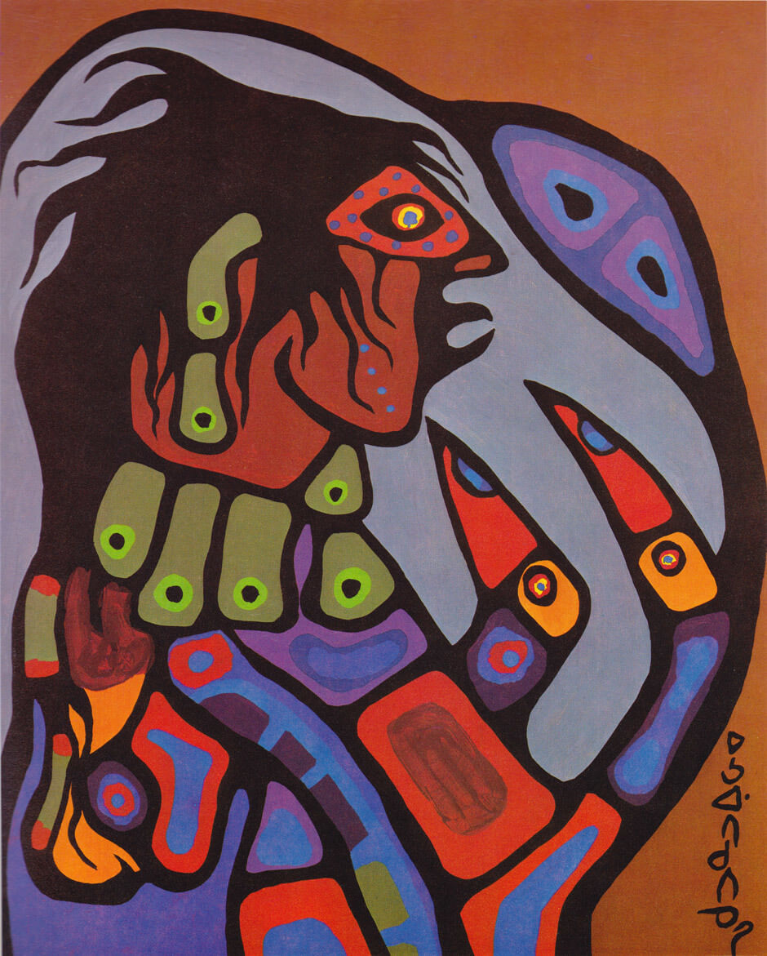
Norval Morrisseau, Ojibway
Shaman Figure, 1975. Morrisseau identified as a shaman artist, and this became an important part of his public identity.

Slide 24
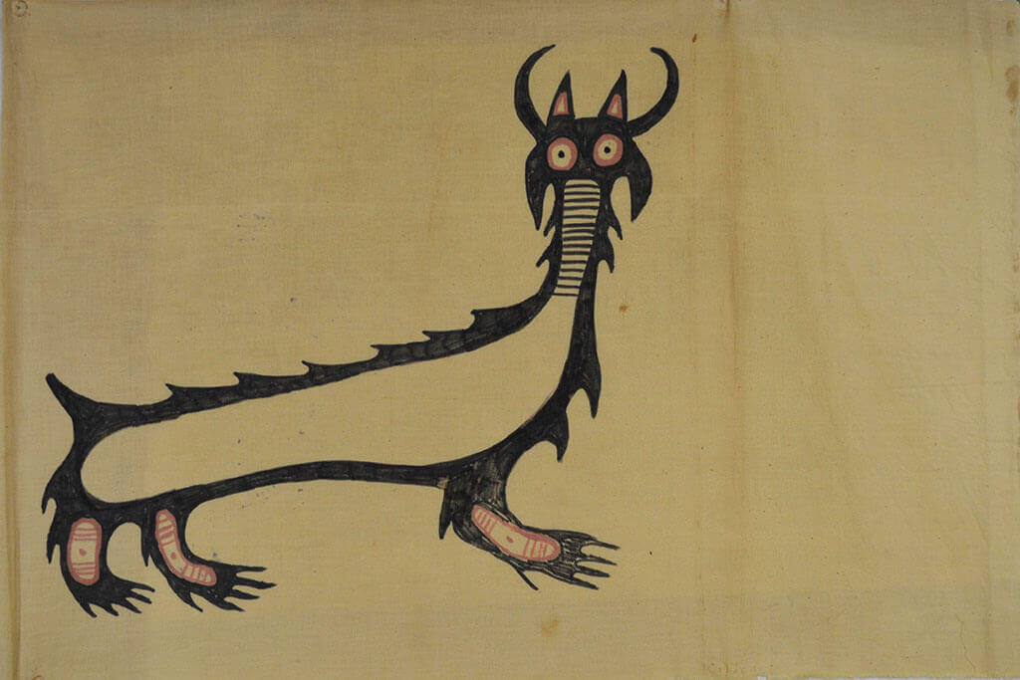
Norval Morrisseau, Mishupishu, n.d. Morrisseau’s representations of the manitou Micipijiu are similar to images of this being in Anishinaabe rock art.

Slide 25
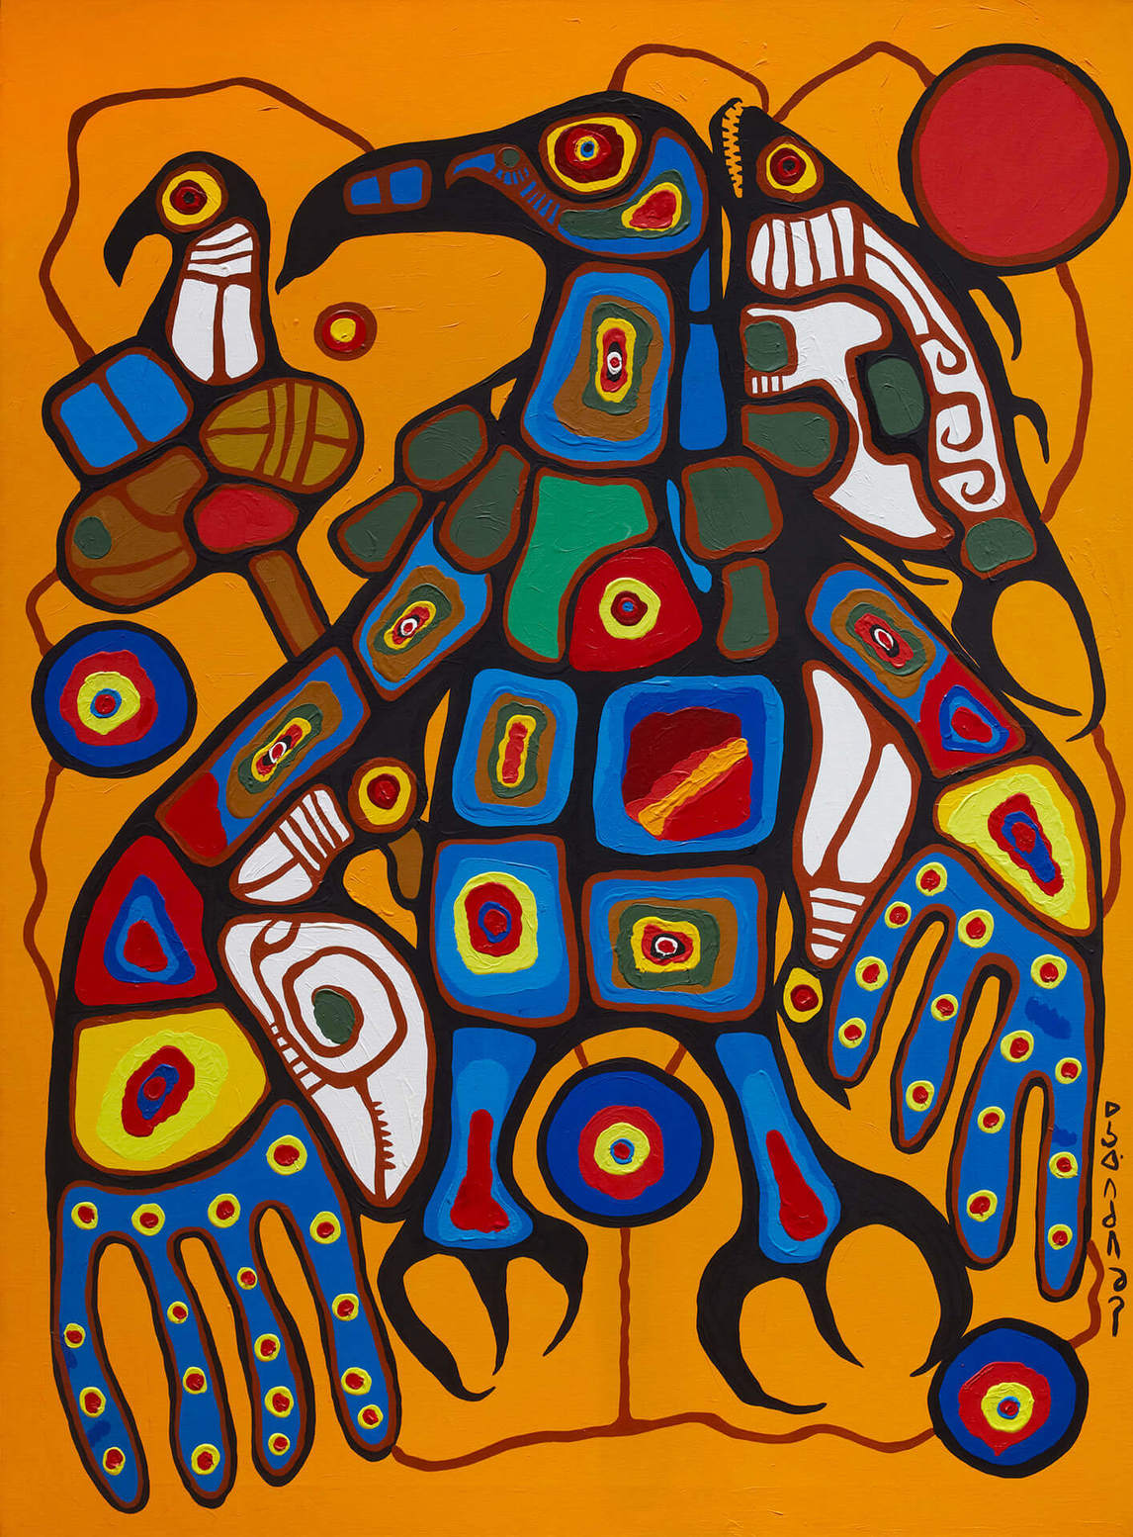
Norval Morrisseau, Man Changing into Thunderbird (detail), 1977. This work includes six panels that together represent the artist’s personal transformation into Copper Thunderbird.

