Slide 2
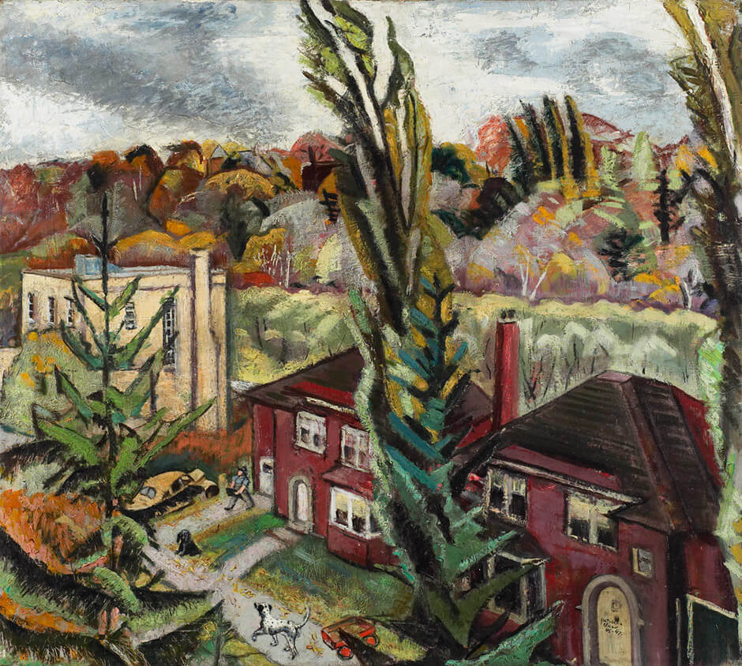
Paraskeva Clark, Our Street in Autumn, 1945–47, oil on canvas, frame: 94 x 101.5 cm, Art Gallery of Ontario, Toronto, Gift from the J.S. McLean Collection, by Canada Packers Inc., 1990 89/794. © Clive Clark.
Clark created several paintings that depict her own community.

Slide 3
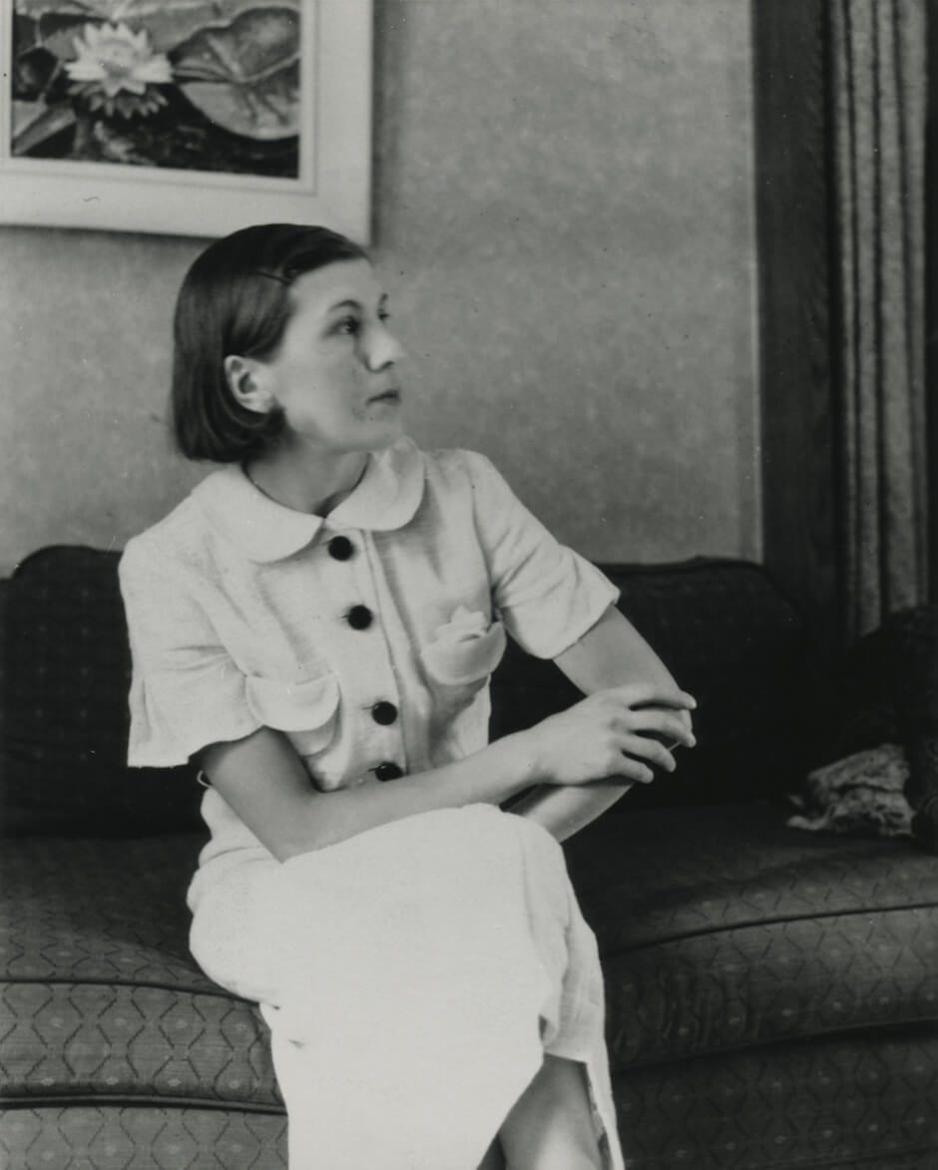
Paraskeva Clark, c.1936.

Slide 4
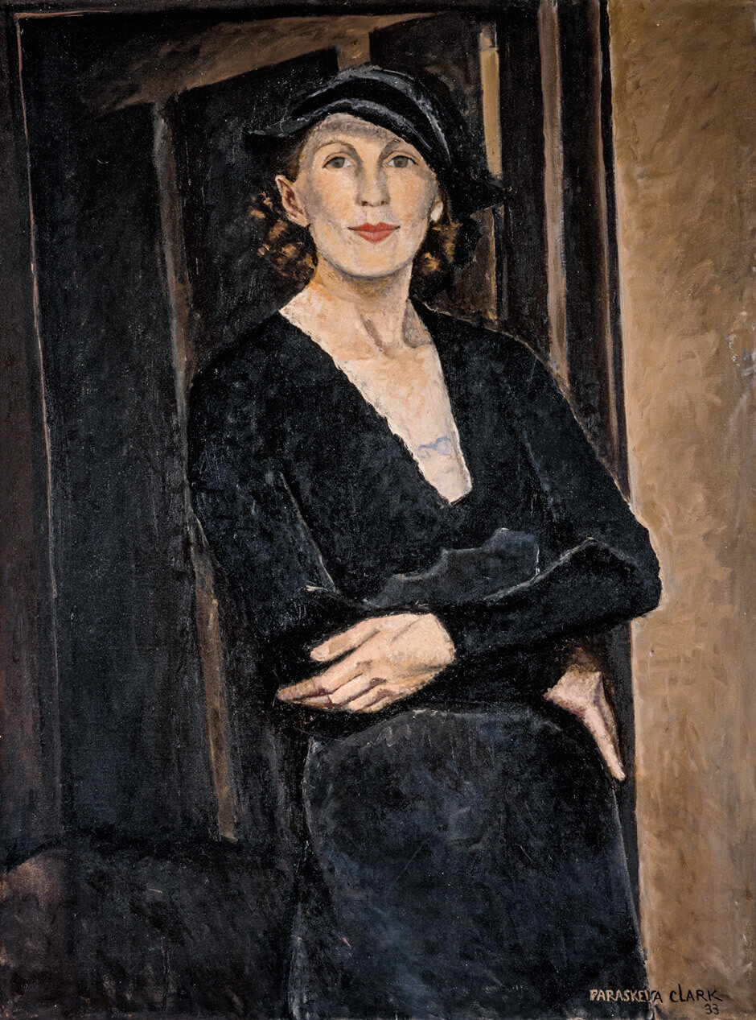
Paraskeva Clark, Myself, 1933. Clark painted this famous self- portrait while she was pregnant with her second son, Clive.

Slide 5
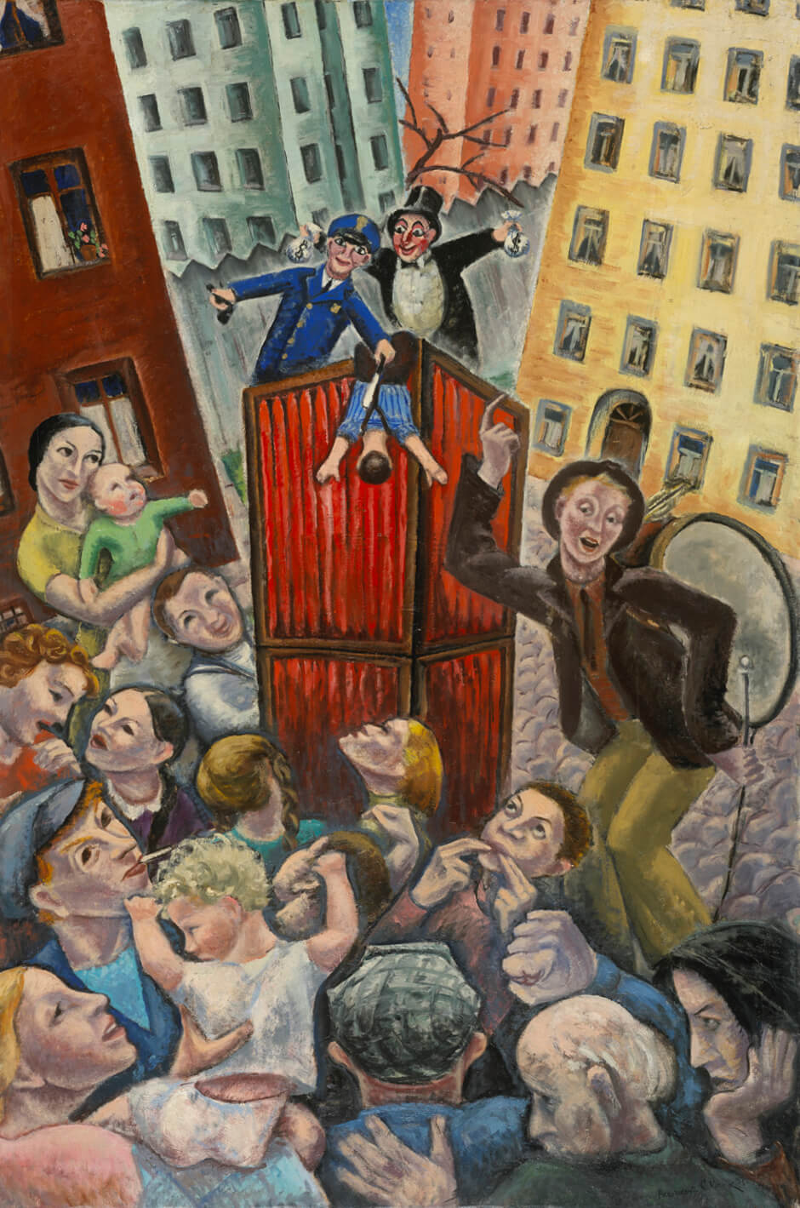
Paraskeva Clark, Petroushka, 1937.
This painting was inspired by a workers’ strike during the Great Depression.

Slide 6
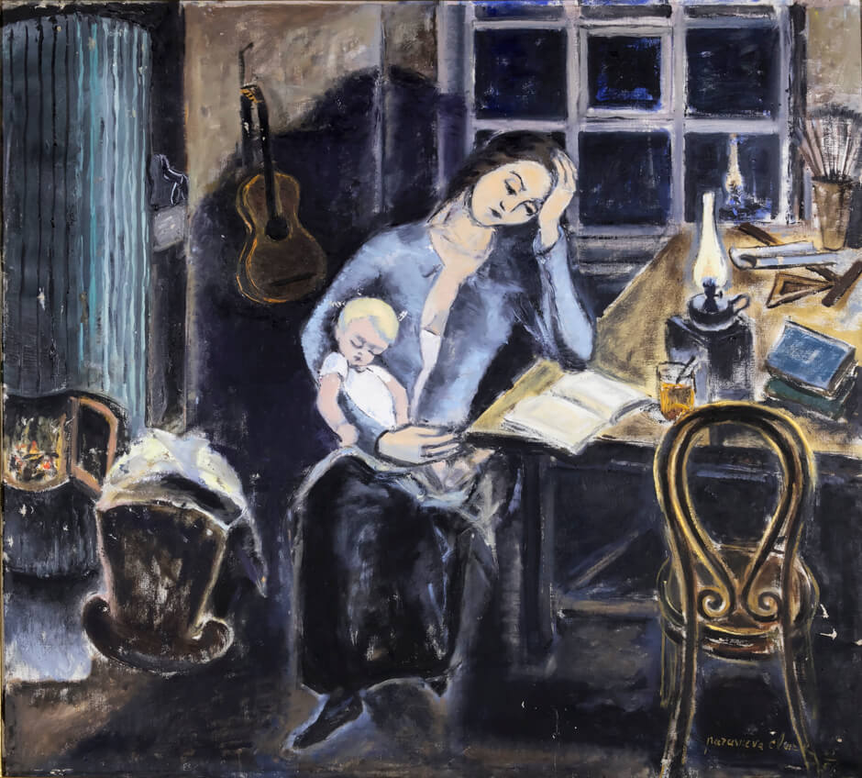
Paraskeva Clark, Souvenirs of Leningrad: Mother and Child, 1955–56. This painting refers to Clark’s memories of being a young mother in Russia.

Slide 7
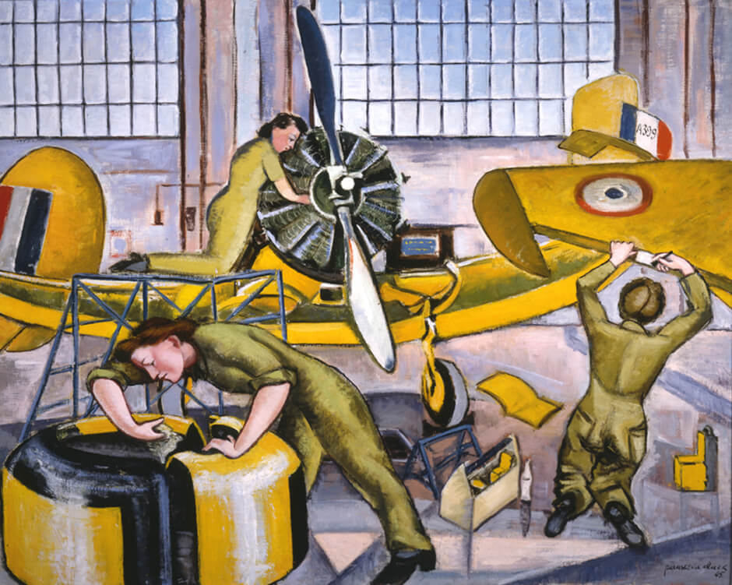
Paraskeva Clark, Maintenance Jobs in the Hangar #6, Trenton RCAF, Station, 1945. To fulfill her wartime commission, Clark visited the RCAF base at Trenton.

Slide 8
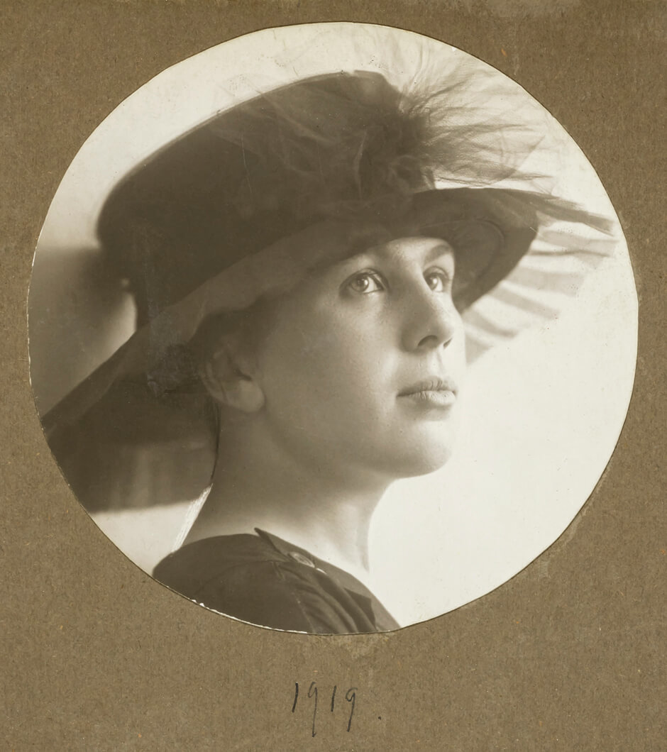
A young Paraskeva Plistik, 1919.

Slide 9
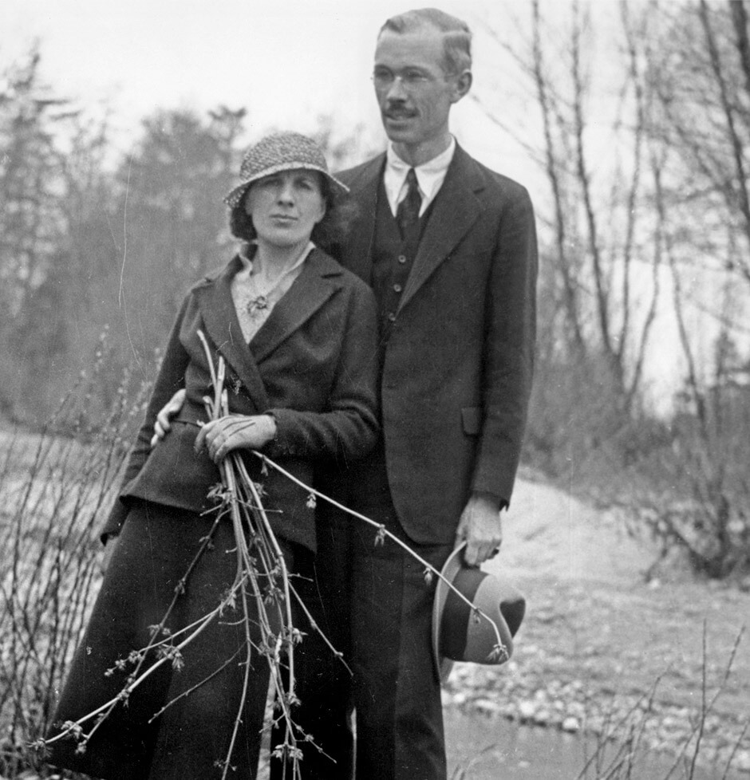
Paraskeva and Philip Clark in Canada, 1931.

Slide 10
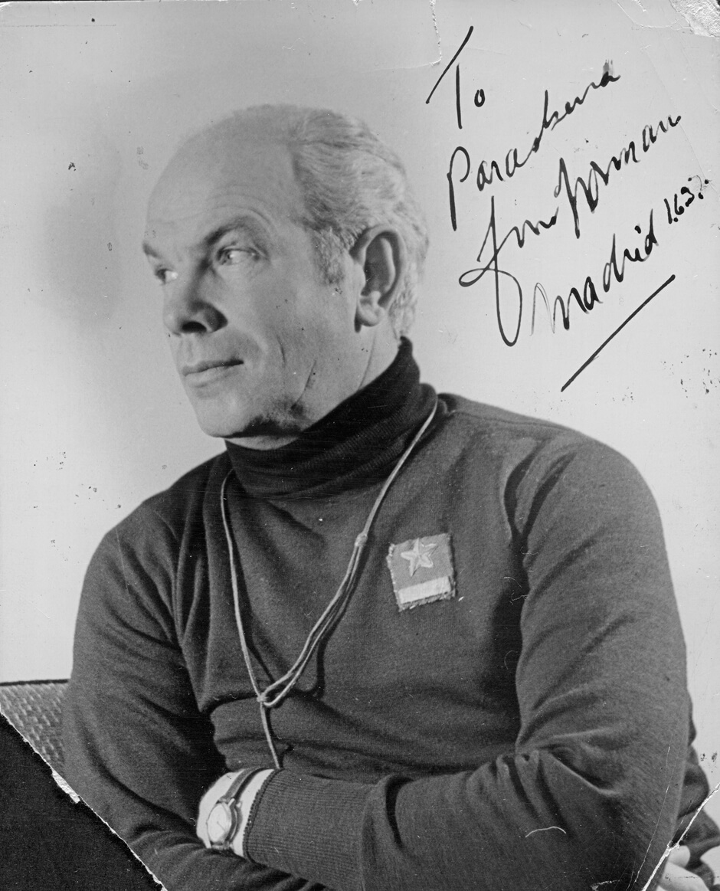
A signed photograph sent to Paraskeva Clark from Dr. Norman Bethune, 1937.

Slide 11
Learning Activity #1
Paraskeva Clark, Petroushka, 1937. Clark considered this work her most important painting.

Slide 12
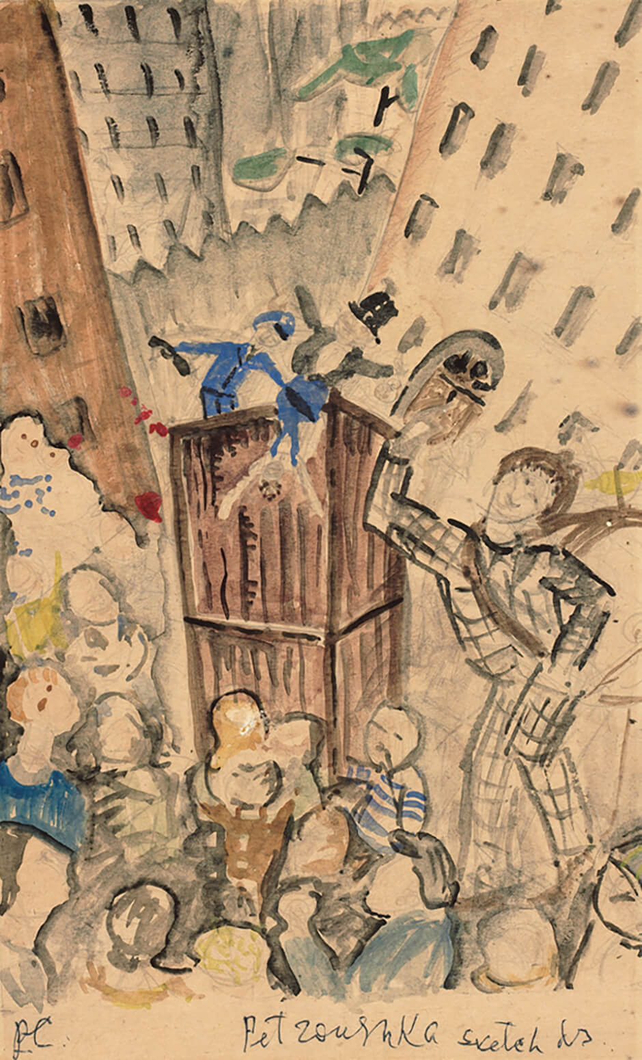
Paraskeva Clark, Study for Petroushka, 1937. In this sketch we see Clark planning the painting; her composition may have been inspired by political posters.

Slide 13
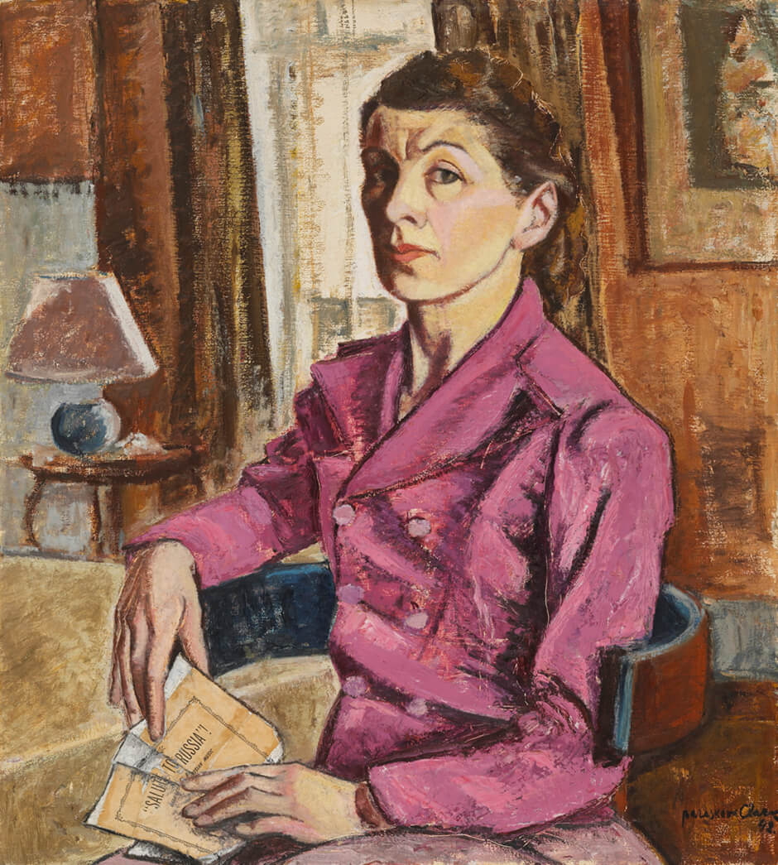
Learning Activity #2
Paraskeva Clark, Self-Portrait with Concert Program, 1942. Here Clark holds the program of a benefit concert for Russia that she attended in late 1941.

Slide 14
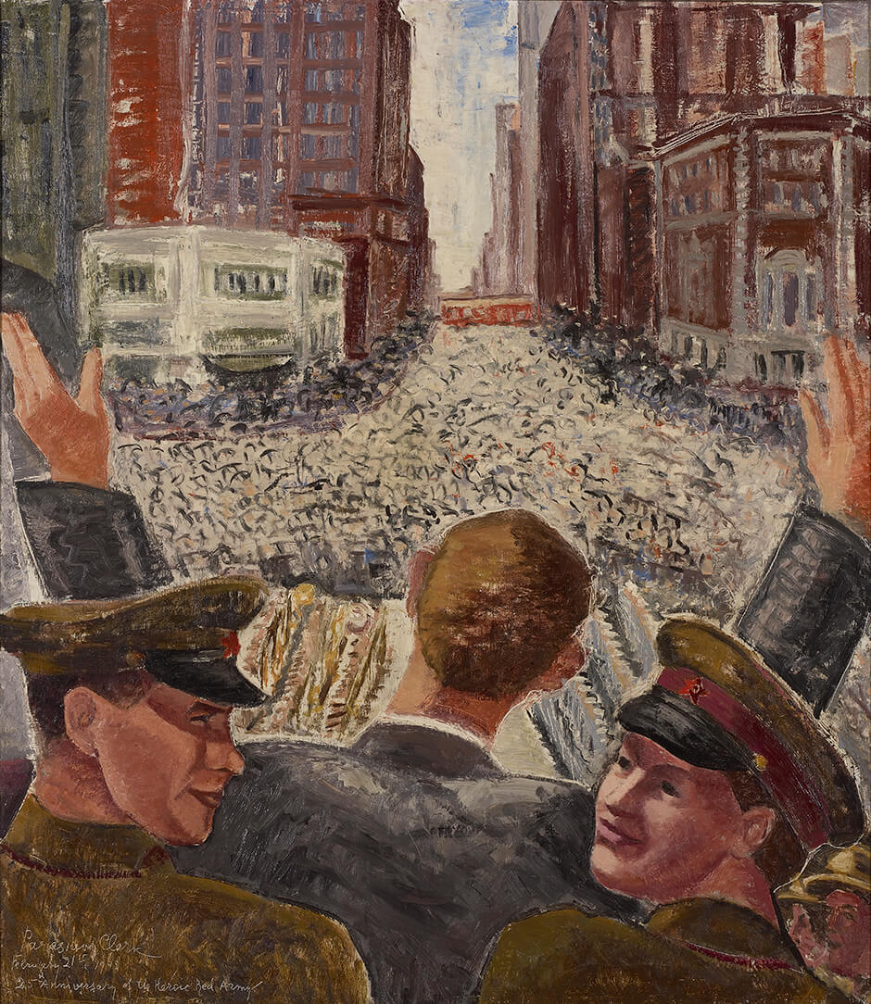
Paraskeva Clark, Pavlichenko and Her Comrades at the Toronto City Hall, 1943, oil on canvas, frame: 90 x 79.7 cm, Art Gallery of Ontario, Toronto, purchased with funds donated by AGO Members, 2000 2000/17. © Clive Clark.
Lieutenant Ludmila Pavlichenko was one of a group of young Russian representatives who were touring North America to raise support for their cause.

Slide 15
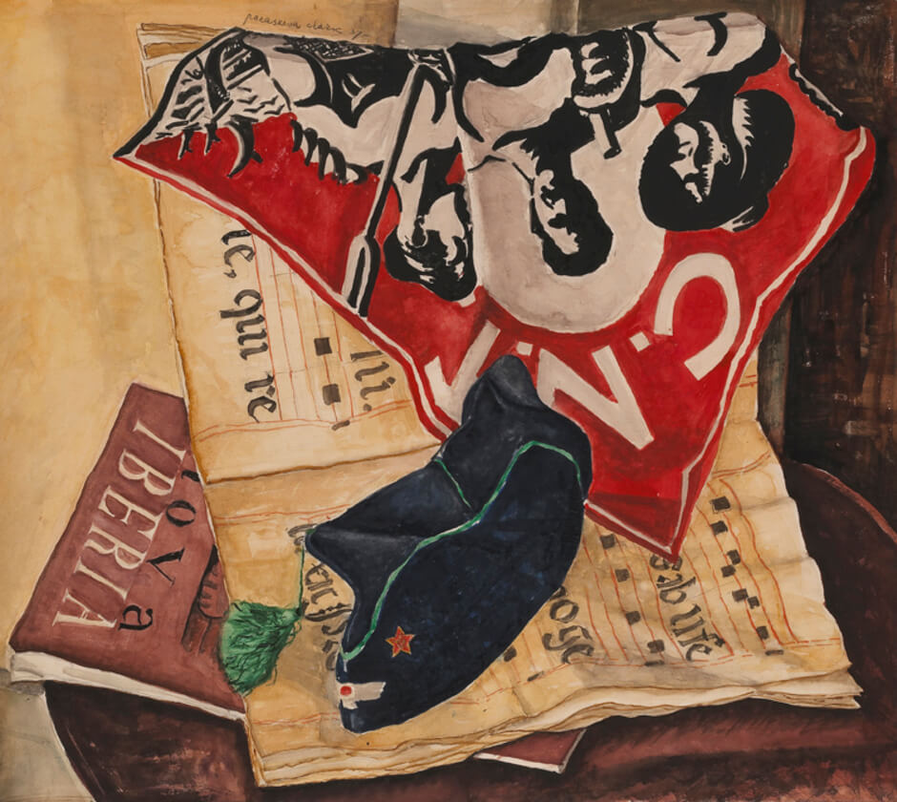
Culminating Task
Paraskeva Clark, Presents from Madrid, 1937. This watercolour was the first work with political content that Clark exhibited.

Slide 16
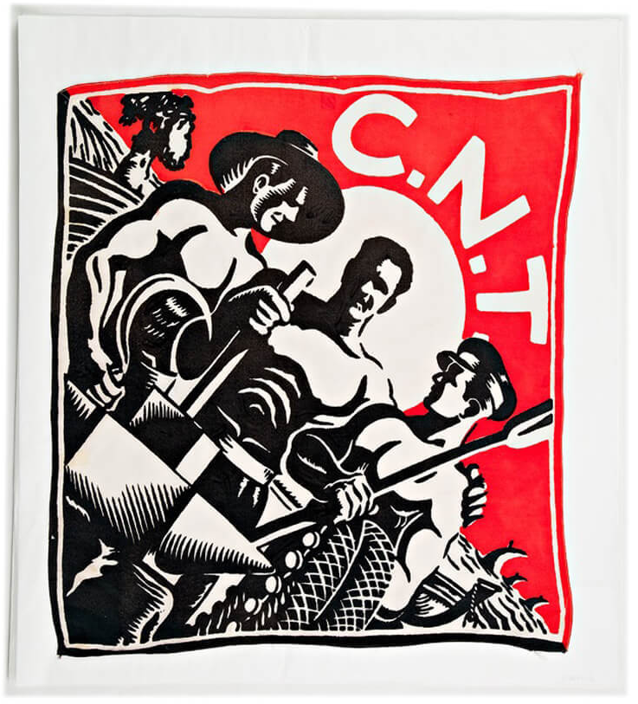
A scarf bearing the emblem of the CNT (Confederación Nacional del Trabajo) that Dr. Norman Bethune sent Paraskeva Clark from Spain, c.1936–37.
Notes:
*insert Ruth’s captions*

Slide 17
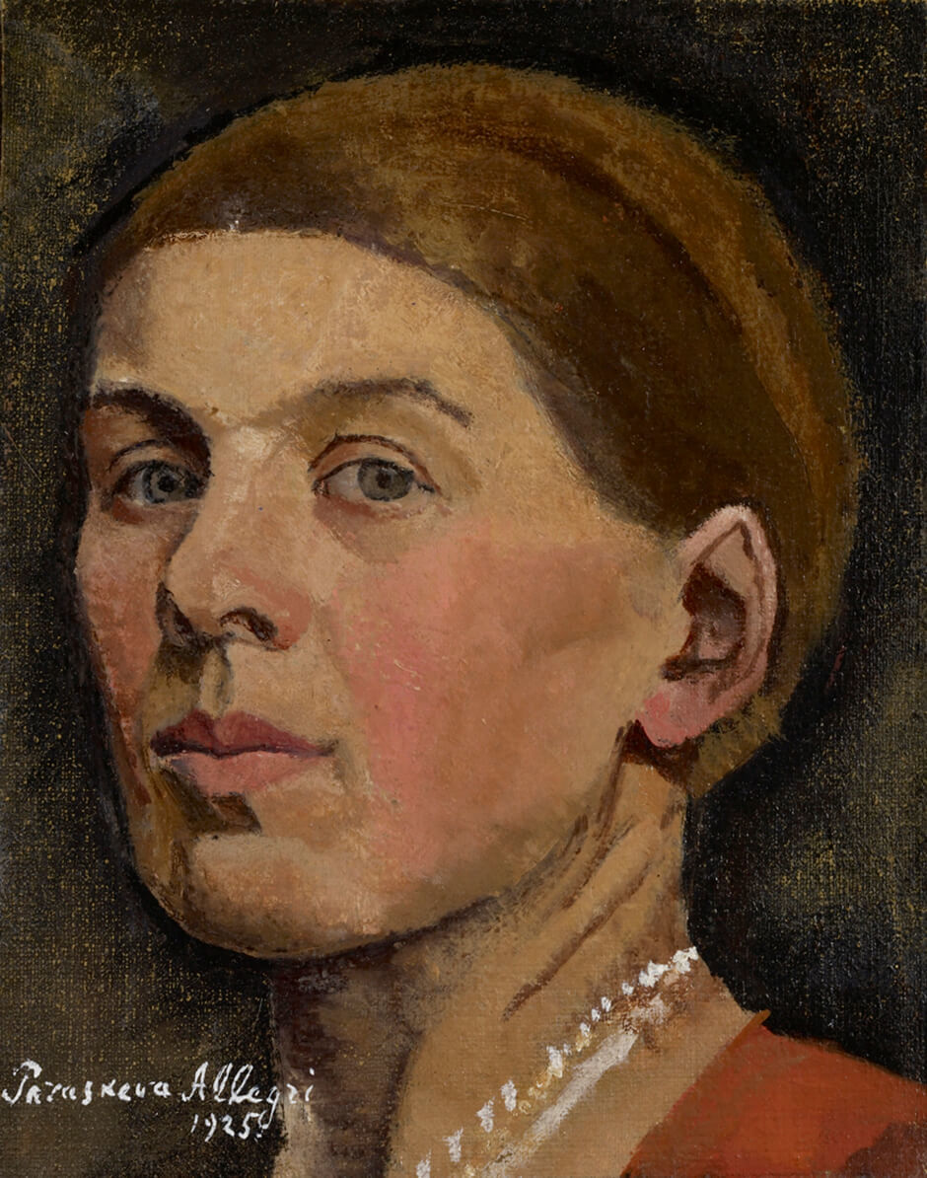
Paraskeva Clark, Self Portrait, 1925, oil on canvas, 28.3 x 22.2 cm, Art Gallery of Ontario, Toronto, purchase with assistance from Wintario, 1979 79/43.
© Clive Clark.
Clark painted this work before she moved to Canada.

Slide 18
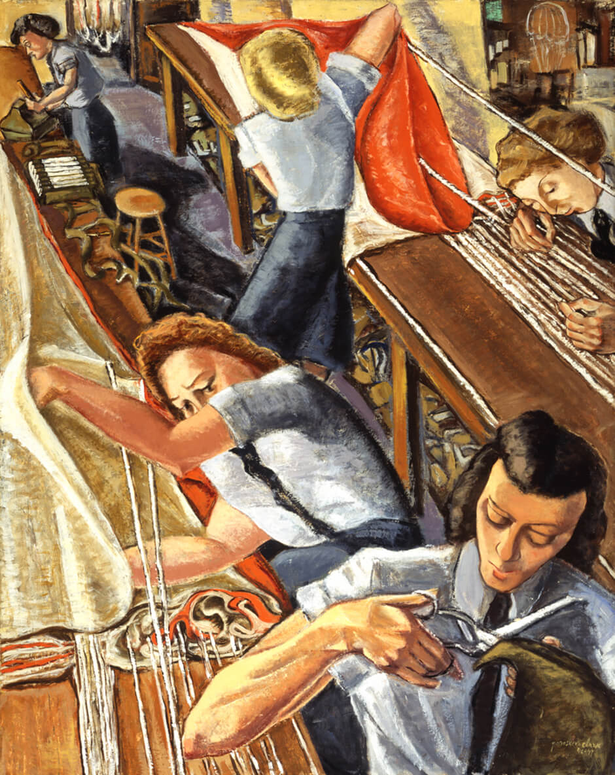
Paraskeva Clark, Parachute Riggers, 1947. Here we see a dramatic view of women in the RCAF packing and repairing parachutes.

Slide 19
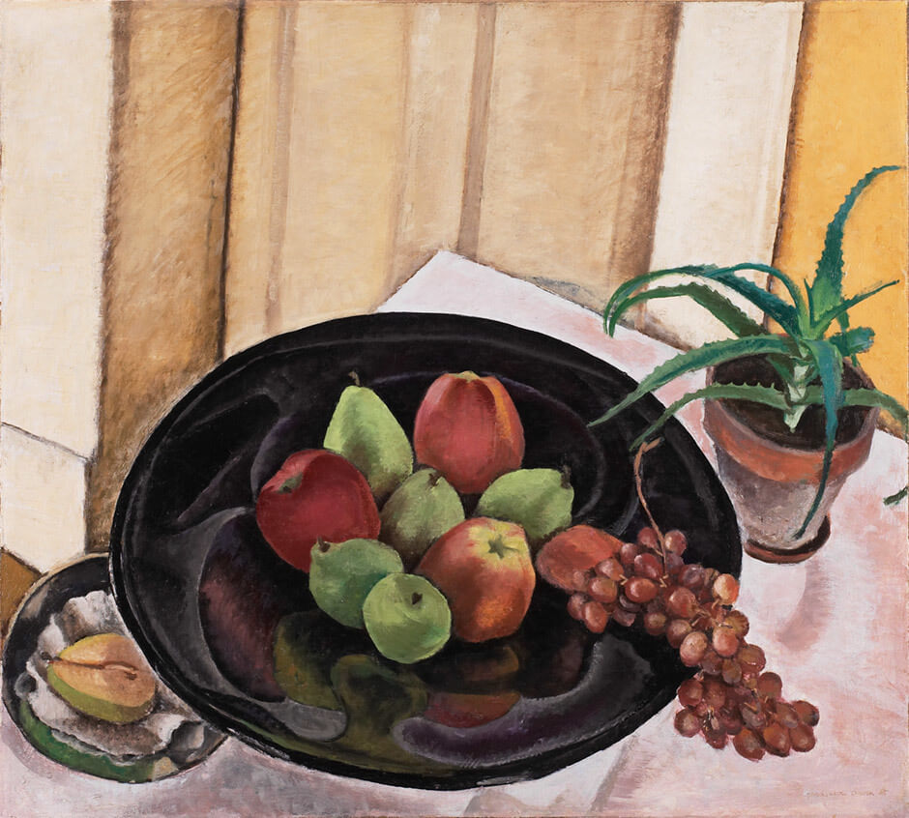
Paraskeva Clark, Still Life with Apples and Grapes, 1935, oil on canvas, 68.6 x 76.2 cm, The Thomson Collection at the Art Gallery of Ontario, Toronto, AGOID.104118. © Clive Clark.
In this work Clark painted the table-top on a sloping angle, as though viewers were looking down on the arrangement.

Slide 20
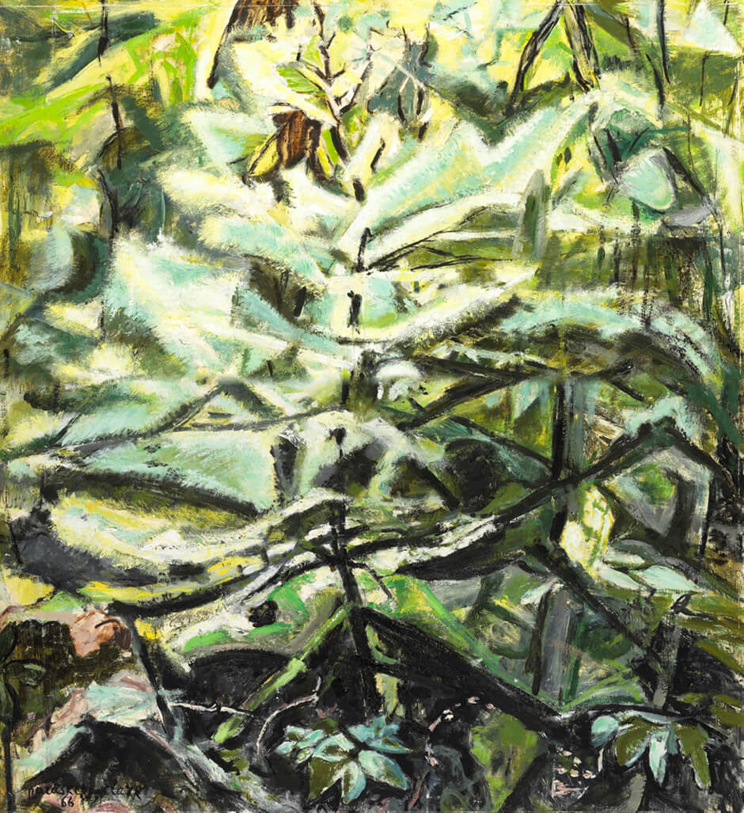
Paraskeva Clark, Sunlight in the Woods, 1966. Clark’s later paintings reveal an interest in abstract organic forms.

Slide 21
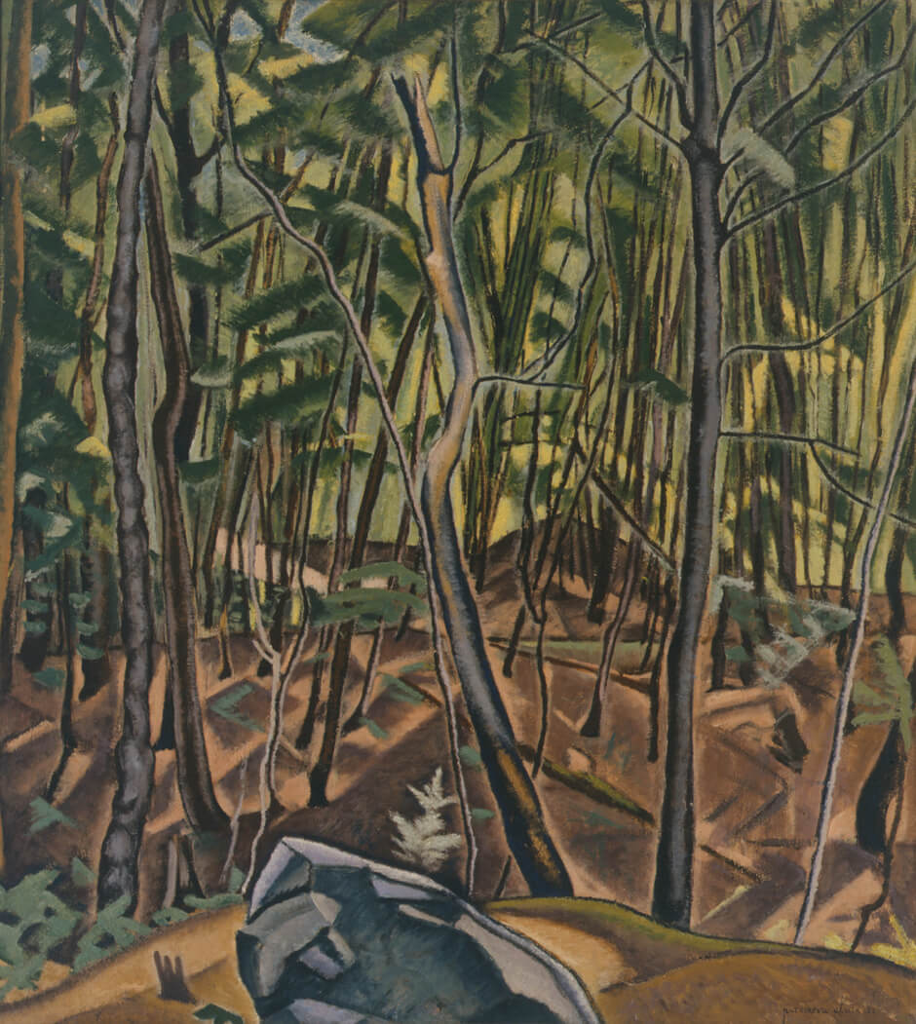
Paraskeva Clark, In the Woods, 1939. Clark painted several views of forest interiors.

Slide 22
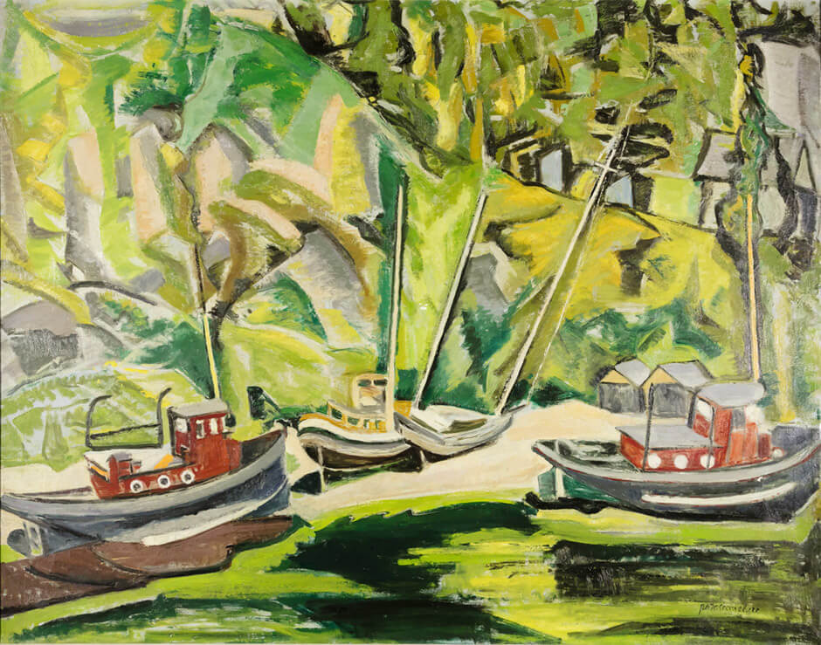
Paraskeva Clark, Boats in Dry Dock, 1946. Clark sometimes made oil sketches in situ, later working them up into larger canvases in the studio.

Slide 23
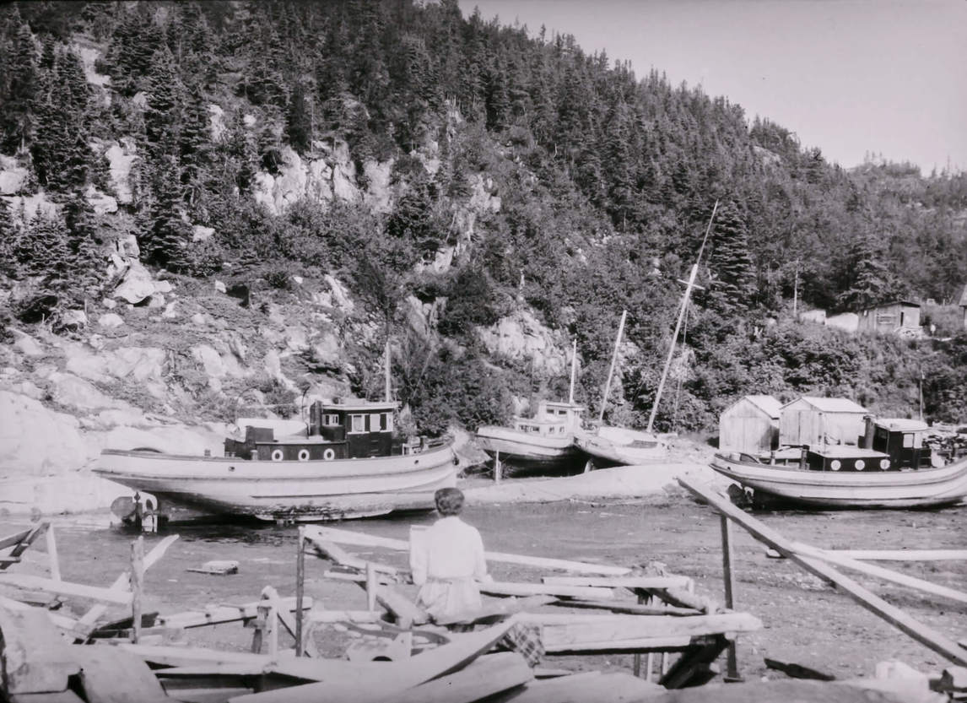
Paraskeva Clark painting Sketch for Tadoussac, Boats in Dry Dock, 1944.

