Slide 1
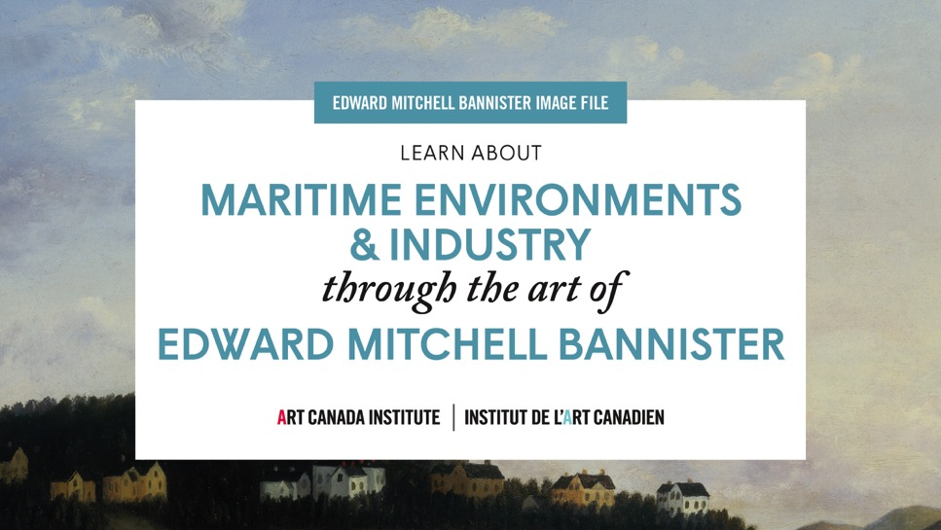

Slide 2
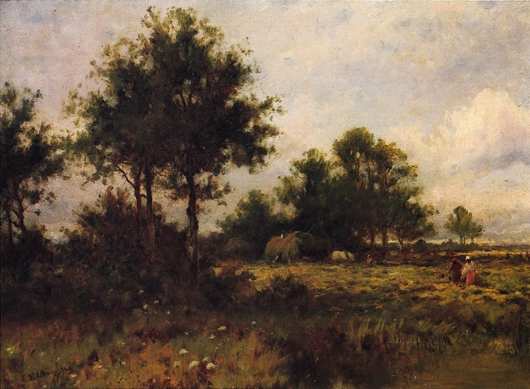
Edward Mitchell Bannister, Hay Gatherers, c.1893. In this painting, Bannister depicted African-American women and children working in a field.

Slide 3
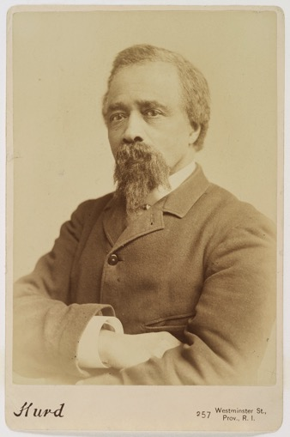
Portrait of Edward Mitchell Bannister, c.1880.

Slide 4
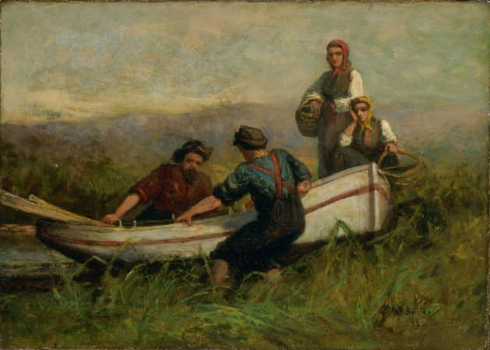
Edward Mitchell Bannister, People Near Boat, 1893. In this scene, the man on the far left may be the artist himself.

Slide 5
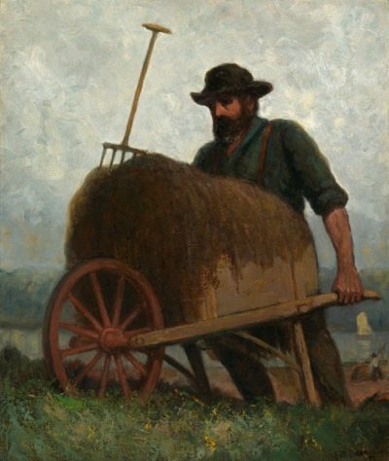
Edward Mitchell Bannister, Seaweed Gatherers, 1898 (?). Here Bannister shows a worker in close focus, asking us to reflect on the man’s strength.

Slide 6
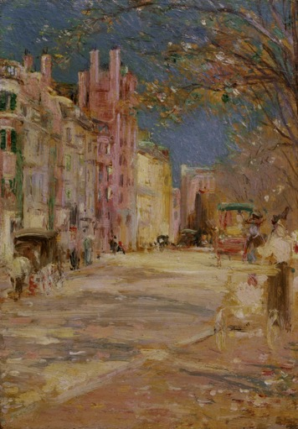
Edward Mitchell Bannister, Boston Street Scene (Boston Common), 1898–99. This late painting is unusually colourful compared to Bannister’s many rural landscapes.

Slide 7
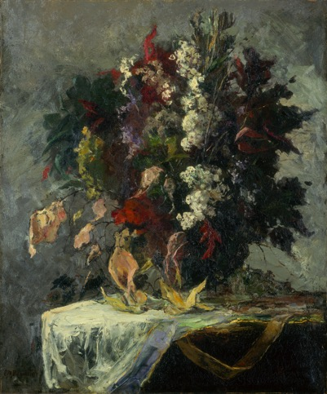
Edward Mitchell Bannister, Untitled (floral still life), n.d. Though best known for painting the countryside, the coast, and the ocean, Bannister also painted still lifes and portraits.

Slide 8
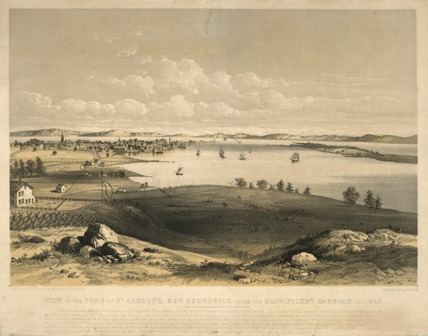
Frederick Wells, View of the Town of St. Andrews, New Brunswick, with Its Magnificent Harbour and Bay, 1840.

Slide 9
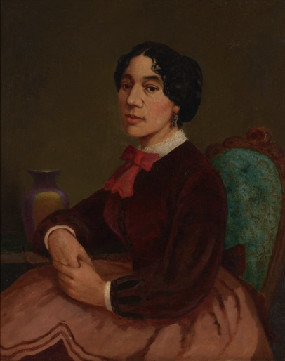
Edward Mitchell Bannister, Portrait of Christiana Carteaux Bannister, c.1860.

Slide 10
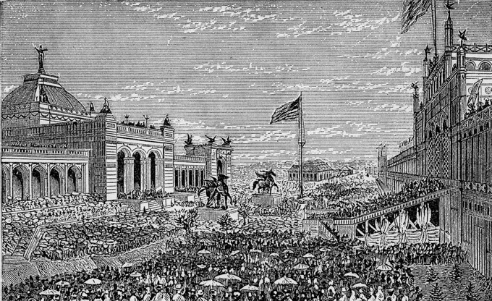
Opening day ceremonies at the Centennial Exhibition in Philadelphia, May 10, 1876.

Slide 11
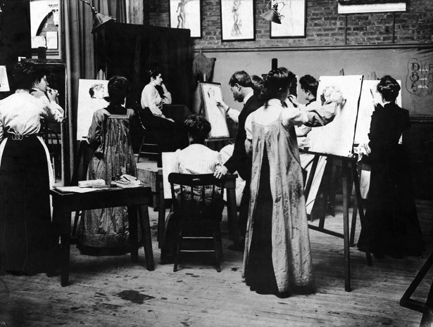
Portrait class at the Rhode Island School of Design, date unknown.

Slide 12
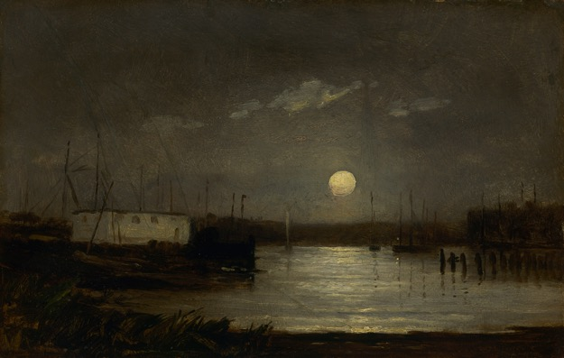
Learning Activity #1
Edward Mitchell Bannister, Untitled (moon over a harbor, wharf scene with full moon and masts of boats), c.1868. This work may have been painted when Bannister lived in Boston, a city known for its harbour.

Slide 13
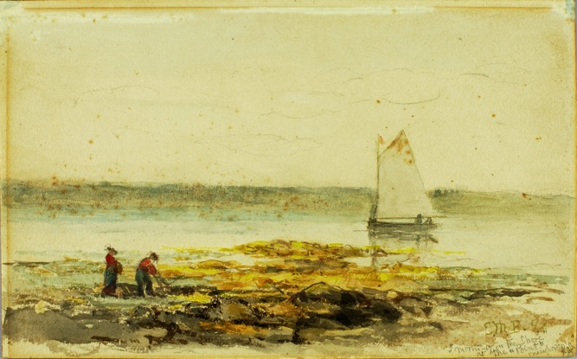
Learning Activity #1
Edward Mitchell Bannister, Morning on the Shore, 1892. The inscription on this watercolour identifies the place in the painting as The Point, in Newport, Rhode Island.

Slide 14
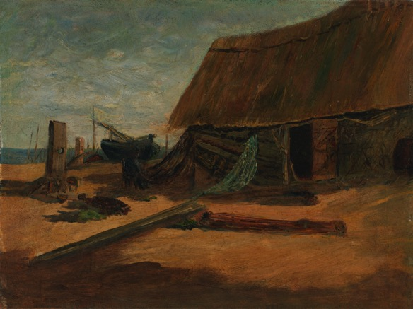
Learning Activity #1
Edward Mitchell Bannister, Fishing Shacks, c.1877–85. In this scene, Bannister has included fishing boats in the background.

Slide 15
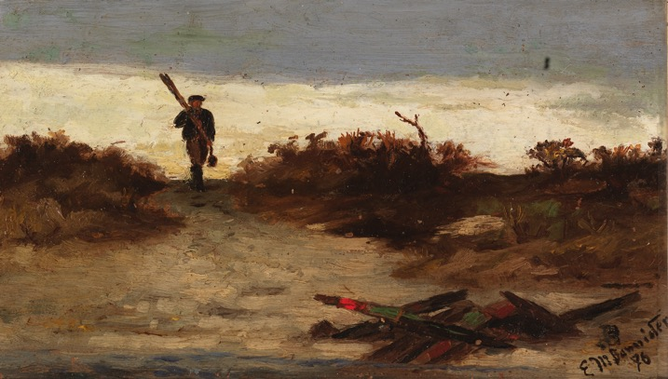
Learning Activity #1
Edward Mitchell Bannister, Fisherman by Water, 1886. Seen against a beautifully lit sky, this fisherman has a striking silhouette.

Slide 16
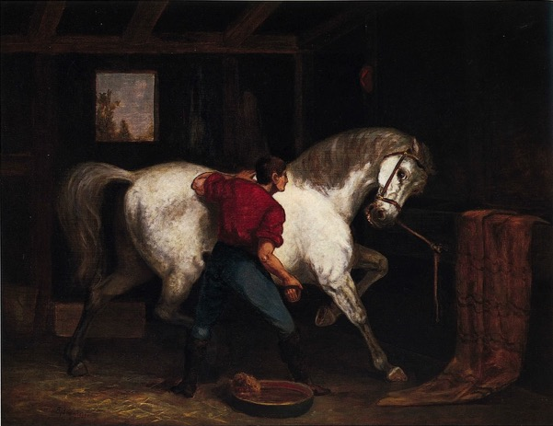
Learning Activity #1
Edward Mitchell Bannister, Governor Sprague’s White Horse, 1869. When Bannister painted this work, monumental images of animals were very popular.

Slide 17
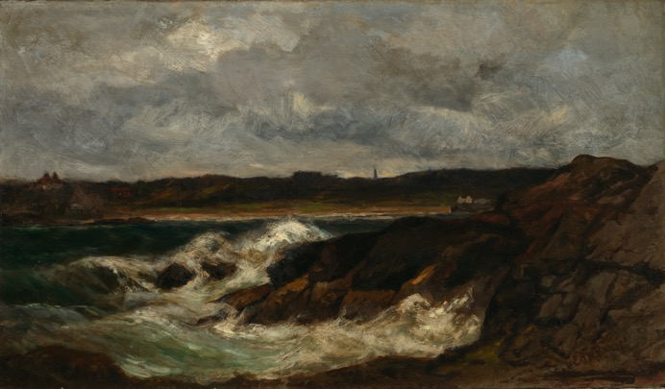
Learning Activity #2
Edward Mitchell Bannister, Newport, 1877–82. Here Bannister’s vigorous brush strokes capture the intense energy of the waves.

Slide 18
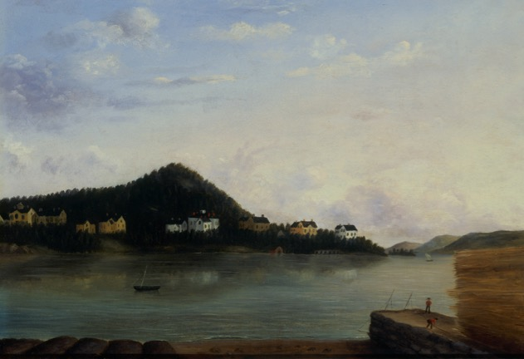
Learning Activity #2
Edward Mitchell Bannister, Dorchester 1856, 1856. The houses shown here were summer residences for wealthy people.

Slide 19
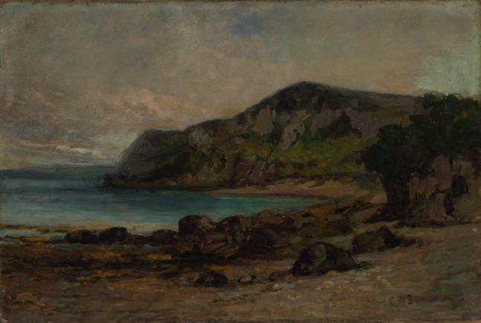
Learning Activity #2
Edward Mitchell Bannister, Rocks at Newport, c.1877–85. Bannister was known for painting atmospheric skies.

Slide 20
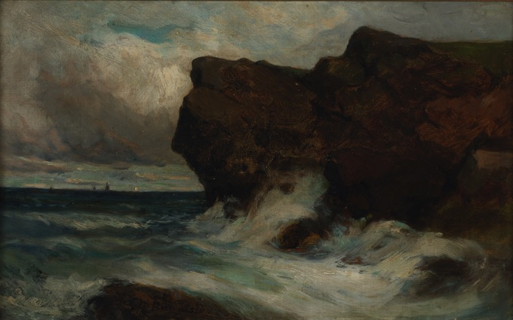
Learning Activity #2
Edward Mitchell Bannister, Ocean Cliffs, 1881. In this painting, boats are just visible on the horizon.

Slide 21
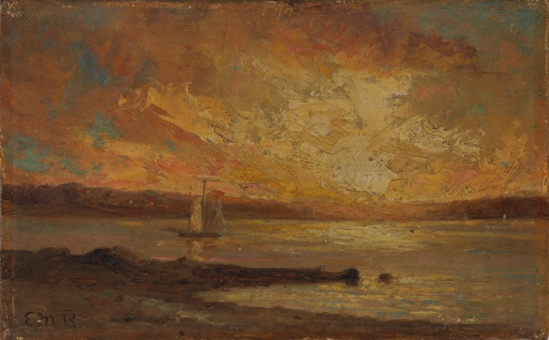
Learning Activity #2
Edward Mitchell Bannister, Boat on Sea, n.d. This view represents Narragansett Bay, Rhode Island.
Notes:
*insert Ruth’s captions*

Slide 22
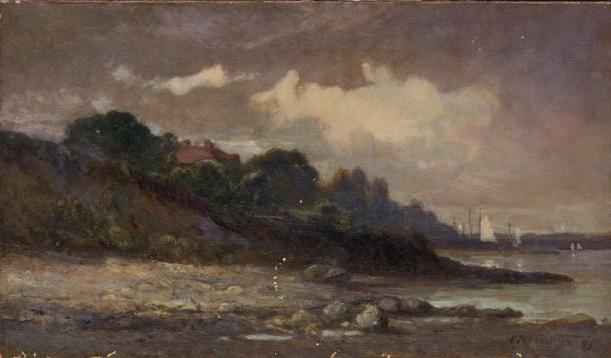
Learning Activity #2
Edward Mitchell Bannister, Untitled (shoreline with sailboats and roof), 1893. Here a rocky beach fills the foreground.
Notes:
*insert Ruth’s captions*

Slide 23
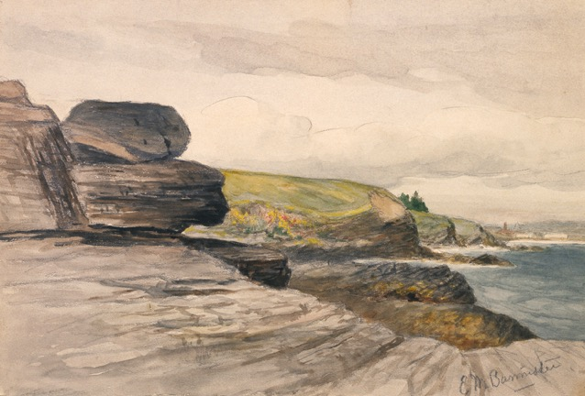
Learning Activity #2
Edward Mitchell Bannister, Newport Scene, c.1880–89. Painting in watercolour enabled Bannister to create distinctive effects with light.
Notes:
*insert Ruth’s captions*

Slide 24
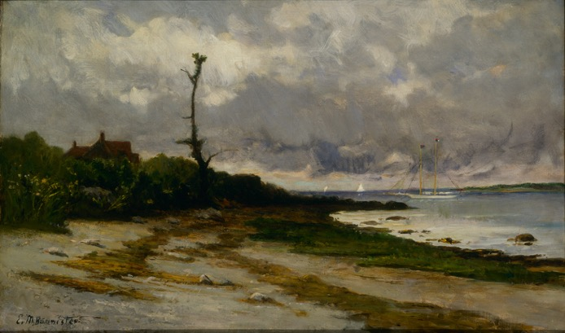
Culminating Task
Edward Mitchell Bannister, Landscape near Newport, R. I., c.1877–78. Bannister lived in Providence, Rhode Island, for over thirty years and painted many landscapes depicting the surrounding region.

Slide 25
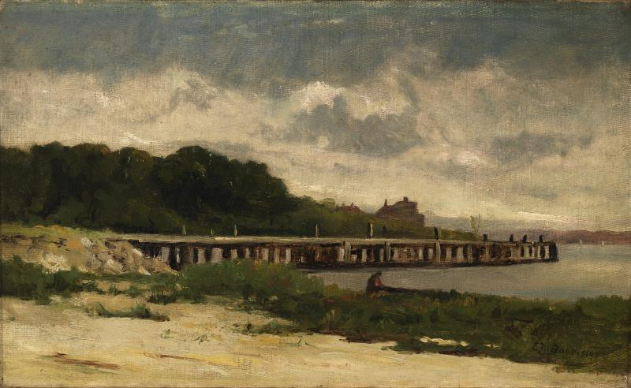
Culminating Task
Edward Mitchell Bannister, Untitled (landscape with pier), n.d. In this painting, Bannister captures the rich plant life on the coast.

Slide 26
Edward Mitchell Bannister, Boat on Sea, n.d. Here Bannister depicts the full range of colours in this powerful blazing sunset over the water.

Slide 27
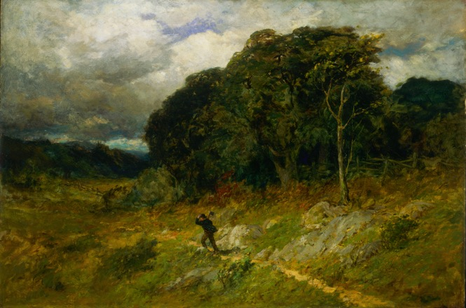
Edward Mitchell Bannister, Approaching Storm, 1886. In this dramatic landscape, a man struggles to walk through the wind.

Slide 28
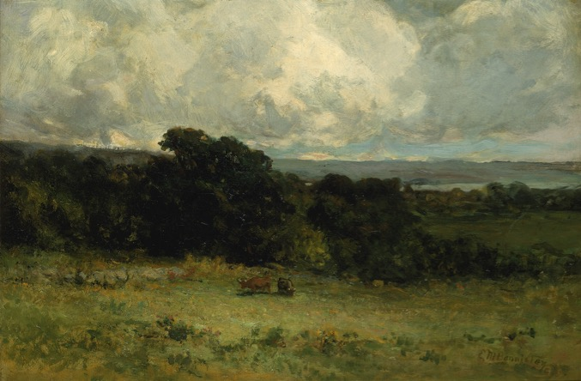
Edward Mitchell Bannister, Pleasant Pastures, 1887. Two cows graze in this idyllic field, where the sea is visible in the distance.

Slide 29
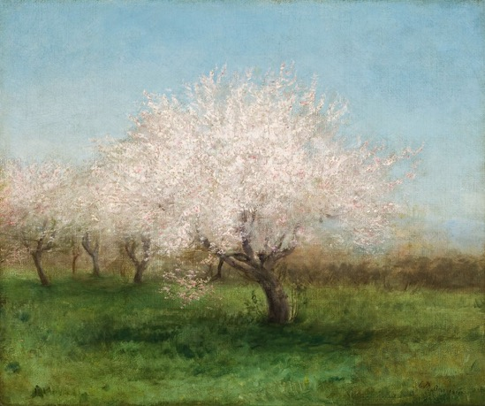
Edward Mitchell Bannister, Apple Trees in a Meadow, c.1890. Bannister celebrates springtime with this soft and peaceful painting of apple trees in bloom.

Slide 30
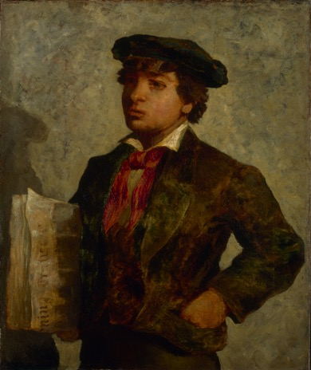
Edward Mitchell Bannister, Newspaper Boy, 1869. In this work Bannister shows an African-American boy preparing to sell newspapers.

Slide 31
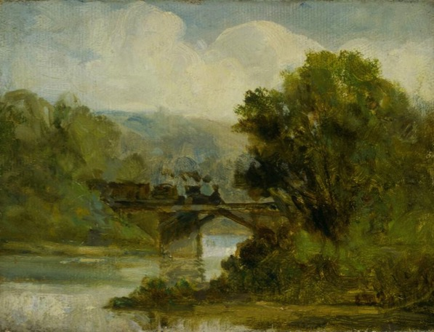
Edward Mitchell Bannister, Train, c.1875–80. Though this scene features lush trees and a peaceful river, a smoky train cuts through the middle, suggesting a concern about pollution.

