Slide 2
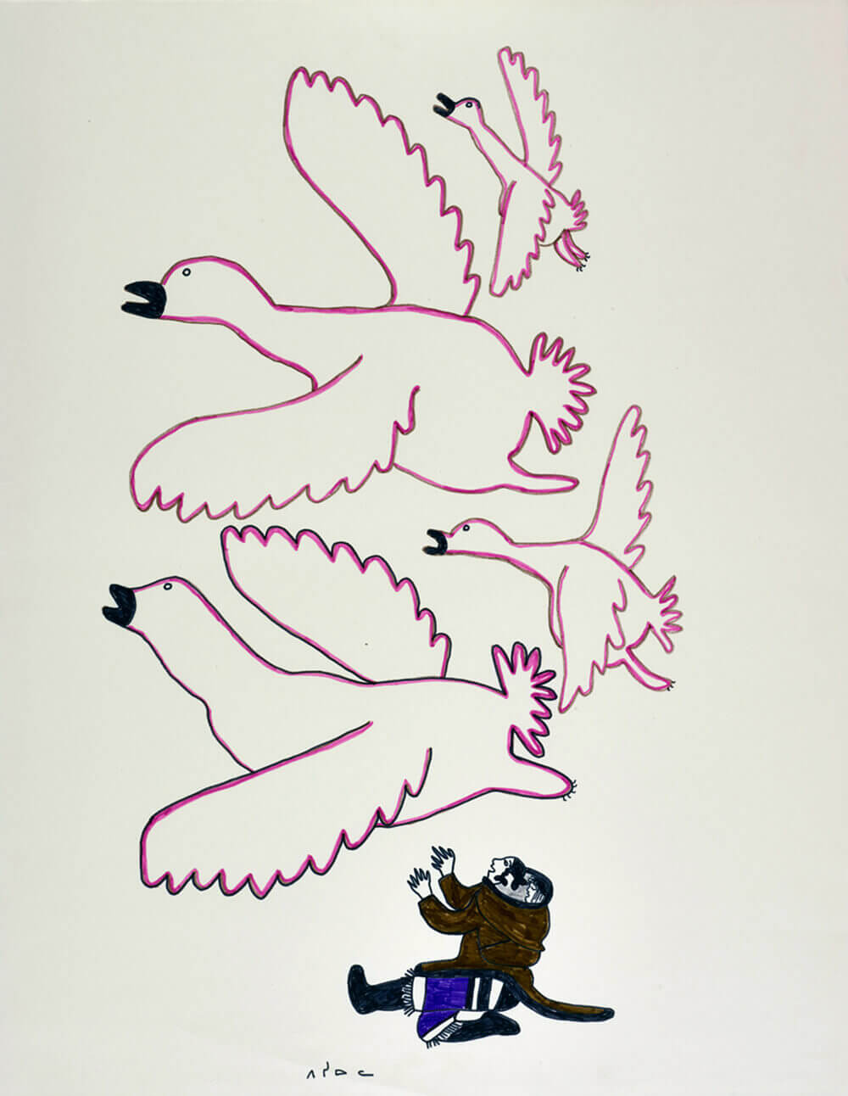
Pitseolak Ashoona, Untitled (Birds Flying Overhead), c.1966–67. Here Pitseolak shows a solitary woman reaching her arms towards birds in the sky.

Slide 3
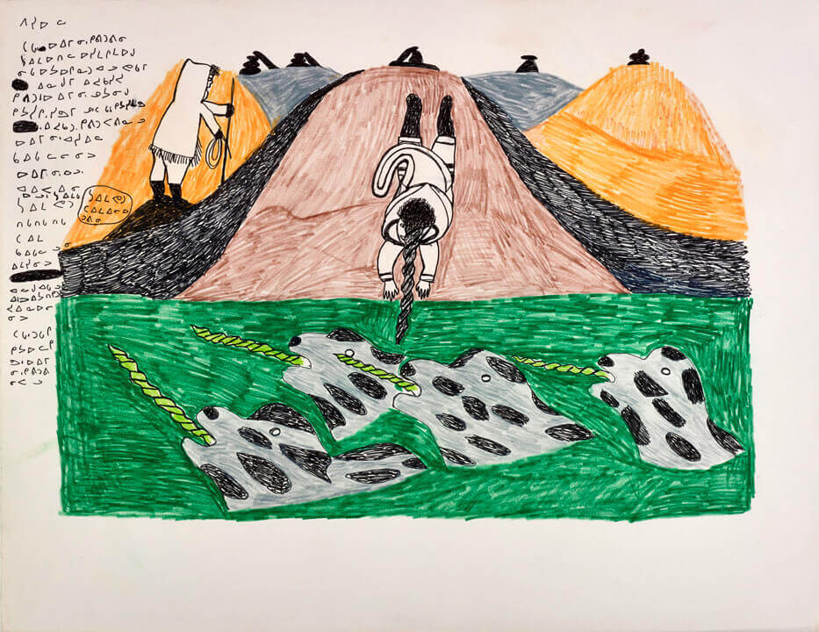
Pitseolak Ashoona, Untitled, 1976. In the legend illustrated here, a woman dives into the sea and transforms into a narwhal.

Slide 4
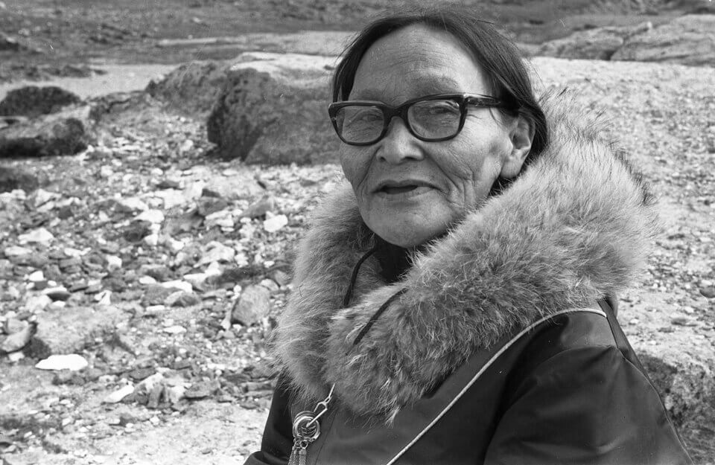
Pitseolak Ashoona in Kinngait, 1968.

Slide 5
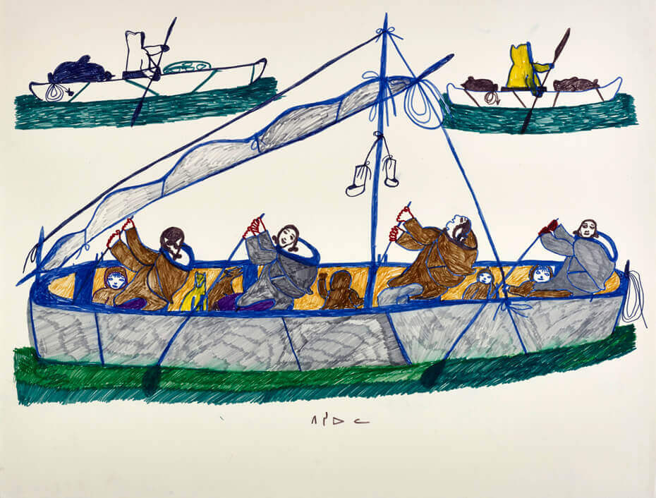
Pitseolak Ashoona, drawing for print Journey to Toodja, c.1973. Here a family journeys to a camp on Akudluk (Salisbury Island).

Slide 6
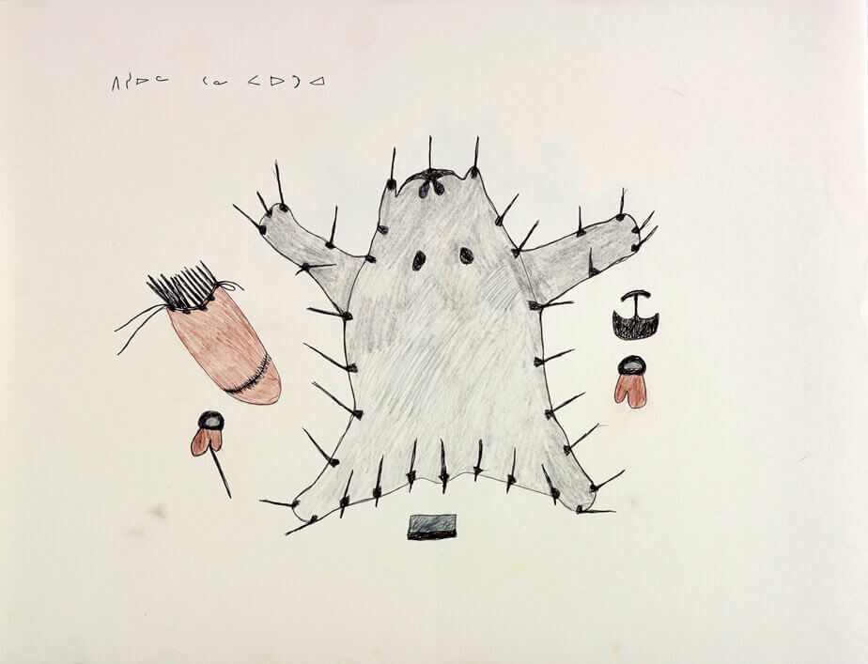
Pitseolak Ashoona, Untitled, c.1979–80. This drawing shows a stretched polar bear skin and the tools used by Inuit women.

Slide 7
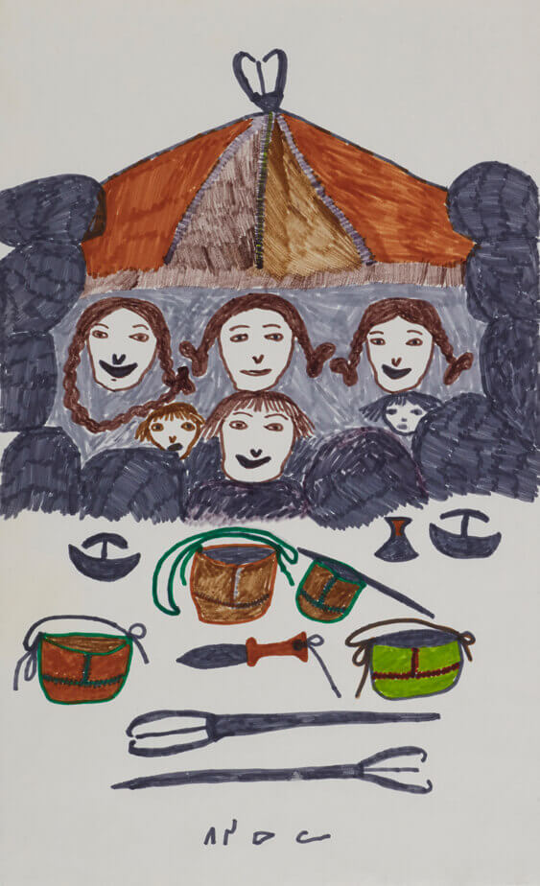
Pitseolak Ashoona, Untitled, c.1966–76. In this scene of summer camping, Pitseolak places a family in a fishing weir, with fishing spears, skin pails, and other tools in the foreground.

Slide 8
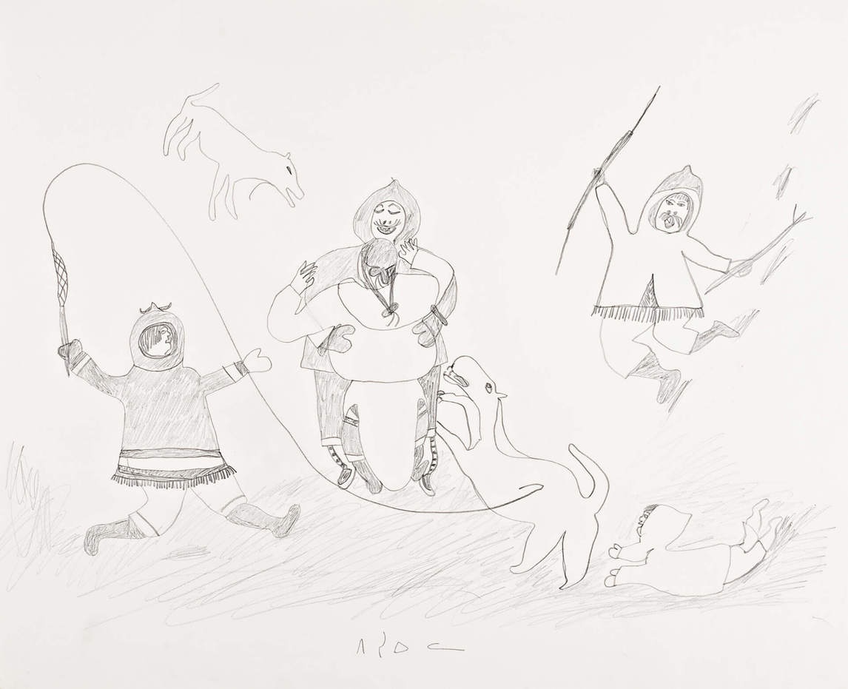
Pitseolak Ashoona, Untitled (Camp joyfully greeting the return of a family member), 1976. In this scene dogs share the family’s happiness.

Slide 9
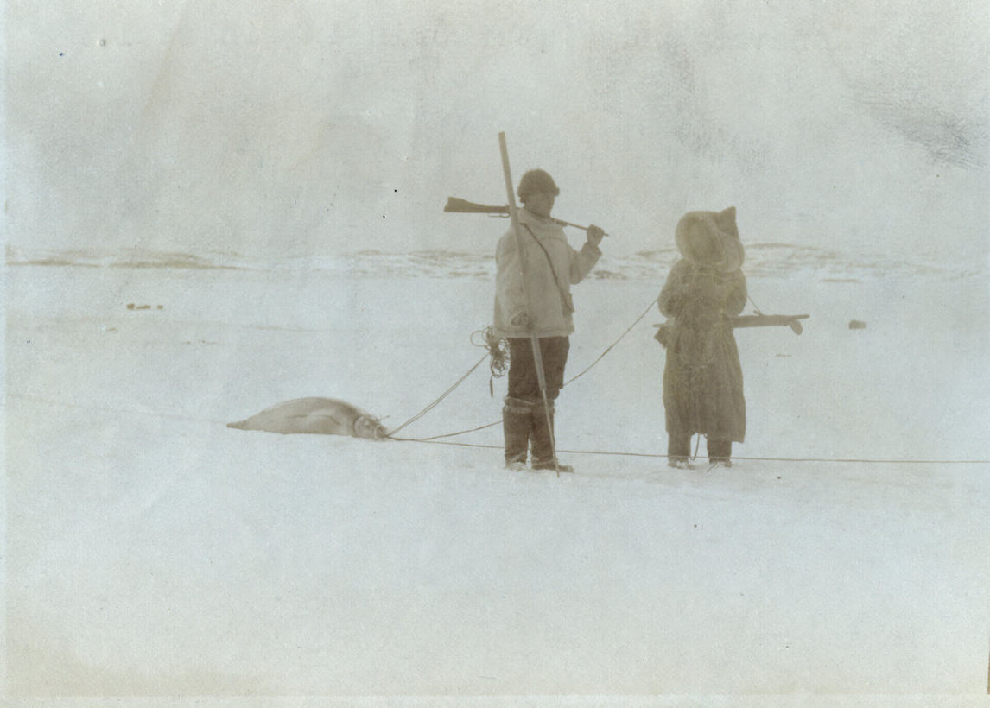
Pitseolak and her brother Kavavow, recently returned from a hunt, c.1921–22.

Slide 10
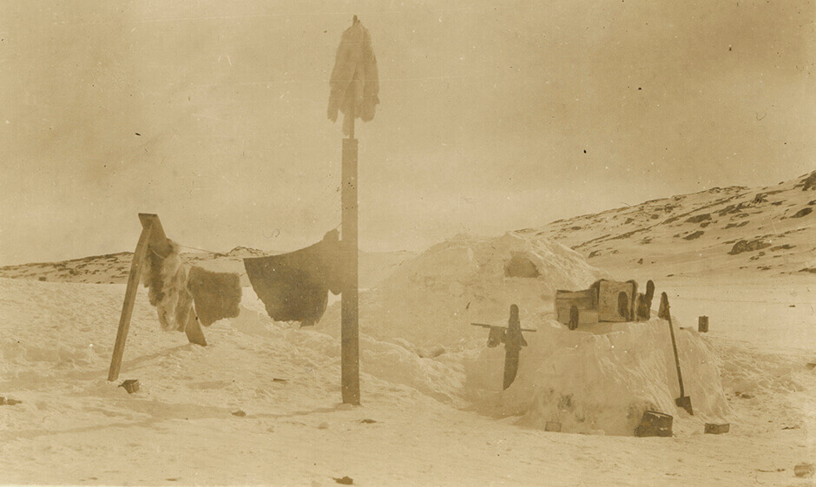
The camp of Pitseolak’s uncle Kavavow at Idjirituq in the winter, c.1921–22.

Slide 11
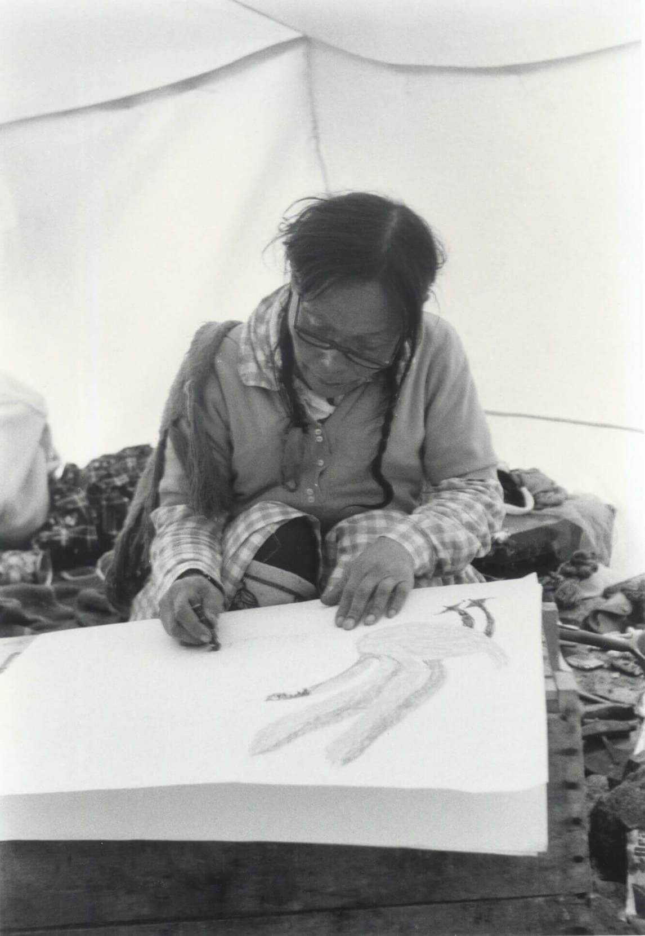
Pitseolak drawing in her summer tent in Kinngait, June 1967.

Slide 12
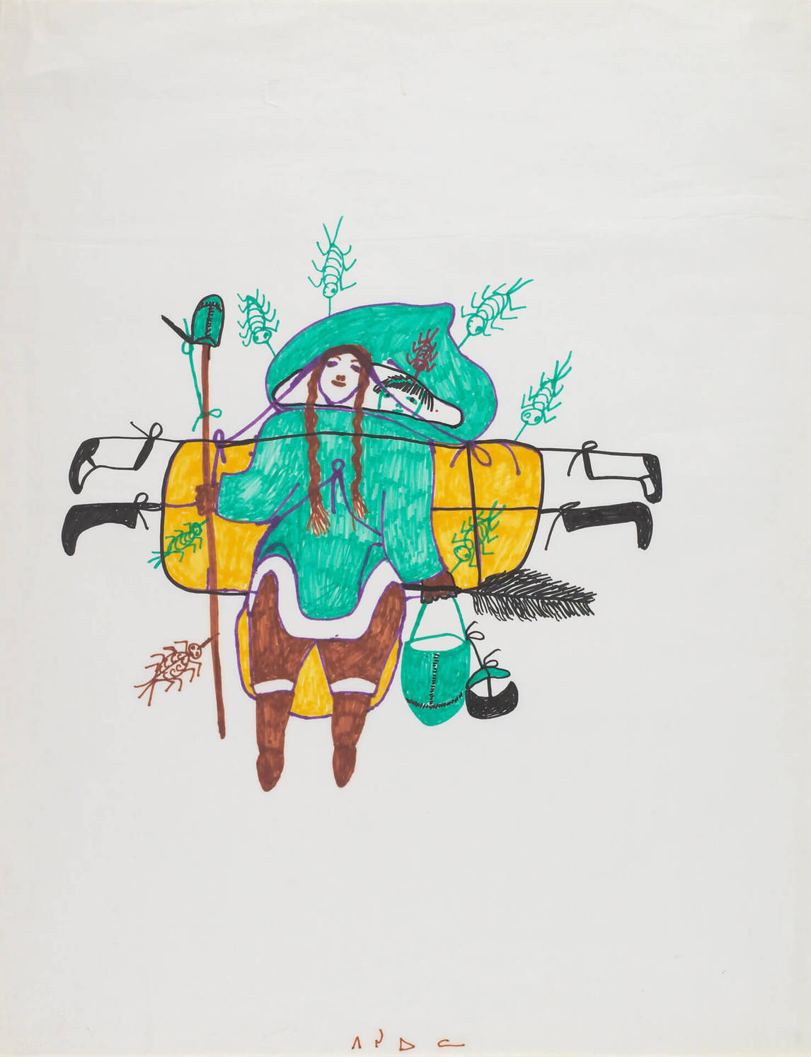
Pitseolak Ashoona, In summer there were always very big mosquitoes, 1970, porous pointed pen, 68.6 x 53.5 cm, Art Gallery of Ontario, Toronto, Gift of Samuel and Esther Sarick, Toronto, 2002, 2002/10664. © Estate of Pitseolak Ashoona. Reproduced with the permission of Dorset Fine Arts.
This work appeared on the cover of Pitseolak’s autobiography.

Slide 13
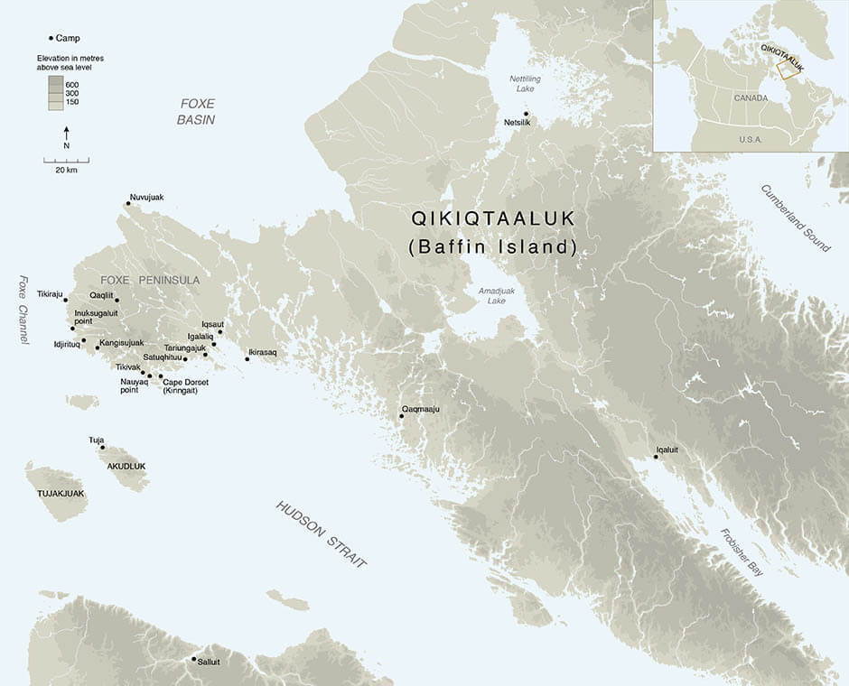
Learning Activity #1
This map of southern Qikiqtaaluk (Baffin Island) locates the hunting camps where Pitseolak lived until the late 1950s.

Slide 14
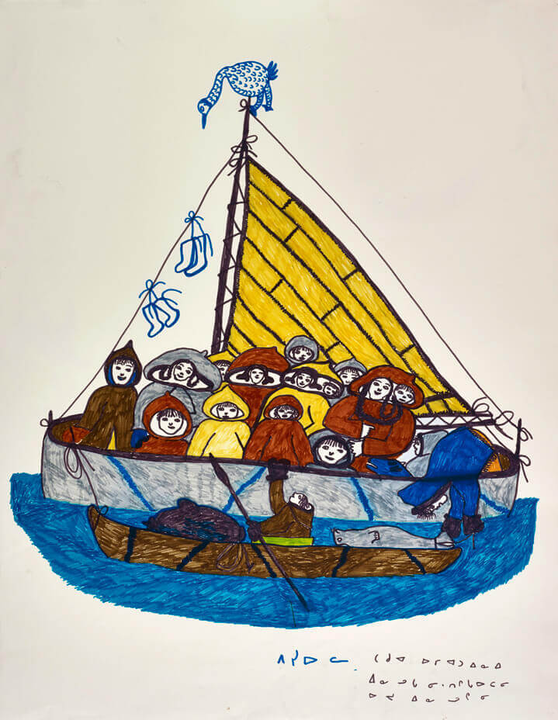
Learning Activity #1
Pitseolak Ashoona, drawing for print Eskimos on Sealskin Boat, c.1966–72. This drawing shows a group of women and children in an umiak and a man in a kayak.

Slide 15
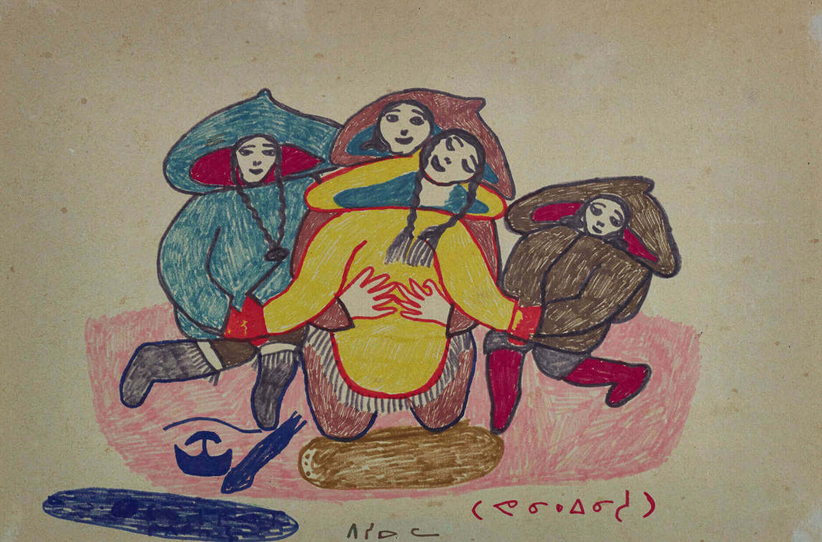
Learning Activity #1
Pitseolak Ashoona, drawing for print Memories of Childbirth, 1976. Here Pitseolak shows a woman in labour, kneeling and surrounded by women supporting her.

Slide 16
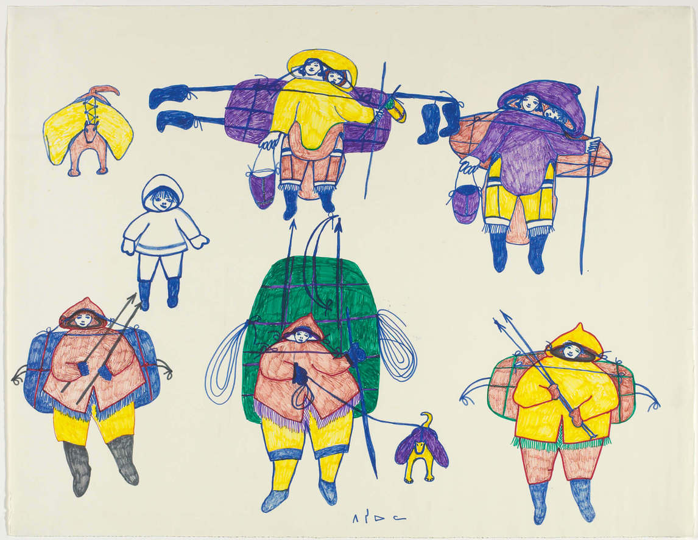
Learning Activity #1
Pitseolak Ashoona, Moving Camp, c.1971, coloured porous-point pen on paper, 51.8 × 66.3 cm, Art Gallery of Ontario, Toronto, Gift of Samuel and Esther Sarick, Toronto, 2002, 2002/10671. © Estate of Pitseolak Ashoona. Reproduced with the permission of Dorset Fine Arts.
In this drawing a family group moves together.

Slide 17
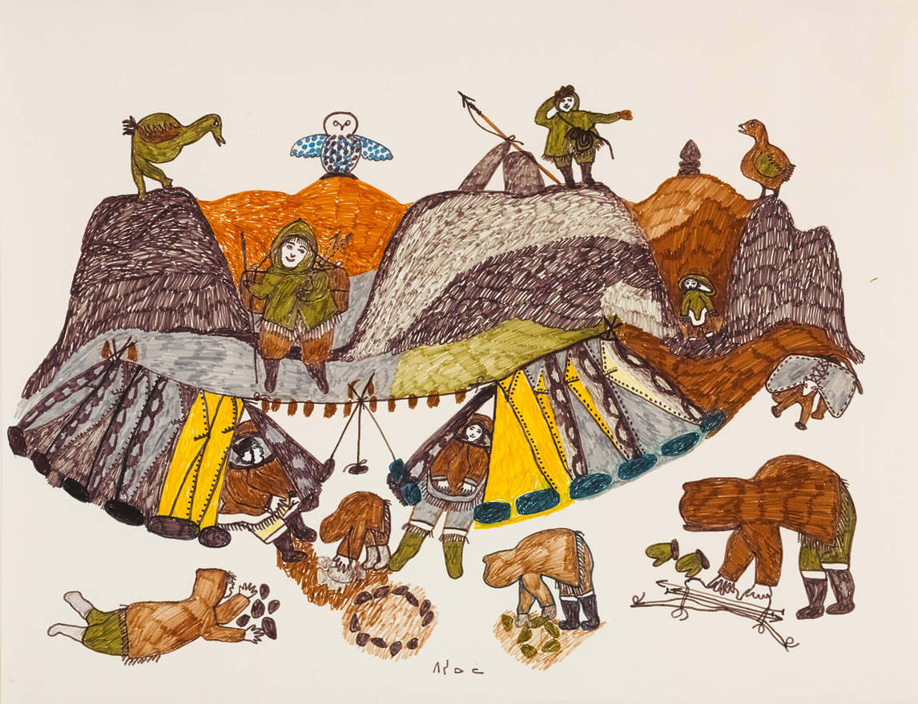
Learning Activity #1
Pitseolak Ashoona, Summer Camp Scene, c.1974. This family’s camp is between two hills.

Slide 18
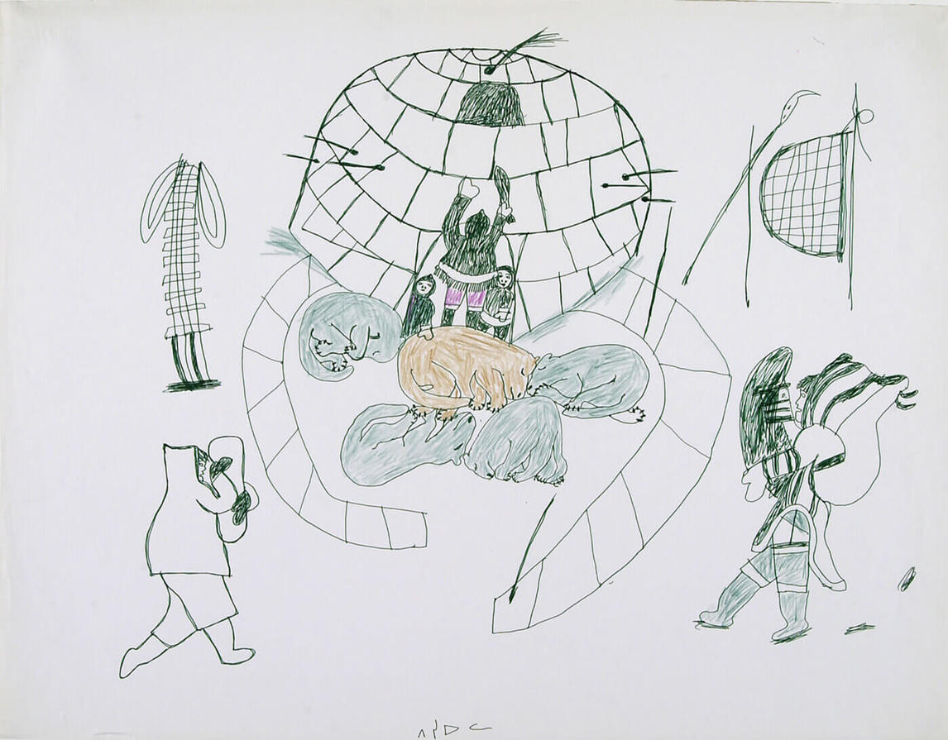
Learning Activity #1
Pitseolak Ashoona, Winter Camping, 1966–76, porous pointed pen and coloured pencil, 50.8 x 65.7 cm, Art Gallery of Ontario, Toronto, Gift of Samuel and Esther Sarick, Toronto, 2002, 2002/10675. © Estate of Pitseolak Ashoona. Reproduced with the permission of Dorset Fine Arts.
In this scene, dogs rest at the entrance to a newly built igloo.

Slide 19
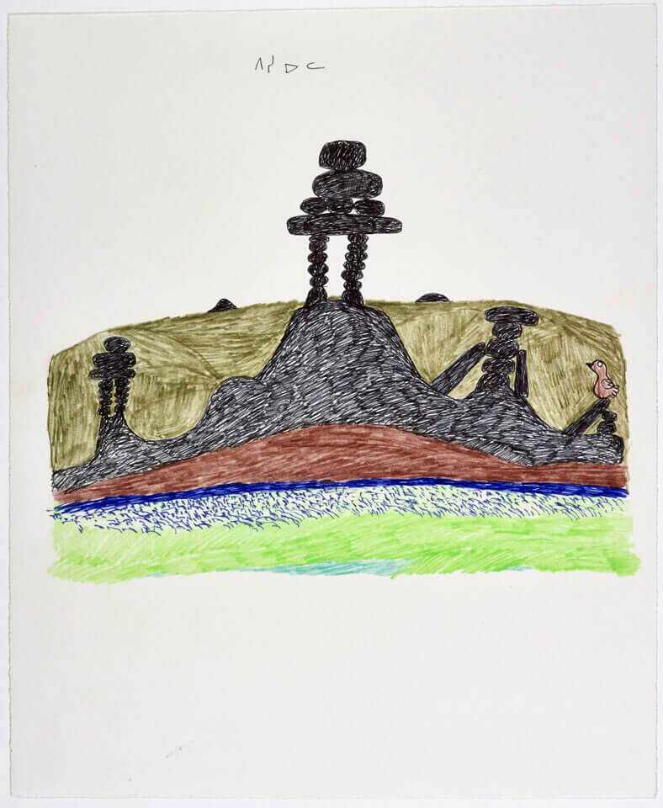
Pitseolak Ashoona, Untitled, c.1966–76. Inuksuit appear in almost all of Pitseolak’s landscapes.

Slide 20
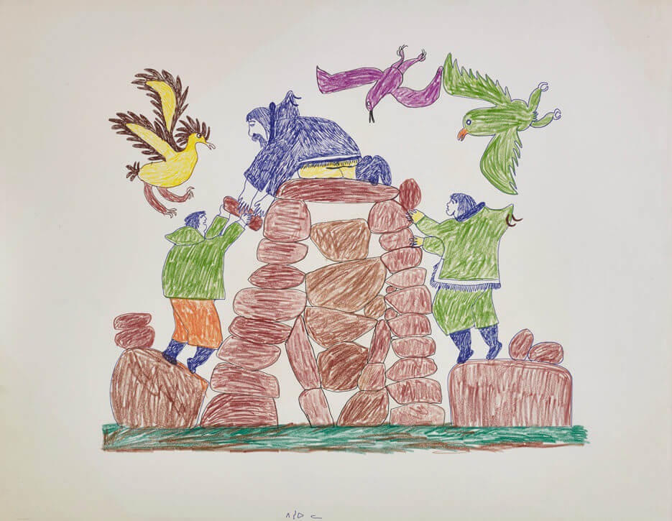
Learning Activity #2
Pitseolak Ashoona, drawing for print Innukshuk Builders, c.1966–68. In this scene, the man placing the top stone is Pitseolak’s father, Ottochie.

Slide 21
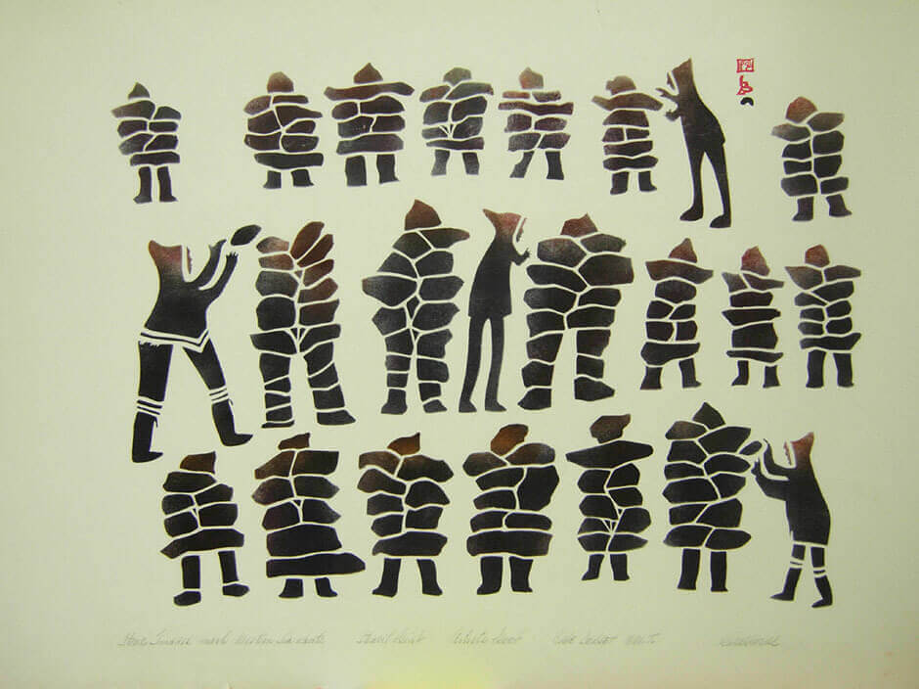
Learning Activity #2
Kiakshuk, Stone Images Mark the Western Sea Route, 1960. This print shows men constructing a series of Inuksuit.

Slide 22
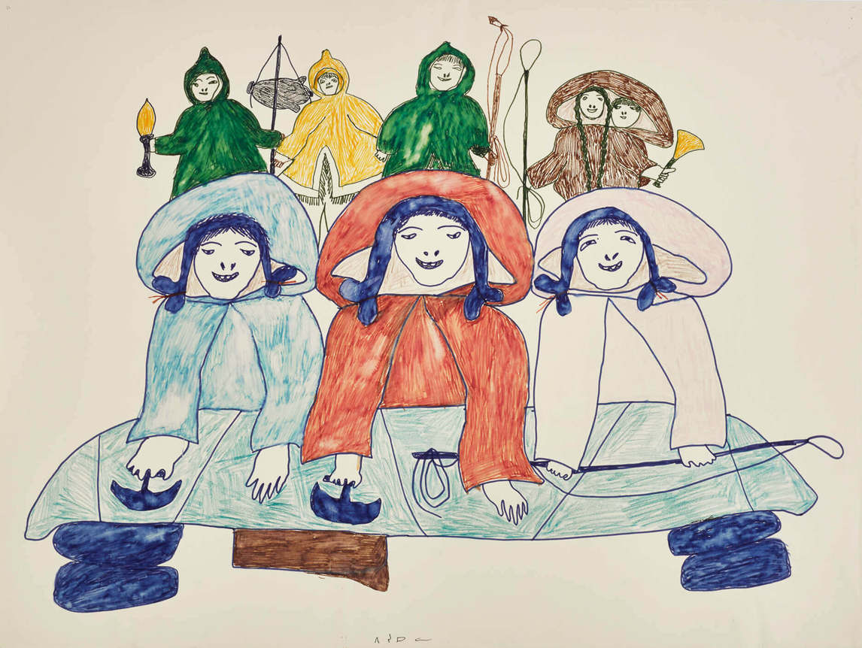
Pitseolak Ashoona, drawing for print Summer Camp Scene, c.1966–76. Here Pitseolak shows women working together.

Slide 23
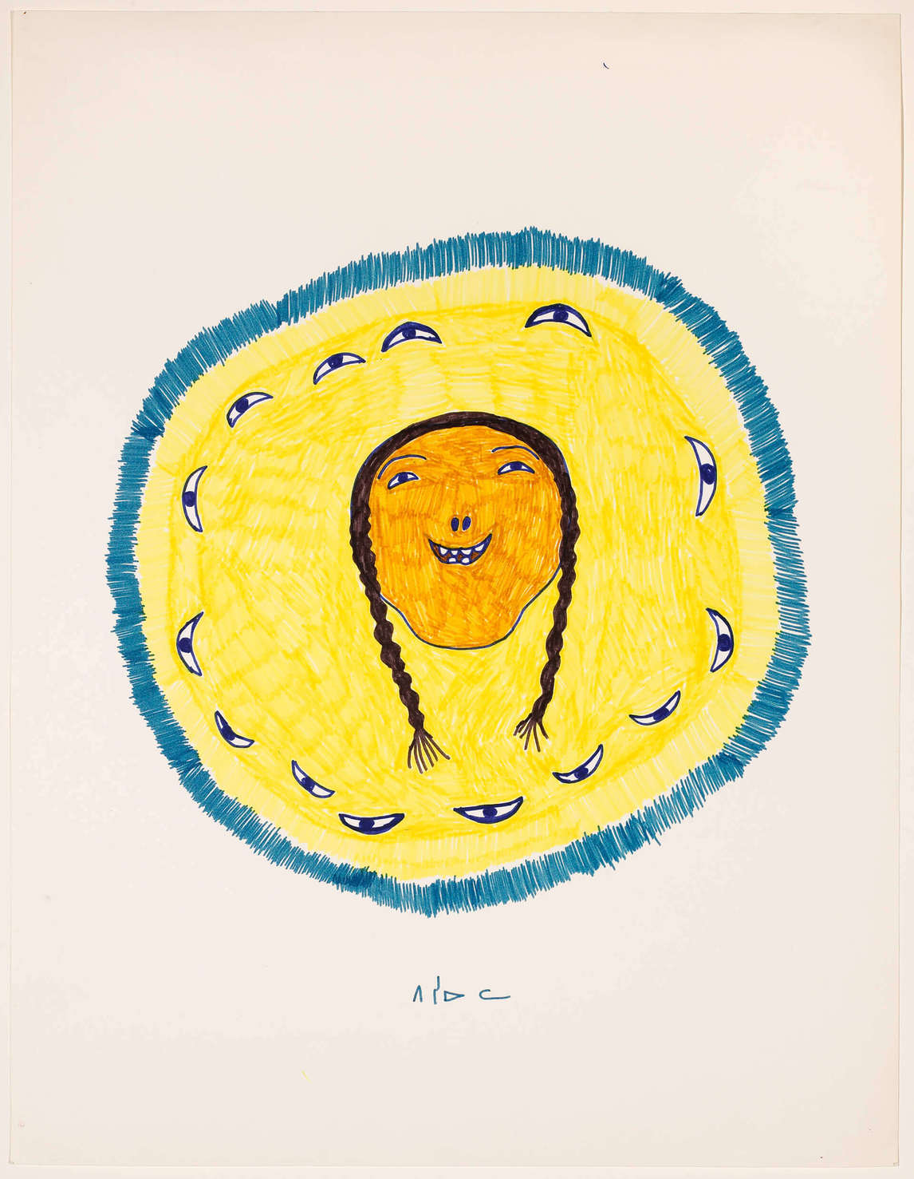
Culminating Task
Pitseolak Ashoona, The Eyes of a Happy Woman, c.1974. This work illustrates Pitseolak’s desire to express hope and happiness.

Slide 24
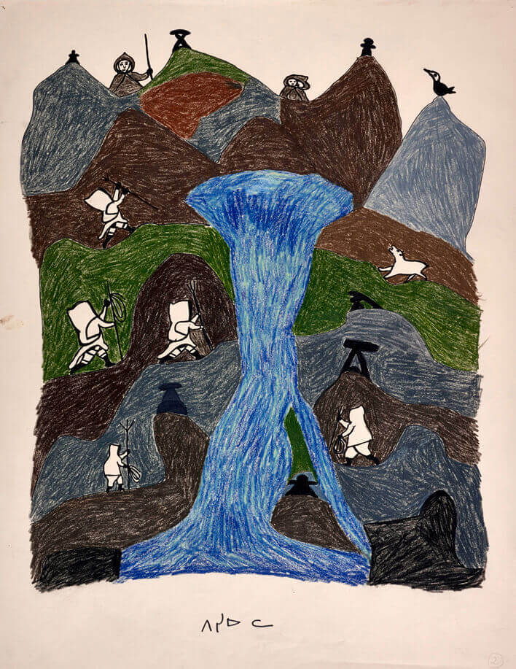
Culminating Task
Pitseolak Ashoona, drawing for print The River at Netsilik, c.1966–76. Pitseolak travelled to the camp at Netsilik with her husband.

Slide 25
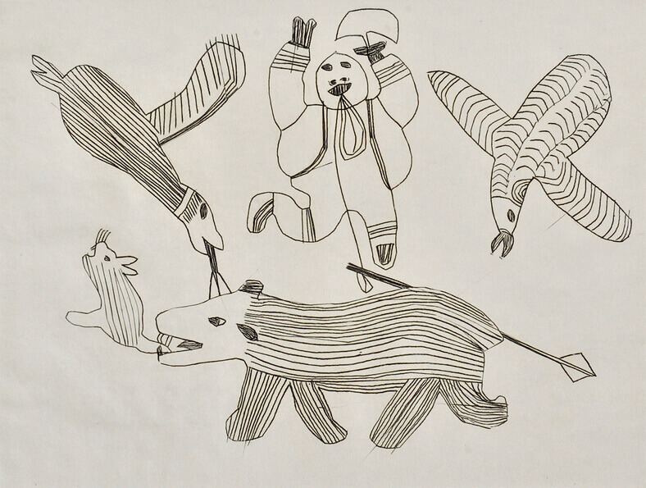
Pitseolak Ashoona, Woman with an Ulu, 1962. This work is one of Pitseolak’s early prints.

Slide 26
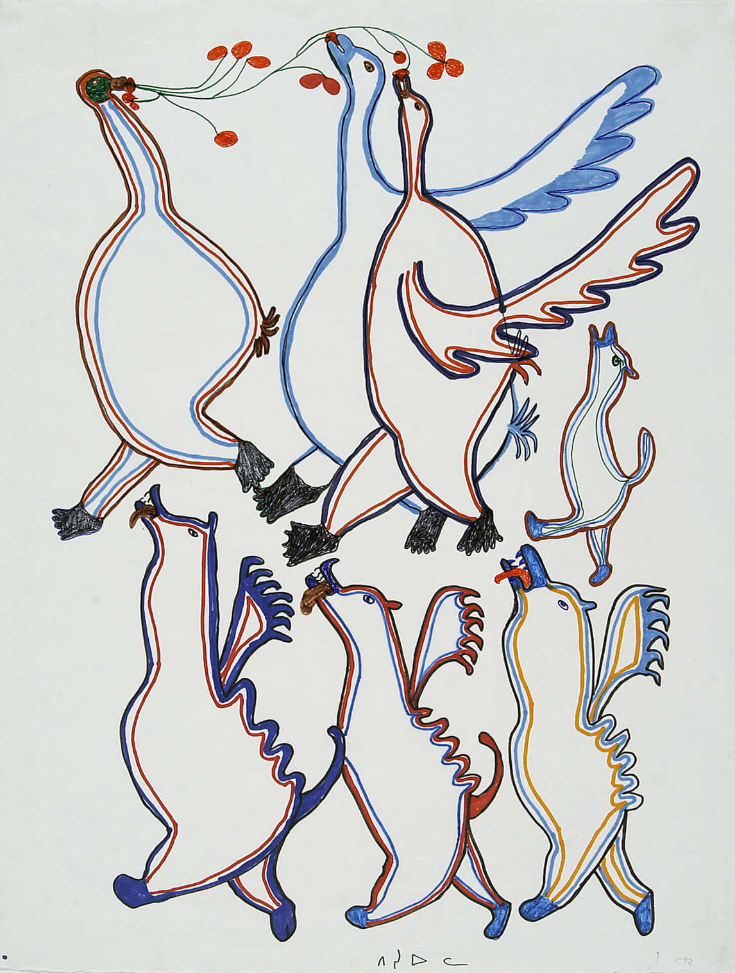
Pitseolak Ashoona, Fantastic Animals, c.1970, porous pointed pen, 66.1 x 50.7 cm, Art Gallery of Ontario, Gift of Samuel and Esther Sarick, Toronto, 2002, 2002/10668. © Estate of Pitseolak Ashoona. Reproduced with the permission of Dorset Fine Arts.
In her lifetime, Pitseolak created thousands of drawings of birds.

Slide 27
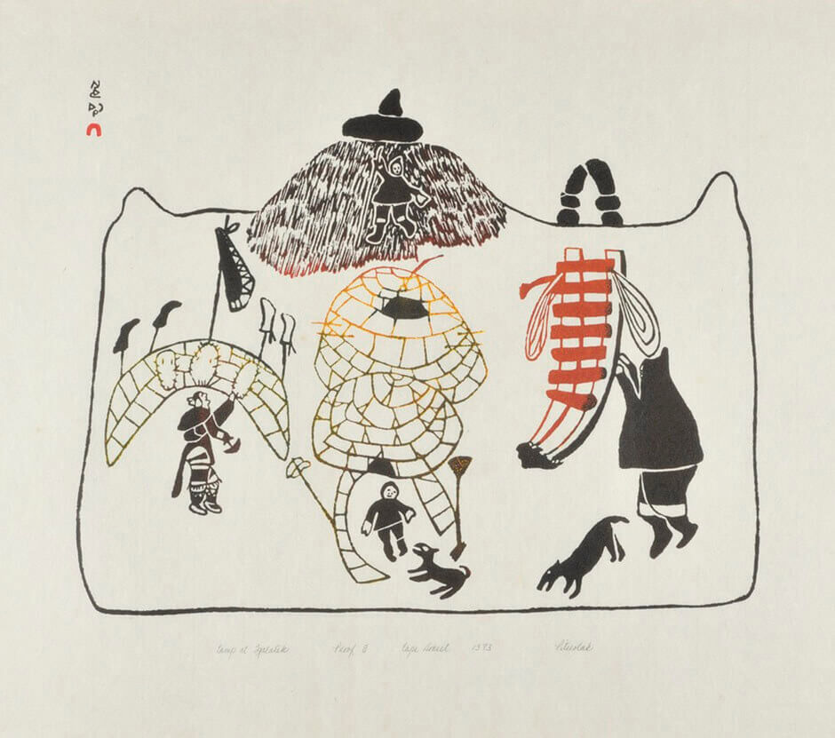
Pitseolak Ashoona, Camp at Igalalik, 1973. Pitseolak and her husband often camped at Igalaliq in the summer.

Slide 28
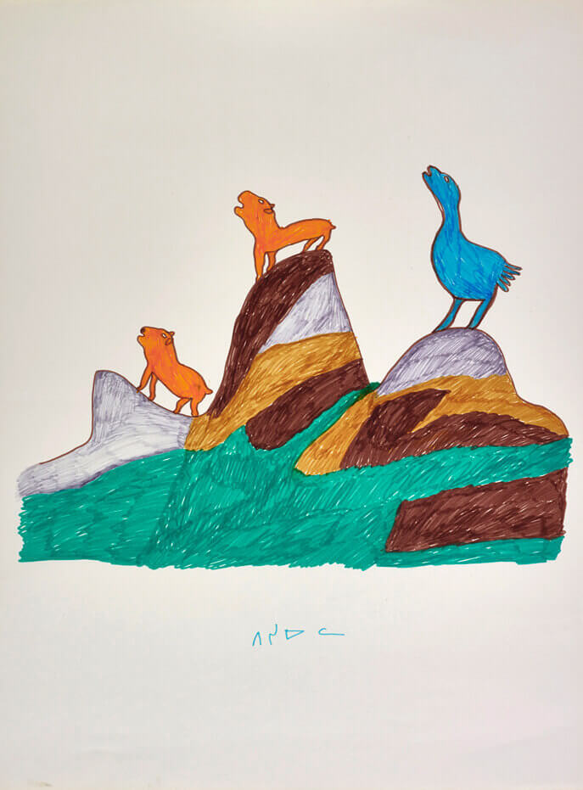
Pitseolak Ashoona, Untitled, 1966–67. This drawing shows Pitseolak’s early attempts to integrate animal figures into a lush, colourful landscape.

Slide 29
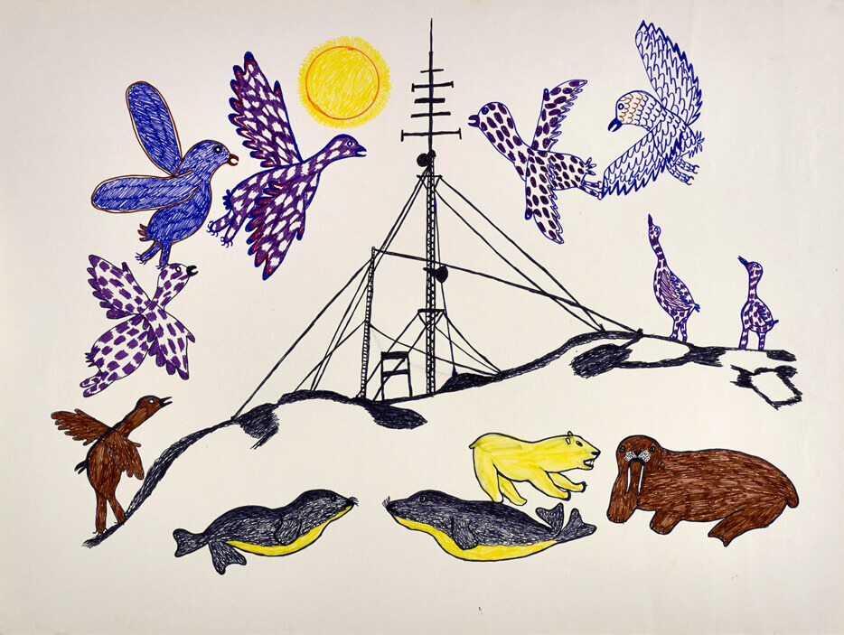
Pitseolak Ashoona, Untitled, c.1966–76. Pitseolak includes a microwave tower in this unusual landscape drawing.

