Slide 1
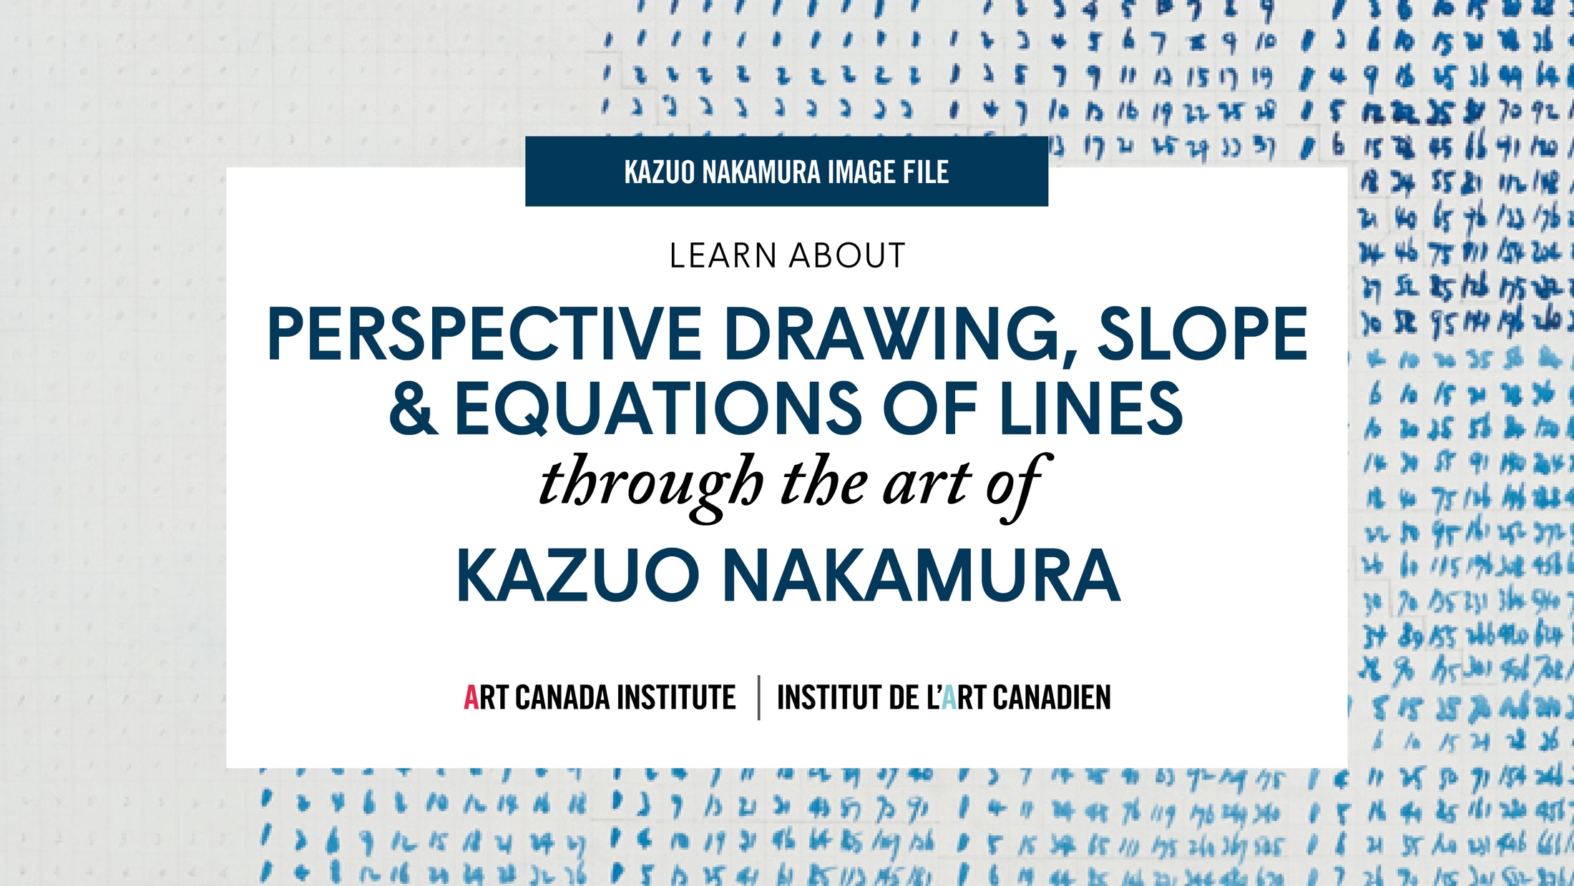
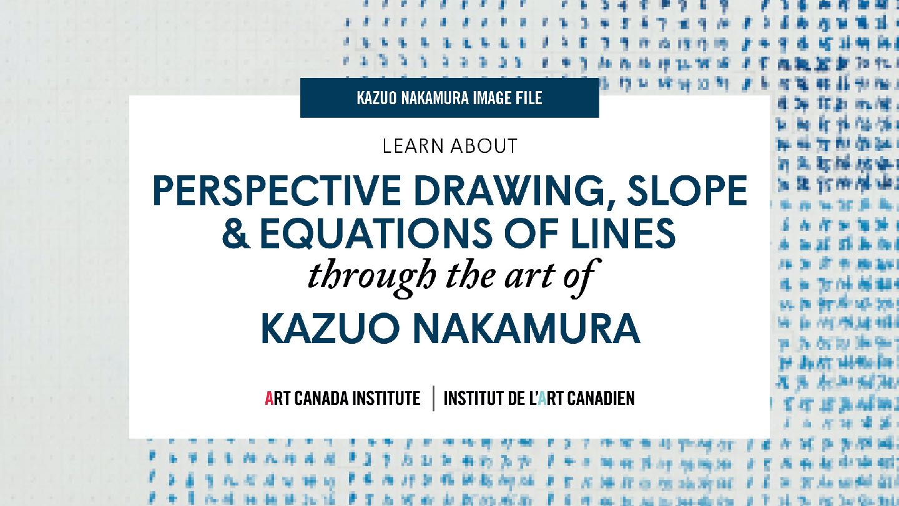

Slide 2
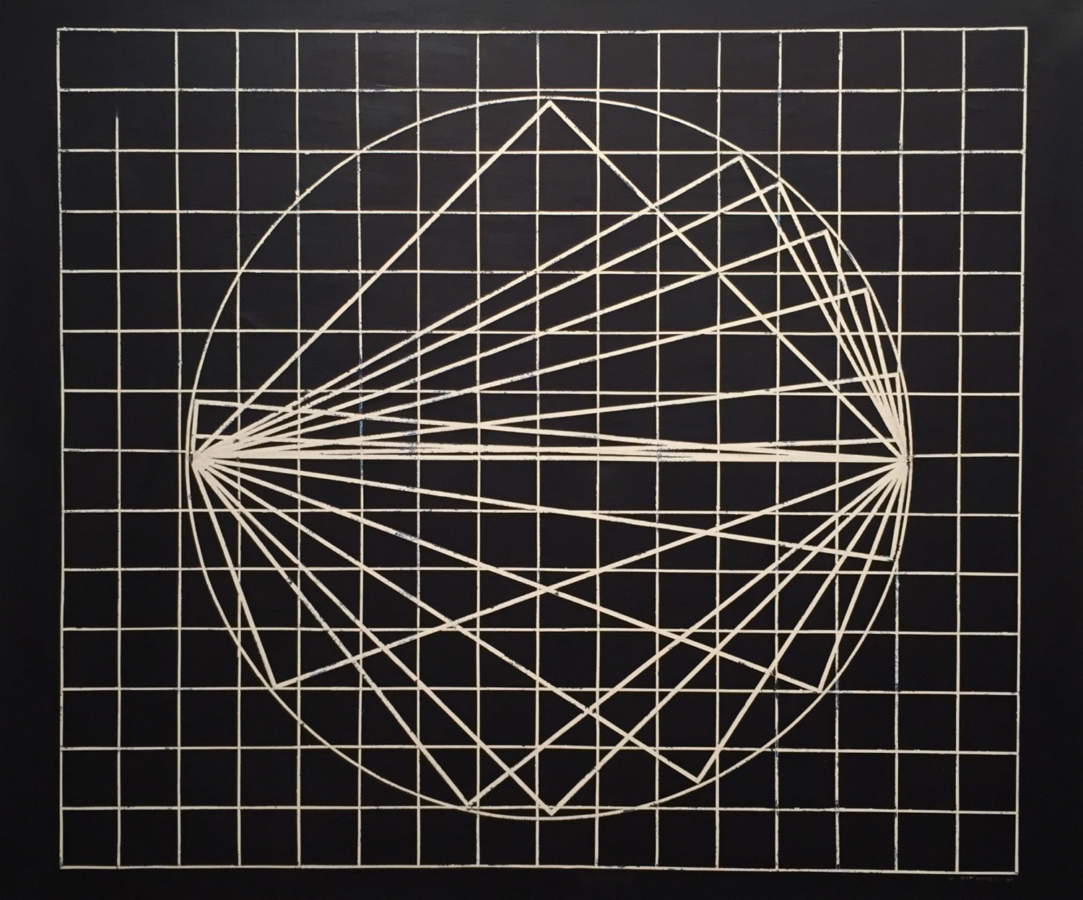
Kazuo Nakamura, Geometric Suspension, 1969. This painting reflects Nakamura’s longstanding interest in geometry.

Slide 3
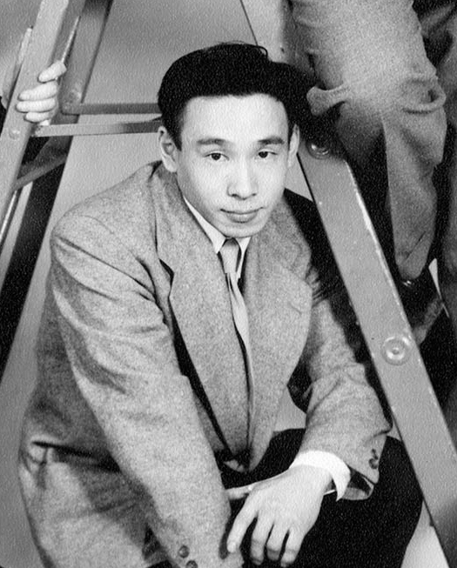
Kazuo Nakamura in 1953.

Slide 4
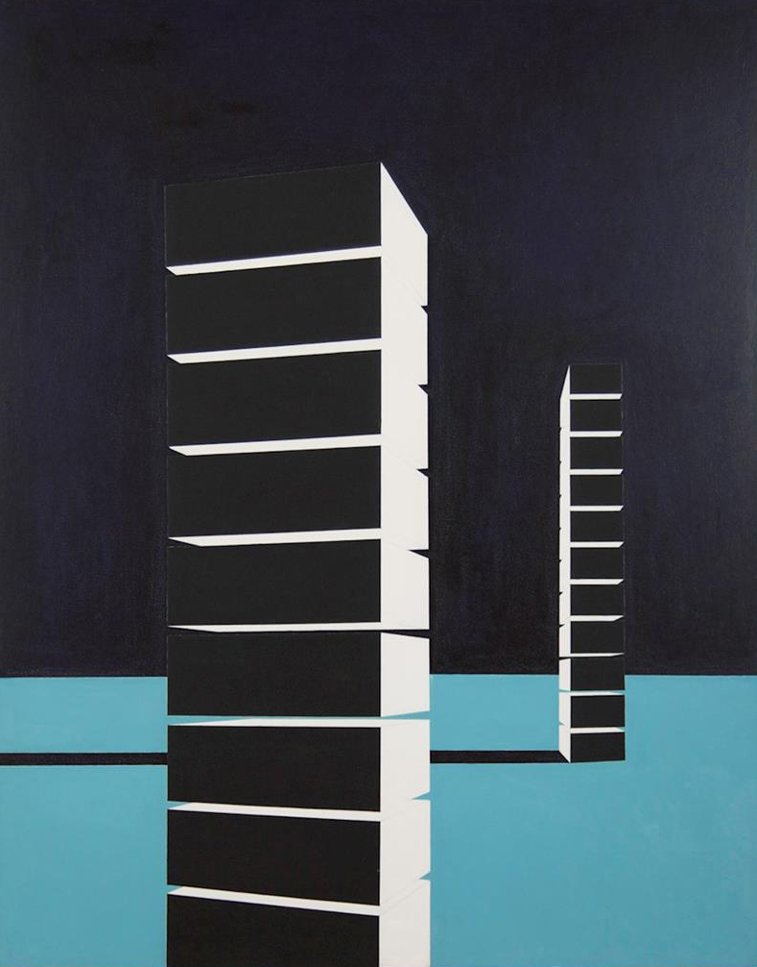
Kazuo Nakamura, Block Structure, 1956. Nakamura created several paintings representing block-like forms.

Slide 5
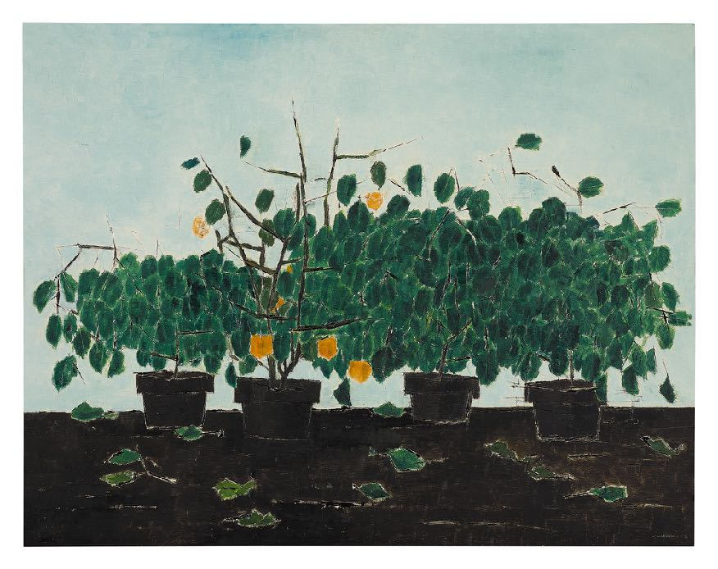

Kazuo Nakamura, Four Plants, 1958. With his still life paintings, Nakamura explored patterns in nature.

Slide 6
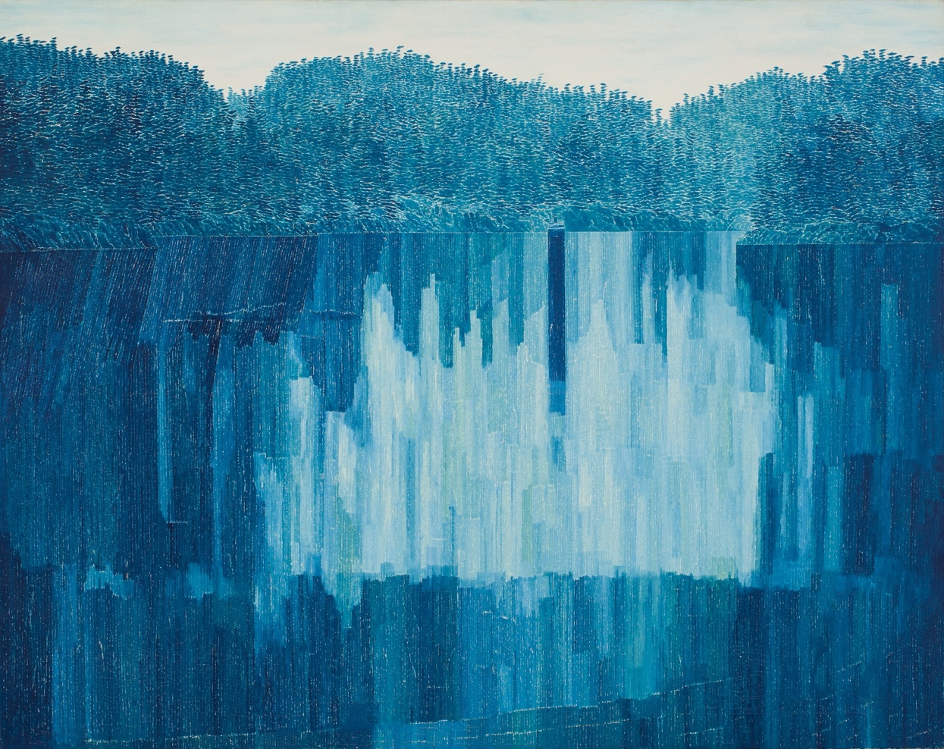
Kazuo Nakamura, Blue Reflections, B.C., 1964. In the 1960s Nakamura was well-known for distinctive blue-green landscapes.

Slide 7
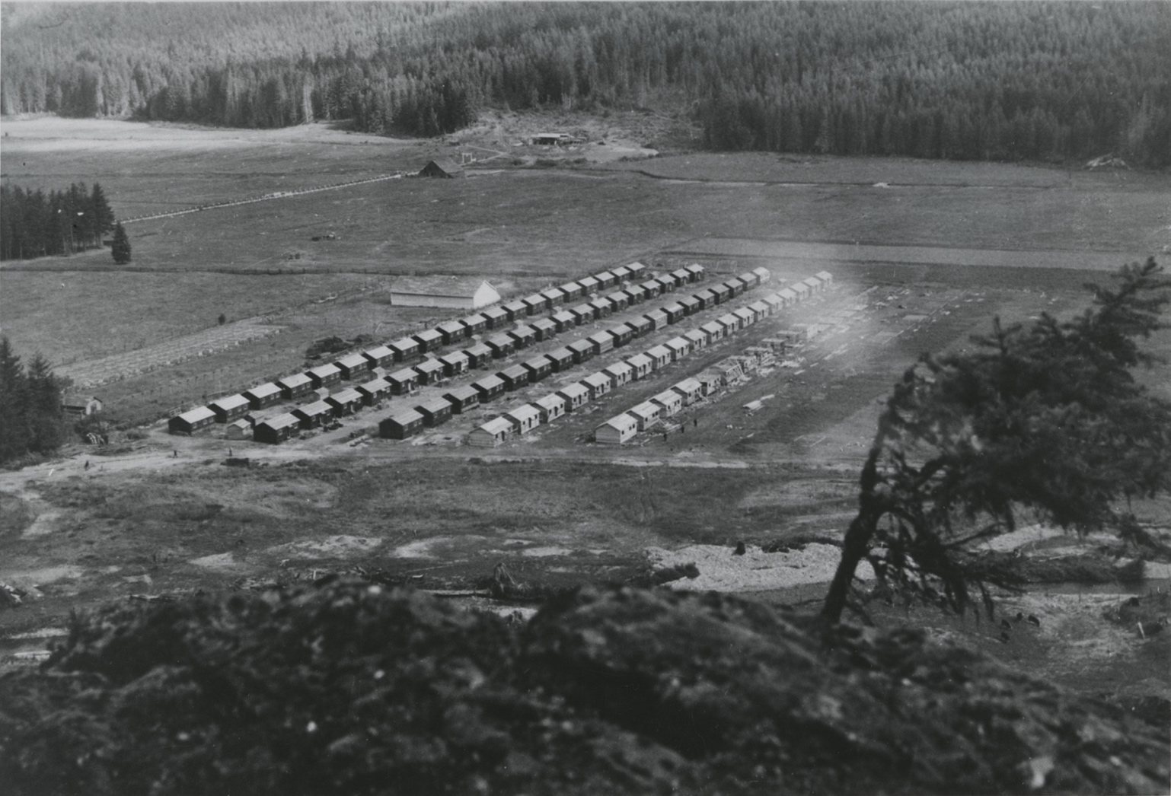
Tashme Camp under construction, 1942.

Slide 8
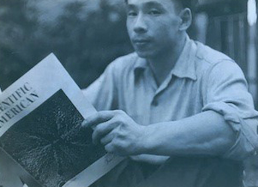
Kazuo Nakamura reading an issue of Scientific American, 1957.

Slide 9
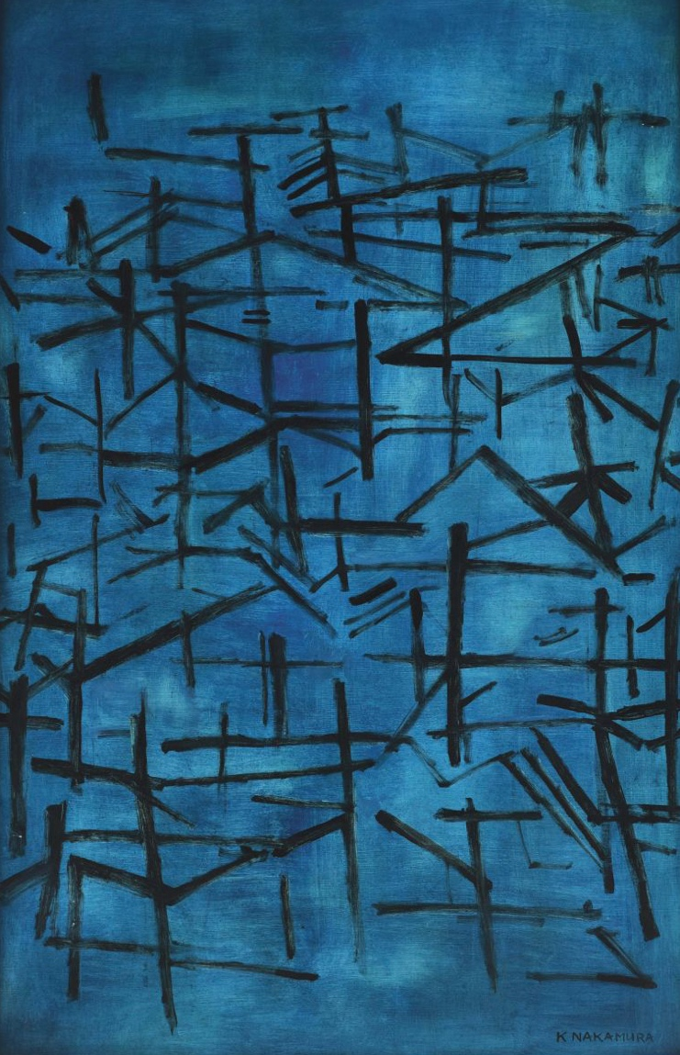
Kazuo Nakamura, Untitled Abstract in Blue, n.d. Nakamura painted several works similar to this one in the mid 1950s.

Slide 10
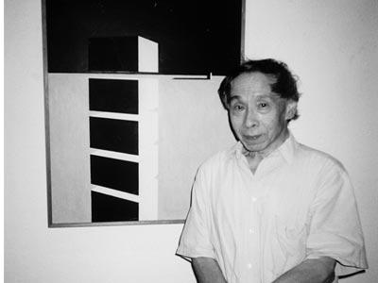
Kazuo Nakamura with one of his paintings.

Slide 11
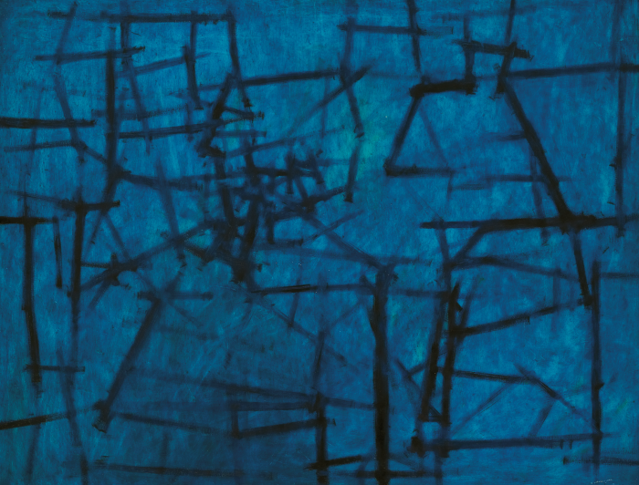
Learning Activity #1
Kazuo Nakamura, Inner Structure, 1956, oil on hardboard, 60.8 x 78.8 cm. Collection of Art Gallery of Ontario, Gift of Mr. Charles McFaddin, Toronto, 1985, 85/115. © Estate of Kazuo Nakamura.
This painting represents the artist’s interest in atomic motion.

Slide 12
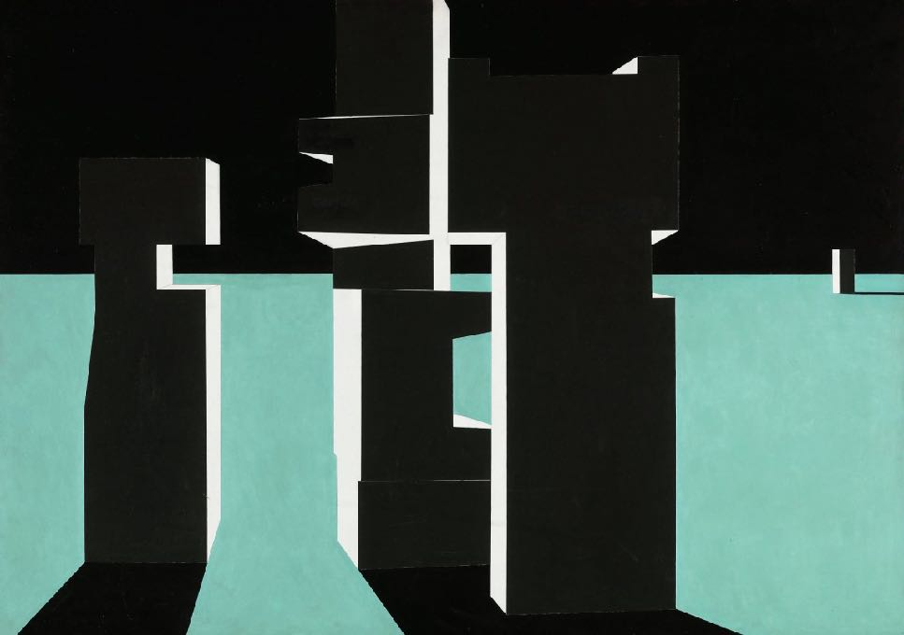
Learning Activity #1
Kazuo Nakamura, Prairie Towers, 1956. Through its title, this work alludes to the tall grain elevators common in the prairies.

Slide 13
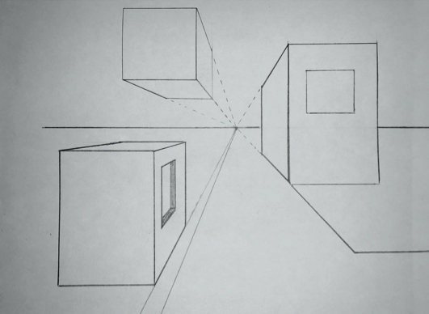
Learning Activity #1
This drawing illustrates key lines in one-point perspective.

Slide 14
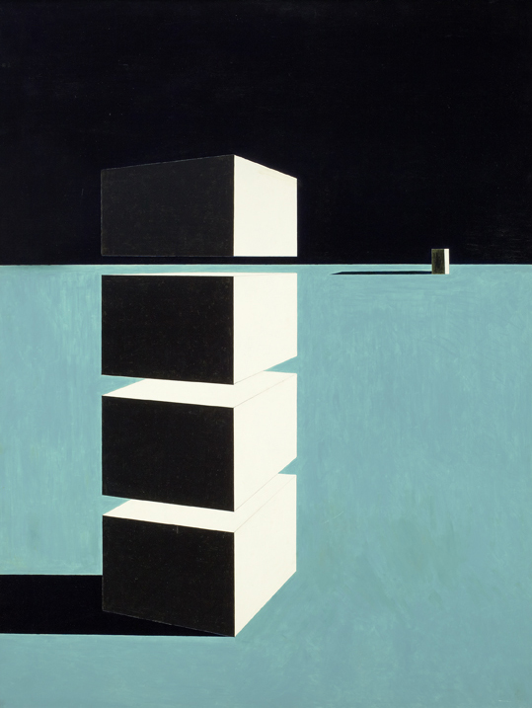
Learning Activity #2
Kazuo Nakamura, Suspension, 1956. In this painting, the blocks appear to float.

Slide 15
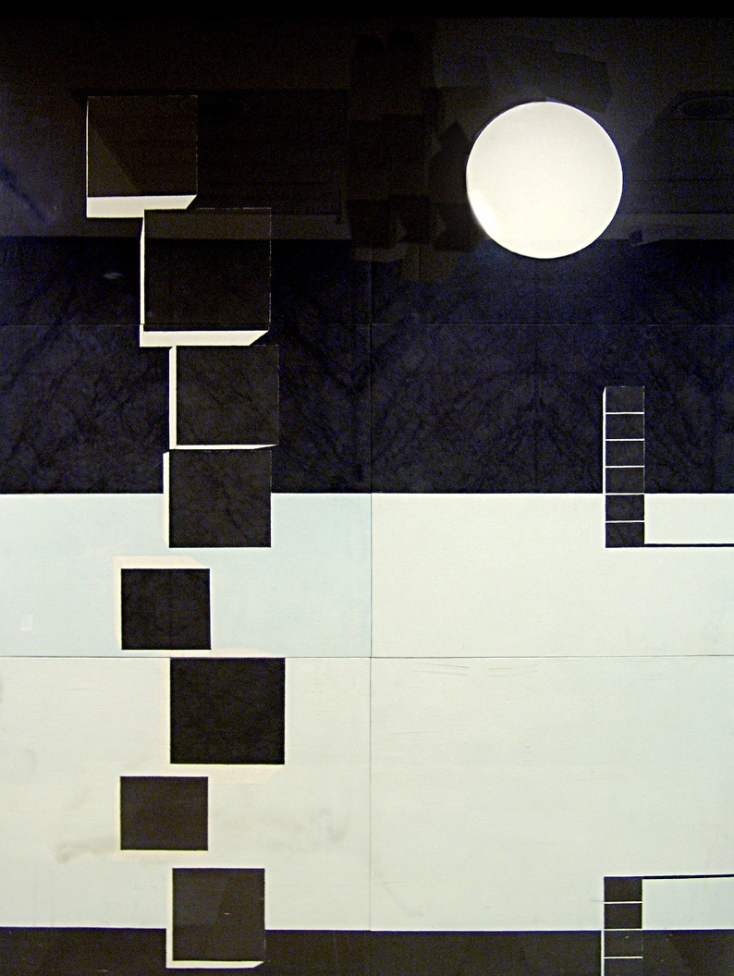
Learning Activity #2
Kazuo Nakamura, Two Horizons, 1968. This work was a special commission from the government of Ontario.

Slide 16
Learning Activity #2
Kazuo Nakamura, Prairie Towers, 1956. Although this image is abstract, Nakamura has also created the impression of a landscape.

Slide 17
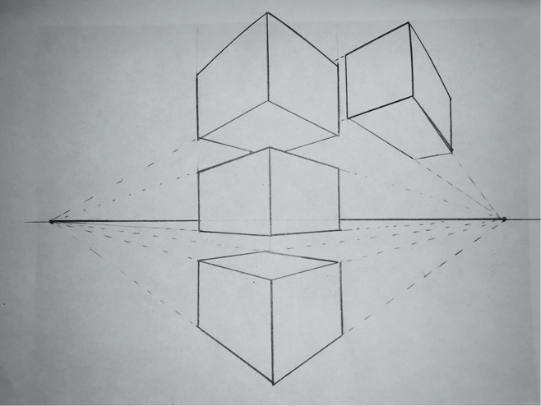
Learning Activity #2
Illustration of key lines in two-point perspective.

Slide 18
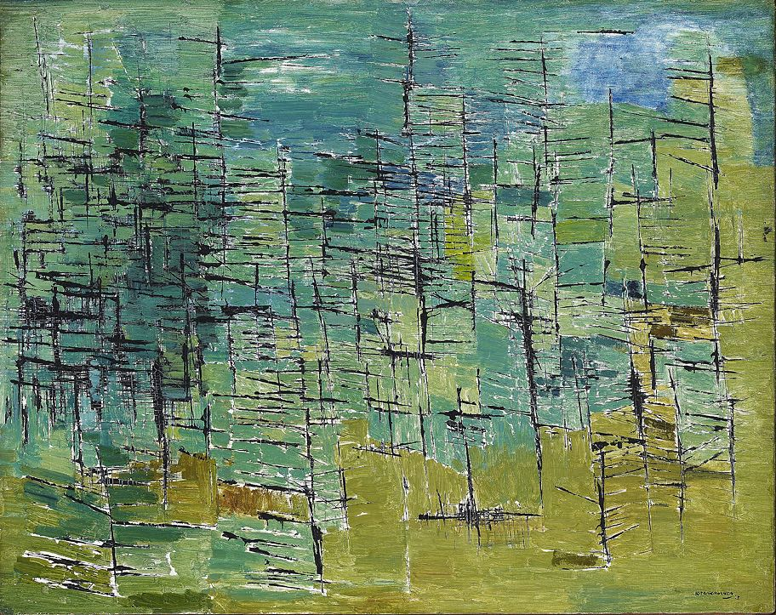
Kazuo Nakamura, Forest, 1953. In this work, Nakamura created a rich texture of brushstrokes reminiscent of a dense forest.

Slide 19

Culminating Task
Kazuo Nakamura, Block Structure, 1956. Nakamura sometimes painted with crisp, pristine lines.

Slide 20
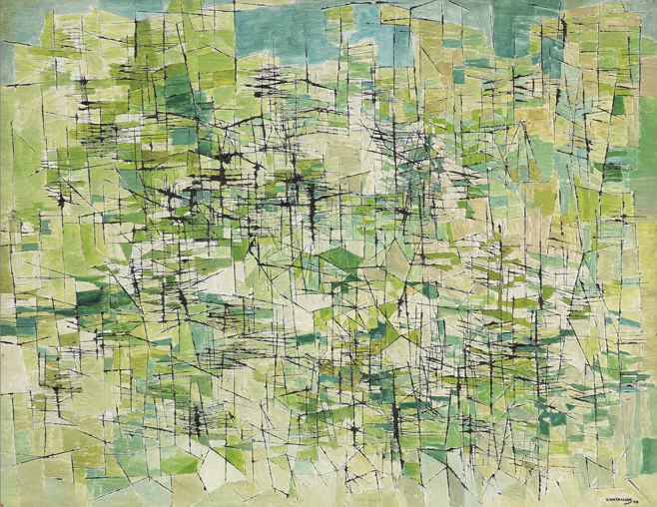
Culminating Task
Kazuo Nakamura, Hillside, 1954. An abstracted image of trees on a hillside, this work is dominated by an intense pattern of greens.

Slide 21
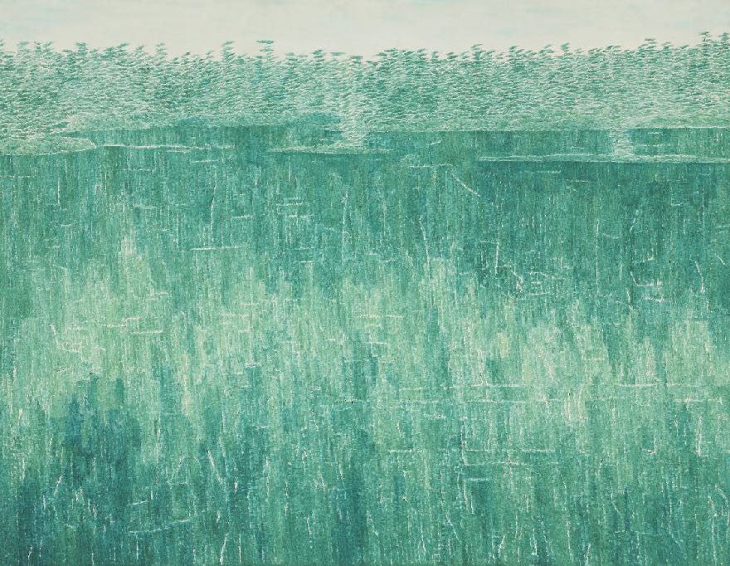
Culminating Task
Kazuo Nakamura, August, Morning Reflections, 1961. The exceptional delicacy shown in this landscape was critical to Nakamura’s unique style.

Slide 22
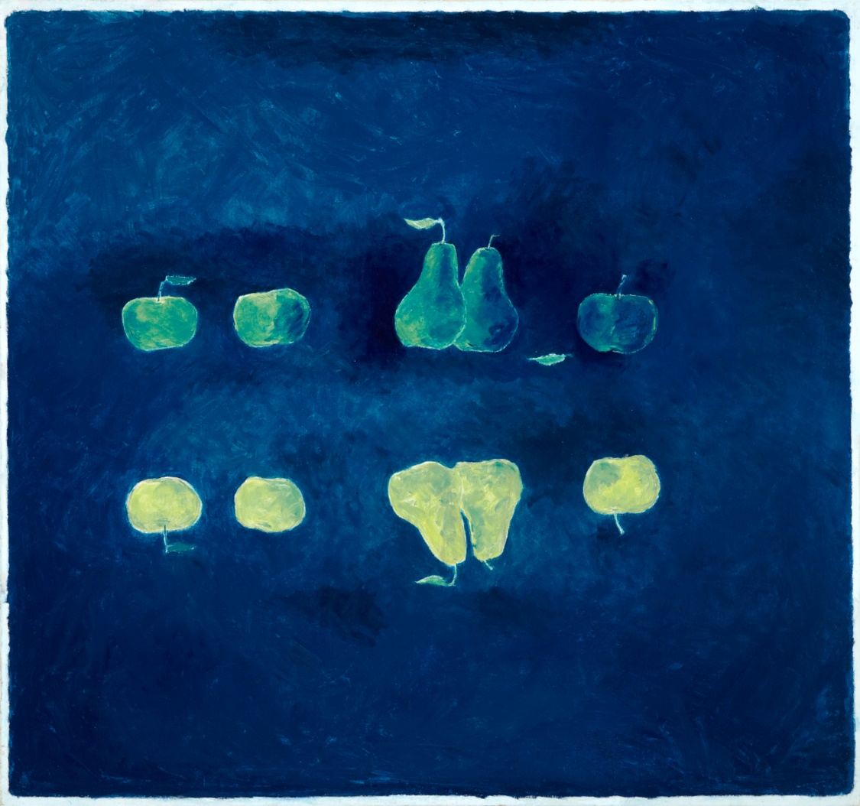
Culminating Task
Kazuo Nakamura, Reversed Image, 1965. With this composition, Nakamura experimented with mirroring his subject.

Slide 23
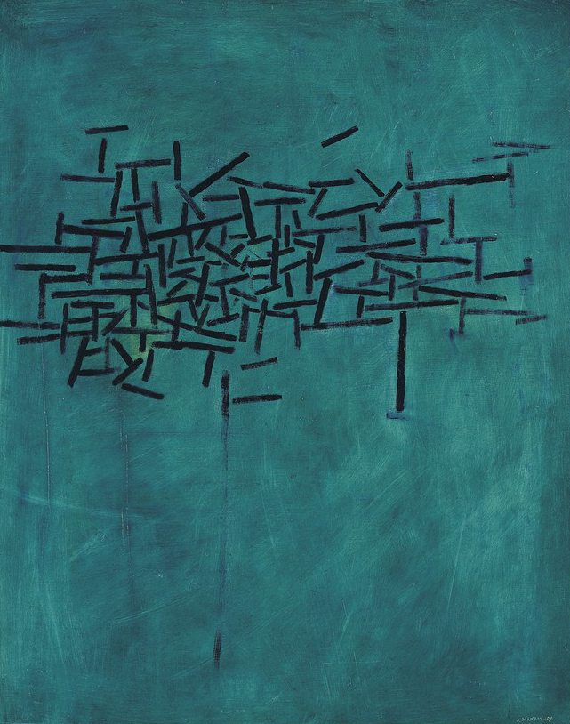
Culminating Task
Kazuo Nakamura, Inner Structure, c.1956, oil on untampered hardboard, 61.1 x 48.4 cm. Collection of Art Gallery of Ontario, Toronto, purchase with the assistance of the Estate of Christian Claude, 2001, 2000/1152. © Art Gallery of Ontario.
For this painting, Nakamura worked with subtle shades of turquoise.

Slide 24
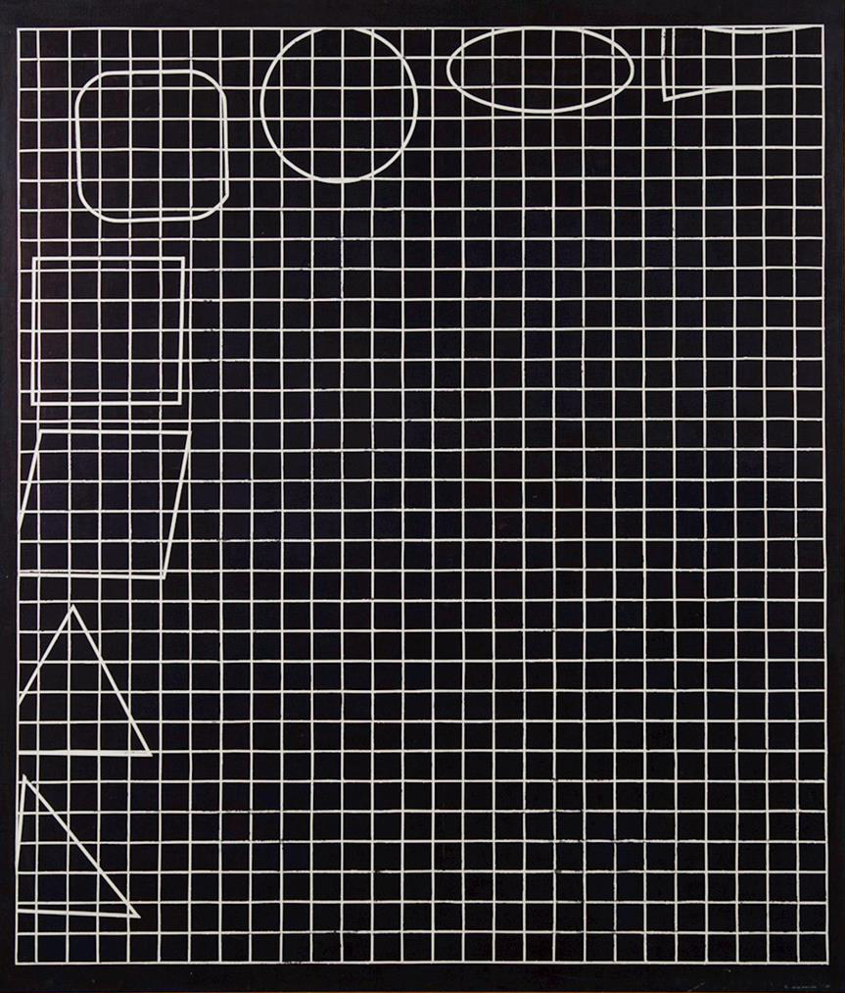
Kazuo Nakamura, Spatial Concept, Geometry, 1968. The shapes in this work symbolize the progress of art and science through history.

Slide 25
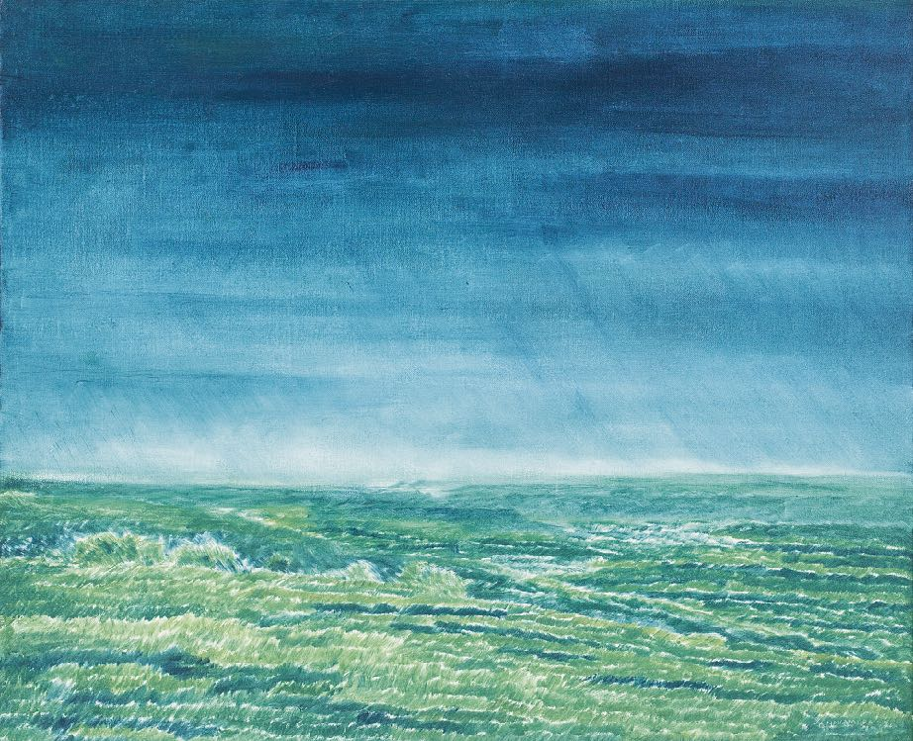
Kazuo Nakamura, Morning, 1982. In this late landscape, Nakamura captures the glow of early morning light.

Slide 26
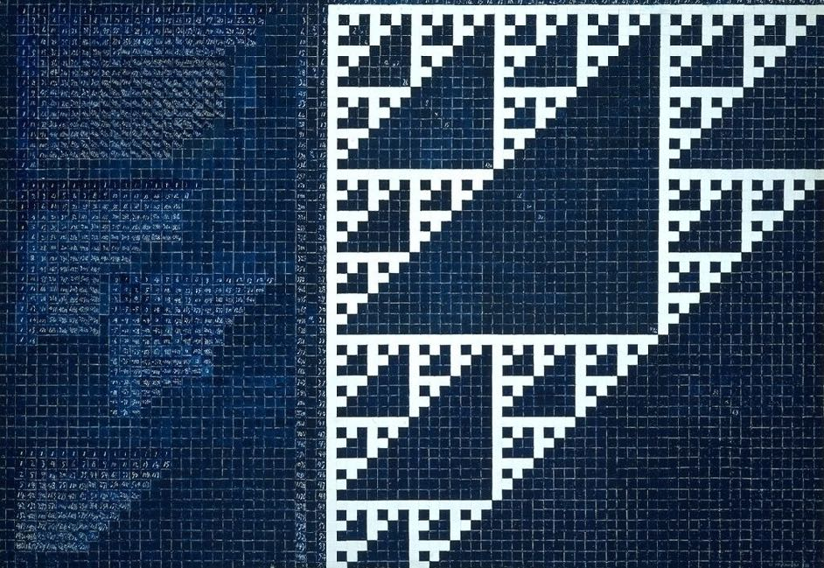
Kazuo Nakamura, Number Structure and Fractals, 1983. In one of the most ambitious series in his career, Nakamura painted highly structured compositions representing numerical patterns.

Slide 27
Kazuo Nakamura, Number Structure No. 9, 1984. For this work, Nakamura painted hundreds of tiny numbers.

