Slide 1
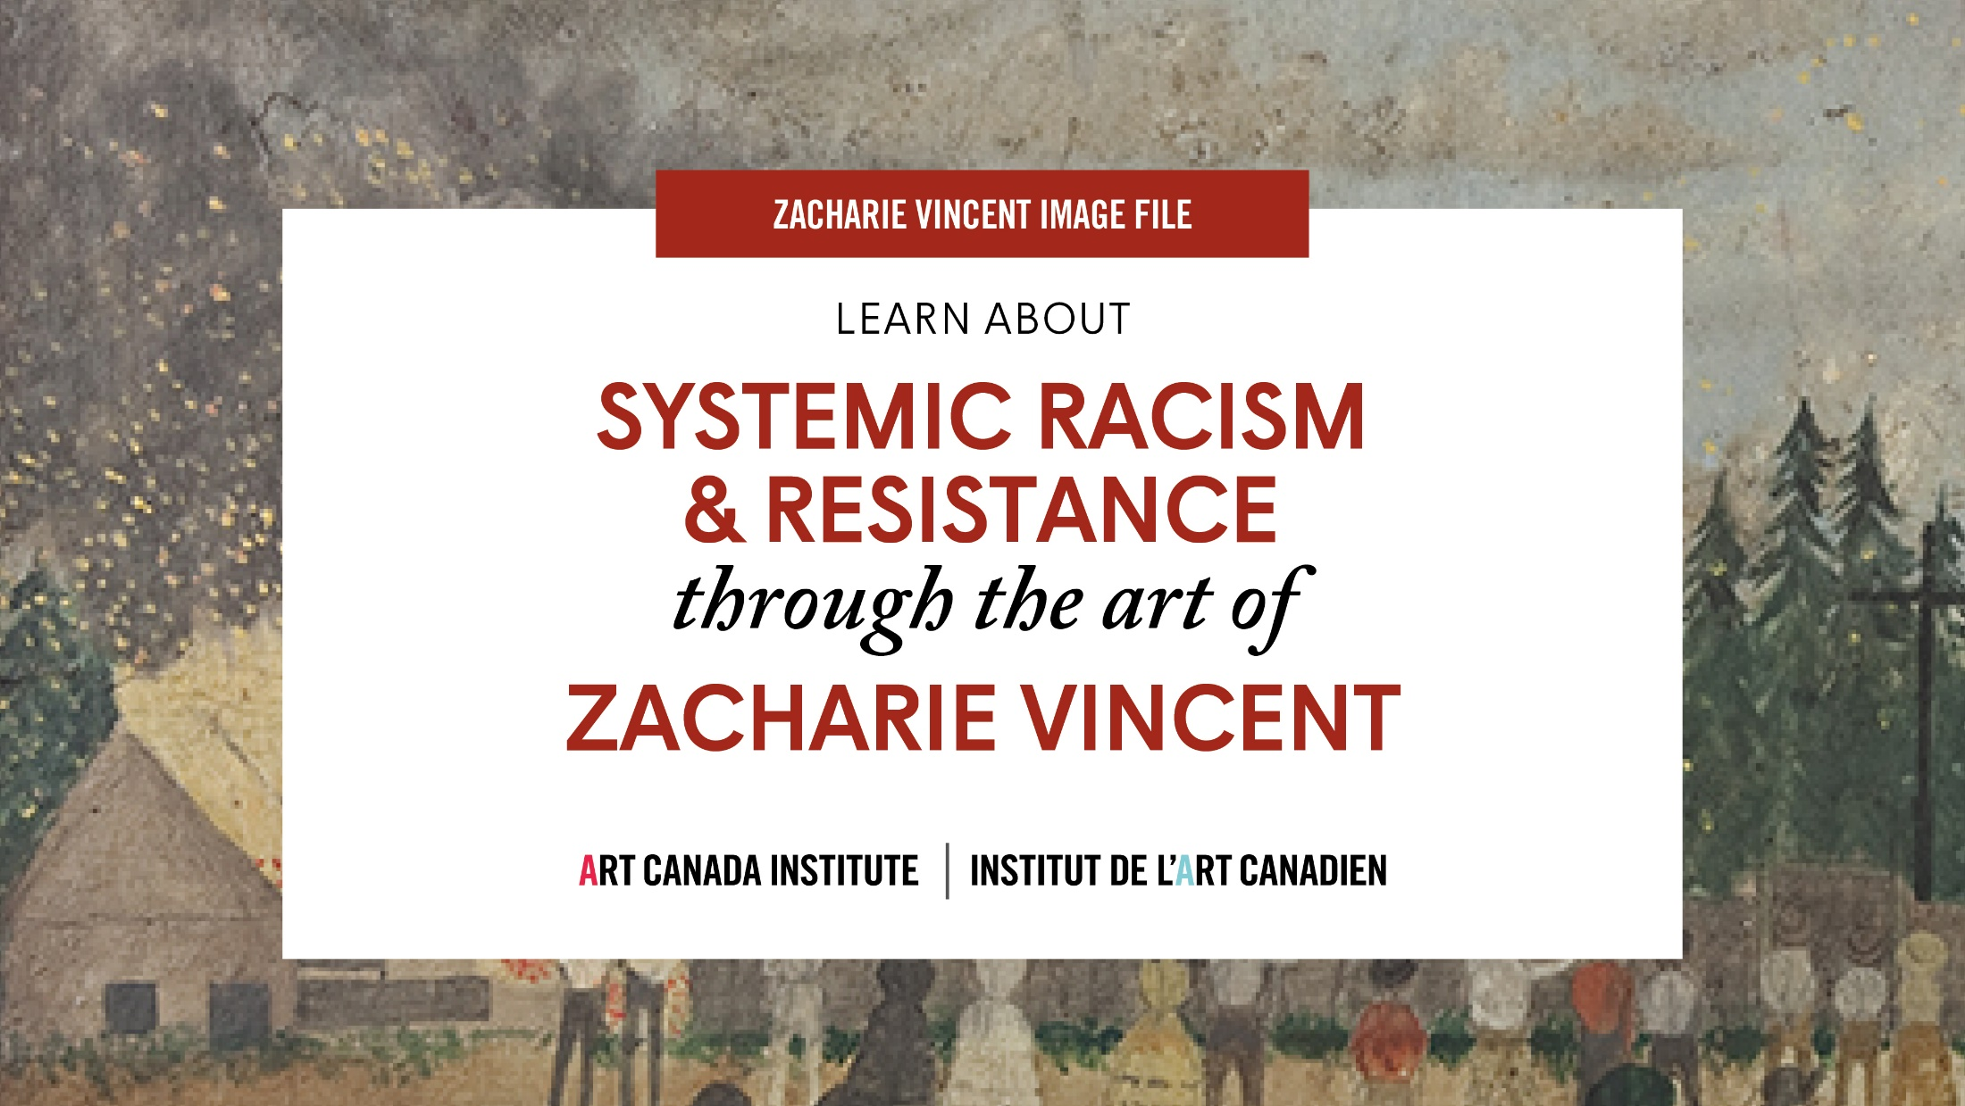
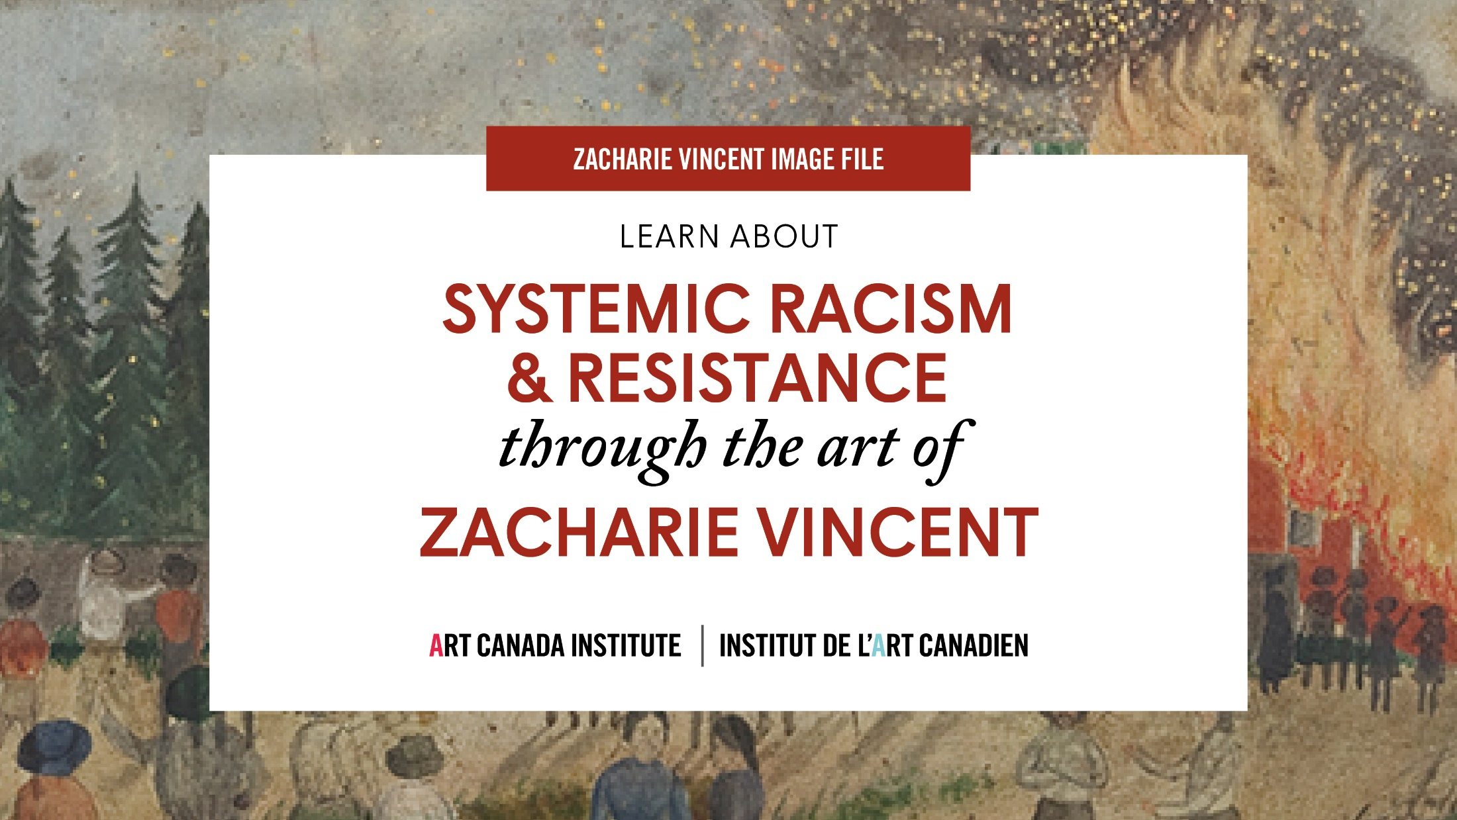
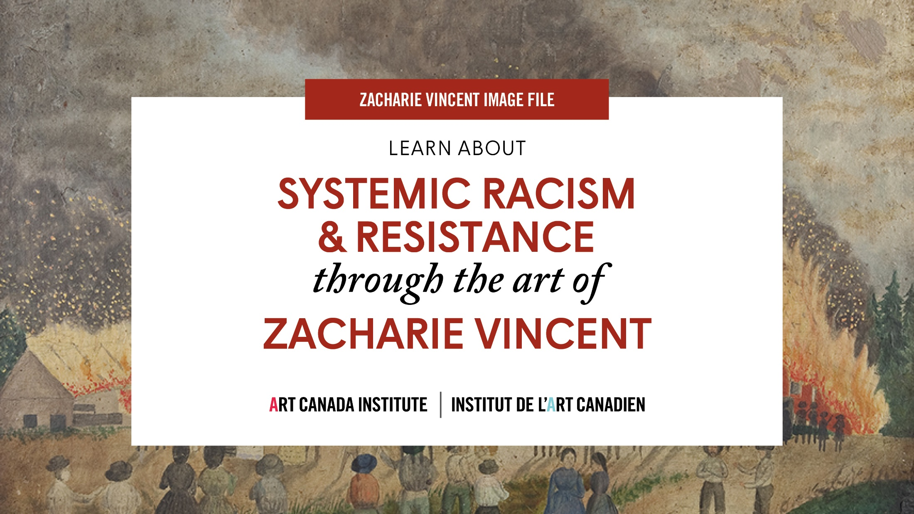

Slide 2
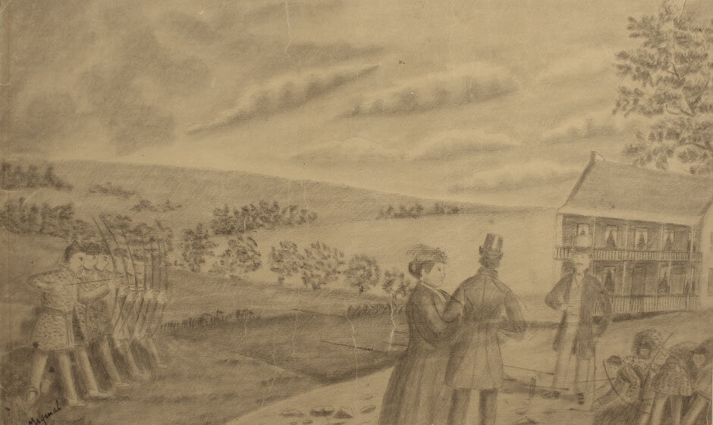
Zacharie Vincent, Indian Skirmish, n.d. In this scene, the Huron-Wendat figures on the left display their talent in archery.

Slide 3
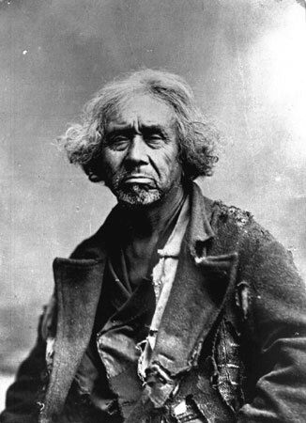
Zacharie Vincent, c.1875–78.

Slide 4
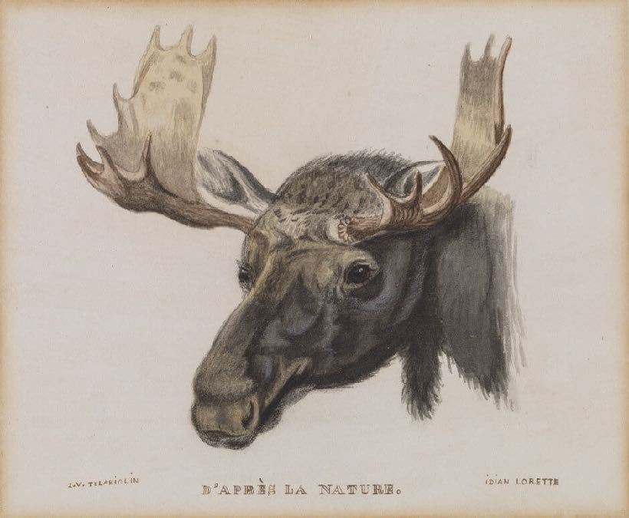
Zacharie Vincent, Head of a Moose, From Nature, c.1855. This drawing reveals Vincent’s deep knowledge of nature.

Slide 5
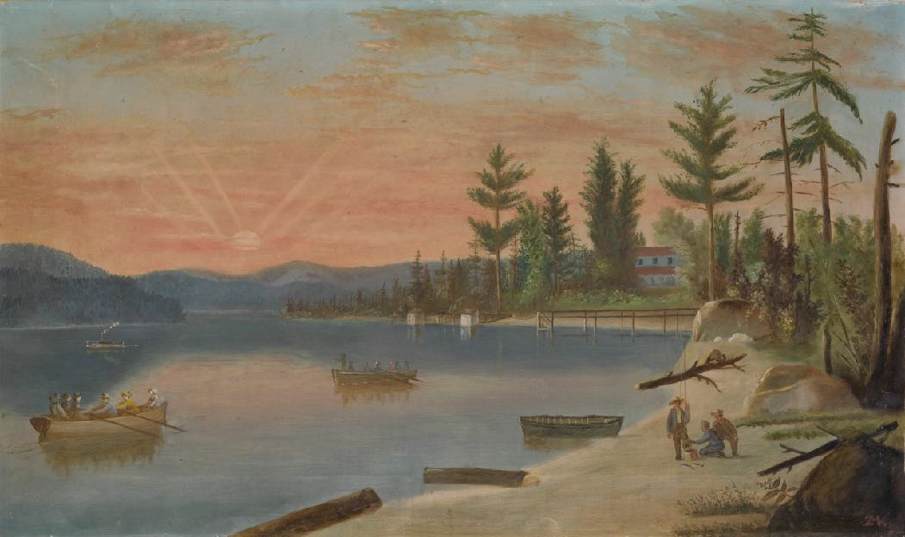
Zacharie Vincent, Lake Saint-Charles, c.1860. With this landscape Vincent depicts the increasing settlement around Lake Saint-Charles.

Slide 6
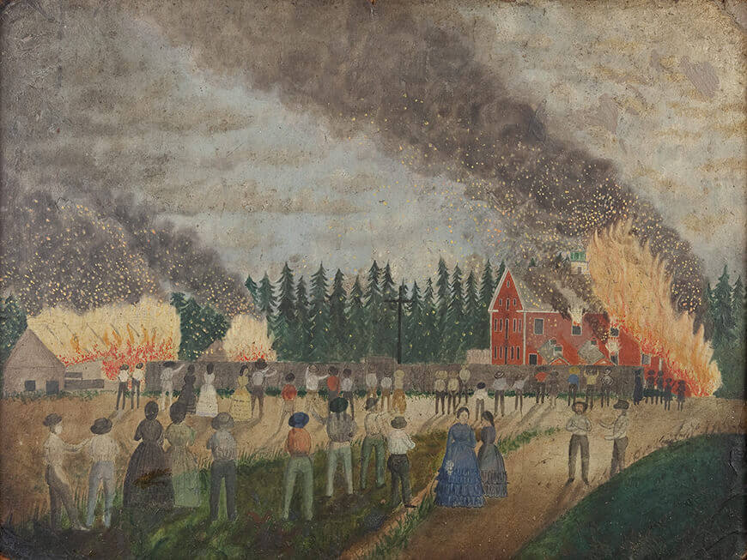
Zacharie Vincent, Fire at the Paper Mill in Lorette, c.1862. Here Vincent depicts a fire that broke out on June 10, 1862, at the Smith paper mill.

Slide 7
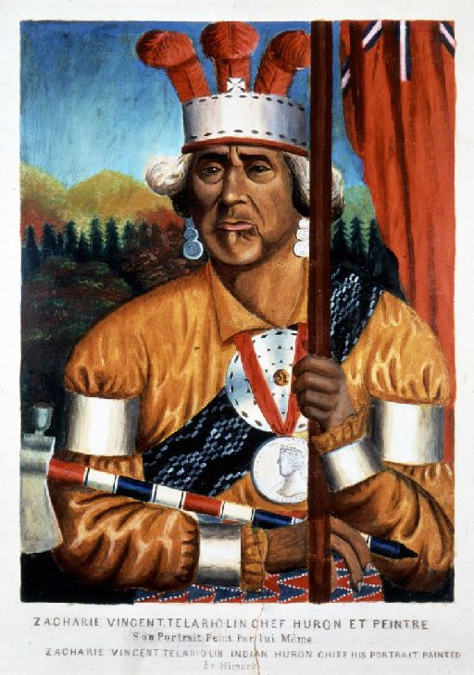
Zacharie Vincent, Zacharie Vincent Telari-o-lin, Huron Chief and Painter, c.1875–78. Vincent likely painted this self-portrait using a photograph.

Slide 8
Zacharie Vincent, c.1875–78.

Slide 9
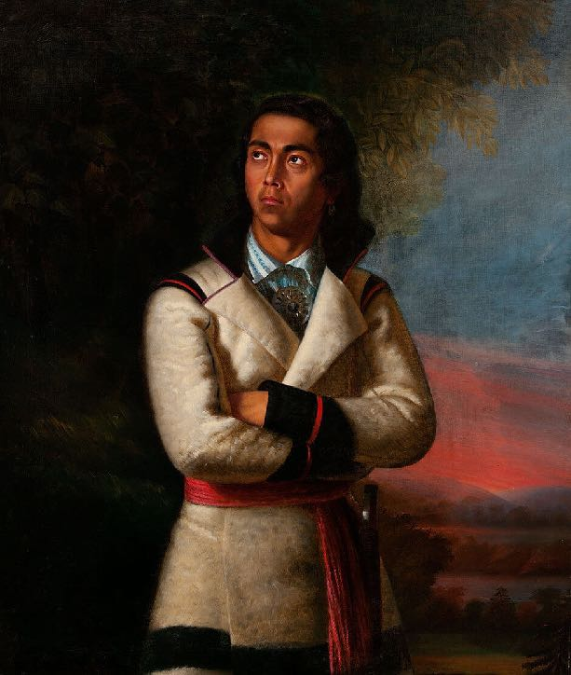
Antoine Plamondon, Portrait of Zacharie Vincent, Last of the Hurons, 1838.

Slide 10
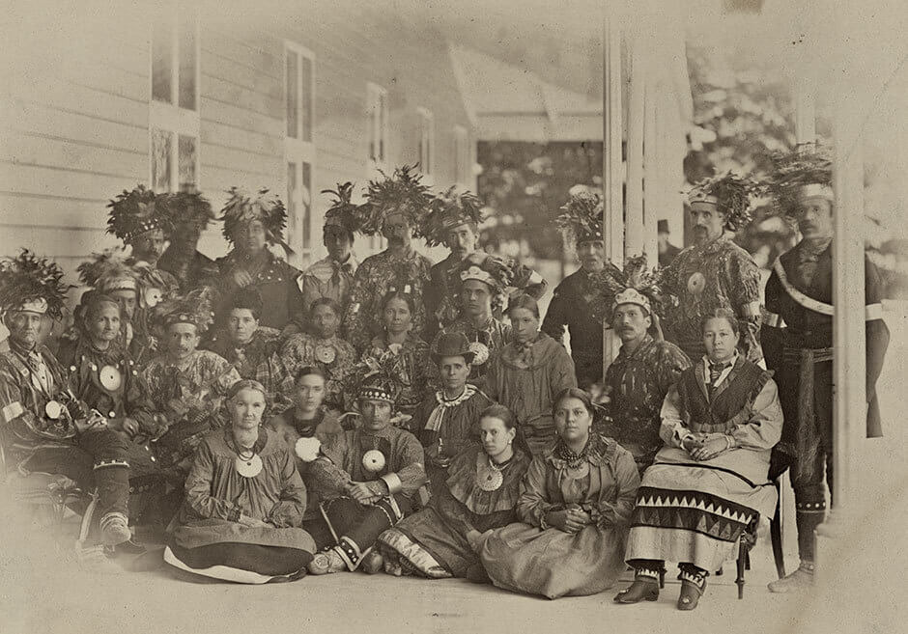
A Huron-Wendat group at Spencerwood, Quebec City, 1880.

Slide 11
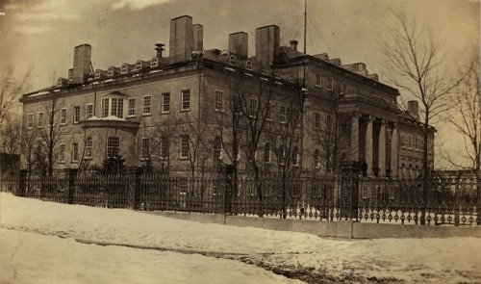
Marine Hospital, Quebec City, 1875.

Slide 12
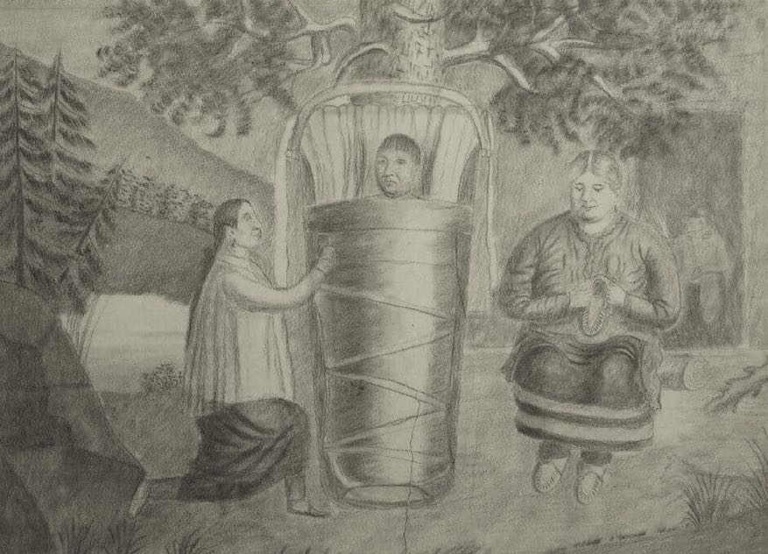
Zacharie Vincent, Two Women with Figure in an Infant Carrier, n.d.
This drawing shows an initiation rite for the accession of a new chief.

Slide 13
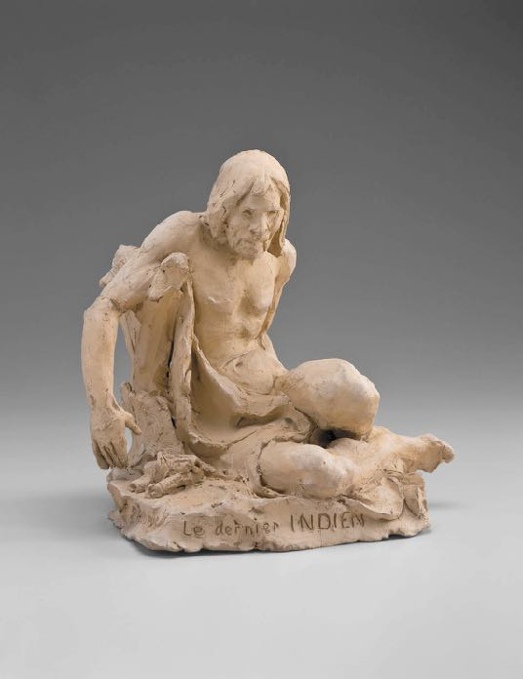
Learning Activity #1
Louis-Philippe Hébert, The Last Indian, 1901. Hébert was one of the most famous sculptors in Canada in the early 1900s.

Slide 14
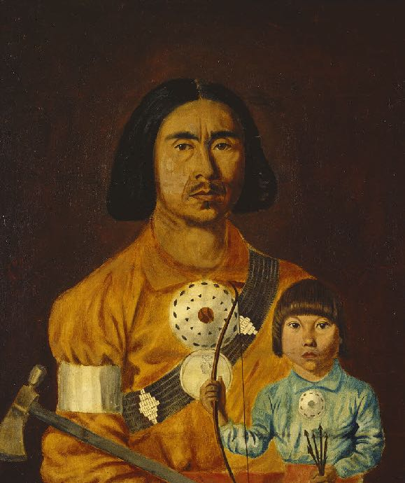
Learning Activity #1
Zacharie Vincent, Zacharie Vincent and His Son Cyprien, c.1851. Vincent had four children, and Cyprien was the eldest.

Slide 15
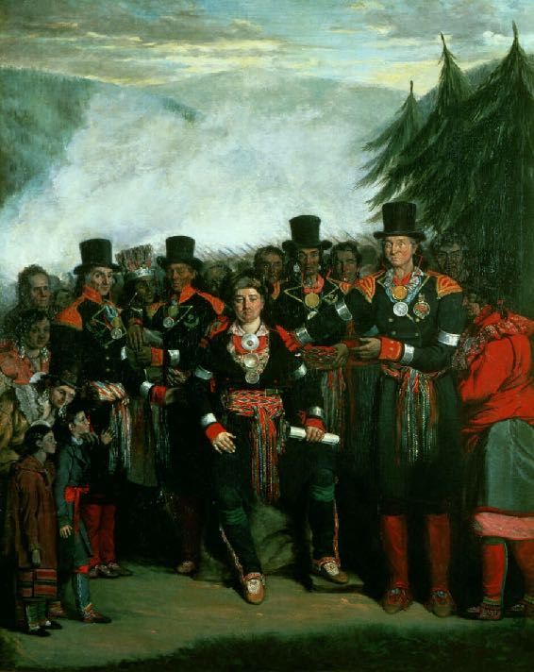
Learning Activity #2
Henry Daniel Thielcke, Presentation of a Newly Elected Chief of the Huron Tribe, 1838. Here Vincent appears in the back row, wearing a silver headdress with feathers.

Slide 16
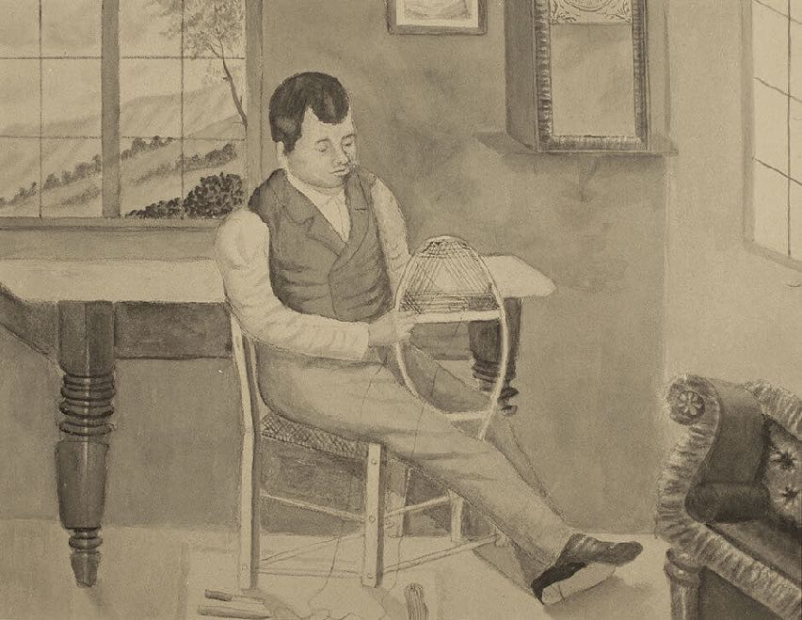
Zacharie Vincent, Snowshoe Maker, n.d. This drawing shows an artisan at work.

Slide 17
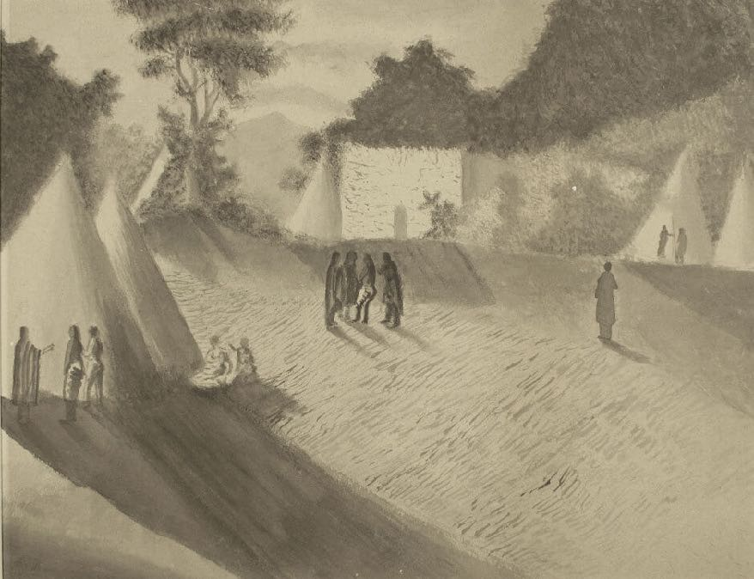
Zacharie Vincent, Camp Site (Man with Long Coat), n.d. Here Vincent has filled the scene with long shadows.

Slide 18
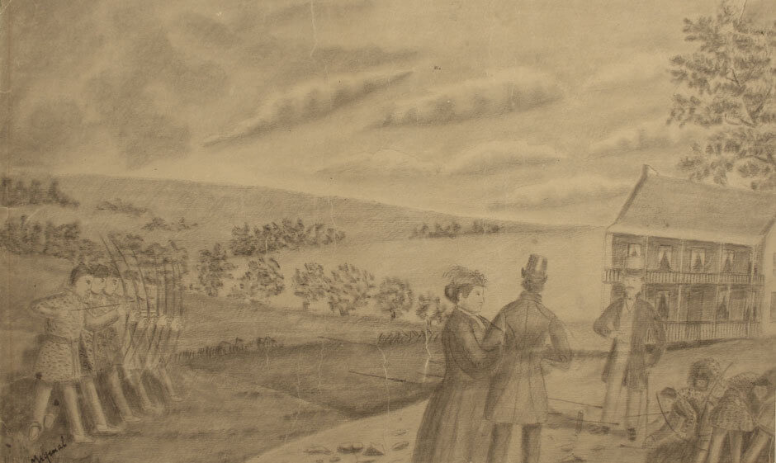
Zacharie Vincent, Indian Skirmish, n.d. This scene shows white settlers visiting the Huron community.

Slide 19
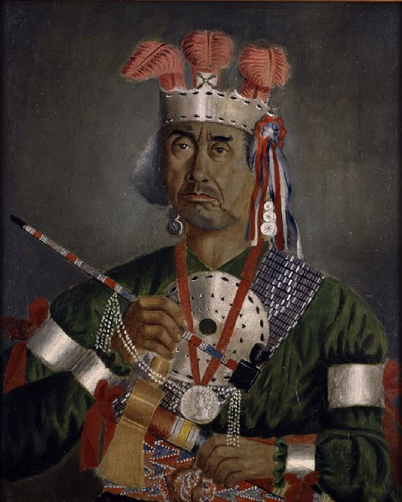
Culminating Task
Zacharie Vincent, Self-Portrait, n.d. In this self-portrait, Vincent is wearing regalia that represents his status as chief.

Slide 20
Culminating Task
Antoine Plamondon, Portrait of Zacharie Vincent, Last of the Hurons, 1838. This painting shows Vincent as a young man.

Slide 21
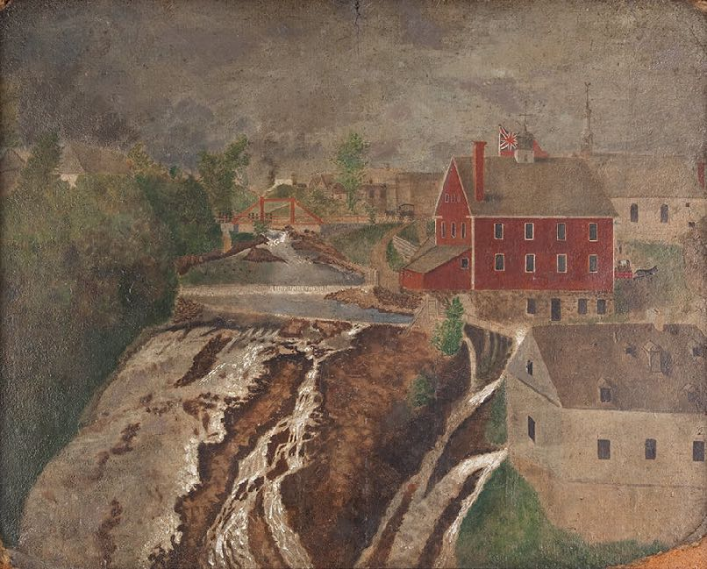
Zacharie Vincent, Lorette Falls, c.1860. Vincent captured the energy of the waterfall with thick paint and vigorous brushstrokes.

Slide 22
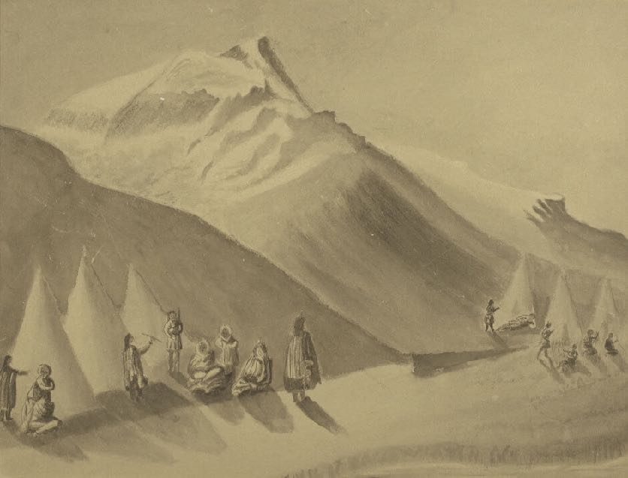
Zacharie Vincent, Camp at the Foot of the Mountain, n.d. Here Vincent uses ink to create strong shadows.

Slide 23
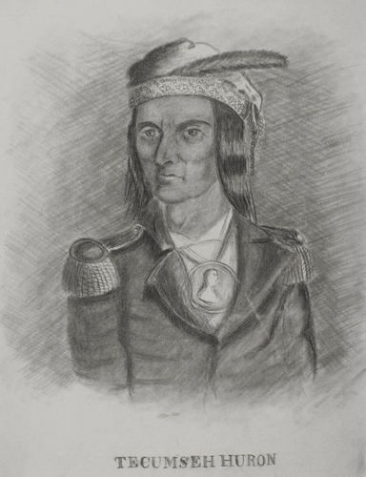
Zacharie Vincent, Tecumseh, Huron, n.d. Tecumseh was an important First Nations leader in the late 1700s and early 1800s, but he was not from the Huron community.

Slide 24
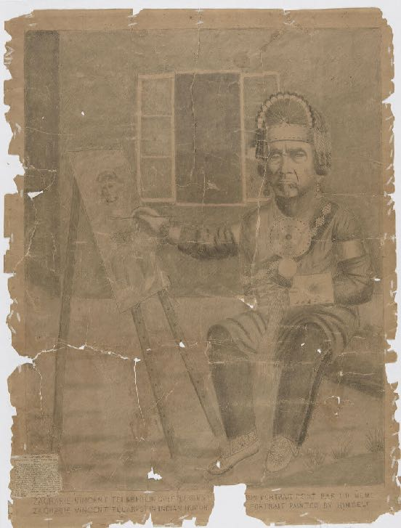
Zacharie Vincent, Huron Chief Zacharie Vincent Telariolin Painting a Self-Portrait, c.1875. Here Vincent shows himself as both a chief and an artist, two important parts of his identity.

Slide 25
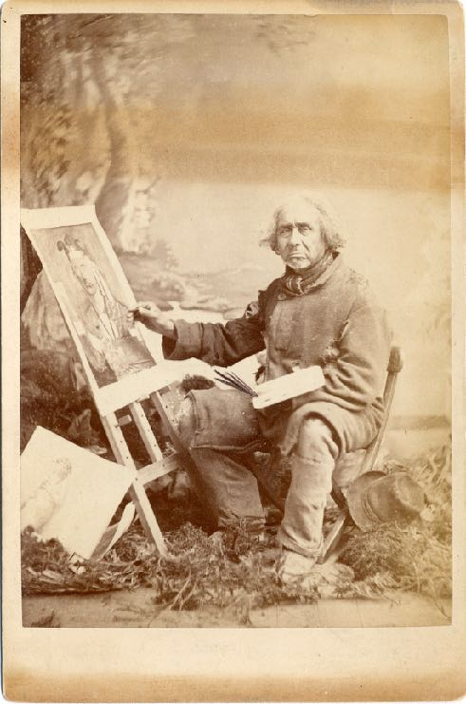
Zacharie Vincent seated at his easel, at work on a self-portrait, c.1875–78.

Slide 26
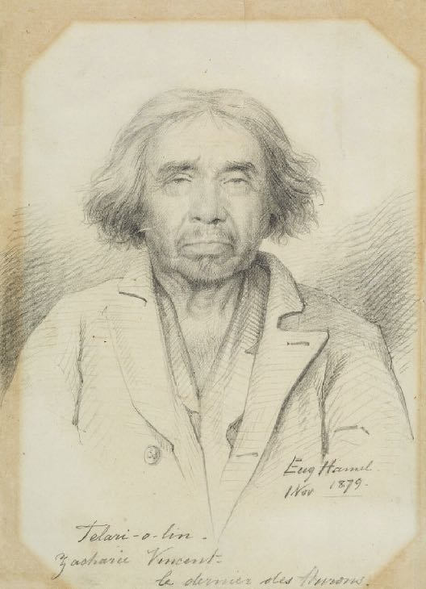
Eugène Hamel, Telari-o-lin, the Last of the Hurons of Lorette, 1879. This work is a sketch made in preparation for a painting.

