Slide 2
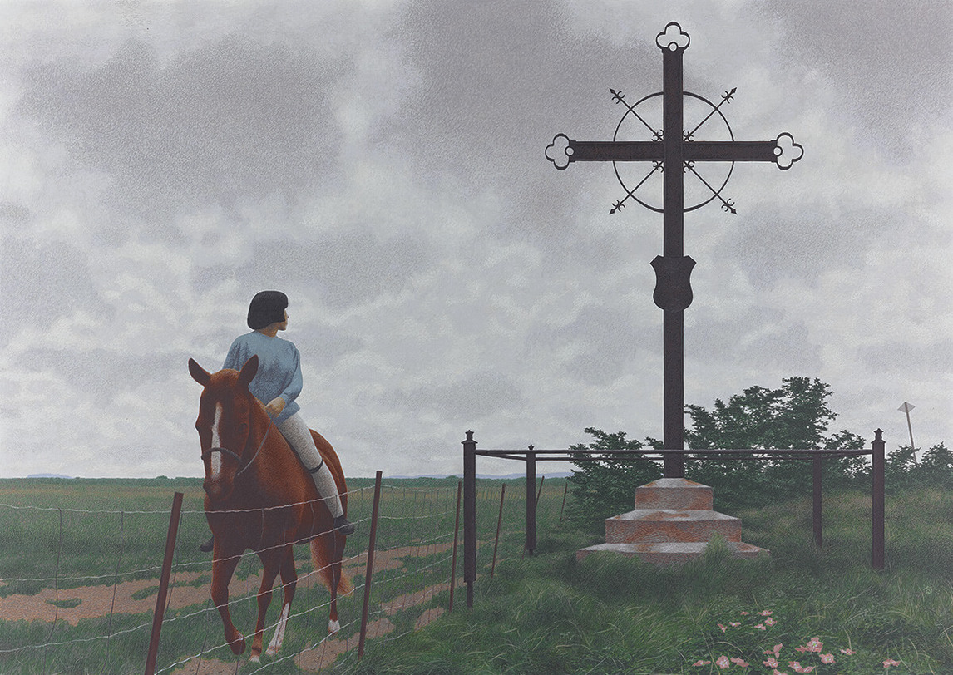
Alex Colville, French Cross, 1988. In this painting, a rider has stopped to look at the Acadian Deportation Cross at Grand Pré, Nova Scotia.

Slide 3
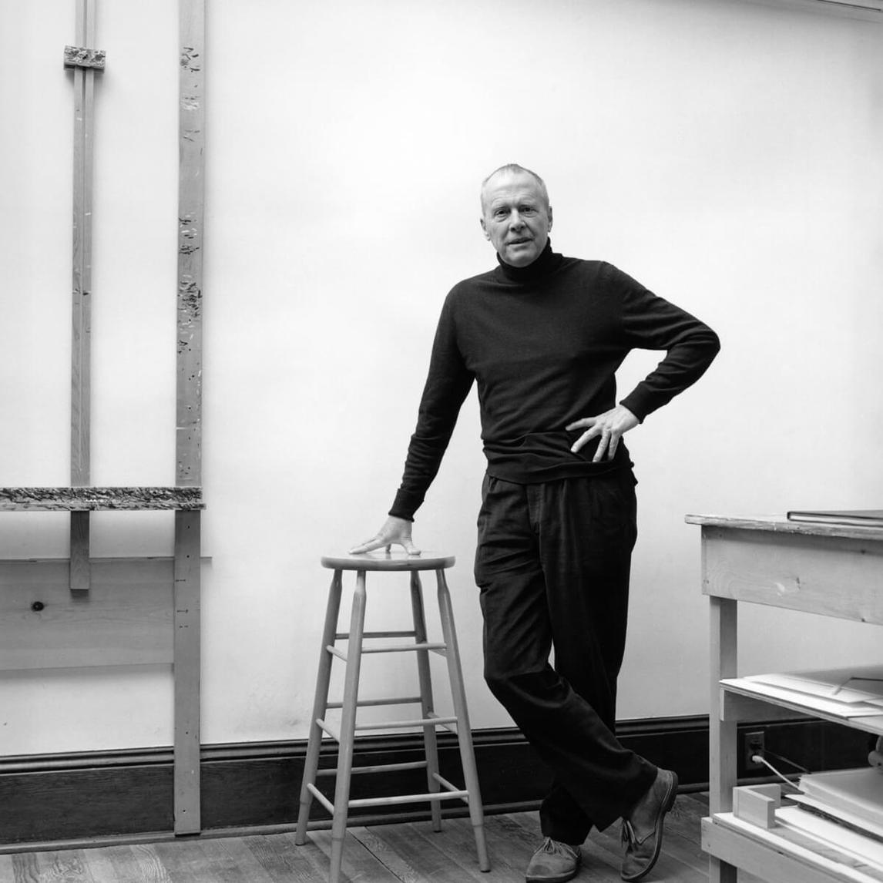
Alex Colville, C.C. (Companion, Order of Canada), 1986.

Slide 4
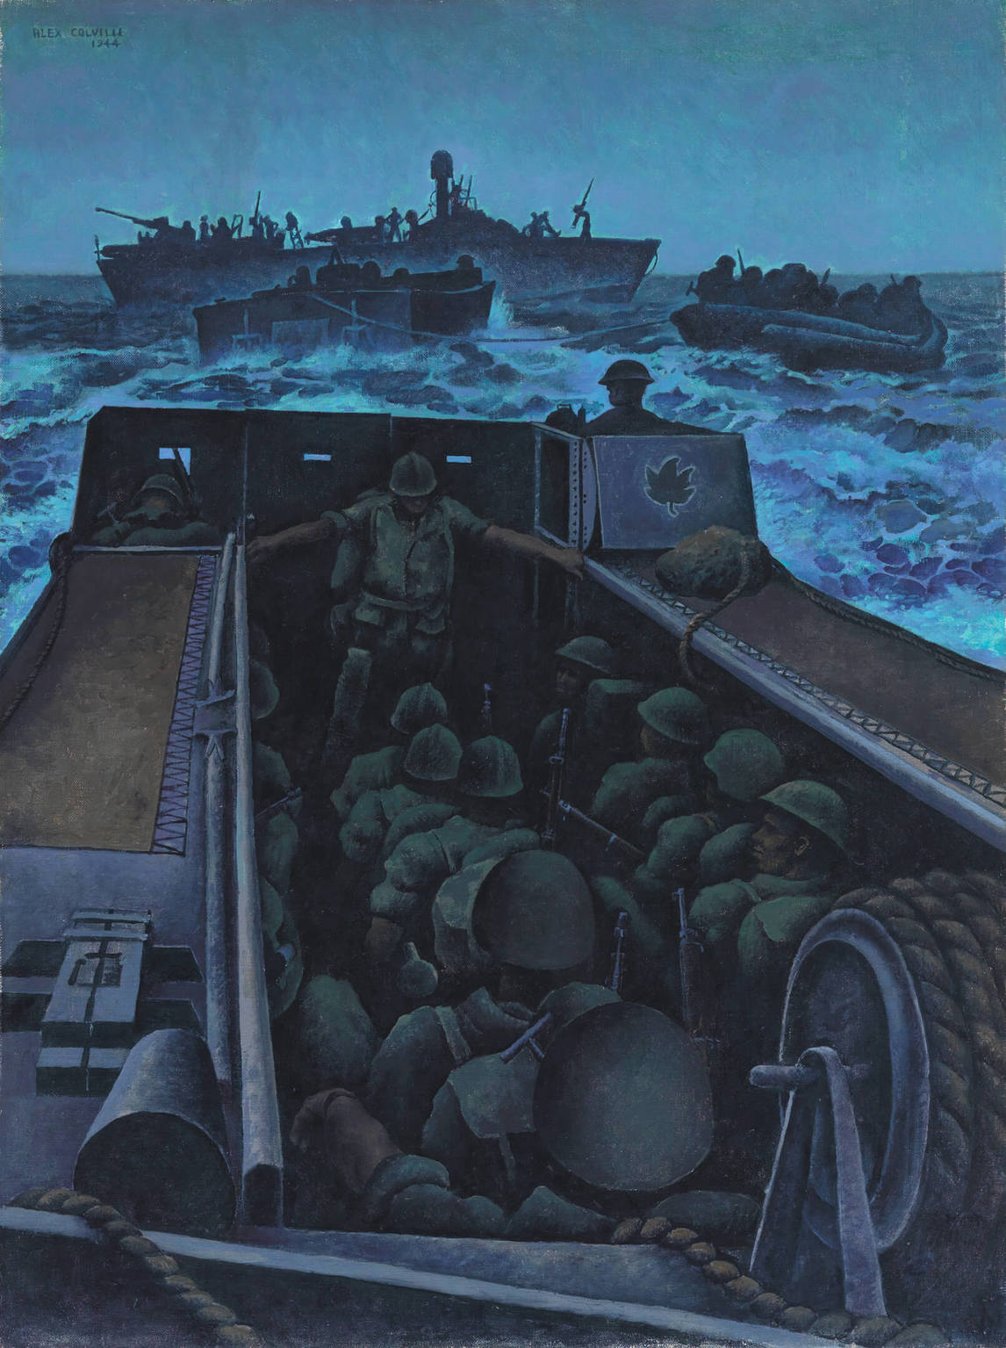
Alex Colville, Landing Craft Assault Off Southern France, 1944. After the D-Day invasion, the allied forces sent troops to southern France. Colville was stationed on one of the ships.

Slide 5
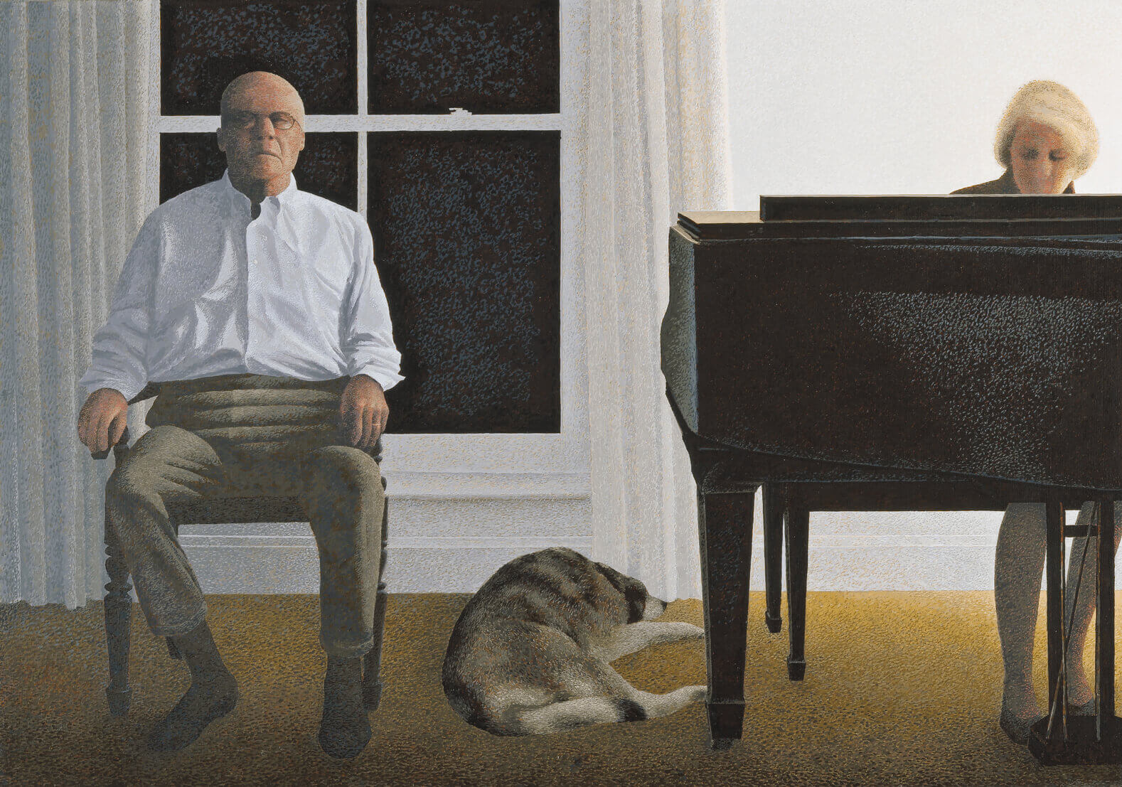
Alex Colville, Living Room, 1999–2000. This work is one of Colville’s last paintings.

Slide 6
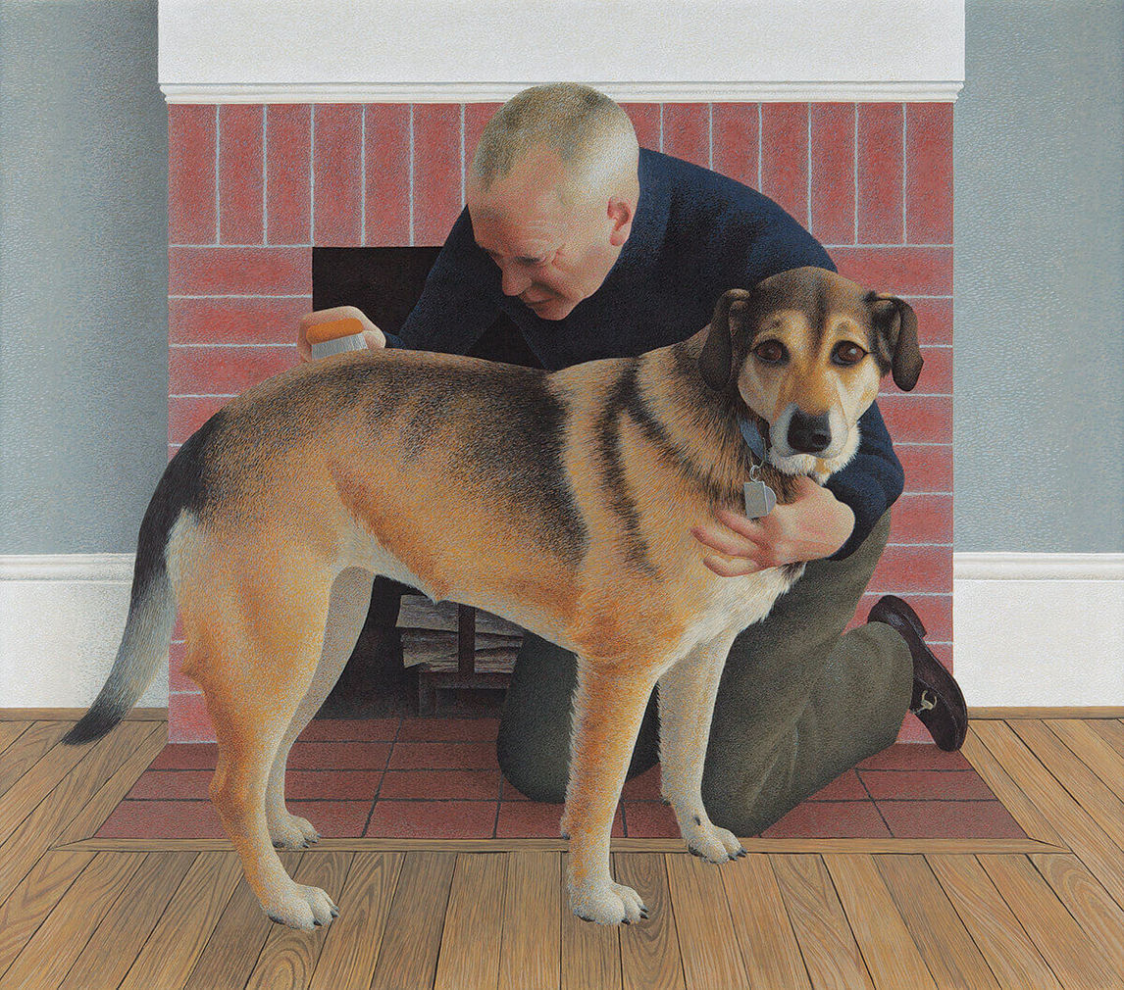
Alex Colville, Dog and Groom, 1991. Family dogs are important figures in many of Colville’s paintings.

Slide 7
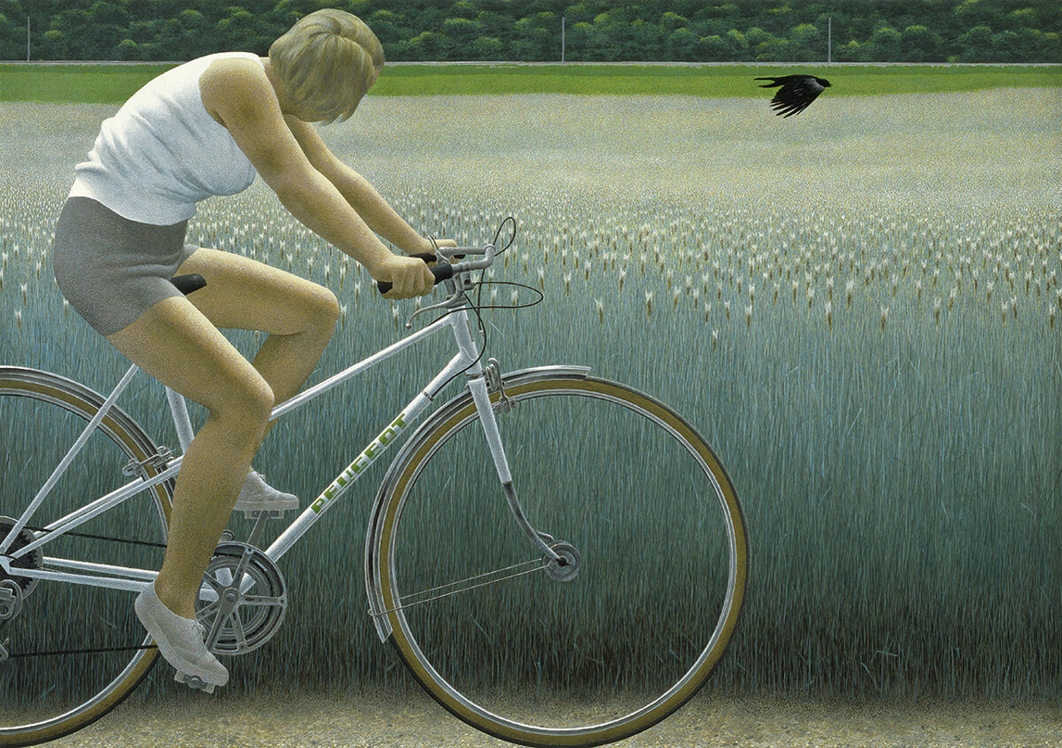
Alex Colville, Cyclist and Crow, 1981. In this scene, the woman appears to look towards the crow flying nearby.

Slide 8
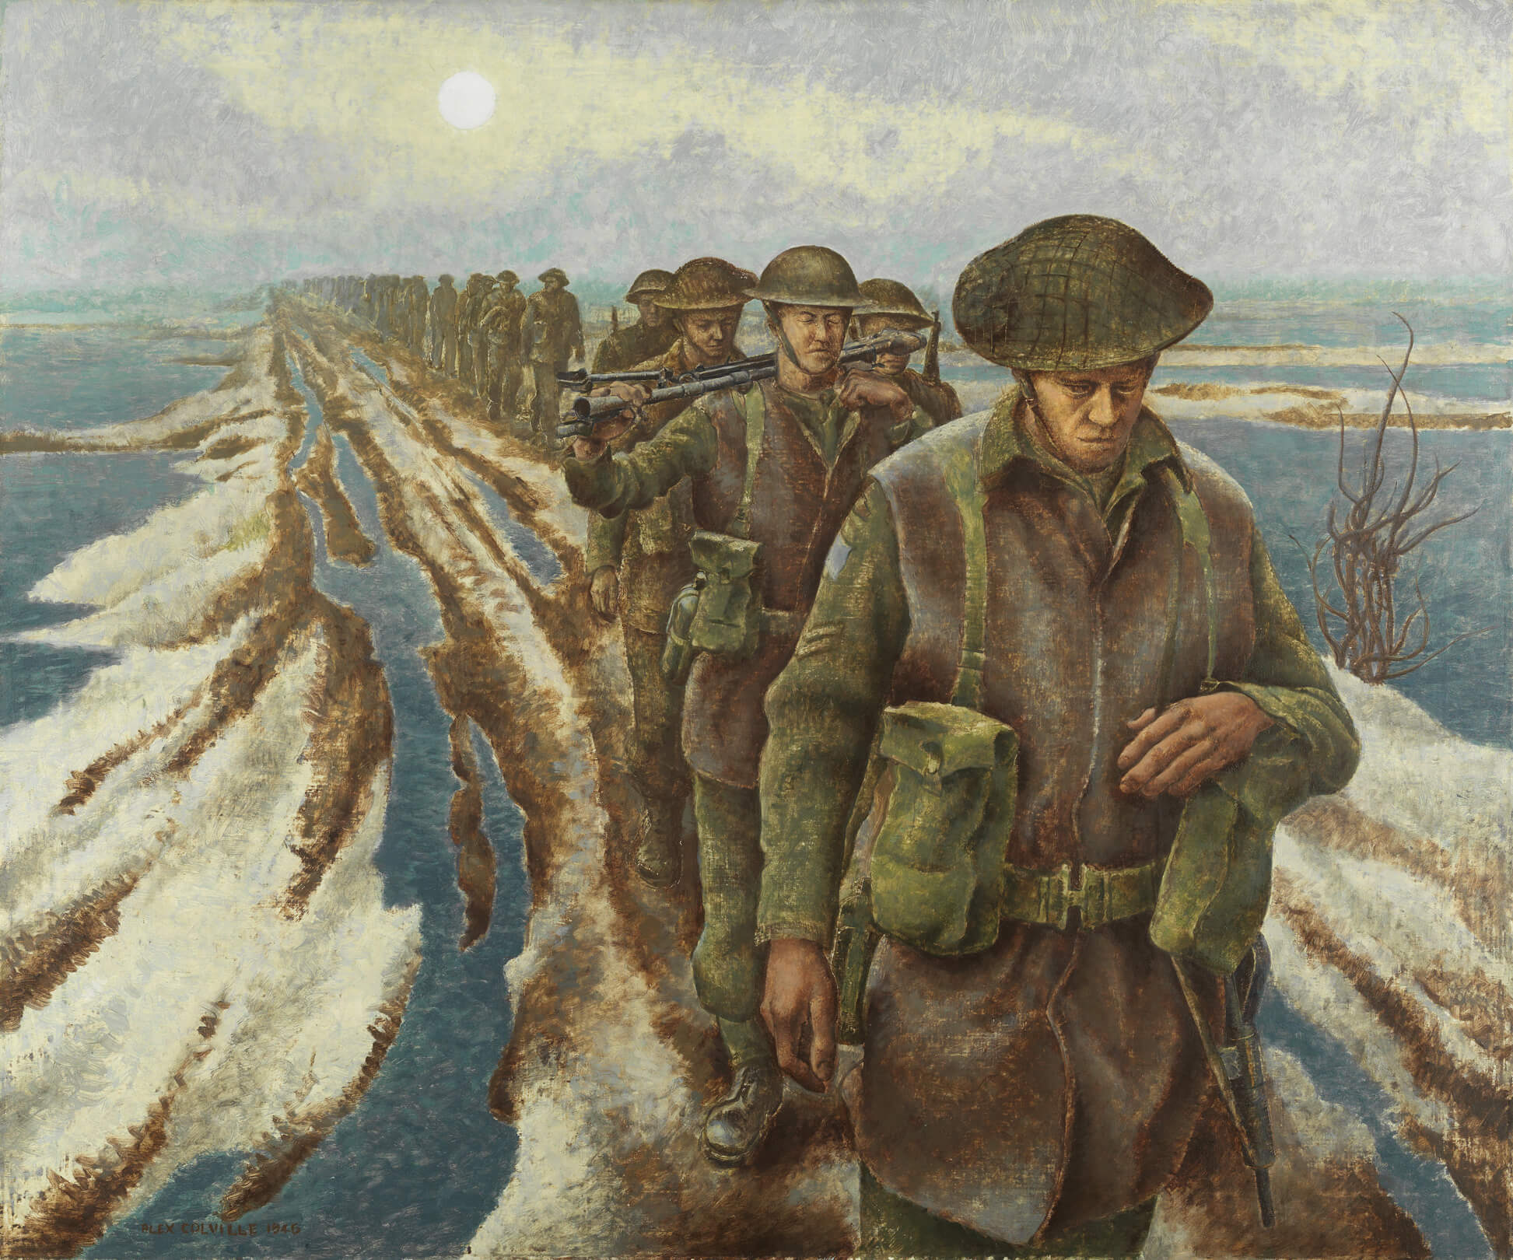
Alex Colville, Infantry, Near Nijmegen, Holland, 1946. As a war artist, Colville created hundreds of paintings, drawings, and watercolours.

Slide 9
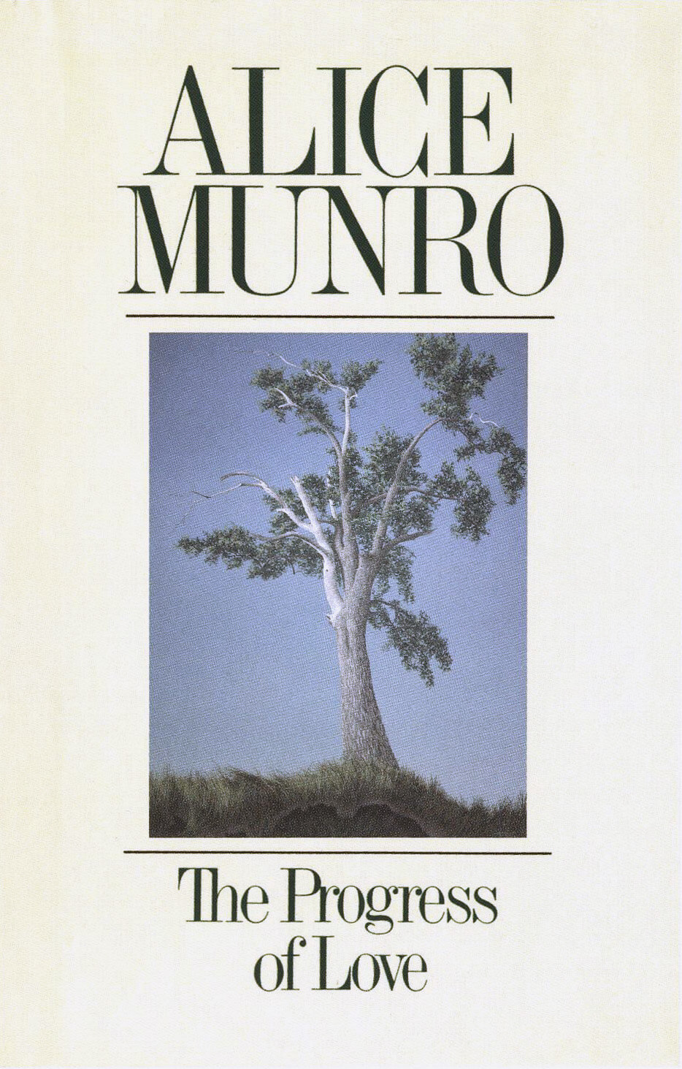
Cover of Alice Munro’s The Progress of Love (1986), featuring Alex Colville’s painting Elm Tree at Horton Landing, 1956.

Slide 10
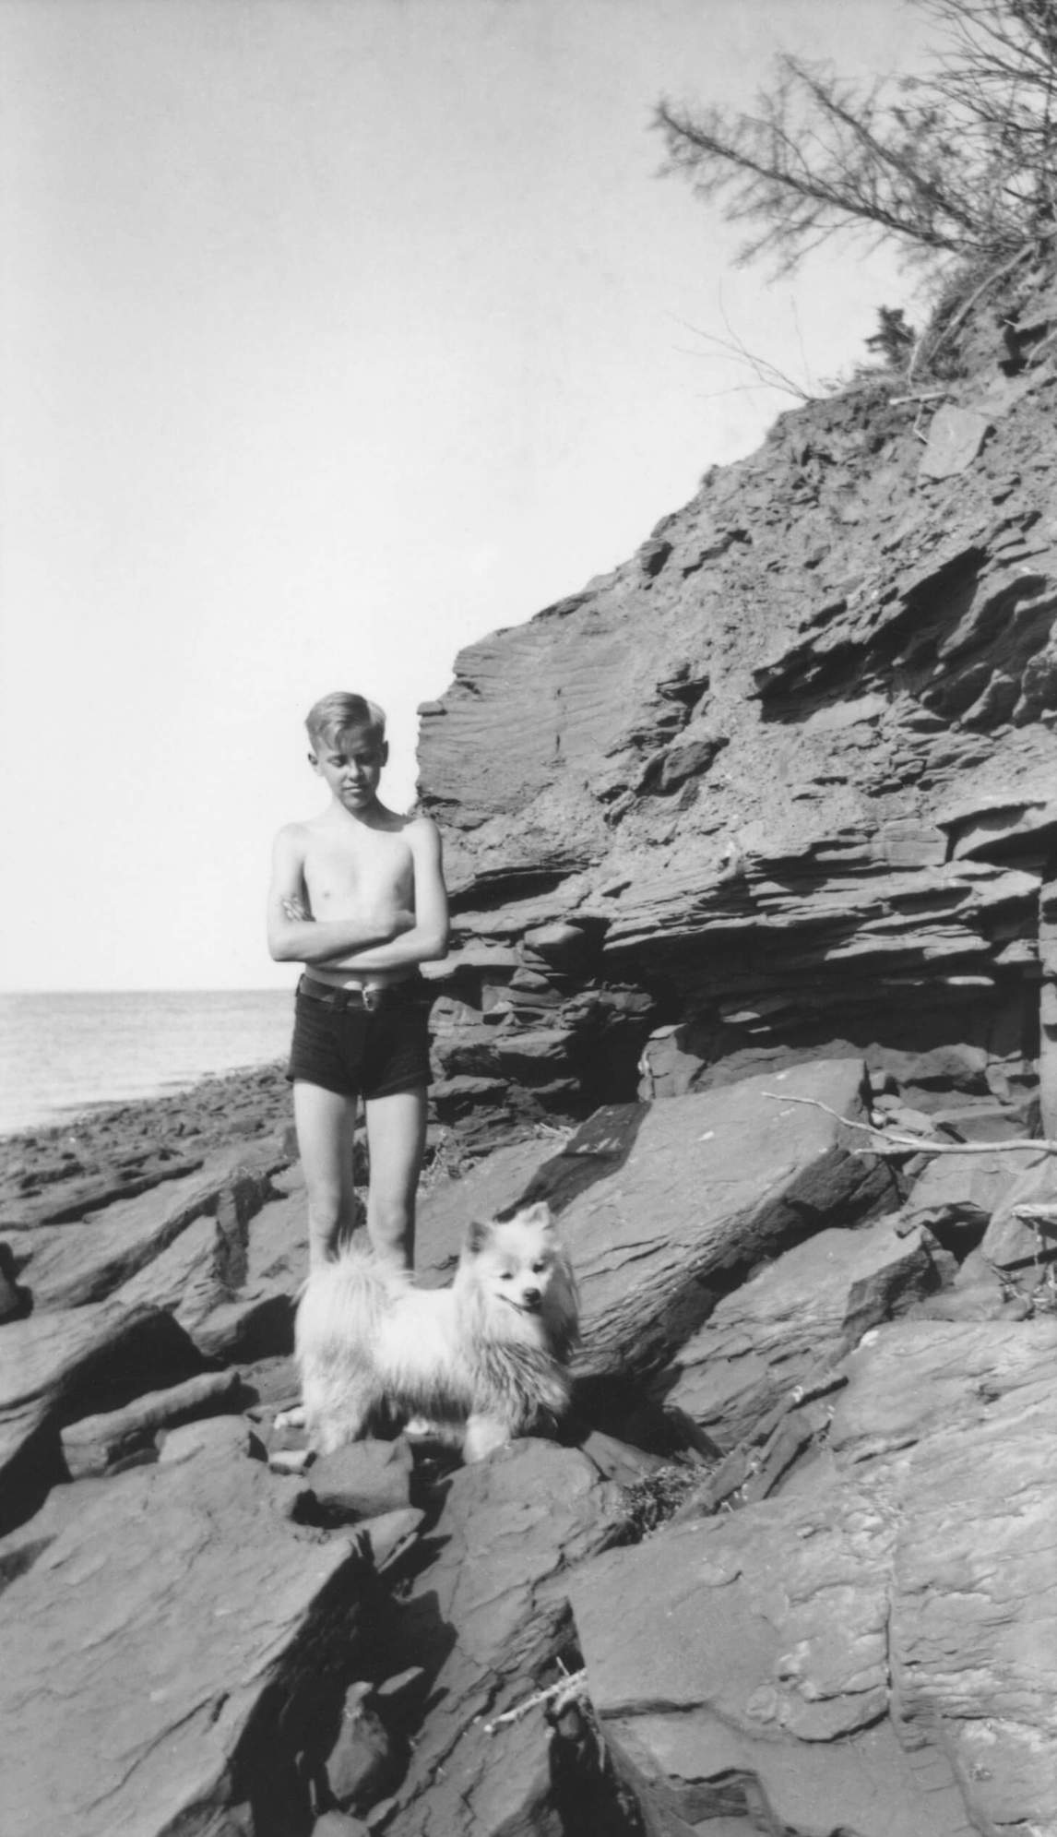
Alex Colville, age eleven, near Tidnish, Nova Scotia, where his family had a summer cottage, c.1931.

Slide 11
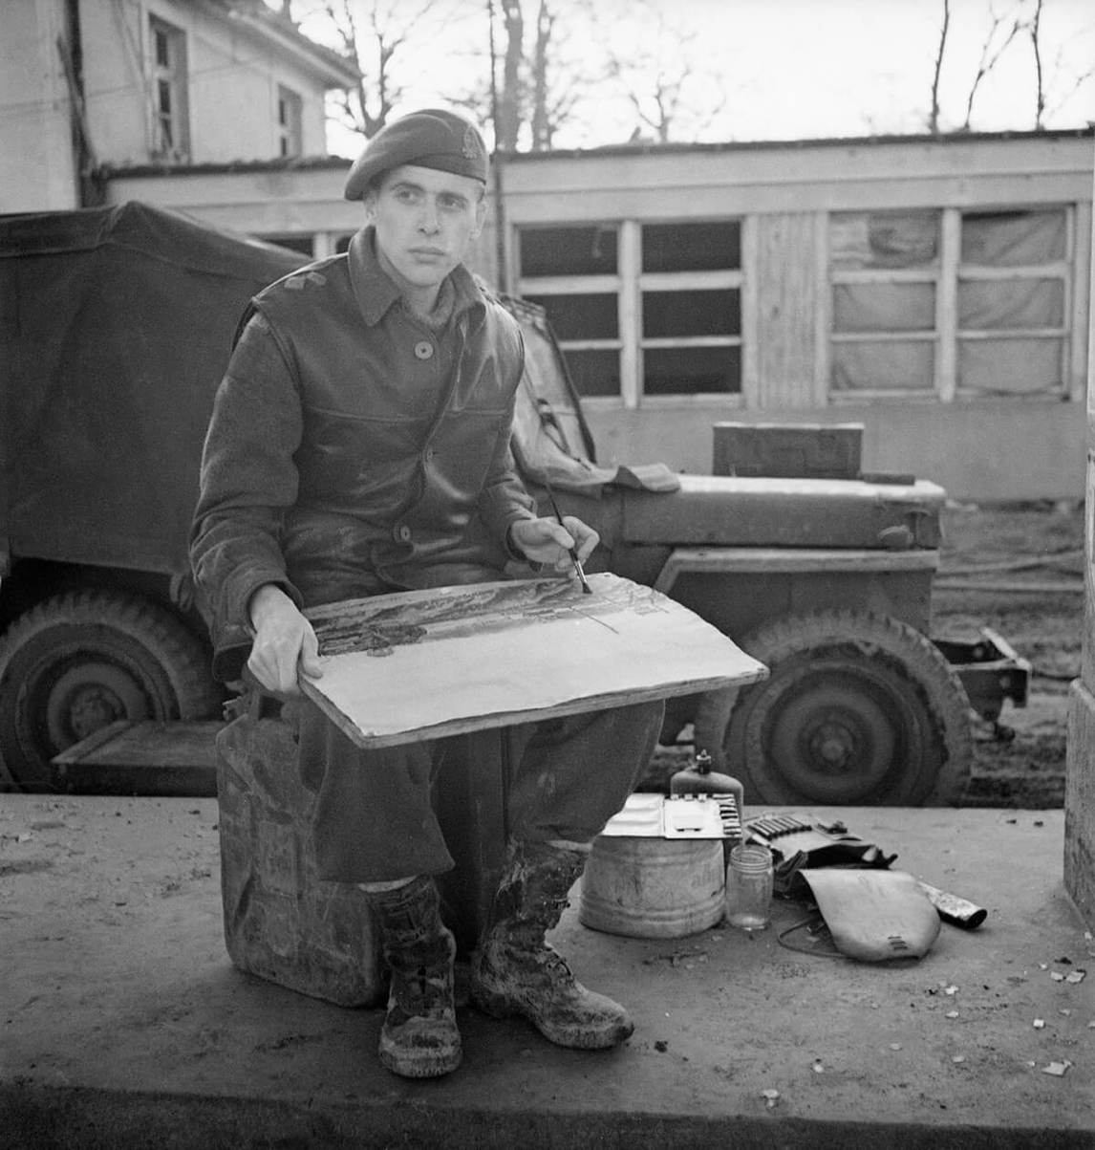
Lieutenant D. Alex Colville, war artist, Third Canadian Infantry Division, Germany, March 4, 1945.

Slide 12
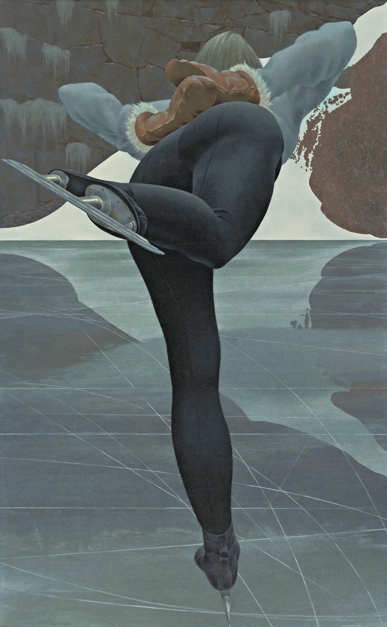
Alex Colville, Skater, 1964. Colville created this work shortly after he left Mount Allison.

Slide 13
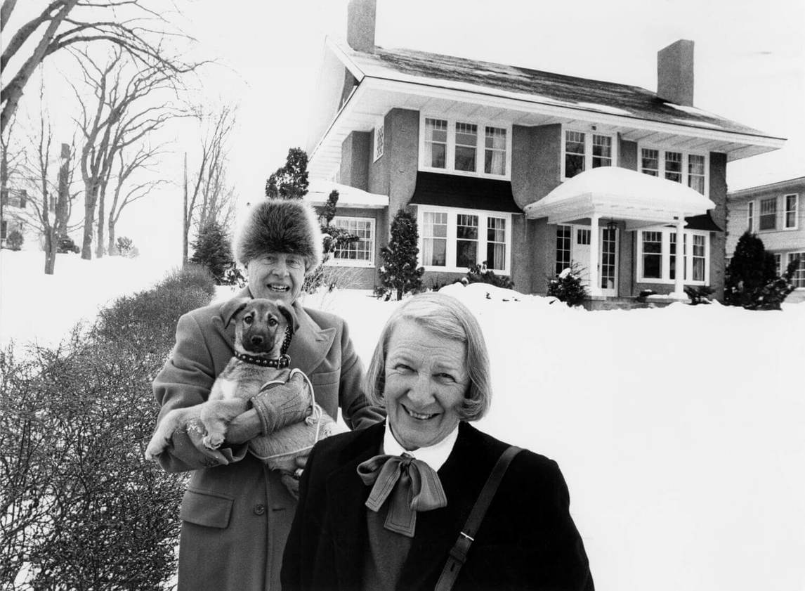
Alex and Rhoda Colville, with Min, outside their home in Wolfville, Nova Scotia, 1988.

Slide 14
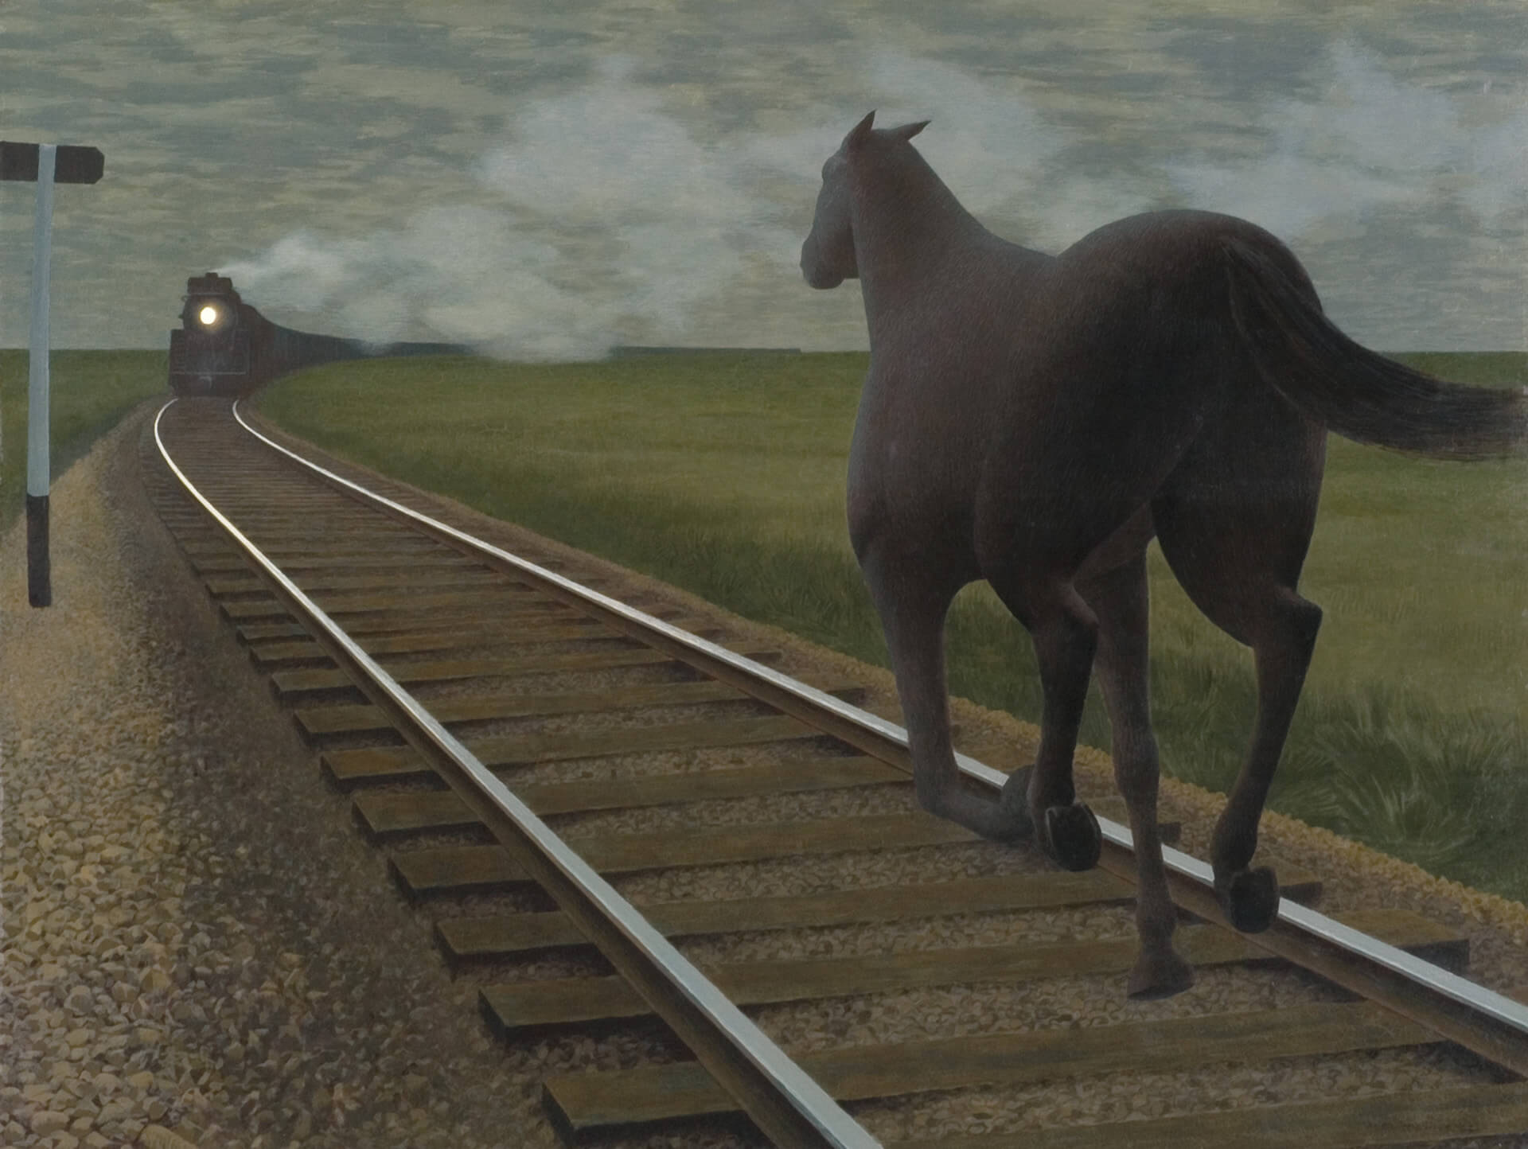
Learning Activity #1
Alex Colville, Horse and Train, 1954. This painting was inspired by a poem by South African writer Roy Campbell (1901–1957).

Slide 15
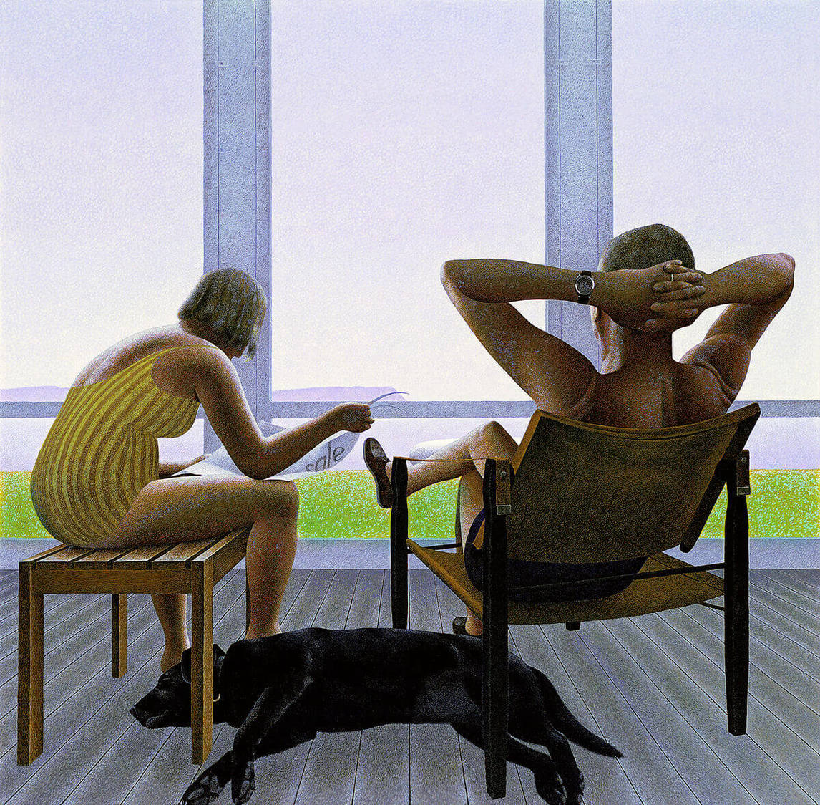
Learning Activity #1
Alex Colville, Verandah, 1983. Although Verandah depicts a casual moment, Colville would have planned the composition very carefully.

Slide 16
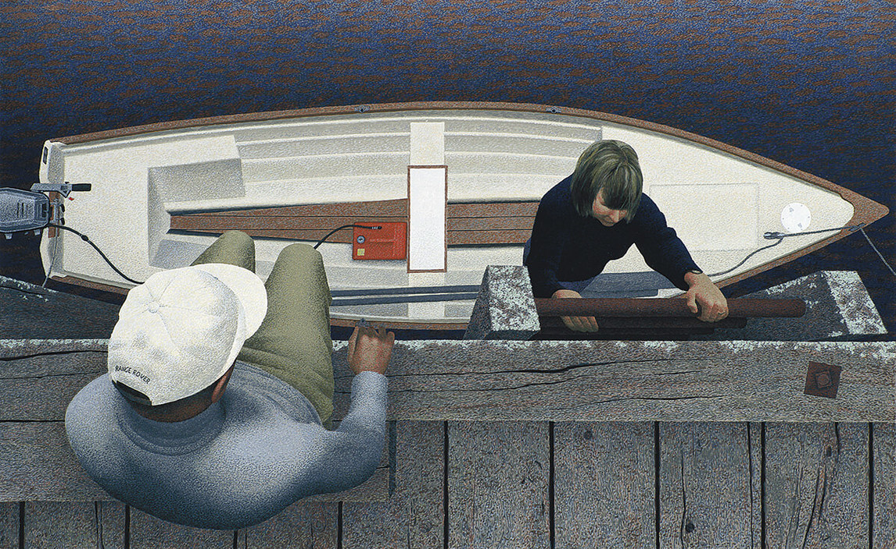
Learning Activity #1
Alex Colville, Embarkation, 1994. In this work the viewer sees the scene from above.

Slide 17
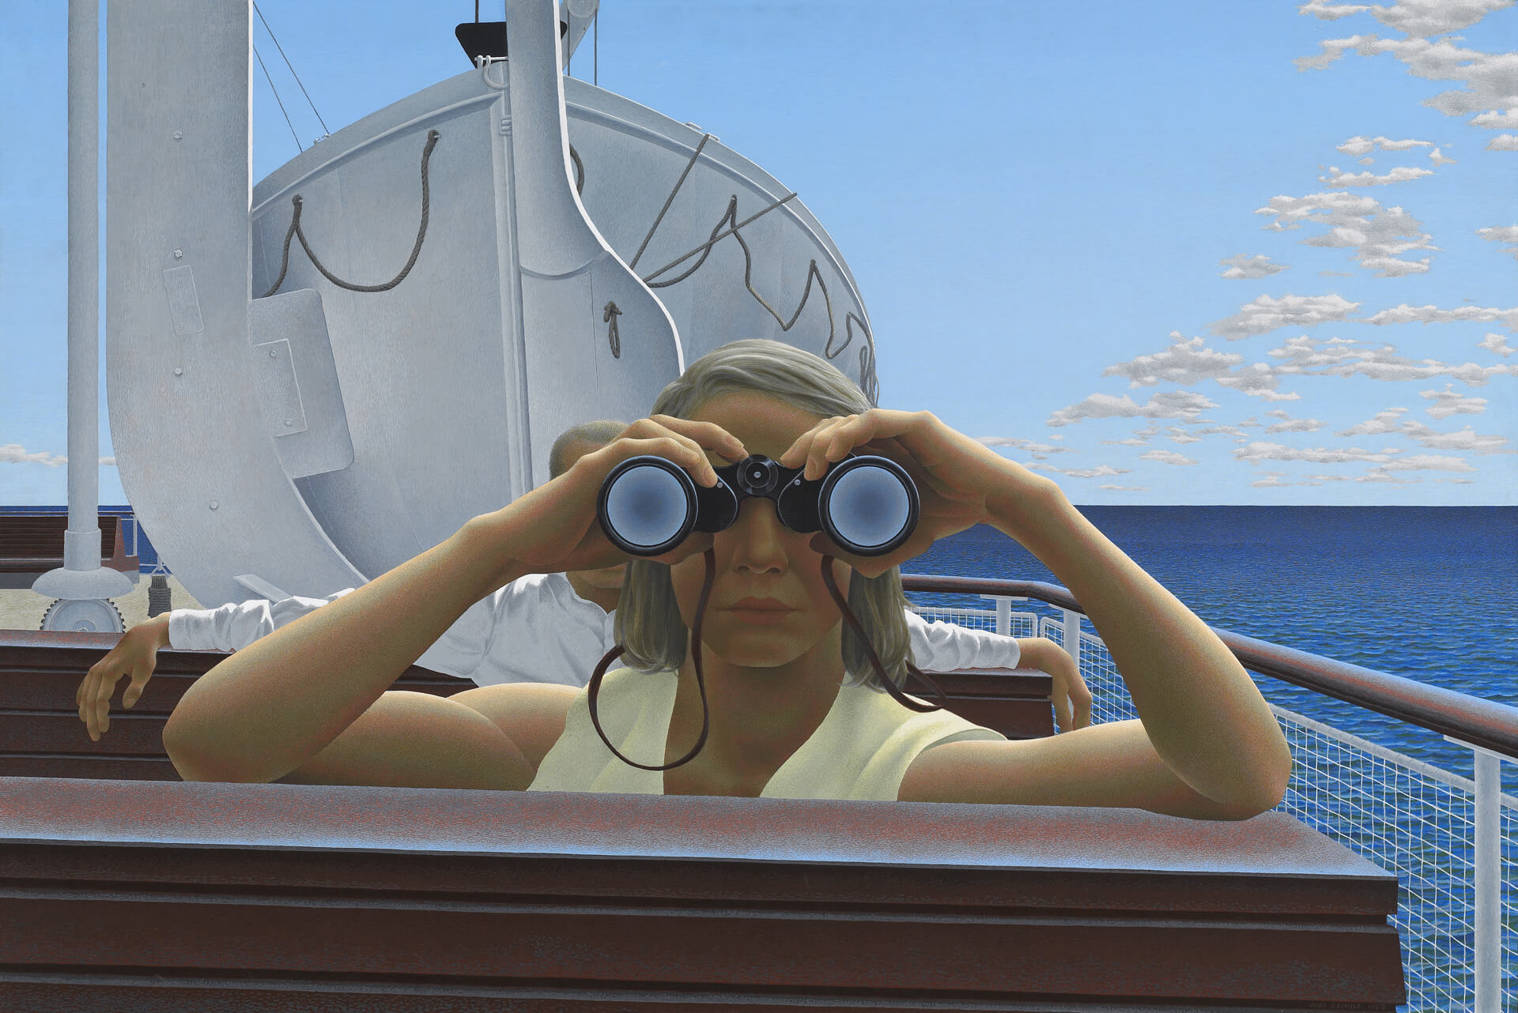
Learning Activity #1
Alex Colville, To Prince Edward Island, 1965. One of Colville’s most famous works, this painting shows a scene on the top deck of a P.E.I. ferry.

Slide 18
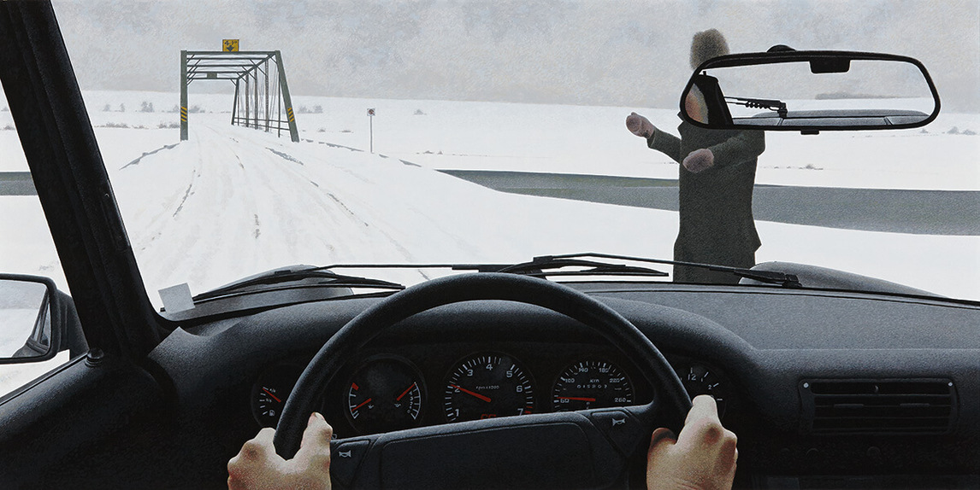
Learning Activity #1
Alex Colville, Traveller, 1992. In this painting a curving diagonal line leads to the horizon.

Slide 19
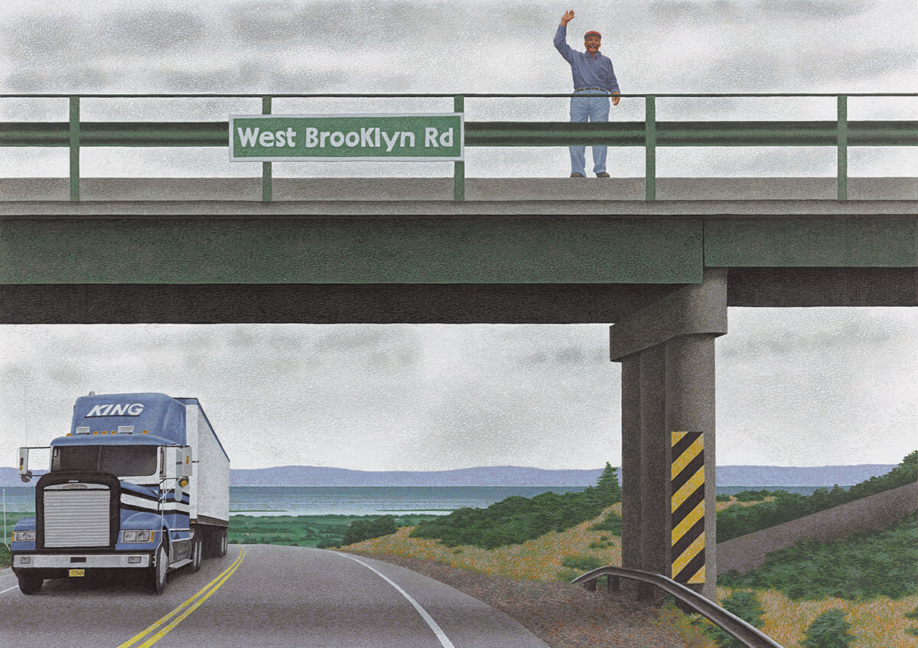
Alex Colville, West Brooklyn Road, 1996. West Brooklyn Road represents a scene on Nova Scotia Highway 101 near Wolfville, where Colville lived.

Slide 20
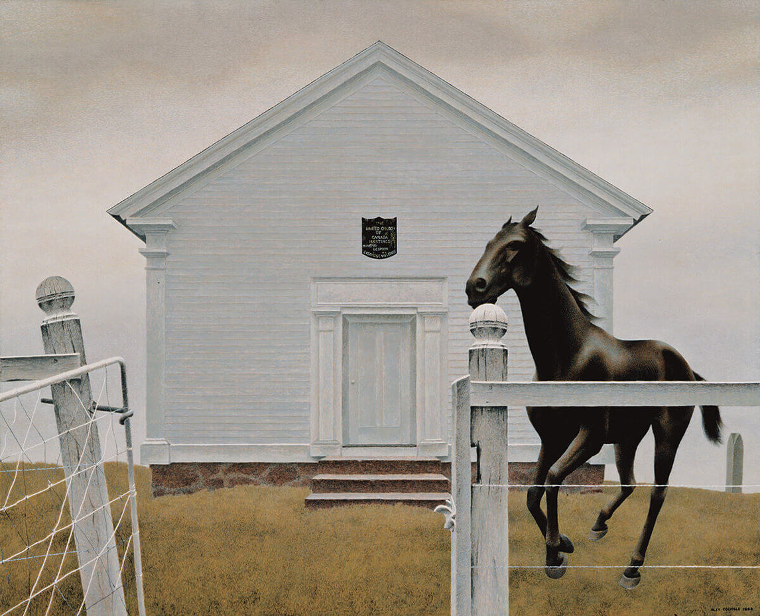
Learning Activity #2
Alex Colville, Church and Horse, 1964. This painting became one of Colville’s most famous works.

Slide 21
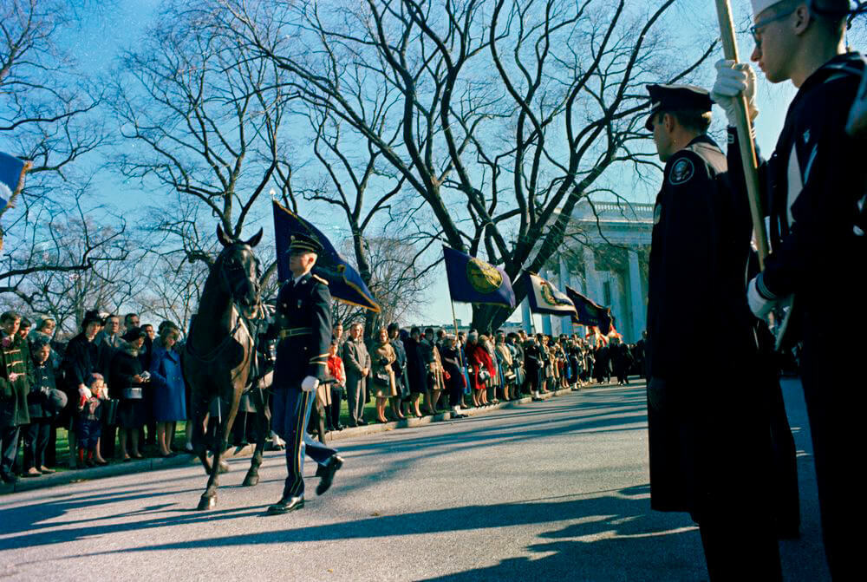
Learning Activity #2
Riderless Horse in President John F. Kennedy’s Funeral Procession to St. Matthew’s Cathedral, November 25, 1963.

Slide 22
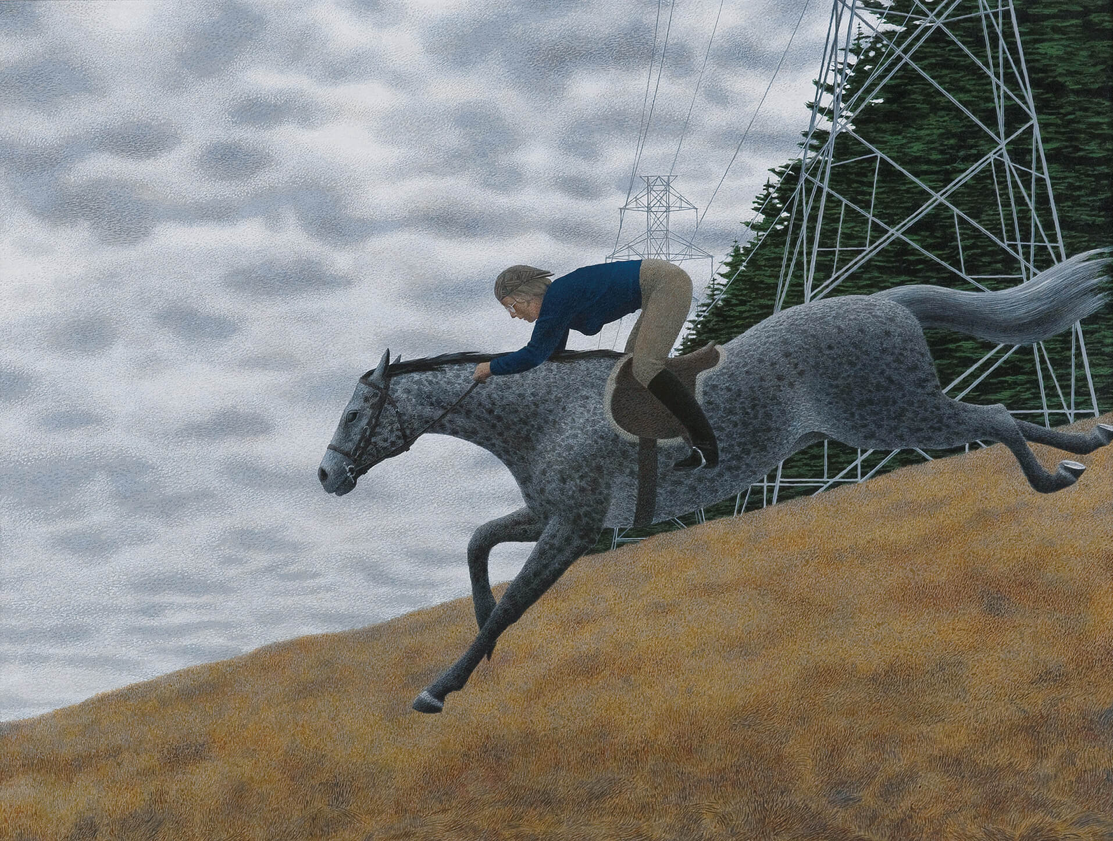
Alex Colville, Horse and Girl, 1984. Horses appear in several of Colville’s paintings.

Slide 23
Alex Colville, To Prince Edward Island, 1965. A scene in Wes Anderson’s Moonrise Kingdom (2010) was inspired by this painting.

Slide 24
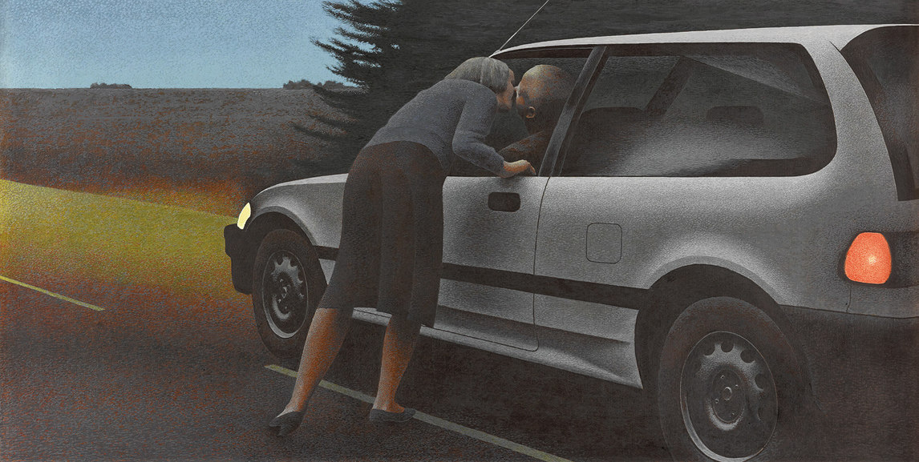
Alex Colville, Kiss with Honda, 1989. Here a couple exchanges a kiss—perhaps in greeting, or perhaps in farewell.

Slide 25
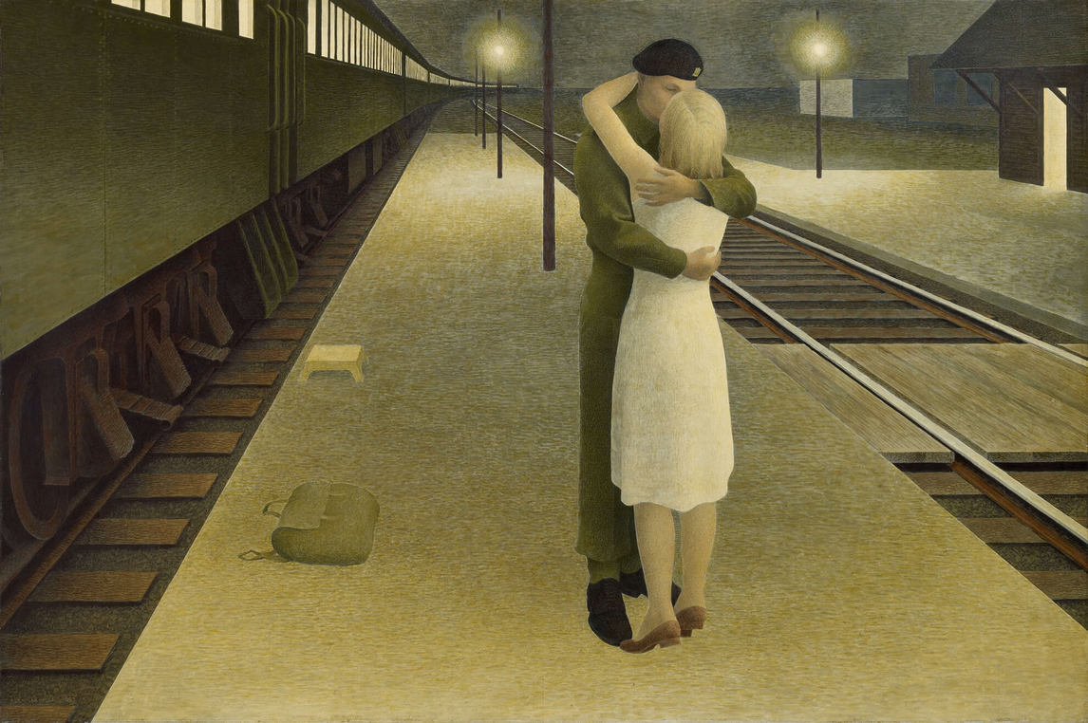
Culminating Task
Alex Colville, Soldier and Girl at Station, 1953, glazed tempera on hardboard, 40.6 x 61 cm. The Thomson Collection at the Art Gallery of Ontario, Toronto (103990). © A.C. Fine Art Inc.

Slide 26
Culminating Task
Alex Colville, Horse and Train, 1954.

Slide 27
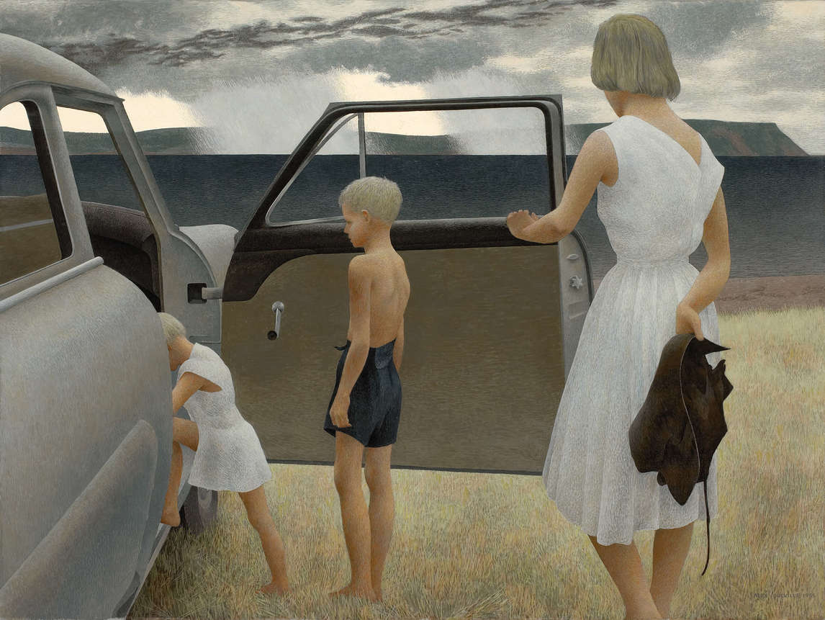
Culminating Task
Alex Colville, Family and Rainstorm, 1955.

Slide 28
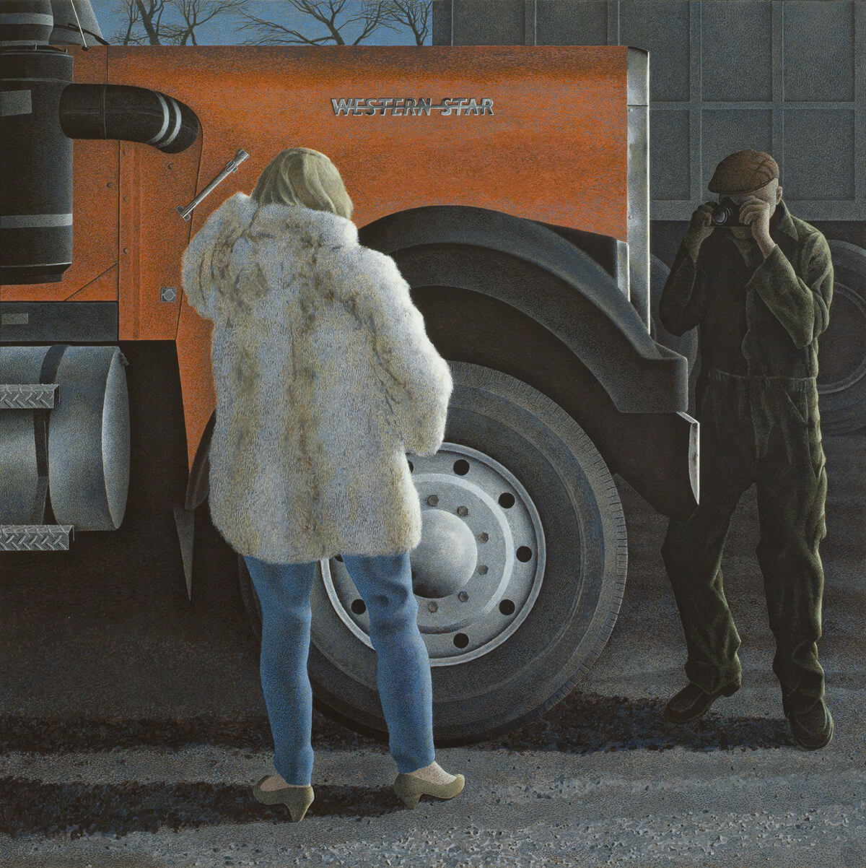
Culminating Task
Alex Colville, Western Star, 1985.

Slide 29
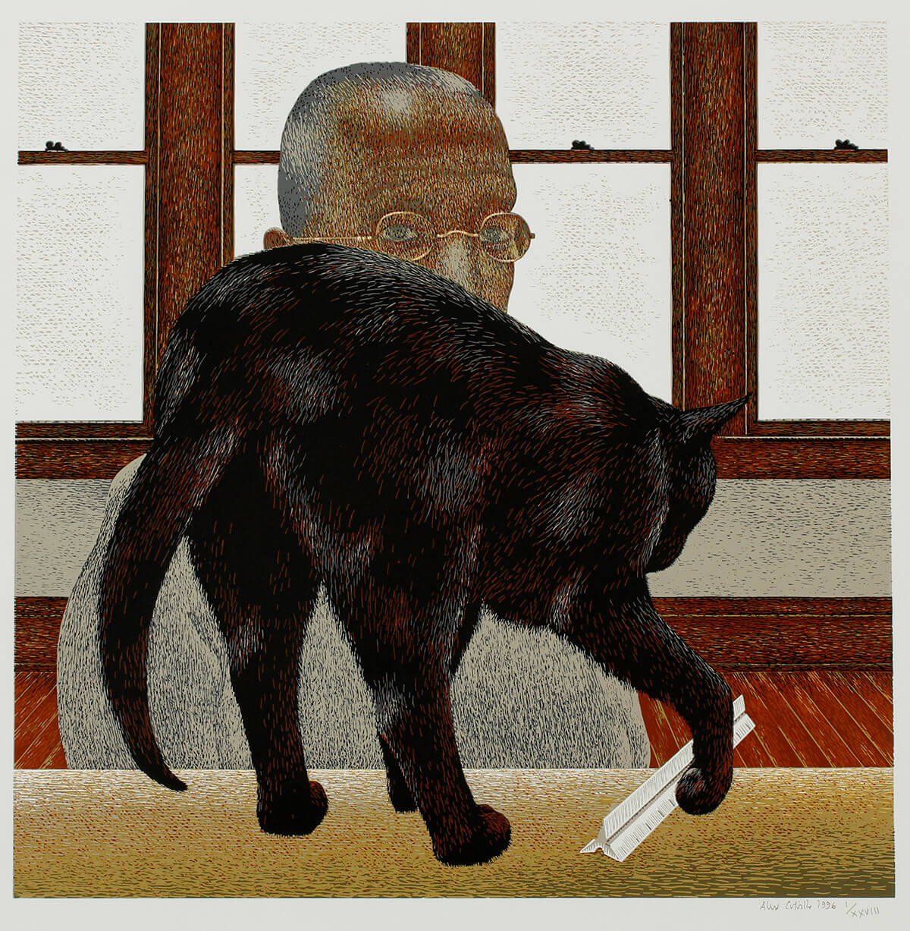
Alex Colville, Black Cat, 1996. In this print Colville’s cat appears to be playing with a ruler.

Slide 30
Alex Colville, To Prince Edward Island, 1965. Looking through her binoculars, the woman in this painting seems to look right through the viewer.

Slide 31
Alex Colville, West Brooklyn Road, 1996. Colville painted several scenes in which the viewer seems to share the view of a car driver or passenger.

Slide 32
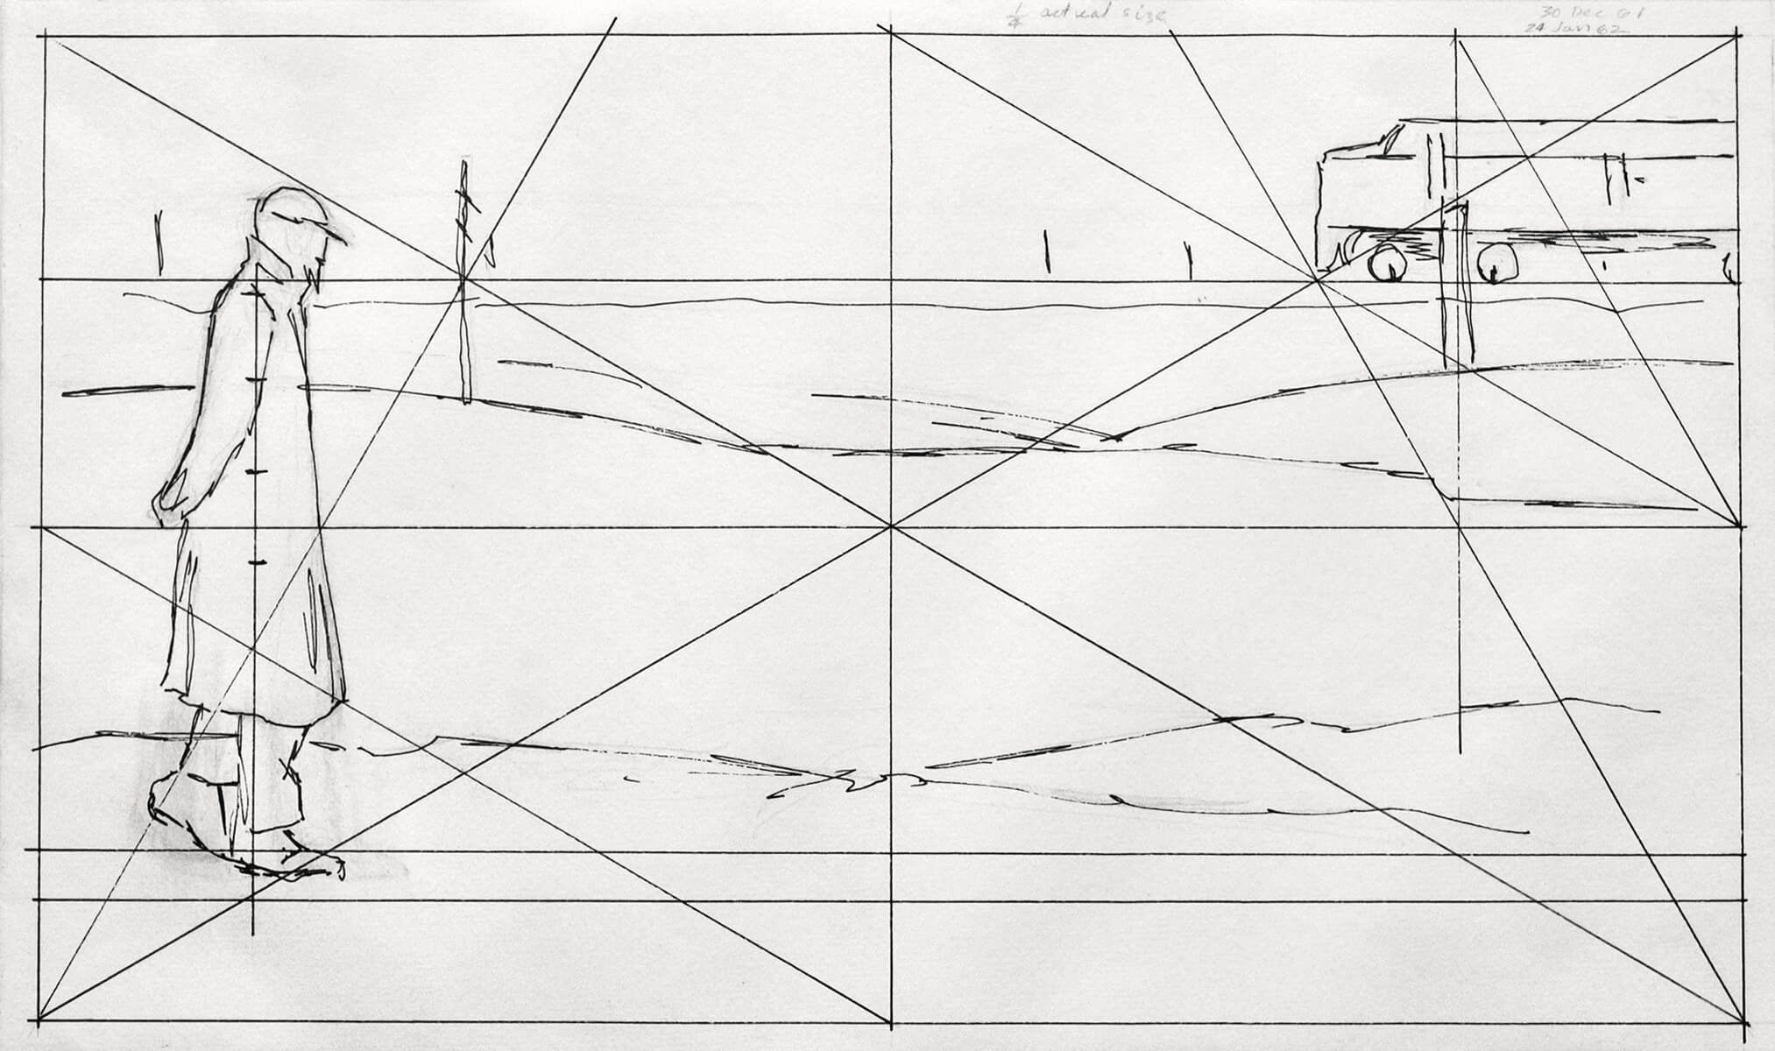
Alex Colville, Sketch for Ocean Limited, c.1961. For his painting Ocean Limited, Colville created numerous sketches to work out the underlying geometry.

Slide 33
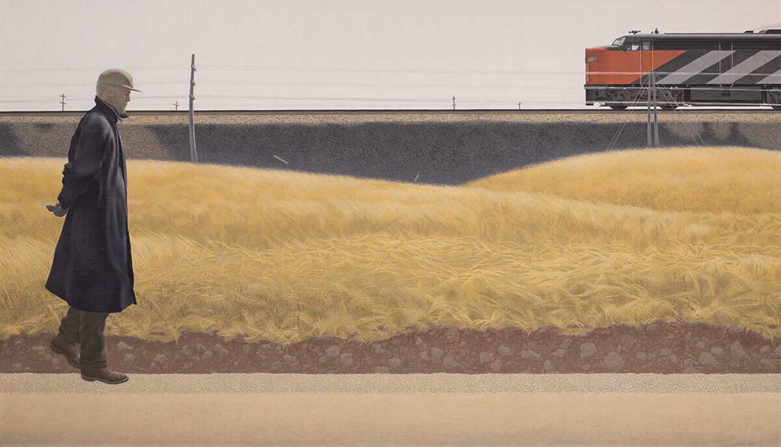
Alex Colville, Ocean Limited, 1962. Every element of this composition, from the figure to the telephone poles, was carefully placed.

Slide 34
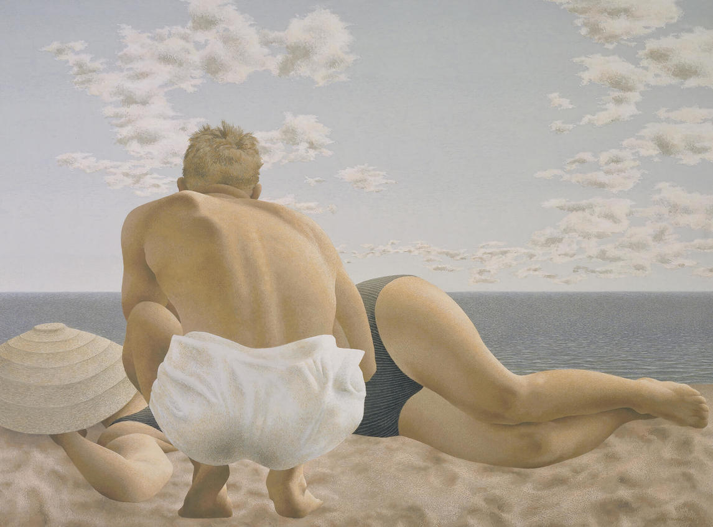
Alex Colville, Couple on the Beach, 1957. Couple on the Beach is one of Colville’s early works, painted only six years after his first solo show.

Slide 35
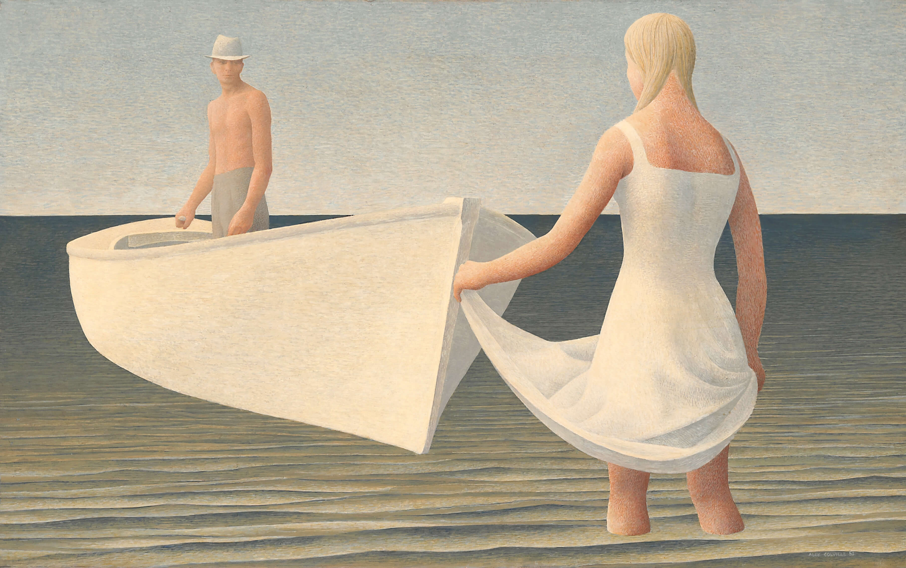
Alex Colville, Woman, Man, and Boat, 1952. In this painting the relationship between the figures is ambiguous.

