Slide 2
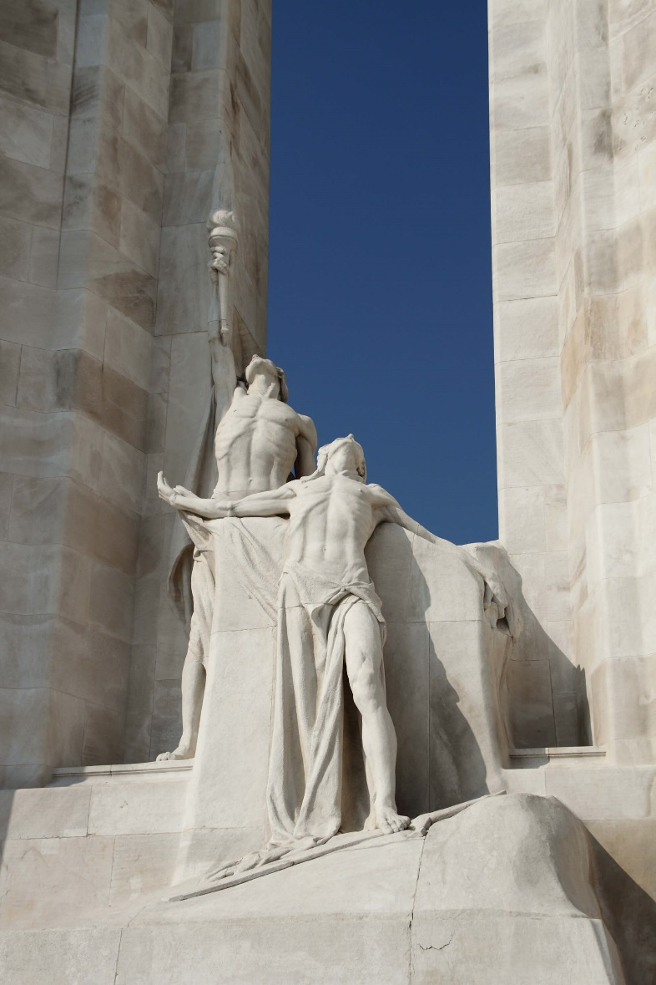
Walter S. Allward, Vimy Memorial (detail of The Spirit of Sacrifice and The Passing of the Torch), 1921–36. Allward’s monument at Vimy includes twenty sculpted figures.

Slide 3
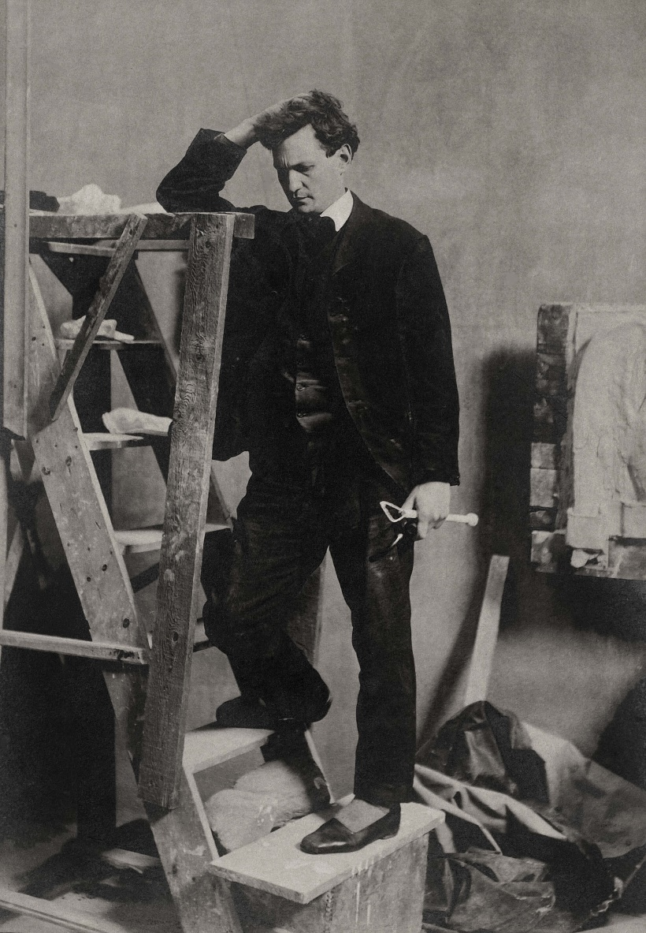
Walter S. Allward, c.1909.

Slide 4
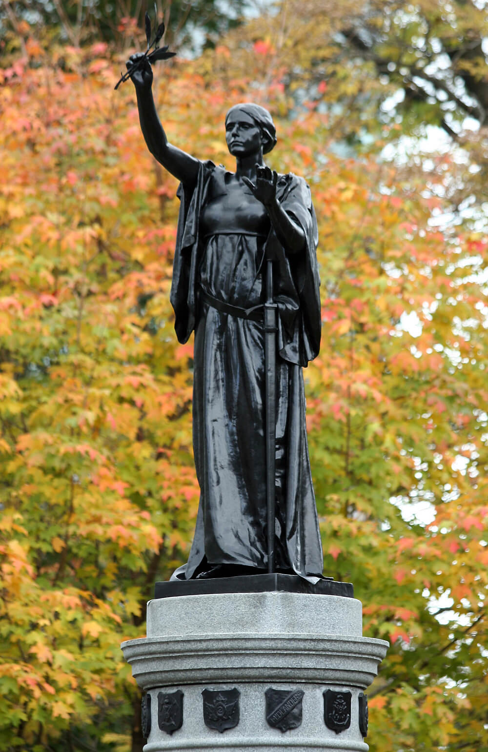
Walter S. Allward, Northwest Rebellion Monument (detail), 1894–96. This memorial features a sculpture of Peace.

Slide 5
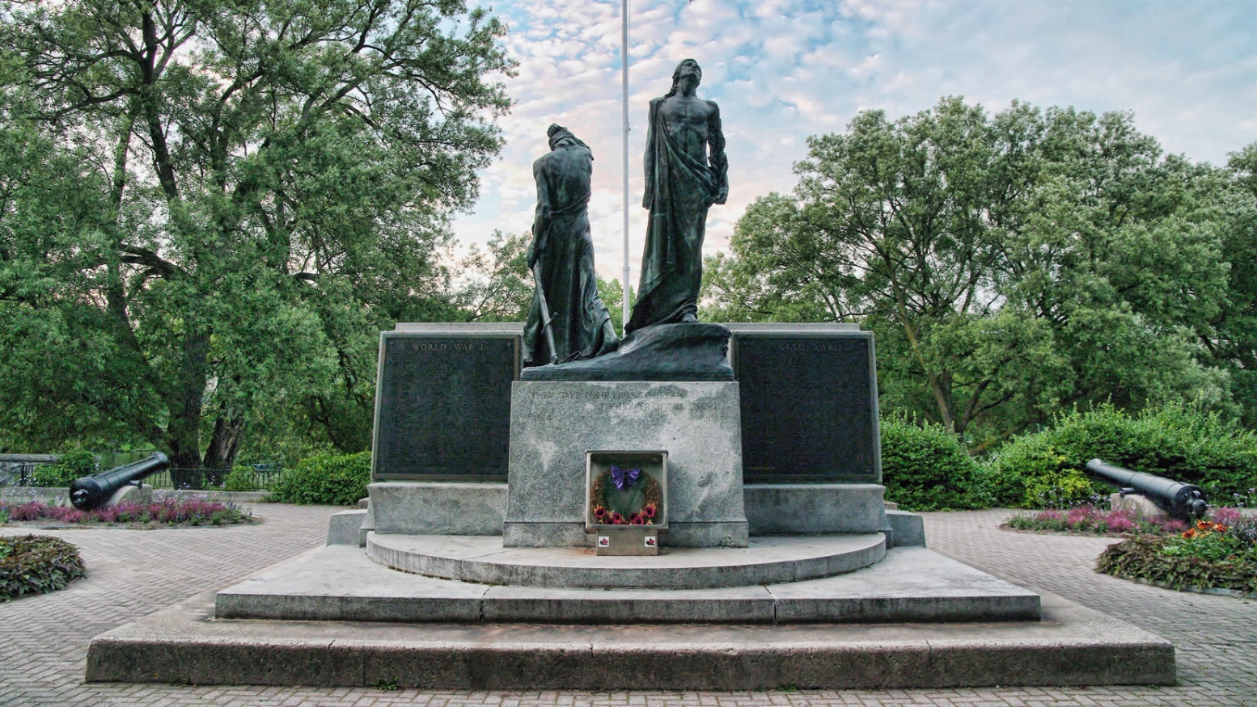
Walter S. Allward, Stratford War Memorial, 1919–22. This monument is one of hundreds built by local communities after the First World War.

Slide 6
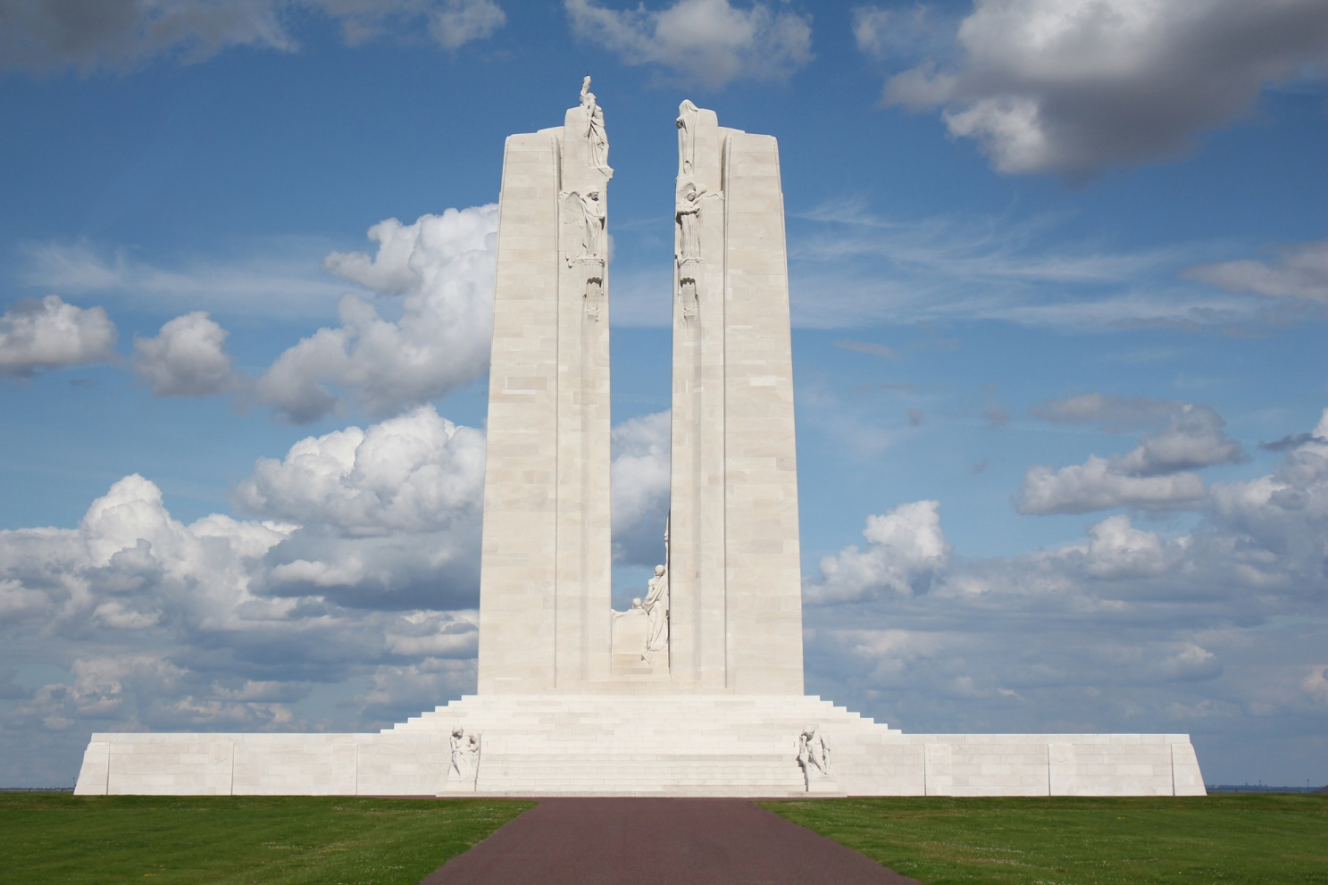
Walter S. Allward, Vimy Memorial, 1921–36. This monument marks the site of one of the most famous battles Canadians participated in during the First World War.

Slide 7
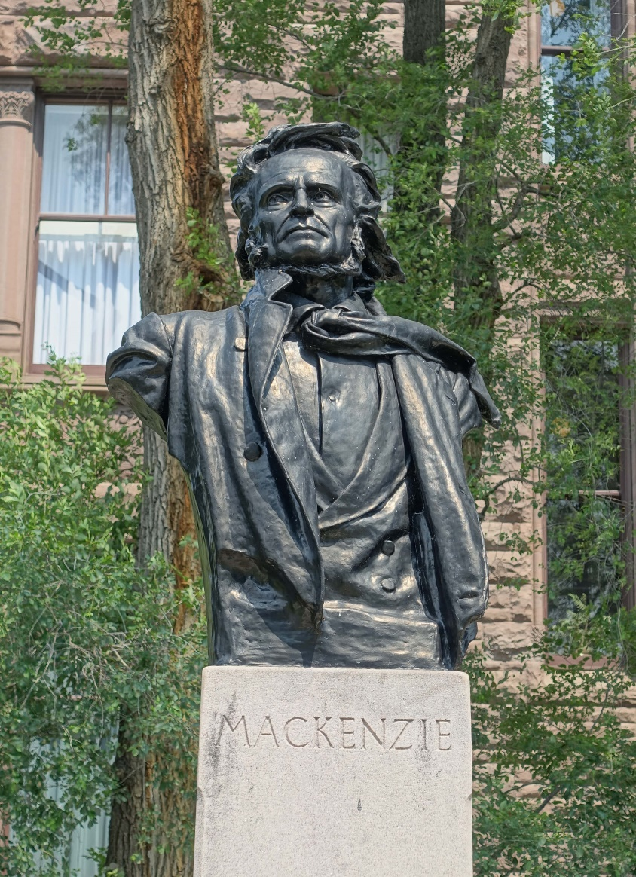
Walter S. Allward, William Lyon Mackenzie
Memorial (detail), 1936–40. Allward’s
final memorial features this dramatic bronze
bust of the man it commemorates.

Slide 8
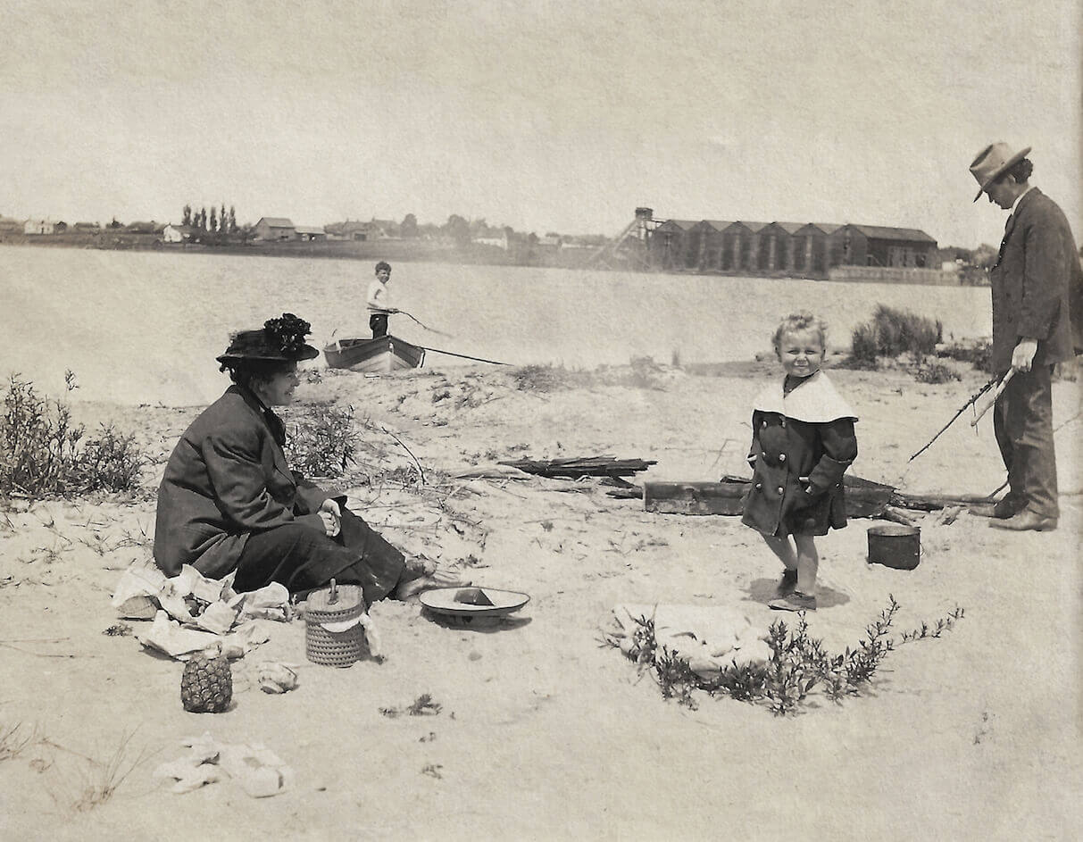
Walter S. Allward at the beach with his wife, Margaret, and his
two children, Hugh and Don, n.d.

Slide 9
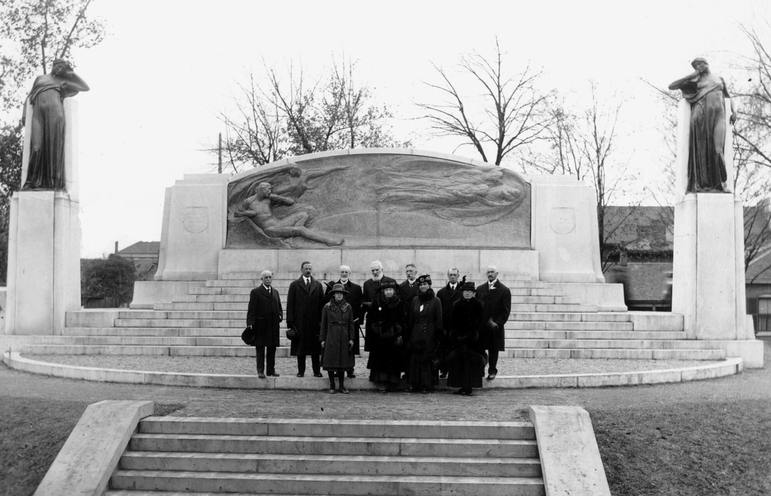
View of the dedication of the Bell Memorial, erected to commemorate the invention of the telephone by Bell in Brantford, Ontario, 1917.

Slide 10
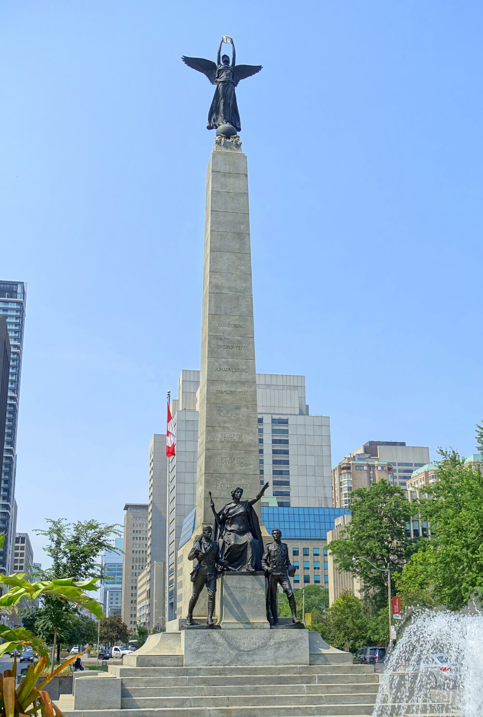
Walter S. Allward, South African War Memorial, 1904–11.

Slide 11
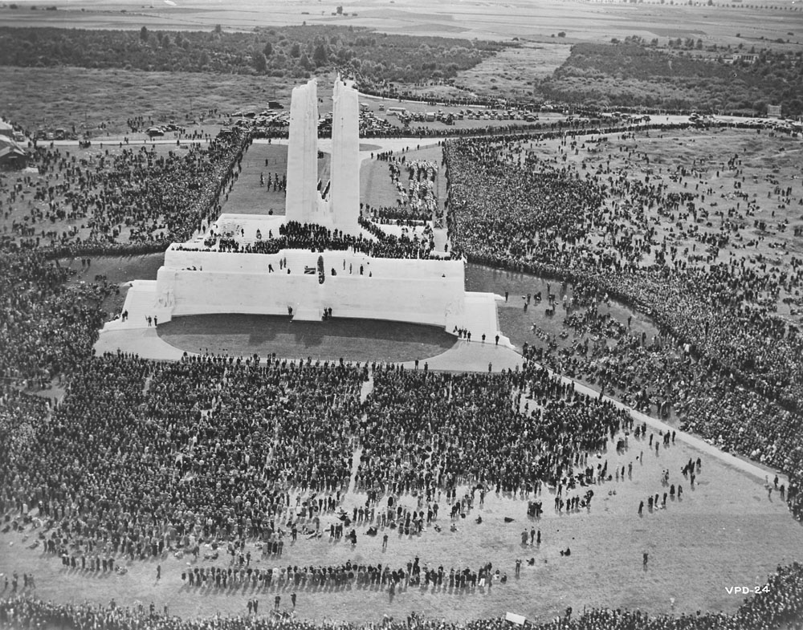
Aerial view of the Vimy Memorial dedication ceremony, 1936.

Slide 12
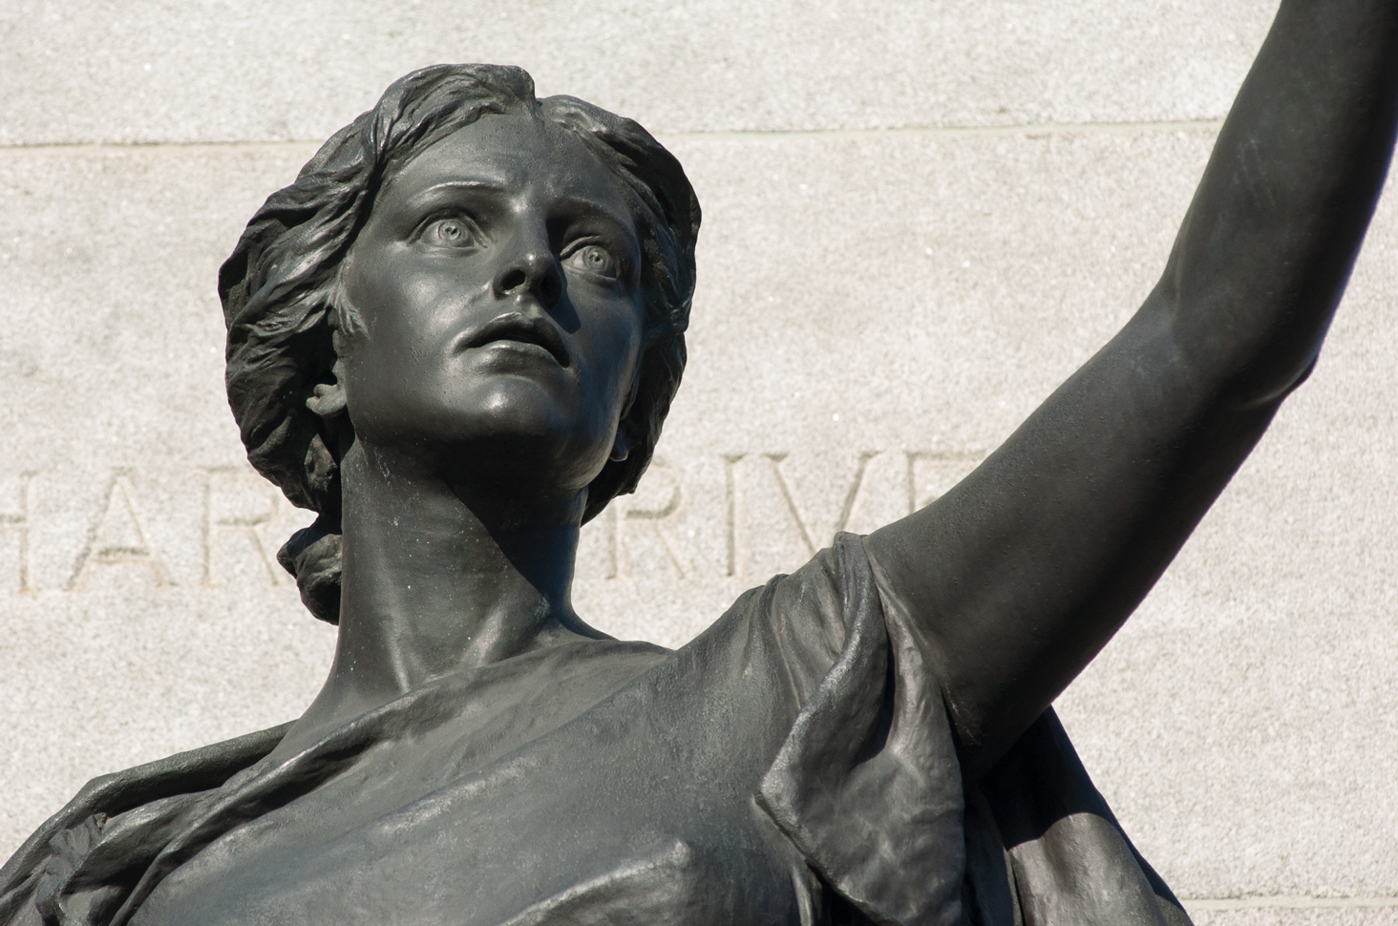
Walter S. Allward, South African War Memorial, 1904–11.

Slide 13
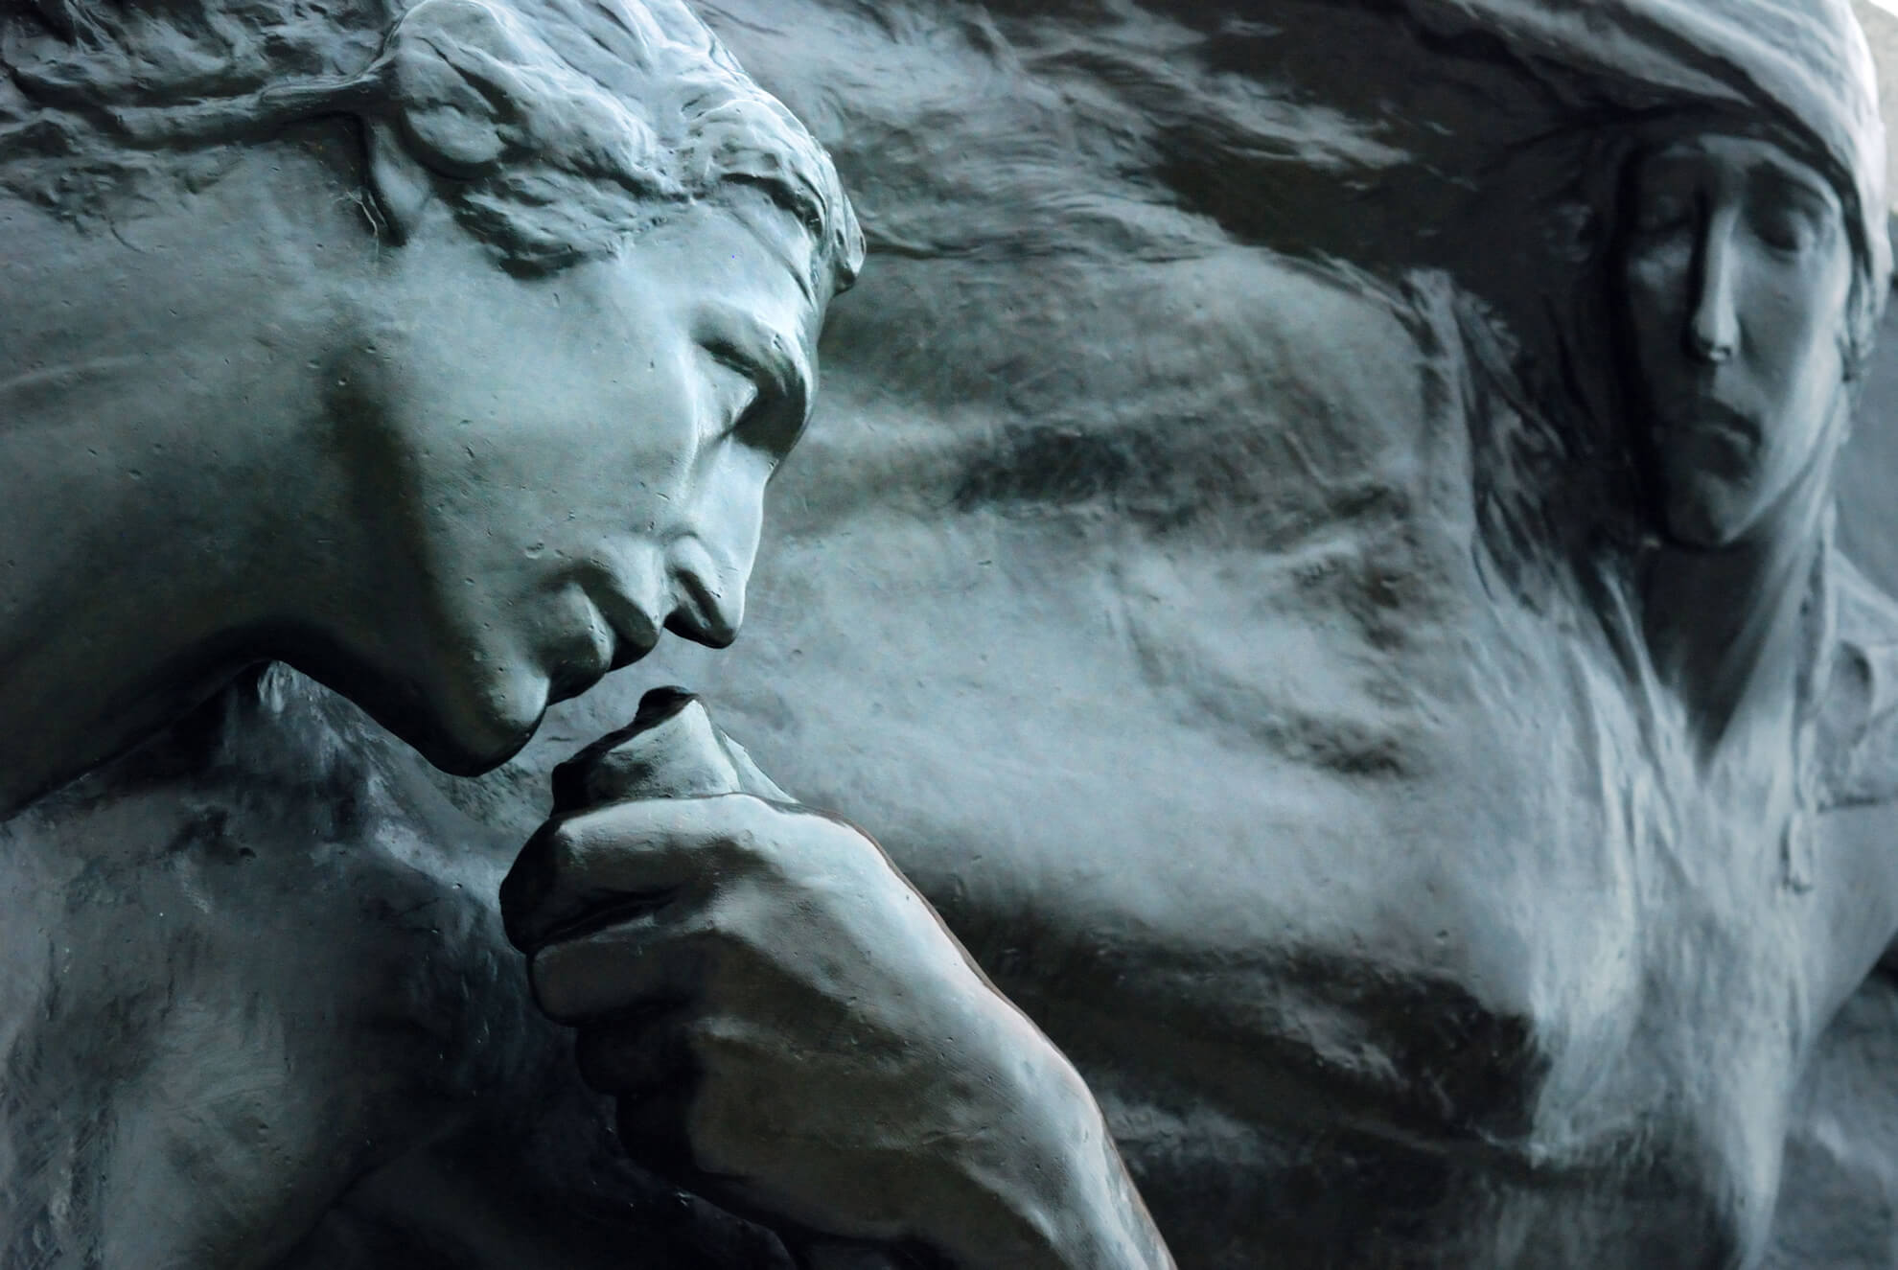
Walter S. Allward, Bell Memorial (detail of central panel), 1909–17. Allward often worked in bronze, and this monument is one of his most complex projects.

Slide 14
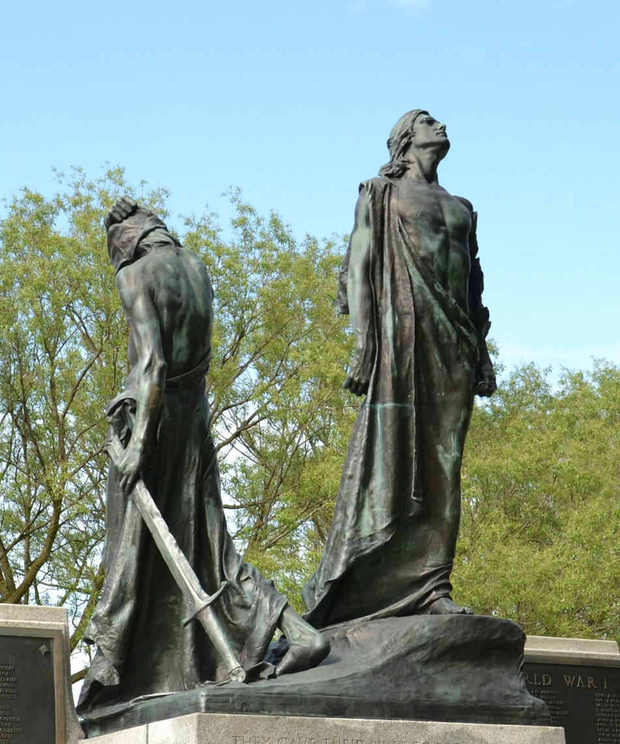
Learning Activity #1
Walter S. Allward, Stratford War Memorial (detail), 1919–22. Allward’s work depicts figures representing the triumph of right over brute force.

Slide 15
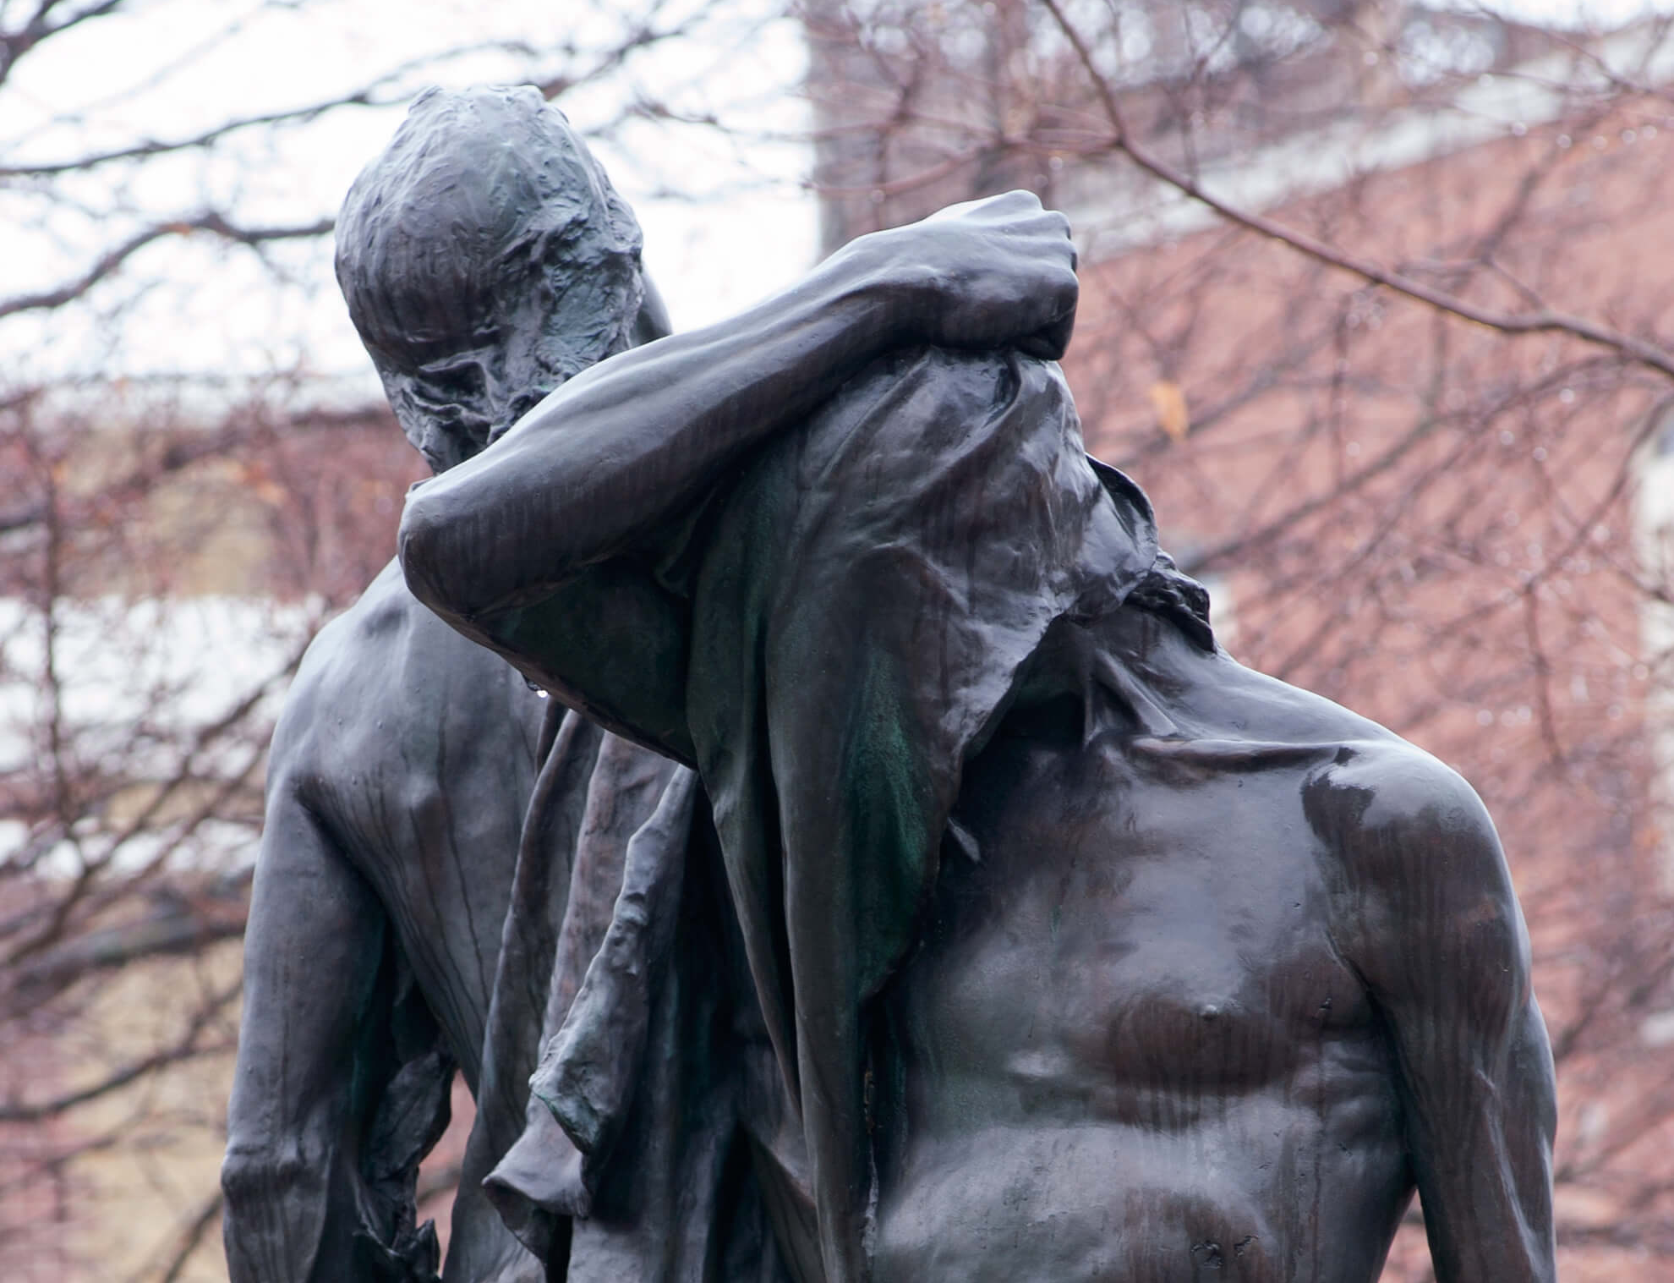
Learning Activity #1
Walter S. Allward, Stratford War Memorial
(detail of bronze figures), 1919–22. In 1919, this
monument design was unusual because it depicts allegorical values instead of a soldier.

Slide 16
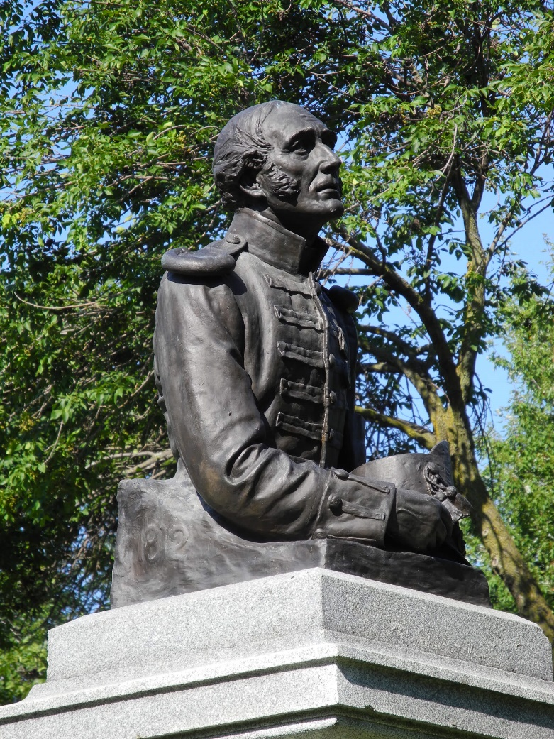
Learning Activity #1
Walter S. Allward, The Old Soldier, War
of 1812 Memorial (detail of bust), 1903–7. For
this work, Allward represented a dignified,
sombre veteran.

Slide 17
Learning Activity #1
Walter S. Allward, South African War Memorial (detail of lower figures), 1904–11. This monument is positioned in the centre of a major road, giving it a commanding view.

Slide 18
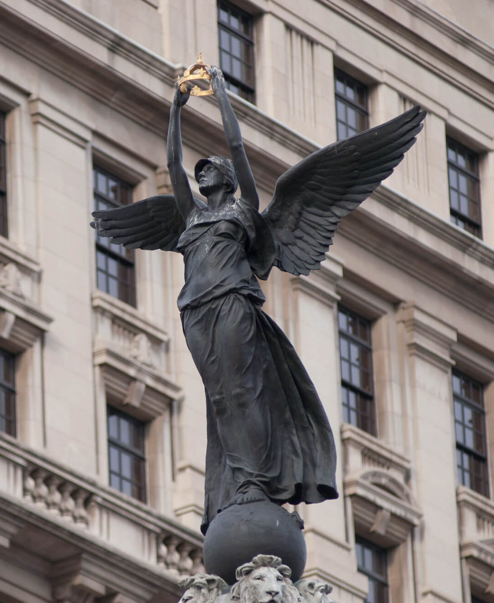
Learning Activity #1
Walter S. Allward, South African War
Memorial (detail of Victory), 1904–11. This
figure was inspired by an ancient Greek
statue of the goddess of Victory.

Slide 19
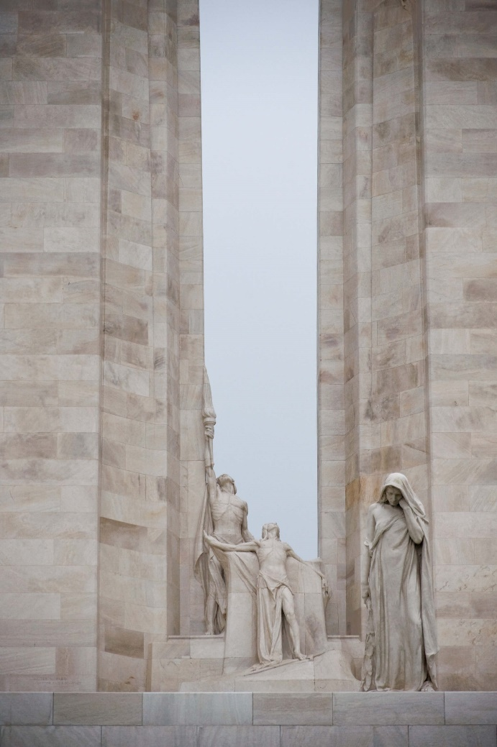
Learning Activity #1
Walter S. Allward, Vimy Memorial (detail of Canada Bereft in the foreground and The Spirit of Sacrifice and The Passing of the Torch), 1921–36. The statues at Vimy represent grief as well as sacrifice, alluding to the
complex emotions people felt after the war.

Slide 20
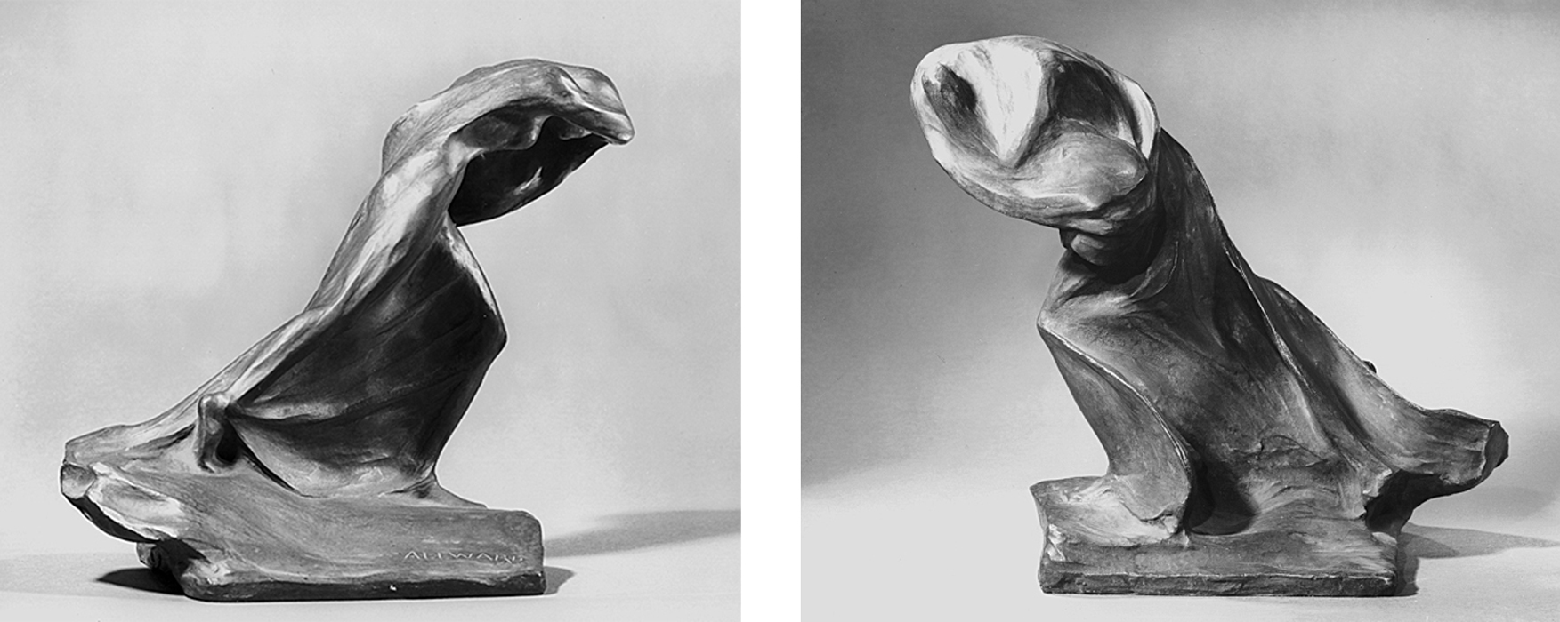
Learning Activity #2
Walter S. Allward, The Storm (front [left] and back [right]), 1920. This small sculpture portrays a woman leaning forward, her face hidden by her raised arm and her cloak.

Slide 21
Learning Activity #2
Walter S. Allward, South African War Memorial, 1904–11.

Slide 22
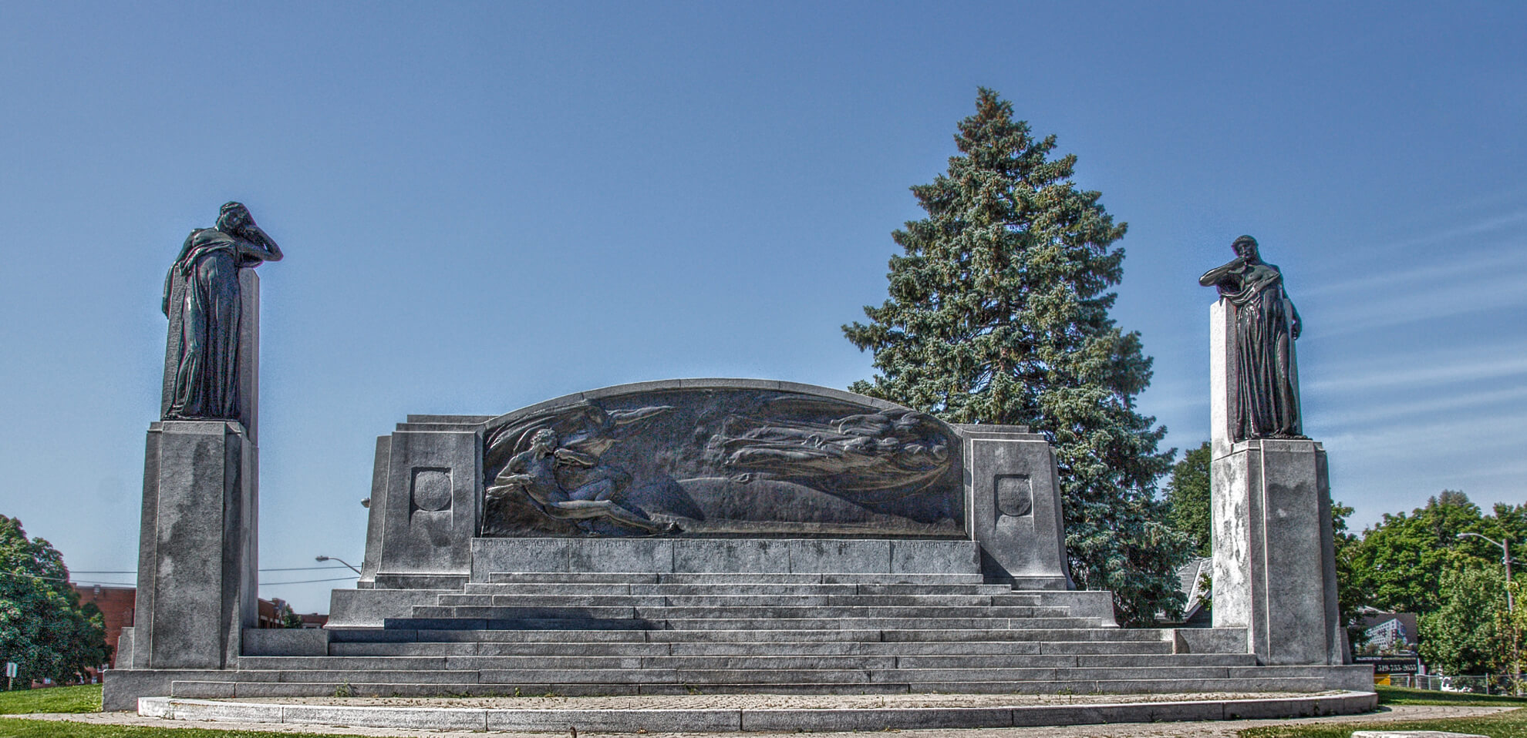
Learning Activity #2
Walter S. Allward, Bell Memorial, 1909–17. With this design, Allward included a series of steps,
encouraging people to come closer to the sculptures on the monument.

Slide 23
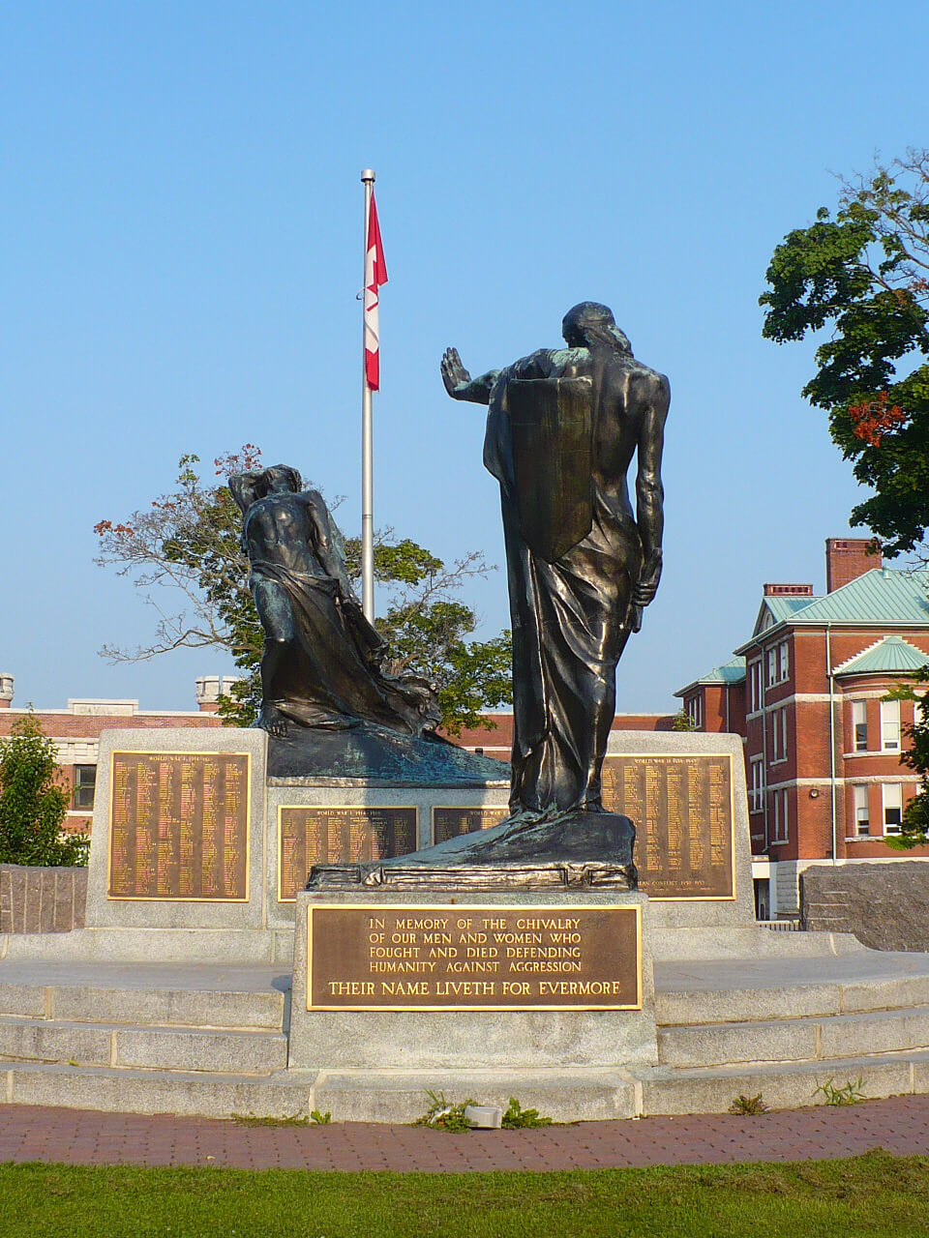
Learning Activity #2
Walter S. Allward, Peterborough
War Memorial, 1921–29. This monument is
somewhat similar to the monument Allward
designed for Stratford.

Slide 24
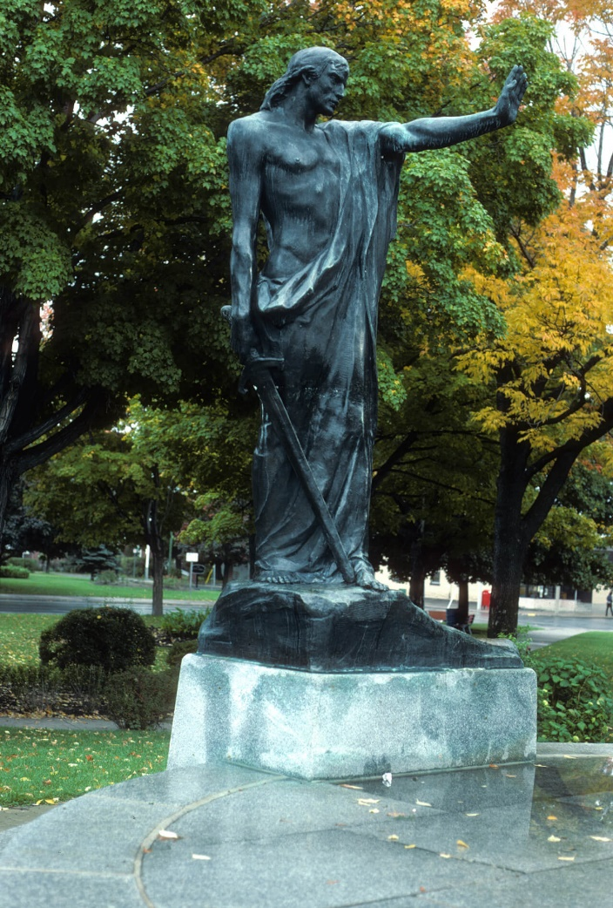
Learning Activity #2
Walter S. Allward, Peterborough War
Memorial (detail of Civilization), 1921–29.

Slide 25
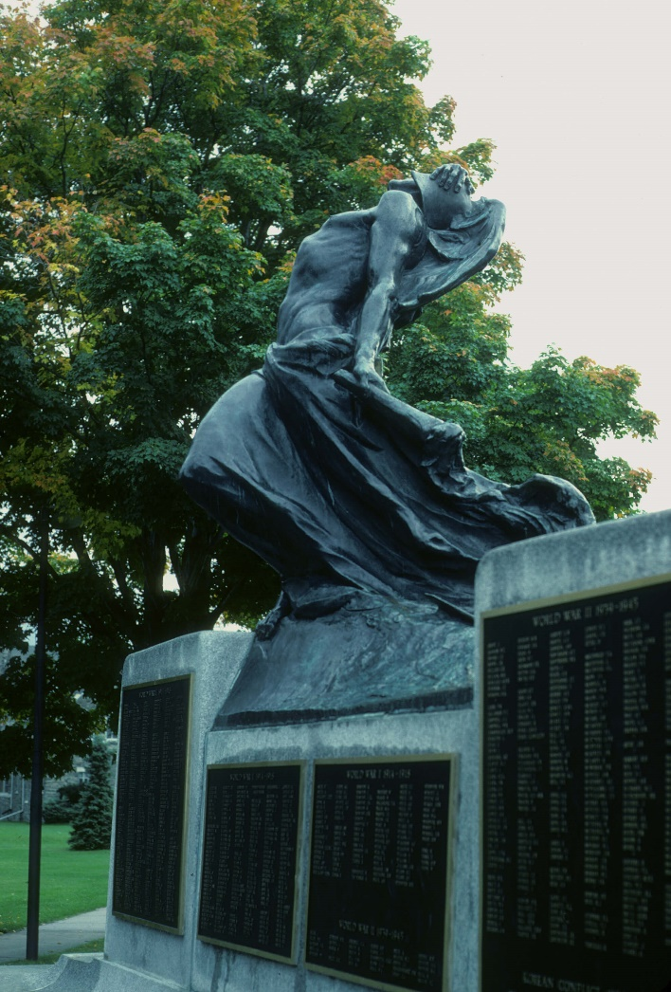
Learning Activity #2
Walter S. Allward, Peterborough War
Memorial (detail of Strife), 1921–29.

Slide 26
Culminating Task
Walter S. Allward, Vimy Memorial, 1921–36. This monument commemorates the 61,000 Canadians who lost their lives during the First World War.

Slide 27
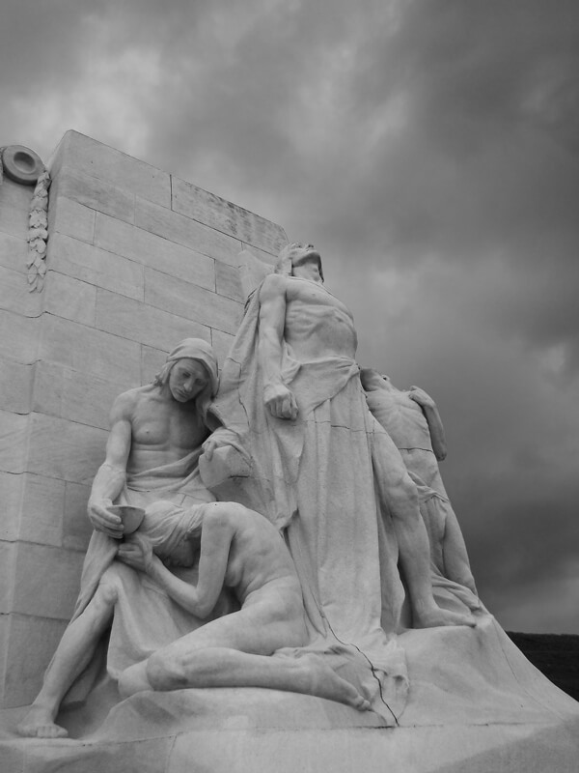
Culminating Task
Walter S. Allward, Vimy Memorial (detail of The Sympathy of the Canadians for the Helpless), 1921–36. Allward worked with several assistants to carve all the sculptures.

Slide 28
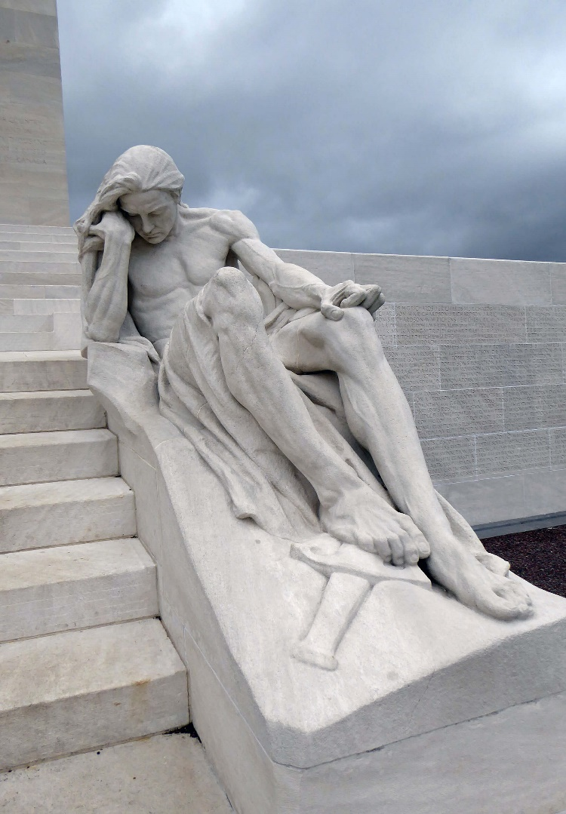
Culminating Task
Walter S. Allward, Vimy Memorial (detail of Male Mourner), 1921–36. This giant figure was inspired by a work by Michelangelo.

Slide 29
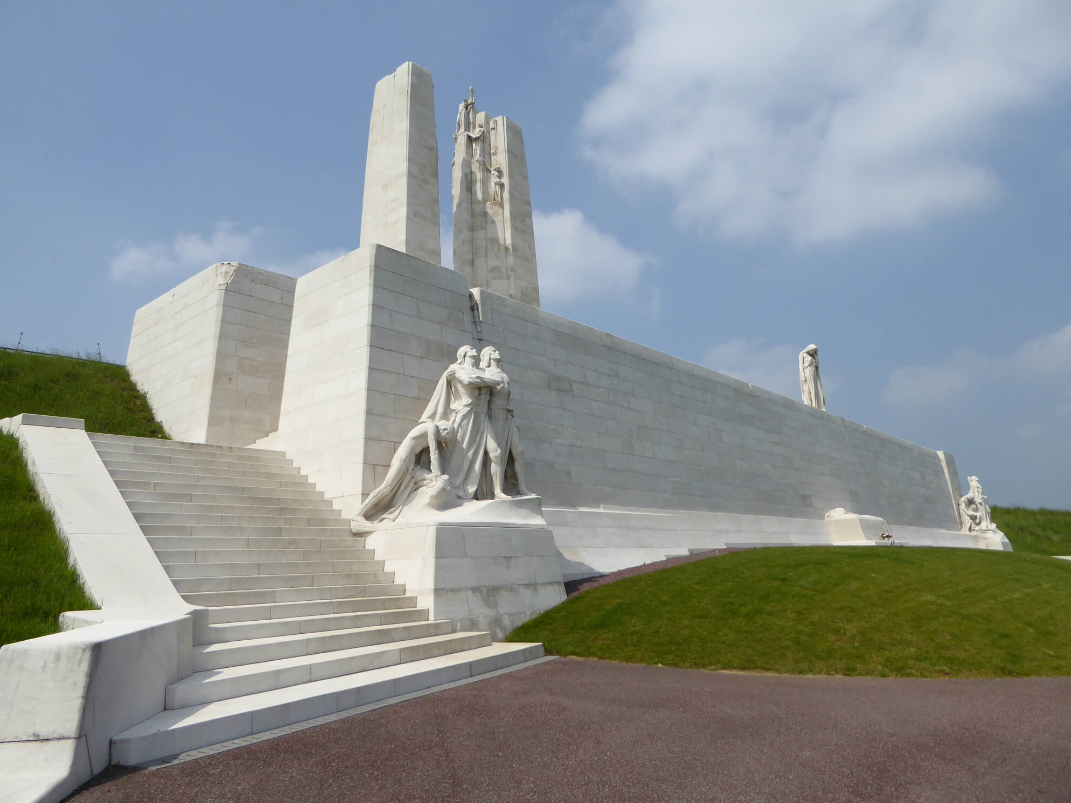
Culminating Task
Walter S. Allward, Vimy Memorial, 1921–36. The monument at
Vimy is designed to encourage people to walk around it.

Slide 30
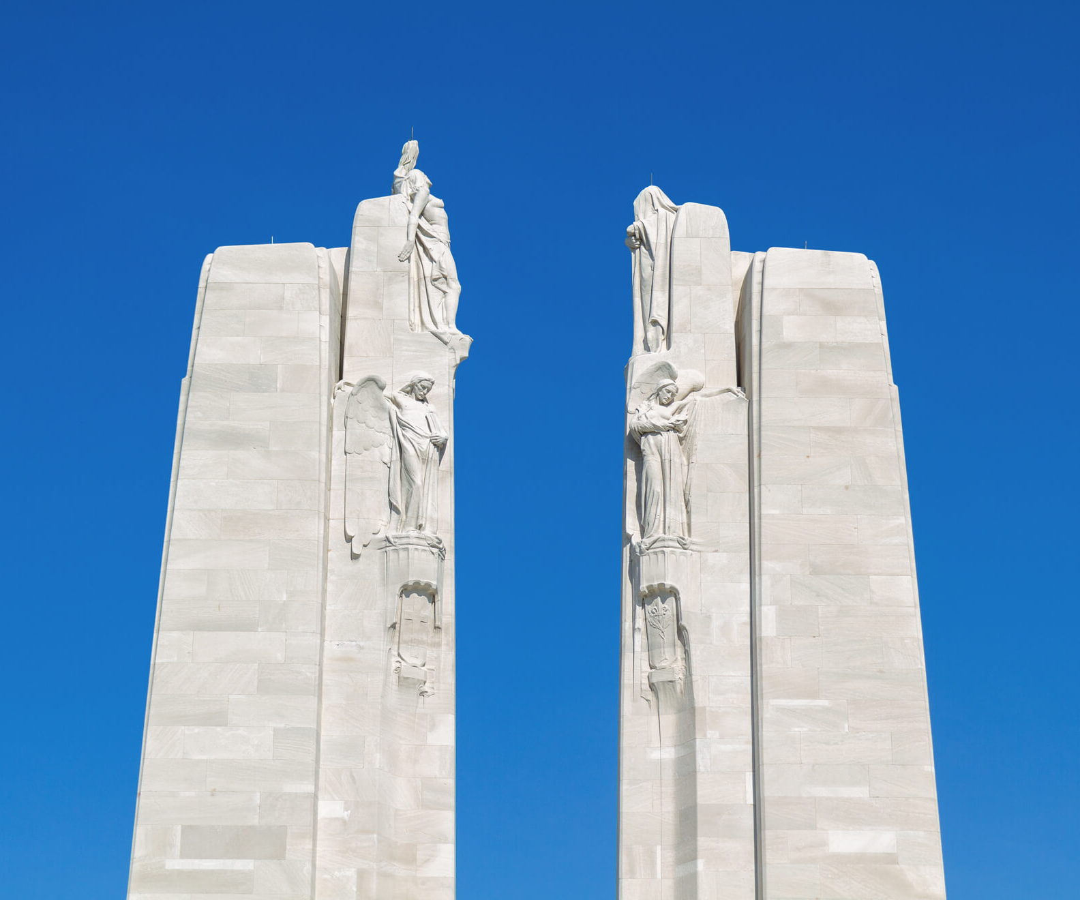
Culminating Task
Walter S. Allward, Vimy Memorial (detail of the Chorus), 1921–36. The highest sculptures on the monument are 100 feet above the ground.

Slide 31
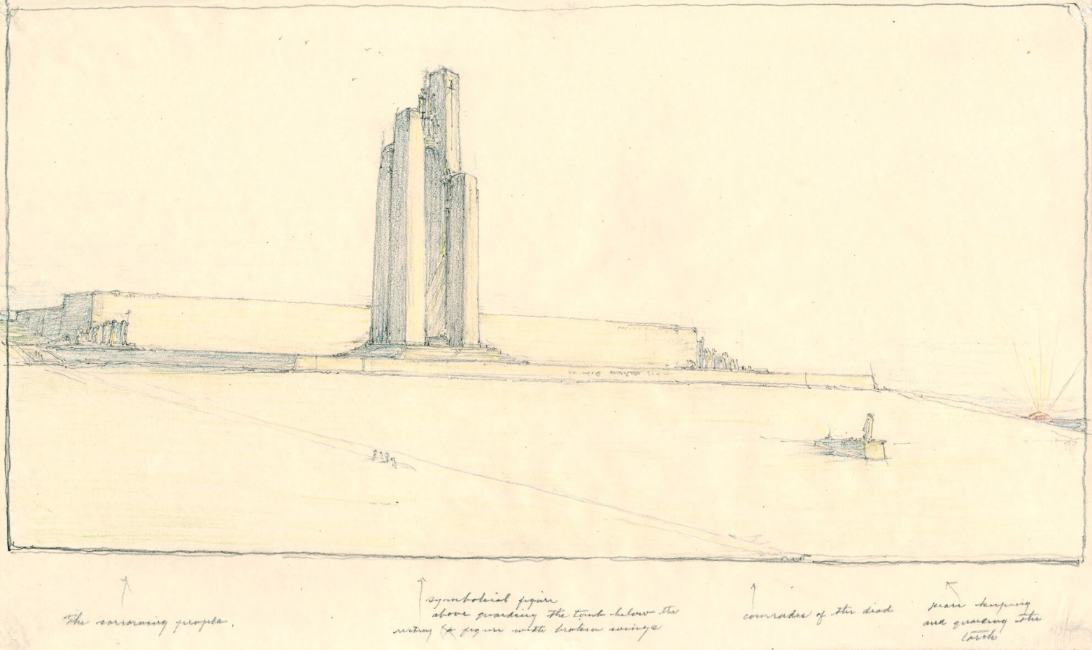
Walter S. Allward, Alternative design for the Vimy Memorial, n.d. Allward made over 150 sketches while designing this memorial.

Slide 32
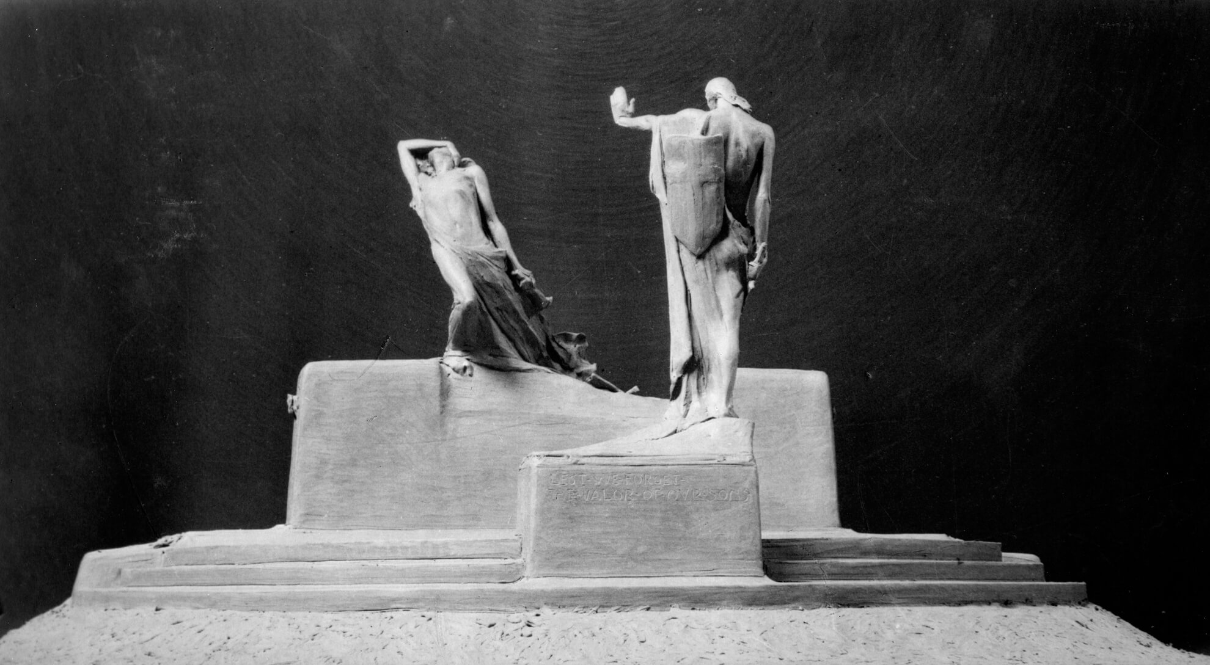
Walter S. Allward, Maquette for Peterborough War Memorial, n.d. This maquette shows Allward’s plan for the giant bronze and stone monument in Peterborough.

Slide 33
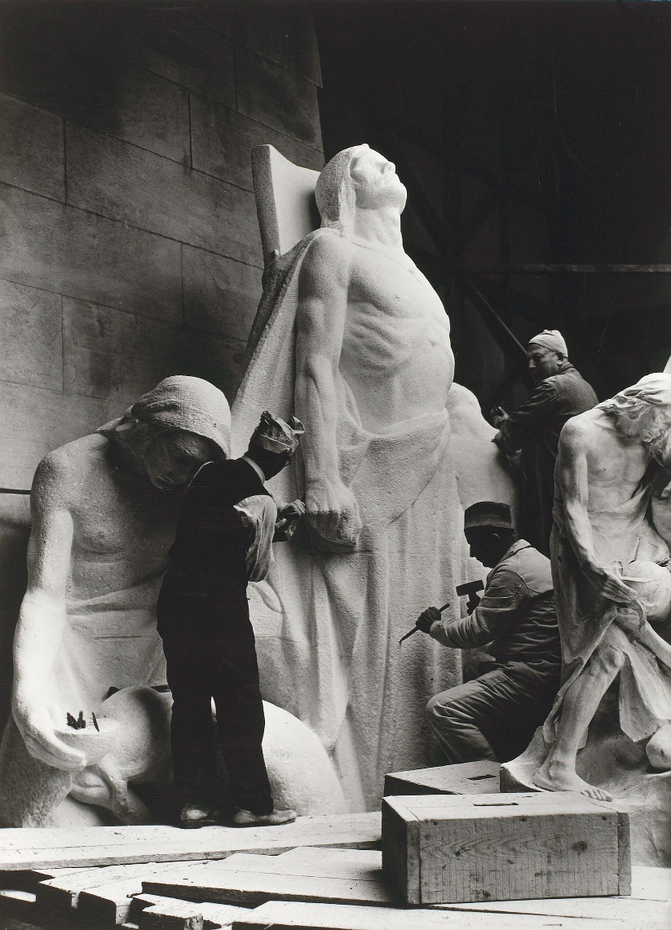
Carvers working on The Sympathy of the Canadians for the Helpless sculpture for the Vimy Memorial, n.d. Allward’s assistants at Vimy worked with models he had made to create the final sculptures.

Slide 34
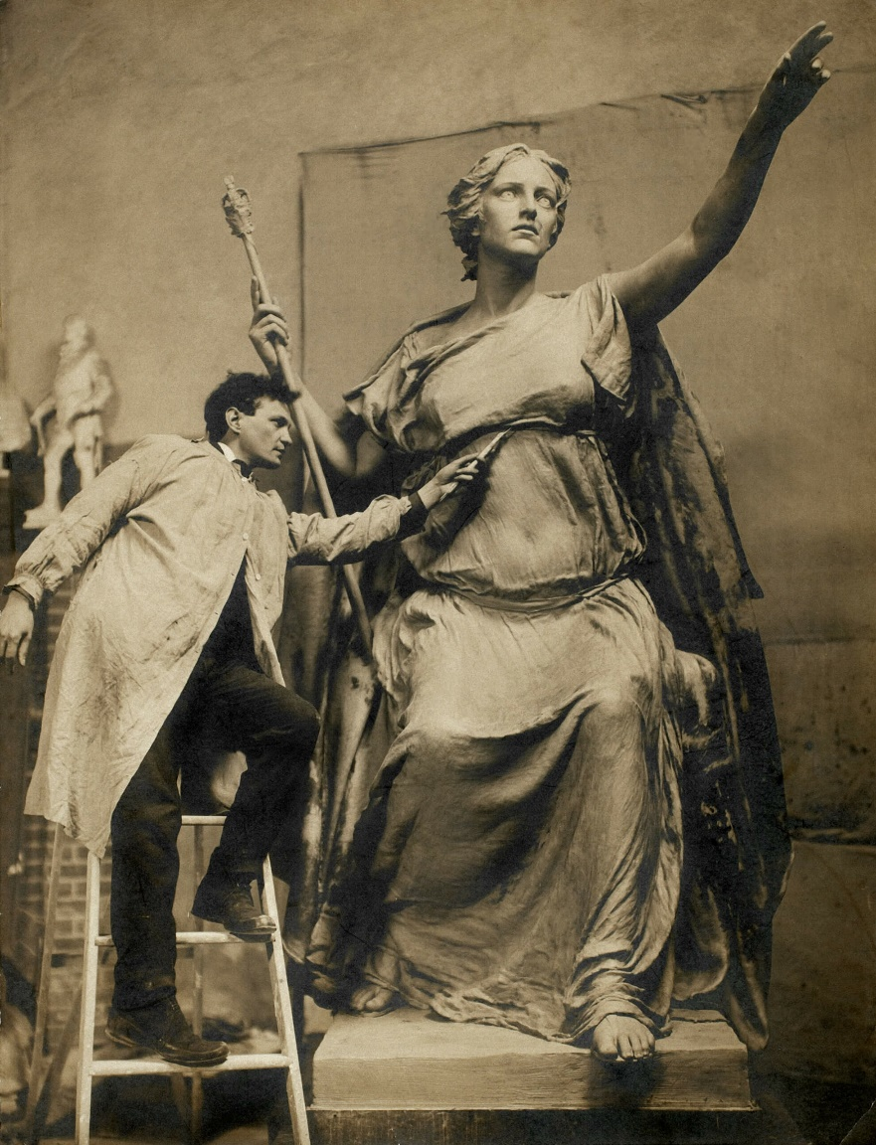
Walter S. Allward working in clay on the main
figure for the South African War Memorial, Toronto, 1906.

Slide 35
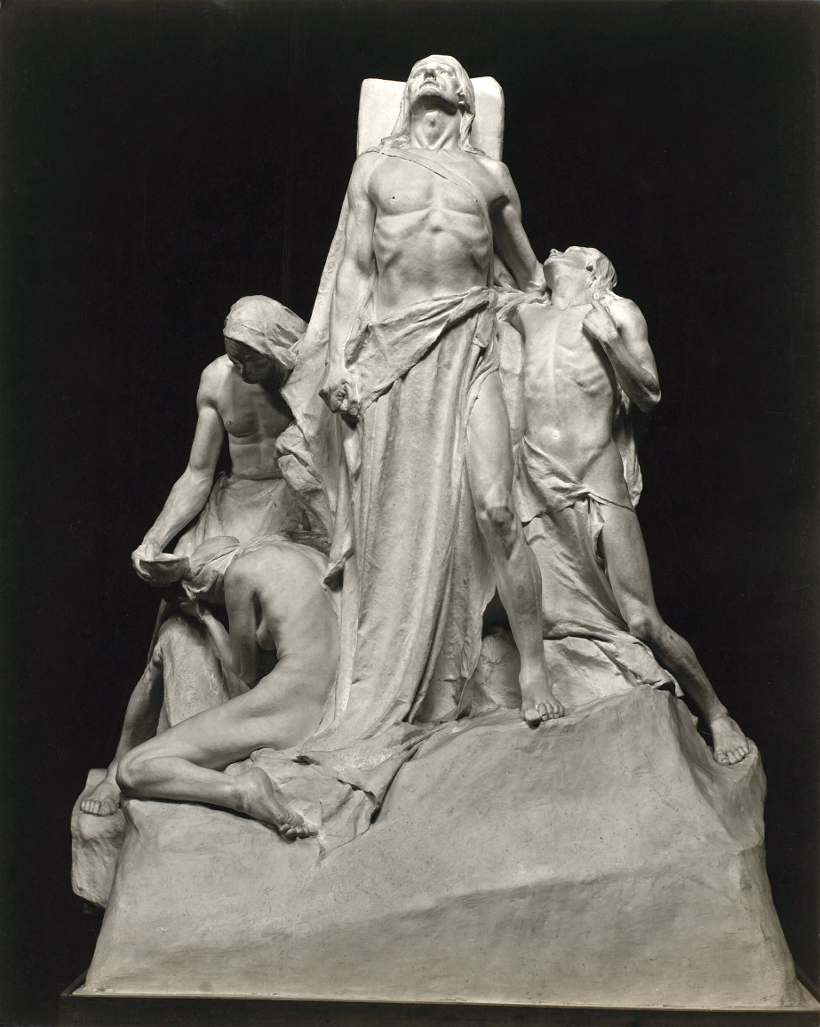
Walter S. Allward, Plaster model of The Sympathy of the Canadians for the Helpless for the Vimy Memorial, n.d. Allward’s models for the Vimy project are now in Canadian museums.

Slide 36
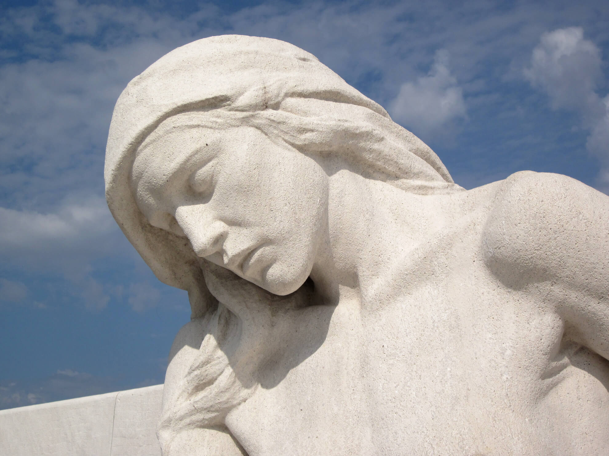
Walter S. Allward, Vimy Memorial (detail of Female Mourner), 1921–36. With this stone statue, Allward attempted to represent grief.

