Slide 2
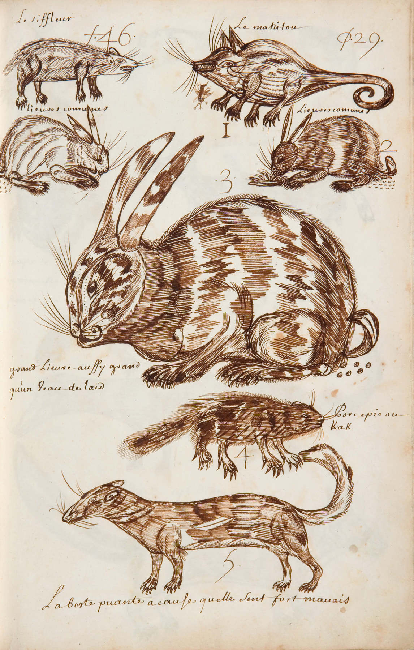
Louis Nicolas, The Whistler, Codex Canadensis, page 29, n.d. Nicolas often illustrated several animals on a single page.

Slide 3
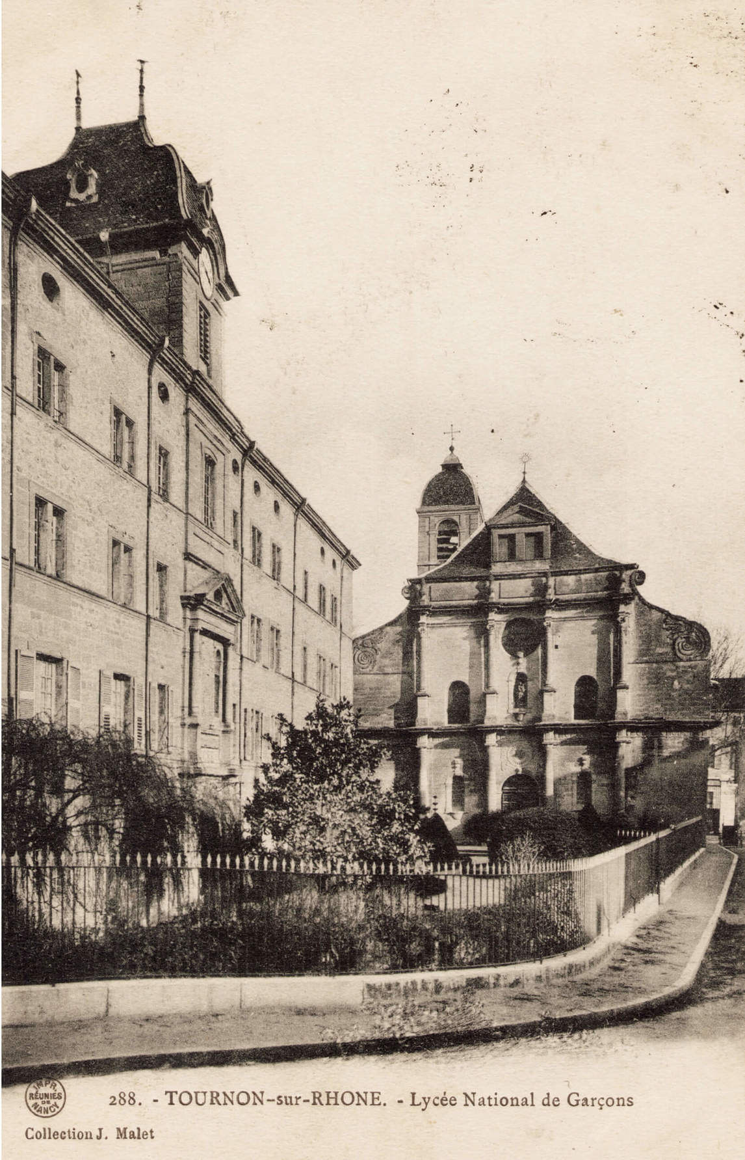
The Jesuit College at Tournon-sur-Rhône. Nicolas studied at this school.

Slide 4
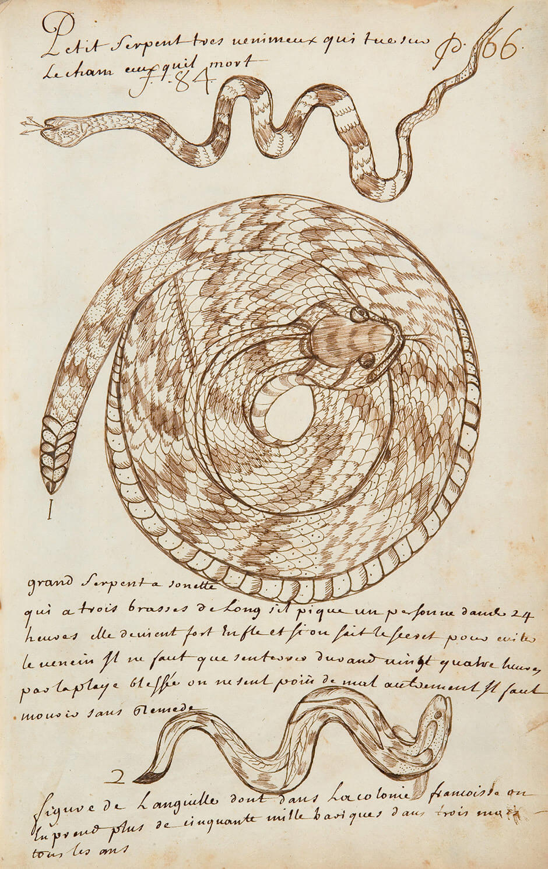
Louis Nicolas, Small, Very Poisonous Snake That Kills Immediately Those That It Bites, Codex Canadensis, page 66, n.d. Next to this illustration of a rattlesnake, Nicolas made notes about how to treat the snake’s bite.

Slide 5
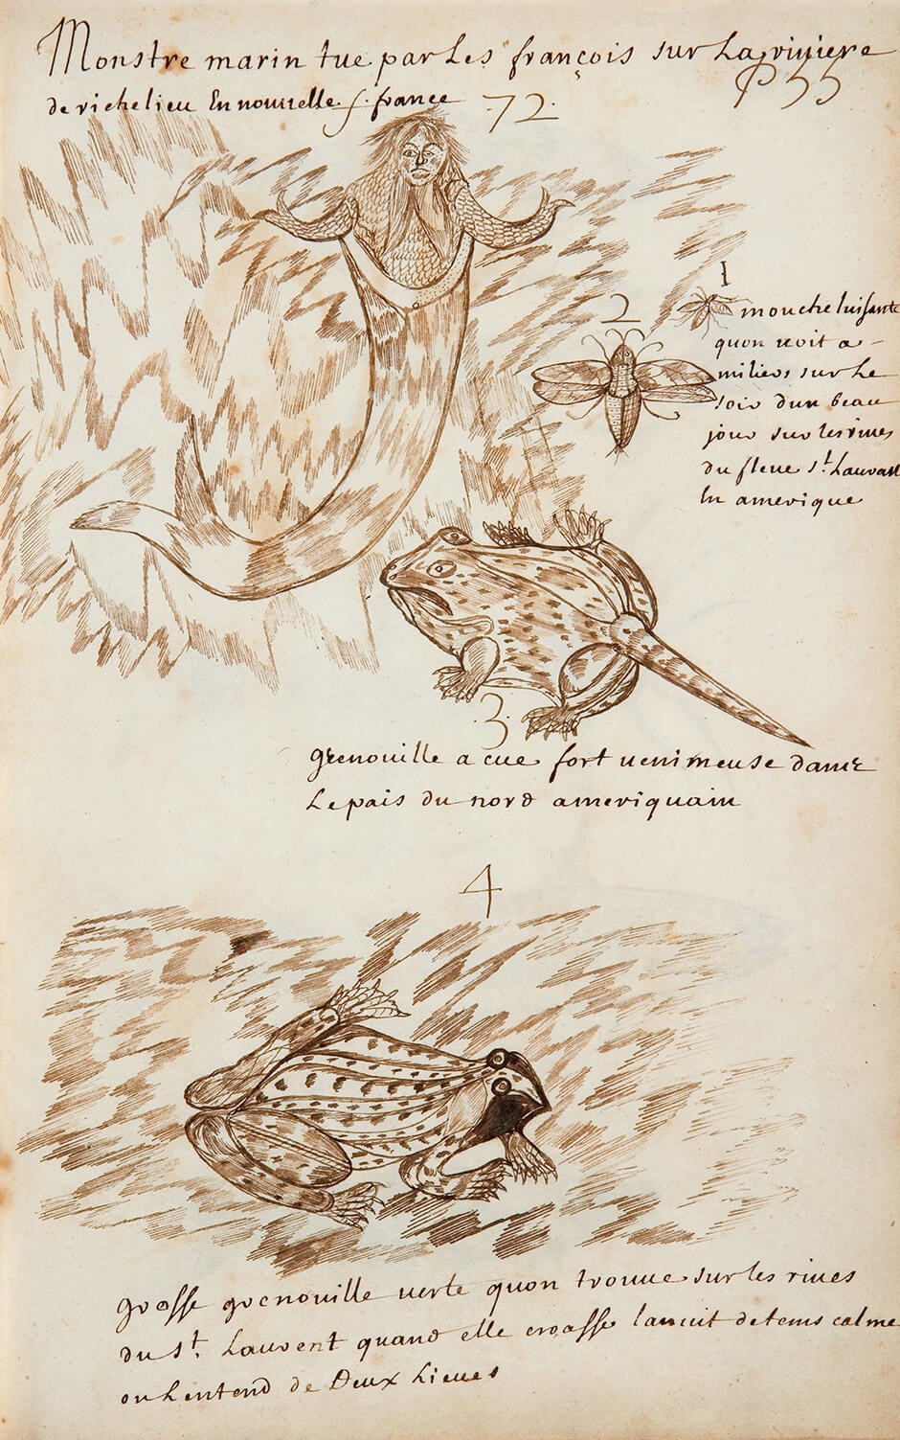
Louis Nicolas, Sea Monster Killed by the French, page 55, n.d. Nicolas’s book included some fantastic animals as well as real ones.

Slide 6
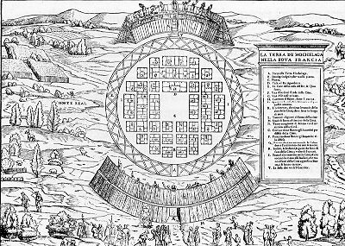
In Giovanni Battista Ramusio’s work, Jacques Cartier and his men are shown being welcomed at the entrance of the village of Hochelaga, on what is currently the island of Montreal.

Slide 7
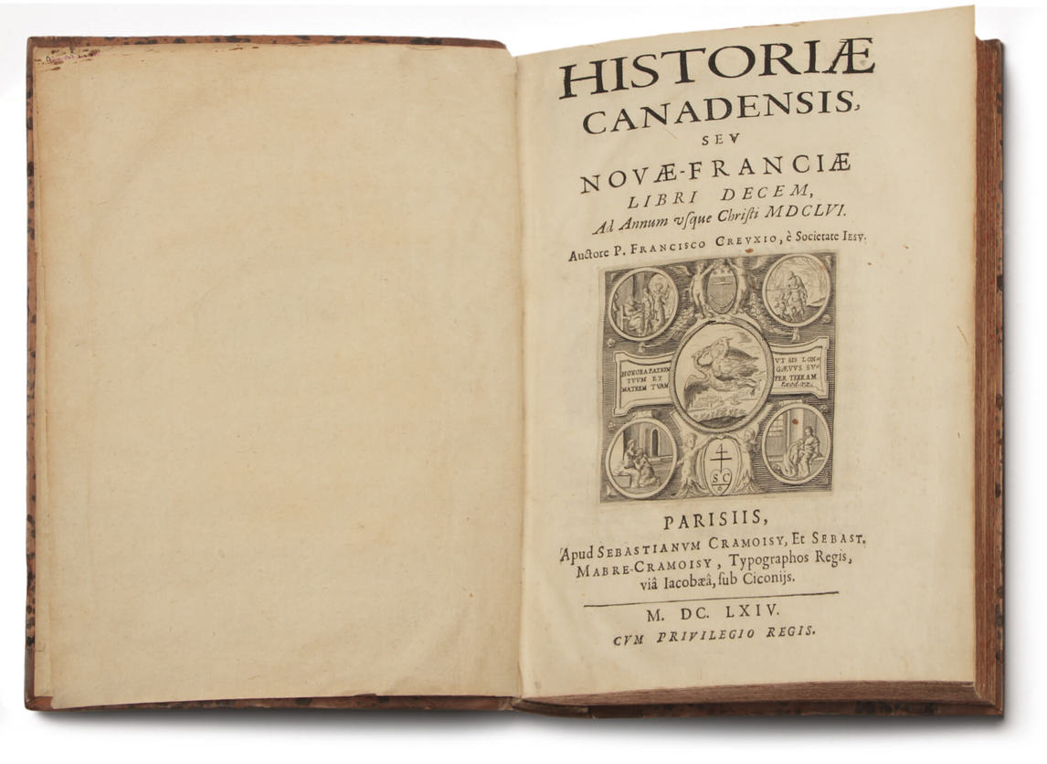
Interior of François Du Creux’s The History of Canada, or of New France (Historiae Canadensis seu Novae Franciae Libri Decem), 1664.

Slide 8
The Dish With One Spoon Wampum is a commitment to sharing lands in peace. This is a reproduction of the original belt.

Slide 9
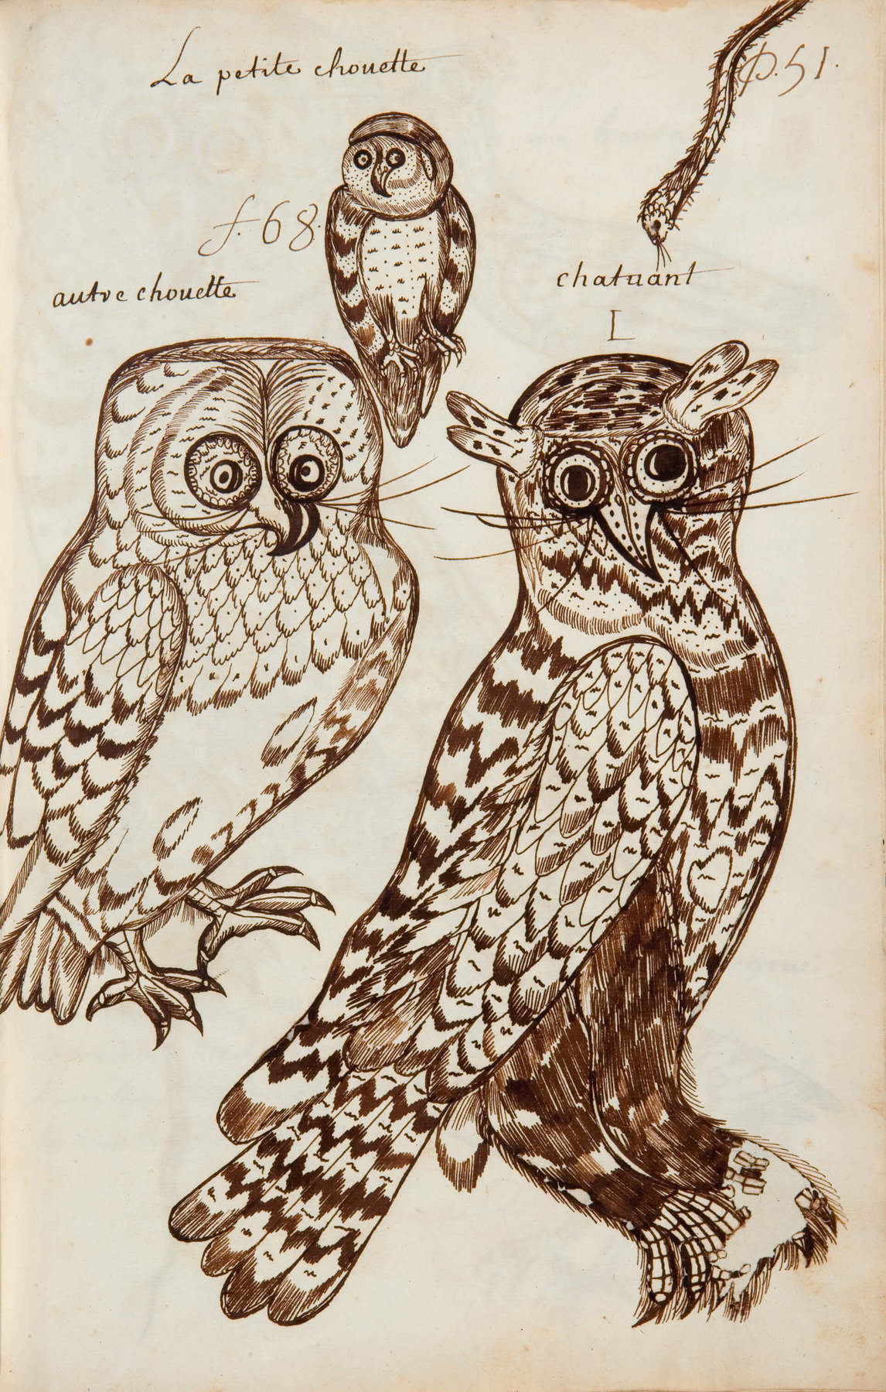
Louis Nicolas, The Small Owl, Codex Canadensis, page 51, n.d. Nicolas illustrated many different birds.

Slide 10
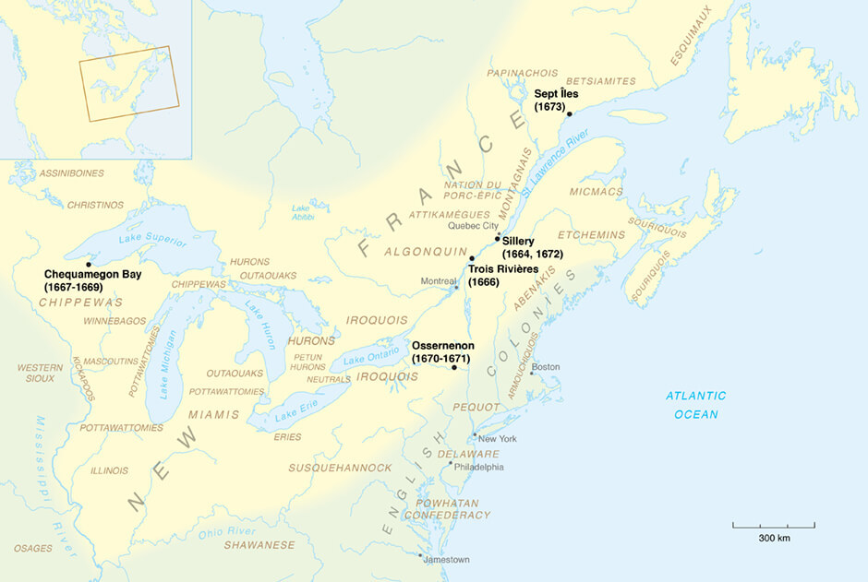
A map showing the range of Louis Nicolas’s missions.

Slide 11
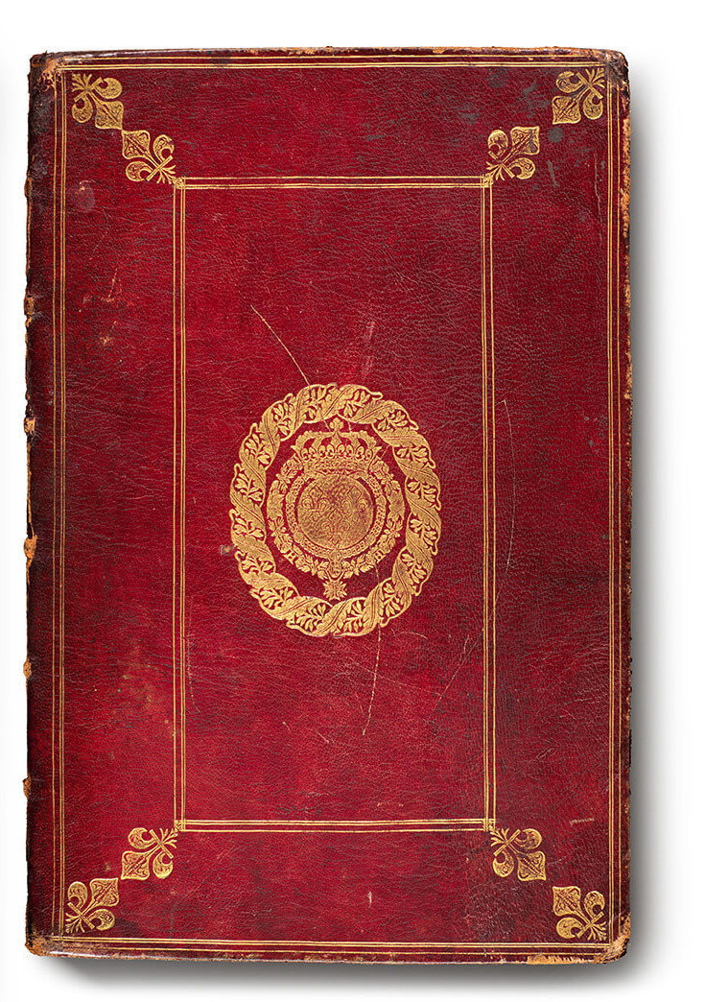
The cover of the Codex Canadensis, n.d.

Slide 12
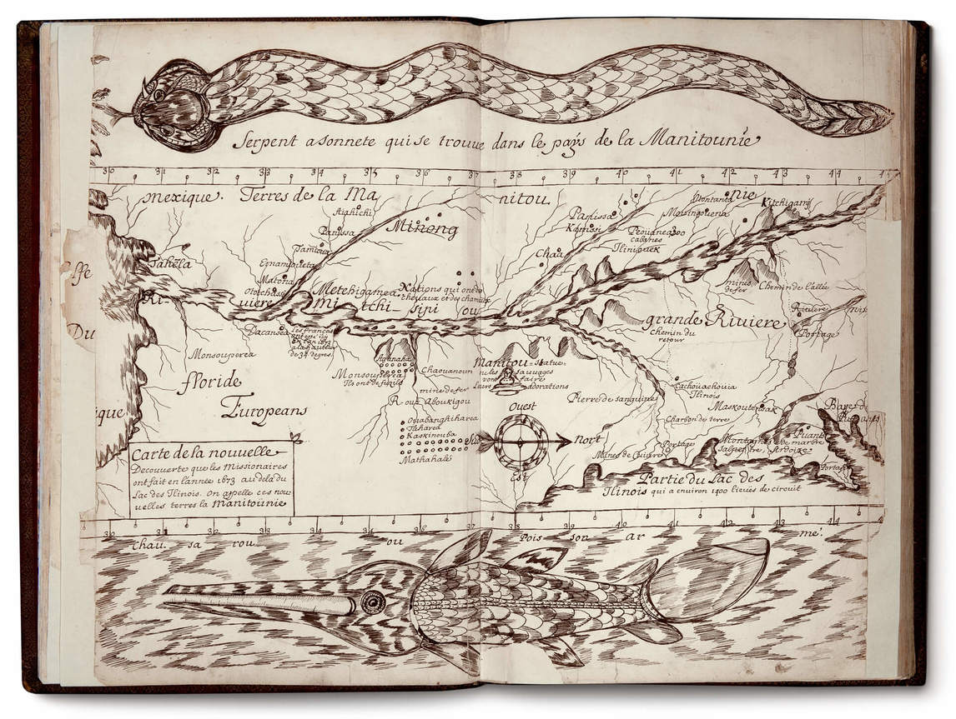
Learning Activity #1
Louis Nicolas, Map, Codex Canadensis, n.d. Framed with illustrations of a snake and a fish, this map represents the Mississippi River.

Slide 13
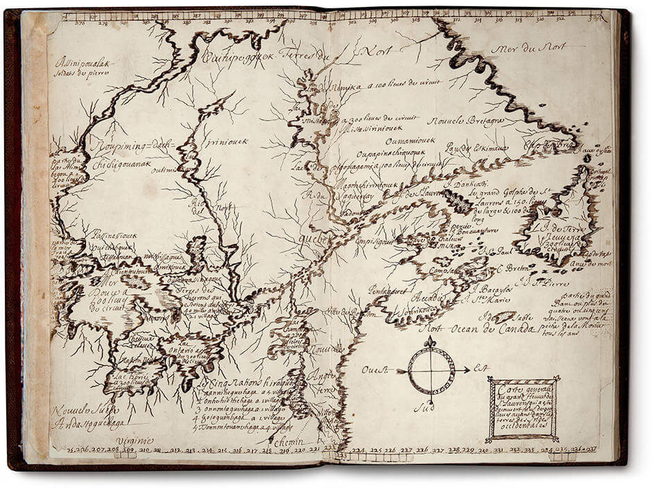
Learning Activity #1
Louis Nicolas, Map, Codex Canadensis, n.d. This map represents the St. Lawrence River and the surrounding region.

Slide 14
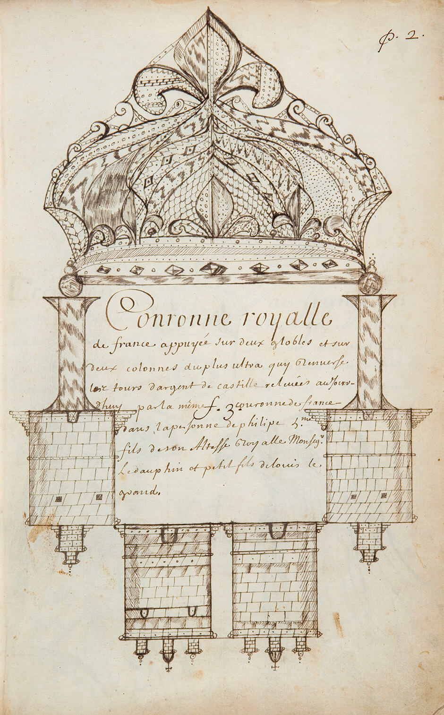
Learning Activity #2
Louis Nicolas, Royal Crown of France, Codex Canadensis, page 2, n.d. Nicolas drew the crown of France because he was dedicating his work to the King of France, Louis XIV.

Slide 15
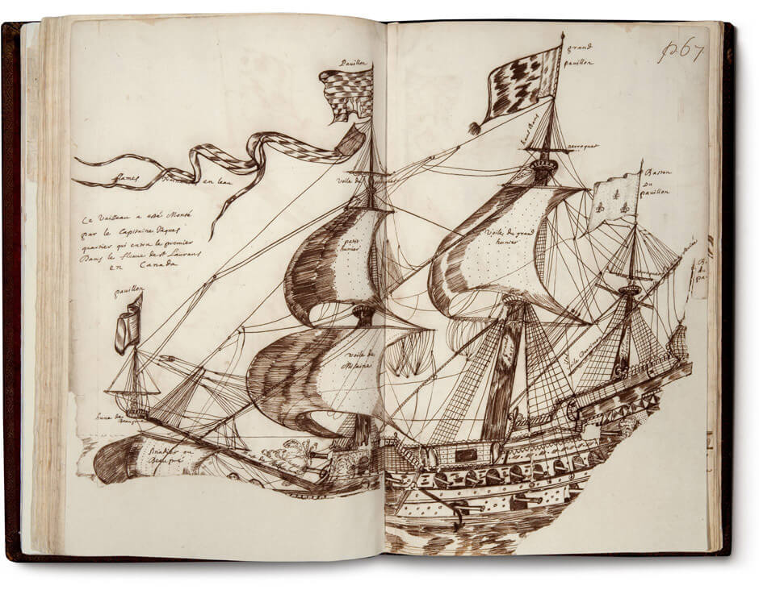
Learning Activity #2
Louis Nicolas, Jacques Cartier’s Ship, Codex Canadensis, page 67, n.d. To create this image, Nicolas turned to an image of a French naval ship, since he did not know what Cartier’s ship had actually looked like.

Slide 16
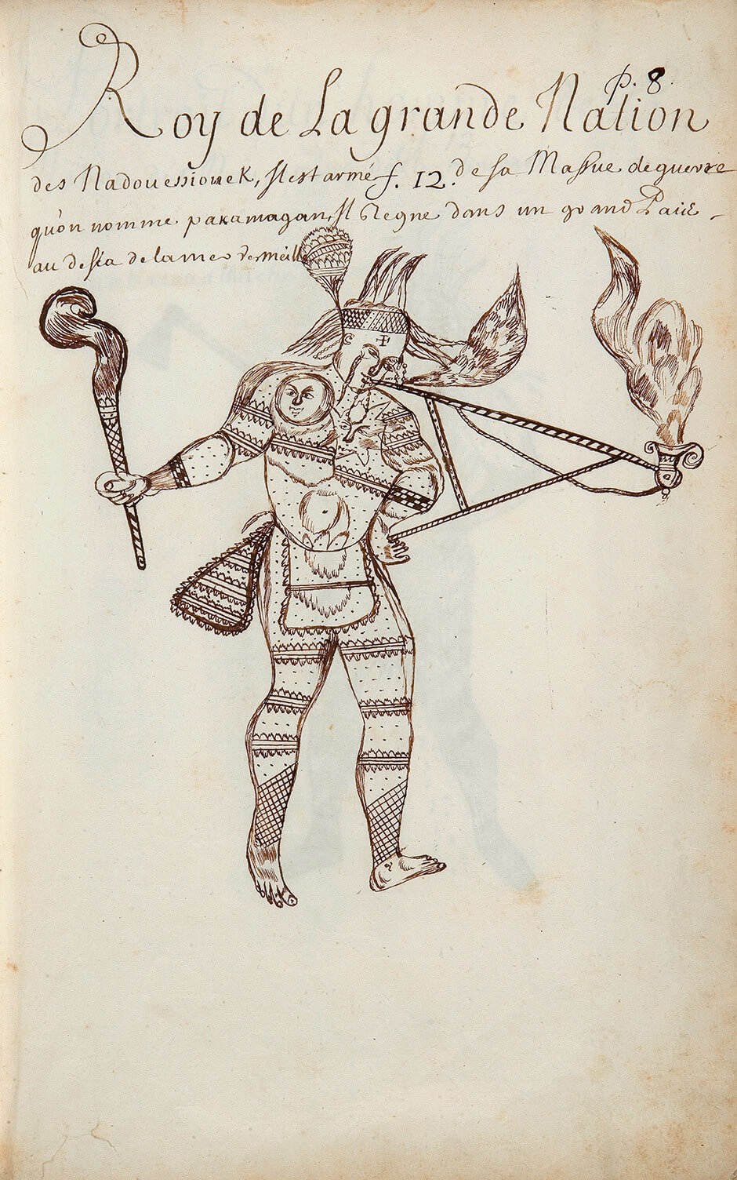
Learning Activity #2
Louis Nicolas, King of the Great Nation of the Nadouessiouek, Codex Canadensis, page 8, n.d. Here Nicolas has represented a leader of the Sioux, but the image does not represent a specific person.

Slide 17
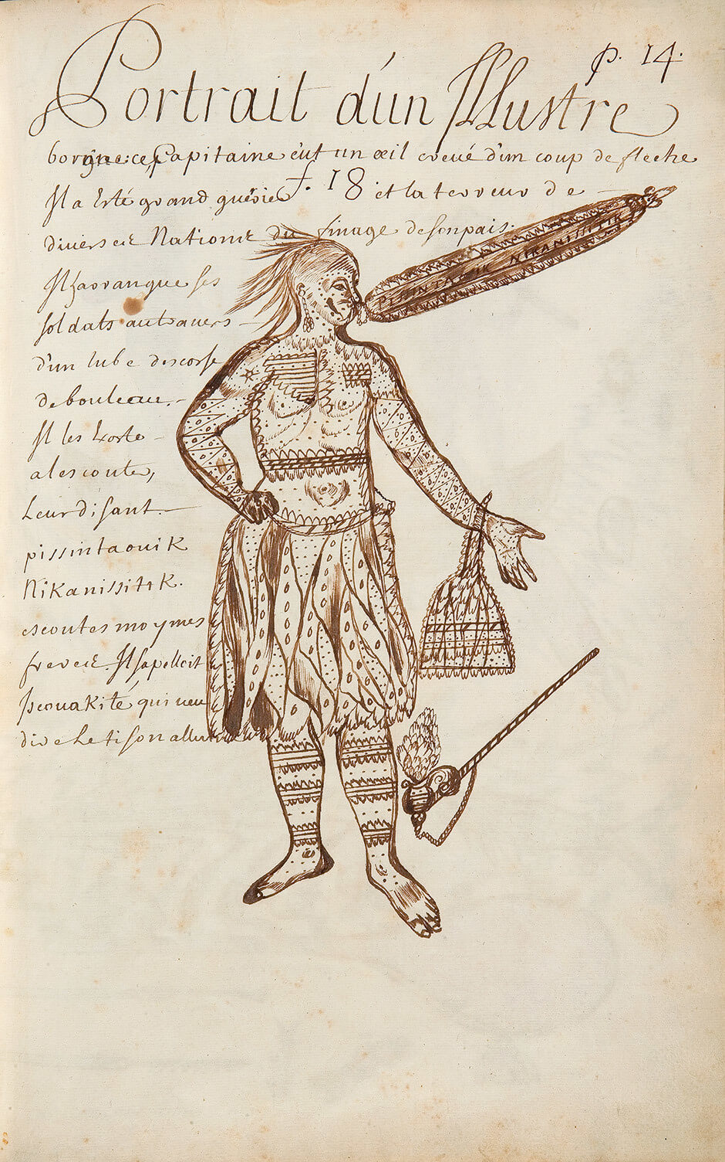
Learning Activity #2
Louis Nicolas, Portrait of a Famous One-eyed Man, Codex Canadensis, page 14, n.d. A leader of the Ottawa Nation, Iscouakité was known as a powerful orator, and Nicolas has represented him as if he is addressing his men.

Slide 18
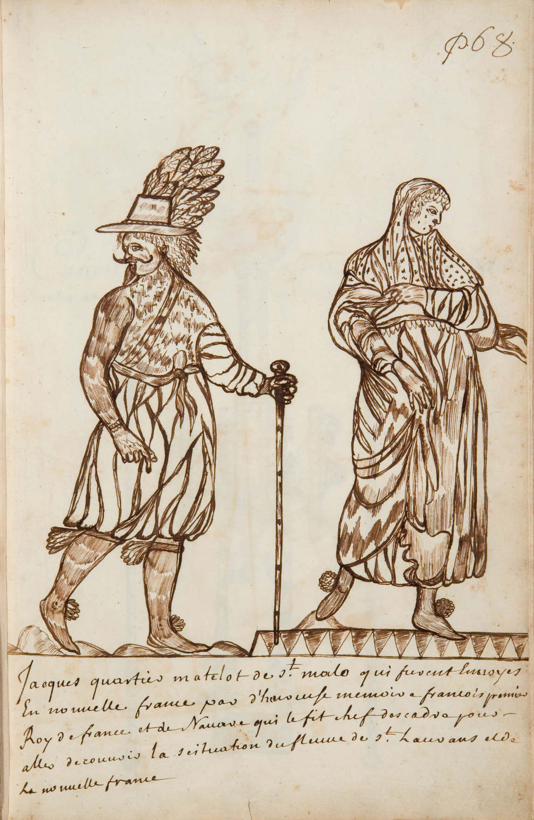
Learning Activity #1
Louis Nicolas, Jacques Cartier, Codex Canadensis, page 68, n.d. There are no known portraits of Cartier, so Nicolas had to imagine this image.

Slide 19
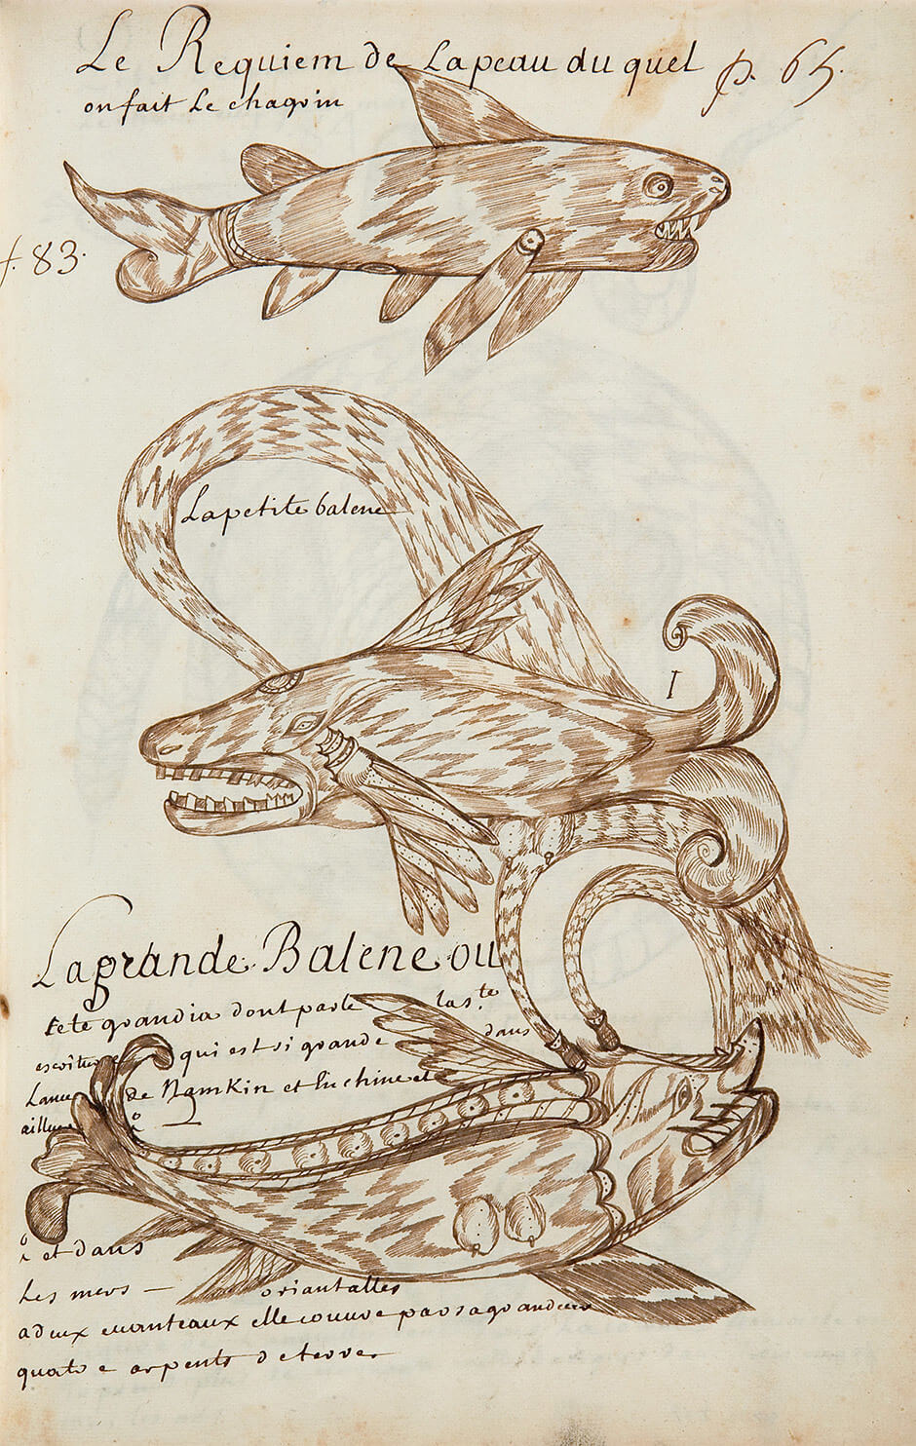
Culminating Task
Louis Nicolas, The Shark, from Whose Skin Shagreen Is Made (Le Requiem de la peau du quel on fait le chagrin), Codex Canadensis, page 65, n.d. Nicolas grouped animals by size as well as habitat.

Slide 20
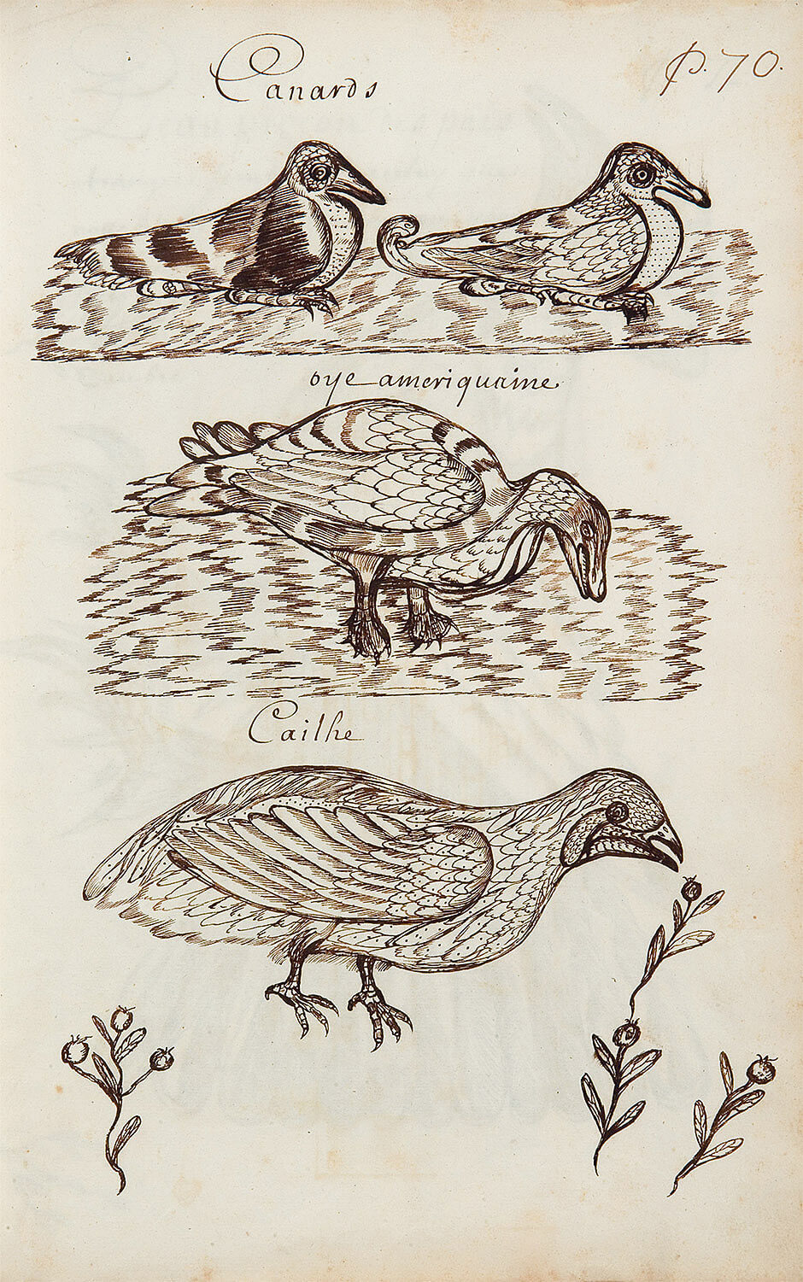
Culminating Task
Louis Nicolas, Ducks (Canards), Codex Canadensis, page 70, n.d. This illustration of ducks reveals Nicolas’s attention to birds’ feathers.

Slide 21
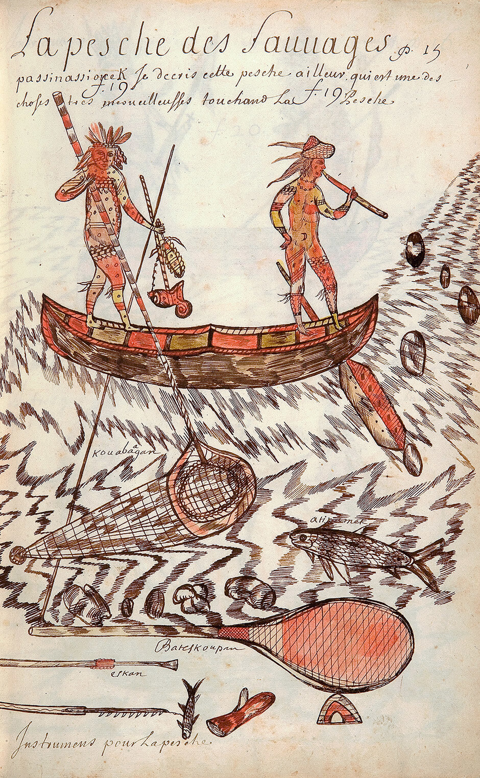
Culminating Task
Louis Nicolas, Fishing by the Passinassiouek, Codex Canadensis, page 15, n.d. Here Nicolas depicts Sioux men from Eastern Dakota in a canoe, fishing on the rippling waters of southwestern Lake Superior. The use of the term “Sauvages” reflects his racist worldview.

Slide 22
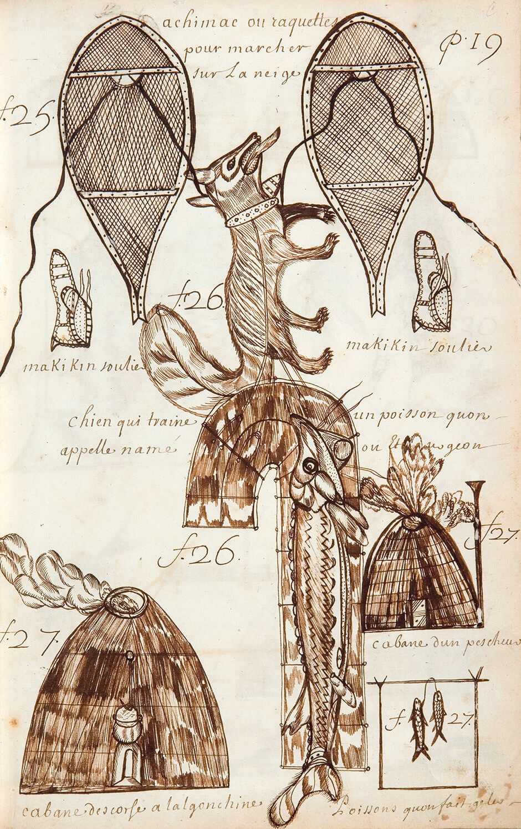
Culminating Task
Louis Nicolas, Means of Transportation and Habitations, Codex Canadensis, page 19, n.d. On this page, Nicolas illustrated Indigenous buildings and forms of transportation, including snowshoes.

Slide 23
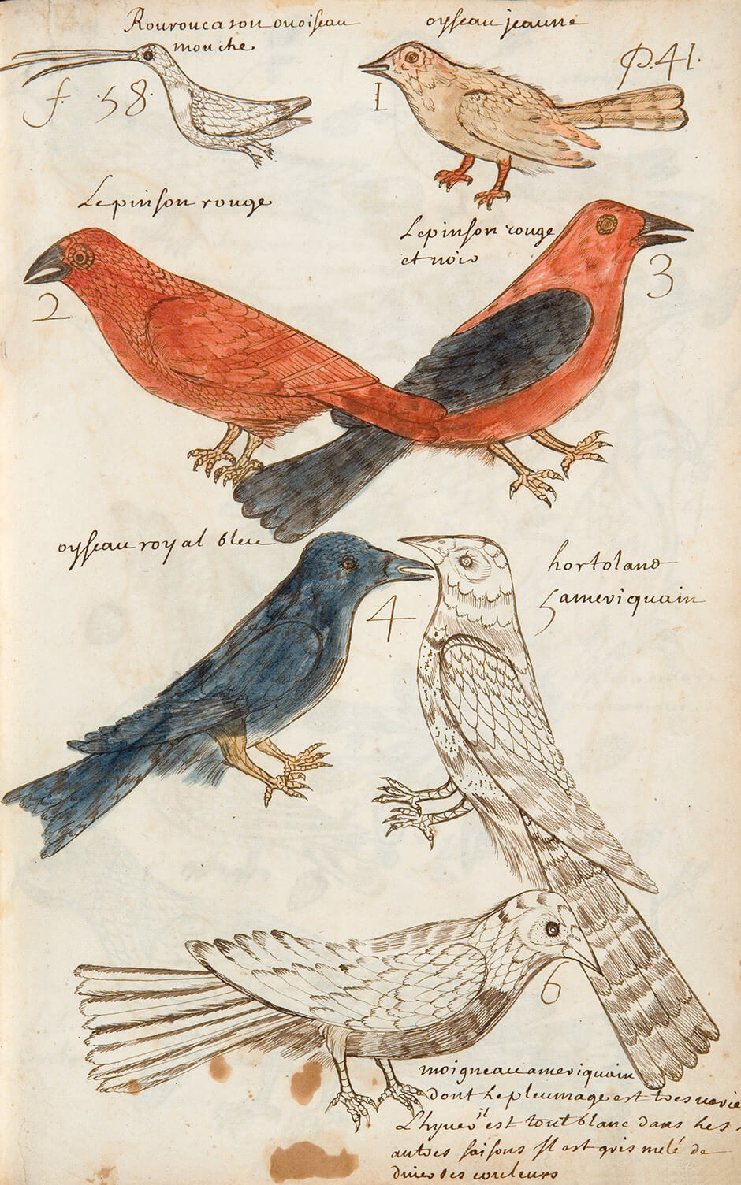
Culminating Task
Louis Nicolas, Birds, Codex Canadensis, page 41, n.d. Some of the birds that Nicolas drew can be identified as specific species; the birds represented here include the ruby-throated hummingbird, the purple finch, the scarlet tanager, and the eastern bluebird.

Slide 24
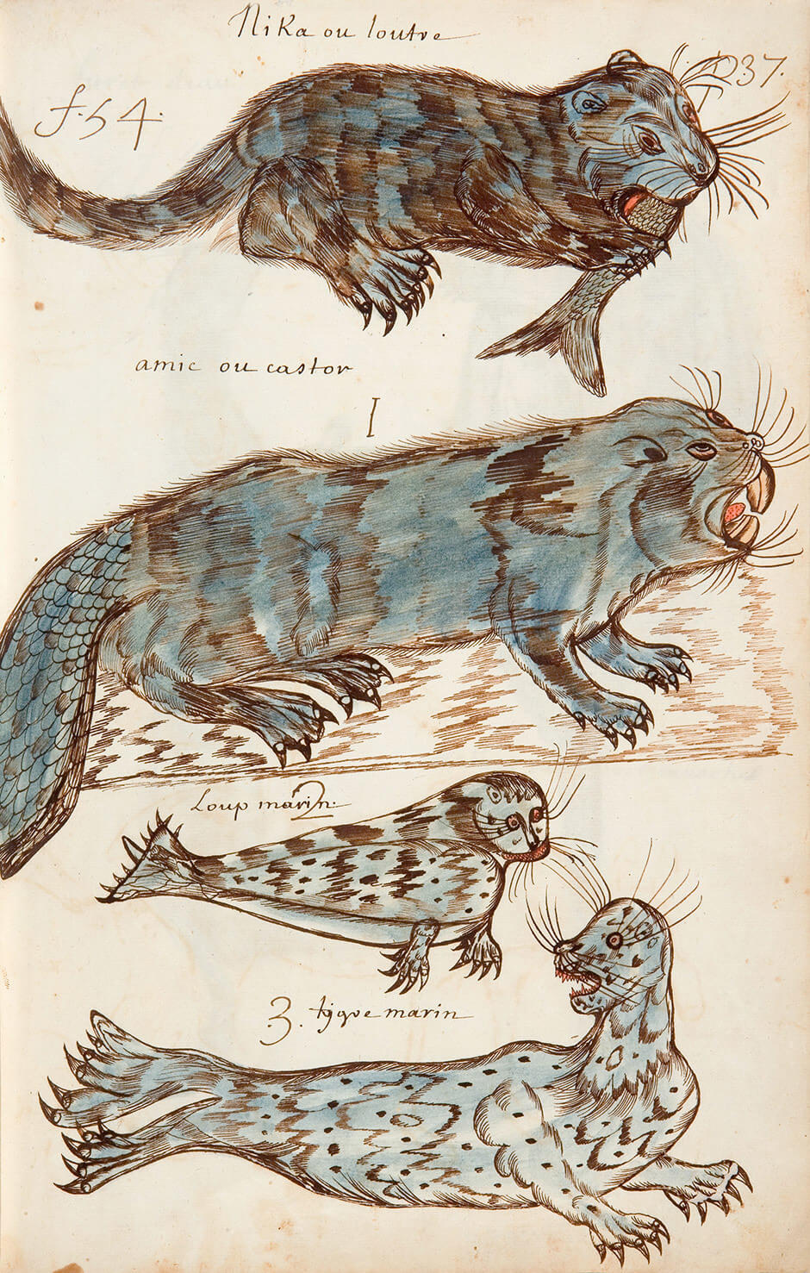
Culminating Task
Louis Nicolas, Amphibians, Codex Canadensis, page 37, n.d. The “amphibians” Nicolas depicts here are the otter, the beaver, and seals; today, these animals are classified as mammals.

Slide 25
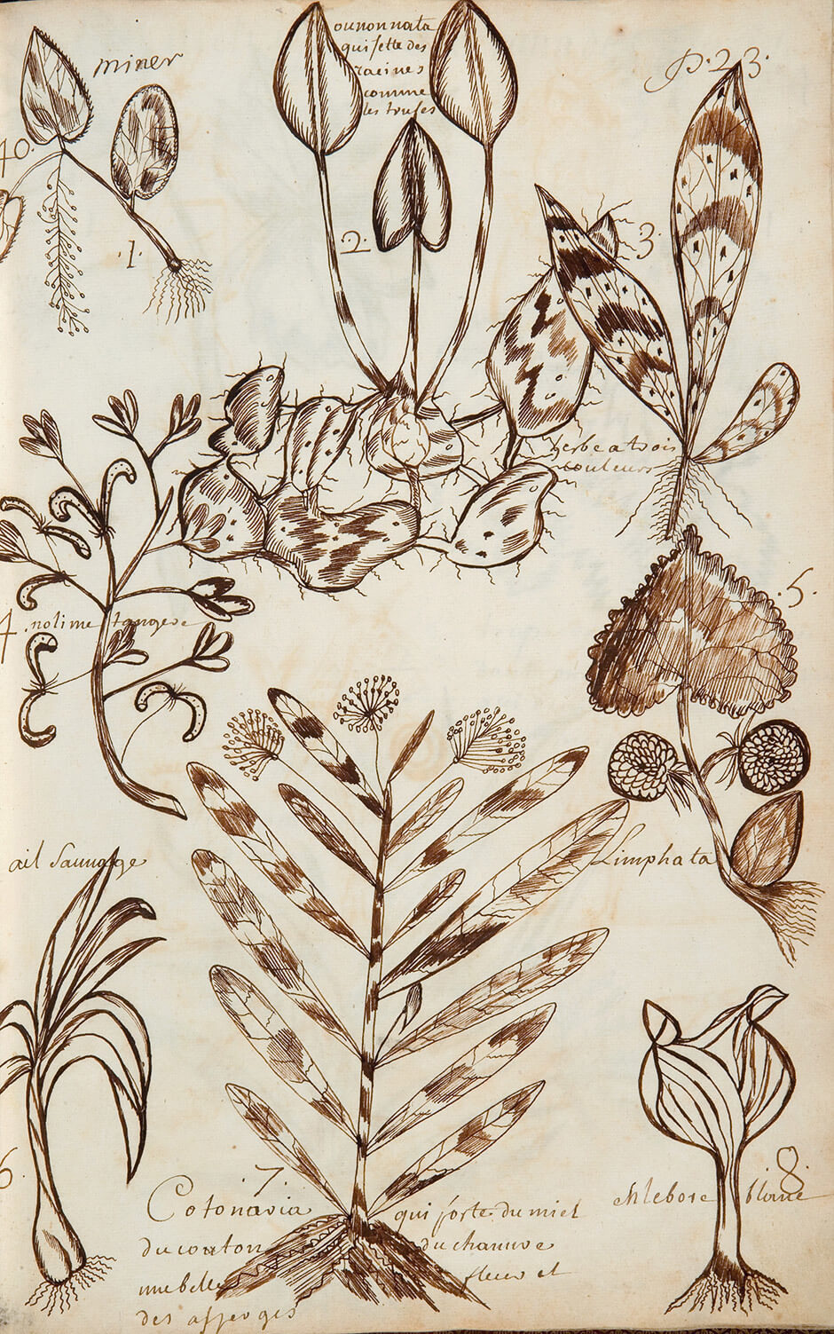
Culminating Task
Louis Nicolas, Plants, Codex Canadensis, page 23, n.d. Nicolas was interested in how plants were useful to humans as food and medicine.

Slide 26
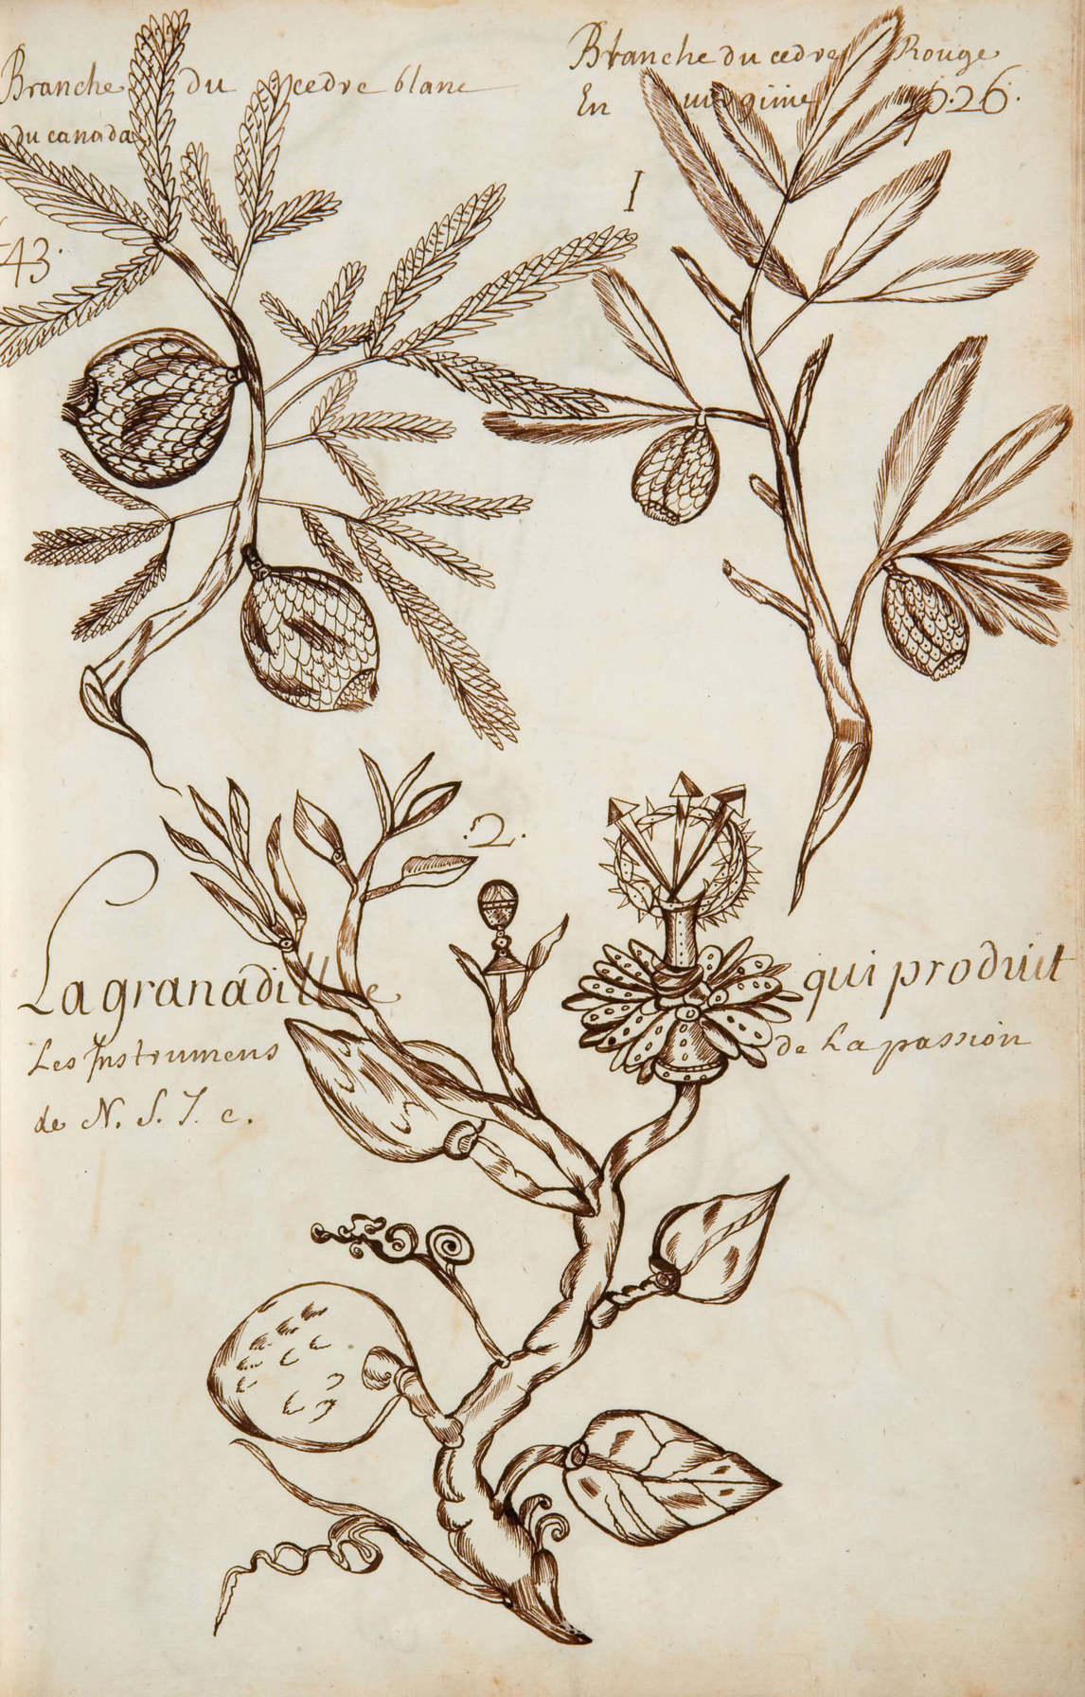
Culminating Task
Louis Nicolas, Branch of the White Cedar of Canada, Codex Canadensis, page 26, n.d. Nicolas may have sketched this plant in Canada, but he created this drawing in France.

Slide 27
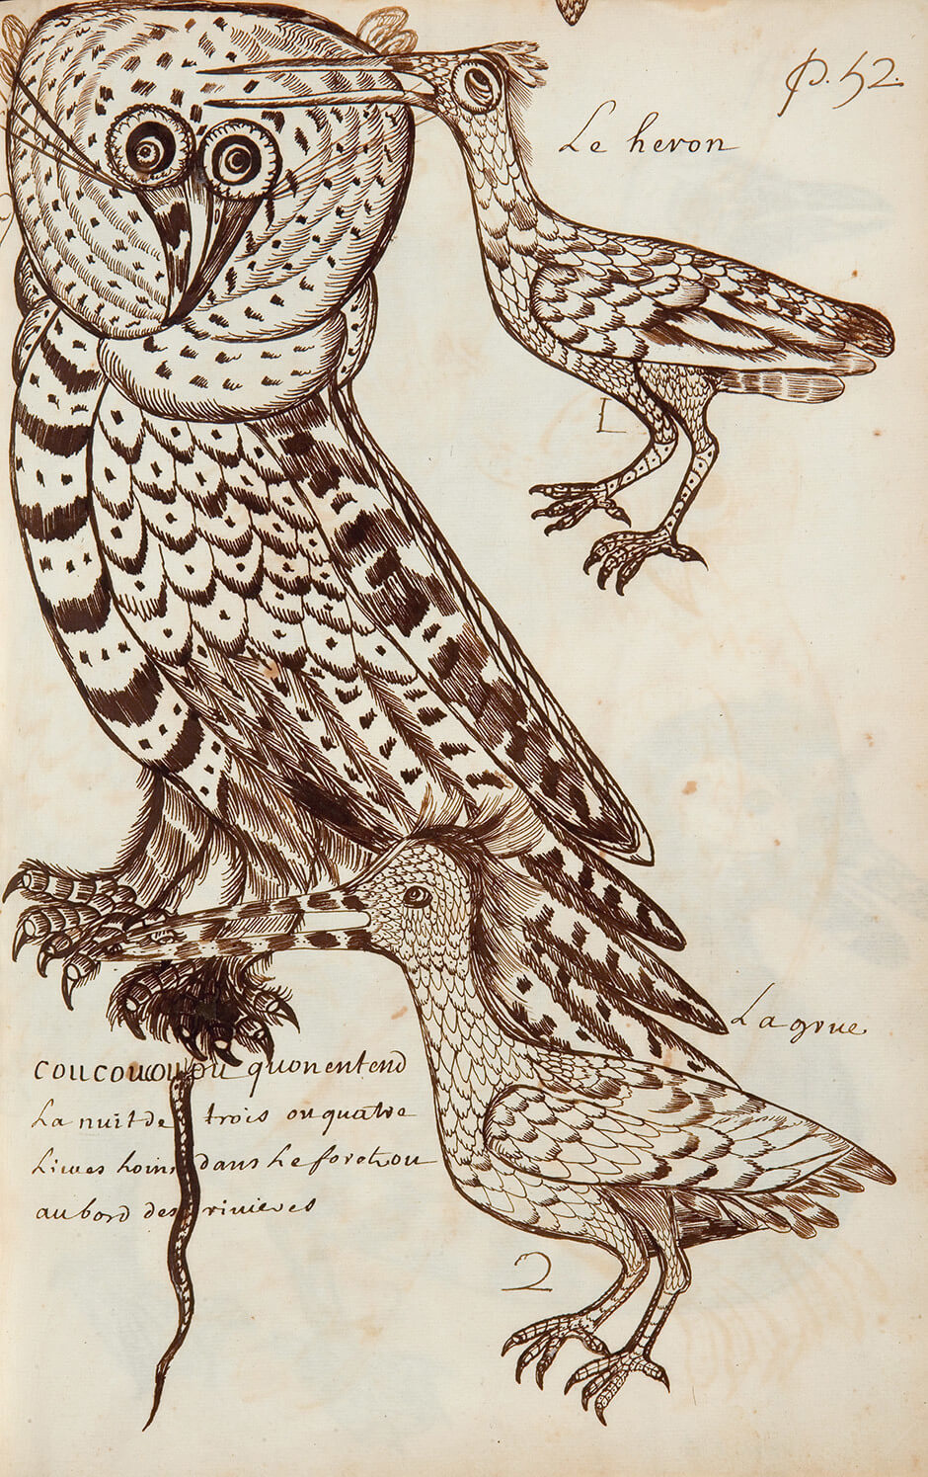
Culminating Task
Louis Nicolas, Coucoucouou, Codex Canadensis, page 52, n.d. The “Coucoucouou” (so named in imitation of its call) is probably the Great Grey Owl, pictured here with a long-tailed mouse in its claws.

Slide 28
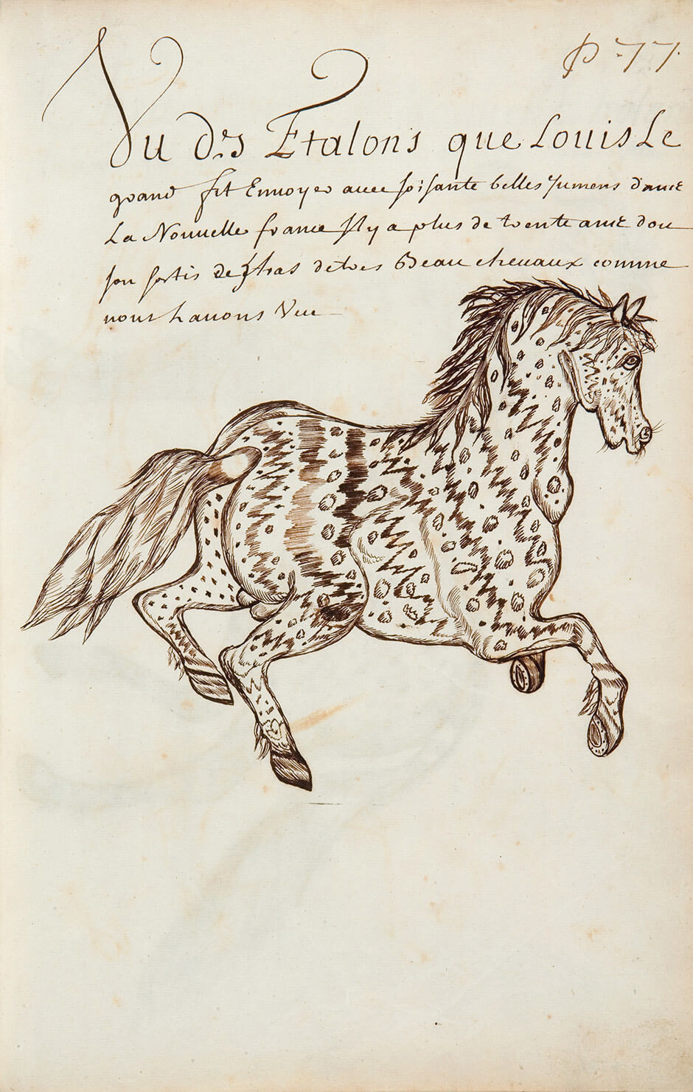
Culminating Task
Louis Nicolas, One of the Stallions that Louis the Great Sent . . . , Codex Canadensis, page 77, n.d. In 1667 Louis XIV sent stallions to New France to help the colony raise more horses.

Slide 29
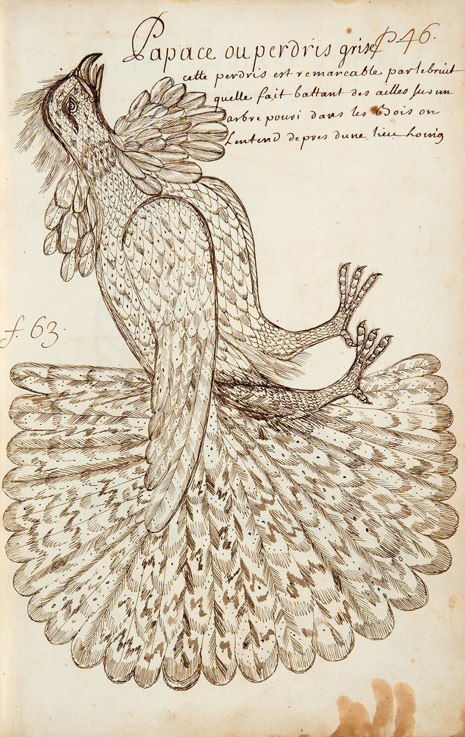
Louis Nicolas, Papace, or Grey Partridge, Codex Canadensis, page 46, n.d. This is one of Nicolas’s most spectacular bird illustrations.

Slide 30
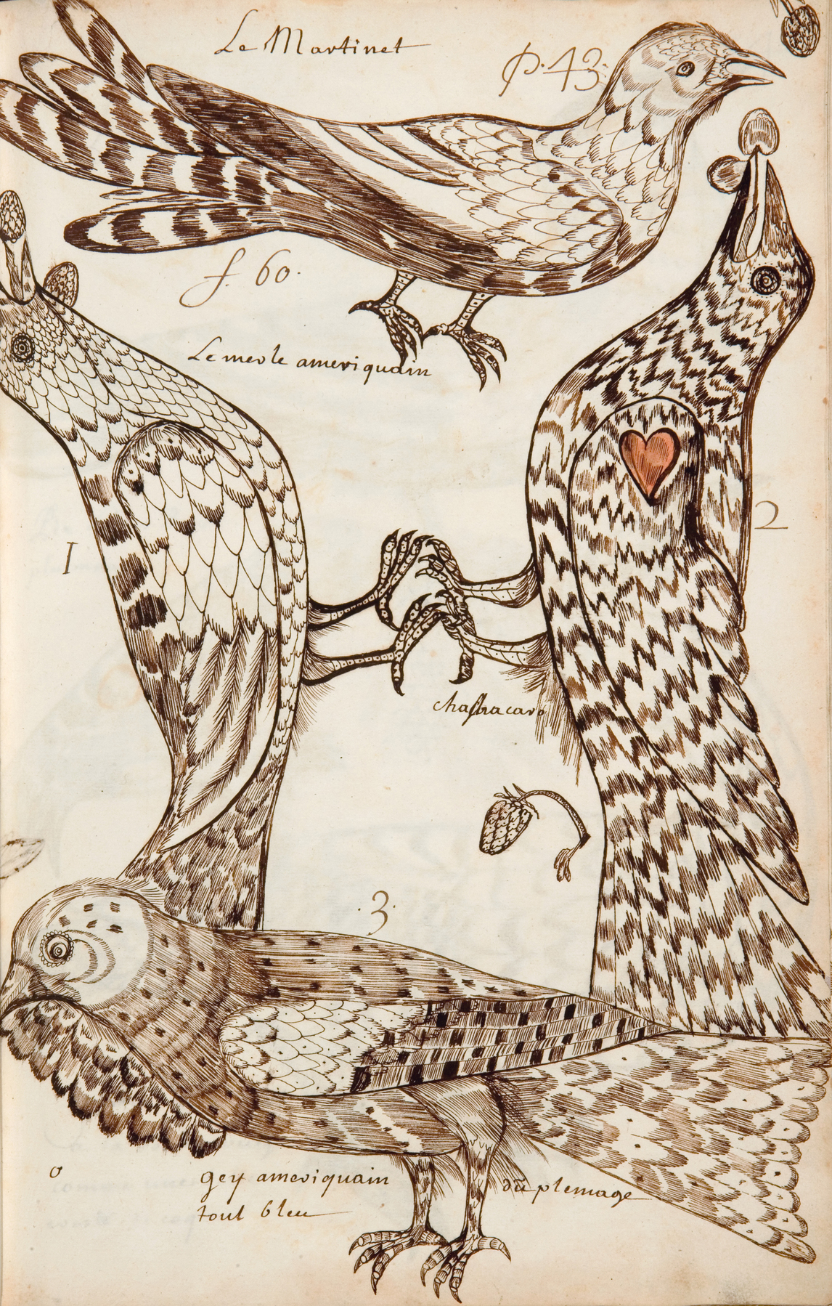
Louis Nicolas, The Swift, Codex Canadensis, page 43, n.d. The red heart in the image alludes to a red patch on the bird’s wings.

Slide 31
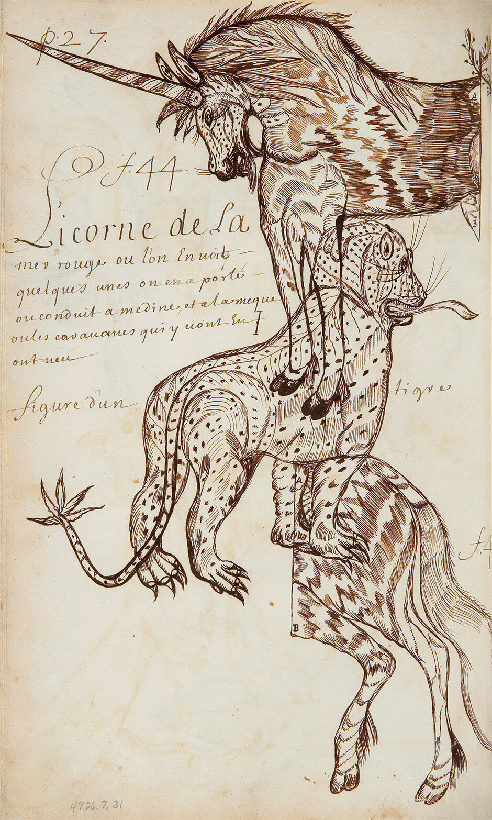
Louis Nicolas, Unicorn of the Red Sea, Codex Canadensis, page 27, n.d. Nicolas has drawn a tiger in between the two halves of the unicorn’s body—a very curious choice.

Slide 32
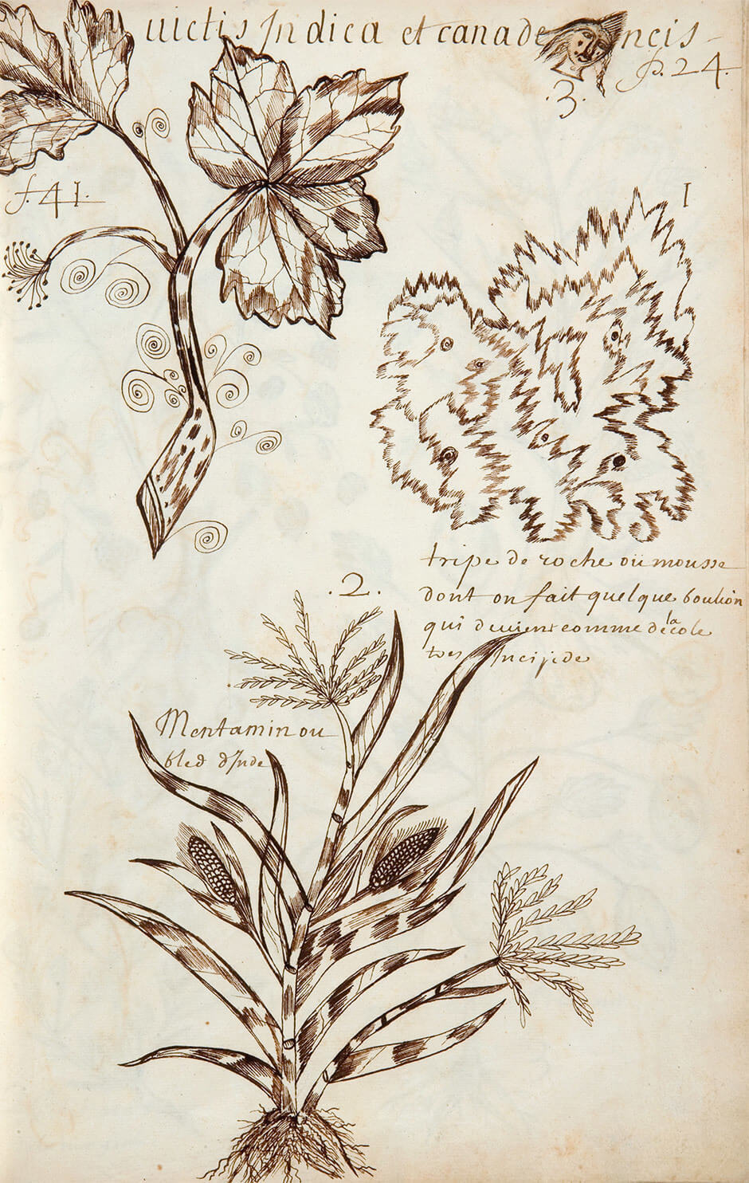
Louis Nicolas, Tripe de Roche, or Moss, Codex Canadensis, page 24, n.d. Nicolas’s images of plants are among his most original.

