Slide 2
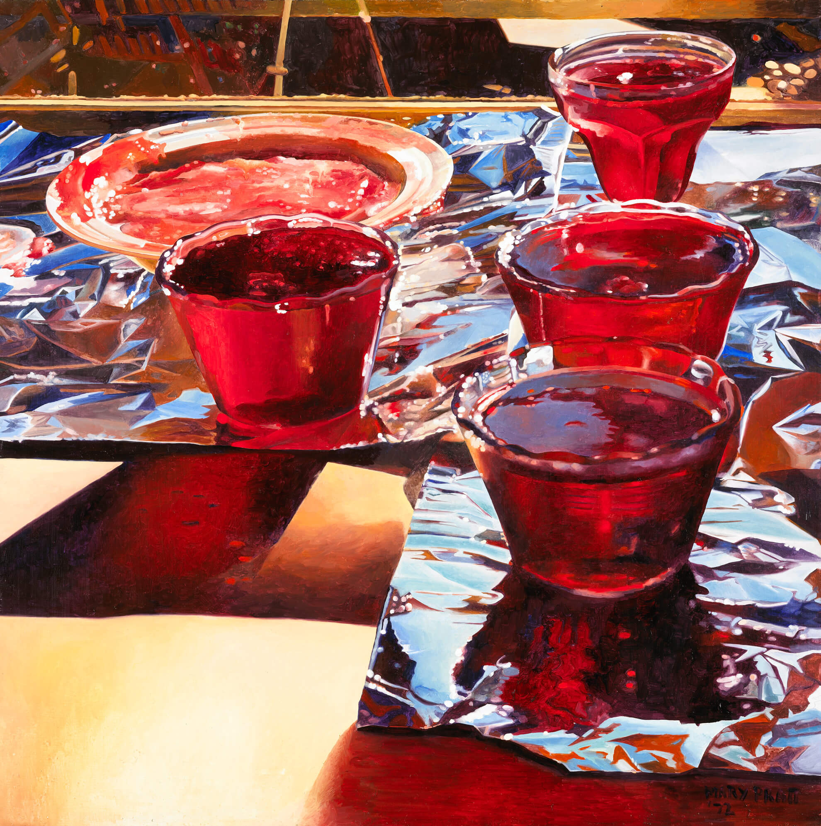
Mary Pratt, Red Currant Jelly, 1972. Jars of jelly and jam appear frequently in Mary Pratt’s paintings, often catching the light.

Slide 3
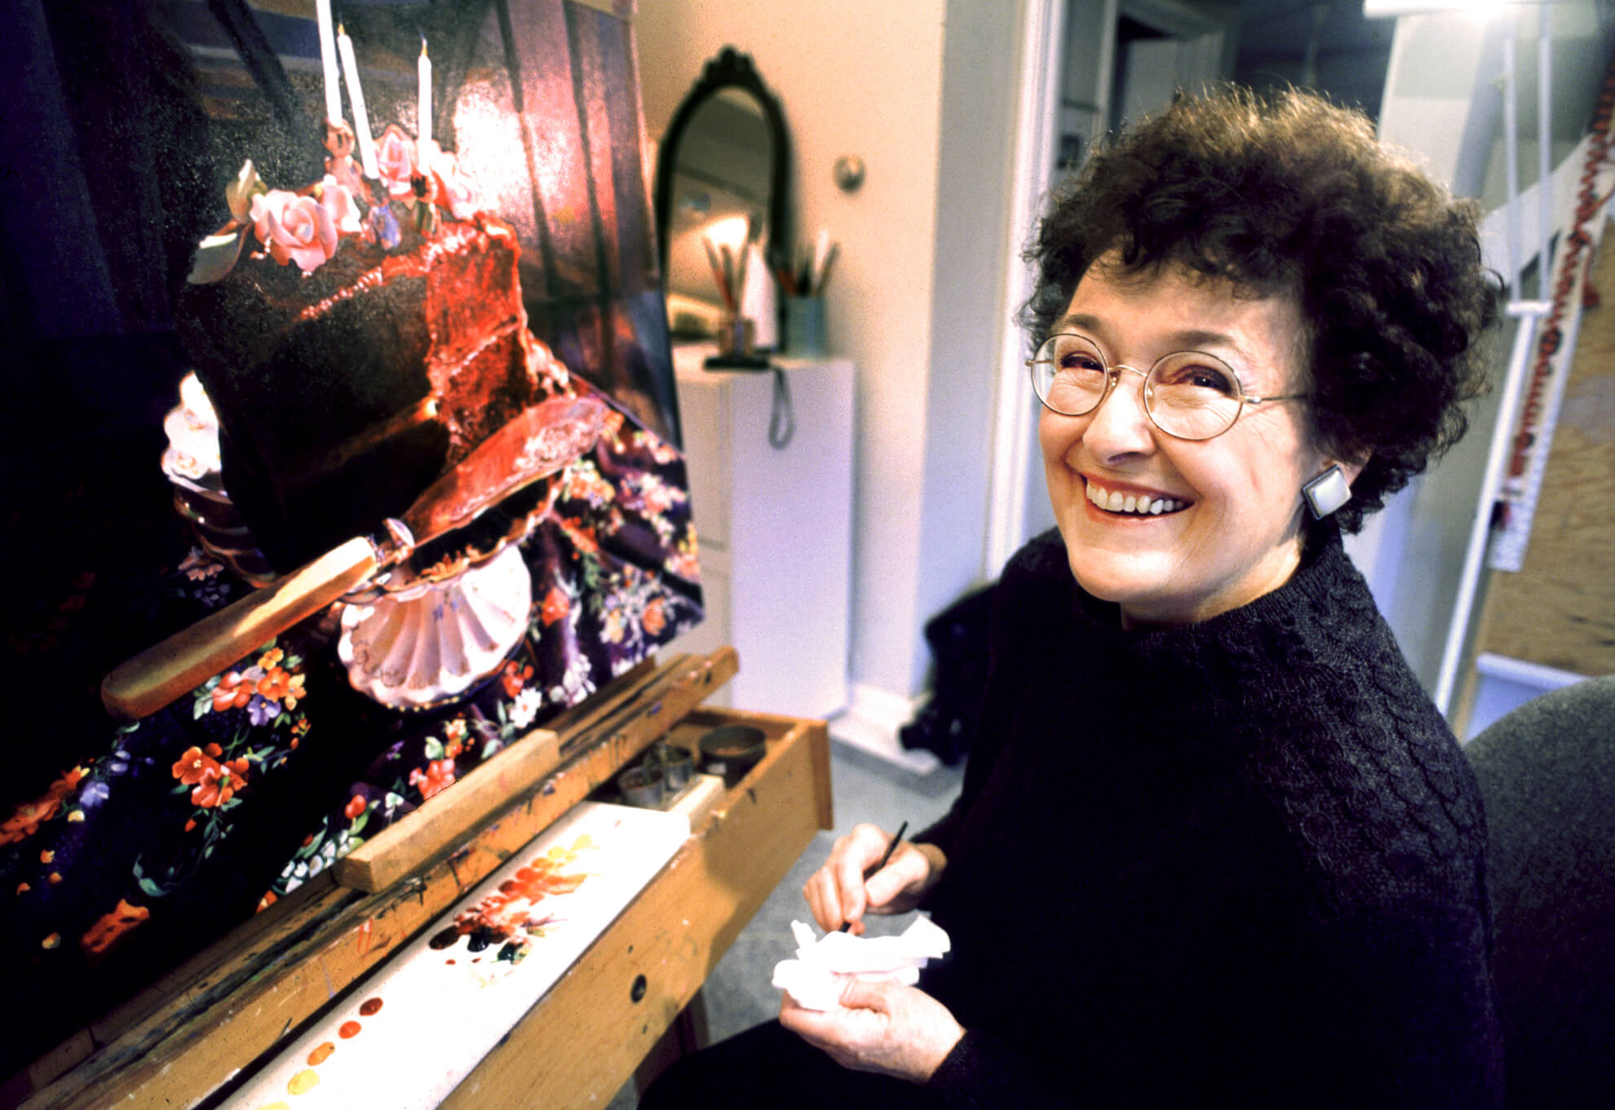
Mary Pratt with her painting Chocolate Birthday Cake, 1997.

Slide 4
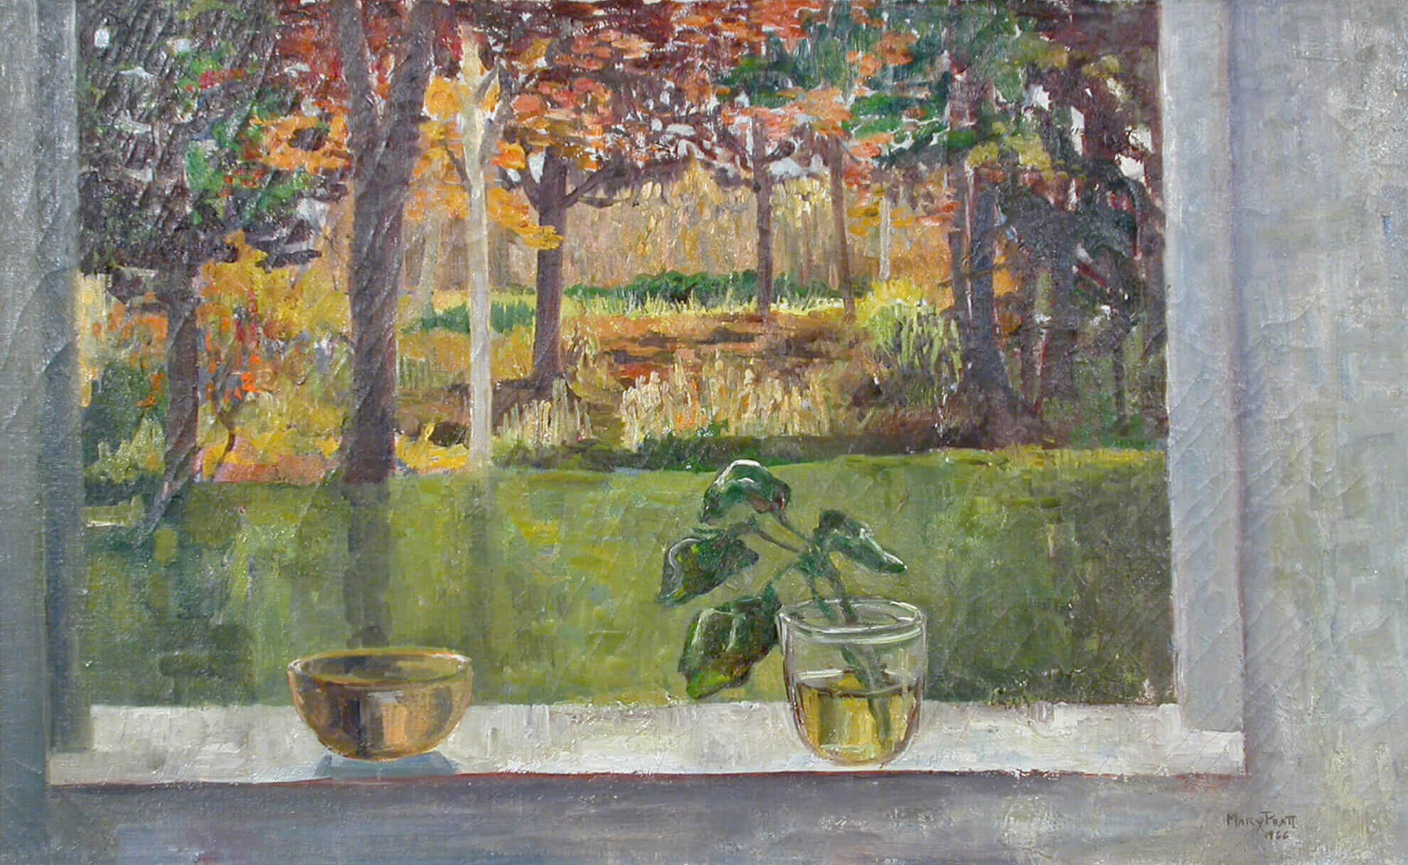
Mary Pratt, October Window, 1966. In her early work, Pratt experimented with “impressionistic” painting, characterized by loose brush strokes.

Slide 5
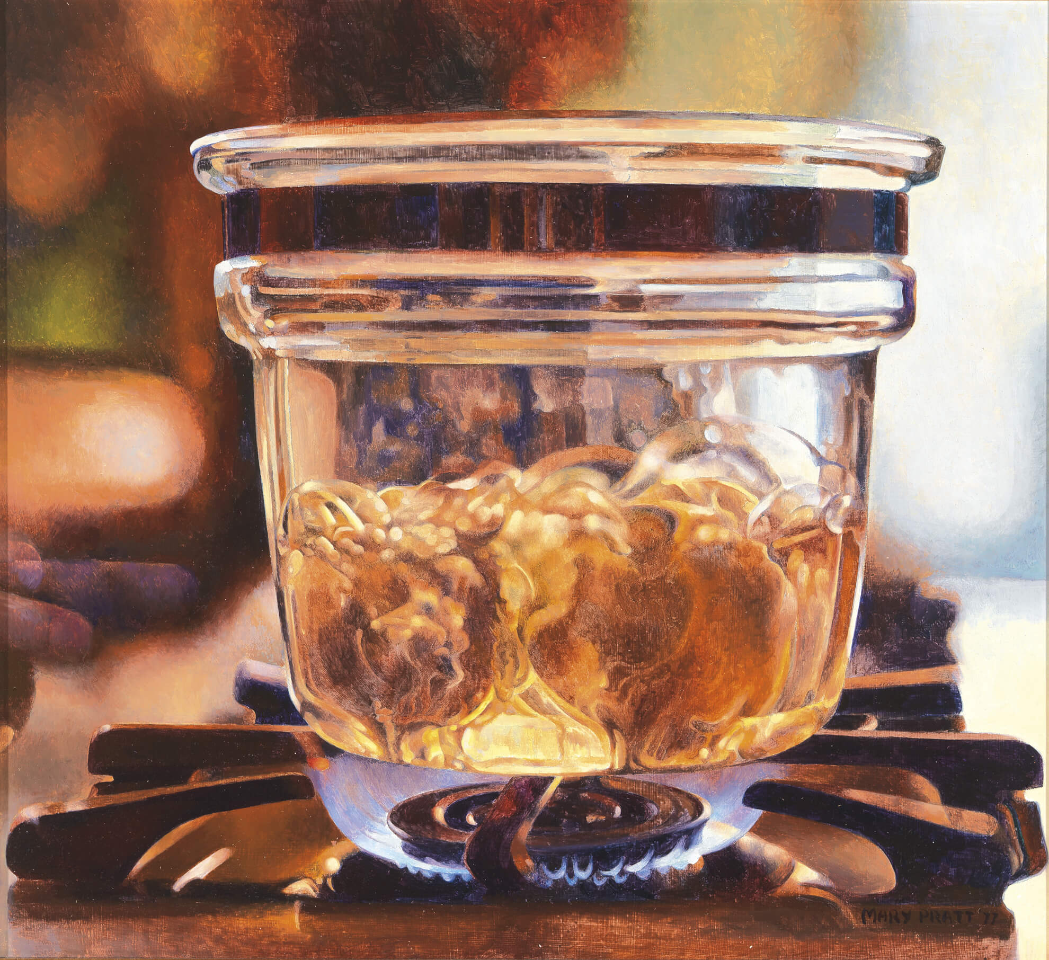
Mary Pratt, Pyrex on Gas Flame, 1977. This painting reveals Pratt’s talent for meticulously rendering everyday objects.

Slide 6
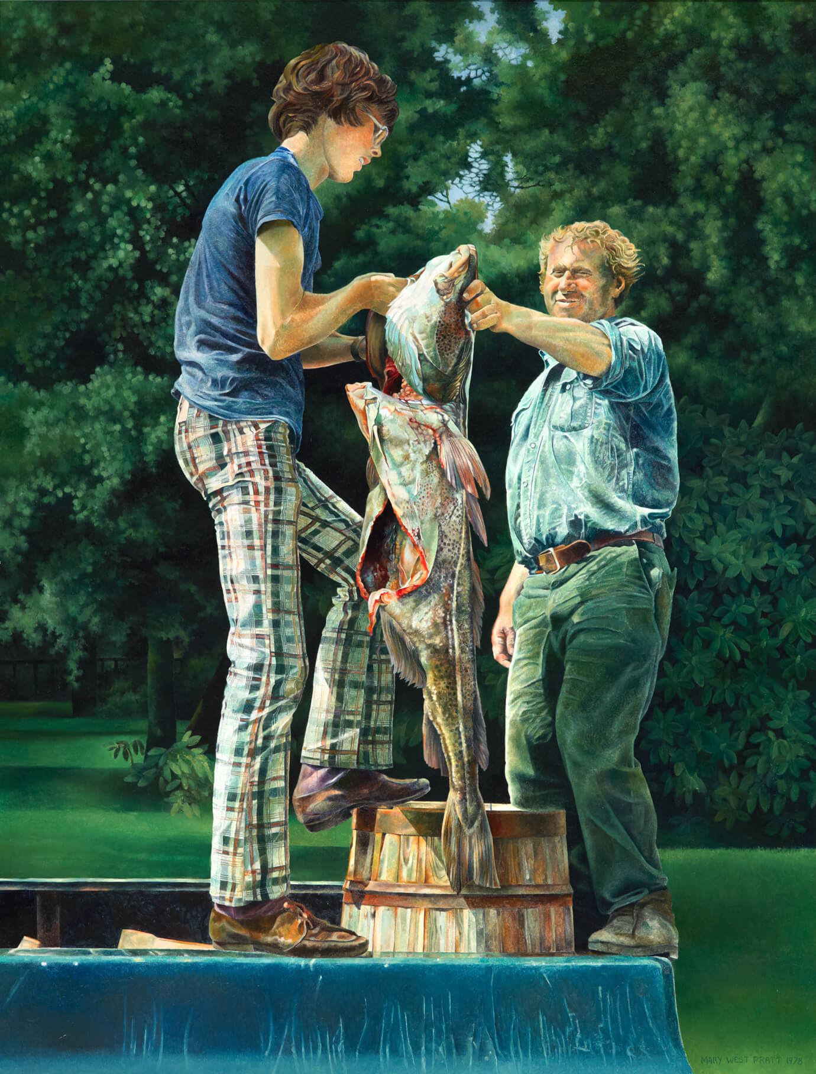
Mary Pratt, Another Province of Canada, 1978. Pratt lived in Newfoundland, and salmon—an important fish in the province—appear in many of her works.

Slide 7
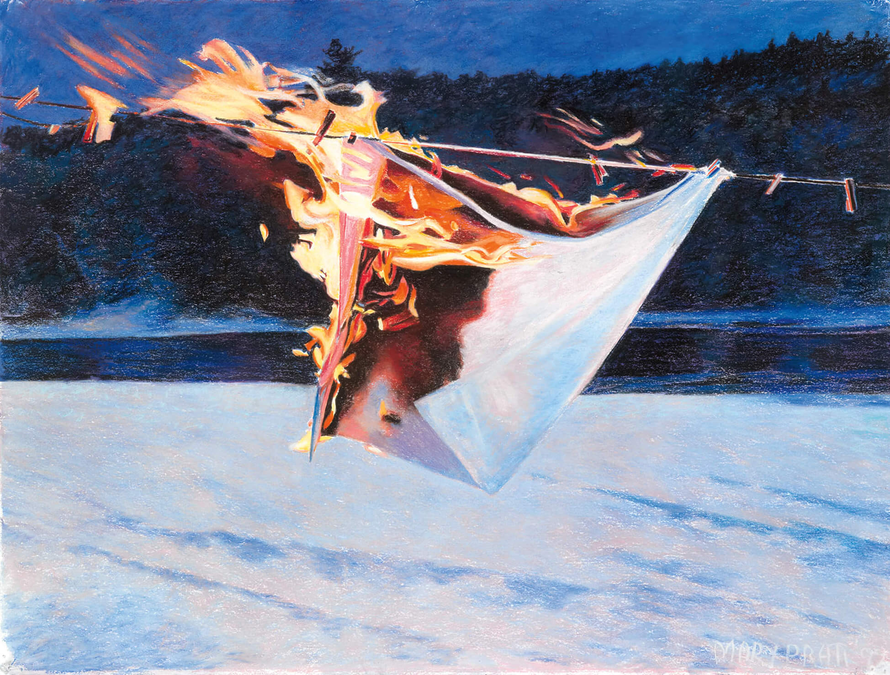
Mary Pratt, Dishcloth on Line #3, 1997. In the 1990s, Pratt began using pastels and watercolour on paper, as in this mixed-media work.

Slide 8
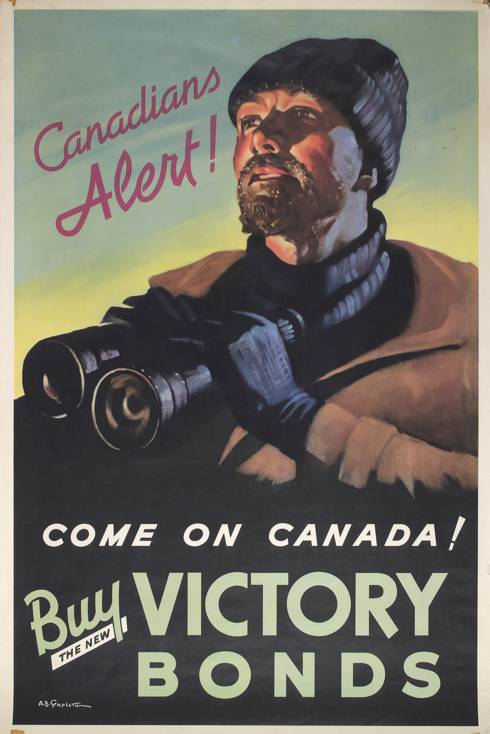
Second World War poster, 1942.

Slide 9
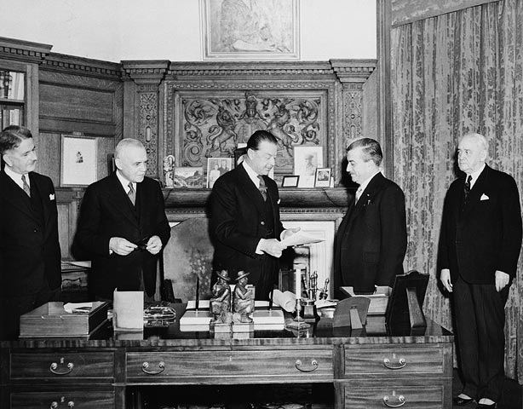
Harold Alexander, Governor General of Canada, receives the bill concerning the terms of the union of Newfoundland with Canada, 1949.

Slide 10
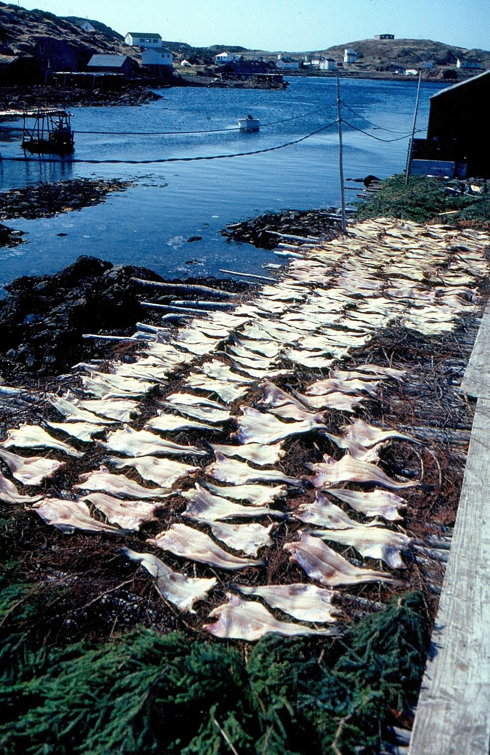
Drying codfish, 1982.

Slide 11
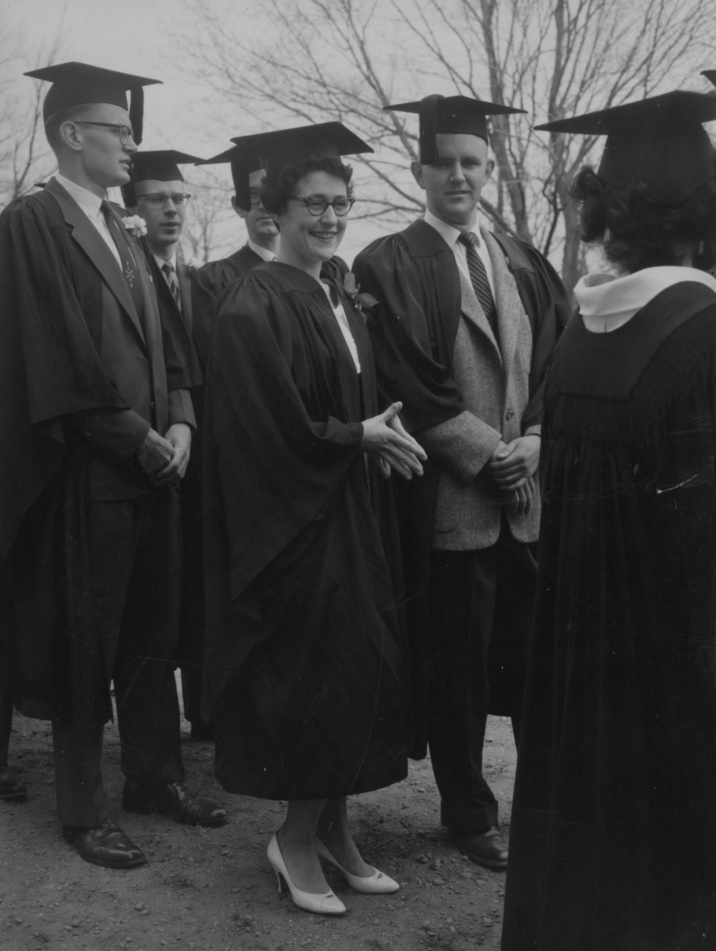
Mary Pratt (centre) with Christopher Pratt at their graduation from Mount Allison University, May 16, 1961.

Slide 12
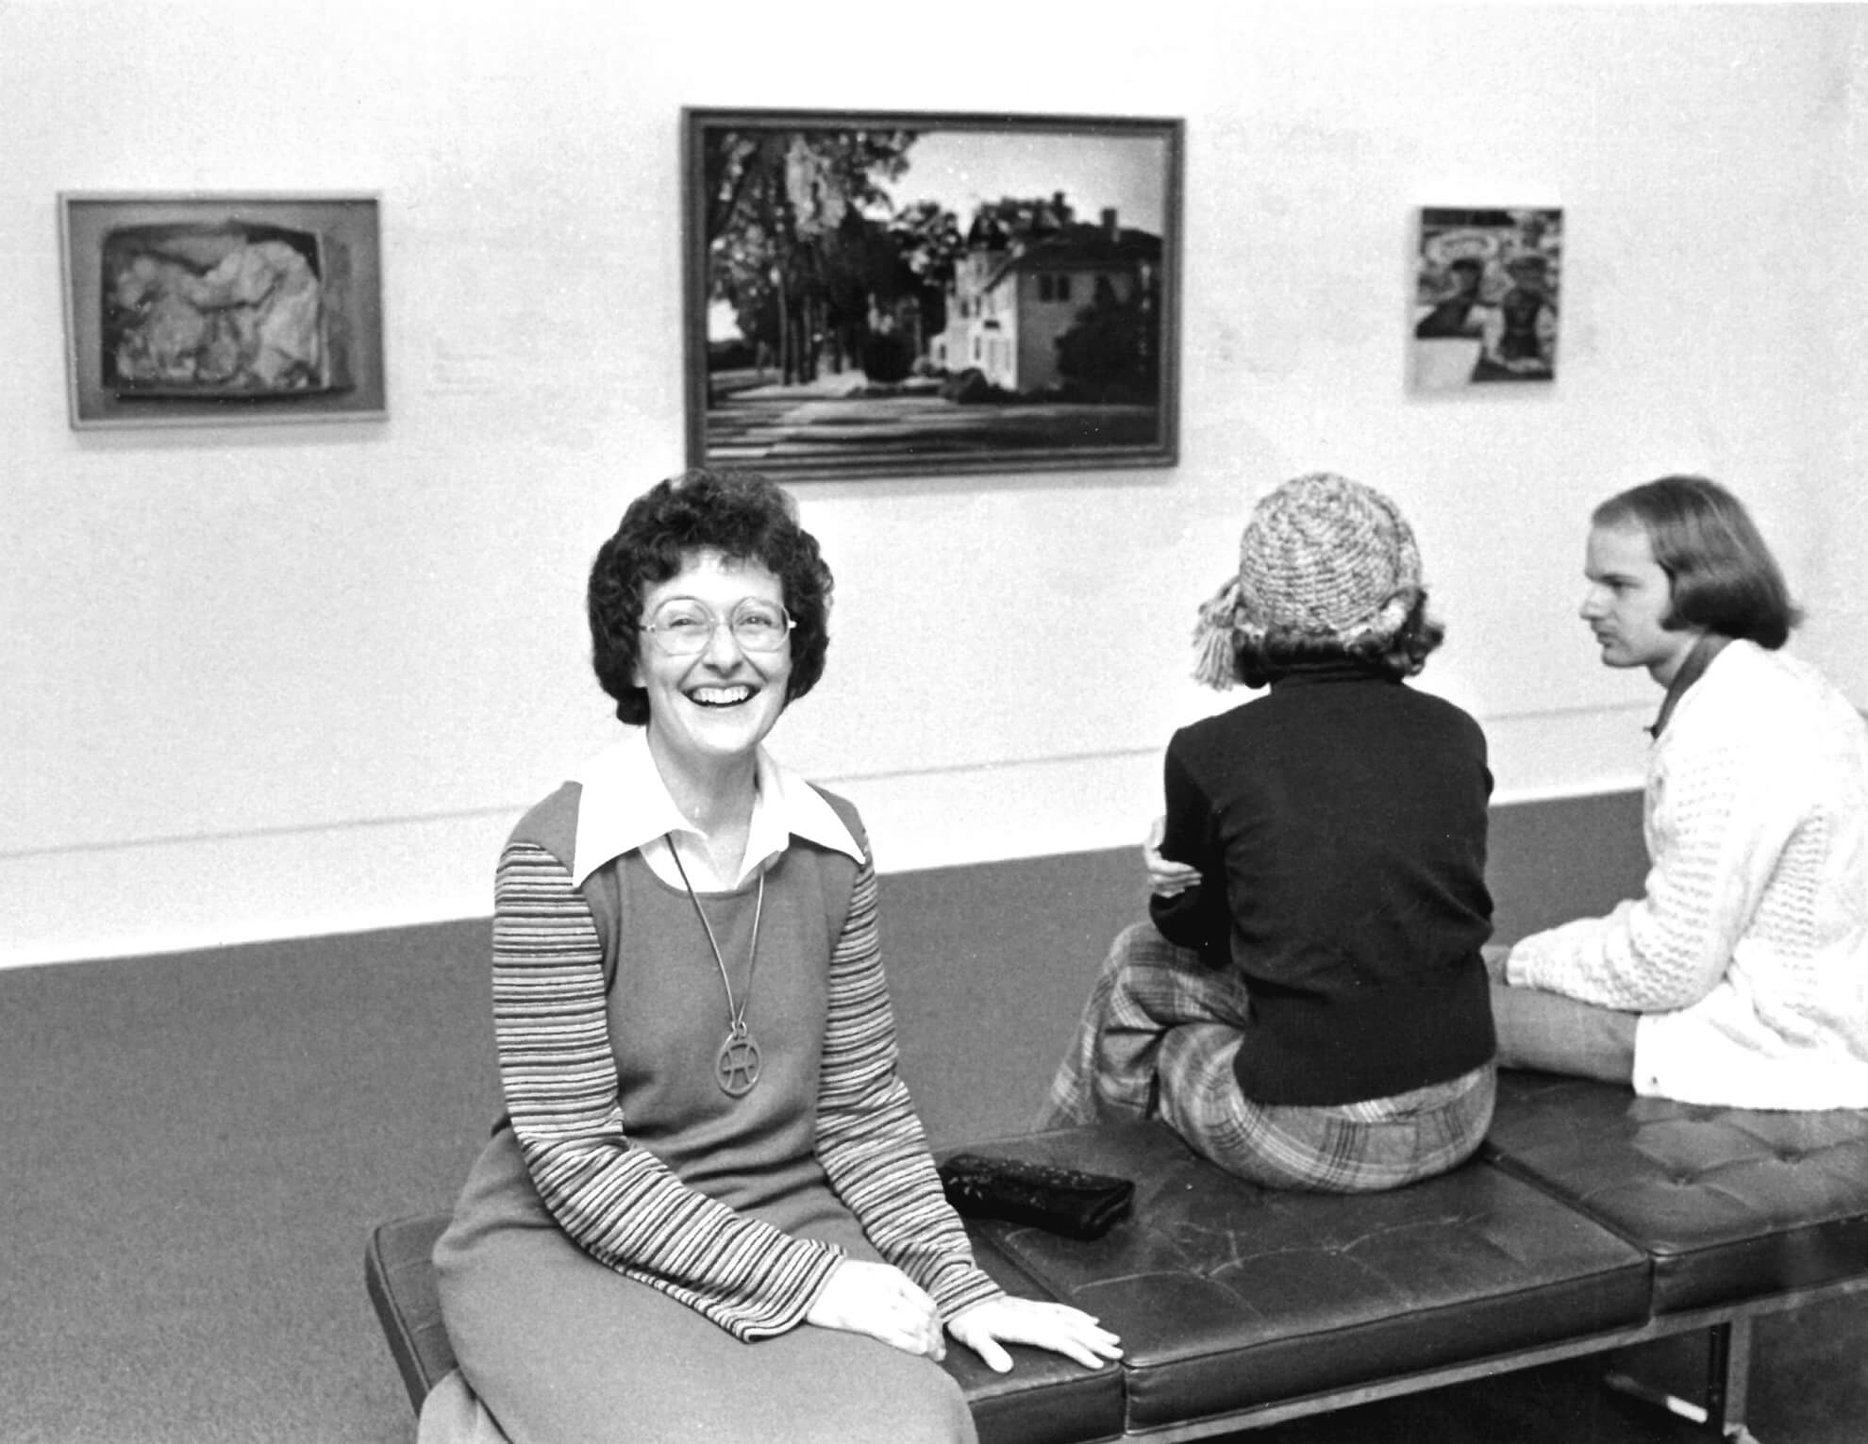
Mary Pratt at the opening of Some Canadian Women Artists at the National Gallery of Canada, Ottawa, 1975.

Slide 13
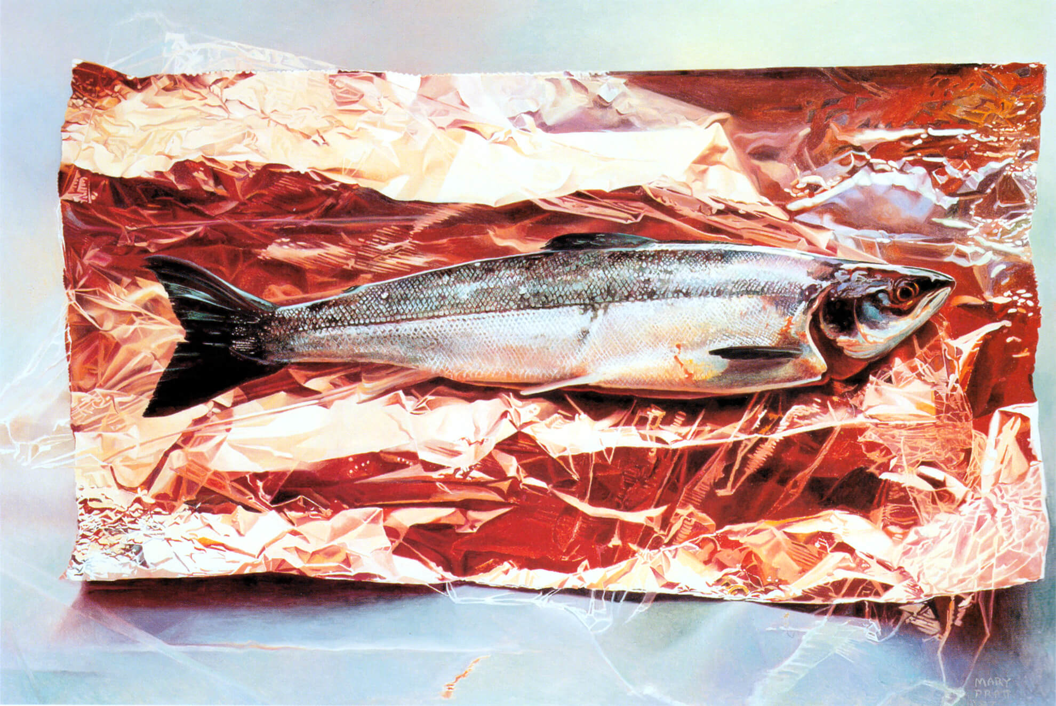
Mary Pratt, Silver Fish on Crimson Foil, 1987. Pratt mastered the realist style of painting.

Slide 14
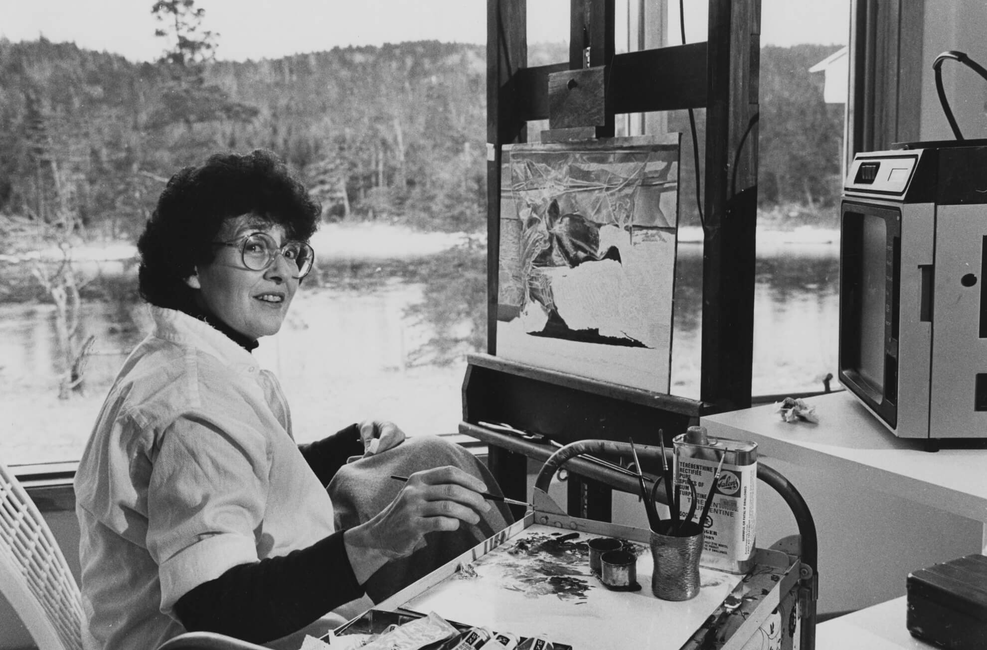
Mary Pratt in her studio, 1990s.

Slide 15
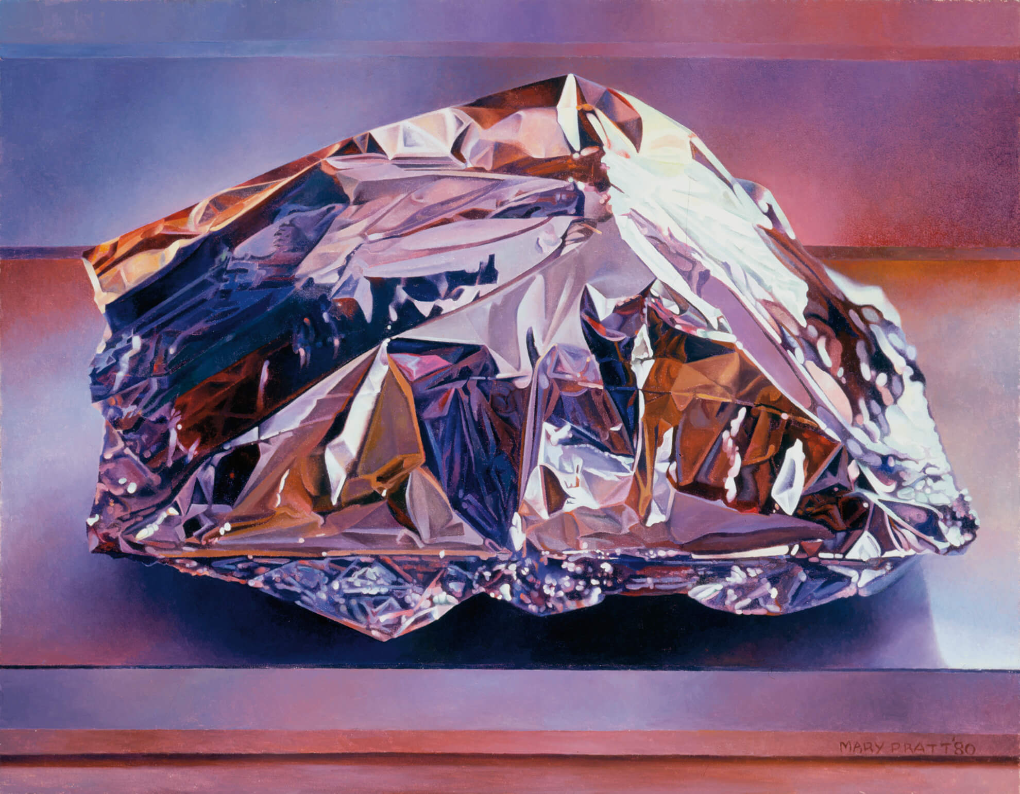
Learning Activity #1
Mary Pratt, Christmas Turkey, 1980. This work is an example of the close observation of light and texture that is typical of Pratt’s art.

Slide 16
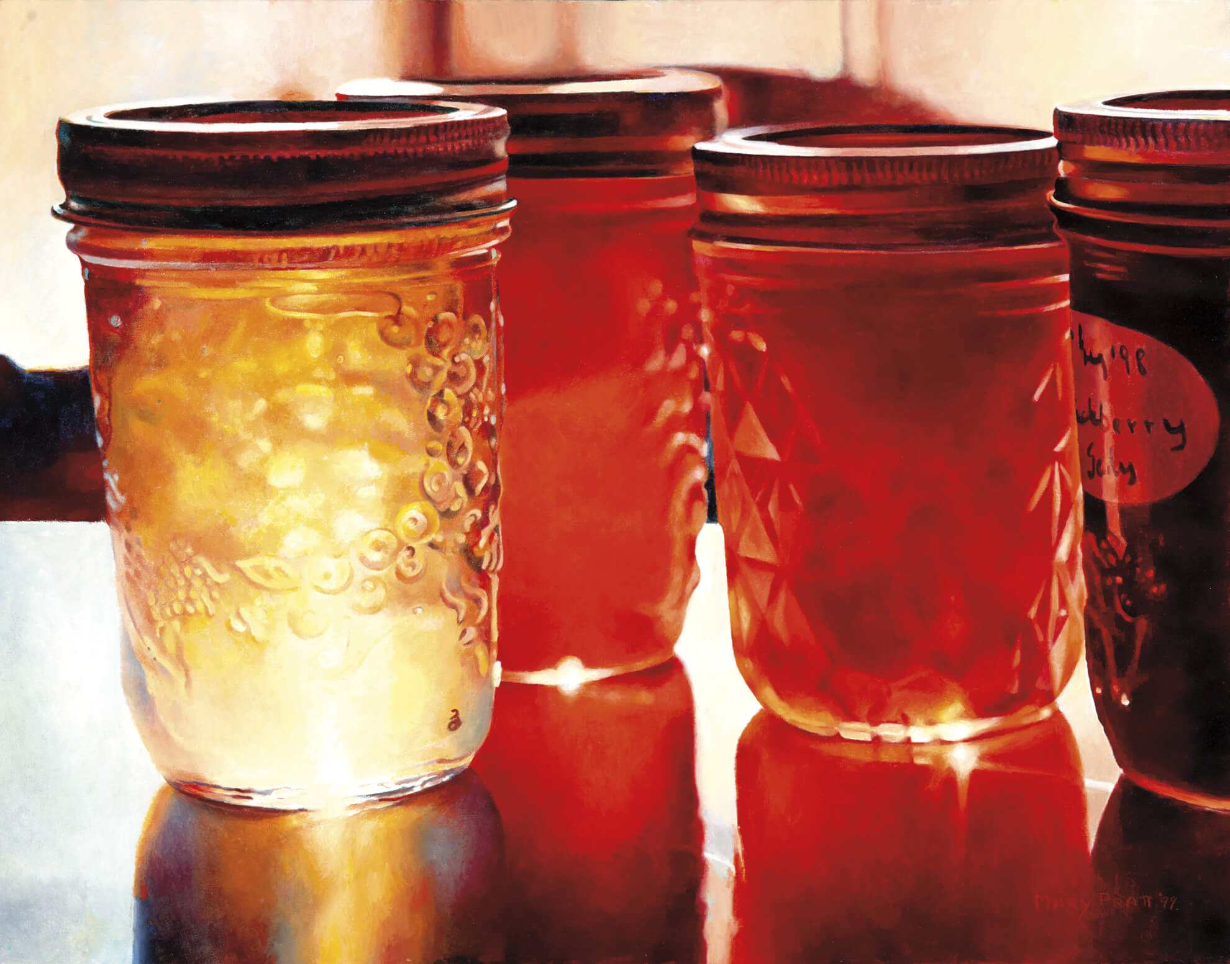
Learning Activity #1
Mary Pratt, Jelly Shelf, 1999. This painting was inspired by a childhood memory of seeing light coming through the jars of jelly.

Slide 17
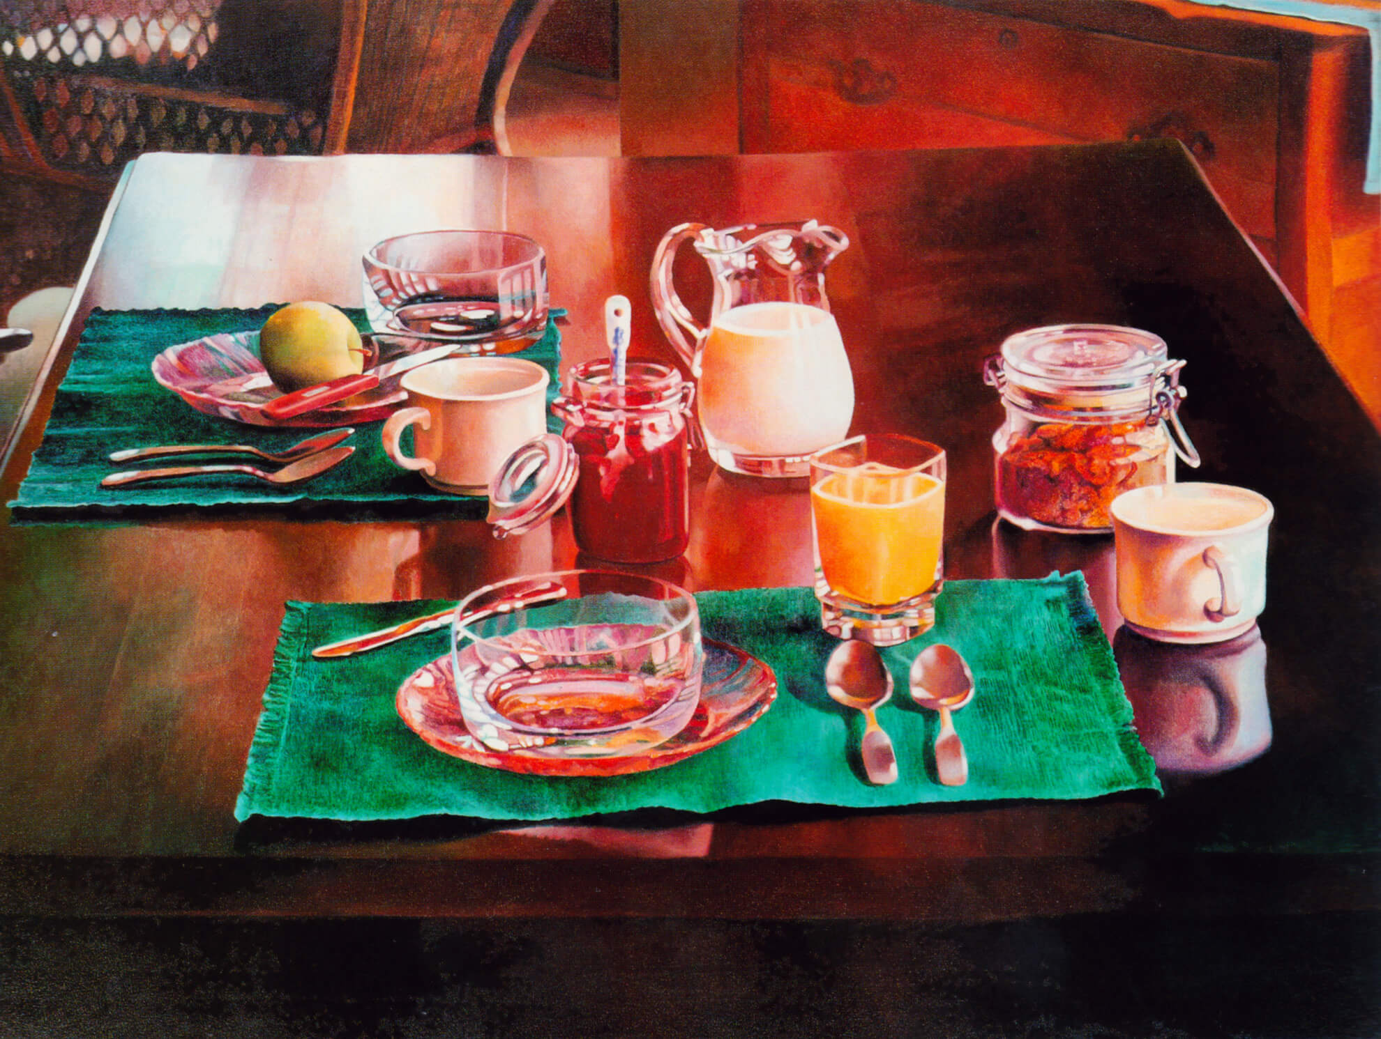
Learning Activity #1
Mary Pratt, Breakfast Last Summer, 1994. Alongside her still-life works, Pratt also liked to paint domestic interiors.

Slide 18
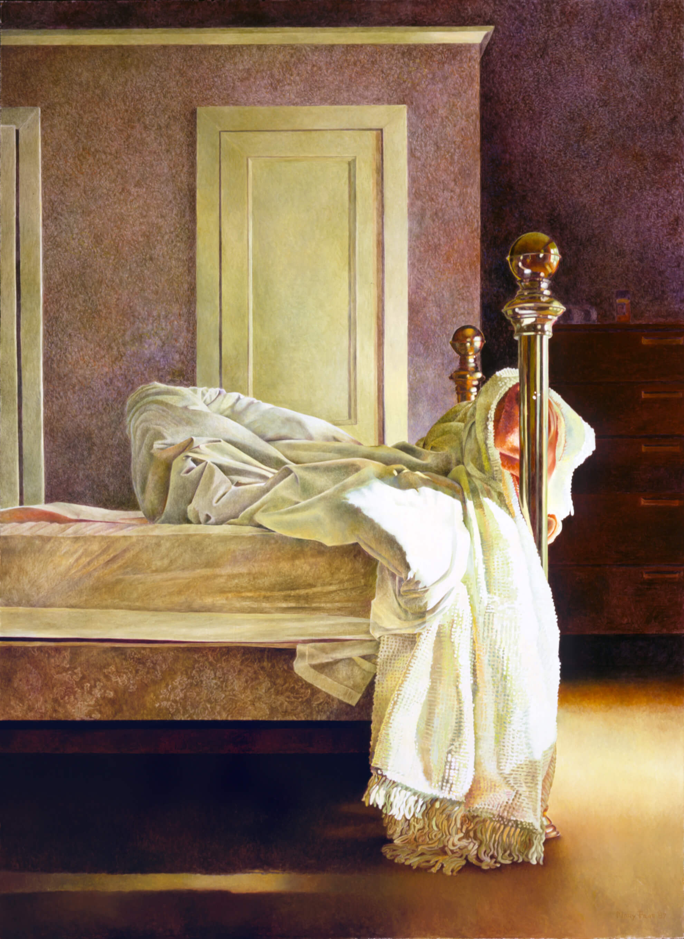
Learning Activity #1
Mary Pratt, Bedroom, 1987. In this painting, Pratt evokes human presence without picturing people by representing an unmade bed.

Slide 19
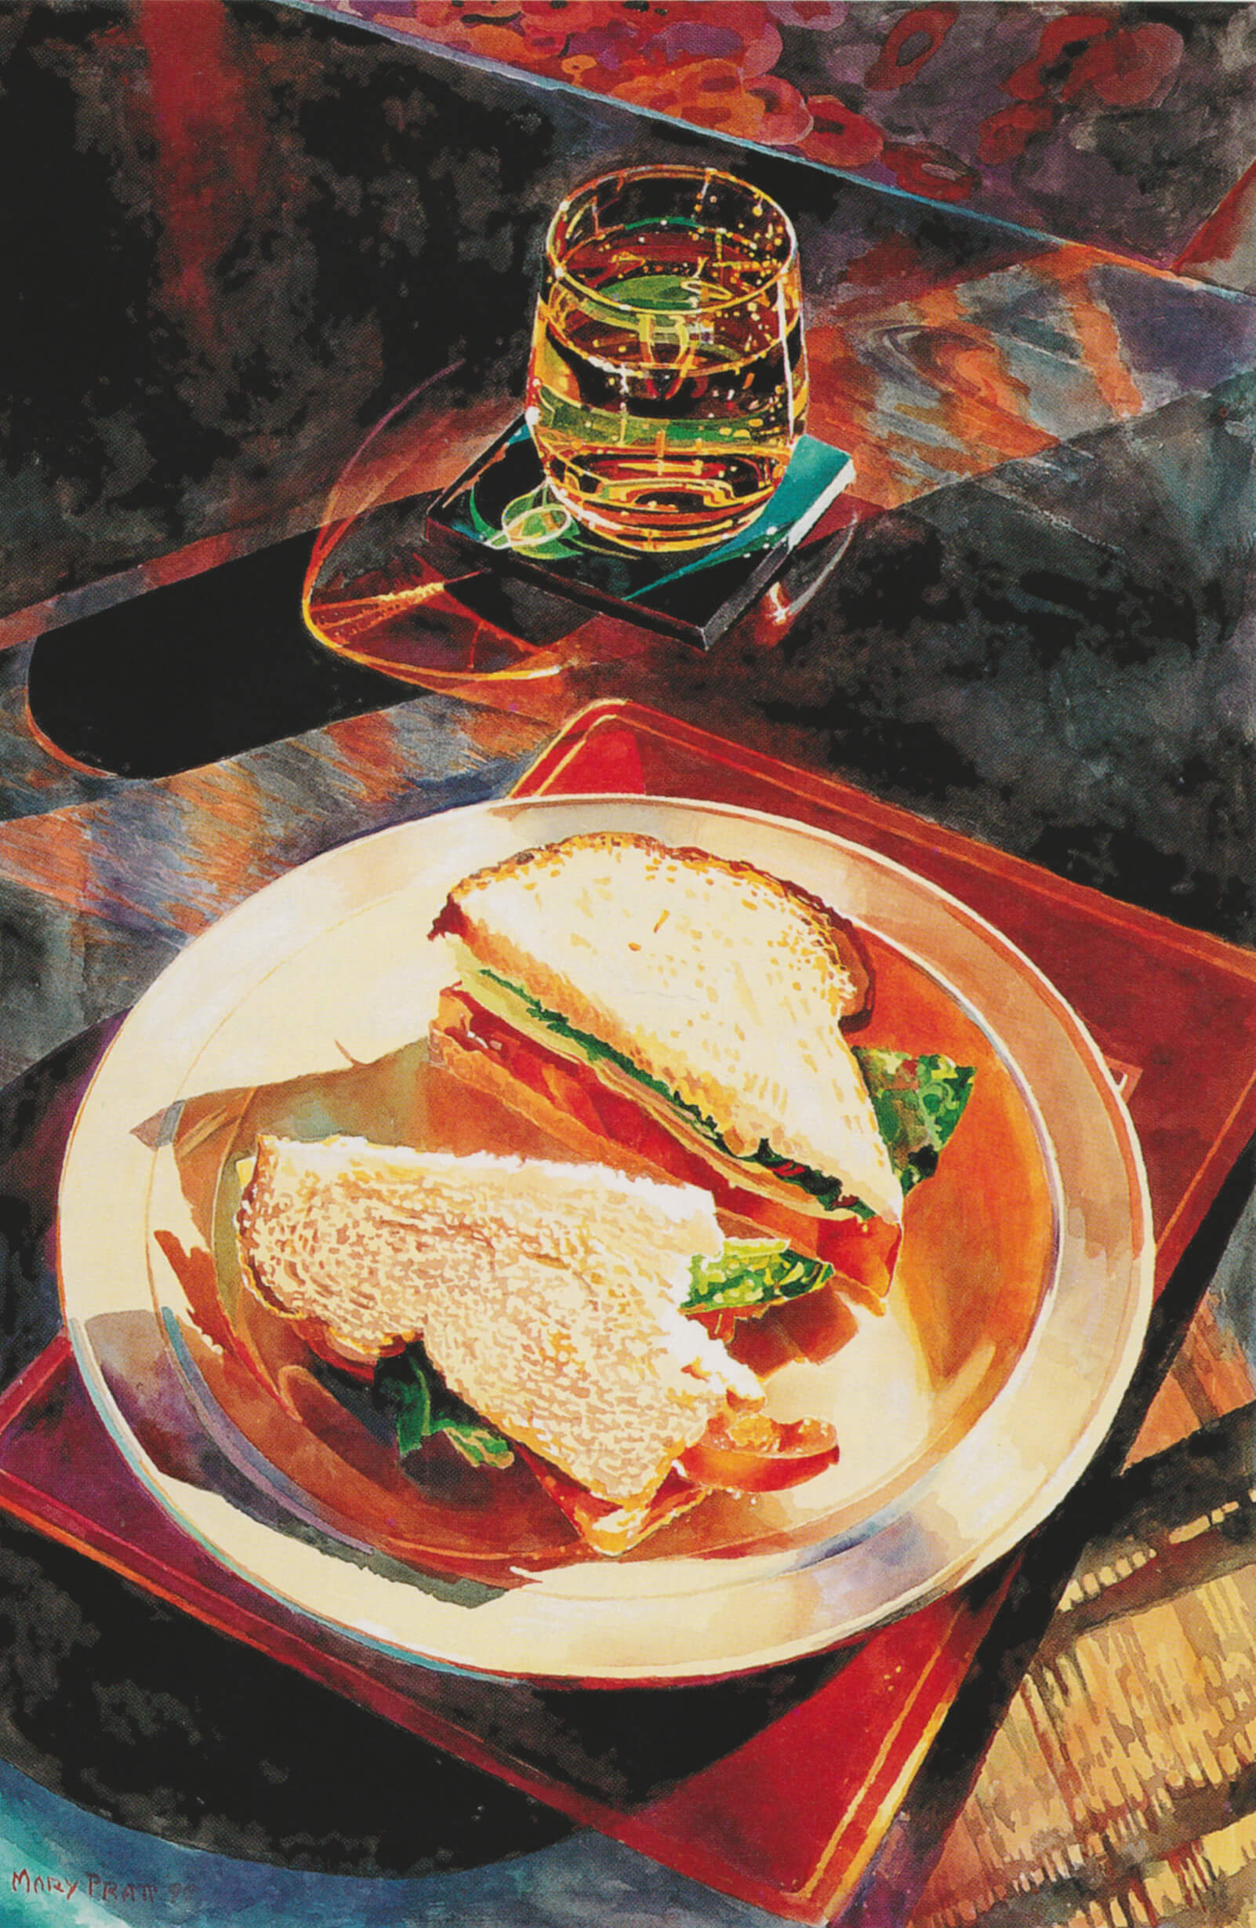
Learning Activity #2
Mary Pratt, Ginger Ale and Tomato Sandwich No. 1, 1999. A “bird’s eye view” perspective is masterfully portrayed in this image of a partially-eaten snack.

Slide 20
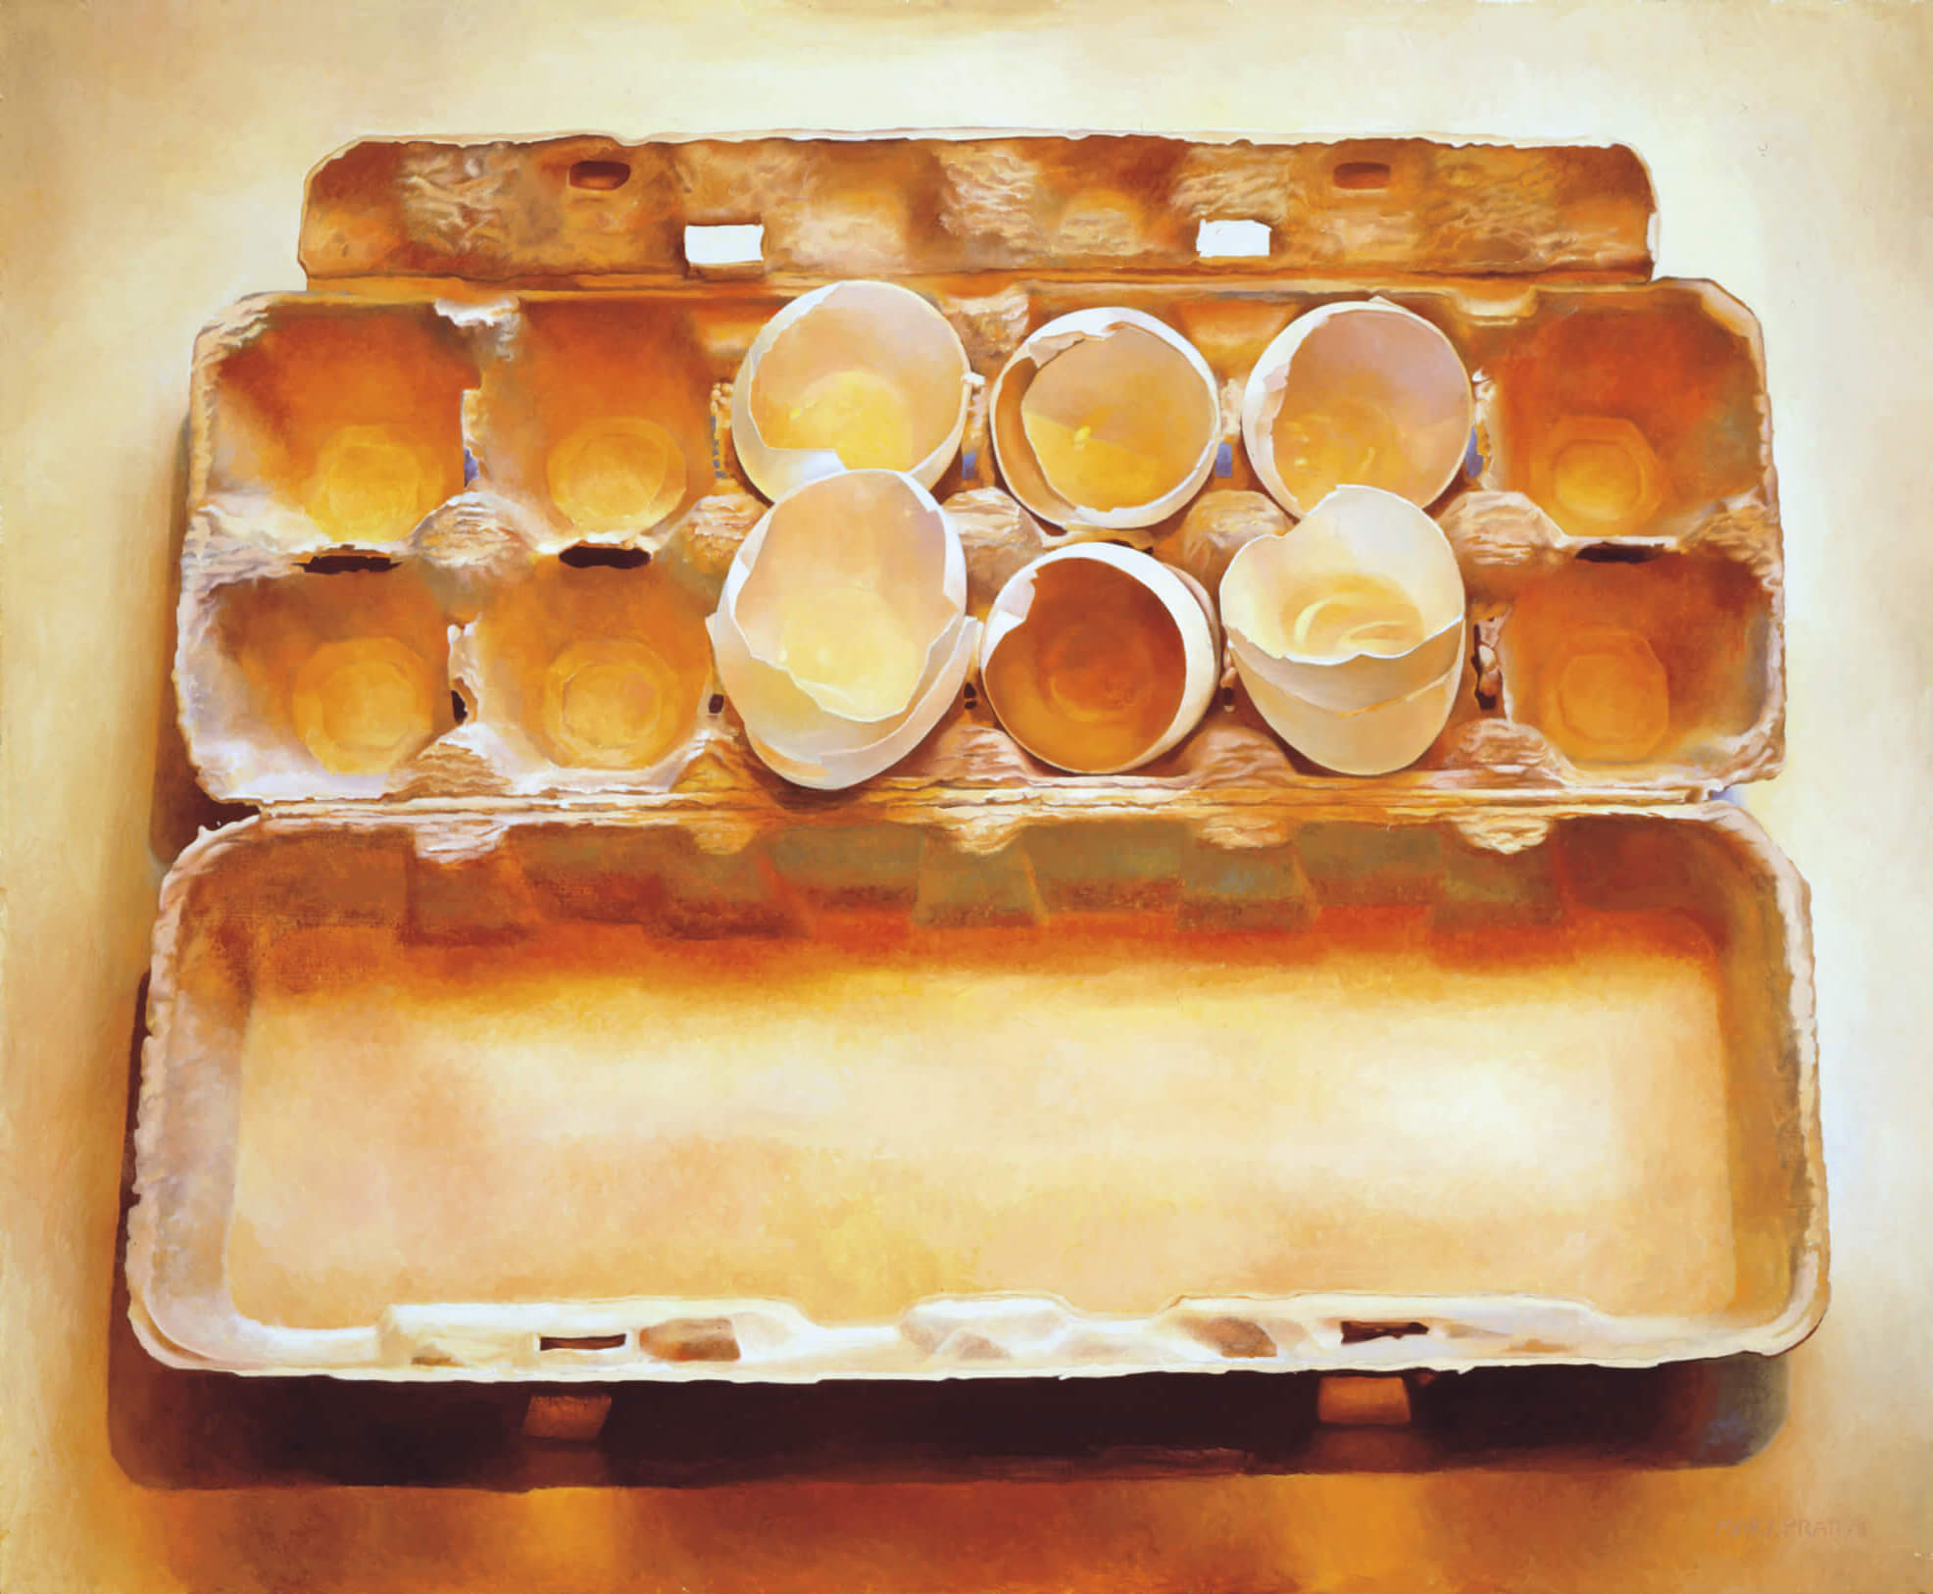
Learning Activity #2
Mary Pratt, Eggs in an Egg Crate, 1975. Pratt created this work after being struck by the slippery interior of the empty eggshells.

Slide 21
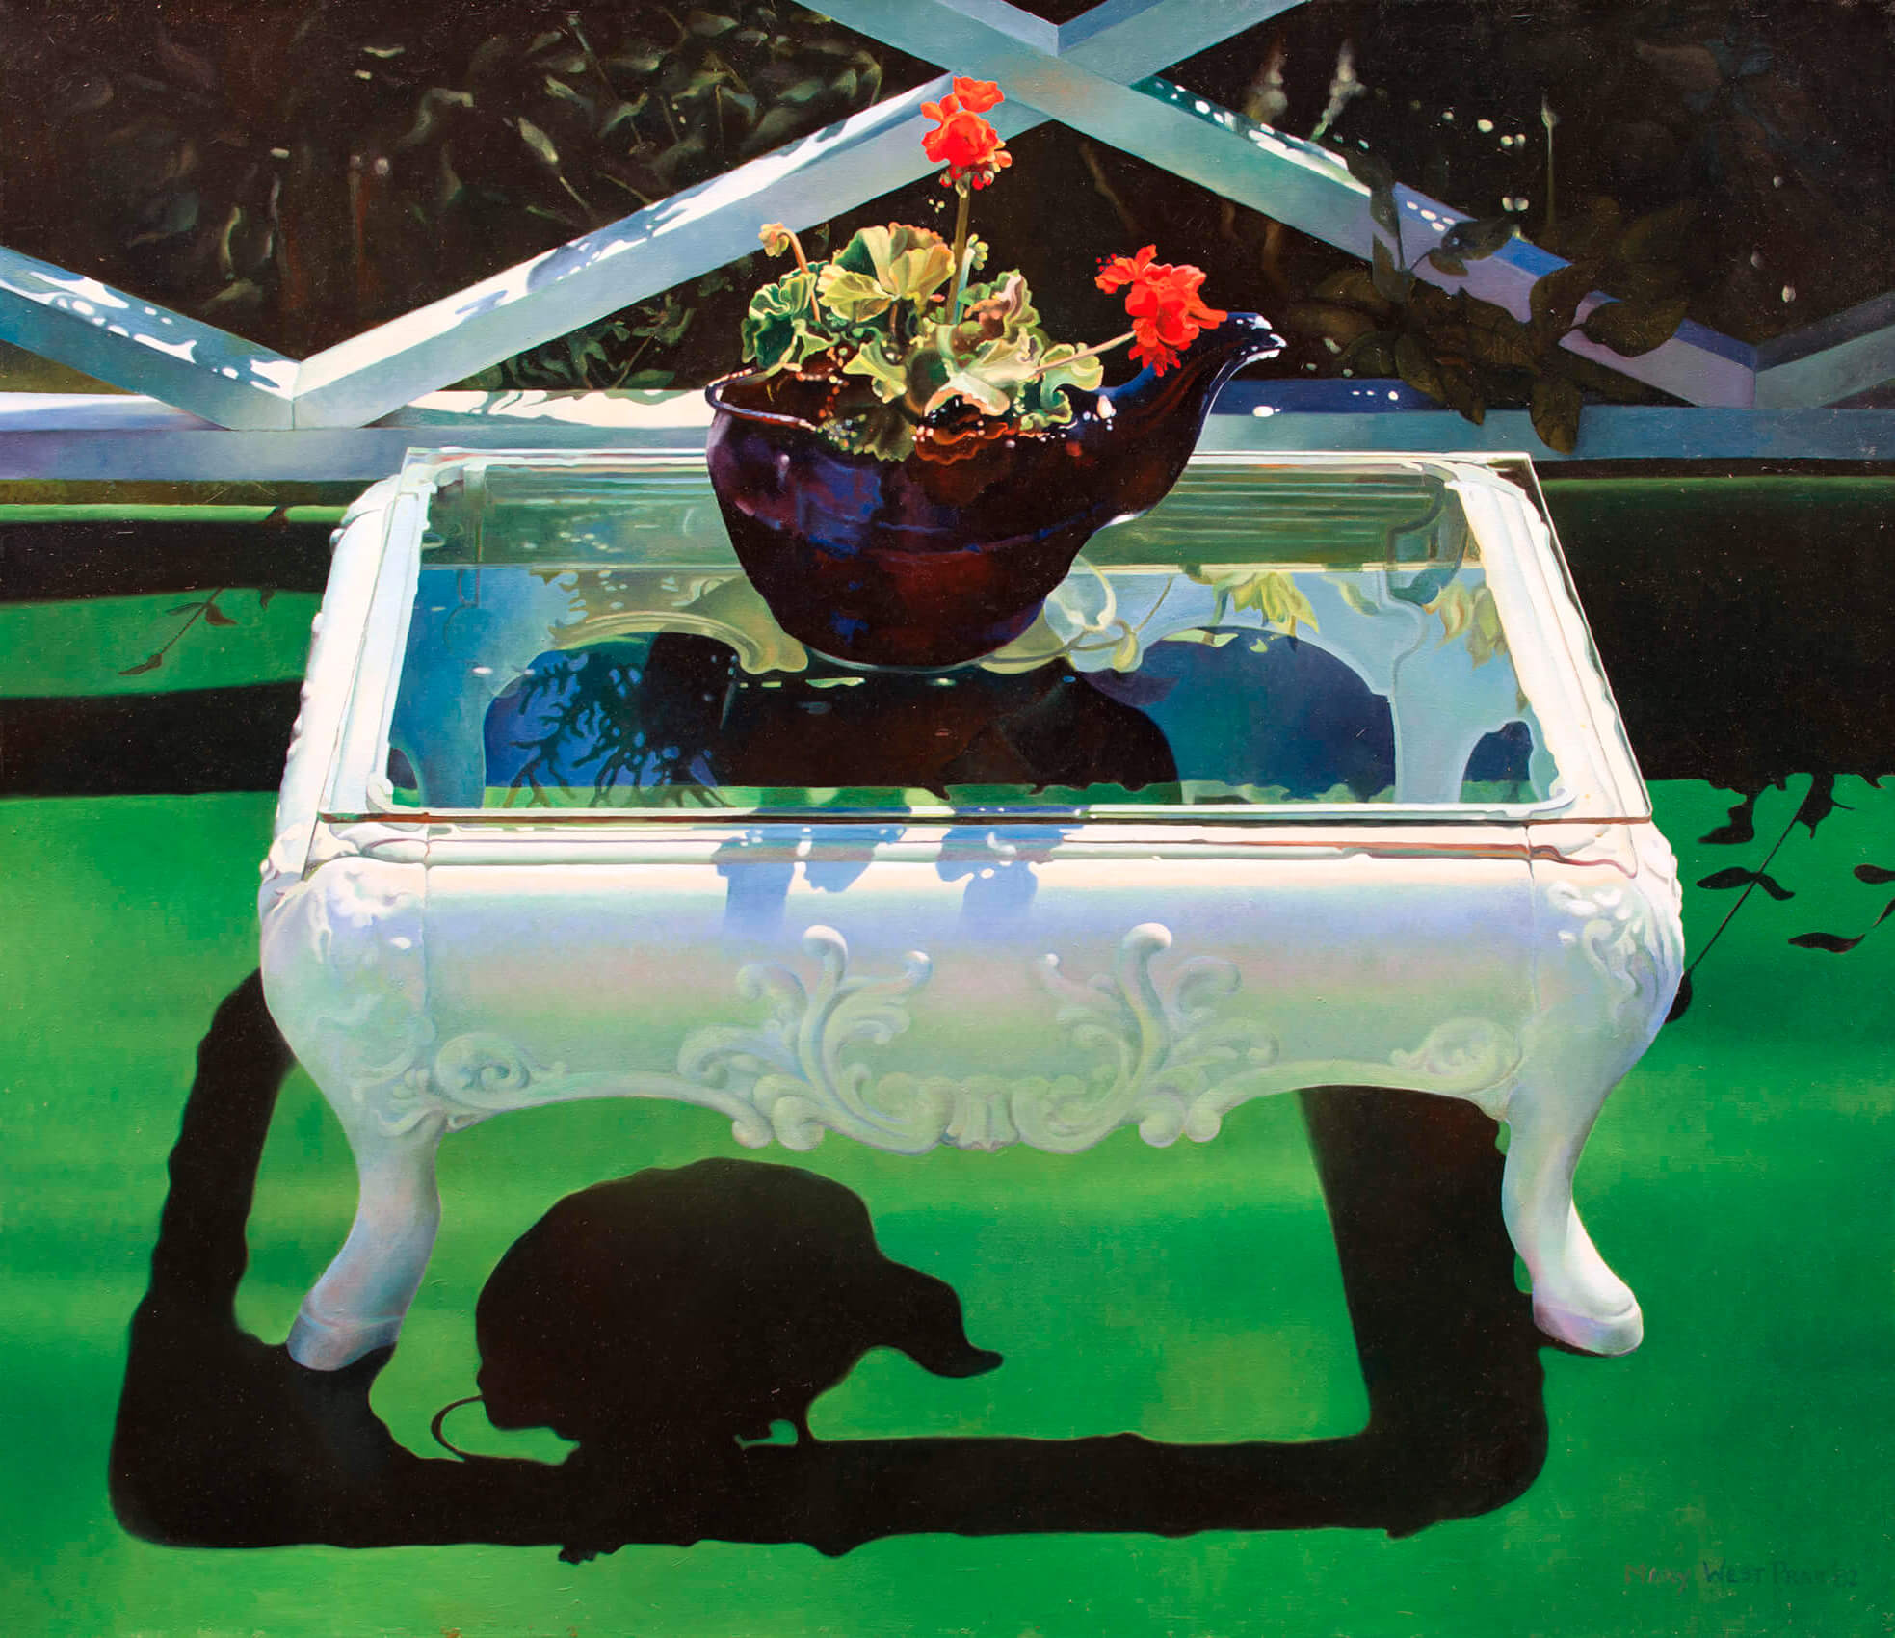
Learning Activity #2
Mary Pratt, Artifacts on Astroturf, 1982. This work brings together an interesting mix of materials, both natural and artificial.

Slide 22
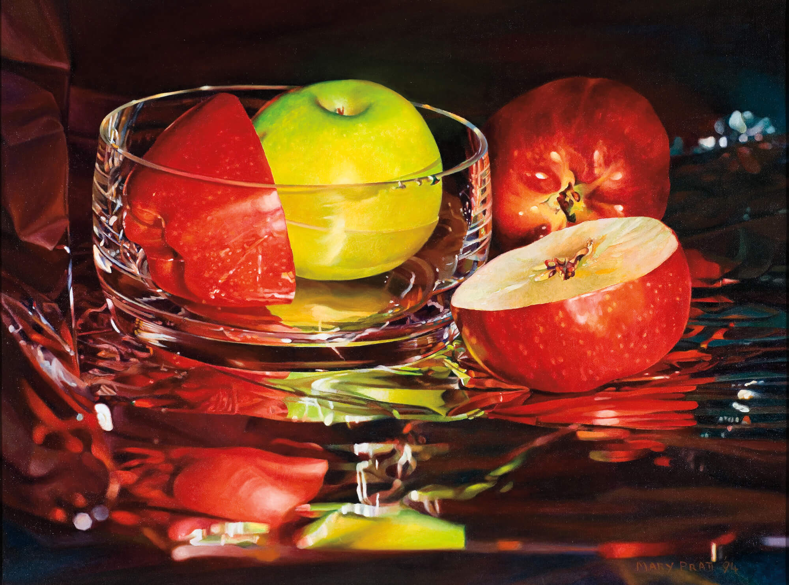
Learning Activity #2
Mary Pratt, Glassy Apples, 1994. Fruit is a common theme in Pratt’s work, and sometimes functioned as a metaphor.

Slide 23
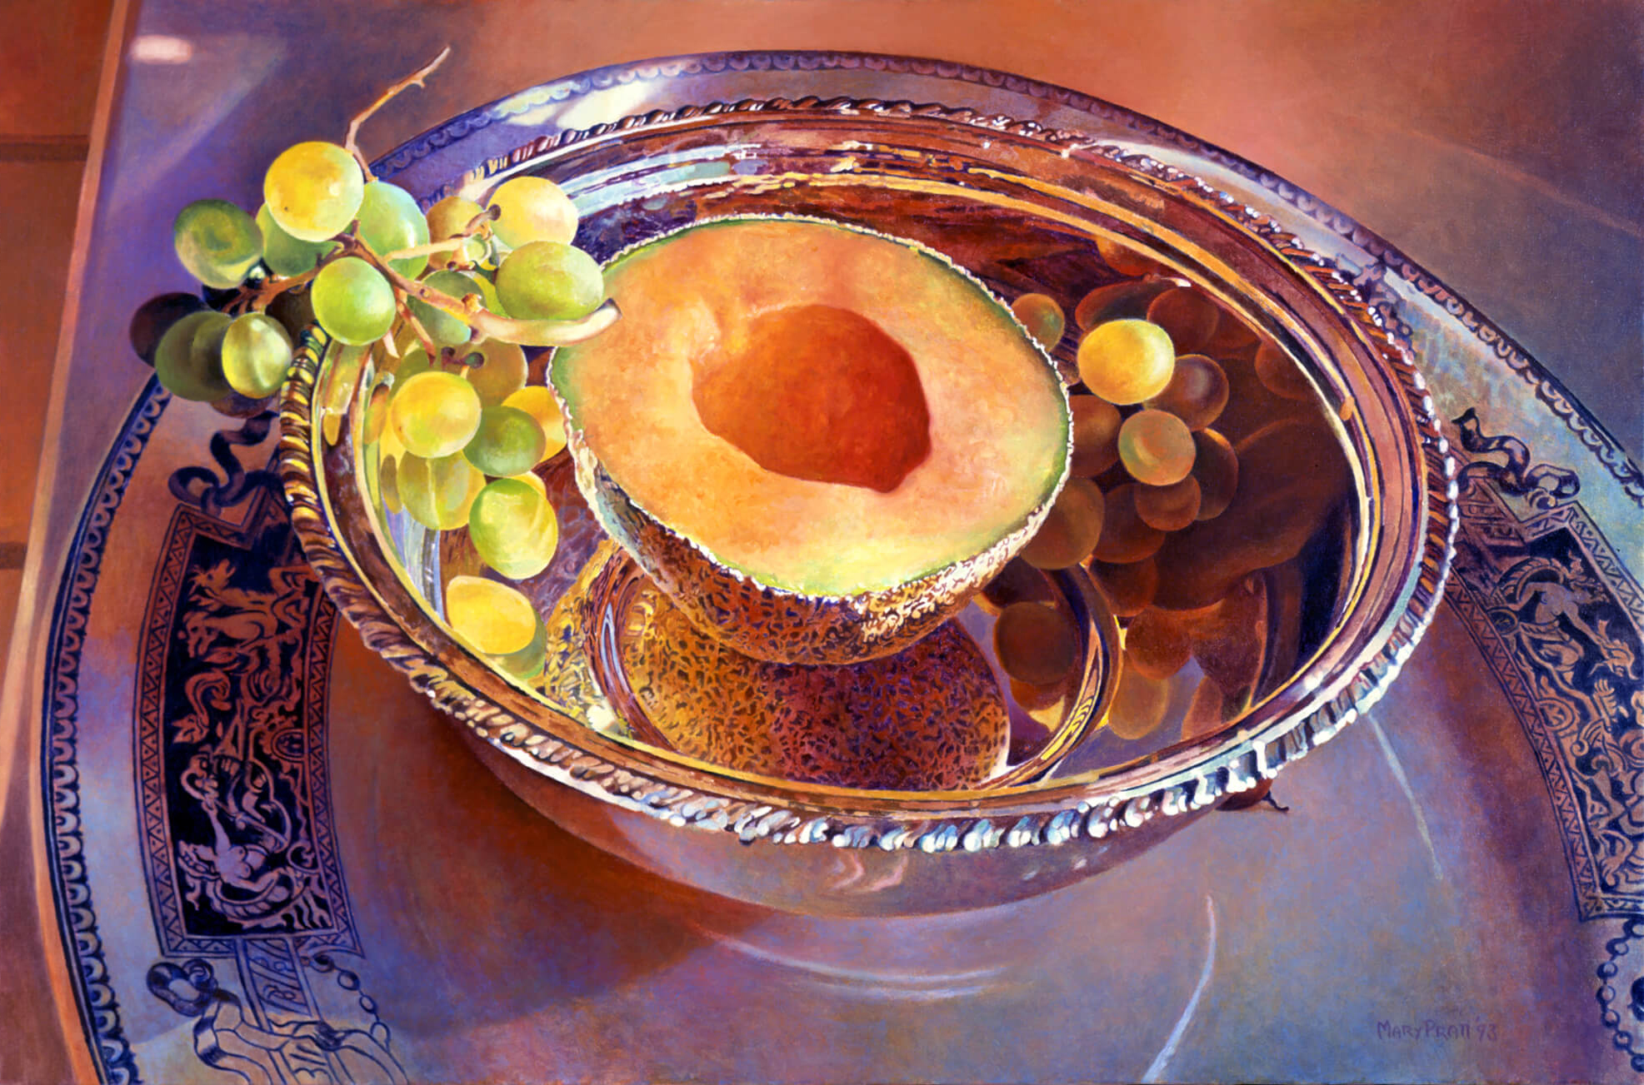
Learning Activity #2
Mary Pratt, Green Grapes and Wedding Presents with Half a Cantaloupe, 1993. Still-life is a painting tradition that dates back to the 1600s—here Pratt presents a contemporary twist.

Slide 24
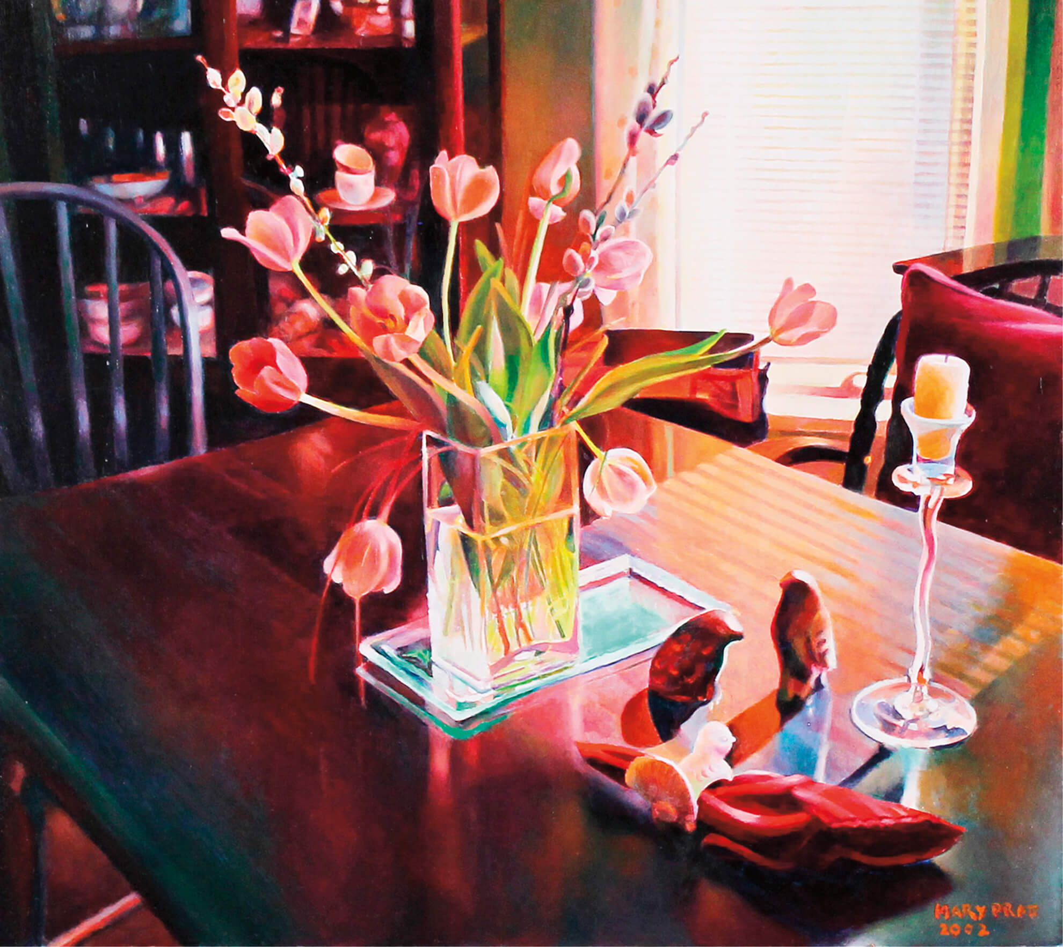
Culminating Task
Mary Pratt, Two Stone Birds in the Spring, 2002. Shadows and projections are central in this painting, visible through the pattern of the window blinds.

Slide 25
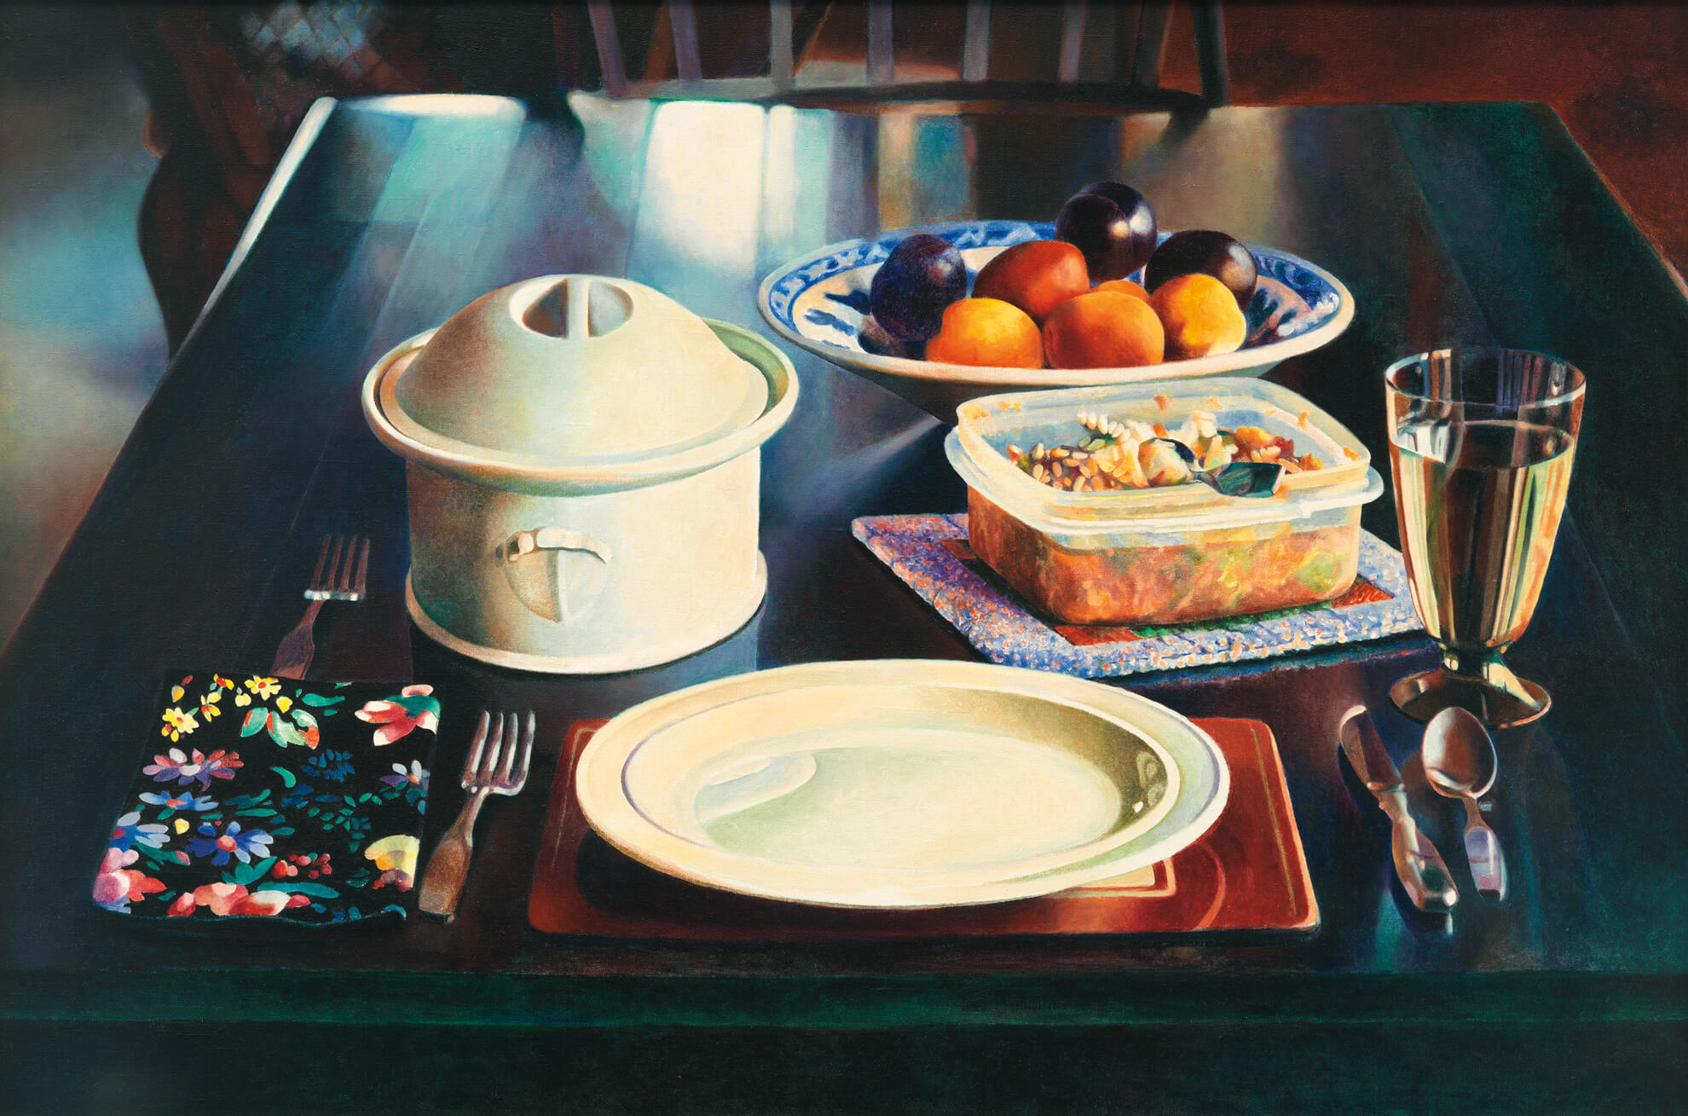
Culminating Task
Mary Pratt, Dinner for One, 1994. Solitude became a theme in Pratt’s paintings after she split up with her husband, the artist Christopher Pratt.

Slide 26
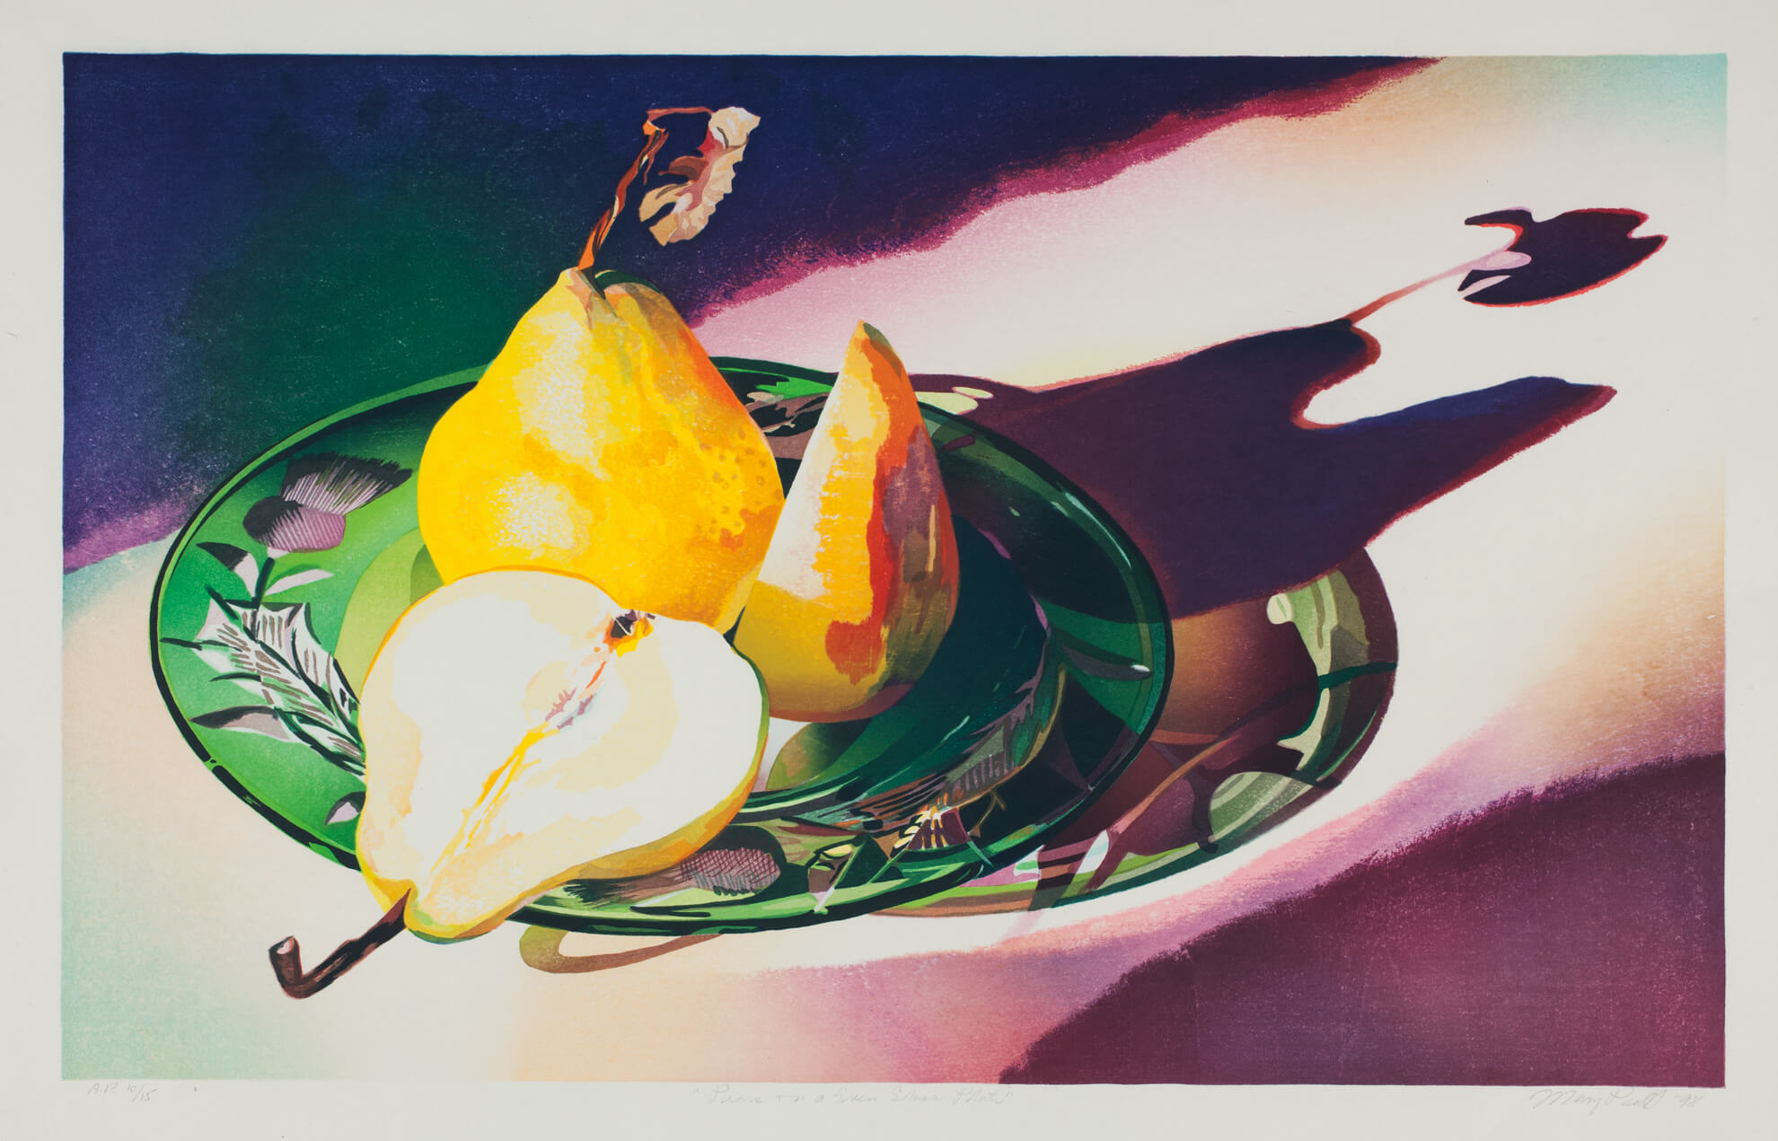
Culminating Task
Mary Pratt, Pears on a Green Glass Plate, 1998. This print represents dramatic light effects, especially through the pear’s shadow.

Slide 27
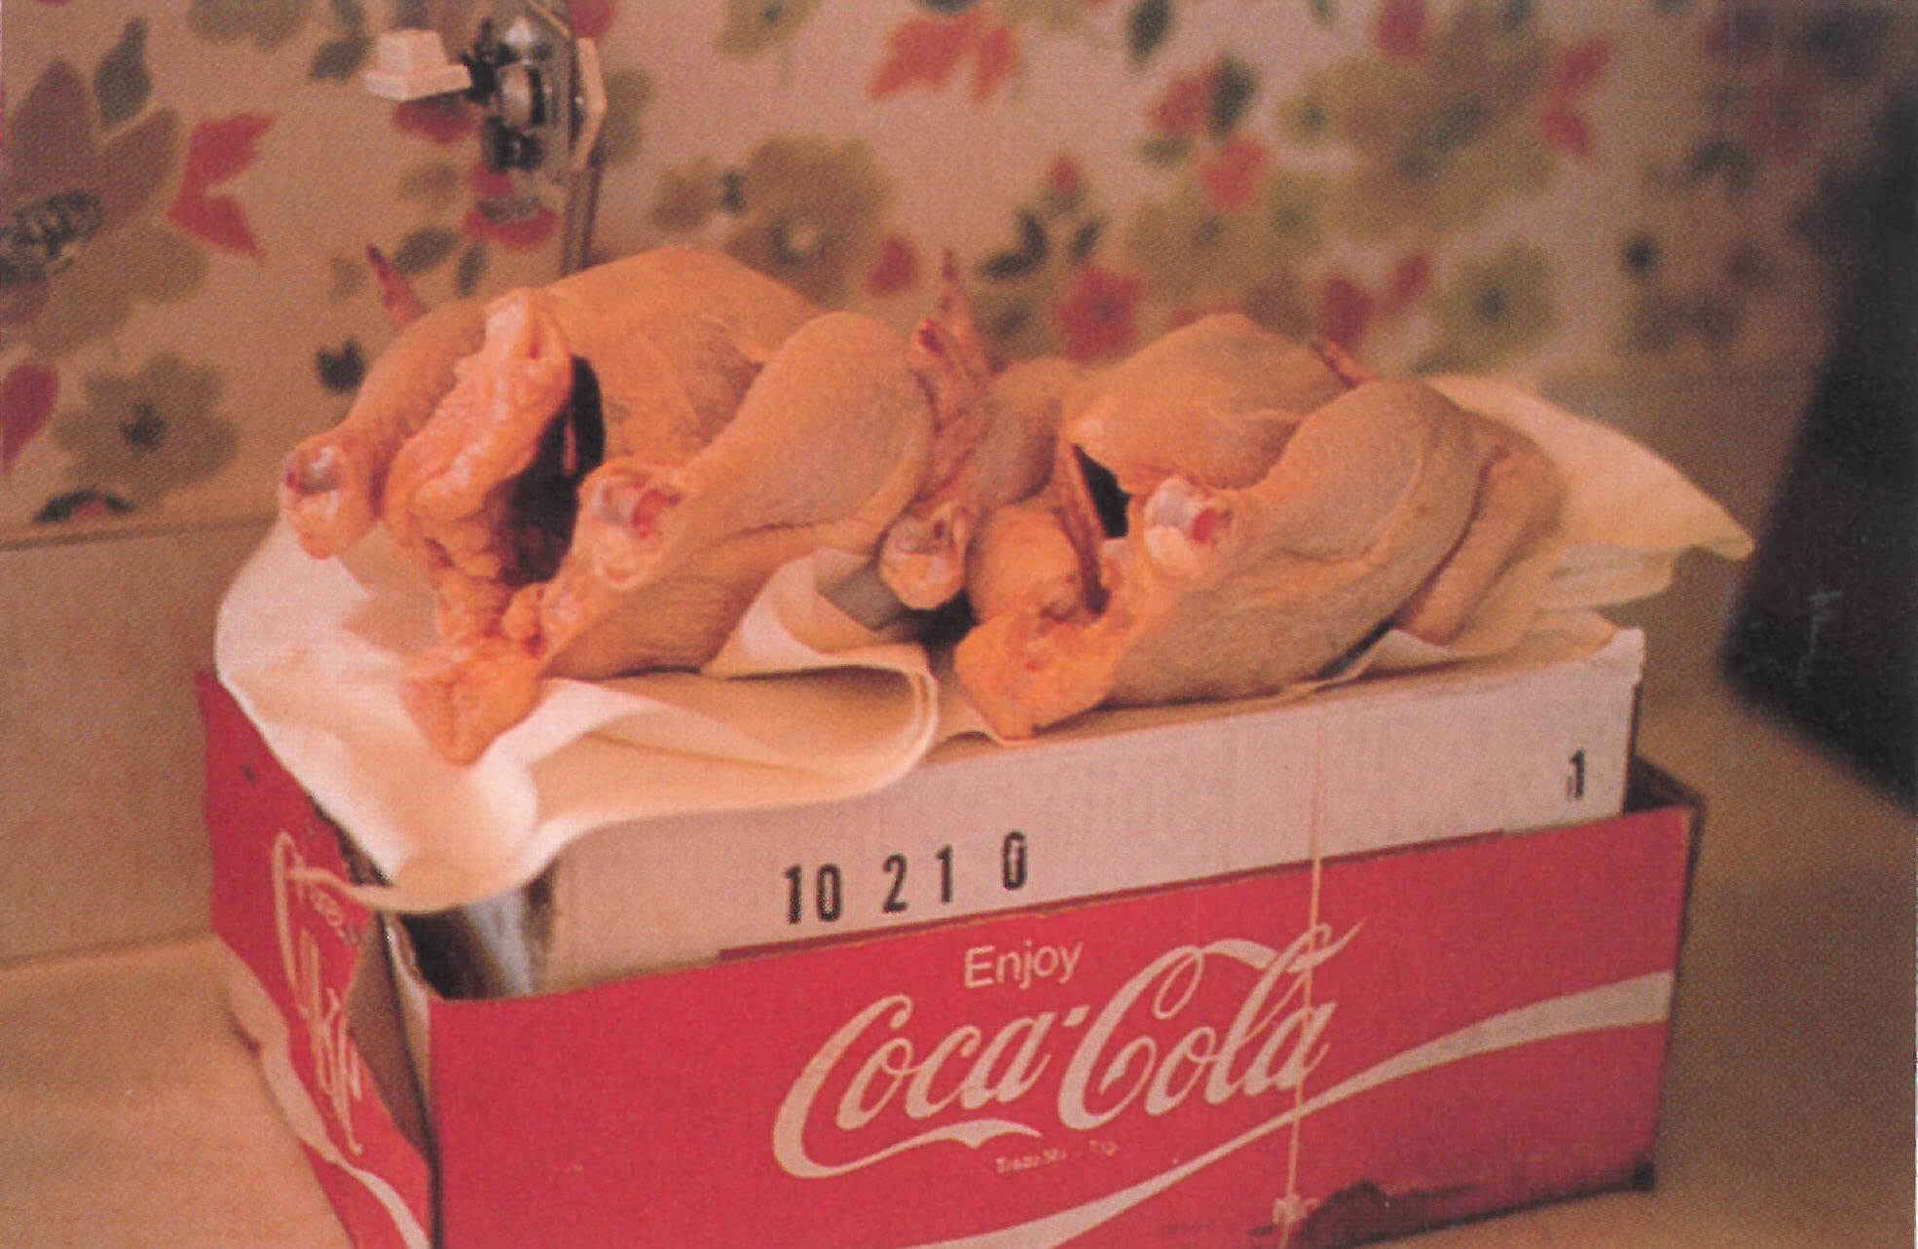
Photography was central to Pratt’s process: this 35mm slide was used for her painting Eviscerated Chickens, 1971.

Slide 28
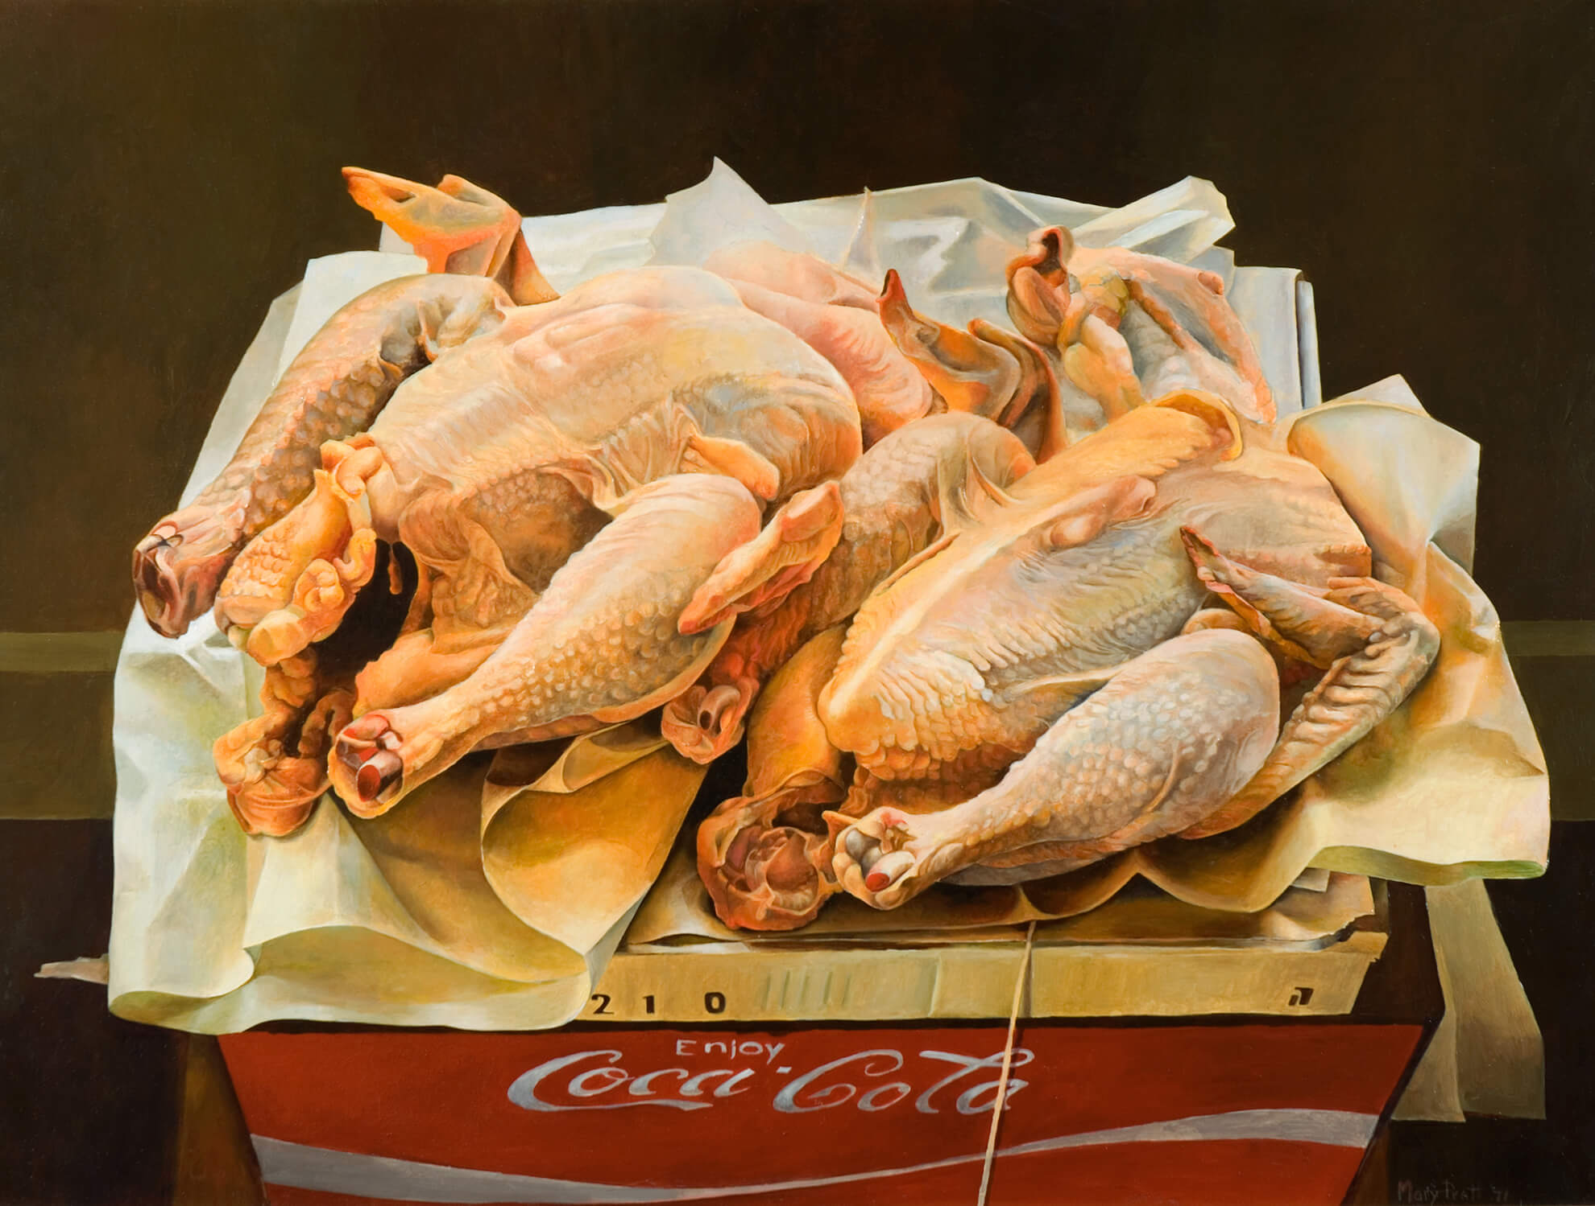
Mary Pratt, Eviscerated Chickens, 1971. The beautiful handling of light and perspective in this work contrasts with the raw subject.

Slide 29
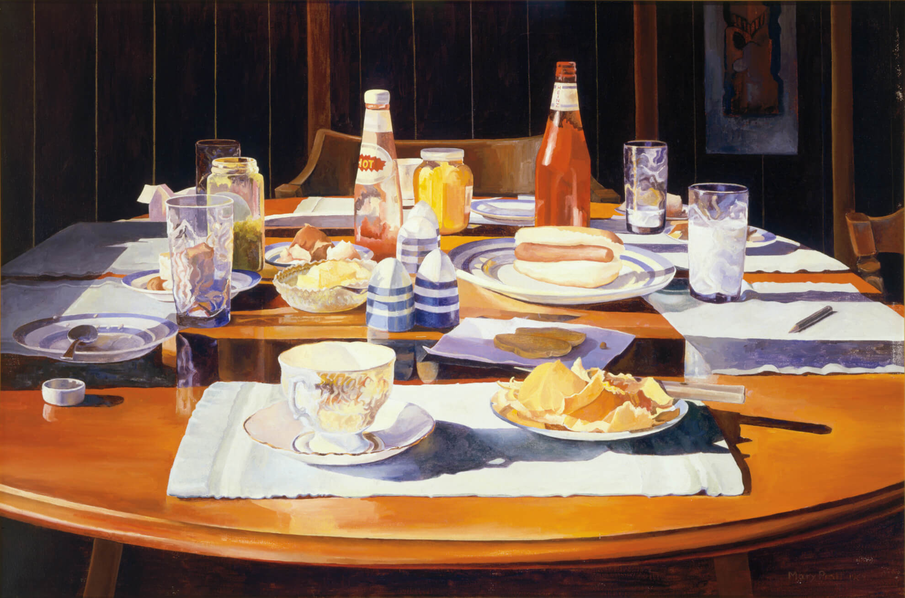
Mary Pratt, Supper Table, 1969. This painting is the result of one of Pratt’s “epiphanies,” in which she realized that there was artistic potential in everyday, fleeting moments.

Slide 30
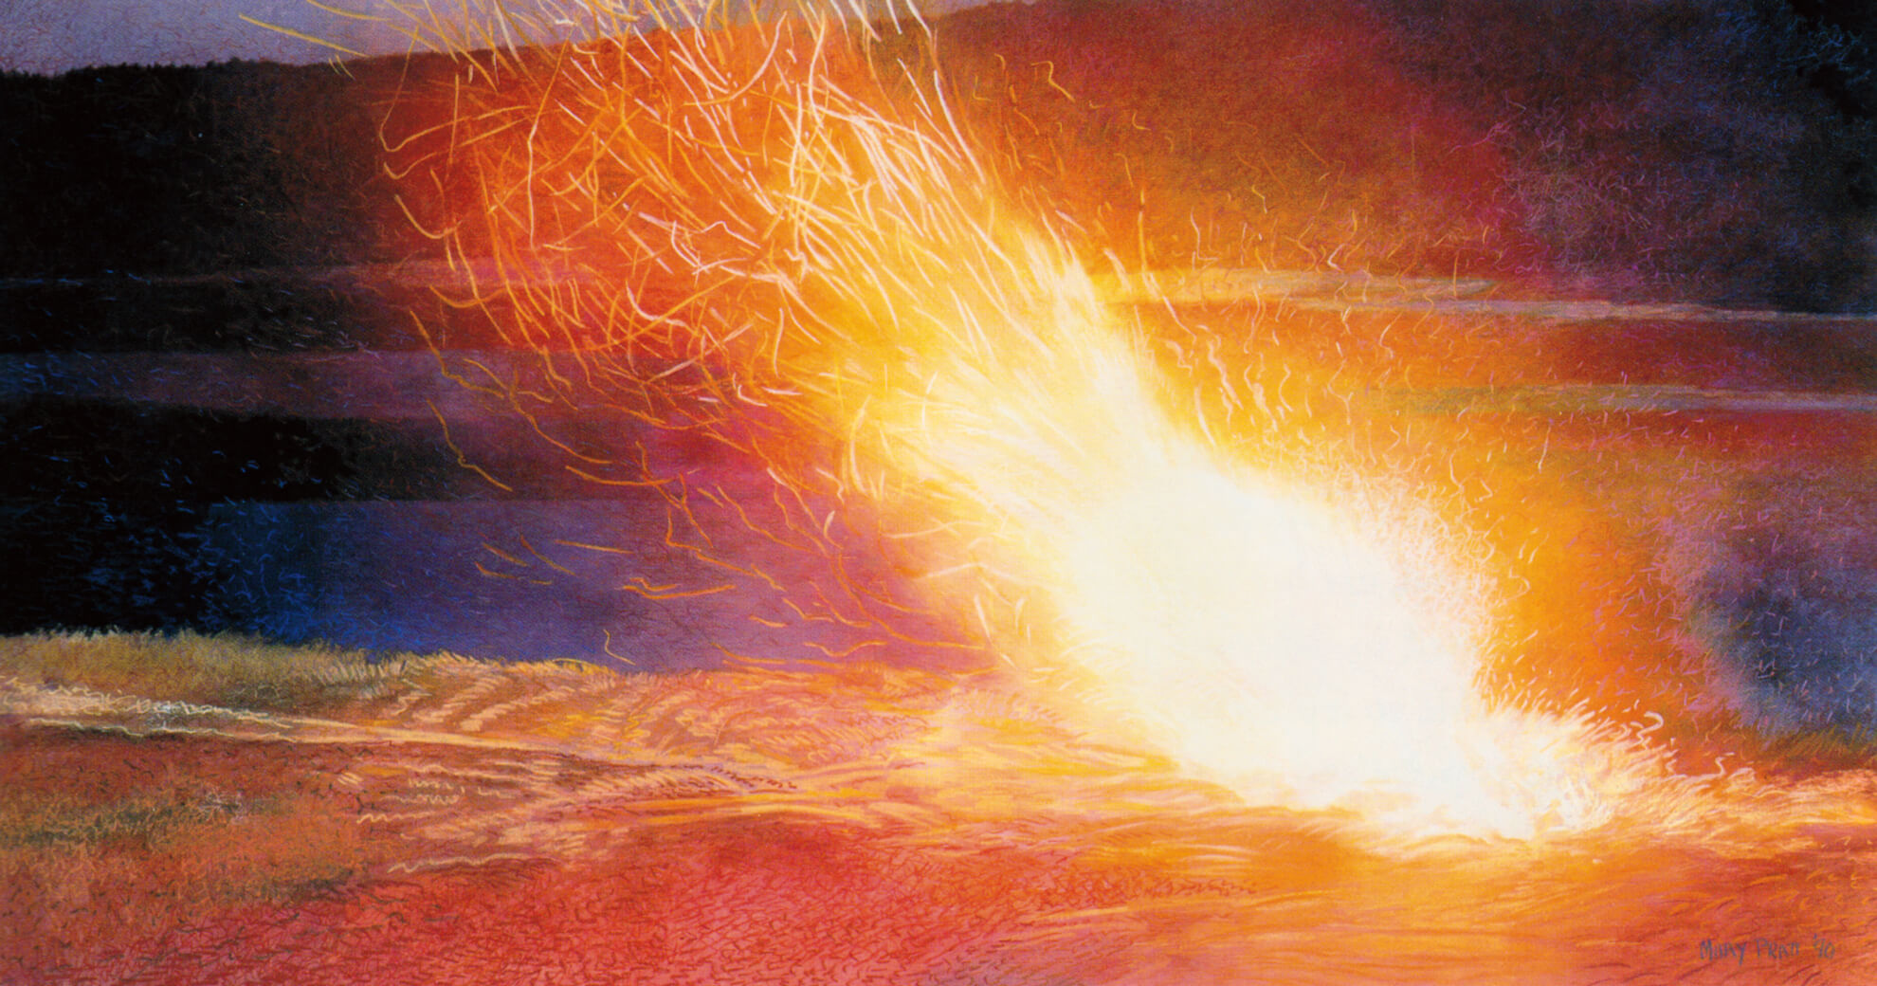
Mary Pratt, Burning the Rhododendron, 1990. Starting in the late 1980s, Pratt started to create a series of paintings and mixed-media drawings about fire.

Slide 31
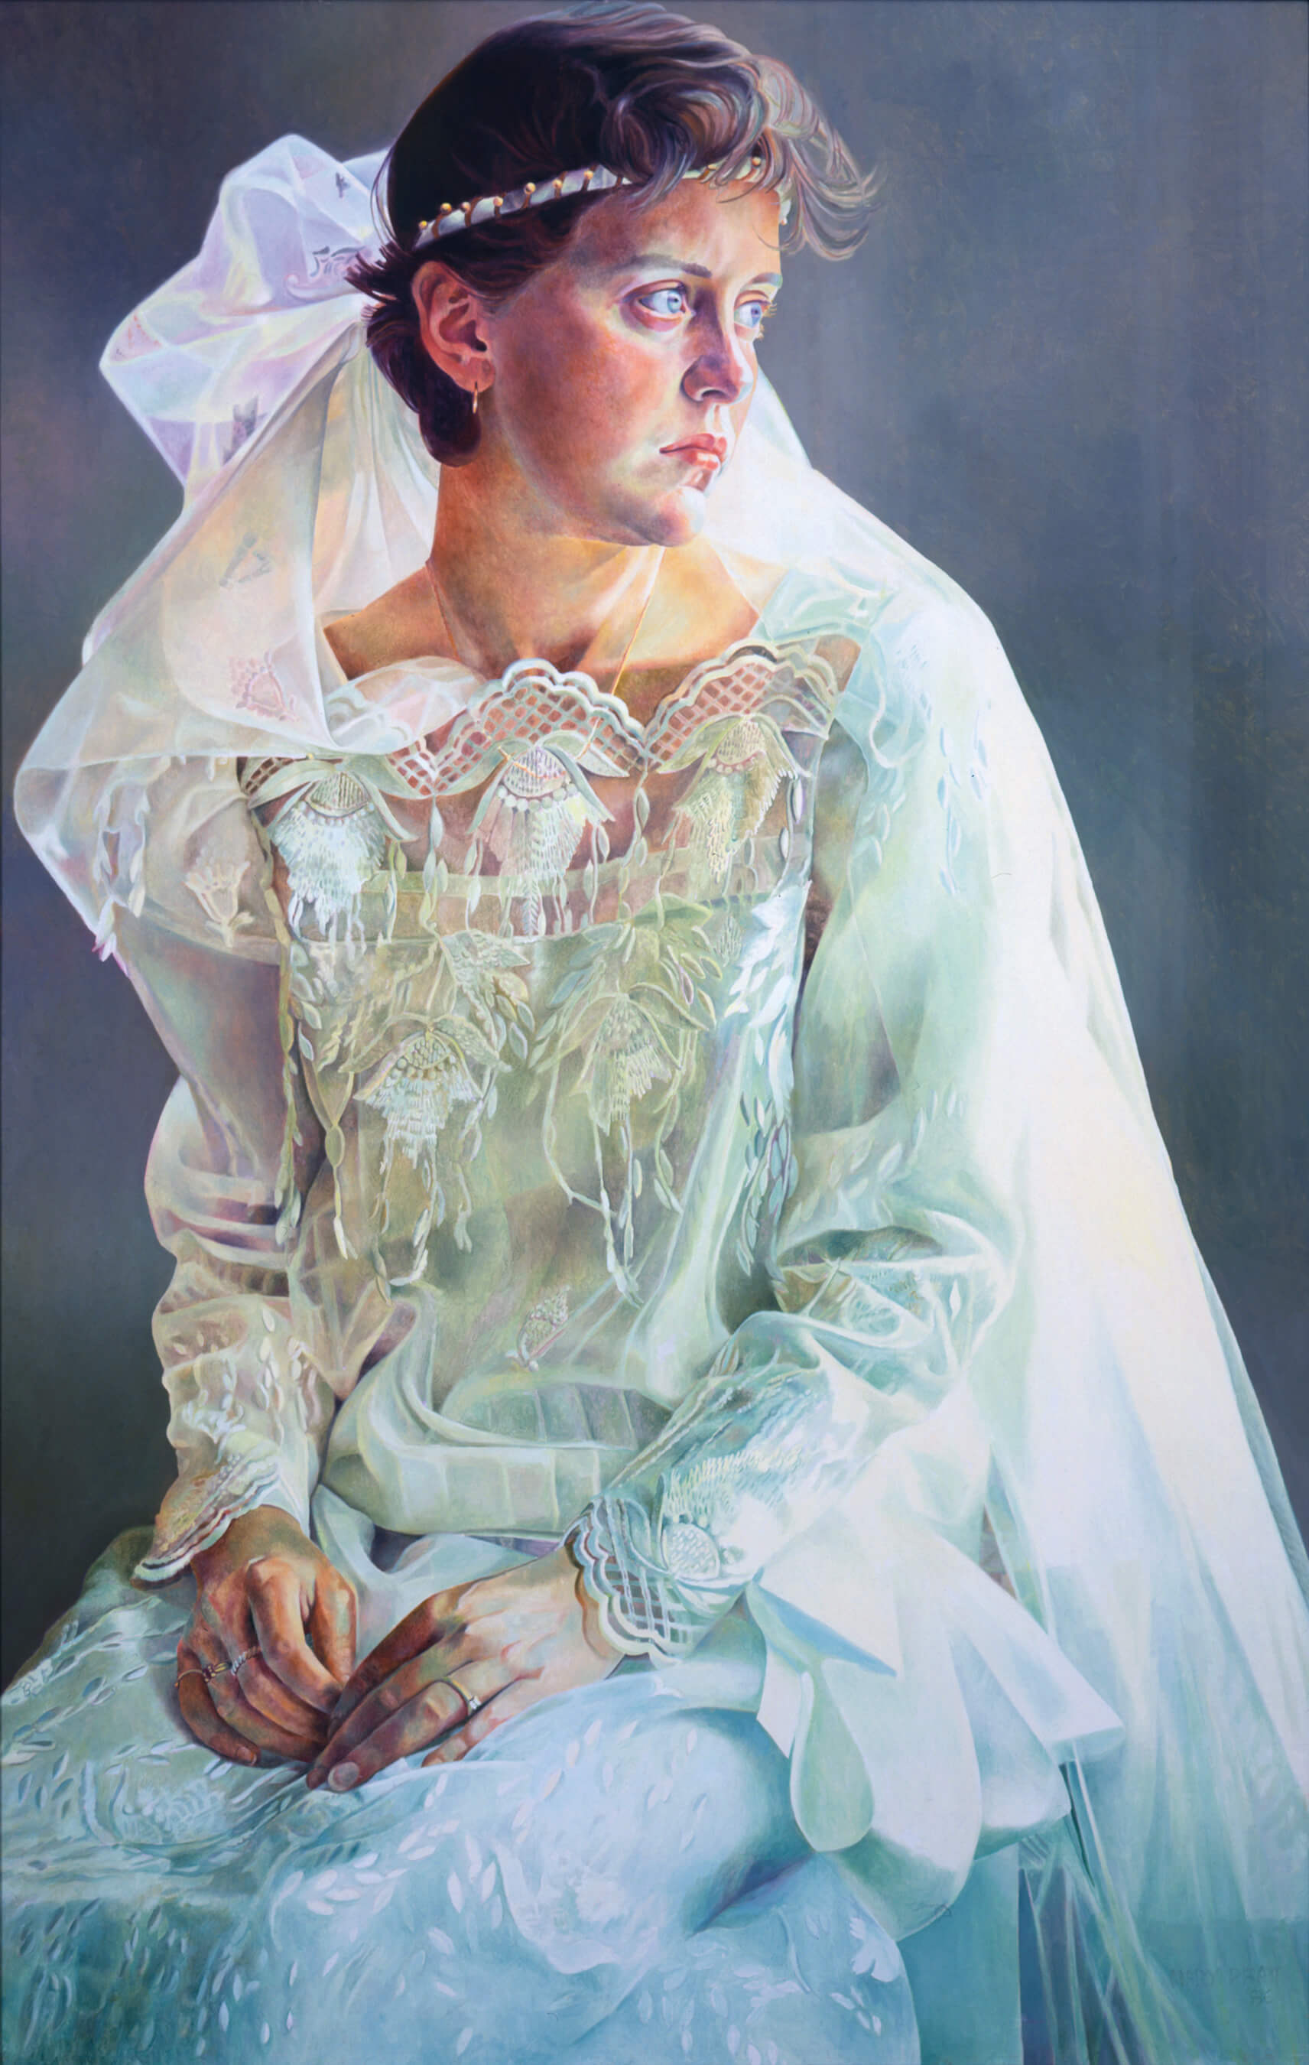
Mary Pratt, Barby in the Dress She Made Herself, 1986. This portrait pictures Pratt’s daughter Barbara (Barby) on the occasion of her wedding.

