Slide 1
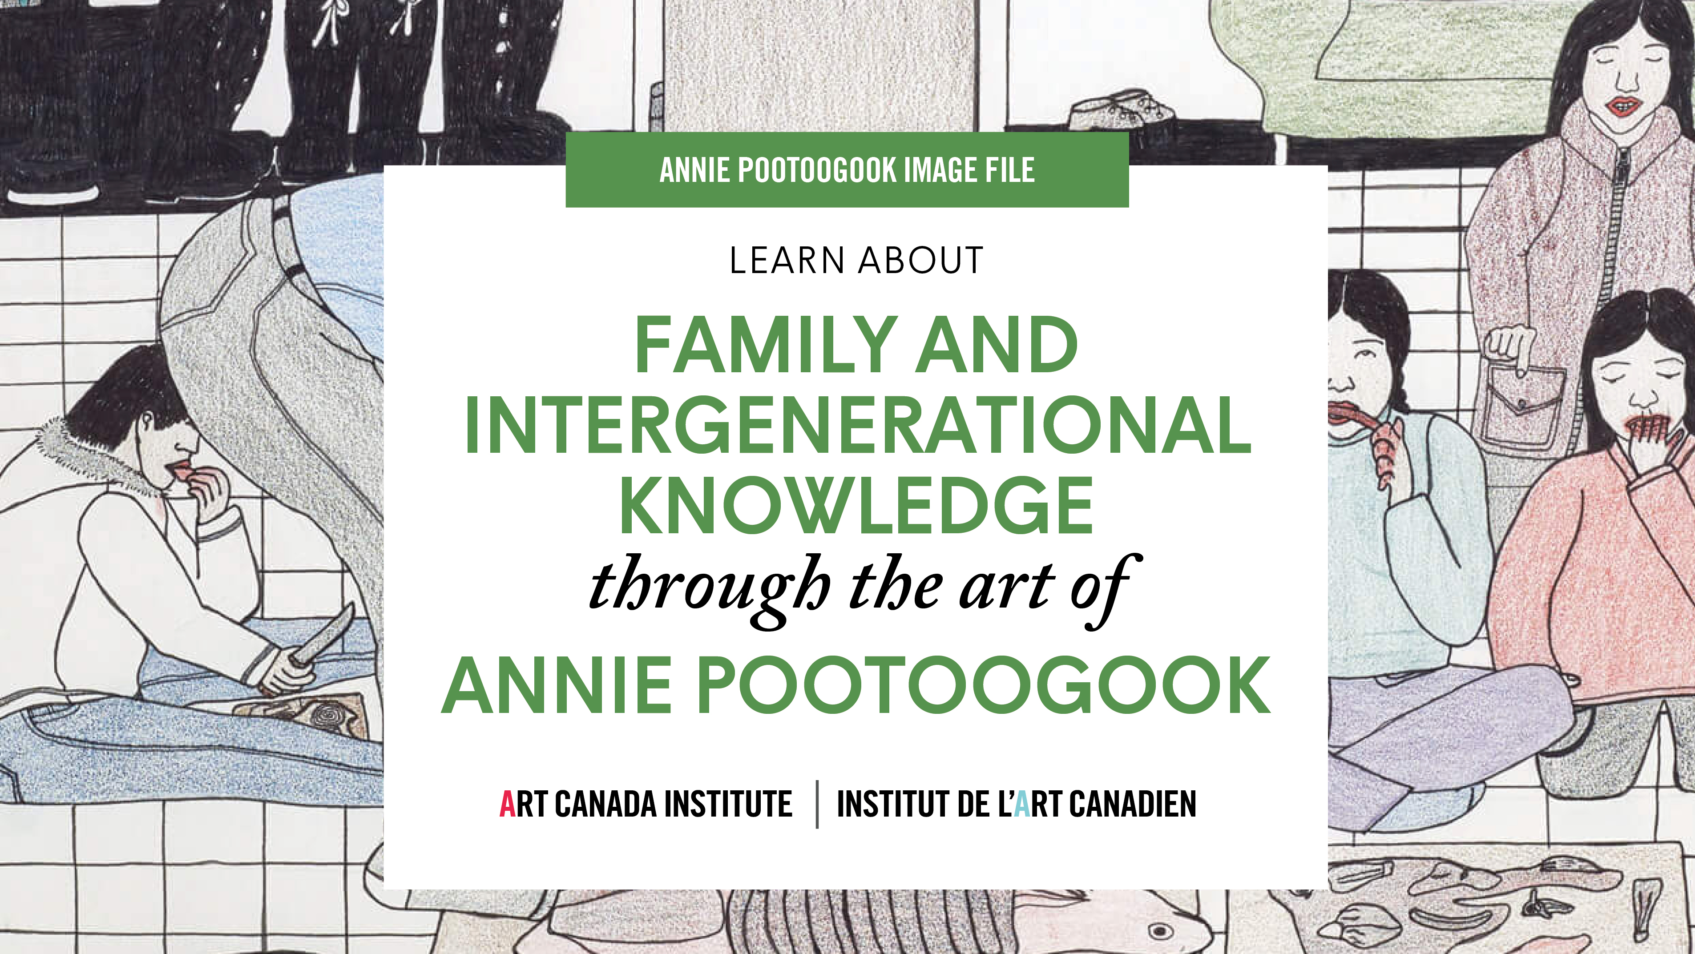

Slide 2
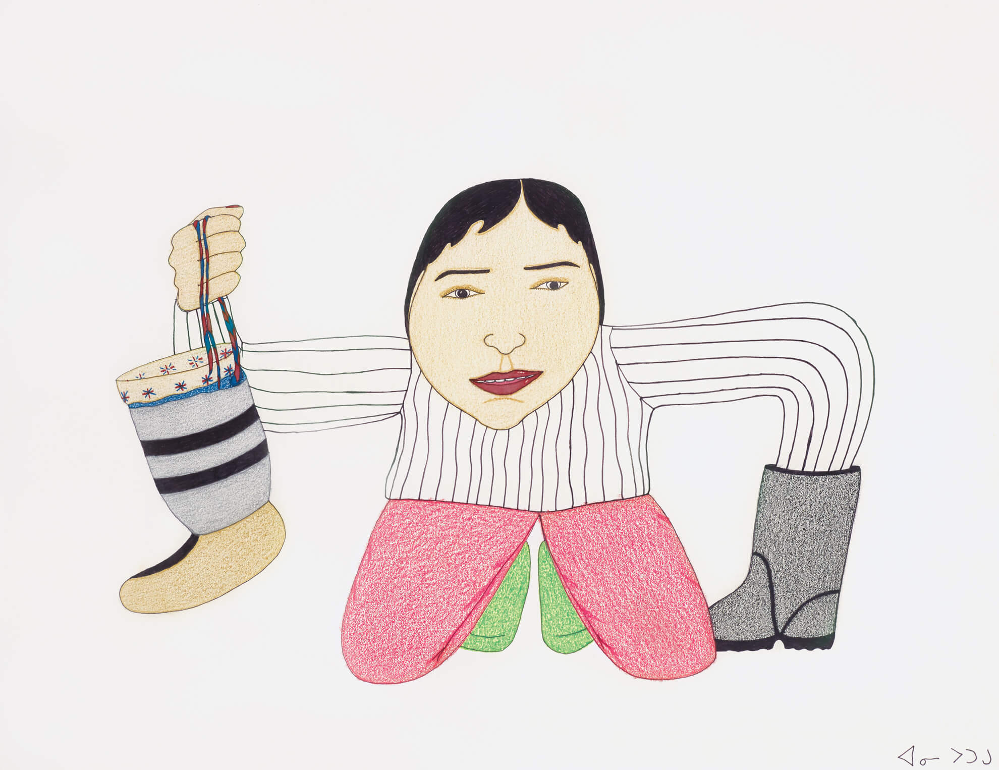
Annie Pootoogook, Holding Boots, 2004. This playful drawing was part of the artist’s major exhibition at The Power Plant Contemporary Art Gallery.

Slide 3
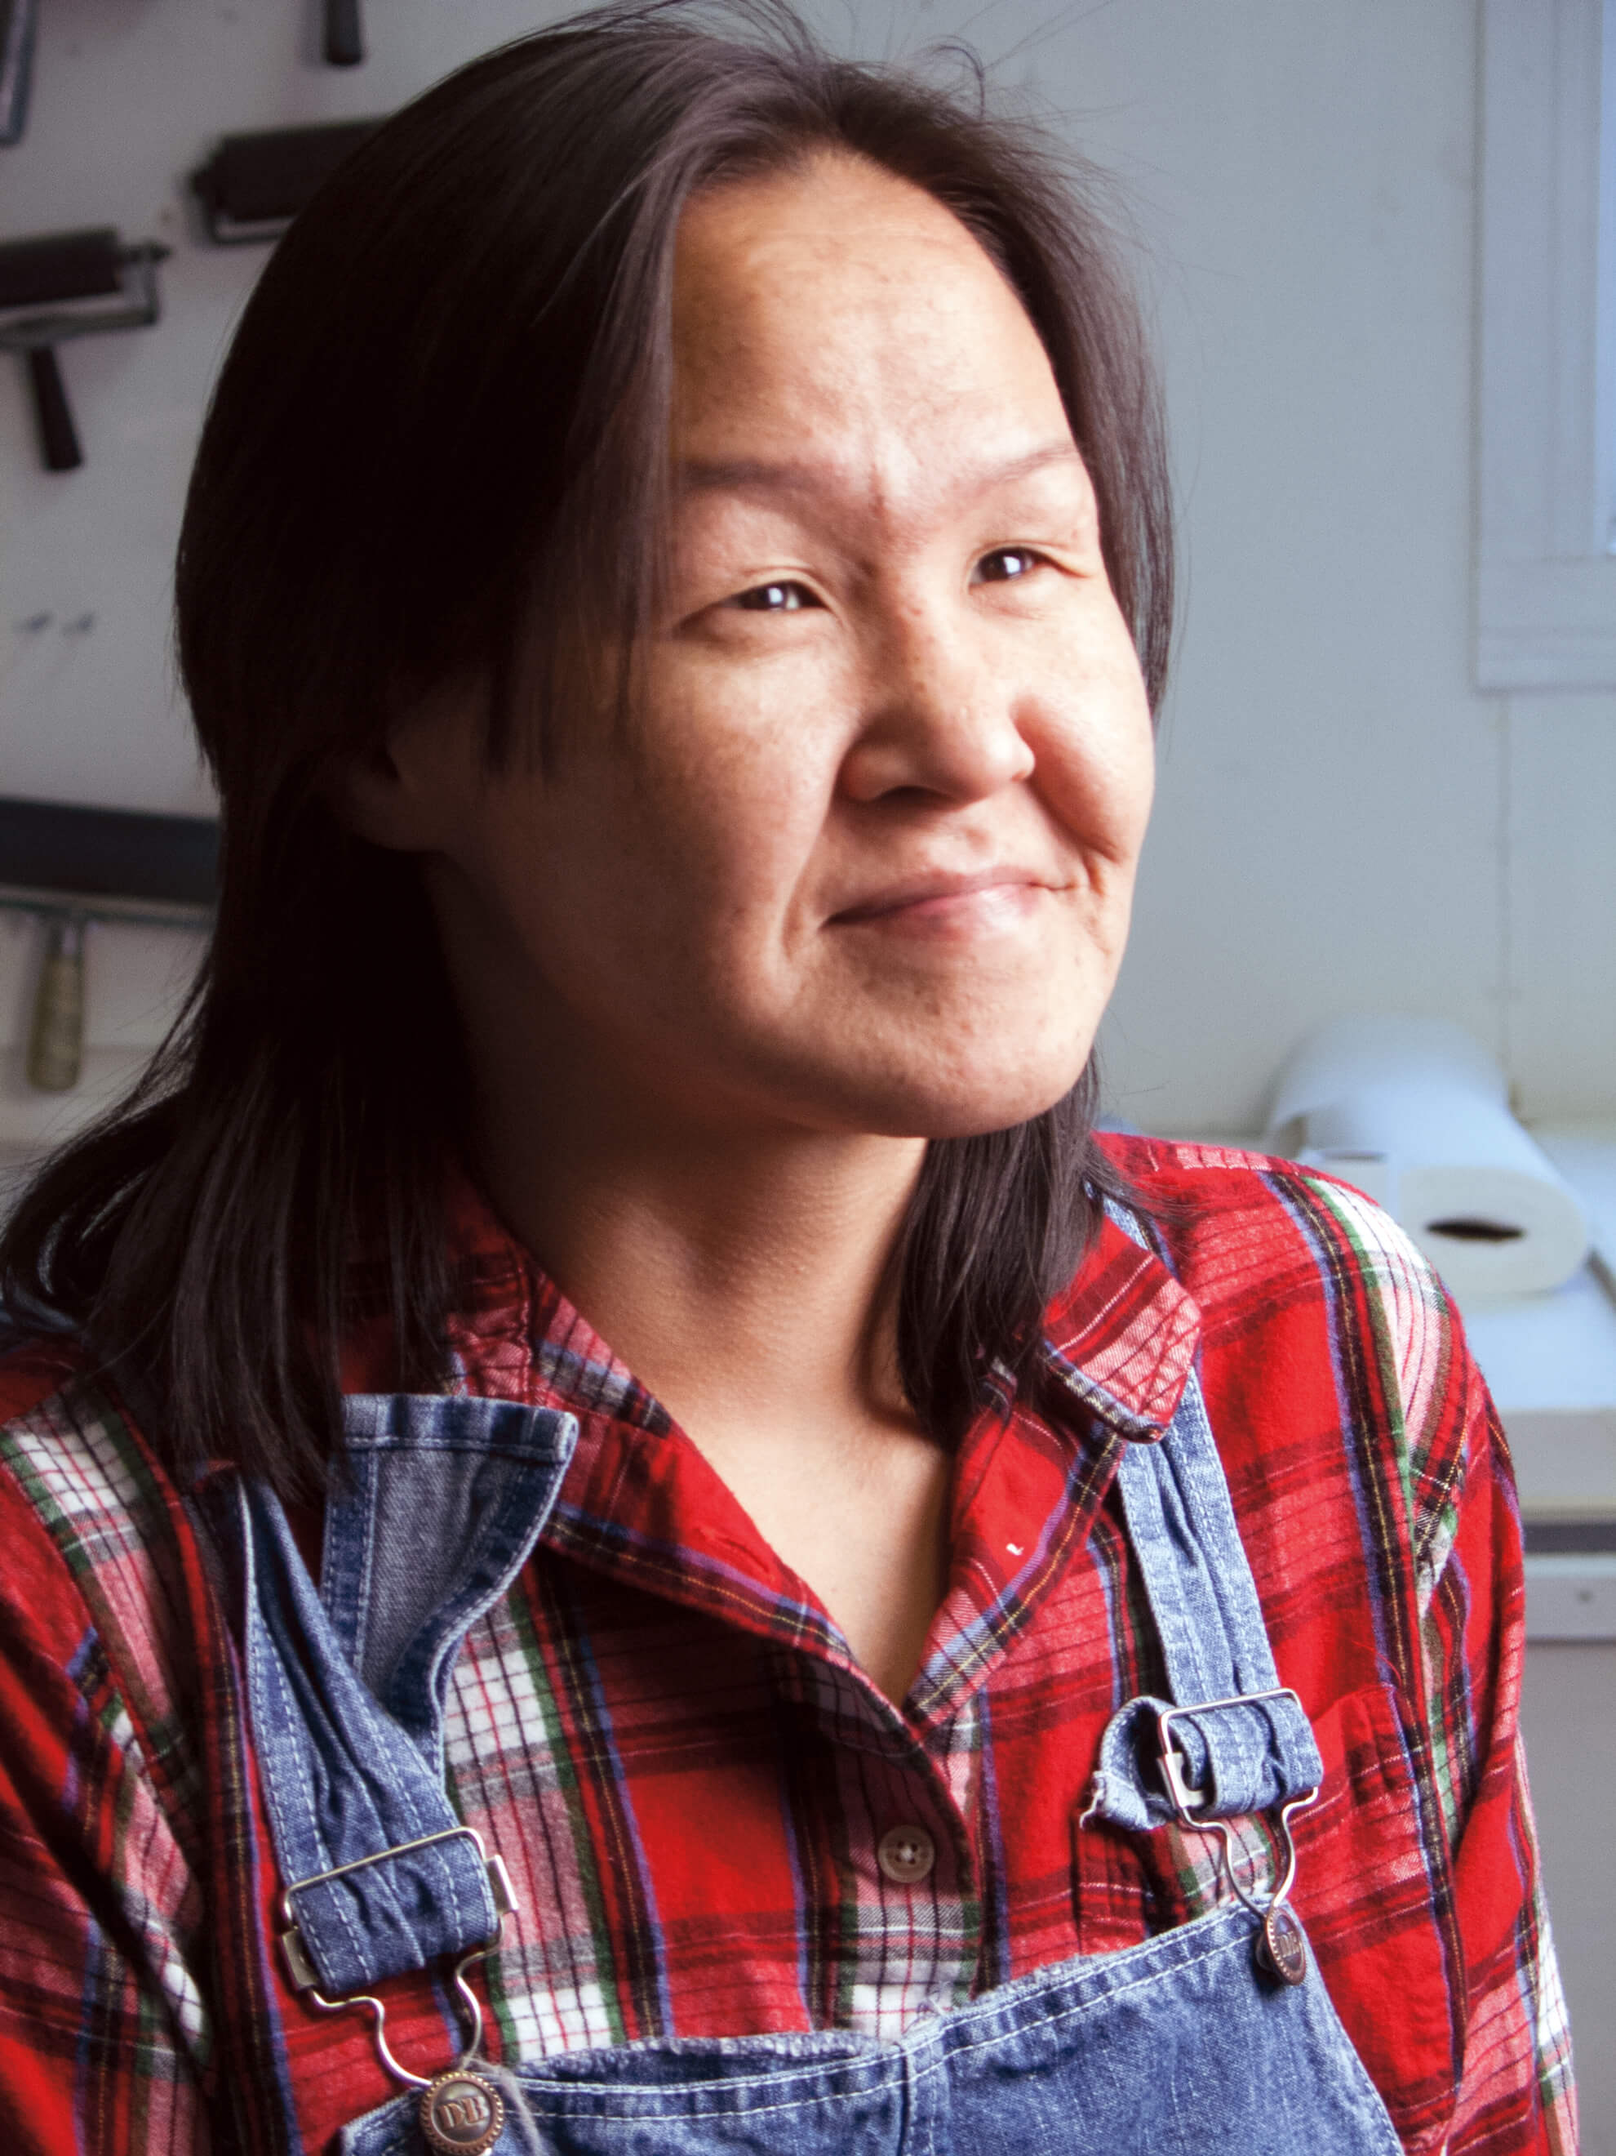
Annie Pootoogook, 2006.

Slide 4
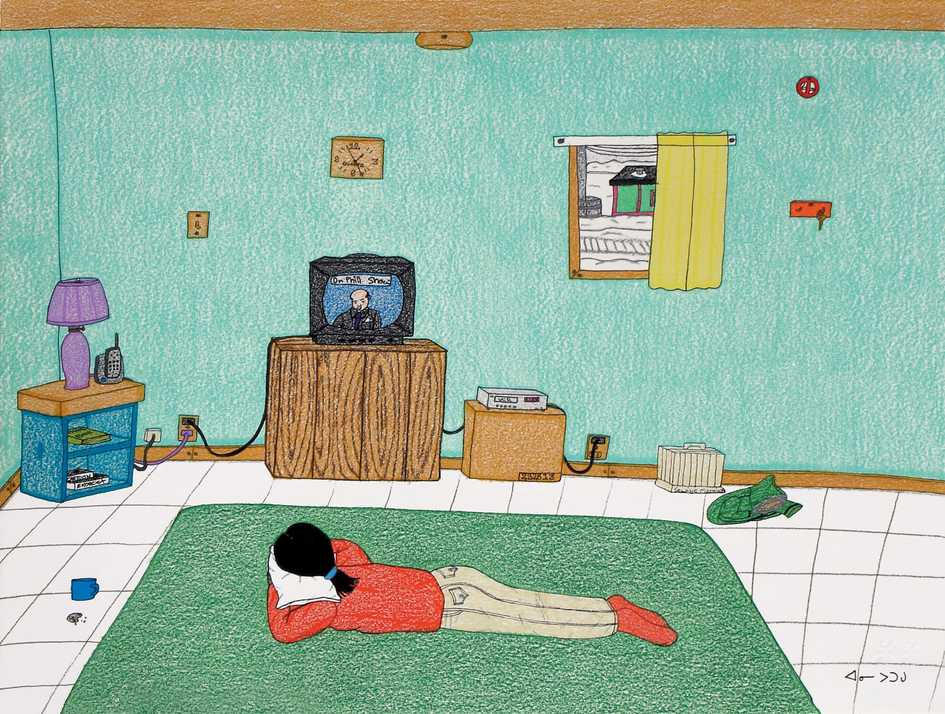
Annie Pootoogook, Dr. Phil, 2006. Many of Pootoogook’s drawings include people watching television.

Slide 5
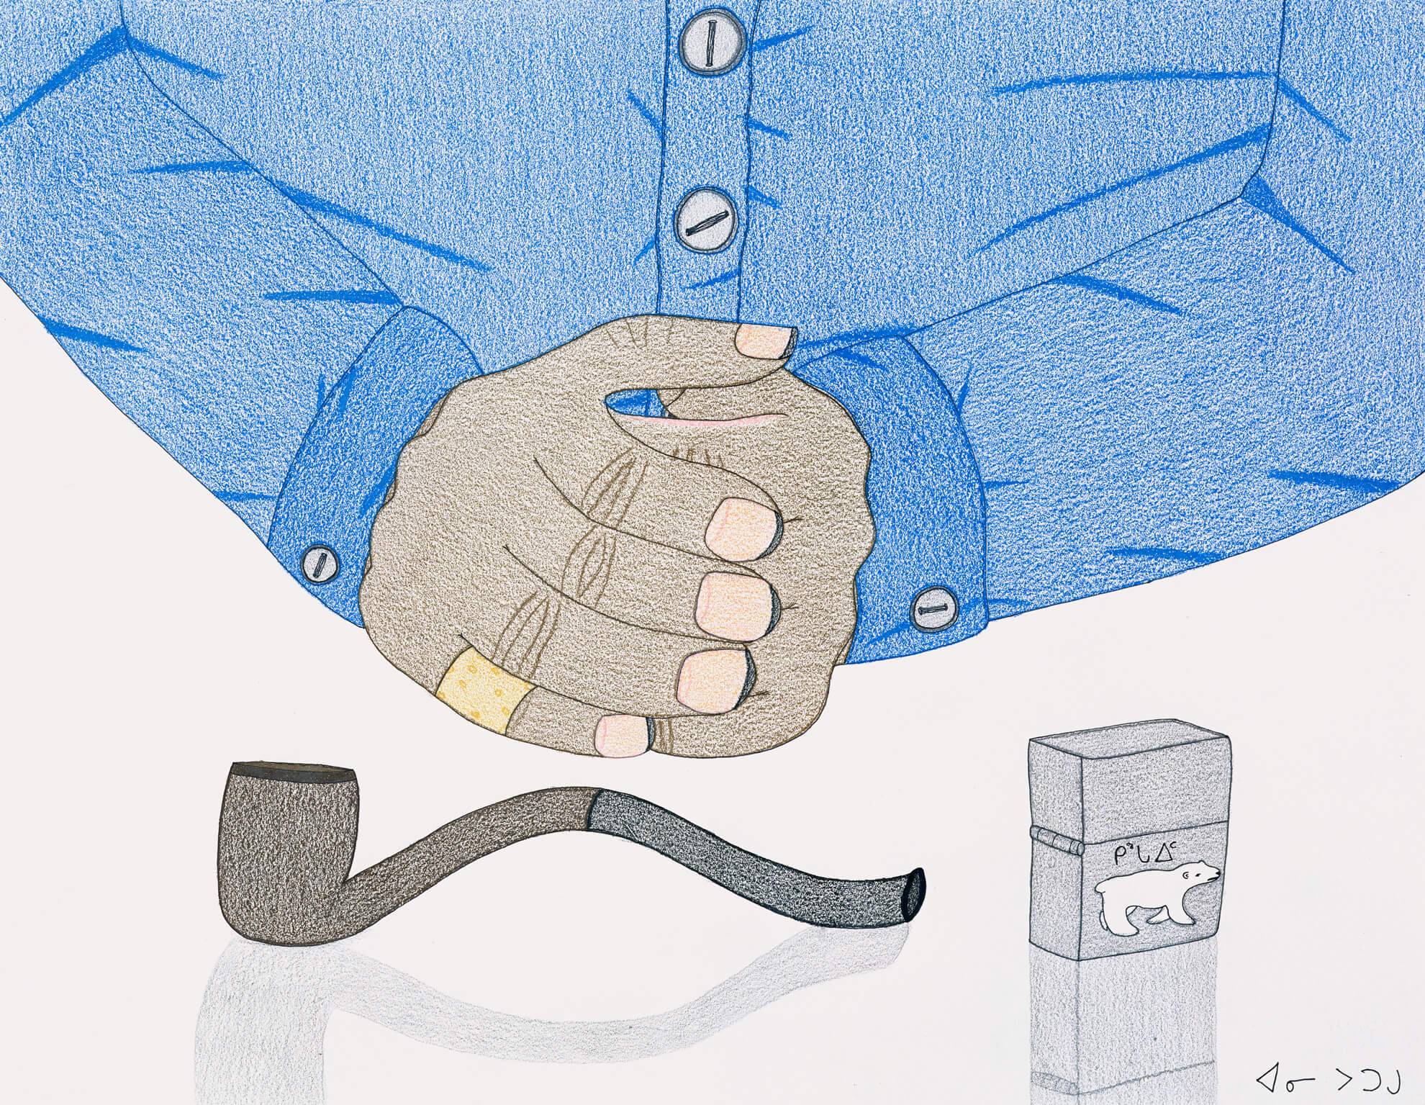
Annie Pootoogook, Sculptor with Pipe, 2003–4. This image likely depicts a fellow artist in Pootoogook’s community.

Slide 6
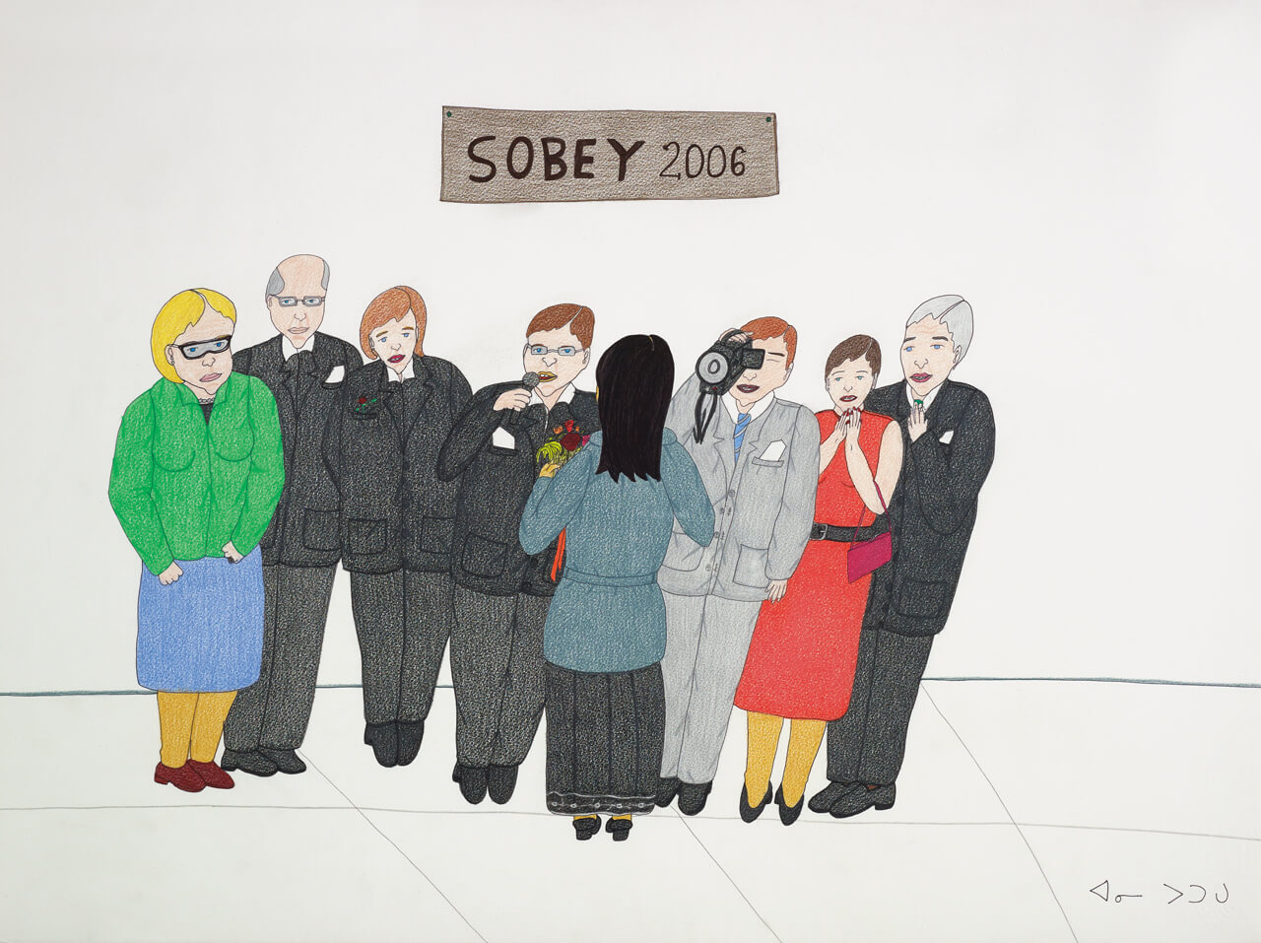
Annie Pootoogook, Sobey Awards, 2006. The artist won this prestigious Canadian art prize in 2006.

Slide 7
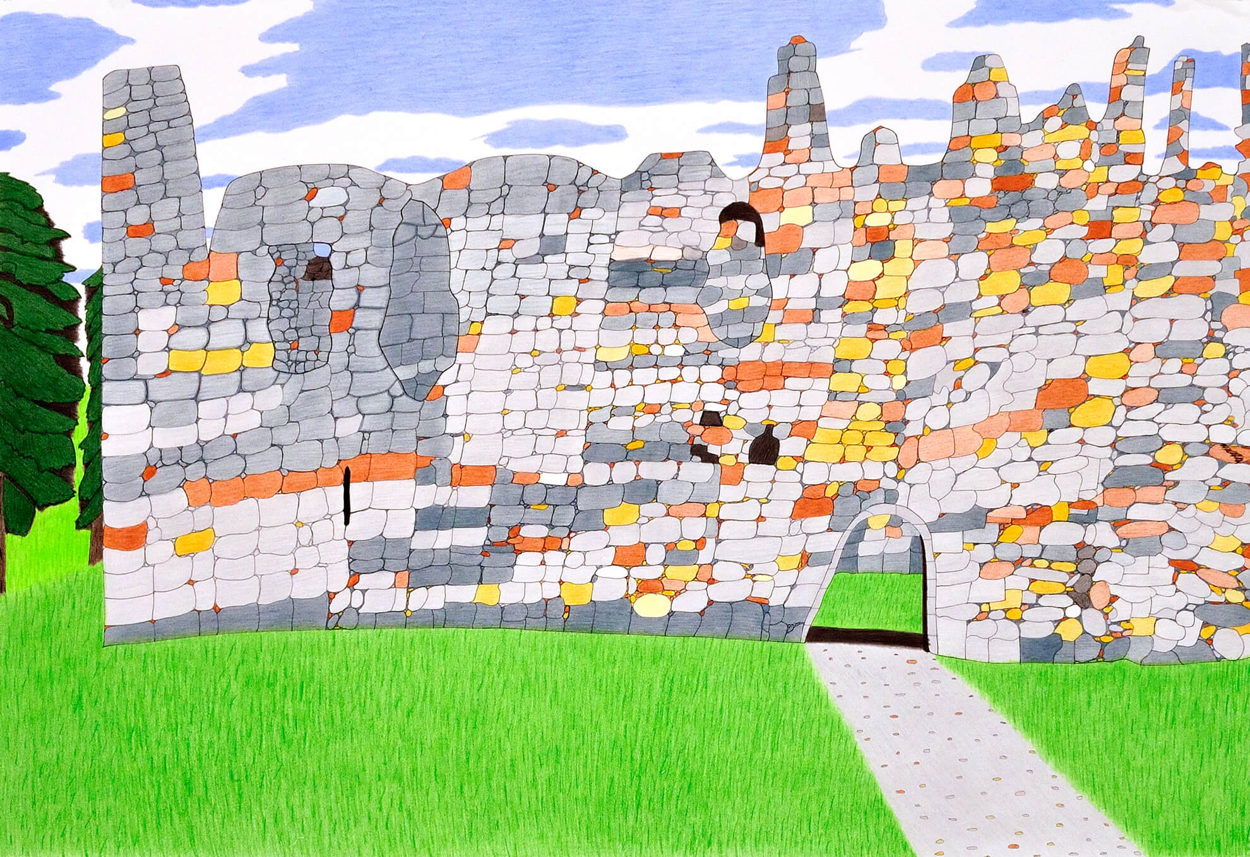
Annie Pootoogook, Balvenie Castle, 2006. This drawing was inspired by Pootoogook’s artist residency in Scotland.

Slide 8
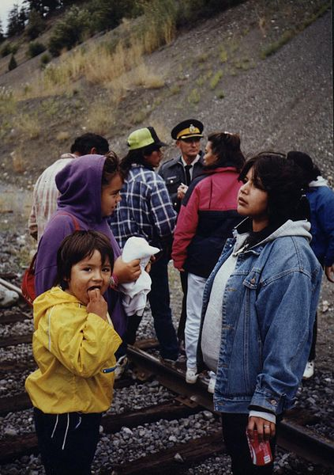
Members of the Seton Lake Indian Band blockade the BC Rail line in support of Oka, while an RCMP officer looks on, 1990.

Slide 9
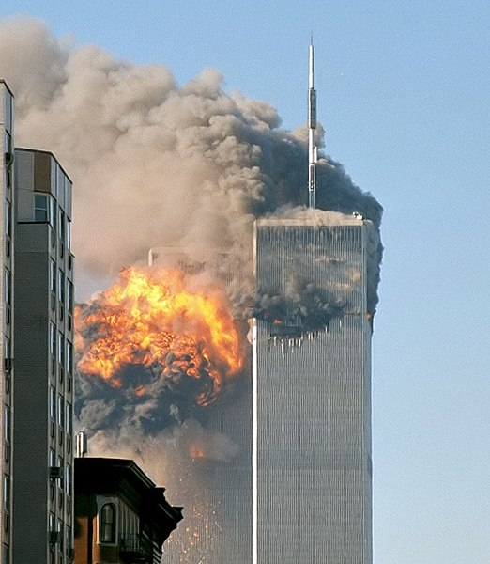
World Trade Center (south tower) after being struck by a plane on September 11, 2001.

Slide 10
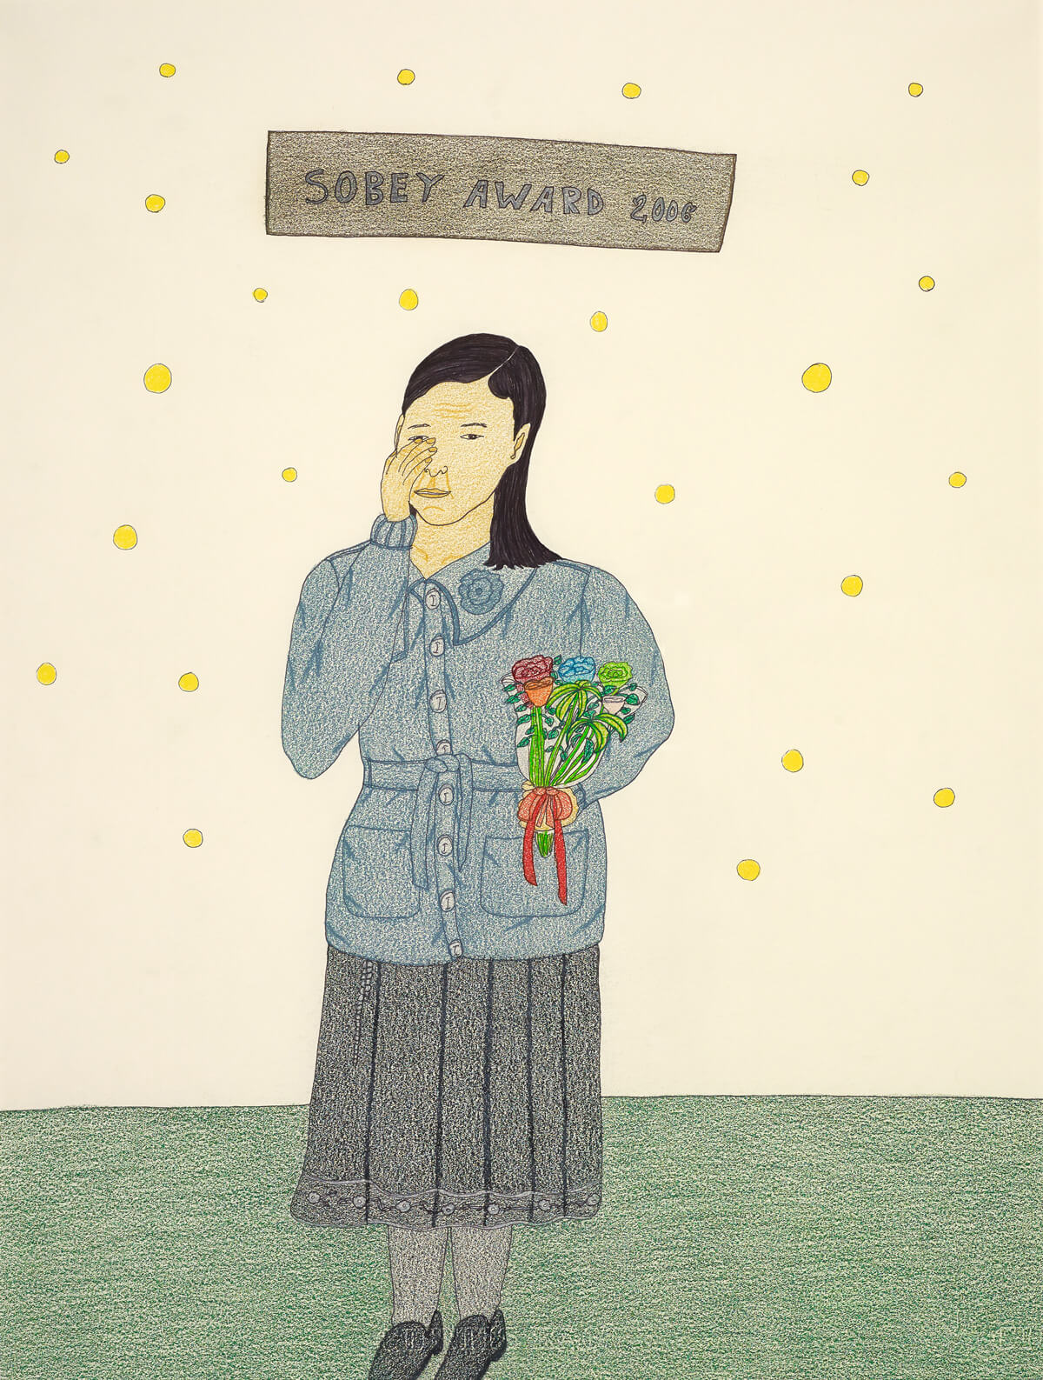
Annie Pootoogook, Sobey Award 2006, 2007. Pootoogook was the first Inuit artist to be awarded the Sobey prize.

Slide 11
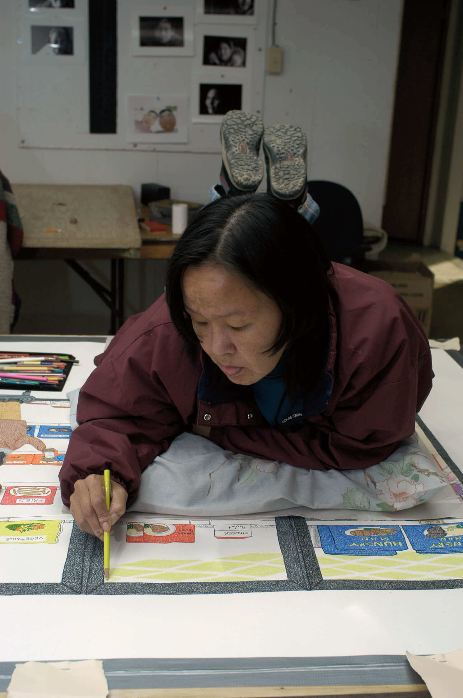
Annie Pootoogook working on Cape Dorset Freezer, 2005, at Kinngait Studios.

Slide 12
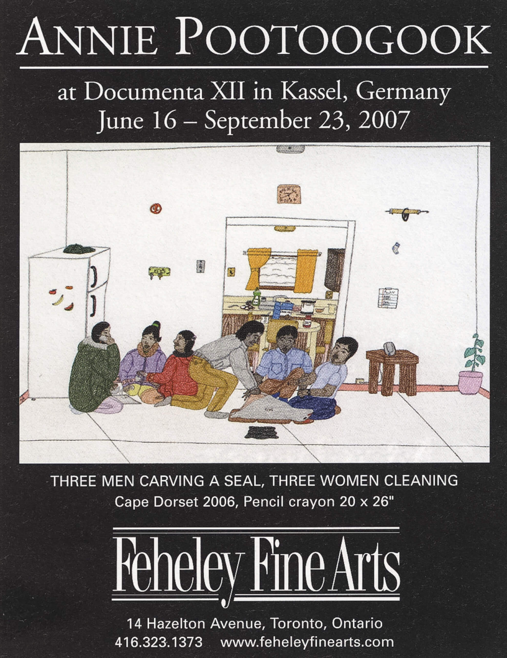
Promotional poster by Feheley Fine Arts for Annie Pootoogook at Documenta XII, Kassel, Germany, 2007.

Slide 13
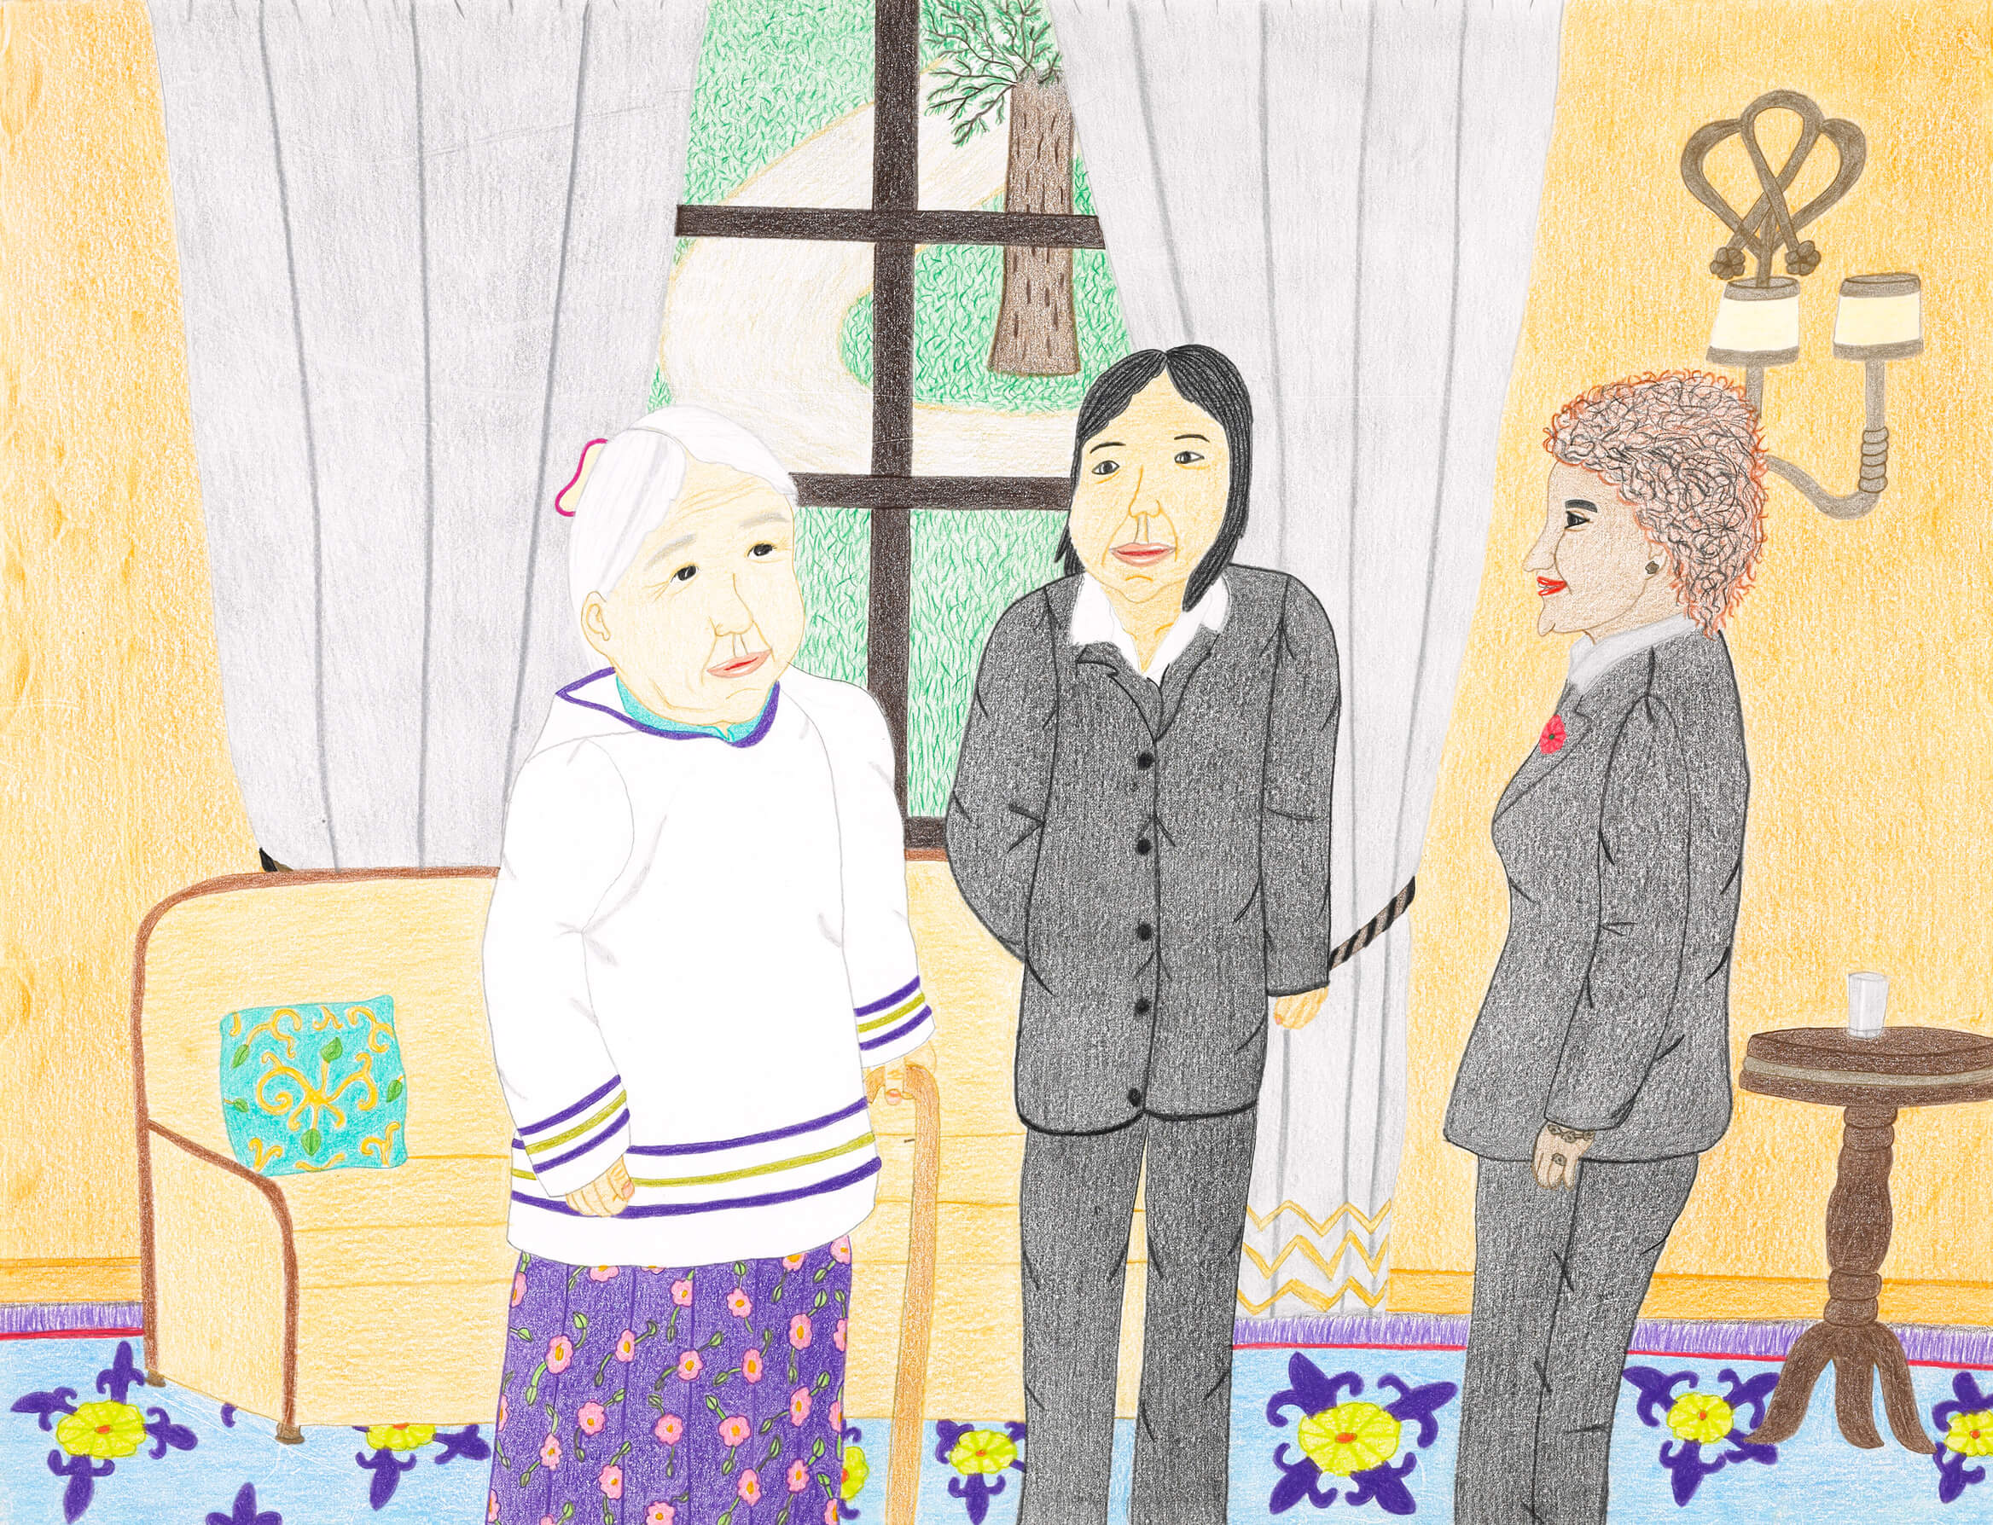
Annie Pootoogook, Untitled (Kenojuak and Annie with Governor General Michaëlle Jean),
2010.

Slide 14
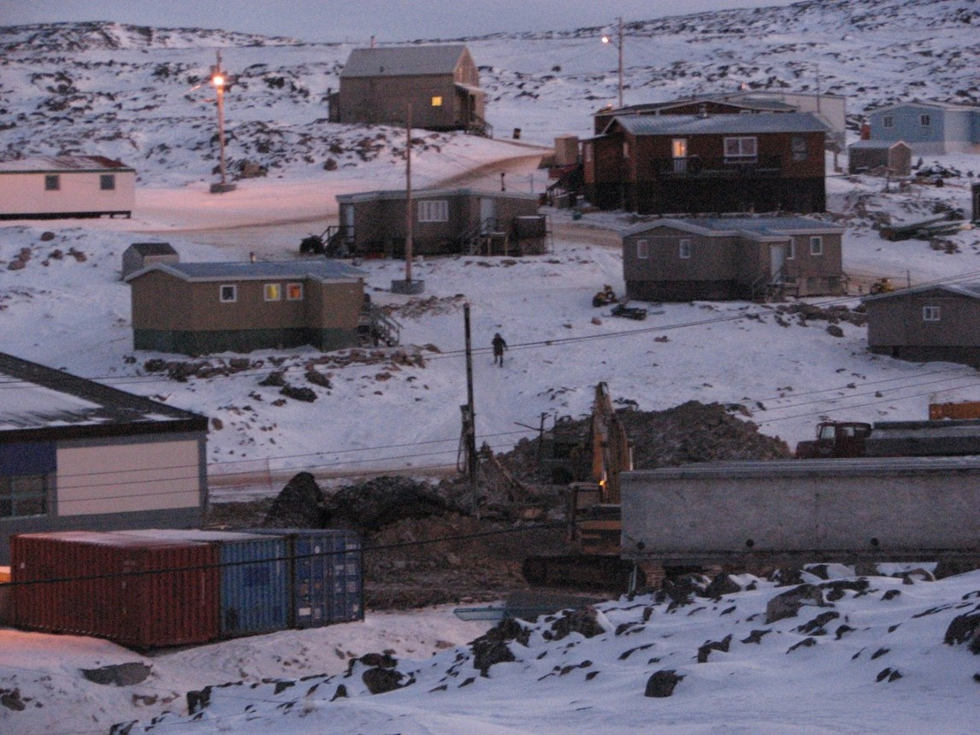
Learning Activity #1
Kinngait (Cape Dorset), c.2005. This photograph pictures the community where Pootoogook lived.

Slide 15
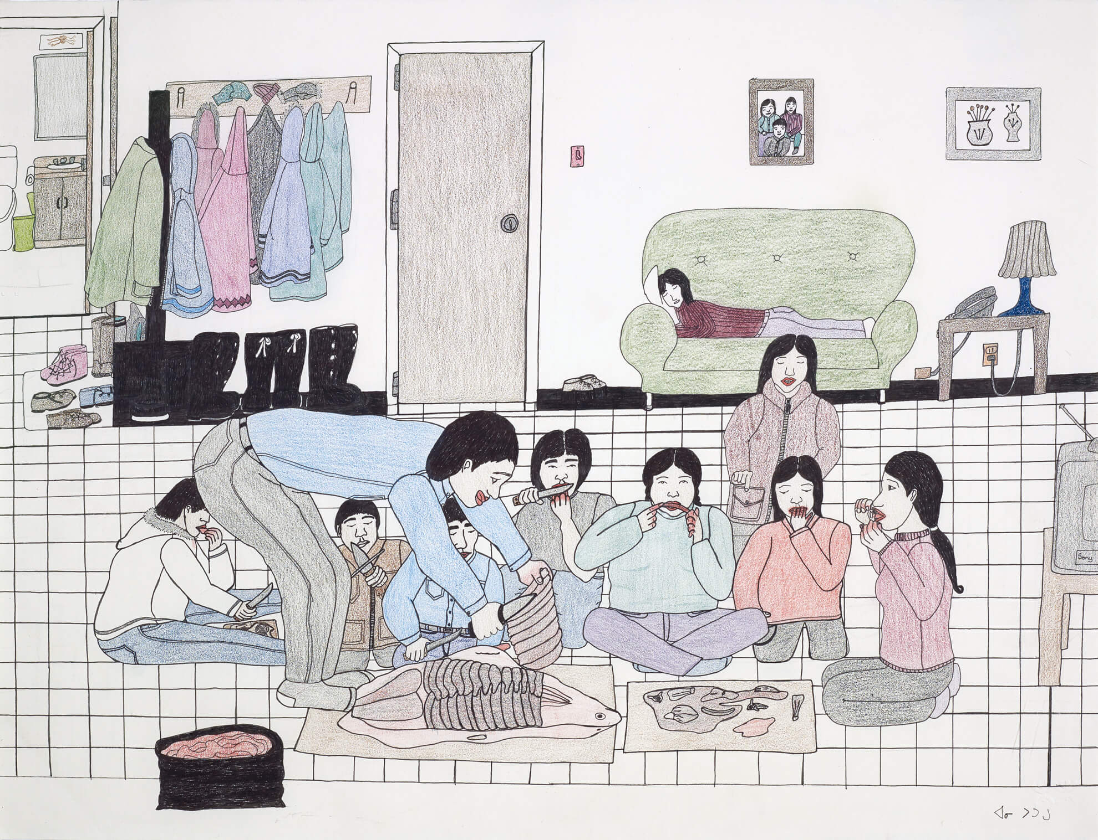
Learning Activity #1
Annie Pootoogook, Eating Seal at Home, 2001. Here a group of figures
is eating traditional Inuit food.

Slide 16
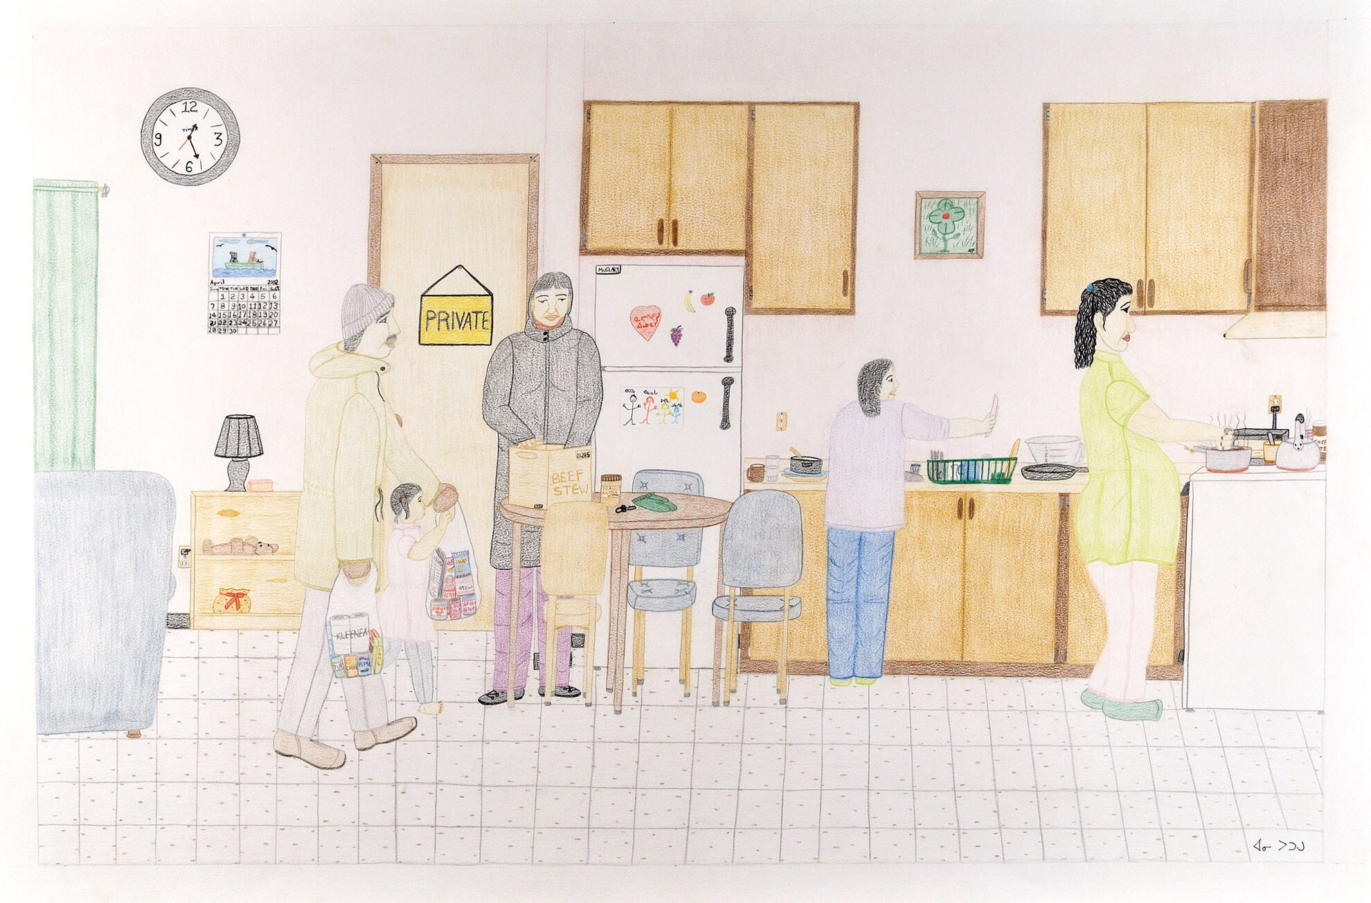
Learning Activity #1
Annie Pootoogook, Composition (Family Cooking in Kitchen), 2002. Domestic life is a central theme in Pootoogook’s work.

Slide 17
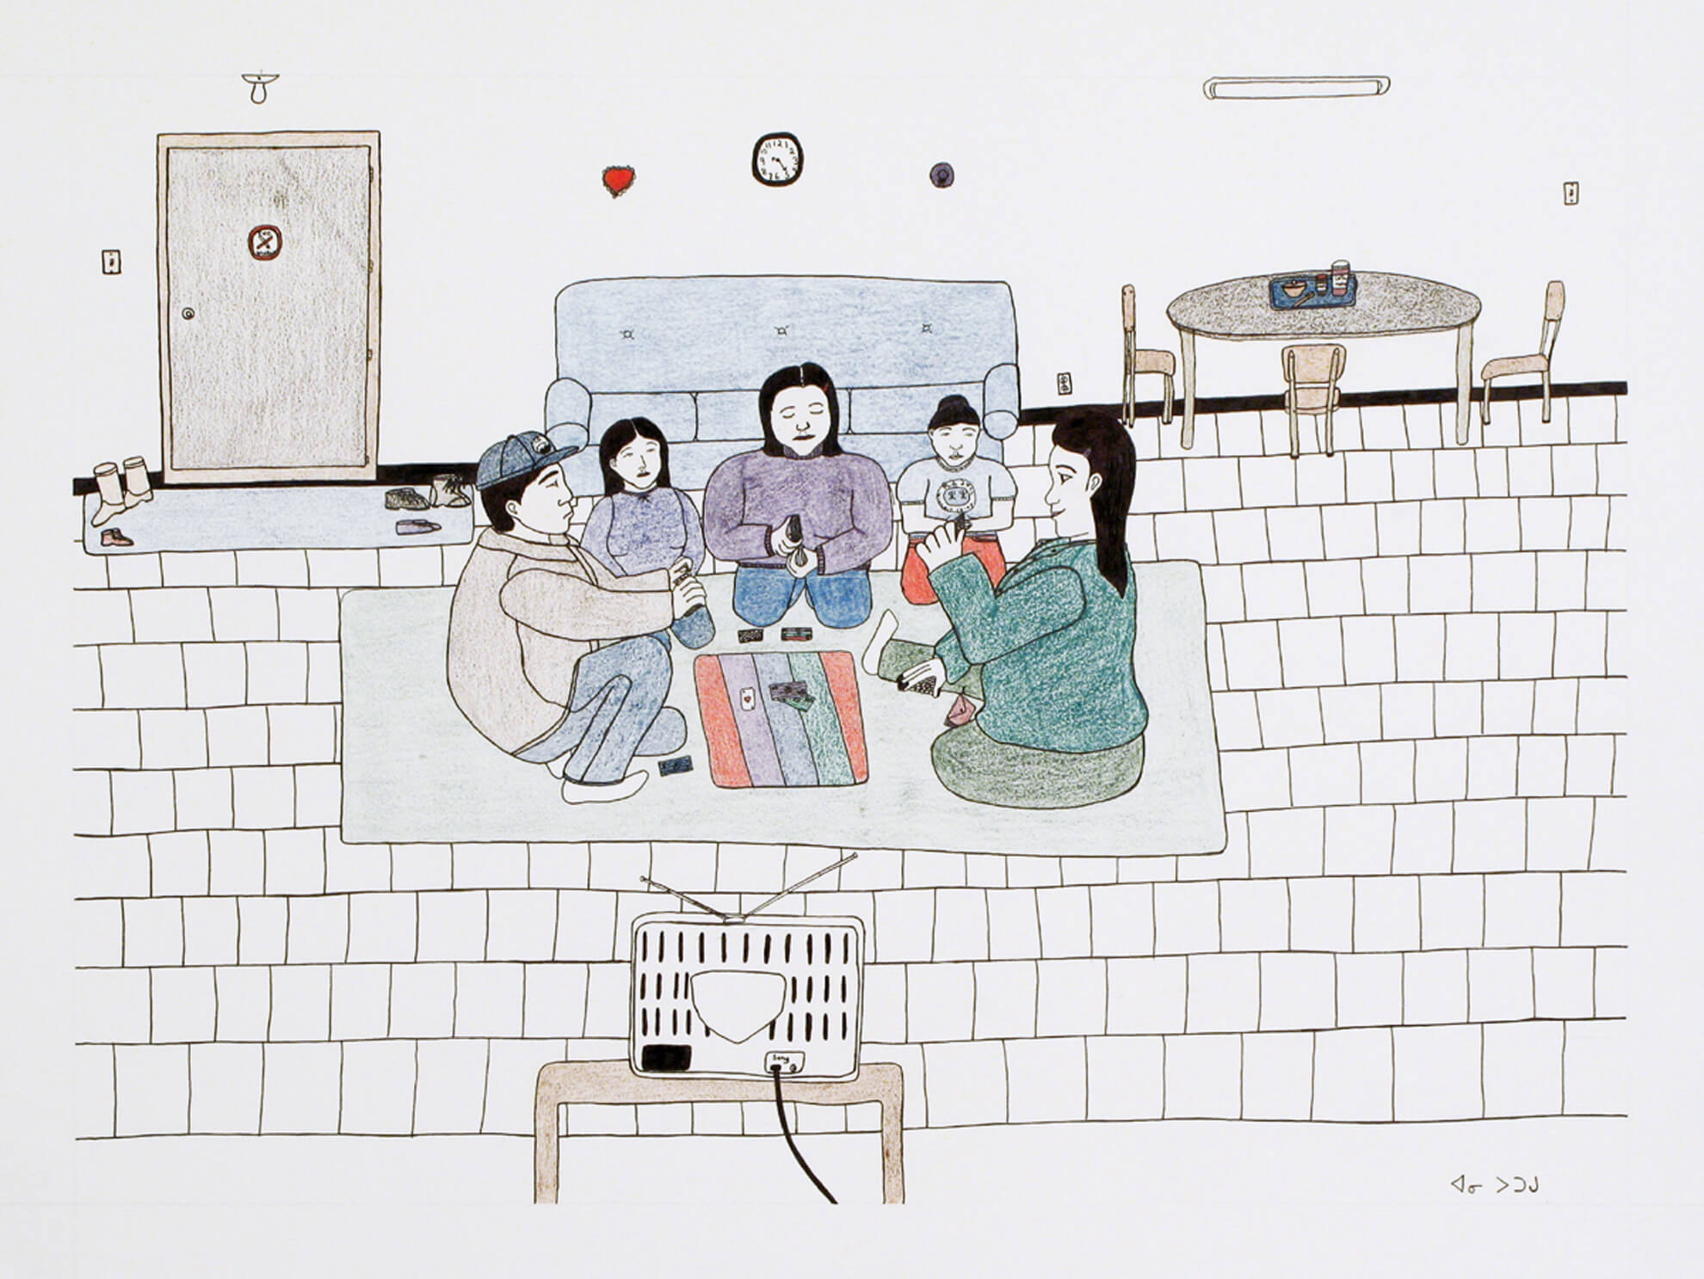
Learning Activity #1
Annie Pootoogook, Composition (Family Playing Cards), 2000–1. With its relatively simple composition, this image is typical of Pootoogook’s early work.

Slide 18
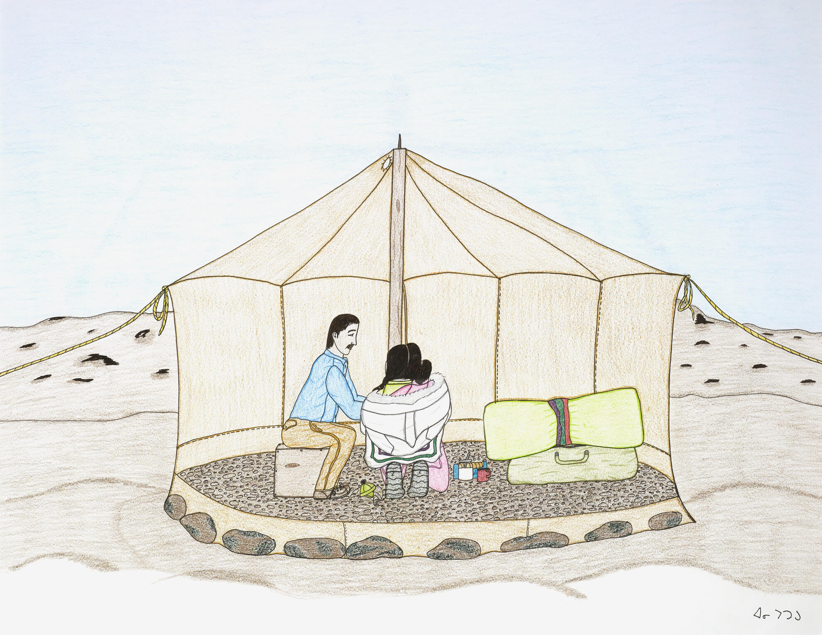
Learning Activity #1
Annie Pootoogook, Family Camping on the Land, 2001–2. Pootoogook created a number of outdoor scenes like this one.

Slide 19
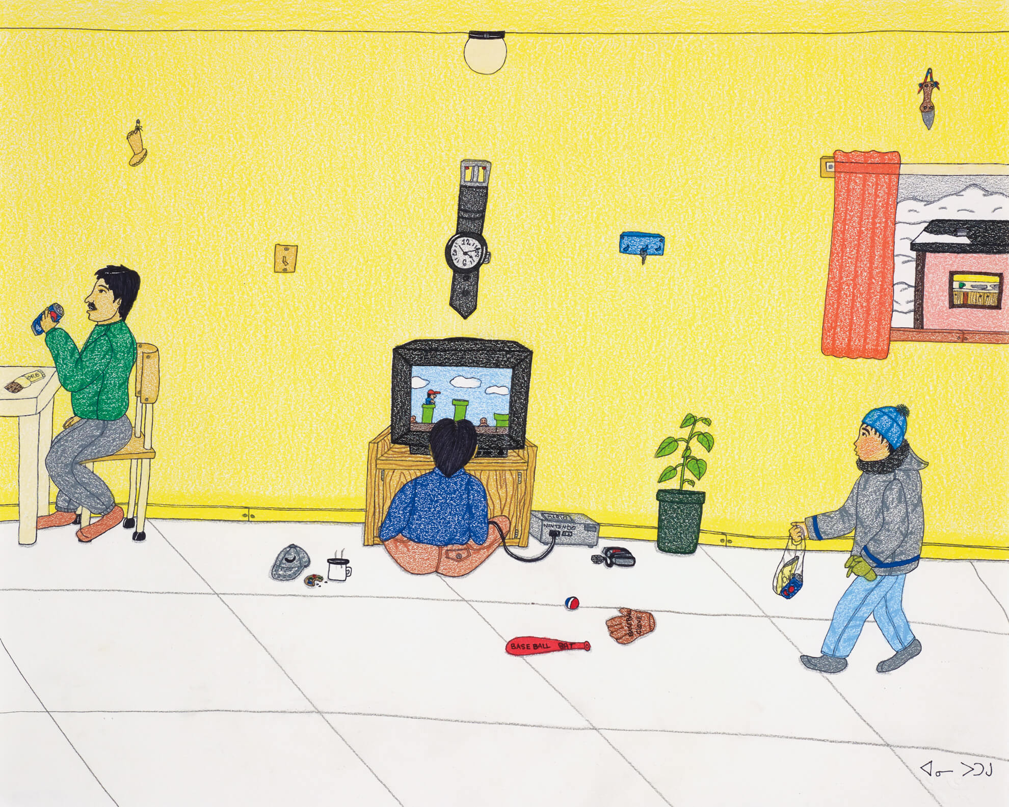
Learning Activity #1
Annie Pootoogook, Playing Nintendo, 2006. In later works, Pootoogook used bold bursts of colour.

Slide 20
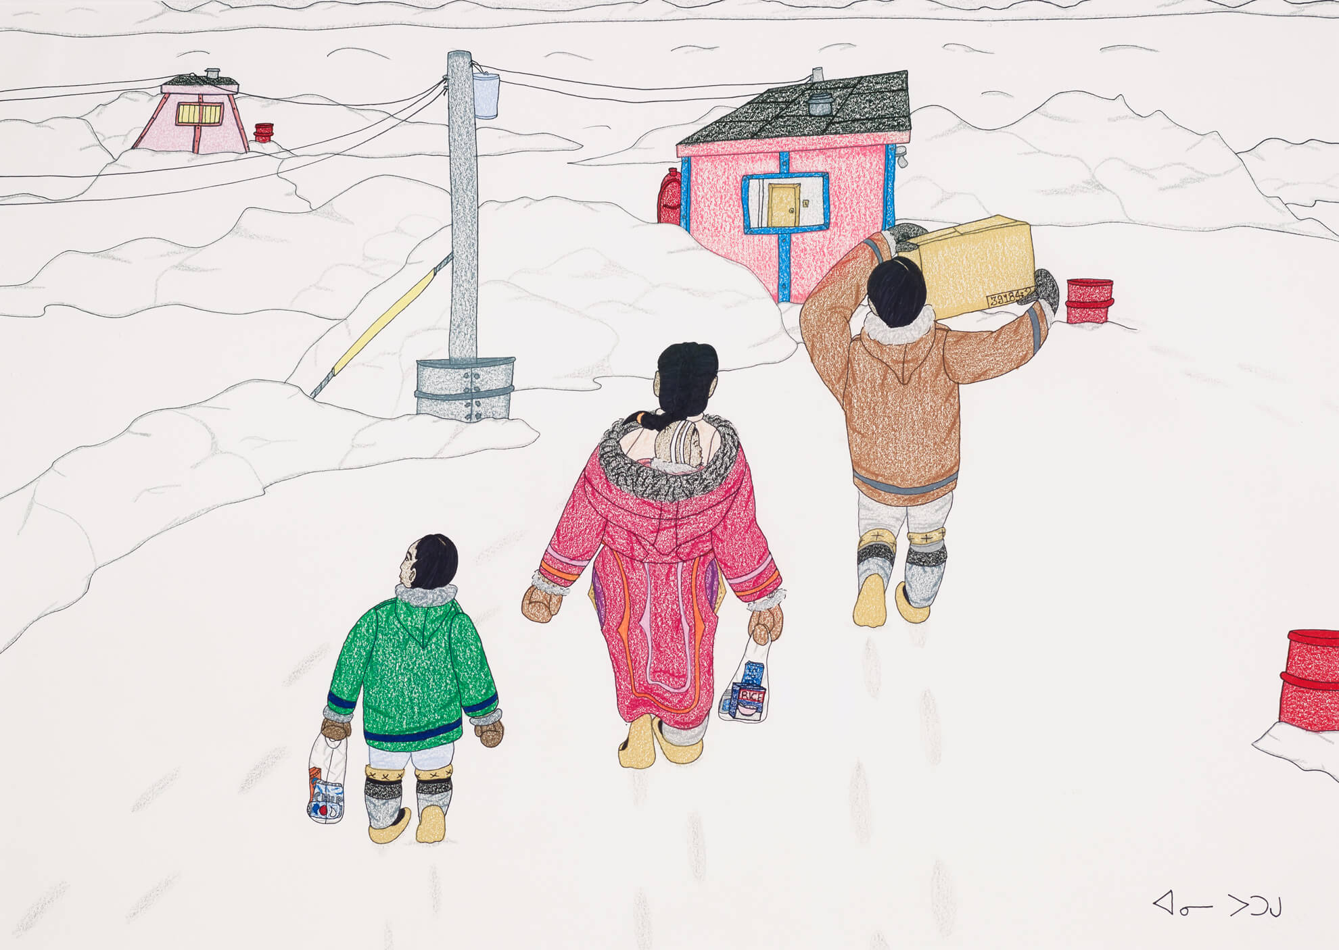
Learning Activity #2
Annie Pootoogook, Family Taking Supplies Home, 2006. A family carries food and other supplies to their home in this winter scene.

Slide 21
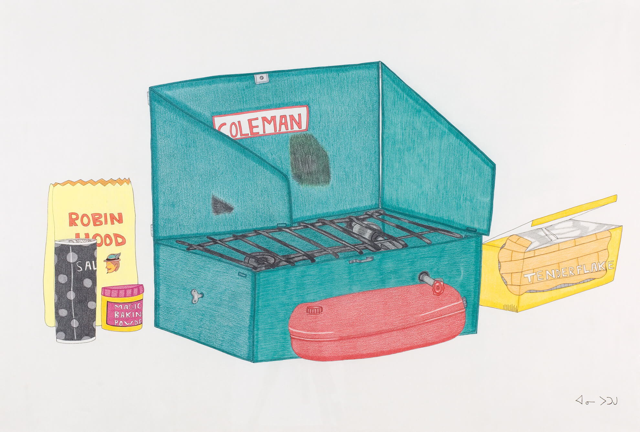
Learning Activity #2
Annie Pootoogook, Coleman Stove with Robin Hood Flour and Tenderflake, 2003–4. Many brand names are on display in this image, which shows ingredients for making bannock.

Slide 22
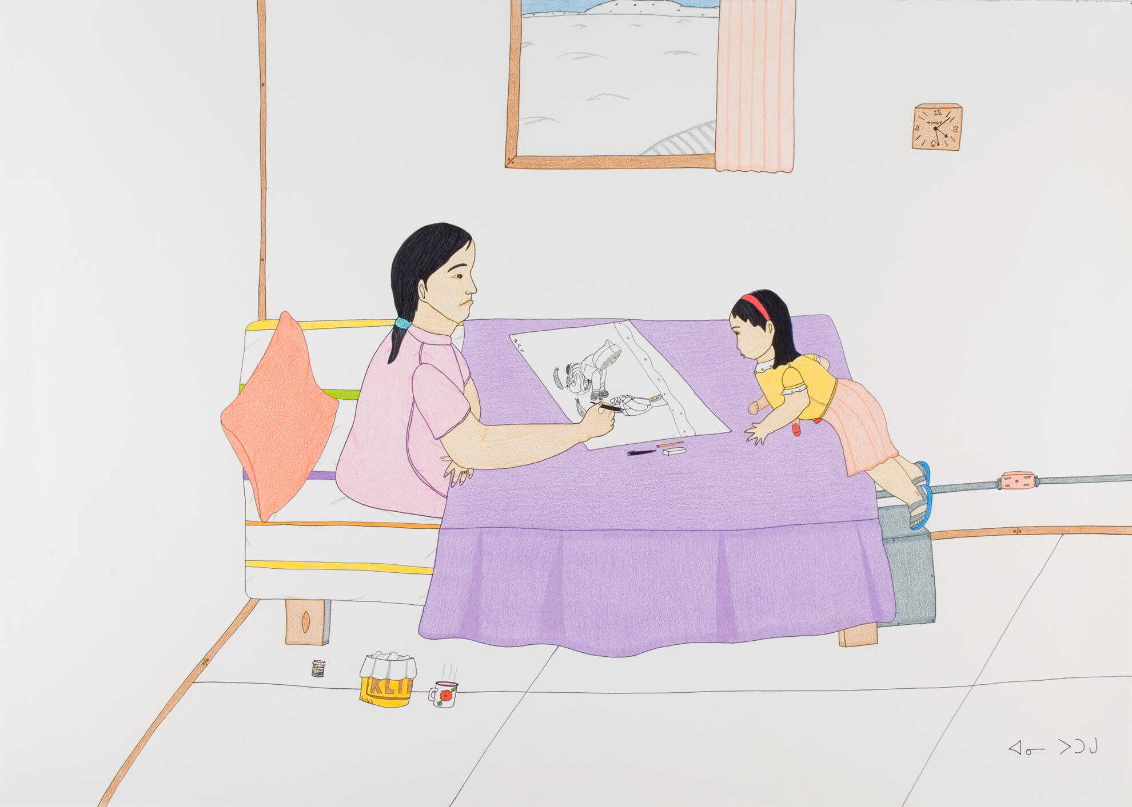
Learning Activity #2
Annie Pootoogook, My Mother and I, 2004–5. Pootoogook’s mother was Napachie Pootoogook, herself a celebrated artist.

Slide 23
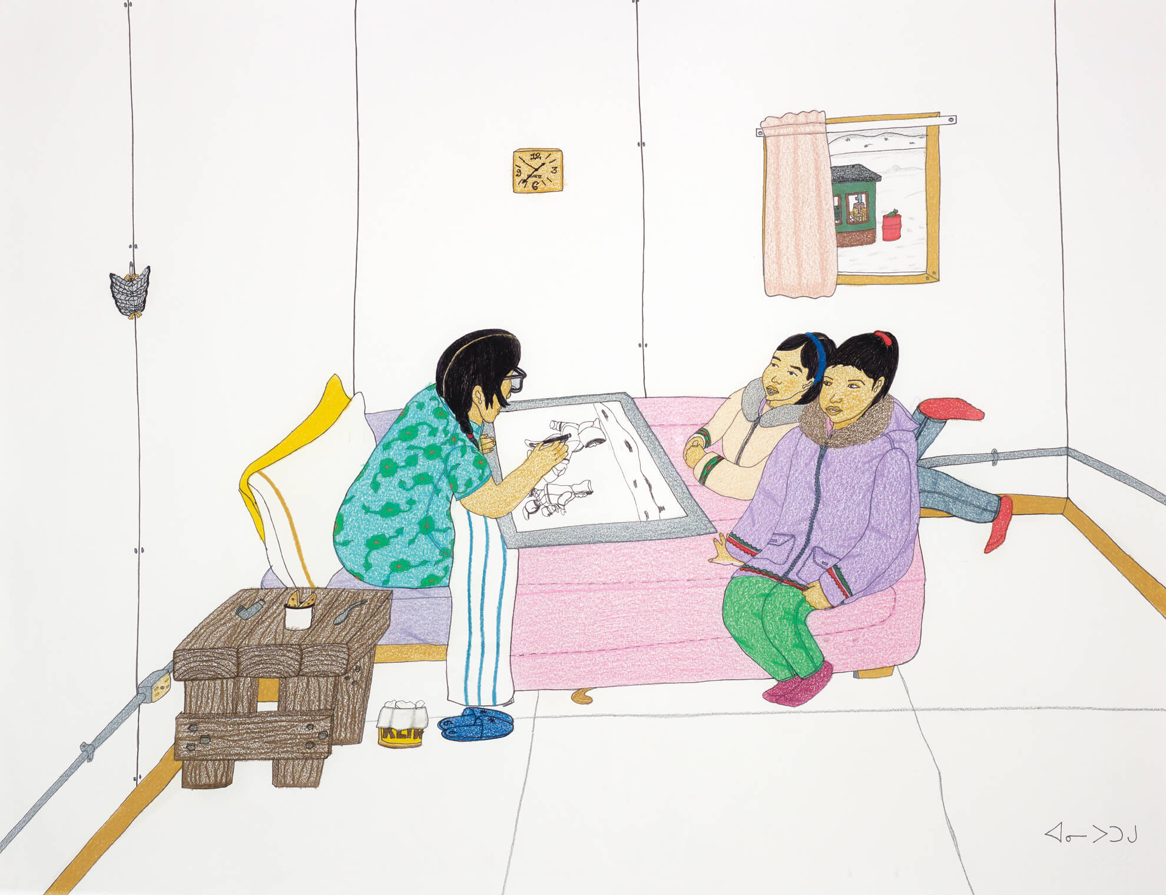
Learning Activity #2
Annie Pootoogook, Pitseolak Drawing with Two Girls on Her Bed, 2006. This work pictures Pootoogook’s grandmother Pitseolak Ashoona, also a
famous artist.

Slide 24
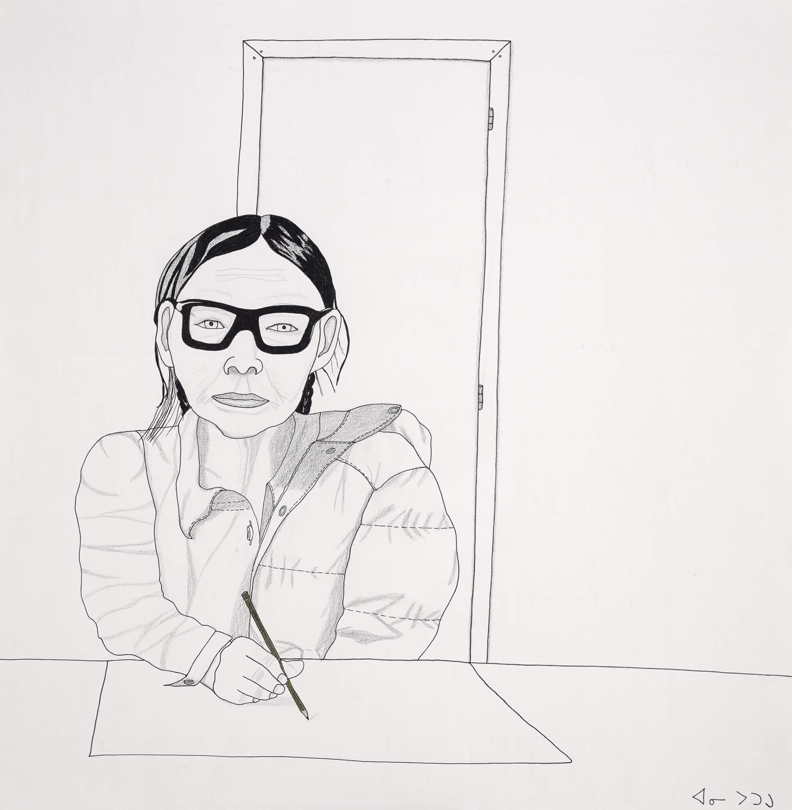
Learning Activity #2
Annie Pootoogook, Portrait of My Grandmother, 2004. Pitseolak Ashoona is often identifiable in Pootoogook’s works by her thick framed glasses.

Slide 25
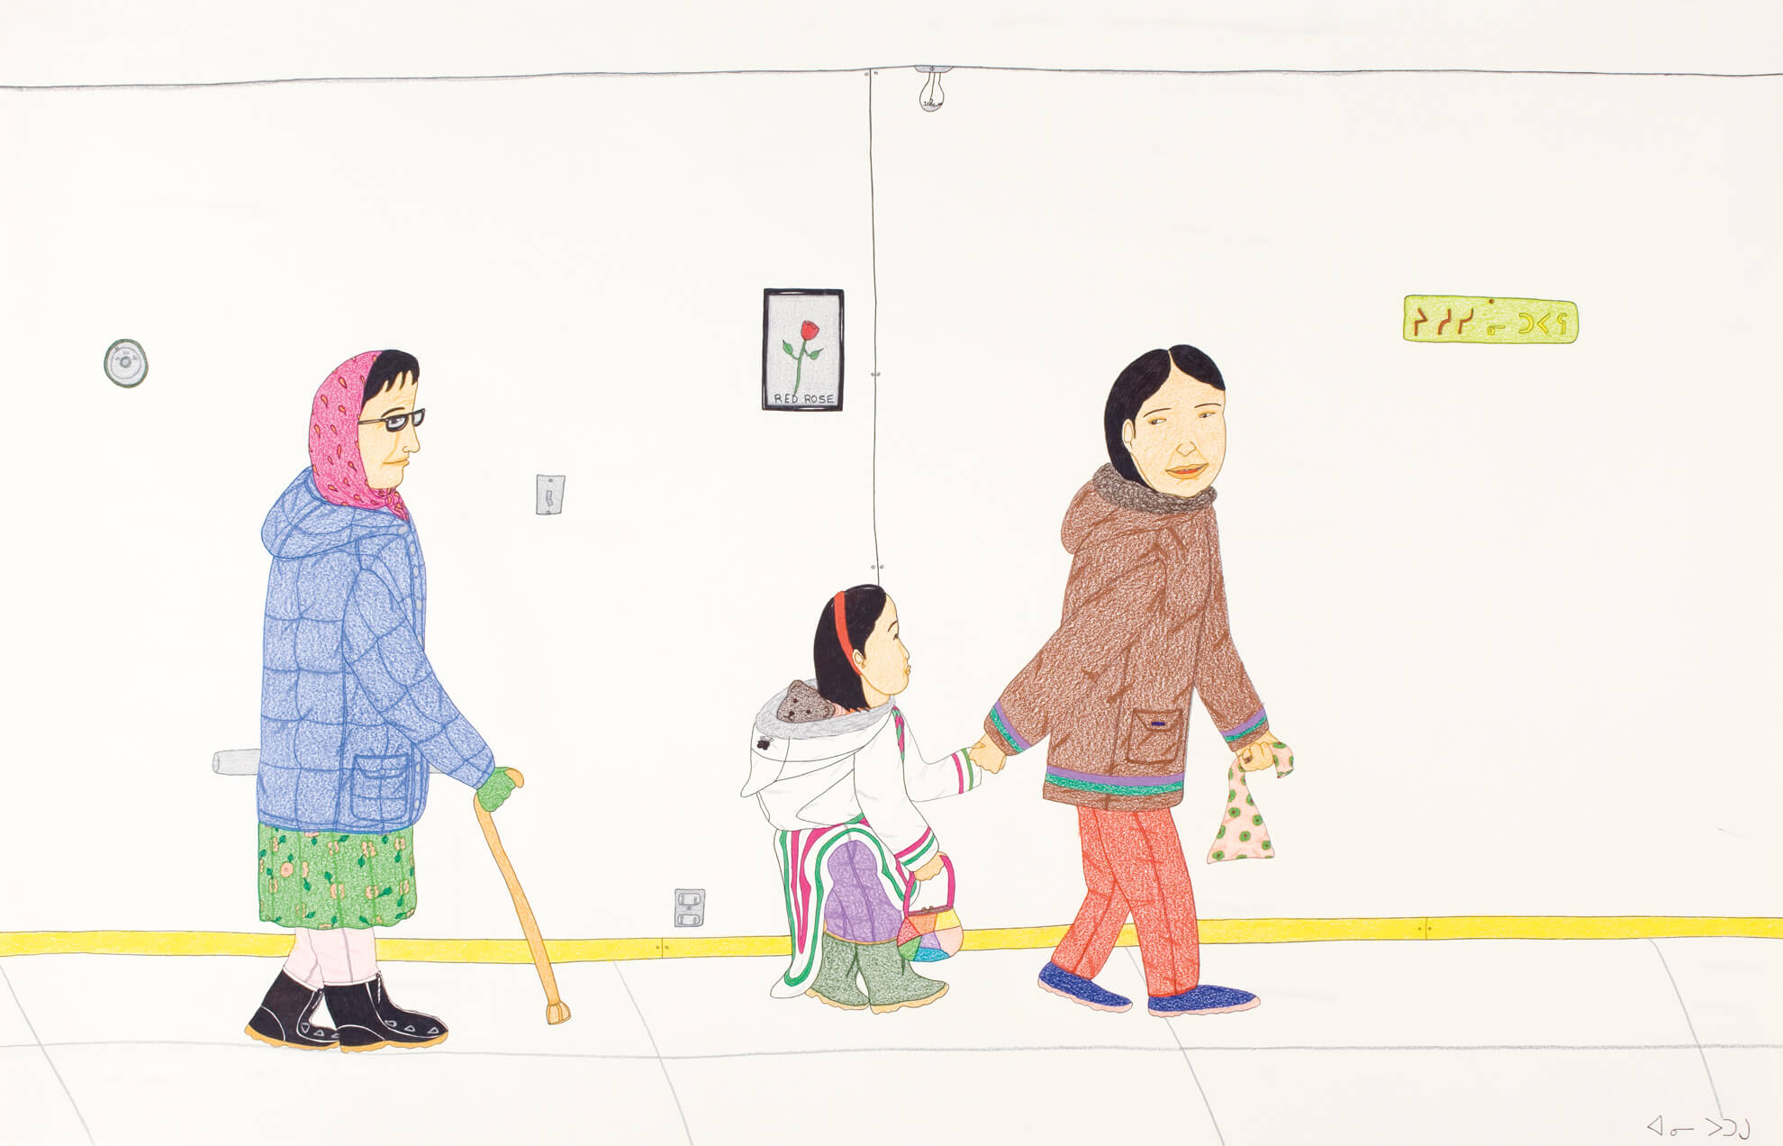
Learning Activity #2
Annie Pootoogook, 3 Generations, 2004–5. This drawing celebrates intergenerational relationships.

Slide 26
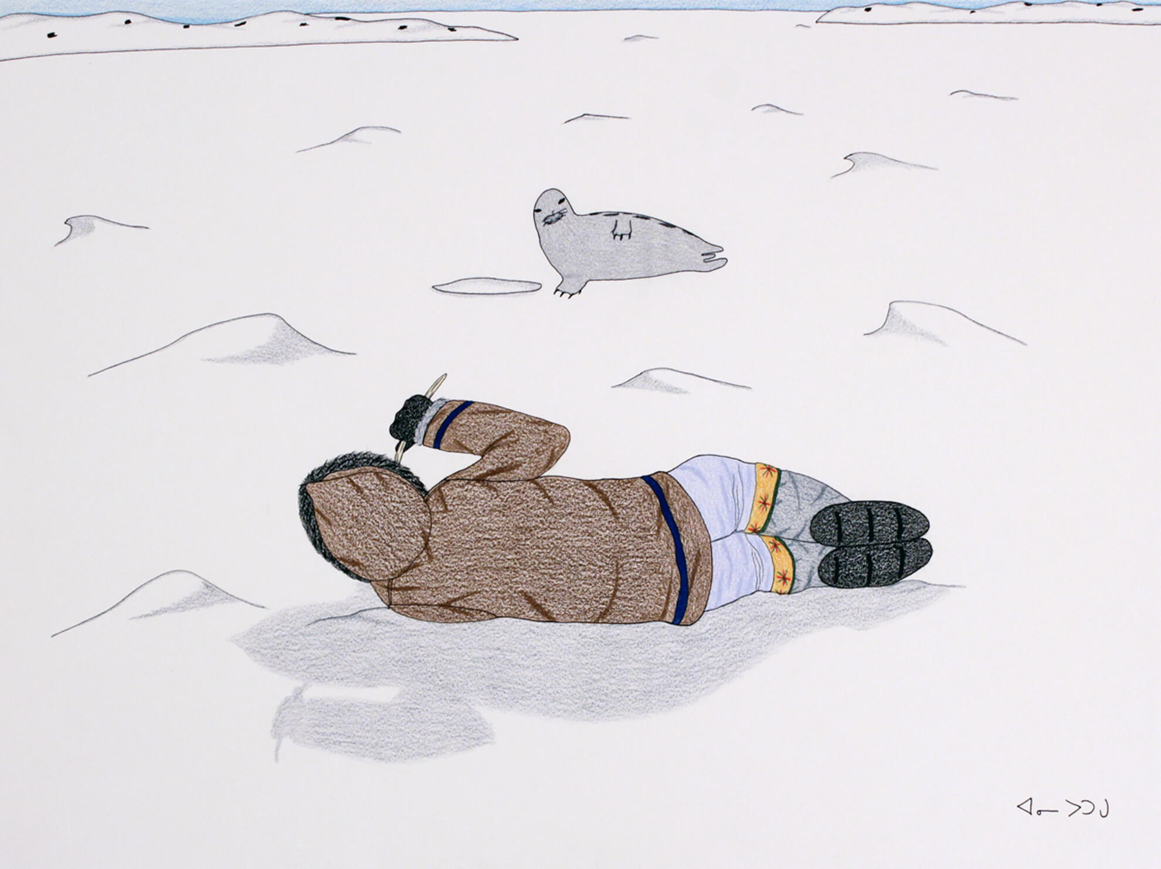
Learning Activity #2
Annie Pootoogook, Hunter Mimics Seal, 2006. Traditional Inuit practices, like the seal hunt, appear in many of Pootoogook’s works.

Slide 27
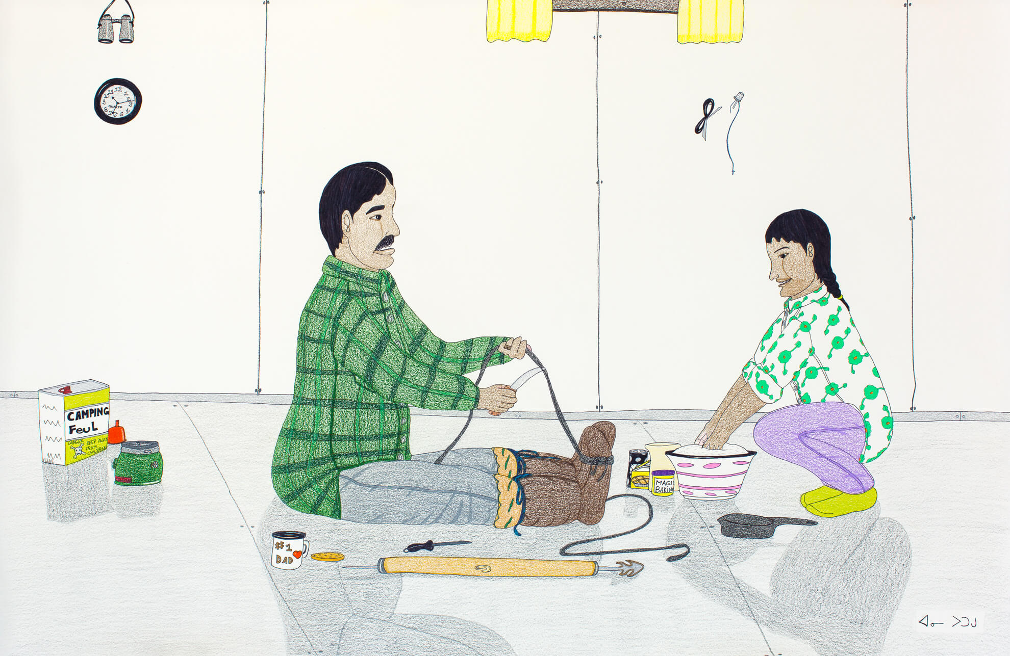
Learning Activity #2
Annie Pootoogook, Untitled (Making Rope and Bannock), 2004–5. This image pictures two figures working together at home.

Slide 28
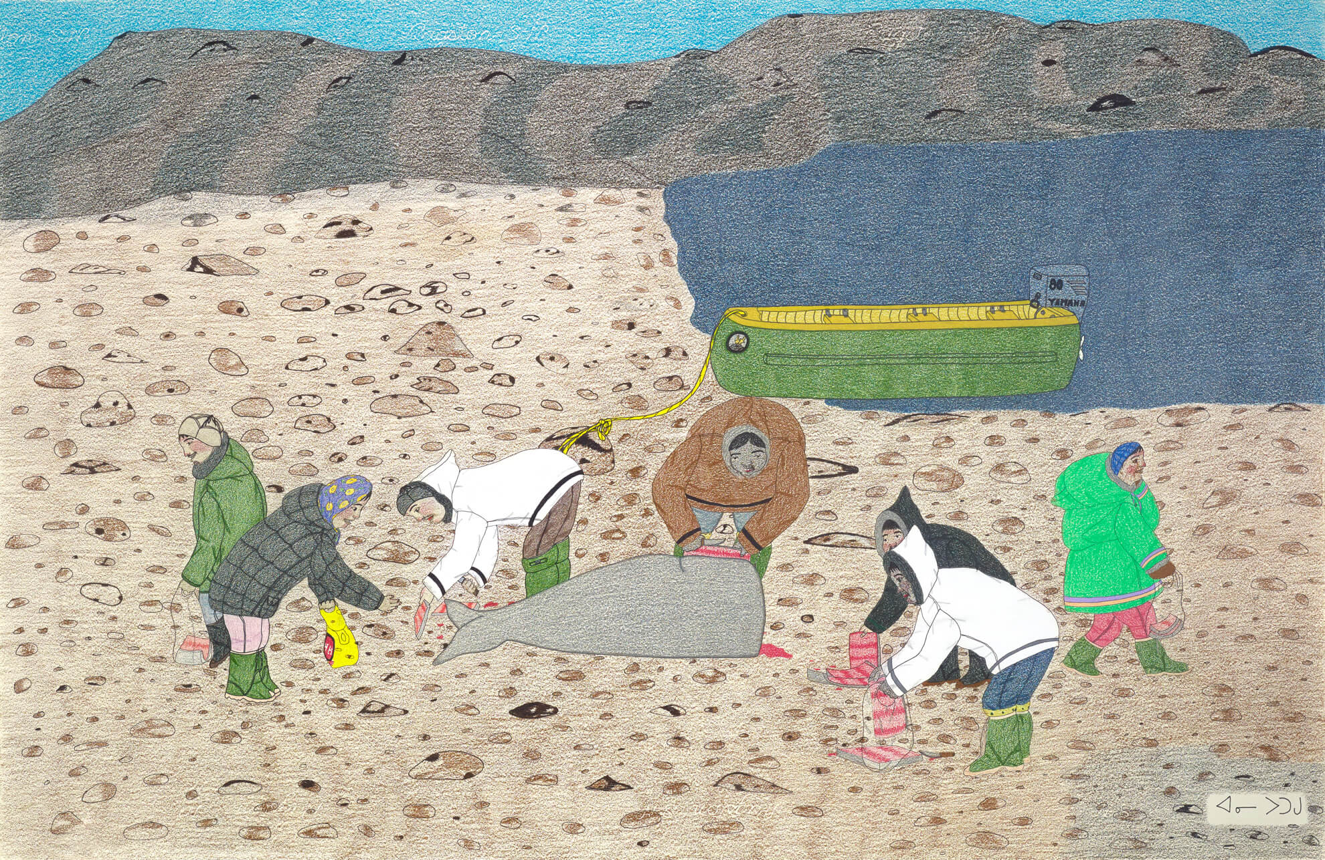
Learning Activity #2
Annie Pootoogook, Composition: Women Gathering Whale Meat, 2003–4. Pootoogook often emphasized the importance of women in Inuit traditional practices.

Slide 29
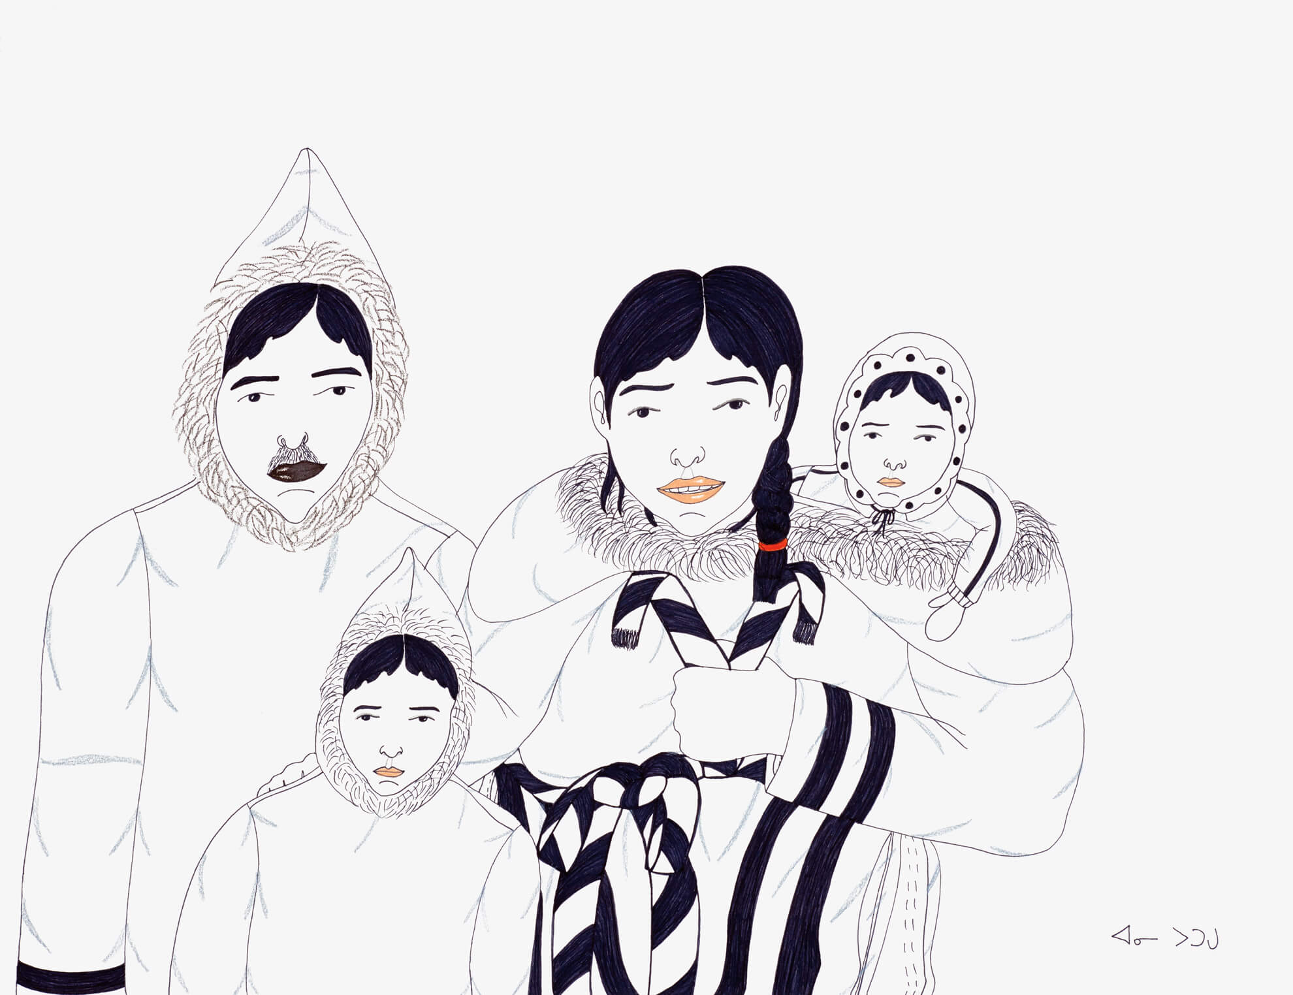
Culminating Task
Annie Pootoogook, Composition (Family Portrait), 2005–6. Here Pootoogook uses colour sparingly, adding delicate pink lips and a red hairband to create greater contrast.

Slide 30
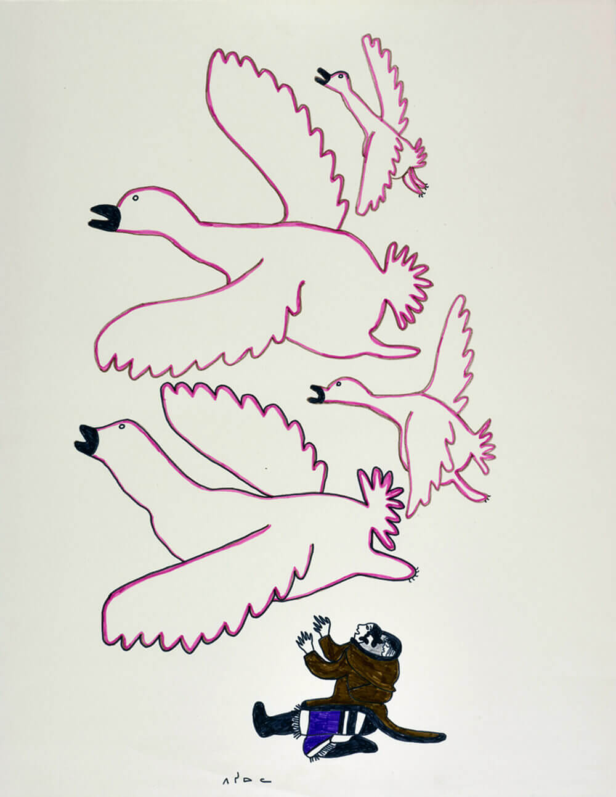
Culminating Task
Pitseolak Ashoona, Untitled (Birds Flying Overhead), c.1966–67. Animals and arctic wildlife were central components of Pitseolak Ashoona’s creations.

Slide 31
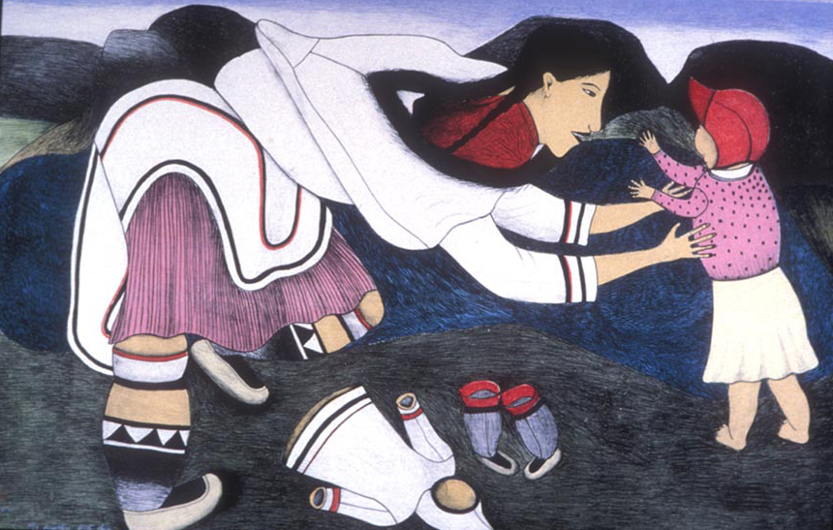
Culminating Task
Napachie Pootoogook, My Daughter’s First Steps, 1990. In this work, Pootoogook’s mother, Napachie, represents a tender moment between mother and daughter.

Slide 32
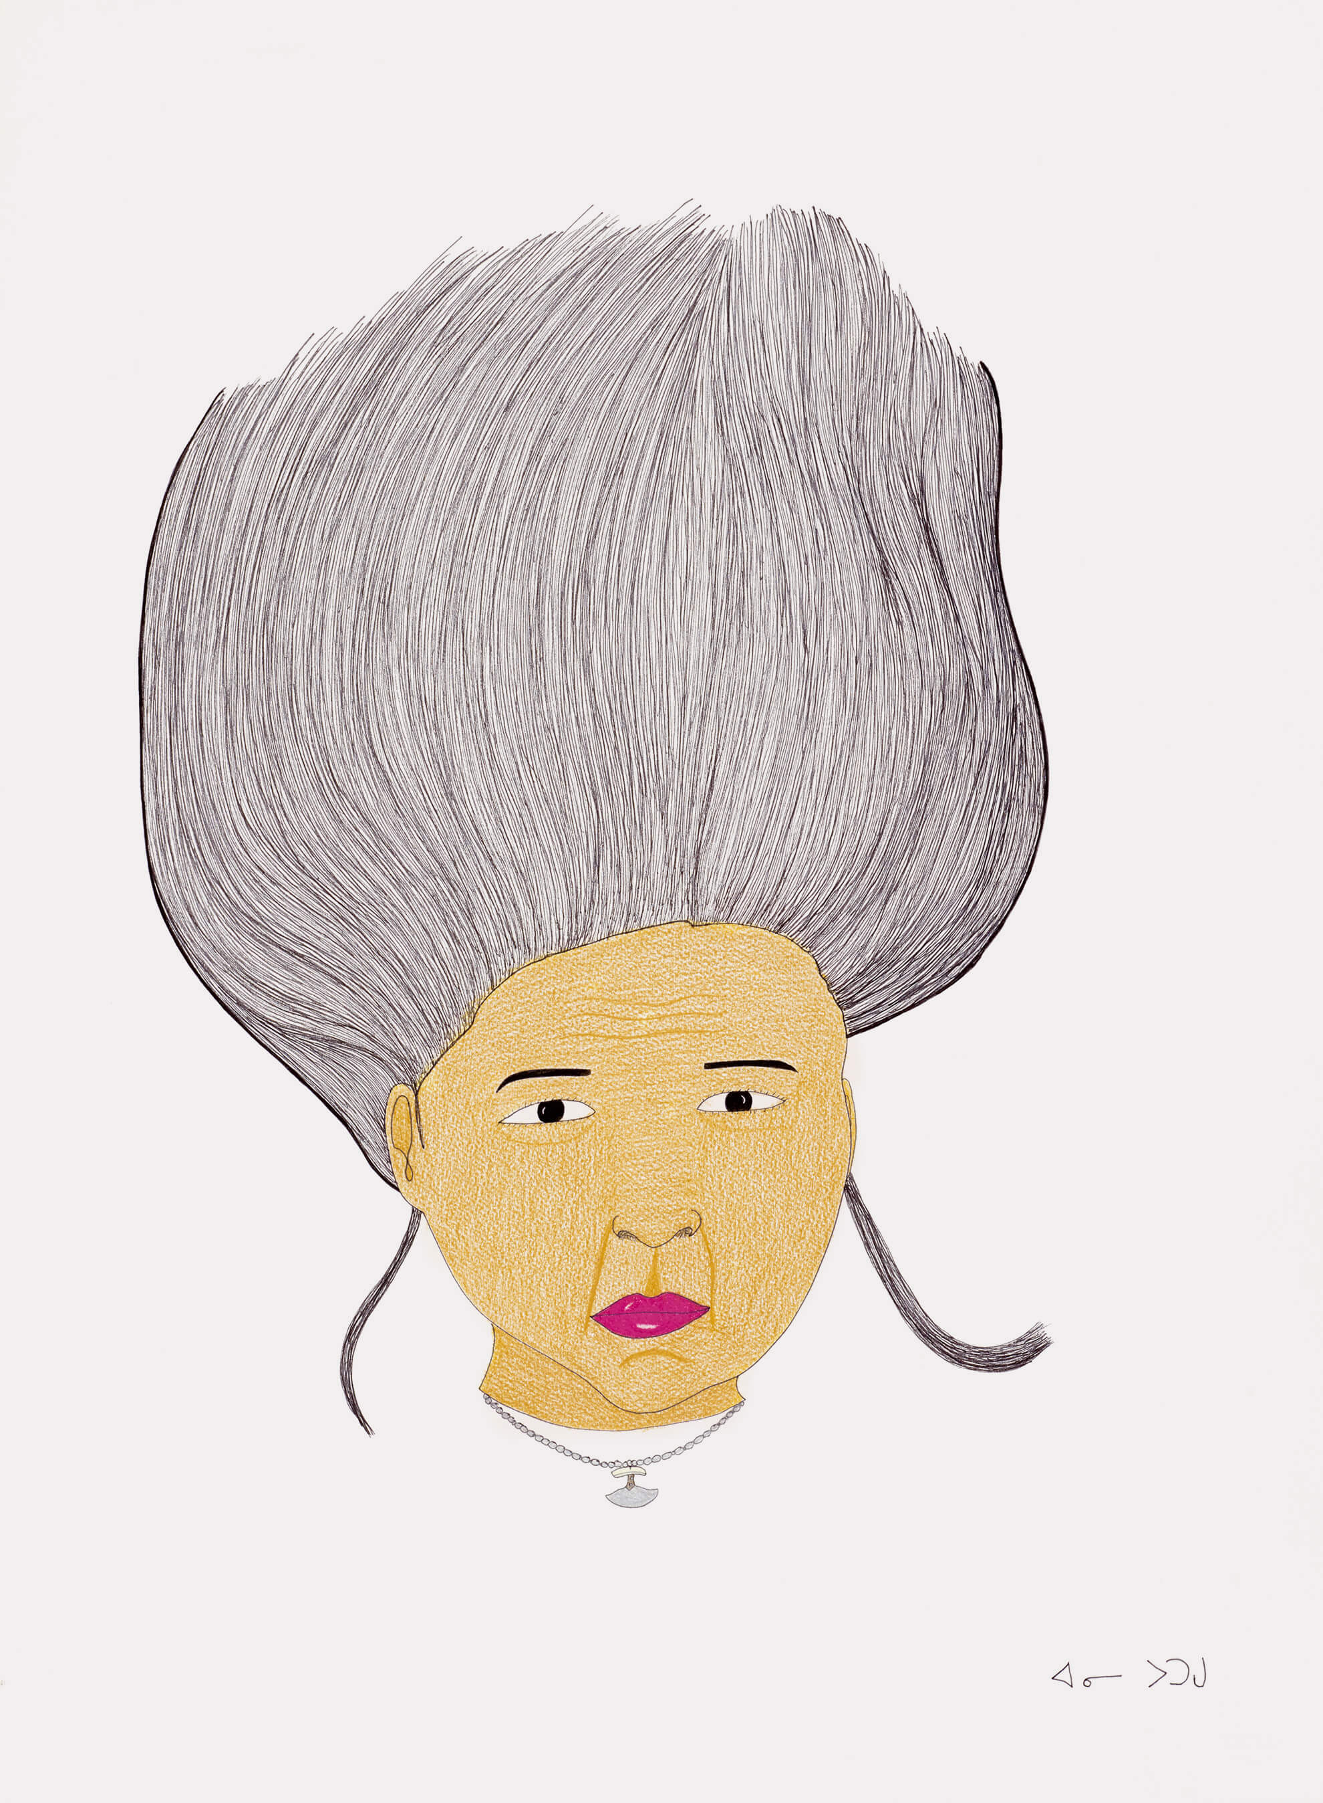
Culminating Task
Annie Pootoogook, Myself in Scotland, 2005–6. A rare self-portrait, this drawing shows the artist while at an international residency.

Slide 33
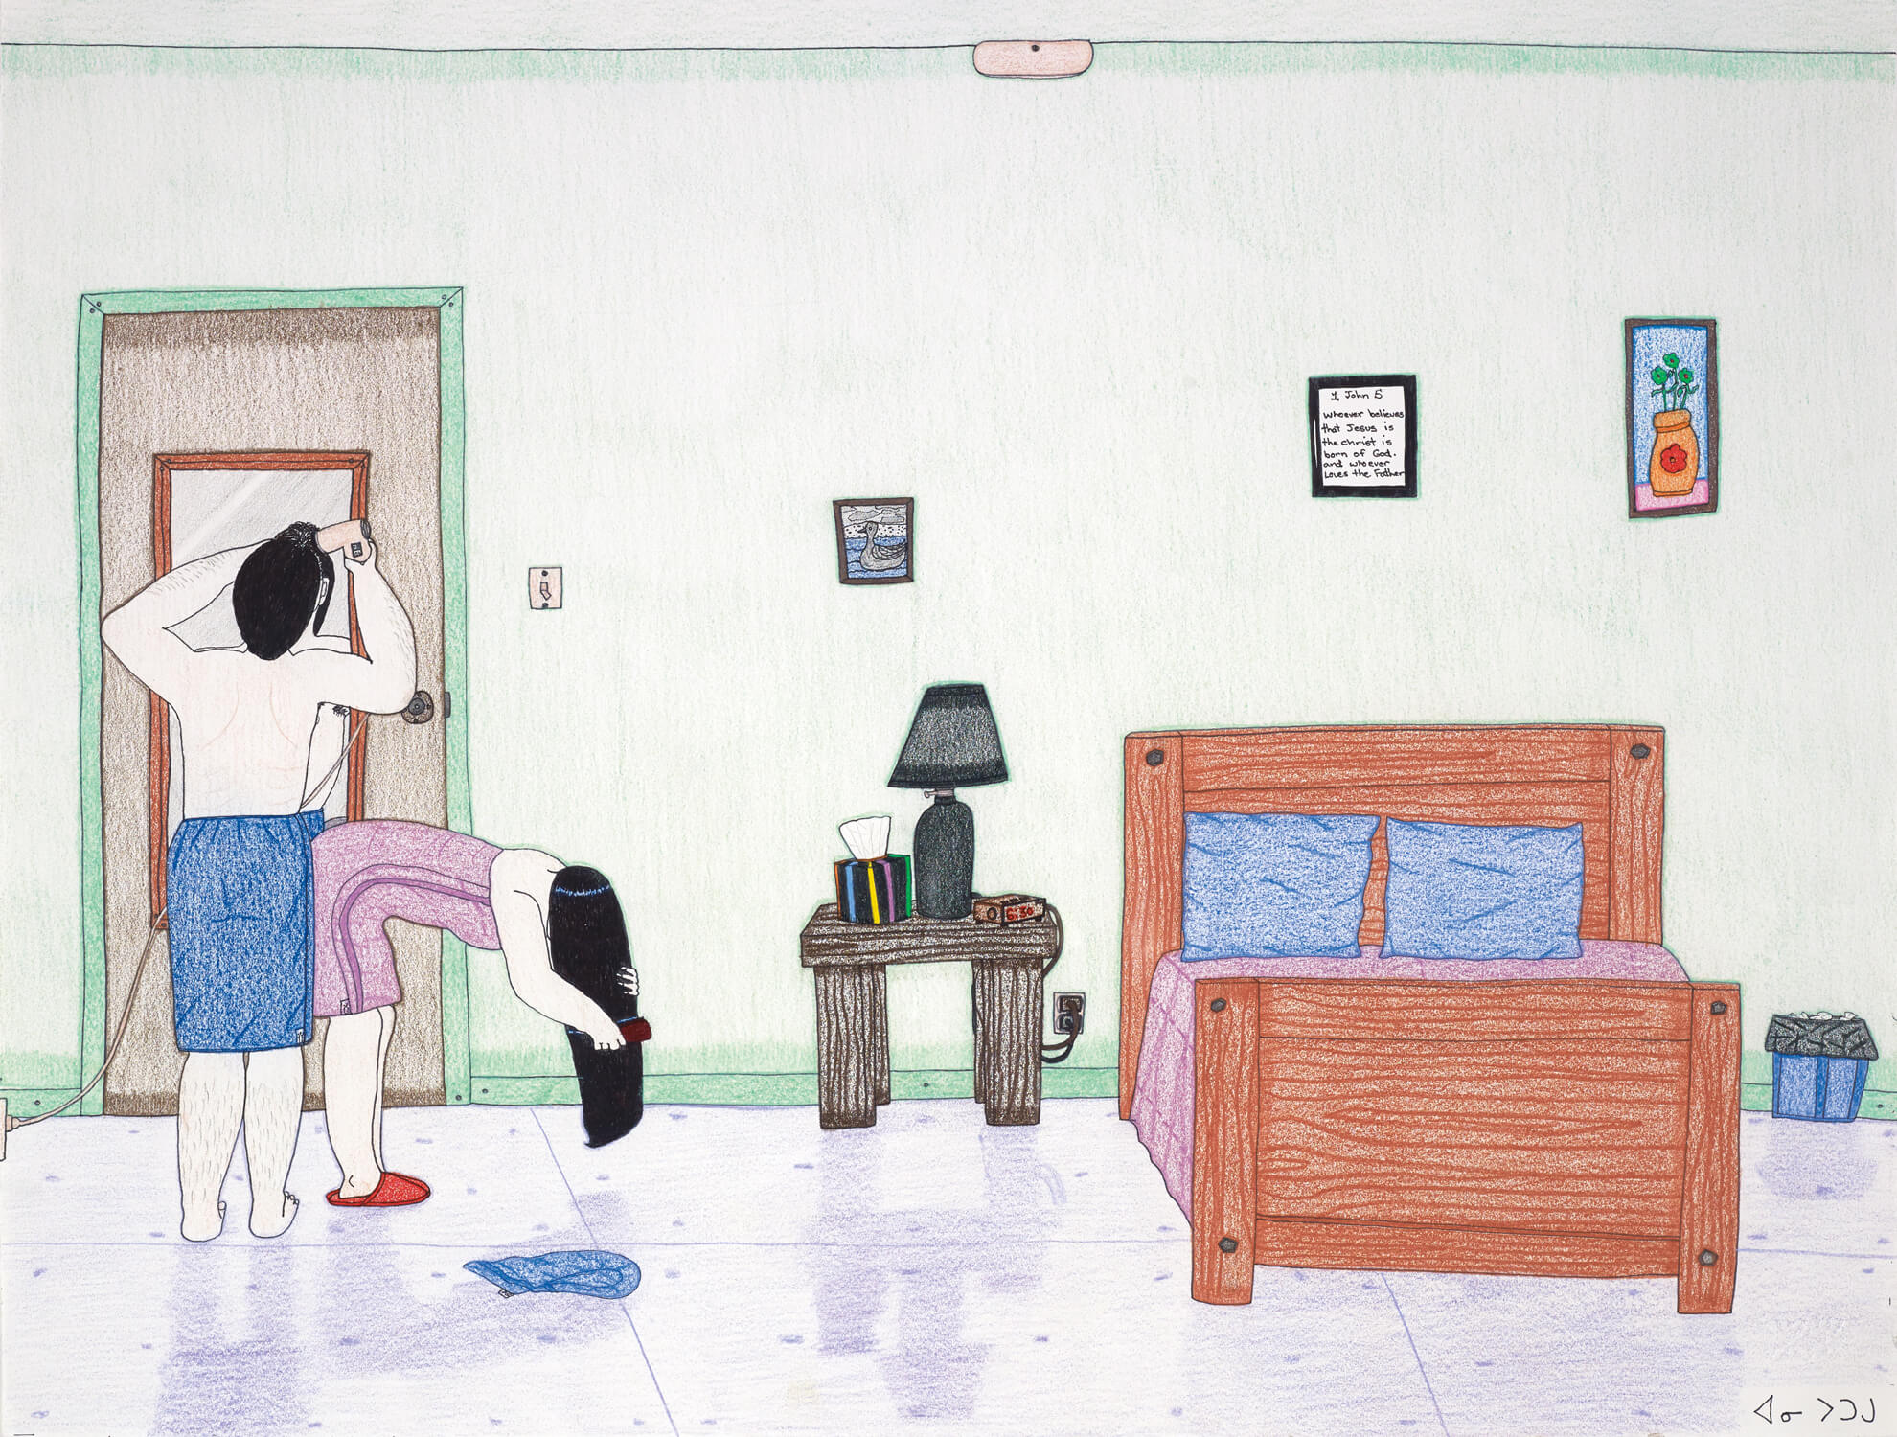
Annie Pootoogook, Morning Routine, 2003. Contemporary scenes of everyday life are a cornerstone of Pootoogook’s work.

Slide 34
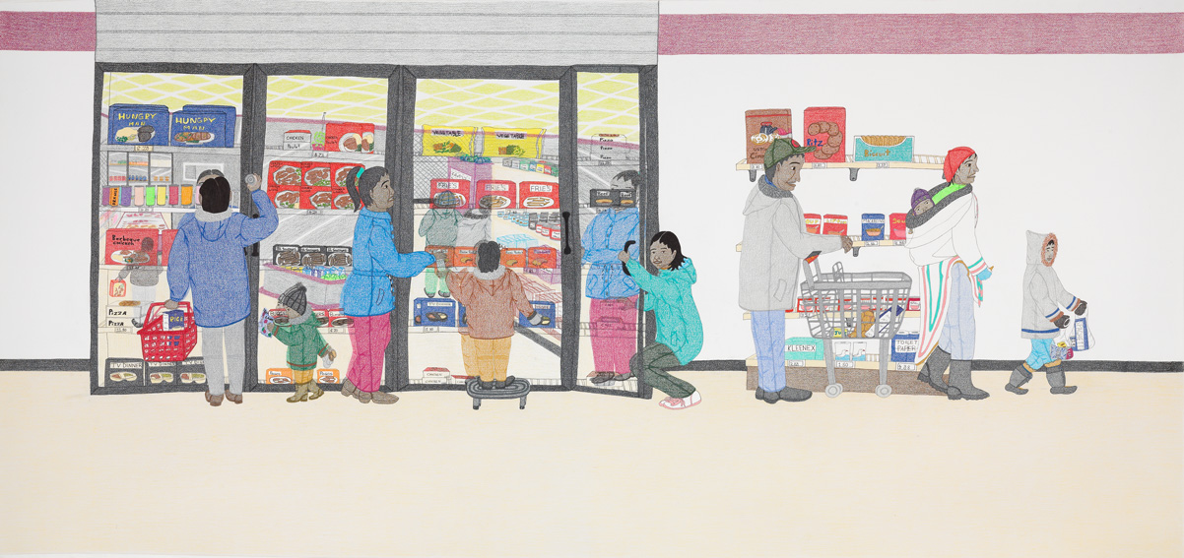
Annie Pootoogook, Cape Dorset Freezer, 2005. Pootoogook made this drawing for her exhibition at The Power Plant Contemporary Art Gallery.

Slide 35
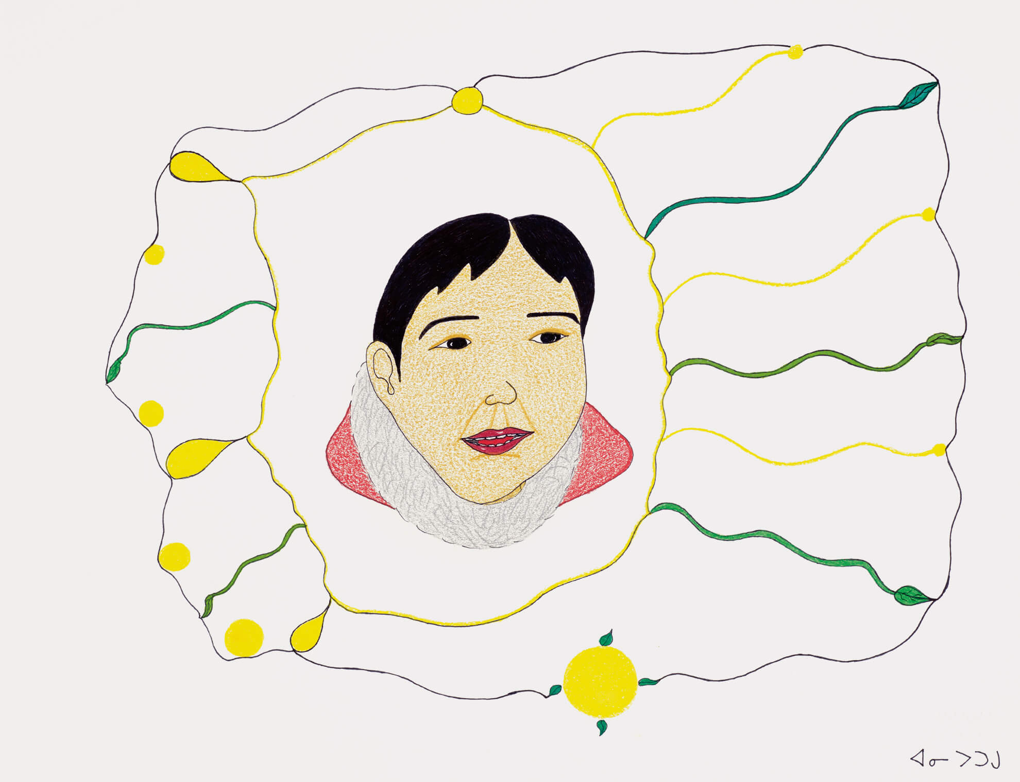
Annie Pootoogook, Composition (Happy Woman), 2003–4. In some images, Pootoogook used dramatic lines to depict her feelings.

Slide 36
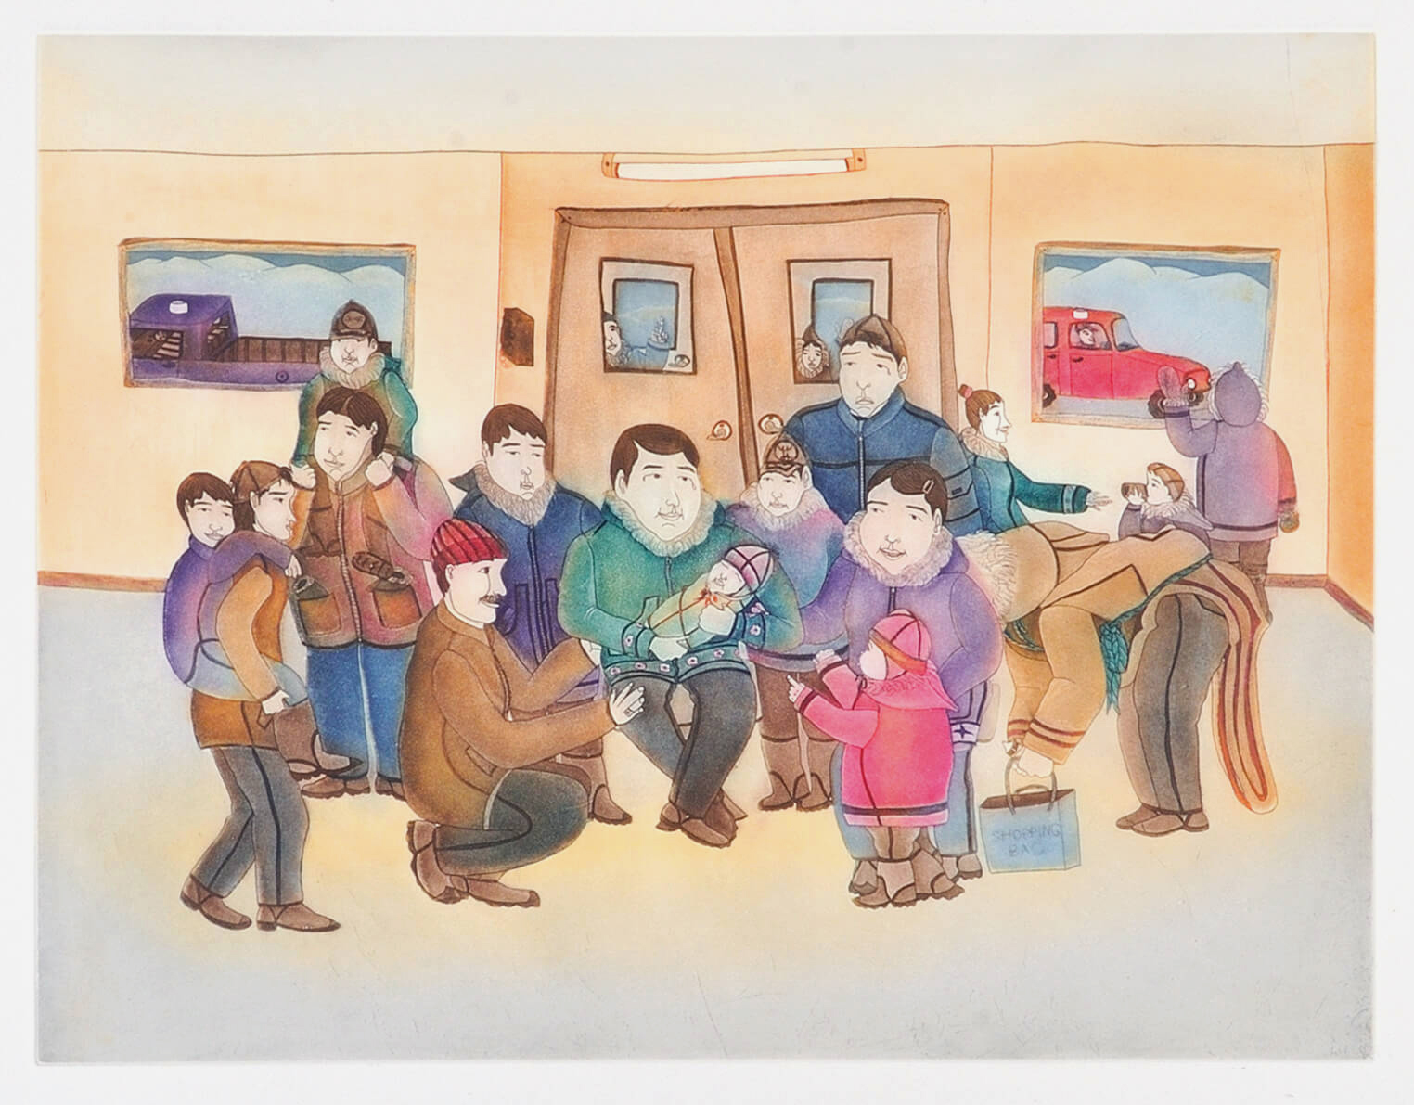
Annie Pootoogook, The Homecoming, 2006. This print focuses on Pootoogook’s love of community.

Slide 37
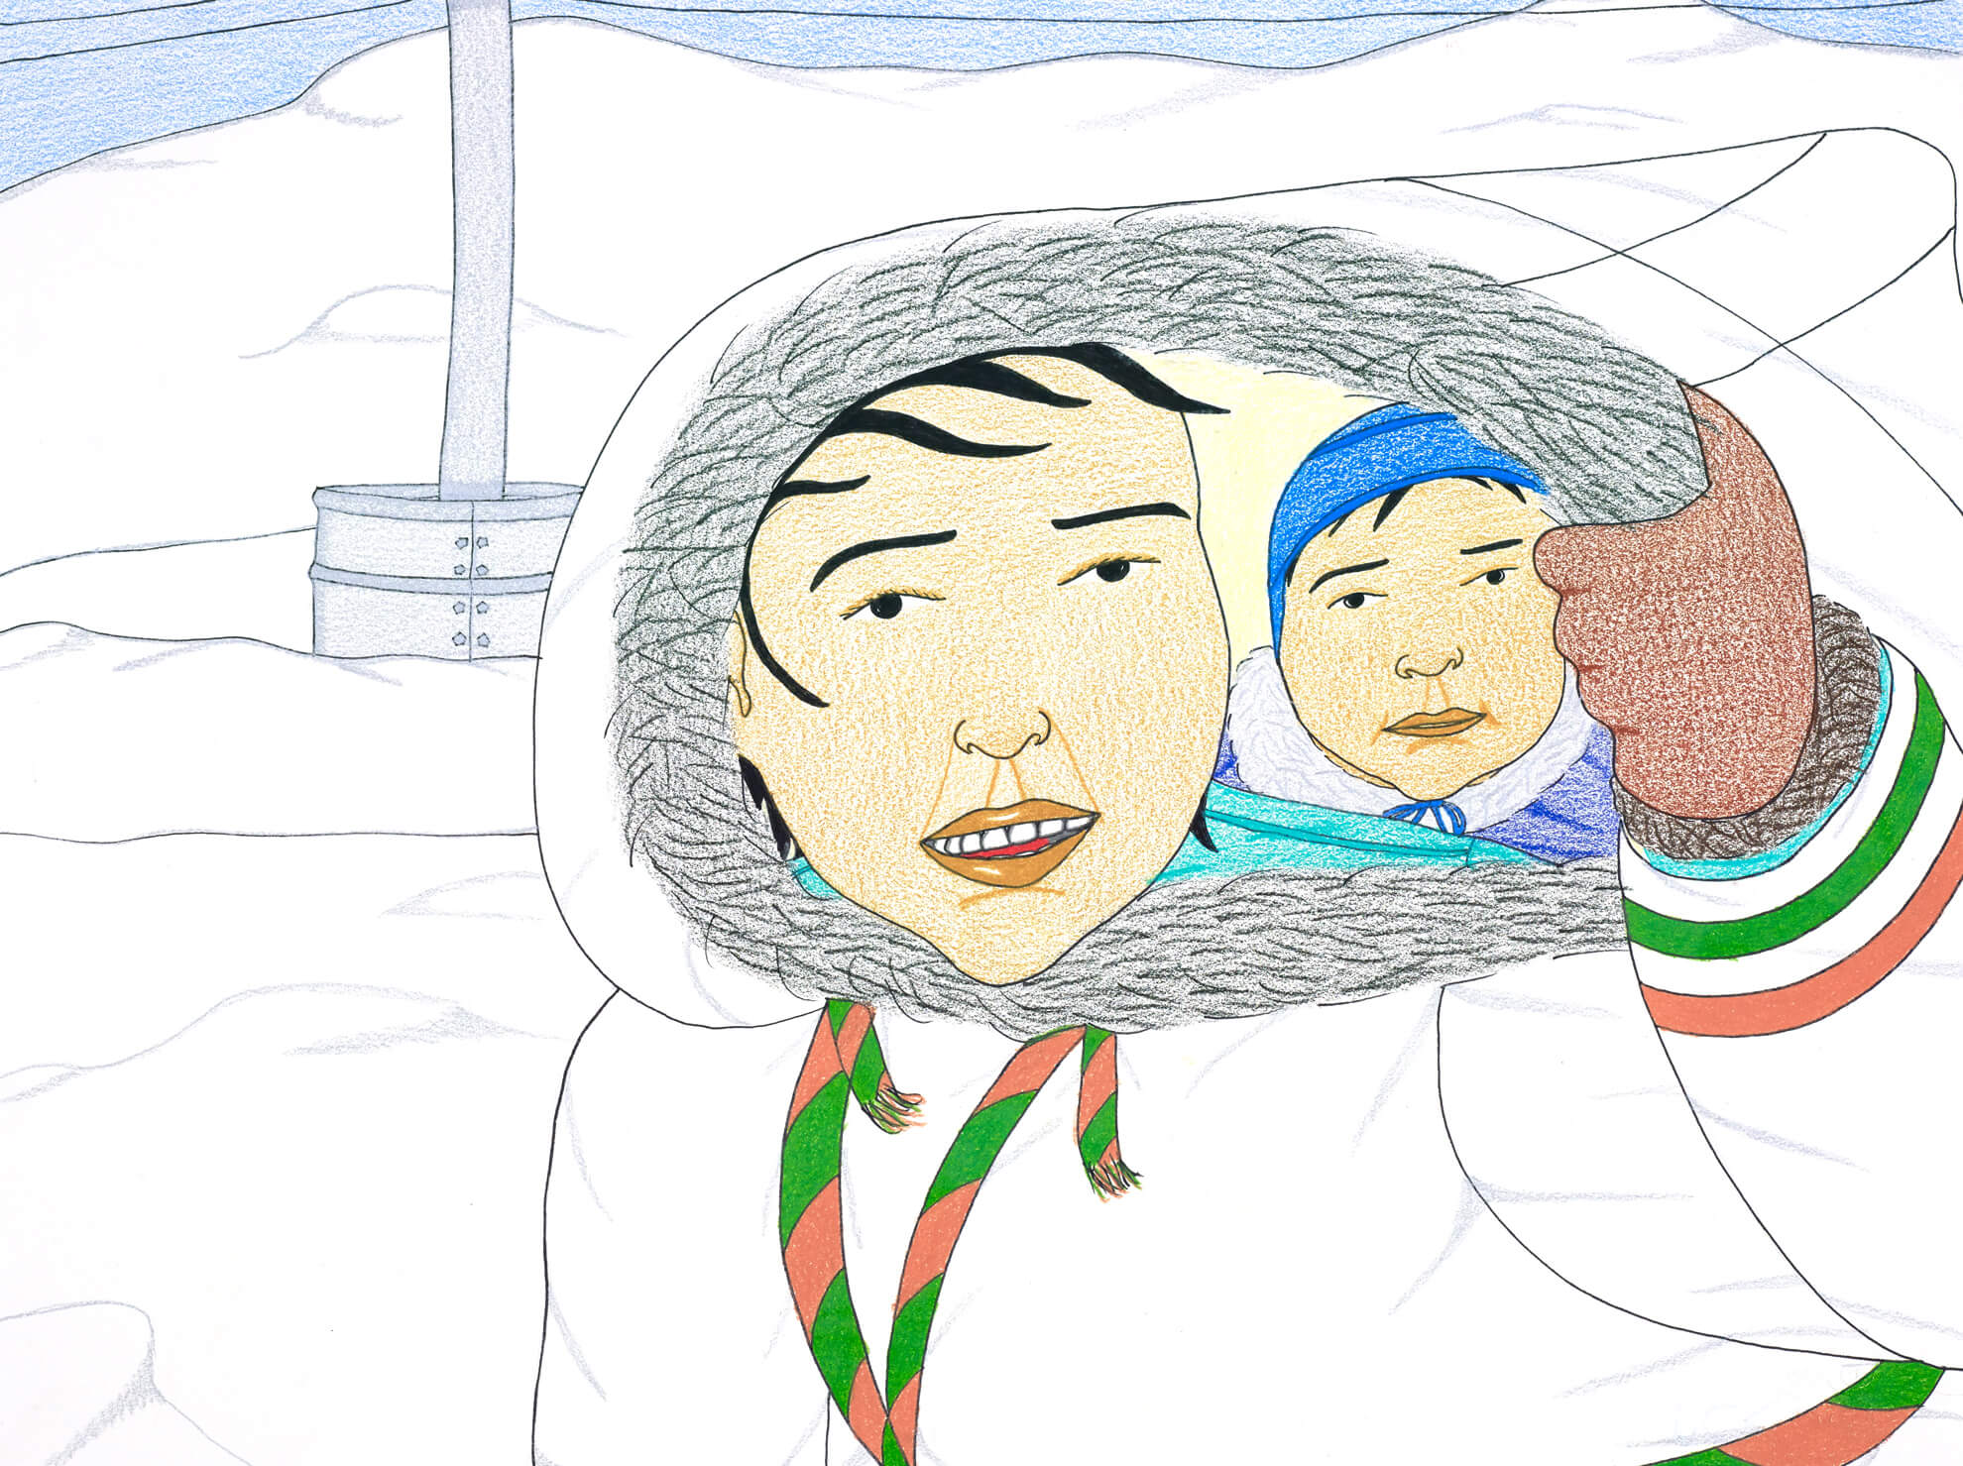
Annie Pootoogook, Composition (Mother and Child), 2006. In this joyful image, a small child peeks out from their mother’s parka or anorak.

Slide 38
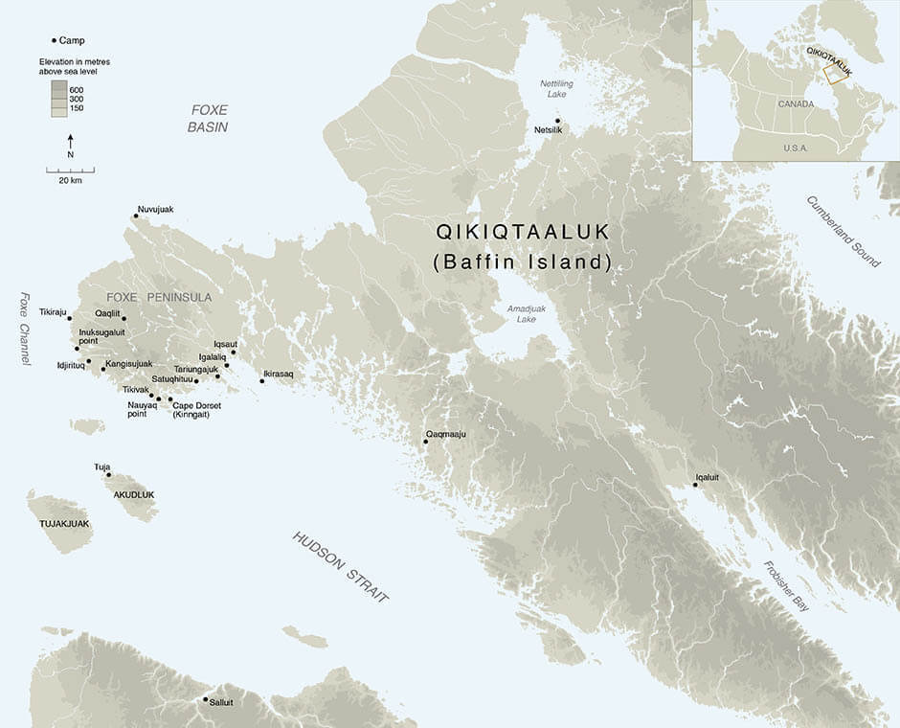
Map of Qikiqtaaluk (Baffin Island).

Slide 39
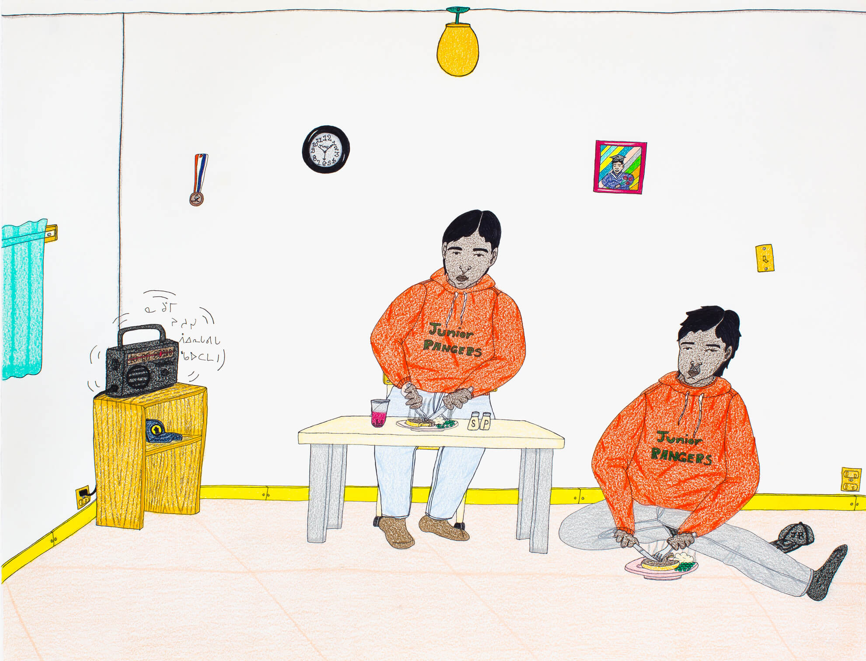
Annie Pootoogook, Junior Rangers, 2006. This work makes reference to the media through the radio vibrating in the corner.

