Slide 1
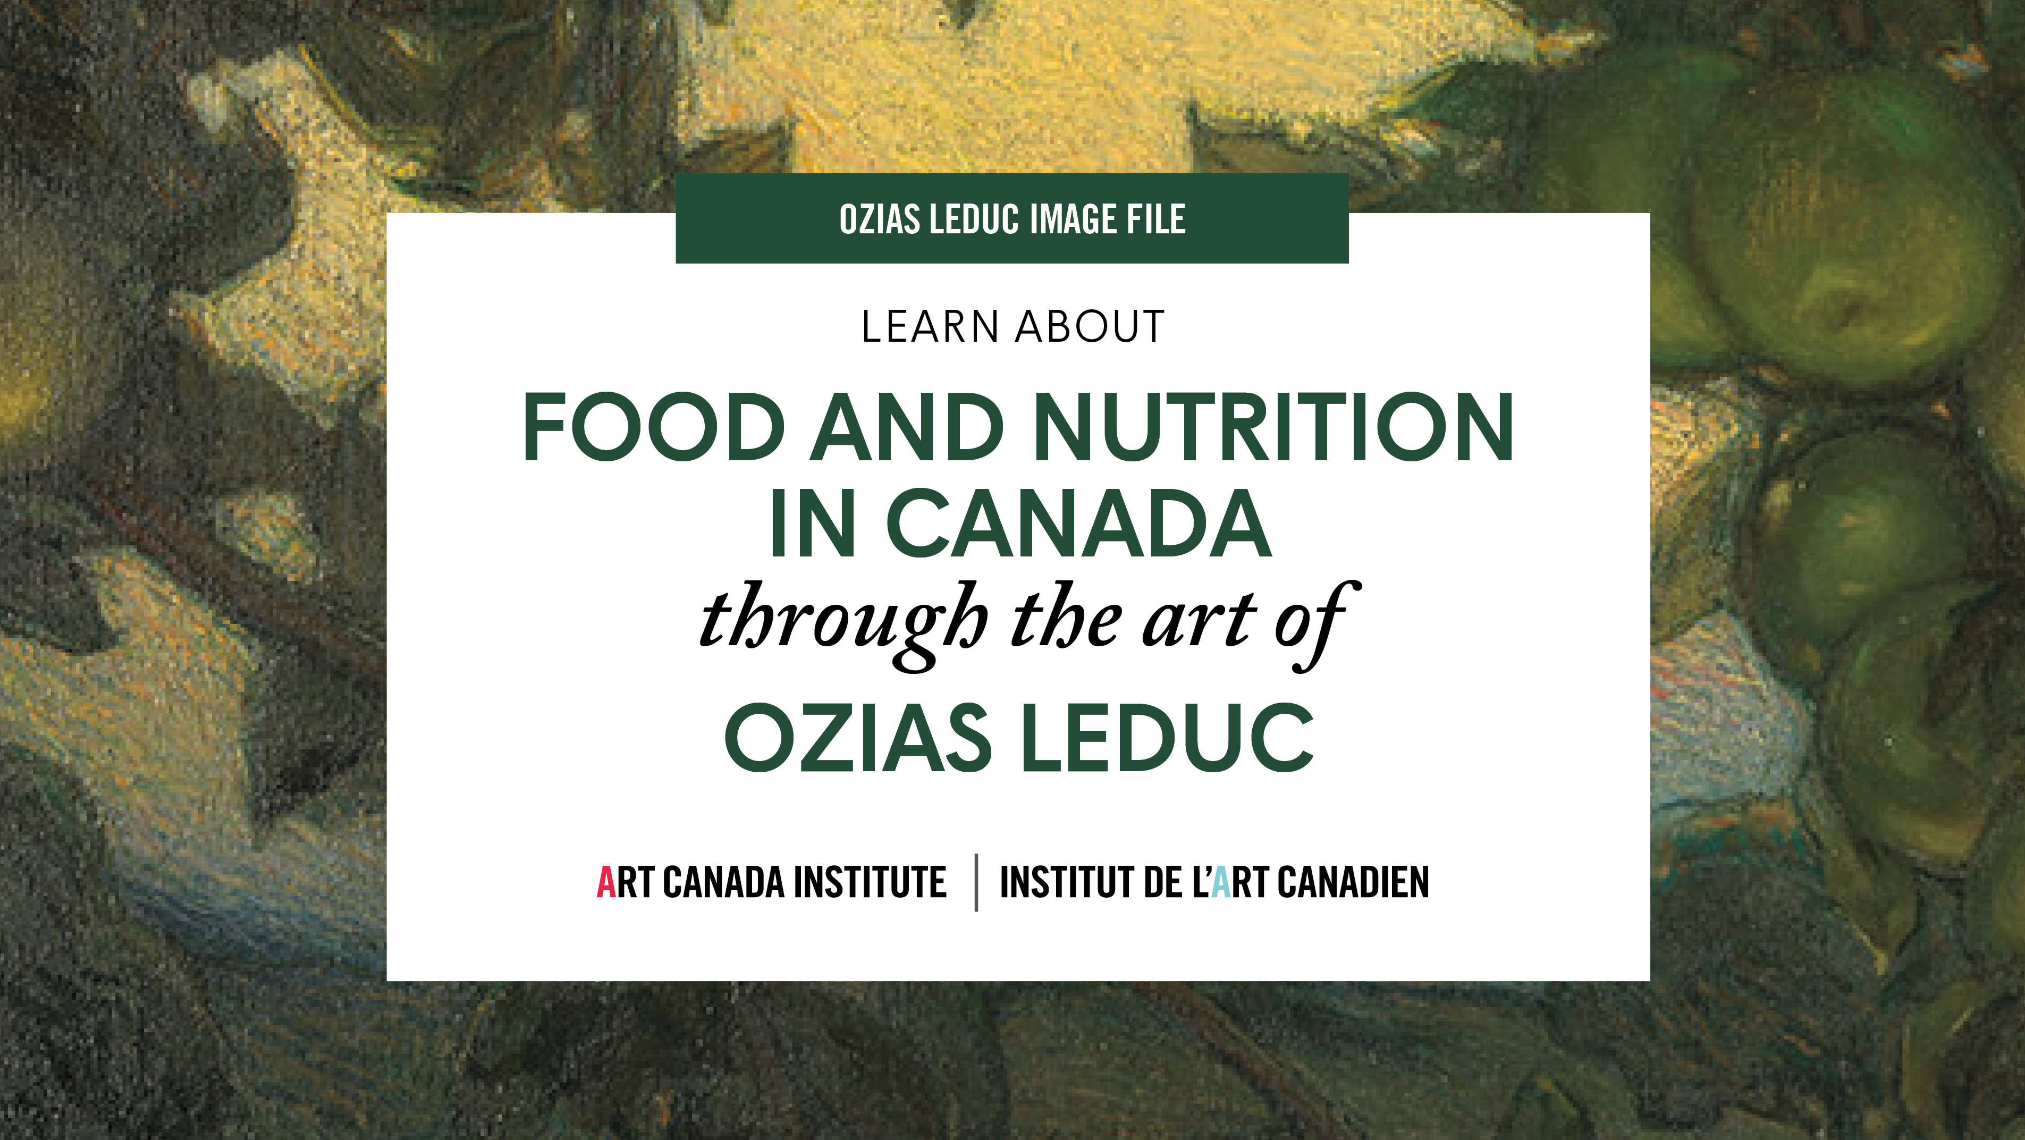

Slide 2
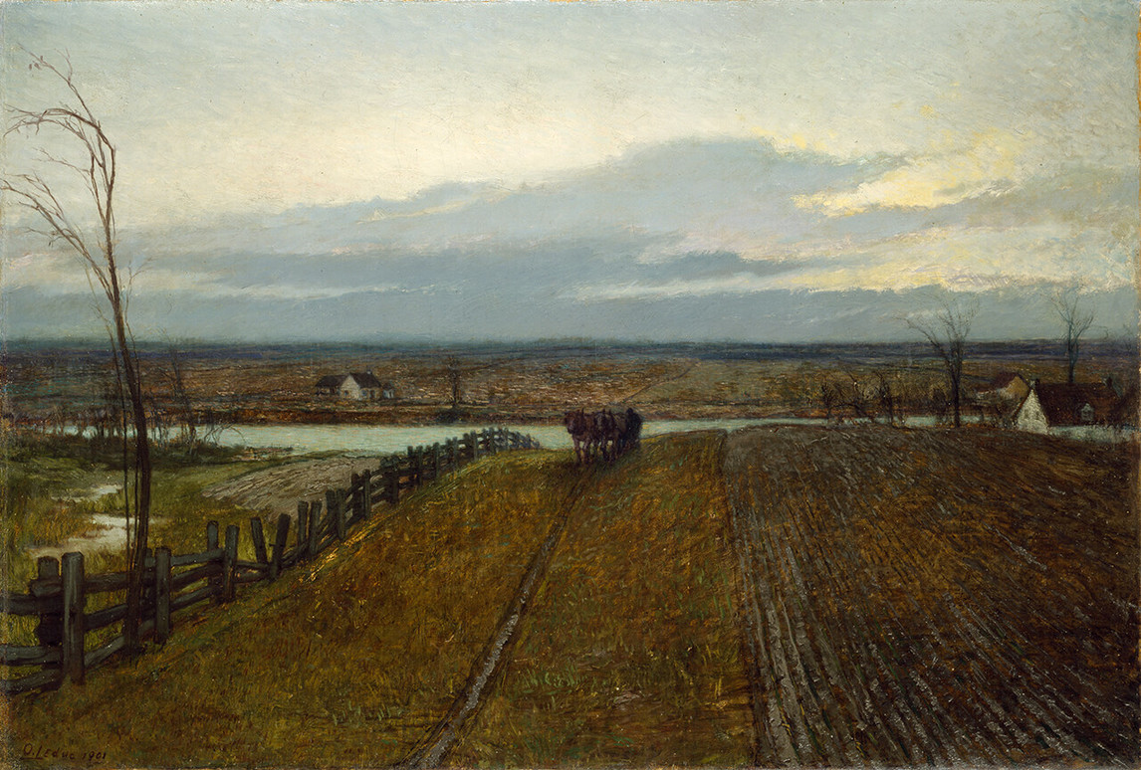
Ozias Leduc, Autumn Tillage, 1901. This large painting was inspired by the landscape of Saint-Hilaire, the region Leduc was from.

Slide 3
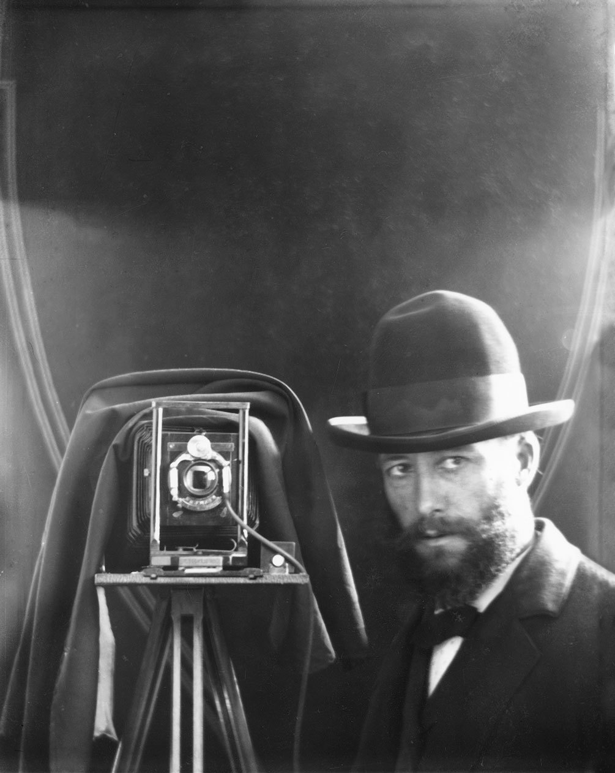
Self-Portrait with Camera (Autoportrait à la caméra), c.1899.

Slide 4
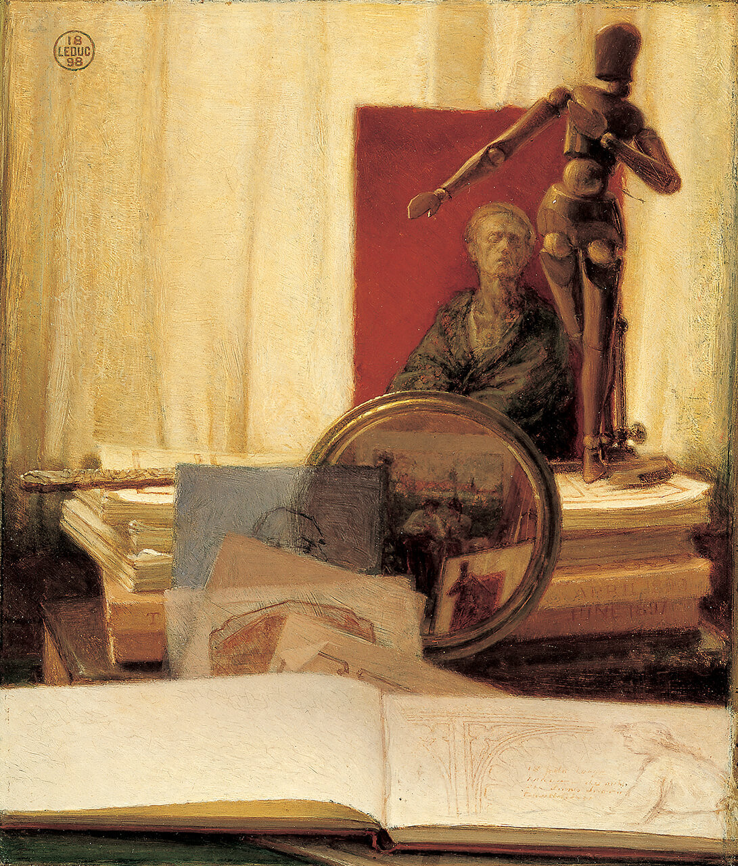
Ozias Leduc, Still Life with Lay Figure, 1898. Leduc created this painting in part as a reflection on his own artworks, and it includes some of his drawings.

Slide 5
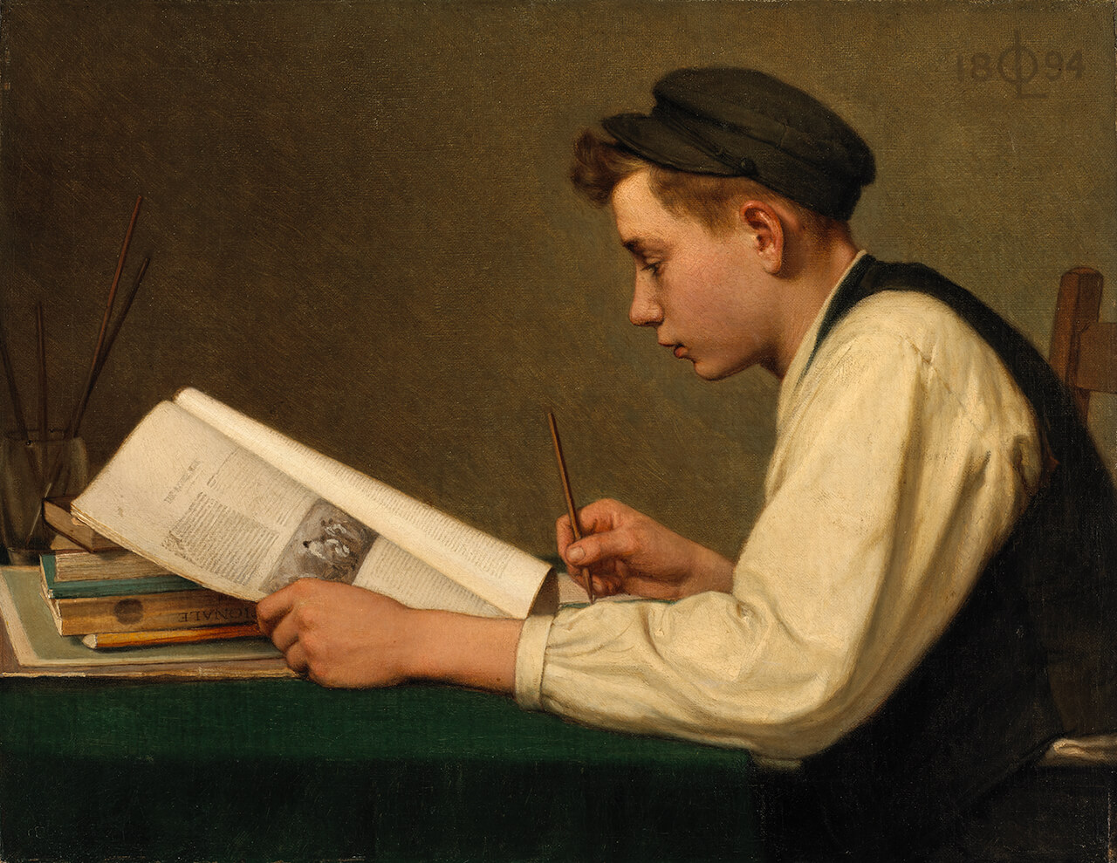
Ozias Leduc, The Young Student, 1894. For this painting, Leduc’s brother Honorius was his model.

Slide 6
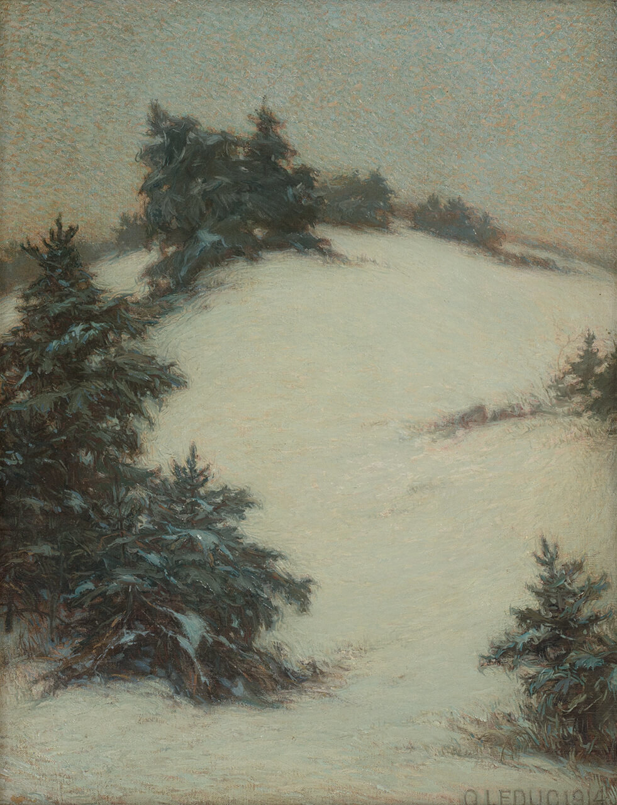
Ozias Leduc, Grey Effect, Snow (Effet gris, neige), 1914. The subdued tone of this painting is possibly due to the First World War.

Slide 7
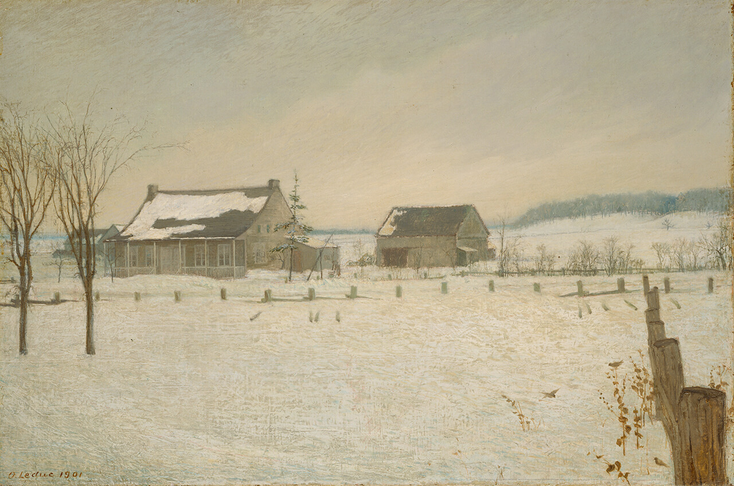
Ozias Leduc, The Choquette Farm, Beloeil, 1901. Leduc planned this work carefully, making sketches outdoors and photographing the site.

Slide 8
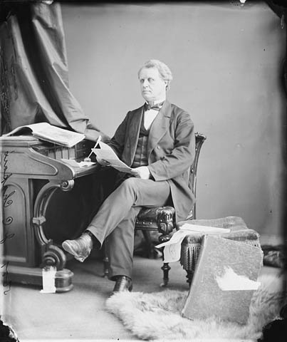
Jean-Charles Chapais, 1870.

Slide 9
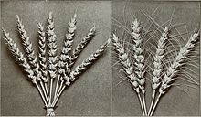
An image of Marquis wheat from A Review of the Work of the Experimental Farms (1913), by James Burns Spencer.

Slide 10

Canada’s Food Guide to Healthy Eating (1992).

Slide 11
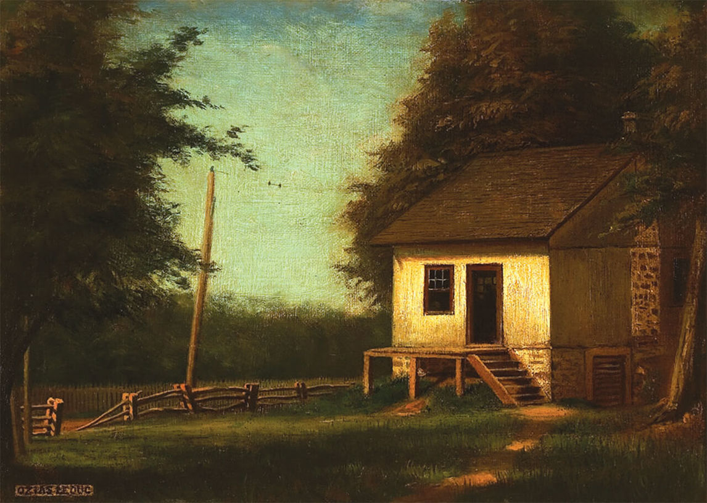
Ozias Leduc, The Birthplace, c.1910. The Leduc family home.

Slide 12
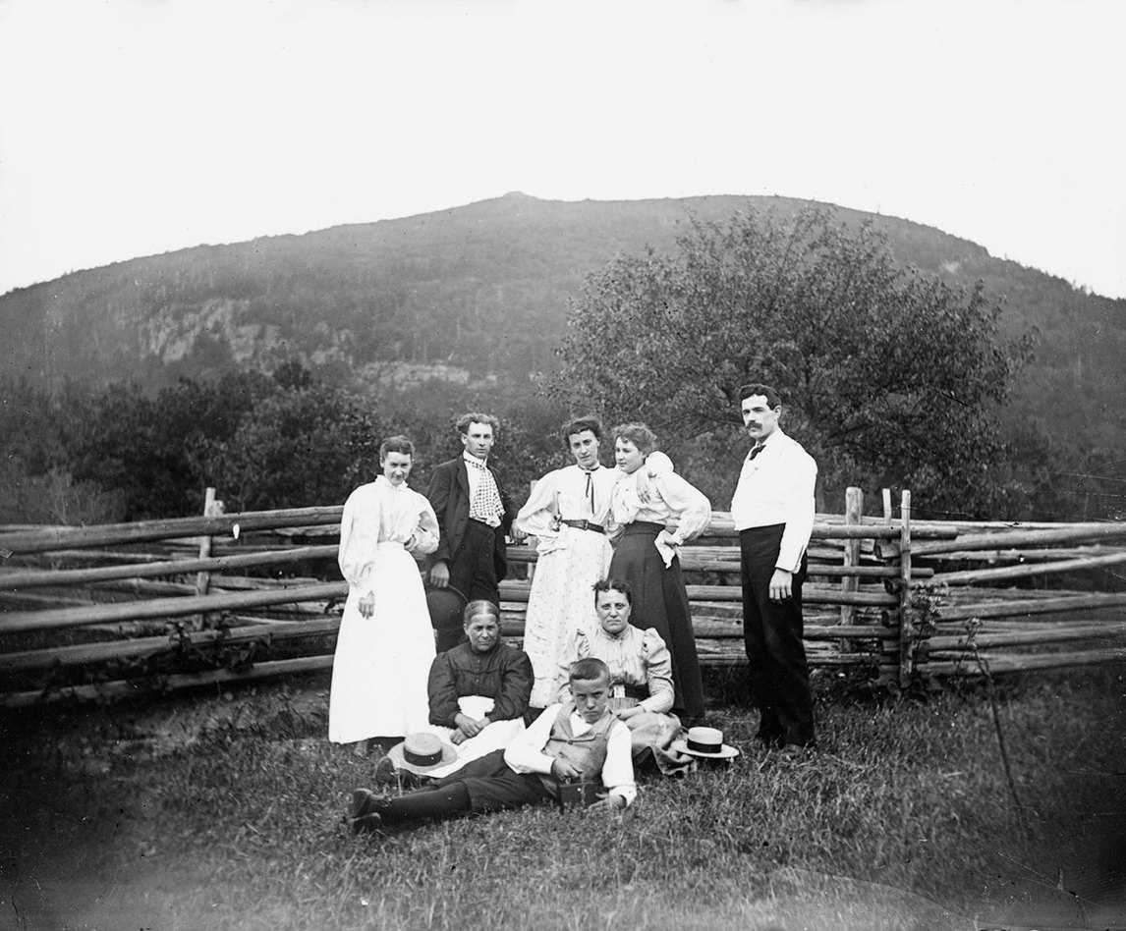
The Leduc family. Left to right: Adélia, Honorius, unidentified, Ozéma, and Ernest Lebrun. Sitting: Émilie Leduc (née Brouillette), unidentified, Ulric, n.d., photograph by Ozias Leduc.

Slide 13
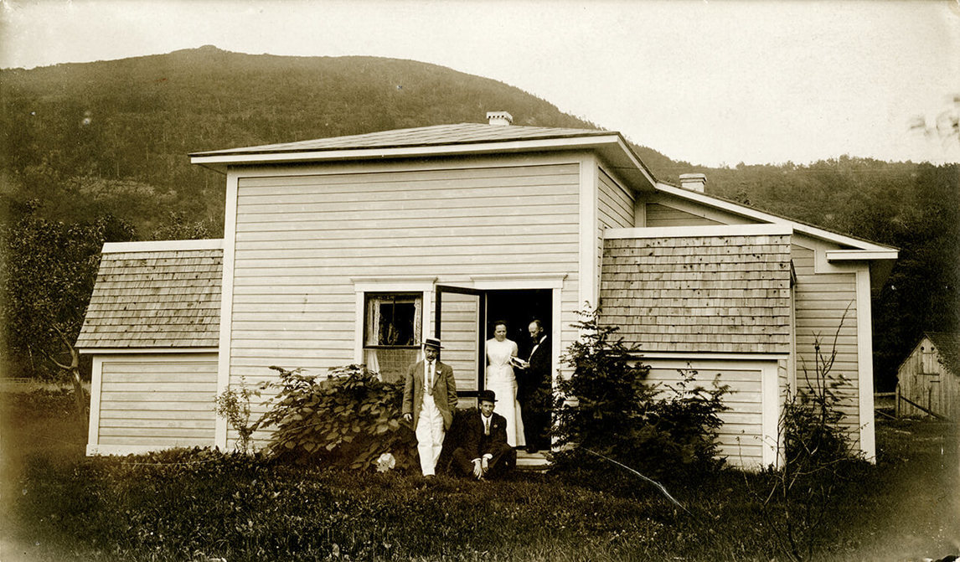
Correlieu expanded, 1906, photograph by Ozias Leduc. The additions included a dark room, an archive, and an extra bedroom.

Slide 14
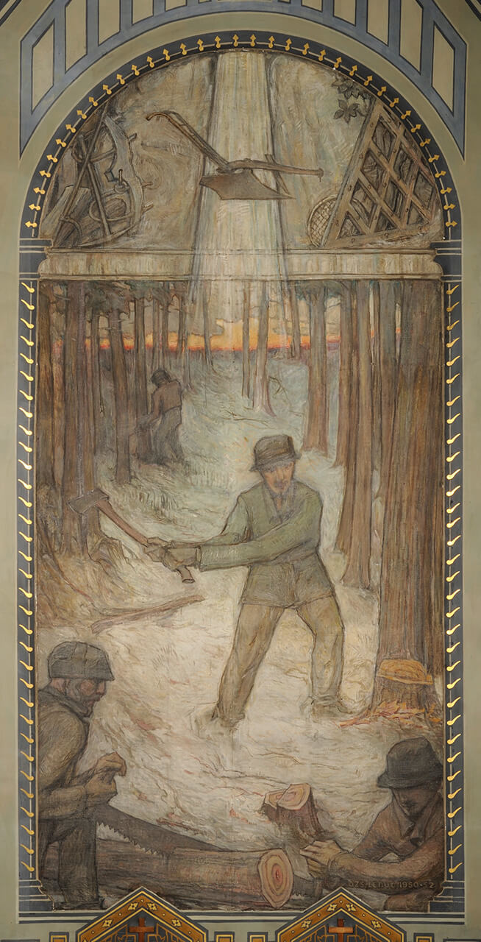
Ozias Leduc, The Pioneers, c.1950. This painting was part of Leduc’s project for the Church of Notre-Dame-de-la-Présentation.

Slide 15
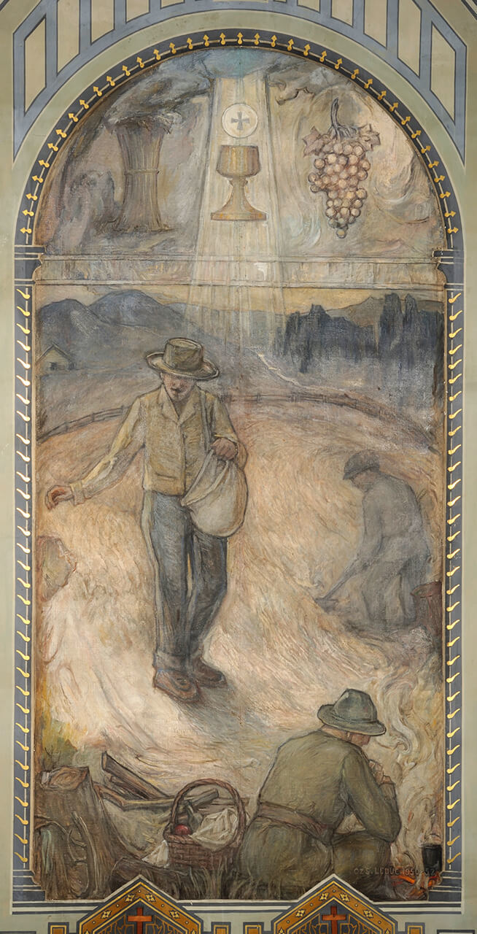
Learning Activity #1
Ozias Leduc, The Sower, c.1950. This painting was inspired by labourers in Shawinigan, and includes Christian symbolism referring to the Eucharist at the top of the painting.

Slide 16
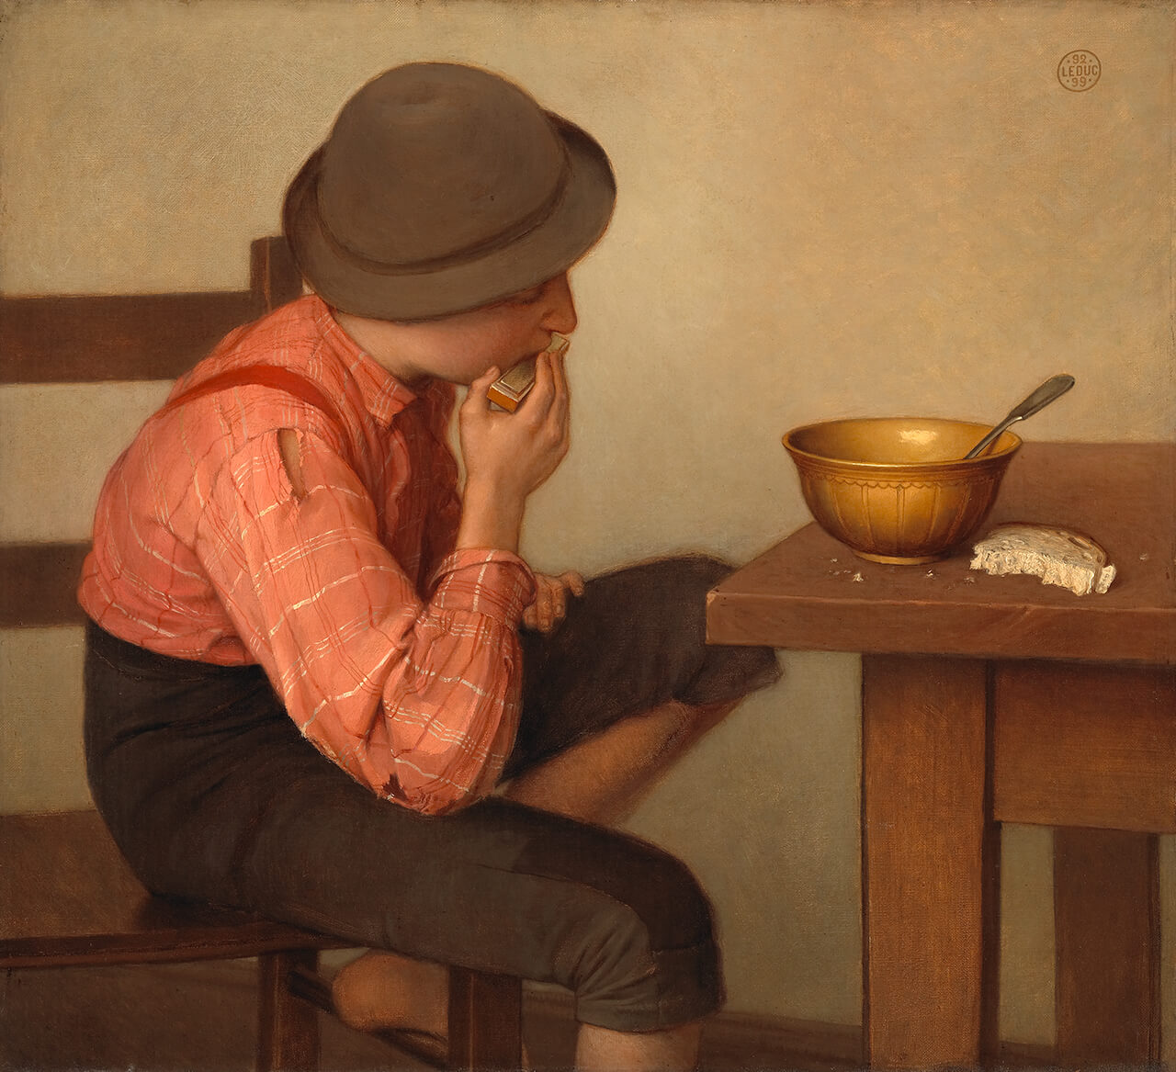
Learning Activity #1
Ozias Leduc, Boy with Bread, 1892–99. Leduc created a large drawing to plan the composition of this painting.

Slide 17
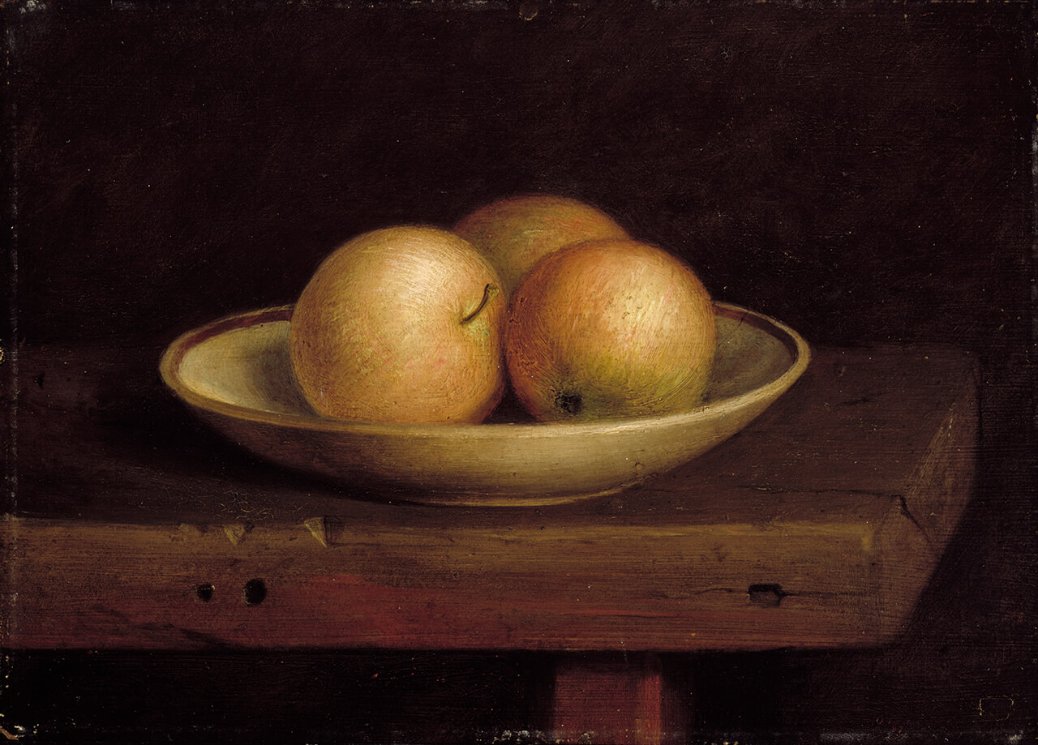
Learning Activity #1
Ozias Leduc, The Three Apples, 1887. In this work, Leduc celebrates the work of the carpenter and of the apple grower, trades practised by his father.

Slide 18
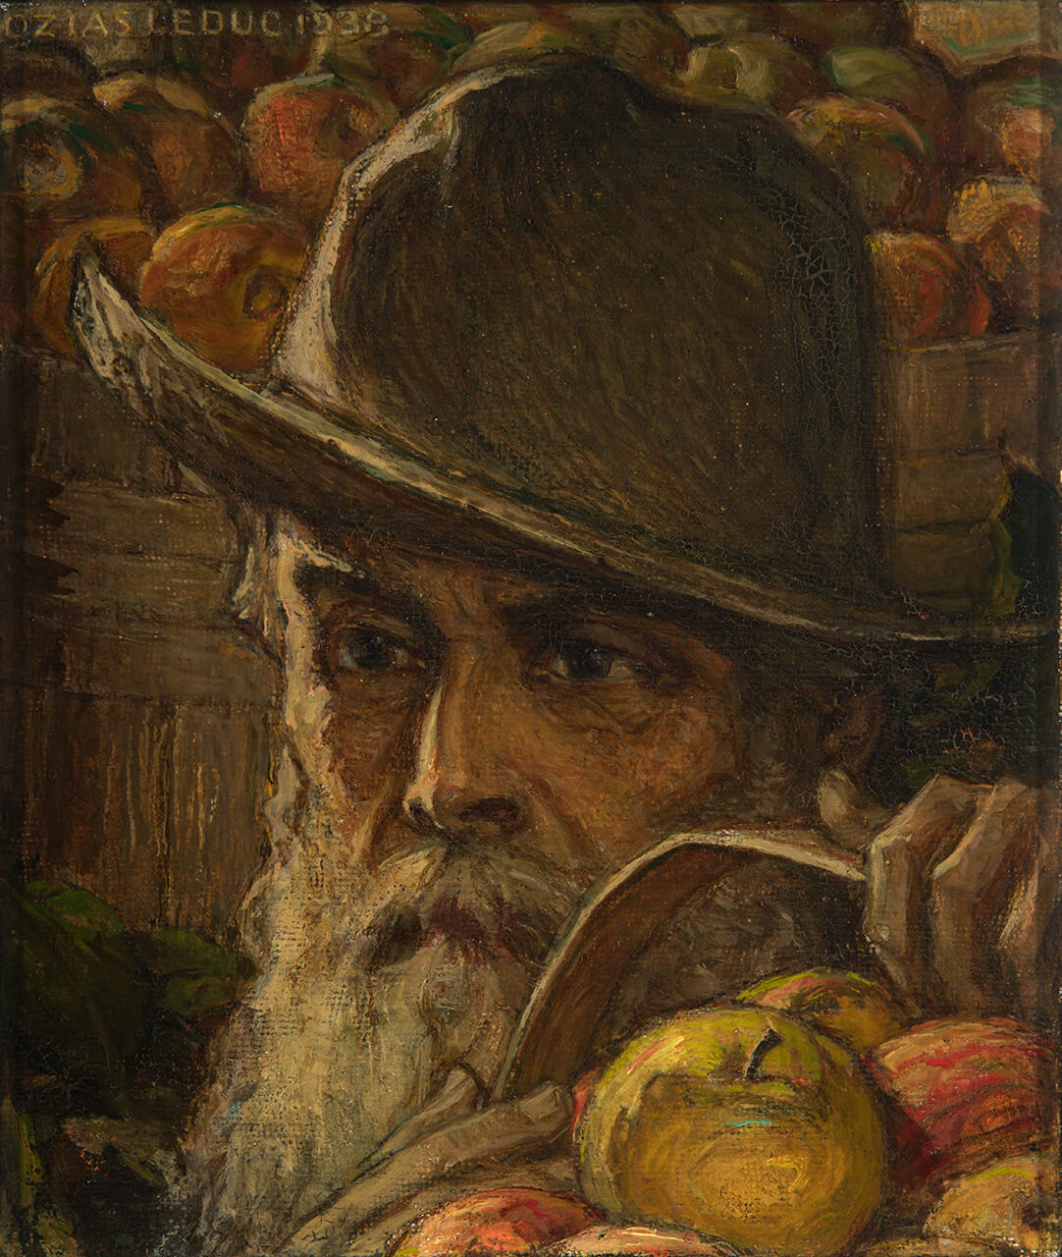
Learning Activity #2
Ozias Leduc, The Old Man with Apples, 1938. Leduc inherited his family’s apple orchard of three hundred trees.

Slide 19
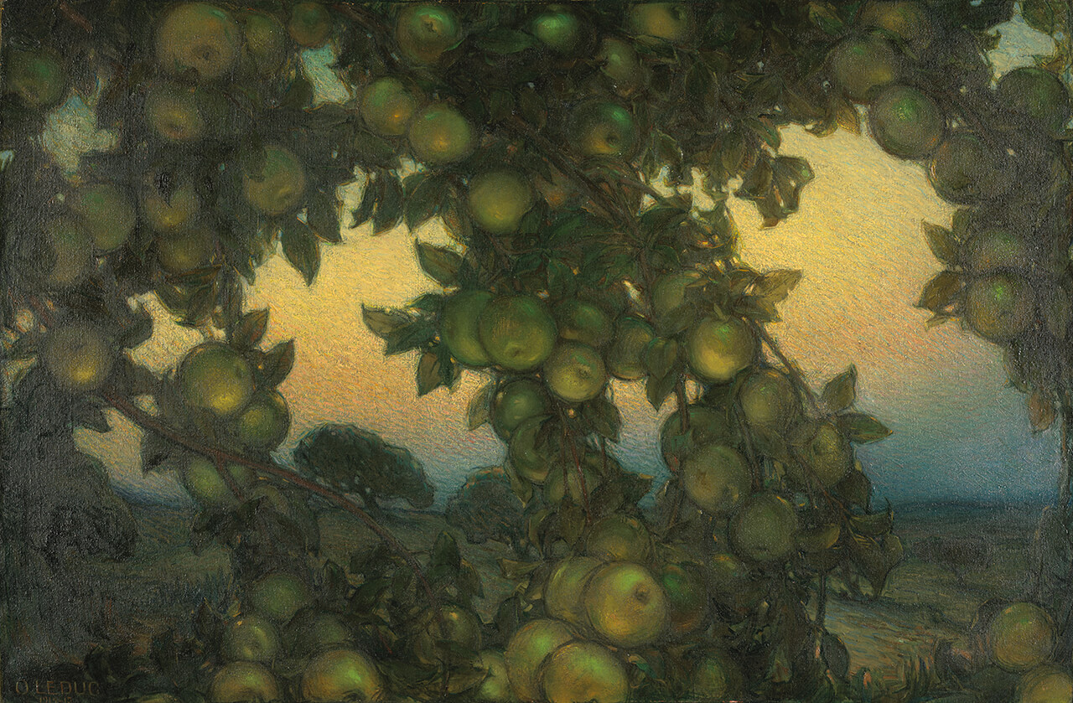
Learning Activity #2
Ozias Leduc, Green Apples, 1914–15. In this painting the viewer seems to be close to a tree trunk, looking out through branches heavy with fruit.

Slide 20
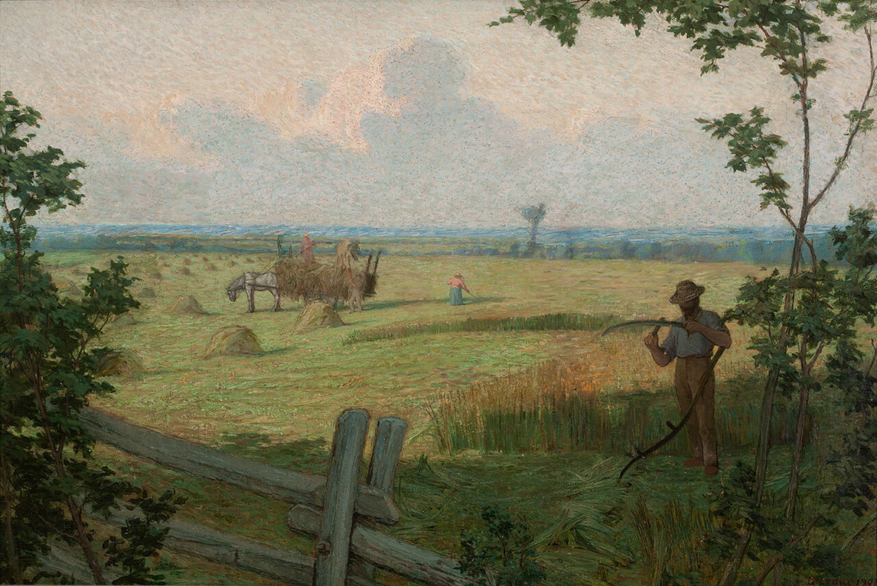
Culminating Task
Ozias Leduc, Harvest, 1901. This work is one of a series of regional landscape paintings of Saint-Hilaire.

Slide 21
Culminating Task
Ozias Leduc, Autumn Tillage, 1901. The perspective in this work is vast, and farm buildings are visible in the distance.

Slide 22
Culminating Task
Ozias Leduc, The Three Apples, 1887. Leduc chose to arrange these apples so that the base, stalk, and stem are visible.

Slide 23
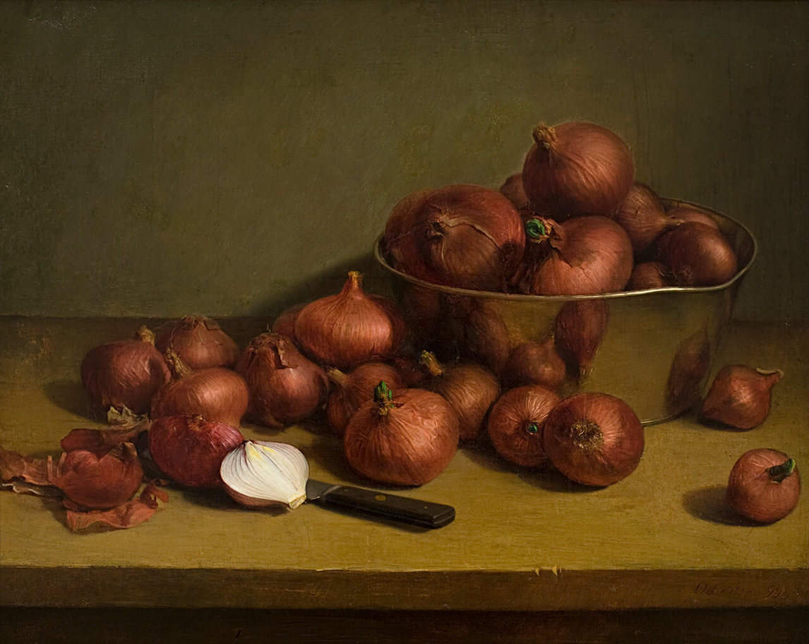
Culminating Task
Ozias Leduc, Still Life, Onions, 1892. Here Leduc paints a simple vegetable from different angles and in multiple variations—whole, sprouting, cut in half, and reflected.

Slide 24
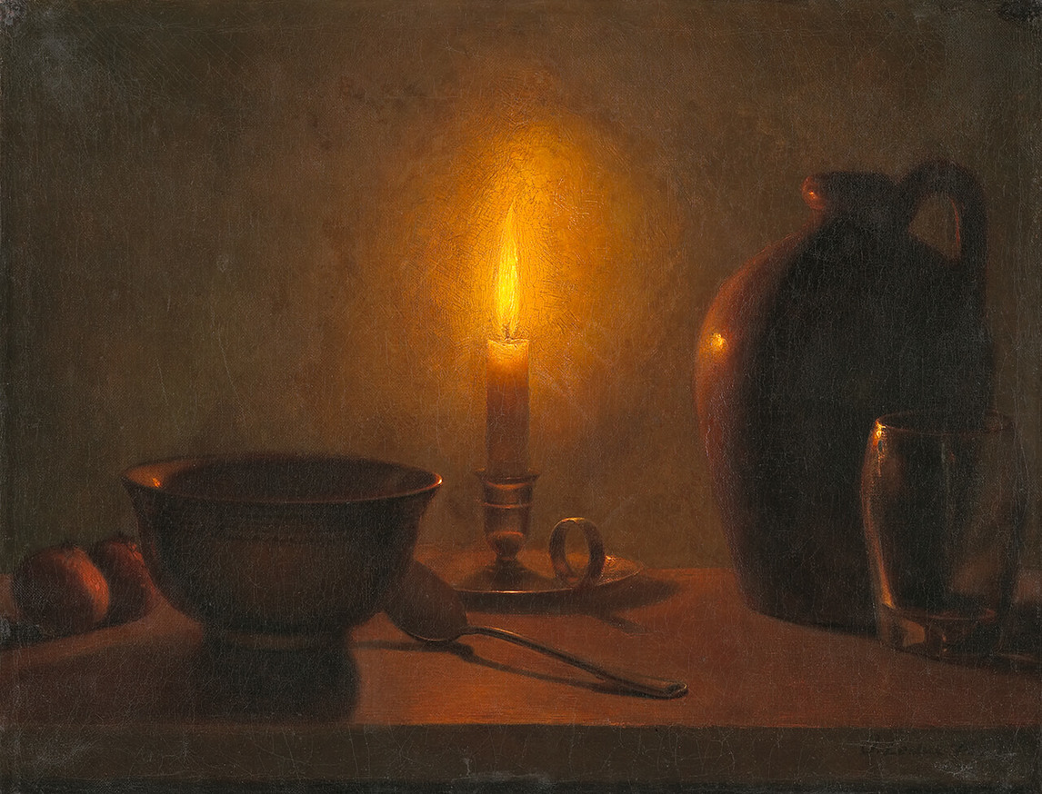
Culminating Task
Ozias Leduc, Still Life, Study by Candlelight, 1893. This painting depicts ordinary dishes, but the candlelight makes the arrangement dramatic.

Slide 25
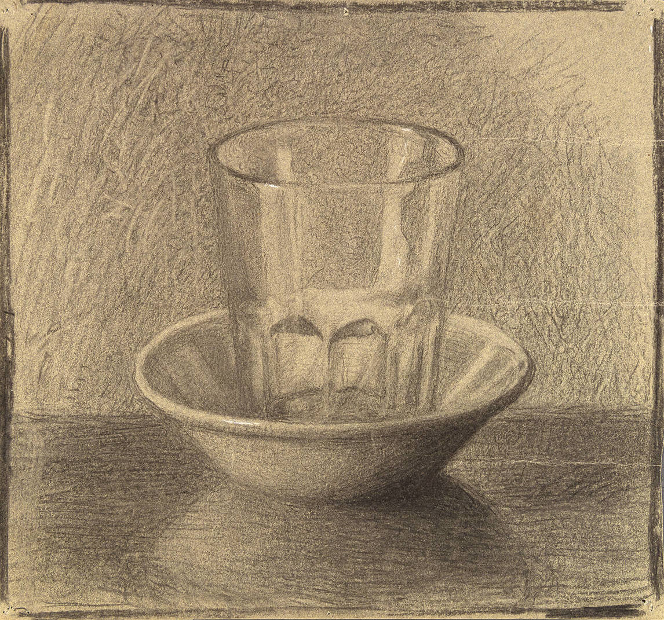
Culminating Task
Paul-Émile Borduas and Ozias Leduc, Glass in a Saucer, 1923. Borduas was Leduc’s assistant when he began this drawing, and Leduc retouched it for him.

Slide 26
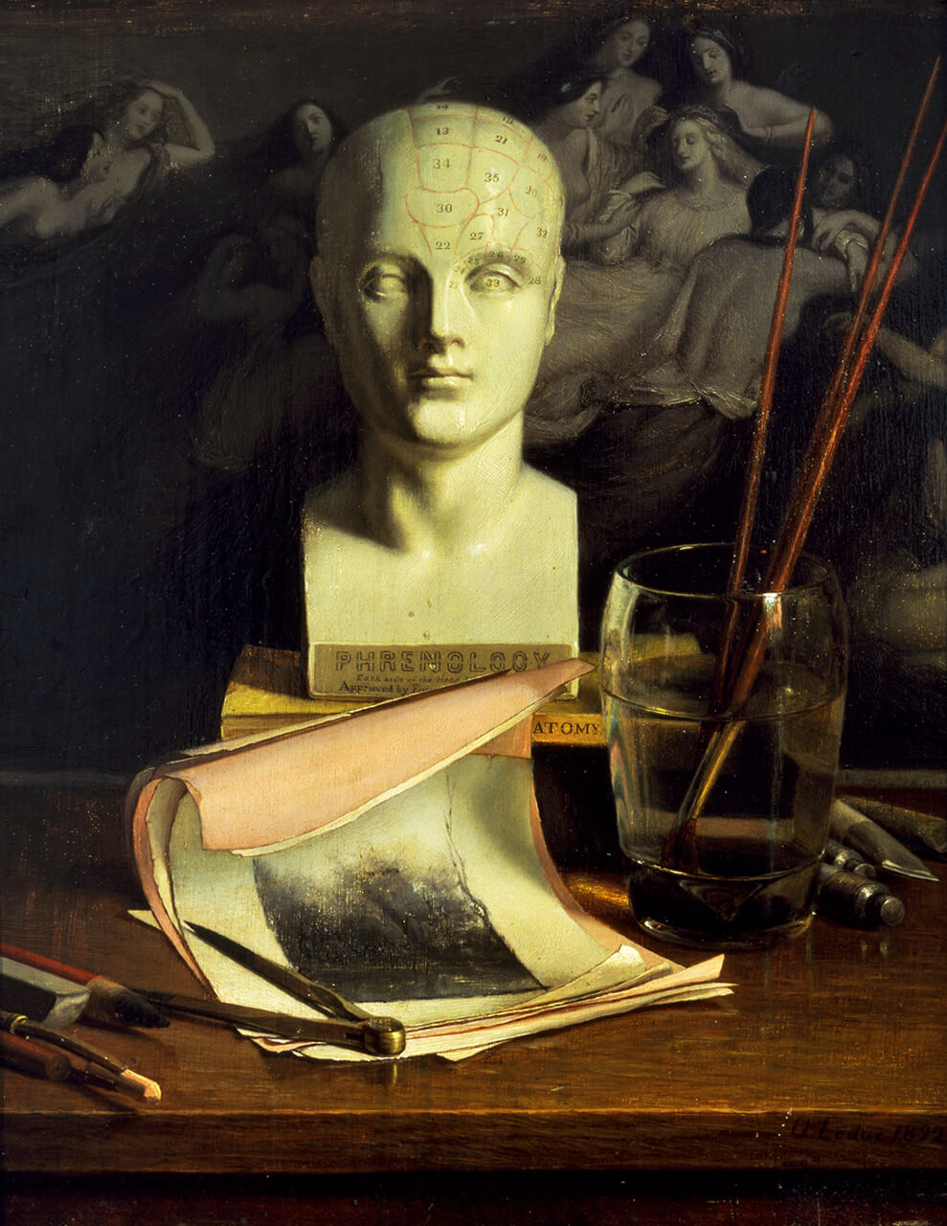
Ozias Leduc, Phrenology, 1892. The art materials pictured here include charcoal, brushes, a compass, tubes of colour, paper, and an eraser.

Slide 27
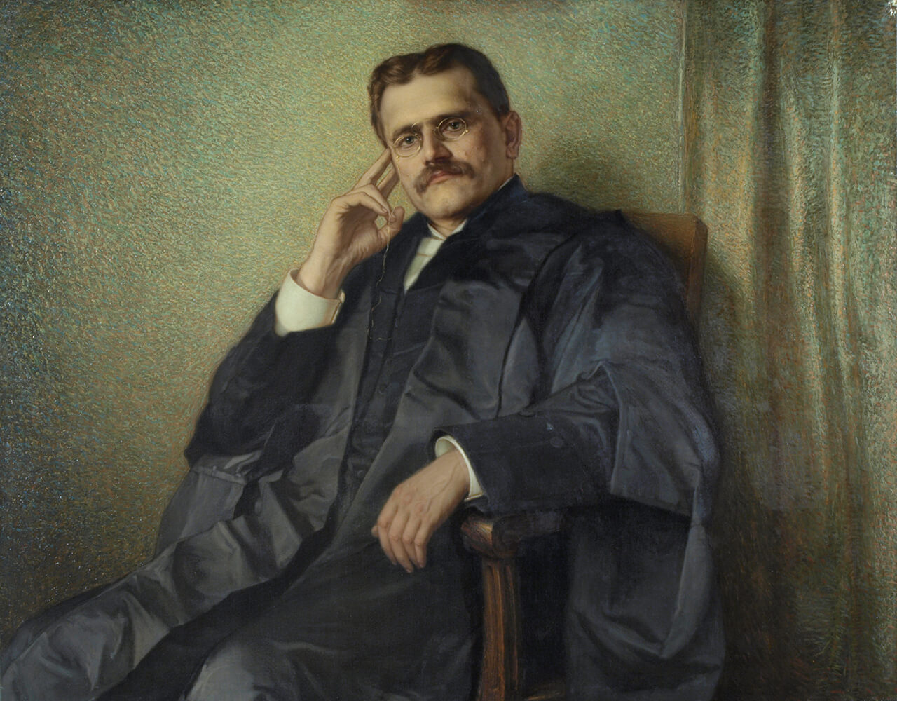
Ozias Leduc, Portrait of the Honourable Louis-Philippe Brodeur, 1901–4. This portrait marked Brodeur’s role as Speaker of the House of Commons from 1901 to 1904.

Slide 28
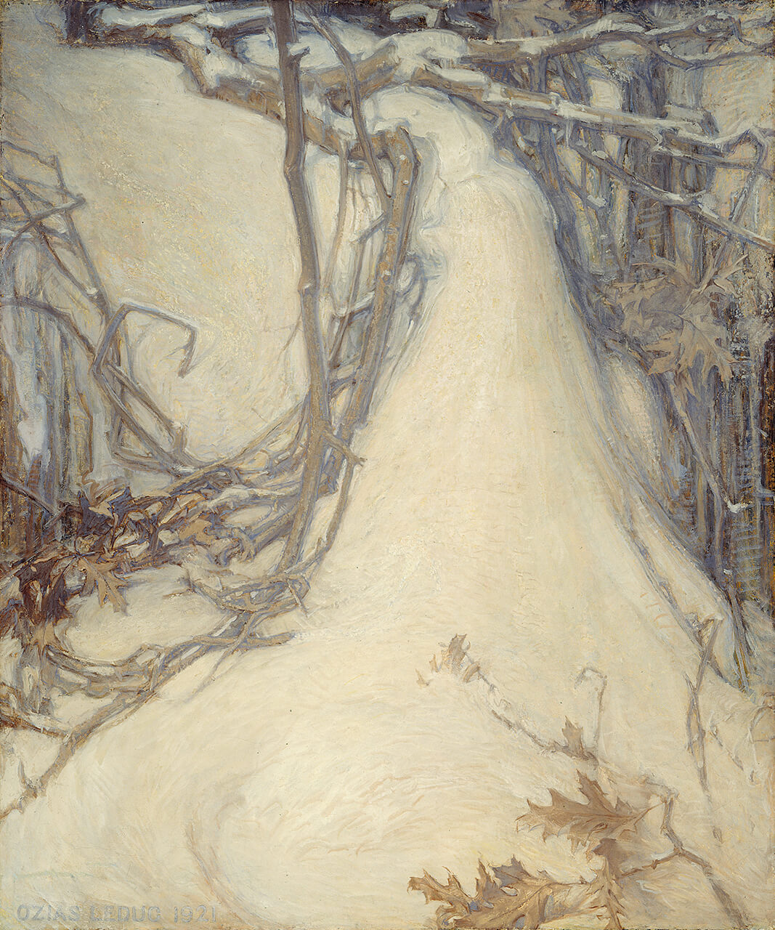
Ozias Leduc, Mauve Twilight, 1921.
In this painting, Leduc details an oak limb fallen in the snow.

Slide 29
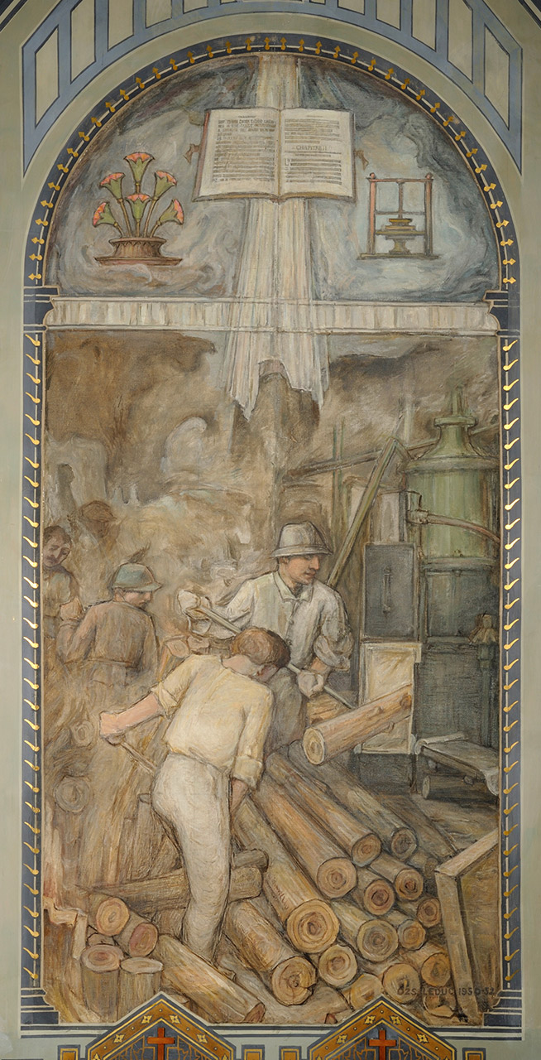
Ozias Leduc, The Millworkers, c.1950. These men are working at a paper mill, feeding logs into the mill to be pulped.

Slide 30
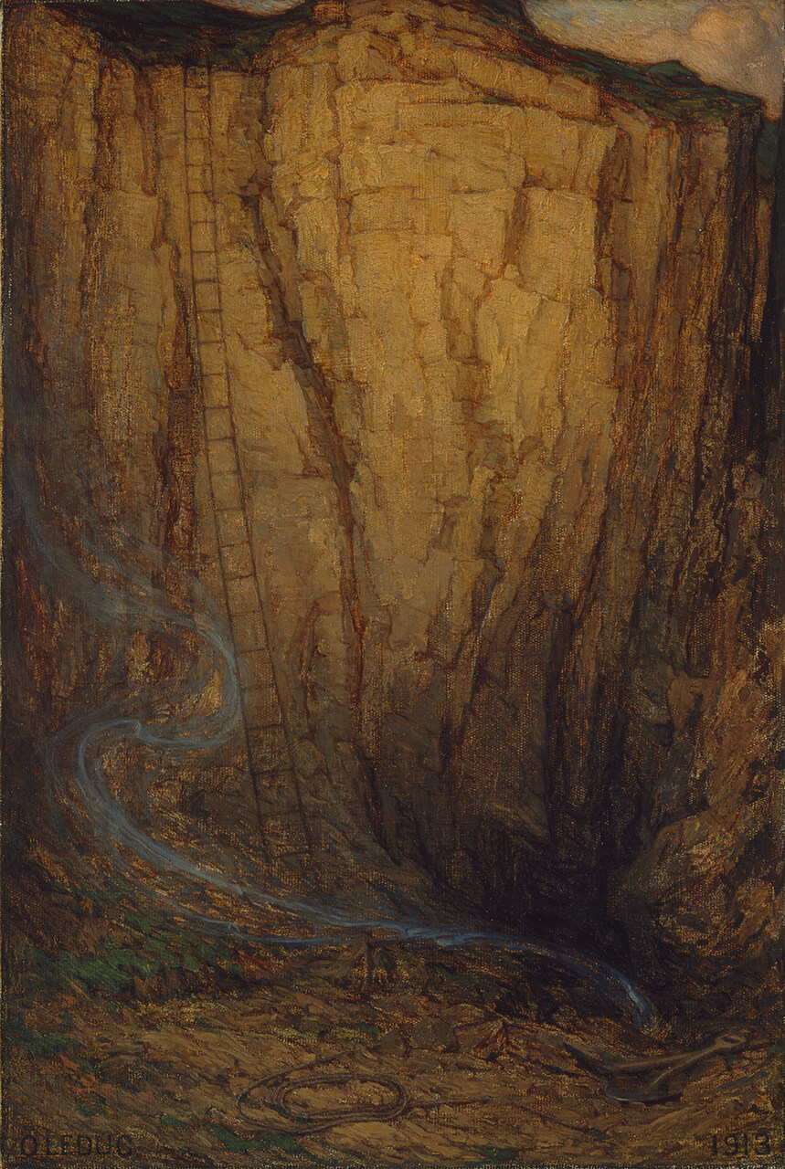
Ozias Leduc, Day’s End, 1913. In this work Leduc’s subject is the bottom of a quarry.

Slide 31
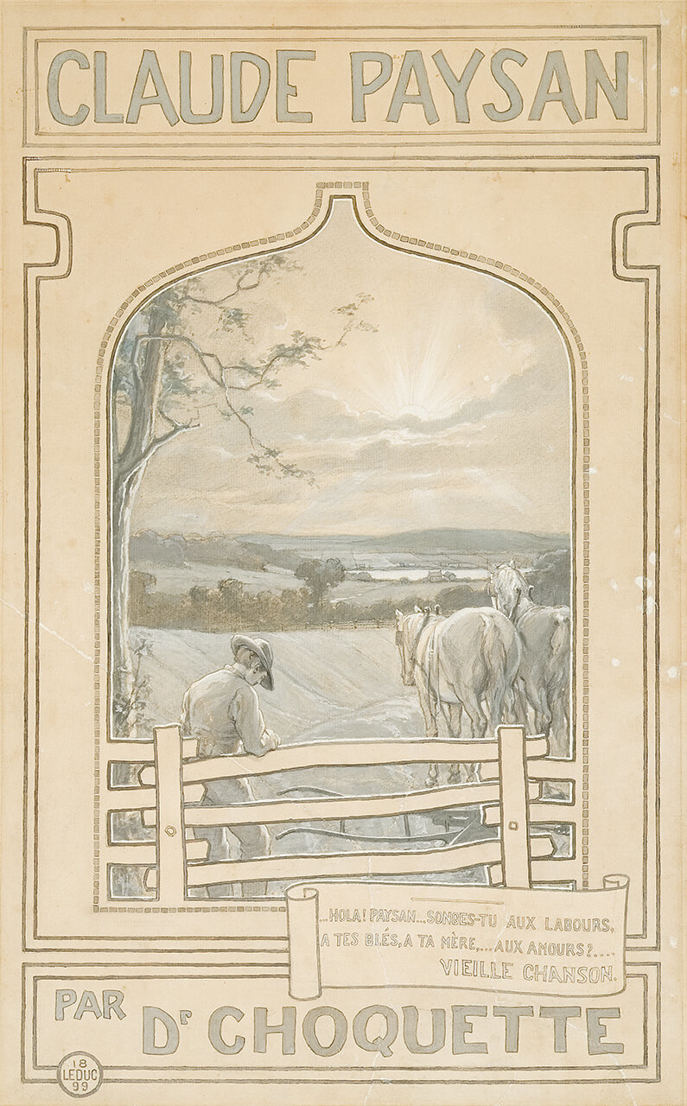
Ozias Leduc, illustration for the cover of the novel Claude Paysan, by Ernest Choquette. This novel is about rural life.

