Slide 2
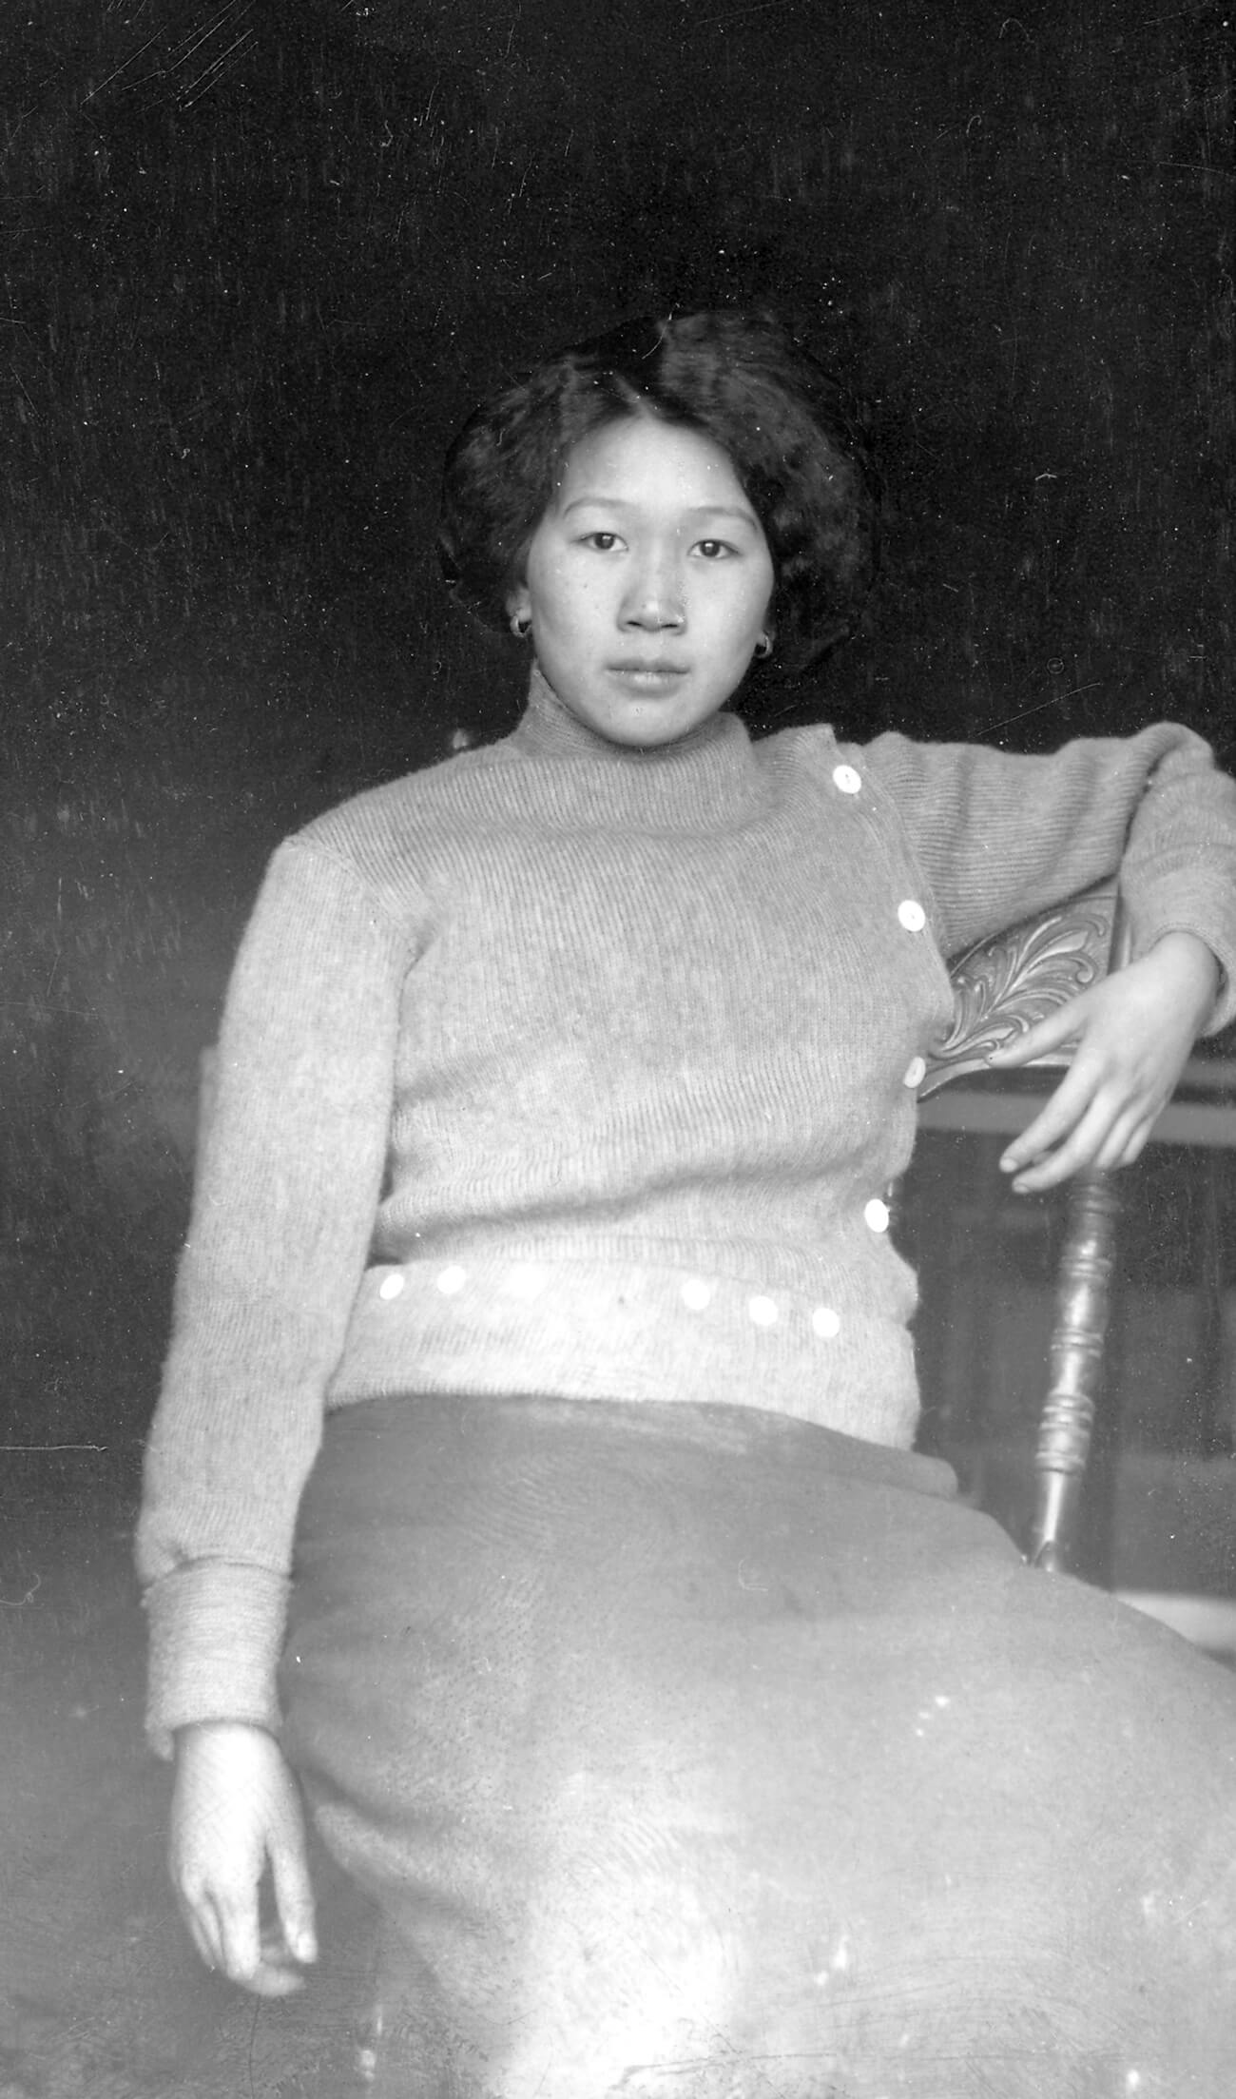
C.D. Hoy, Laura (Yee) Sing, c.1915. This woman’s direct gaze at the camera suggests strong self-confidence.

Slide 3
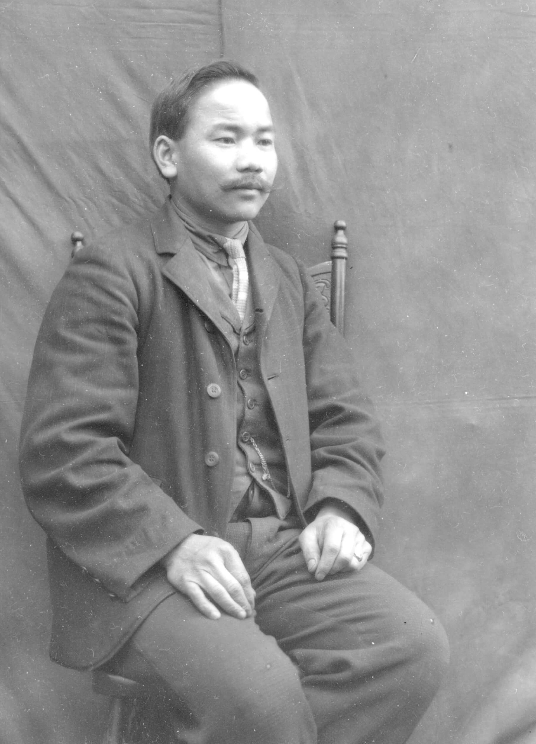
C.D. Hoy, Hoy Self Portrait,c.1910.

Slide 4
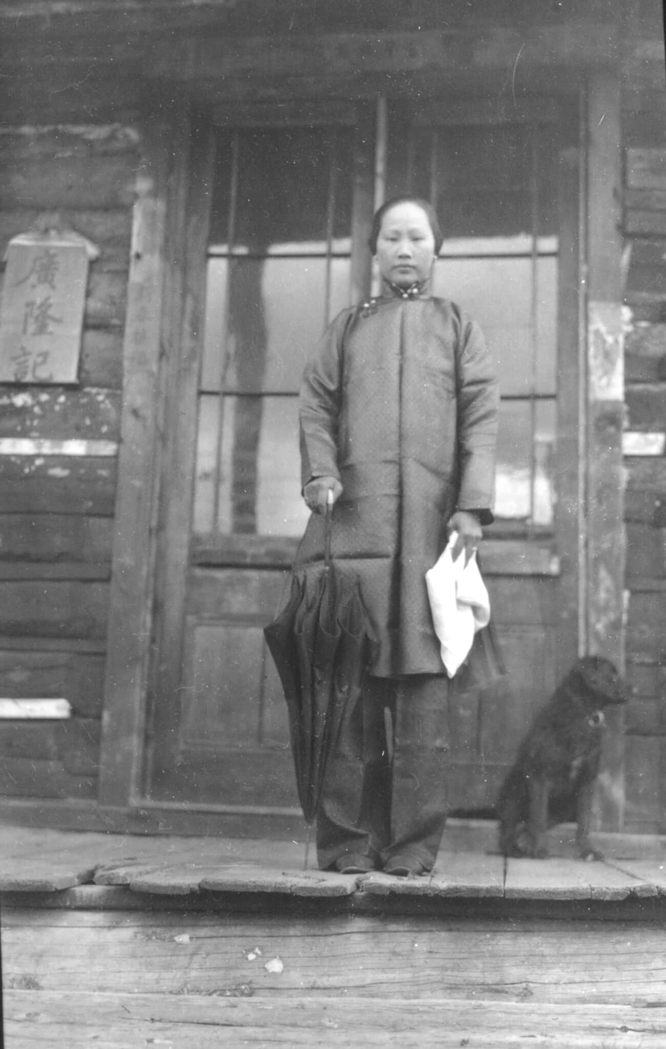
C.D. Hoy, Mrs. Won Gar Wong, 1912. Here Hoy represents the wife of a local merchant wearing traditional Chinese clothing.

Slide 5
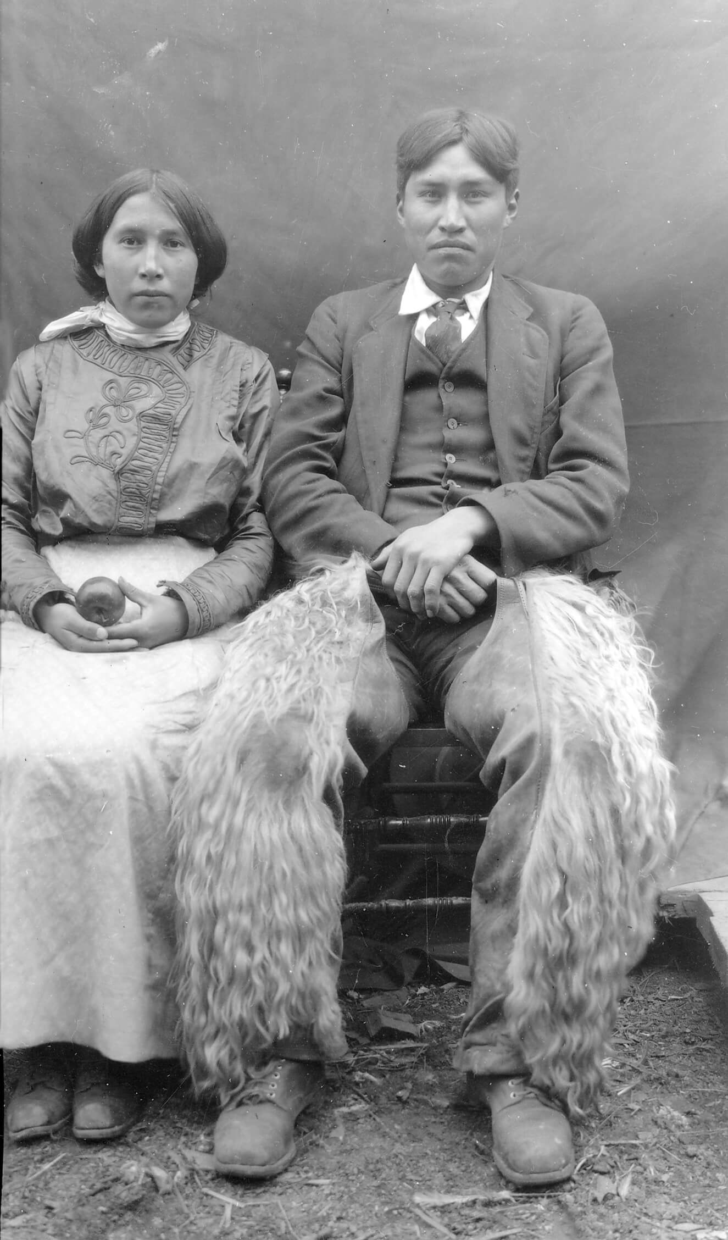
C.D. Hoy, Elaine Charleyboy and Chief William Charleyboy (Redstone), c.1910. This powerful portrait of Tsilhqot'in Chief William Charleyboy and his wife Elaine from Redstone is one of the most striking of Hoy’s images.

Slide 6
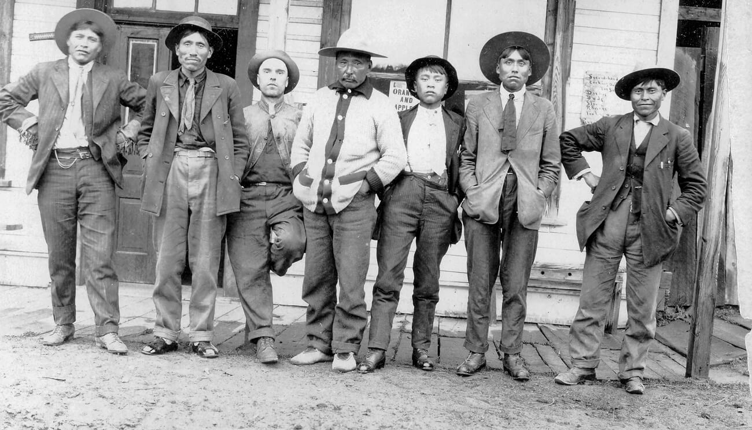
C.D. Hoy, Group of men in front of C.D. Hoy’s store in Quesnel, left to right: Jerry Boyd (Kluskus), Captain Marc Mack (Nazko), John Lazzarin (blacksmith), Chief Michel (Nazko), unknown Chinese man, Moffat Harris (Nazko), and Chief Morris Molize (Kluskus), c.1910. This picture represents the many groups living in Quesnel in the early 1900s.

Slide 7
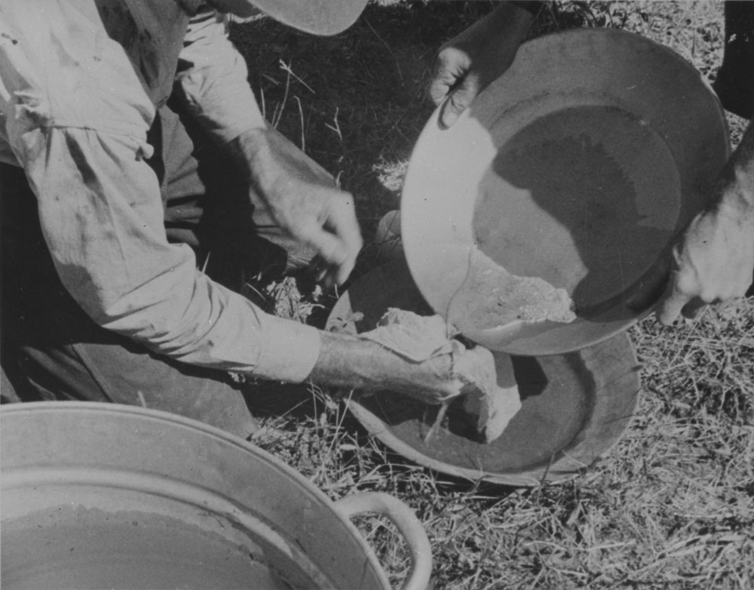
Gravel Machine Clean-up: Fraser River, 5 miles North of Quesnel, B.C. 1938. The possibility of finding gold in the Fraser River drew many miners to the region.

Slide 8
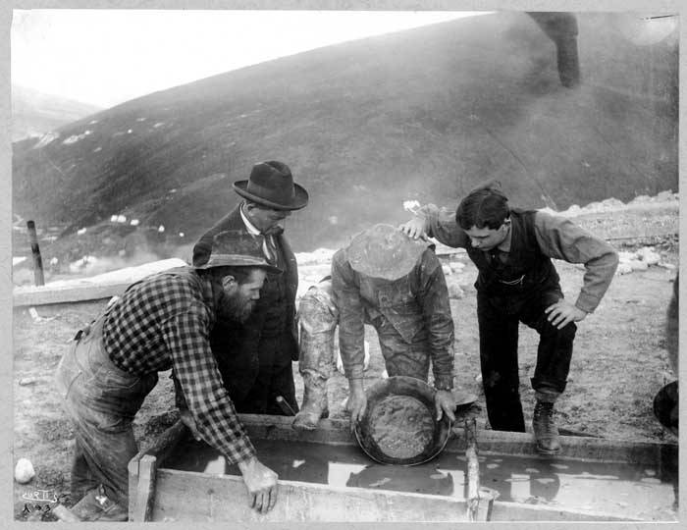
Panning for gold at Gold Hill, Yukon Territory, c.1898. The Klondike Gold Rush drew hundreds of people to the Yukon.

Slide 9
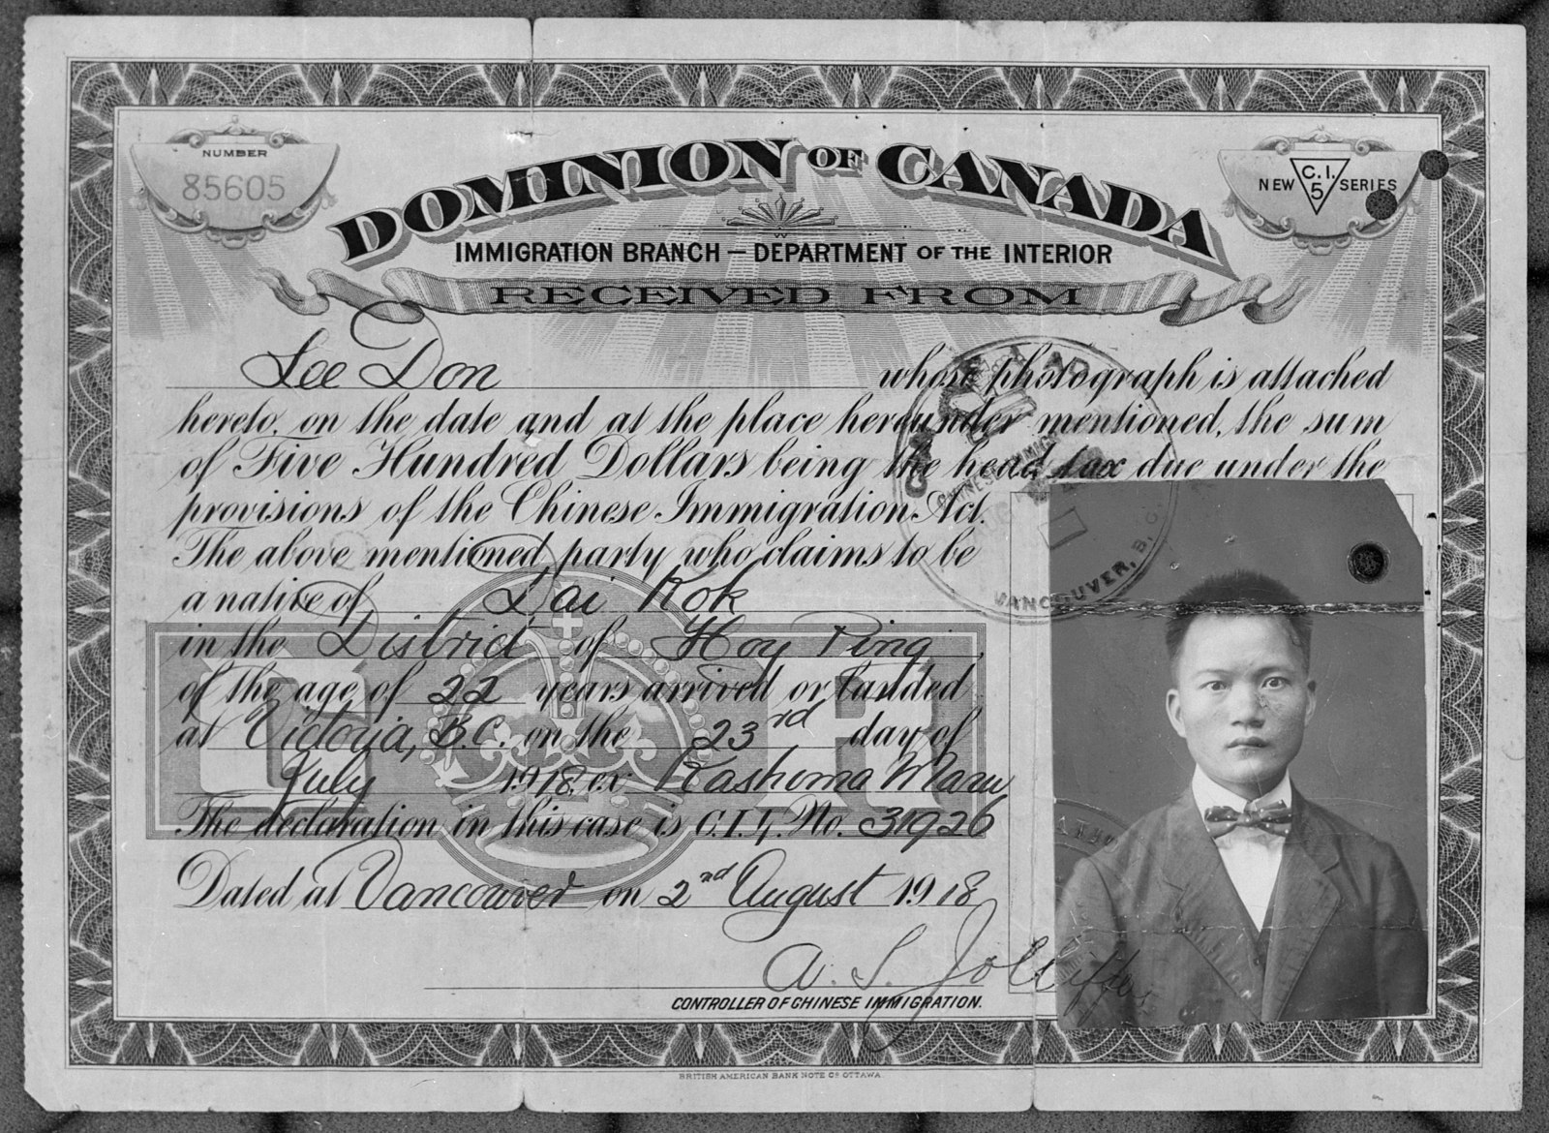
Certificate for Don Lee showing “the sum of five hundred dollars being the head tax due under the provisions of the Chinese Immigration Act,” August 1918.

Slide 10
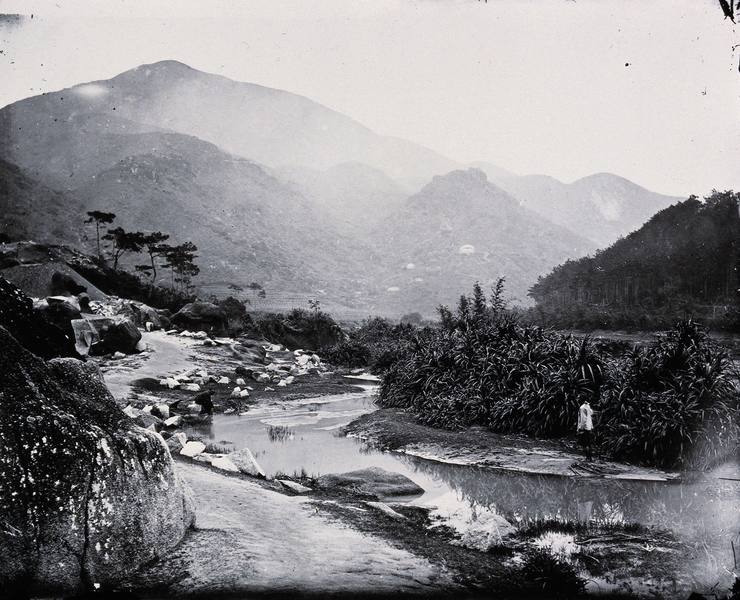
Pearl River, Guangdong province, China, 1870.

Slide 11
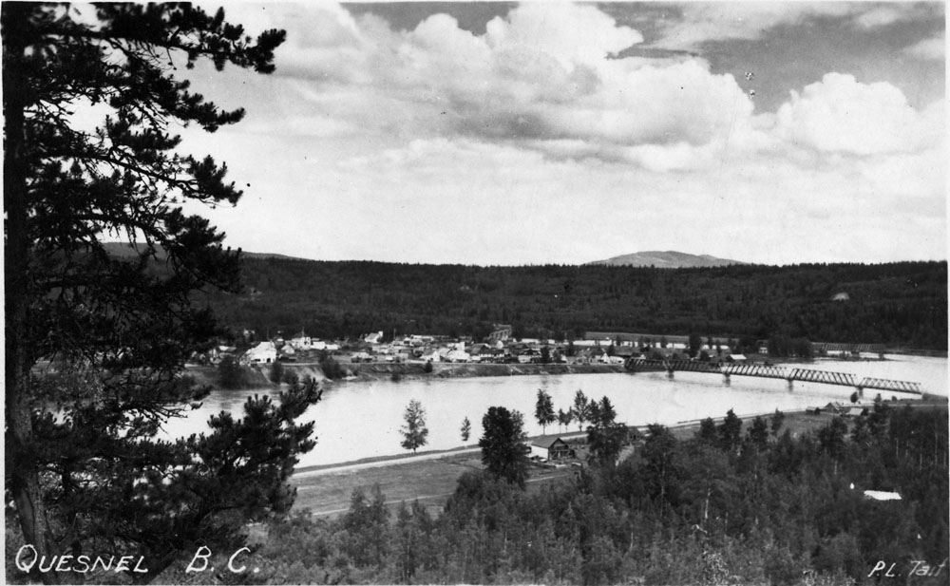
Quesnel, B.C.

Slide 12
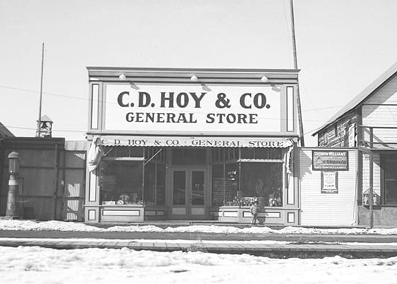
C.D. Hoy & Co. General Store in Quesnel. The business closed in 1979.

Slide 13
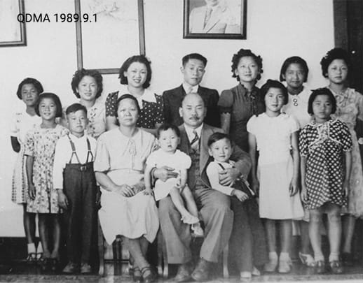
The Hoy family.

Slide 14
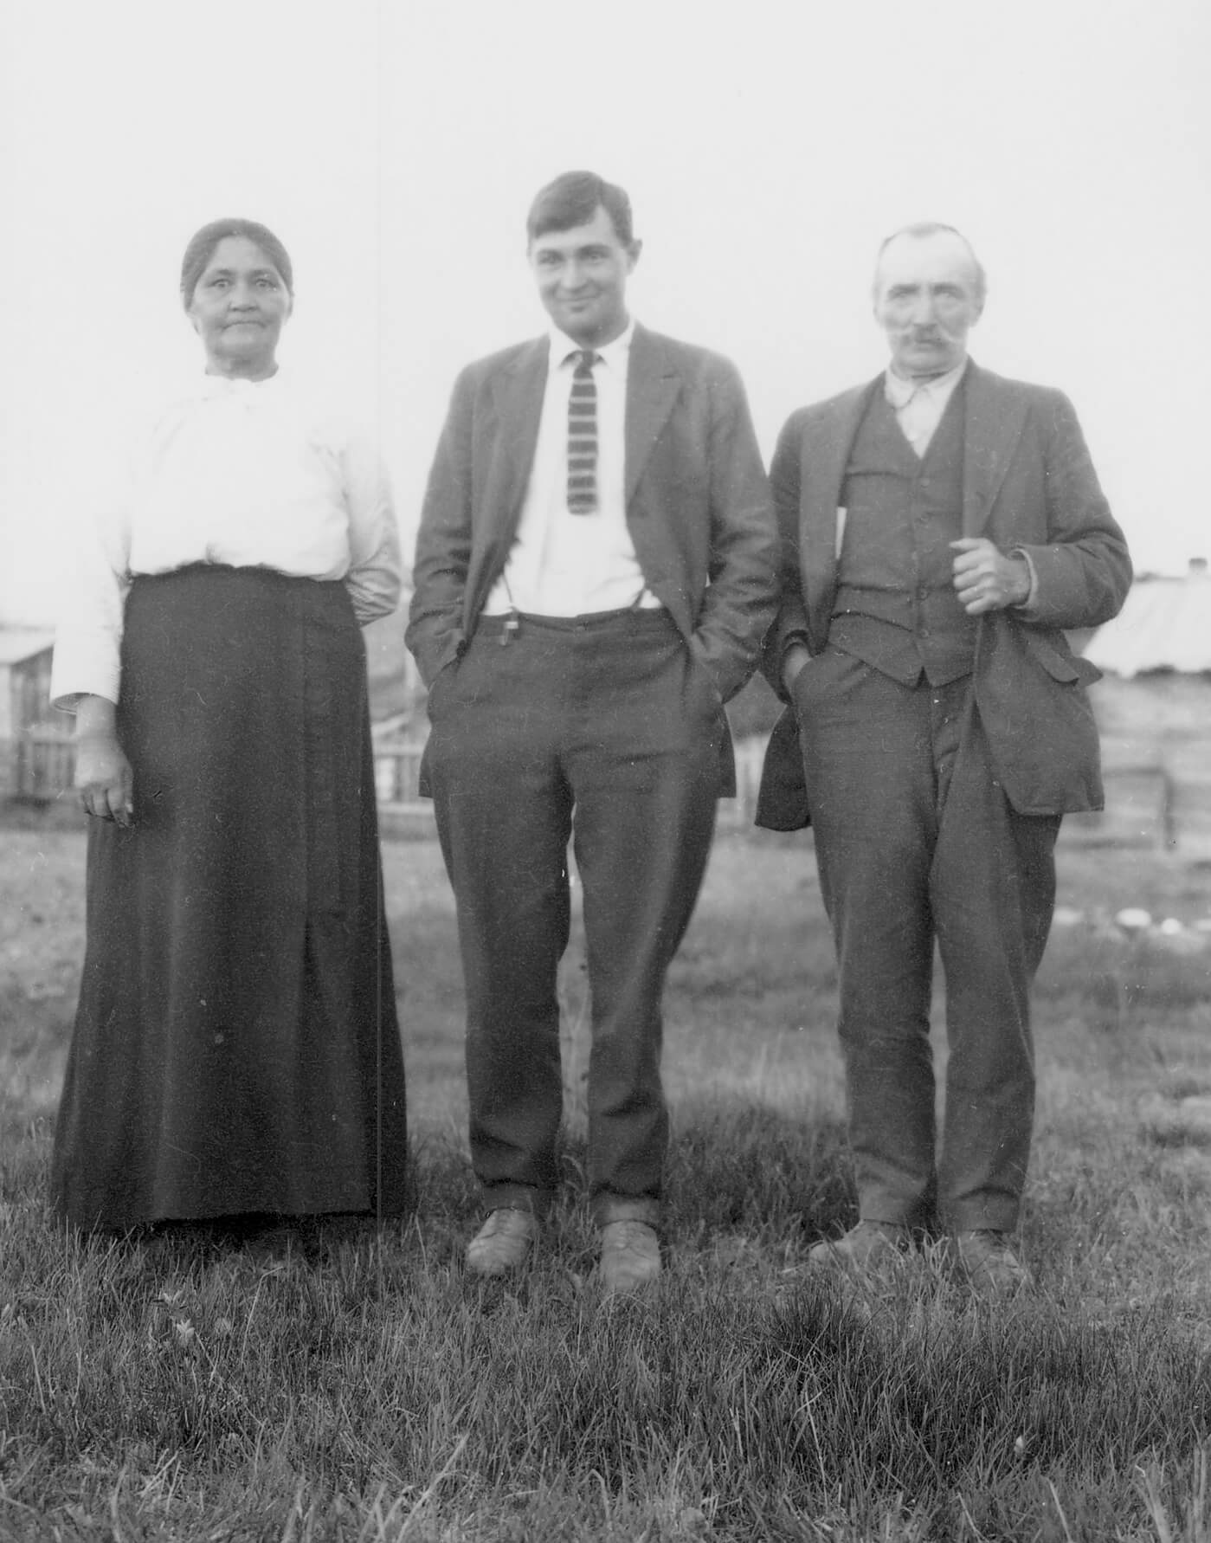
Learning Activity #1
C.D. Hoy, Cecilia, Marvin, and August (Sr.) Baker, 1910–20. In this family portrait, Mary Cecilia Susan Baker (née Elmore) and her husband August Baker (originally Boulanger) flank their son, Marvin. August was an immigrant from France, while Cecilia was the daughter of a First Nations woman.

Slide 15
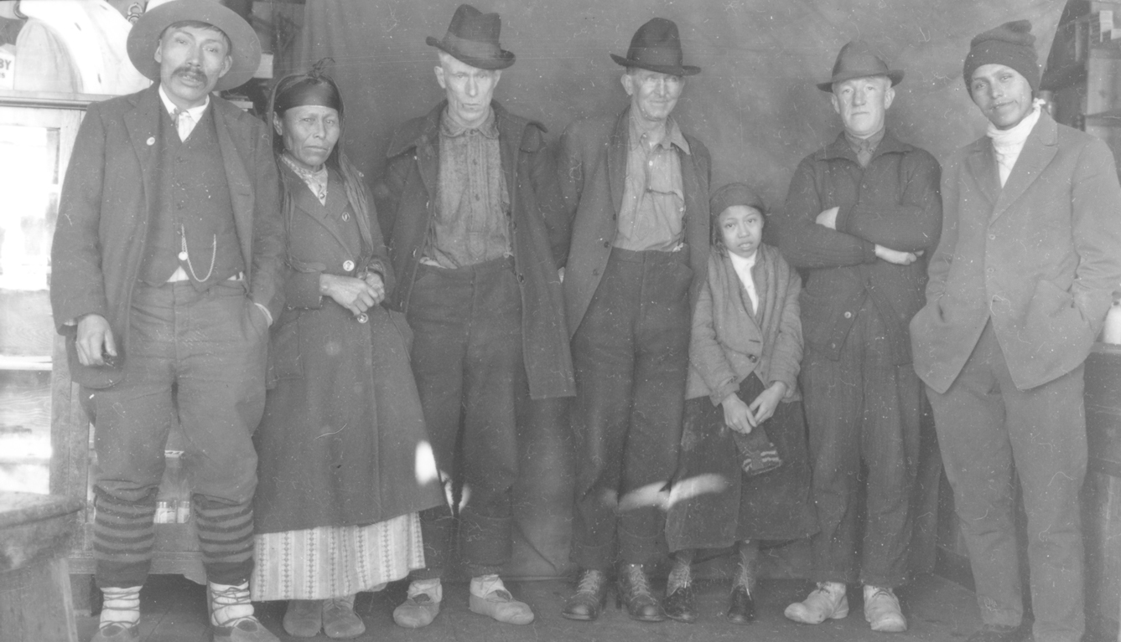
Learning Activity #1
C.D. Hoy, Four unidentified Indigenous people—two men, a woman and a girl—and three unidentified Caucasian men, c.1910. While the occasion of this photograph is unknown, it illustrates connections between Caucasian settlers and Indigenous people in the community.

Slide 16
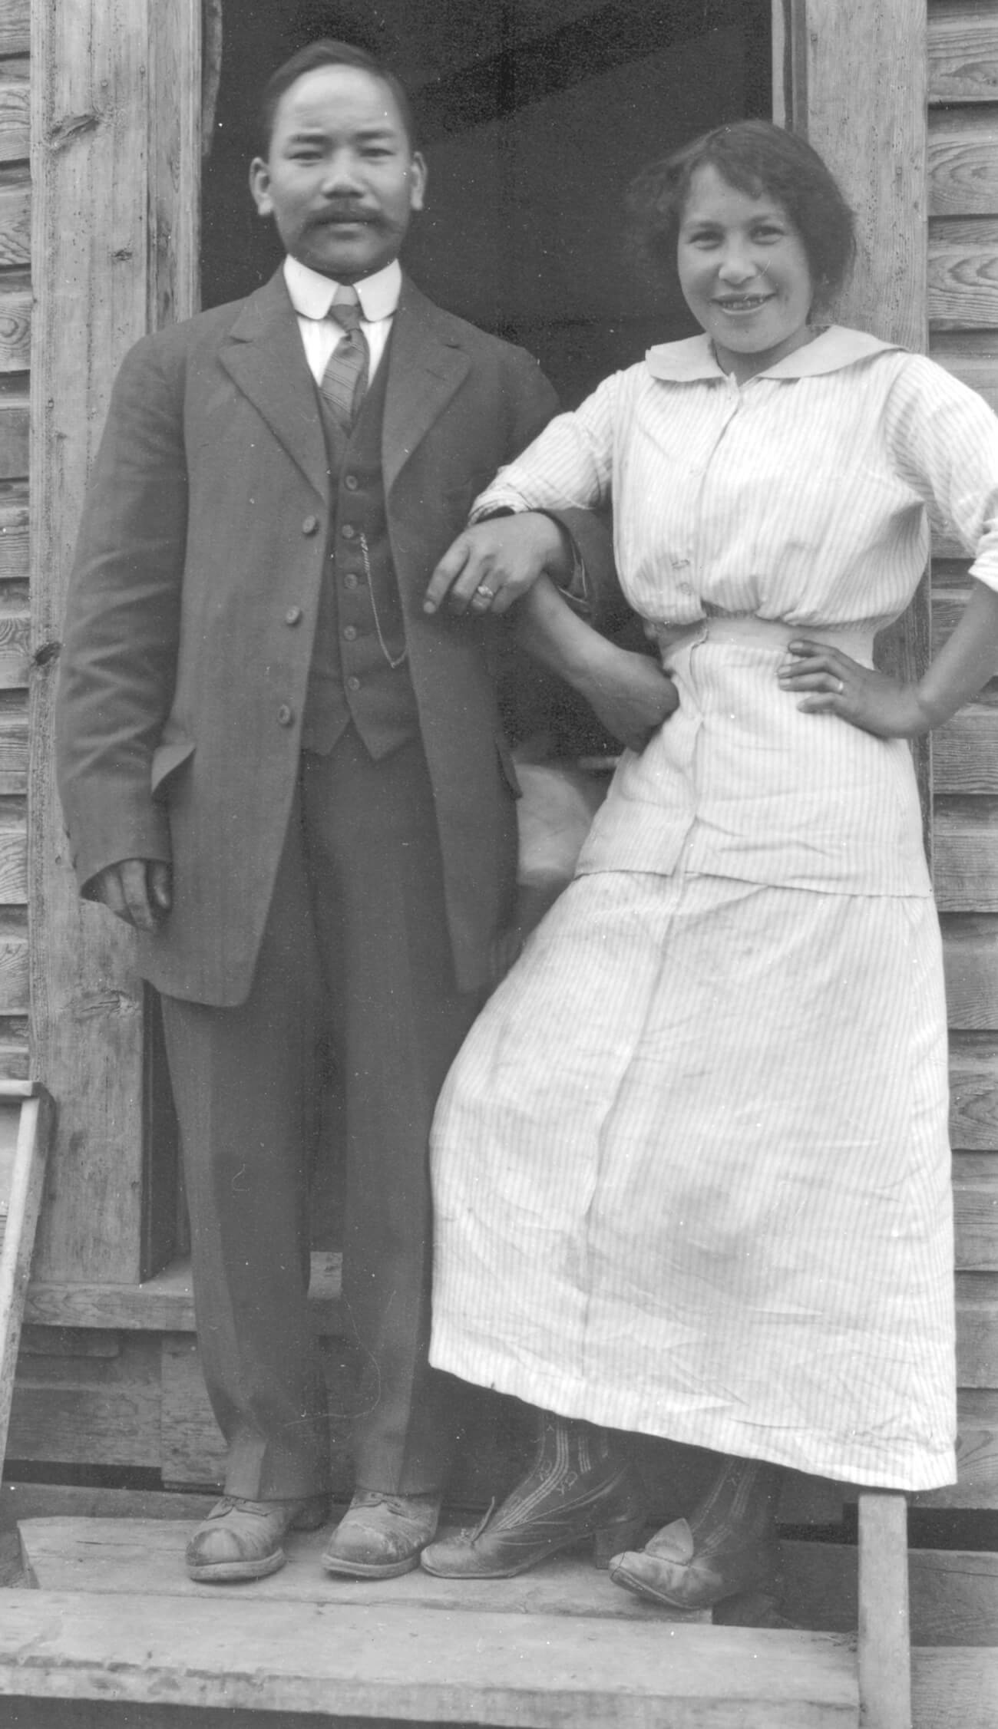
Learning Activity #1
C.D. Hoy, C.D. Hoy and Josephine Alexander, c.1915. In this image Hoy is pictured with Josephine Alexander, a Tsilhqot'in woman who worked for him.

Slide 17
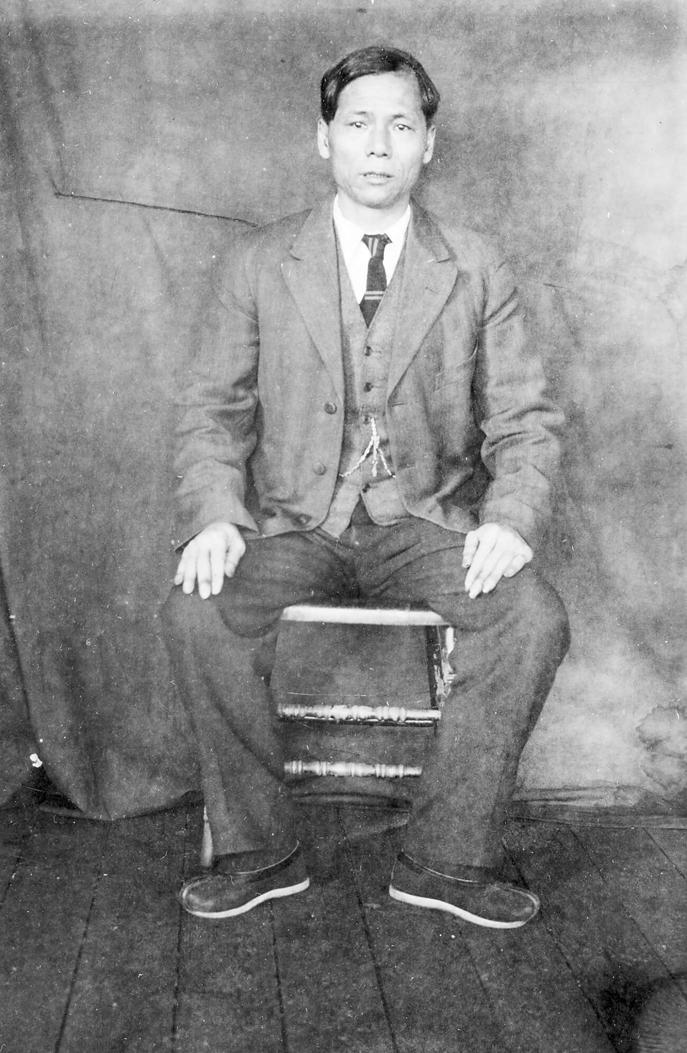
Learning Activity #1
C.D. Hoy, Chinese man in business suit and traditional Chinese shoes, c.1910. Like many of the Chinese men Hoy photographed, this man wears a Western-style business suit, but he also wears traditional Chinese shoes.

Slide 18
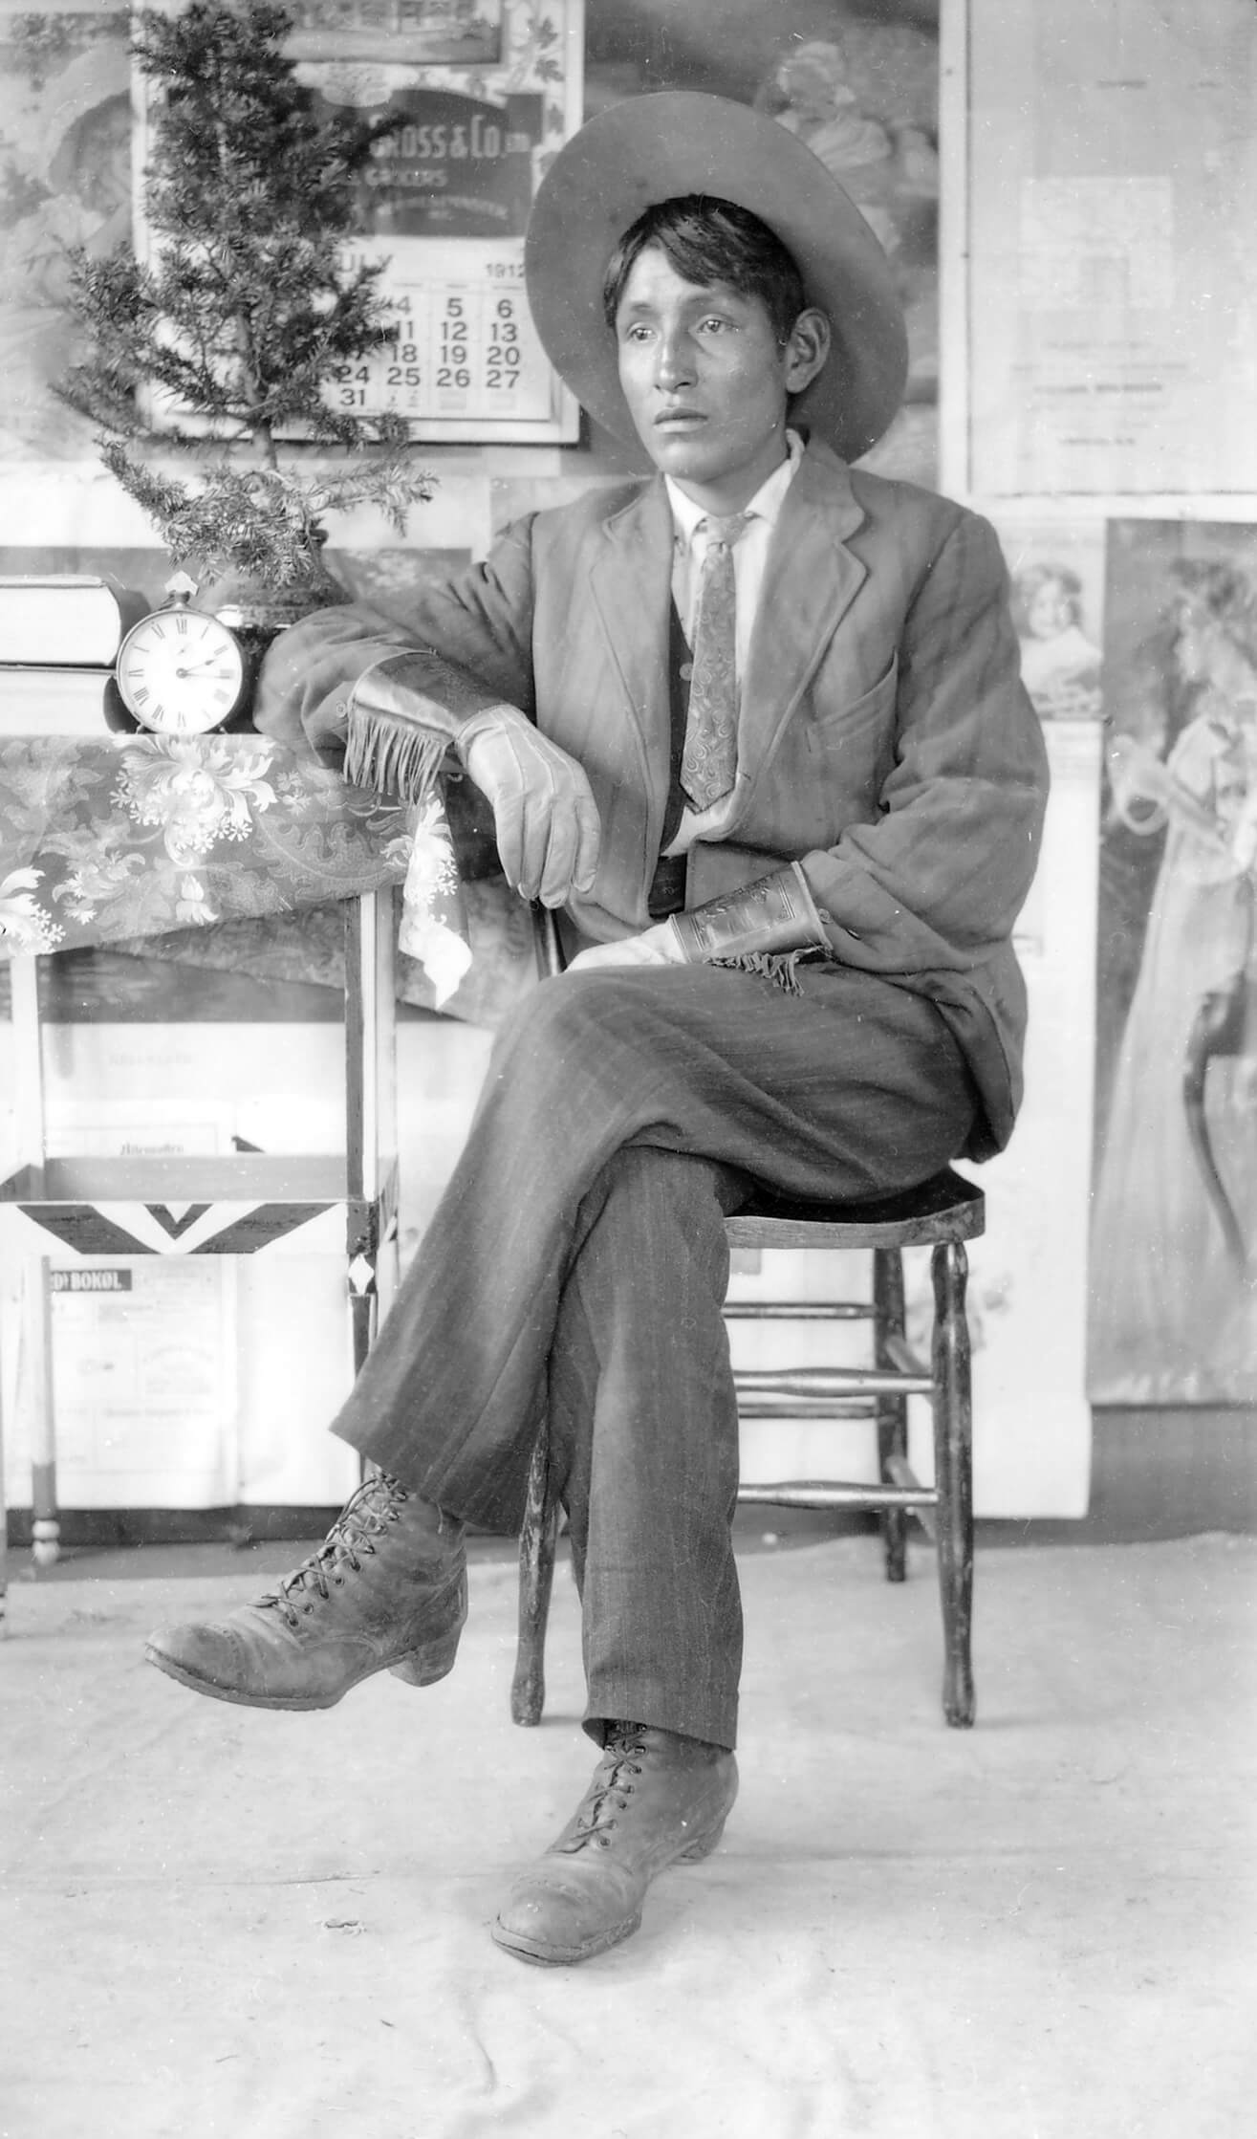
Learning Activity #1
C.D. Hoy, Long Jim, c.1912. This portrait represents a Tsilhqot'in man who visited Hoy’s studio.

Slide 19
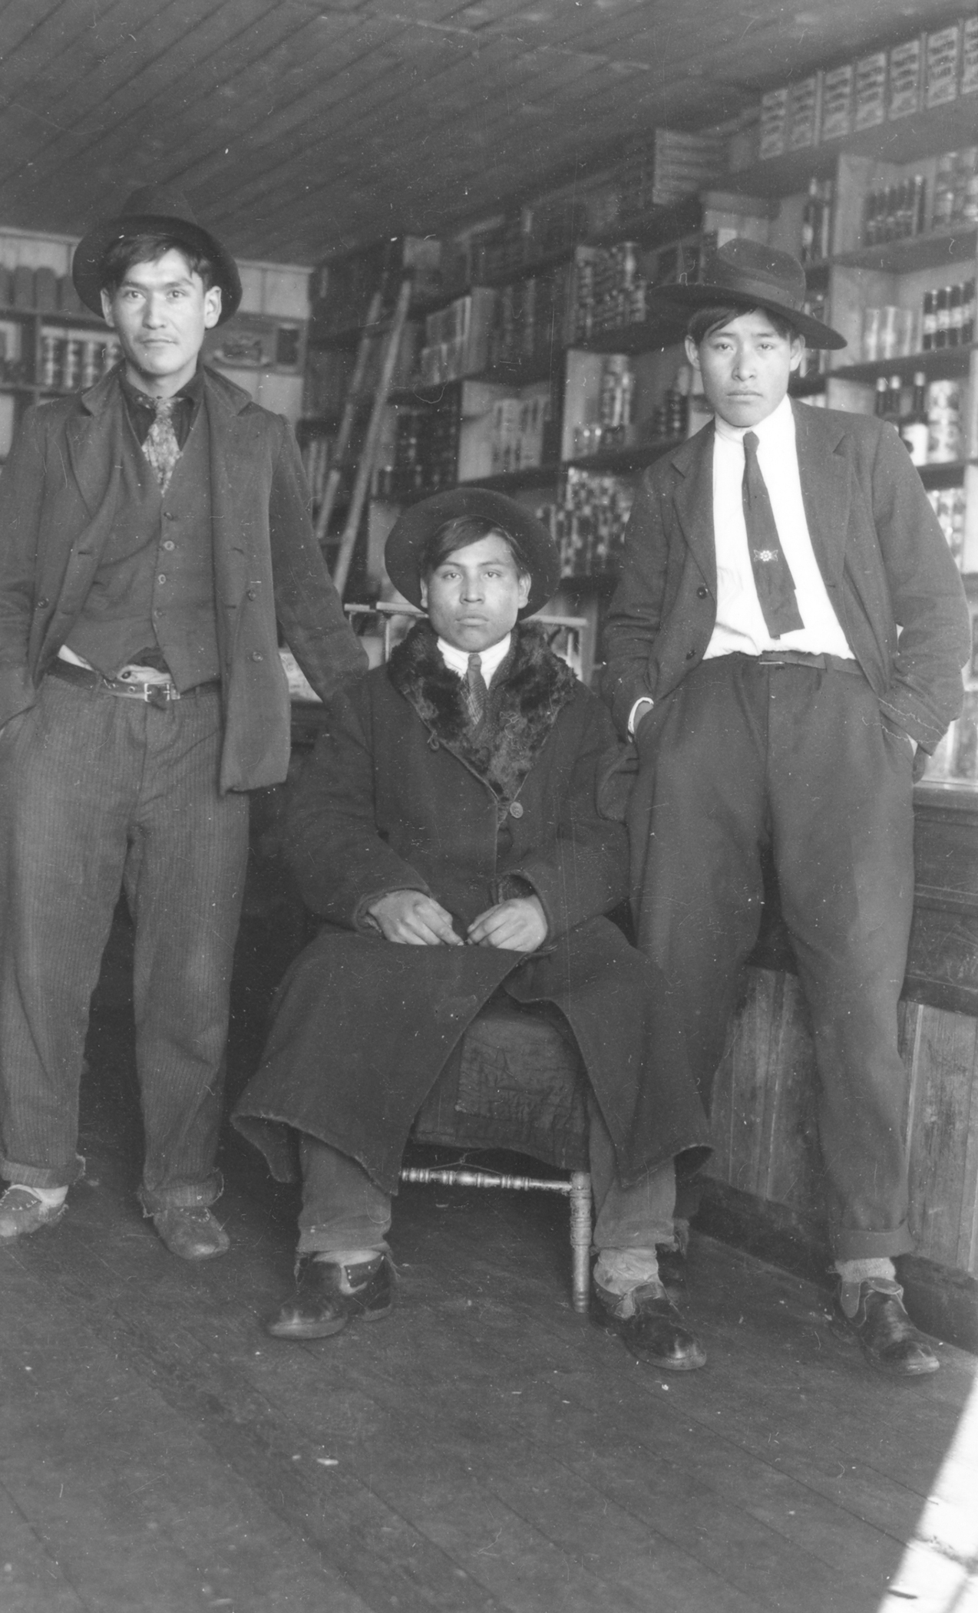
Learning Activity #2
C.D. Hoy, Three unidentified Indigenous men in C.D. Hoy’s store, 1910–20. Many of Hoy’s subjects were also customers at his store.

Slide 20
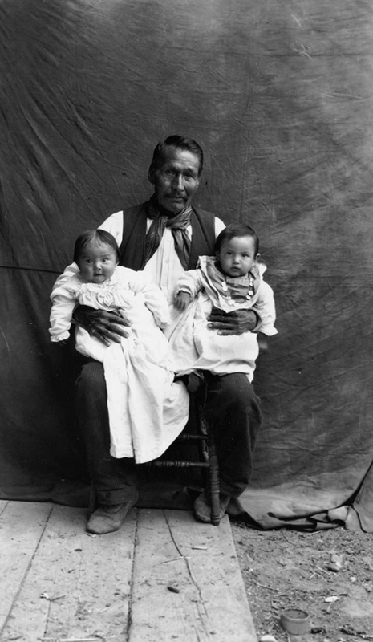
Learning Activity #2
C.D. Hoy, Man Holding Two Babies, c.1910. Many people in the community came to Hoy for family portraits.

Slide 21
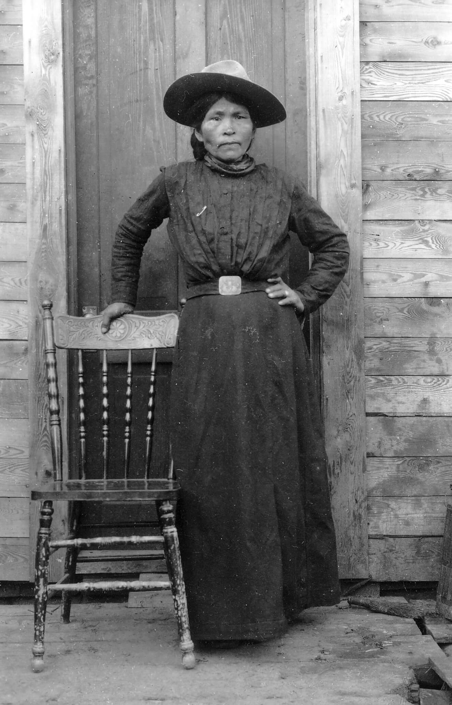
Learning Activity #2
C.D. Hoy, Mathilda Joe, c.1910. This dignified portrait depicts Mathilda Joe, wife of the Hereditary Chief of ʔEsdilagh.

Slide 22
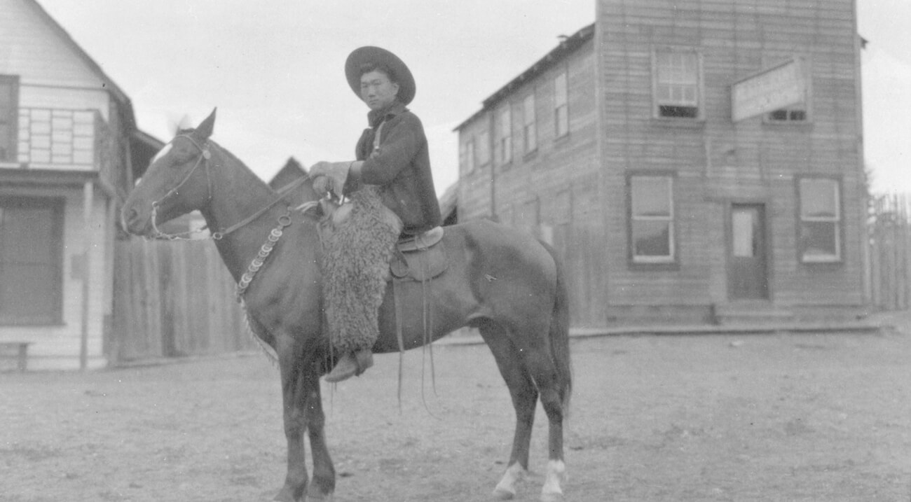
Learning Activity #2
C.D. Hoy, Kong Shing Sing on a horse on Barlow Avenue in Quesnel, c.1910. This dramatic portrait depicts Kong Shing Sing, a son of the Nam Sing ranching family in Quesnel, on horseback.

Slide 23
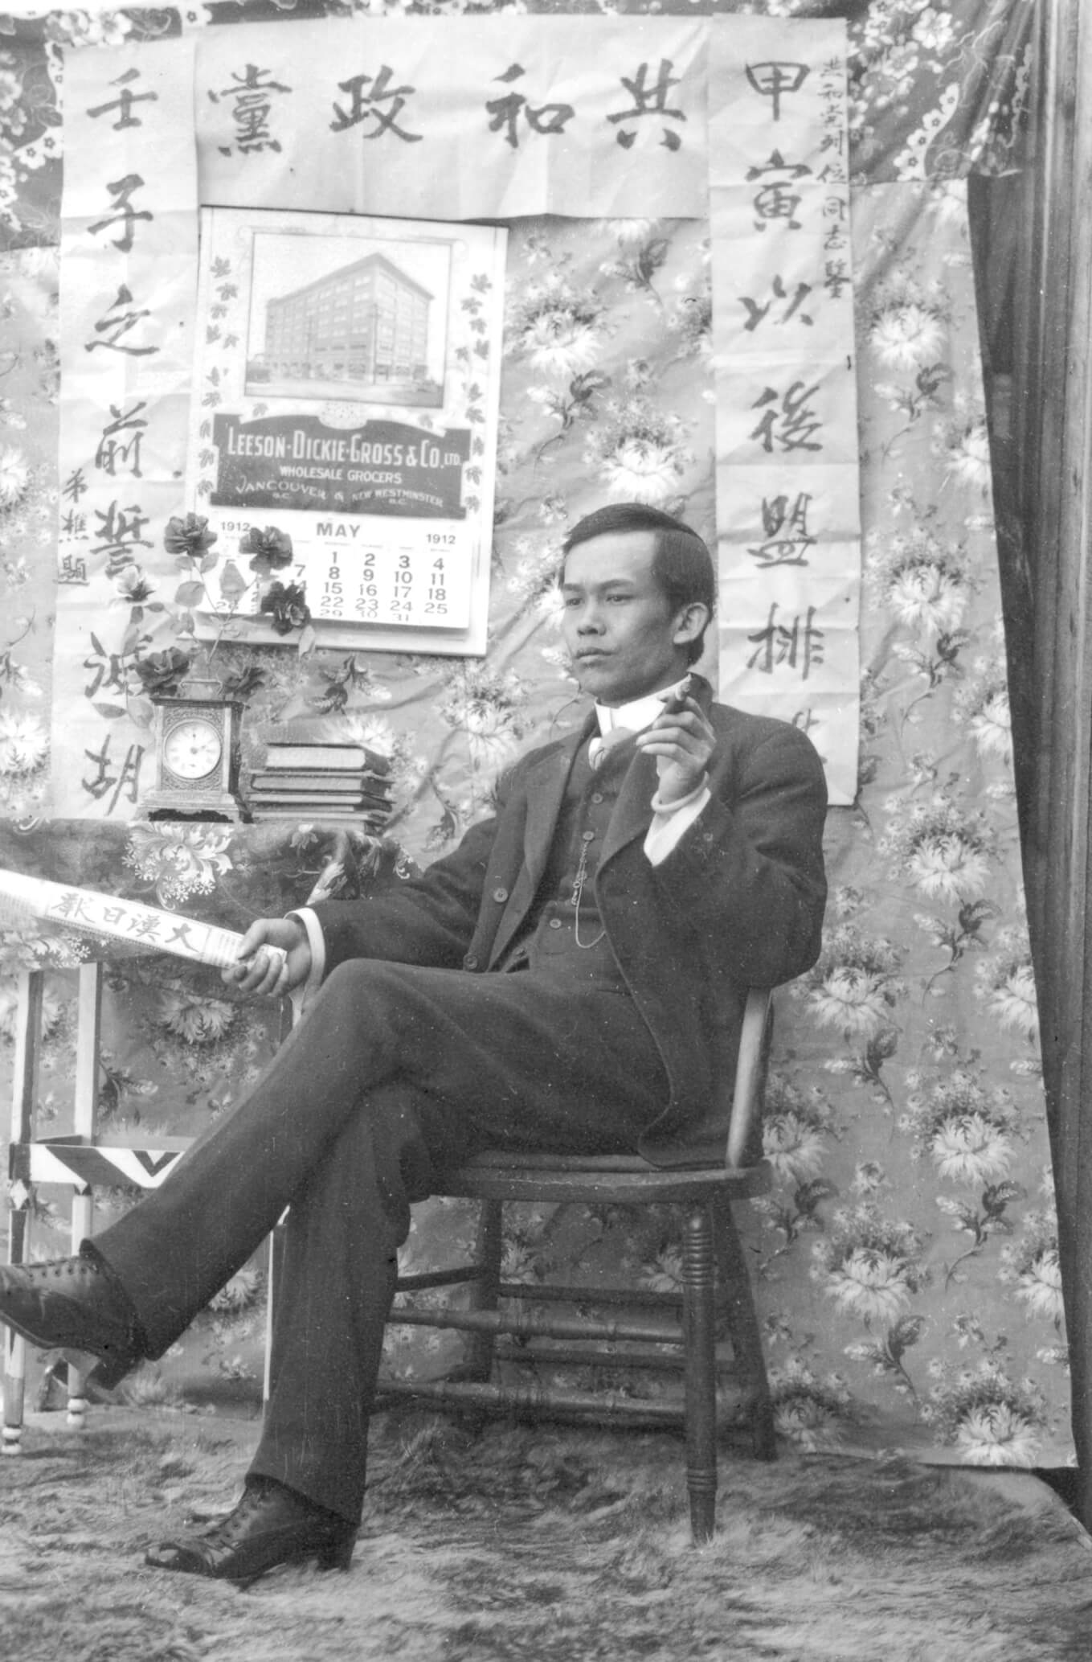
Culminating Task
C.D. Hoy, Chinese man in Revolutionary background, 1912. Hoy’s studio backdrops sometimes include Chinese posters.

Slide 24
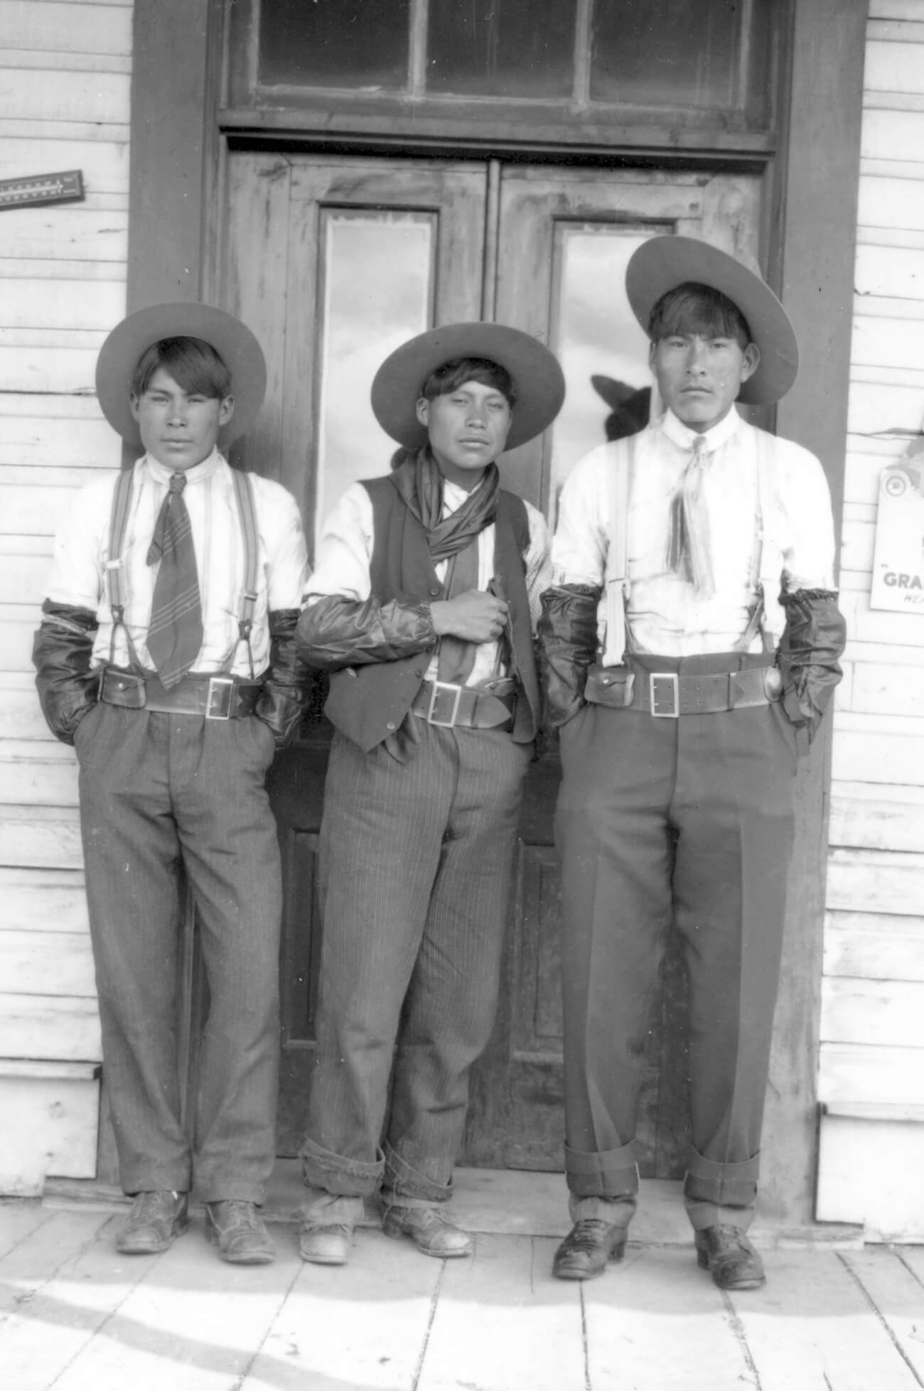
Culminating Task
C.D. Hoy, Joe Elkin, Baptiste Elkin, and Willie Long Jimmie standing in front of C.D. Hoy’s store in Quesnel with their outer pair of pants rolled up to reveal another pair underneath, c.1910. These men are wearing two pairs of pants to protect their best pair from the dust.

Slide 25
Culminating Task
C.D. Hoy, Elaine Charleyboy and Chief William Charleyboy (Redstone), c.1910. This portrait may have been taken when the couple visited Quesnel for the rodeo.

Slide 26
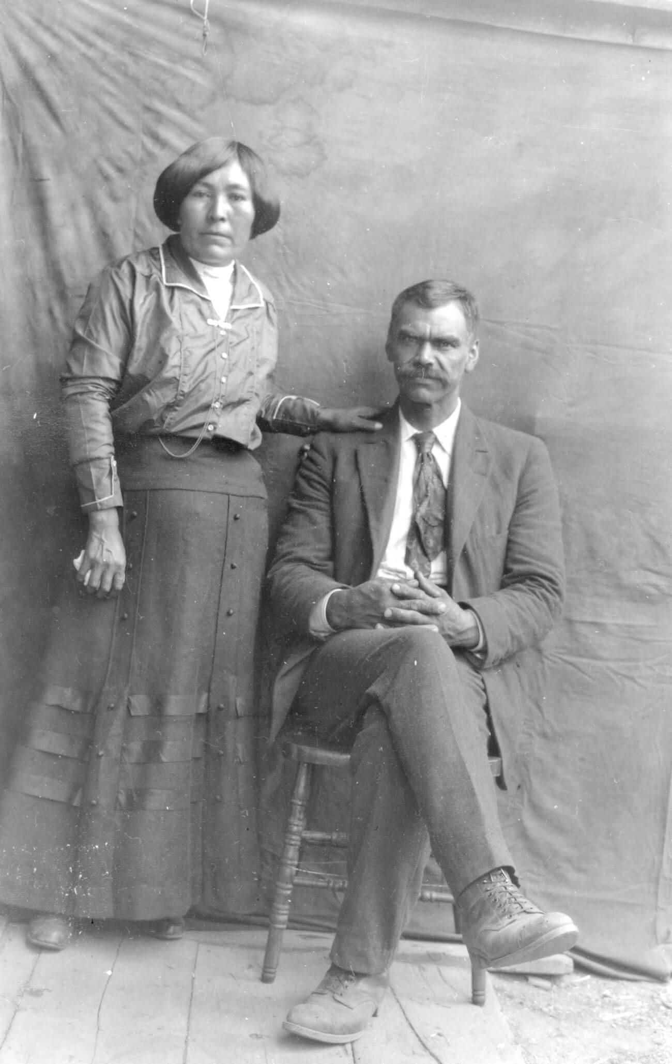
Culminating Task
C.D. Hoy, Betsy Adams (née Duchamp) and George P. Adams, c.1910. This portrait depicts George P. Adams, a settler in the Cariboo region who is believed to have been of African descent, and Betsy Duchamp, a local Indigenous woman.

Slide 27
C.D. Hoy, Mathilda Joe, c.1910. An Indigenous leader, Mathilda Joe was known as an excellent hunter who provided meat for the entire community.

Slide 28
C.D. Hoy, Chinese man in business suit and traditional Chinese shoes, c.1910. This man’s pose may have been inspired by Chinese ancestor portraiture and early Hong Kong studio photography.

Slide 29
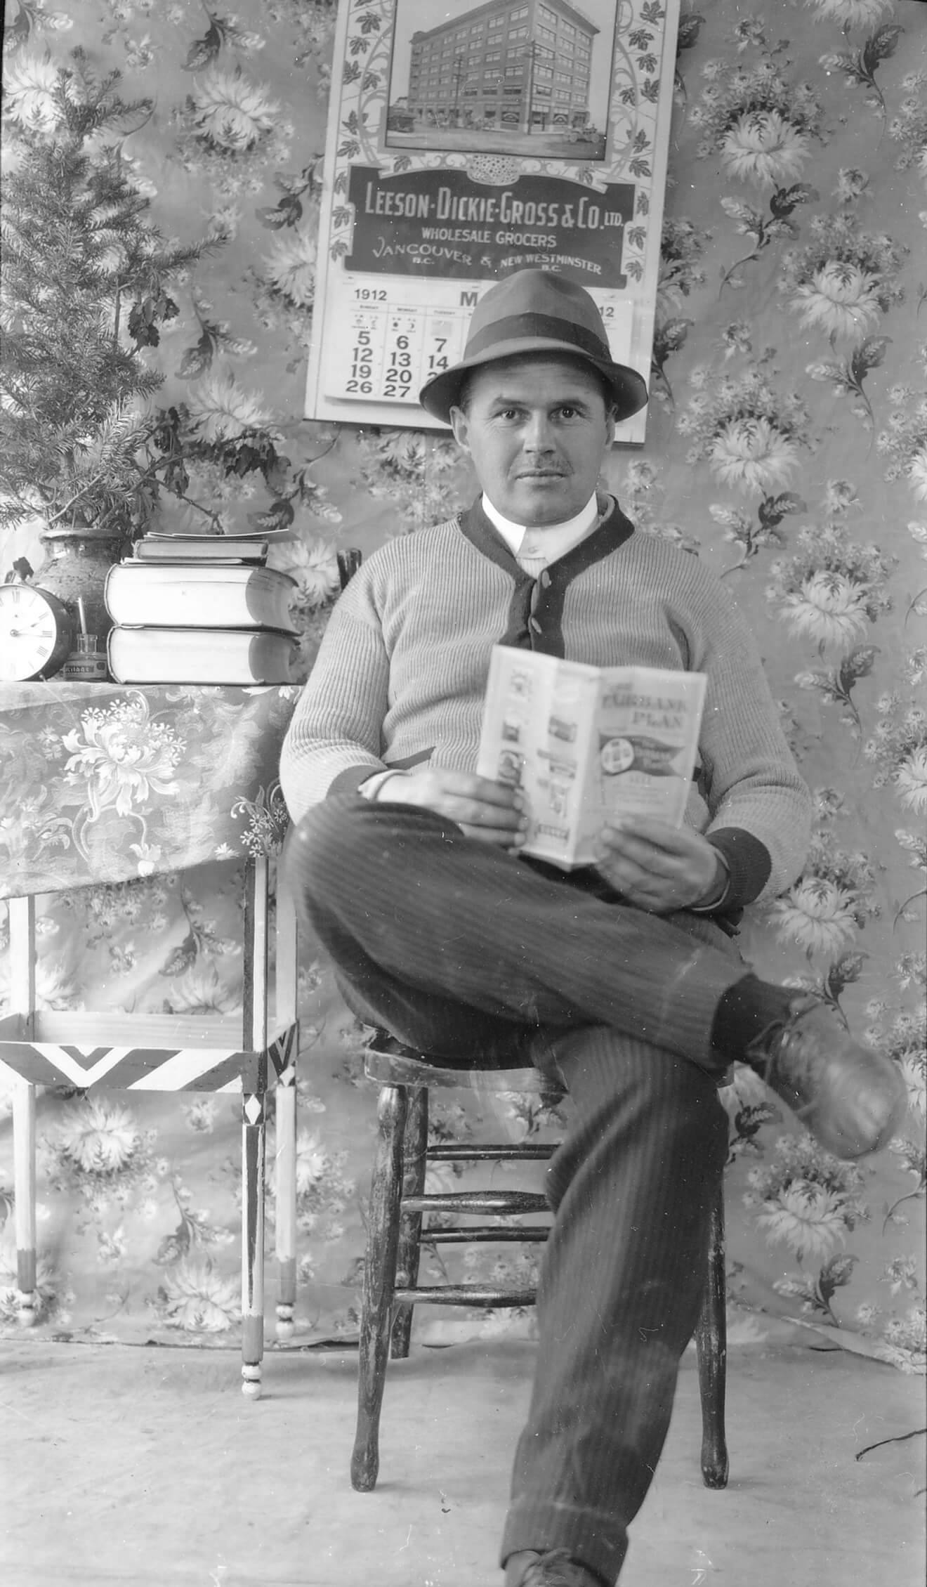
C.D. Hoy, Caucasian man with pamphlet, 1912. A cloth backdrop covered in chrysanthemums appears in many of Hoy’s images.

Slide 30
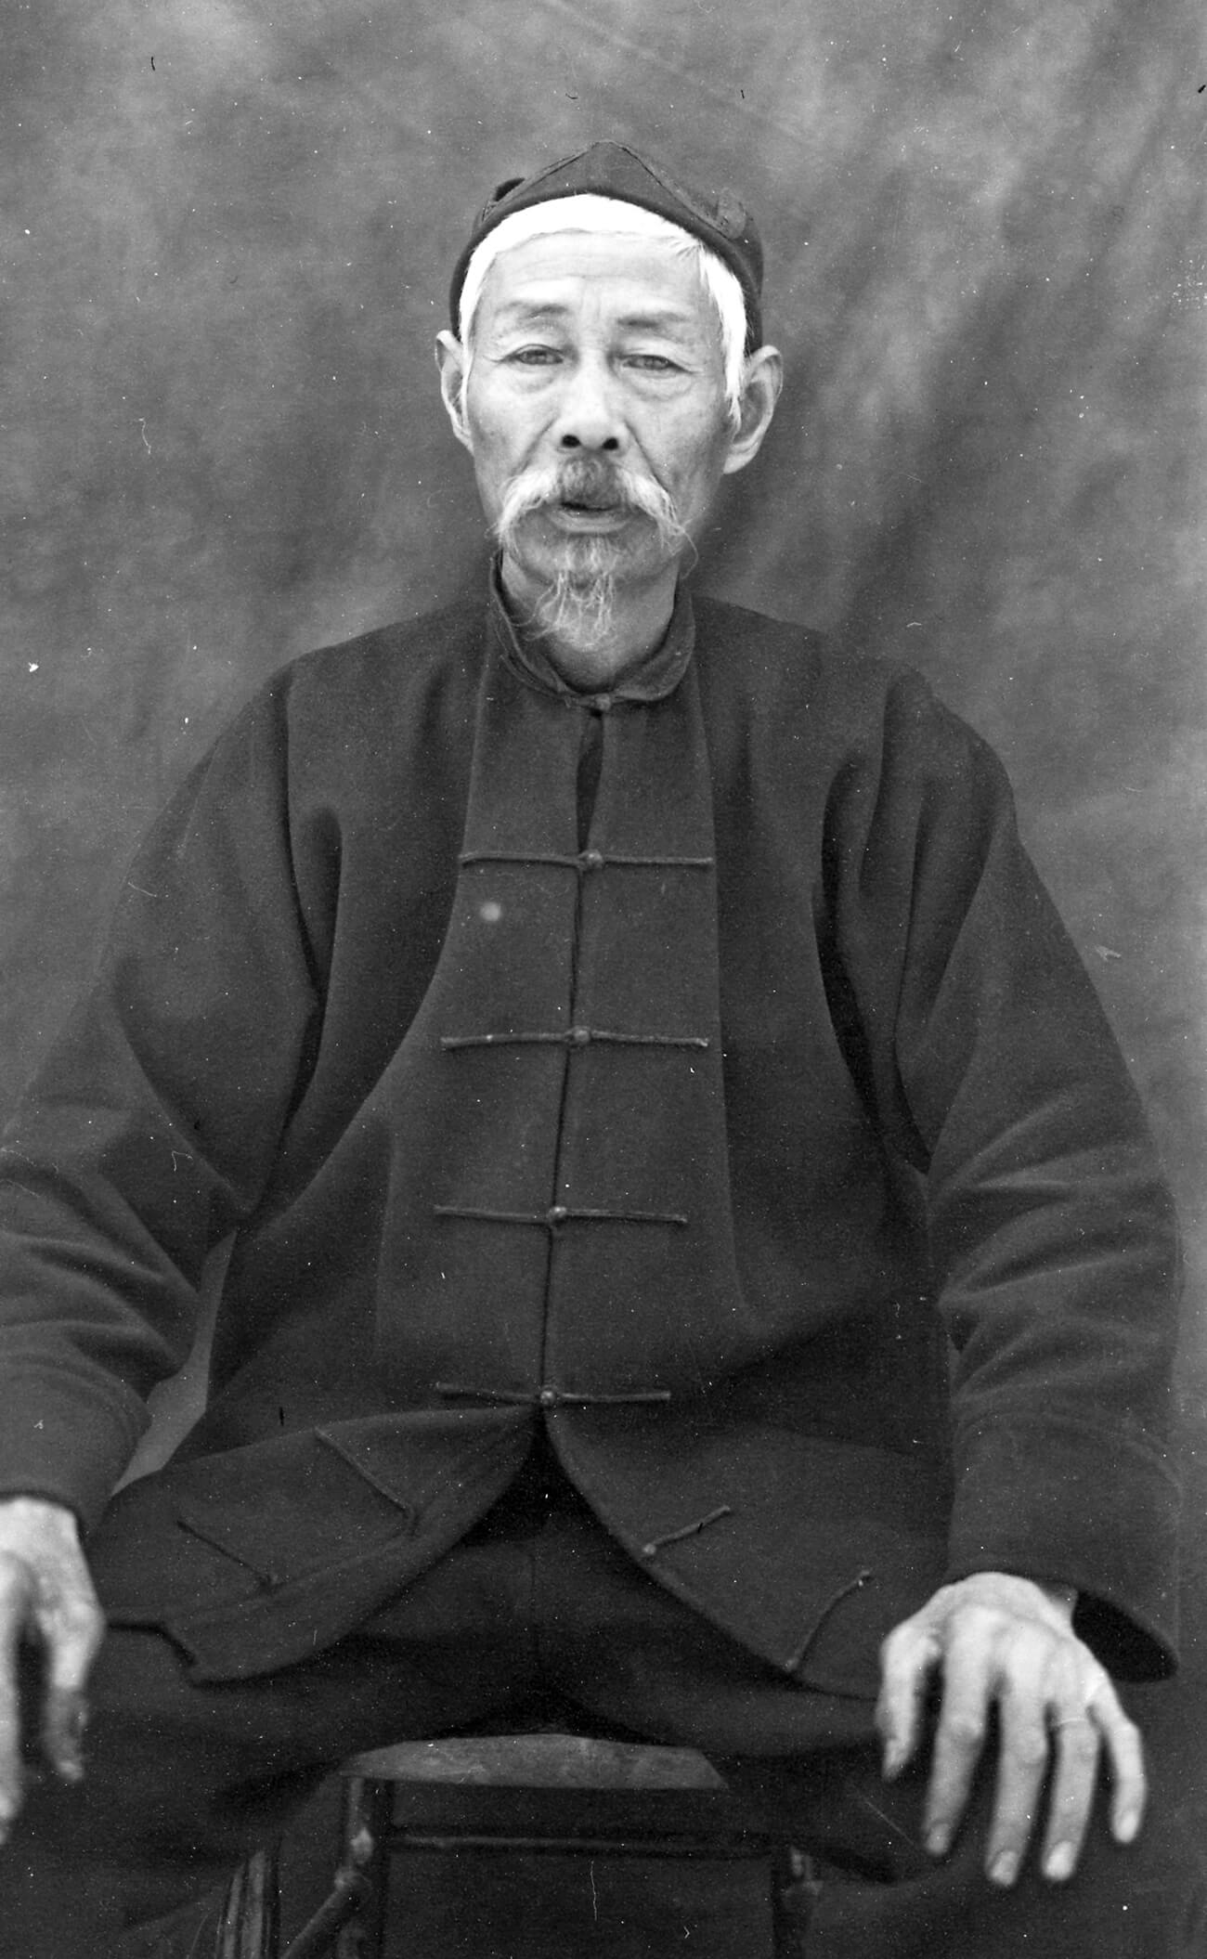
C.D. Hoy, Lim Poi (likely), a pig farmer near Prince George and business owner in Quesnel and Barkerville, c.1910. The man in this portrait has chosen to be represented in traditional Chinese dress.

Slide 31
C.D. Hoy, Laura (Yee) Sing, c.1915. This woman was one of two daughters born to the Nam Sing family (and the sister of Kong Shing Sing), an early Chinese farming and ranching family in Quesnel.

Slide 32
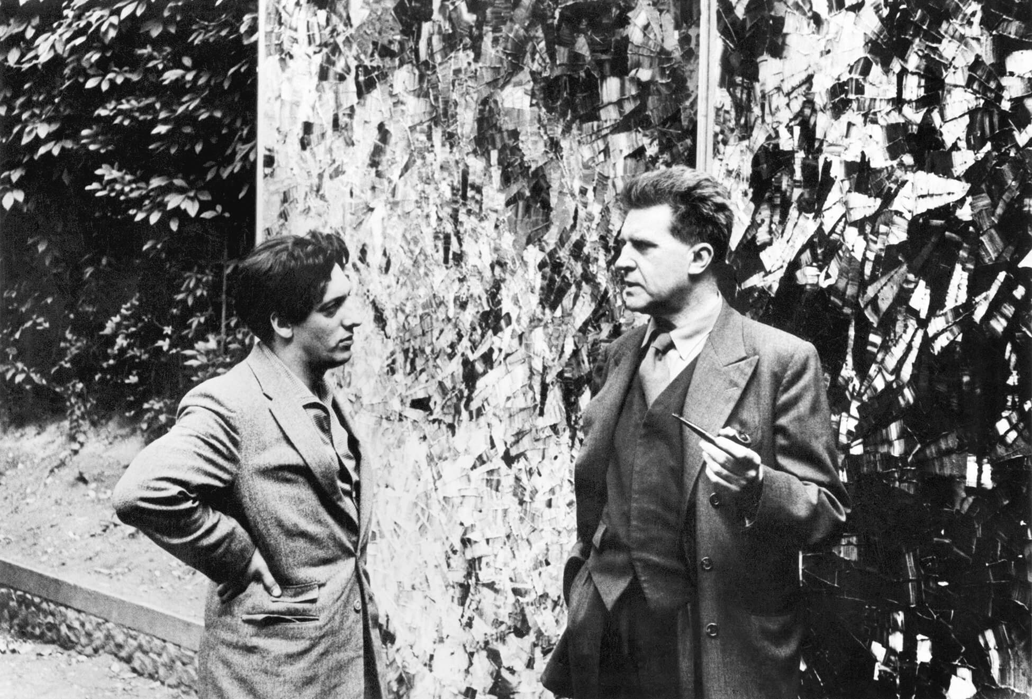
C.D. Hoy, Kong Shing Sing on a horse on Barlow Avenue in Quesnel, c.1910. An expert blacksmith, teamster, and cowboy, Kong was the son of Chinese rancher Chew Nam Sing, one of the very first Asian men drawn to Cariboo by the lure of gold.

