Slide 1
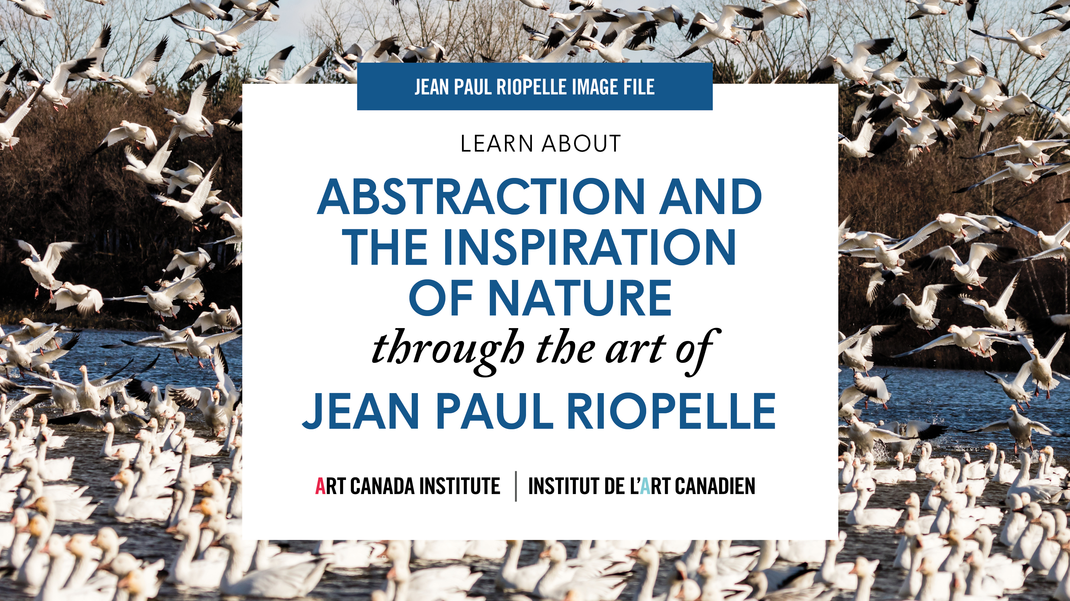

Slide 2
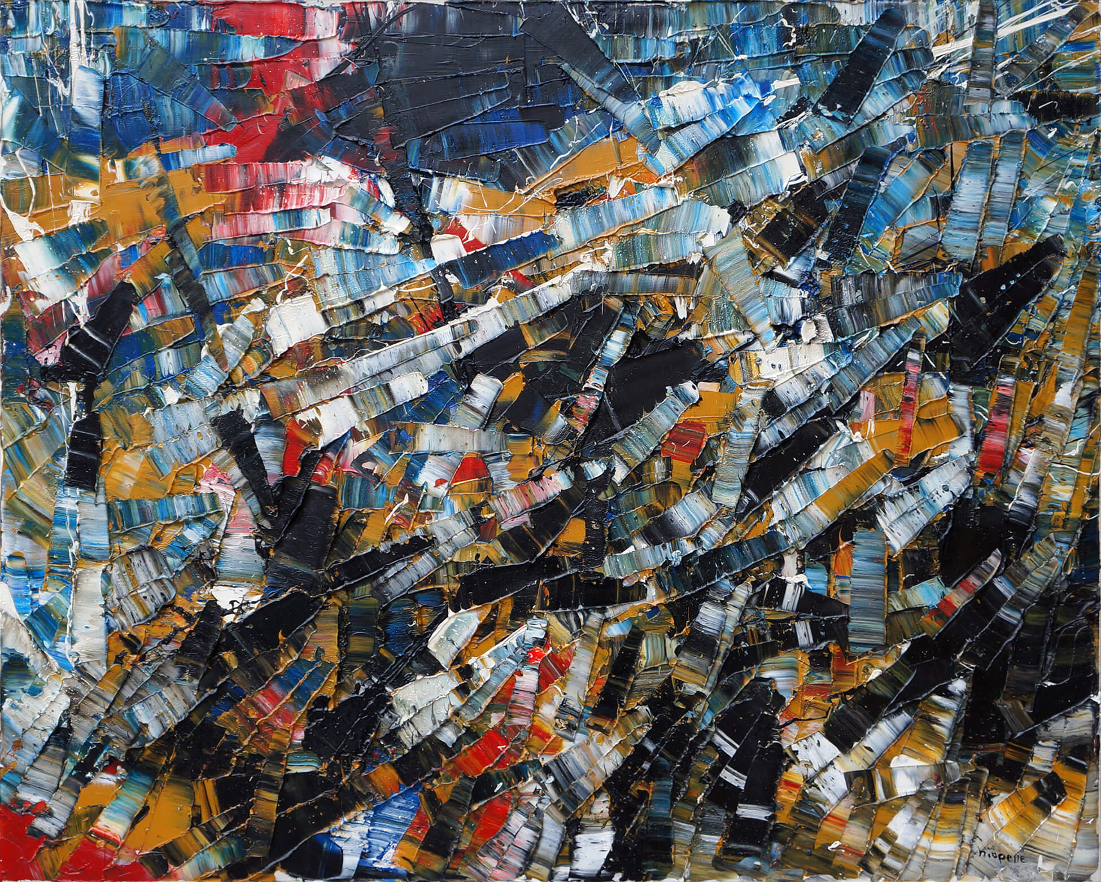
Jean Paul Riopelle, Composition, 1954, oil on canvas, 81.3 x 99,1 cm.
© Jean Paul Riopelle Estate / SOCAN (2022). Private collection, Toronto.

Slide 3
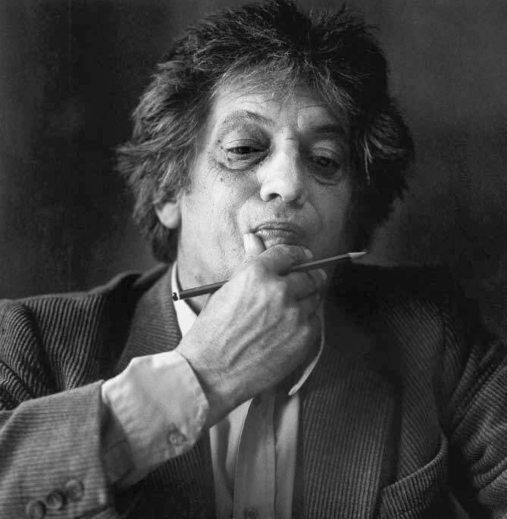
Jean Paul Riopelle in Paris, 1985, photograph by Michel Nguyen. © Michel Nguyen.

Slide 4
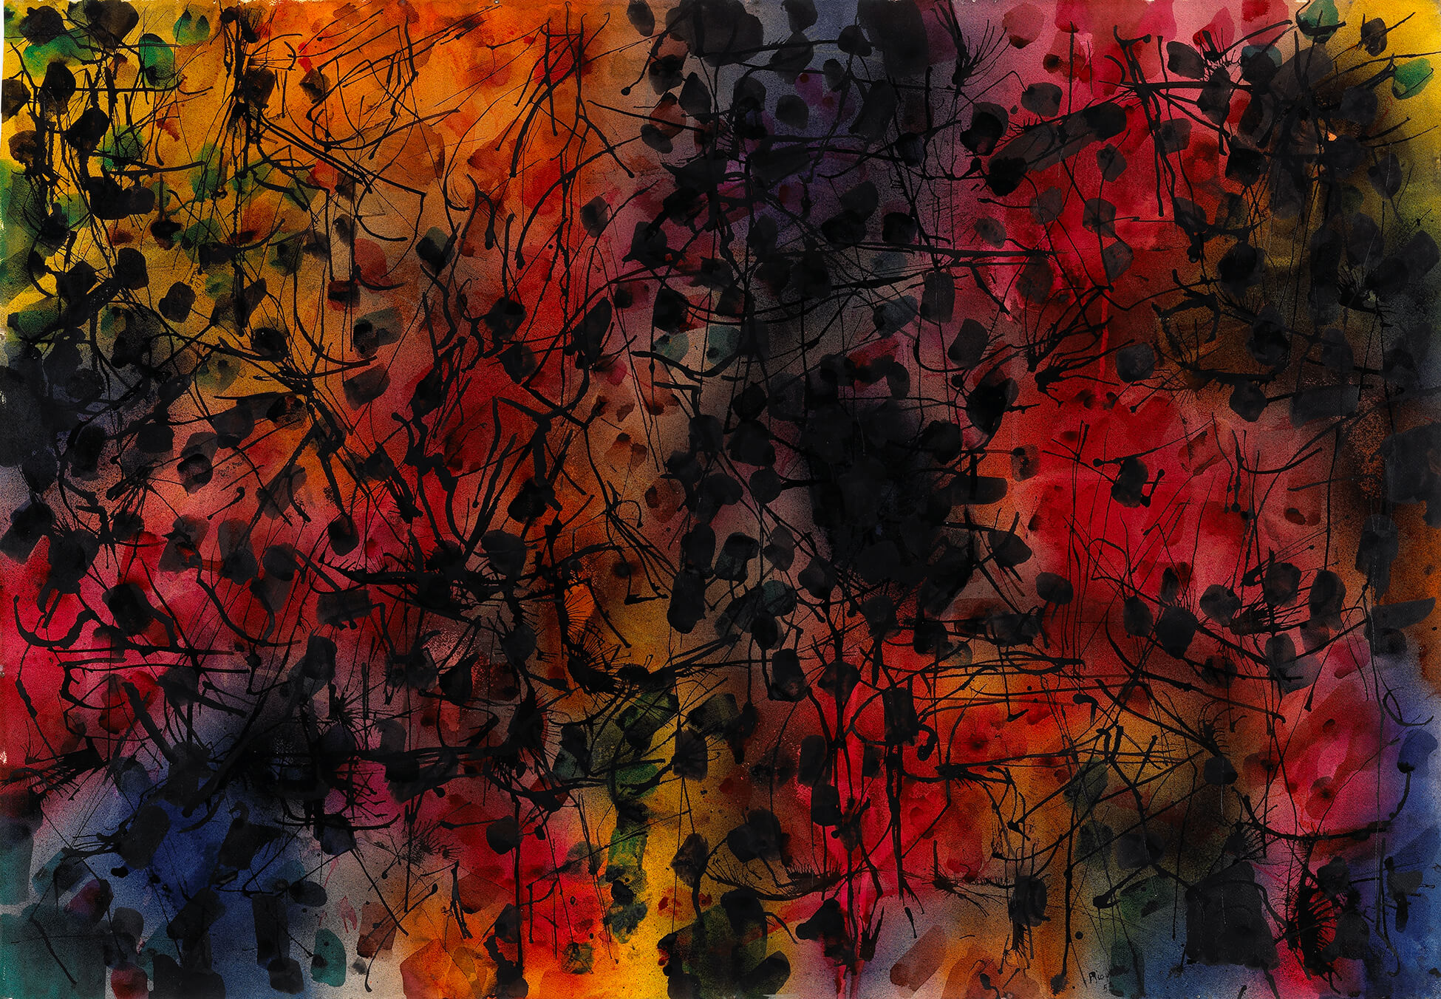
Jean Paul Riopelle, Sans titre (Untitled), 1953, coloured ink on wove paper, 74.5 x 107.4 cm. © Jean Paul Riopelle Estate / SOCAN (2022). National Gallery of Canada, Ottawa.

Slide 5
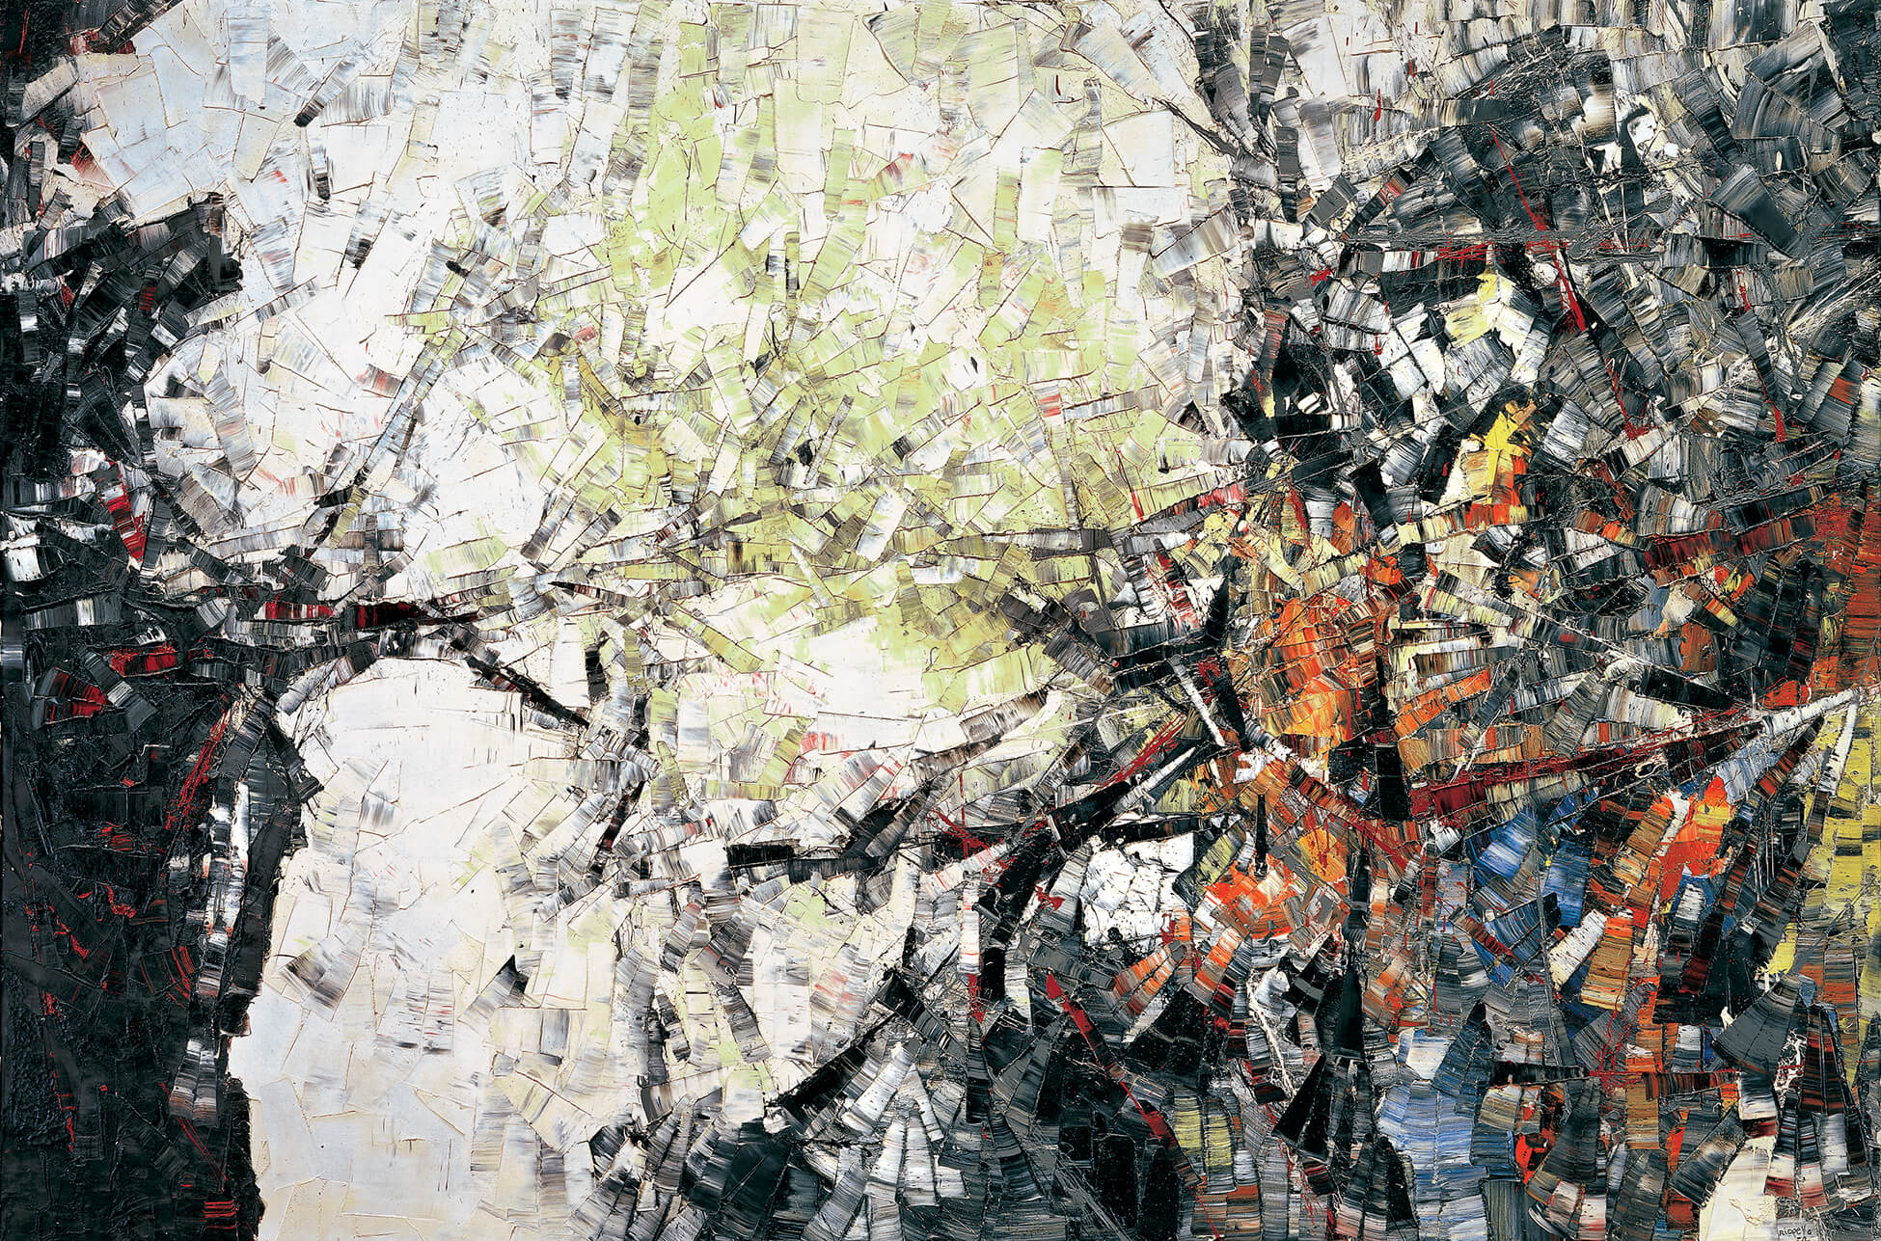
Jean Paul Riopelle, Autriche III (Austria III), 1954, oil on canvas, 200 x 300.7 cm. © Jean Paul Riopelle Estate / SOCAN (2022). Montreal Museum of Fine Arts.

Slide 6
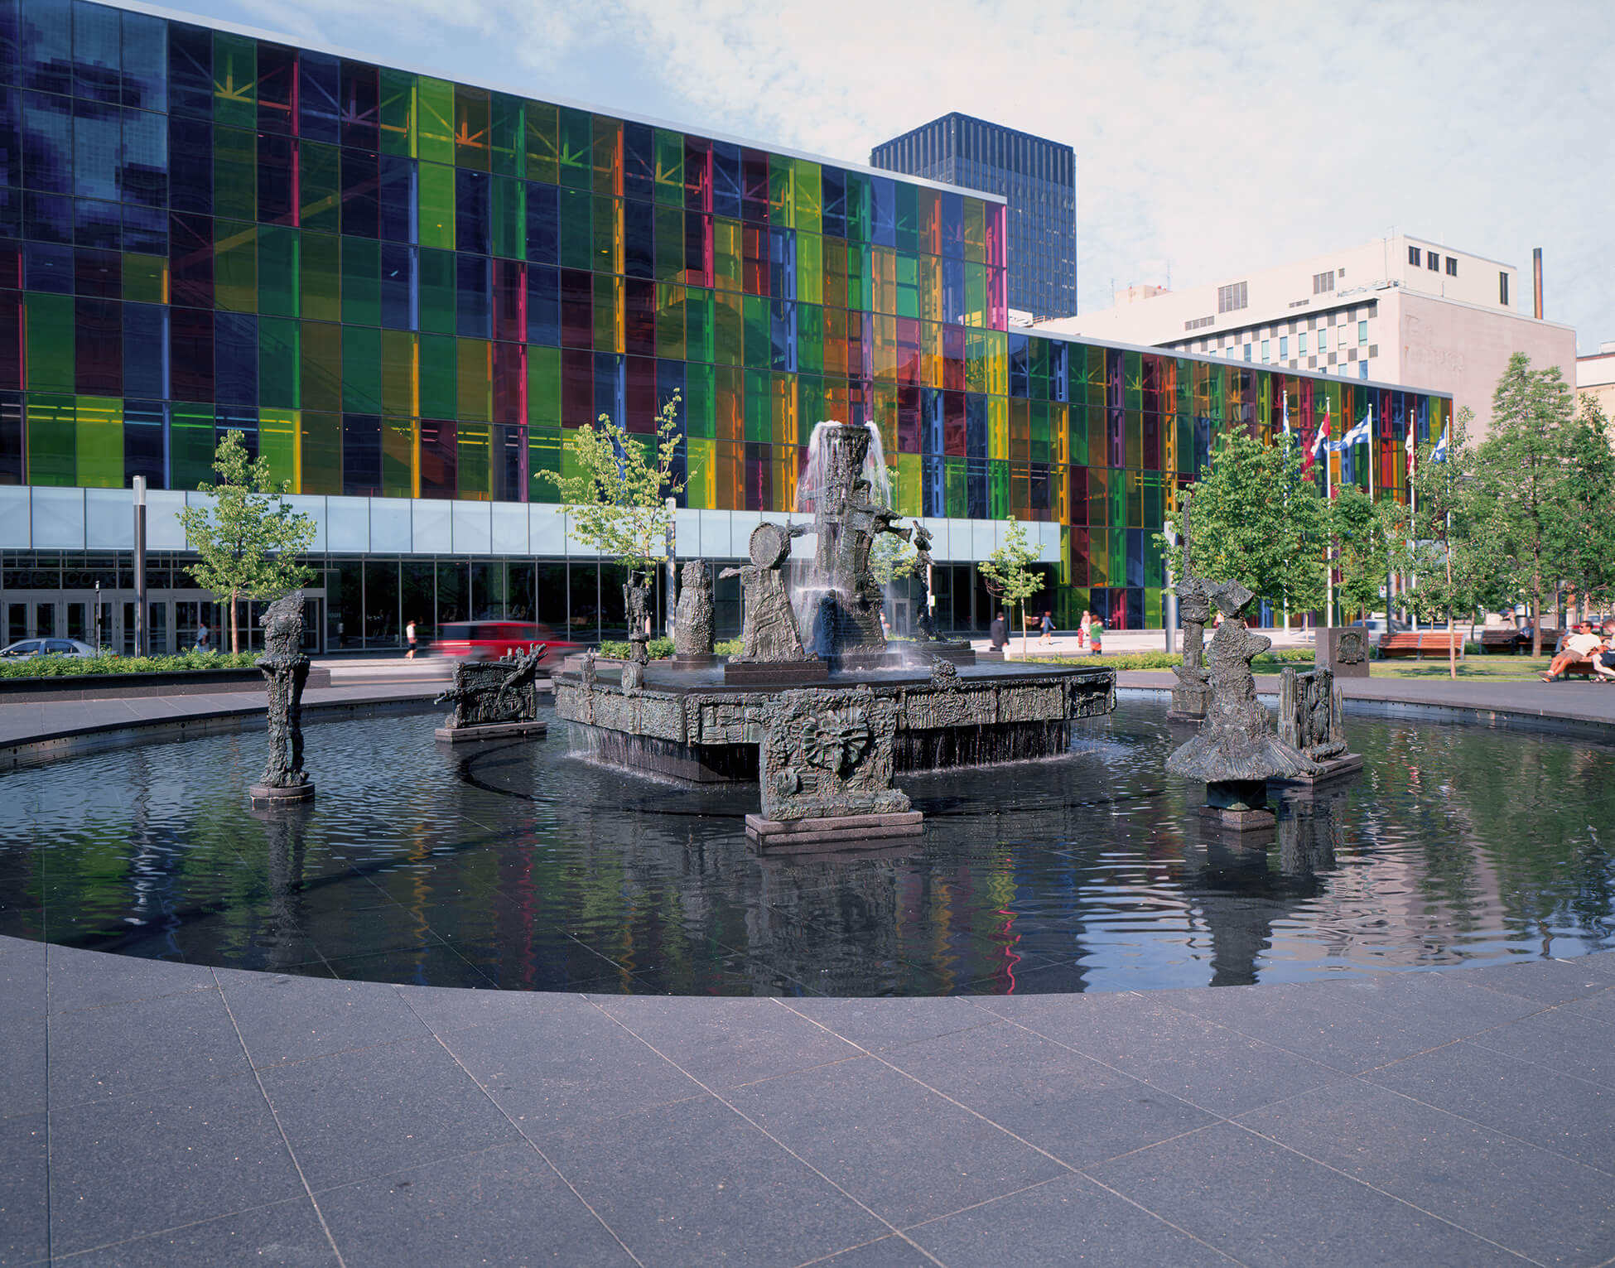
Jean Paul Riopelle, La Joute (The Joust), 1969–70 (cast in bronze c.1974), bronze, 380 cm high x 1,240 cm in diameter (approximate dimensions). © Jean Paul Riopelle Estate / SOCAN (2022). Musée d’art contemporain de Montréal.

Slide 7
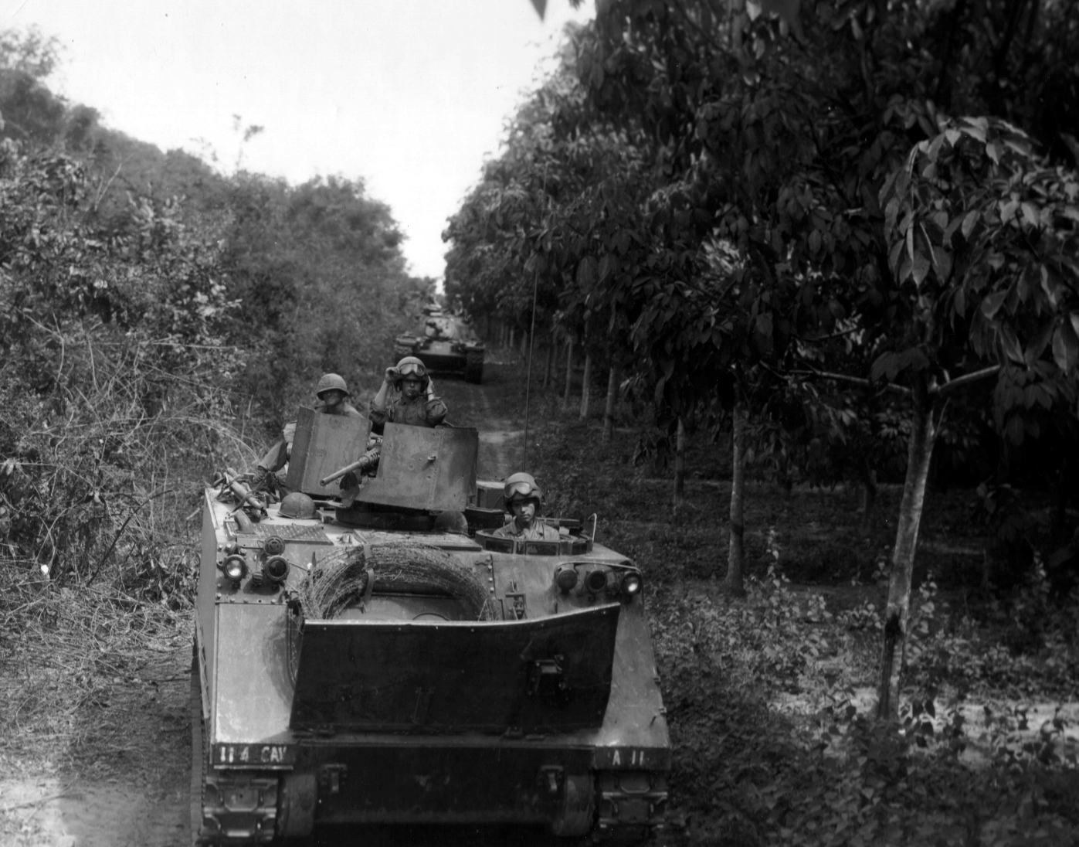
Tanks move through the jungle during the Vietnam War.

Slide 8
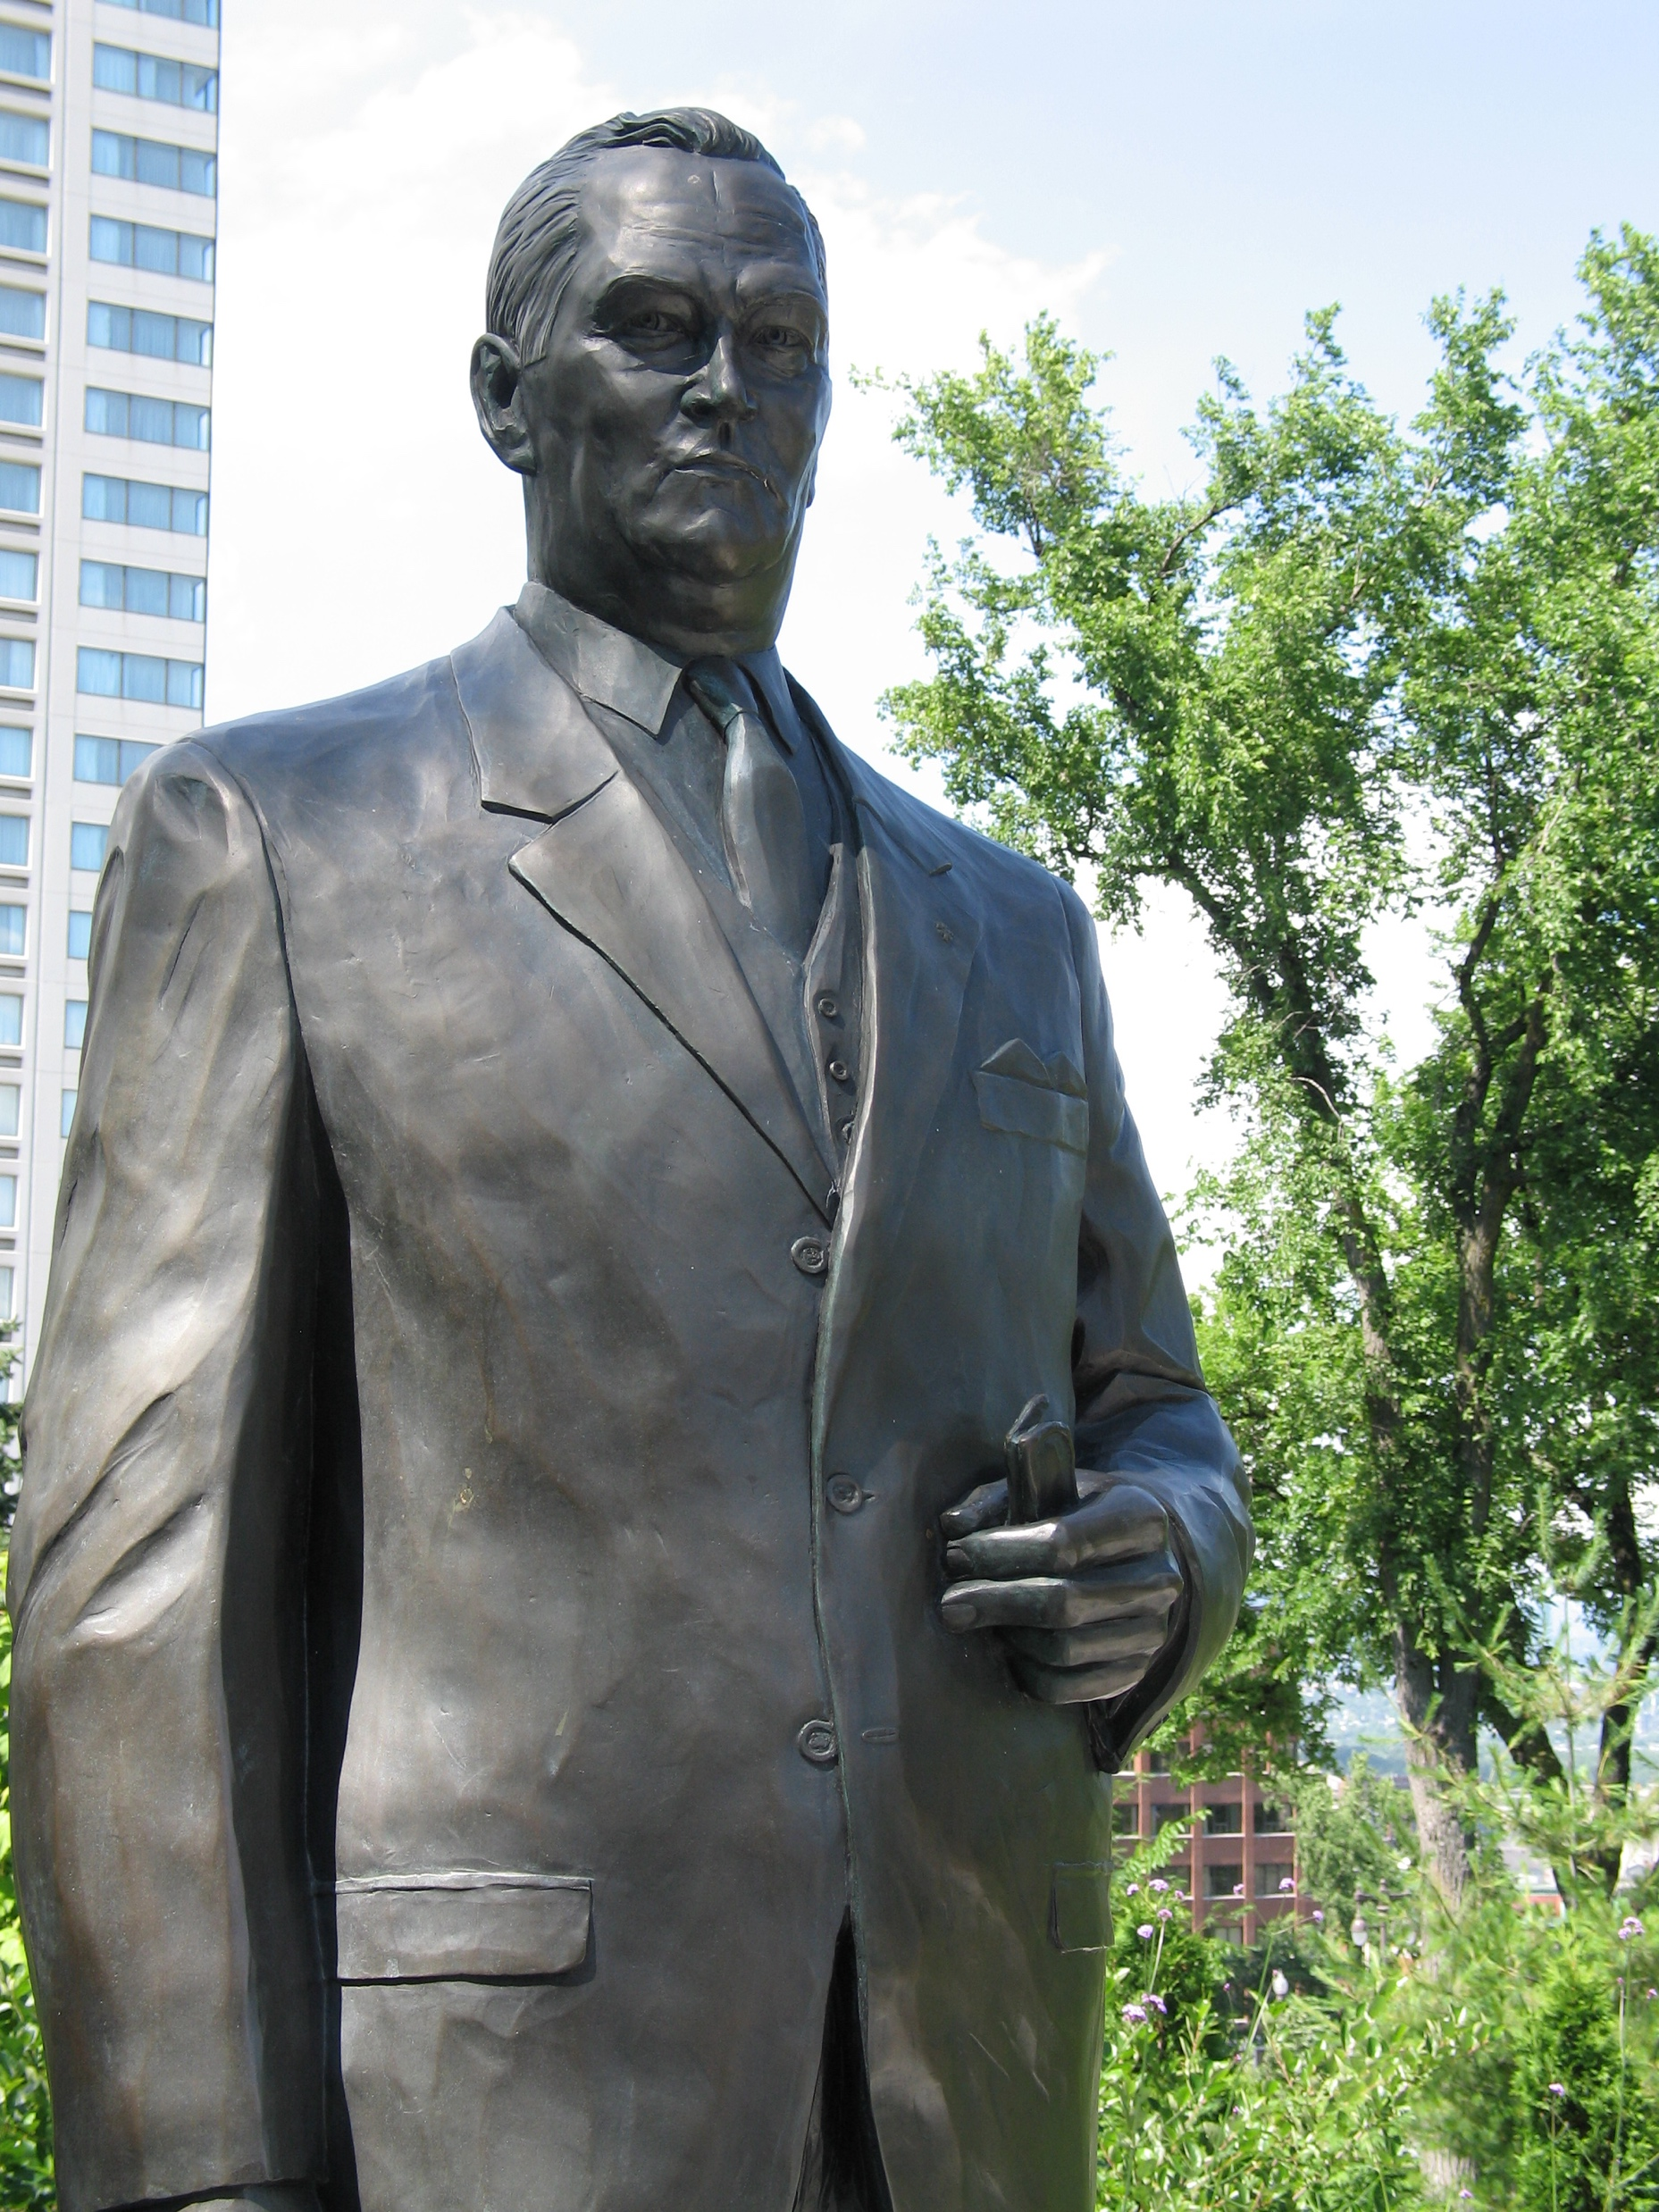
Statue of Jean Lesage in front of the Parliament Building of Quebec, Quebec City.

Slide 9
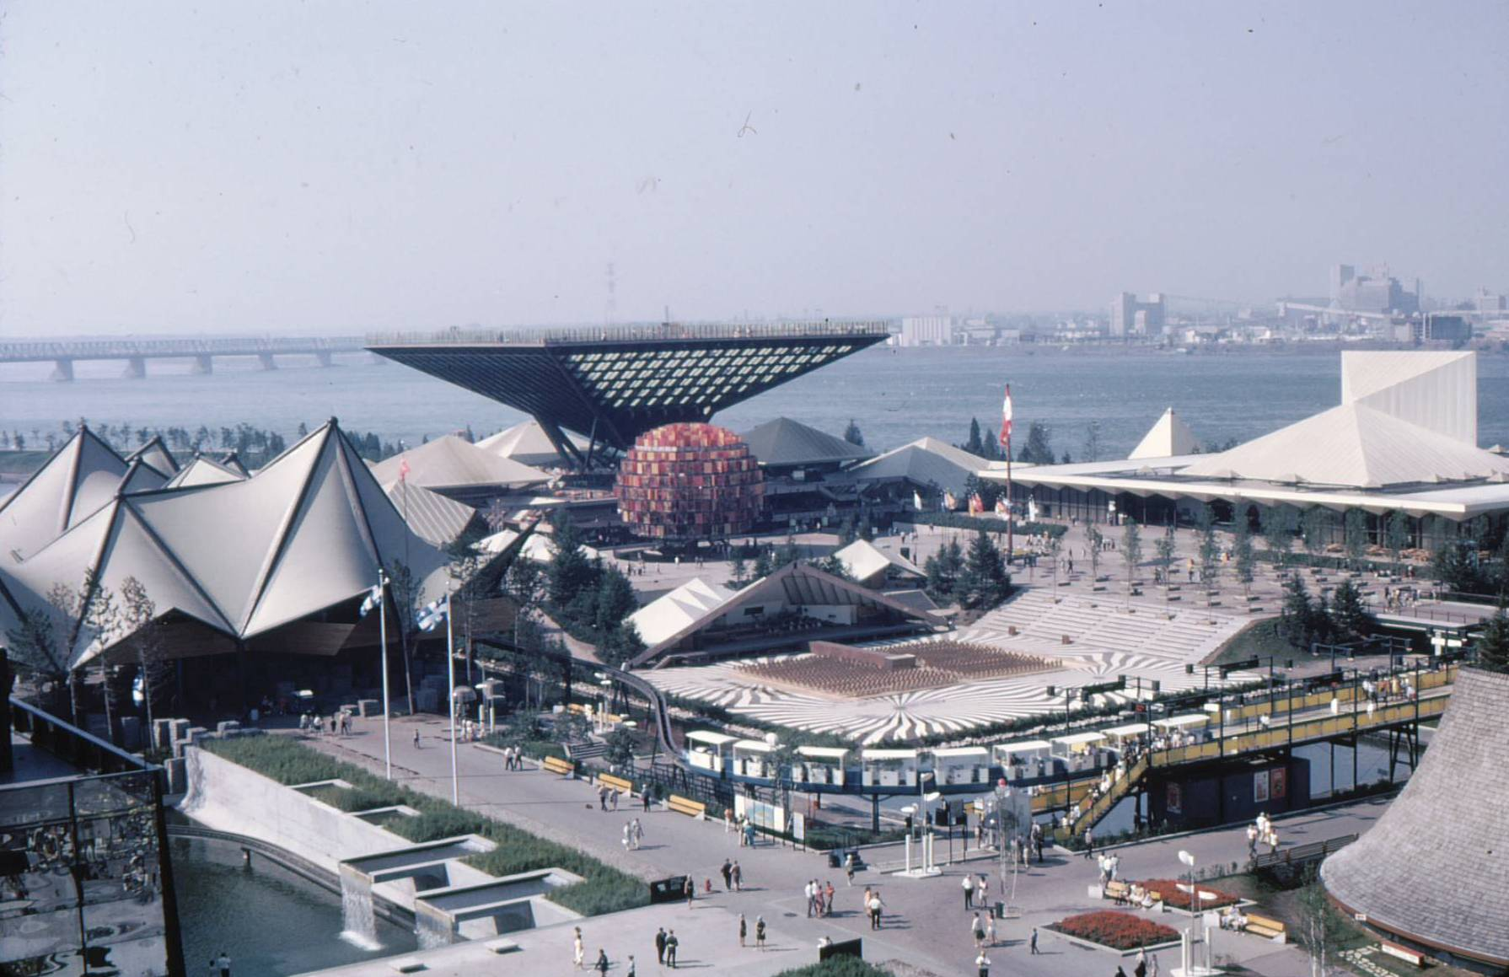
The Canadian Pavilion at Expo 67 in Montreal, 1967.

Slide 10
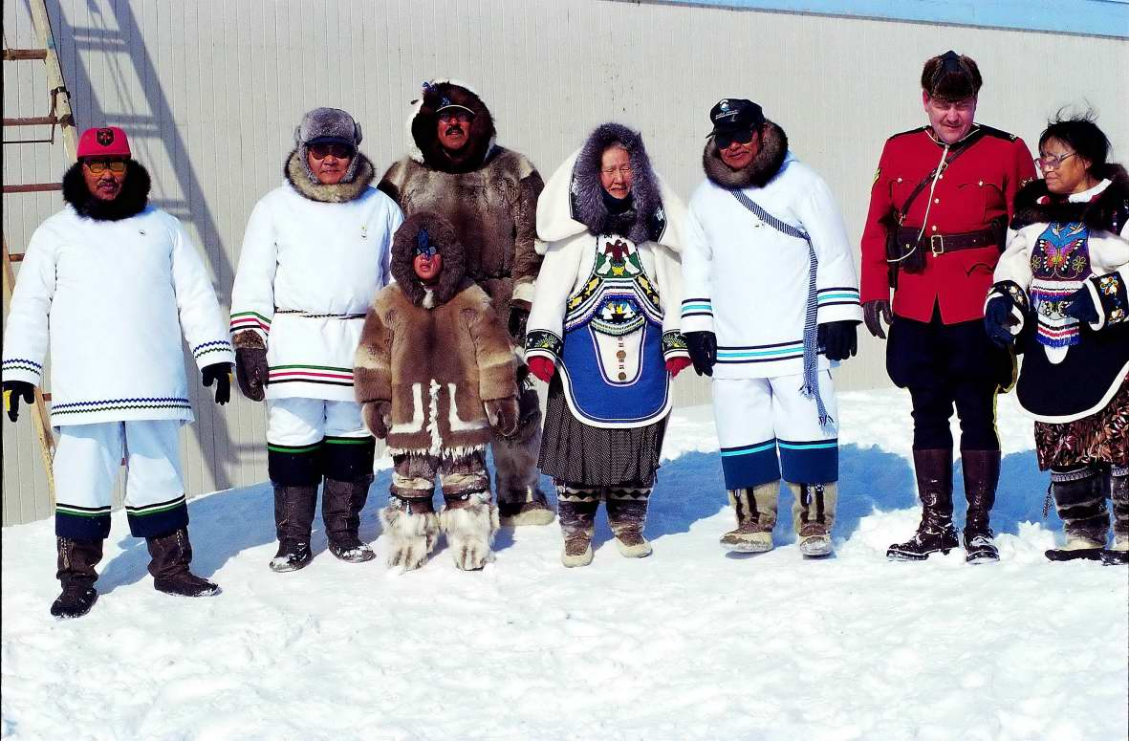
Ceremony on the occasion of the foundation of Nunavut, April 1st, 1999.

Slide 11
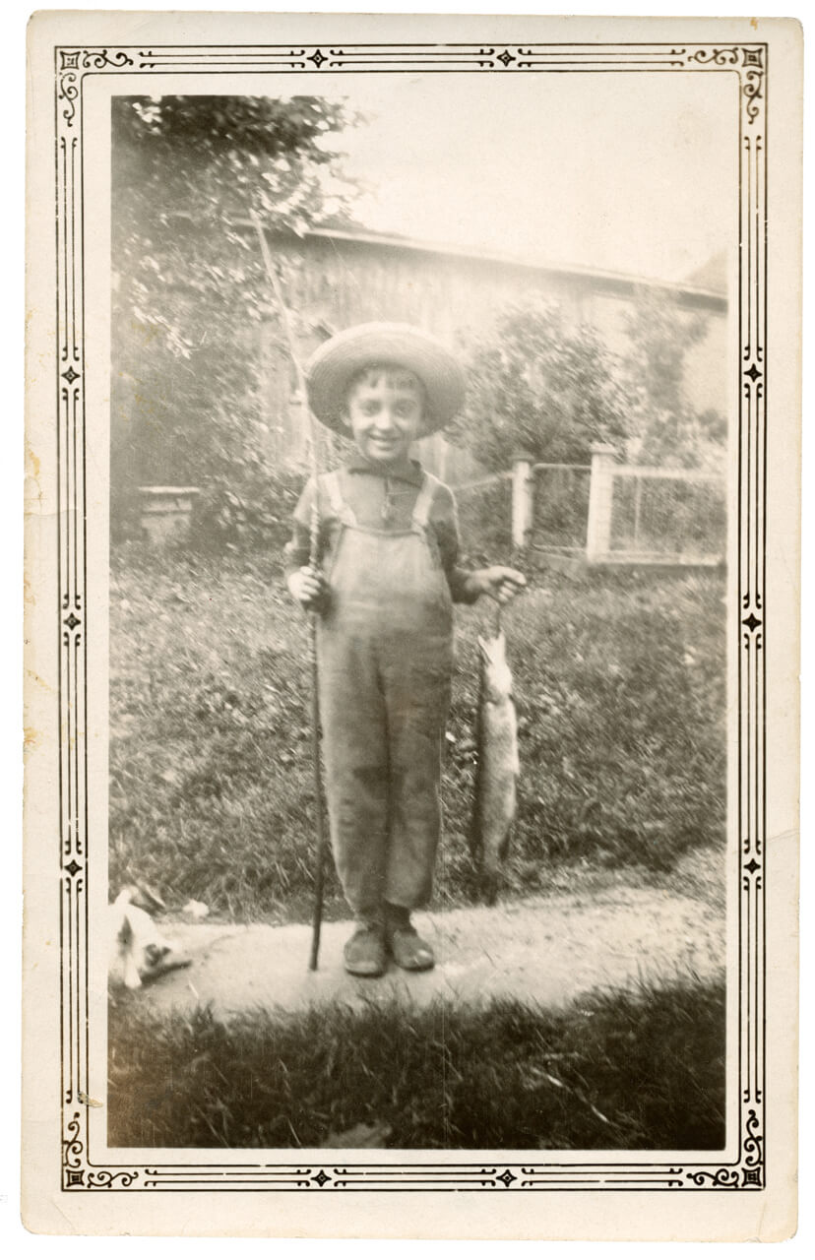
Jean Paul Riopelle, c.1928, photographer unknown. Archives of the Catalogue raisonné of Jean Paul Riopelle. This photograph of Riopelle, then about five years old, shows his early love of fishing.

Slide 12
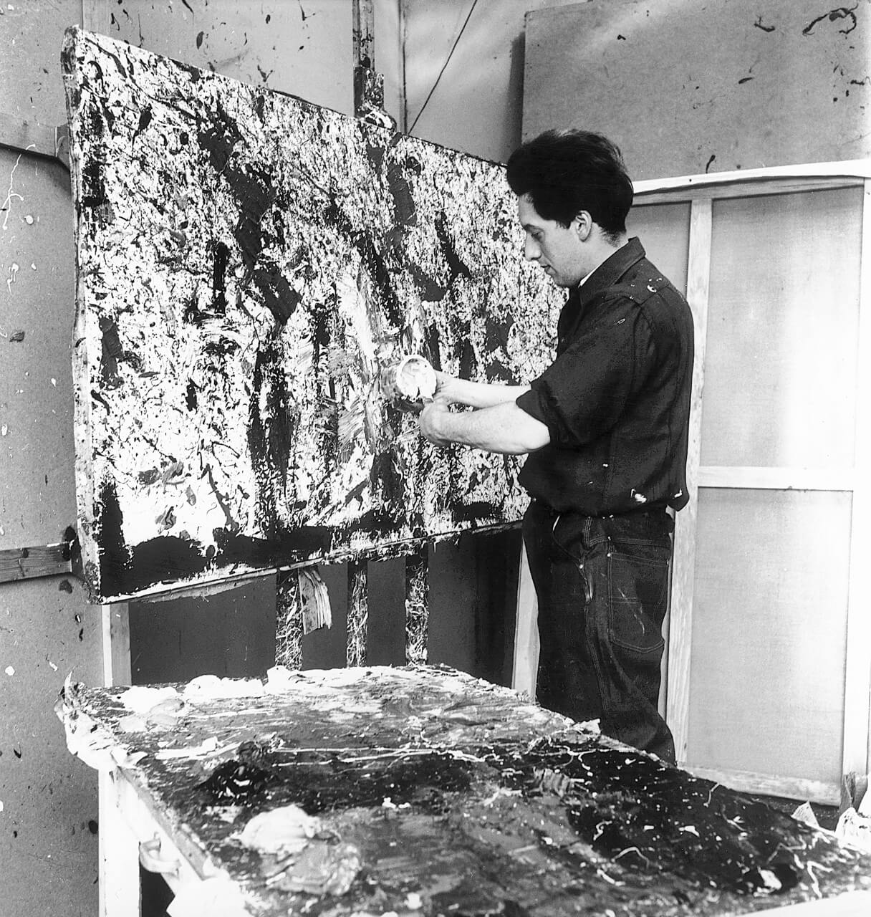
Jean Paul Riopelle in his studio on rue Durantin, Paris, in 1952. © Jean Paul Riopelle Estate / SOCAN (2022). Photograph by John Craven. Archives of the Catalogue raisonné of Jean Paul Riopelle.

Slide 13
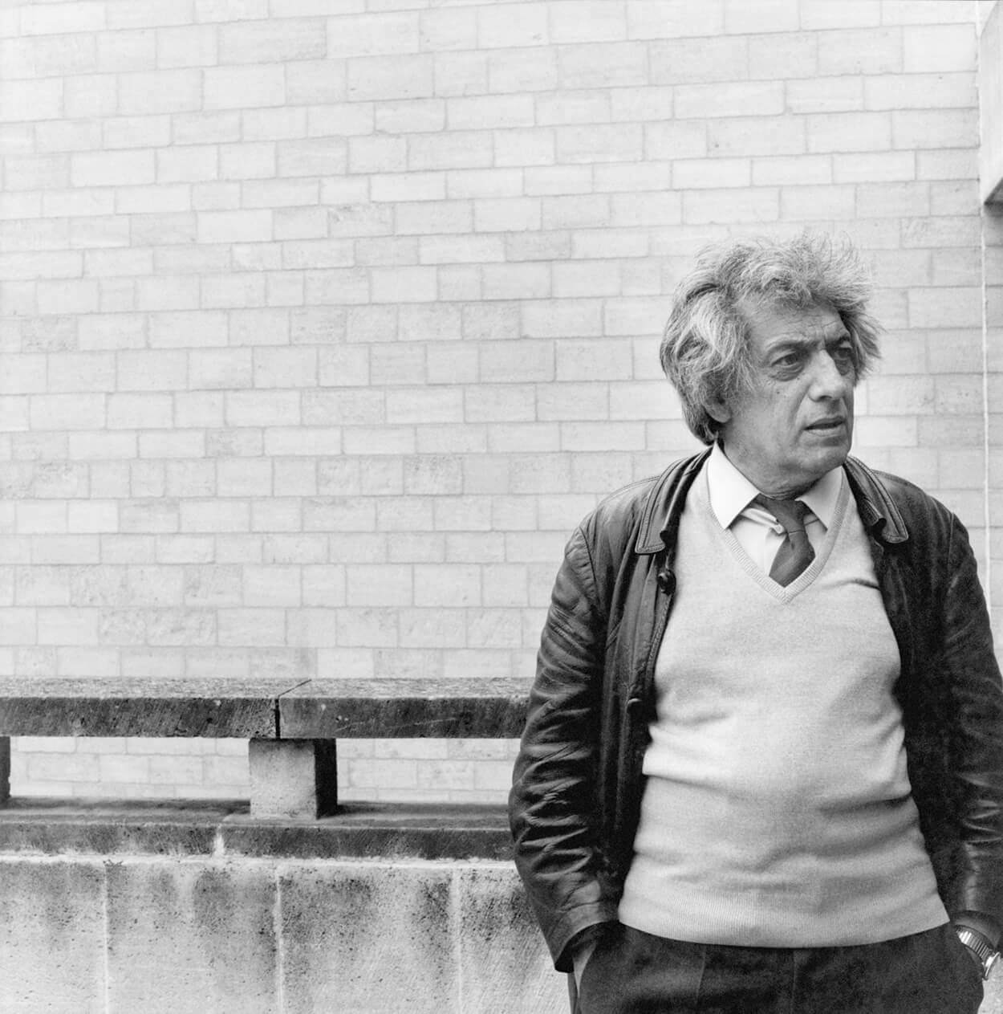
Jean Paul Riopelle on the occasion of the exhibition Riopelle, peintures, estampes (Riopelle, Paintings, Prints) held at the Musée des beaux-arts and at the Hôtel d’Escoville in Caen, Normandy, 1984, photograph by P. Victor. Archives of the Catalogue raisonné of Jean Paul Riopelle.

Slide 14
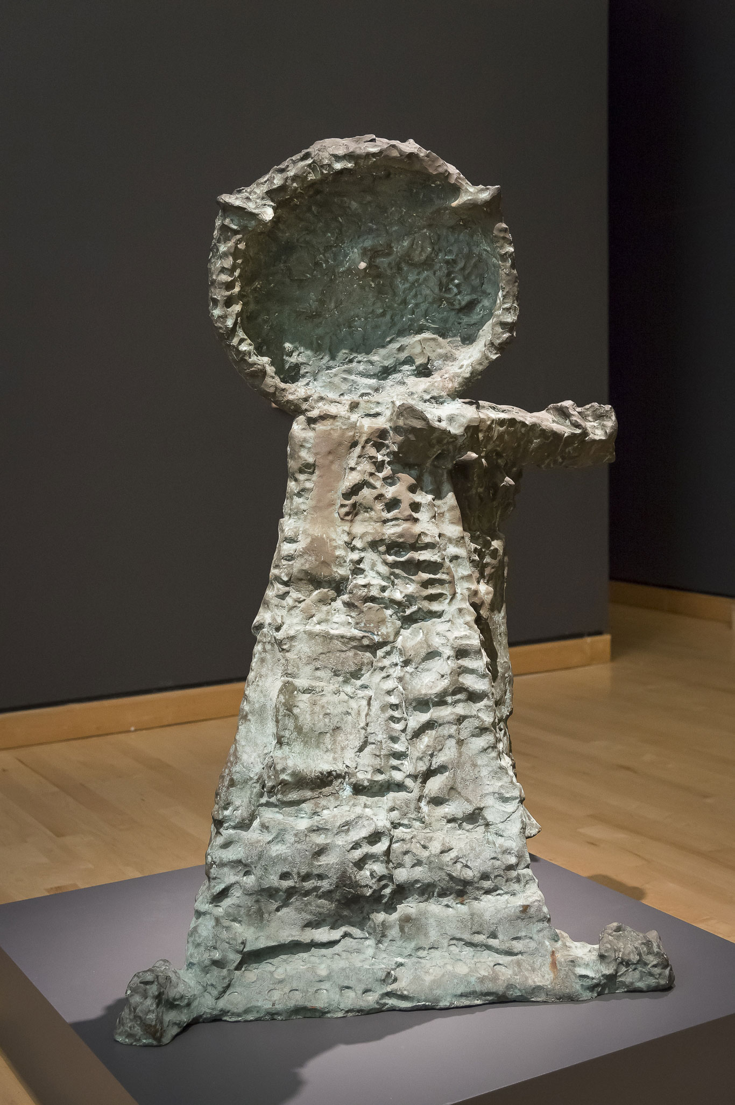
Learning Activity #1
Jean Paul Riopelle, Hibou A (Owl A), 1969–70, (cast c.1974), bronze, 1/4, 143 x 93 x 74 cm. © Jean Paul Riopelle Estate / SOCAN (2022). Musée des beaux-arts du Québec, Quebec City.

Slide 15
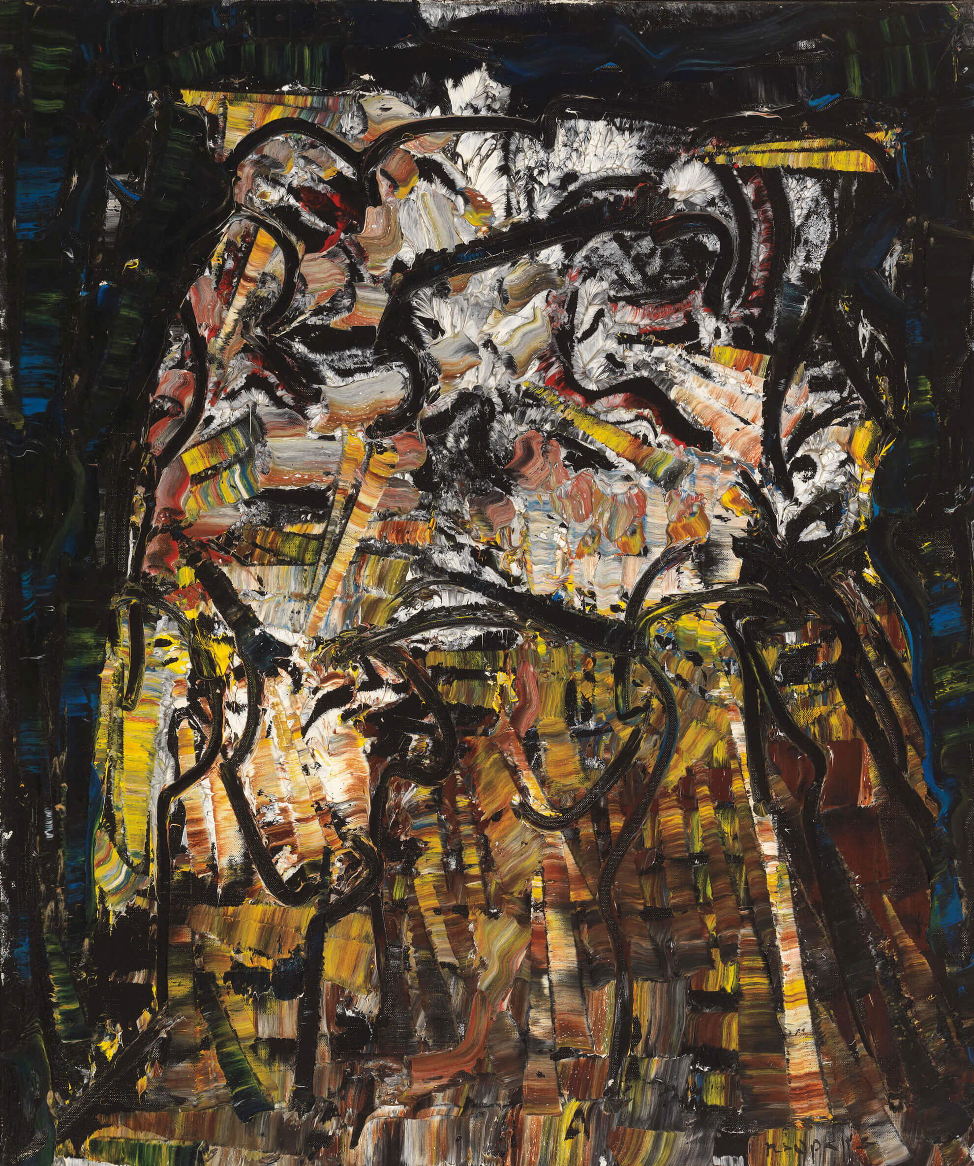
Learning Activity #1
Jean Paul Riopelle, Hibou–Jet Black (Owl–Jet Black), 1970, oil on canvas, 72.4 x 59.7 cm. © Jean Paul Riopelle Estate / SOCAN (2022). Private collection.

Slide 16
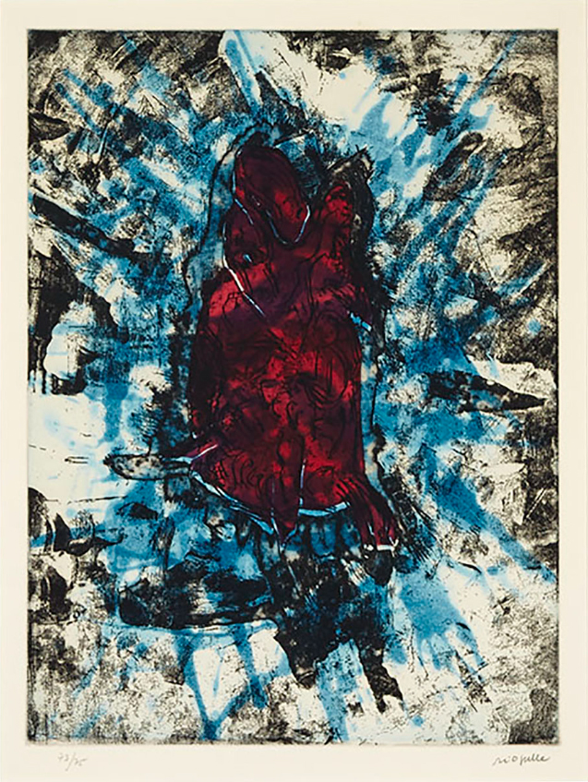
Learning Activity #1
Jean Paul Riopelle, Poisson sur fond bleu (Fish on blue background), 1968, colour etching with aquatint on Mandeure rag paper; signed and numbered 73/75 in pencil to margin, 72.7 x 54.7 cm (sheet). © Jean Paul Riopelle Estate / SOCAN (2022).

Slide 17
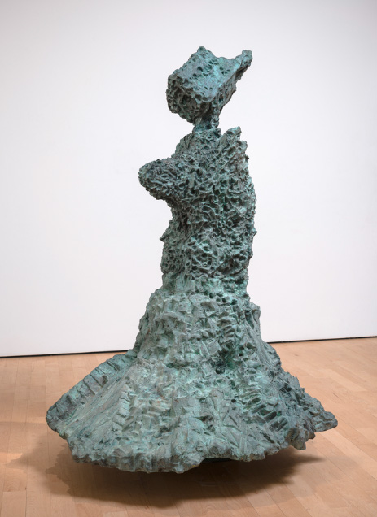
Learning Activity #1
Jean Paul Riopelle, L’Ours (The Bear), 1969–70, bronze, 154 x 122 x 106 cm. © Jean Paul Riopelle Estate / SOCAN (2022). Musée national des beaux-arts du Québec

Slide 18
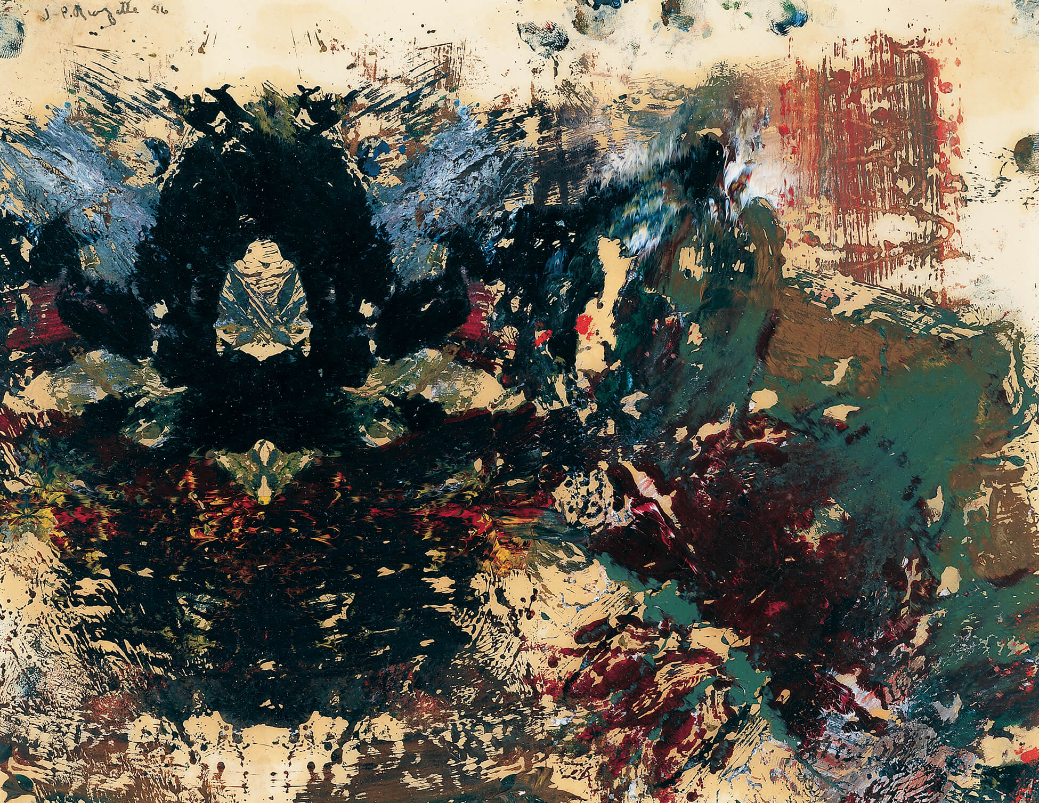
Learning Activity #2
Jean Paul Riopelle, Décalcomanie
nº 1 (Decalcomania No. 1), 1946, oil on paper, 21.5 x 28 cm. © Jean Paul Riopelle Estate / SOCAN (2022). Montreal Museum of Fine Arts.

Slide 19
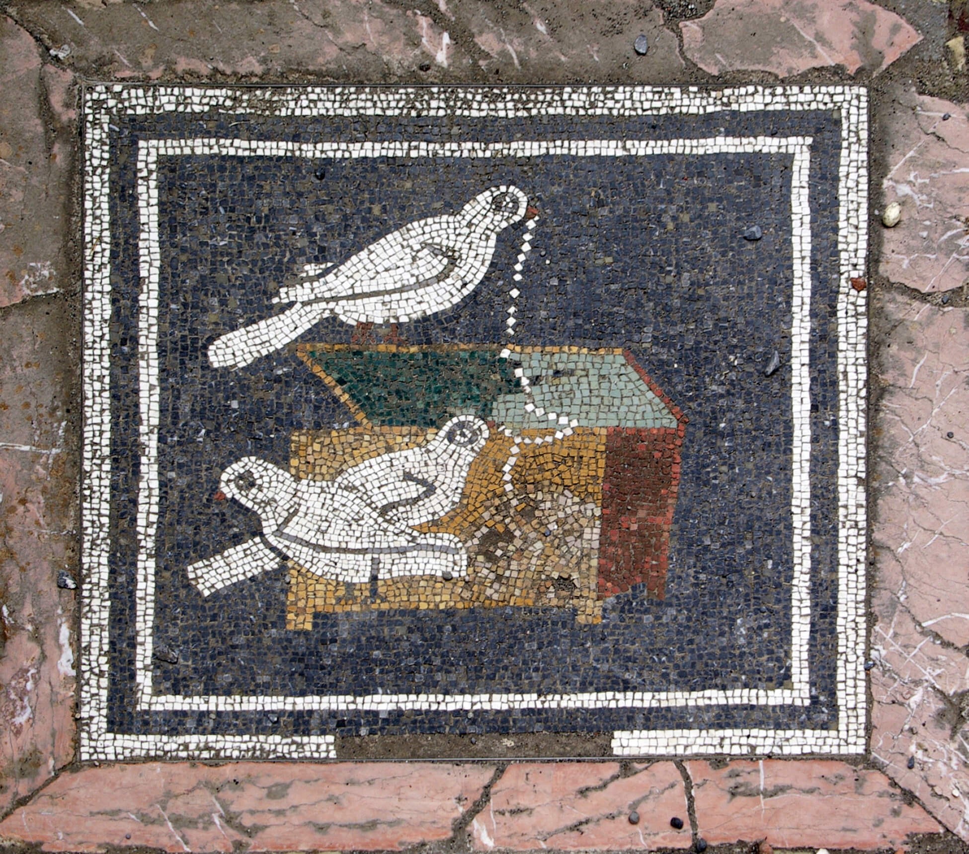
Learning Activity #2
Mosaic with doves at the House of the Faun, Pompeii, second century BCE.

Slide 20
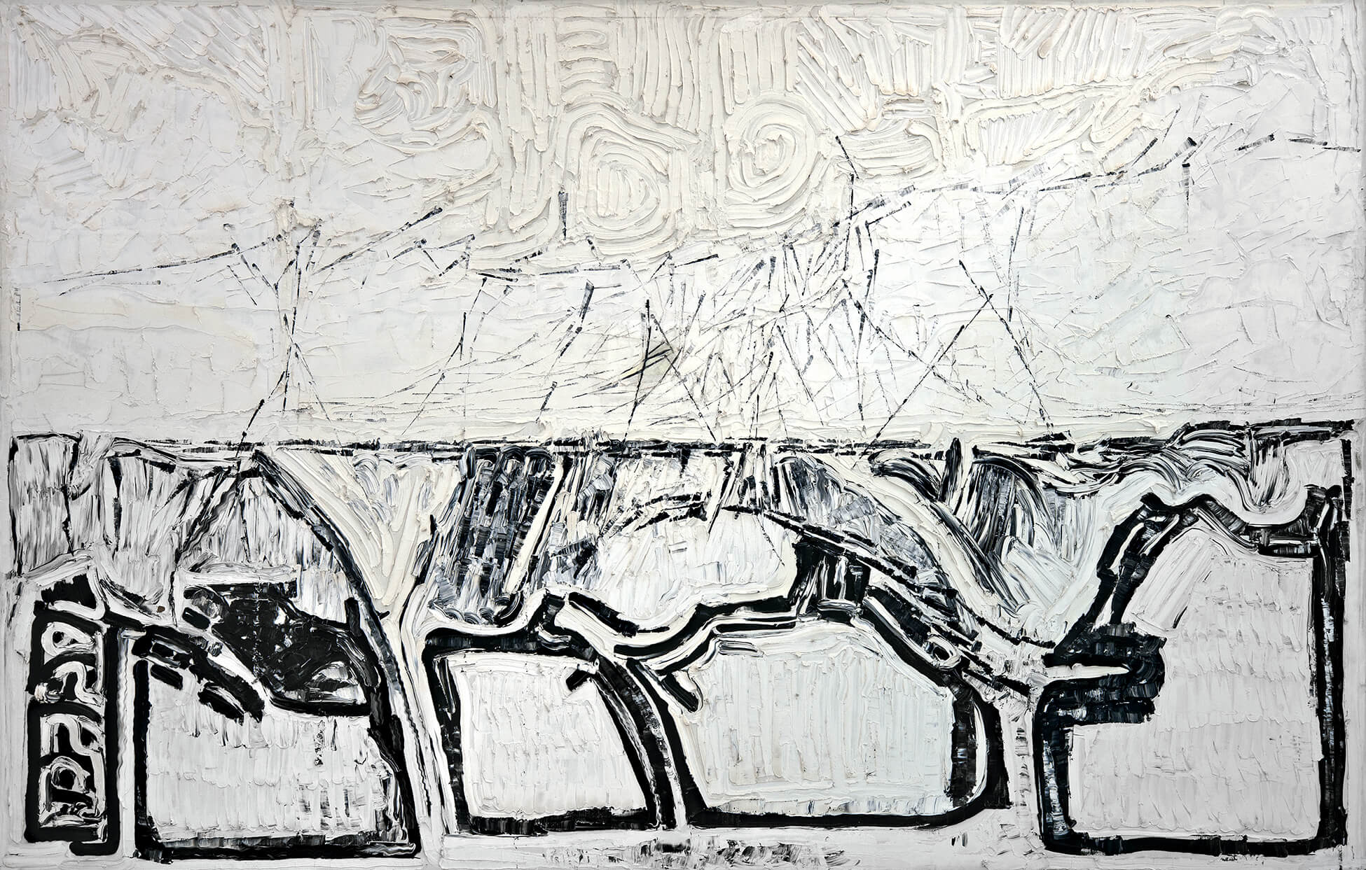
Learning Activity #2
Jean Paul Riopelle, Iceberg nº 1 (Iceberg No. 1), 1977, oil on canvas, 250 x 500 cm.
© Jean Paul Riopelle Estate / SOCAN (2022). Private collection, Montréal.

Slide 21
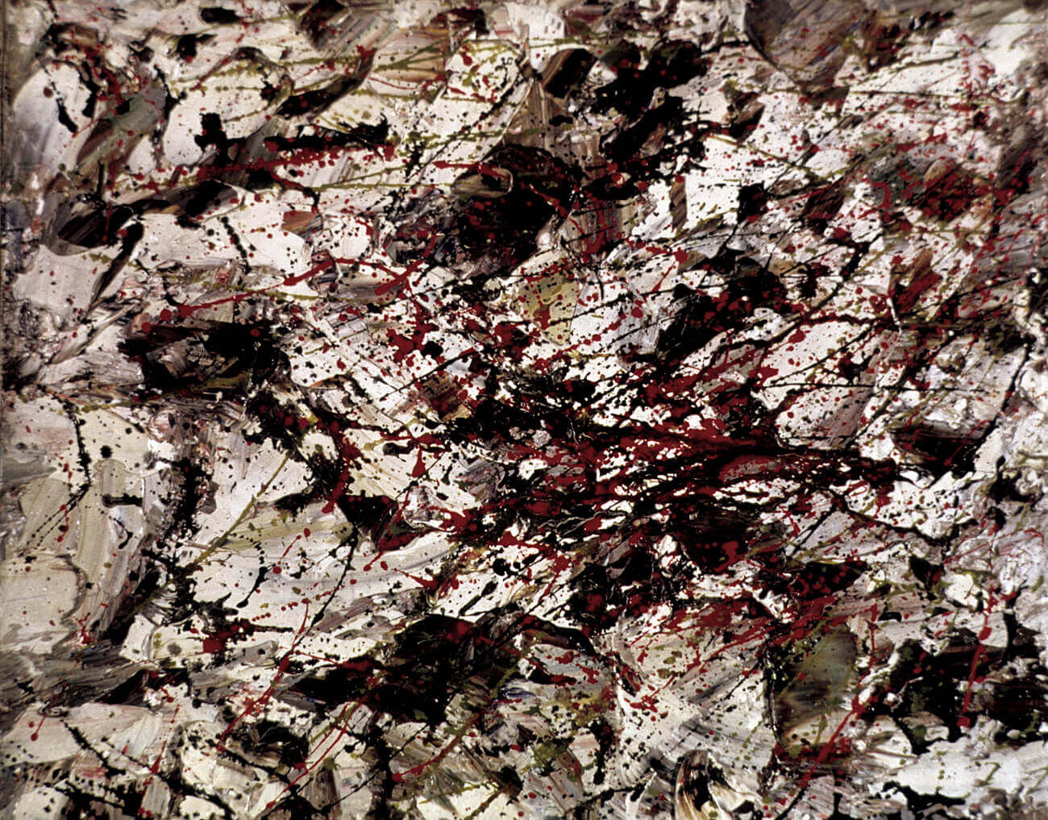
Learning Activity #2
Paul-Émile Borduas, Graffiti, 1954, oil on canvas, 46 x 38 cm, private collection.

Slide 22
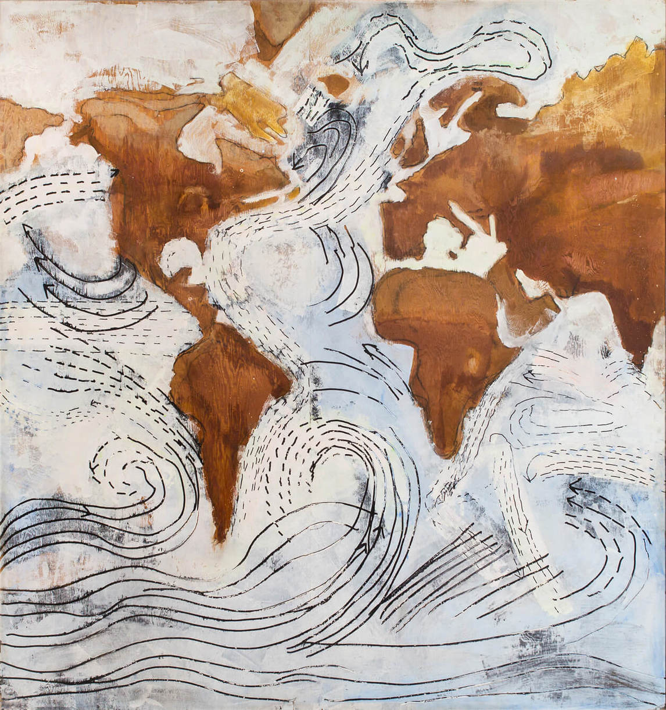
Learning Activity #2
Paterson Ewen, Ocean Currents, 1977, acrylic, pure ochre, and gum arabic on gouged plywood, 243.8 x 228.6 cm, collection of BMO Financial Group.

Slide 23
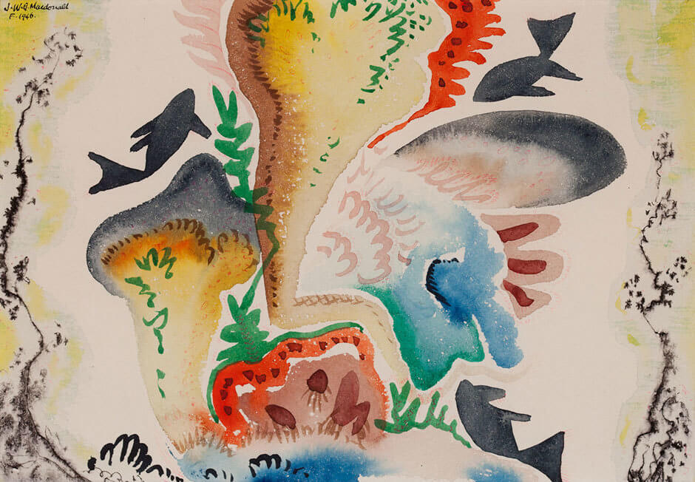
Learning Activity #2
Jock Macdonald, Fish Playground, 1946, watercolour on paper, 32 x 39 cm, Alberta Foundation for the Arts.

Slide 24
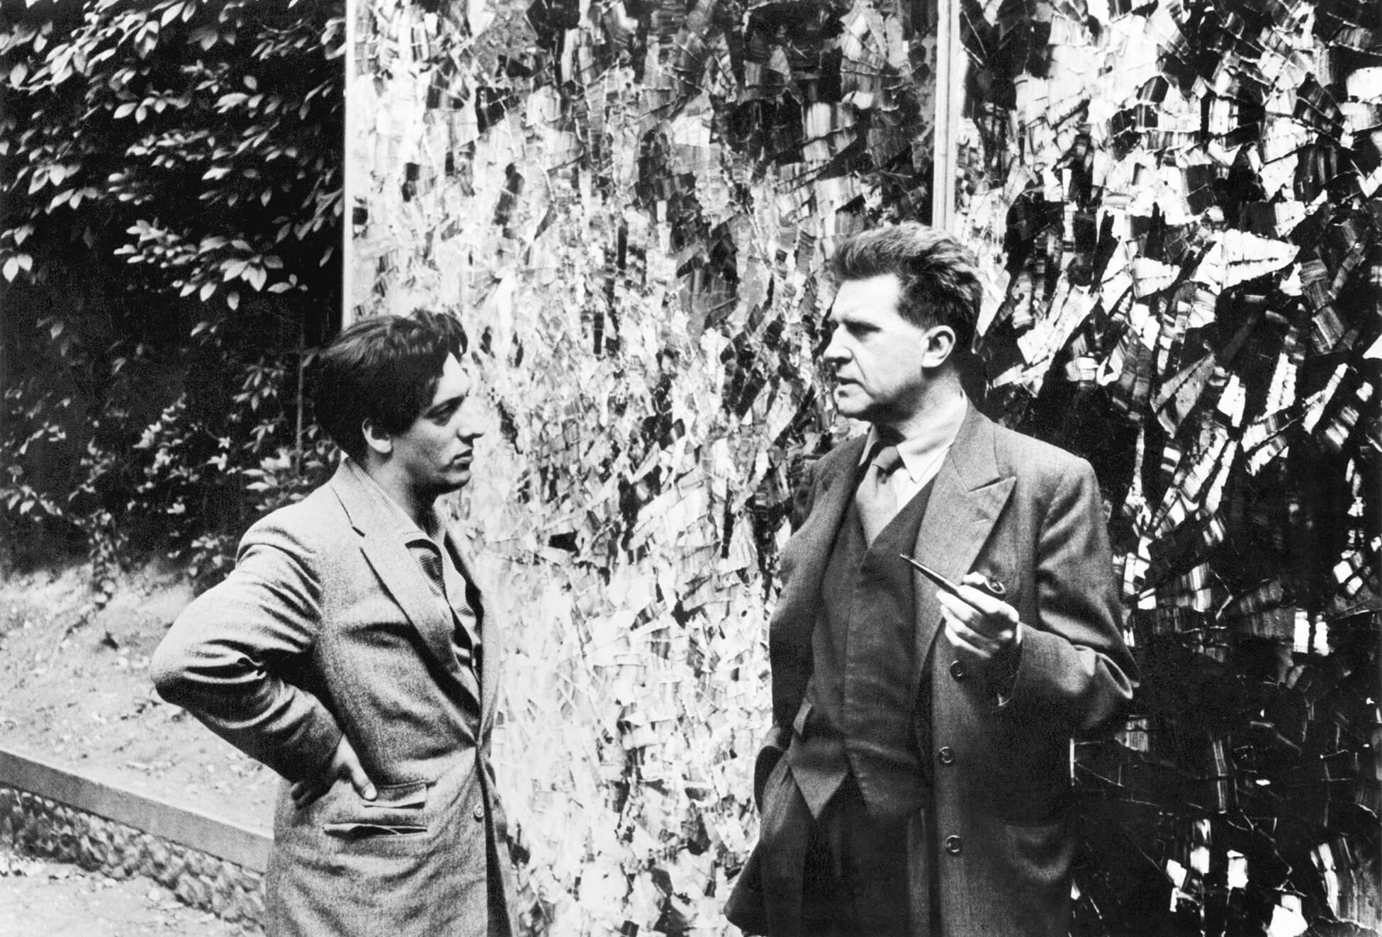
Culminating Task
Jean Paul Riopelle and Georges Duthuit in 1954, in front of Pavane (Hommage aux Nymphéas) (Pavane [Tribute to the Water Lilies]), 1954. © Jean Paul Riopelle Estate / SOCAN (2022). Photographer unknown. Archives of the Catalogue raisonné of Jean Paul Riopelle.

Slide 25
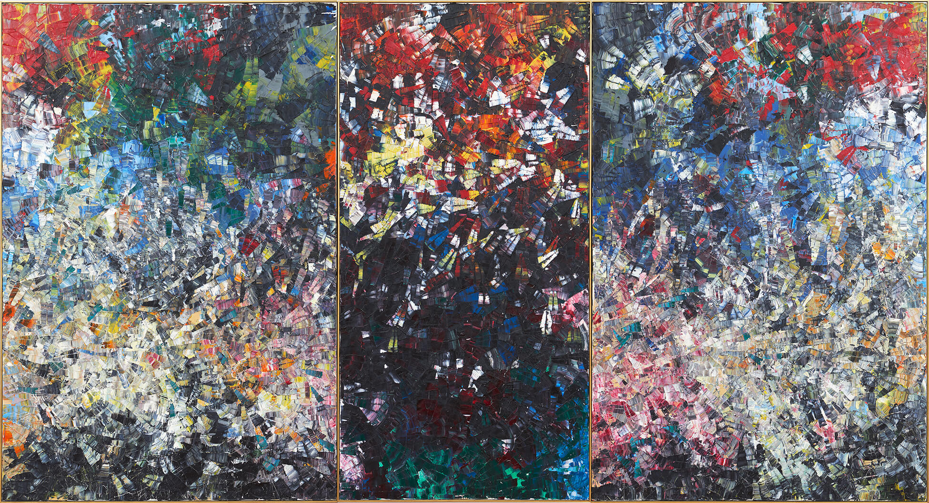
Culminating Task
Jean Paul Riopelle, Pavane (Hommage aux Nymphéas) (Pavane [Tribute to the Water Lilies]), 1954, oil on canvas, 300 x 550.2 cm (triptych). © Jean Paul Riopelle Estate / SOCAN (2022). National Gallery of Canada, Ottawa.

Slide 26
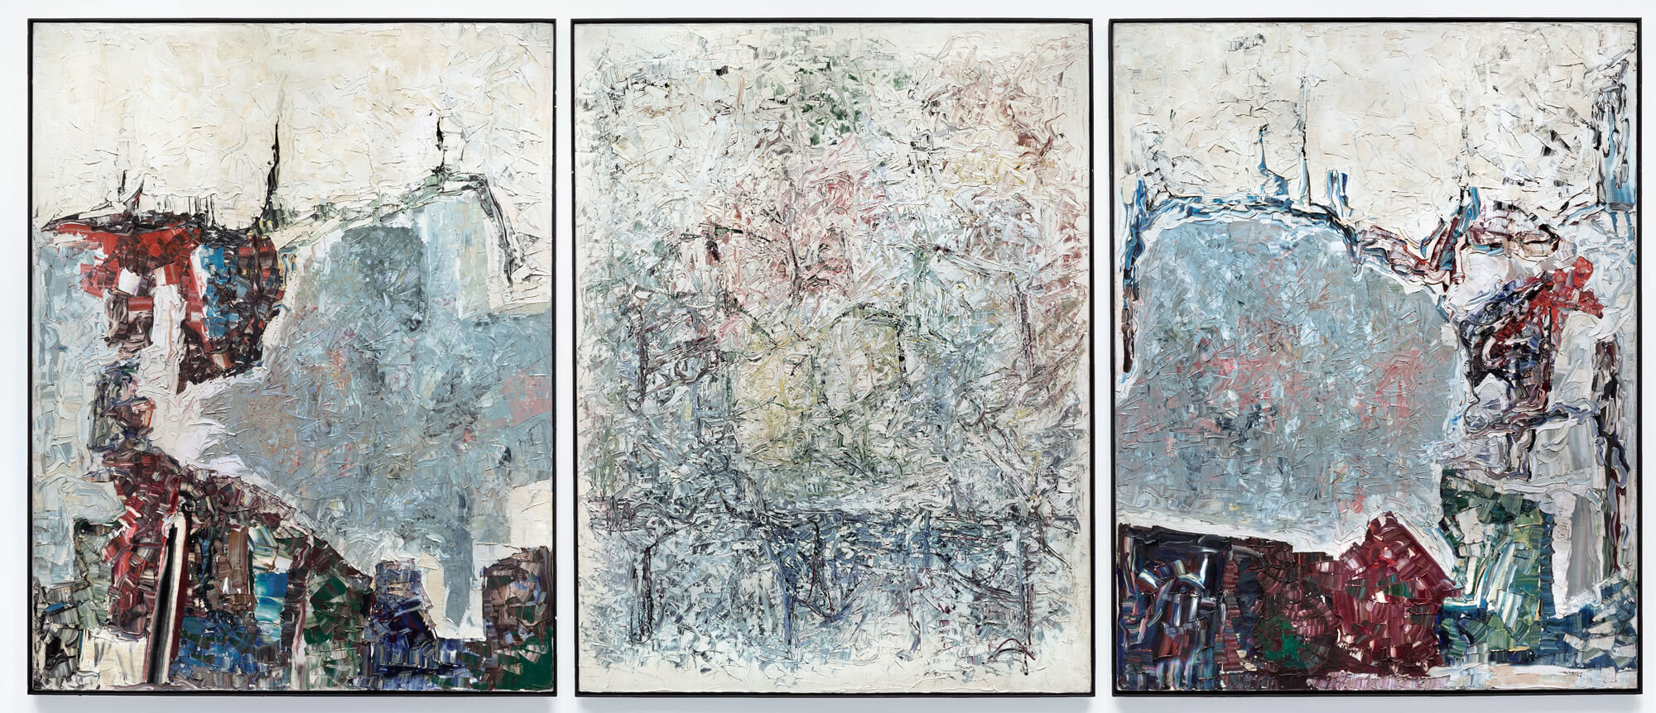
Culminating Task
Jean Paul Riopelle, Sans titre (Untitled), 1964, oil on canvas, 276.4 x 214.5 cm (panel A); 275.5 x 214.7 cm (panel B); 275.5 x 214.5 cm (panel C). © Jean Paul Riopelle Estate / SOCAN (2022). Hirshhorn Museum and Sculpture Garden, Washington, D.C.

Slide 27
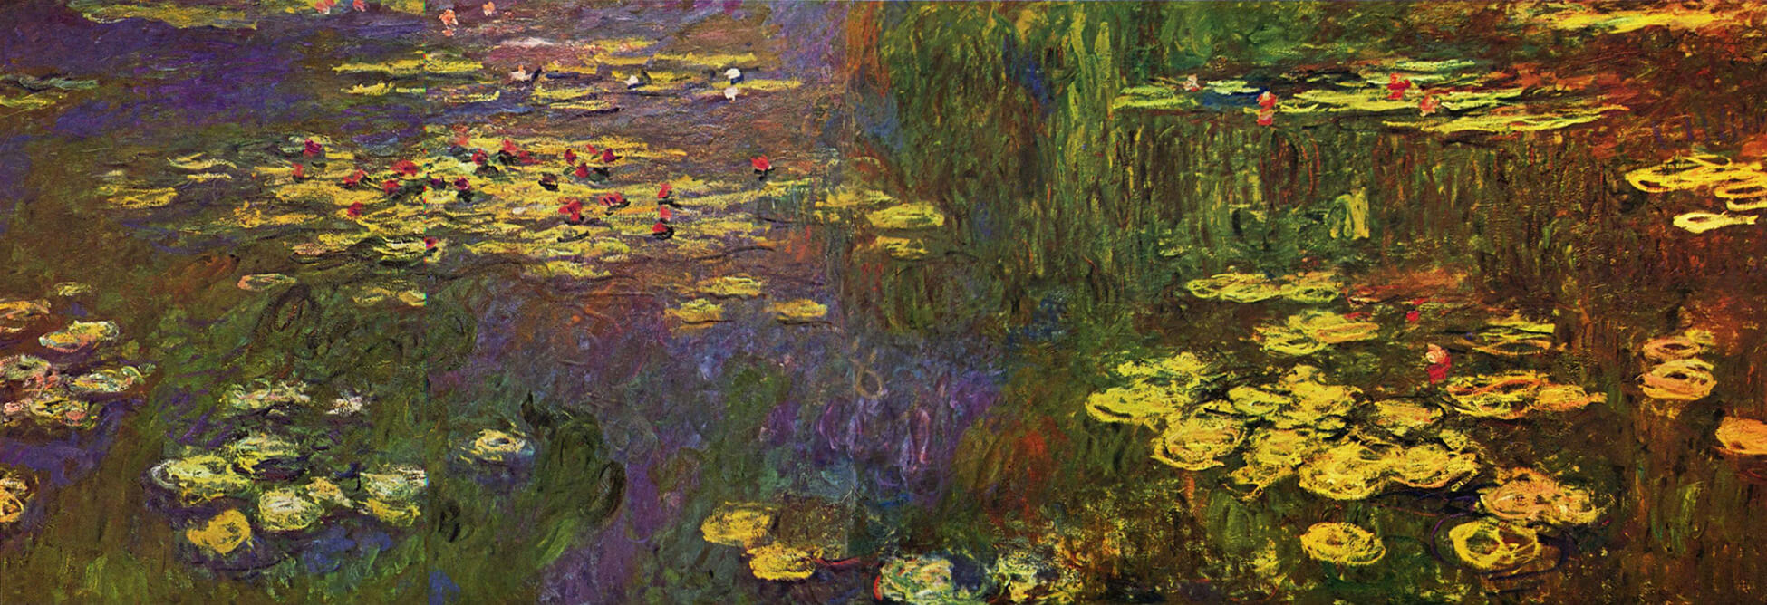
Culminating Task
Claude Monet, Nymphéas (Water Lilies), 1920–26, oil on canvas, 219 x 602 cm, Musée de l’Orangerie, Paris.

Slide 28
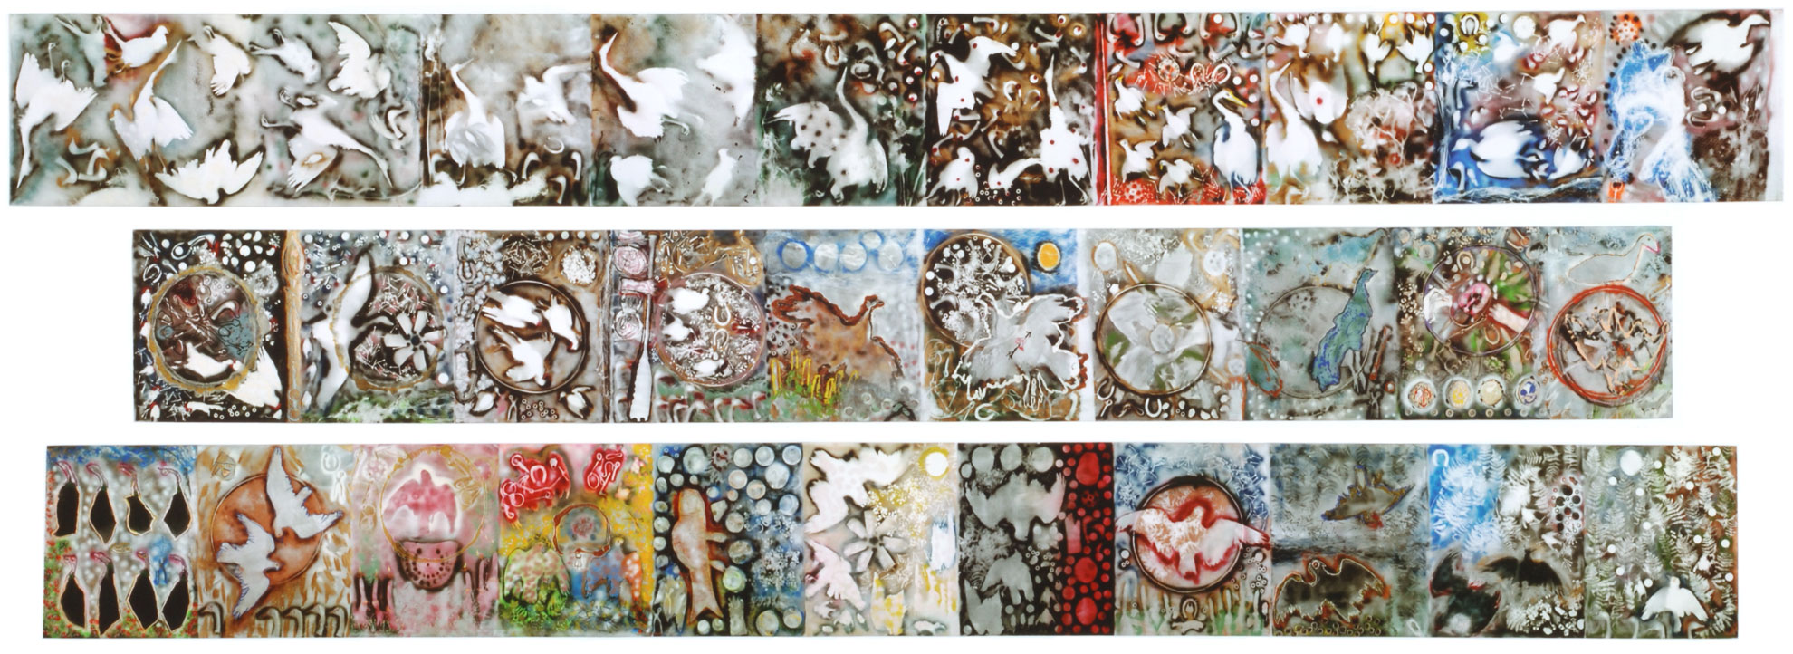
Culminating Task
Jean Paul Riopelle, L’Hommage à Rosa Luxemburg (Tribute to Rosa Luxemburg), 1992, acrylic and spray paint on canvas, 155 x 1,424 cm (1st element); 155 x 1,247 cm (2nd element); 155 x 1,368 cm (3nd element). © Jean Paul Riopelle Estate / SOCAN (2022). Musée national des beaux-arts du Québec, Quebec City.

Slide 29
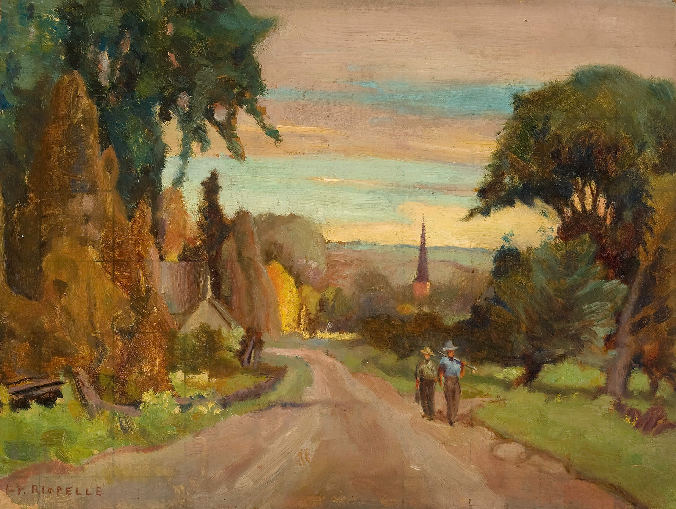
Jean Paul Riopelle, Sans titre (Scène pastorale) (Untitled [Pastoral Scene]), c.1940, oil on cardboard, 23.3 x 30.6 cm. © Jean Paul Riopelle Estate / SOCAN (2022), Montreal Museum of Fine Arts.

Slide 30
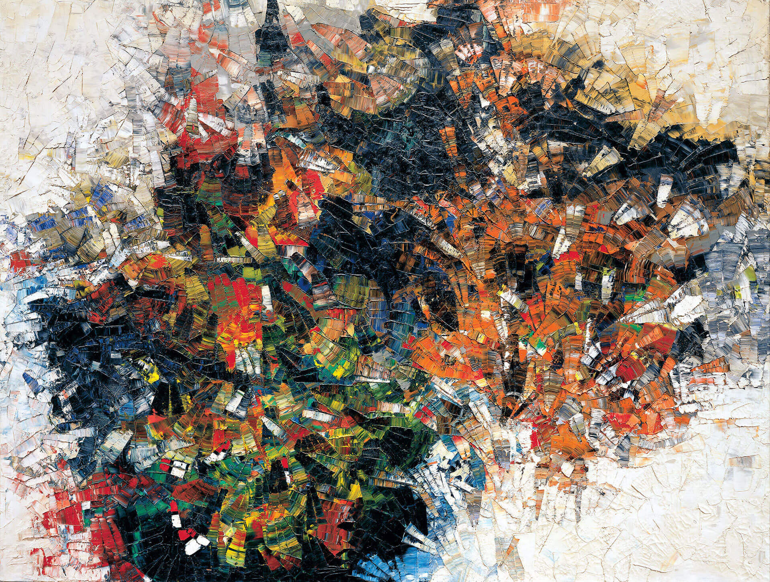
Jean Paul Riopelle, La roue (Cold Dog—Indian Summer) (The Wheel [Cold Dog—Indian Summer]), 1954–55, oil on canvas, 250 x 331 cm.
© Jean Paul Riopelle Estate / SOCAN (2022). Musée des beaux-arts de Montréal.

Slide 31
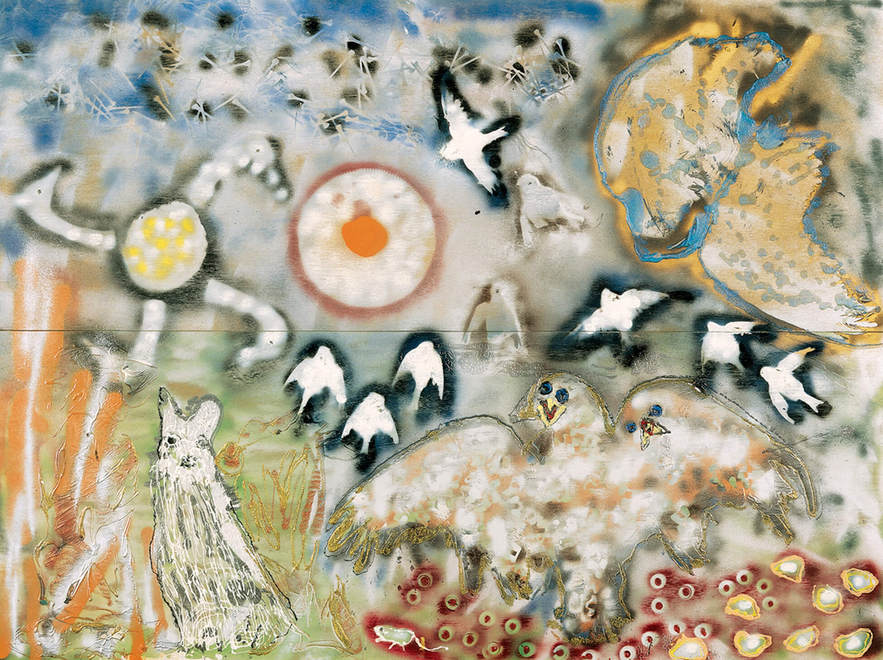
Jean Paul Riopelle, L’Isle heureuse (The Happy Isle), 1992, mixed technique on two wood panels, 154.3 x 203.2 cm. © Jean Paul Riopelle Estate / SOCAN (2022). Private collection.

Slide 32
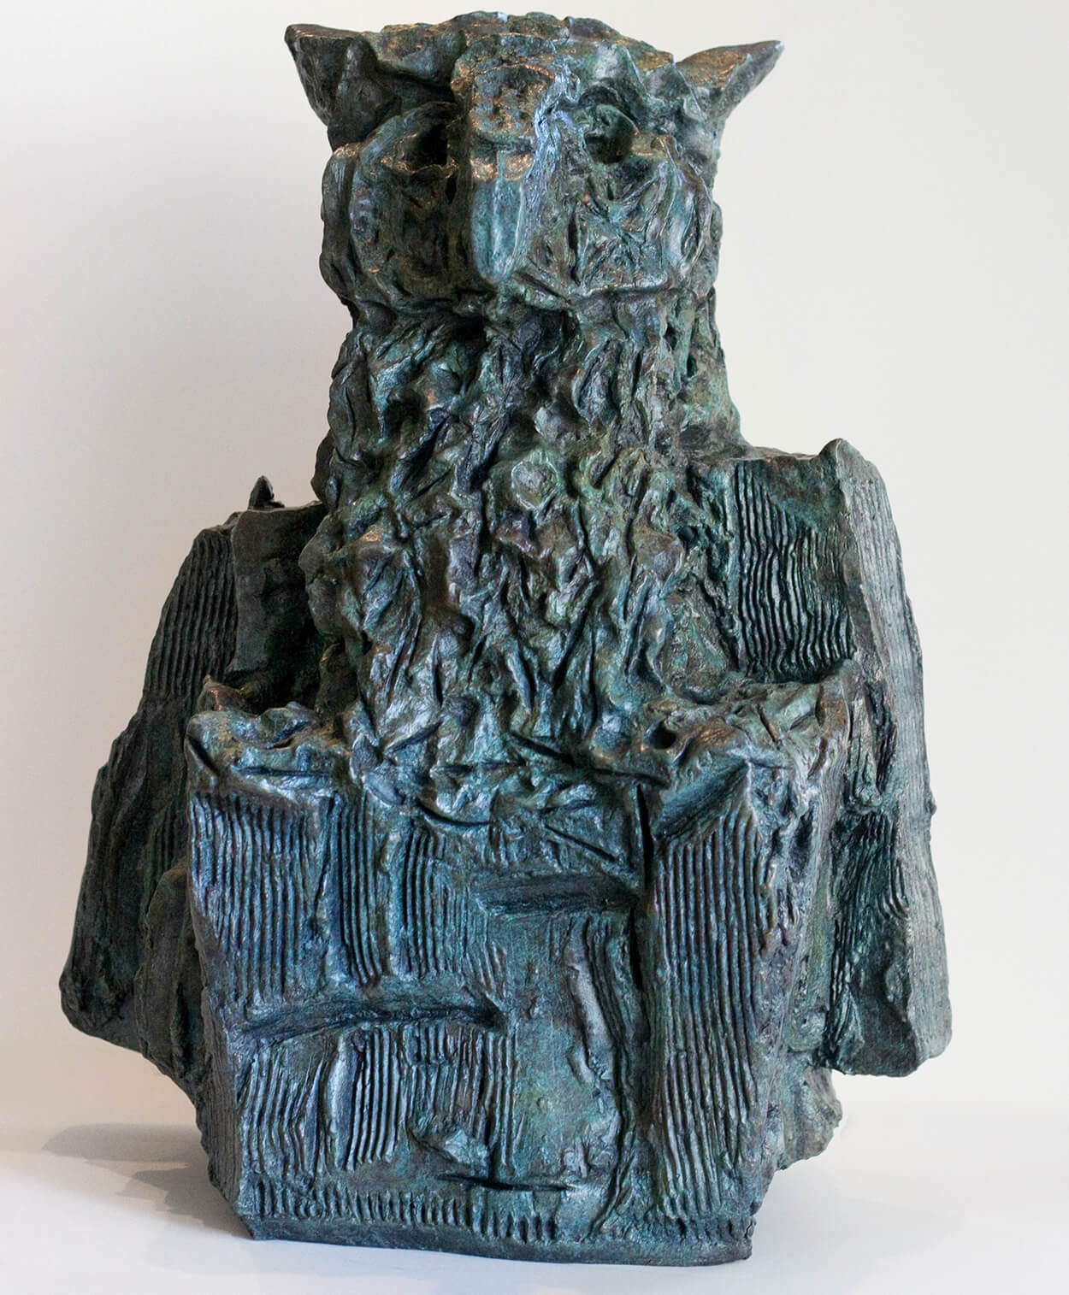
Jean Paul Riopelle, Hibou-Roc (Owl-Rock), 1969–70 (cast in bronze 2010), bronze and leftover wax, 2/8, 54.8 x 44 x 27.3 cm. © Jean Paul Riopelle Estate / SOCAN (2022). Private collection, Winnipeg.

Slide 33
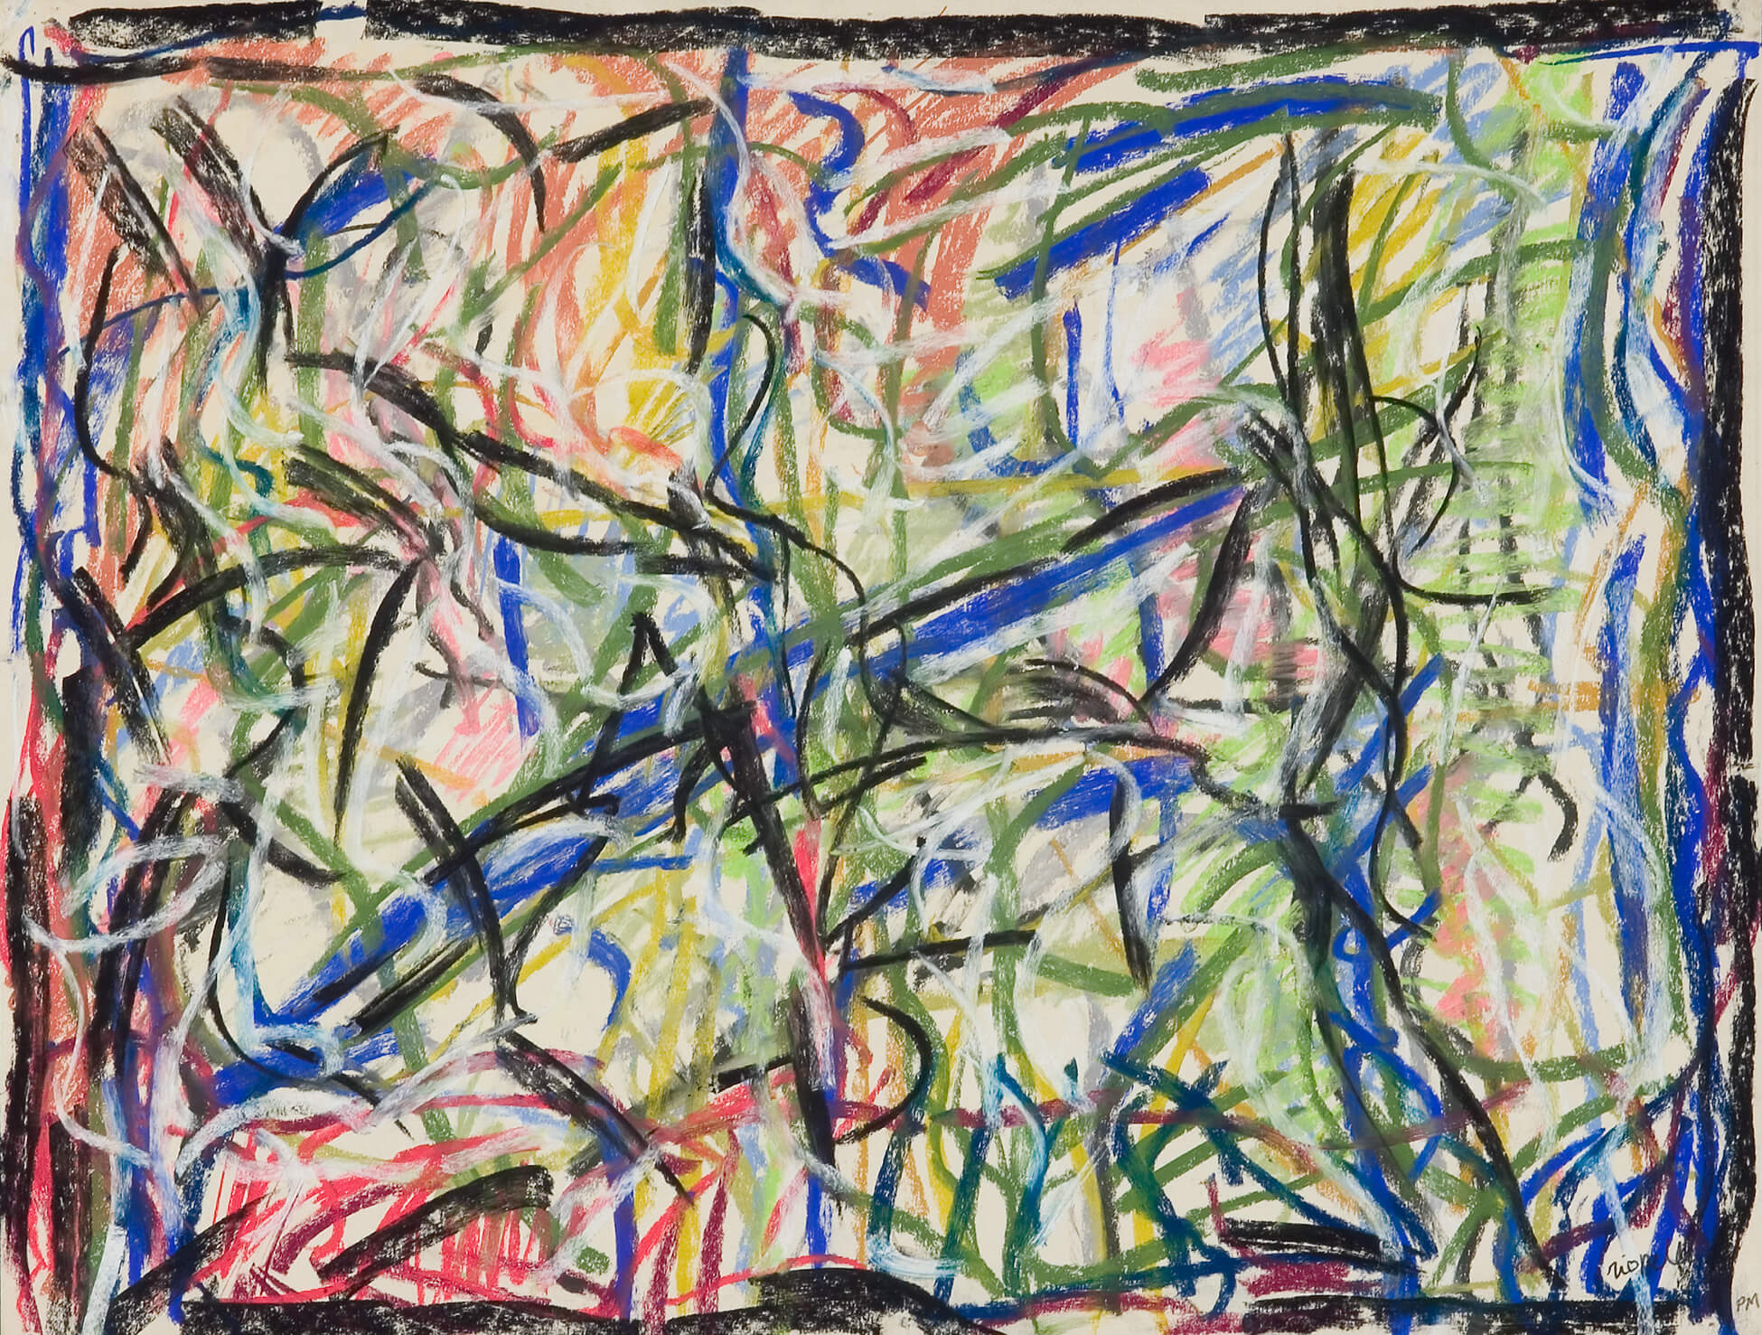
Jean Paul Riopelle, Sans titre (Untitled), 1969, pastel on paper, 50 x 65.5 cm. © Jean Paul Riopelle Estate / SOCAN (2022). Galerie Simon Blais, Montreal.

Slide 34
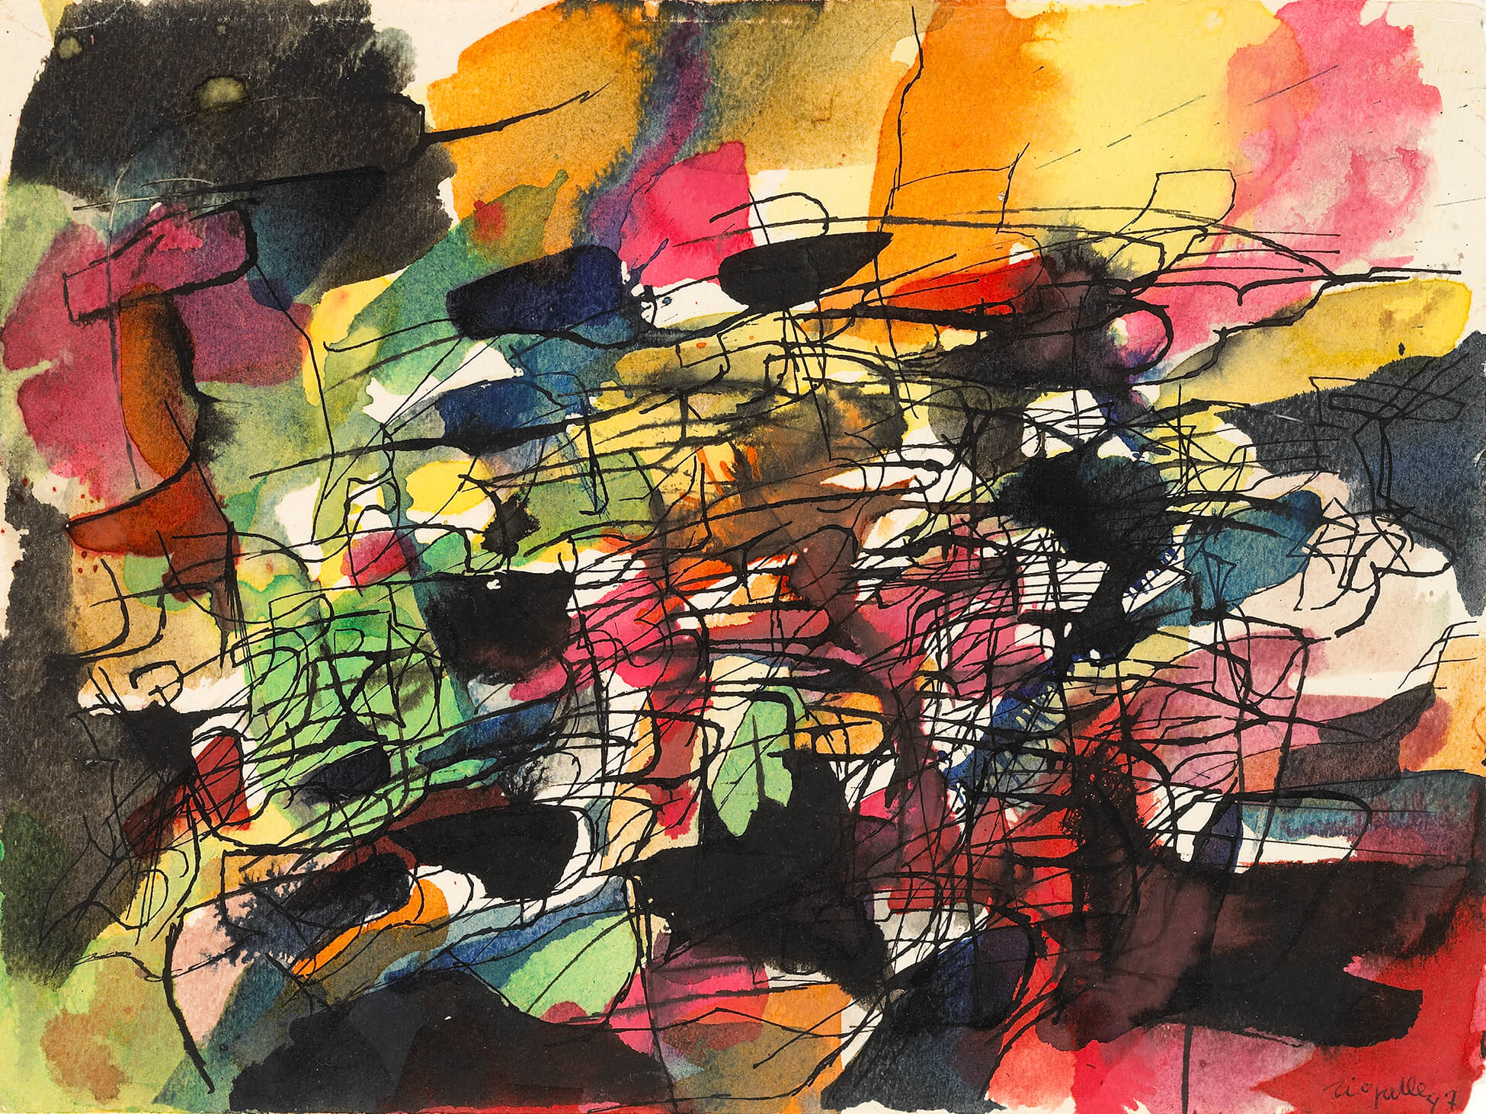
Jean Paul Riopelle, Sans titre (Composition, 1947) (Untitled [Composition, 1947]), 1947, pen and black ink with coloured ink wash on wove paper, 22.8 x 30.5 cm.
© Jean Paul Riopelle Estate / SOCAN (2022). National Gallery of Canada, Ottawa.

