Slide 1
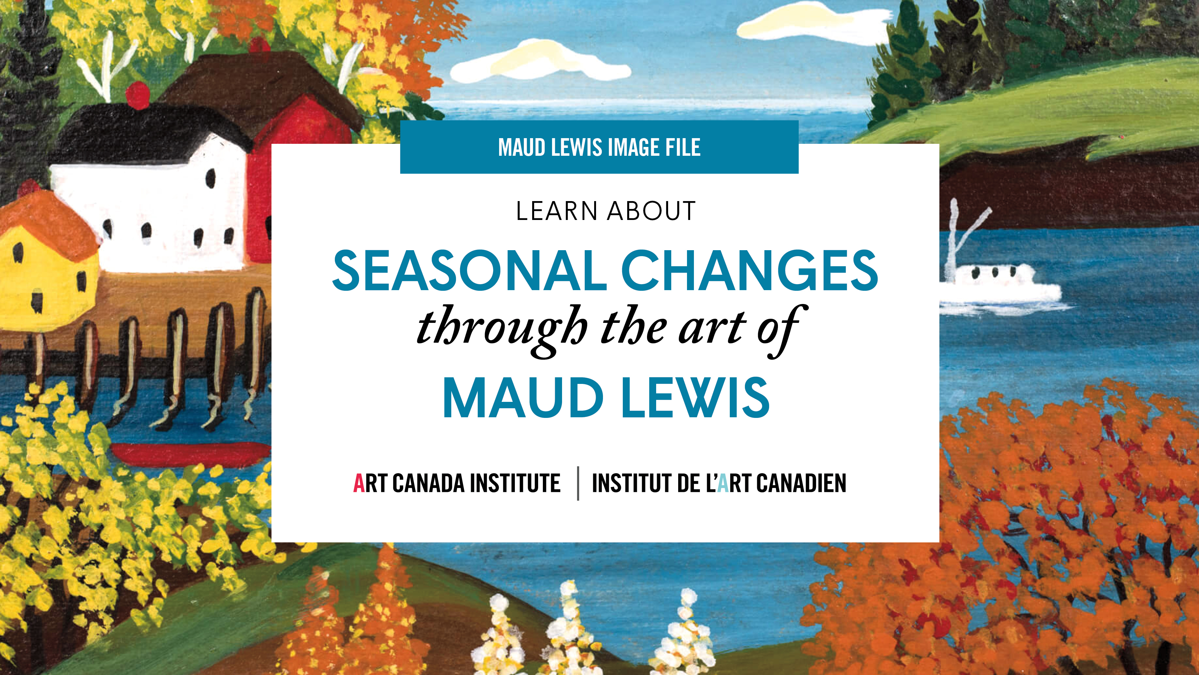

Slide 2
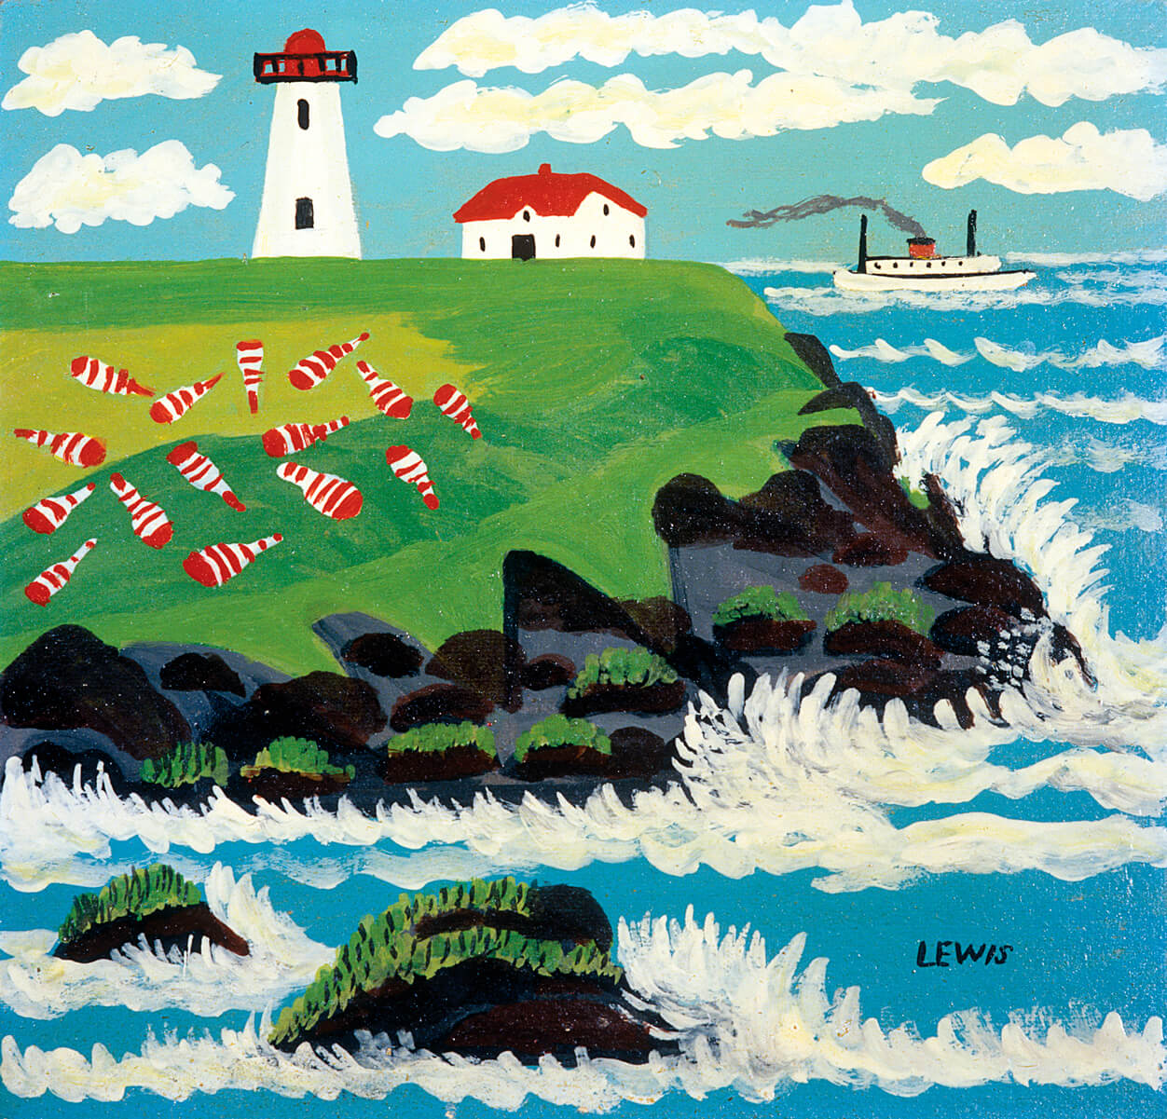
Maud Lewis, Untitled (Digby Ferry Passing Point Prim Lighthouse), 1950s. Lewis spent much of her life living in Digby County.

Slide 3
Maud Lewis, 1965.

Slide 4
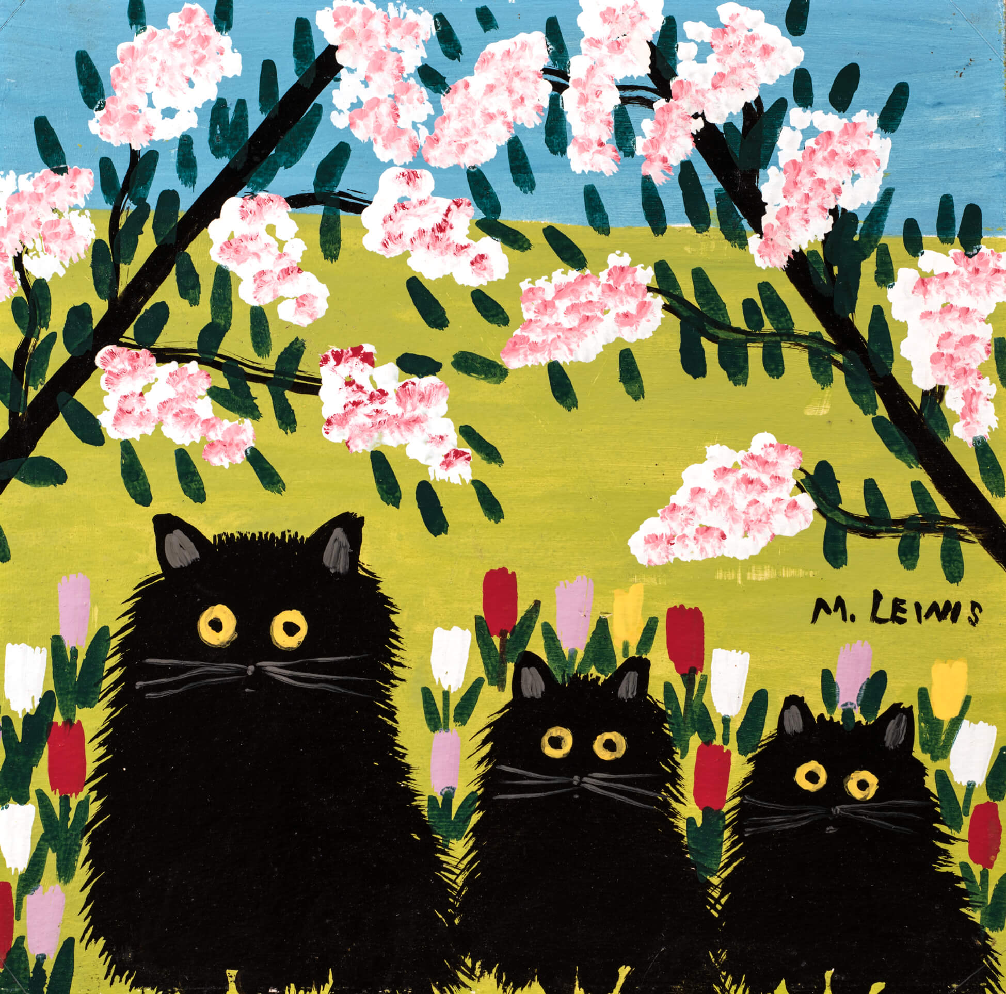
Maud Lewis, Three Black Cats, n.d. This image is among Lewis’s most iconic works.

Slide 5
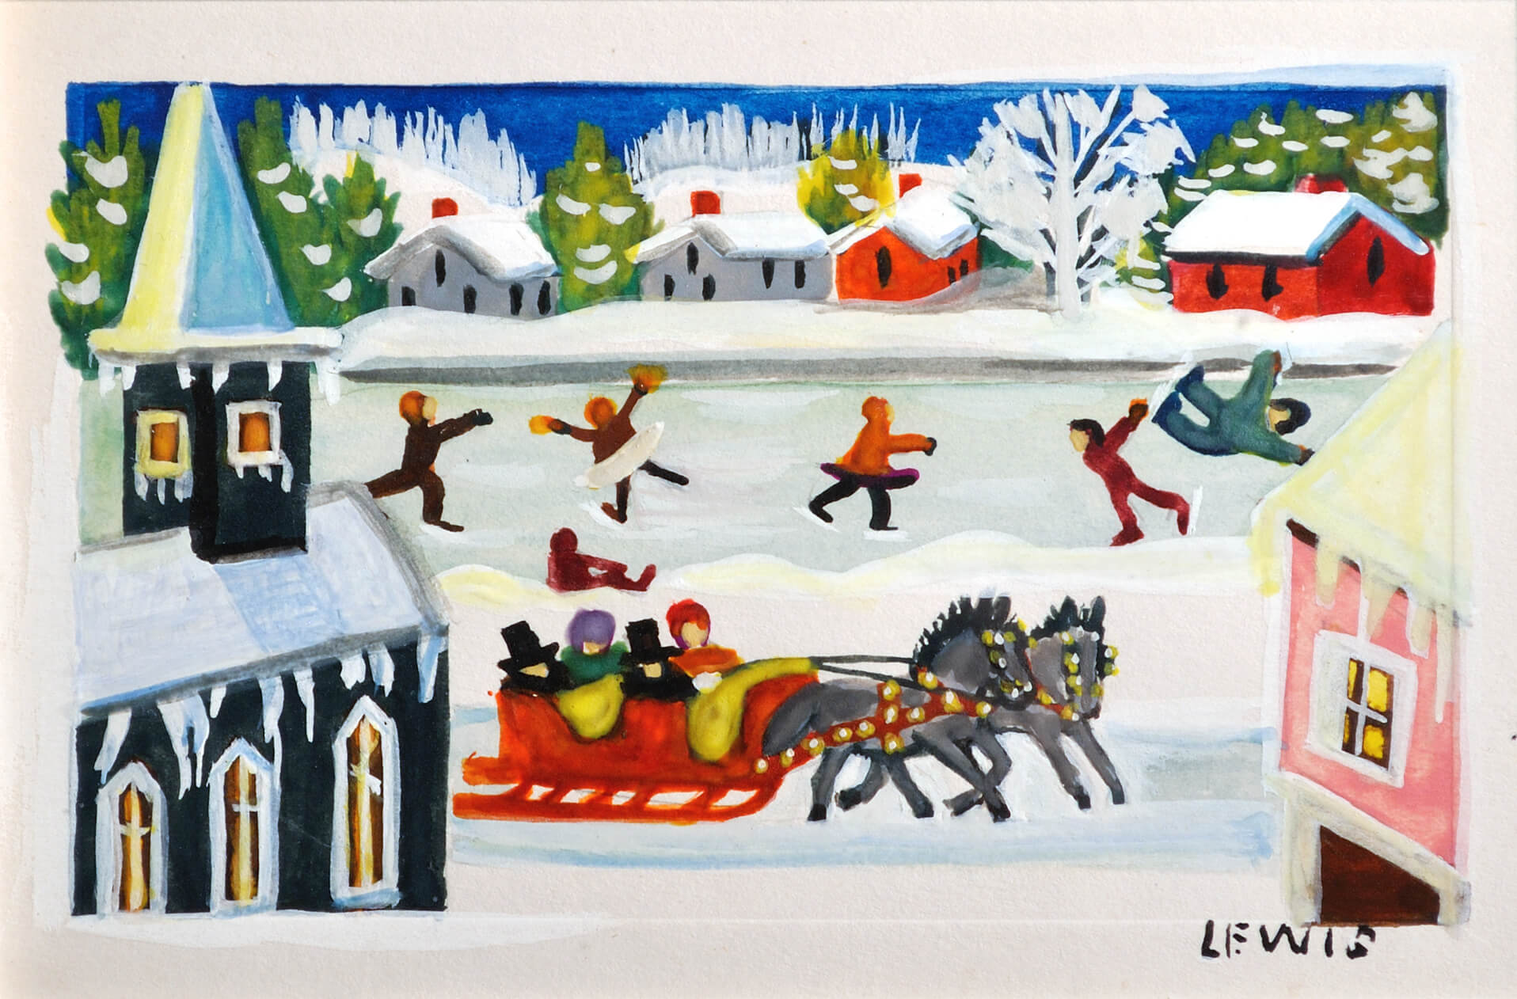
Maud Lewis, Village Scene with Sleigh Ride [Christmas Card], c.1951. For her Christmas cards, Lewis chose subjects already made popular by the greeting card industry.

Slide 6
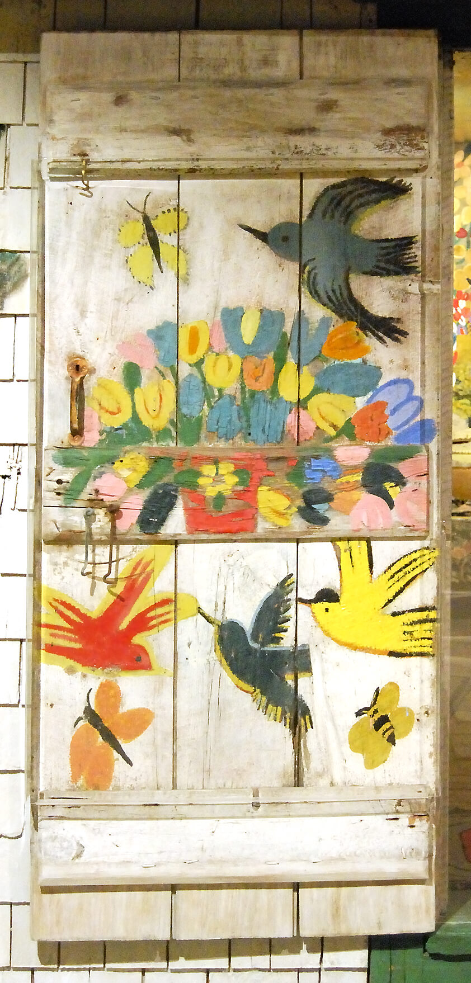
Maud Lewis, Storm Door on the Painted House, n.d. After her marriage, Lewis painted birds, flowers, and butterflies on her new home.

Slide 7
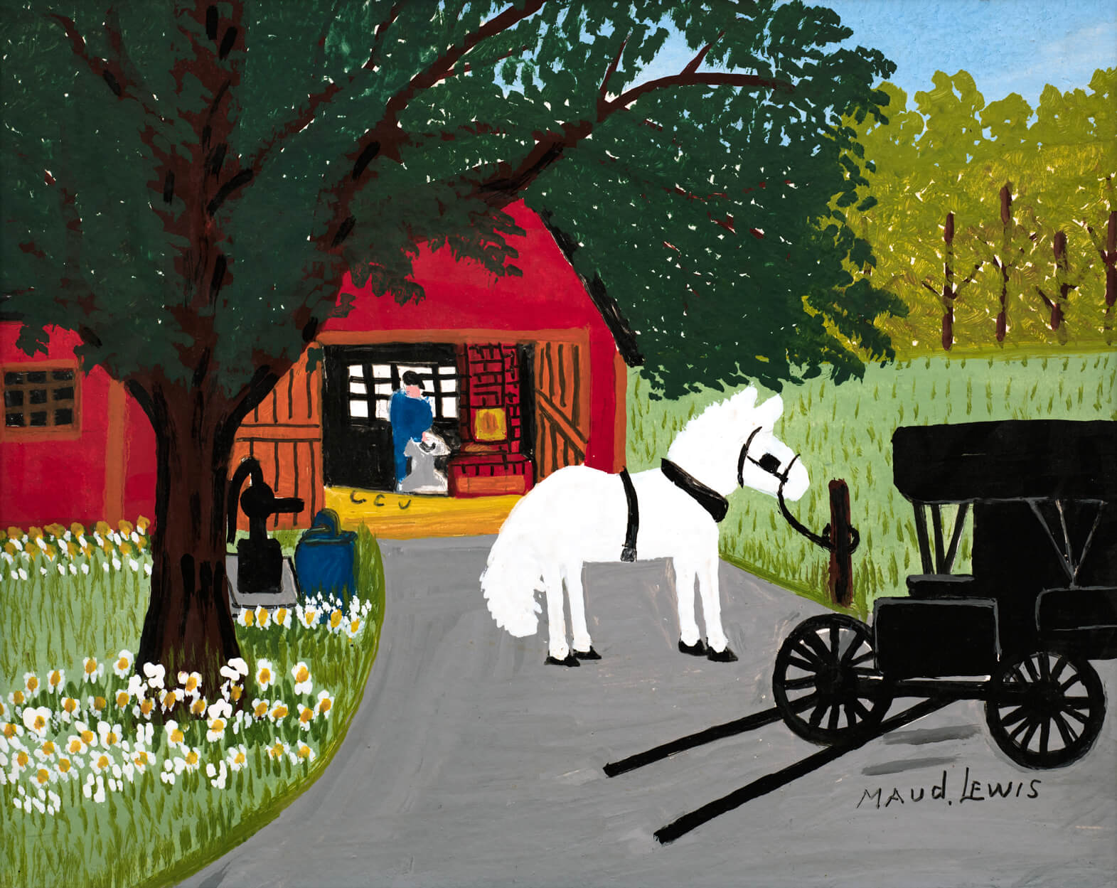
Maud Lewis, Blacksmith’s Shop, 1960s. Lewis’s father was a blacksmith and harness maker.

Slide 8
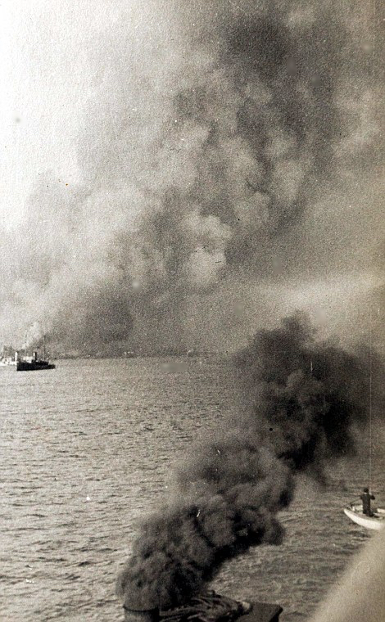
The explosion in Halifax, 1917.

Slide 9
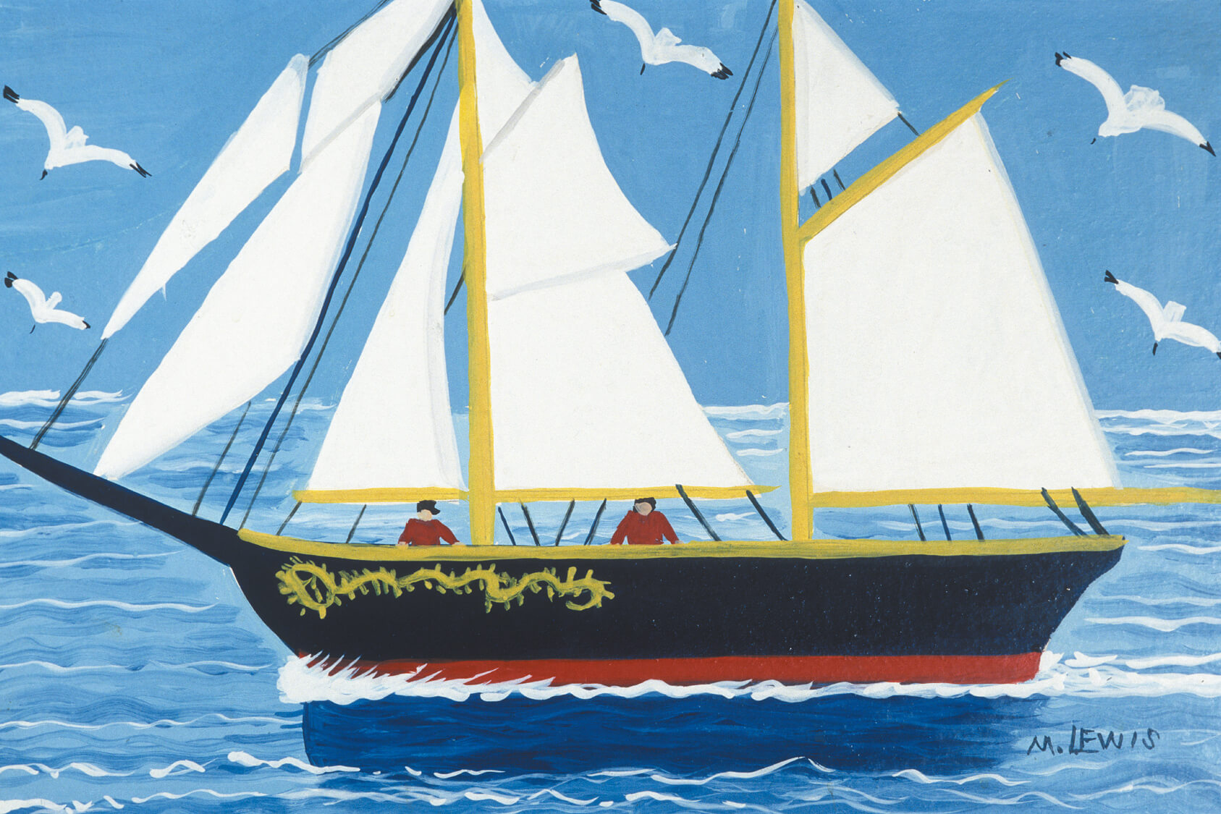
Maud Lewis, The Bluenose, c.1960s.

Slide 10
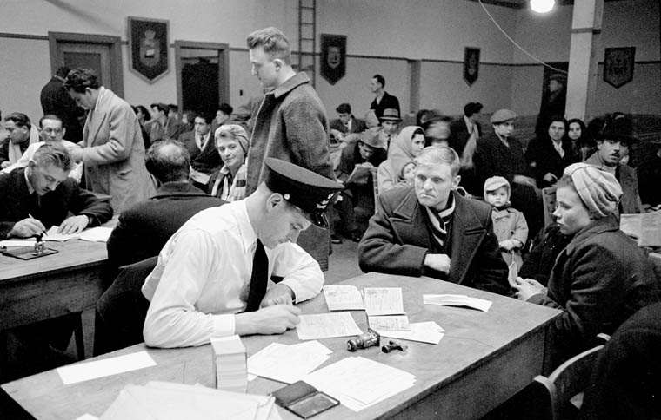
Examining new arrivals in the Immigration Examination Hall, Pier 21, Halifax, 1952.

Slide 11
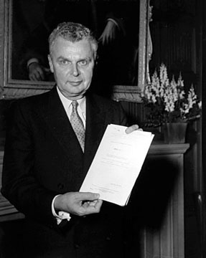
Prime Minister John G. Diefenbaker with “Bill of Rights,” 1958.

Slide 12
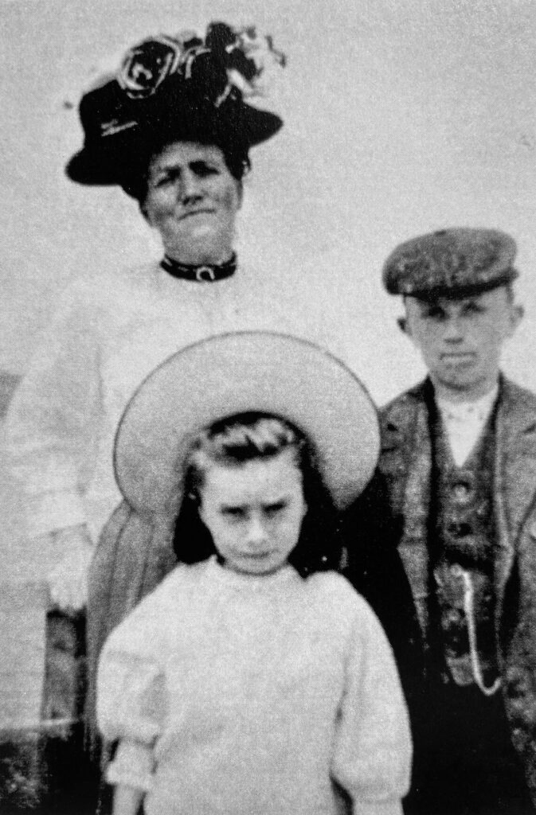
Maud Dowley with her brother, Charles Dowley, and mother, Agnes Mary Dowley, n.d.

Slide 13
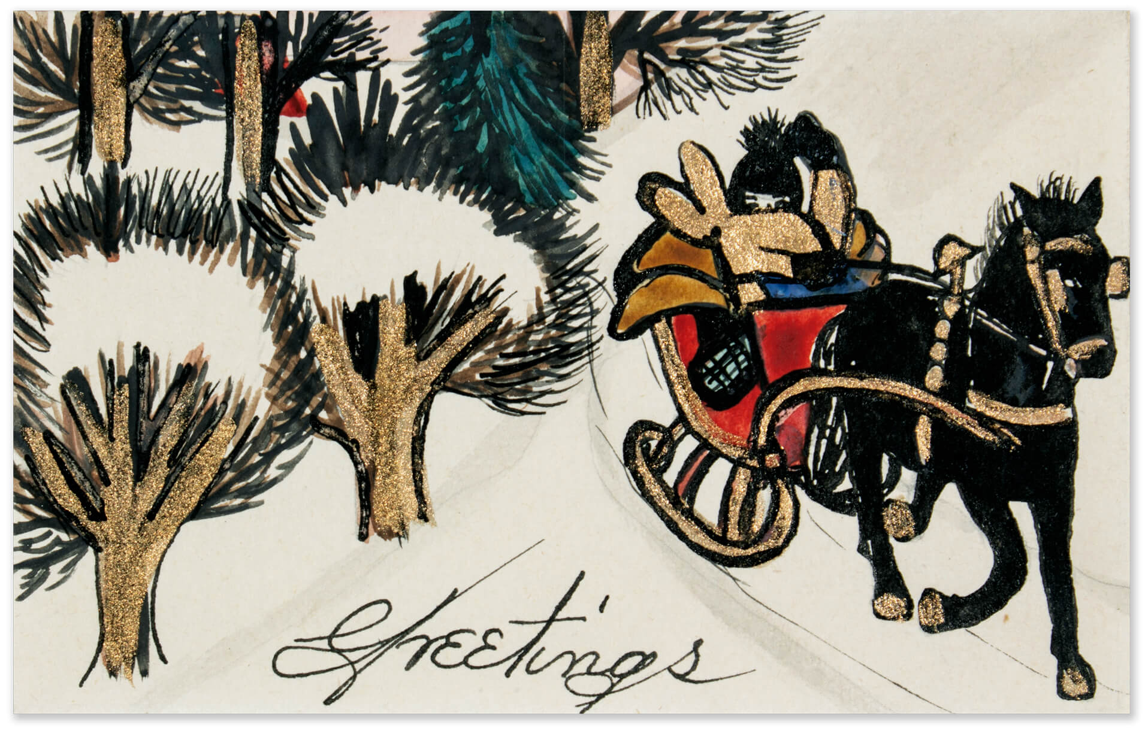
Maud Lewis, Greetings, c.1945. Christmas cards are an important part of Lewis’s early work.

Slide 14
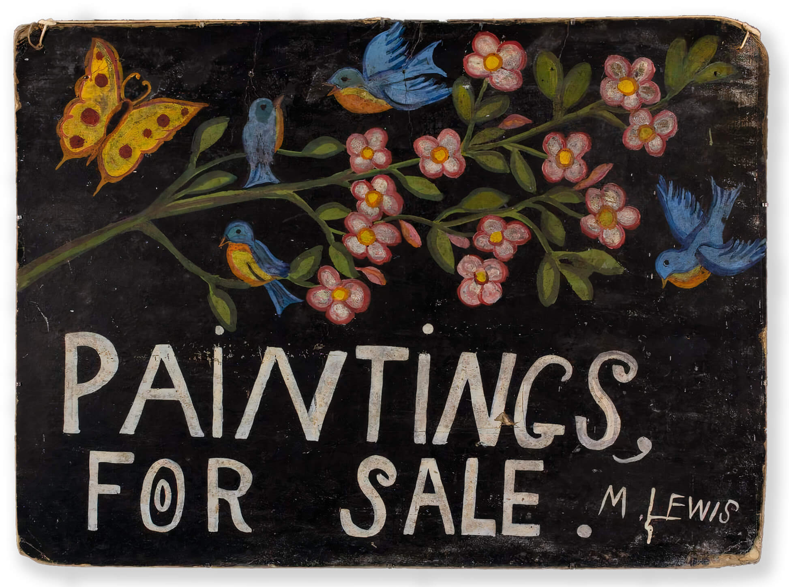
Maud Lewis, Paintings for Sale, 1960s. This sign hung outside Lewis’s home.

Slide 15
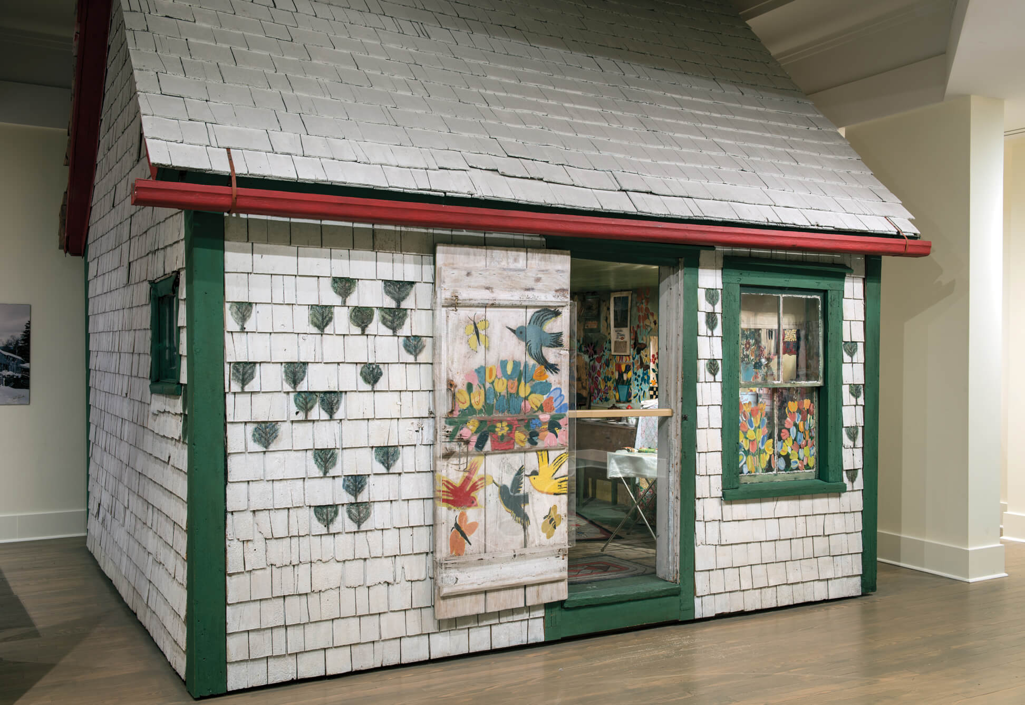
Maud Lewis, Maud Lewis’s Painted House, n.d.

Slide 16
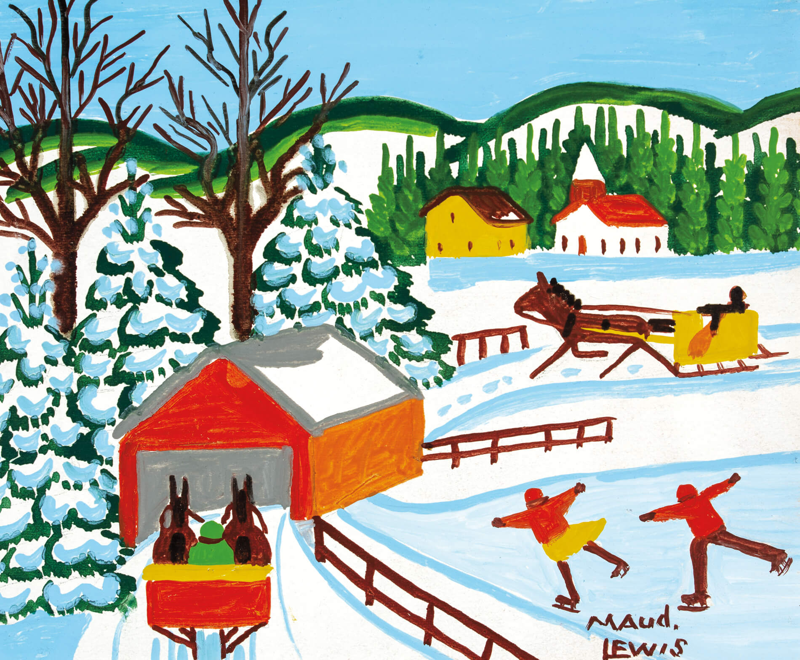
Learning Activity #1
Maud Lewis, Covered Bridge in Winter with Skaters, mid-1960s. In her winter paintings, Lewis used pale blue to show shadows on the snow.

Slide 17
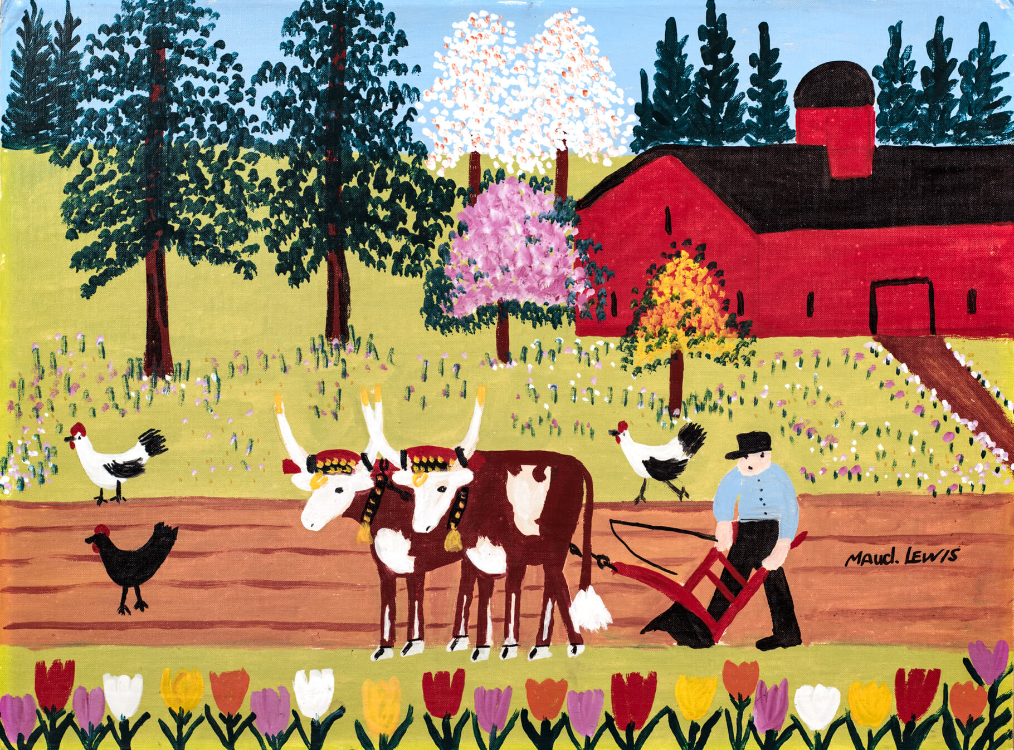
Learning Activity #1
Maud Lewis, Everett Plowing, 1960s. Tulips appear in many of Lewis’s paintings.

Slide 18
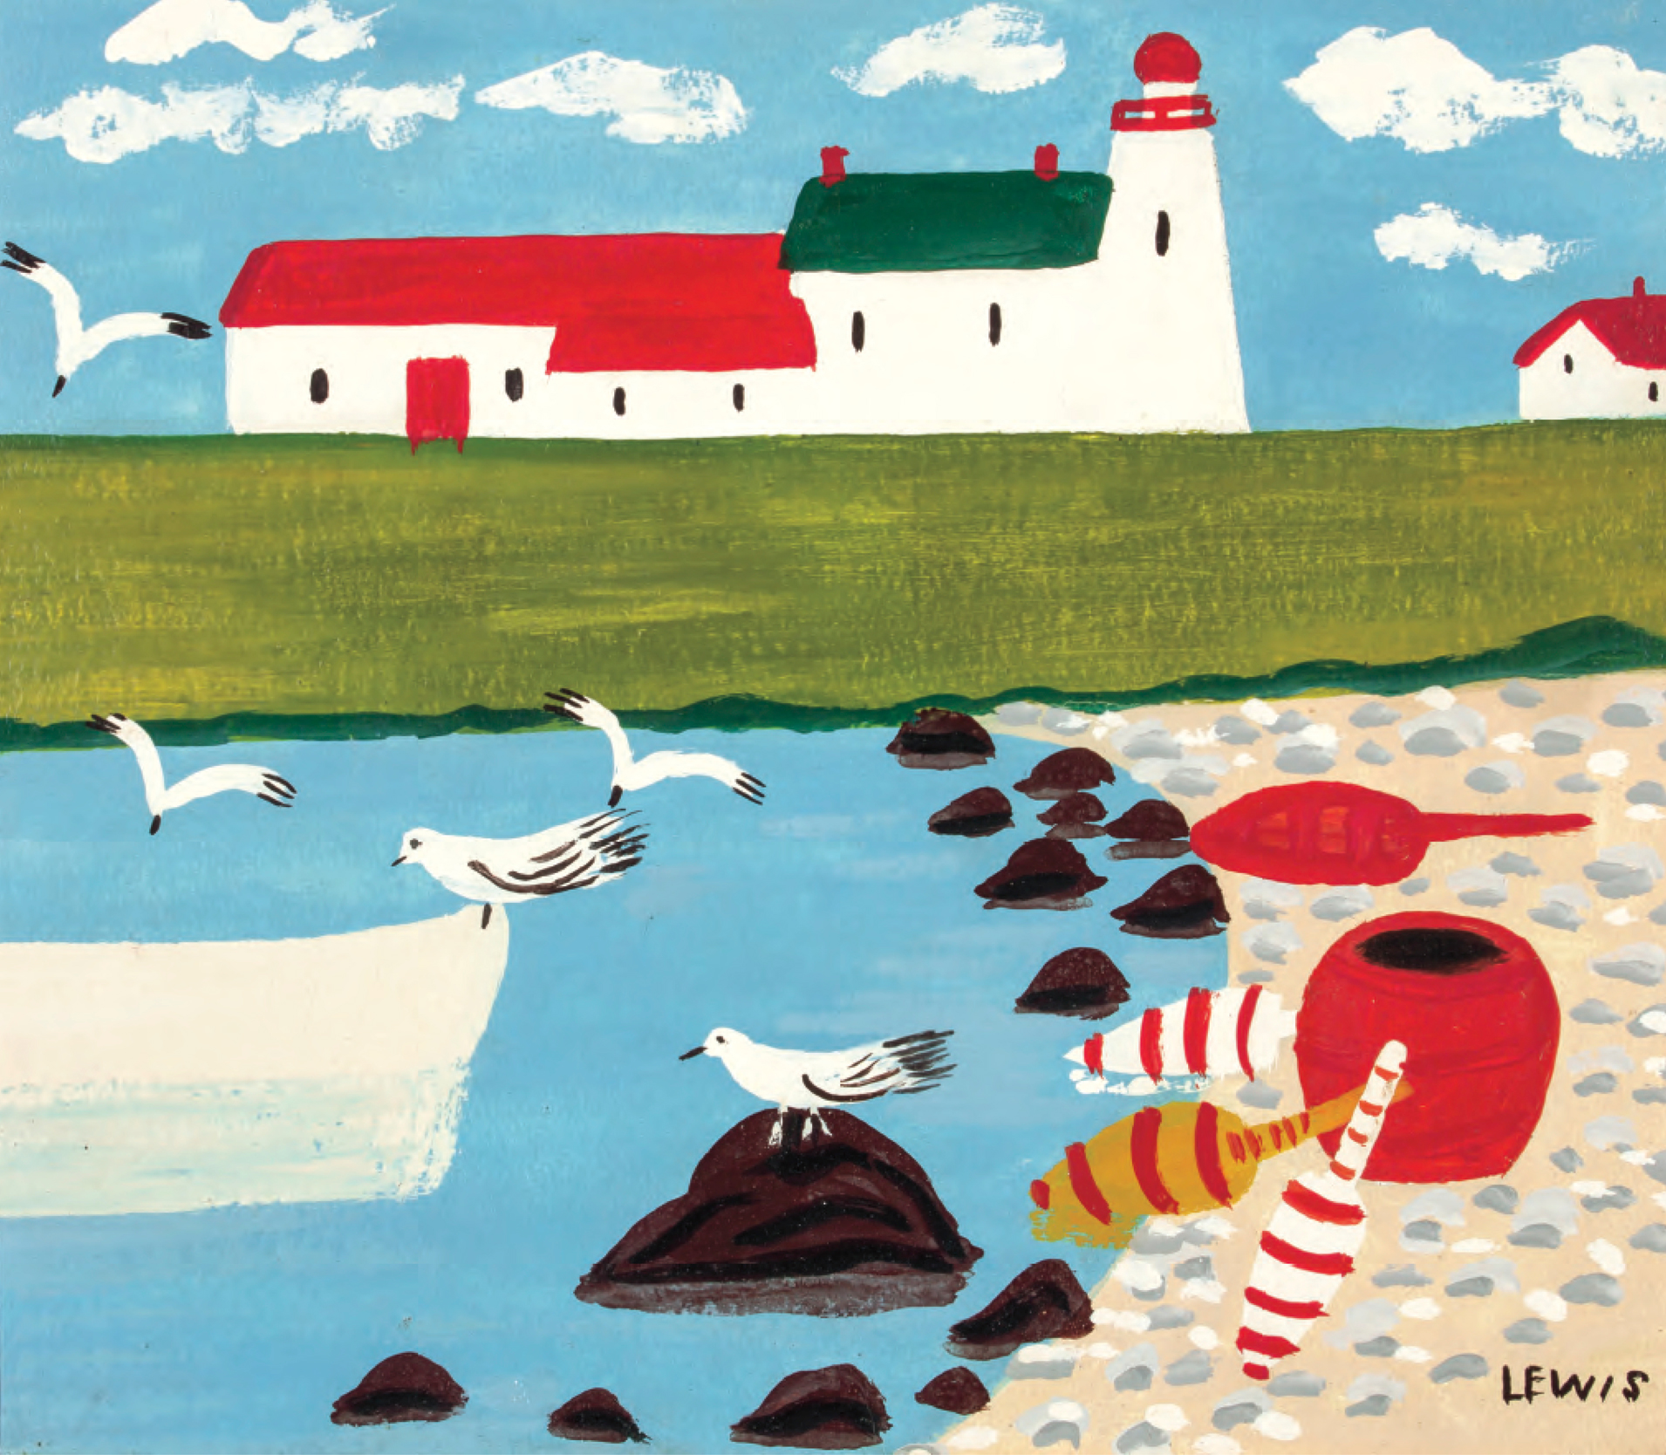
Learning Activity #1
Maud Lewis, Lighthouse and Gulls, n.d. Lewis painted many coastal scenes.

Slide 19
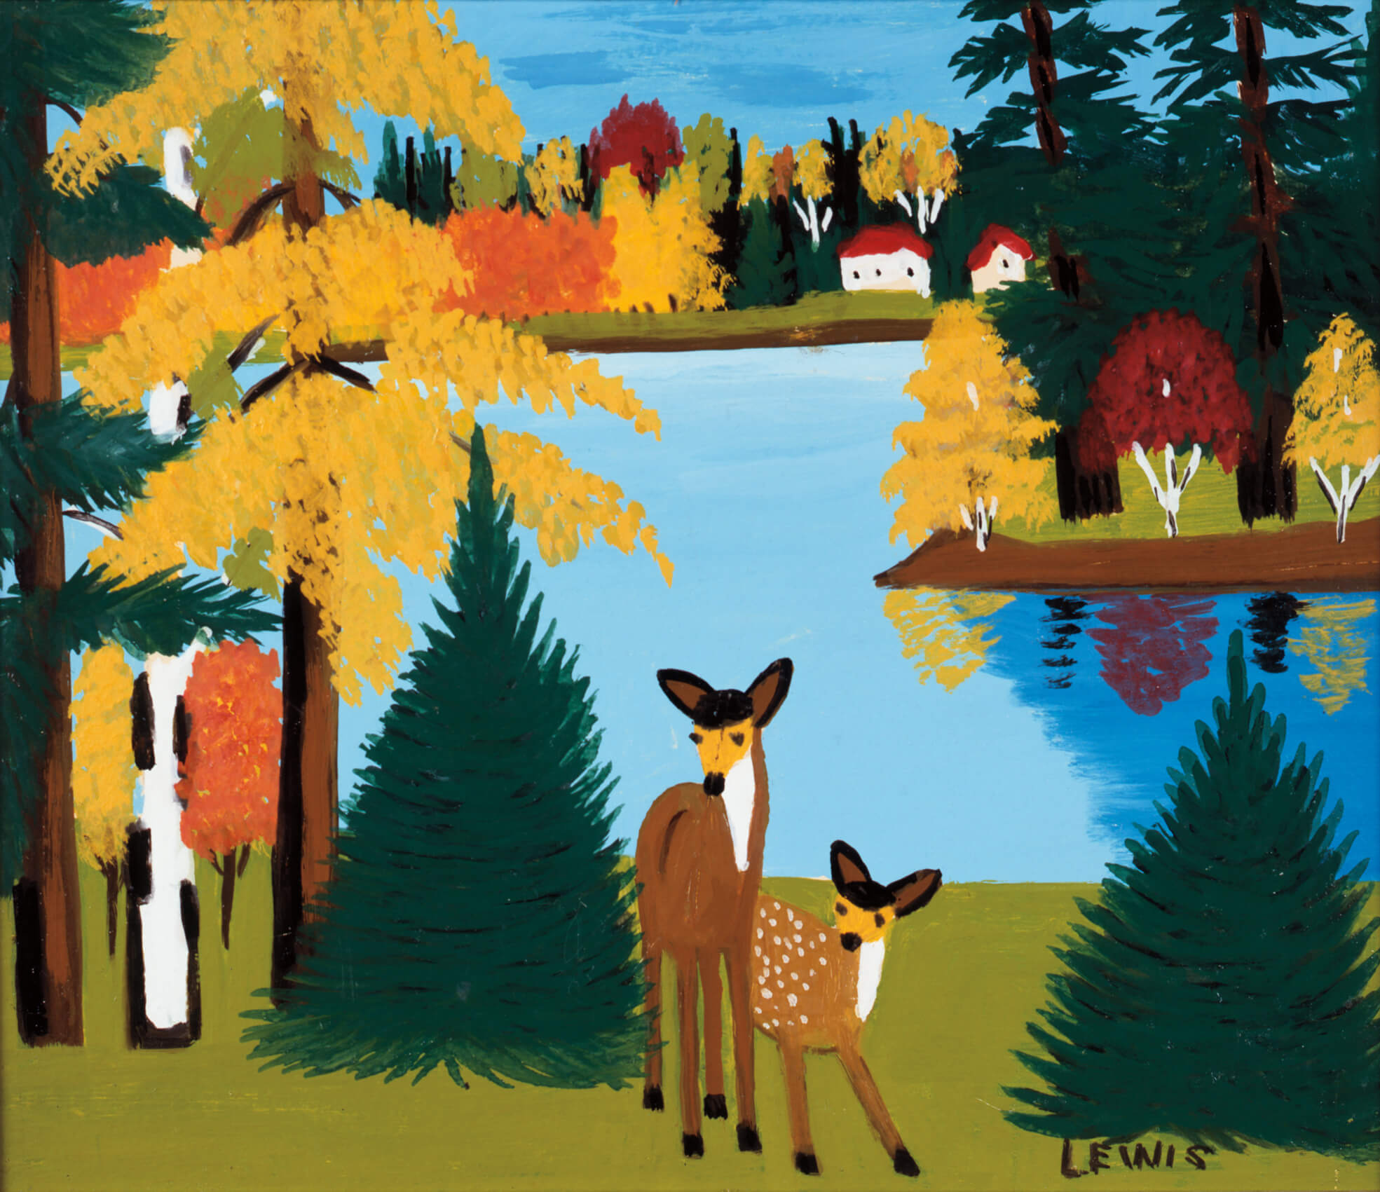
Learning Activity #1
Maud Lewis, Fall Scene with Deer, c.1950. Lewis often painted deer framed by trees.

Slide 20
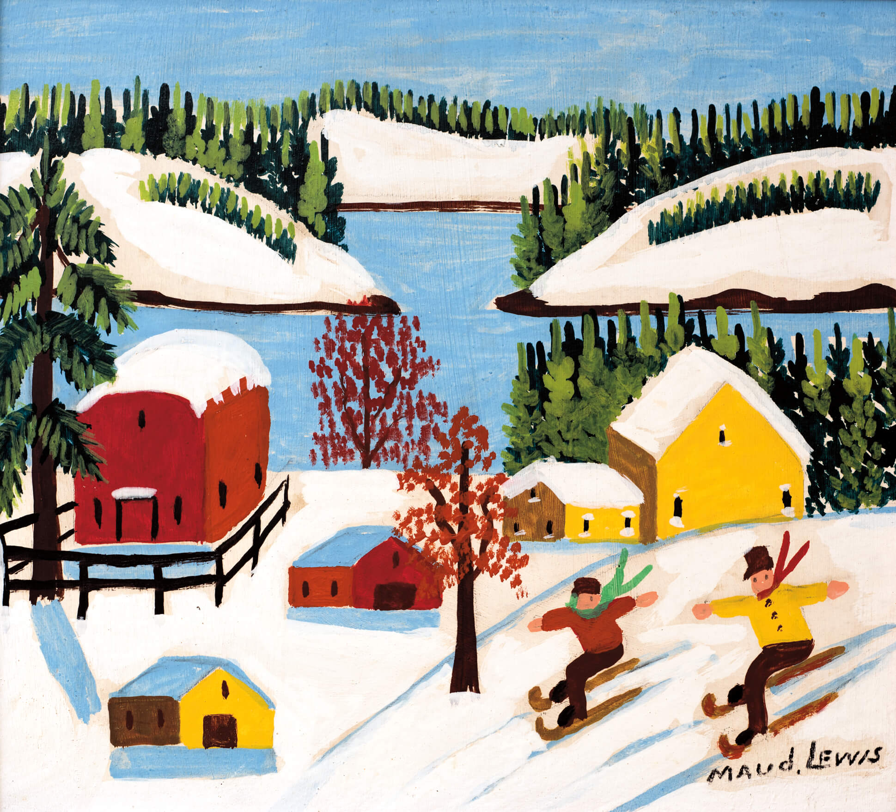
Learning Activity #2
Maud Lewis, Children Skiing, mid-1960s. Lewis painted many scenes of children playing.

Slide 21
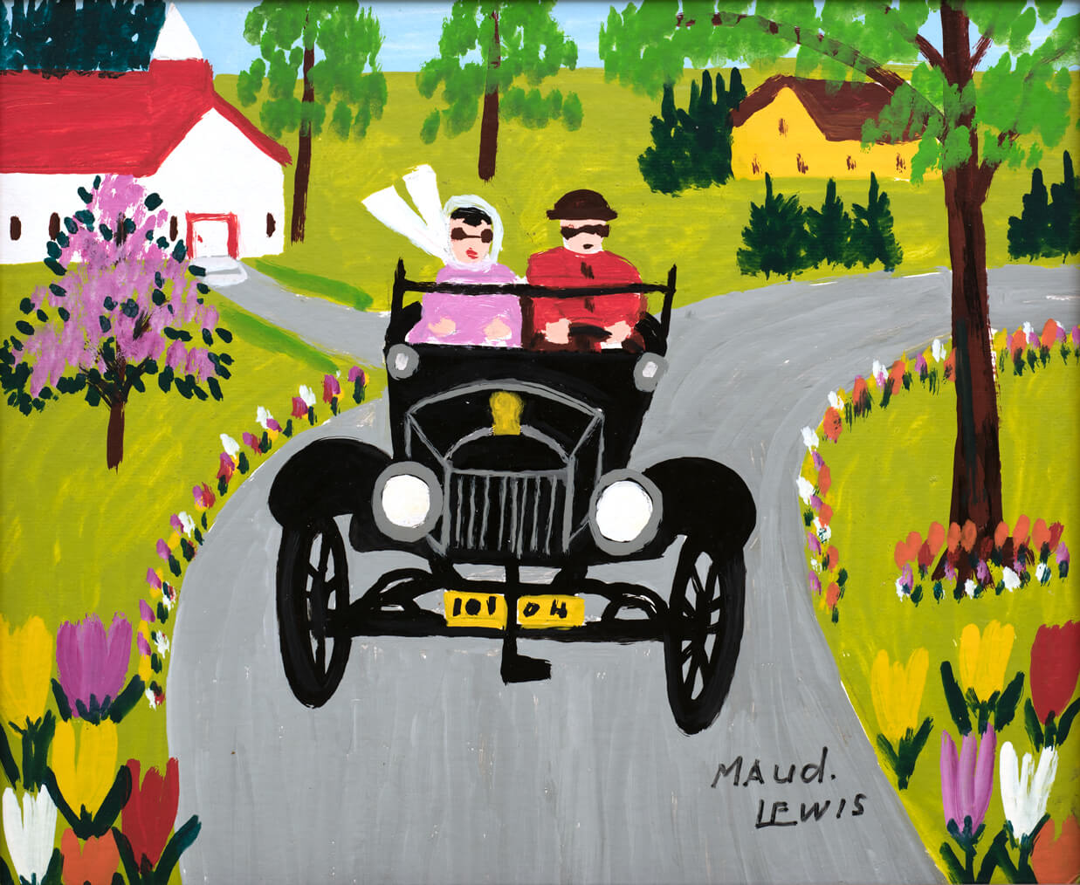
Learning Activity #2
Maud Lewis, Model T on Tour, 1960s. Everett Lewis owned an old Model T Ford when Maud met him in 1937.

Slide 22
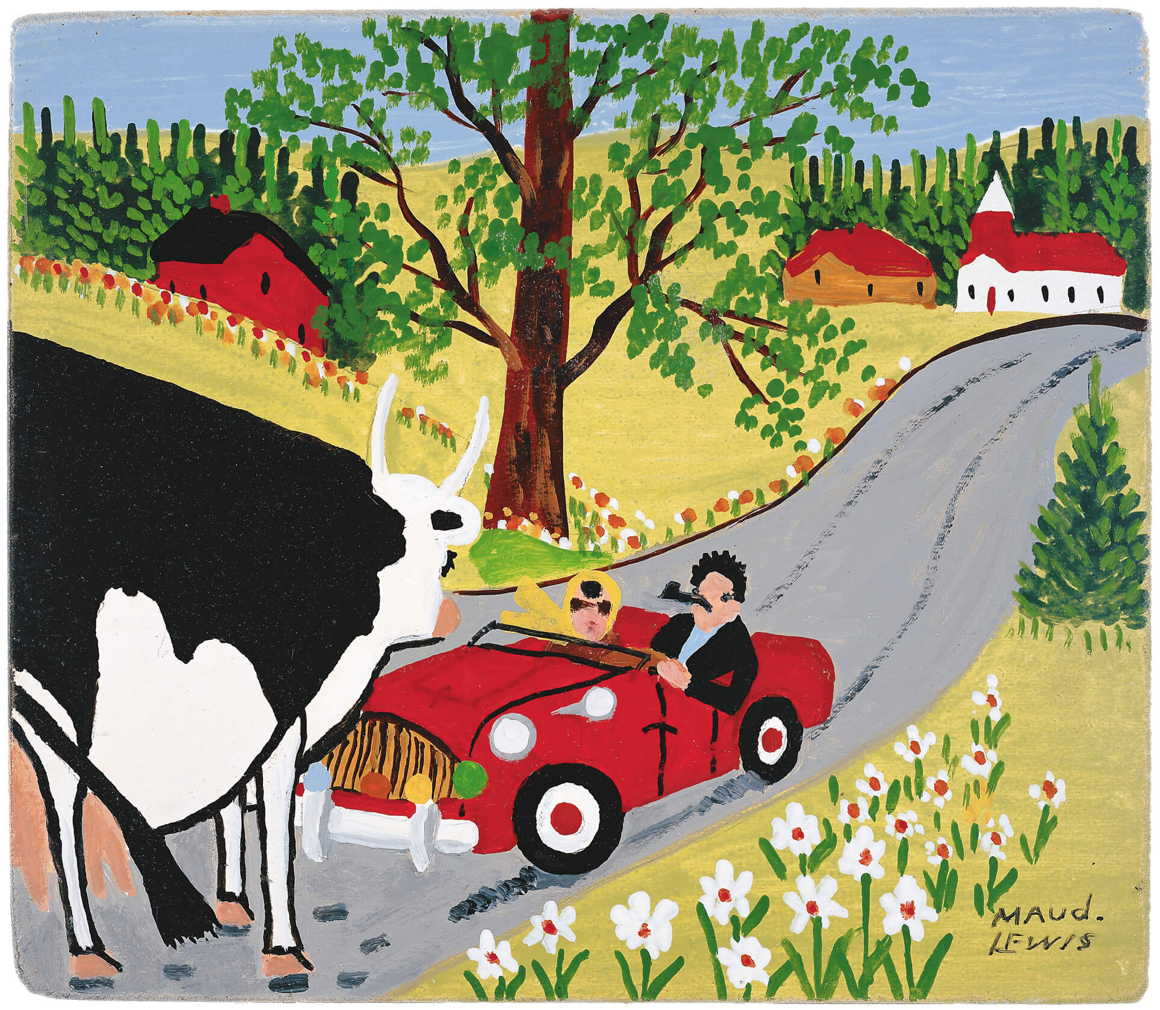
Learning Activity #2
Maud Lewis, Roadster and Cow, c.1960s. This work was based on an illustration on the cover of an issue of Maclean’s magazine from 1956.

Slide 23
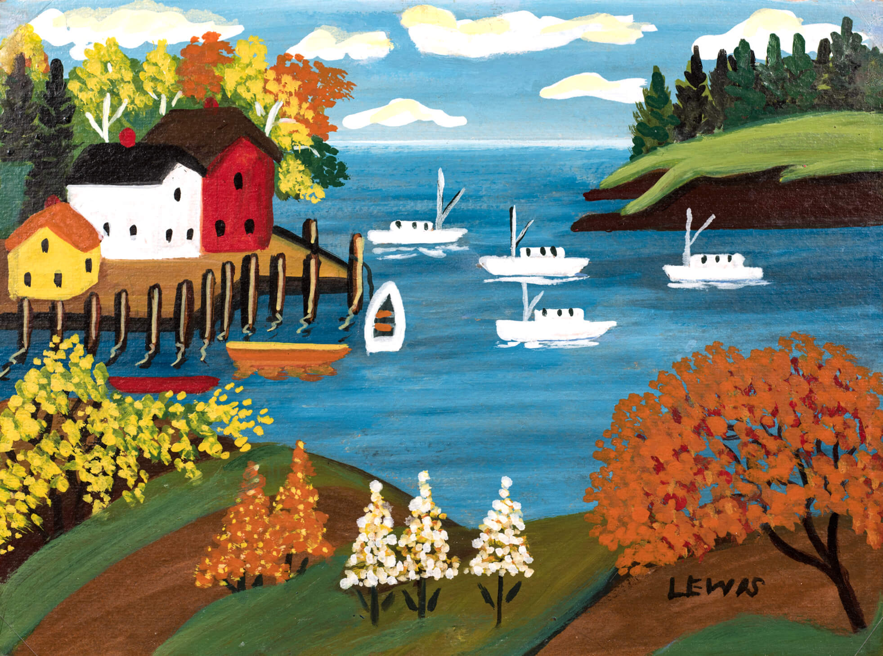
Learning Activity #2
Maud Lewis, Nova Scotia Harbour in Autumn, n.d. Lewis loved flowers, and sometimes painted blossoming trees even if they were not in season.

Slide 24
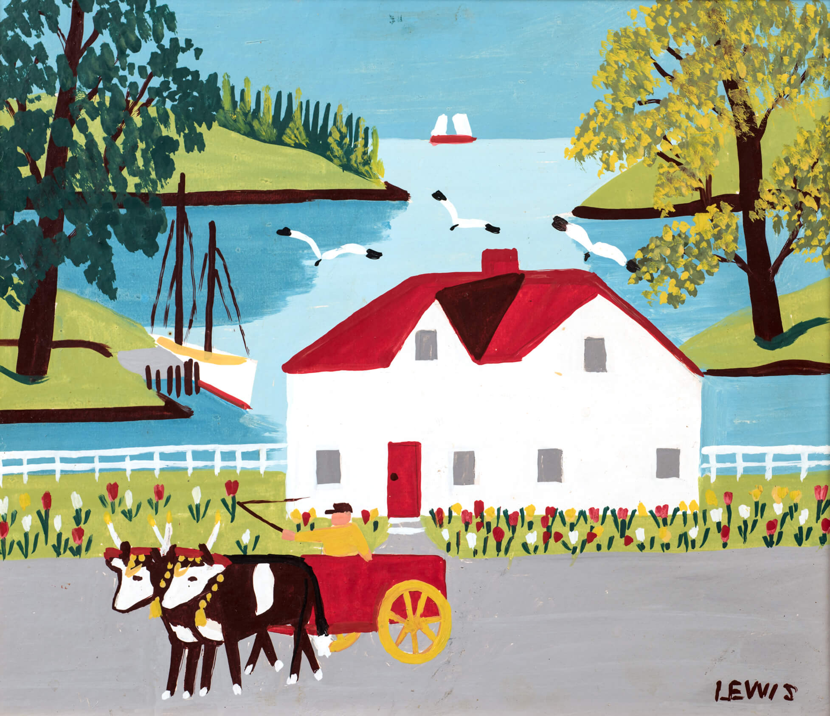
Culminating Task
Maud Lewis, House and Ox Cart by the River, 1960s. Lewis painted variations of this scene several times, and one version was featured in the CBC program about her work.

Slide 25
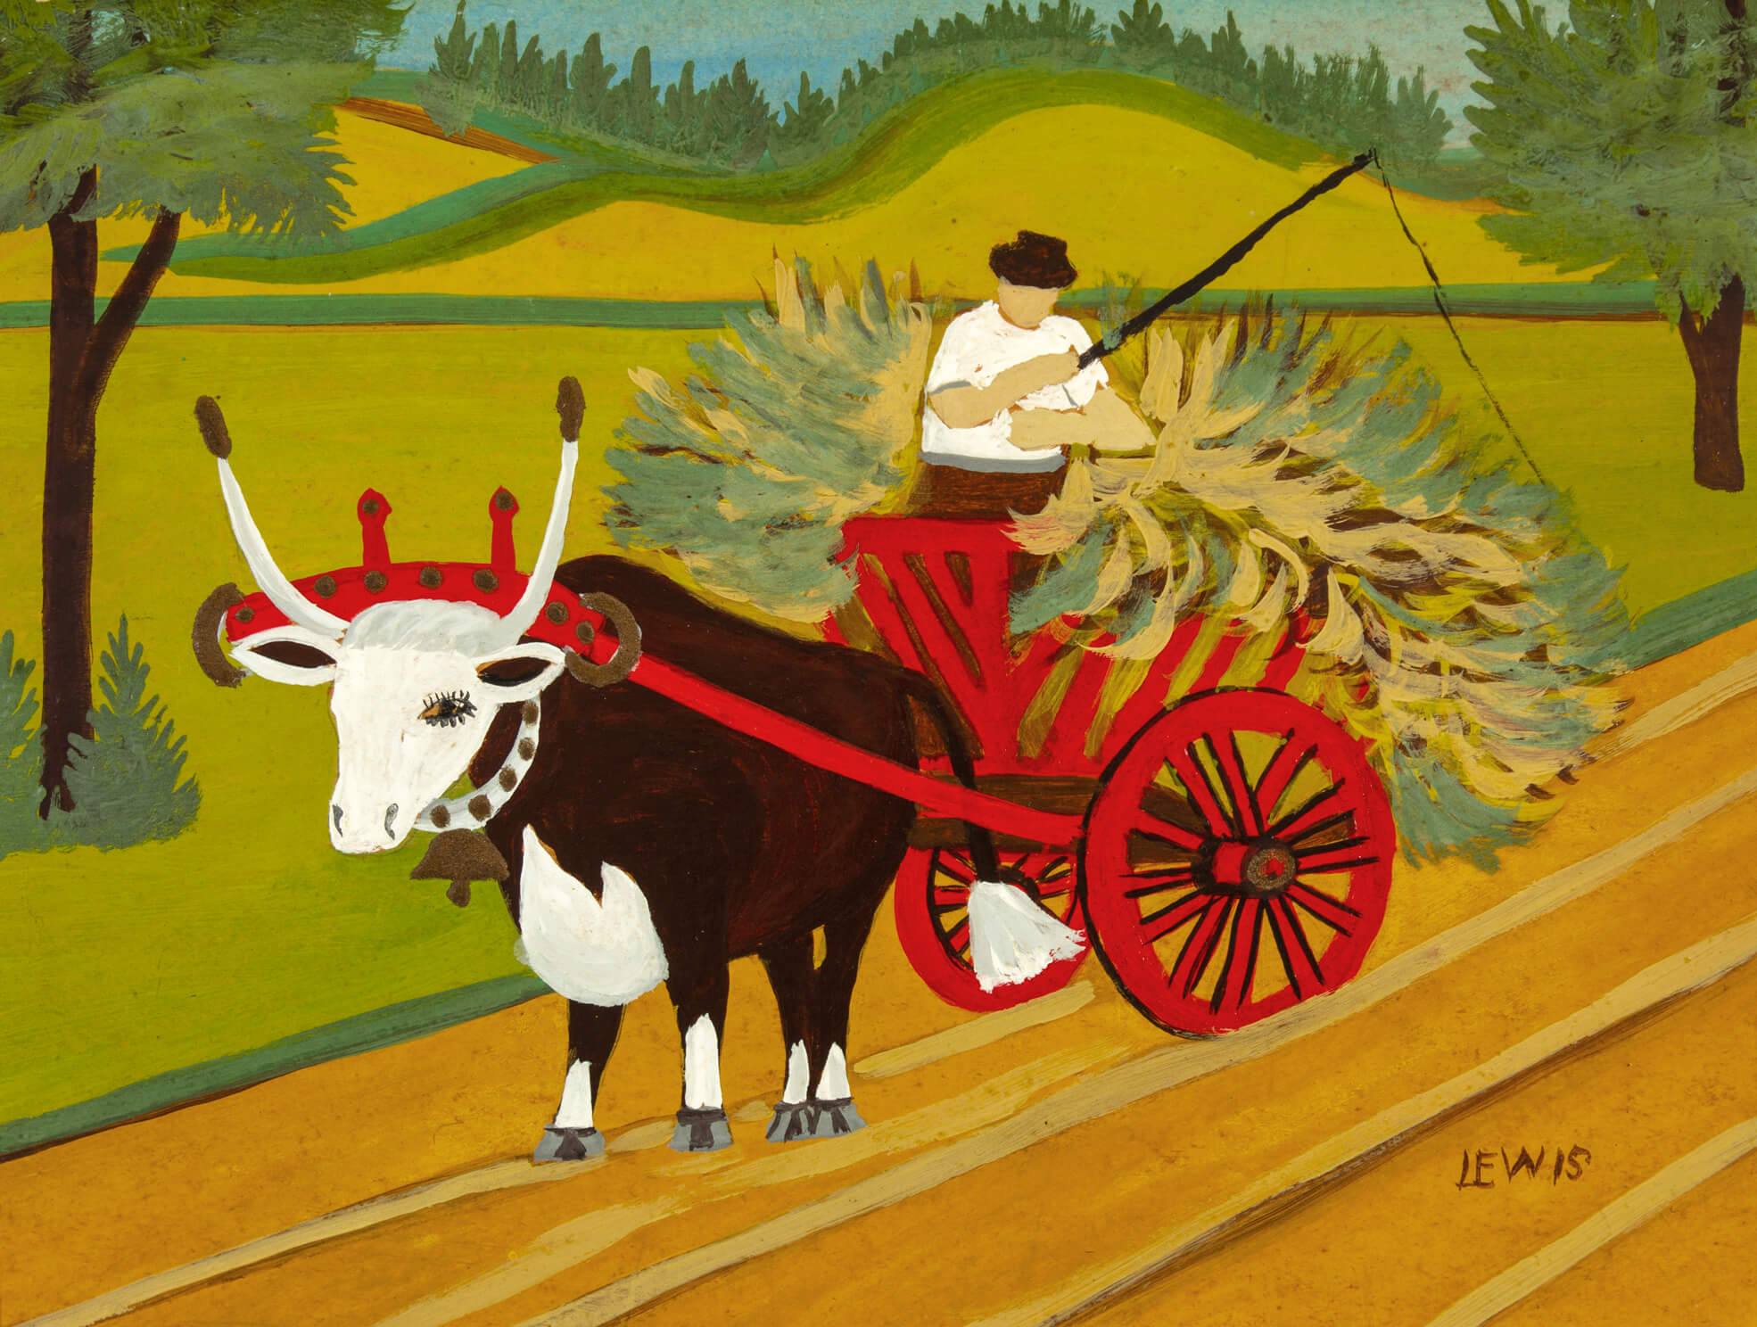
Culminating Task
Maud Lewis, Haywagon, 1940s. Lewis was well known for her paintings of oxen.

Slide 26
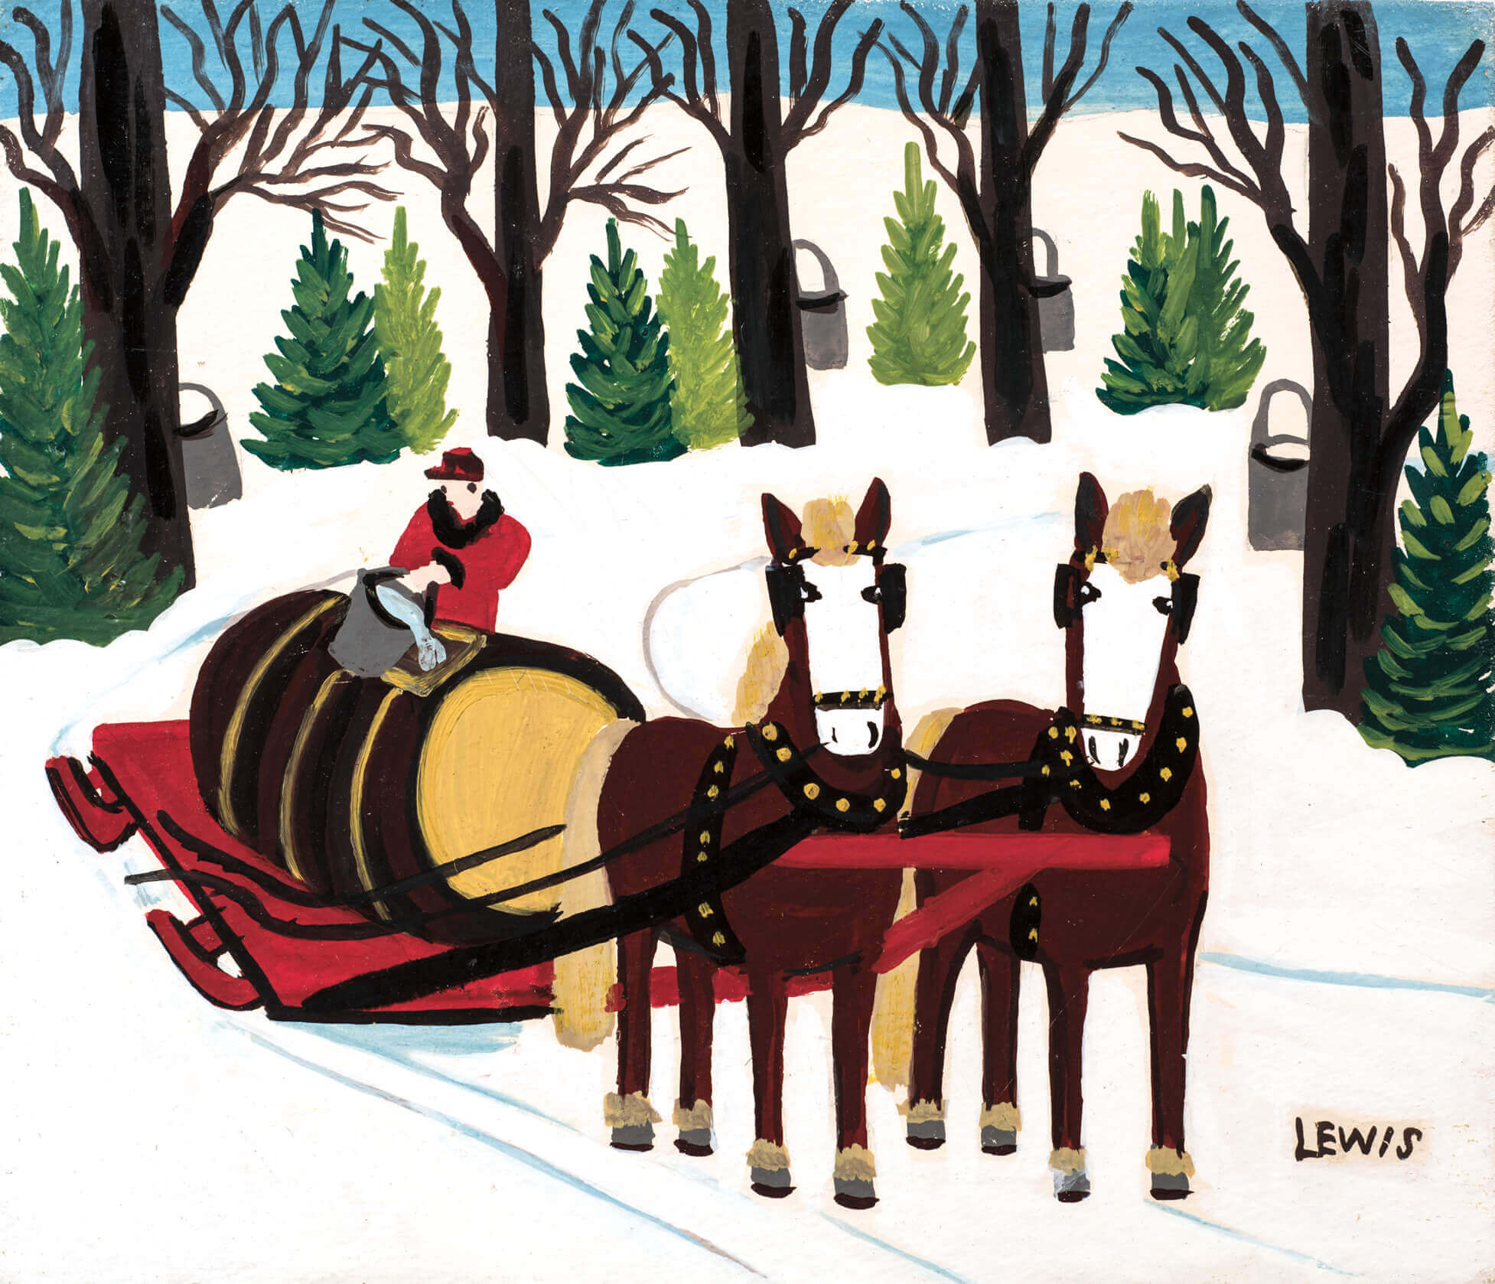
Culminating Task
Maud Lewis, Maple Syrup Gathering, 1960s. Many of Lewis’s paintings show farmers at work.

Slide 27
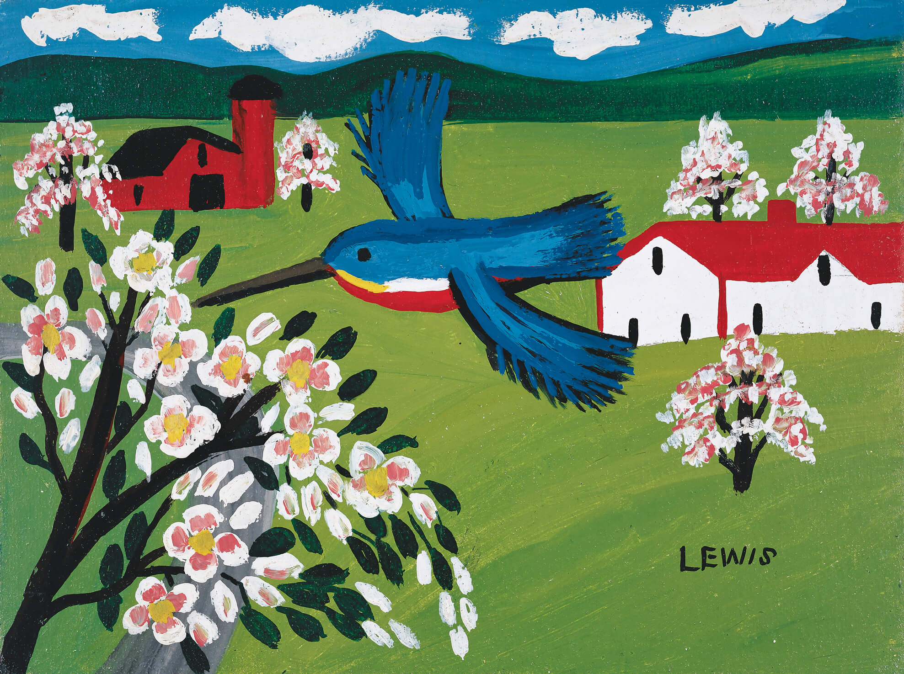
Culminating Task
Maud Lewis, British Kingfisher & Apple Blossoms, 1963. This work was based on an image Lewis saw on a biscuit tin.

Slide 28
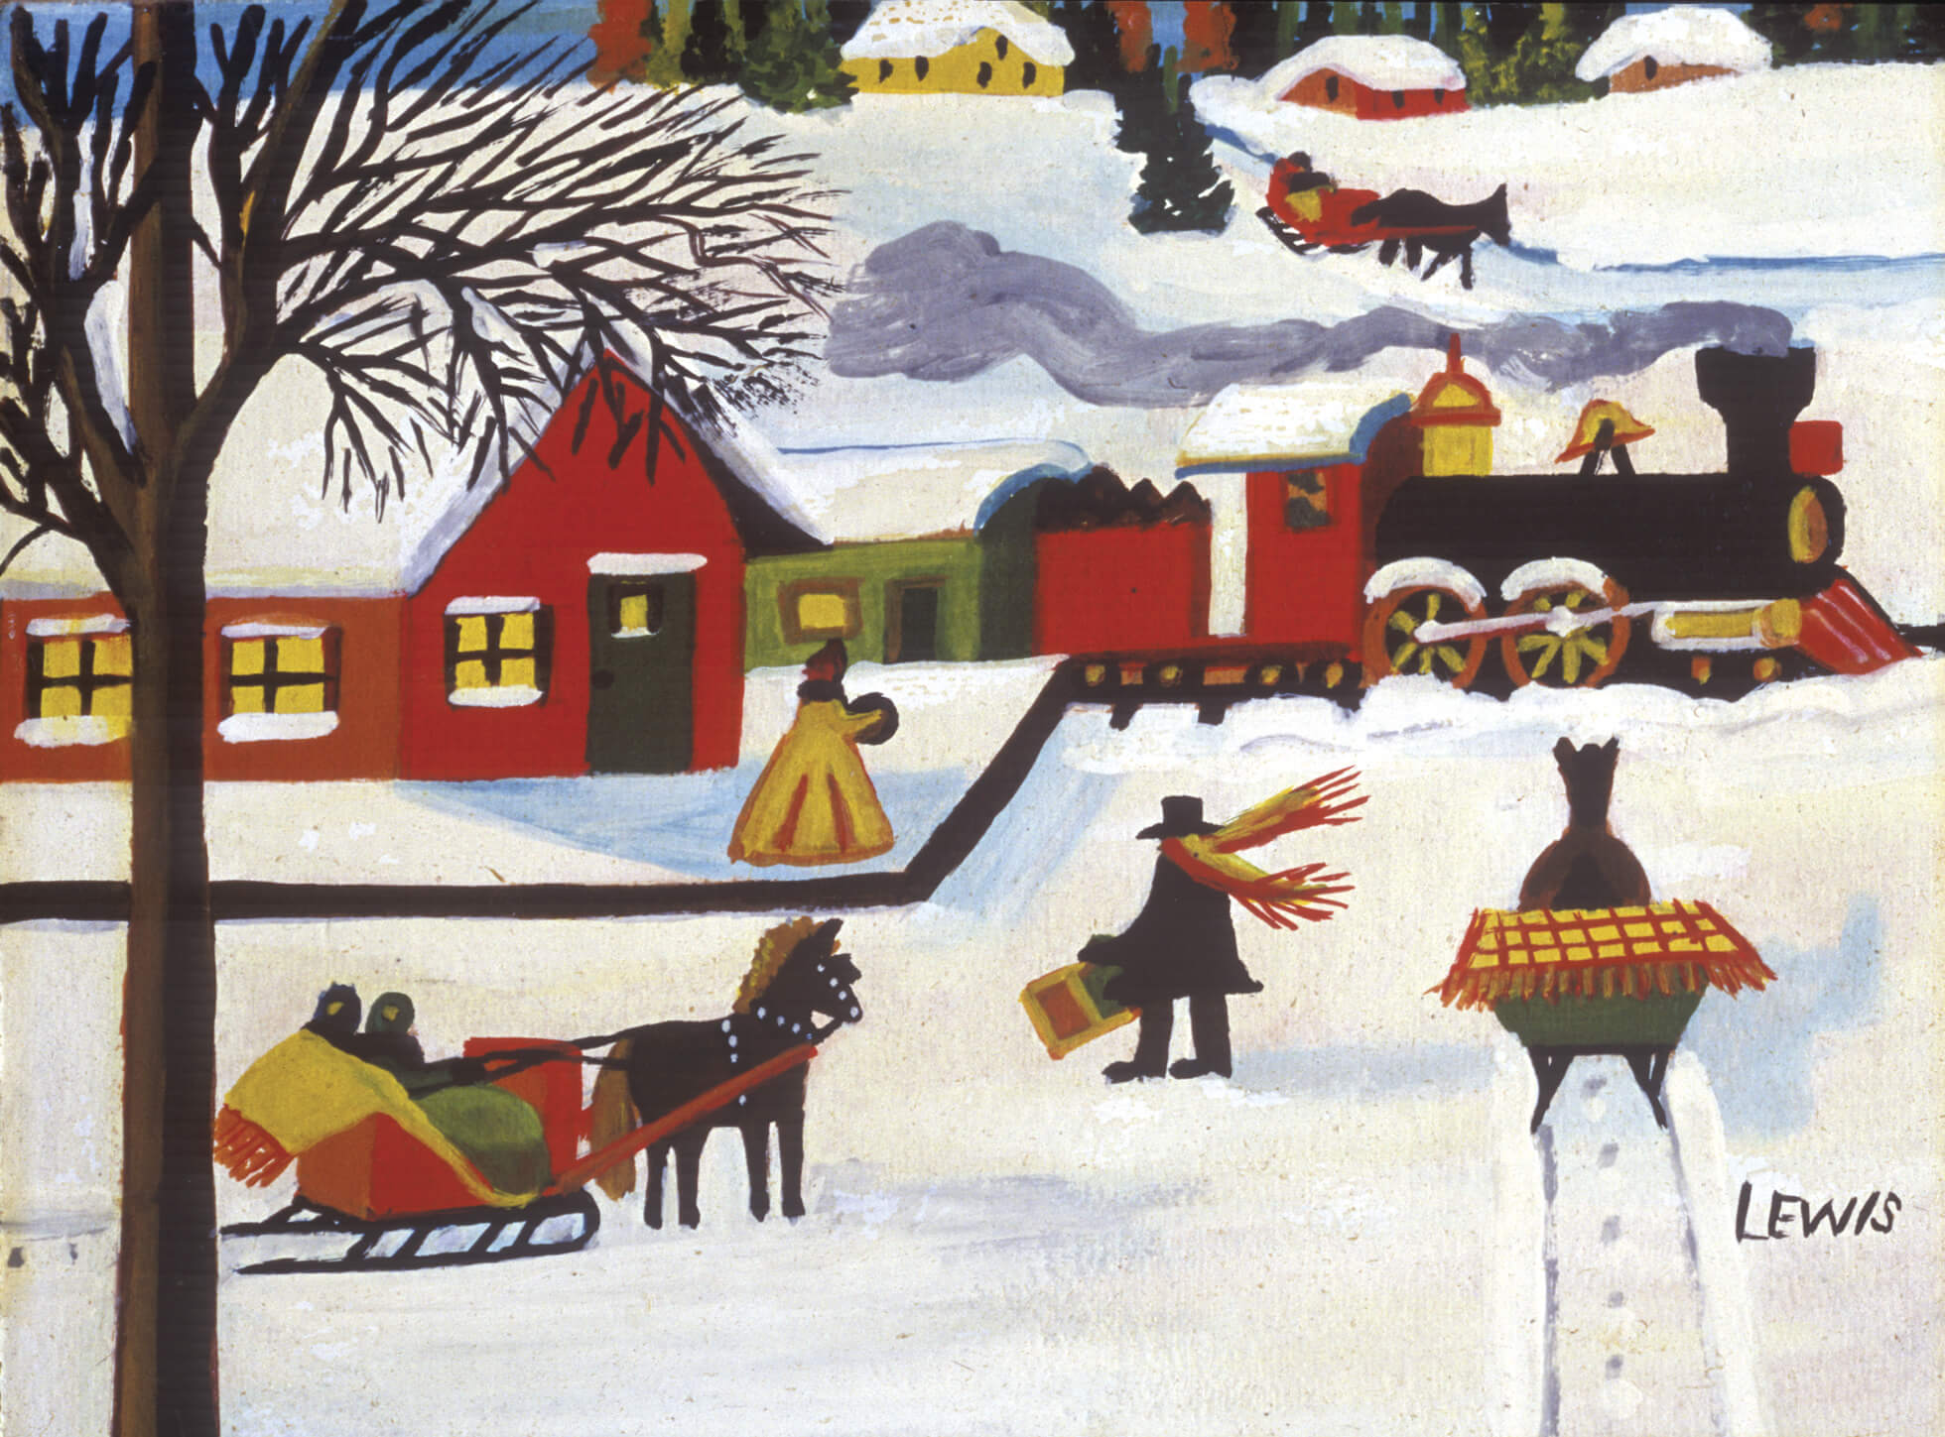
Culminating Task
Maud Lewis, Train Coming into Station, 1949/50. Here Lewis imagines a scene at a train station in the 1800s.

Slide 29
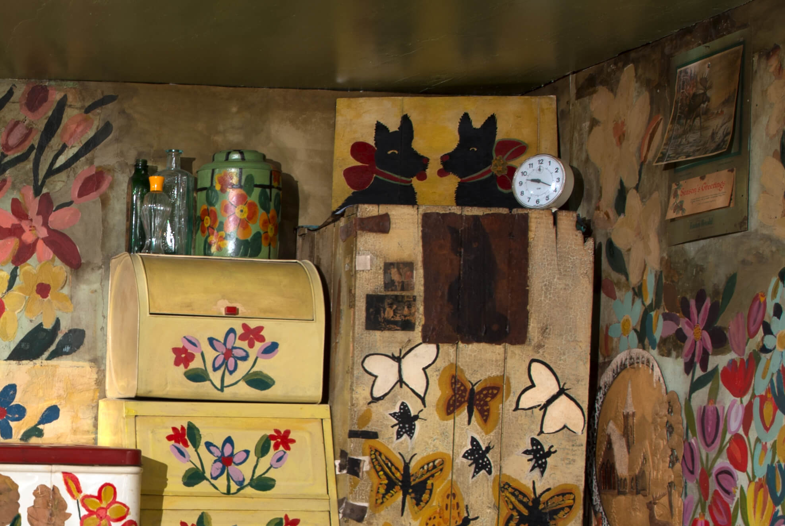
Maud Lewis’s cookie tin in her Painted House, n.d. Lewis painted flowers all over the walls and furniture in her home.

Slide 30
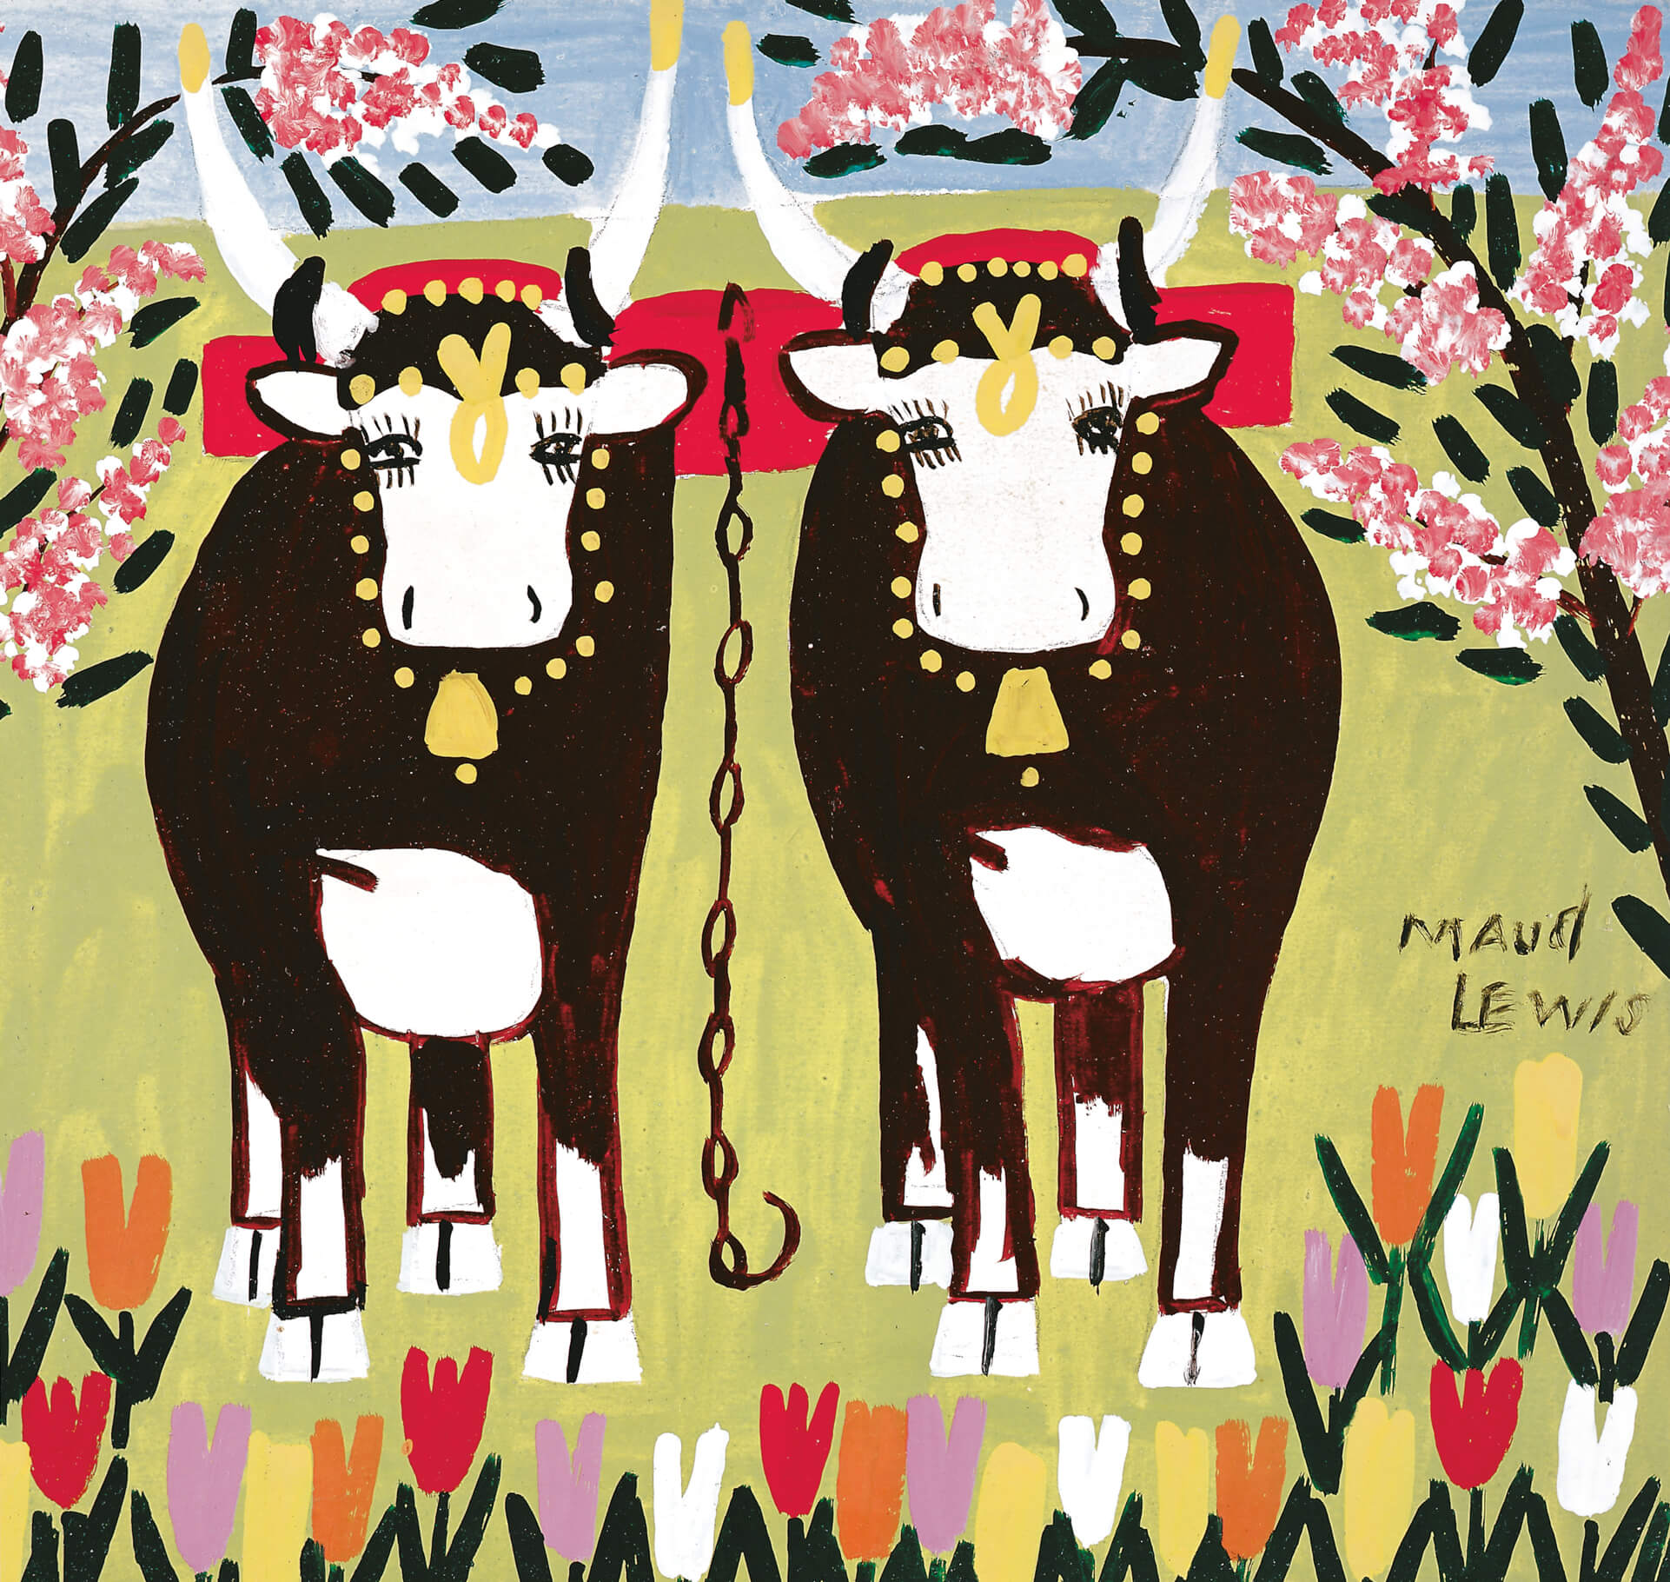
Maud Lewis, Oxen in Spring [Two Oxen with Yoke], c.1960s. Ox teams were a familiar sight in rural Nova Scotia throughout Lewis’s life.

Slide 31
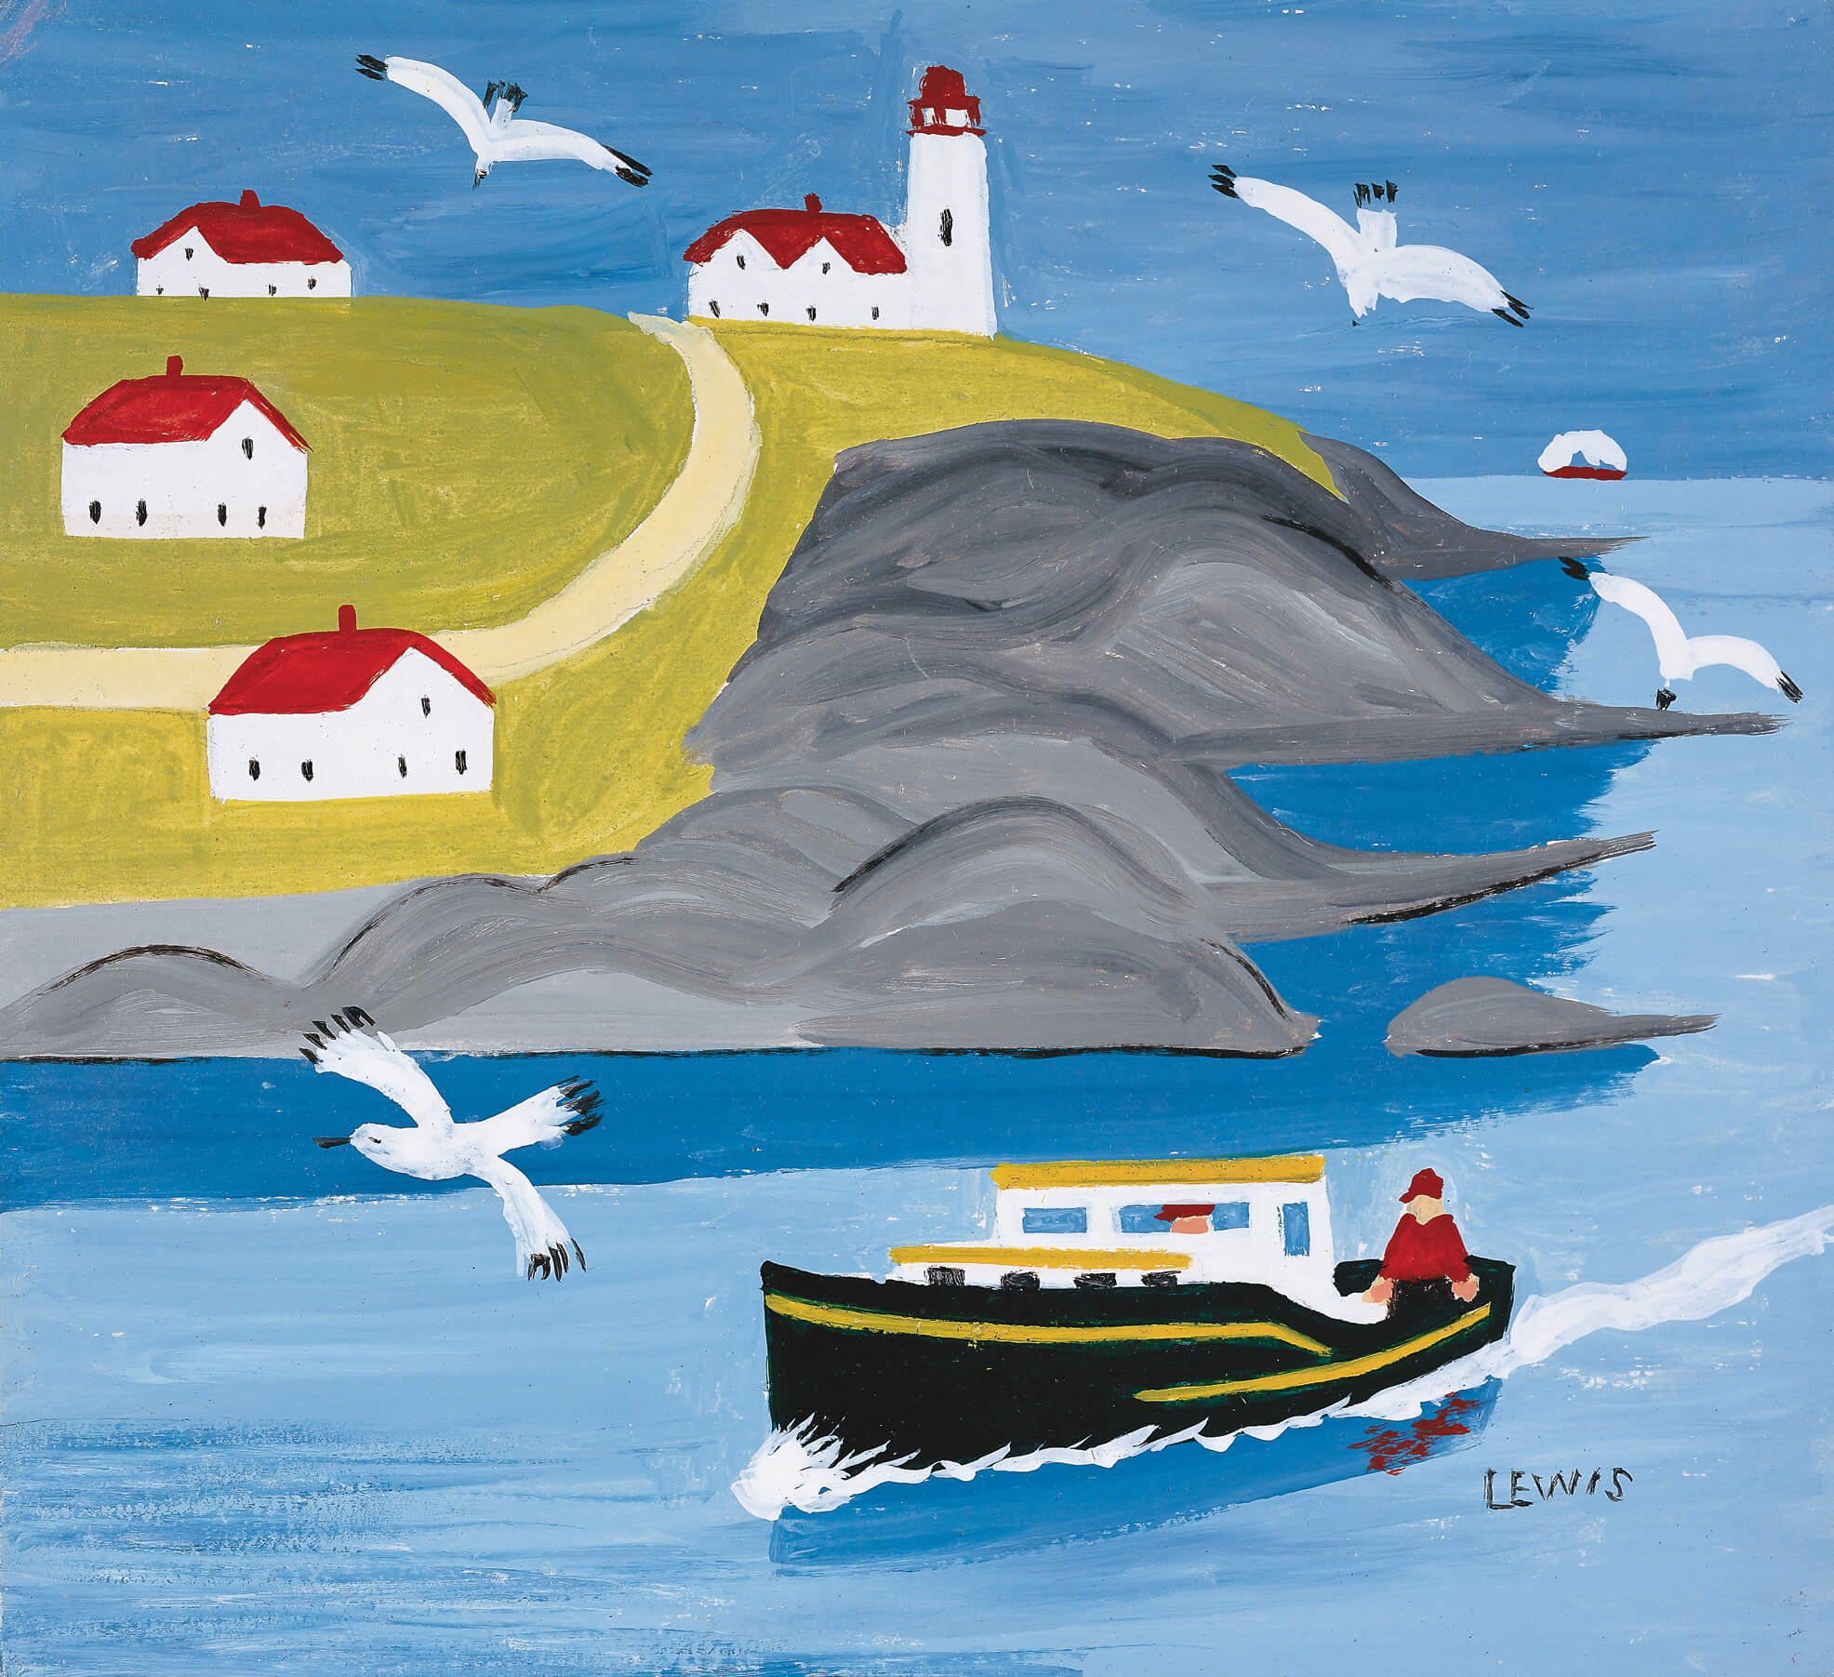
Maud Lewis, Eddie Barnes & Ed Murphy Going Fishing, 1965. Lighthouses and boats appear in many of Lewis’s paintings.

Slide 32
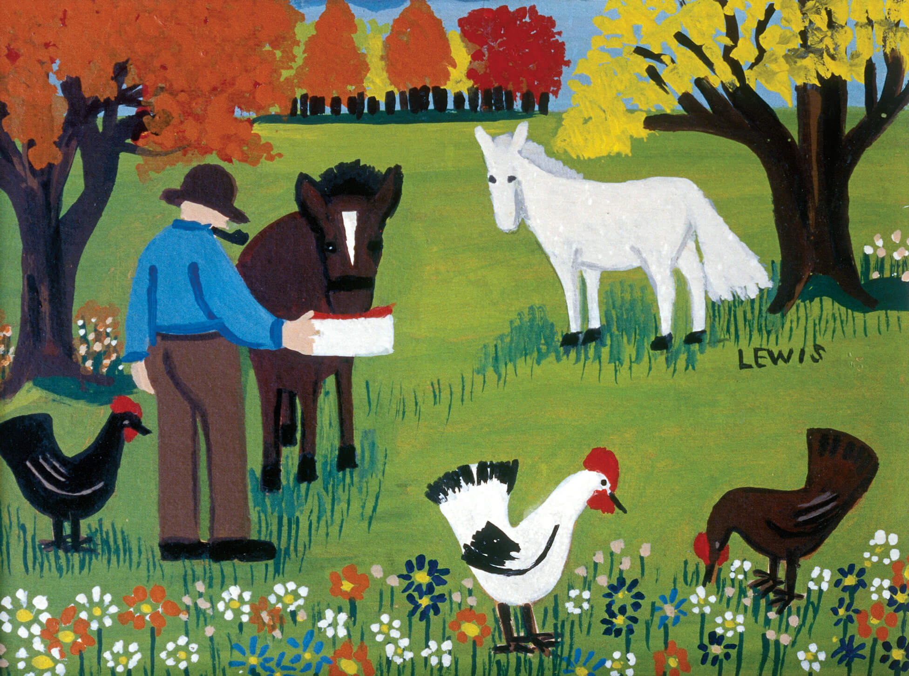
Maud Lewis, Feeding the Horses, n.d. This painting features Lewis’s distinctive images of flowers and autumn trees.

Slide 33
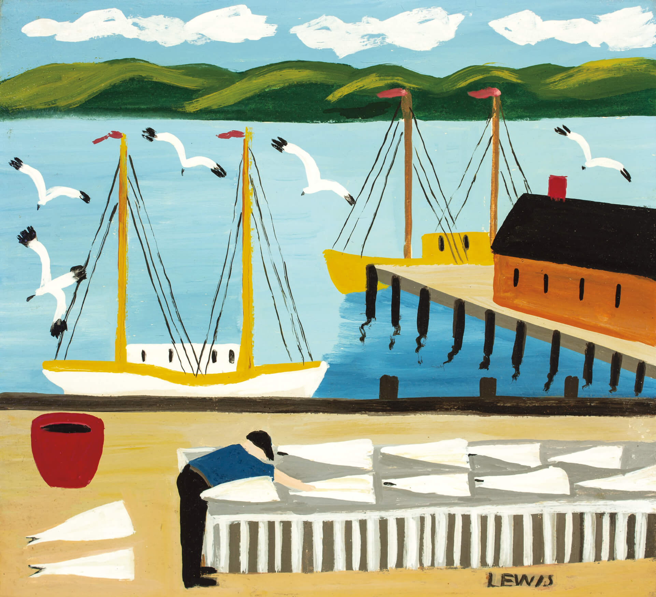
Maud Lewis, Drying Cod Flakes, mid/late 1950s. At the time Maud
and Everett Lewis were married,
he was a fish peddler.

