Slide 1
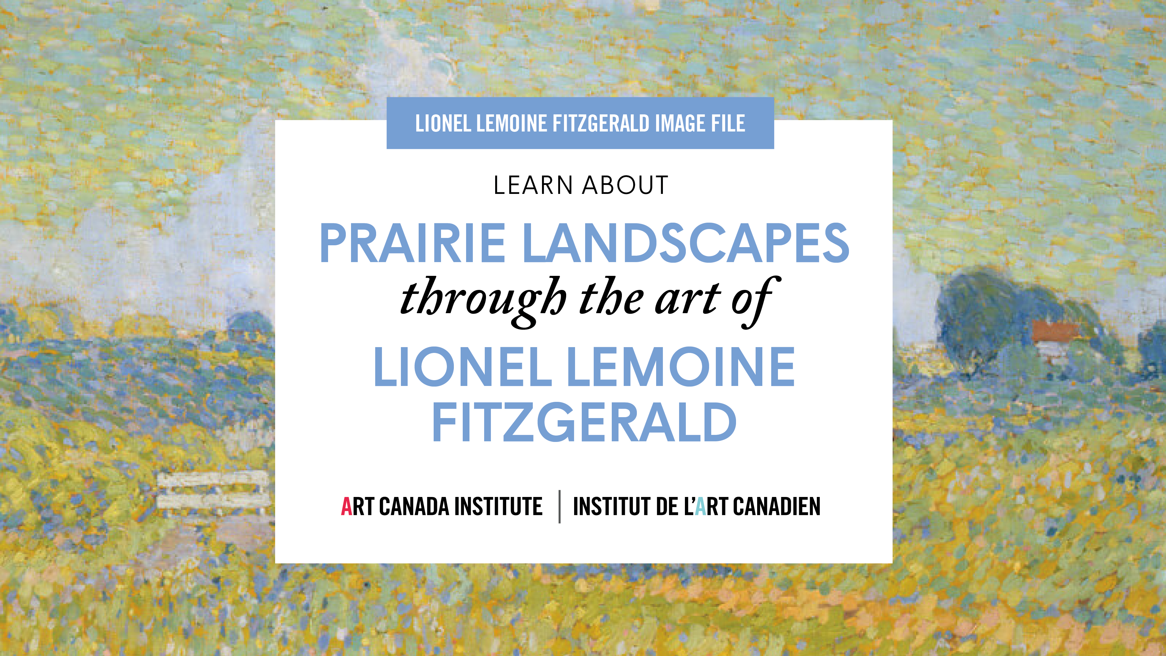

Slide 2
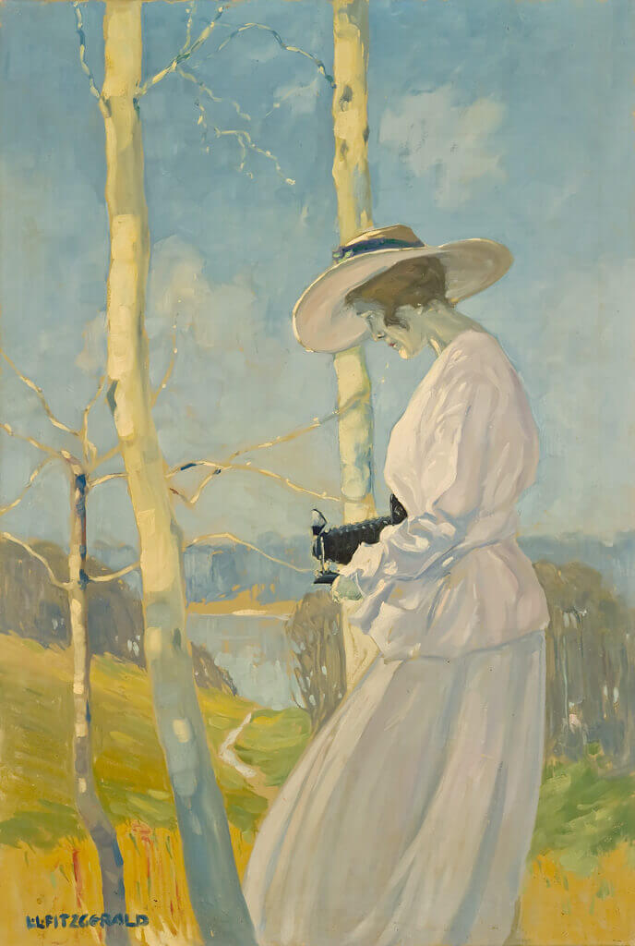
Lionel LeMoine FitzGerald, Woman with Camera Outdoors, c.1917. FitzGerald’s plan for this painting was partly inspired by a camera advertisement.

Slide 3
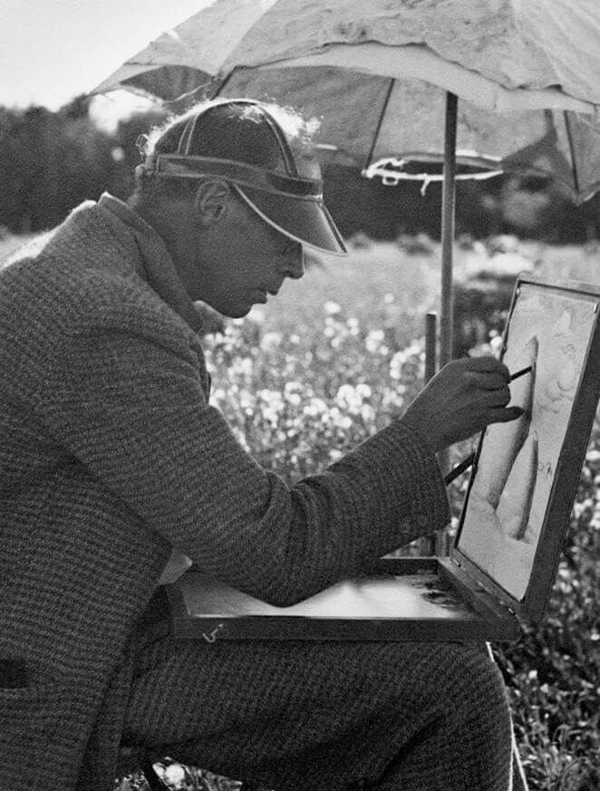
Lionel LeMoine FitzGerald working from a portable sketching box at Silver Heights, August 23, 1934.

Slide 4
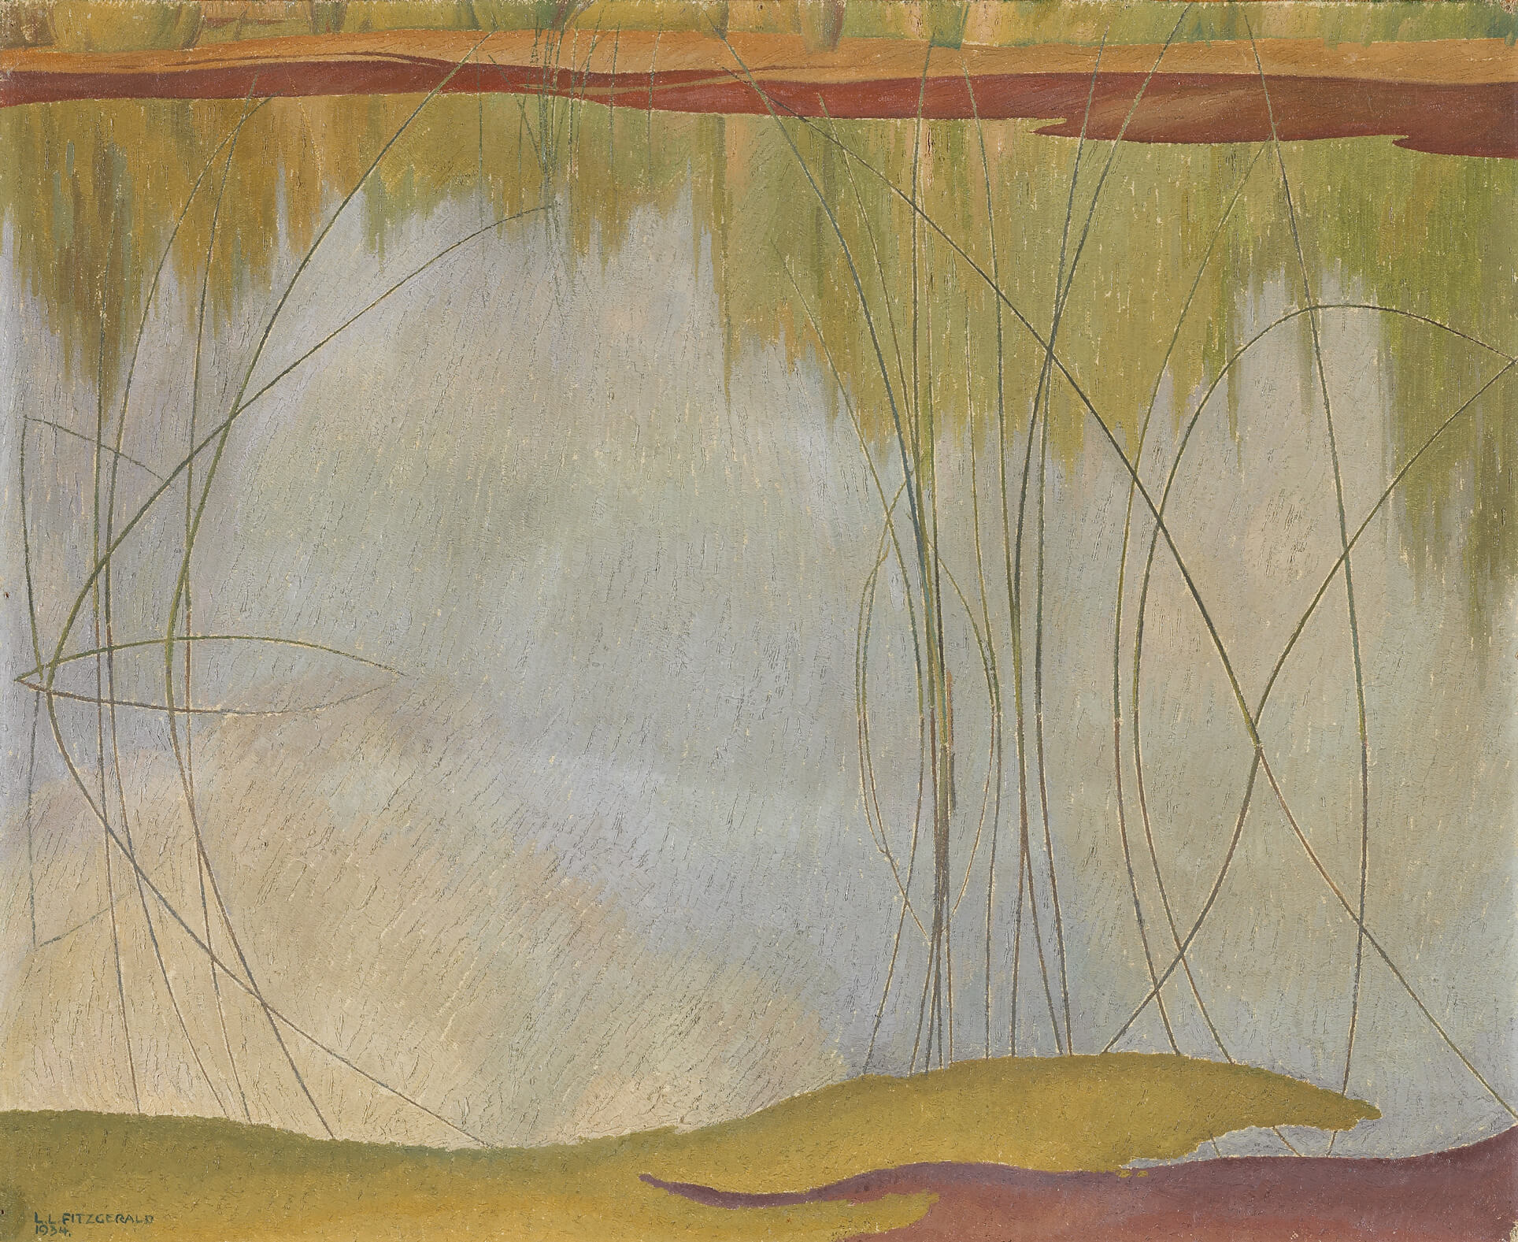
Lionel LeMoine FitzGerald, The Pool, 1934. For this work FitzGerald used the water and reeds to create a composition that was radically different from his other prairie landscapes.

Slide 5
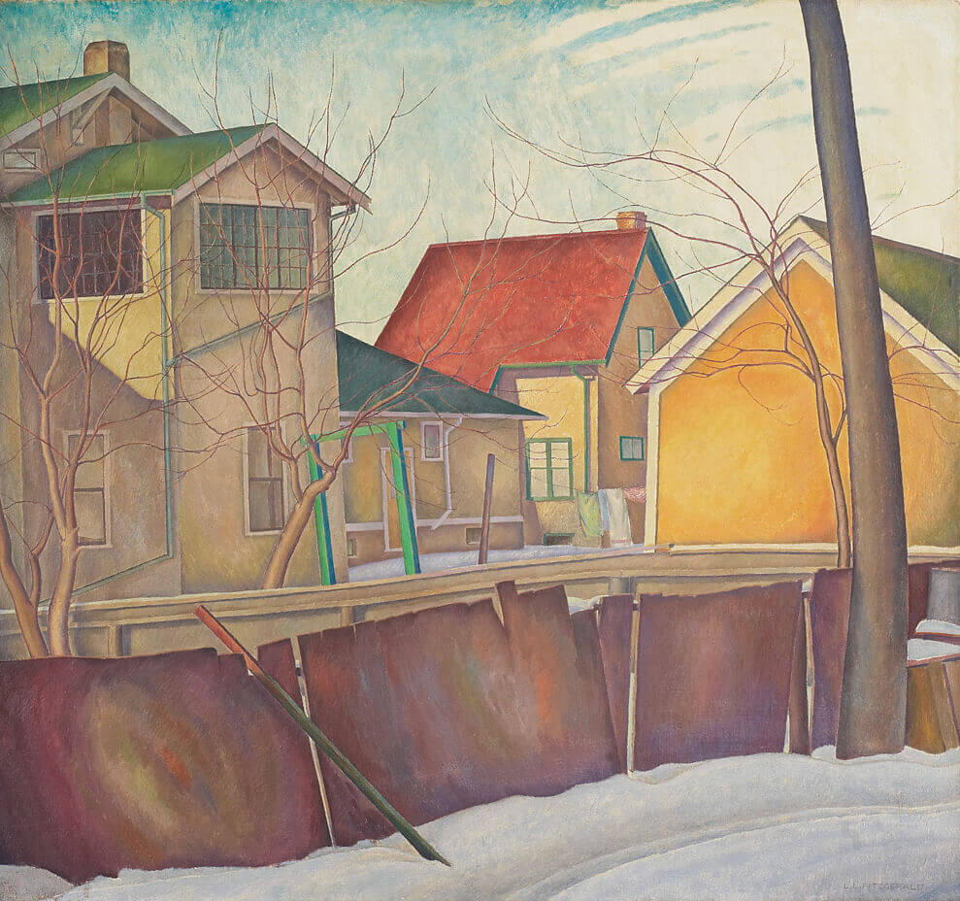
Lionel LeMoine FitzGerald, Pritchard’s Fence, c.1928. Pritchard’s Fence, one of FitzGerald’s most beloved paintings, depicts a typical Winnipeg backyard.

Slide 6
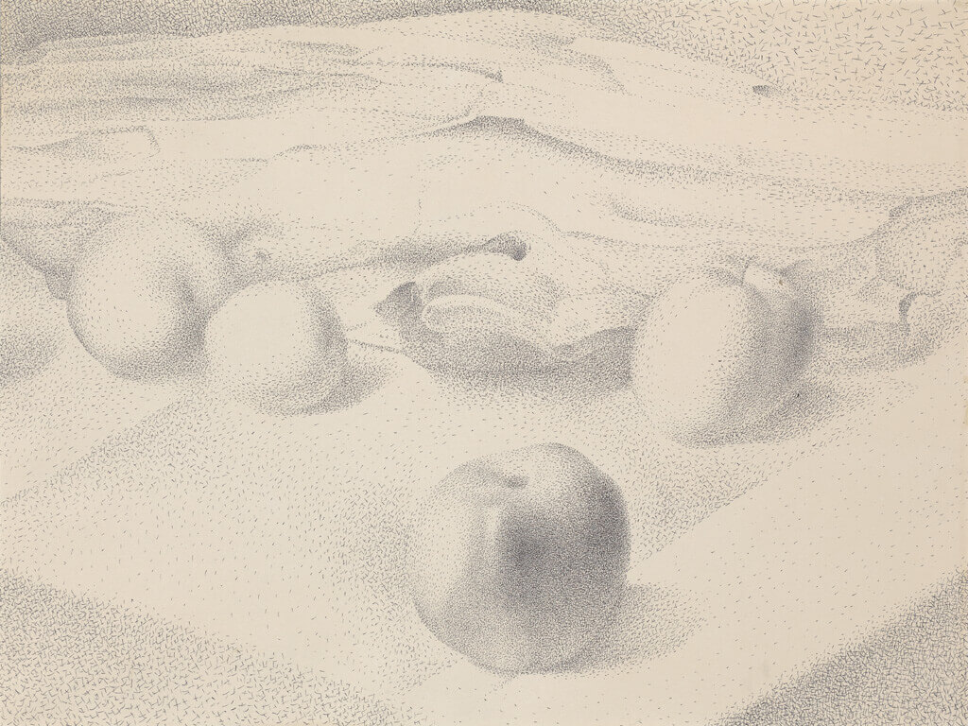
Lionel LeMoine FitzGerald, Four Apples on Tablecloth, December 17, 1947. When FitzGerald created this work, he was exploring new directions in still-life drawing.

Slide 7
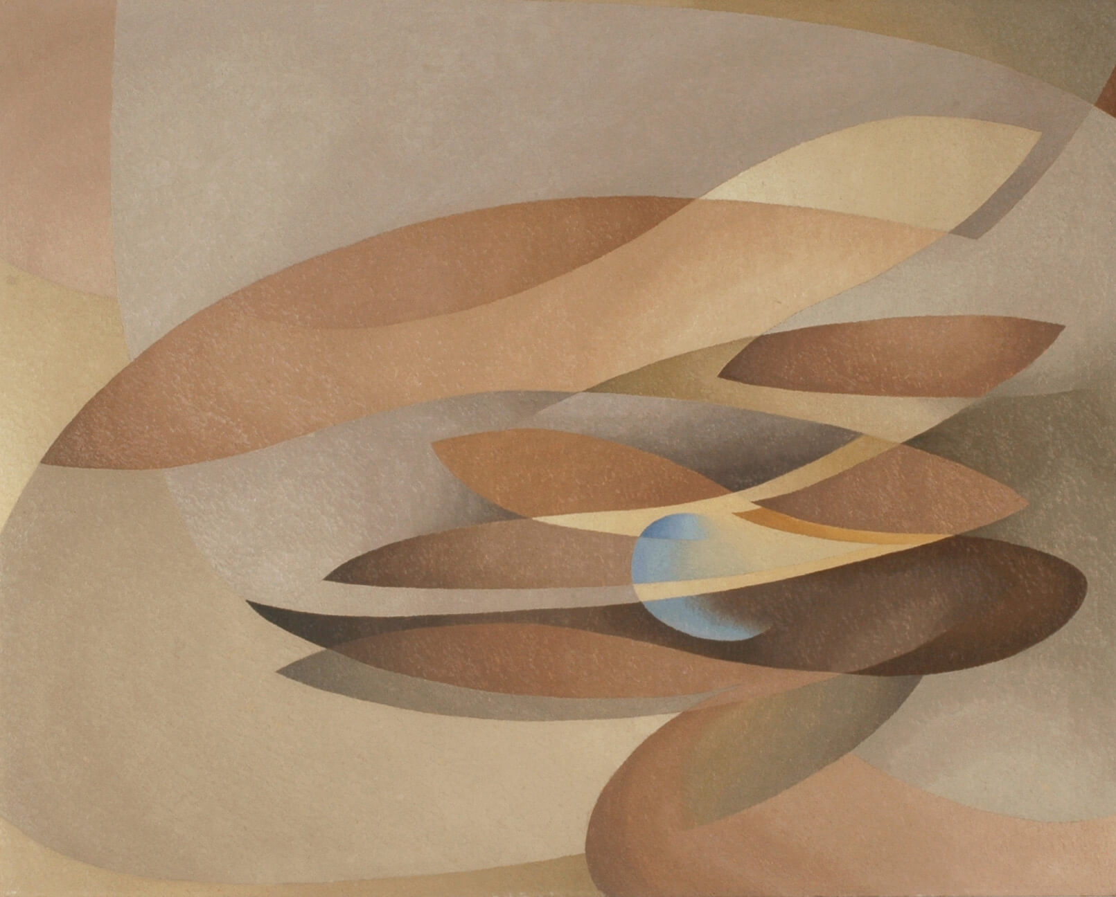
Lionel LeMoine FitzGerald, Autumn Sonata, 1953–54. Autumn Sonata represents a form of abstraction that interested FitzGerald late in his career.

Slide 8
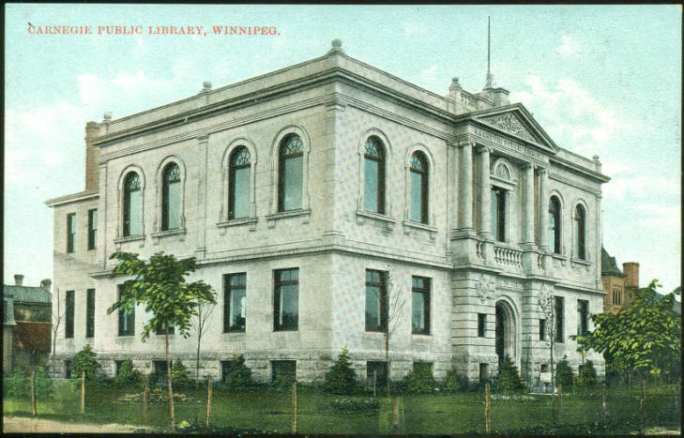
Carnegie Public Library, Winnipeg, 1905–08, postcard published by W.G. MacFarlane.

Slide 9
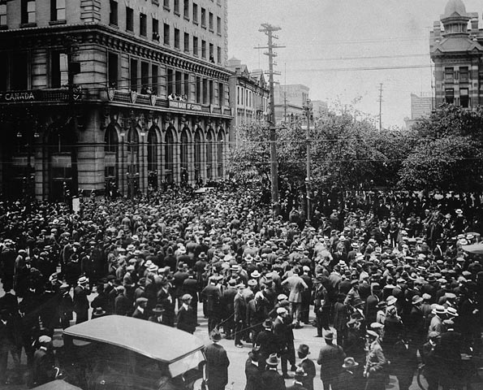
Crowd gathered outside old City Hall during the Winnipeg General Strike, 1919.

Slide 10
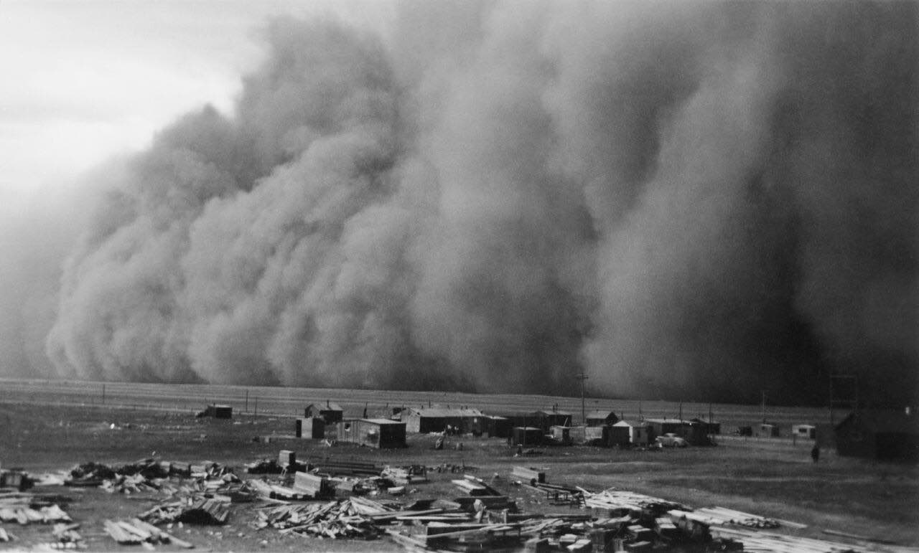
Dust storm, Pearce Airport, Alberta, April 1942.

Slide 11
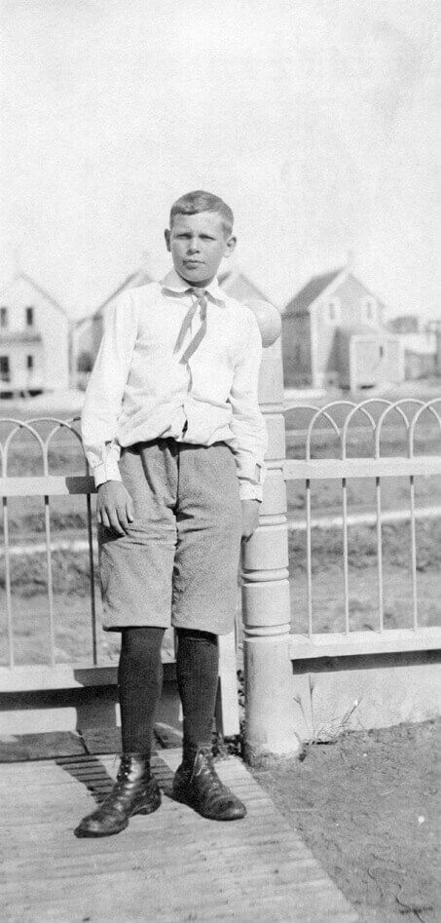
Lionel LeMoine FitzGerald at the front gate of his home, Winnipeg, c.1905.

Slide 12
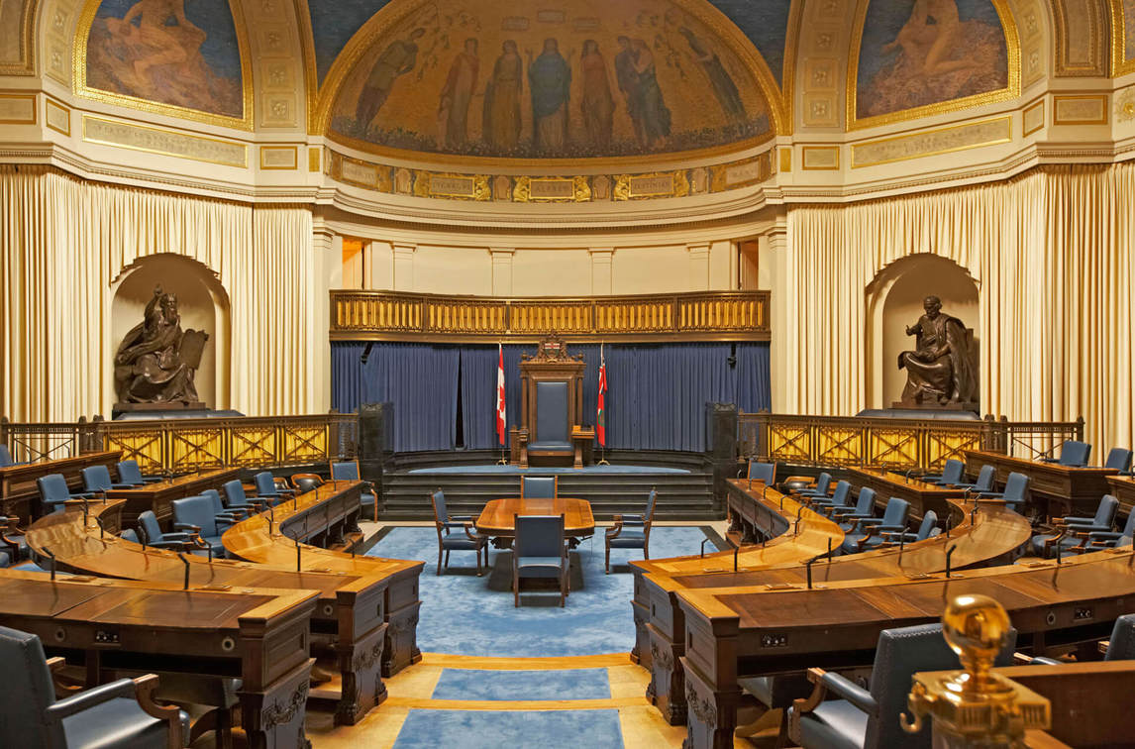
Augustus Vincent Tack’s mural Allegory of Law was unveiled on July 15, 1920, at the Manitoba Legislative Building, Winnipeg.

Slide 13
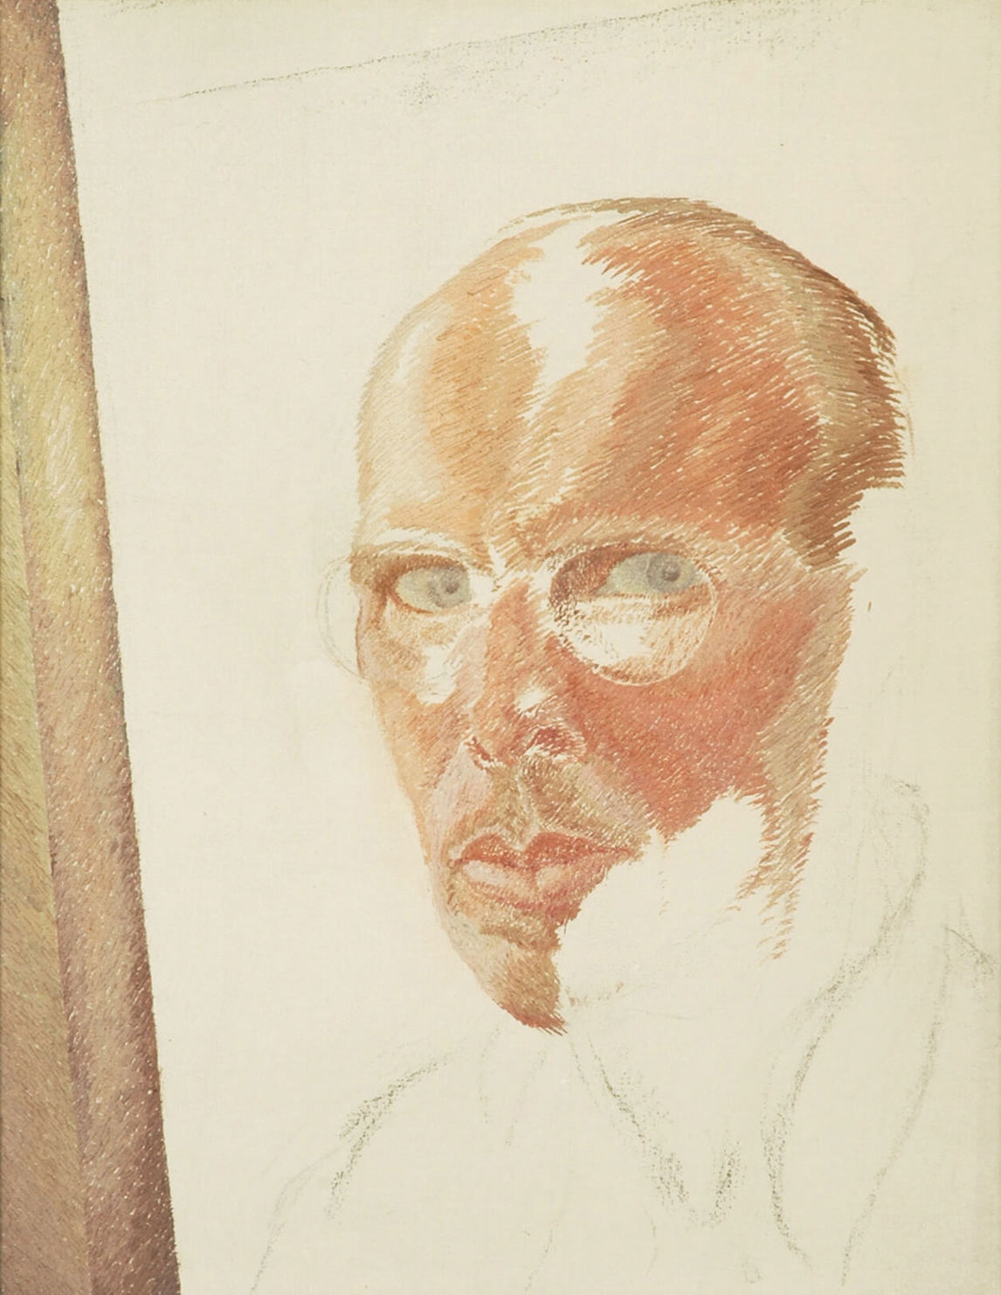
Lionel LeMoine FitzGerald, Self-Portrait, c.1945. Around 1945 FitzGerald created a dozen self-portraits.

Slide 14
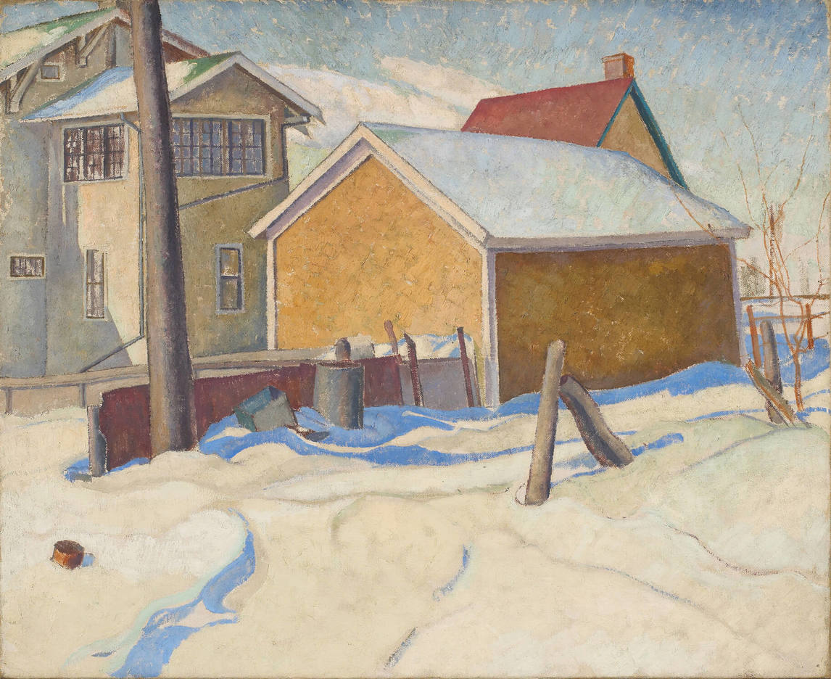
Learning Activity #1
Lionel LeMoine FitzGerald, Garage and House, 1928. FitzGerald was attentive to every detail in a neighbourhood, from buildings and trees to fences and shadows.

Slide 15
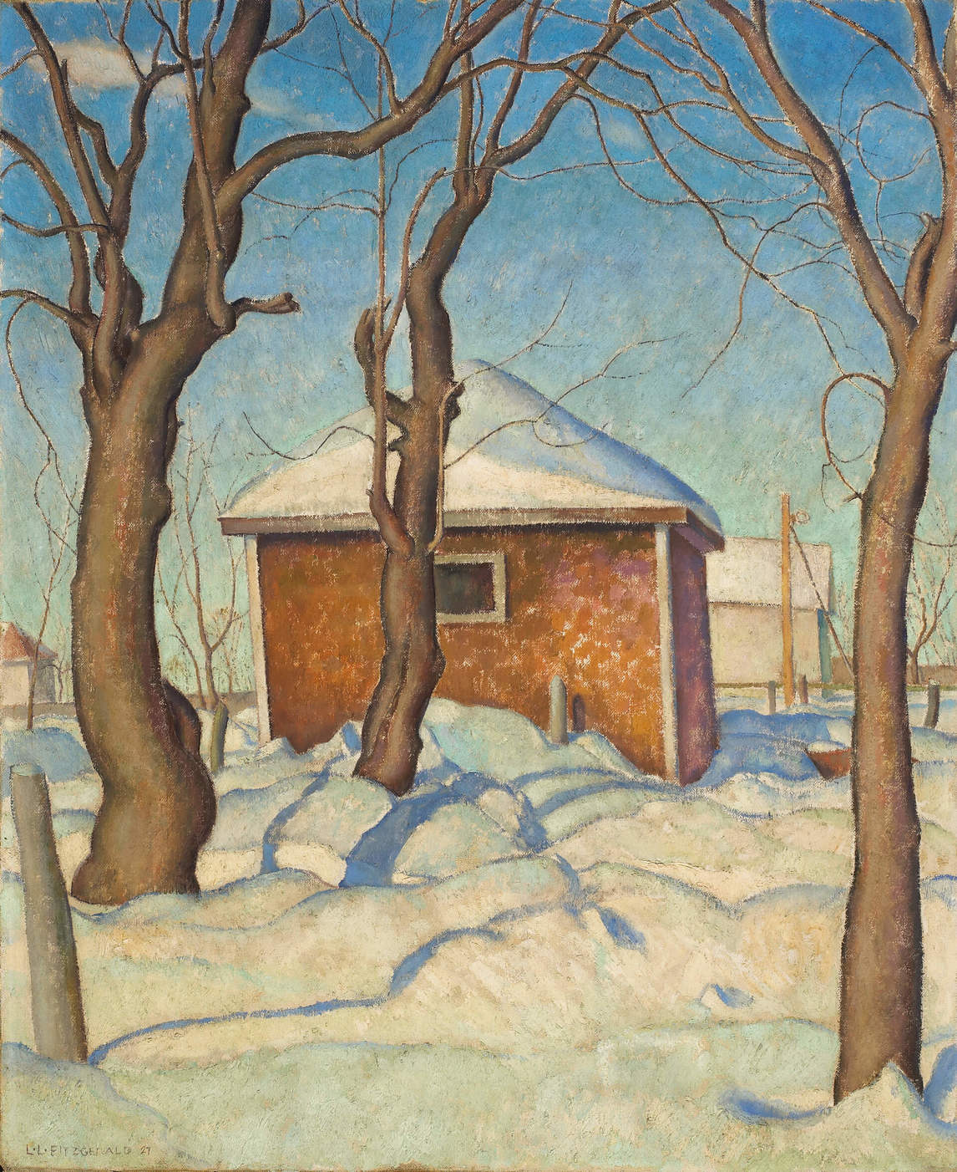
Learning Activity #1
Lionel LeMoine FitzGerald, Williamson’s Garage, 1927. This work was one of FitzGerald’s early efforts to paint a Winnipeg backyard.

Slide 16
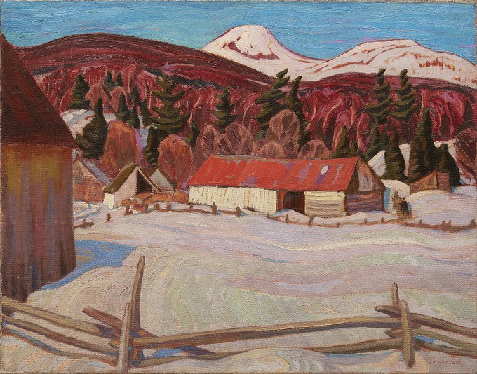
Learning Activity #1
A.Y. Jackson, Red Barn, Petite Rivière, c.1930. Jackson painted many winter landscapes in Quebec.

Slide 17
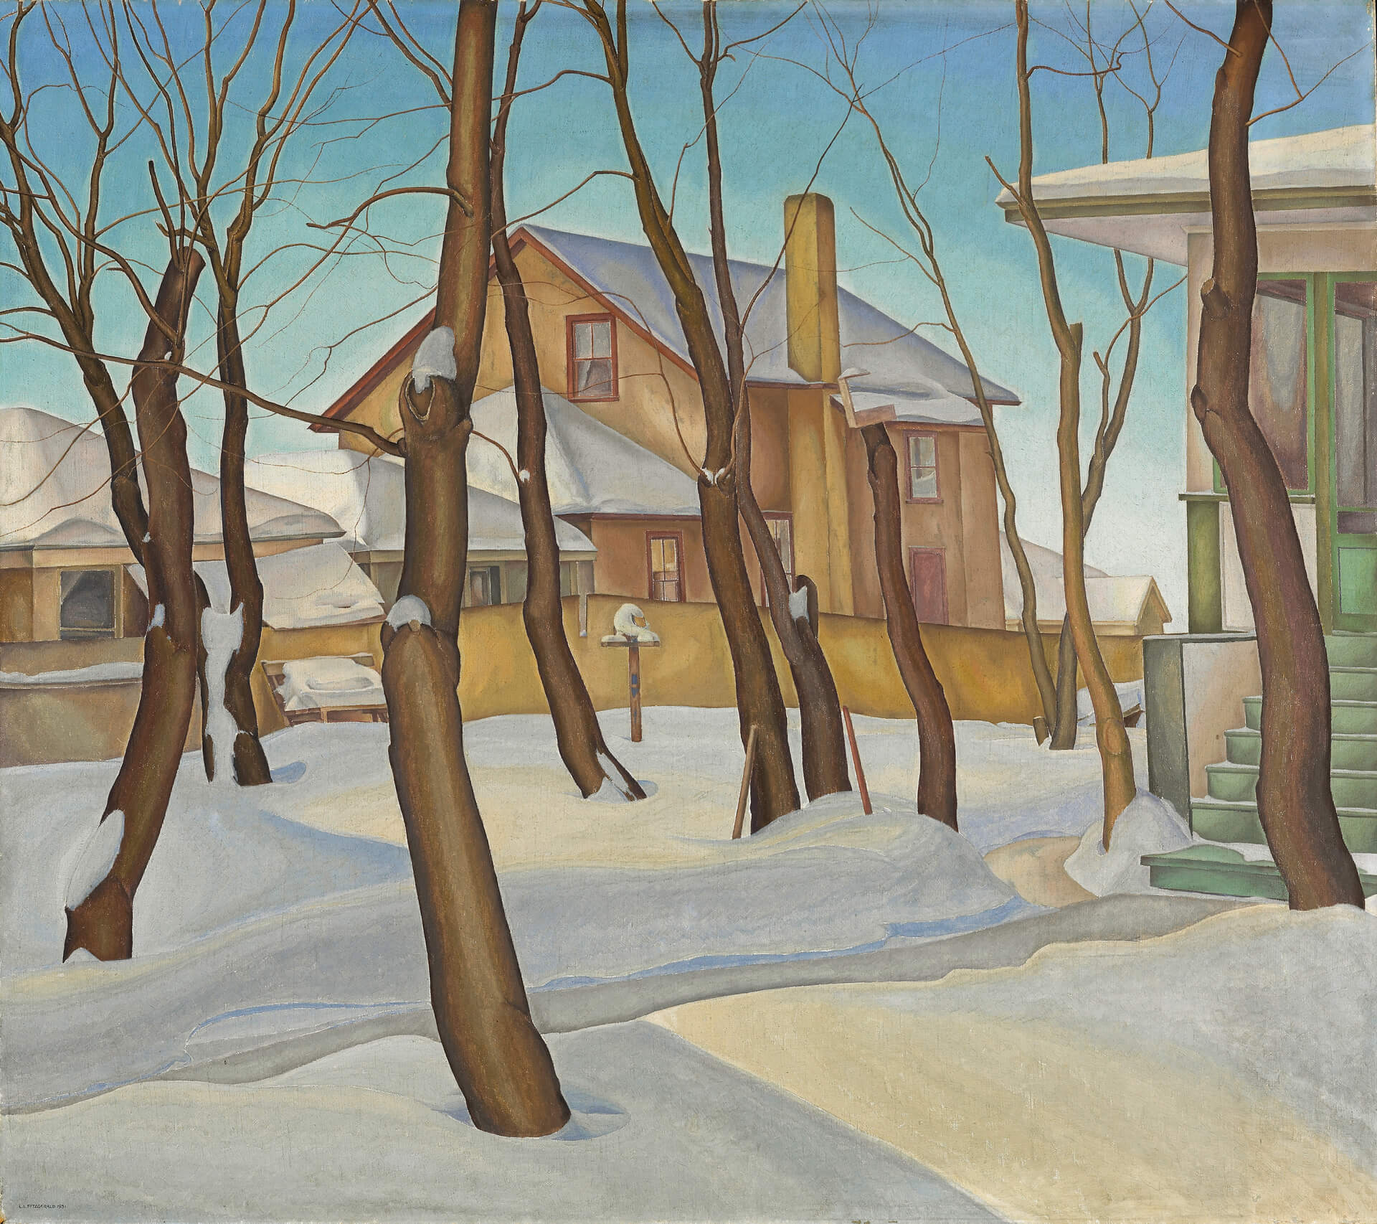
Learning Activity #1
Lionel LeMoine FitzGerald, Doc Snyder’s House, 1931. Dr. Snyder was a Winnipeg dentist and one of FitzGerald’s neighbours.

Slide 18
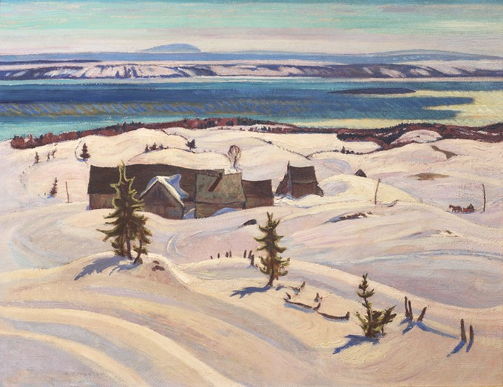
Learning Activity #1
A.Y. Jackson, The St. Lawrence in Winter, c.1931. In this scene the trees and buildings contrast sharply with the thick snow.

Slide 19
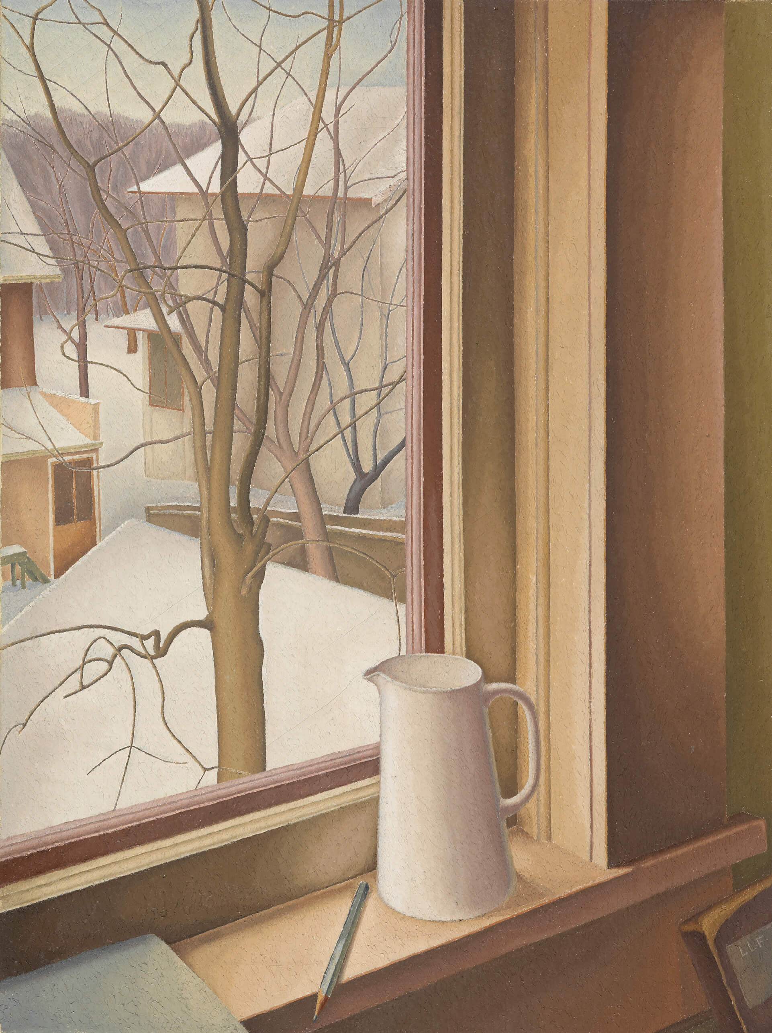
Learning Activity #1
Lionel LeMoine FitzGerald, From an Upstairs Window, Winter, c.1950–51. FitzGerald was particularly interested in this unusual view of a tree that he saw from an attic window.

Slide 20
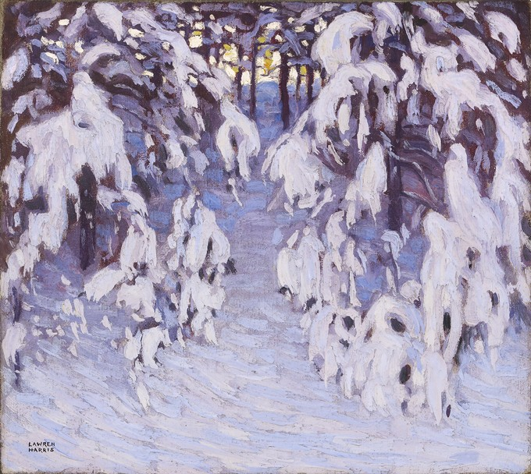
Learning Activity #1
Lawren S. Harris, Snow, Algonquin Park, 1915. Early in his career Harris painted in Algonquin Park.

Slide 21
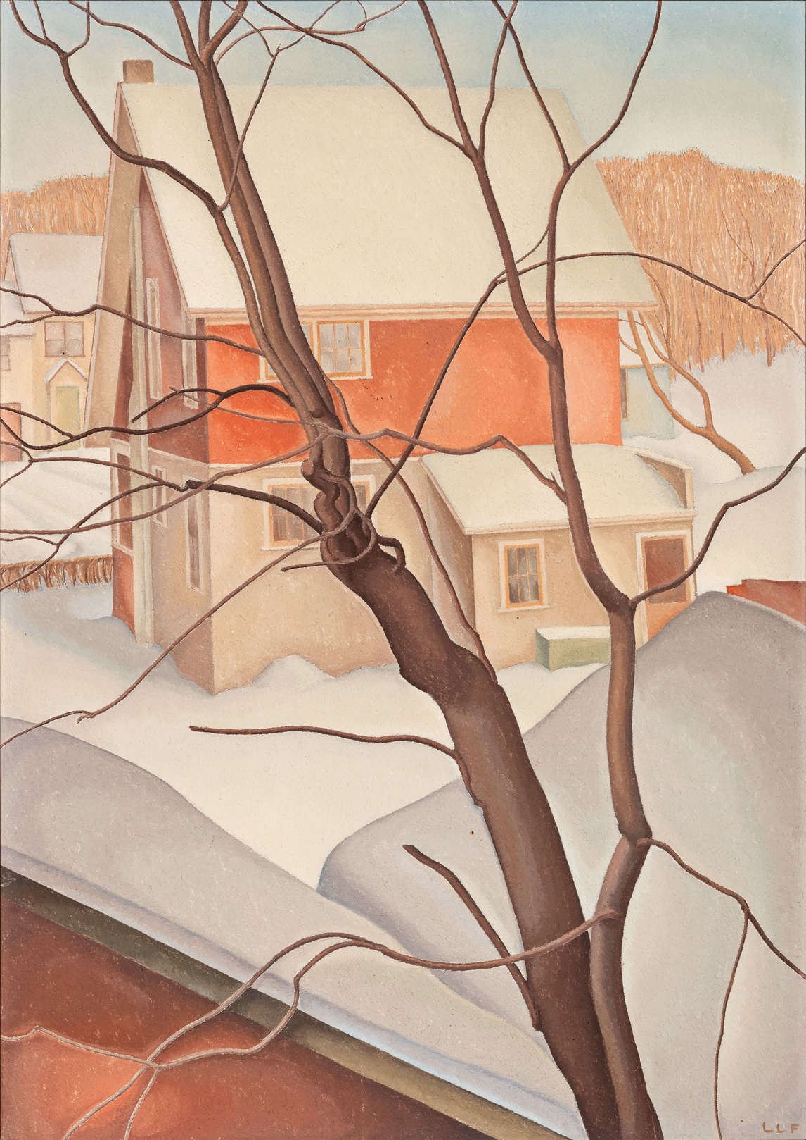
Learning Activity #1
Lionel LeMoine FitzGerald, Oakdale Place, c.1950, oil on Masonite, 59.7 x 42.4 cm, private collection. This painting shows the view directly across to FitzGerald’s neighbour’s house.

Slide 22
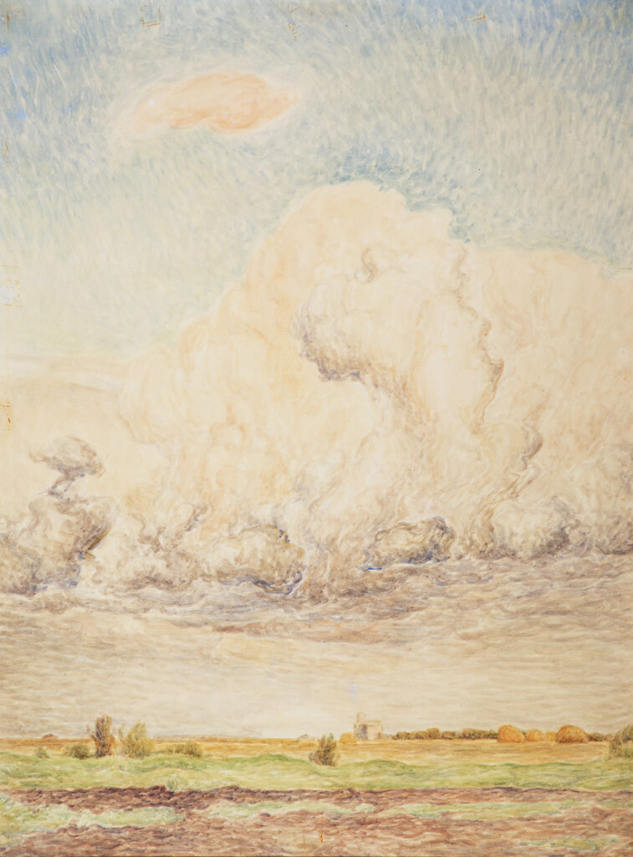
Learning Activity #2
Lionel LeMoine FitzGerald, Manitoba Landscape, 1941. The turbulent clouds in this landscape suggest prairie weather is powerful and ever-changing.

Slide 23
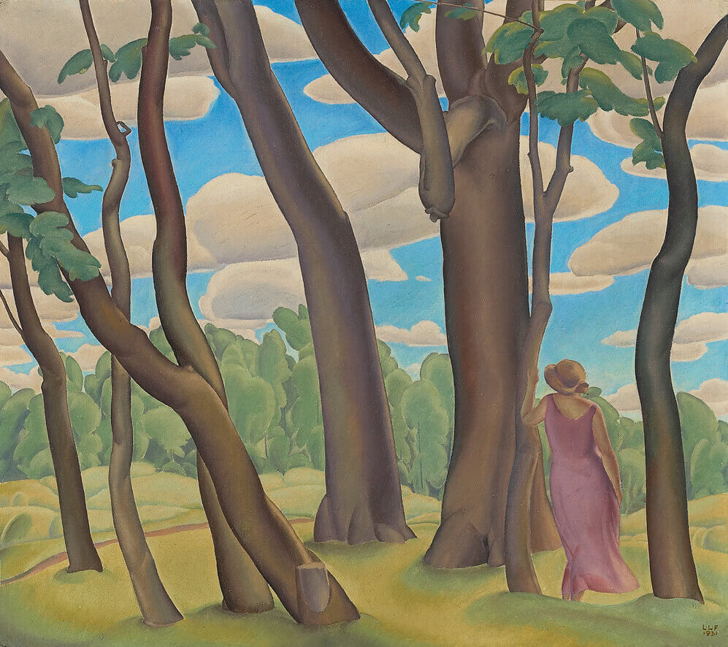
Learning Activity #2
Lionel LeMoine FitzGerald, At Silver Heights, 1931. At Silver Heights represents FitzGerald’s talents at capturing the prairie light in paint.

Slide 24
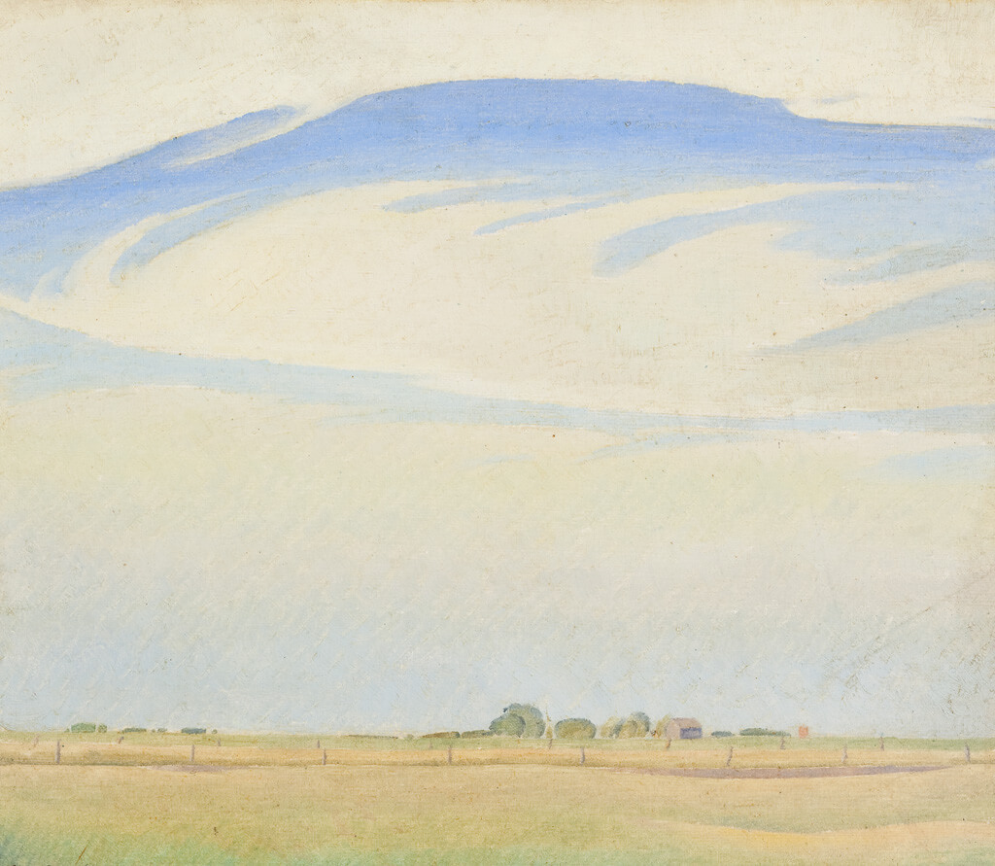
Learning Activity #2
Lionel LeMoine FitzGerald, The Prairie, 1929. In this painting the clouds are delicate but massive.

Slide 25
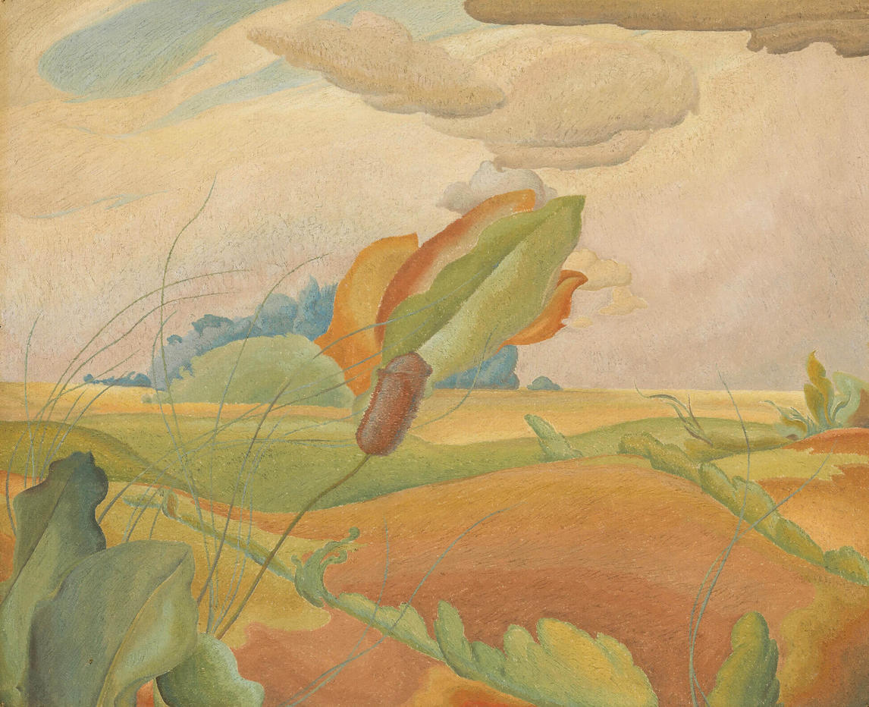
Learning Activity #2
Lionel LeMoine FitzGerald, Prairie Fantasy, c.1934. This work shows small prairie plants set against the horizon and the sky.

Slide 26
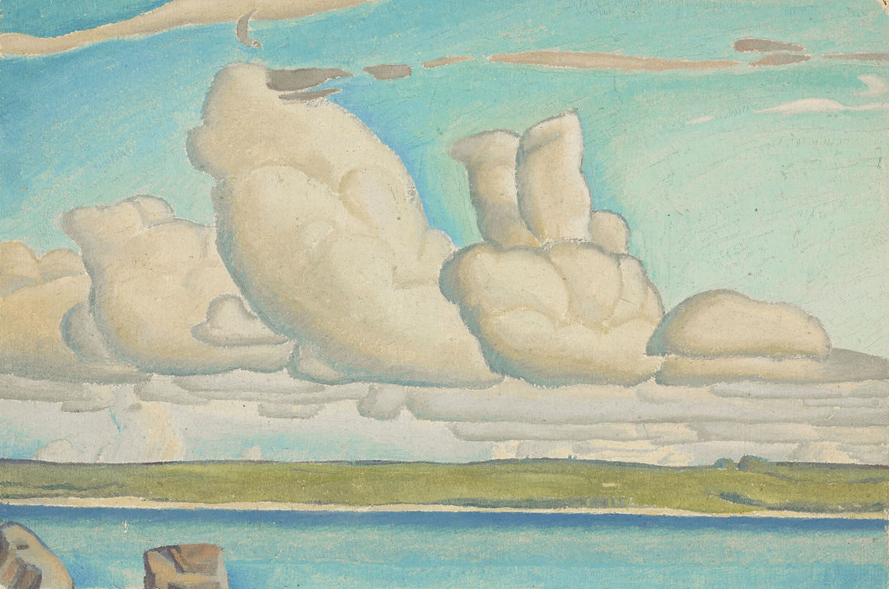
Learning Activity #2
Lionel LeMoine FitzGerald, Prairie Sky, c.1929. The clouds in Prairie Sky have distinct, rounded edges that draw attention to their shapes.

Slide 27
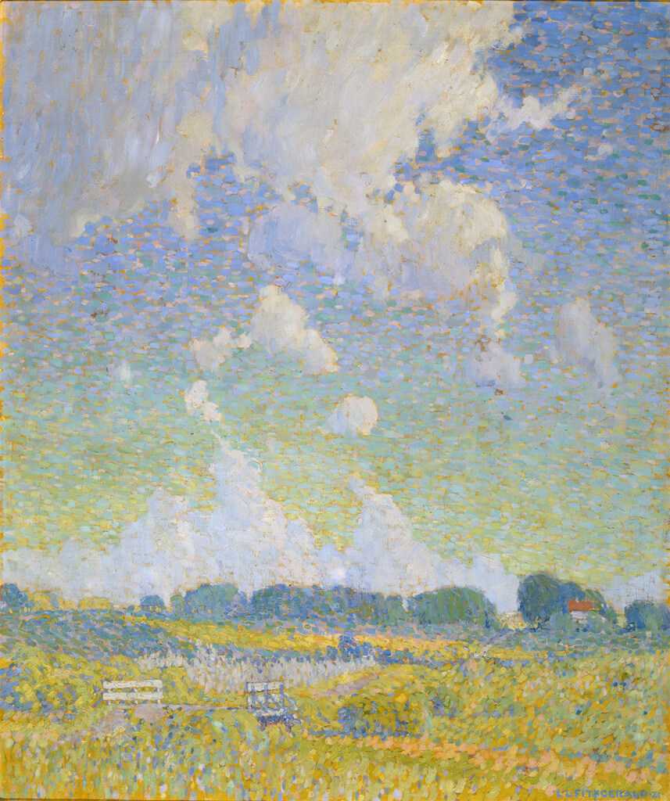
Learning Activity #2
Lionel LeMoine FitzGerald, Summer Afternoon, The Prairie, 1921. This painting was included in major international exhibitions of Canadian art in the 1920s.

Slide 28
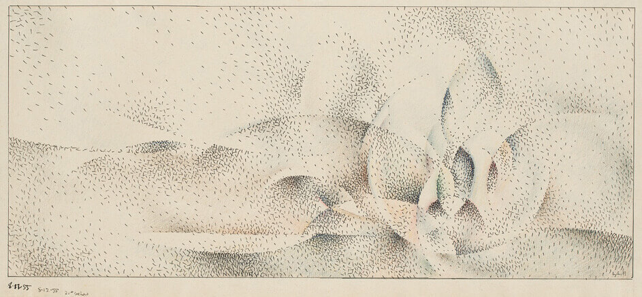
Learning Activity #2
Lionel LeMoine FitzGerald, Abstract, 1955. This drawing is an abstract evocation of landscape and it may have been partly created outdoors—in winter!

Slide 29
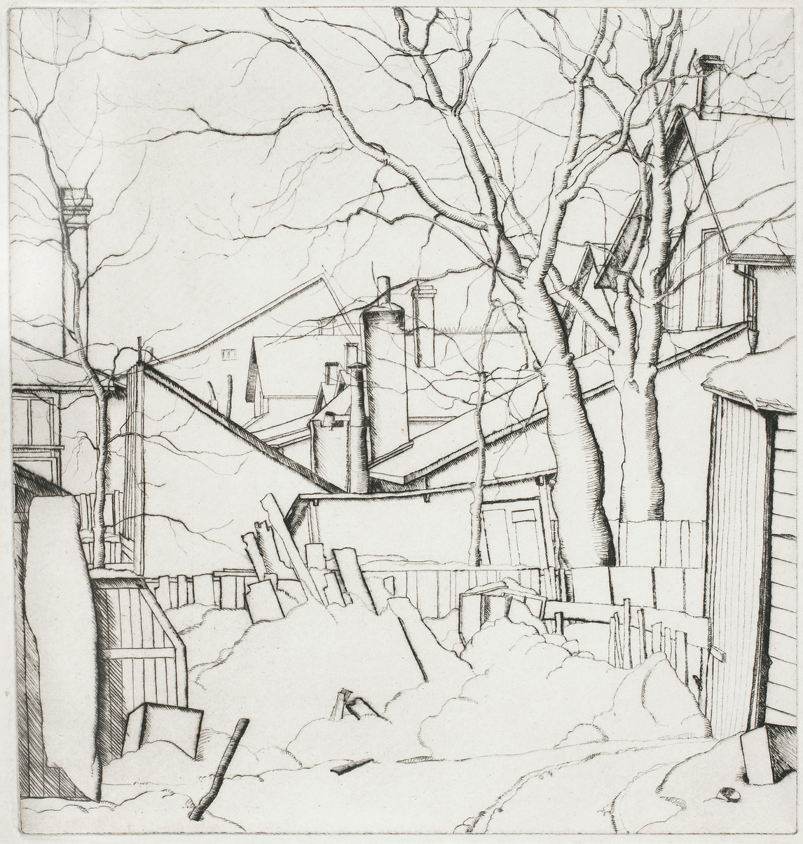
Culminating Task
Lionel LeMoine FitzGerald, Backyards, Water Street, 1927. In this print a blanket of snow lends quiet and harmony to a debris-filled backyard.

Slide 30
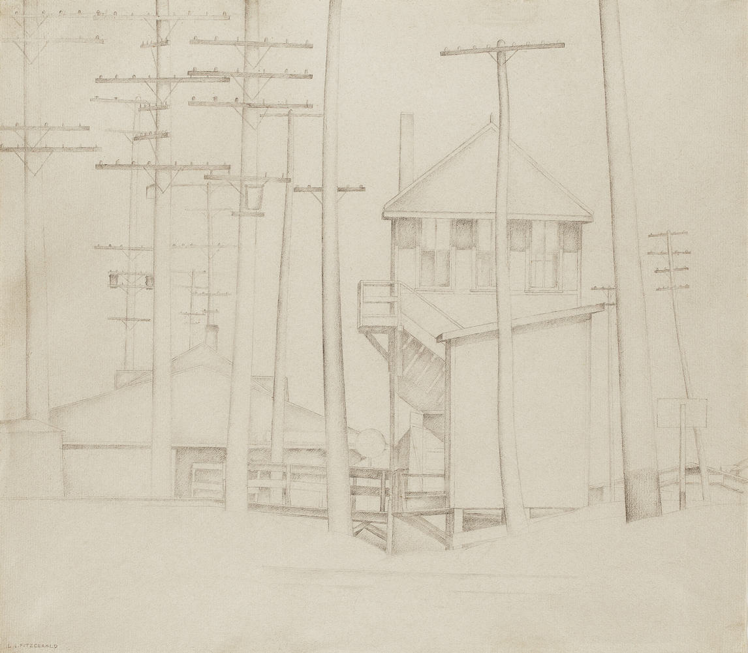
Culminating Task
Lionel LeMoine FitzGerald, Railway Station, c.1931–32. Railway Station shows several different structures, drawn with crisp edges that suggest the strength of the walls and poles.

Slide 31
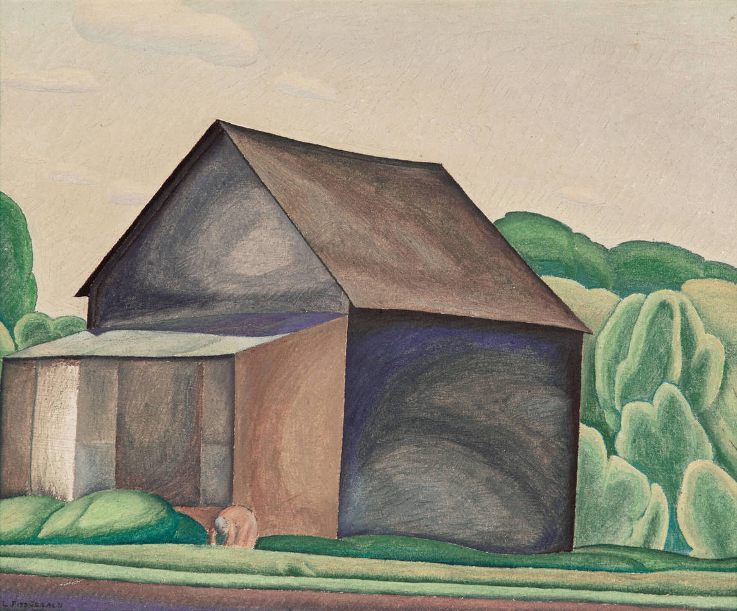
Culminating Task
Lionel LeMoine FitzGerald, The Barn, c.1930. When this painting was exhibited, one critic praised it for “austere beauty.”

Slide 32
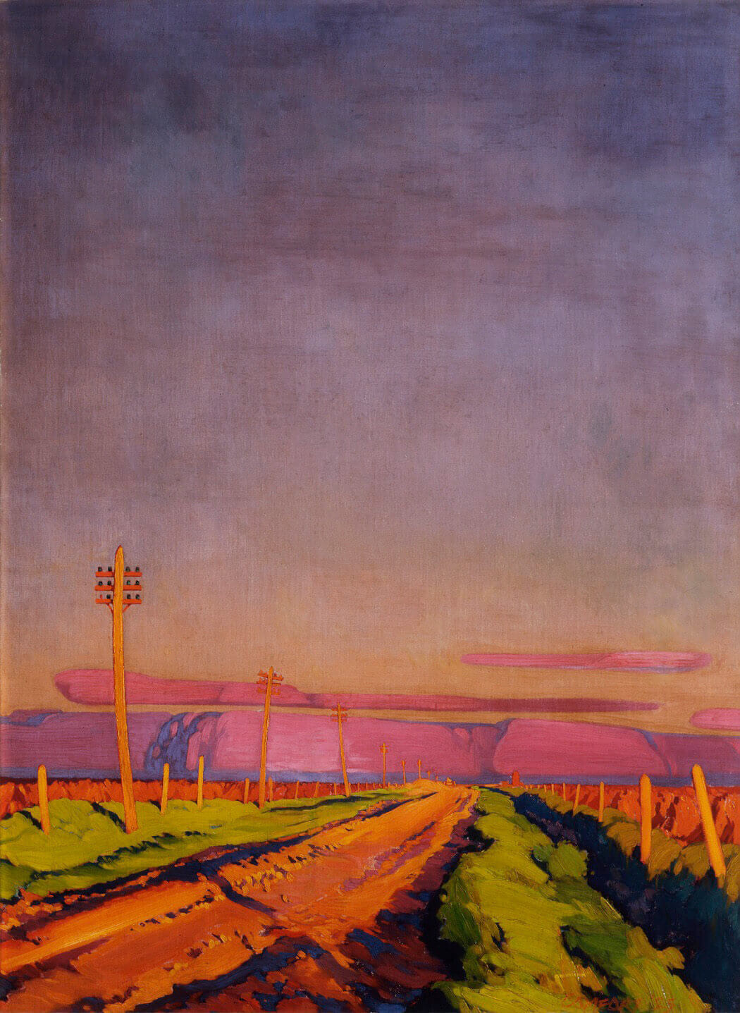
Culminating Task
Charles Comfort, Prairie Road, 1925. Charles Comfort (1900–1994) was a friend of Lionel LeMoine FitzGerald, and he was also interested in the prairie landscape.

Slide 33
Culminating Task
Lionel LeMoine FitzGerald, The Prairie, 1929. In this painting buildings are visible near the horizon.

Slide 34
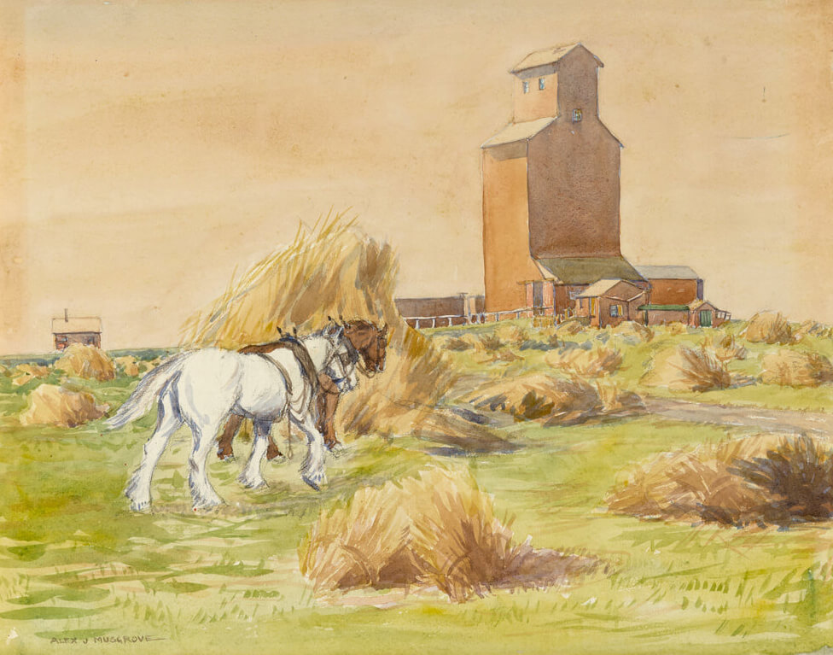
Culminating Task
Alexander J. Musgrove, Country Elevator with Horses and Field of Hay, c.1920–29. Musgrove’s watercolour centres on a grain elevator.

Slide 35
Culminating Task

Slide 36
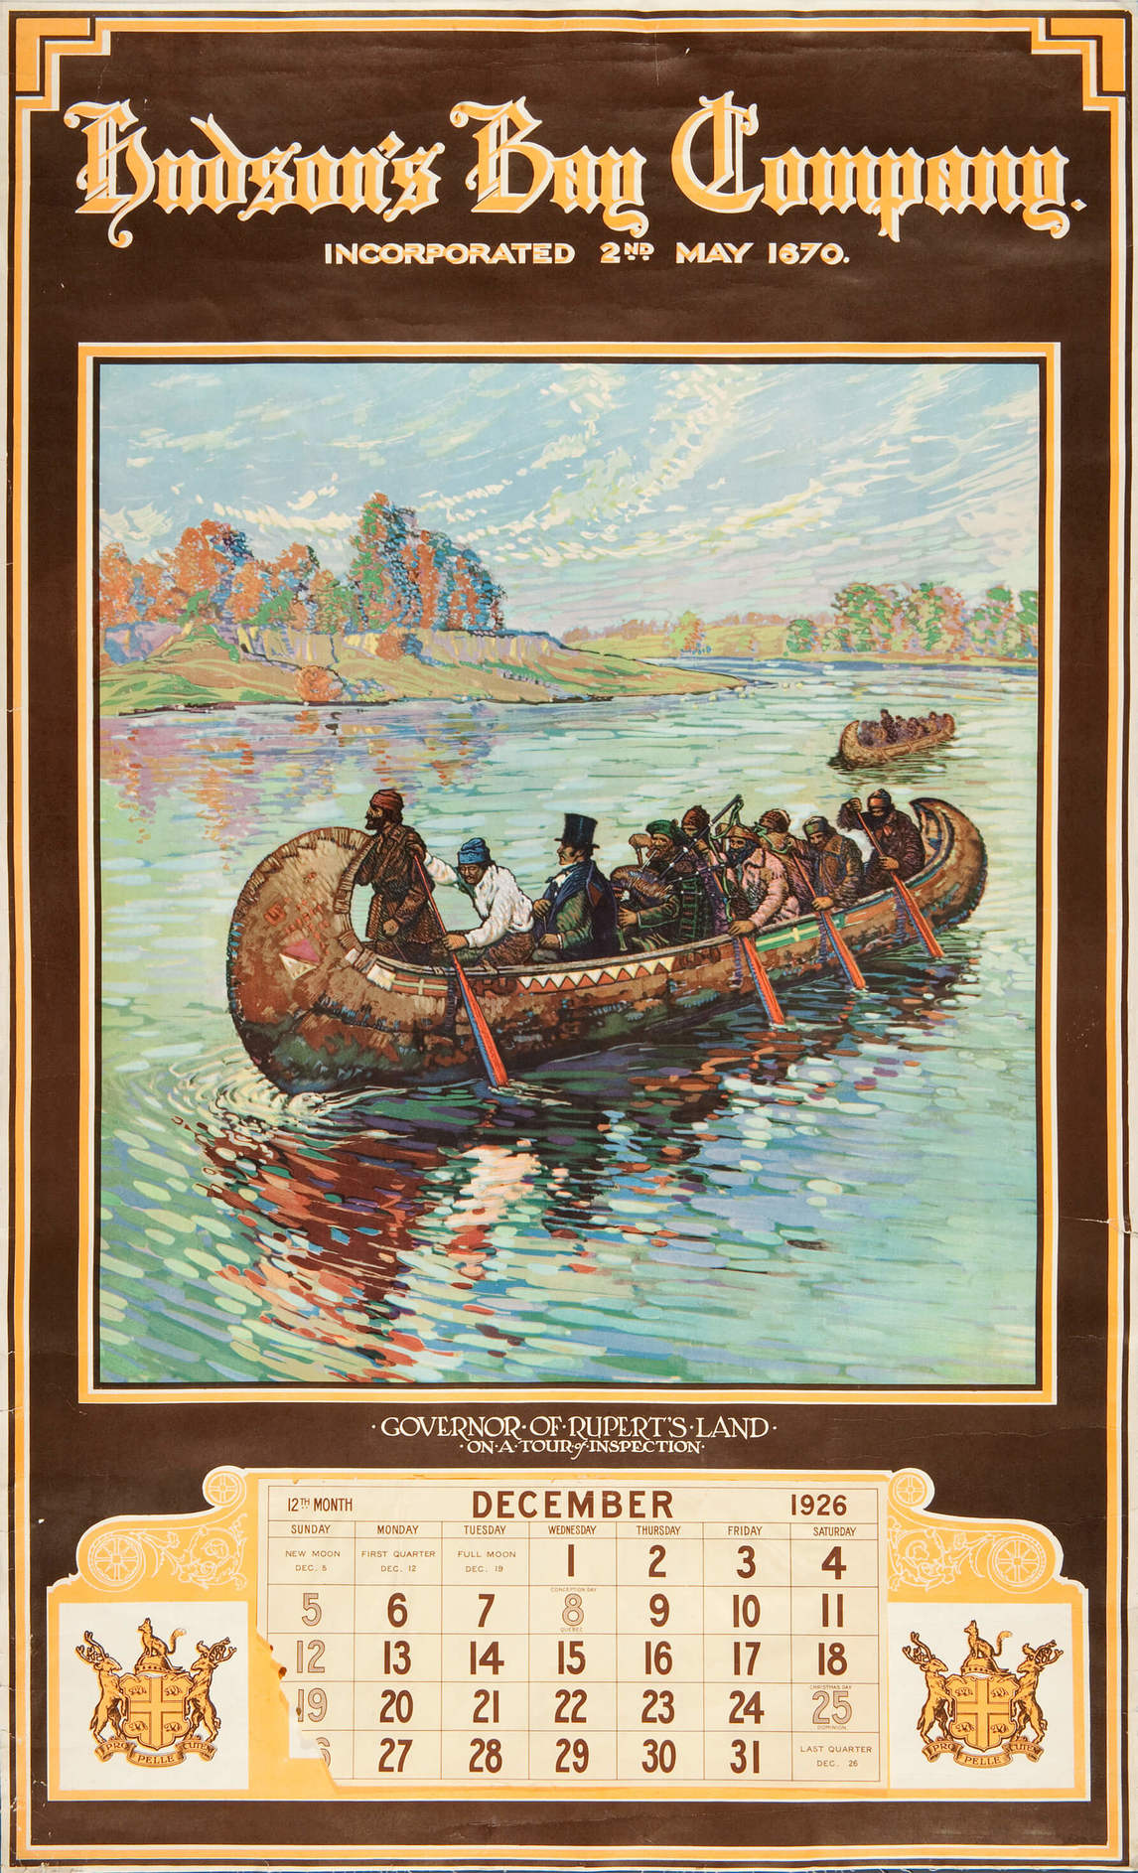
Lionel LeMoine FitzGerald, Sir George Simpson, Governor of Rupert’s Land on a Tour of Inspection Calendar, 1926.

Slide 37
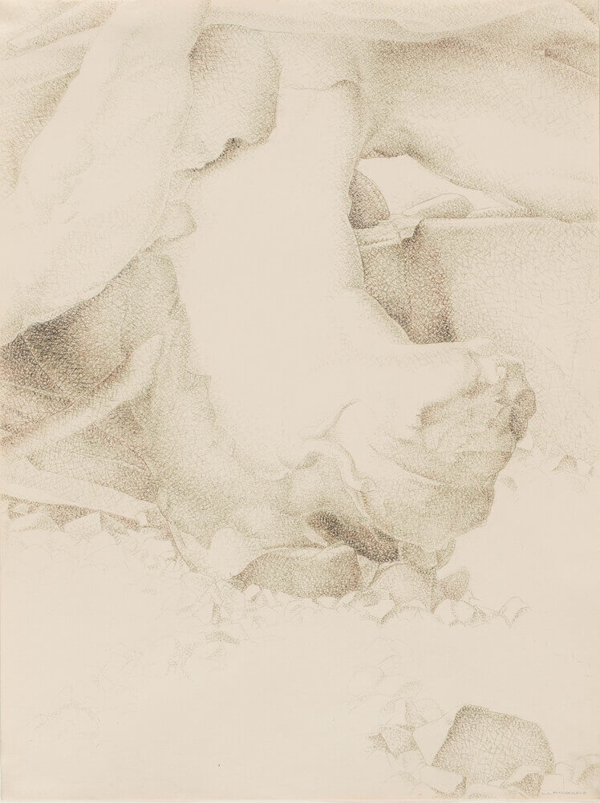
Lionel LeMoine FitzGerald, Driftwood, 1944. This drawing was inspired by a trip to Bowen Island, British Columbia.

Slide 38
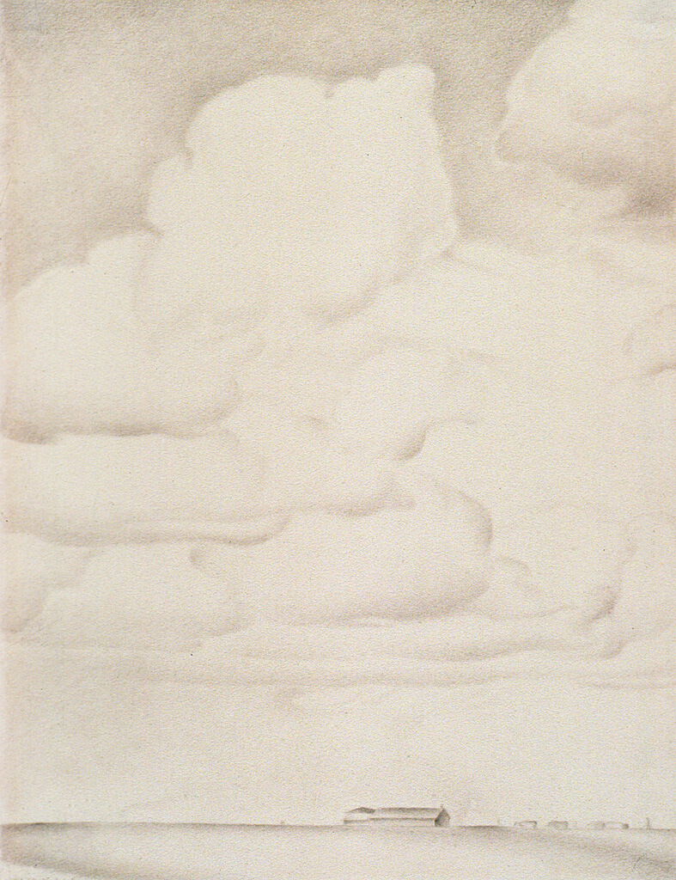
Lionel LeMoine FitzGerald, Prairie Landscape, June 27, 1935. The even pencil work of Prairie Landscape helps convey the uniform light of a sundrenched prairie day.

Slide 39
Lionel LeMoine FitzGerald, Doc Snyder’s House, 1931. This painting took FitzGerald two winters to complete.

Slide 40
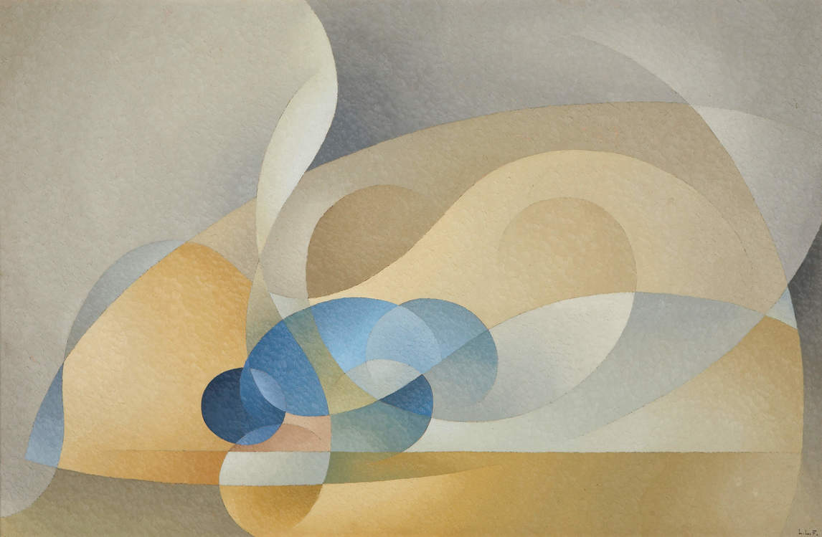
Lionel LeMoine FitzGerald, Abstract in Blue and Gold, 1954. For this painting FitzGerald employed miniscule brush strokes.

Slide 41
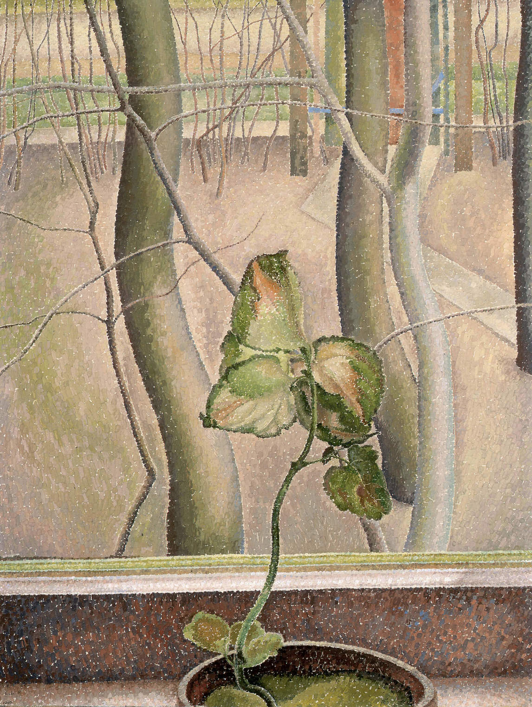
Lionel LeMoine FitzGerald, The Little Plant, 1947. In this painting the exuberant growth of the flowering plant indoors is a counterpoint to the energy of the trees outside.

