Slide 2
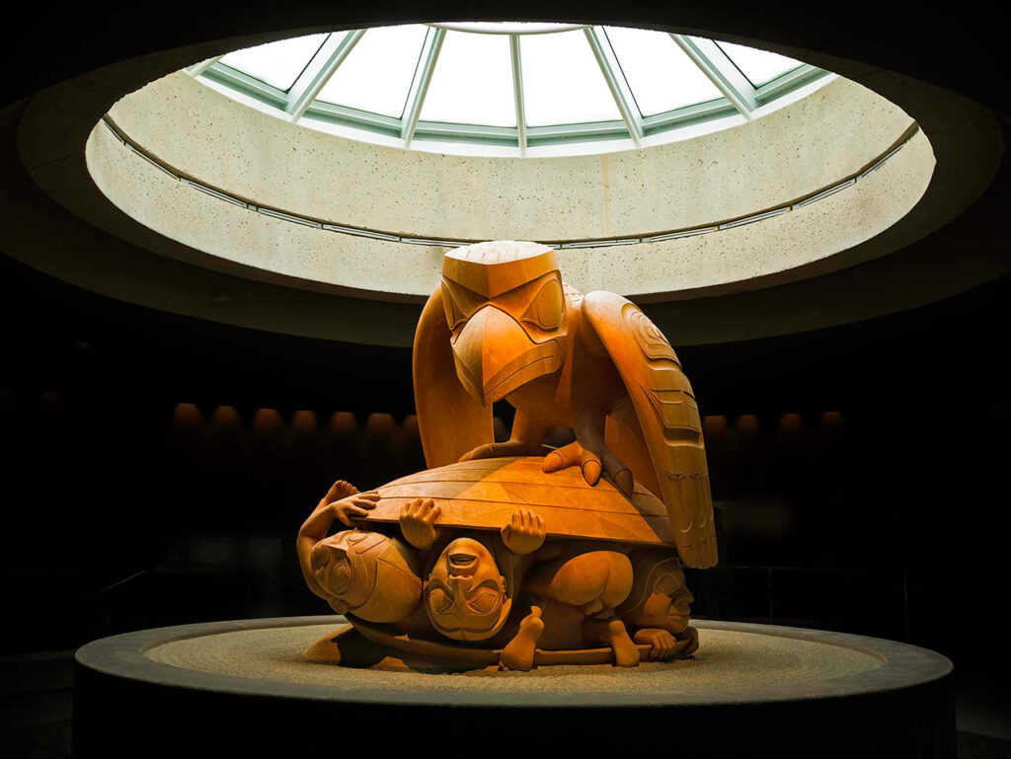
Bill Reid, The Raven and the First Men, 1980. One of Reid’s most iconic large-scale works depicts a Haida creation story.

Slide 3
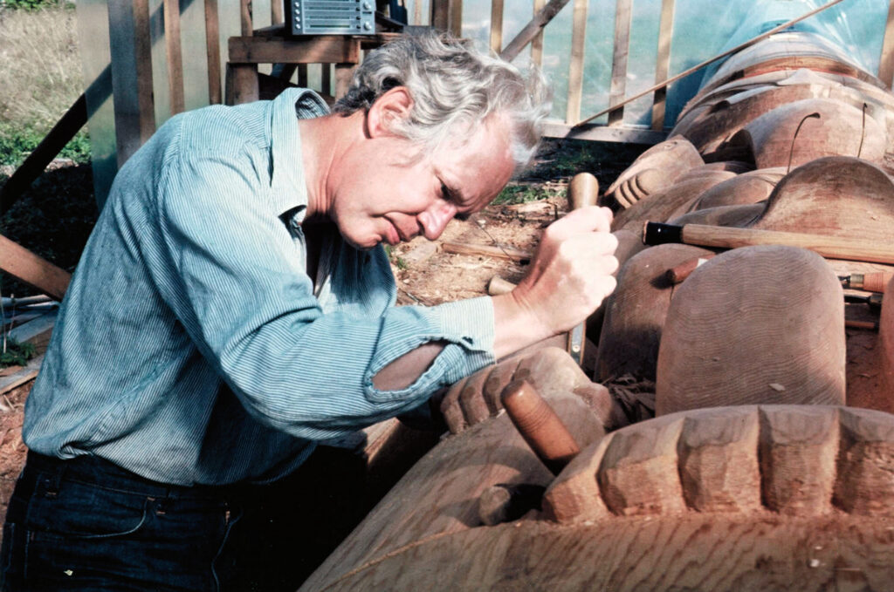
Bill Reid carving in Skidegate, 1976.

Slide 4
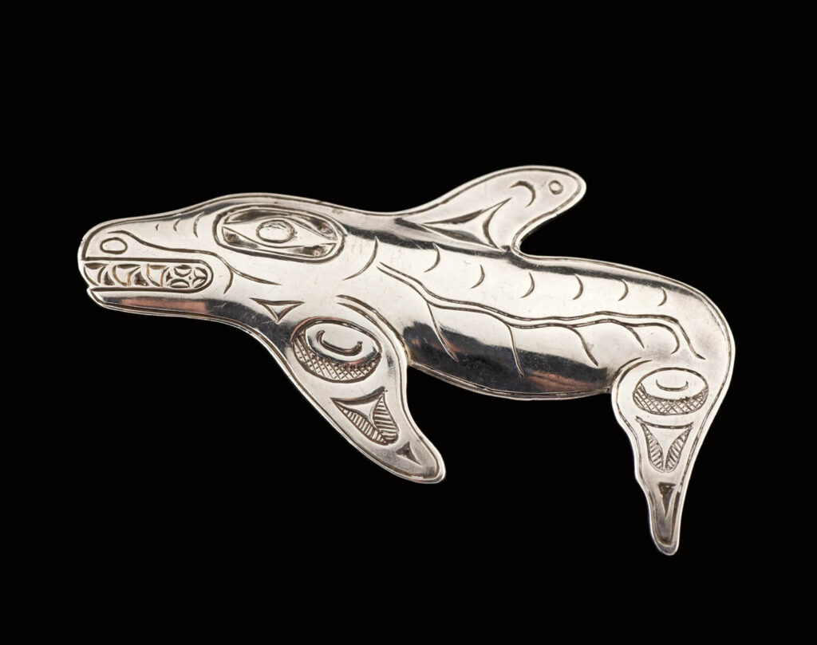
Bill Reid, Killer Whale Brooch, c.1952-53. The Killer Whale appears in much of Reid’s work, as in this delicately carved sterling silver brooch.

Slide 5
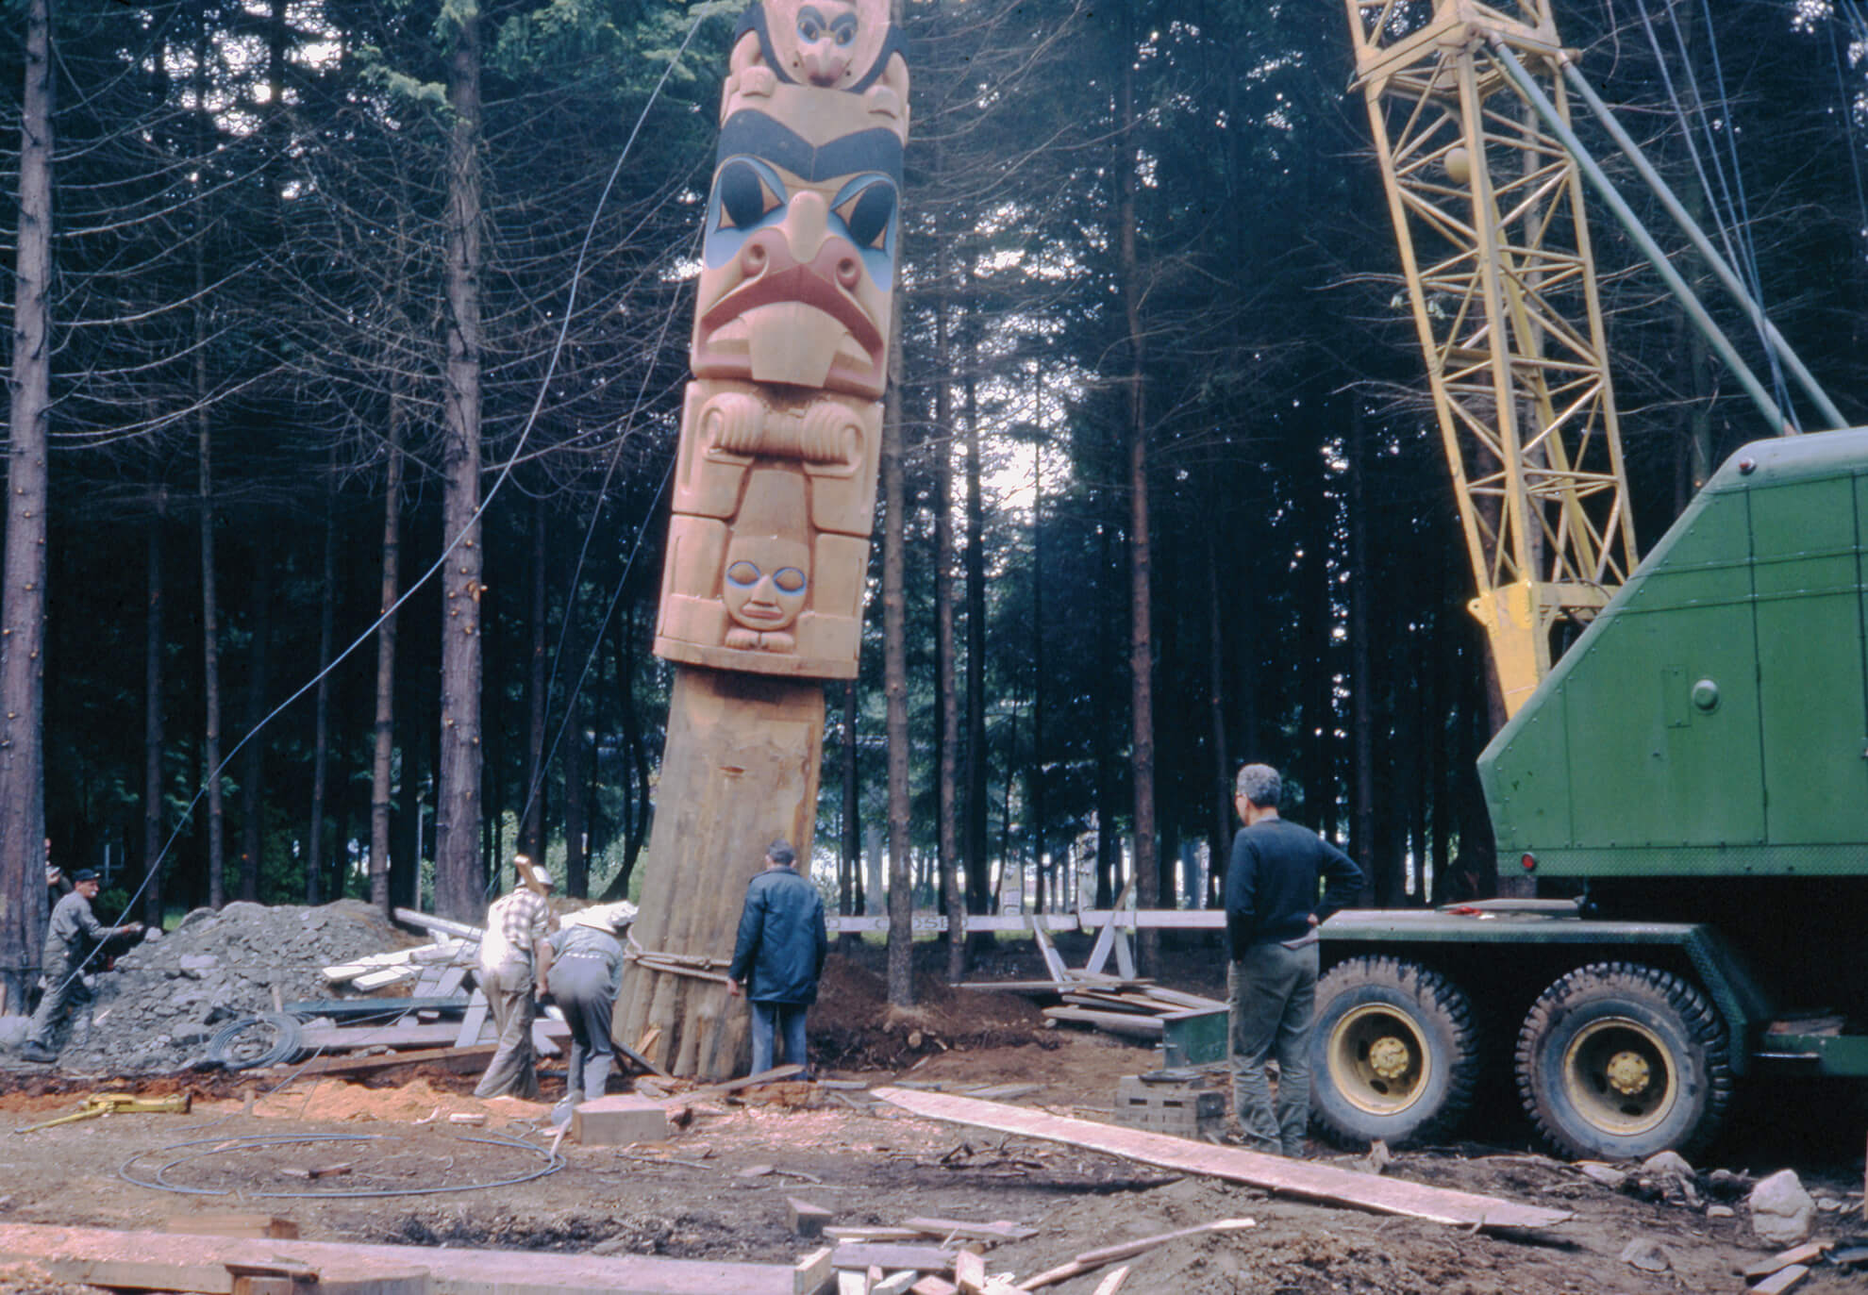
Bill Reid watching memorial pole being raised in the Haida Village at Totem Park at the University of British Columbia, 1962.

Slide 6
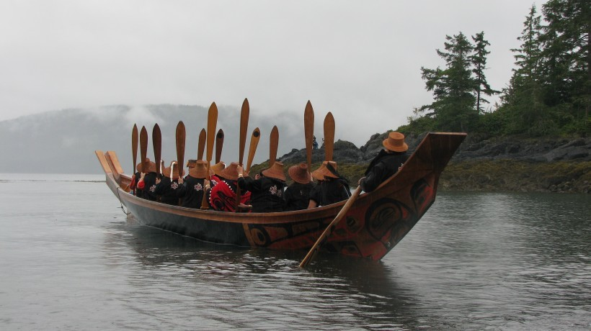
Loo Taas being paddled at the opening of the Haida Heritage Centre at Kay LInagaay, 2007.

Slide 7
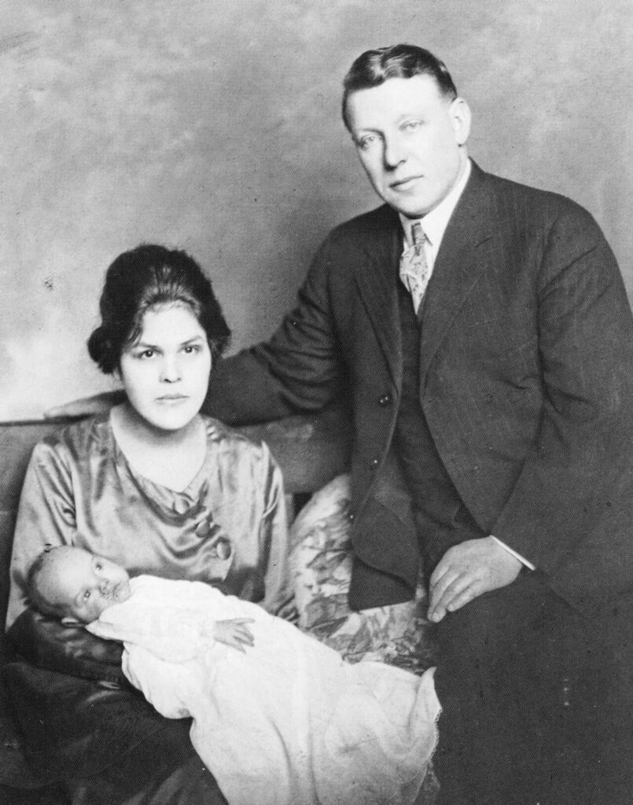
Bill Reid with his mother and father, 1920.

Slide 8
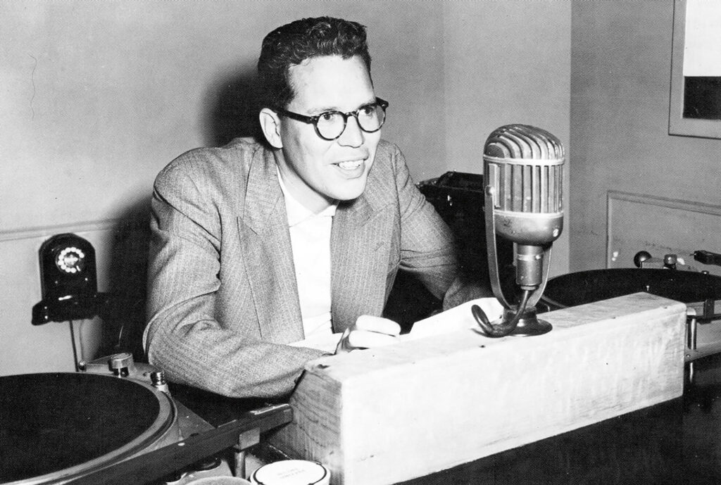
Bill Reid at the CBC, 1950. Reid began taking goldsmithing classes while working as an announcer for the CBC.

Slide 9
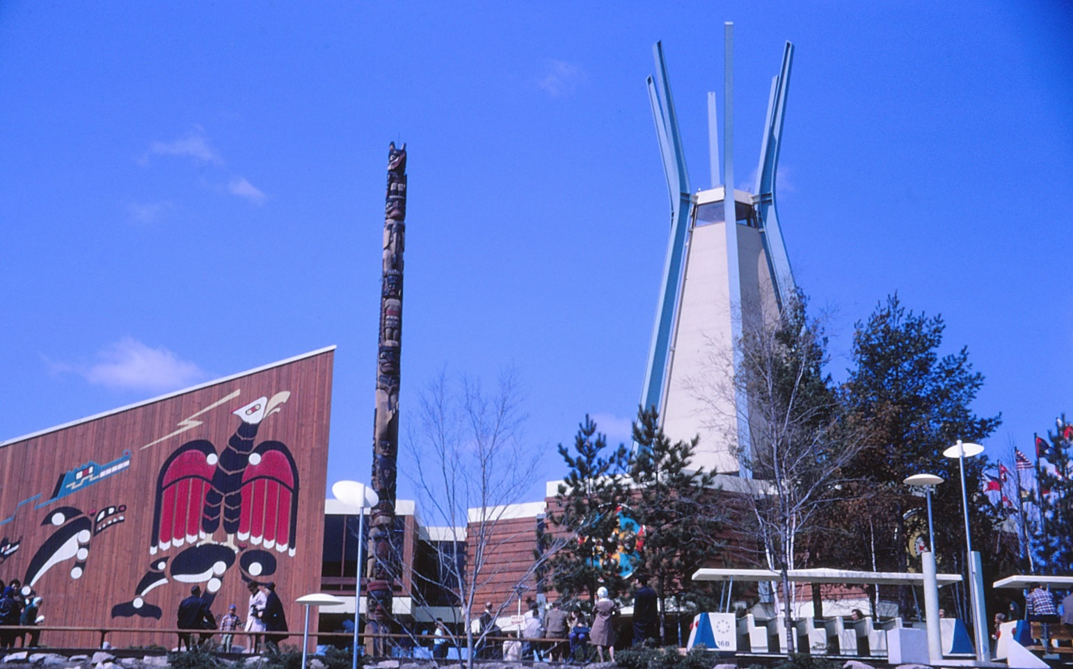
A view of the Indians of Canada Pavilion at Expo 67, 1967. The murals were painted by Francis Kagige. The Kwakiutl totem pole was carved by Tony and Henry Hunt.

Slide 10
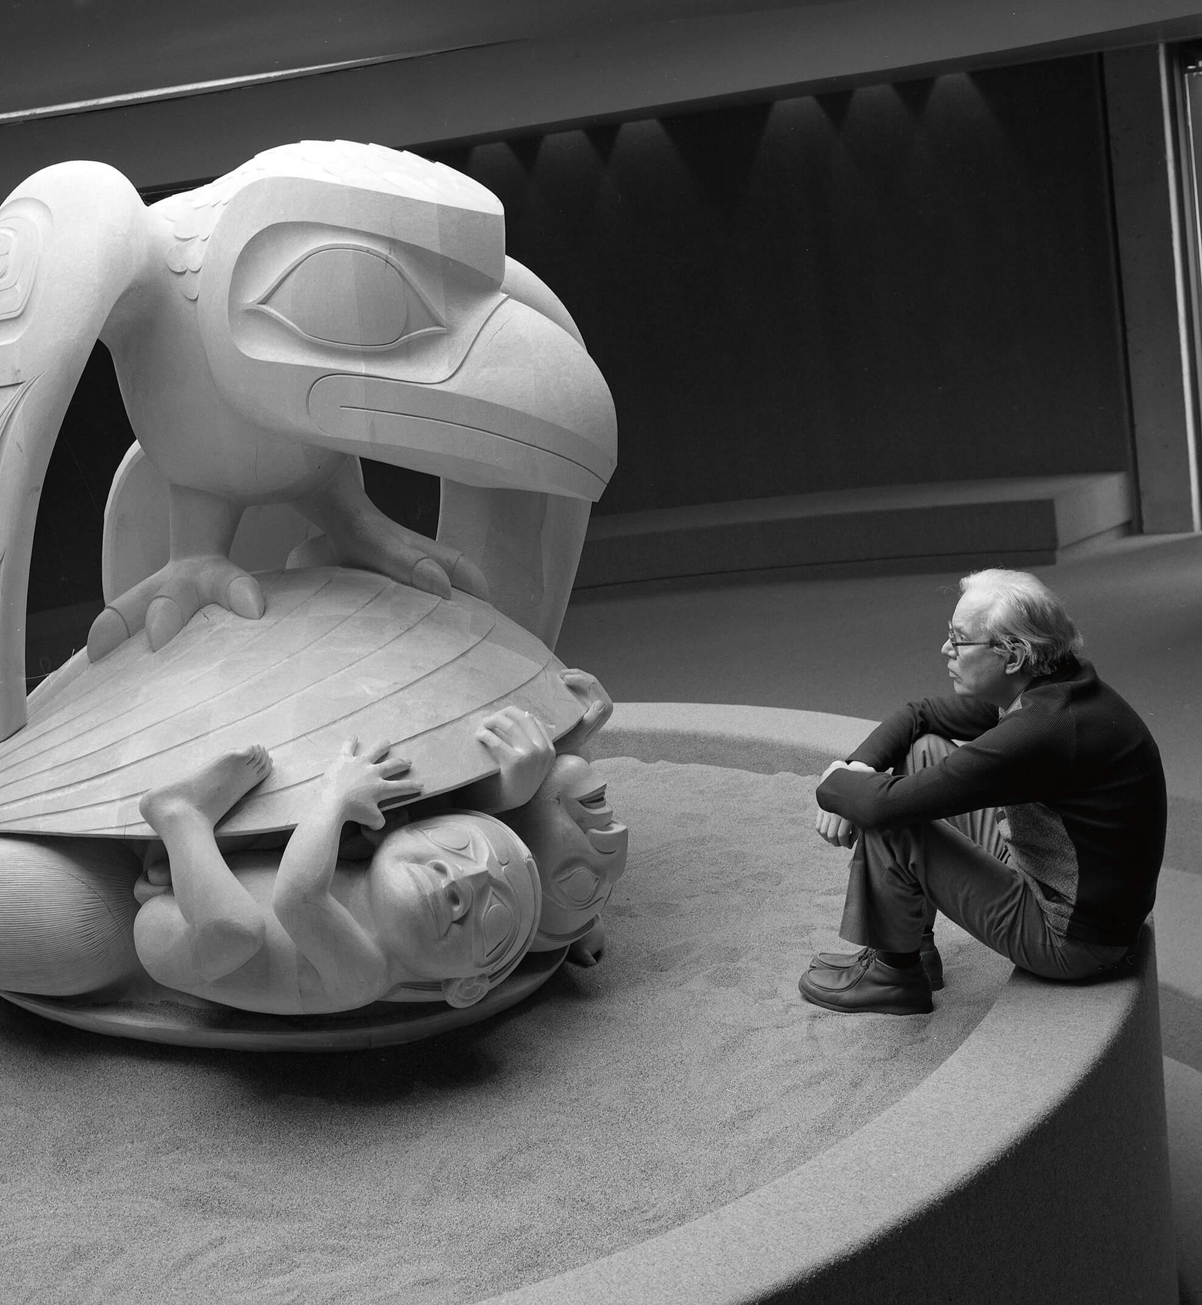
Bill Reid seated beside The Raven and the First Men at the UBC Museum of Anthropology, Vancouver, c. 1980.

Slide 11
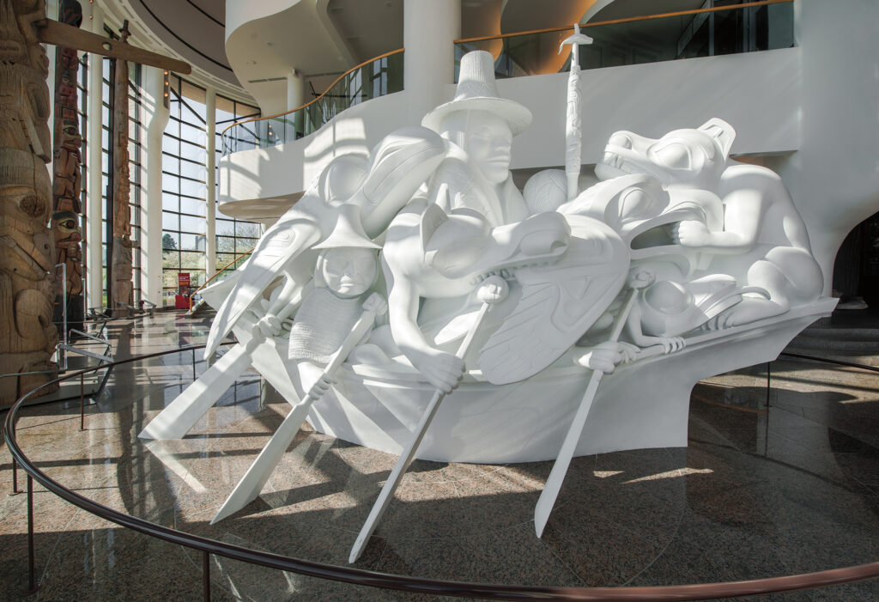
Bill Reid, Spirit of Haida Gwaii, 1986. This is the most complex and best known of Bill Reid’s sculptures.

Slide 12
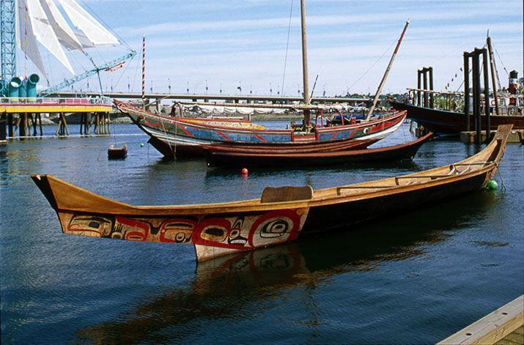
Loo Taas at False Creek, Vancouver during Expo 86 (1986).

Slide 13
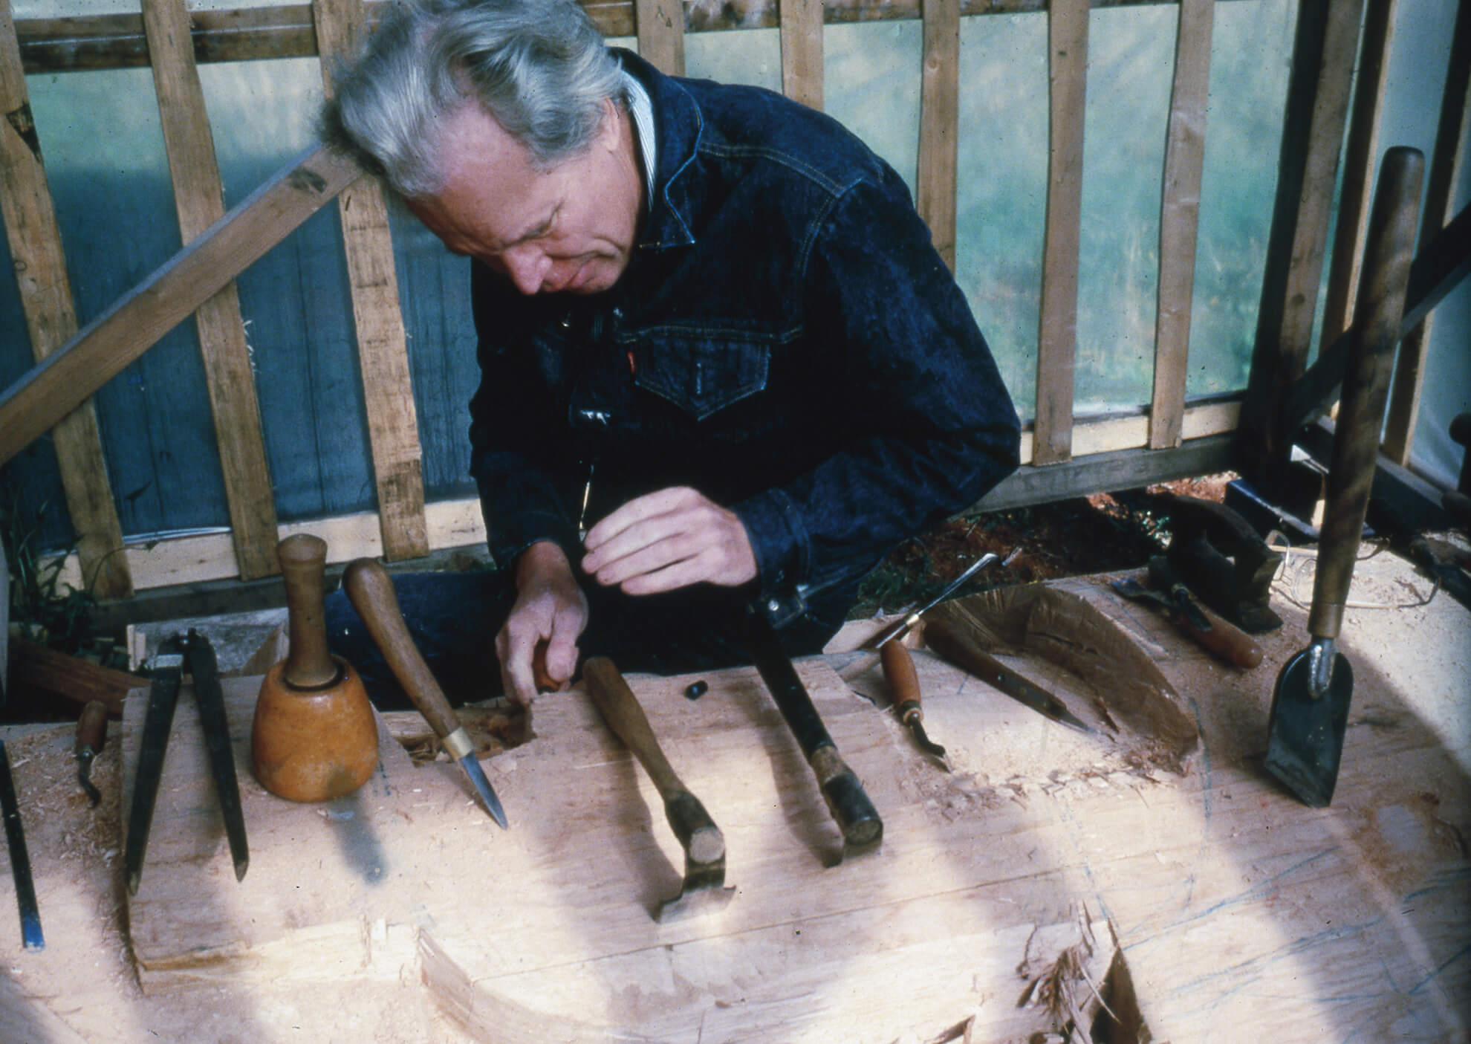
Learning Activity #1
Iljuwas Bill Reid with his tools in Skidegate, 1976.

Slide 14
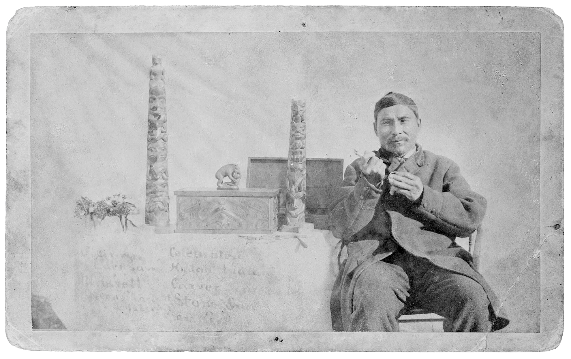
Learning Activity #1
Daxhiigang (Charles Edenshaw) with his works in Masset, British Columbia, c. 1890.

Slide 15
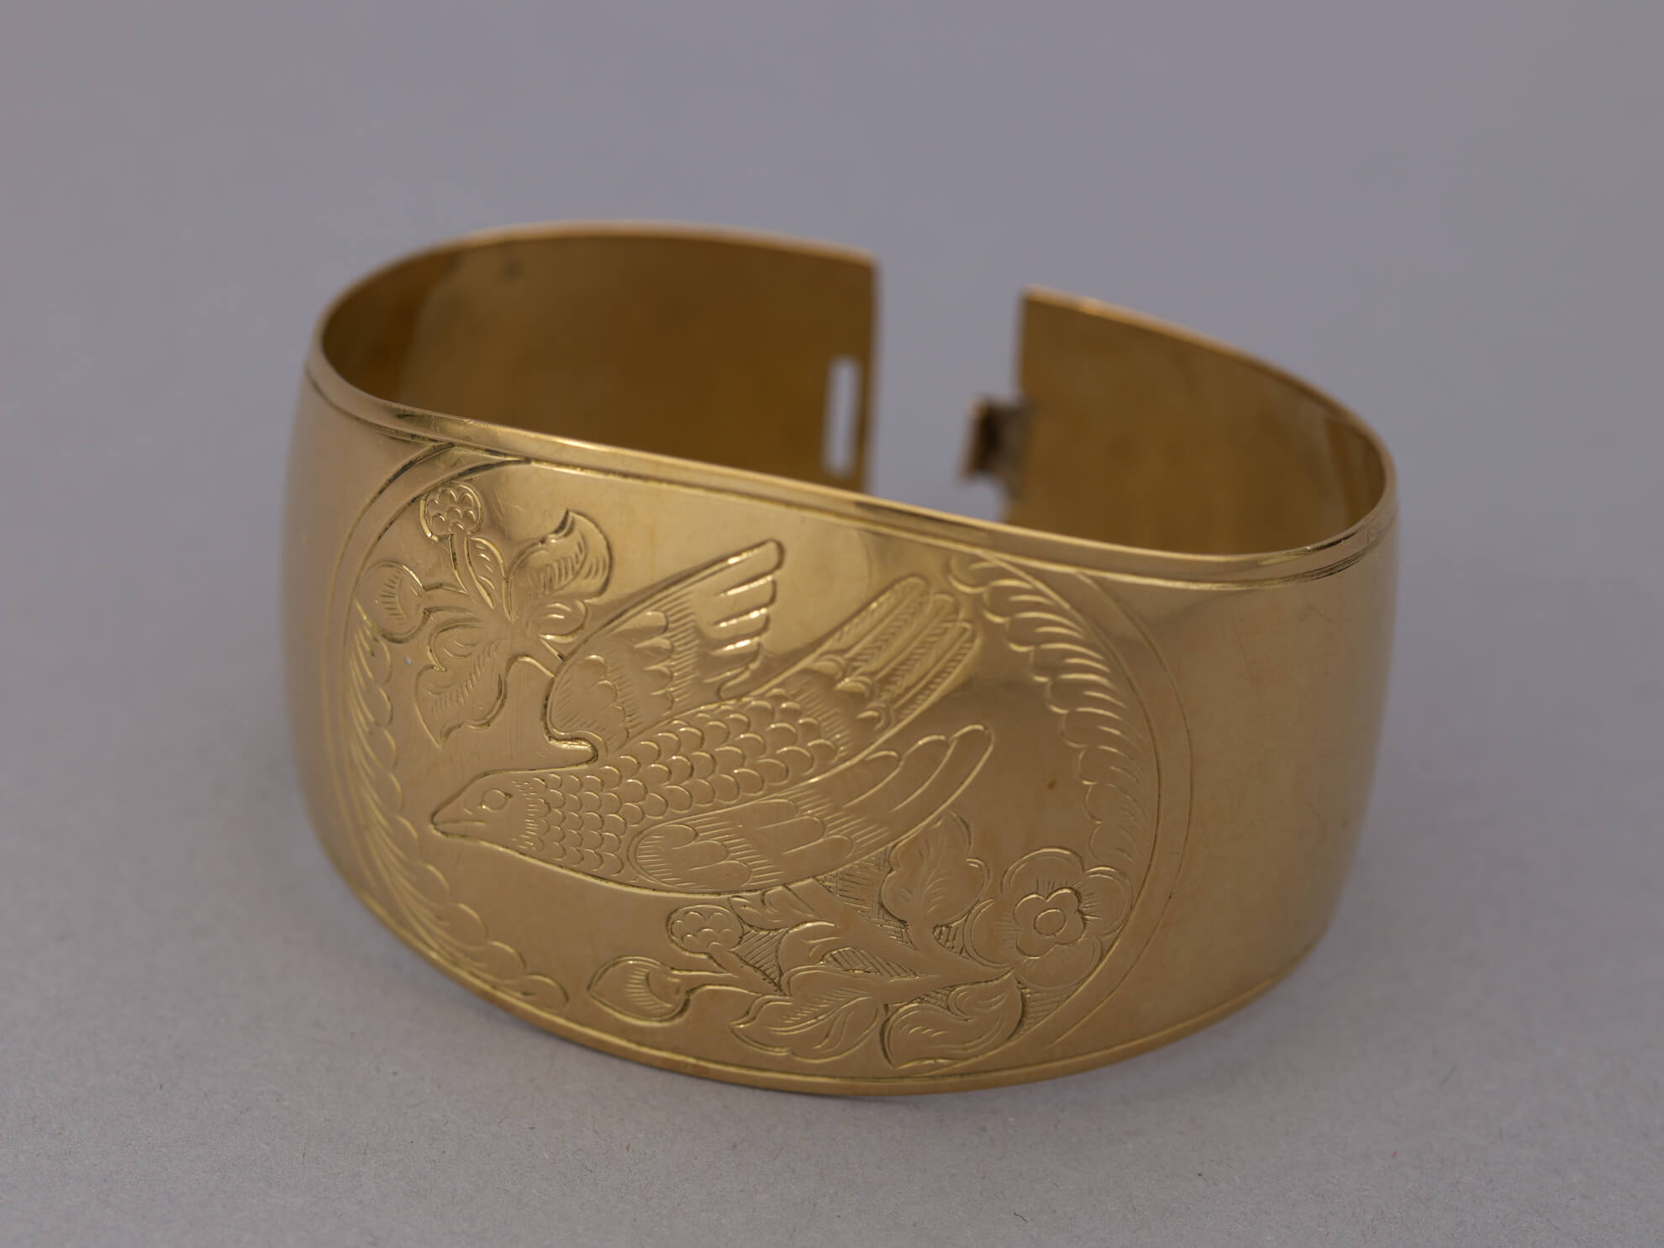
Learning Activity #1
Daxhiigang (Charles Edenshaw), Bracelet, 1909. Bracelets have significance in Haida culture as worn, visual indicators of oral knowledge and family lineages.

Slide 16
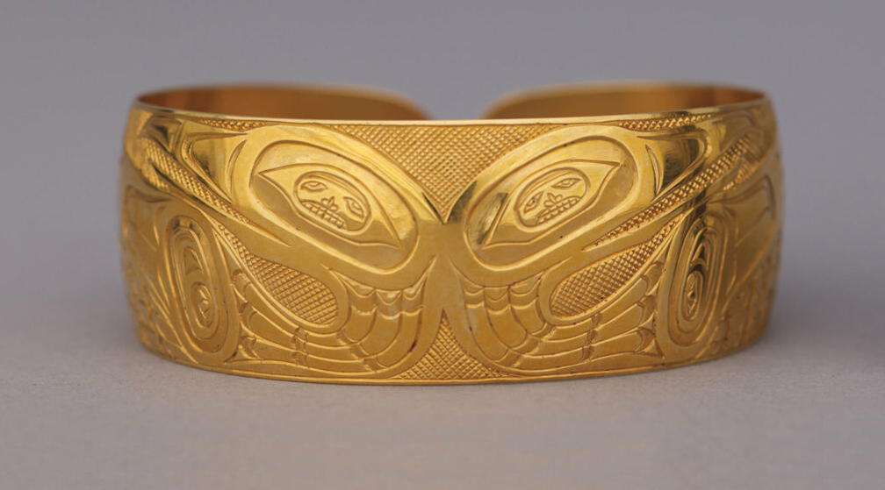
Learning Activity #1
Bill Reid, Bracelet, 1955. Reid regarded bracelets as integral to his practice and study of Haida forms.

Slide 17
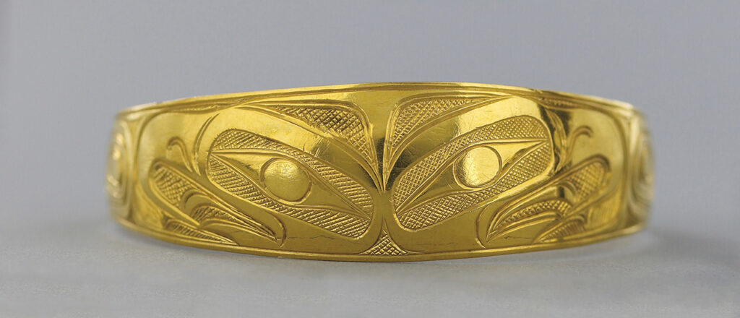
Learning Activity #1
Daxhiigang (Charles Edenshaw), Bracelet, c. 1885. Reid was captivated by Haida design after encountering gold bracelets by Daxhiigang.

Slide 18
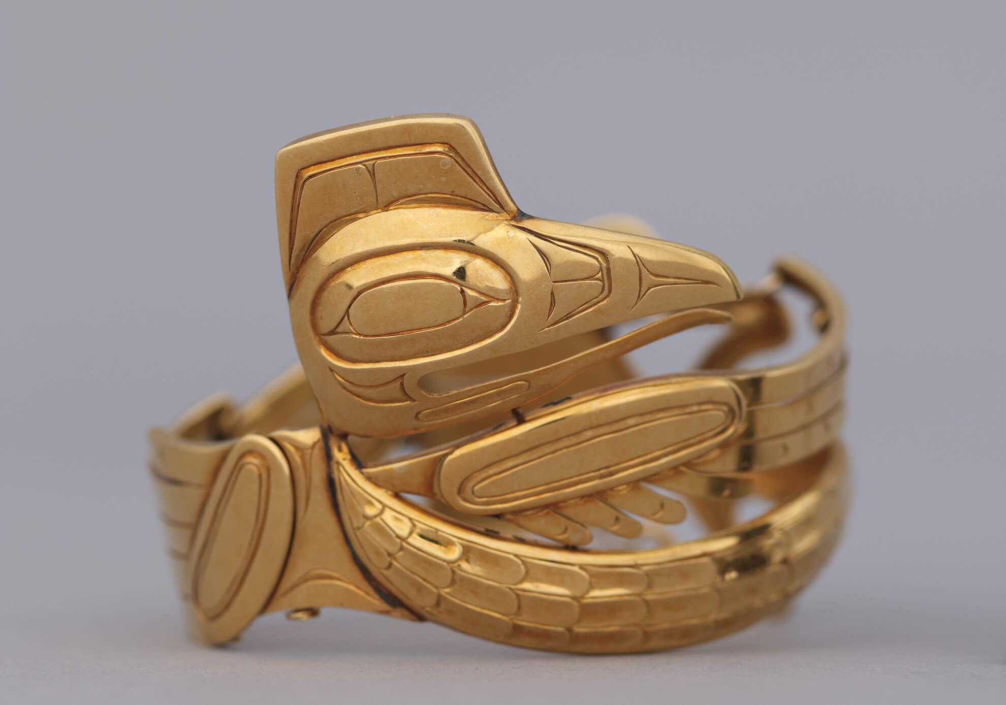
Learning Activity #1
Bill Reid, Hinged Raven Bracelet, c. 1955. This bracelet depicts the Raven (Xhuuya), a cultural hero and trickster in Haida stories.

Slide 19
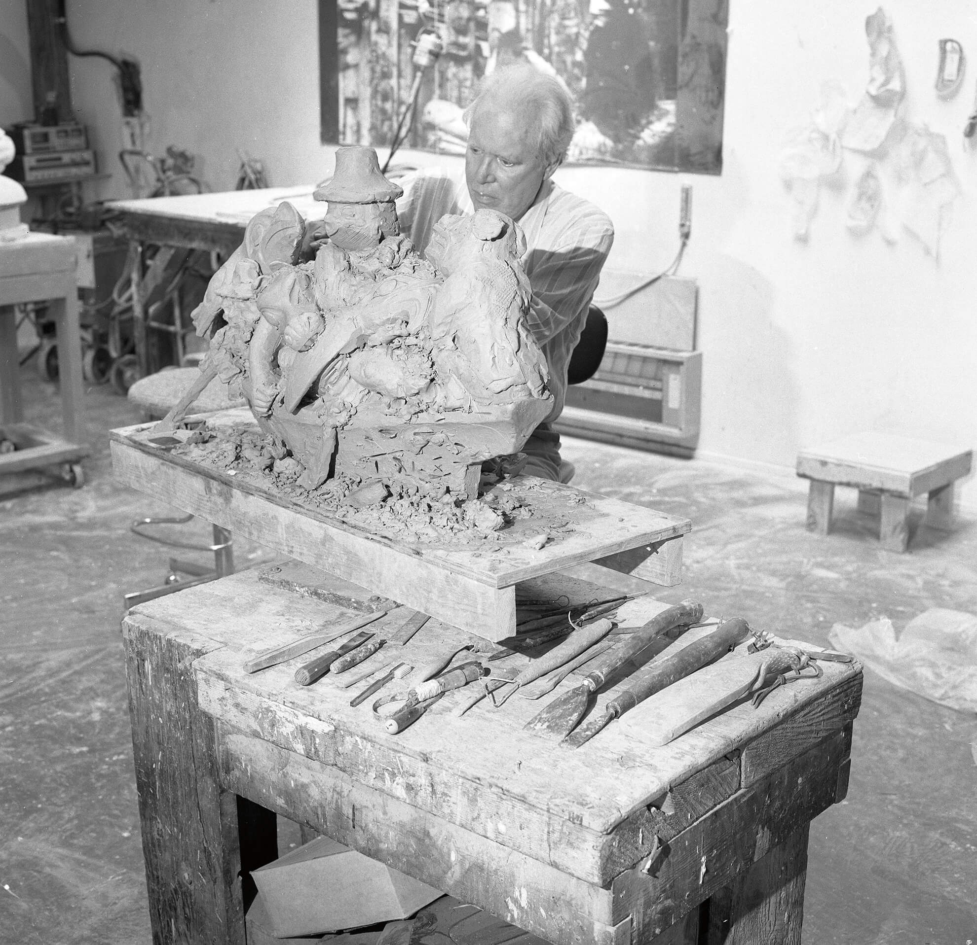
Learning Activity #1
Bill Reid carving a clay model of the sculpture Spirit of Haida Gwaii in 1986.

Slide 20
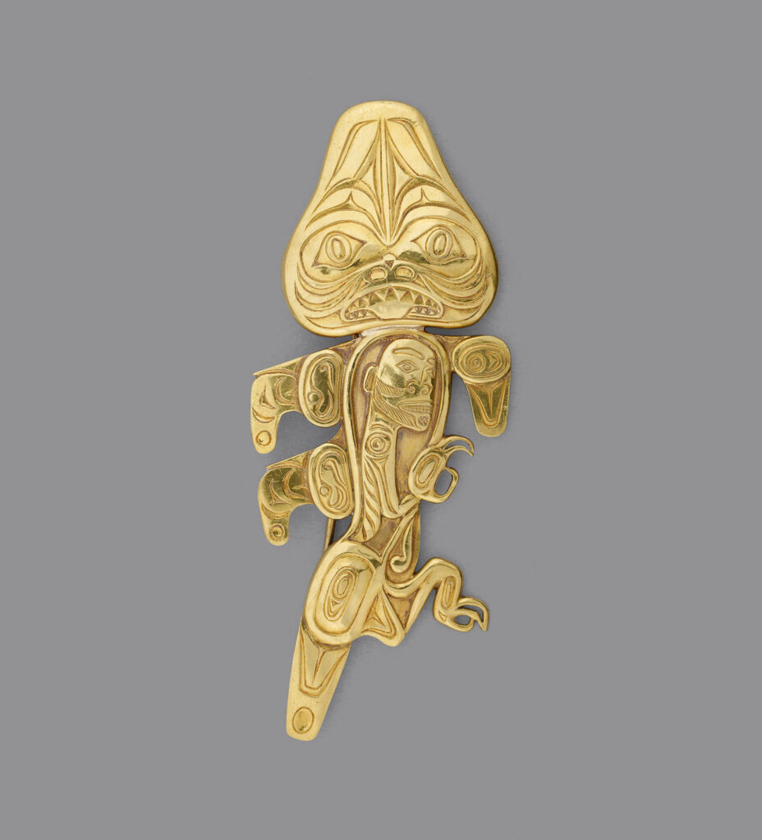
Learning Activity #1
Bill Reid, Dogfish Brooch, c. 1959. The dogfish is a common symbol in Haida culture.

Slide 21
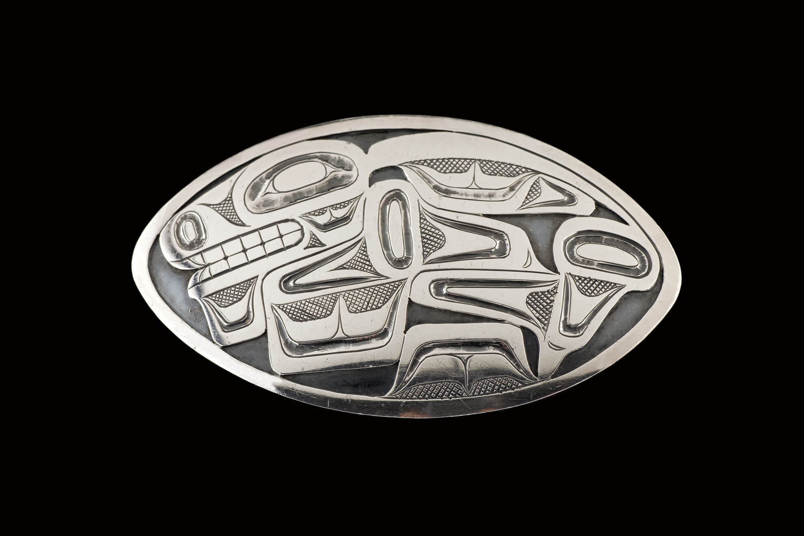
Learning Activity #1
Bill Reid, Tschumos Brooch, 1956. This brooch belonged to Bill Reid’s mother, Sophie Reid (née Gladstone).

Slide 22
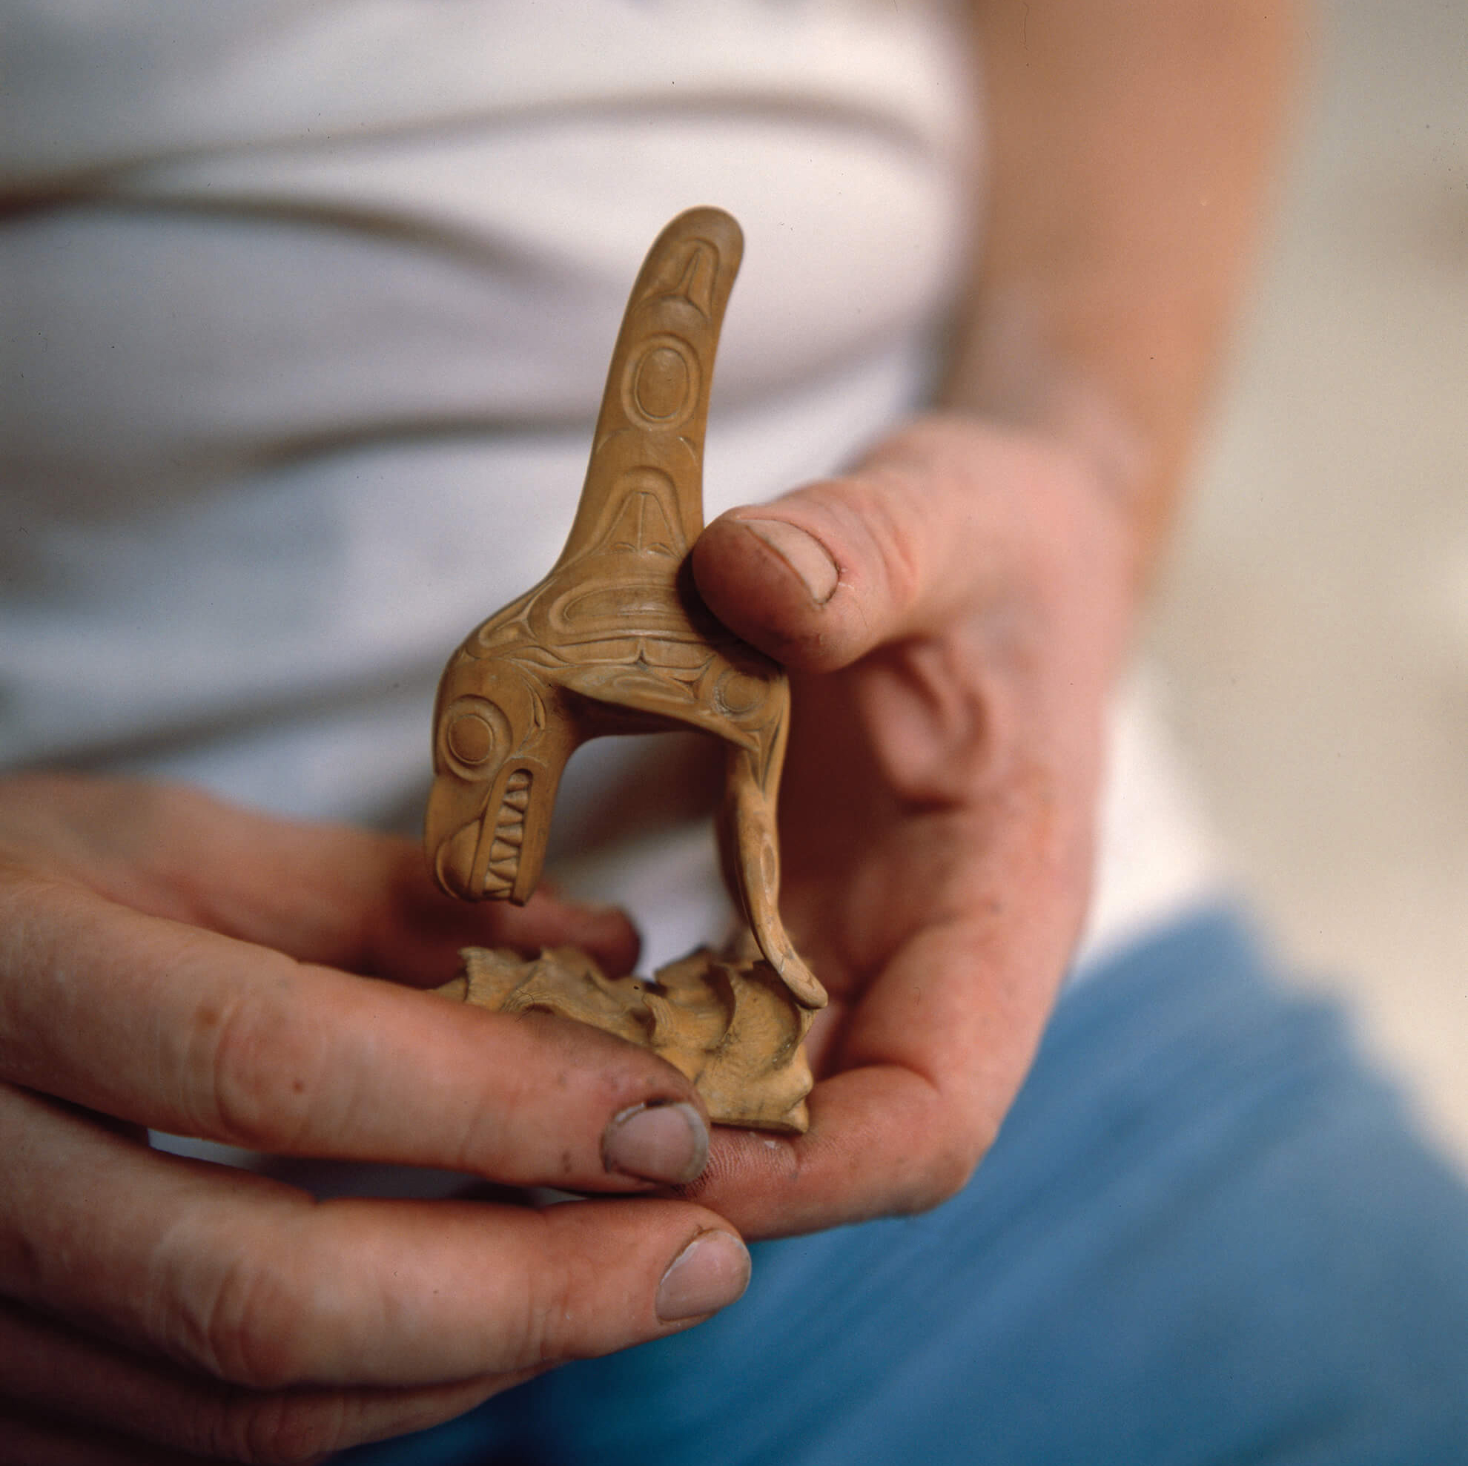
Learning Activity #2
Bill Reid holding Killer Whale (1982), c. 1982. The tiny boxwood sculpture pictured here inspired Reid’s monumental bronze Skaana—Killer Whale, Chief of the Undersea World.

Slide 23
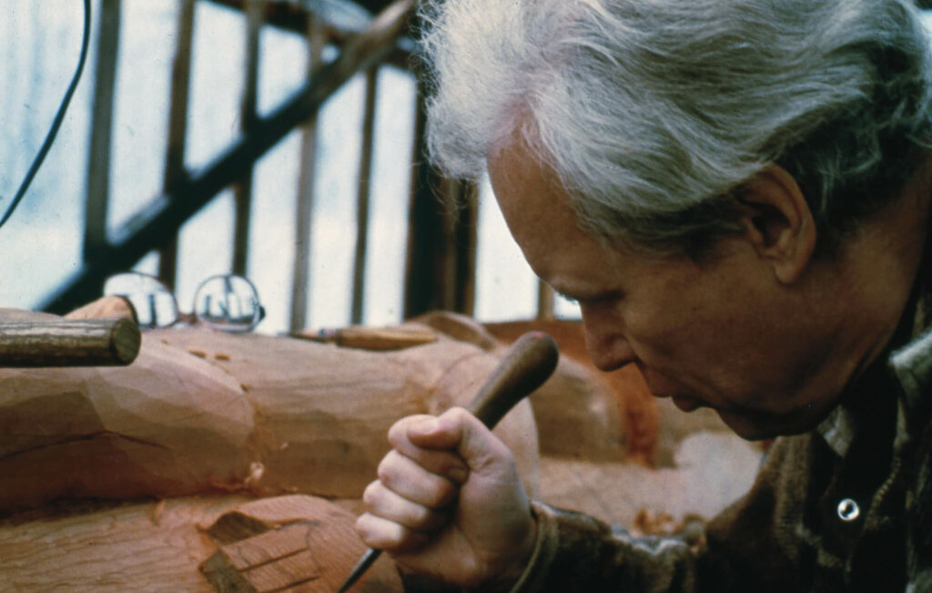
Learning Activity #2
Bill Reid carving the Skidegate Dogfish Pole, c. 1976.

Slide 24
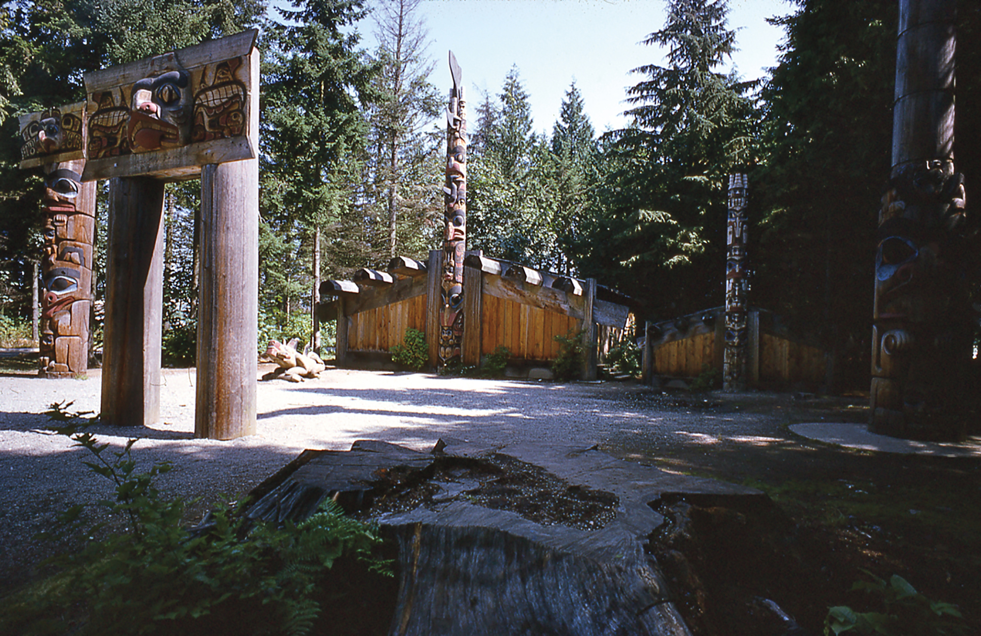
Learning Activity #2
Bill Reid, Haida Village (1958-62), 1966. Haida Village was installed at the University of British Columbia in Vancouver and stands today as a showcase of Haida-style poles.

Slide 25
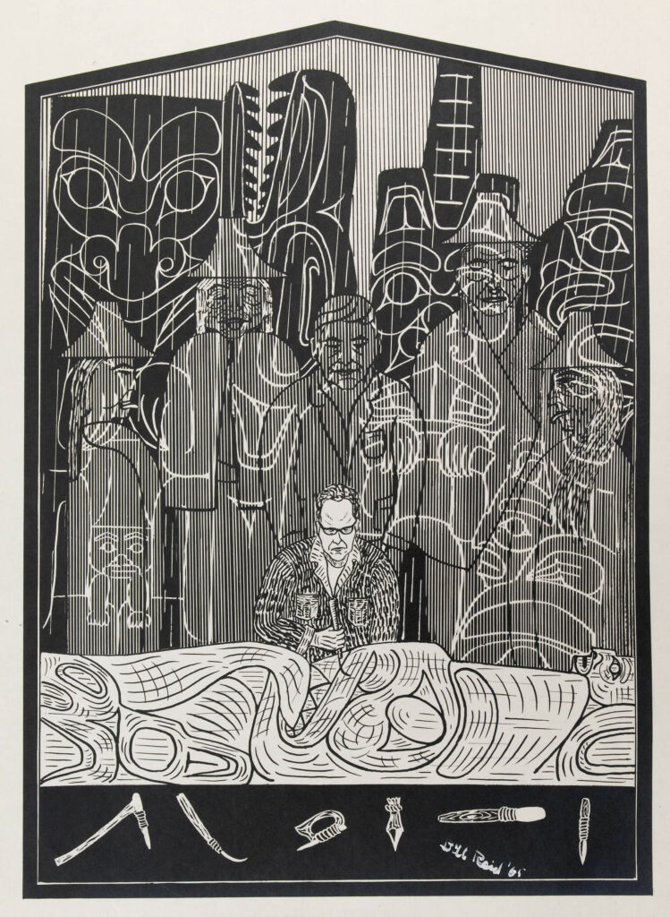
Learning Activity #2
Bill Reid, Self-portrait illustration, 1965, from Raven’s Cry (1965) by Christie Harris.

Slide 26
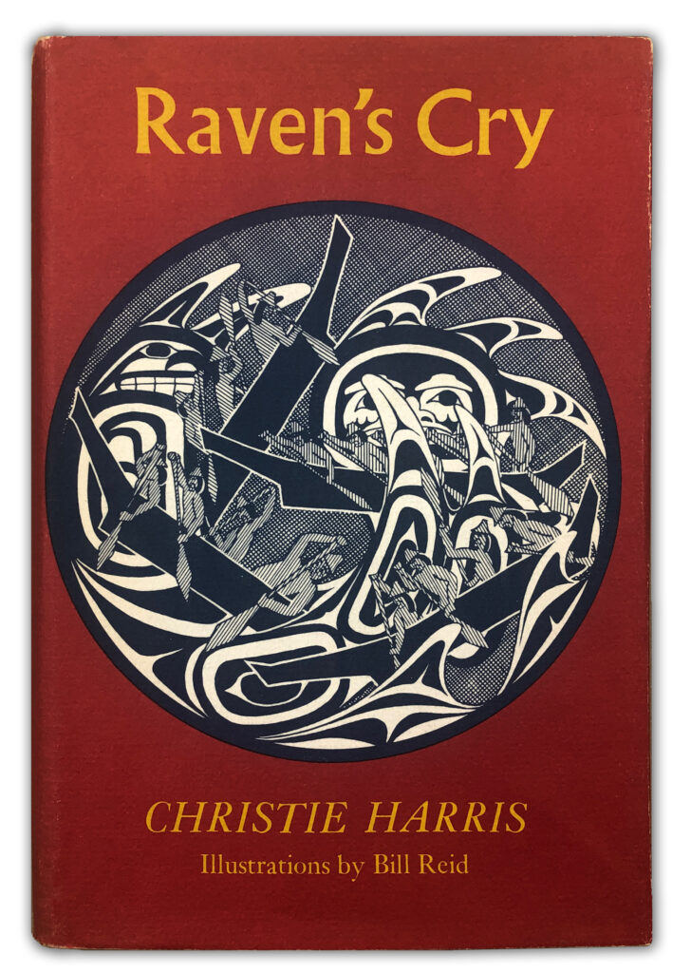
Learning Activity #2
Cover of Raven’s Cry, 1965, by Christie Harris. Raven’s Cry is a fictionalized account of Haida history that includes a character based on Reid.

Slide 27
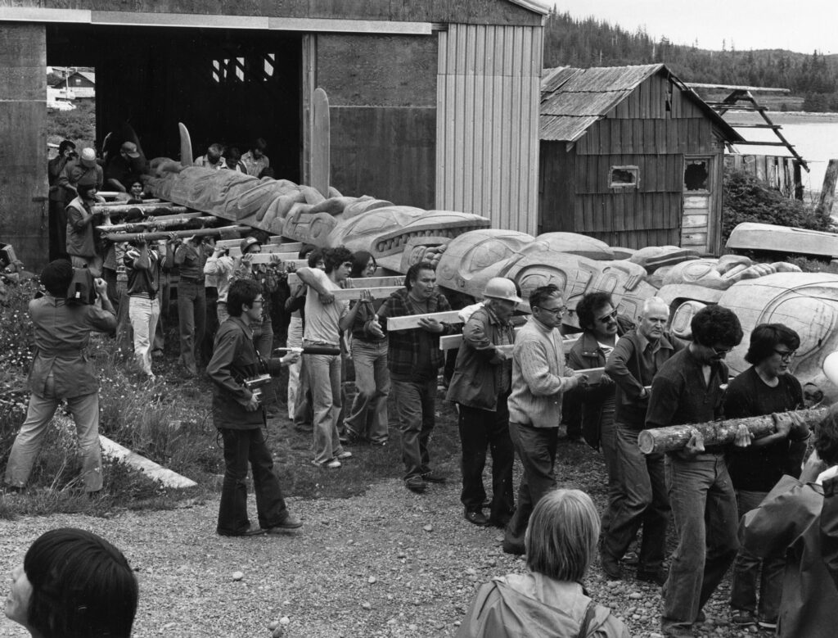
Culminating Task
Haida Gwaii community members carrying the Skidegate Dogfish Pole, 1978.

Slide 28
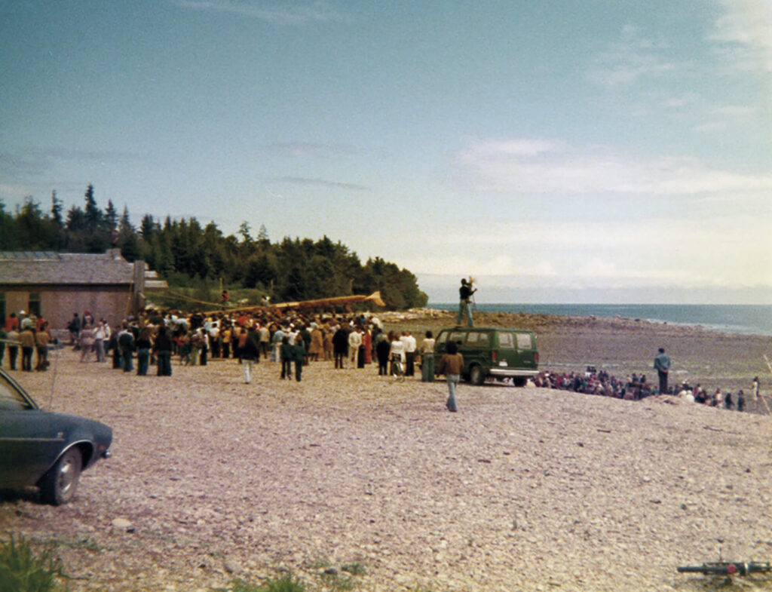
Culminating Task
Skidegate Dogfish Pole raising ceremony in Skidegate, Haida Gwaii, 1978. The raising ceremony was a community endeavor involving a two-day potlatch and the production of new regalia.

Slide 29
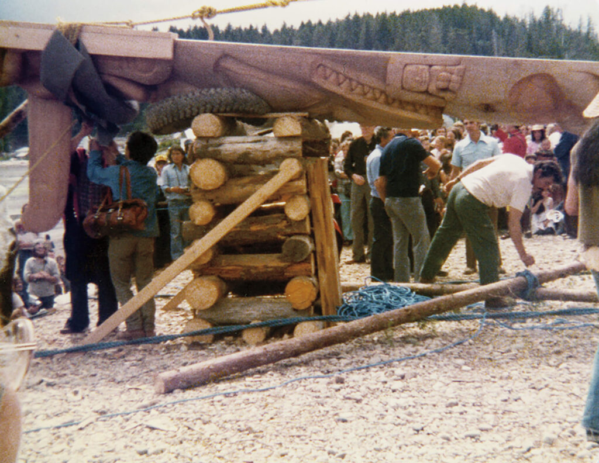
Culminating Task
Skidegate Dogfish Pole raising ceremony in Skidegate, Haida Gwaii, 1978.

Slide 30
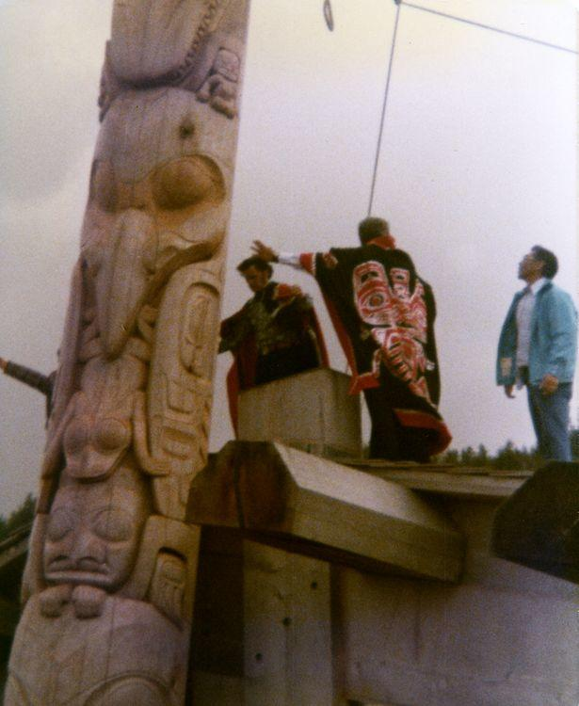
Culminating Task
Skidegate Dogfish Pole raising ceremony in Skidegate, Haida Gwaii, 1978.

Slide 31
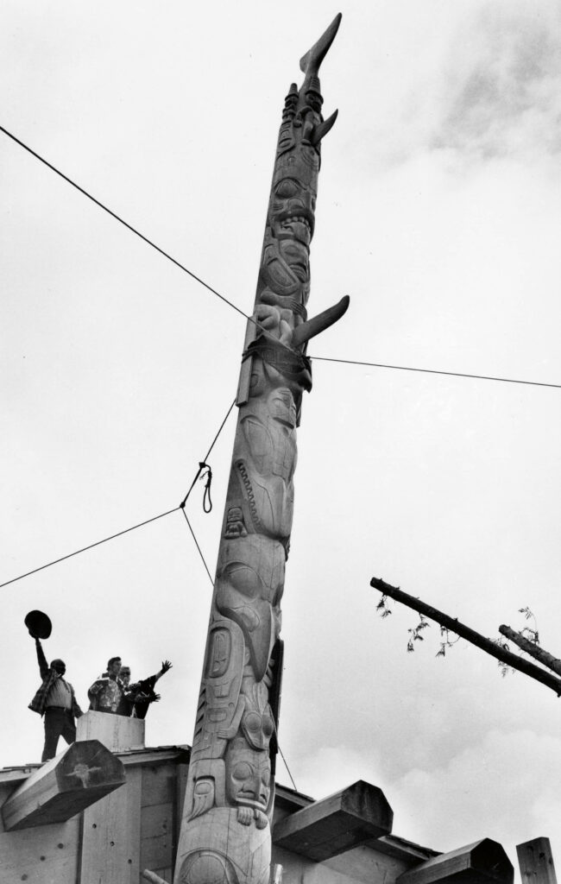
Culminating Task
Rooftop cheer after Skidegate Dogfish Pole raising (left to right: Ernie Wilson, Phil Gladstone and Wes Pearson), 1978.

Slide 32
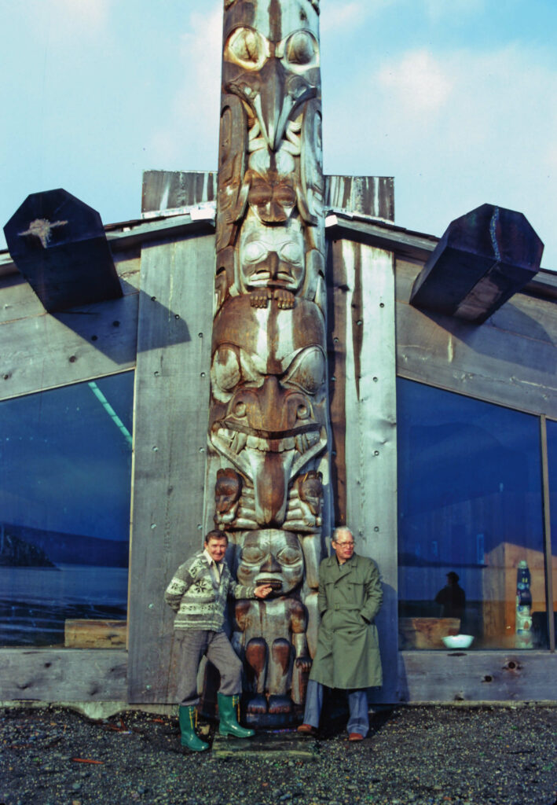
Culminating Task
Skidegate longhouse designed by Rudy Kovach (left) with totem pole by Bill Reid (right), 1978.

Slide 33
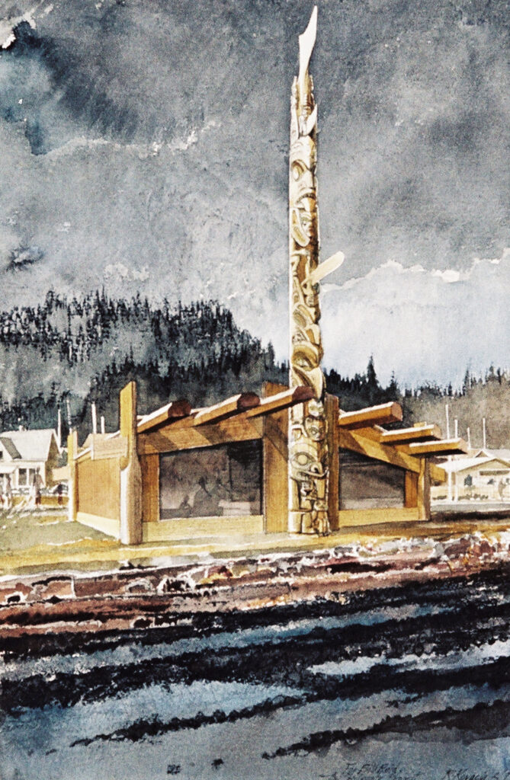
Culminating Task
Rudy Kovach, The Skidegate Project, 1977. In this painting, the artist envisions the Skidegate Dogfish Pole raised in situ, one year before the pole was completed.

Slide 34
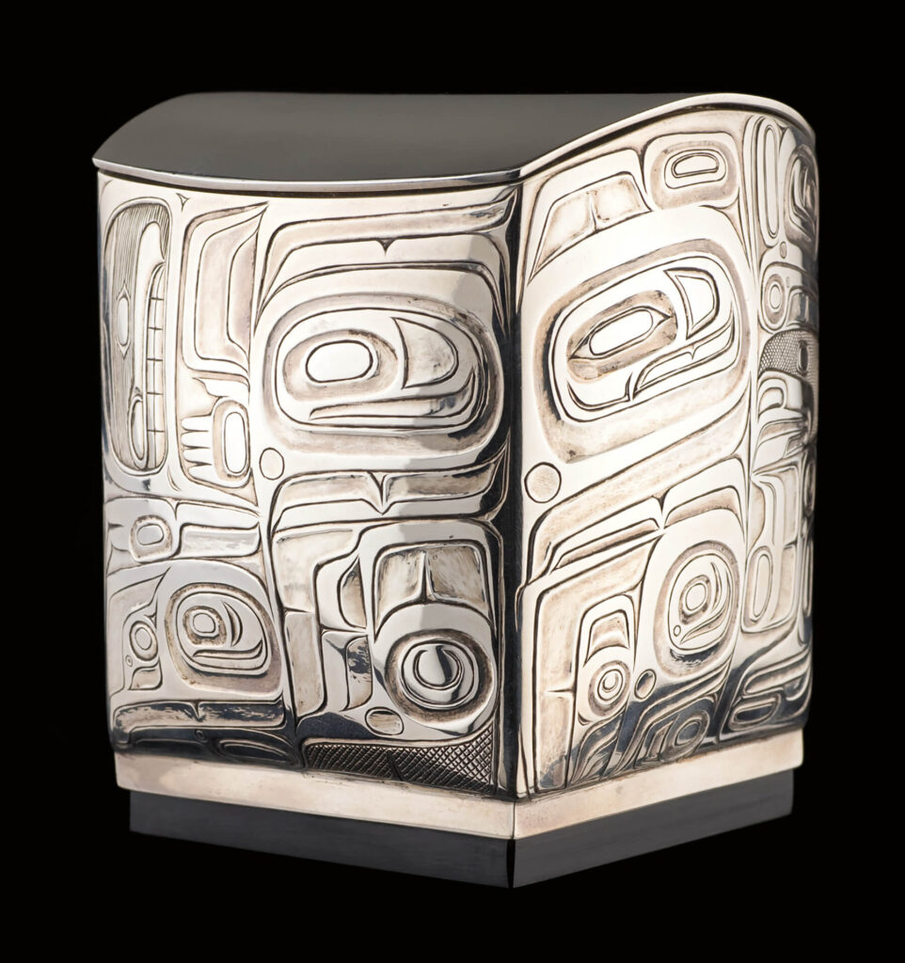
Bill Reid, The Final Exam, 1964. Reid made this small silver box while studying collections of Haida art.

Slide 35
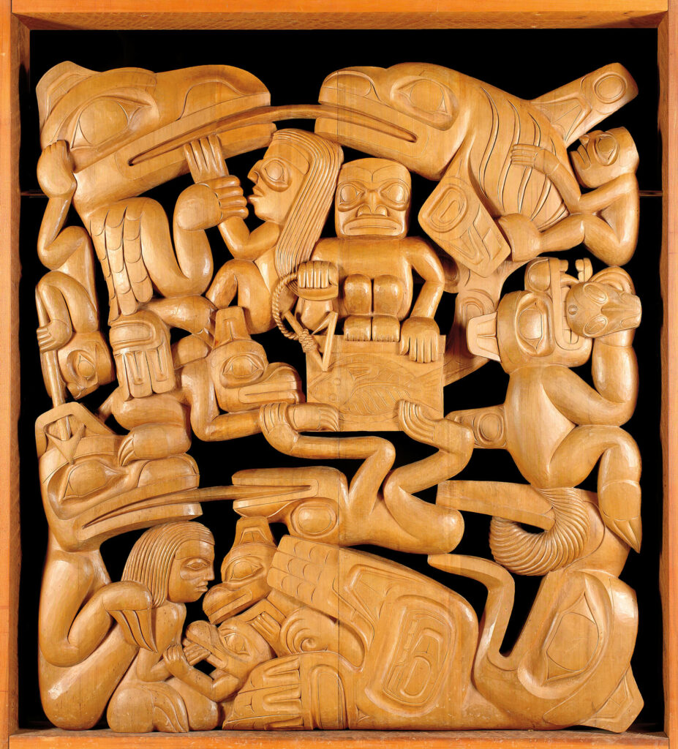
Bill Reid, Cedar Screen, 1968. This was Reid’s first large-scale attempt to combine multiple mythic narratives in a rectilinear relief panel instead of a linear panel or pole.

Slide 36
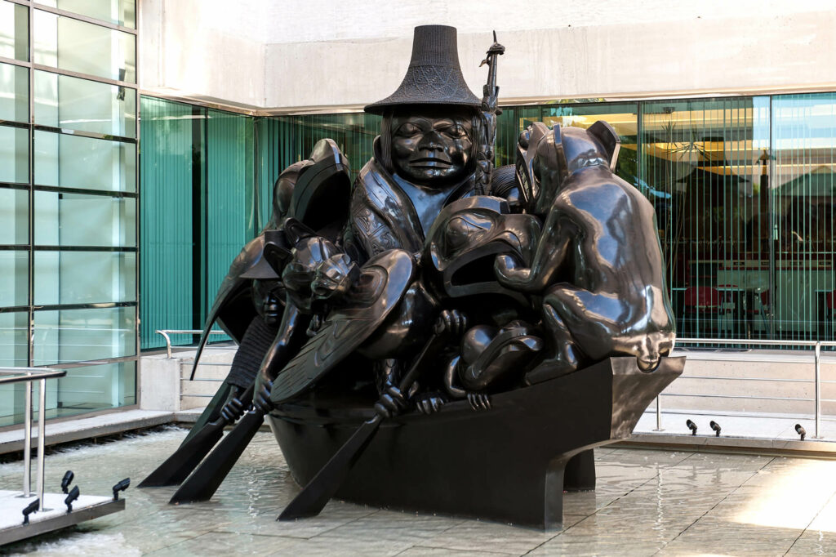
Bill Reid, Spirit of Haida Gwaii: The Black Canoe, 1991. This work appears in the Canadian Embassy in Washington, D.C.

Slide 37
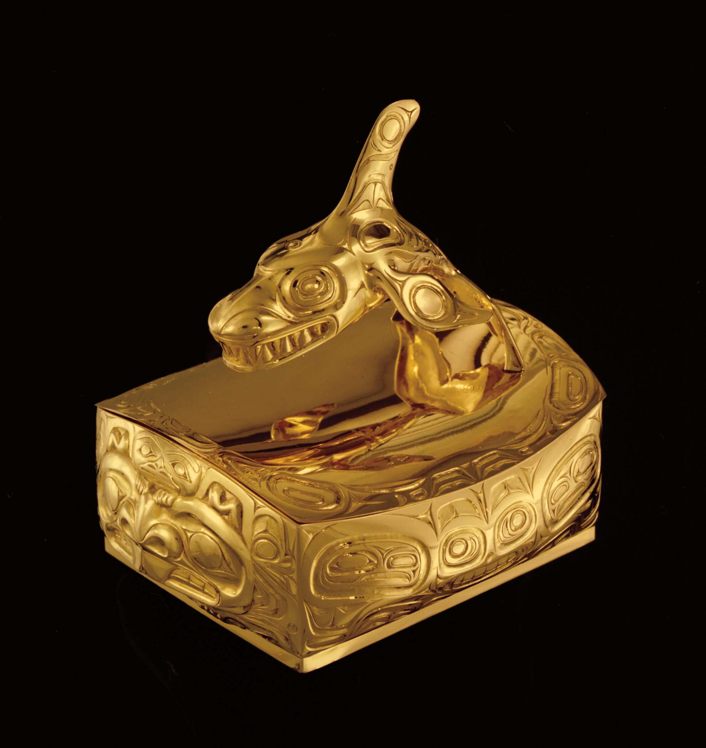
Bill Reid, Killer Whale Box with Beaver and Human, 1971. This container illustrates Reid’s ability to both honour and transform important crests in Haida culture.

Slide 38
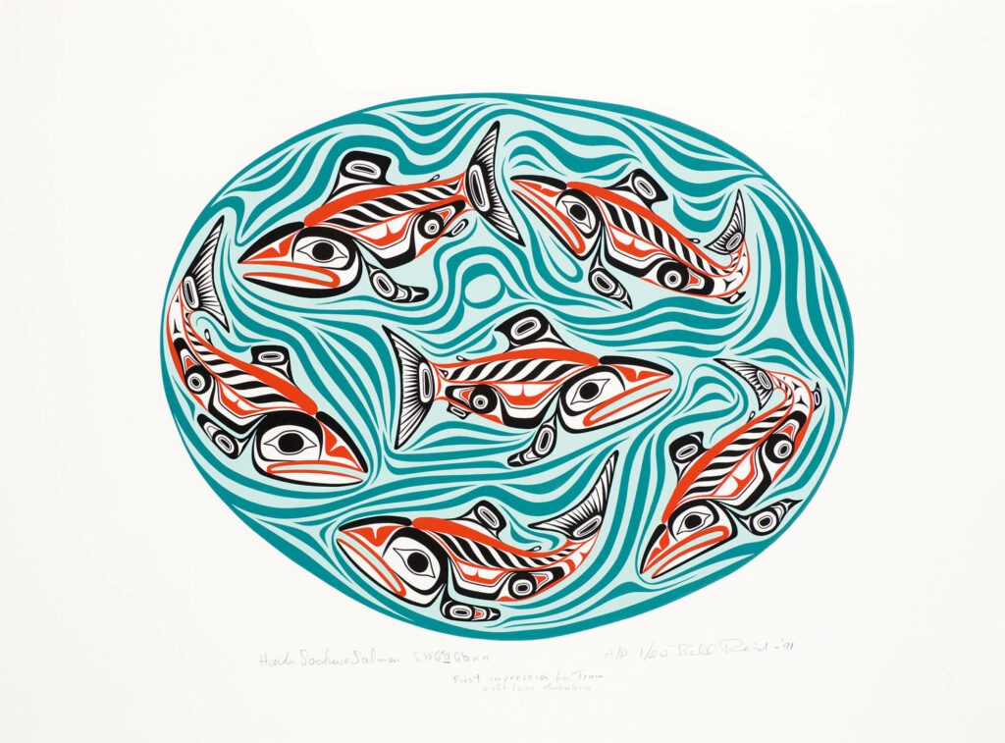
Bill Reid, Sgwaagan – Sockeye Salmon Pool Sgw’ag’aan, 1991. Reid’s multimedia works, like this serigraph print, reflect the dynamic energy of Haida art.

