Slide 2
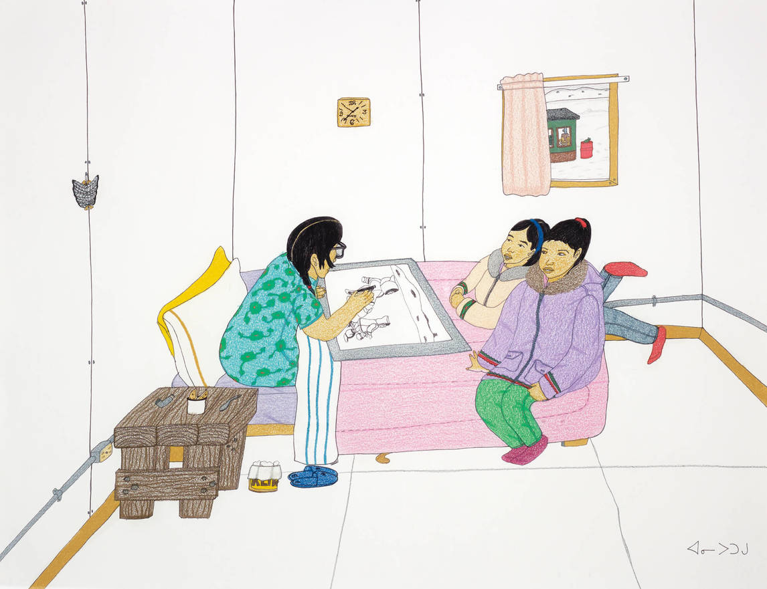
Annie Pootoogook, Pitseolak Drawing with Two Girls on Her Bed, 2006. This work pictures Pootoogook’s grandmother Pitseolak Ashoona, also a famous artist.

Slide 3
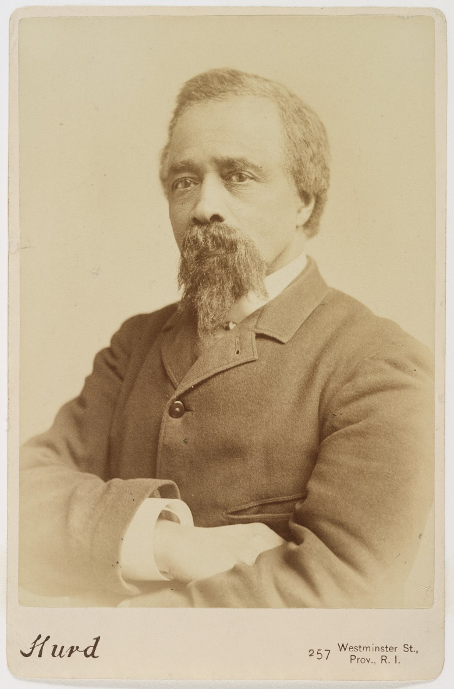
Edward Mitchell Bannister, c.1880.

Slide 4
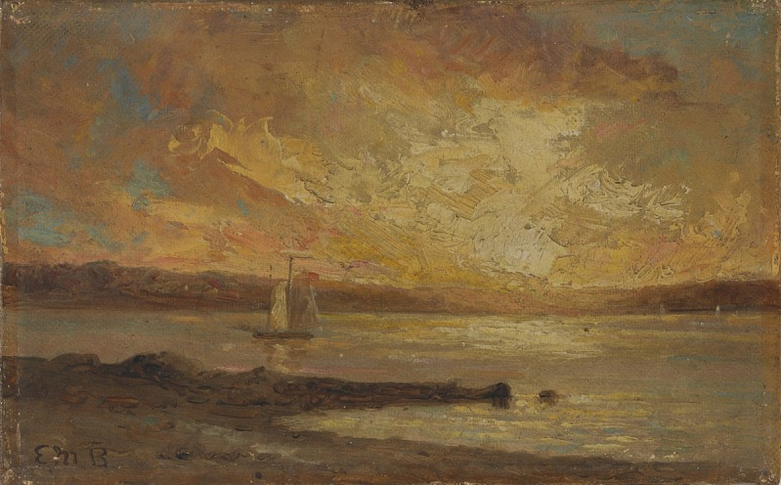
Edward Mitchell Bannister, Boat on Sea, n.d. The sea was a favourite subject for Bannister.

Slide 5
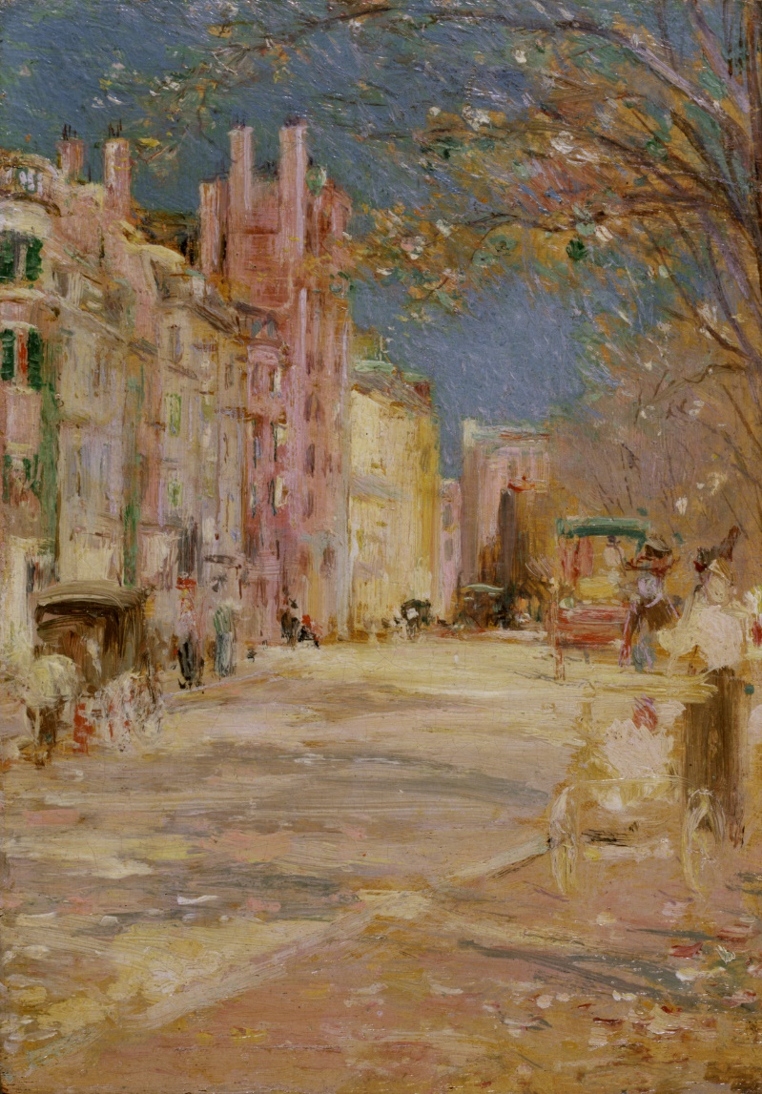
Edward Mitchell Bannister, Boston Street Scene (Boston Common), 1898–99. This cityscape exemplifies Bannister’s shift towards Impressionist techniques.

Slide 6
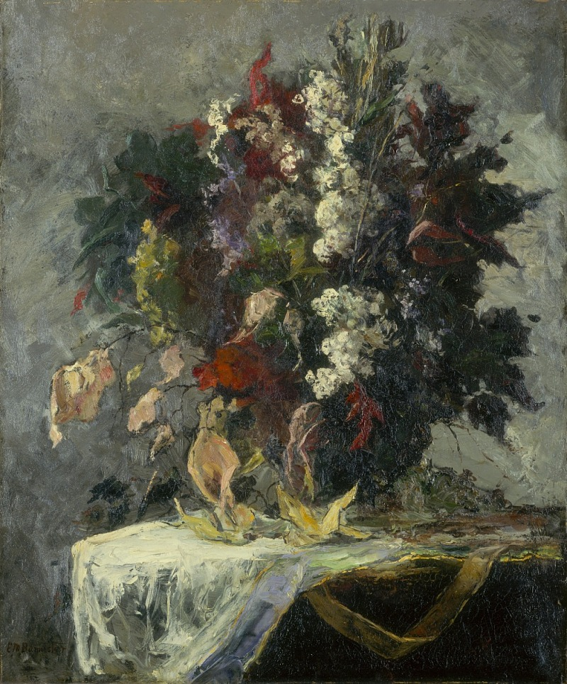
Edward Mitchell Bannister, Untitled (floral still life), n.d. This still life illustrates the artist’s technical proficiency in different genres.

Slide 7
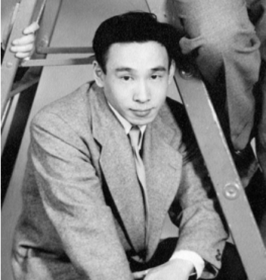
Kazuo Nakamura, 1953.

Slide 8
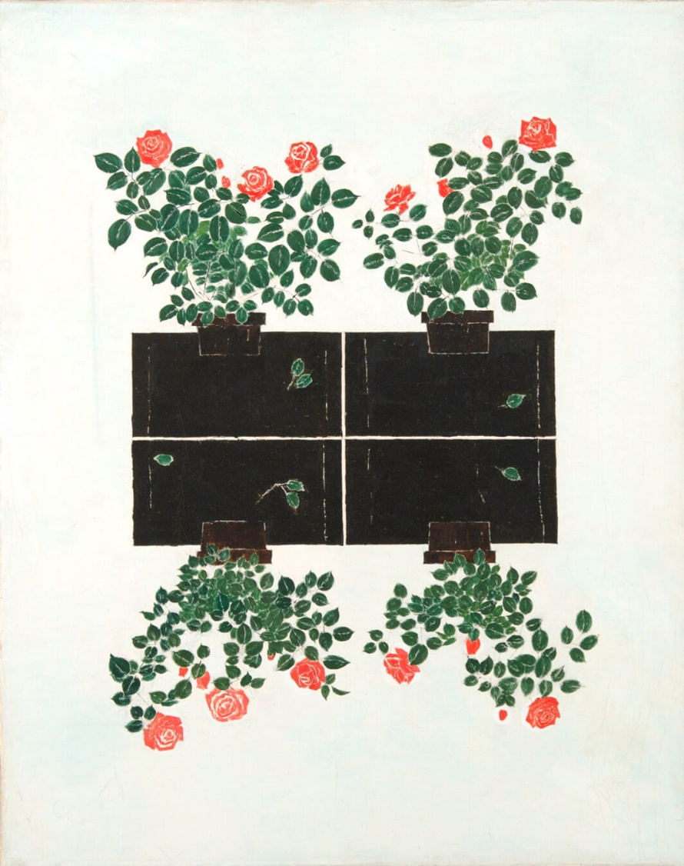
Kazuo Nakamura, Untitled, 1964. With this composition, Nakamura experimented with mirroring his subject.

Slide 9
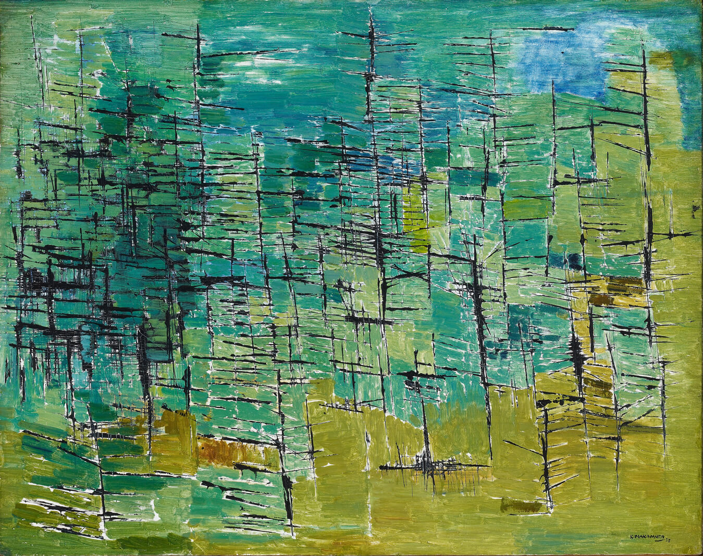
Kazuo Nakamura, Forest, 1953. In this work, Nakamura created a rich texture of brushstrokes reminiscent of a dense forest.

Slide 10
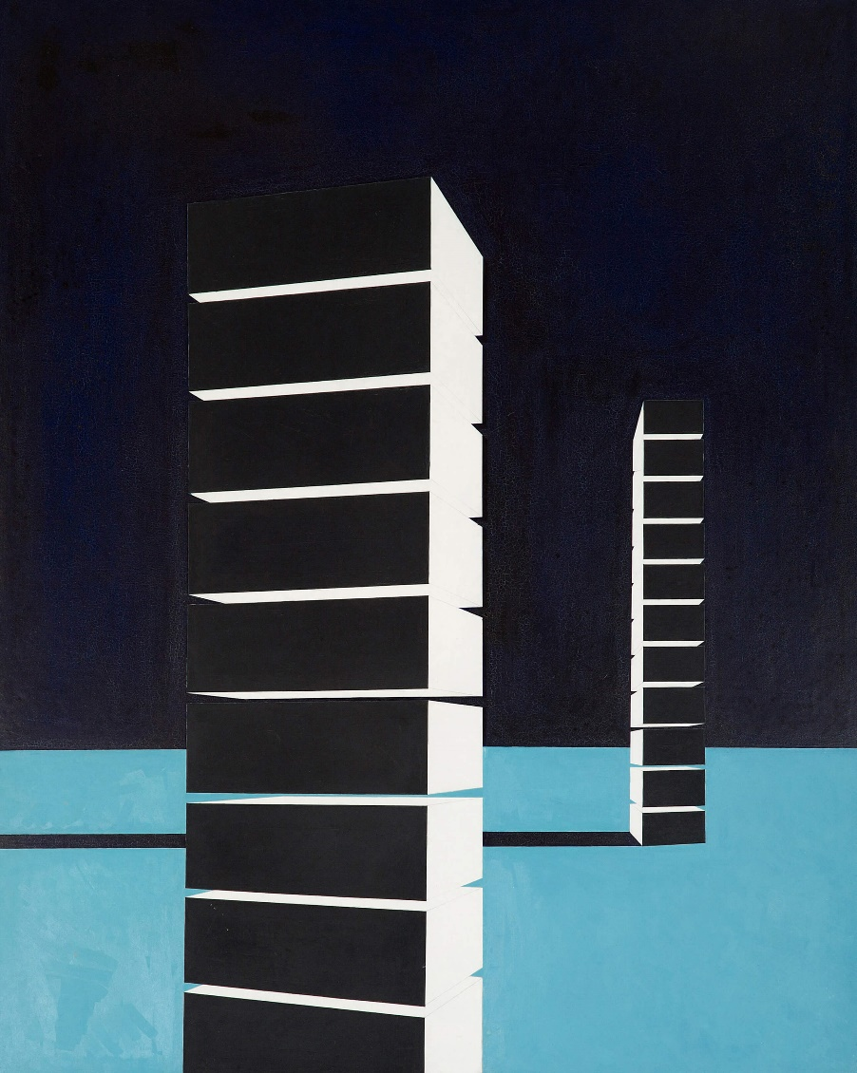
Kazuo Nakamura, Block Structure, 1956. This work was produced during Nakamura’s association with Painters Eleven.

Slide 11
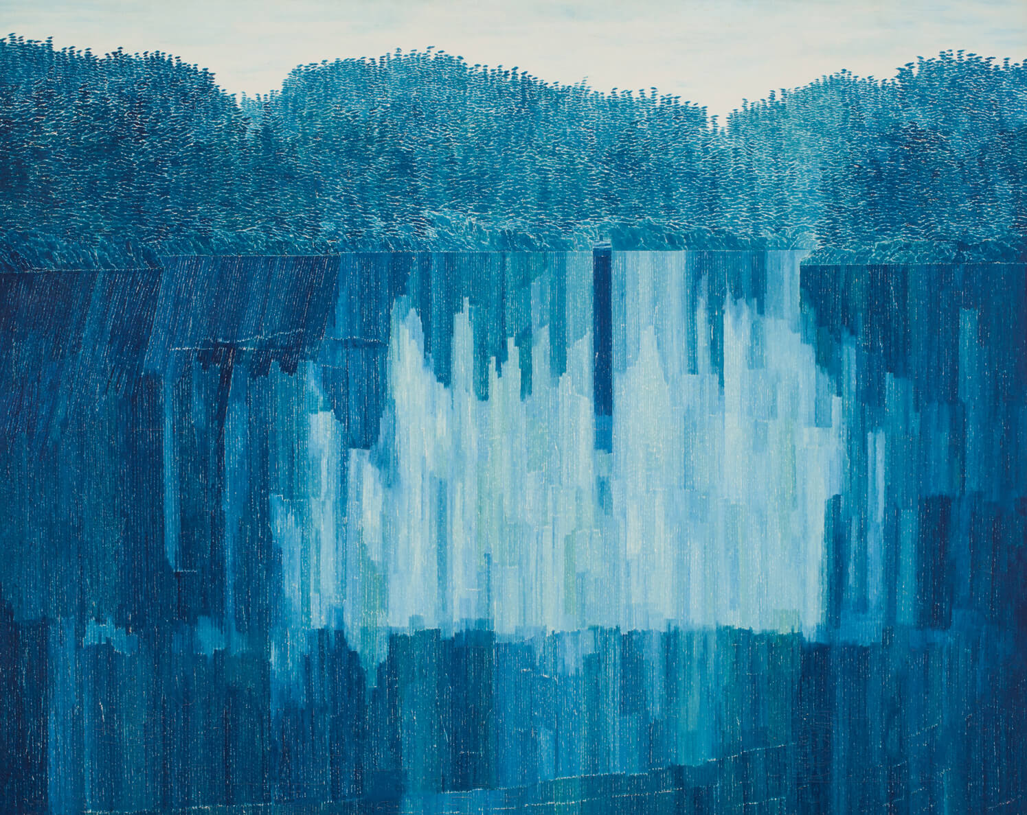
Kazuo Nakamura, Blue Reflections, B.C., 1964. This landscape painting illustrates the blue colour palette that Nakamura became known for.

Slide 12
Annie Pootoogook, 2006.

Slide 13
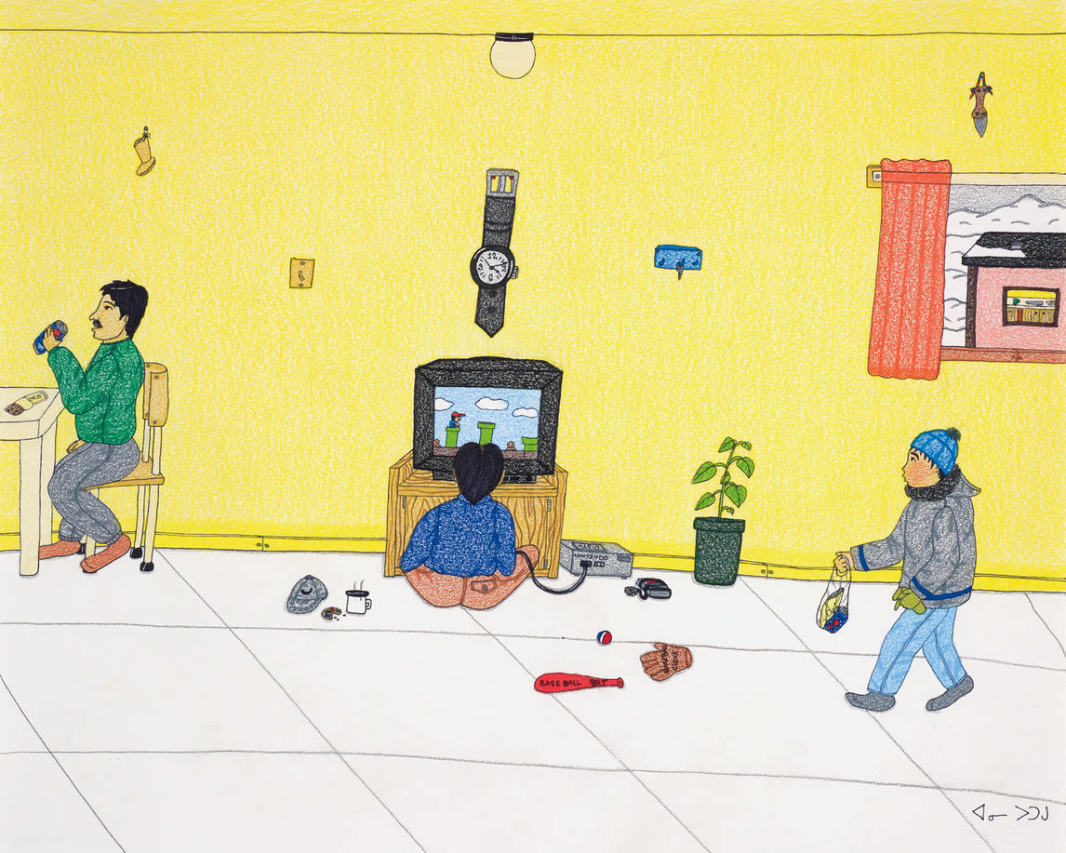
Annie Pootoogook, Playing Nintendo, 2006. Pootoogook is known for her scenes of everyday life in the North.

Slide 14
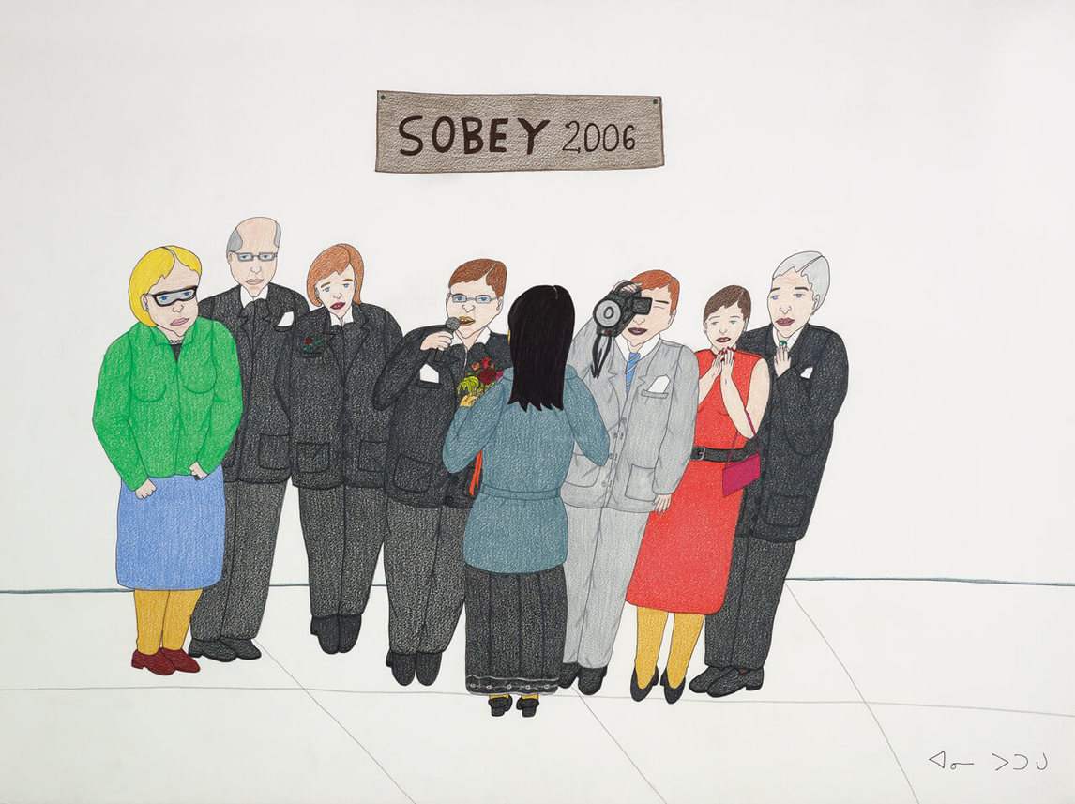
Annie Pootoogook, Sobey Awards, 2006. Pootoogook’s career was transformed after she won the Sobey Art Award.

Slide 15
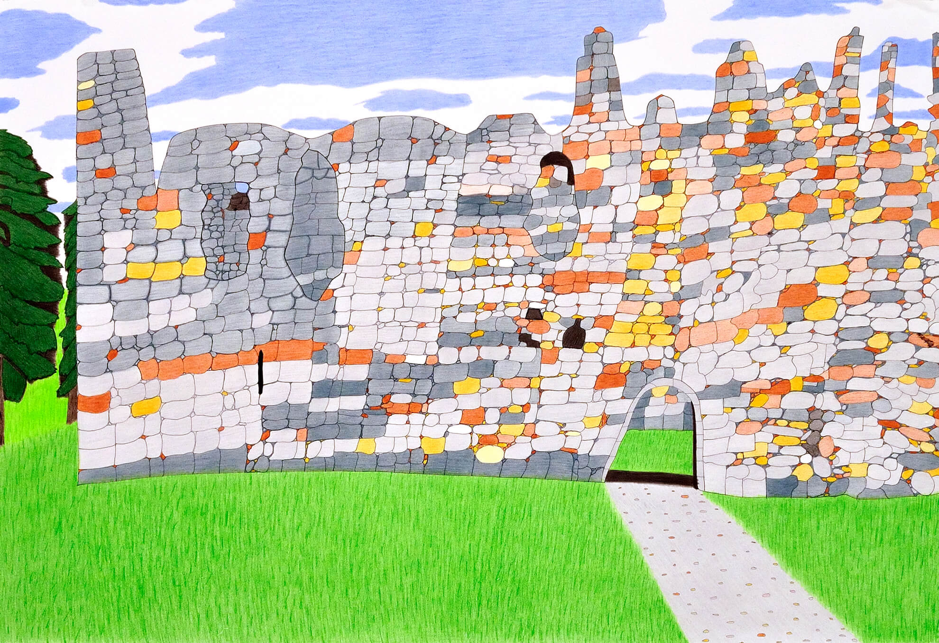
Annie Pootoogook, Balvenie Castle, 2006. This work was created while Pootoogook was attending an artists’ residency in Scotland.

Slide 16
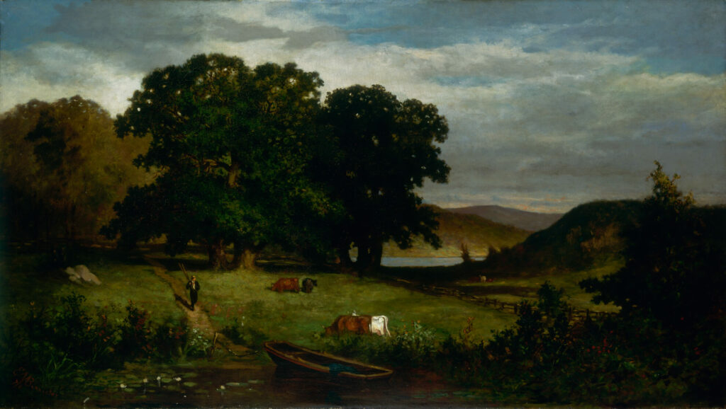
Learning Activity #1
Edward Mitchell Bannister, Oak Trees, 1876. This painting resembles Bannister’s Under the Oaks, which brought him national recognition.

Slide 17
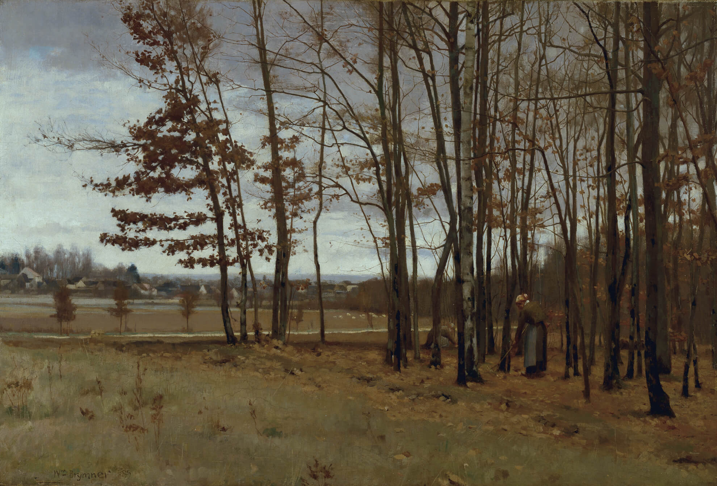
Learning Activity #1
William Brymner, Border of the Forest of Fontainebleau, 1885. Brymner displays his talent for producing complex compositions in this sombre view of the French countryside in winter.

Slide 18
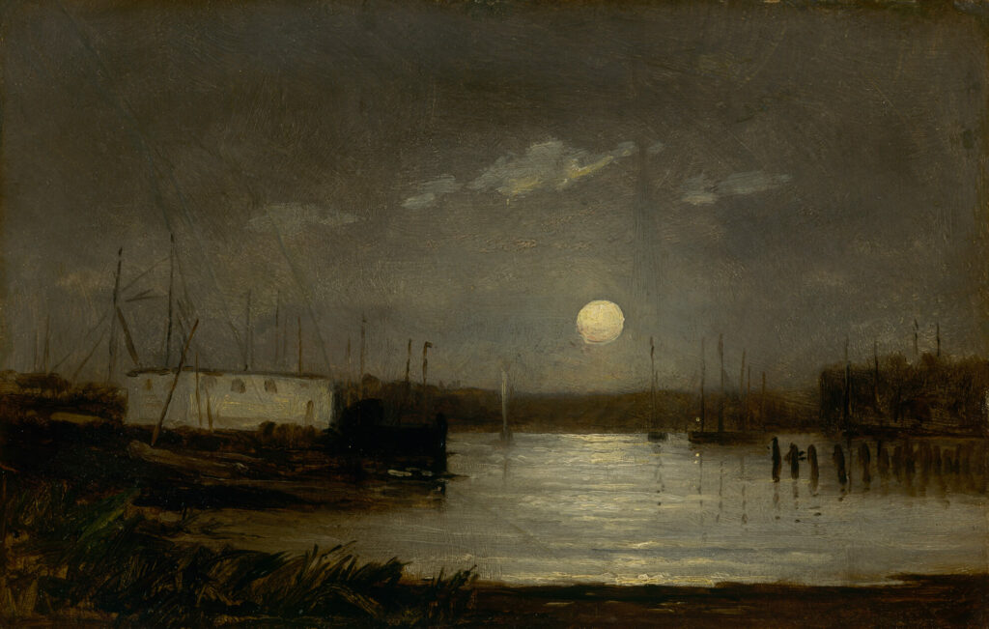
Learning Activity #1
Edward Mitchell Bannister, Untitled (moon over a harbor, wharf scene with full moon and masts of boats), c.1868. Bannister was interested in capturing natural light at different times of the day.

Slide 19
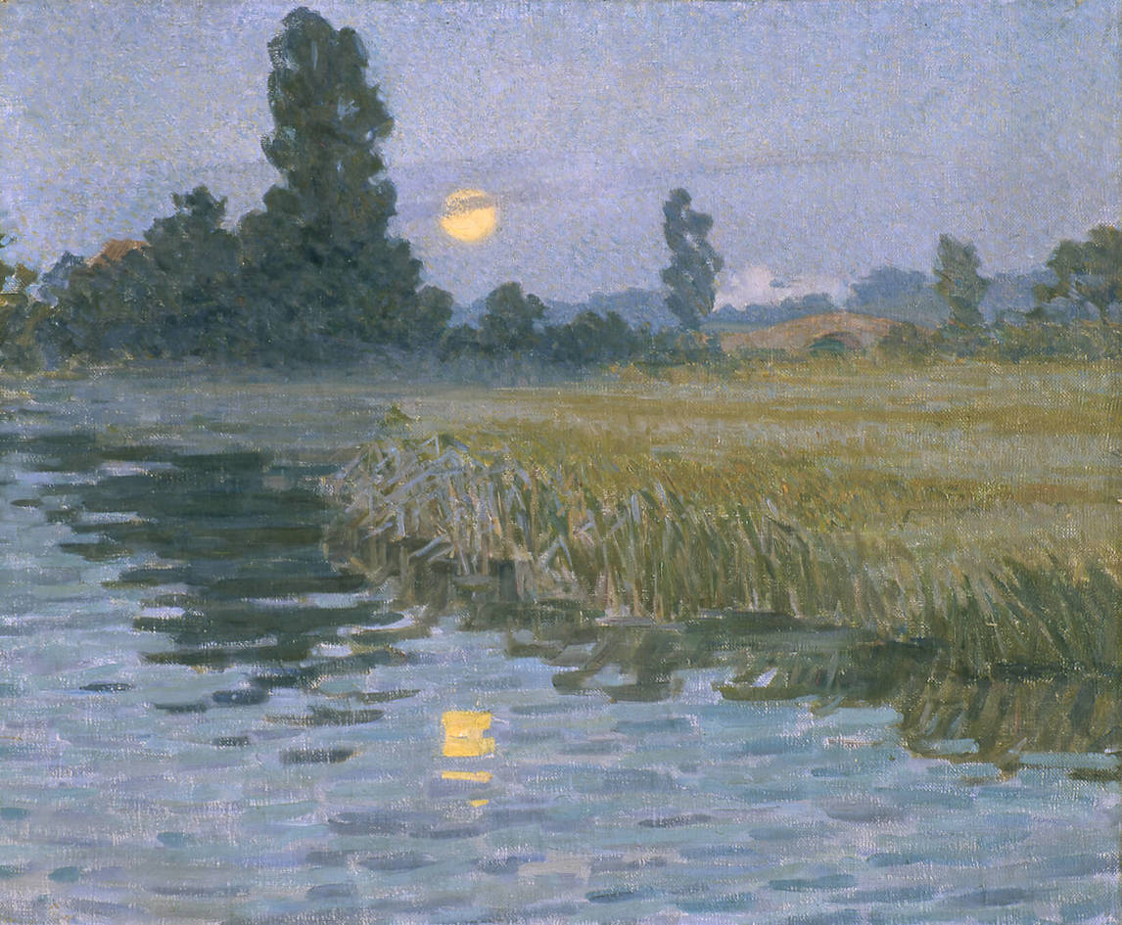
Learning Activity #1
Helen McNicoll, Moonlight, c.1905. This work is a departure from McNicoll’s sunny canvases of mothers and their children.

Slide 20
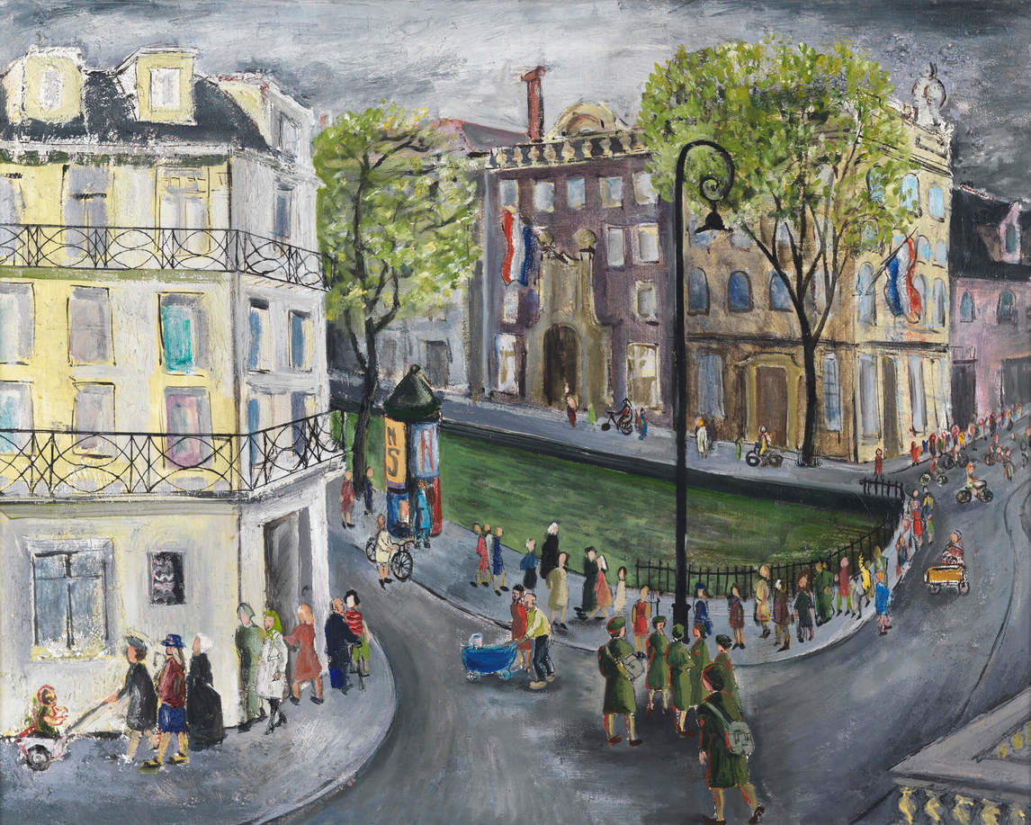
Learning Activity #1
Molly Lamb Bobak, CWACs on Leave in Amsterdam, September, 1945, 1946. Bobak was known for producing lively crowd scenes based from sketches.

Slide 21
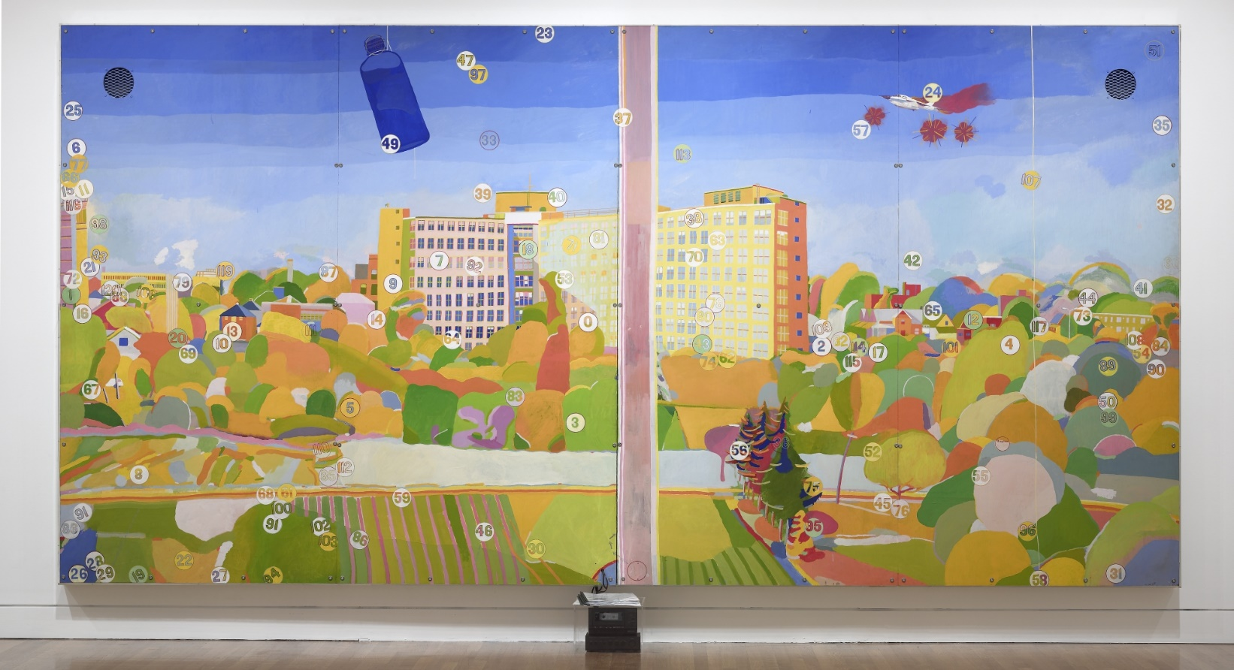
Learning Activity #1
Greg Curnoe, View of Victoria Hospital, Second Series, February 10, 1969–March 10, 1971, 1969–71. This monumental painting is based on a view from the window of Curnoe’s studio in London, Ontario.

Slide 22
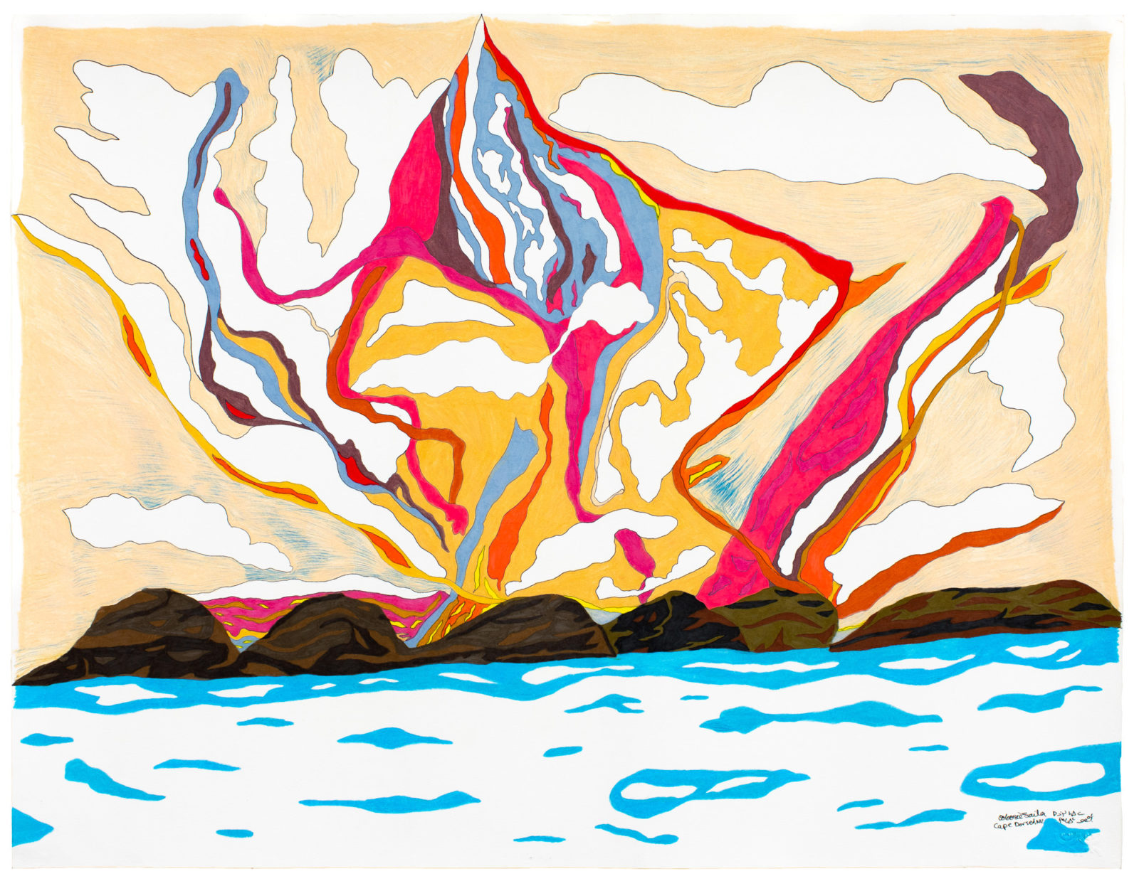
Learning Activity #1
Ooloosie Saila, Untitled (Pink Landscape), 2019. In this Arctic scene, Saila juxtaposes fiery, saturated skies with crisp, ice-blue waters.

Slide 23
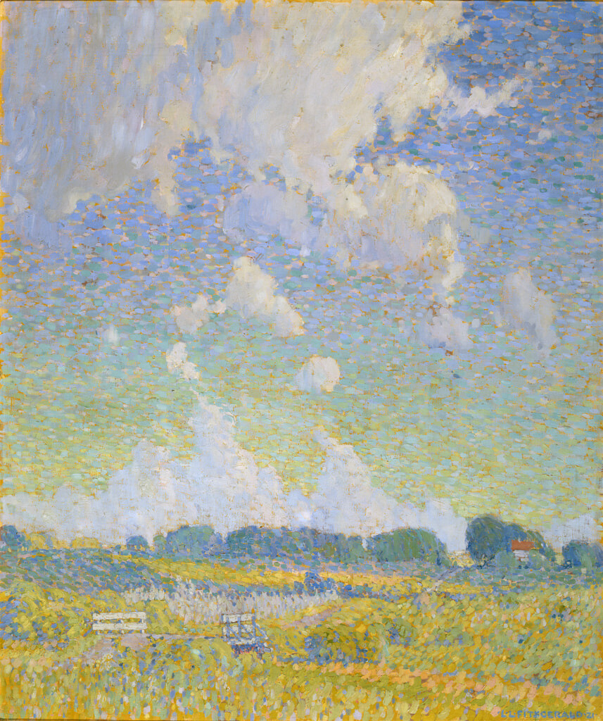
Learning Activity #1
Lionel LeMoine FitzGerald, Summer Afternoon, The Prairie, 1921. This work captures the intense light and infinite space unique to the Prairies.

Slide 24
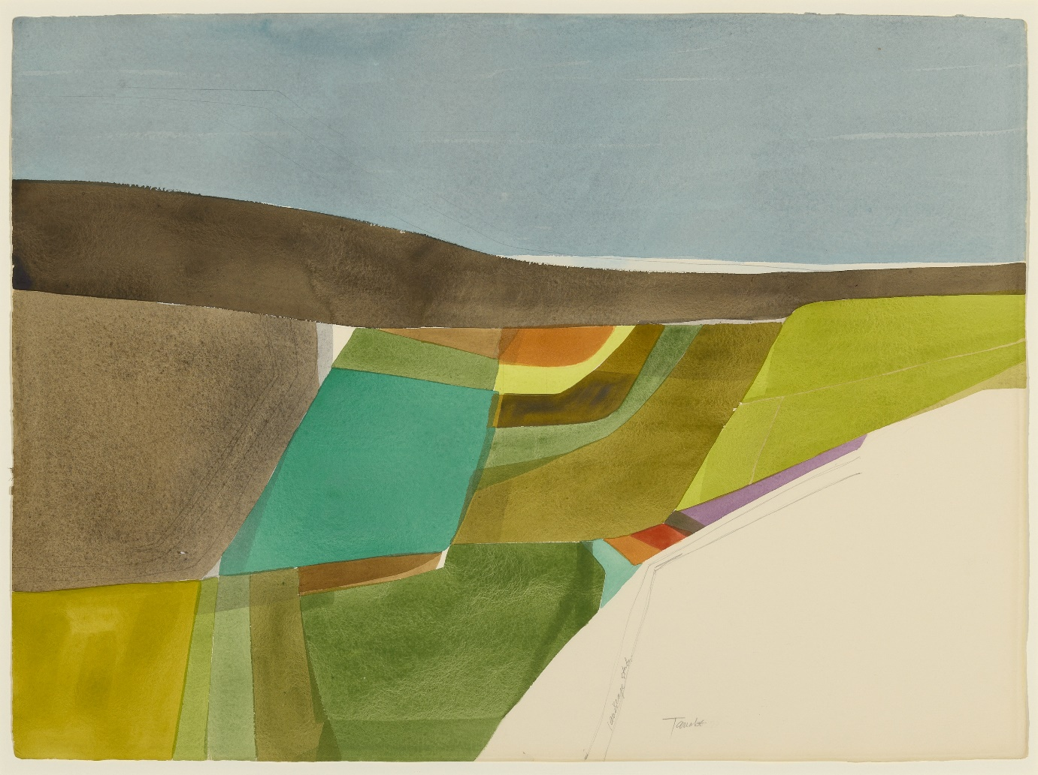
Learning Activity #1
Takao Tanabe, Landscape Study #4, 1972. This landscape features bands of flat colour and loosely drawn geometric shapes.

Slide 25
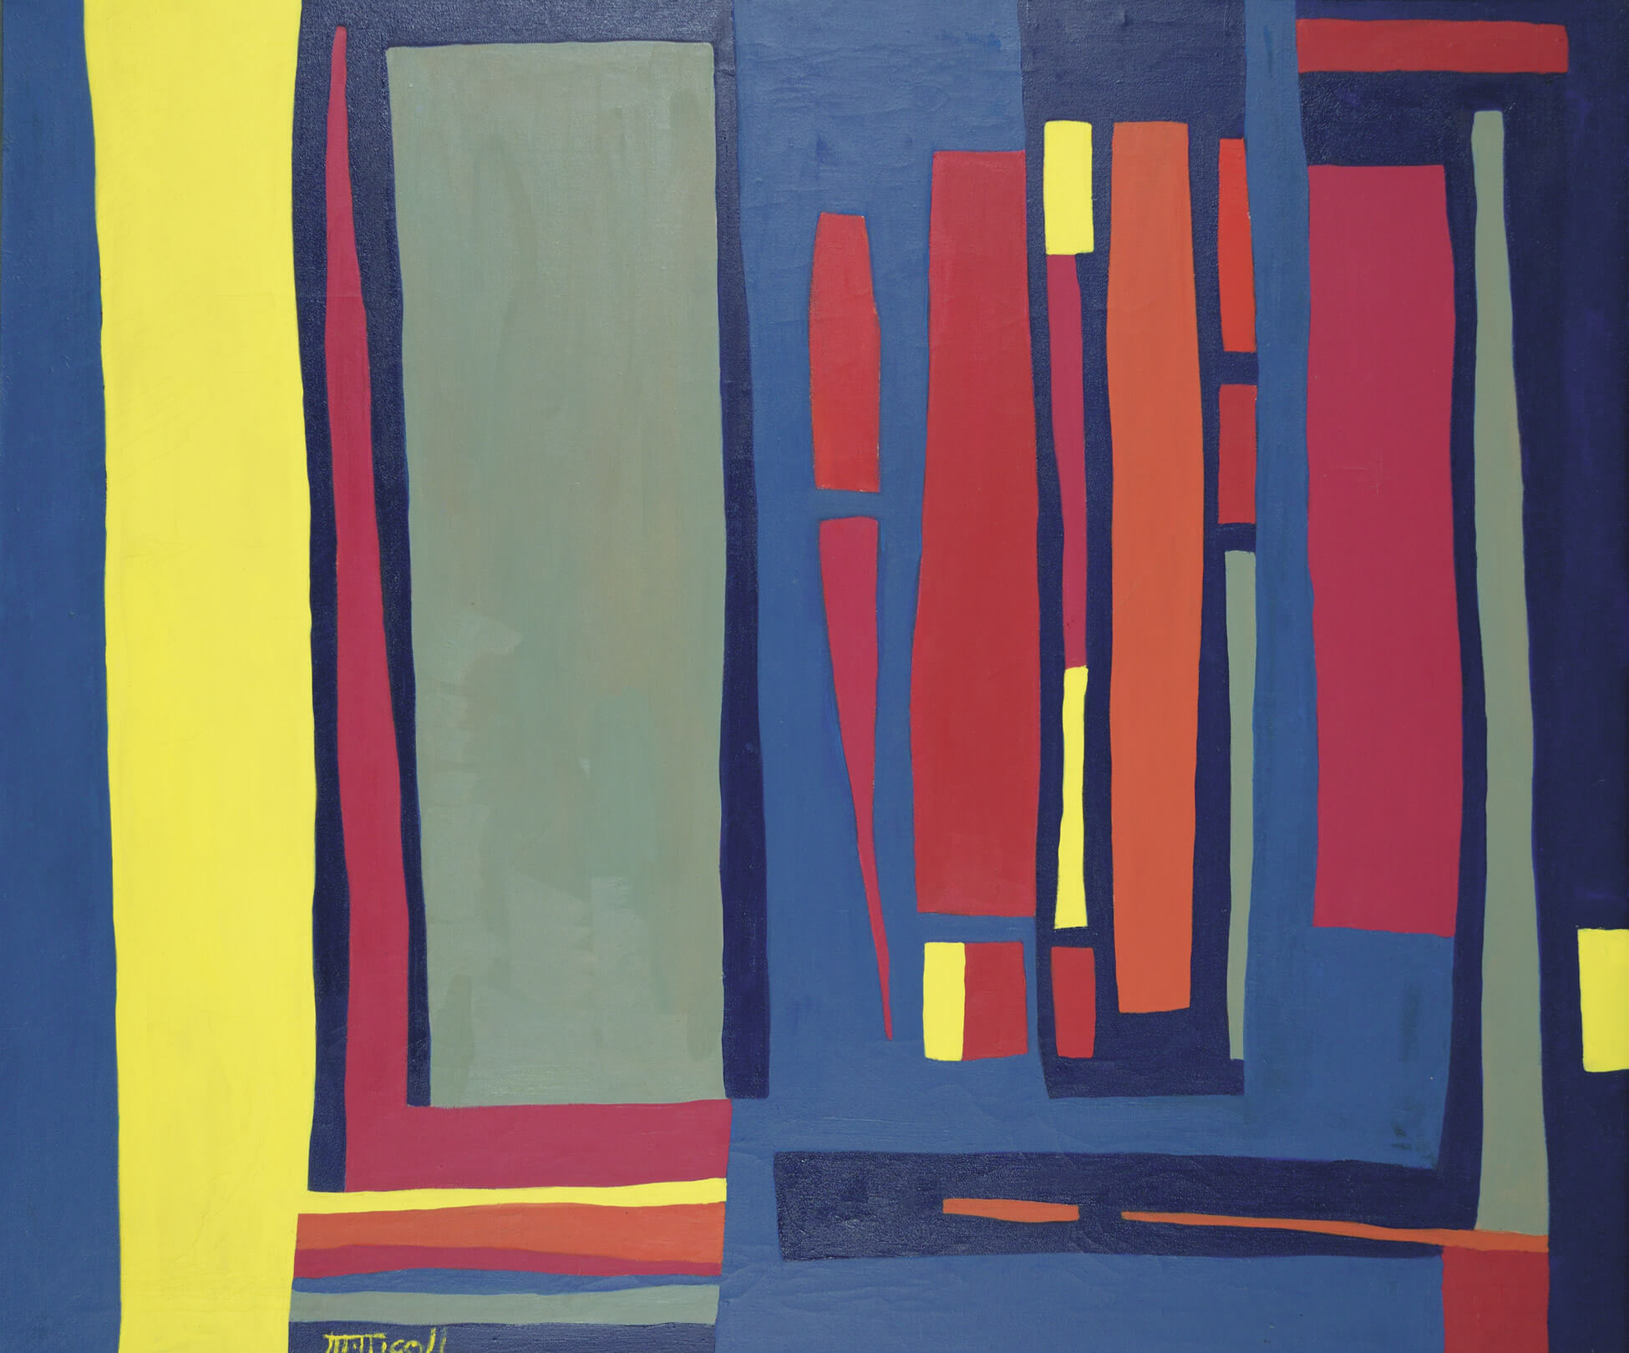
Learning Activity #1
Marion Nicoll, Alberta IV: Winter Morning, 1961. Nicoll’s abstract paintings demonstrate her deep knowledge of the symbolic and emotional effects of colour.

Slide 26
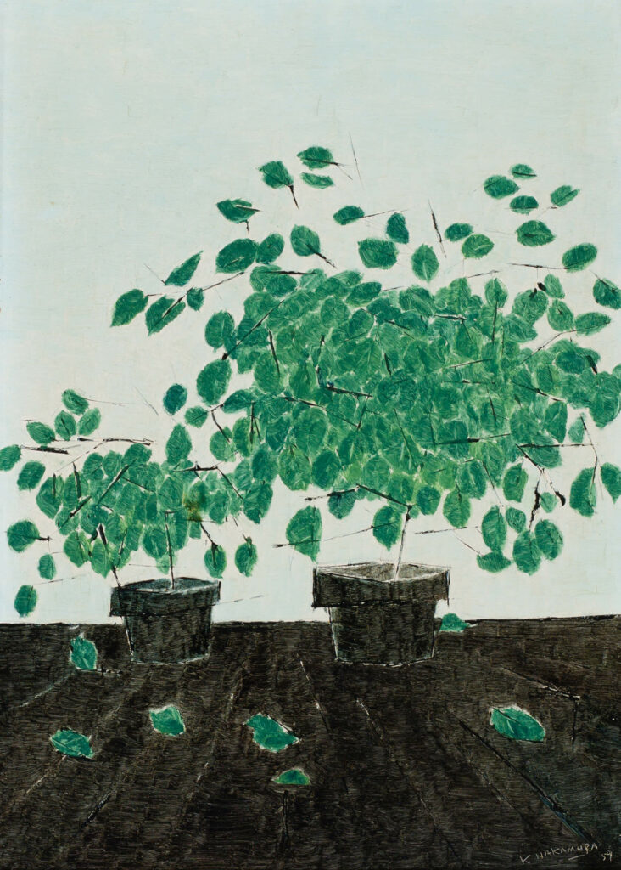
Learning Activity #2
Kazuo Nakamura, Still-Life, 1959. Nakamura painted still lifes periodically throughout the 1950s and 1960s.

Slide 27
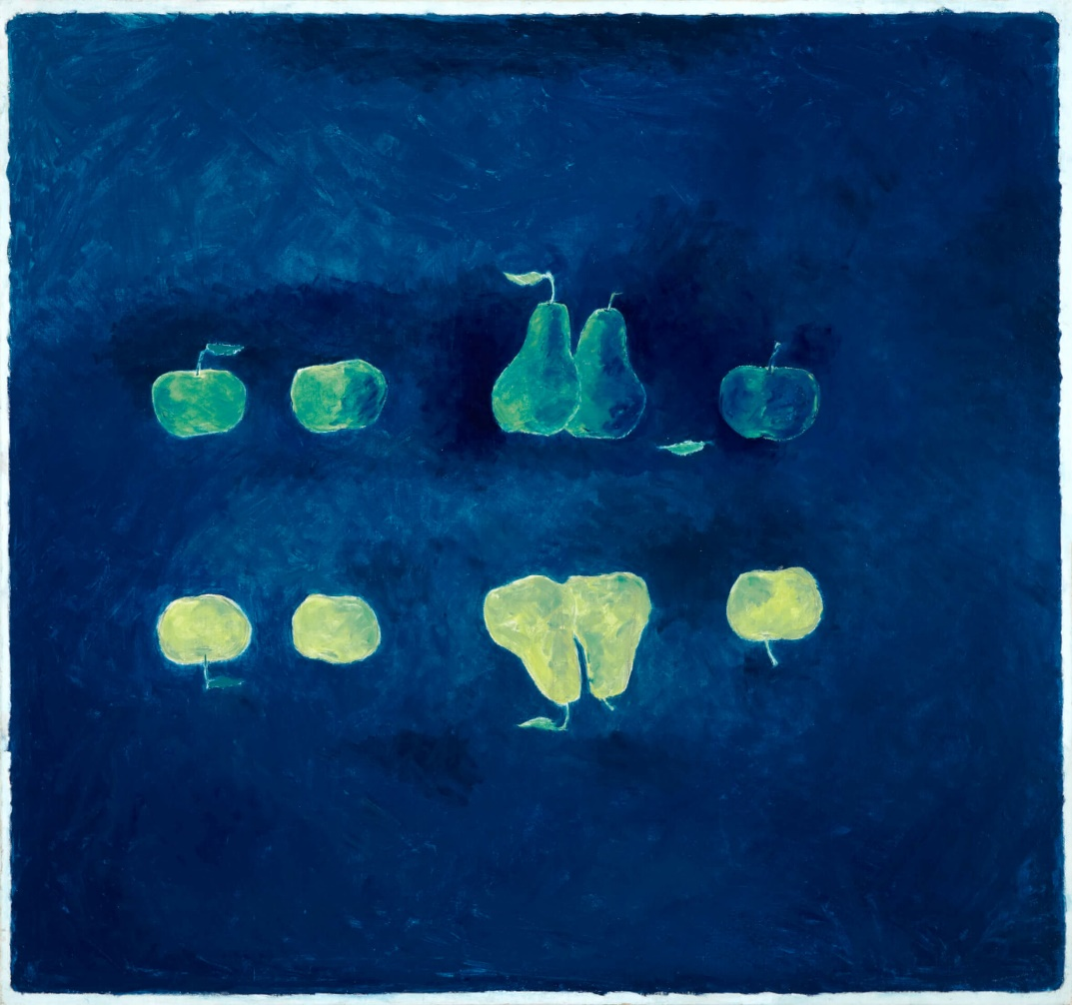
Learning Activity #2
Kazuo Nakamura, Reversed Images, 1965. In this painting of apples and pears, Nakamura illustrates his interest in symmetry.

Slide 28
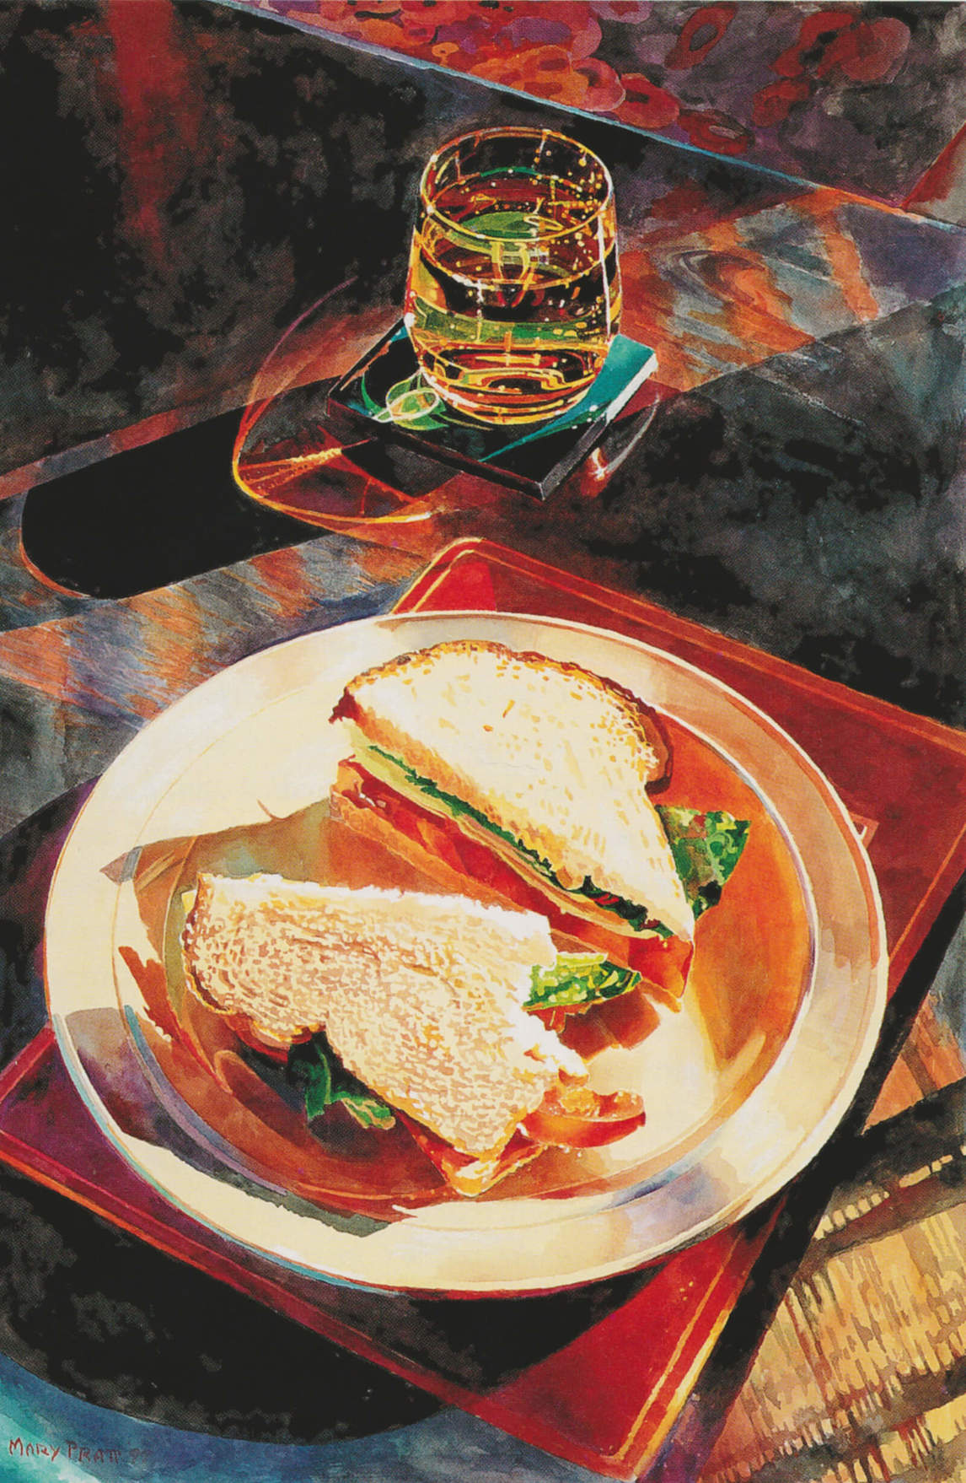
Learning Activity #2
Mary Pratt, Ginger Ale and Tomato Sandwich No. 1, 1999. This work is an example of the close observation of light that is typical of Pratt’s art.

Slide 29
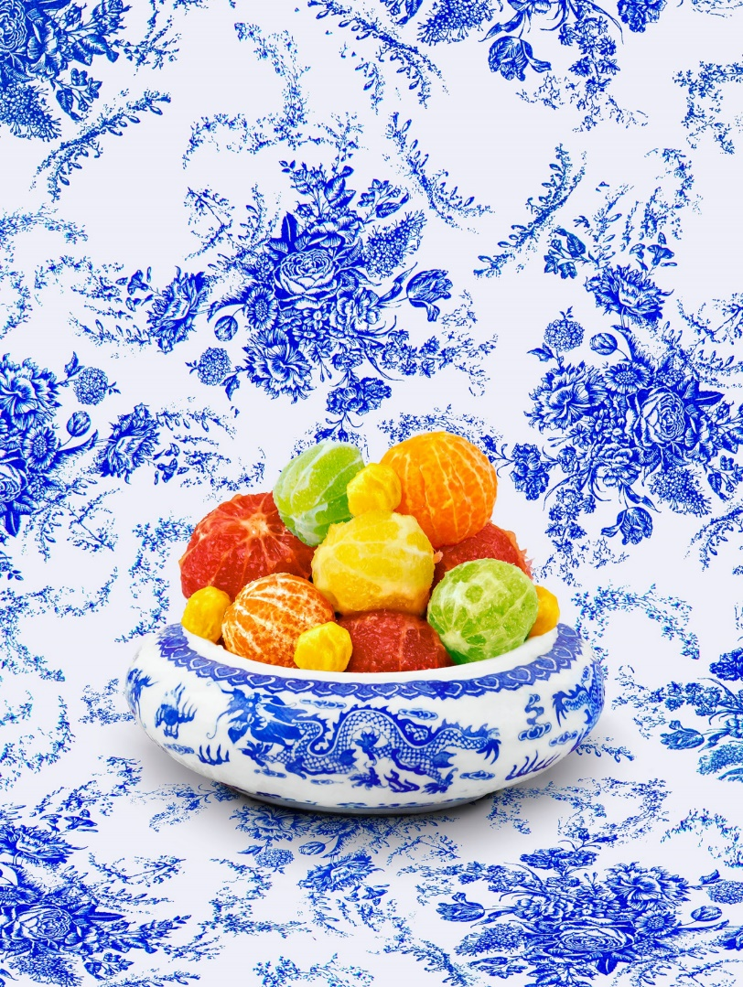
Learning Activity #2
Shellie Zhang, Still Life with Citrus, 2018–19. Zhang’s work takes cues from still life, decorative produce displayed in restaurants, and offerings to temples.

Slide 30
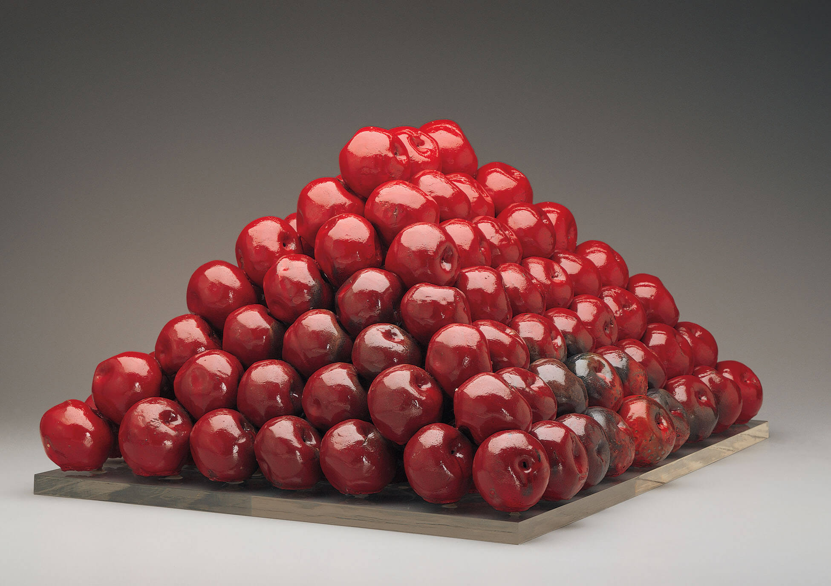
Learning Activity #2
Gathie Falk, 196 Apples, 1969–70. Falk’s sculptural apples are a response to the arrangements of fruit that she saw daily in her neighbourhood food store.

Slide 31
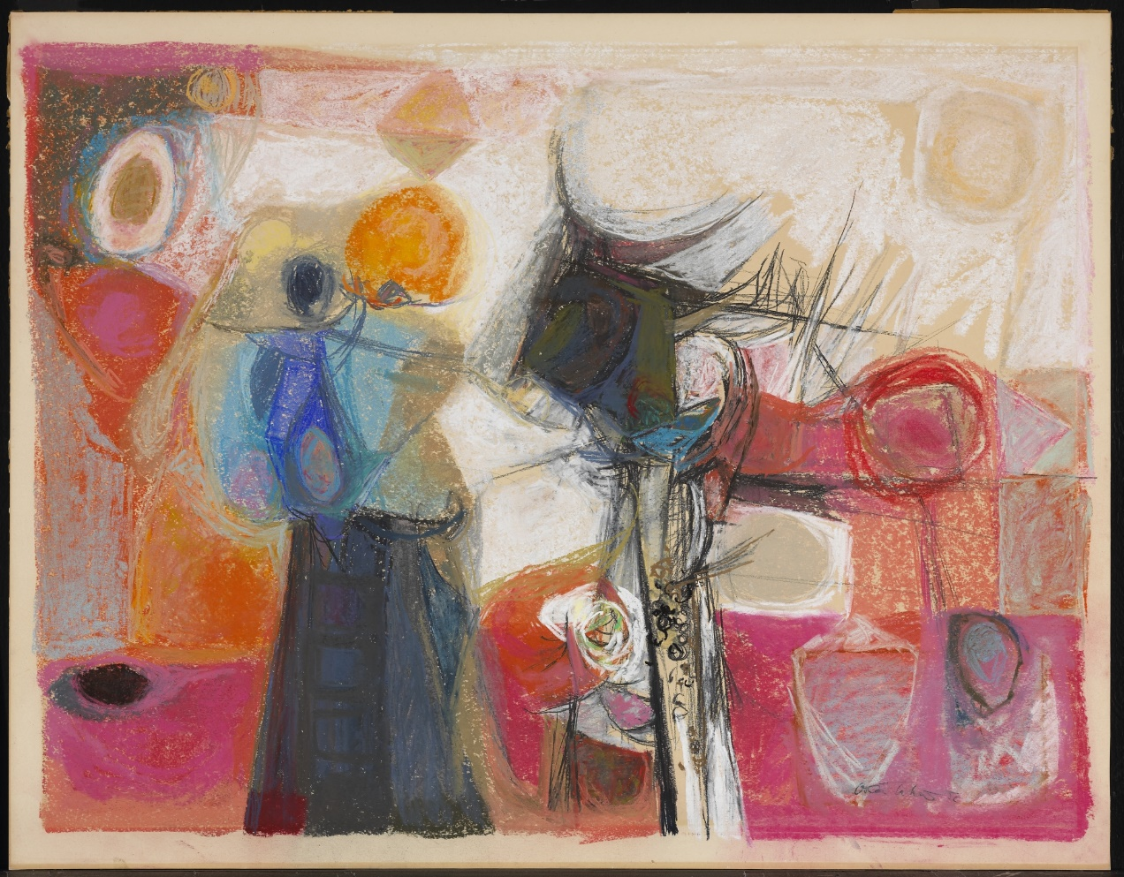
Learning Activity #2
Oscar Cahén, Still-life, 1950. Cahén was a highly versatile artist who often combined several media together.

Slide 32
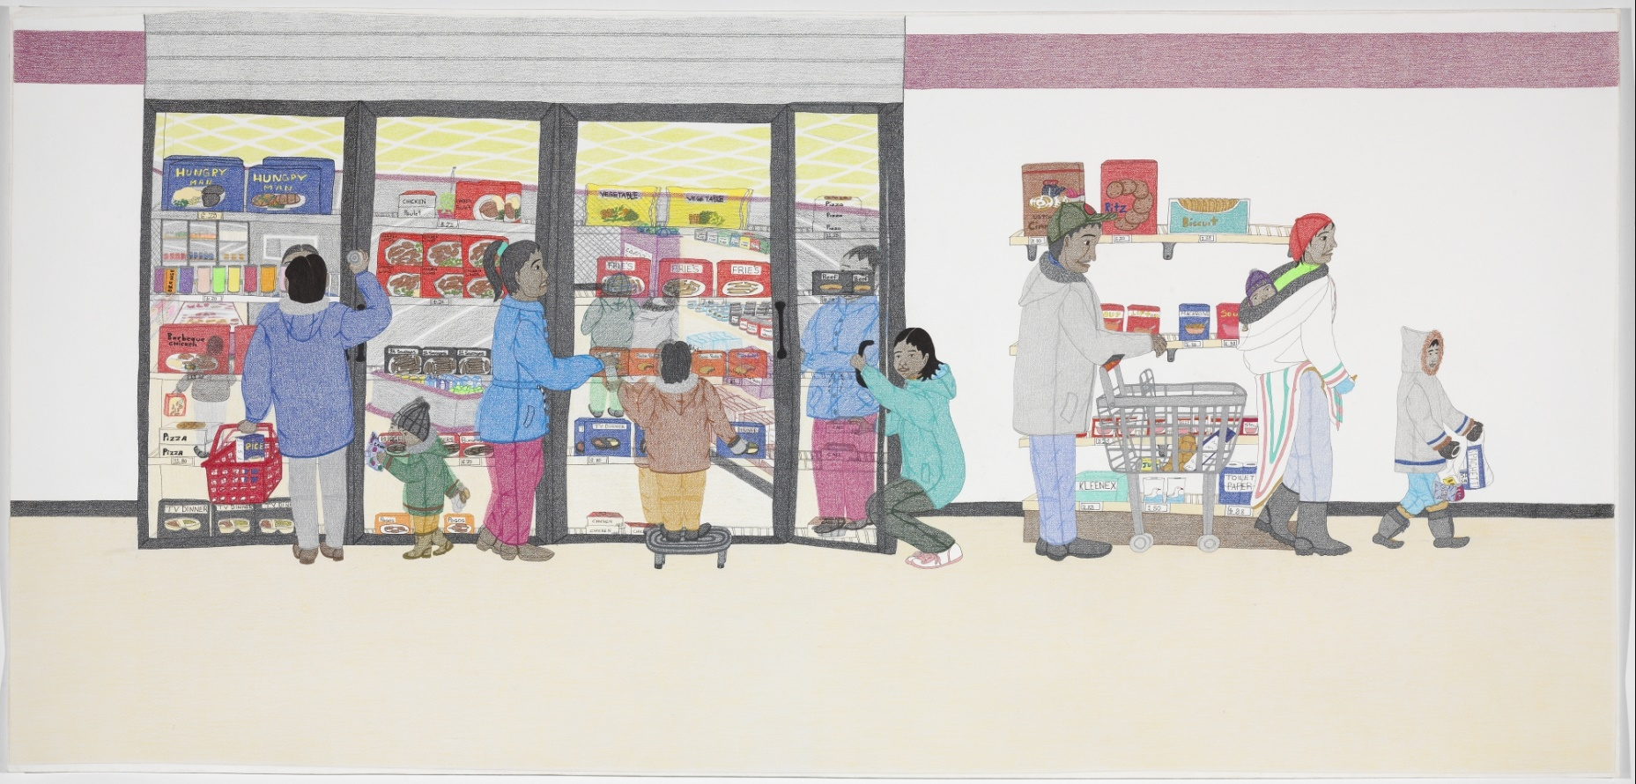
Culminating Task
Annie Pootoogook, Cape Dorset Freezer, 2005. This drawing was one of the first produced in Pootoogook’s innovative large-scale format.

Slide 33
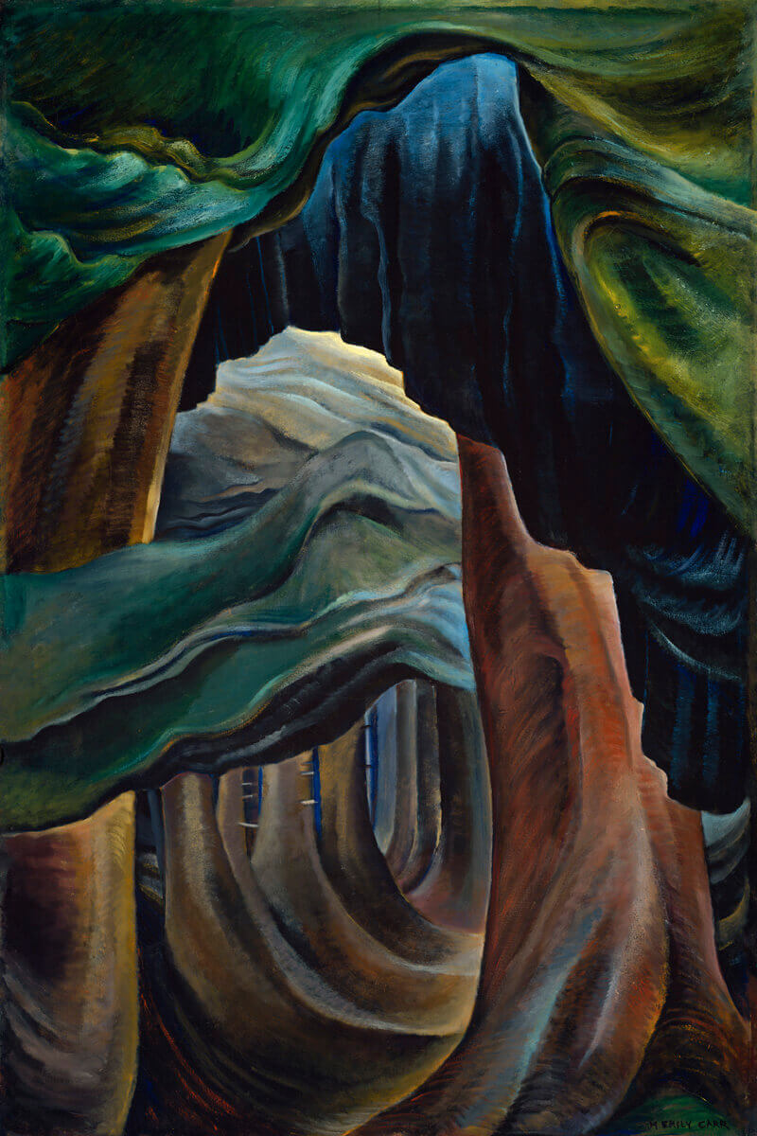
Culminating Task
Emily Carr, Forest, British Columbia, 1931–32. The lush forests of British Columbia held spiritual meaning for Carr.

Slide 34
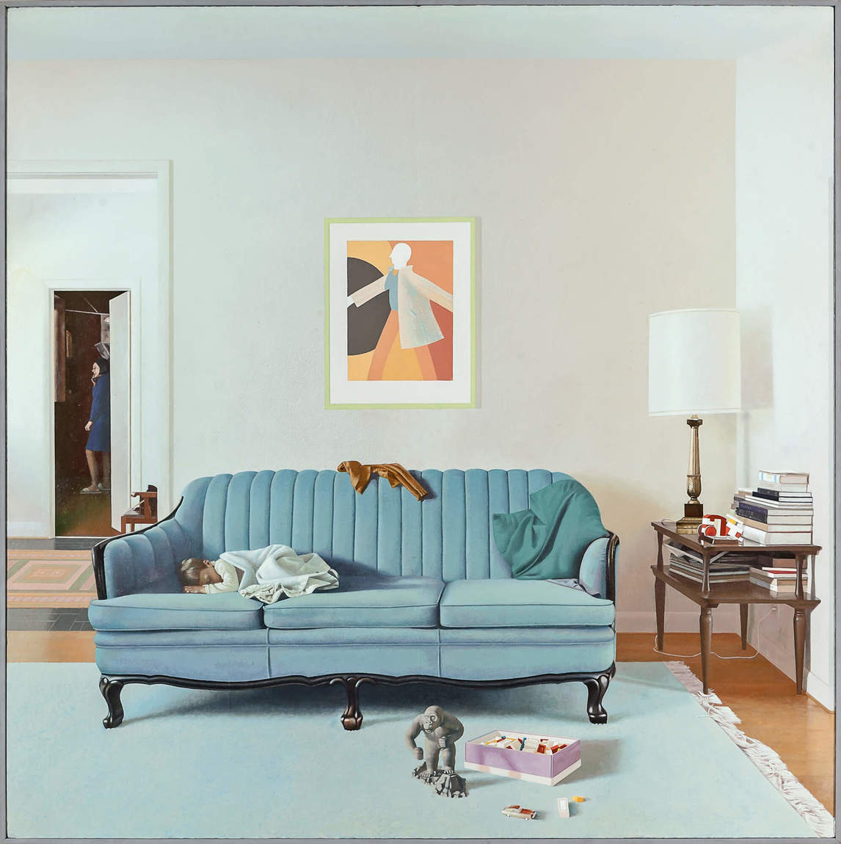
Culminating Task
Jack Chambers, Diego Sleeping No. 2, 1971. This painting is a key example of the artist’s technique of “perceptual realism.”

Slide 35
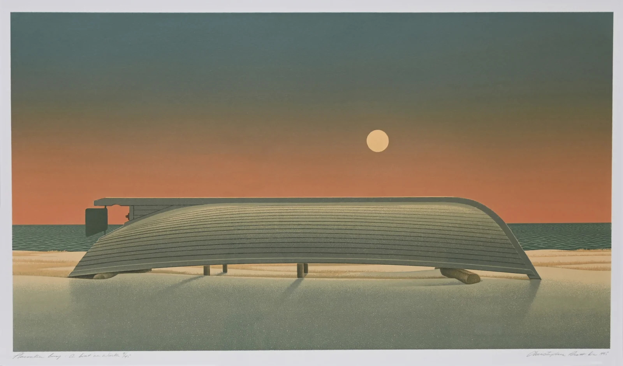
Culminating Task
Christopher Pratt, Placentia Bay: A Boat in Winter, 1996. Born in Newfoundland, Pratt was inspired by its geography and his childhood memories of the province.

Slide 36
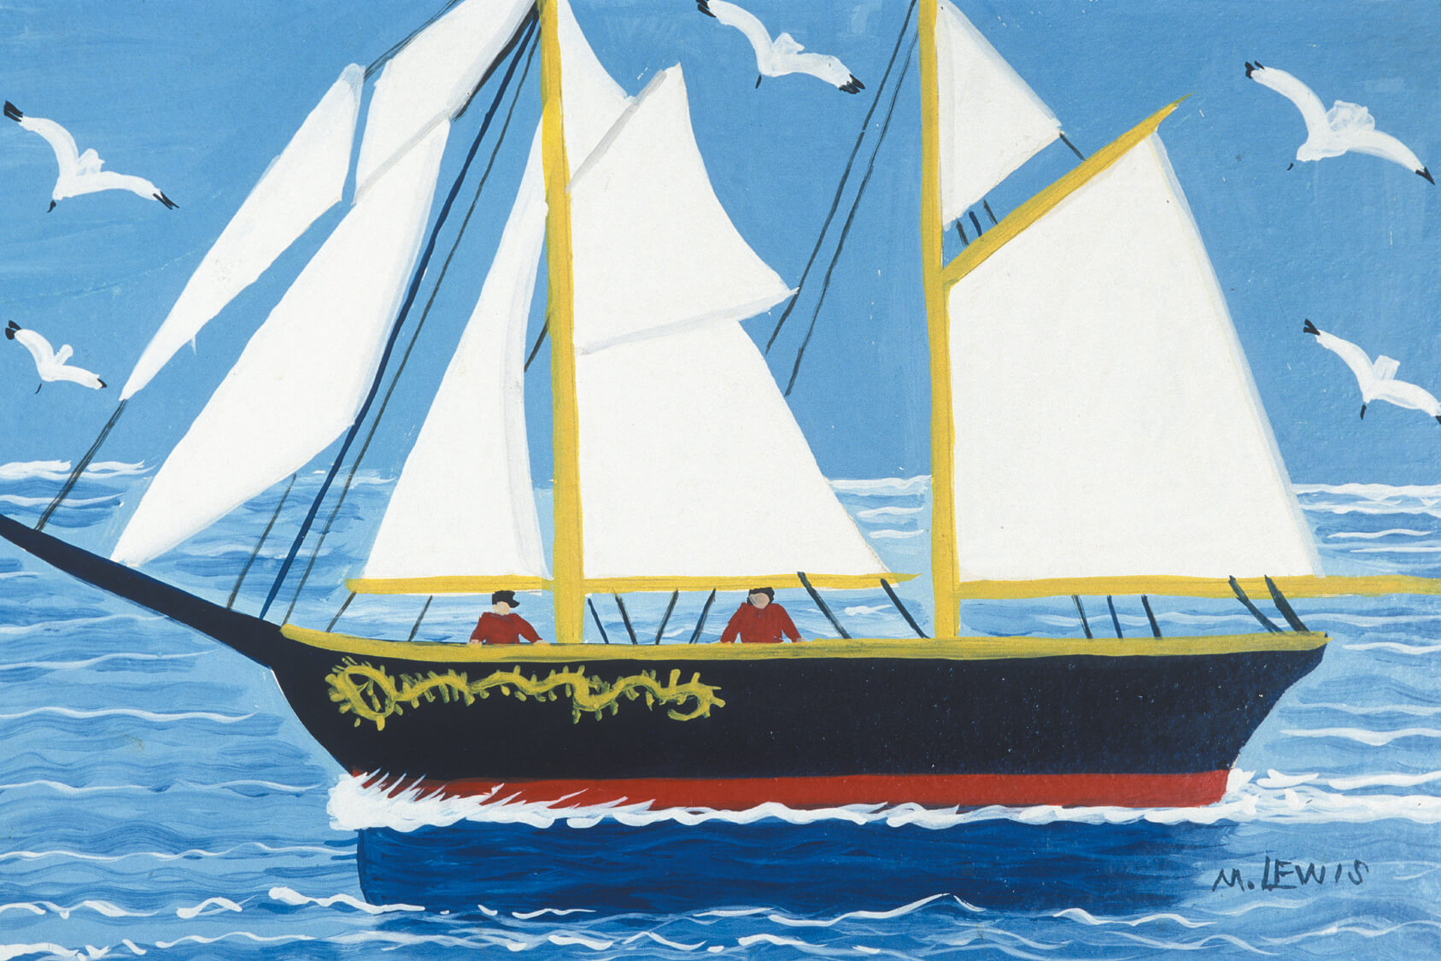
Culminating Task
Maud Lewis, The Bluenose, c.1960s. Lewis often worked with images that were familiar to Nova Scotians, like this iconic fishing schooner.

Slide 37
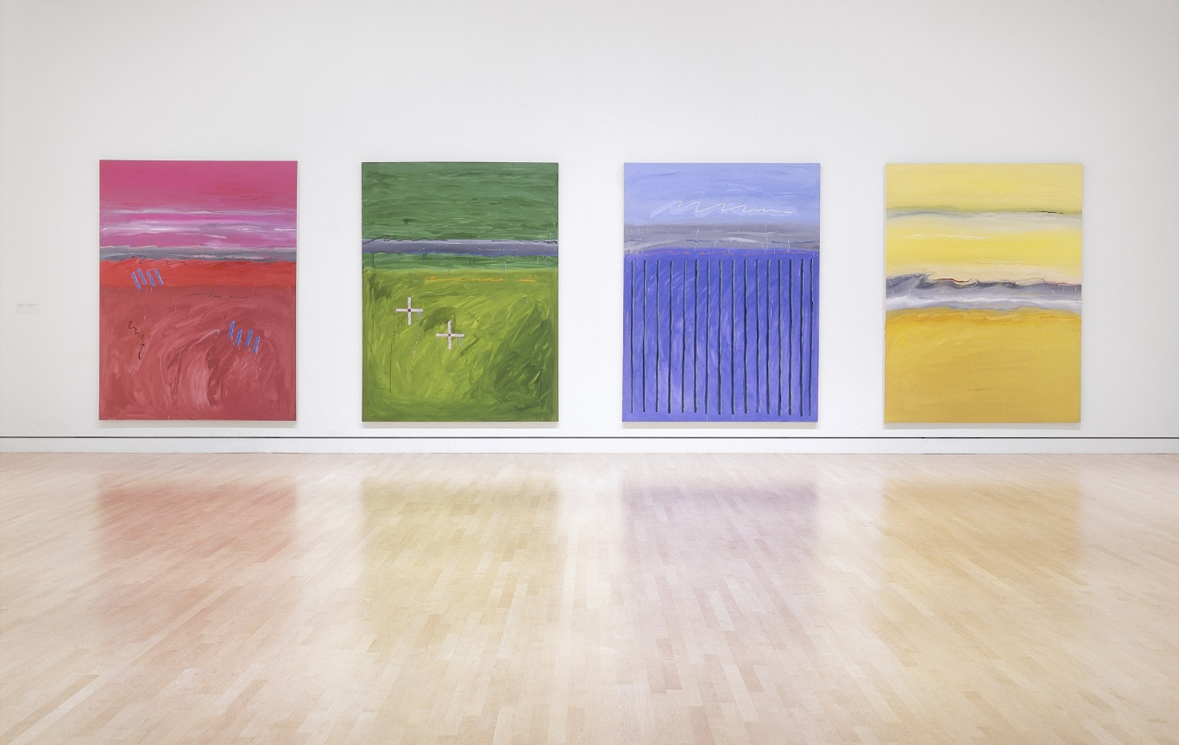
Culminating Task
Robert Houle, Muhnedobe uhyahyuk (Where the gods are present) (Matthew, Philip, Bartholomew, Thomas), 1989. Houle’s paintings are inspired by a sacred Saulteaux pilgrimage site situated near his childhood home.

Slide 38
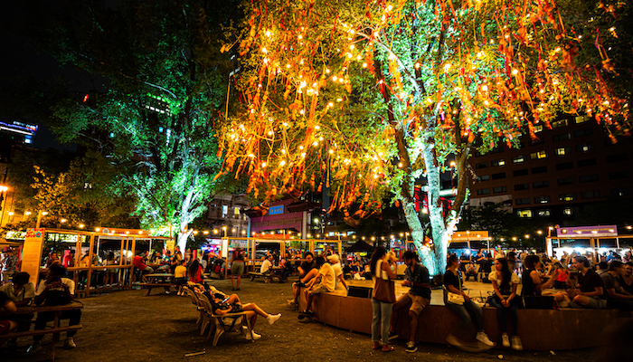
Culminating Task
Karen Tam, Arbre à souhaits / Chinatown Wishing Tree, 2021. Tam’s work pays homage to Montreal’s Chinatown, the community in which it was situated.

Slide 39
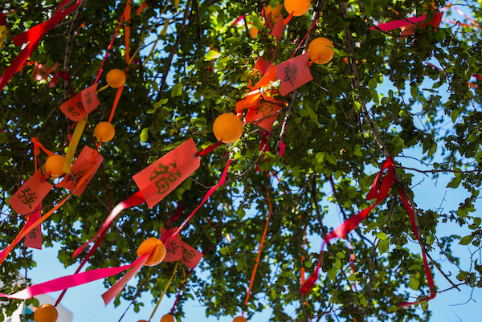
Culminating Task
Karen Tam, Arbre à souhaits / Chinatown Wishing Tree (detail), 2021.

Slide 40
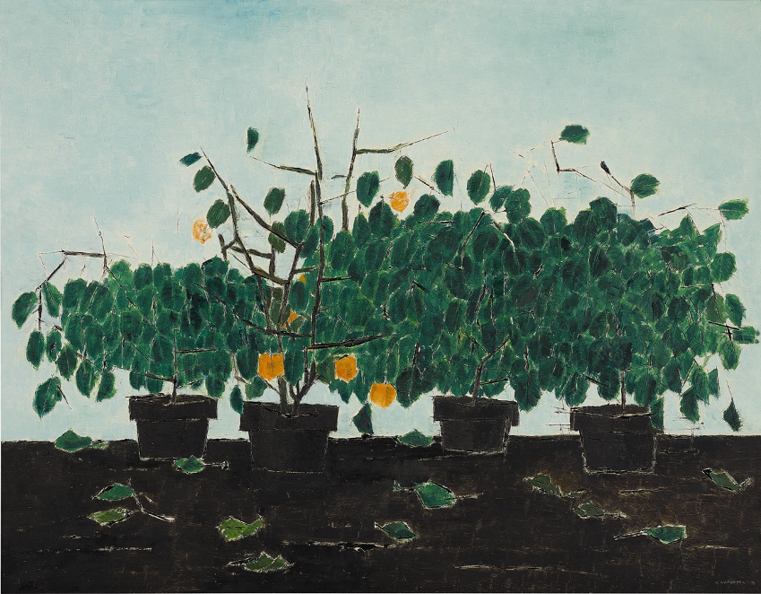
Kazuo Nakamura, Four Plants, 1958. Nakamura was known for oscillating between representational and abstract forms in his work.

Slide 41
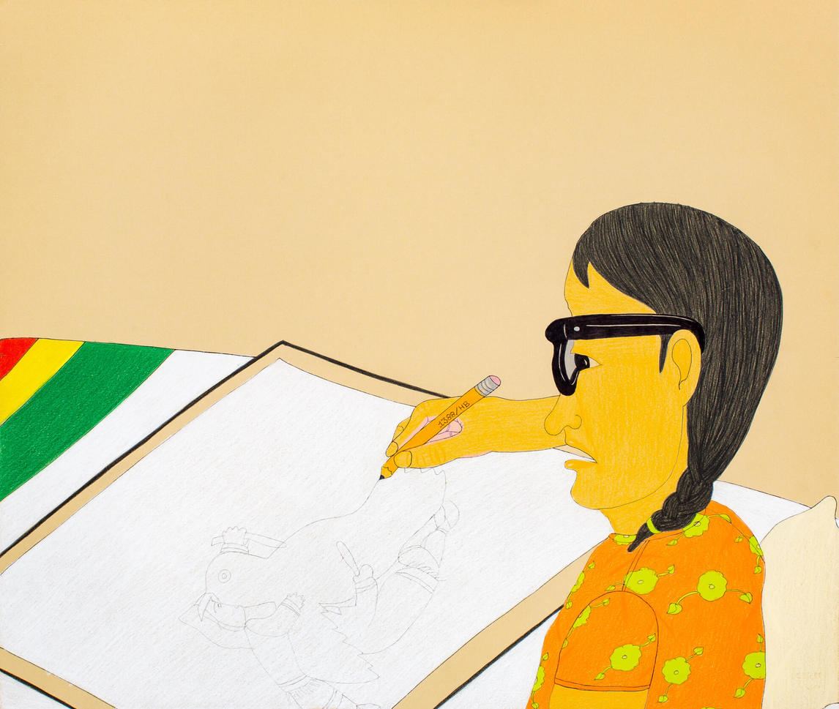
Annie Pootoogook, Drawing with Pencil (Bay Blanket), 2005–6. Pootoogook made several works focused on the act of drawing.

Slide 42
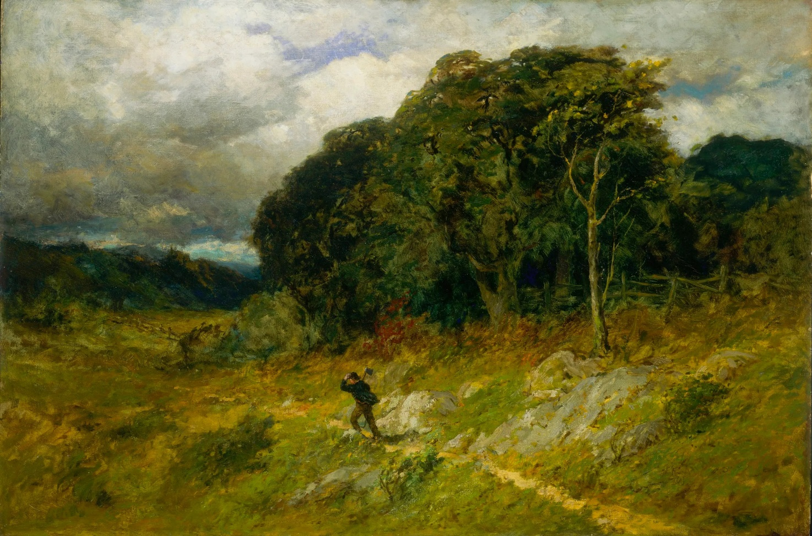
Edward Mitchell Bannister, Approaching Storm, 1886. The ominous presence of storm clouds pictured here on the far left highlights nature as a powerful force.

