Slide 2
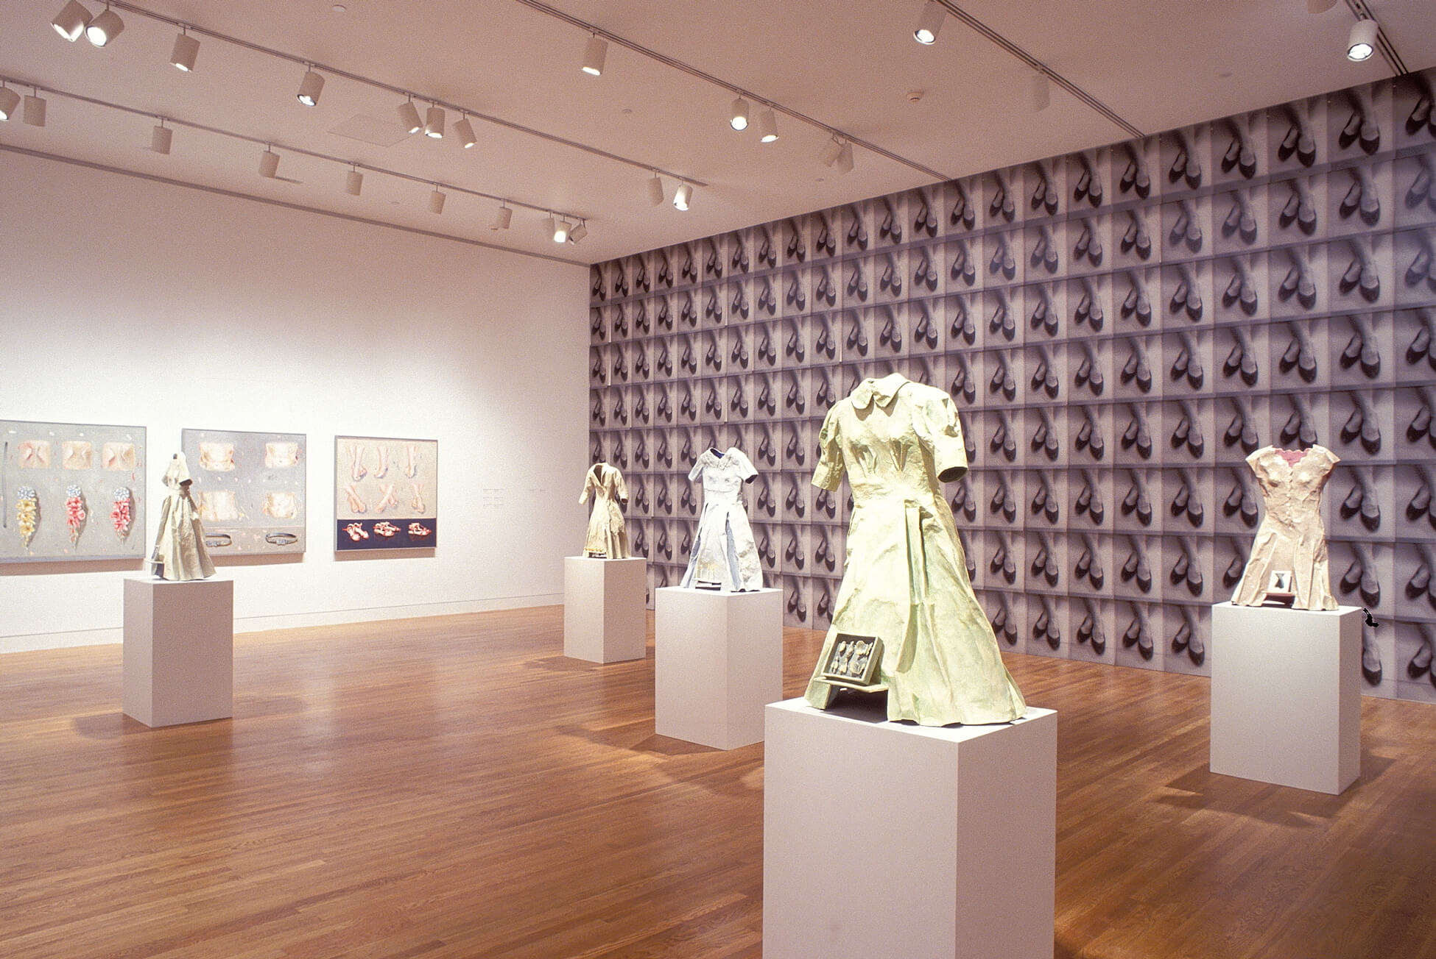
Installation view of Gathie Falk, 2002, at the National Gallery of Canada.

Slide 3
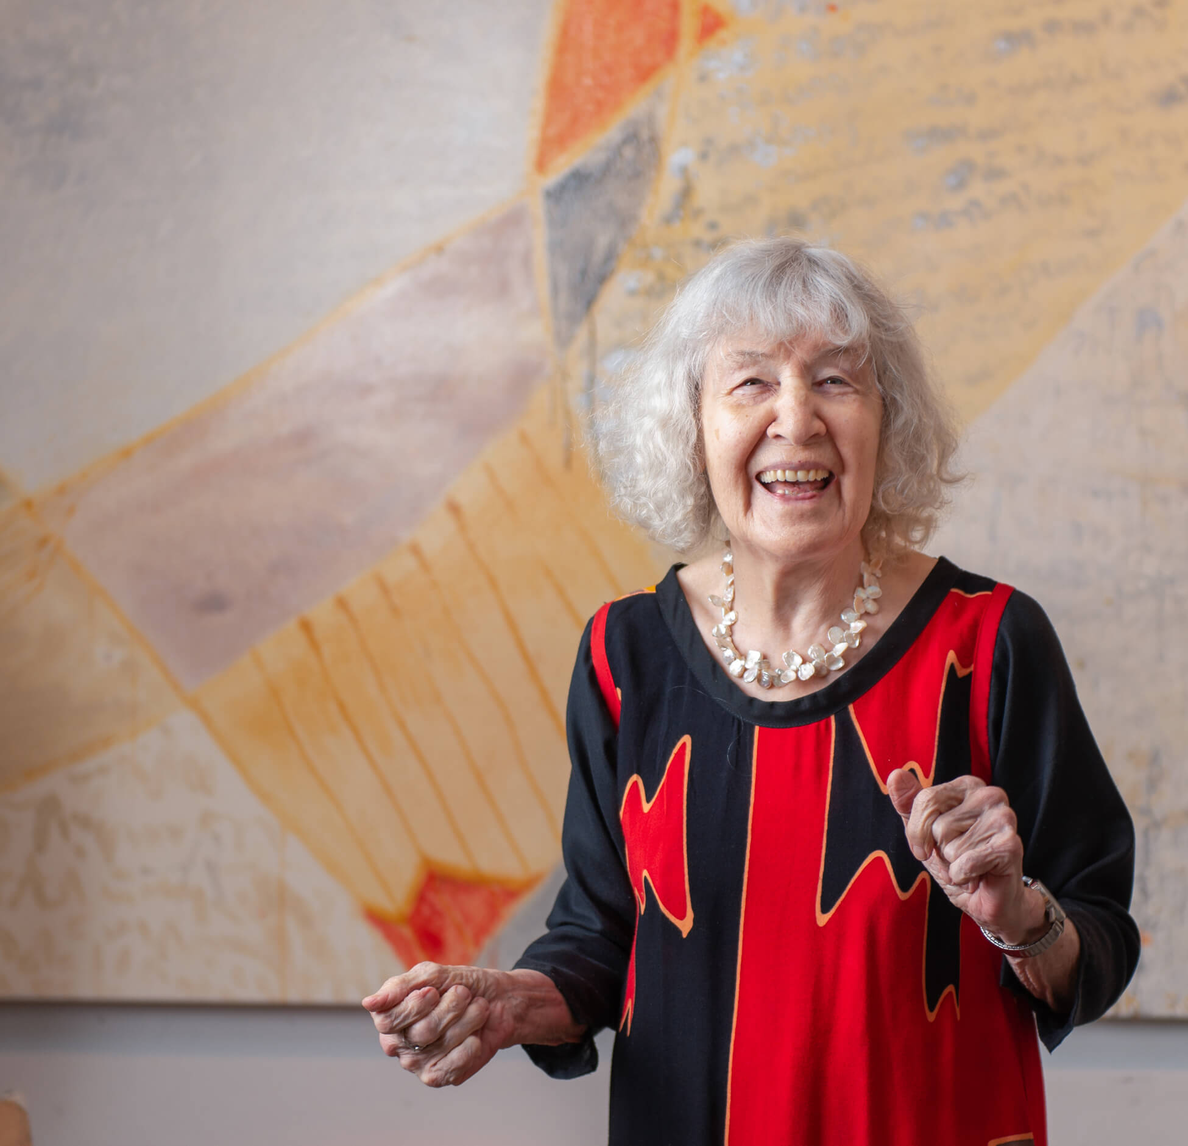
Gathie Falk in 2019.

Slide 4
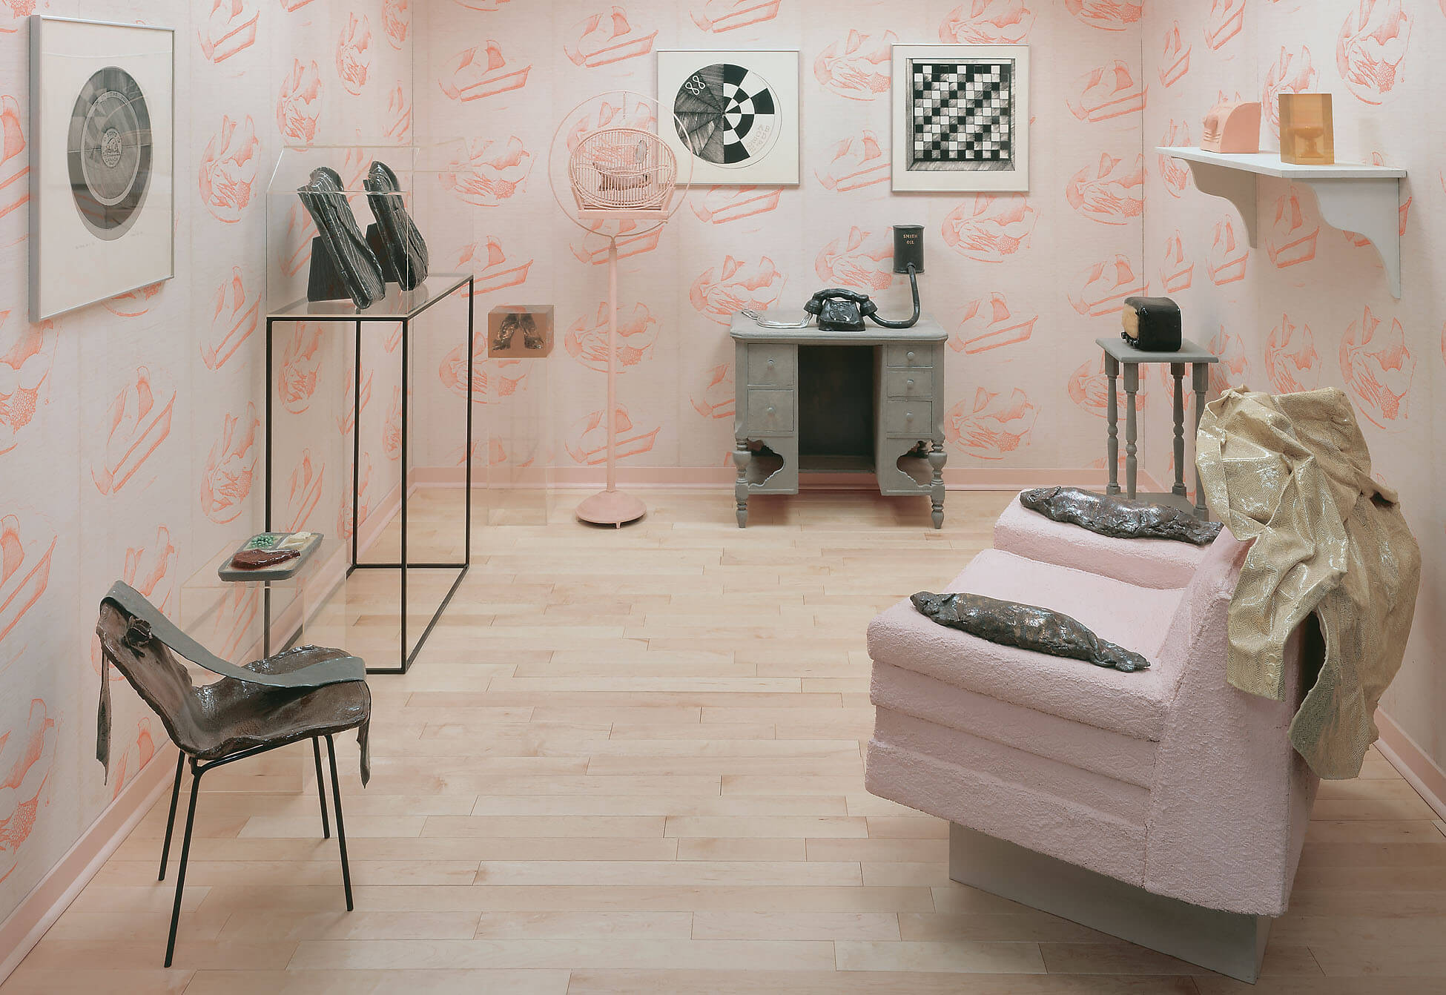
Gathie Falk, Home Environment, 1968. In this room-sized installation, Falk combines found objects with her ceramic renderings of domestic items.

Slide 5
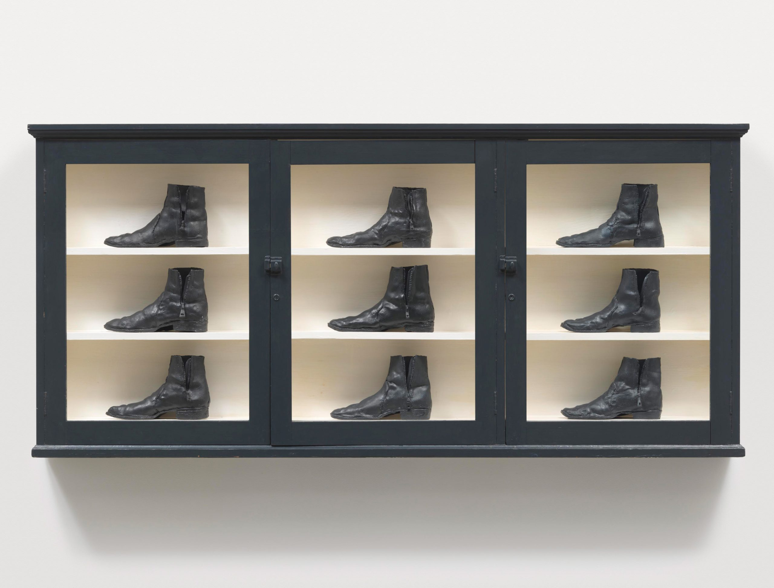
Gathie Falk, Single Right Men’s Shoes: Bootcase with 9 Black Boots, 1973. Falk’s ceramic works possess elements of the still life genre.

Slide 6
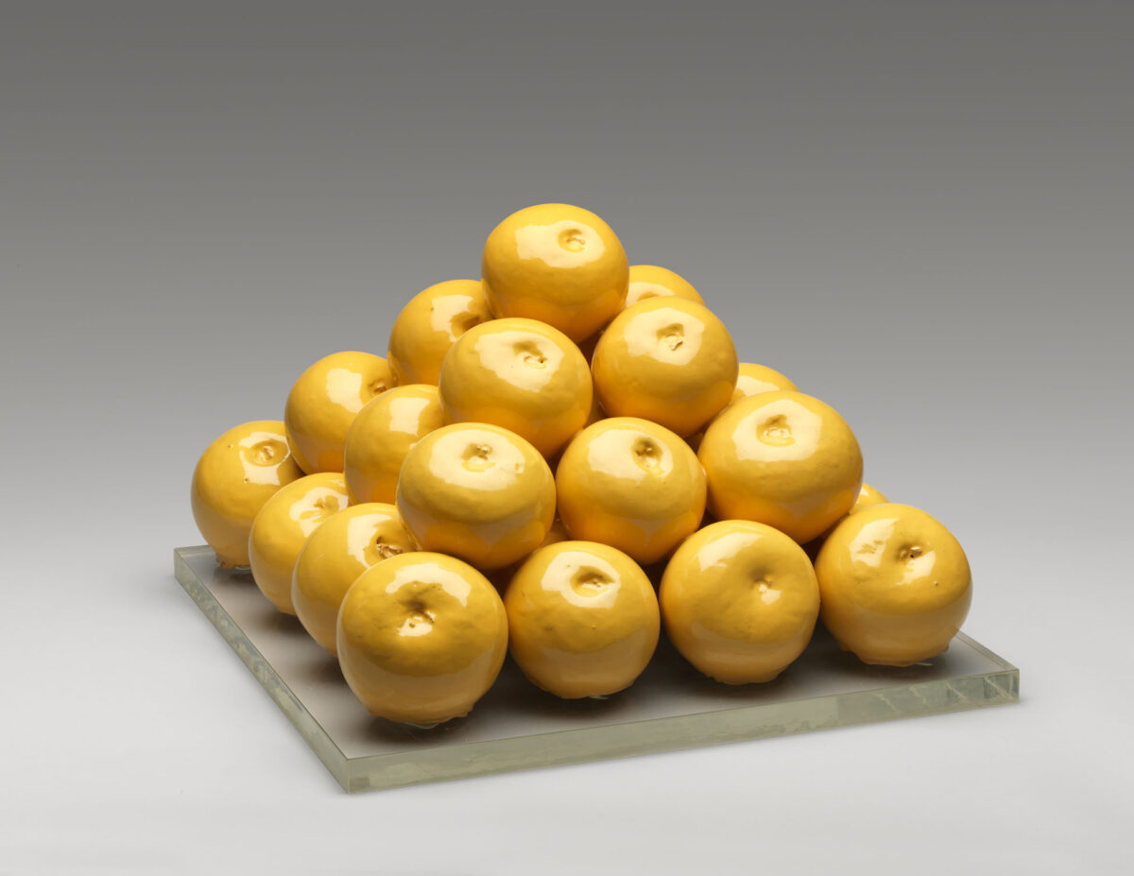
Gathie Falk, 30 Grapefruit, 1970. Works in her “Fruit Piles” series were inspired by the arrangements of fruit Falk saw every day at the greengrocers in her neighbourhood.

Slide 7
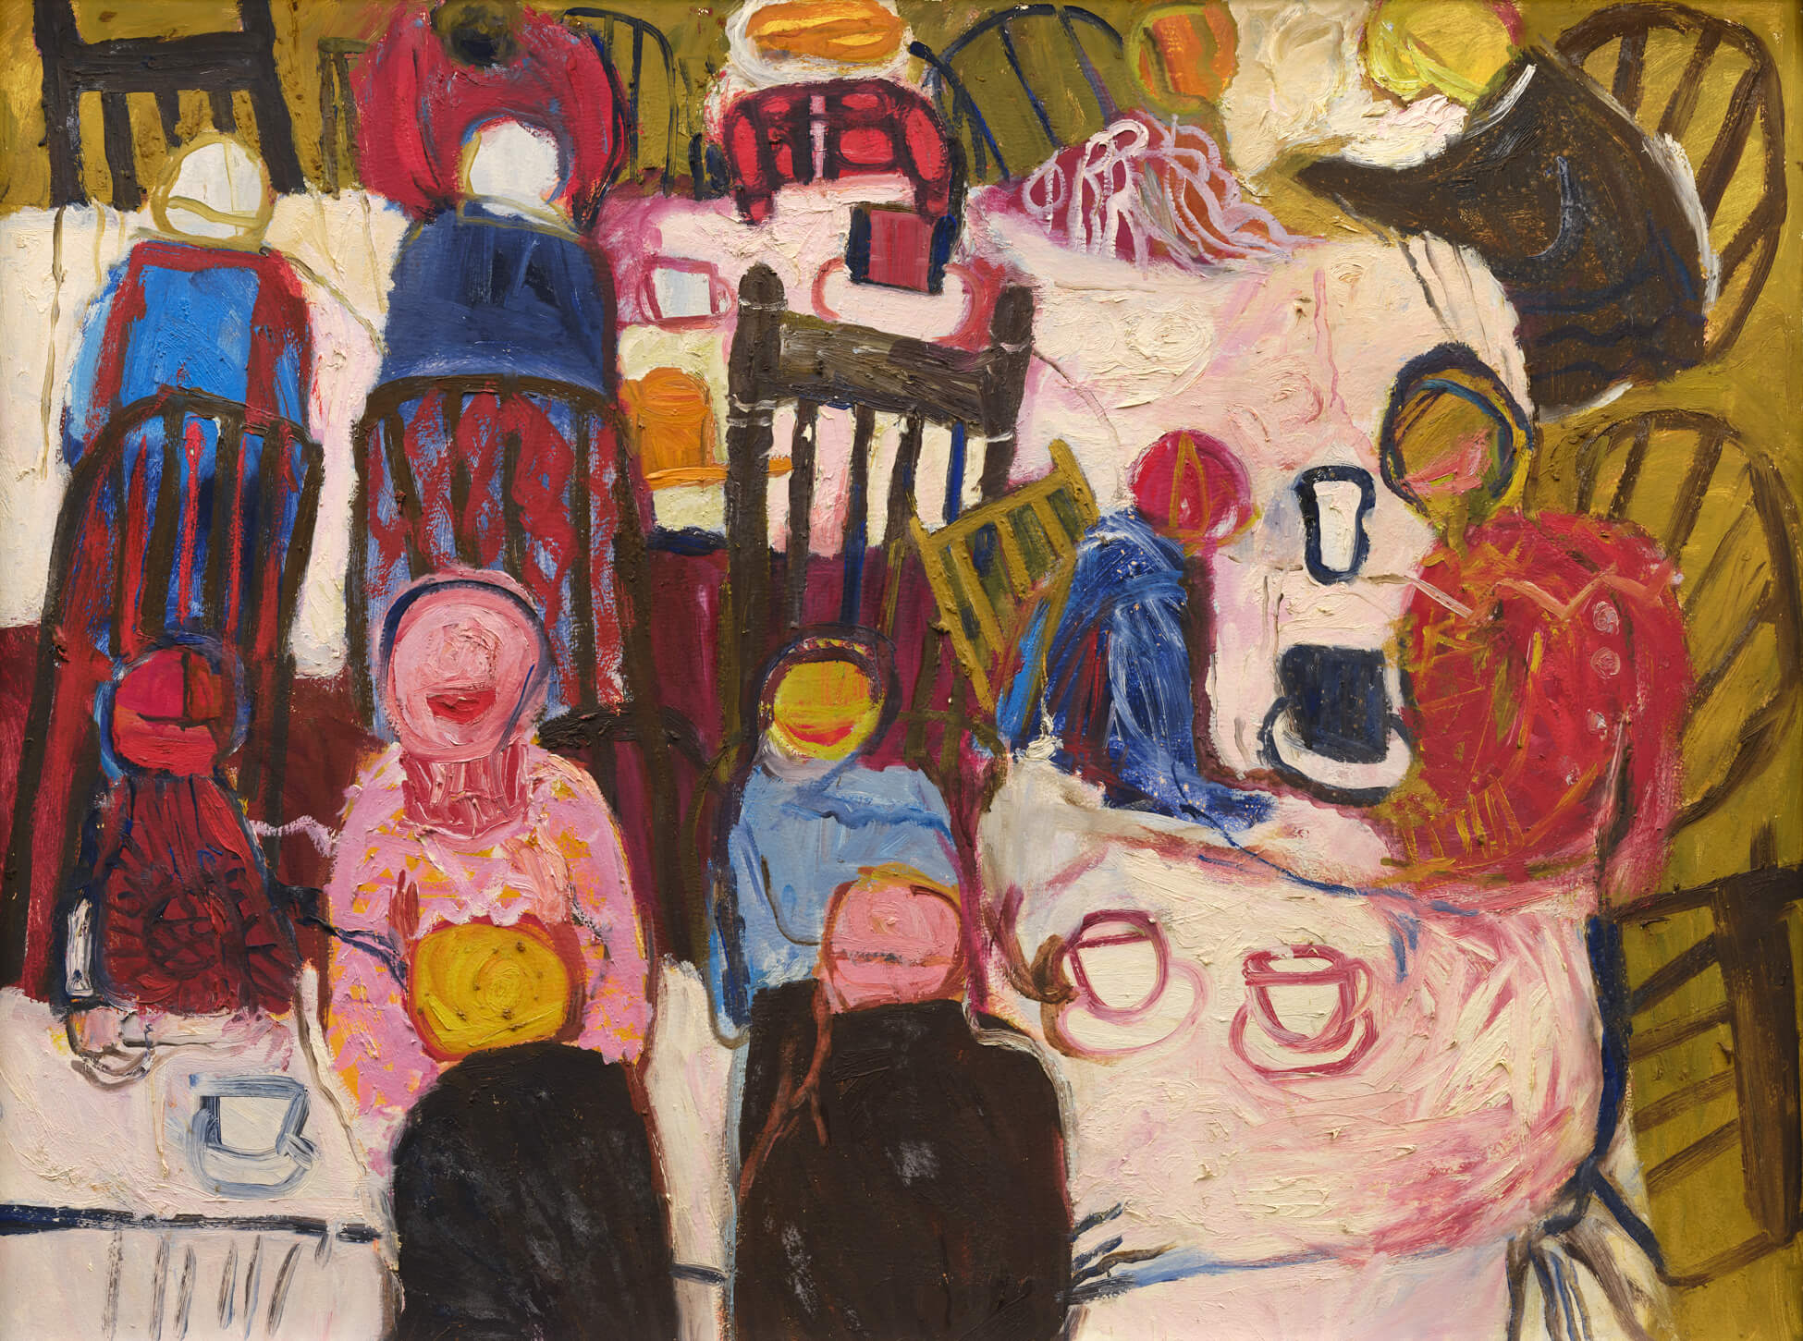
Gathie Falk, The Banquet, 1963. This painting showcases many formal hallmarks of German Expressionism, such as the use of colour and distorted sense of space.

Slide 8
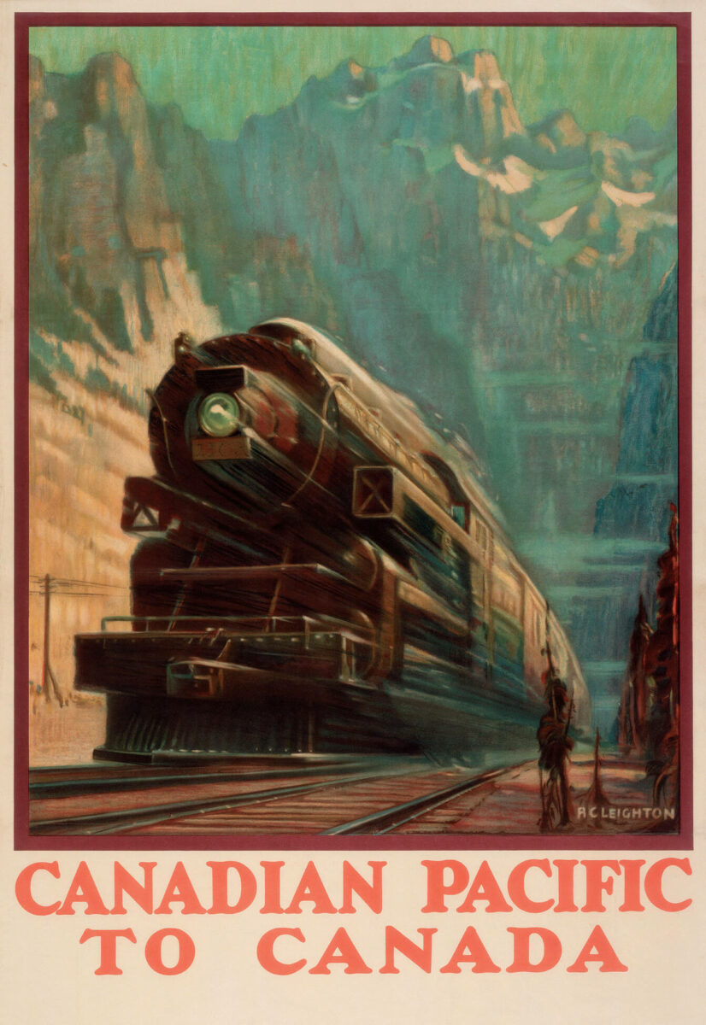
A.C. Leighton, Canadian Pacific to Canada, c.1920. The Canadian Pacific Railway was critical in promoting immigration to the Prairies.

Slide 9
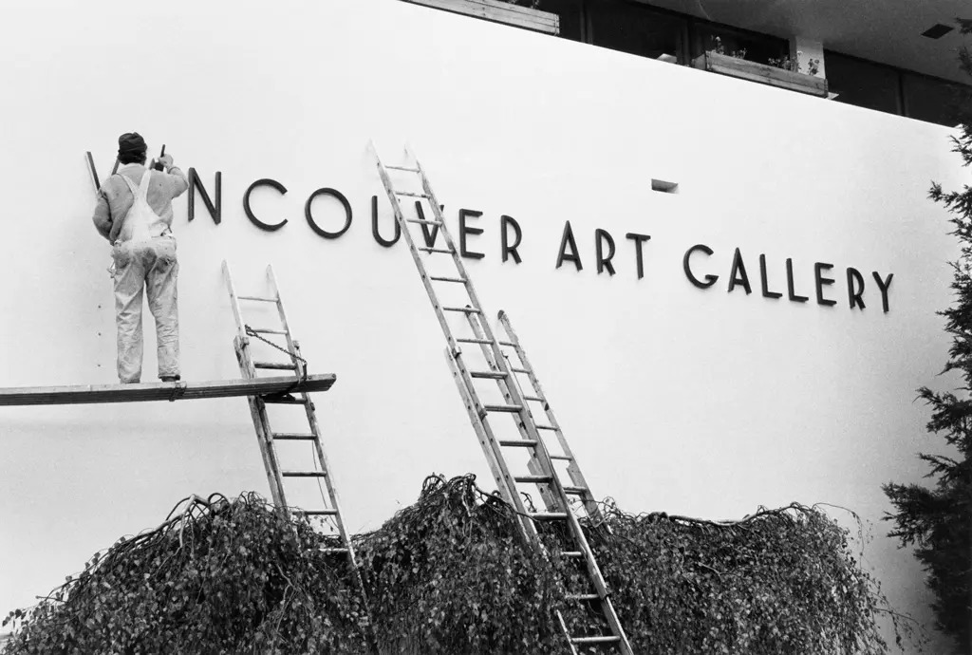
Façade of the Vancouver Art Gallery.

Slide 10
Homemade Canada Flag, made by Walter Lyons and Clothilde Boulay Lyons, 1965. Walter Lyons and his mother Clothilde made this flag to decorate their family porch on Dominion Day.

Slide 11
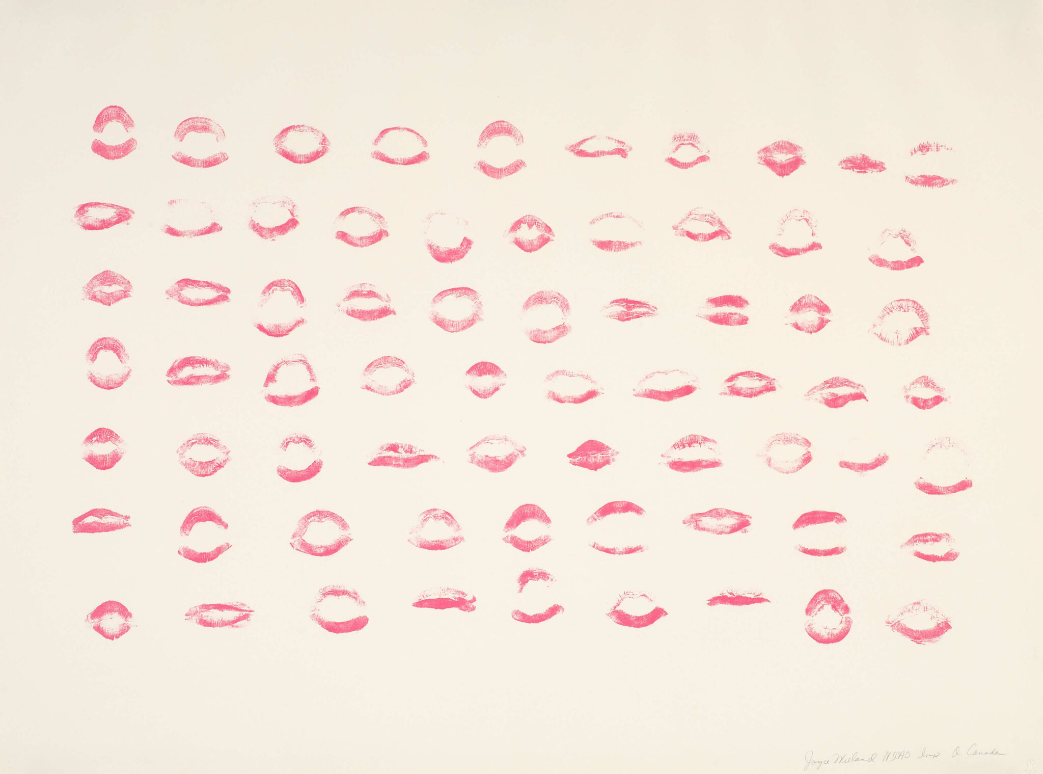
Joyce Wieland, O Canada, 1970. Wieland produced this artwork in response to “O Canada.”

Slide 12
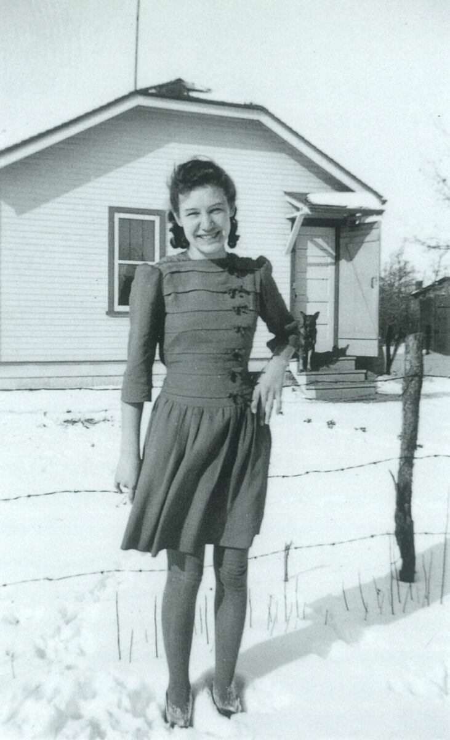
Gathie Falk in a dress of her own design sewn by her mother, Winnipeg, c.1940.

Slide 13
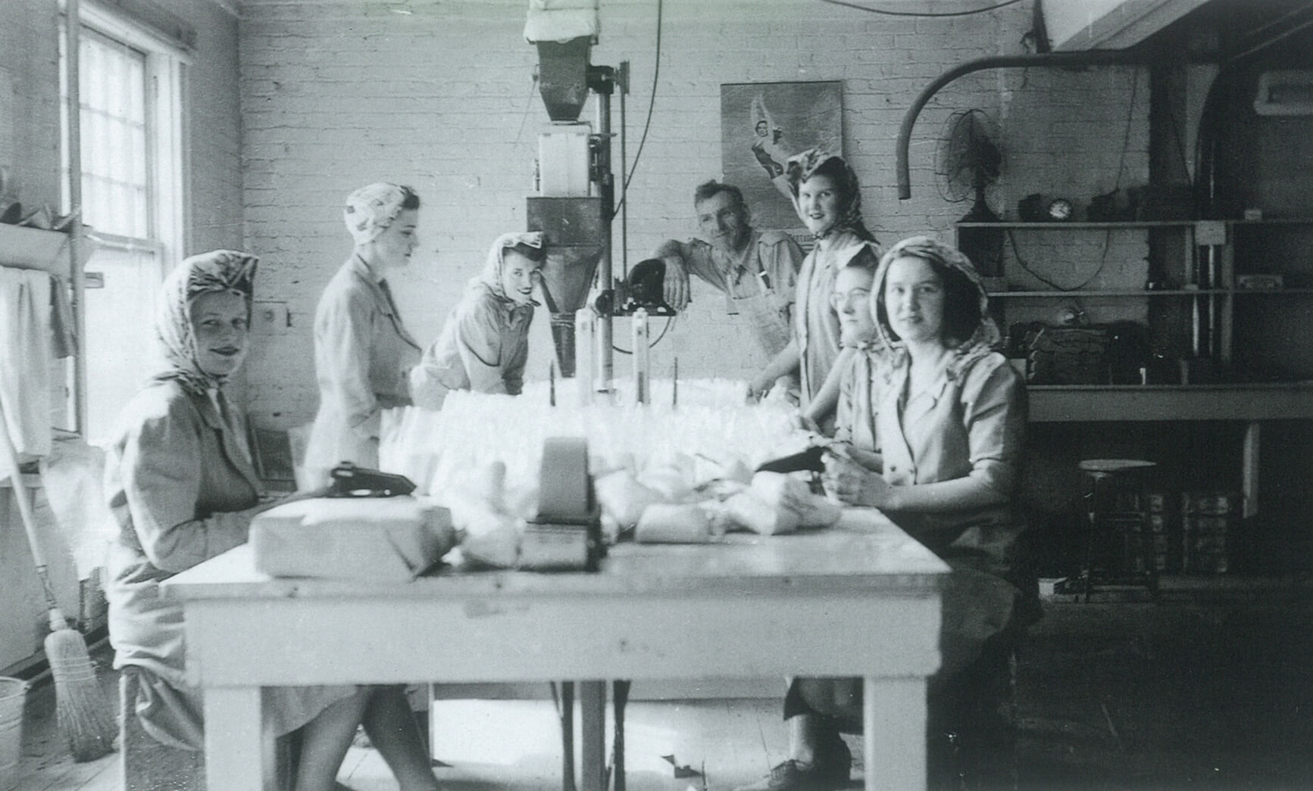
Gathie Falk (far right) with co-workers at a Winnipeg packing plant, c.1945. Falk’s first job after leaving high school was at Macdonalds Consolidated, a food wholesaler.

Slide 14
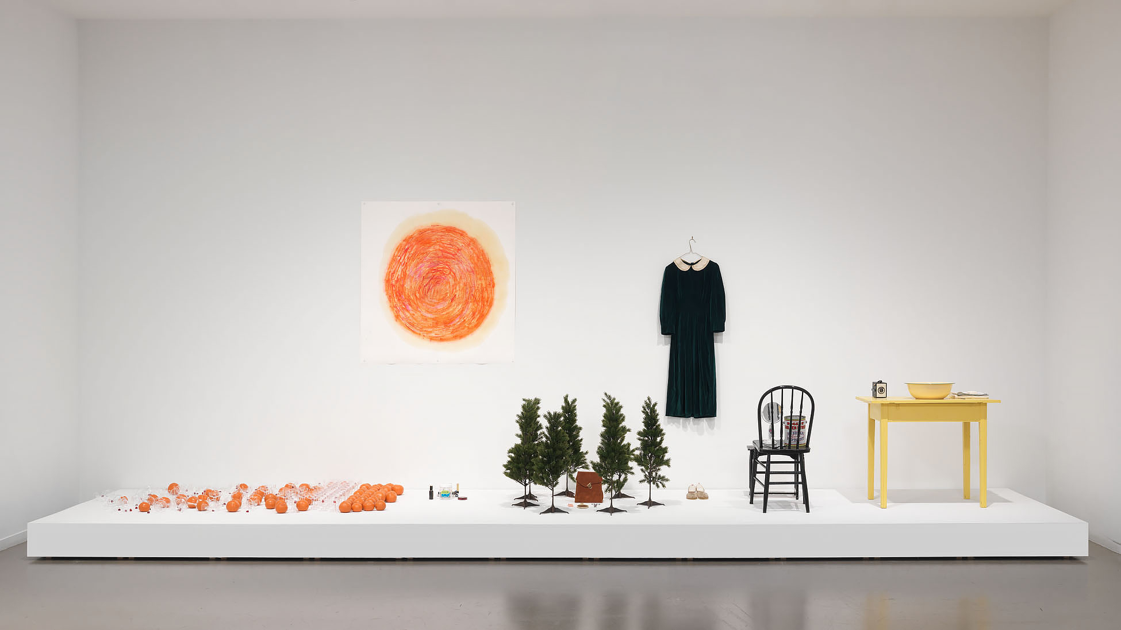
Gathie Falk, A Bird Is Known by His Feathers Alone (performance props), 1968. Falk incorporated musical elements into this and many of her performance works produced in the late 1960s.

Slide 15
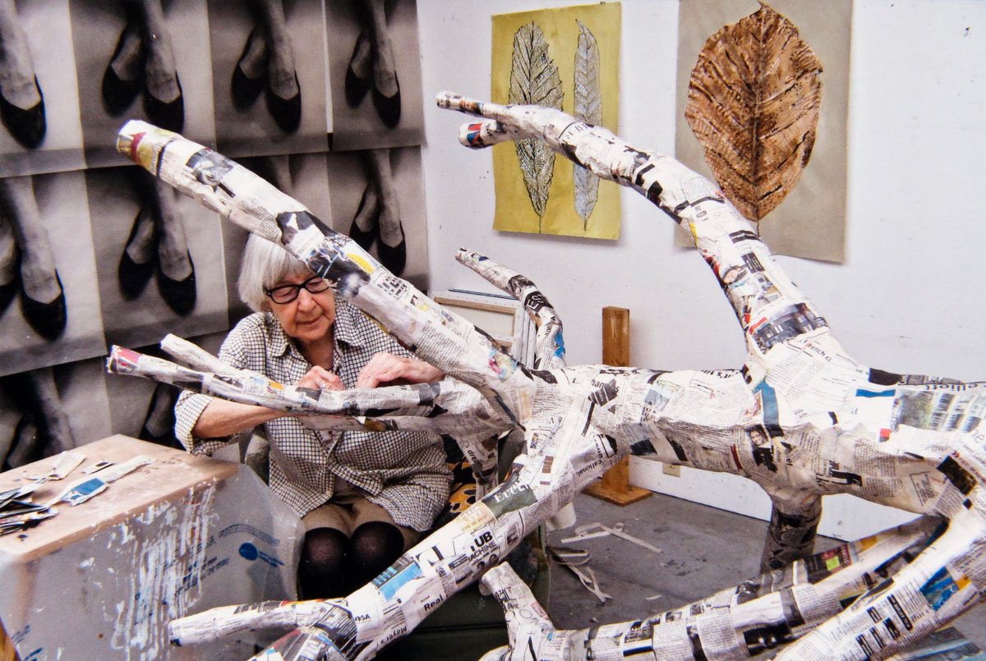
Gathie Falk in her studio working on Winter Tree, 2012.

Slide 16
Learning Activity #1
Gathie Falk, Home Environment, 1968. Rooted in the everyday and yet strangely surreal, this installation helped establish Falk’s career focus on responding to her environments.

Slide 17
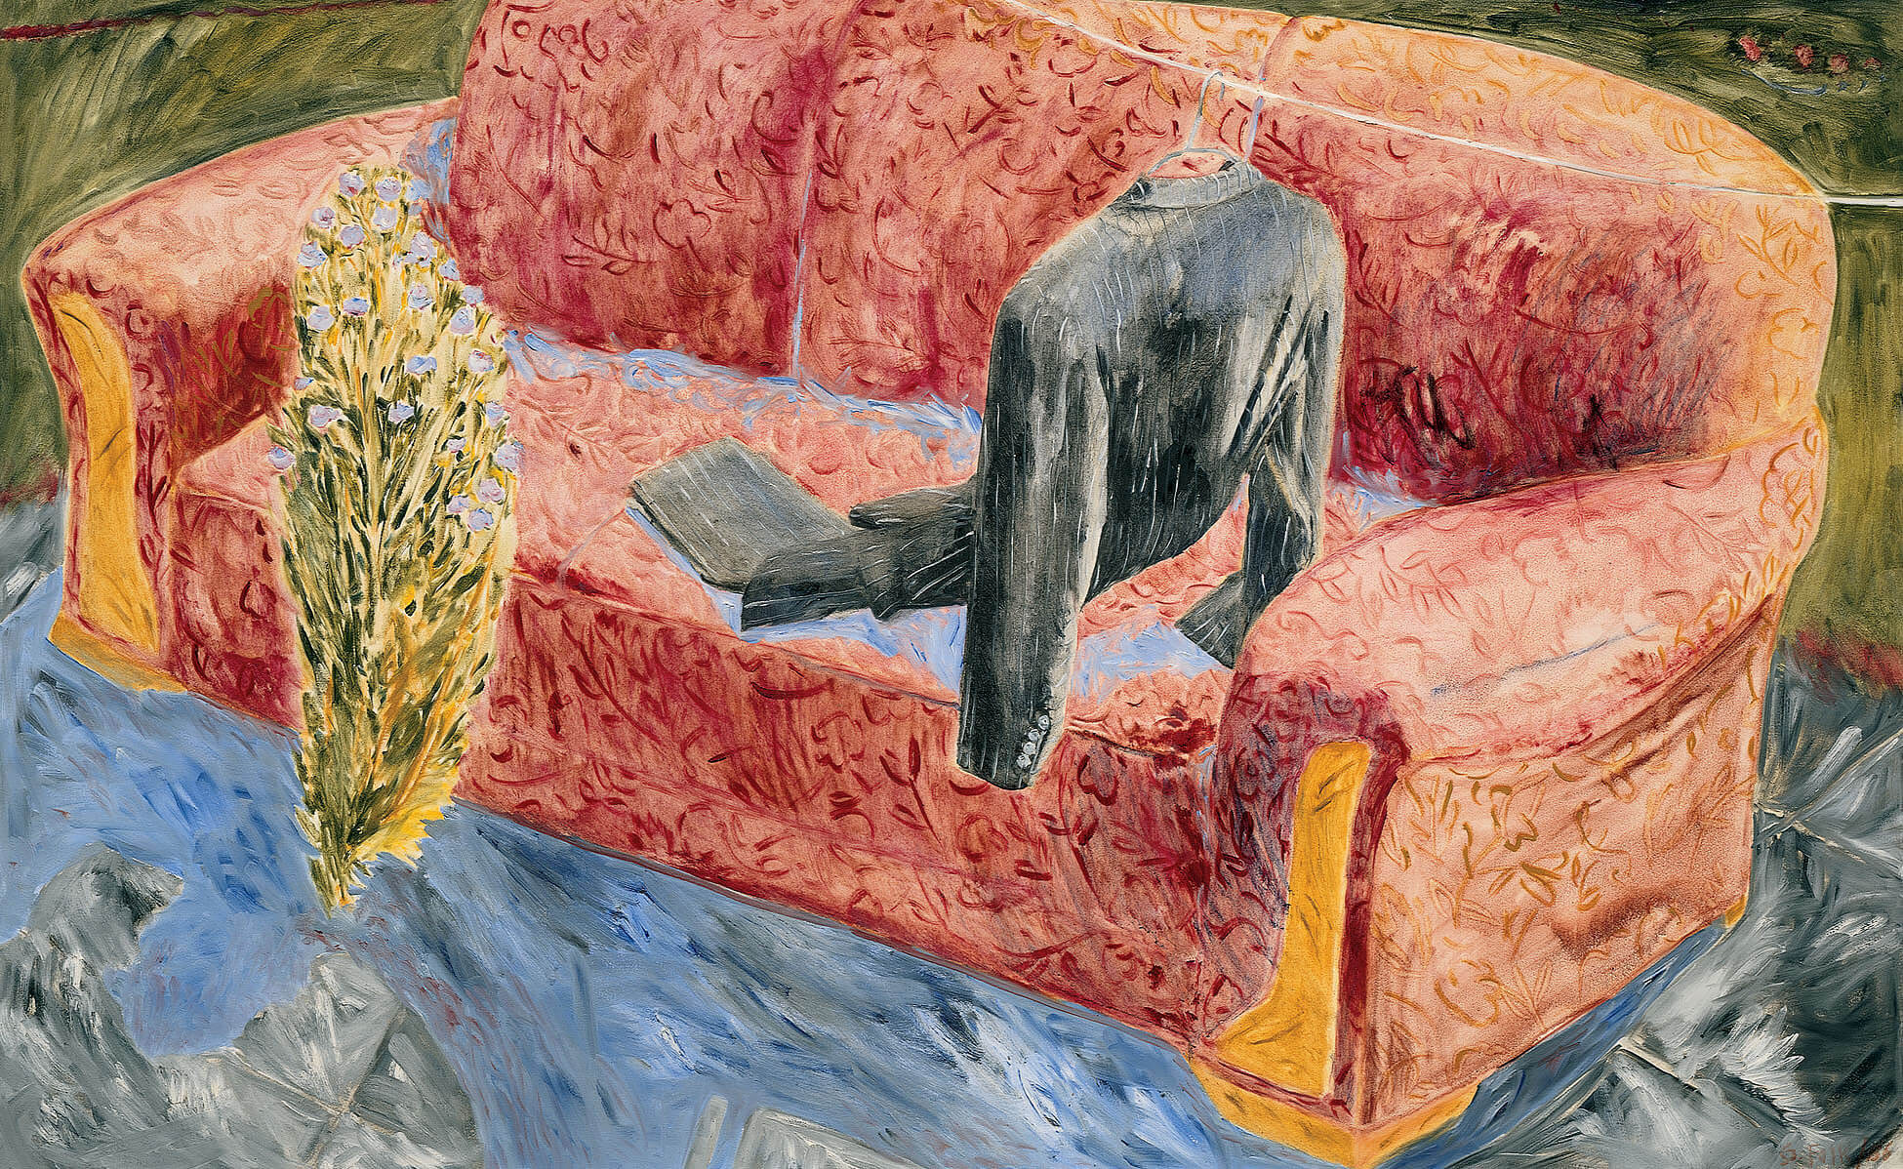
Learning Activity #1
Gathie Falk, Soft Couch with Suit, 1986. Like many of Falk’s paintings featuring chairs and discarded clothing, this works explores the symbolism of domestic forms.

Slide 18
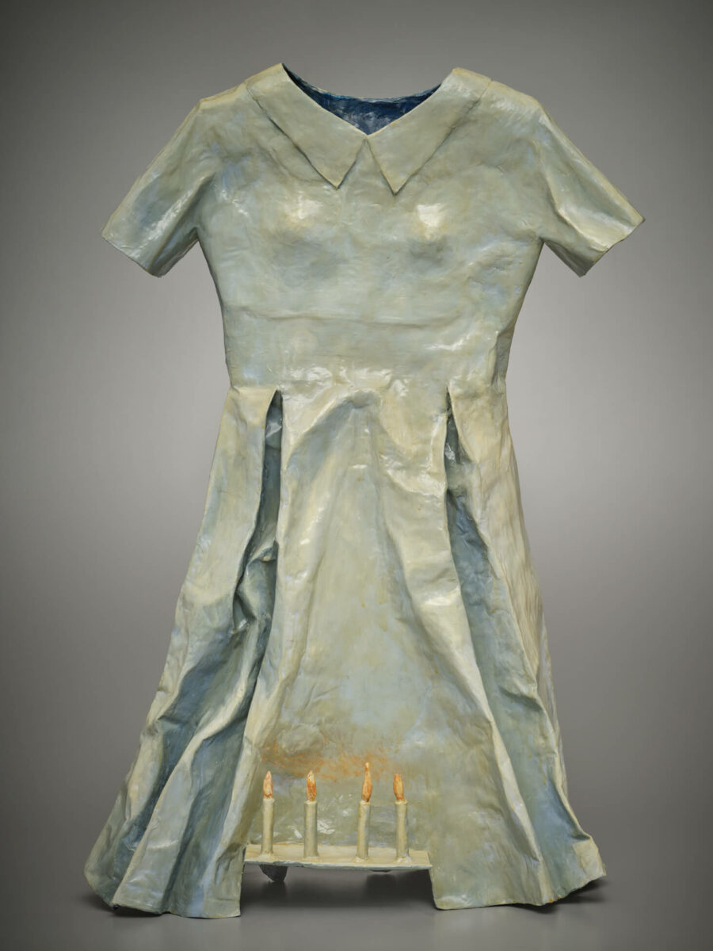
Learning Activity #1
Gathie Falk, Dress with Candles, 1997. Subtle variations in the coloration of this dress were added with paint, making it seem more lifelike.

Slide 19
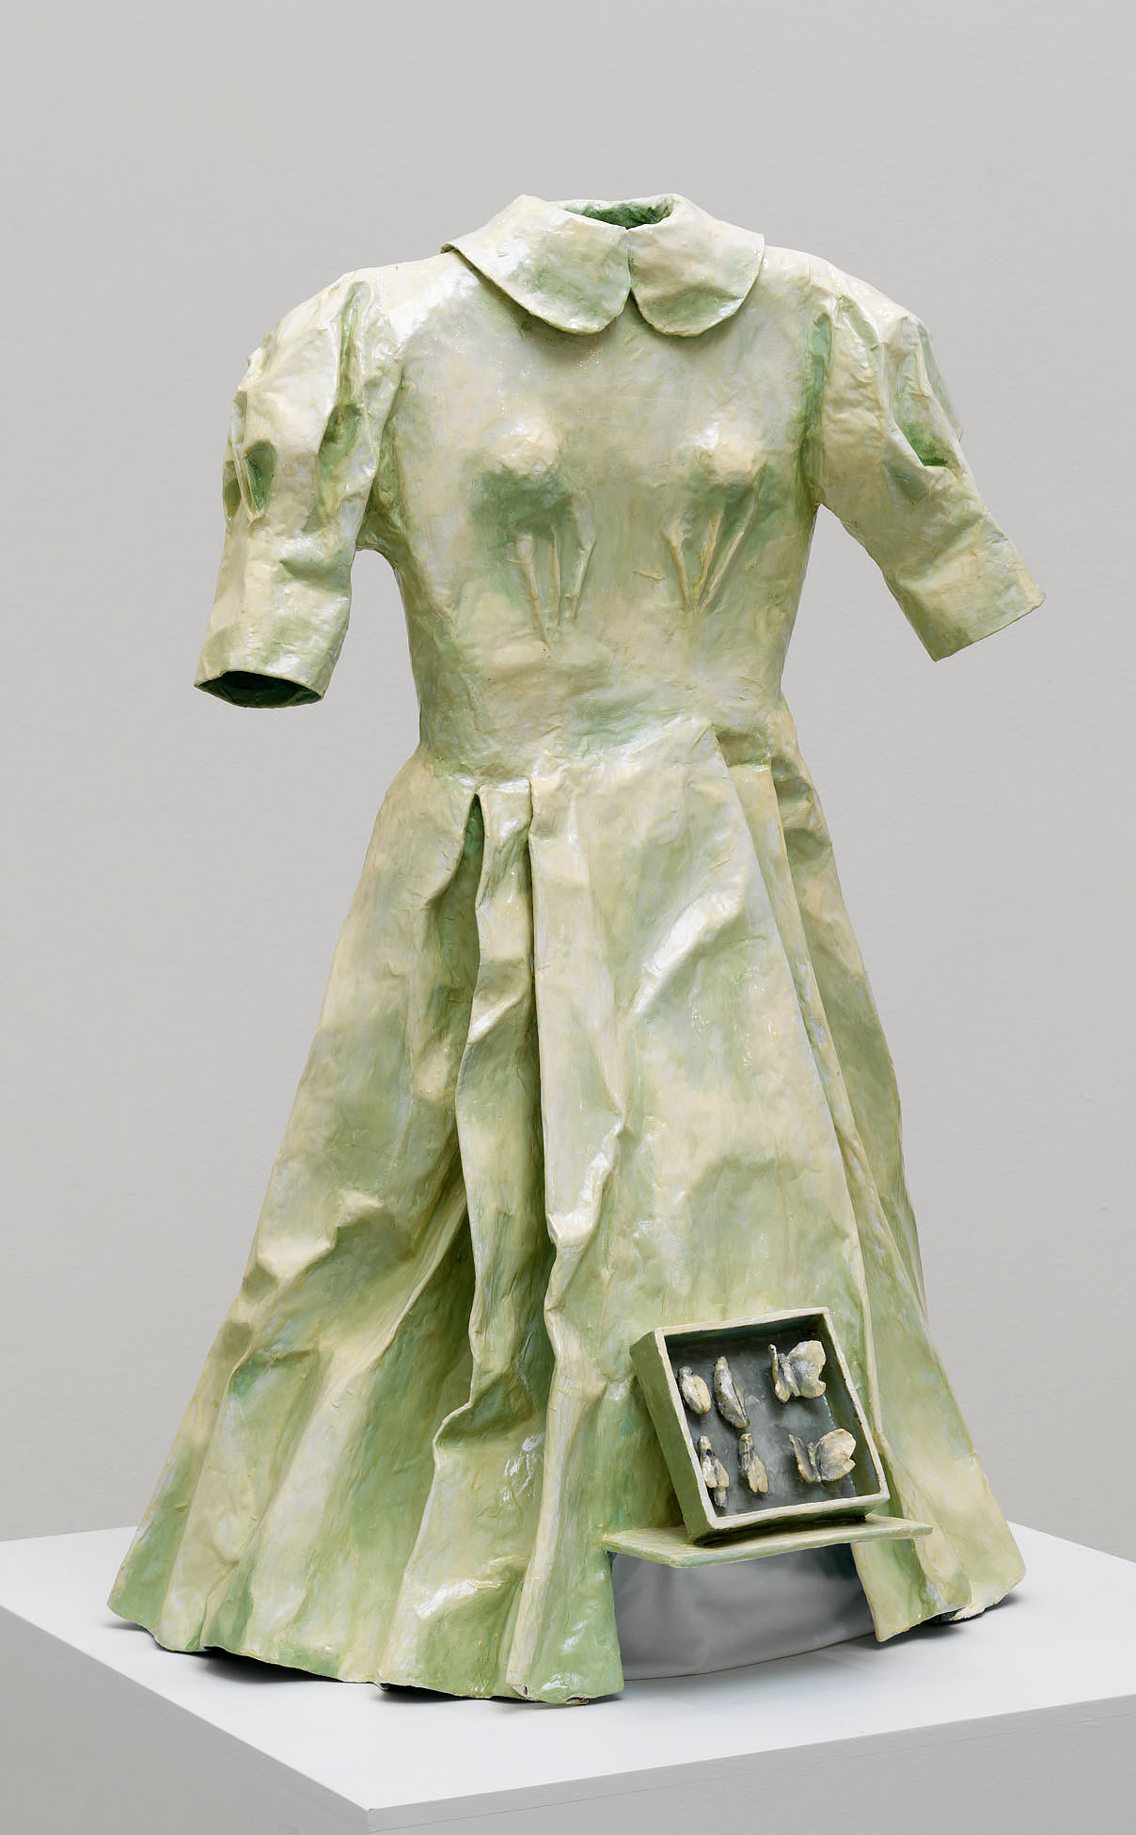
Learning Activity #1
Gathie Falk, Dress with Insect Box, 1998. Falk’s series of papier mâché dress sculptures imagines the lives of women who might have worn them.

Slide 20
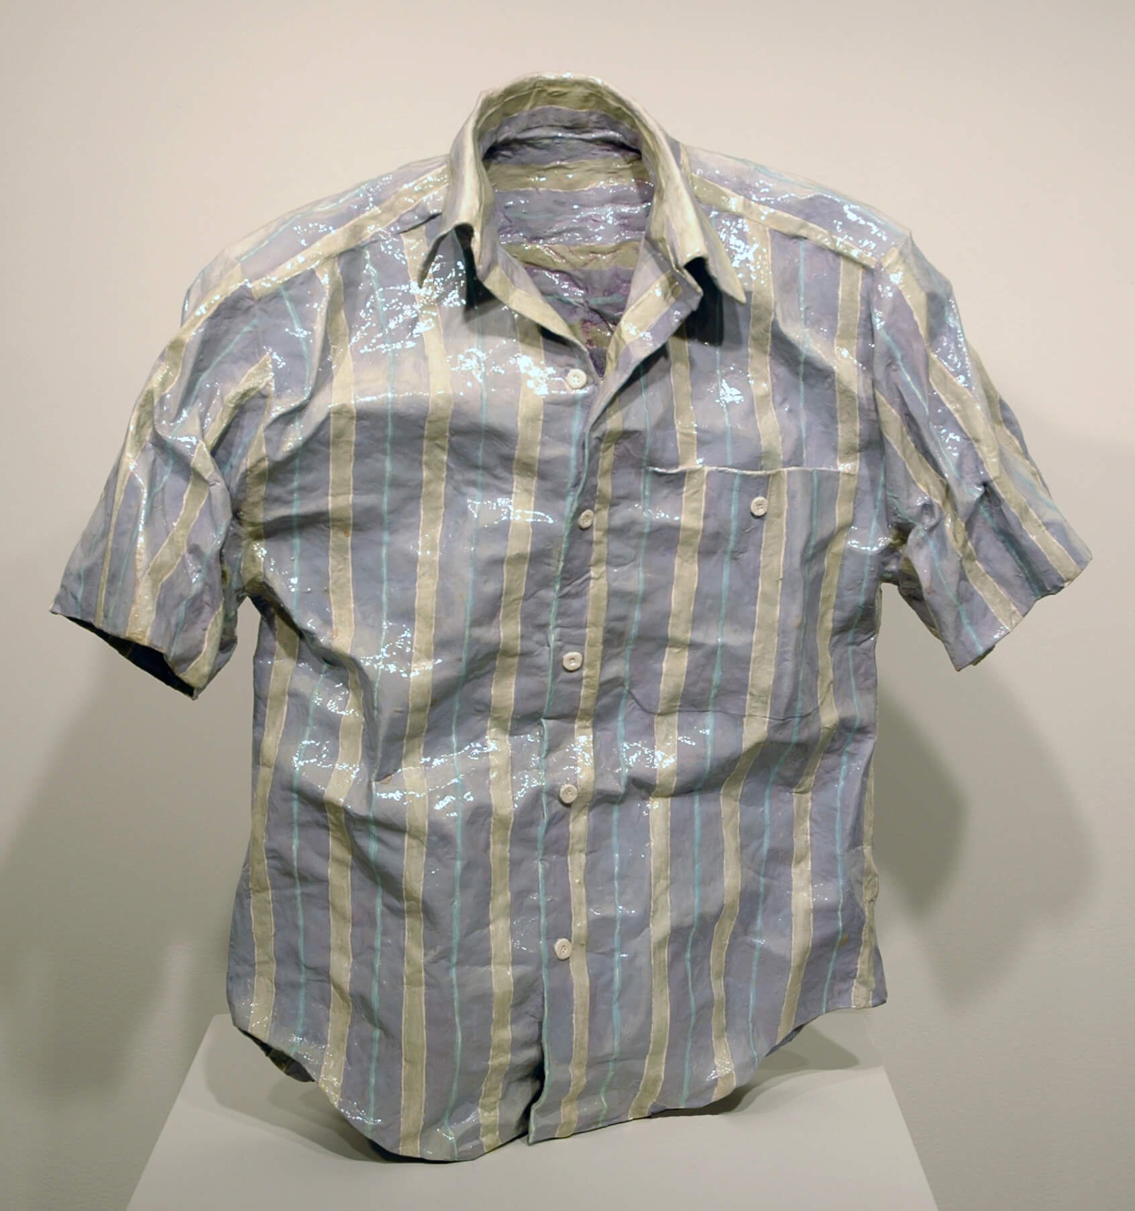
Learning Activity #1
Gathie Falk, Antony, 2001. This sculpture’s form is shaped around the presence of a wearer despite the absence of a body.

Slide 21
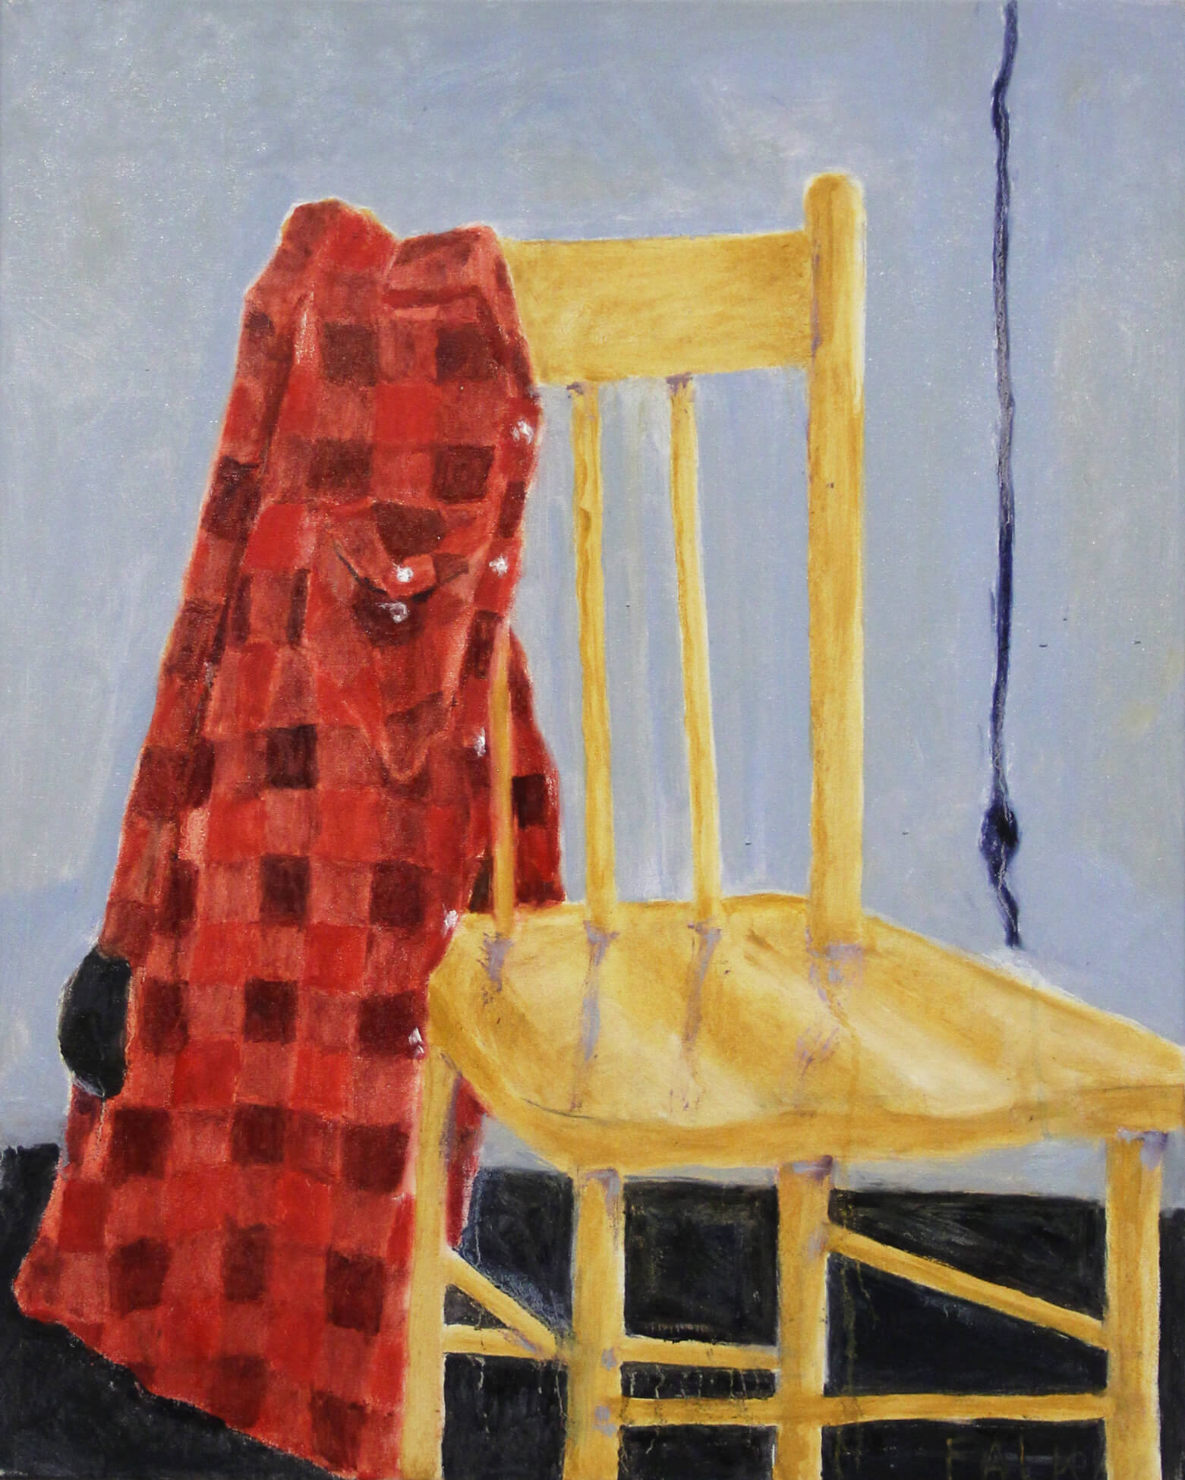
Learning Activity #1
Gathie Falk, My Work Shirt, 2016. This painting features a rendering of the shirt Falk wears while painting.

Slide 22
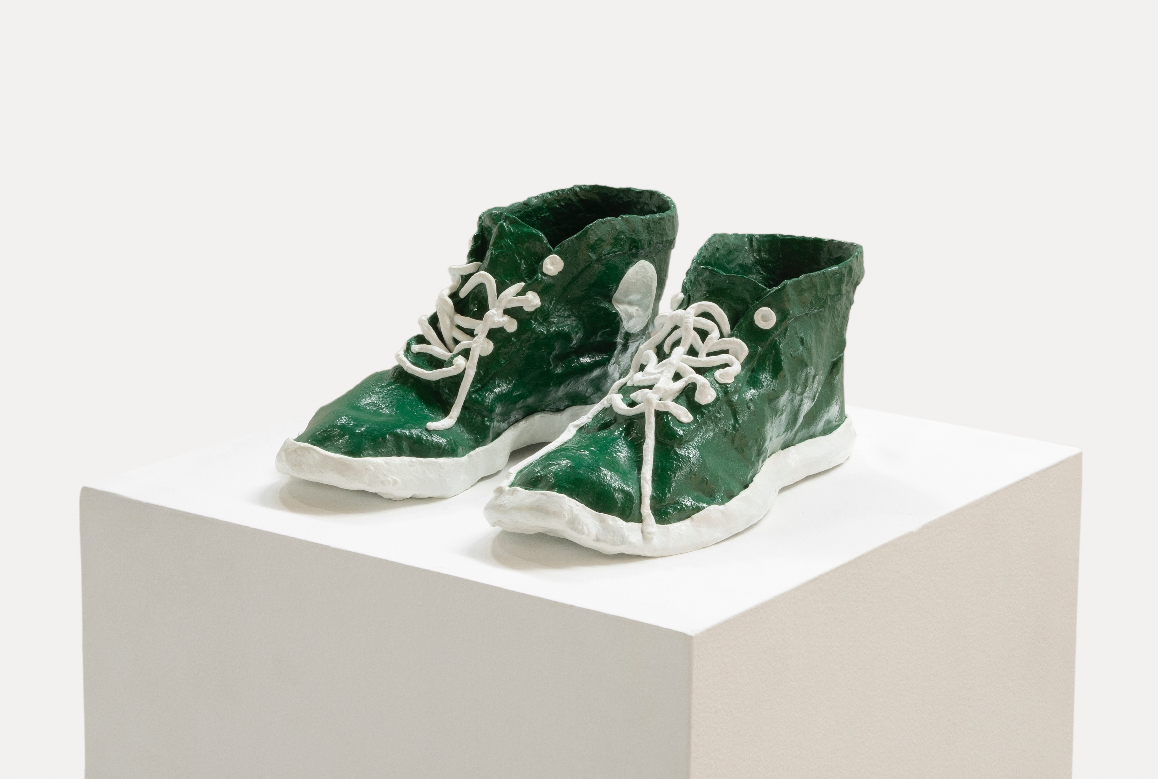
Learning Activity #2
Gathie Falk, Green Running Shoes, 2019. Unlike the much of Falk’s sculptures made from clay or papier mâché, this sculpture was made with bronze.

Slide 23
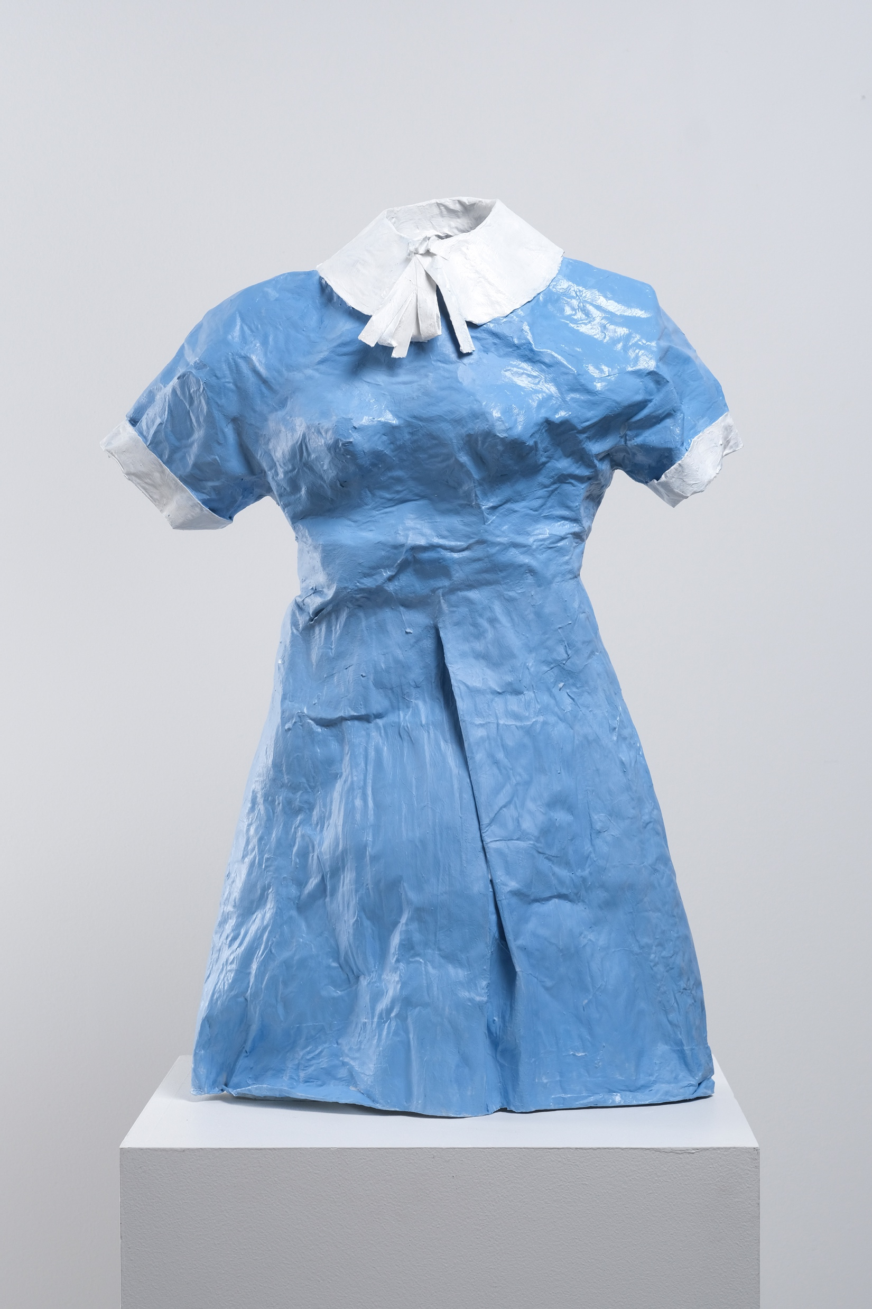
Learning Activity #2
Gathie Falk, Lucy, 2021. The dress depicted here has a high collar and is painted in a vibrant sky-blue hue.

Slide 24
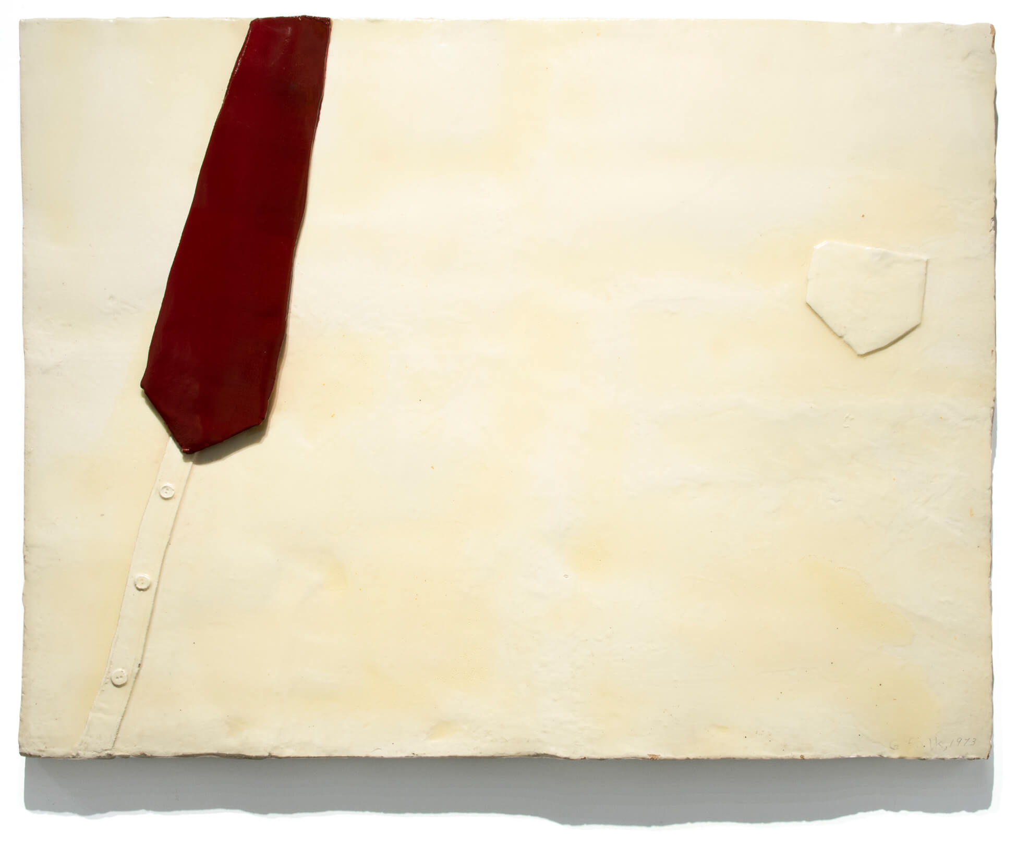
Learning Activity #2
Gathie Falk, Veneration of the White Collar Worker, 1973. This work was produced as part of a commission for the Department of External Affairs building in Ottawa.

Slide 25
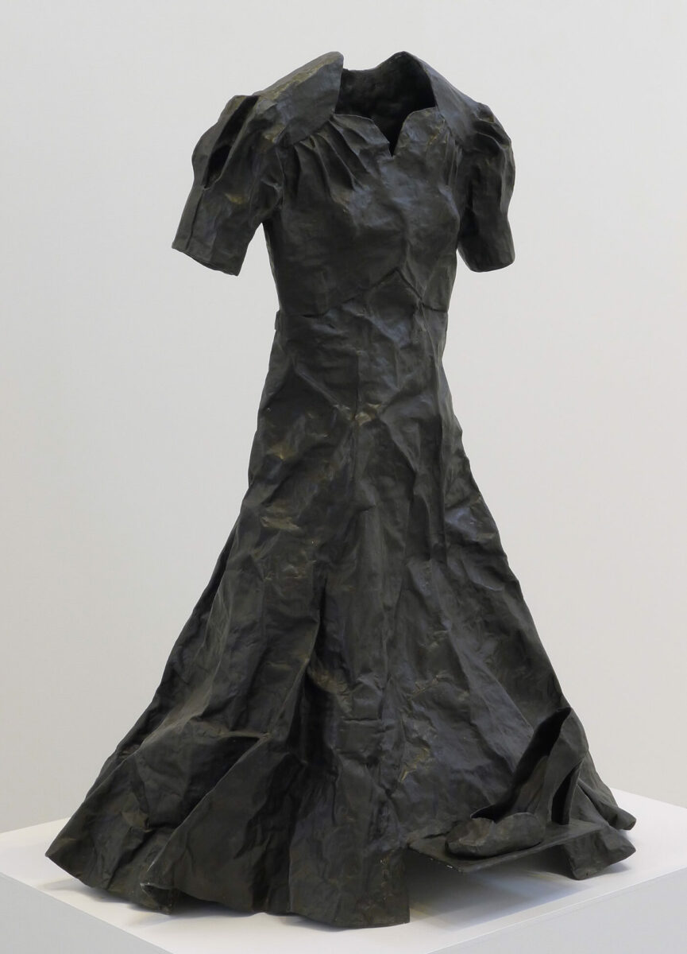
Learning Activity #2
Gathie Falk, Agnes (Black Patina), 2000–2001. A black dress is standard attire to wear to a funeral because the colour black symbolizes mourning.

Slide 26
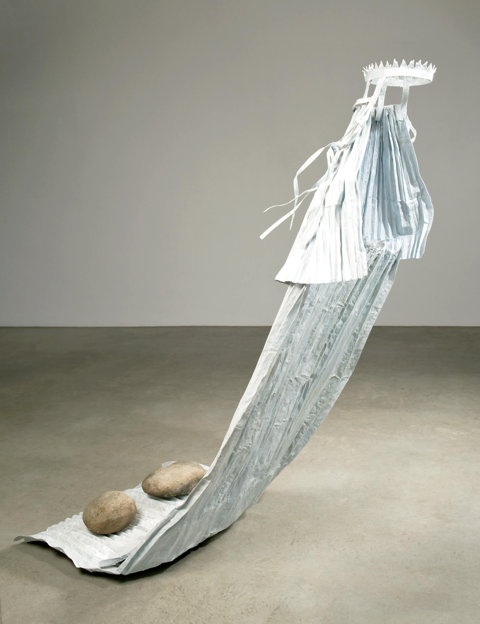
Learning Activity #2
Gathie Falk, The Problem with Wedding Veils, 2010–11. At almost six feet tall, this sculpture critiques cultural expectations of women as brides.

Slide 27
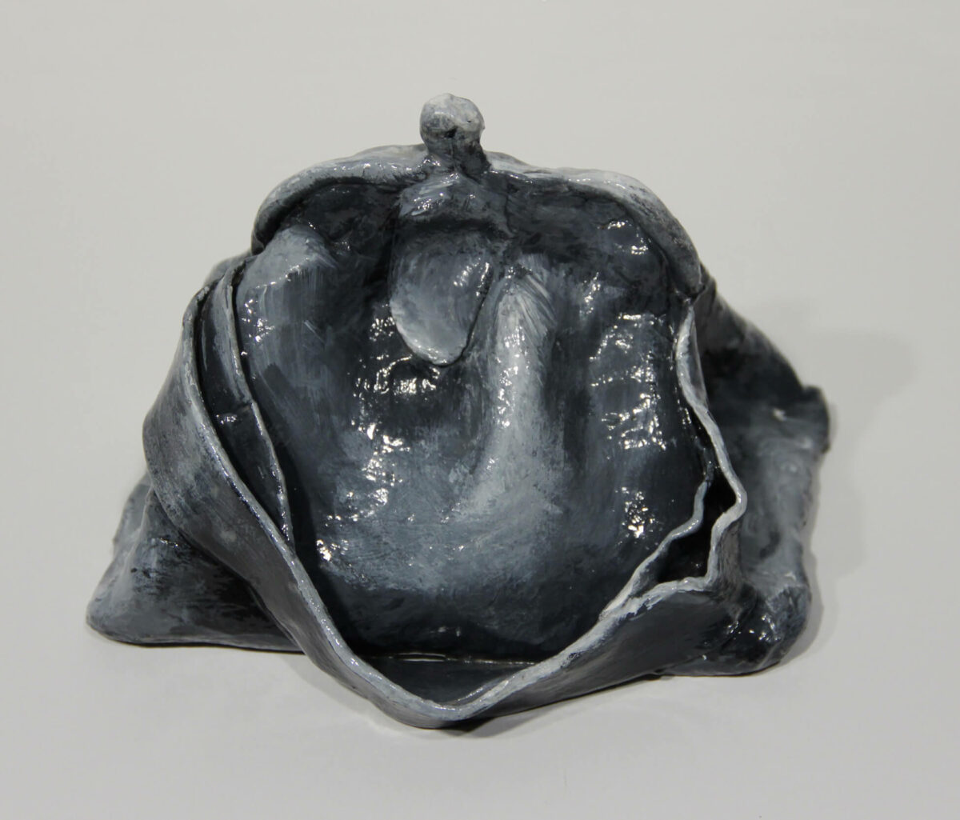
Learning Activity #2
Gathie Falk, Small Purse, c.1970. This sculpture resembles an opened purse.

Slide 28
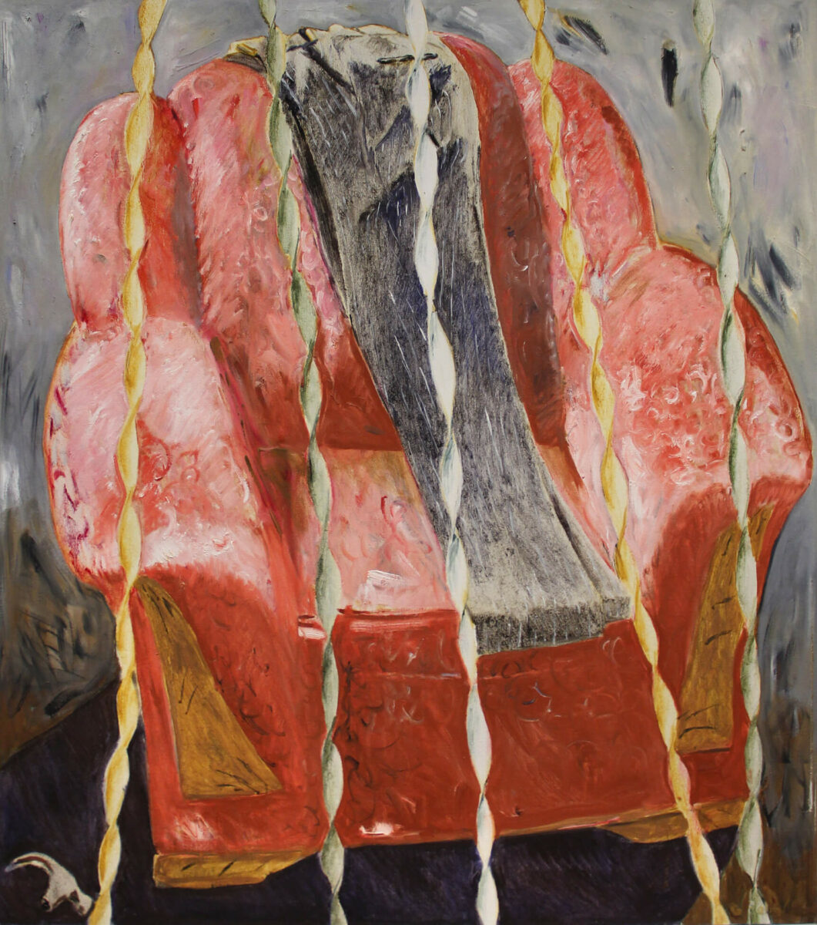
Learning Activity #2
Gathie Falk, Soft Chair with Pants and Hammer Heads, 1986. This painting features a pair of men’s trousers folded and placed upon a plush living room chair.

Slide 29
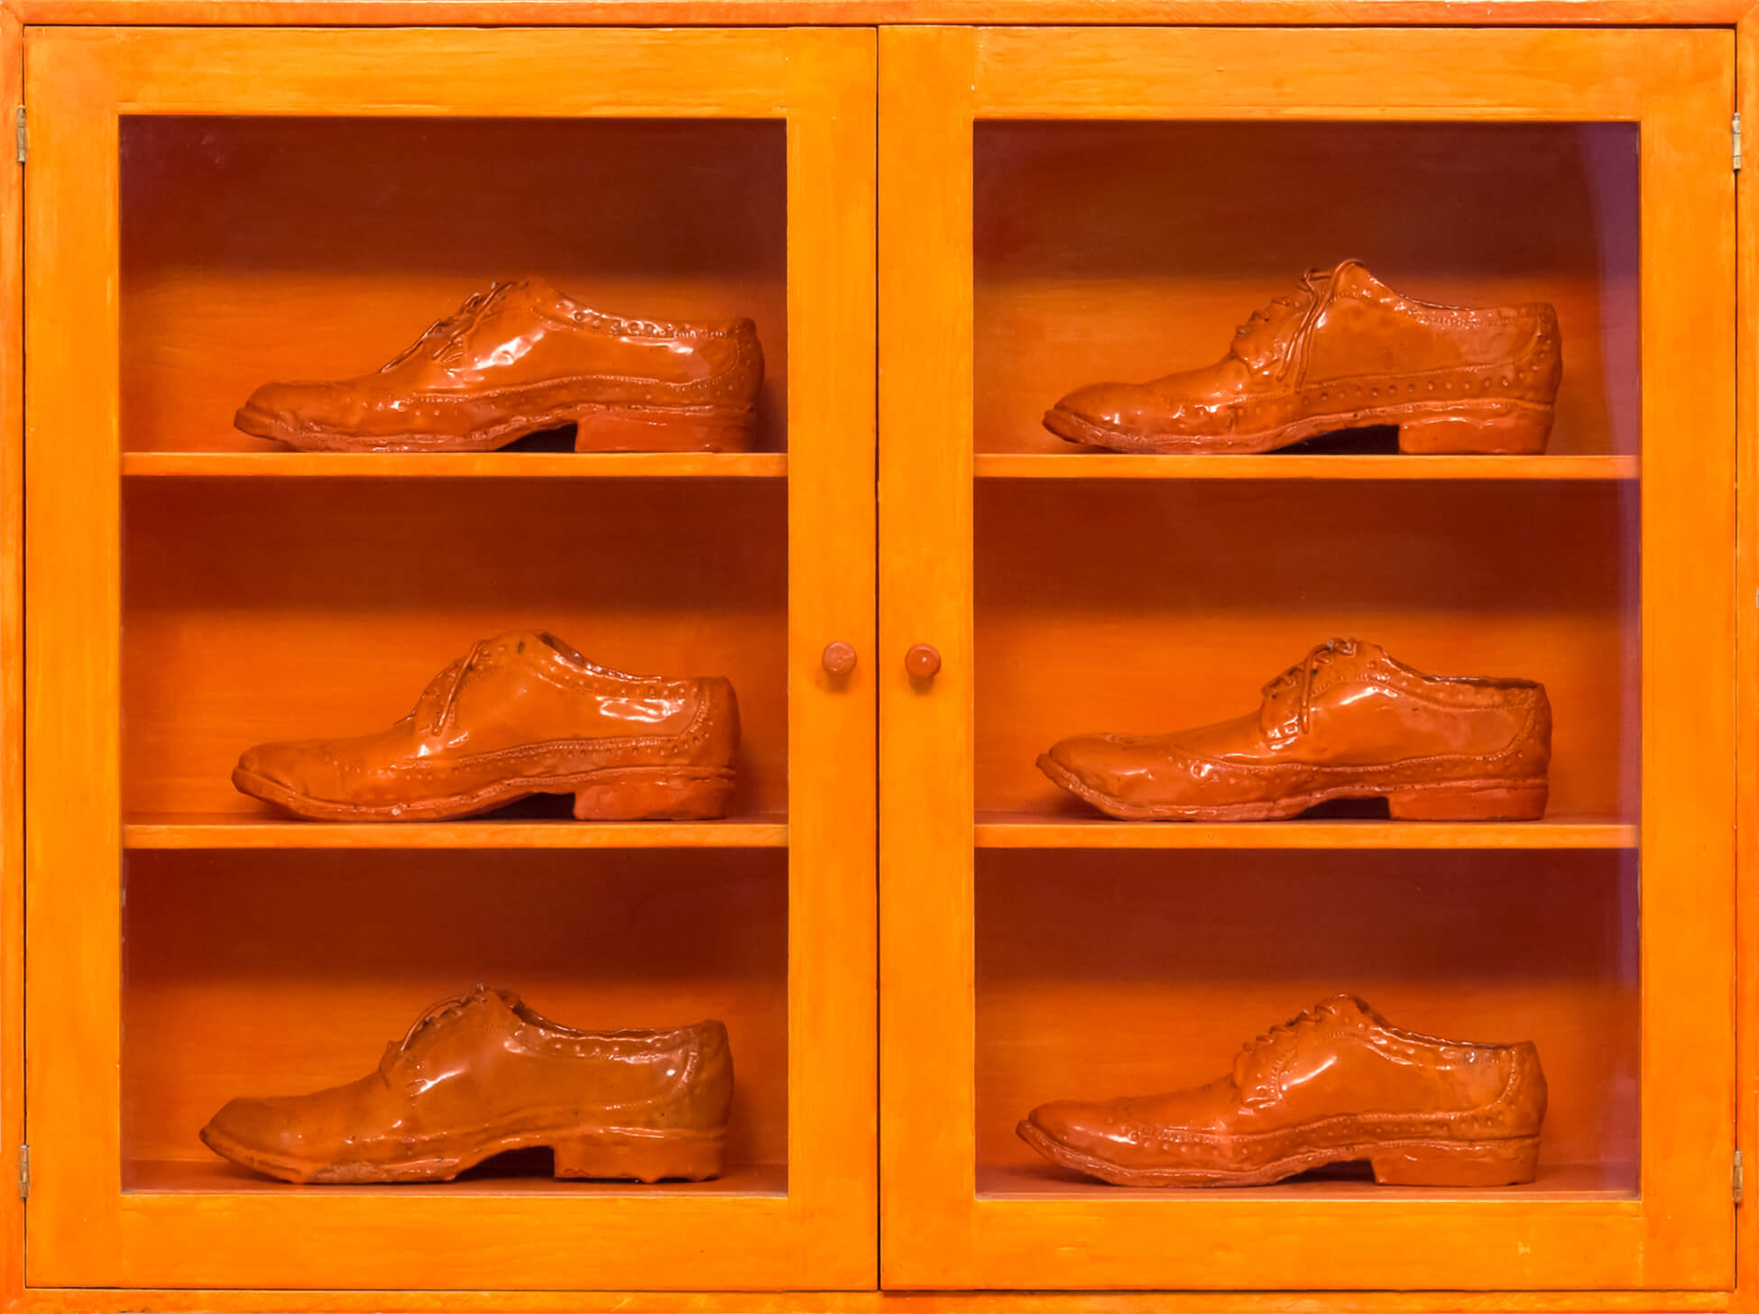
Culminating Task
Gathie Falk, Single Right Men’s Shoes: Bootcase with 6 Orange Brogues, 1973. The glazing of these shoes compels the viewer to notice fine details like the stitching or signs of wear.

Slide 30
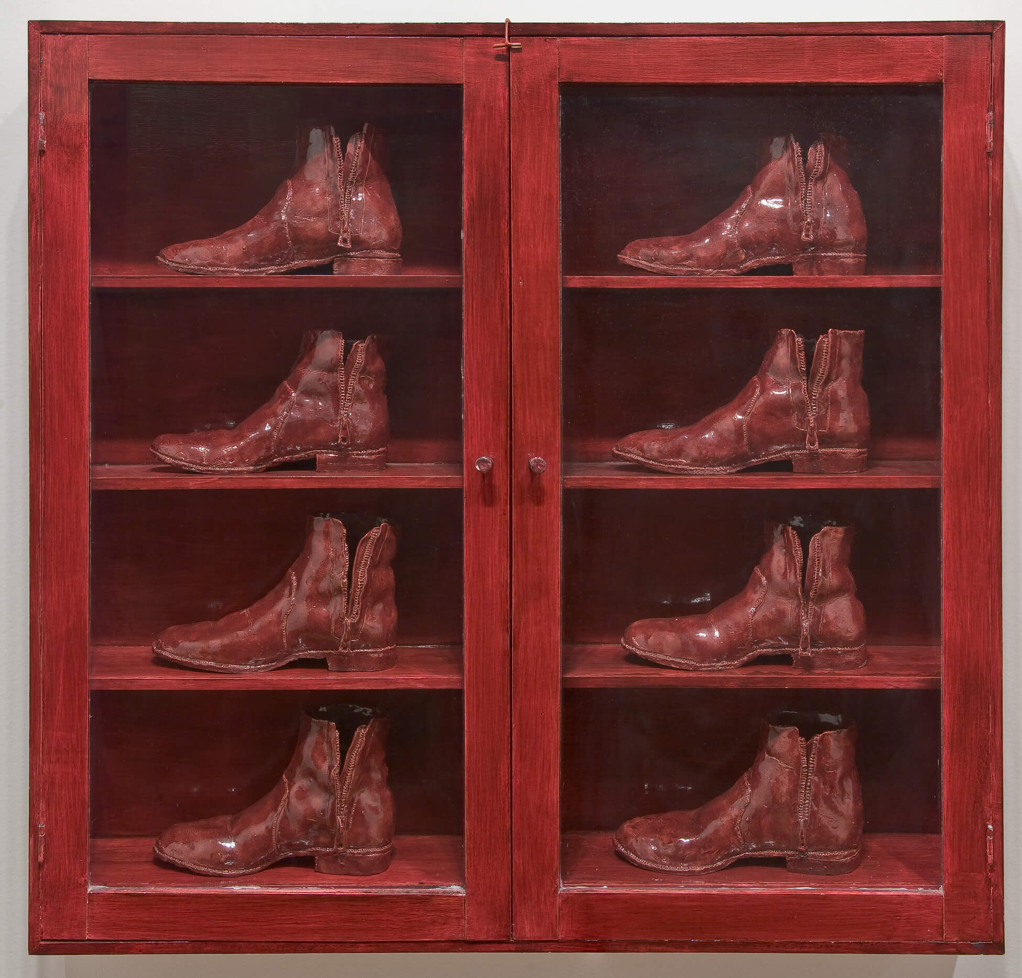
Culminating Task
Gathie Falk, Eight Red Boots, 1973. Part of Falk’s series, “Single Right Men’s Shoes,” this work was exhibited at the Canadian Cultural Centre in Paris in 1974.

Slide 31
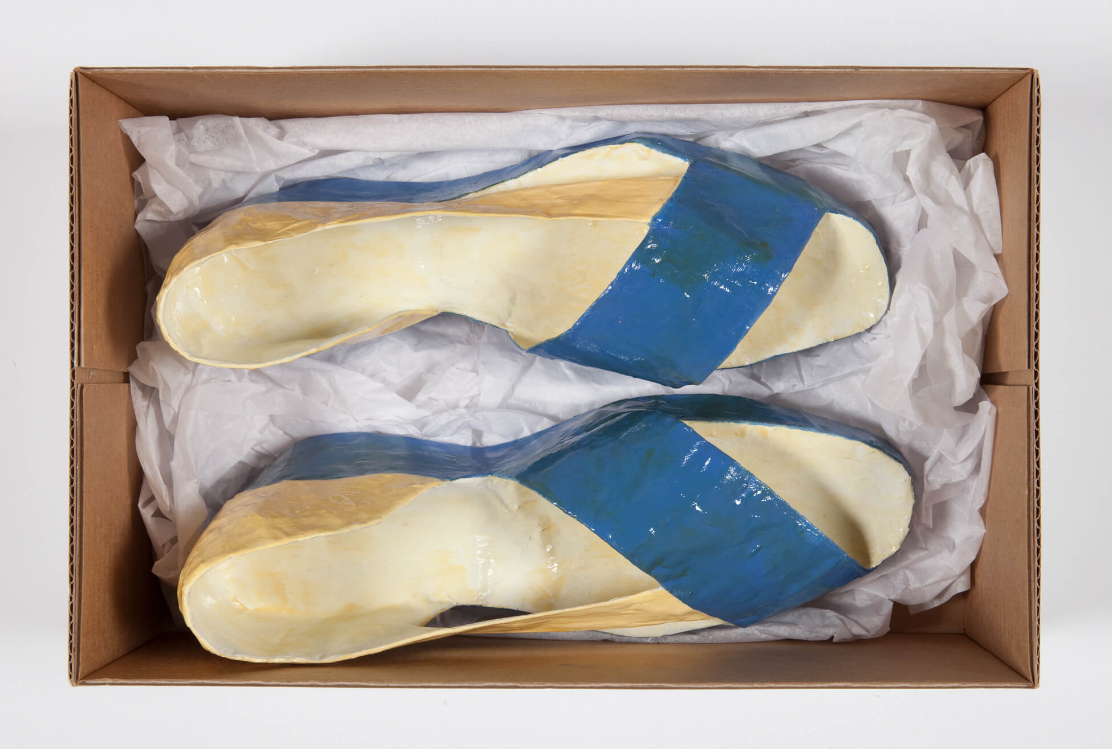
Culminating Task
Gathie Falk, Standard Shoes, The Column (detail), 1998–99. This work is part of a larger sculpture designed to look like a stack of shoe boxes.

Slide 32
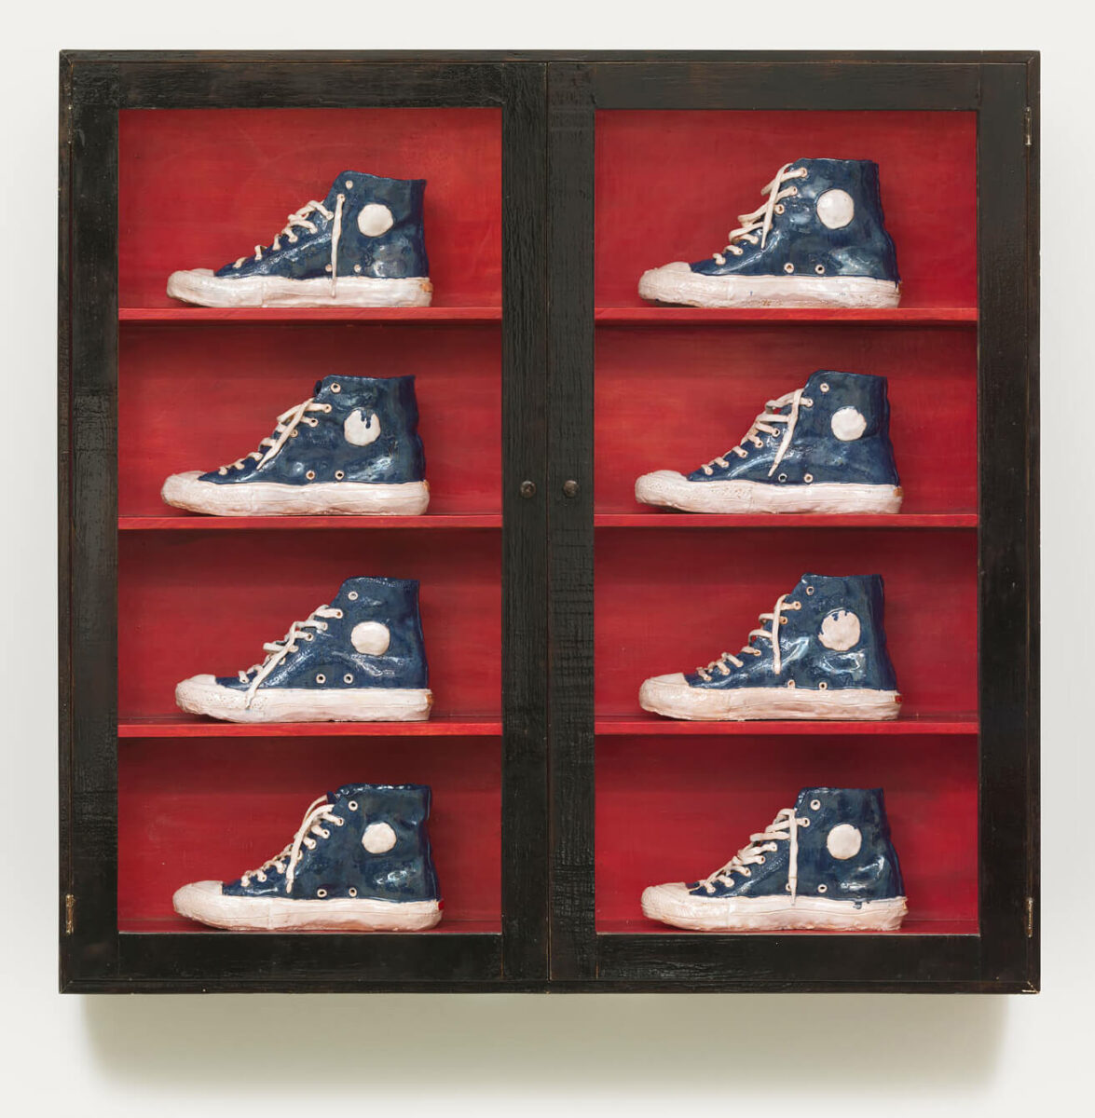
Culminating Task
Gathie Falk, Single Right Men’s Shoes: Blue Running Shoes, 1973. Shaped for only the right foot, these ceramic shoes are showcased like a display in a shoe store.

Slide 33
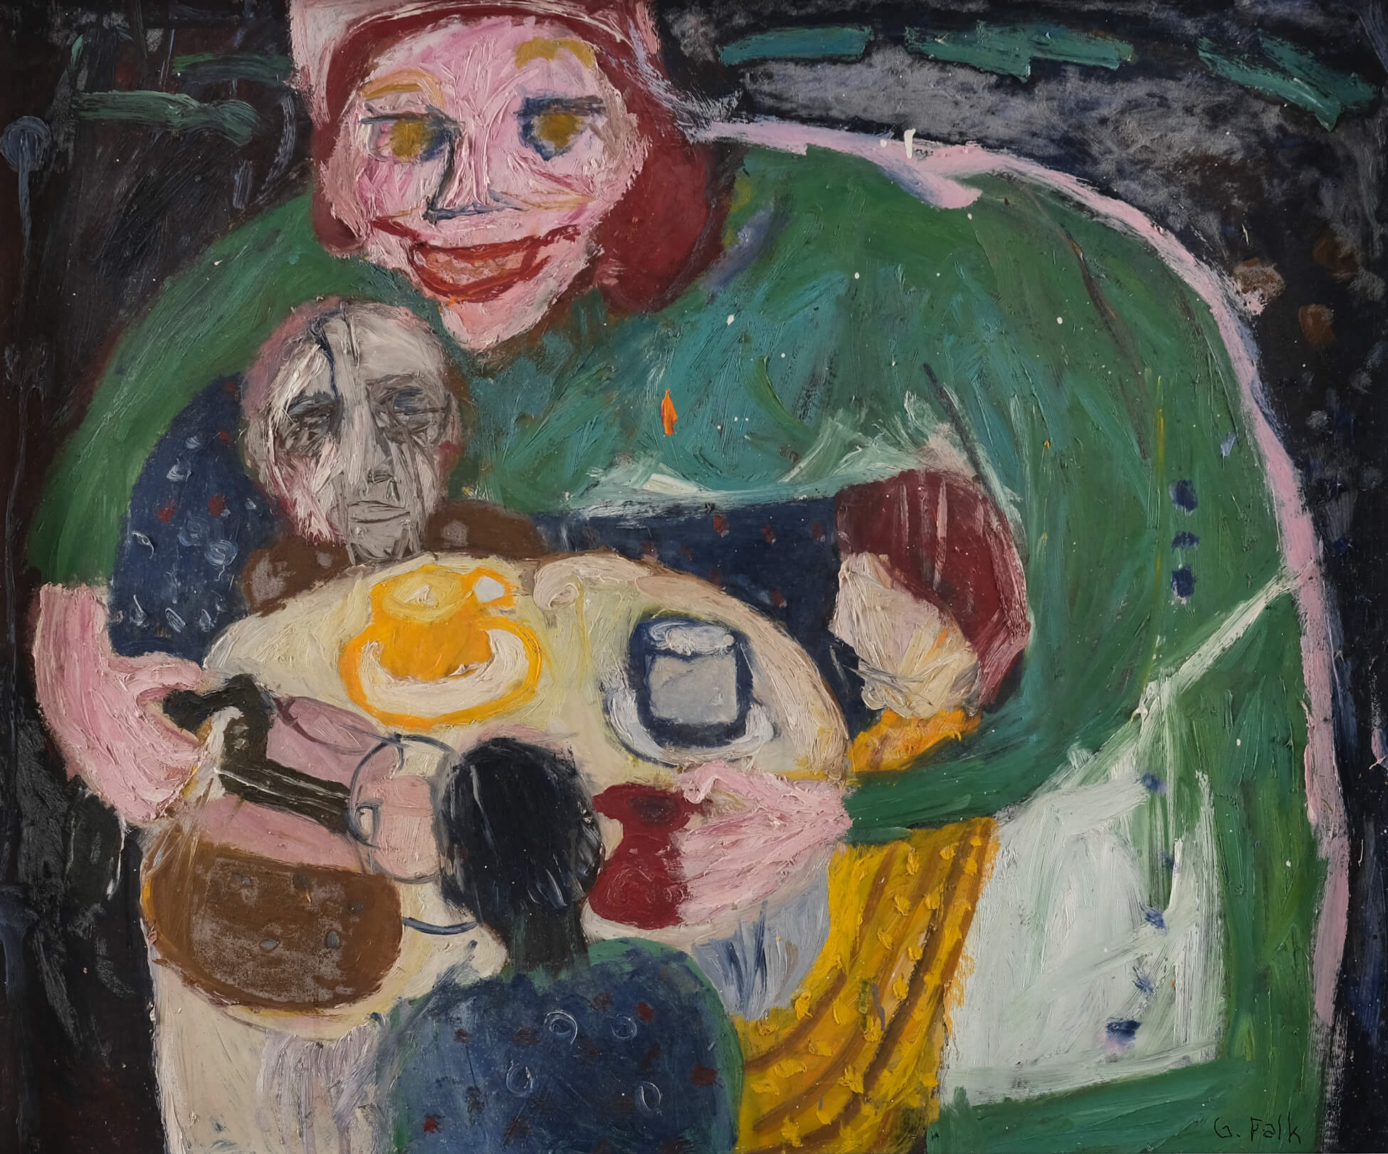
Gathie Falk, The Waitress, 1965. This painting pictures a woman serving coffee to a group of diners.

Slide 34
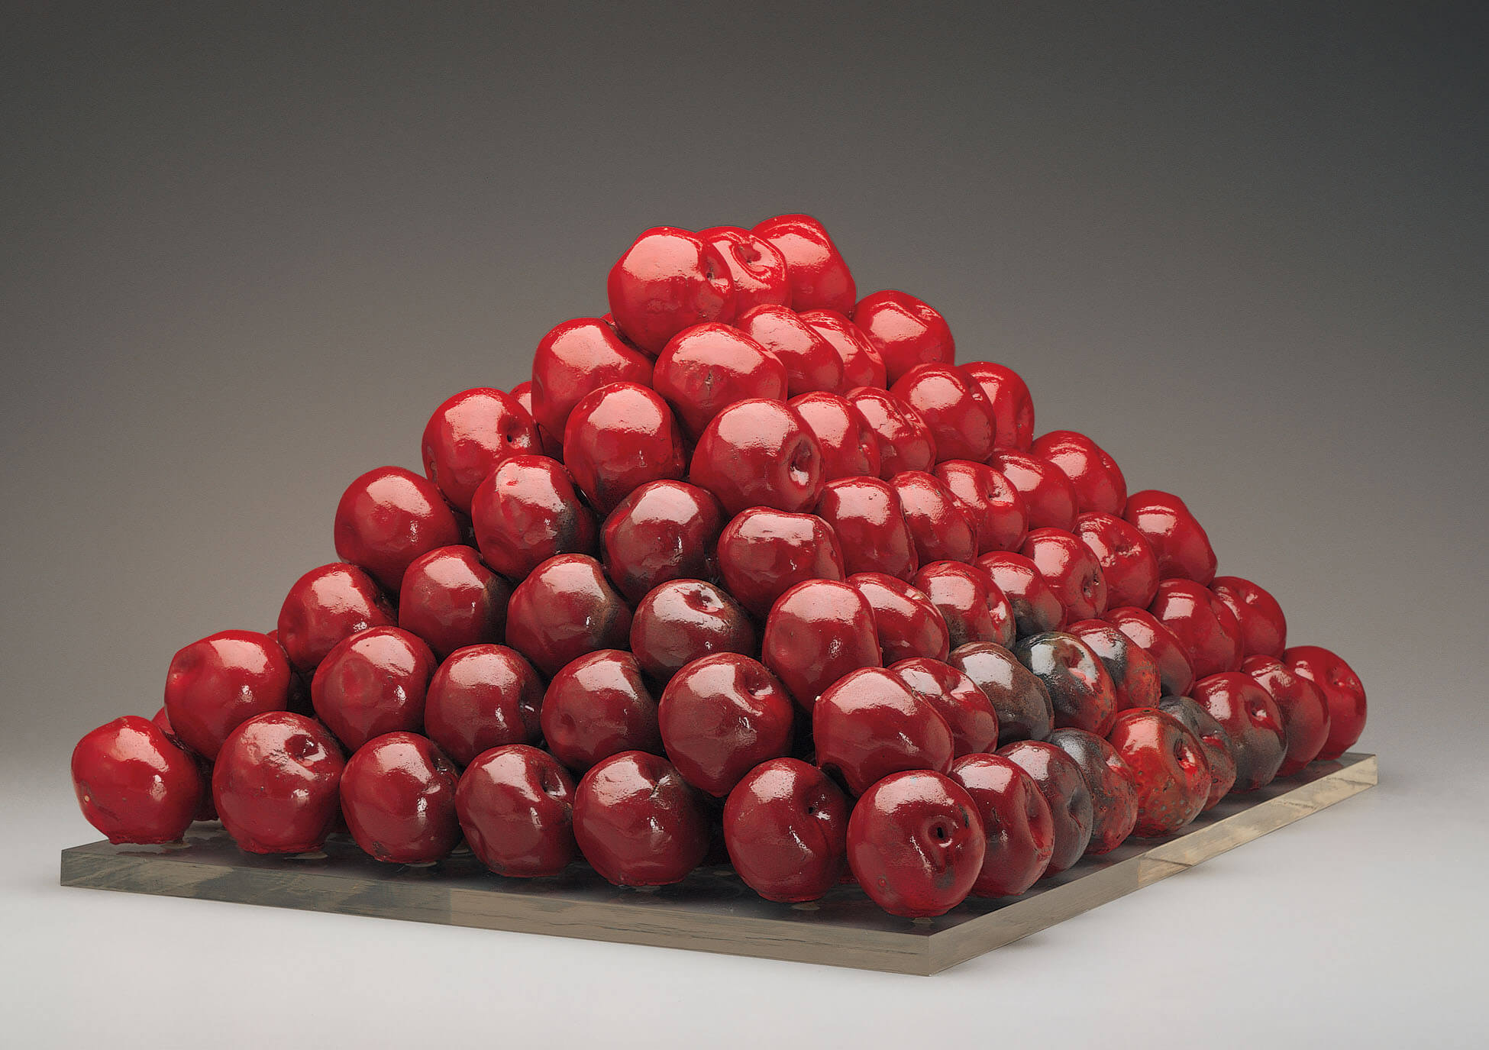
Gathie Falk, 196 Apples, 1969–70. Consistent in size, Falk’s apples are distinct due to the coloration of the glaze, which represents different degrees of texture, ripeness, and bruising.

Slide 35
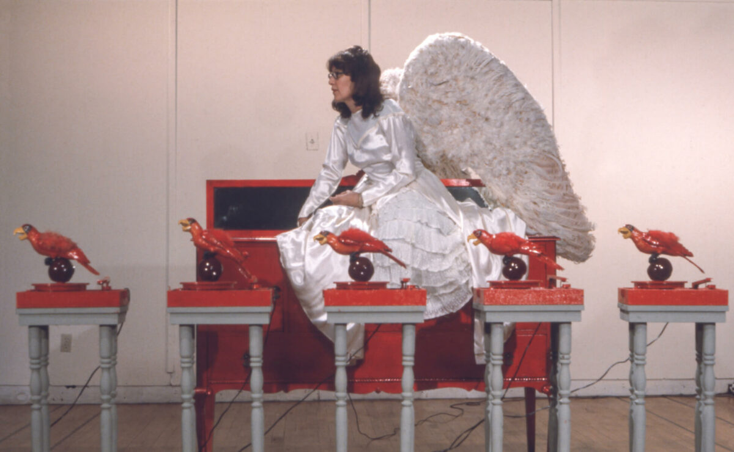
Gathie Falk, Red Angel, 1972. In this performance, Falk, wearing a long white gown and oversized wings, is accompanied by parrots singing “Row, Row, Row Your Boat.”

Slide 36
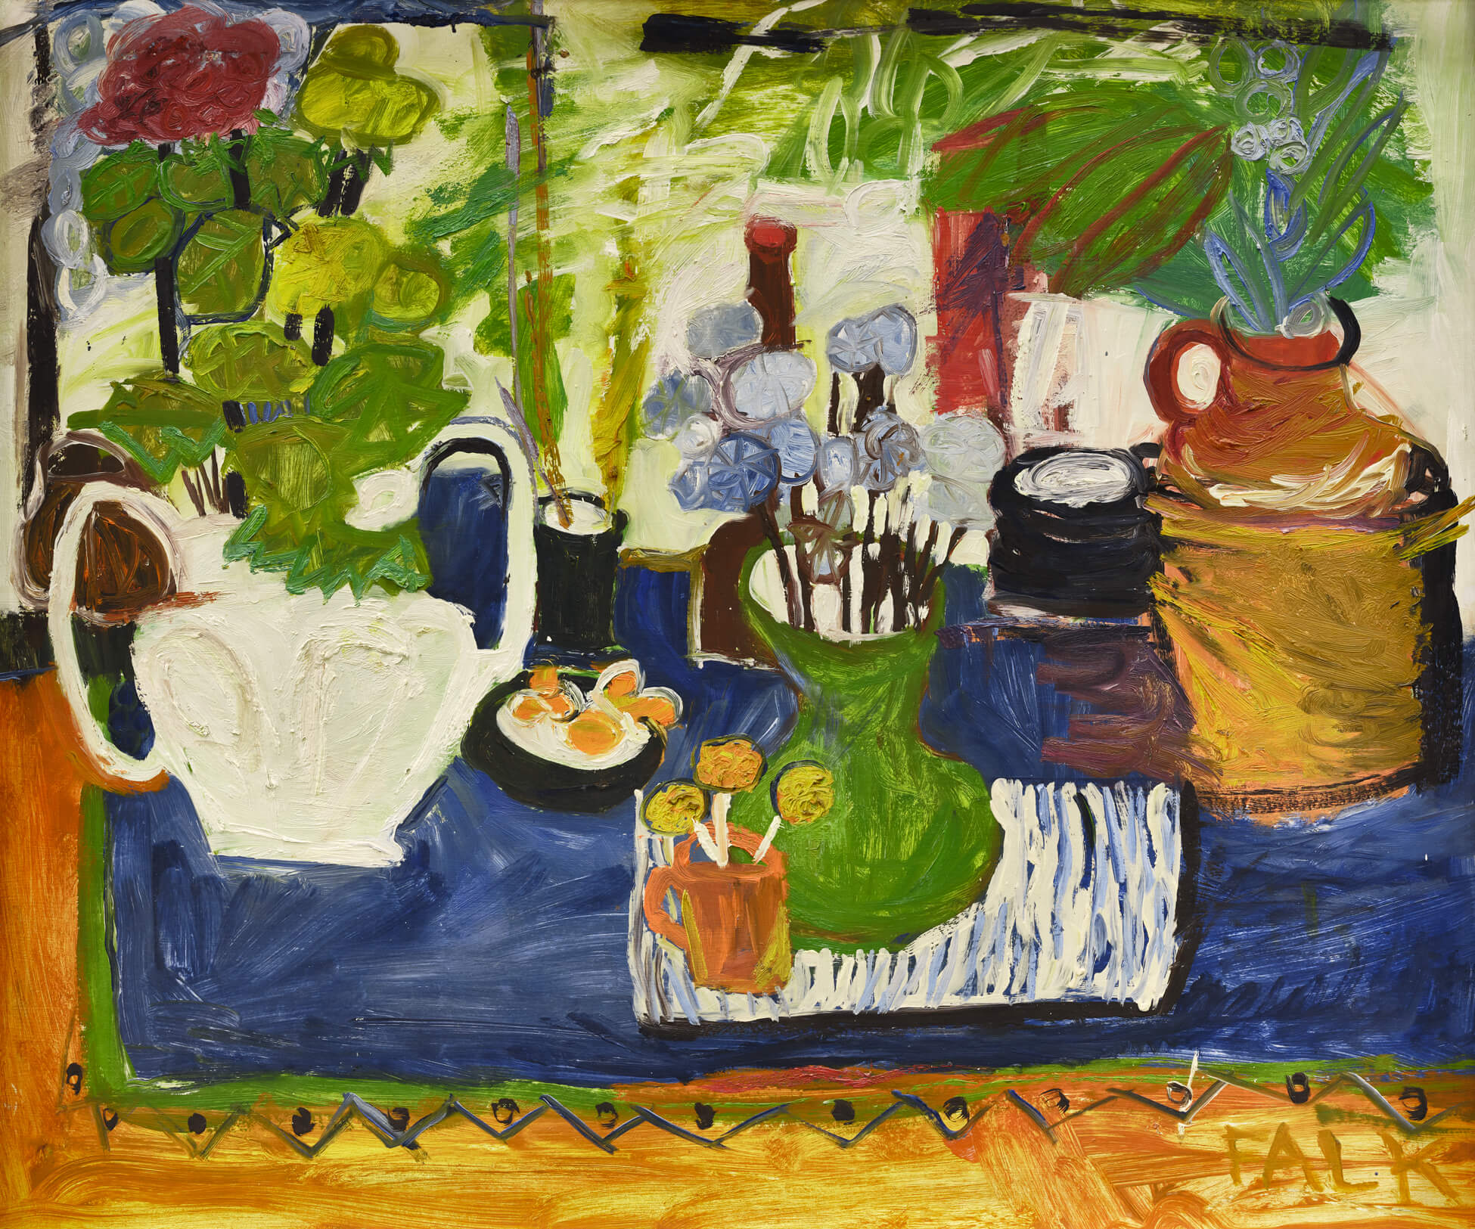
Gathie Falk, Still Life with UBC Jug, 1962. Falk considers this painting one of the earliest she produced without input from her teachers.

Slide 37
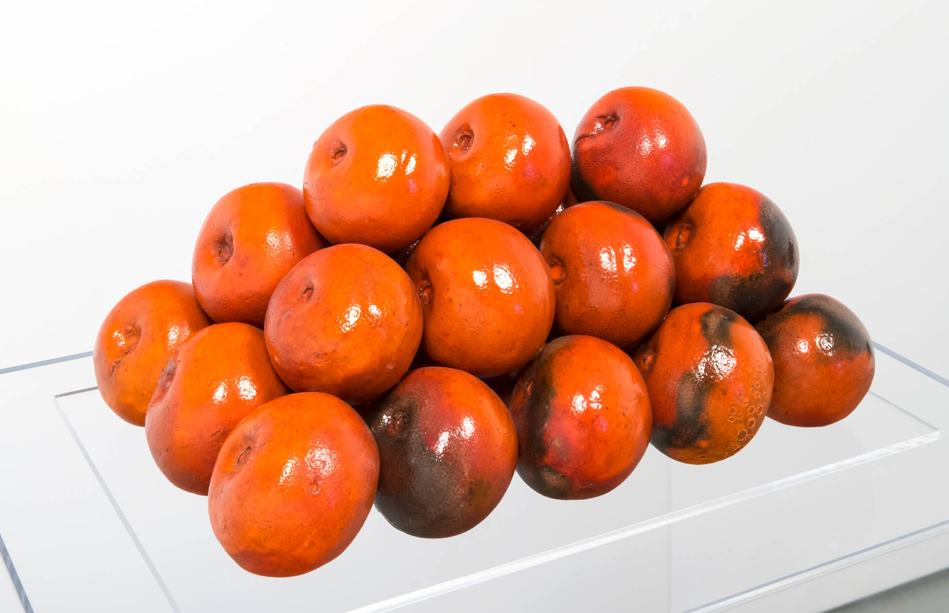
Gathie Falk, 26 Blood Oranges, 1970. Falk’s fruit sculptures remind us of the artfulness and the careful labour behind such delectable displays.

