Slide 2
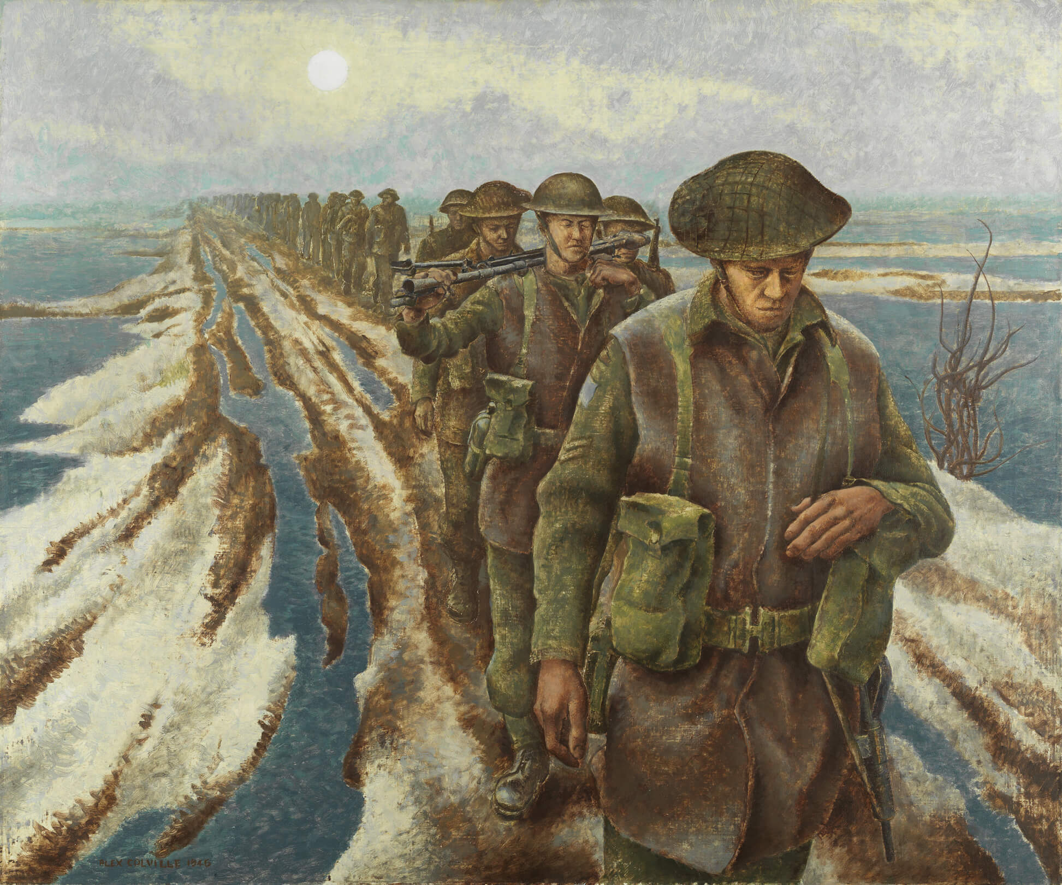
Alex Colville, Infantry, Near Nijmegen, Holland, 1946. Colville produced this work while he served as an official war artist during the Second World War.

Slide 3
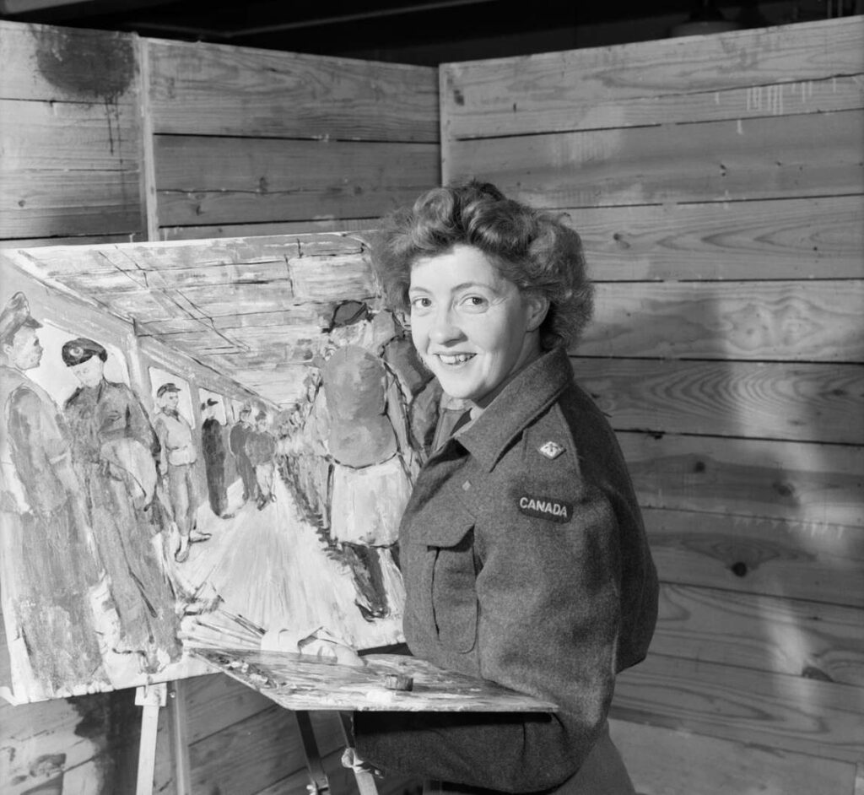
Molly Lamb painting in London, England, July 12, 1945.

Slide 4
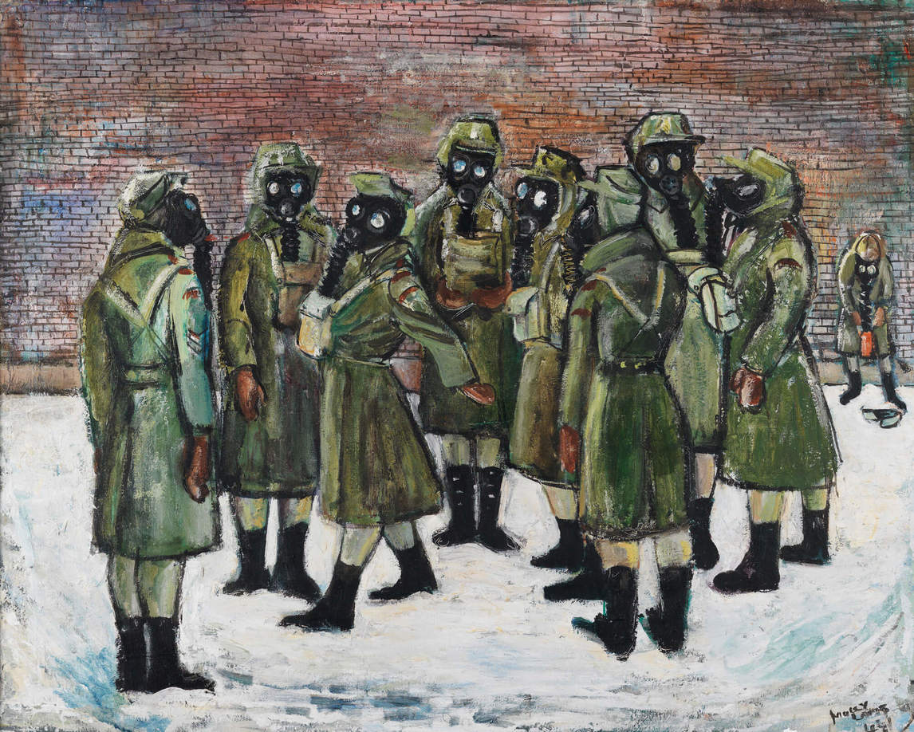
Molly Lamb Bobak, Gas Drill, 1944. Bobak’s war images are an important statement on women’s involvement in the Second World War.

Slide 5
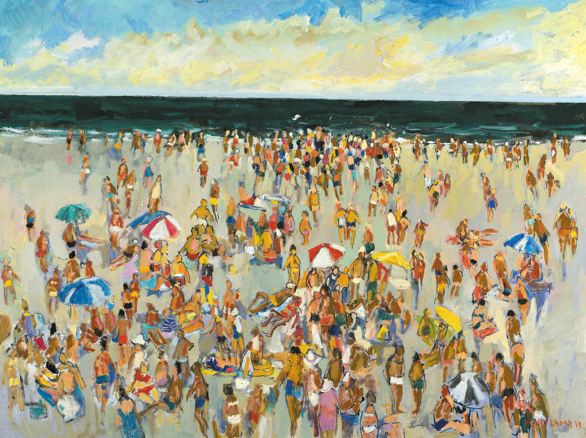
Molly Lamb Bobak, On the Beach, 1983. Bobak is revered for her crowd scenes developed from quick sketches, a technique she honed during her time as an official war artist.

Slide 6
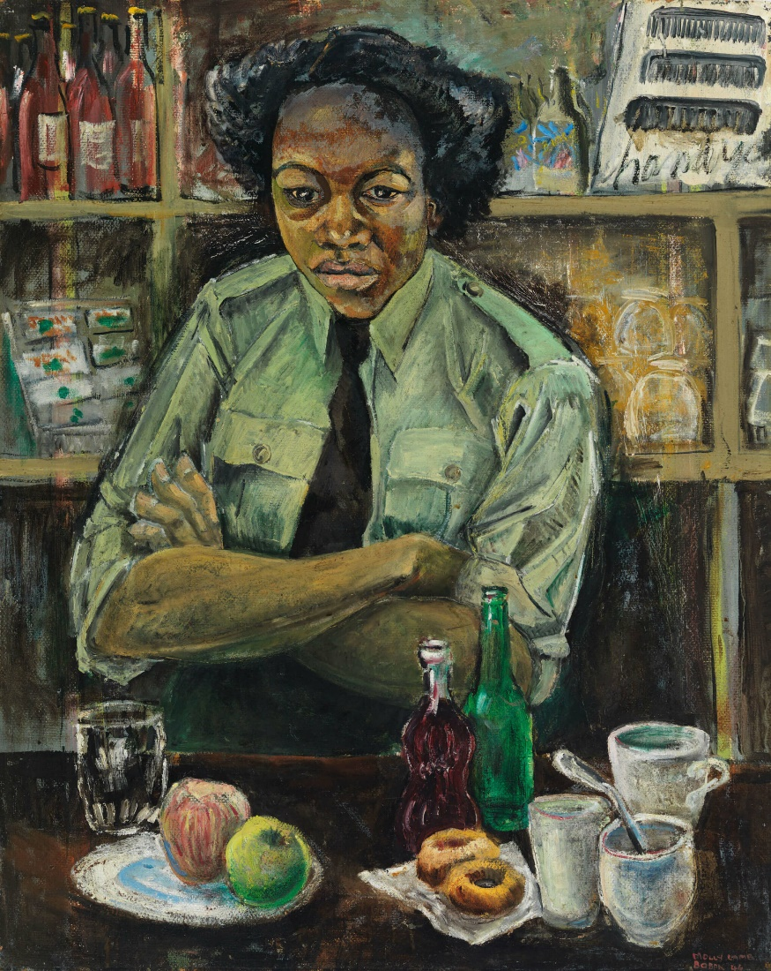
Molly Lamb Bobak, Private Roy, 1946. This portrait depicts Private Eva May Roy, who worked in the Canadian Women’s Army Corps.

Slide 7
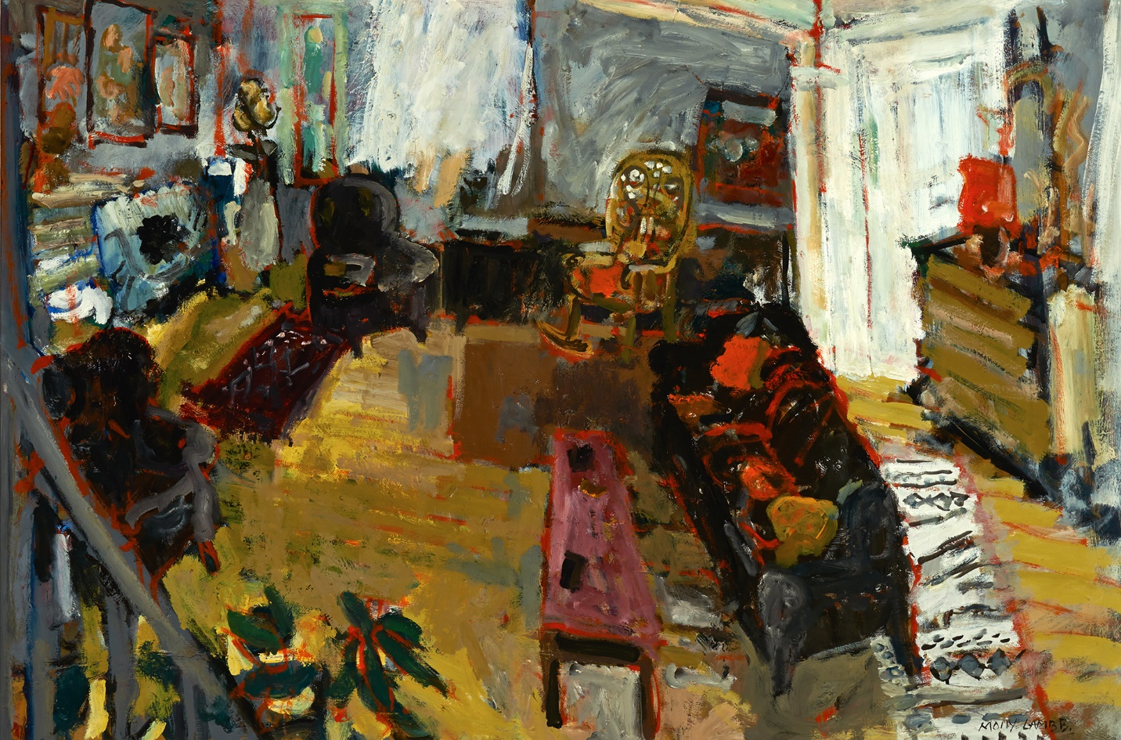
Molly Lamb Bobak, Living Room, c.1973. This work was painted in the Bobak home on Lansdowne Street in Fredericton, N.B.

Slide 8
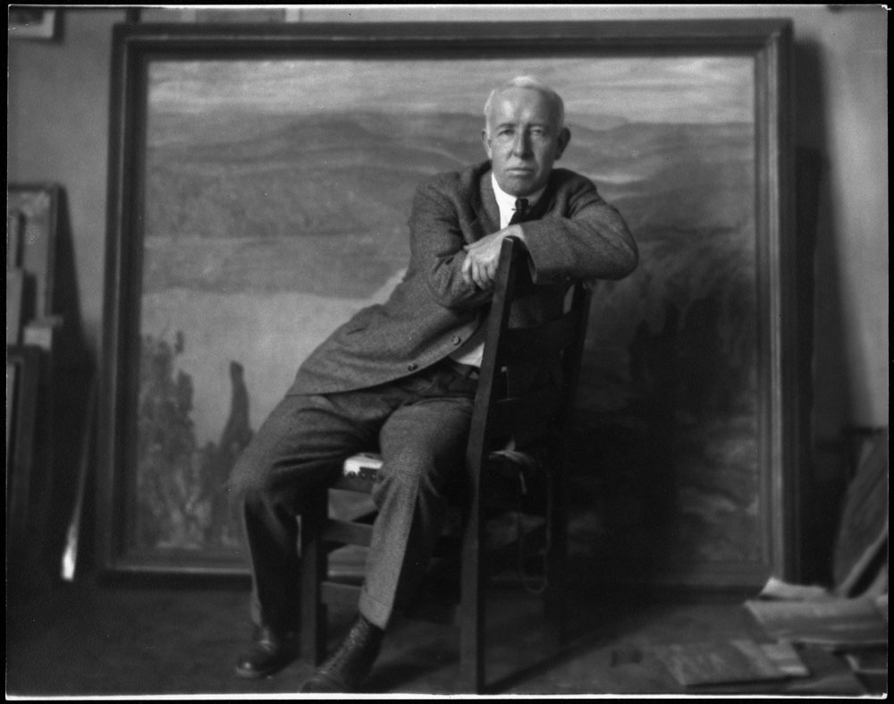
A.Y. Jackson, 1938.

Slide 9
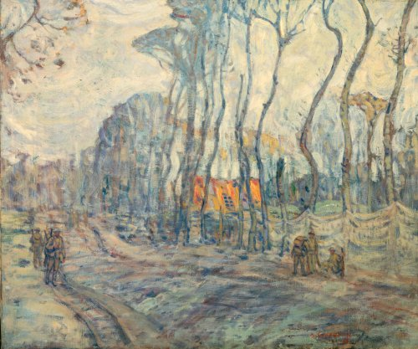
A.Y. Jackson, The Kemmel – Vierstraat Road, 1917. This painting shows the camouflage netting used to conceal the movements of soldiers and equipment from the enemy.

Slide 10
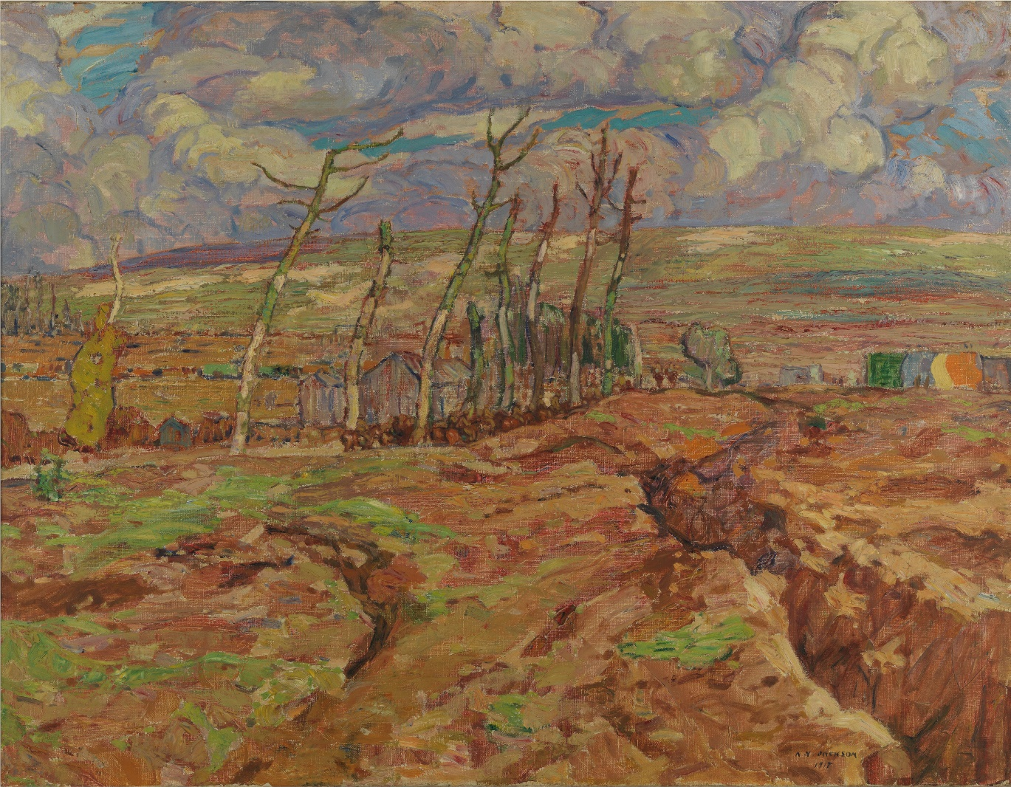
A.Y. Jackson, Vimy Ridge from Souchez Valley, 1918. Based on a sketch of the same subject matter, this painting presents a mottled sky completed with light, feathery strokes.

Slide 11
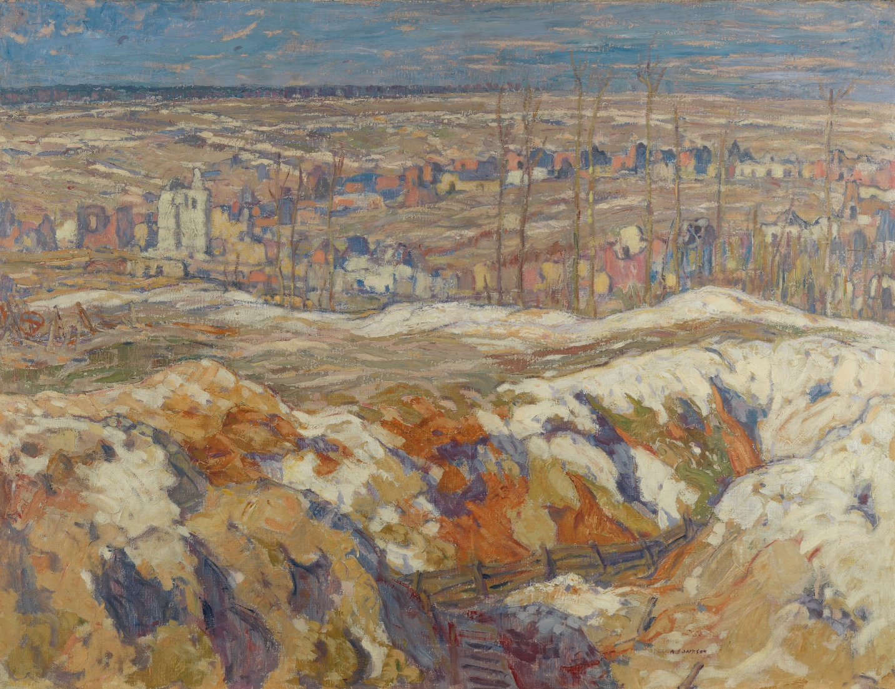
A.Y. Jackson, Angres, 1918. Jackson visited Angres, a village close to Vimy Ridge, six months after the Canadian victory there.

Slide 12
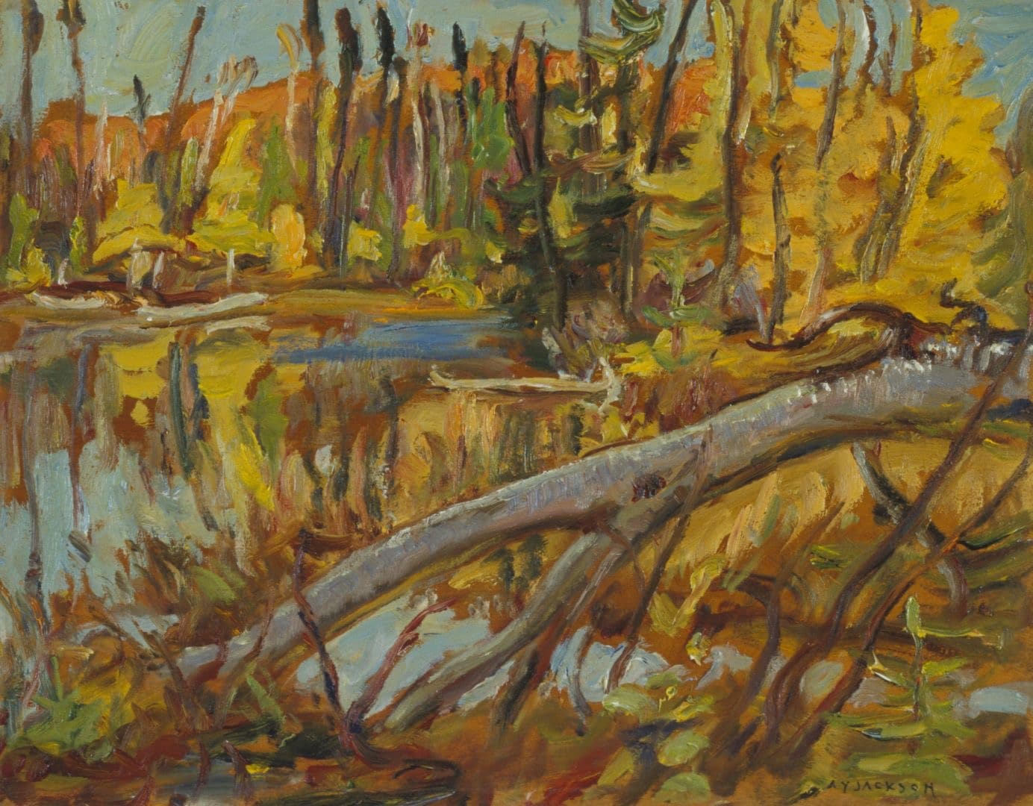
A.Y. Jackson, Beaver Lake, Combermere, Ontario, 1961. Jackson created this work while he was residing in Manotick, a town south of Ottawa.

Slide 13
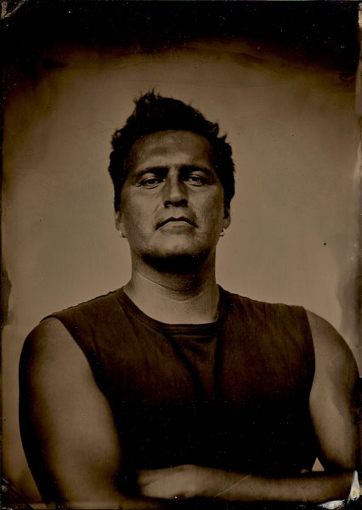
Adrian Stimson, photograph by Will Wilson.

Slide 14
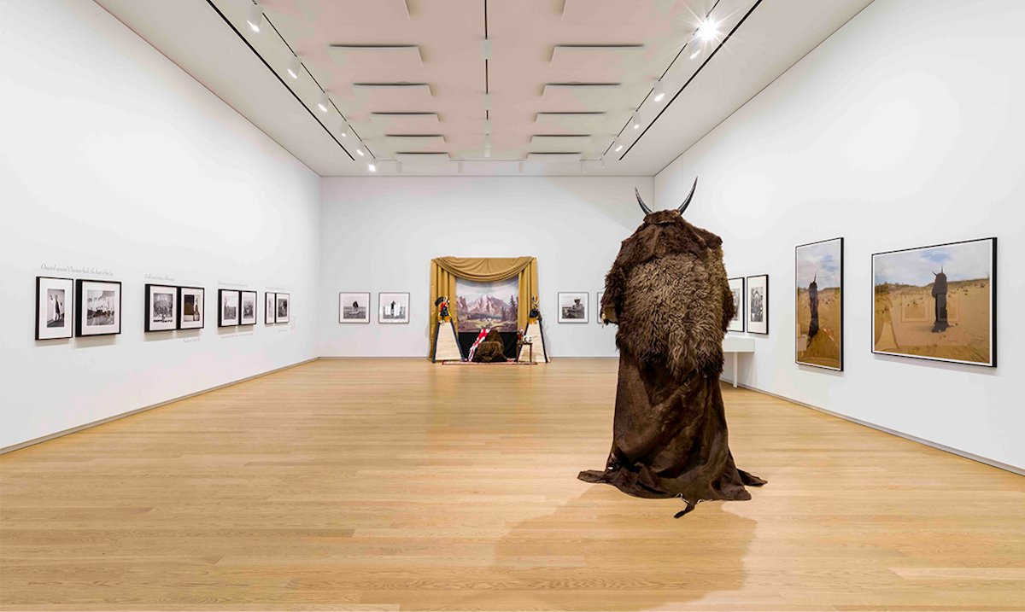
Adrian Stimson, Maanipokaa’iini, 2022, installation view at Remai Modern, Saskatoon. Featuring installation, photography, paintings, and video works, Maanipokaa’iini marks the first-ever survey of Stimson’s artistic career.

Slide 15
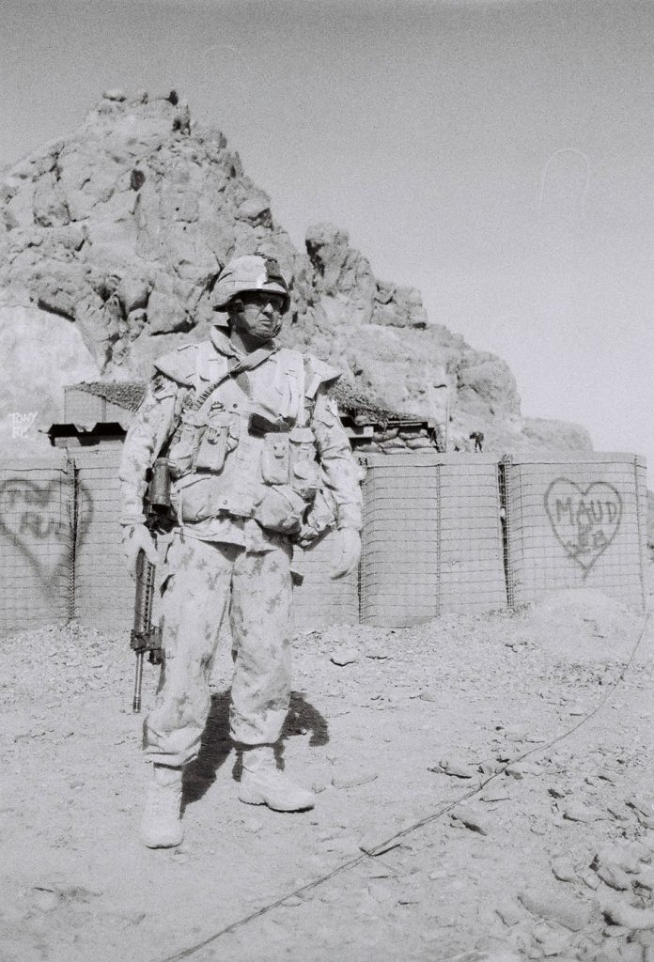
Adrian Stimson, photograph from Holding Our Breath, 2011.

Slide 16
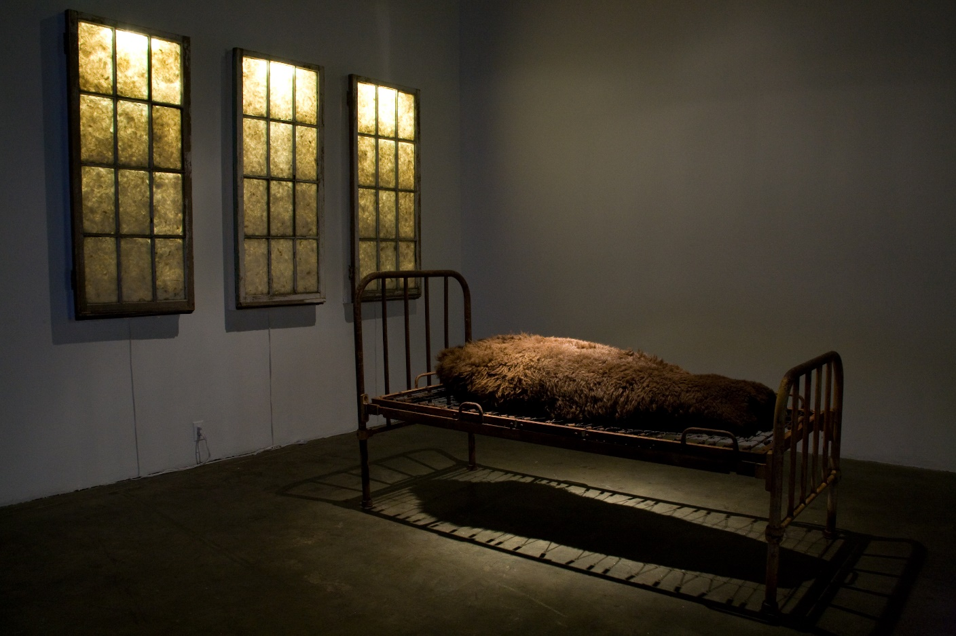
Adrian Stimson, Sick and Tired, 2006. This installation is made of elements from the Old Sun Residential School, which was established in 1883 on the Siksika Blackfoot Reserve near Gleichen, Alberta.

Slide 17
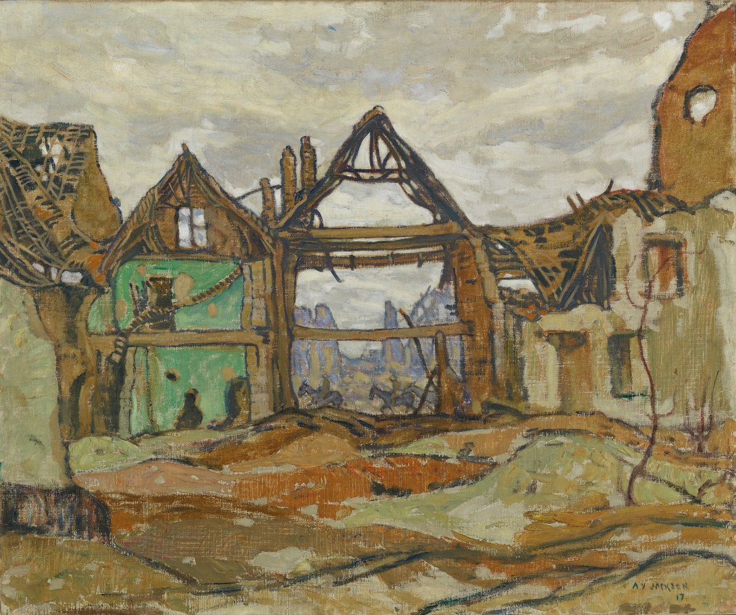
Learning Activity #1
A.Y. Jackson, House of Ypres, 1917–18. This painting pictures a bombed-out house in Ypres, Belgium.

Slide 18
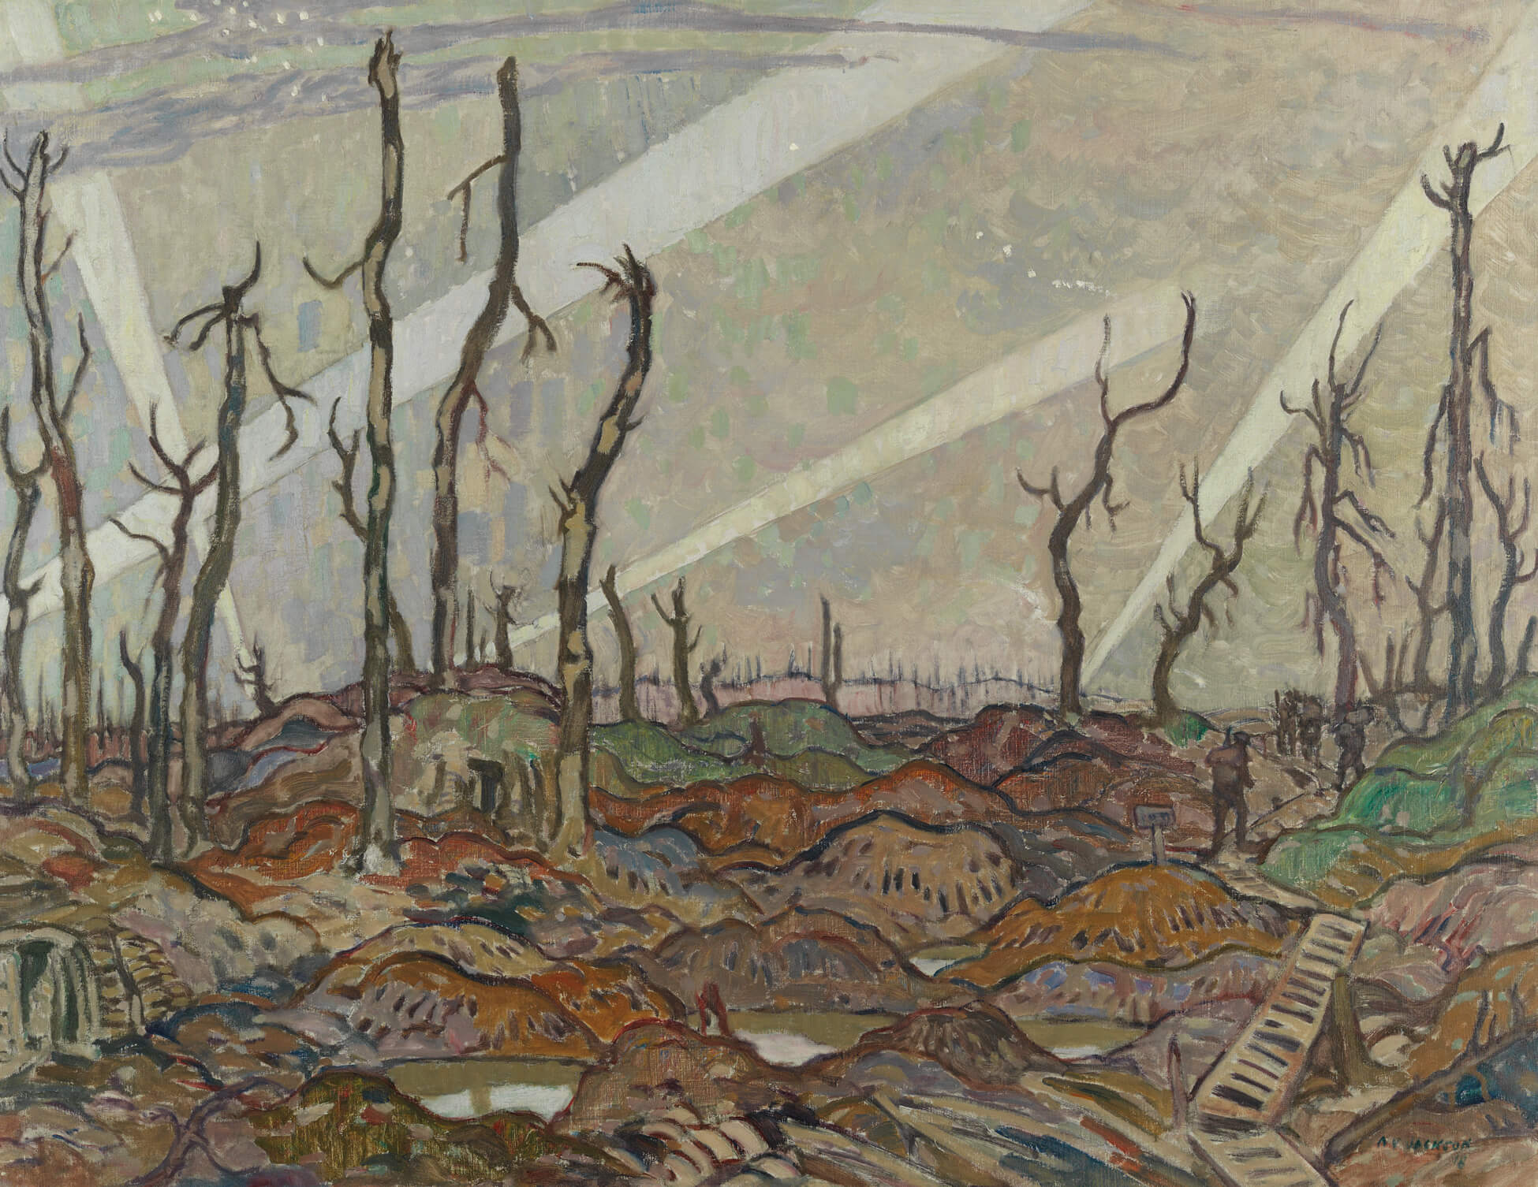
Learning Activity #1
A.Y. Jackson, A Copse, Evening, 1918. Stalwart tree trunks stand stiff and upright amongst battle detritus in this painting capturing the effects of war on the Belgian landscape.

Slide 19
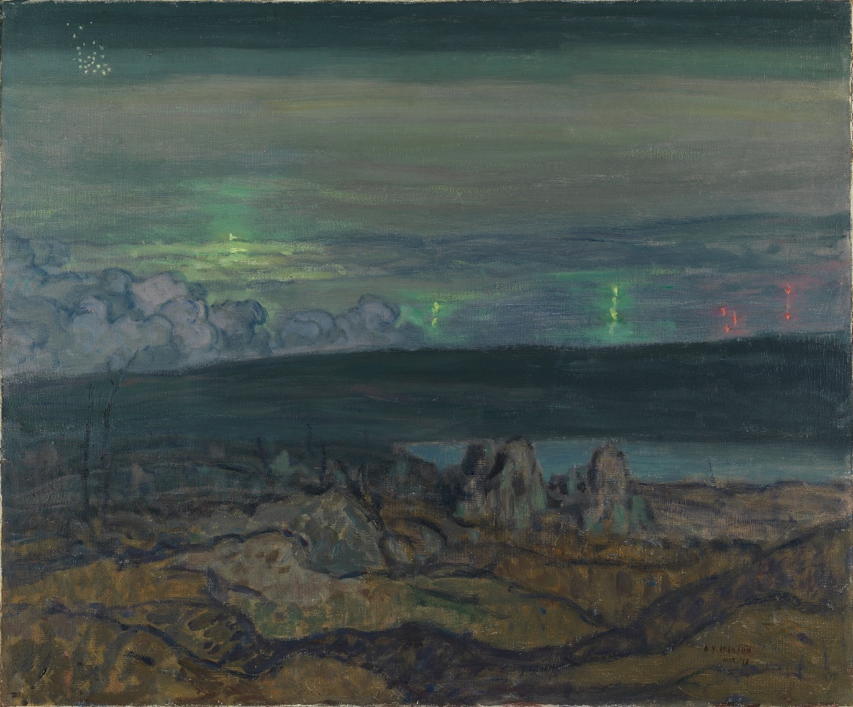
Learning Activity #1
A.Y. Jackson, Gas Attack, Liéven, 1918. This painting depicts an Allied nighttime gas attack on German lines in France.

Slide 20
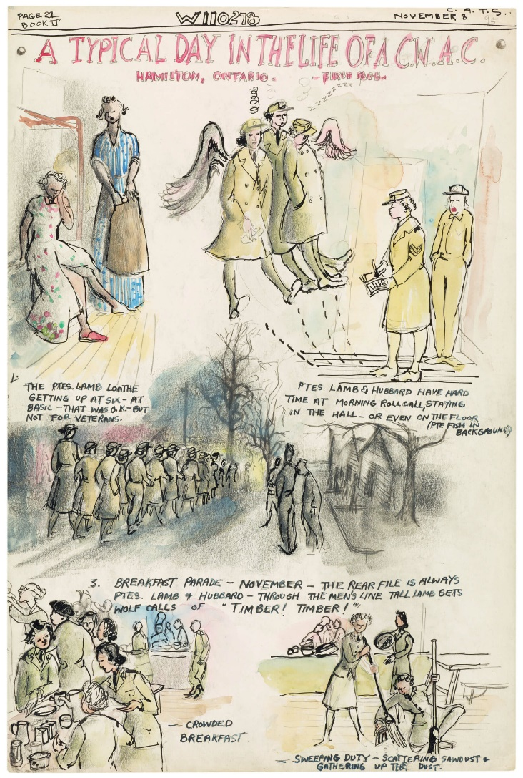
Learning Activity #1
Molly Lamb Bobak, Illustration from W110278: The Personal War Records of Private Lamb, M, 1942–45. Bobak’s wartime diary is unique for its chronicling of army life from a woman’s perspective.

Slide 21
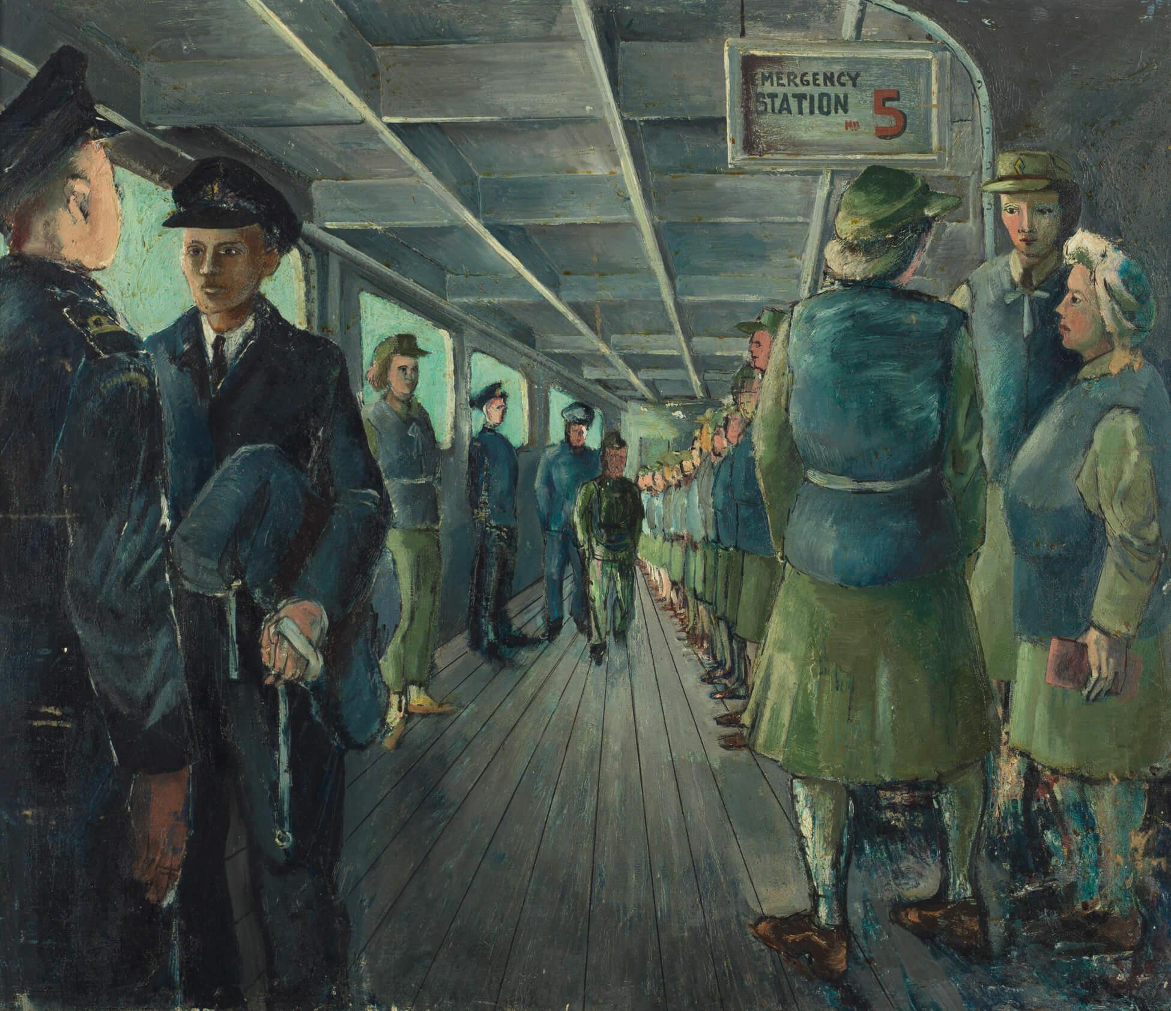
Learning Activity #1
Molly Lamb Bobak, Boat Drill, Emergency Stations, 1945. This painting illustrates the group spirit of the CWACs as well as Lamb’s propensity for caricature.

Slide 22
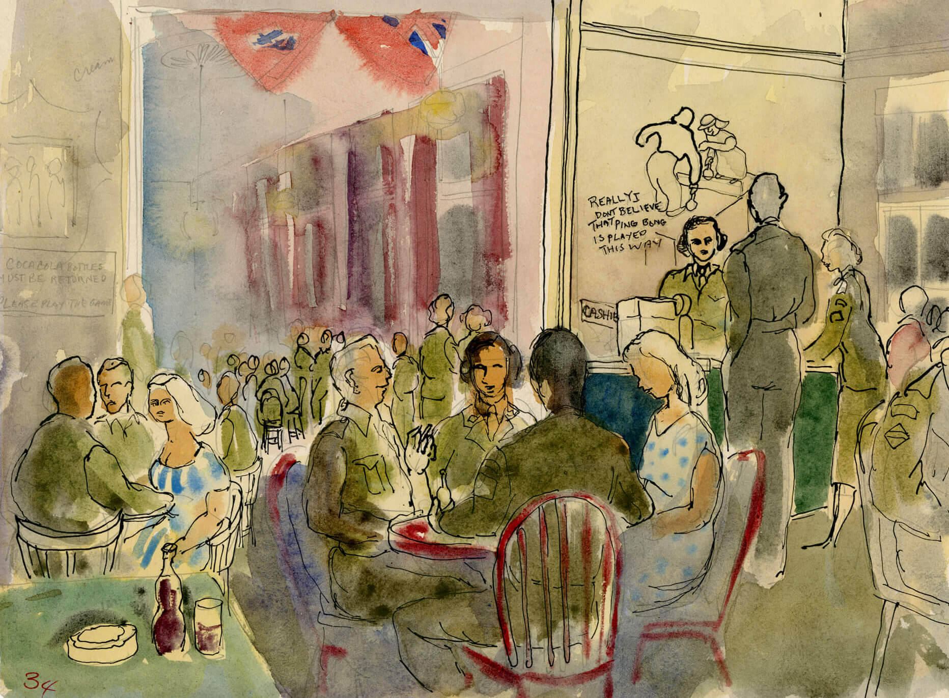
Learning Activity #1
Molly Lamb Bobak, Inside the Auxiliary Service Canteen at Amersfoort, Holland, 1945. As an official war artist, Lamb recorded daily life for the CWACs as well as the aftermath of the war.

Slide 23
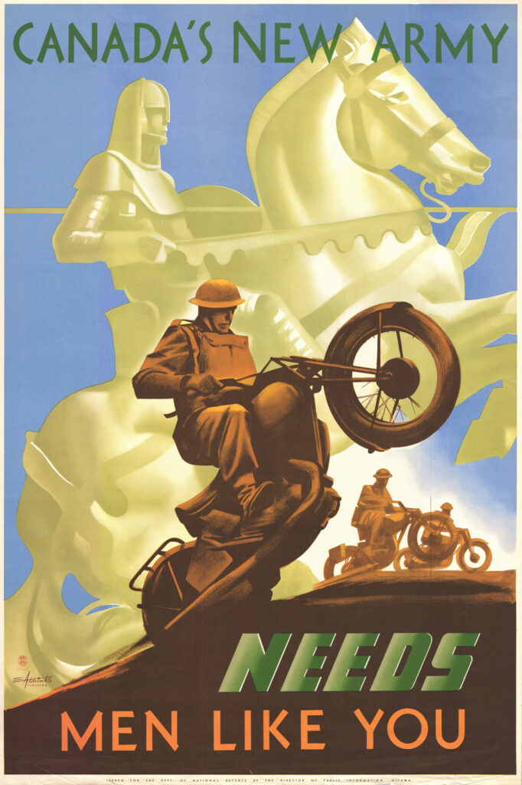
Learning Activity #2
Eric Aldwinckle, Canada’s New Army Needs Men Like You, c.1941–42. During the Second World War, posters depicting acts of heroism were used to persuade people to enlist.

Slide 24
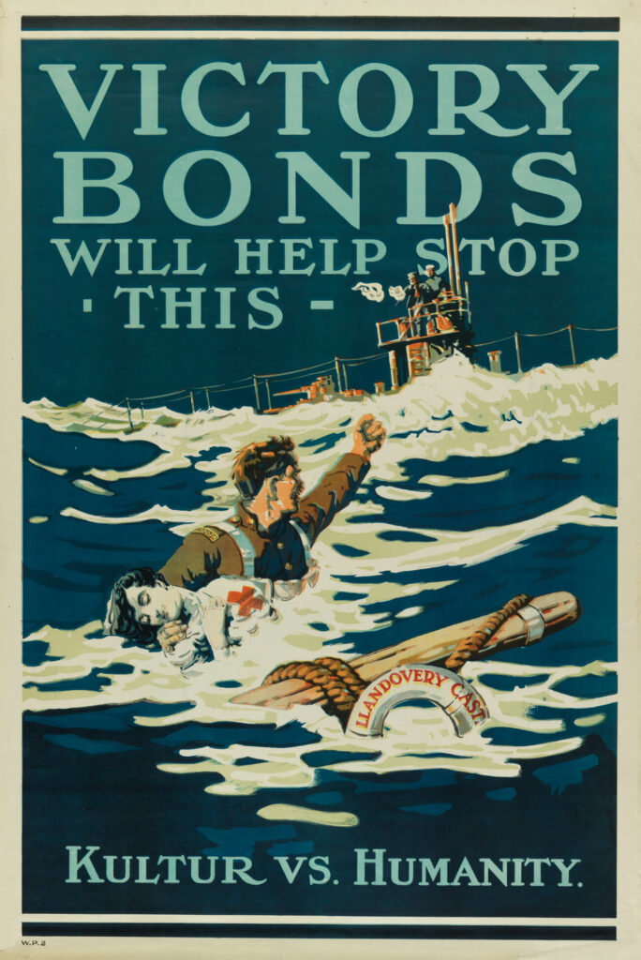
Learning Activity #2
Anonymous, Victory Bonds Will Help Stop This – Kultur vs. Humanity, 1918. This poster played on the outrage sparked by the torpedoing of a hospital ship in 1918.

Slide 25
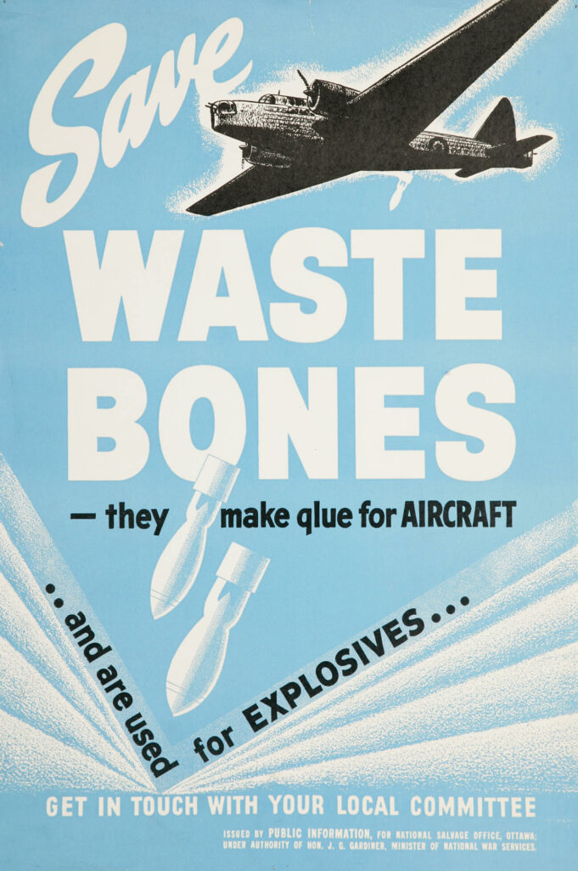
Learning Activity #2
Anonymous, Save Waste Bones – They Make Glue For Aircraft… And Are Used for Explosives, 1940–41. This poster encouraged Canadians to recycle materials that could be used for the war effort.

Slide 26
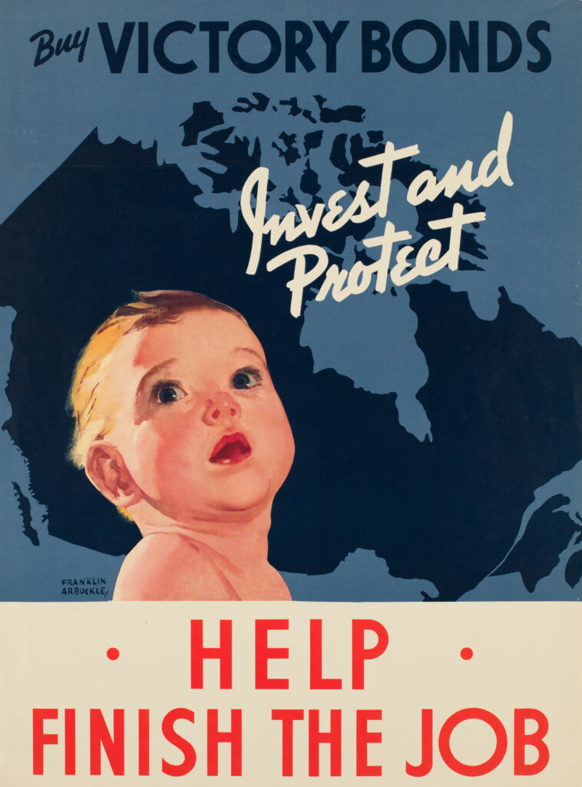
Learning Activity #2
Franklin Arbuckle, Invest and Protect. Help Finish the Job, n.d. The cherubic baby featured in this poster reinforces the idea that all Canadians had to contribute to end the war.

Slide 27
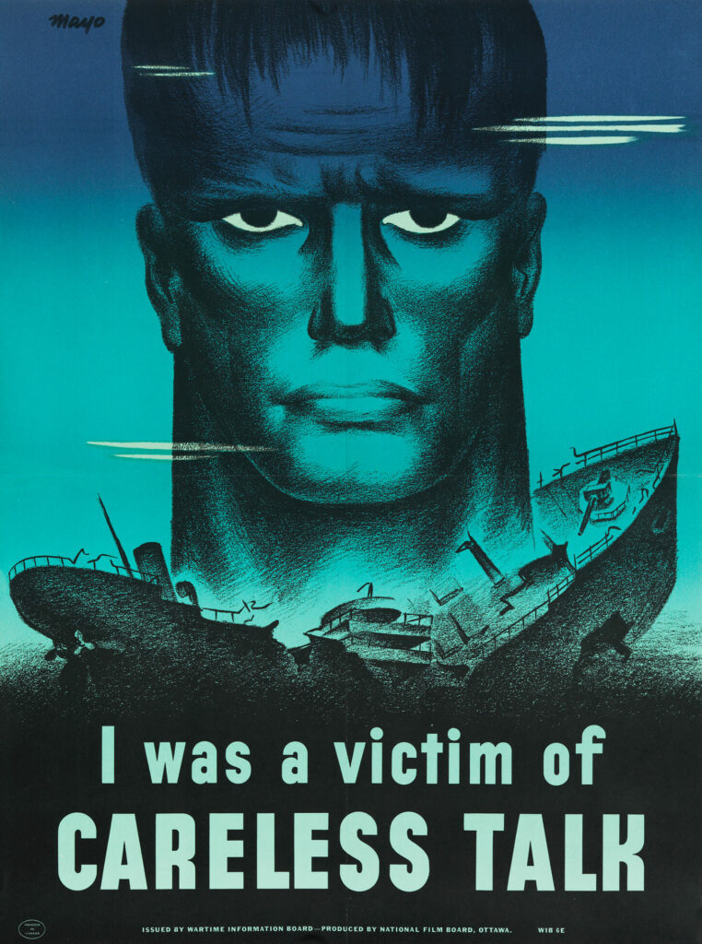
Learning Activity #2
Harry “Mayo” Mayerovitch, I was a Victim of Careless Talk, 1943. This poster was produced by the National Film Board.

Slide 28
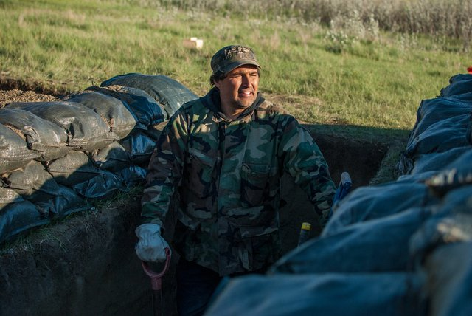
Culminating Task
Adrian Stimson, Trench, 2017. In this five-day performance, Stimson dug a six-foot-deep trench in a U-shape pattern, a Niitsitapi (Blackfoot) symbol of war.

Slide 29
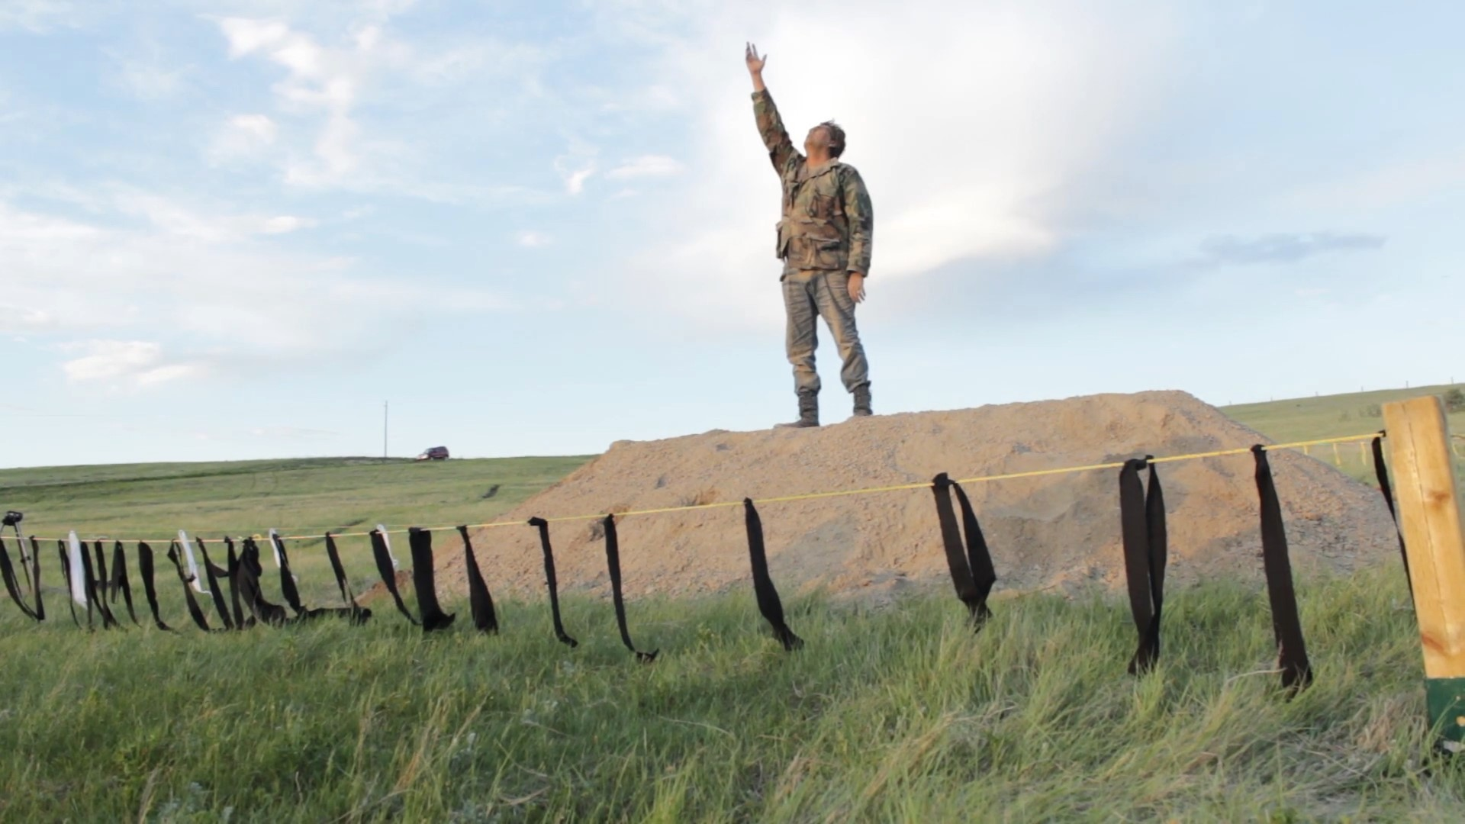
Culminating Task
Adrian Stimson, Trench, 2017. Stimson’s performance attempts to draw attention to how Indigenous soldiers have been excluded from the history of the Second World War.

Slide 30
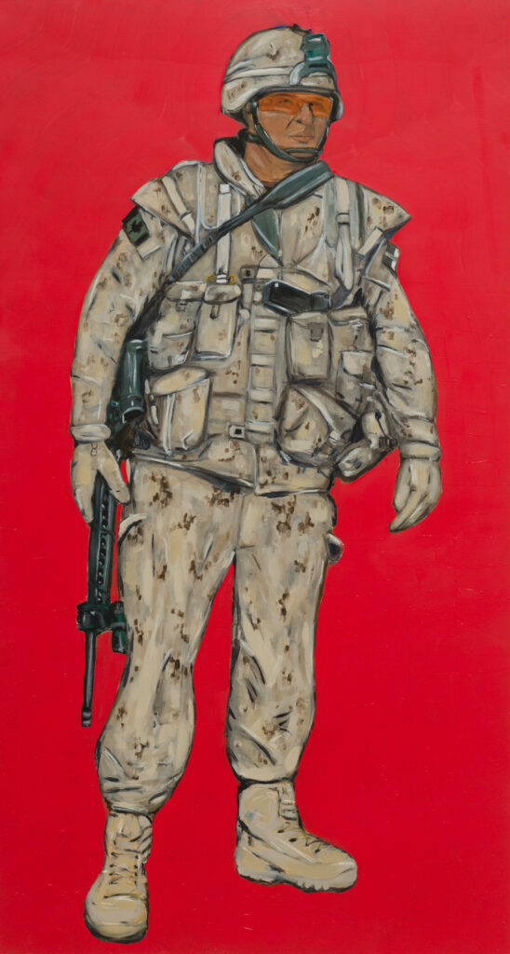
Culminating Task
Adrian Stimson, Master Corporal Jamie Gillman 2010, 2011–12. This portrait is one of two depicting Indigenous soldiers Stimson met while he was stationed in Kandahar in 2010.

Slide 31
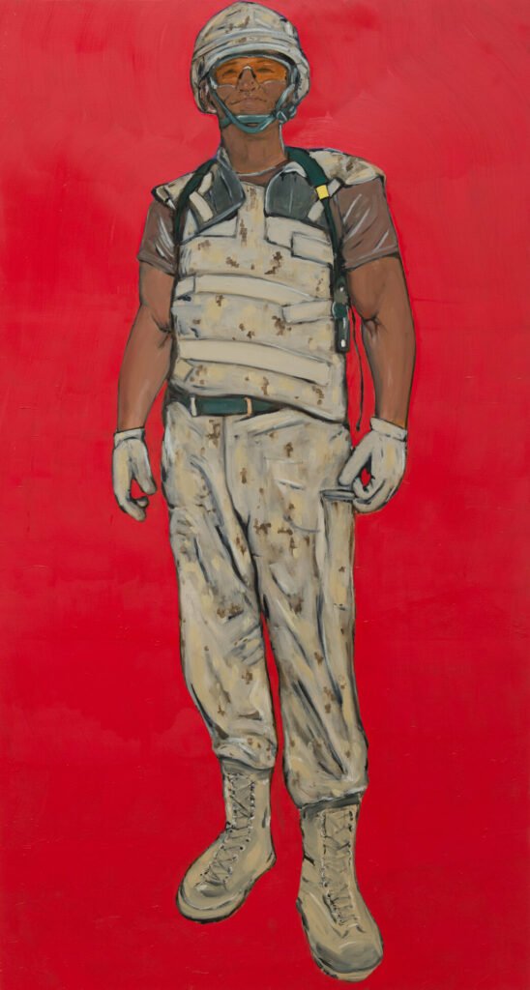
Culminating Task
Adrian Stimson, Corporal Percy Beddard 2010, 2011–12. The red background of this work suggests that it may be more accurately read as a memorial.

Slide 32
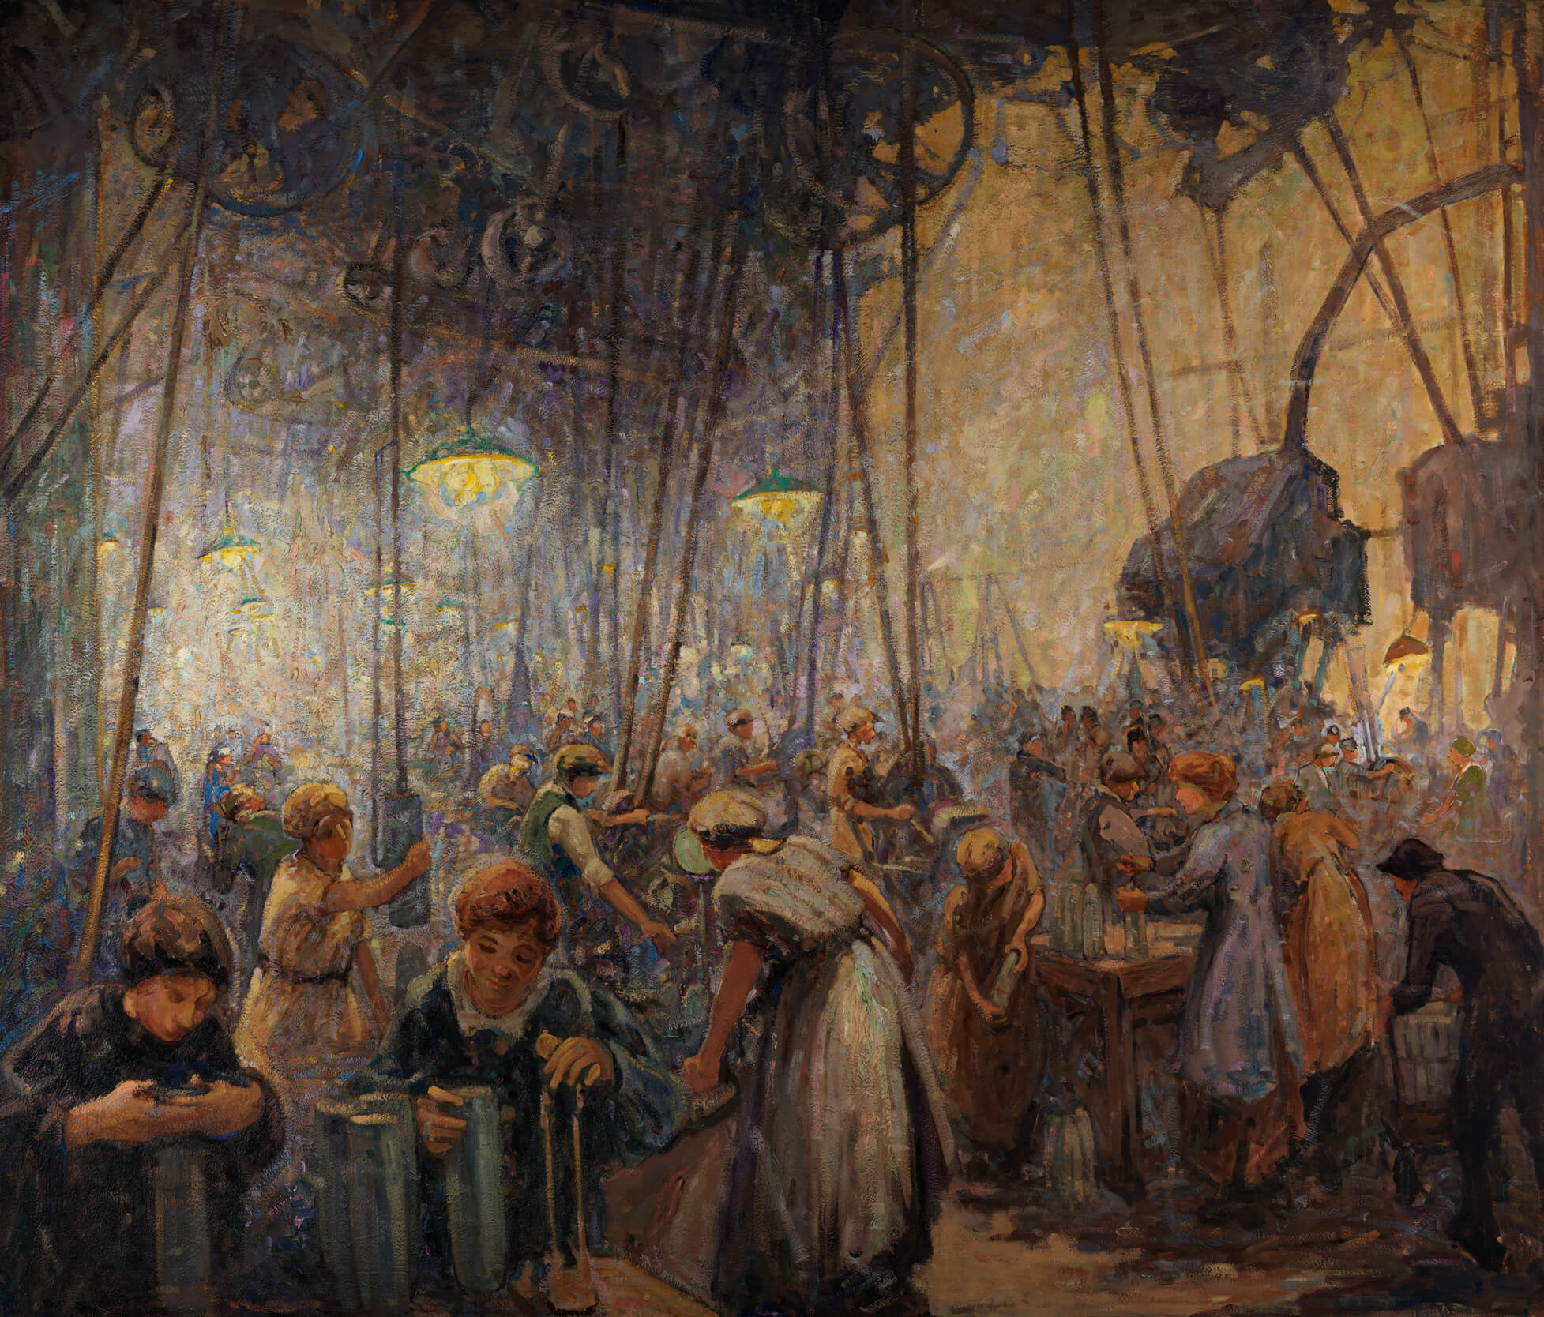
Henrietta Mabel May, Women Making Shells, 1919. May combines her interest in Impressionism with her skills in producing industrial scenes in this painting of a noisy munitions factory.

Slide 33
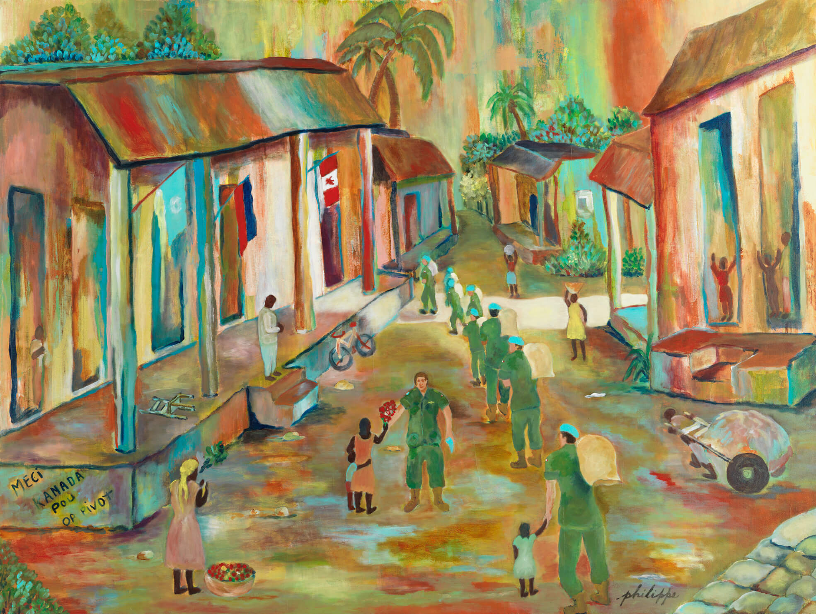
Marc-Bernard Philippe, Peacekeepers, n.d. This painting by Haitian Canadian artist Marc-Bernard Philippe depicts blue-helmeted peacekeepers interacting with Haitian children.

