Slide 2
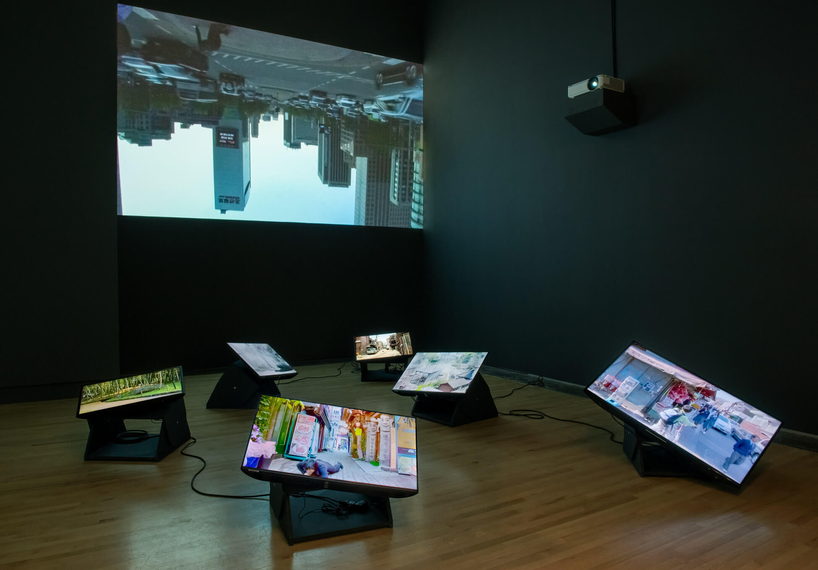
Jin-me Yoon, Installation view of As It Is Becoming (Seoul), 2008, at Kamloops Art Gallery, 2022.

Slide 3
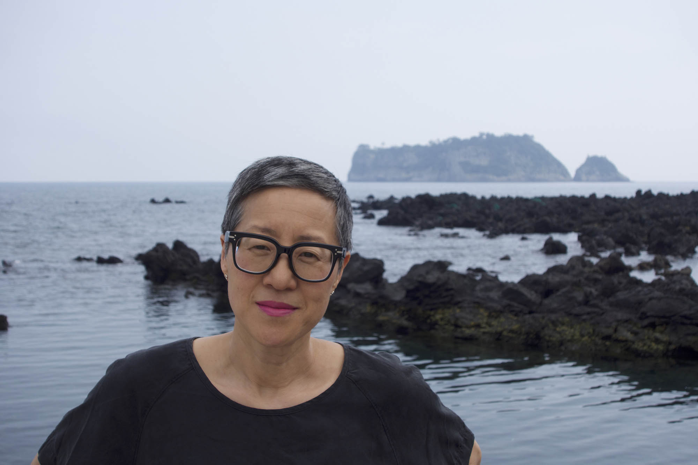
Jin-me Yoon, photograph by Jae Woo Kang.

Slide 4
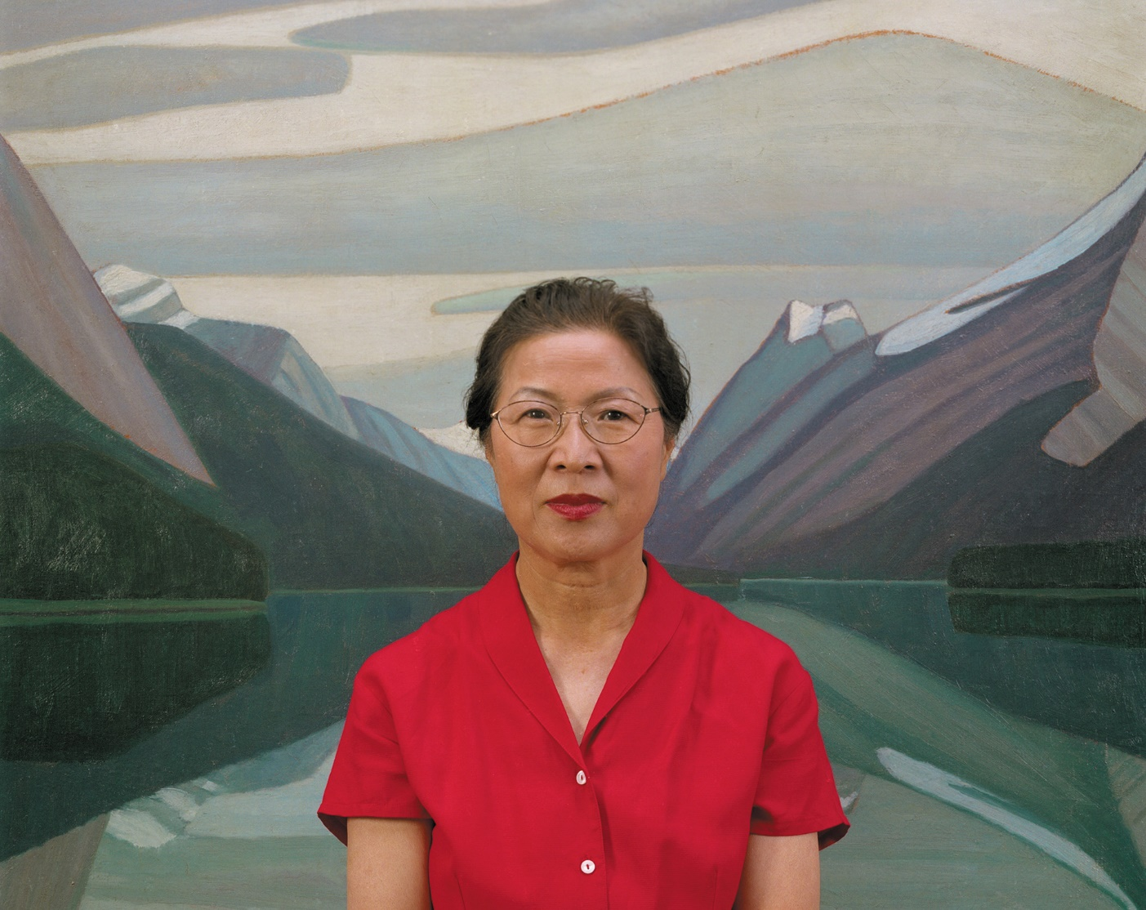
Jin-me Yoon, A Group of Sixty-Seven (front detail), 1996. Perhaps one of Yoon’s most recognizable works, this series demonstrates how photographic images shape meaning.

Slide 5
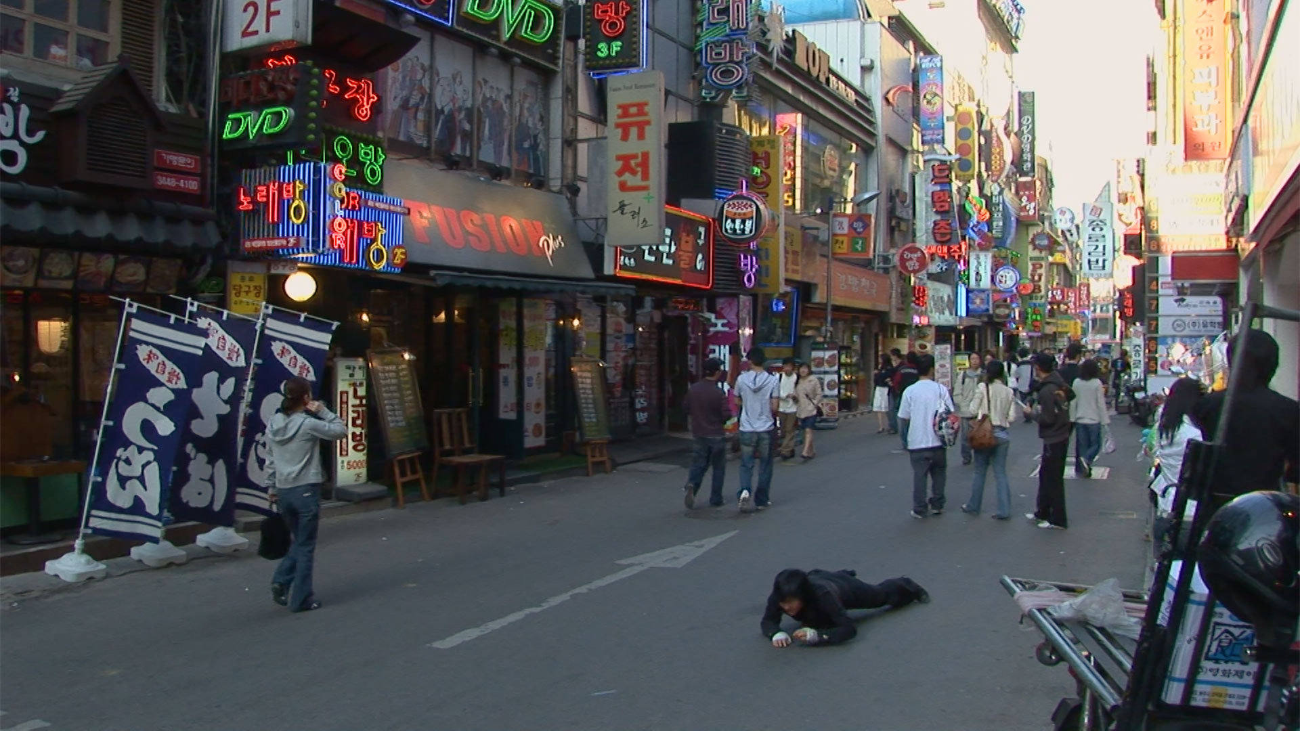
Jin-me Yoon, As It Is Becoming (Seoul) (video still), 2008. Yoon’s mid-career video works critiqued conditions of visual mastery by shifting to a horizonal axis, a move that radically alters the viewer’s line of sight.

Slide 6
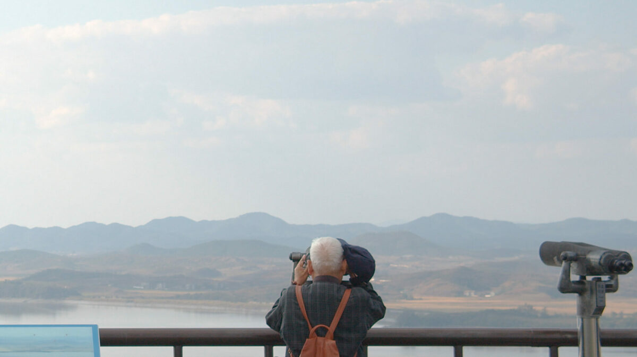
Jin-me Yoon, Dreaming Birds Know No Borders (video still), 2021. In this video, Yoon connects lands on the unceded ancestral territory of the Tsleil-Waututh Nation with lands located near the DMZ (Demilitarized Zone) between North and South Korea.

Slide 7
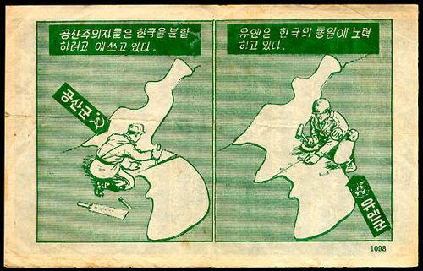
Propaganda pamphlet showing a North Korean soldier dividing the Korean peninsula with a knife, while a UN soldier tries to put it back together, c.1950.

Slide 8
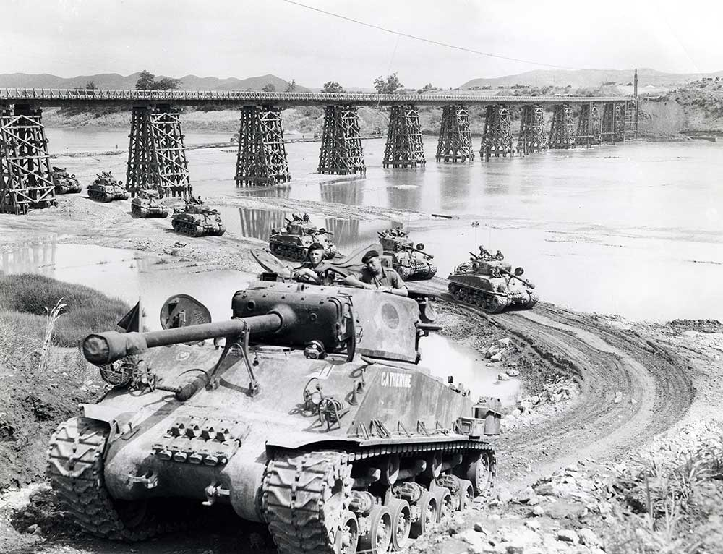
Canadian Sherman tanks on the move in Korea, July 1952.

Slide 9
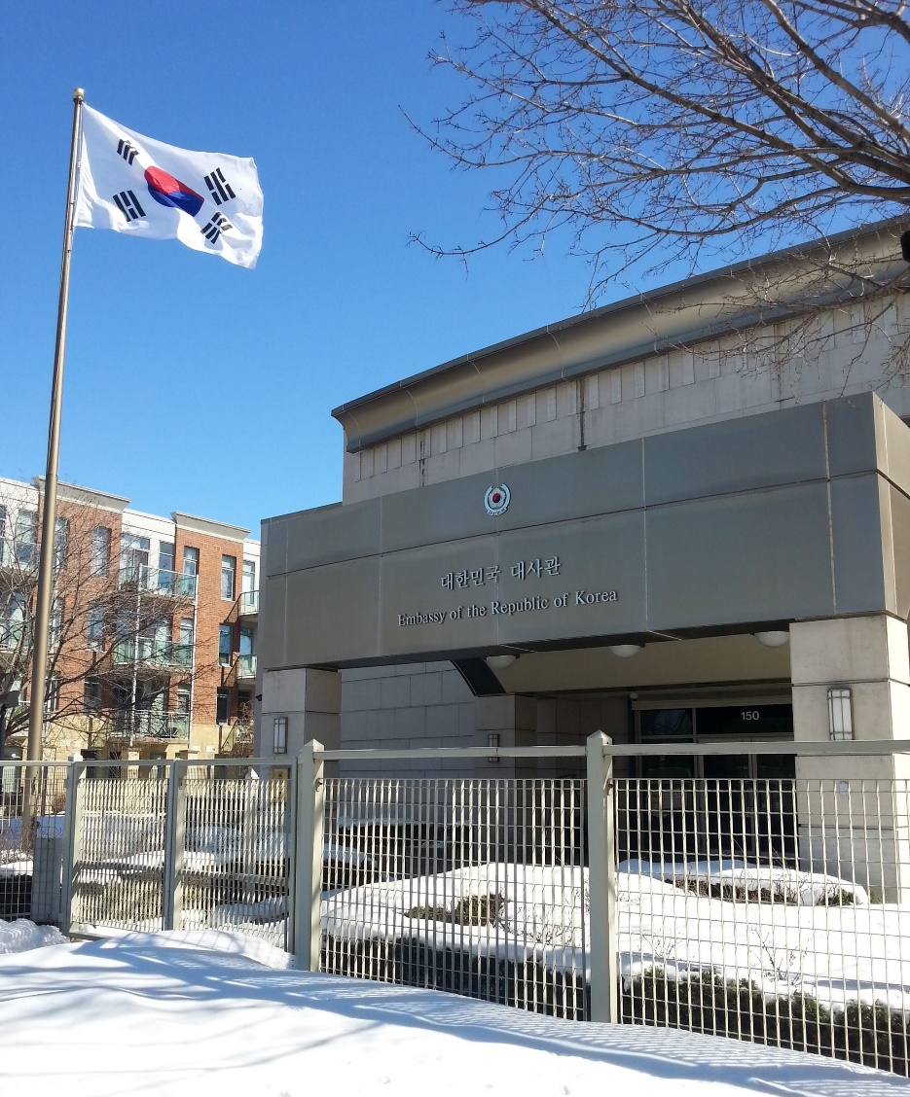
Embassy of the Republic of Korea in Ottawa, Ontario.

Slide 10
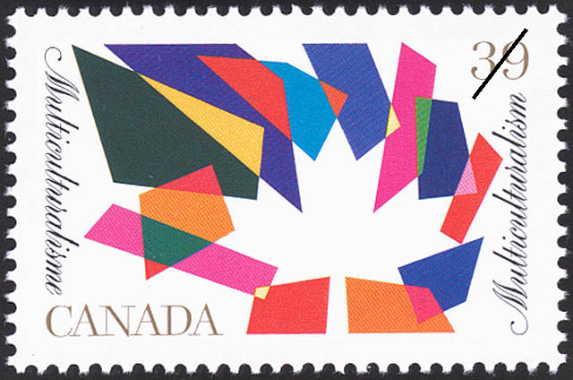
Canada Post, Multiculturalism commemorative stamp designed by Friedrich G. Peter, issued on April 5, 1990.

Slide 11
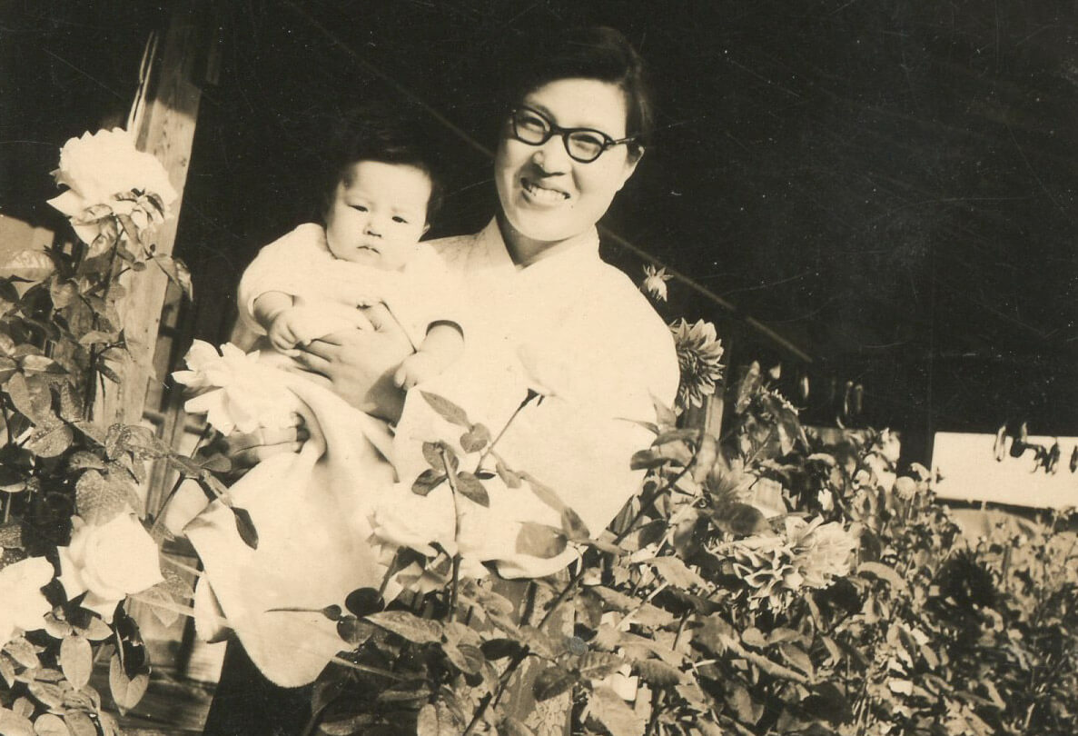
Chung Soon Chin Yoon holding Jin-me Yoon, c.1960.

Slide 12
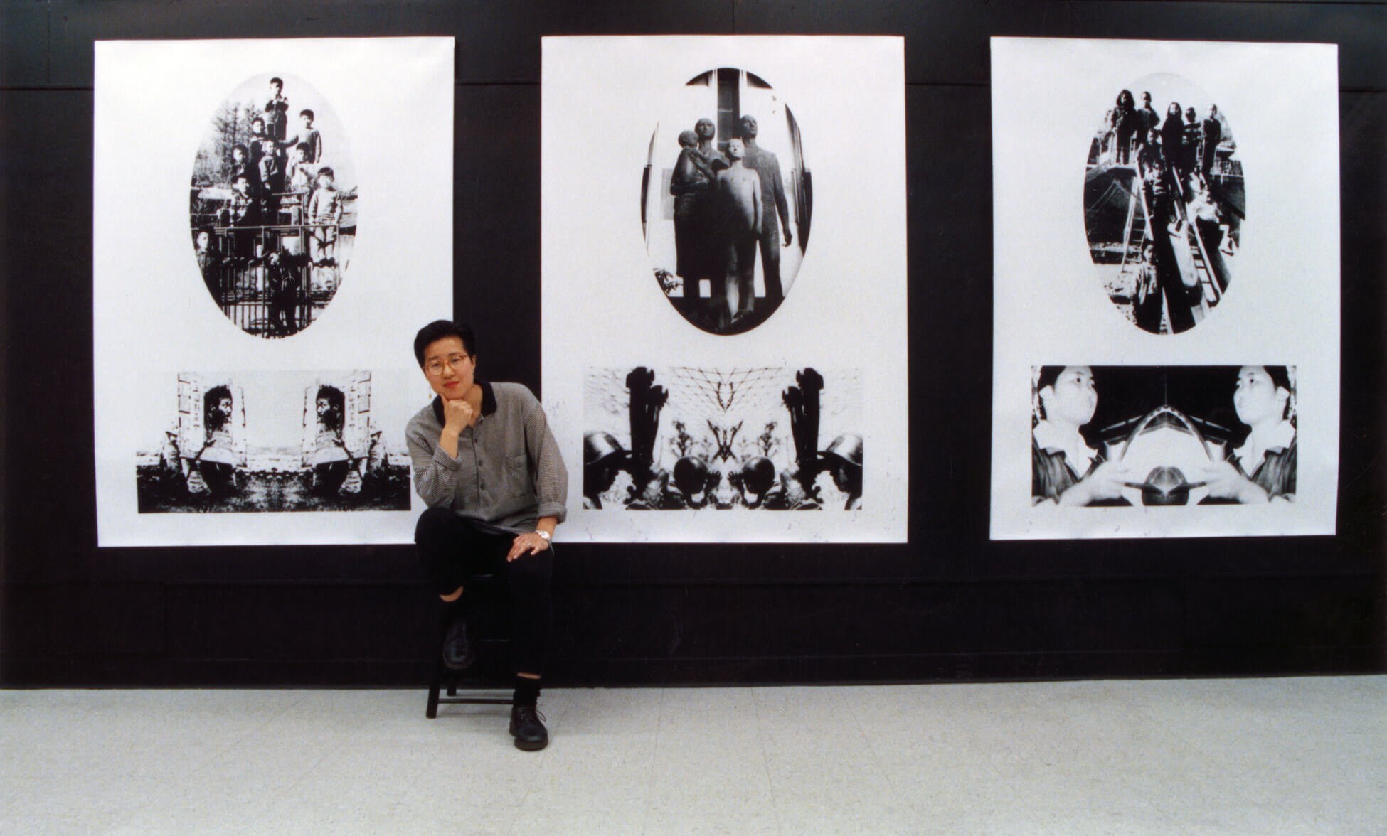
Jin-me Yoon at her BFA Graduation Exhibition, Emily Carr Institute of Art & Design, 1990.

Slide 13
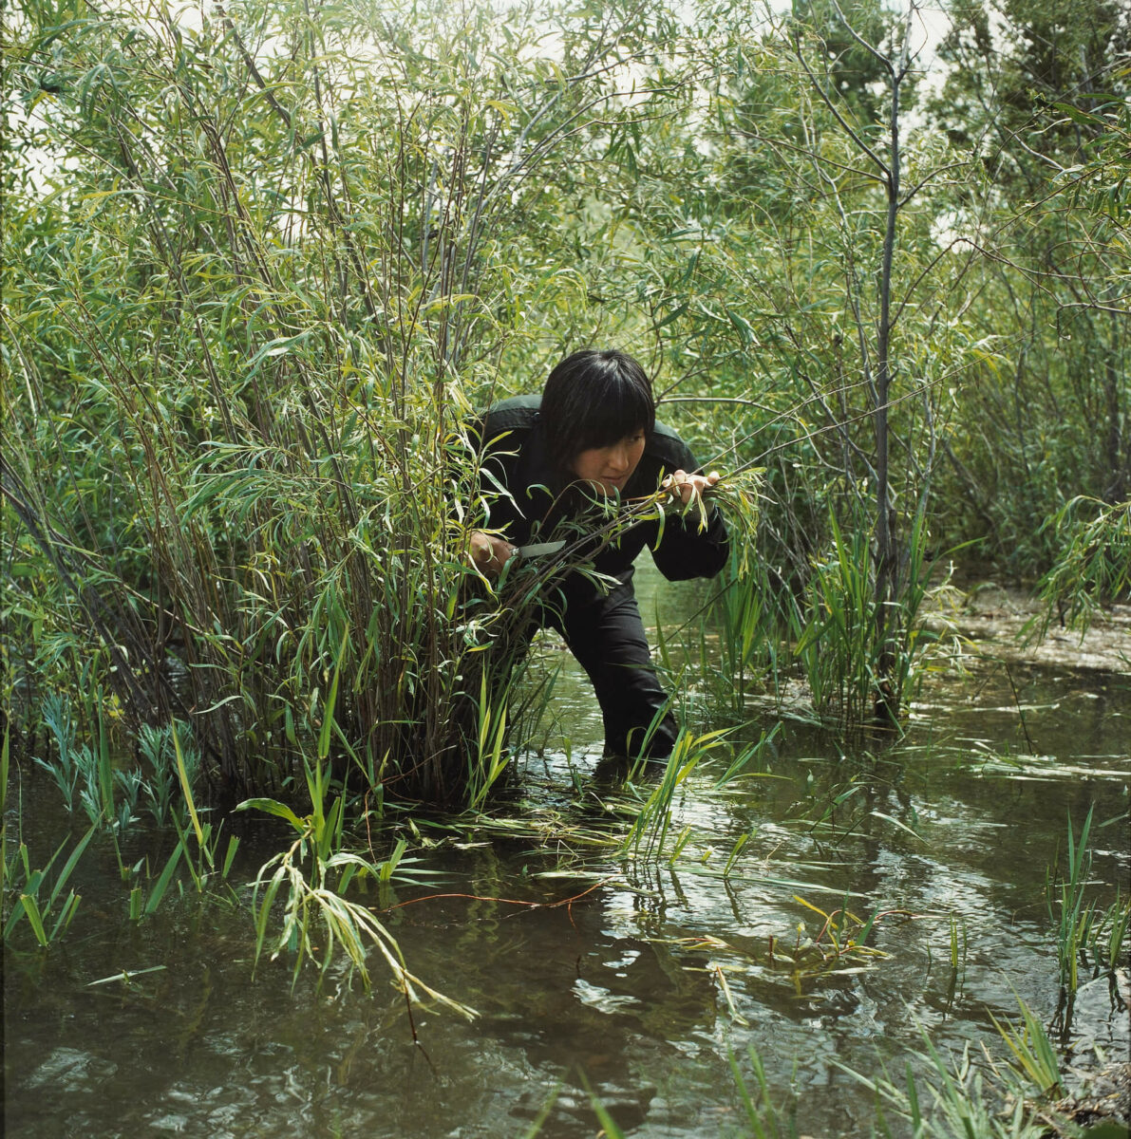
Jin-me Yoon, Fugitive (Unbidden) #3, 2004. This is a
transitional work in Yoon’s oeuvre that moves her art into reflections on difficult histories and the mobility of diasporic memory.

Slide 14
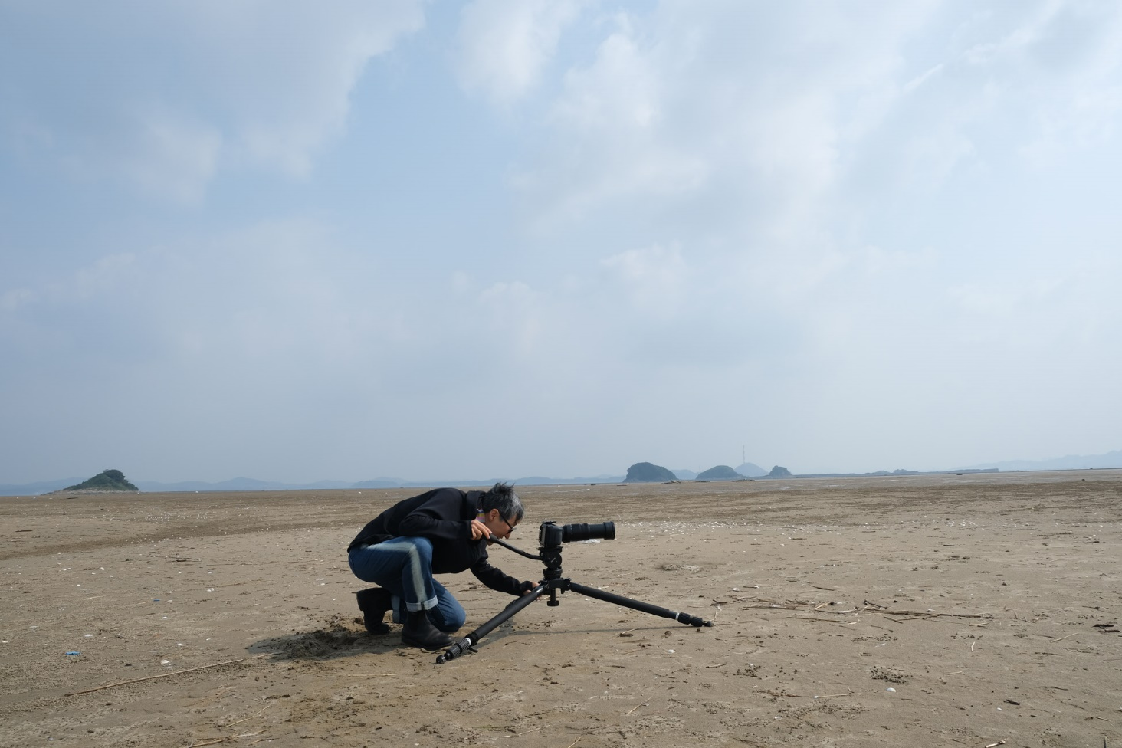
Jin-me Yoon, photograph by Ian Kenji Barbour.

Slide 15
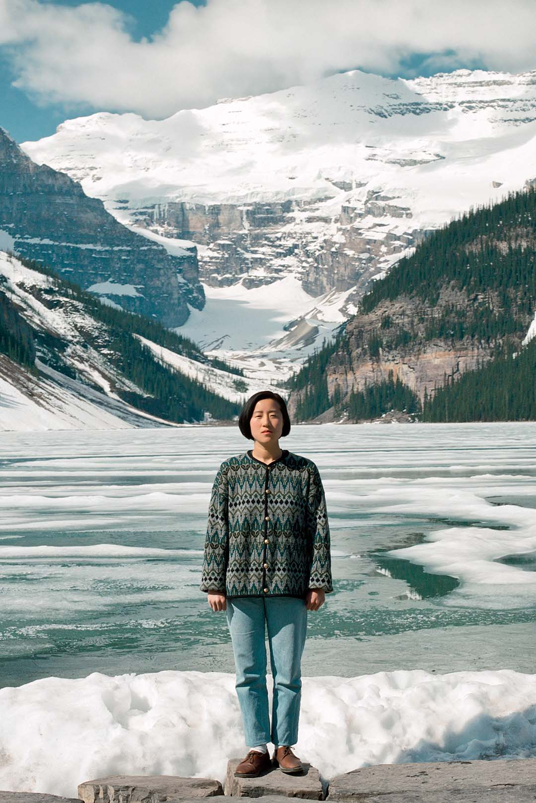
Learning Activity #1
Jin-me Yoon, Souvenirs of the Self (Lake Louise), 1991. In each photograph from this series, Yoon poses in the same expressionless pose in front of tourist destinations in Banff, Alberta.

Slide 16
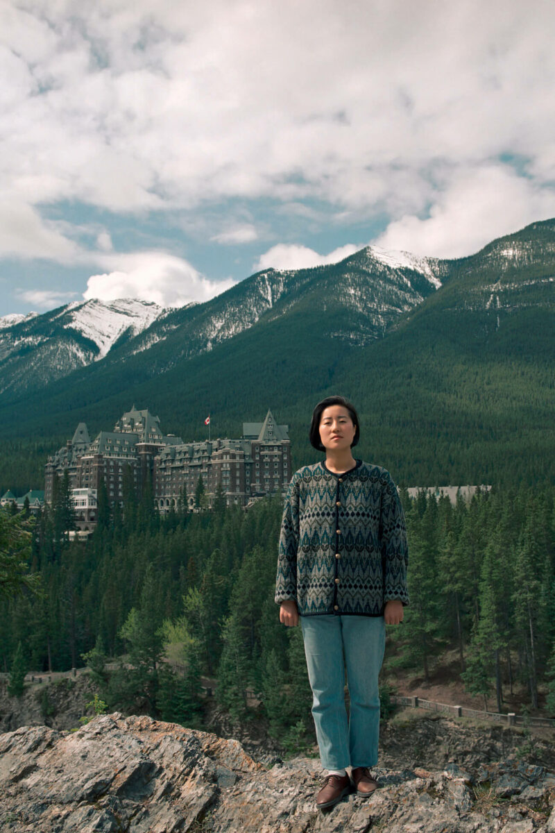
Learning Activity #1
Jin-me Yoon, Souvenirs of the Self (Banff Springs Hotel), 1991. This series of photographs and accompanying postcard set was created while Yoon was working on her MFA at Concordia University.

Slide 17
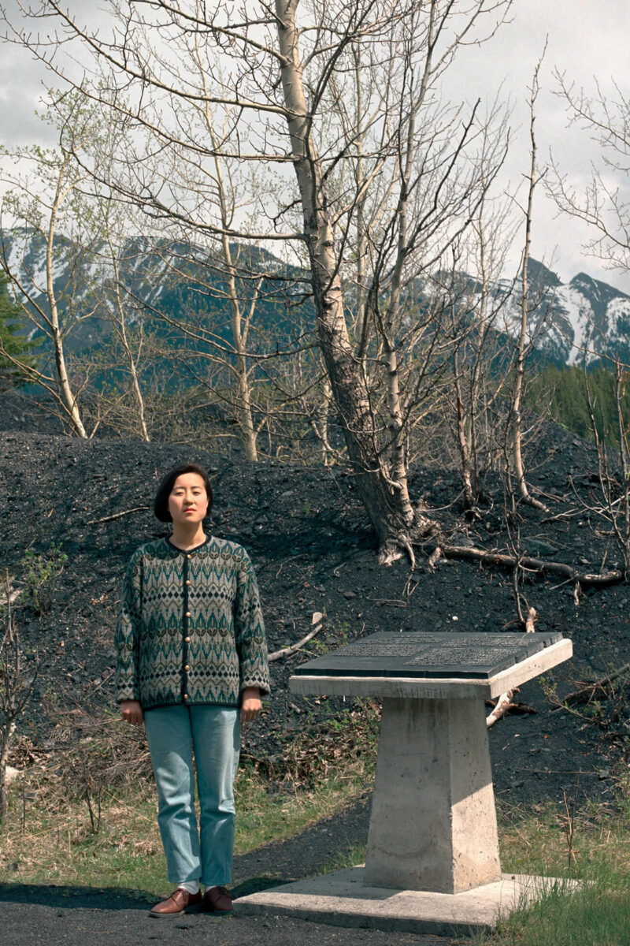
Learning Activity #1
Jin-me Yoon, Souvenirs of the Self (Bankhead), 1991. In their postcard forms, the photographs are accompanied by captions that highlight the disconnect between the represented image and the representation the image critiques.

Slide 18
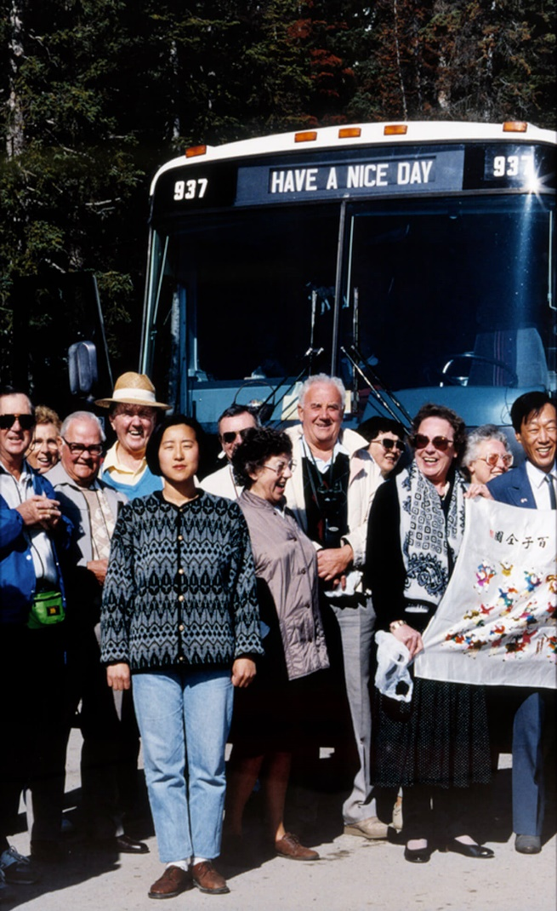
Learning Activity #1
Jin-me Yoon, Souvenirs of the Self (Rocky Mountain Bus Tour), 1991–2000. Yoon uses formal elements to produce staged and conscious representations that interrogate the conditions of belonging to a settler colonial nation.

Slide 19
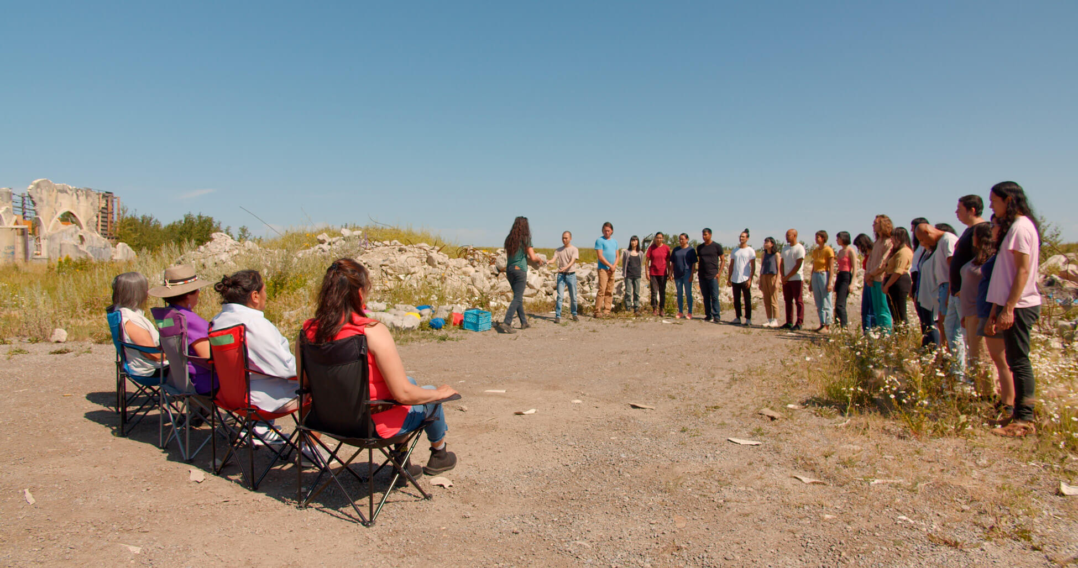
Learning Activity #2
Jin-me Yoon, Untunnelling Vision (video still), 2020.

Slide 20
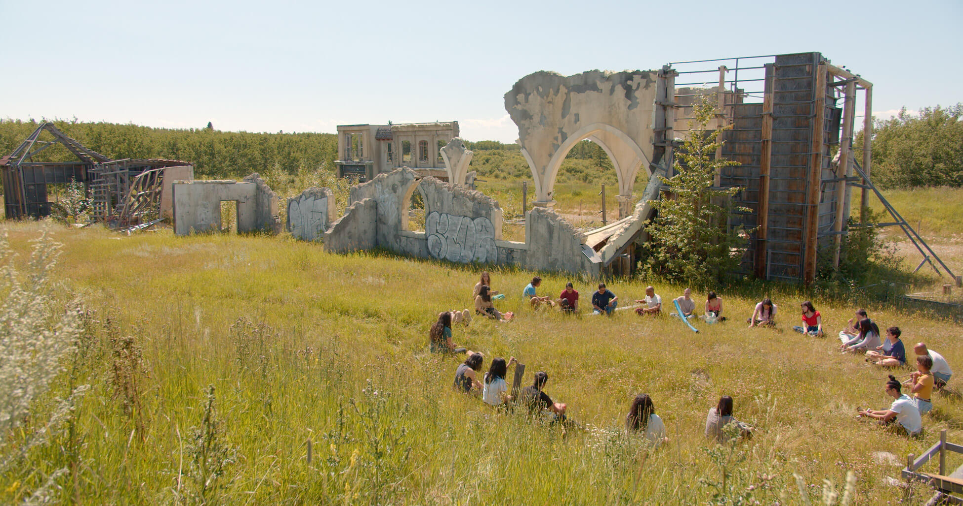
Learning Activity #2
Jin-me Yoon, Untunnelling Vision (video still), 2020. This multimedia installation encompasses elements of social practice and performance.

Slide 21
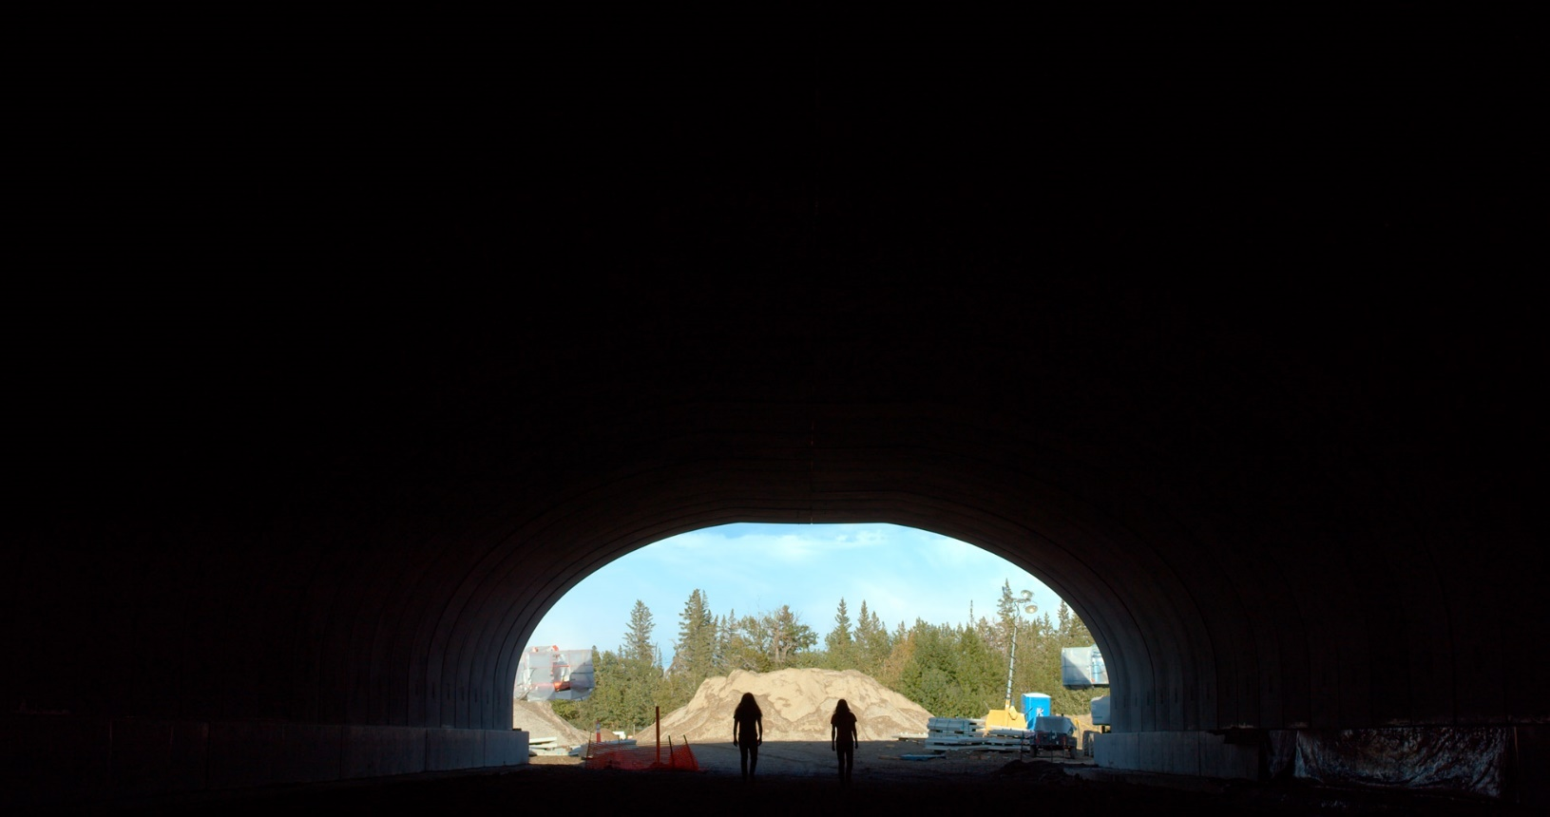
Learning Activity #2
Jin-me Yoon, Untunnelling Vision (video still), 2020. The video for this work is structured in three parts, which use different camera techniques to picture multiple concepts of time, resisting colonial narratives of progress.

Slide 22
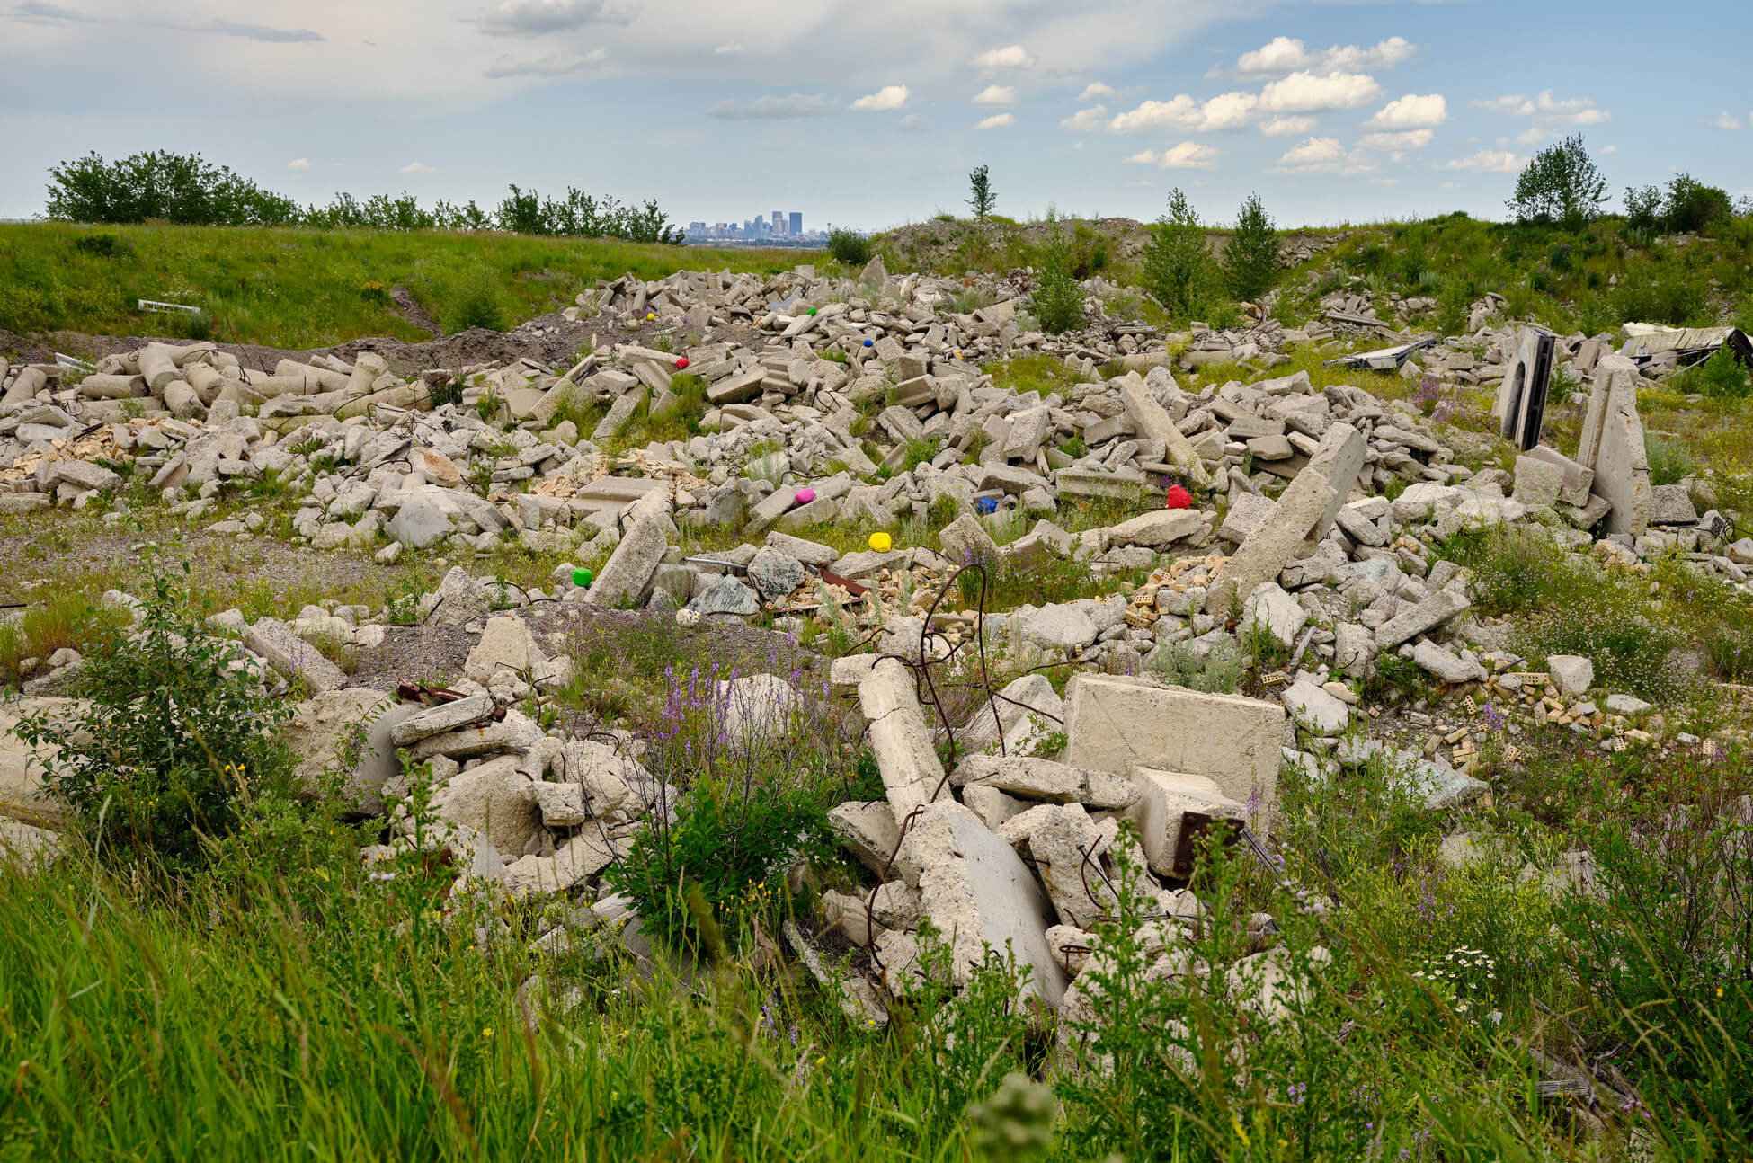
Learning Activity #2
Jin-me Yoon, Upon the Wreckage (Untunnelling Vision), 2020. This photograph pictures a parcel of Tsuut’ina Nation land located outside of the city of Calgary, a site that the Canadian armed forces leased for war simulations.

Slide 23
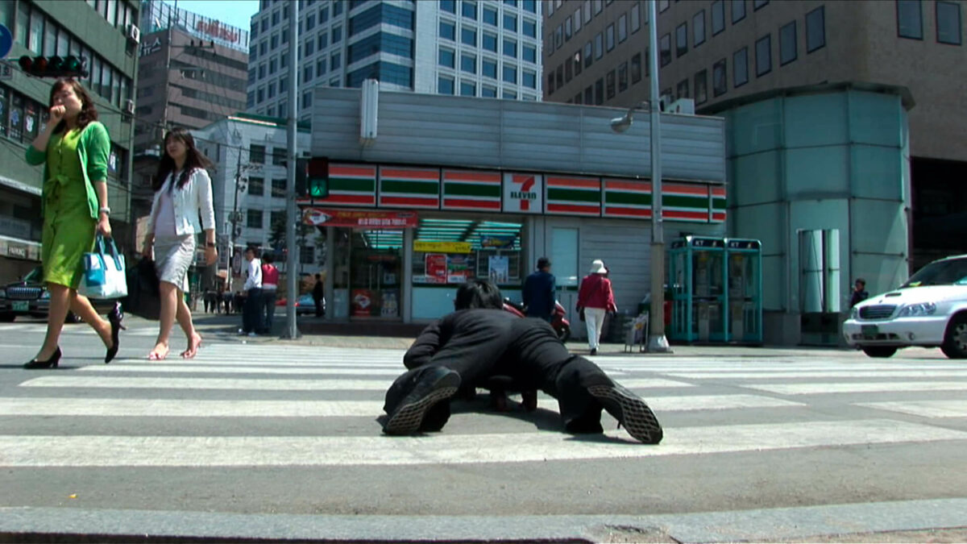
Culminating Task
Jin-me Yoon, The dreaming collective knows no history (US Embassy to Japanese Embassy, Seoul) (video still), 2006. One of Yoon’s “lateral explorations” of embodied histories and sites of significance, this video was created during a residency at Ssamzie Space in Seoul.

Slide 24
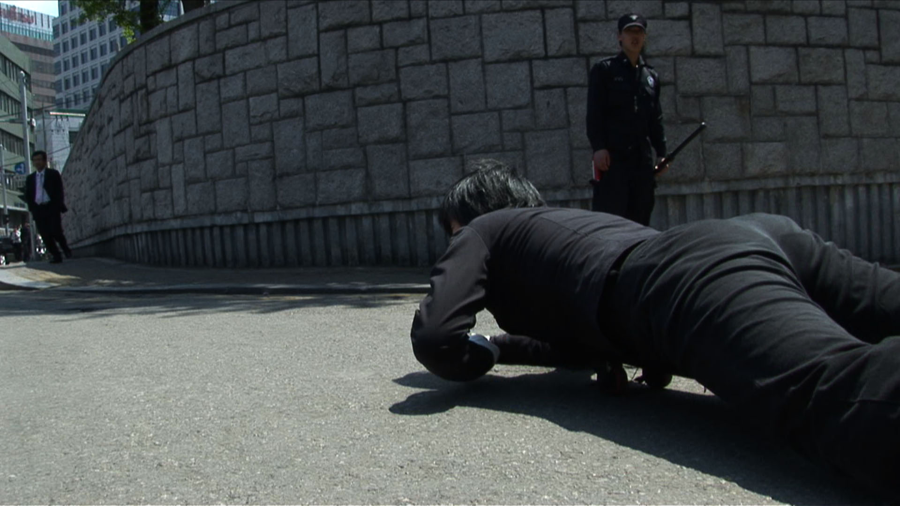
Culminating Task
Jin-me Yoon, The dreaming collective knows no history (US Embassy to Japanese Embassy, Seoul) (video still), 2006. In this video, Yoon drags her body along the ground between the Japanese and U.S. embassies in Seoul, summoning histories of Japanese colonialism and American imperialism in Korea.

Slide 25
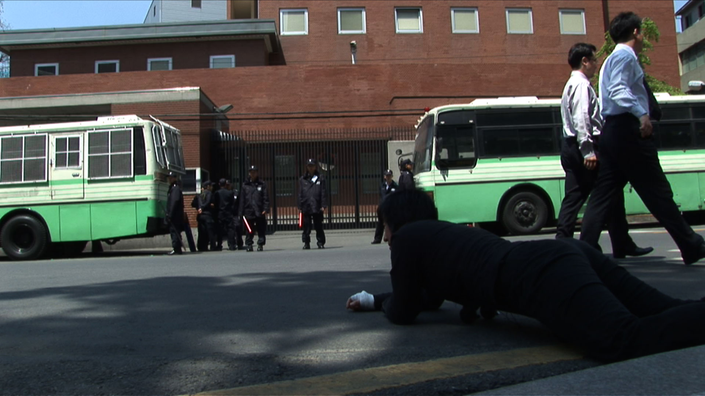
Culminating Task
Jin-me Yoon, The dreaming collective knows no history (US Embassy to Japanese Embassy, Seoul) (video still), 2006. Sound is an important element of this work, in which we hear Yoon’s laboured breathing as she pushes along the ground on a squeaky wheeled platform.

Slide 26
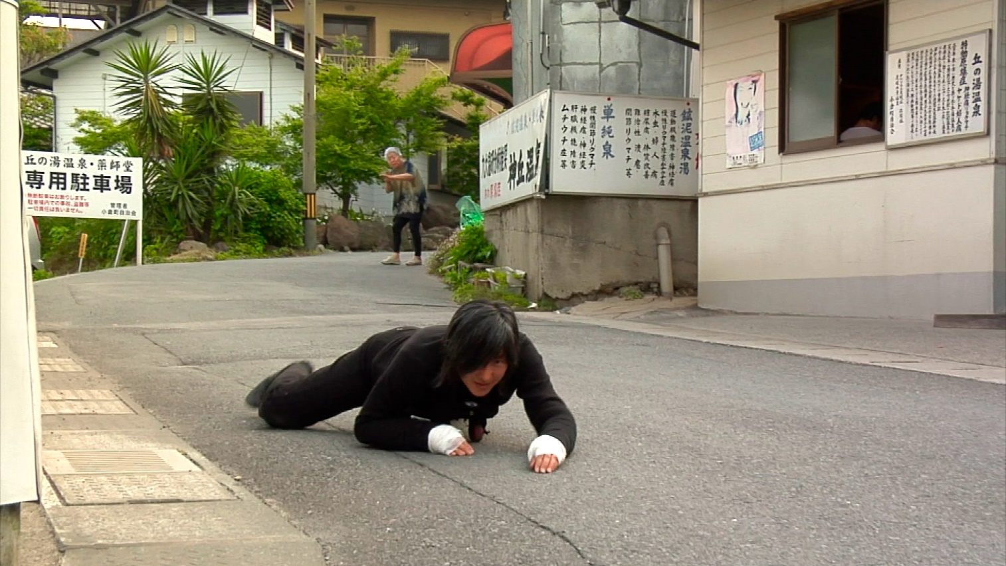
Culminating Task
Jin-me Yoon, As It is Becoming (Beppu: Atomic Treatment Centre) (video still), 2008. This video series extends Yoon’s lateral explorations to sites in Japan, highlighting entangled colonial and wartime histories.

Slide 27
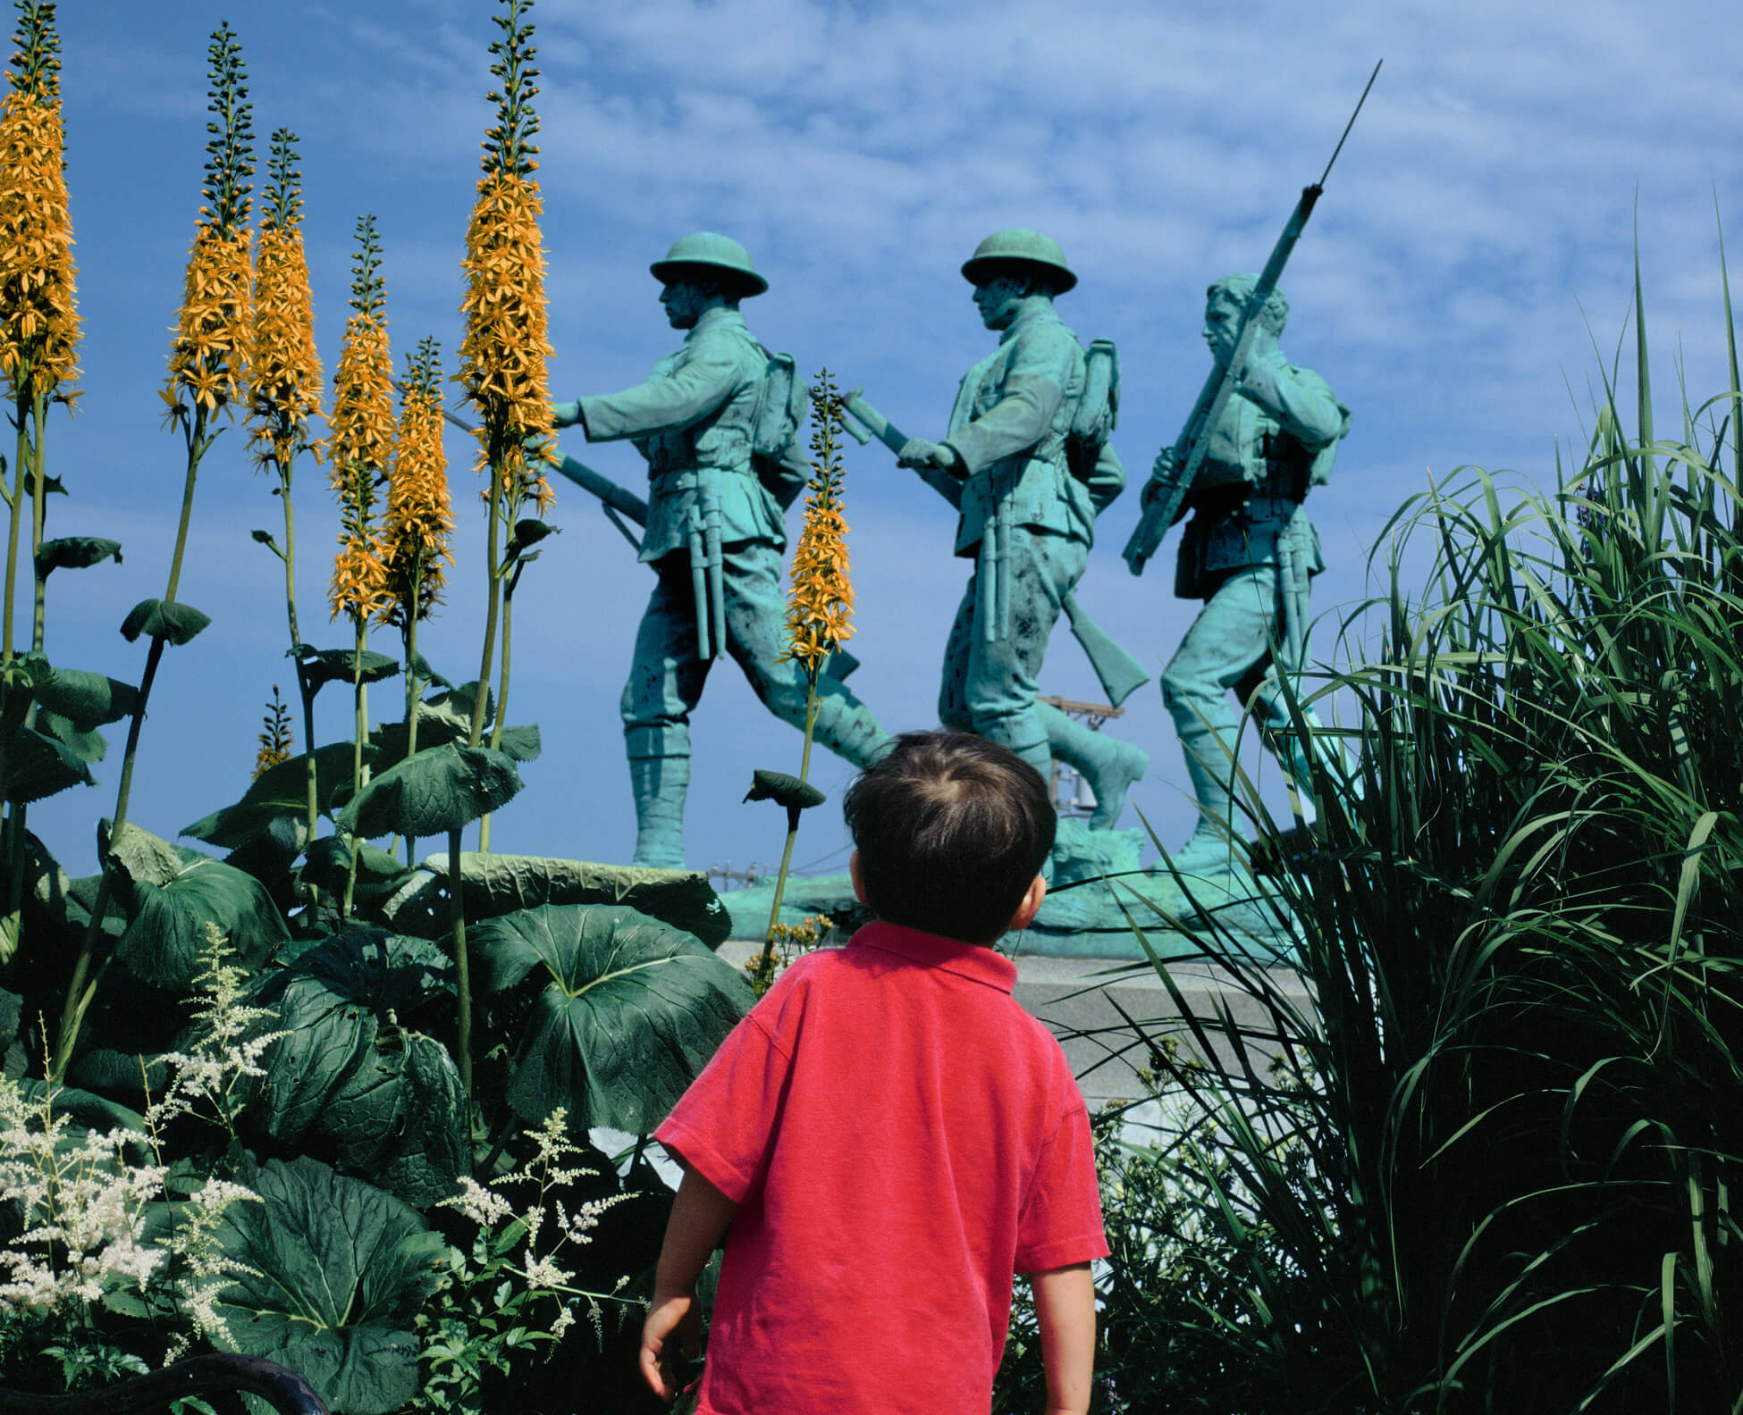
Jin-me Yoon, Touring Home From Away (back panel), 1998. In this photo series, Yoon and members of her family (her husband and two young children) pose in front of tourist and commercial sites on Prince Edward Island.

Slide 28
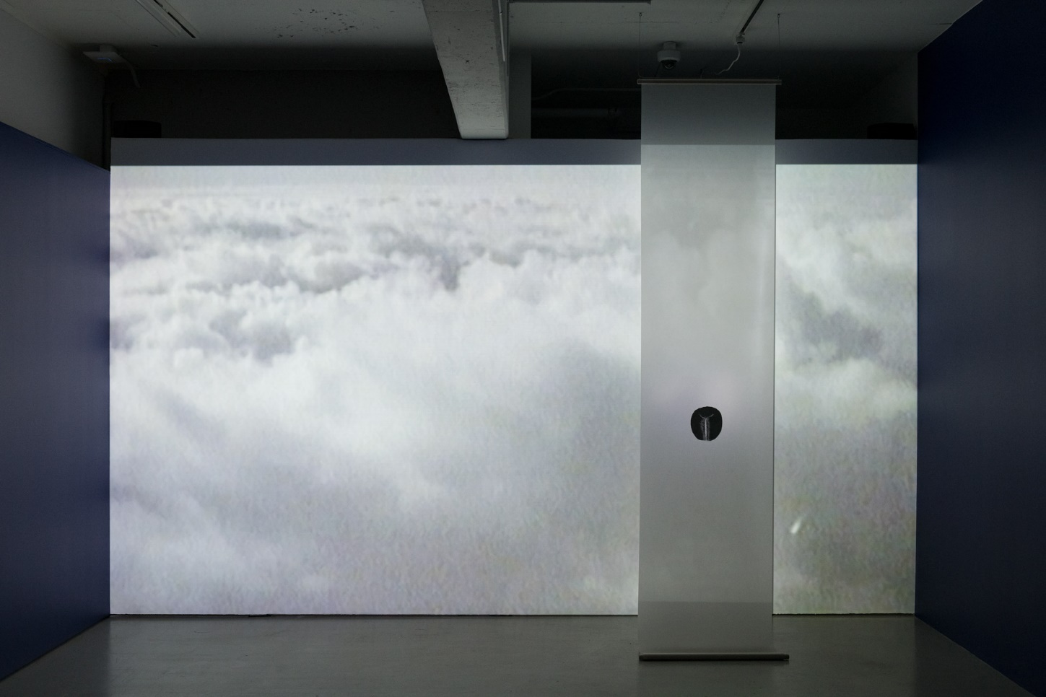
Jin-me Yoon, installation view of between departure and arrival, 1997, at Musée d’art de Joliette, 2019. This was Yoon’s first exhibited work to incorporate video and audio.

Slide 29
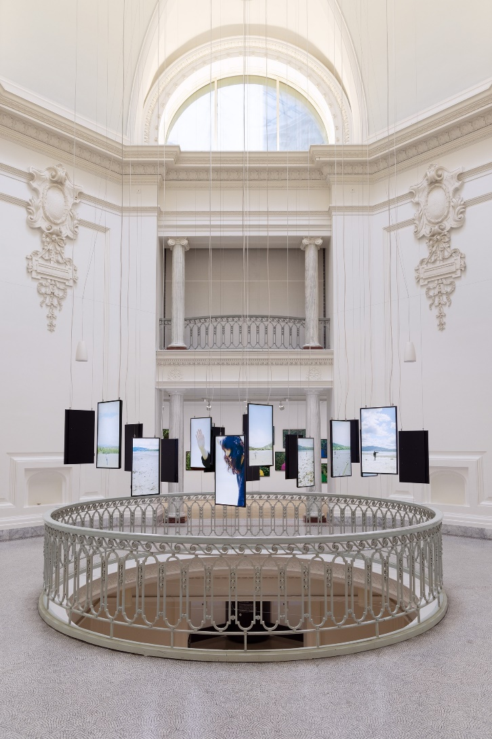
Installation view of Jin-me Yoon, Turning Time (Pacific Flyways), 2022. This 18-channel video installation was included in Jin-me Yoon: About Time at the Vancouver Art Gallery in 2022.

Slide 30
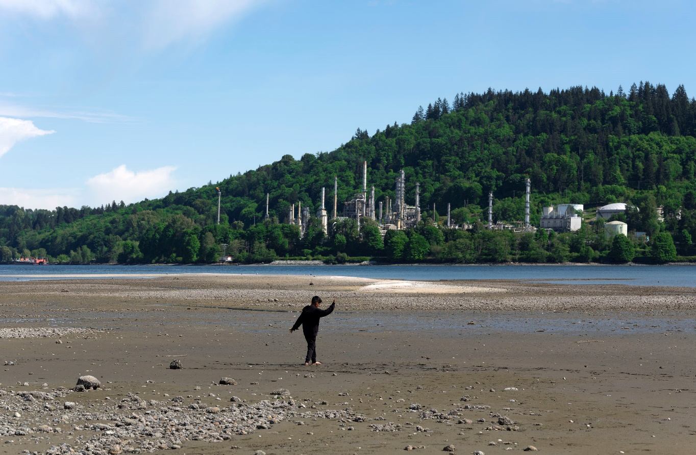
Jin-me Yoon, Becoming Crane 1 (Pacific Flyways), 2022. Yoon imagines non-colonialist futures in this photo series from her later career, which portrays youth of Korean ancestry performing a traditional crane dance.

