Slide 2
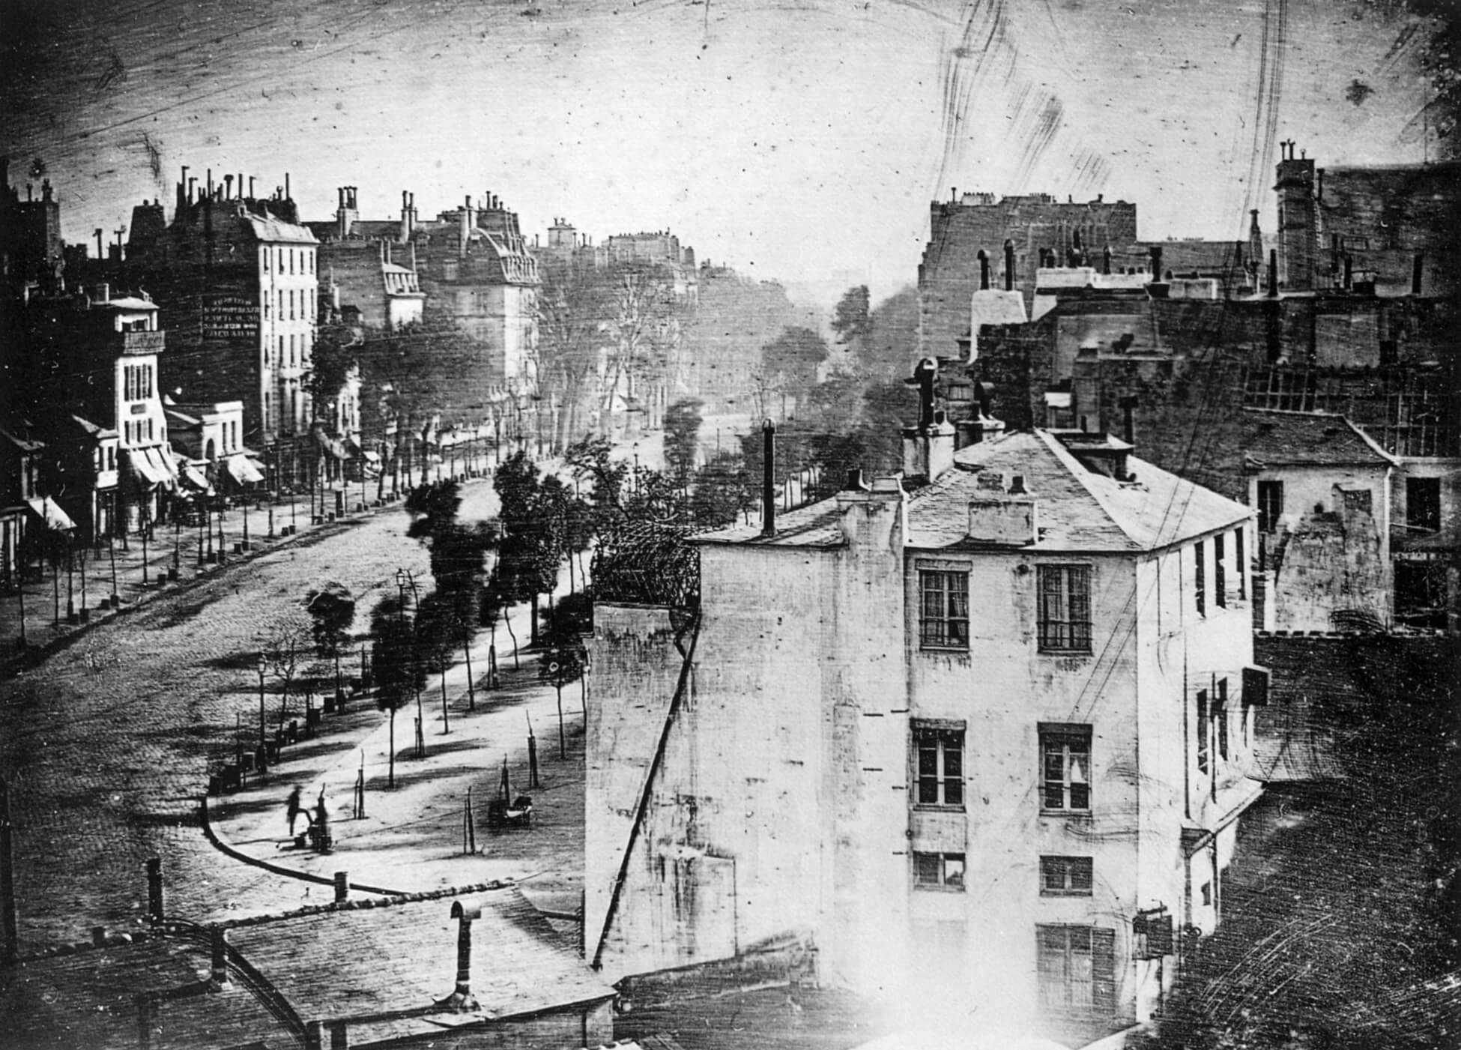
Louis-Jacques-Mandé Daguerre, Boulevard du Temple, Paris, c.1838. This is purported to be one of the first photographic images produced with a daguerreotype camera.

Slide 3
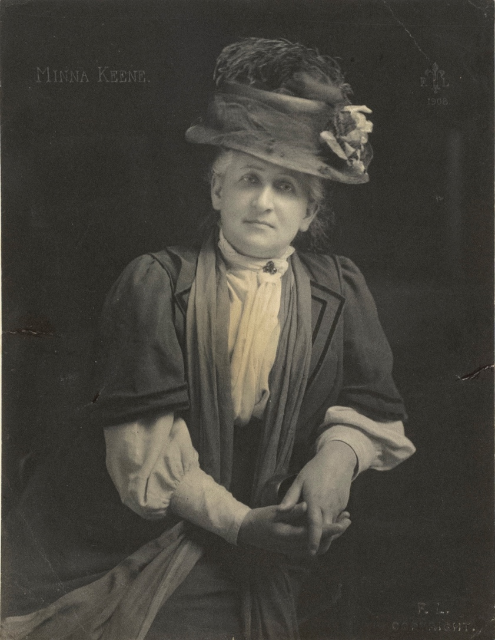
Portrait of Minna Keene, 1908.

Slide 4
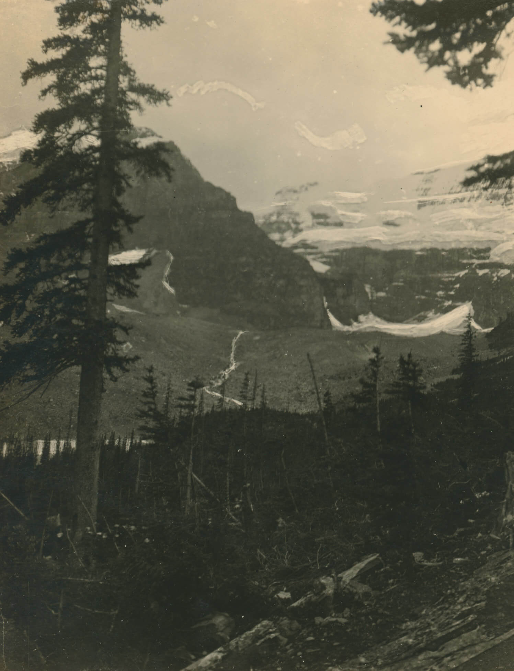
Minna Keene, Evergreens and Mountains, CPR, 1914–15. Like many prominent photographers of her time, Keene was commissioned by the CPR to produce photos that would help boost tourism to the West Coast of Canada.

Slide 5
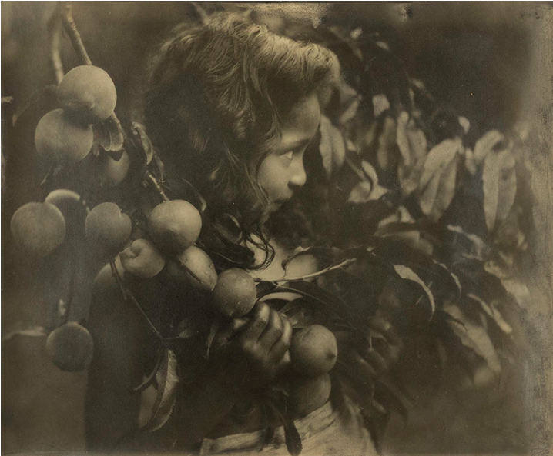
Minna Keene, Girl with Fruit Tree, c.1910. An example of a photograph produced in the Pictorialist style, the aim of this work is to convey a feeling through formal qualities such as tonal balance and composition.

Slide 6
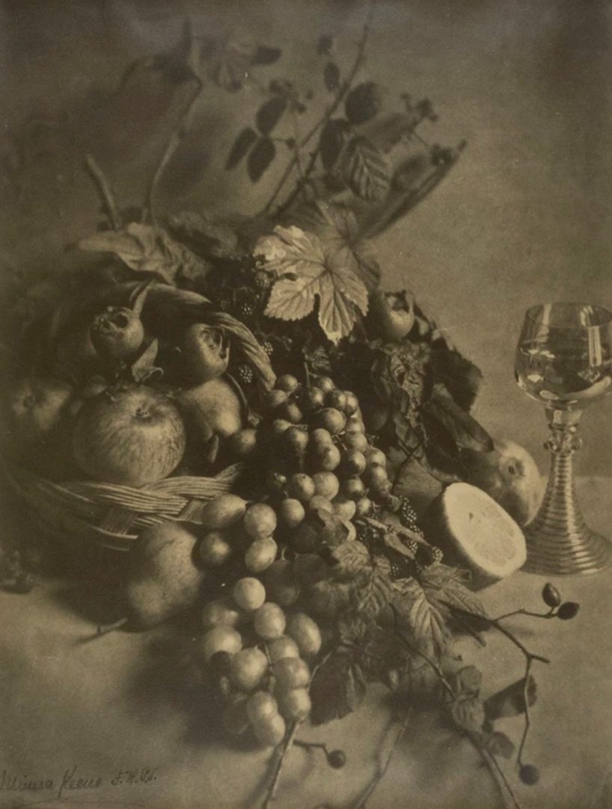
Minna Keene, Fruit Study, c.1910. In some of her earliest works, Keene explored the aesthetic dimensions of photography by adopting the compositional and symbolic elements of still-life paintings.

Slide 7
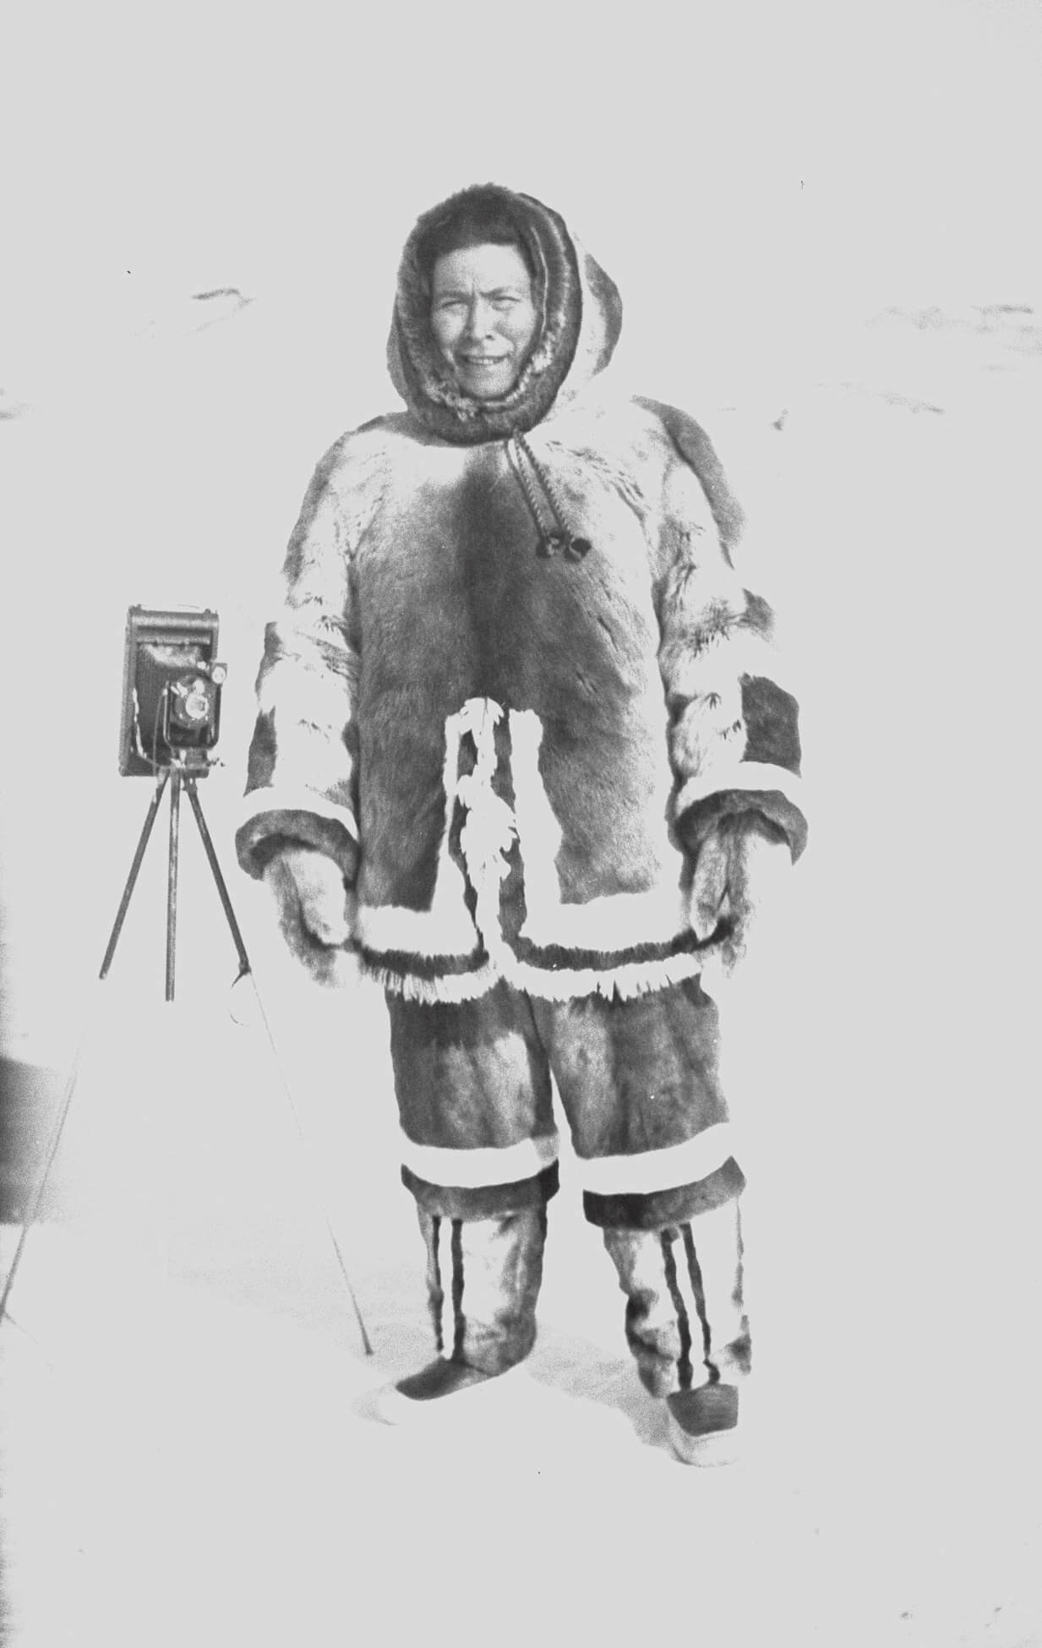
Aggeok Pitseolak, Peter Pitseolak with his favourite 122 camera, c.1946–47.

Slide 8
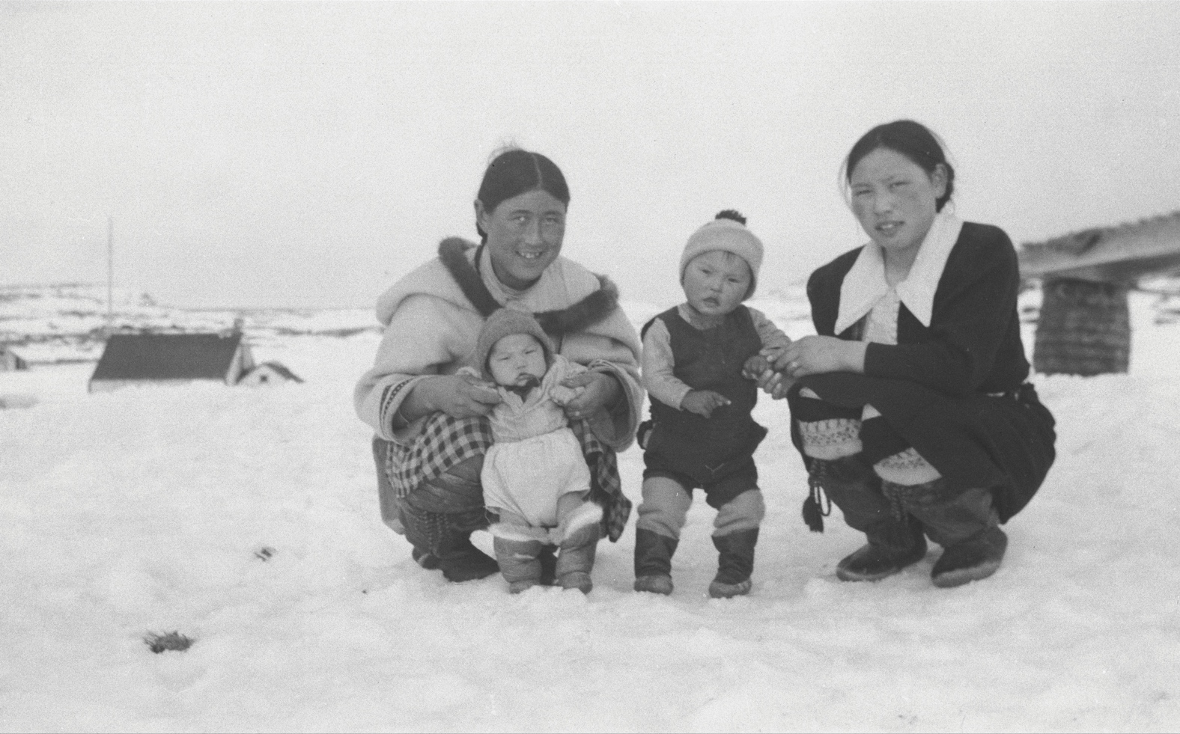
Peter Pitseolak, Aggeok and Udluriak Pitseolak with Mark Tapungai and Petalassie, c.1940–60. Pitseolak often asked his subjects to choose their own poses or wear garments with personal significance to them.

Slide 9
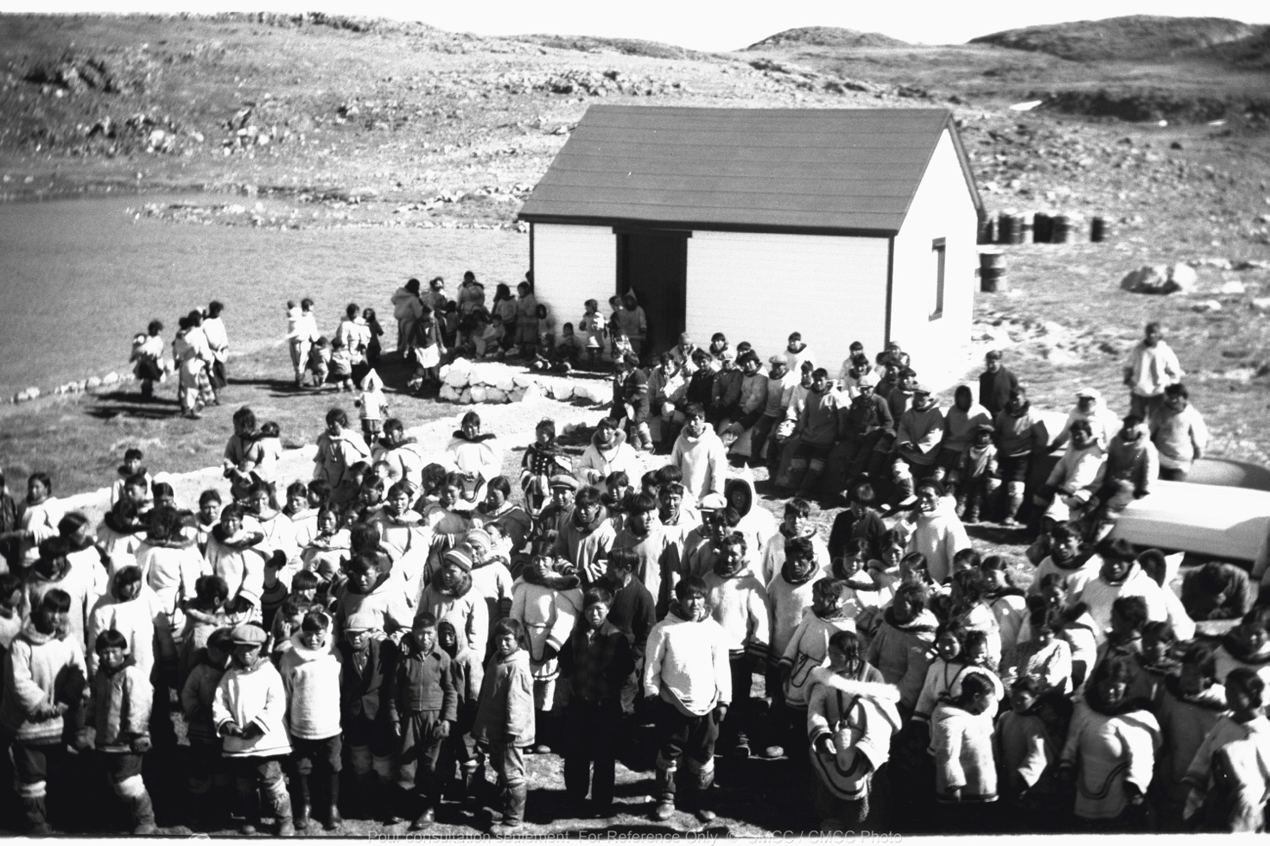
Peter Pitseolak, Campers gathering in Cape Dorset for umiakjuakkanak (“big ship time”), c.1940–60. Pitseolak documented events in his community, such as this gathering to meet a Hudson’s Bay Company ship carrying supplies.

Slide 10
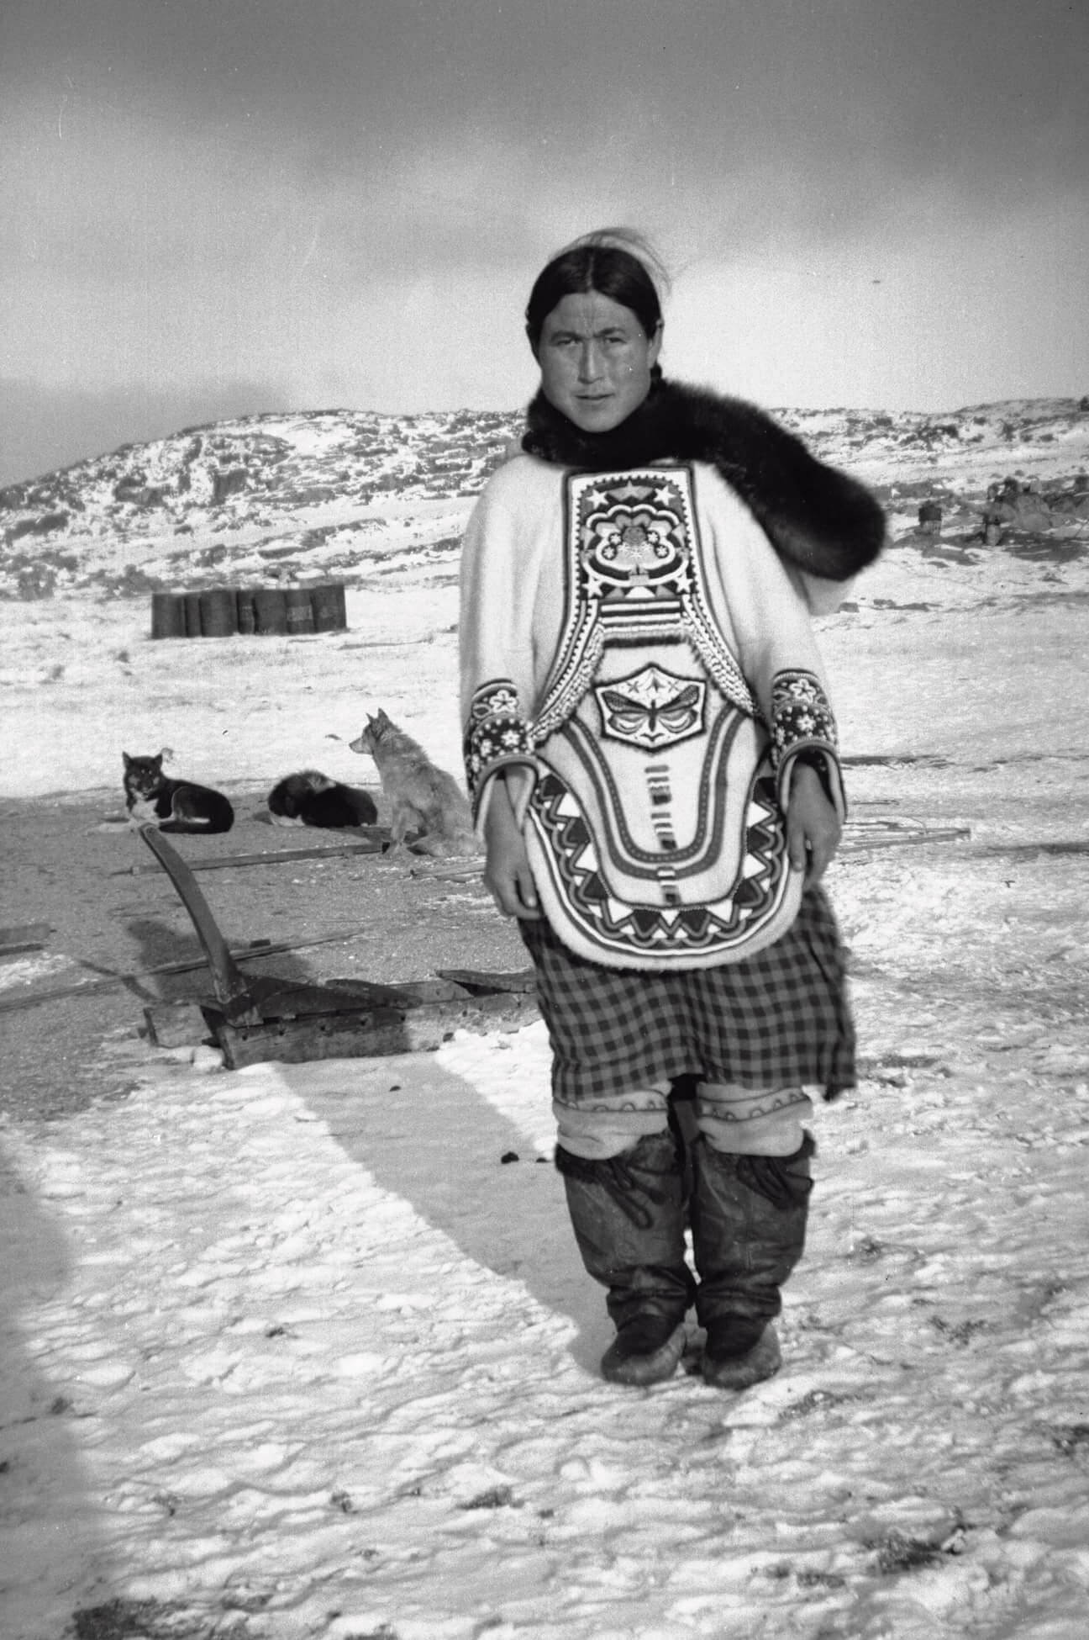
Peter Pitseolak, Aggeok Pitseolak wearing a beaded amauti, c.1940–60. In this portrait, Pitseolak’s wife, Aggeok, wears an amauti, a sealskin garment designed with a large hood and a pouch in which to carry a small child.

Slide 11
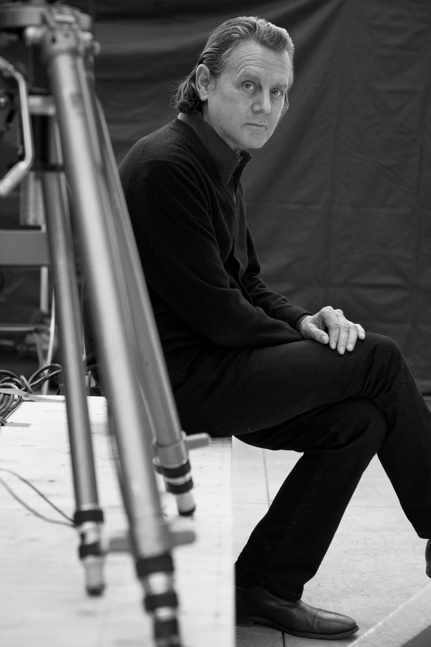
Portrait of Jeff Wall.

Slide 12
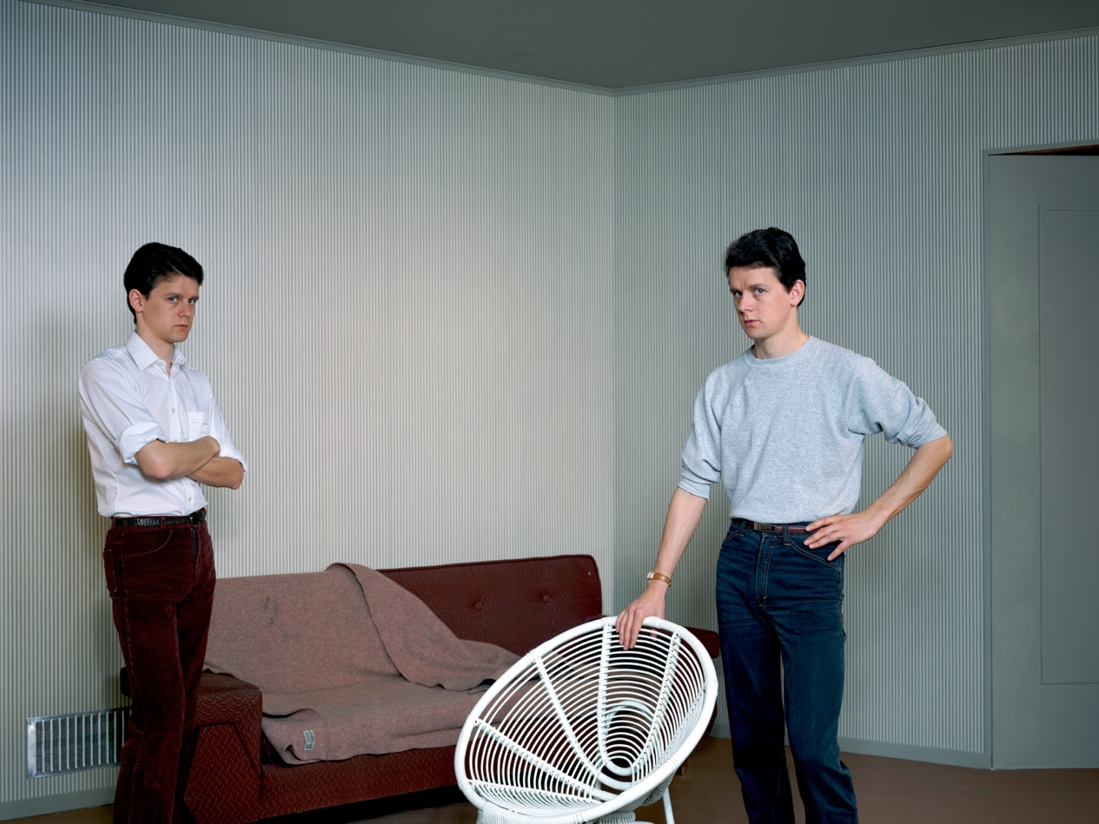
Jeff Wall, Double Self-Portrait, 1979. Wall is revered for creating complex mises-en-scènes in his photographic works, such as in this “double” self-portrait.

Slide 13
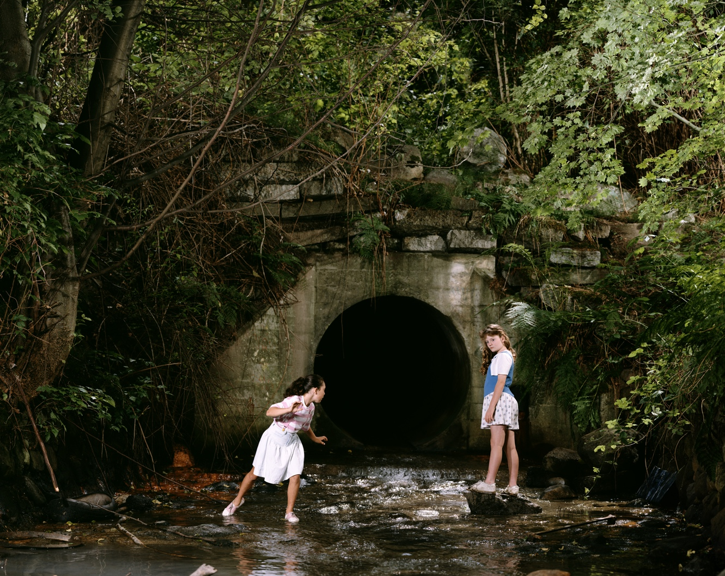
Jeff Wall, The Drain, 1989. Though Wall derives many of his compositions from life, he has also produced a large body of images staged from imagined scenarios, such as the one depicted in The Drain.

Slide 14
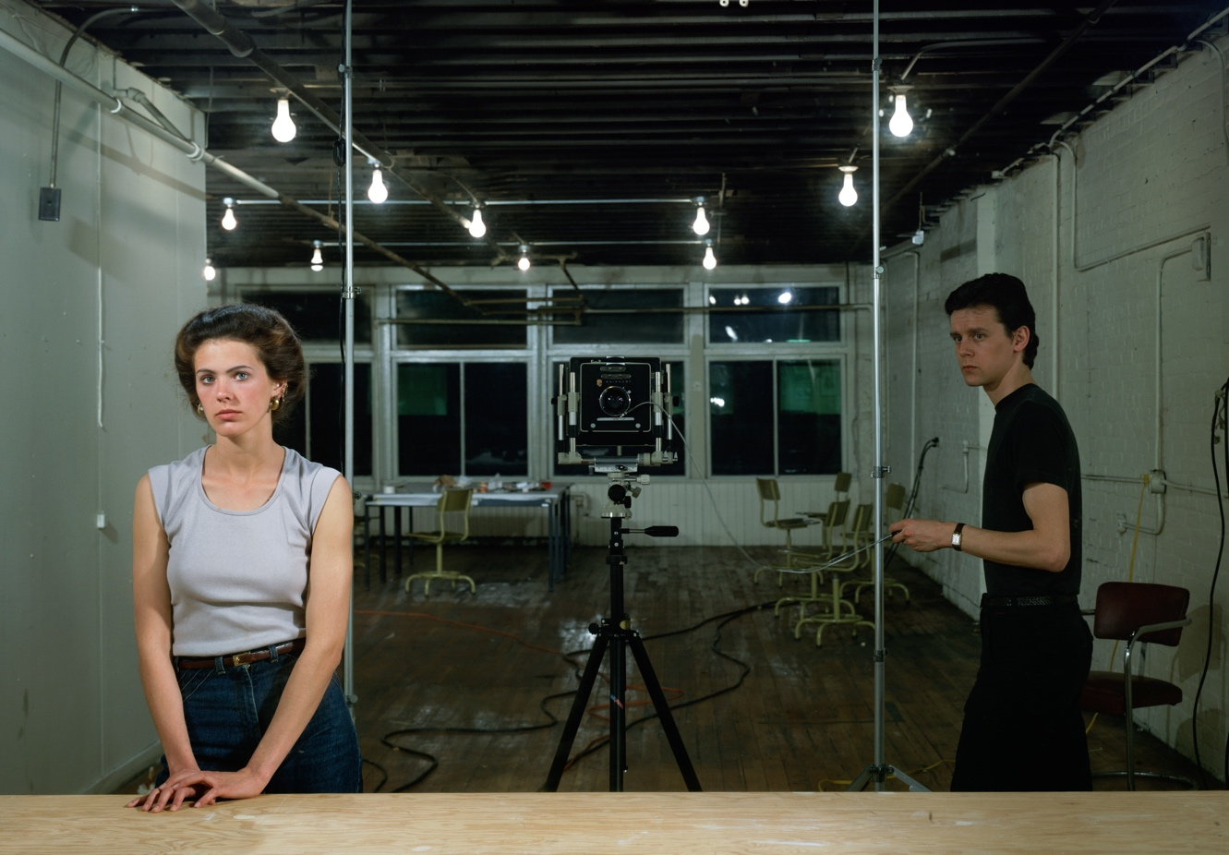
Jeff Wall, Picture for Women, 1979. Created after a nearly decade-long hiatus from artmaking, this work helped establish Wall as an innovator in the field of Conceptual photography.

Slide 15
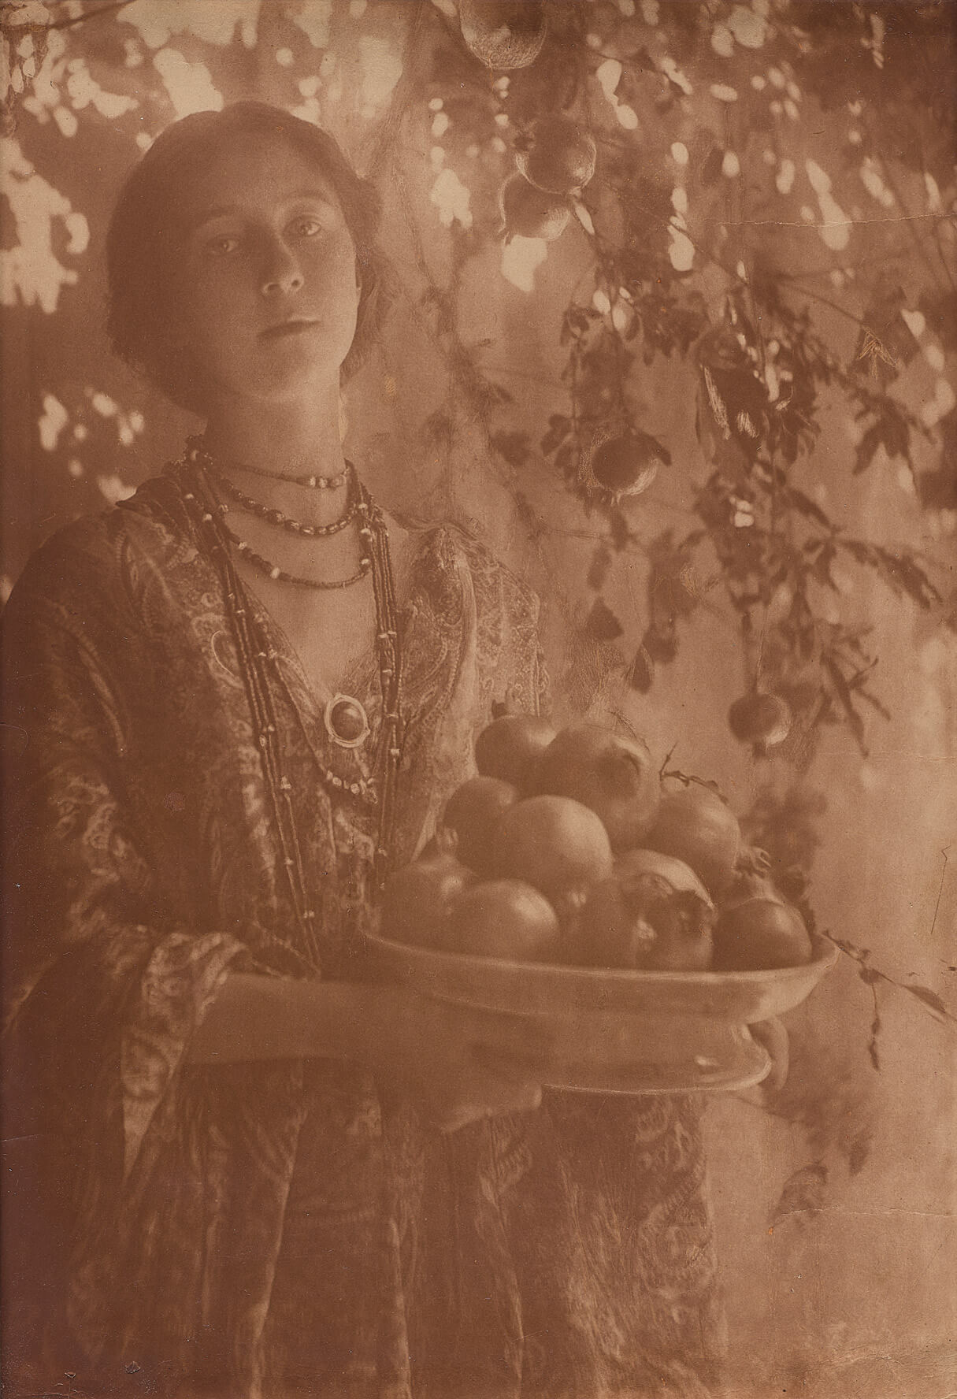
Learning Activity #1
Minna Keene, Pomegranates, c.1910. Featuring Keene’s daughter, Violet, this portrait was named Picture of the Year at the London Salon in 1911.

Slide 16
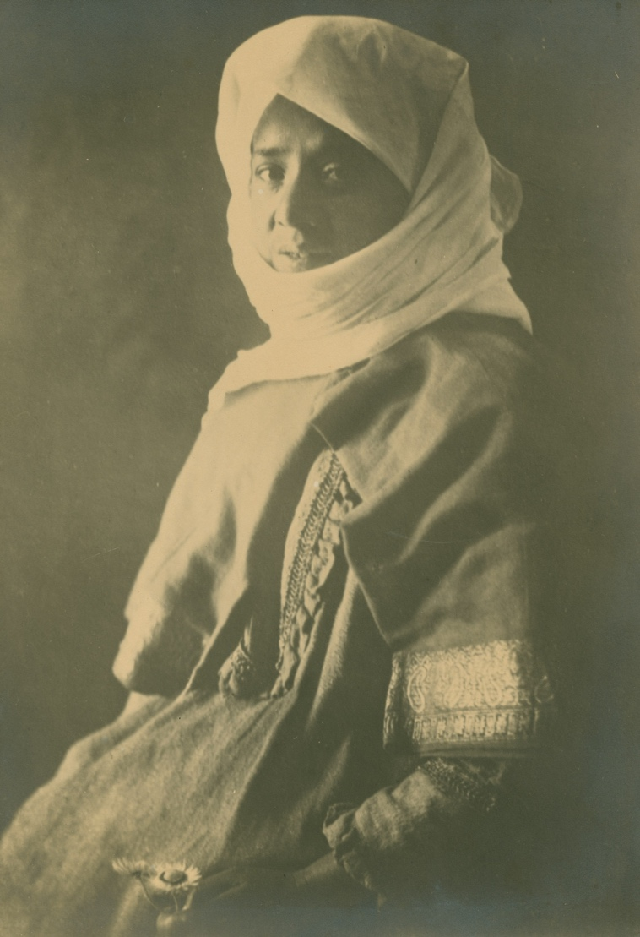
Learning Activity #1
Minna Keene, Our Malay Washerwoman, 1903–10. Many of Keene’s critically acclaimed portraits, especially those produced in South Africa, were sold as postcards.

Slide 17
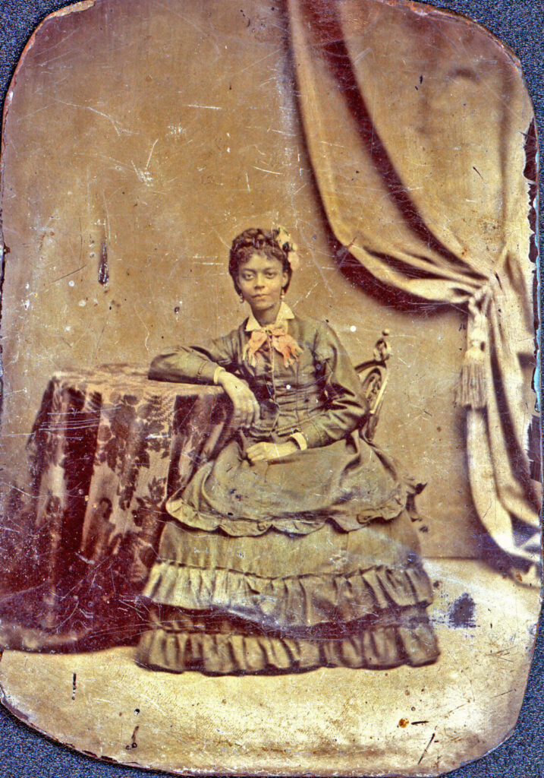
Learning Activity #1
Unknown, Tintype of Young African American Woman Seated at Table, n.d. This portrait is part of a remarkable collection amassed by the Bell-Sloman family, who came to Canada via the Underground Railroad in the 1850s.

Slide 18
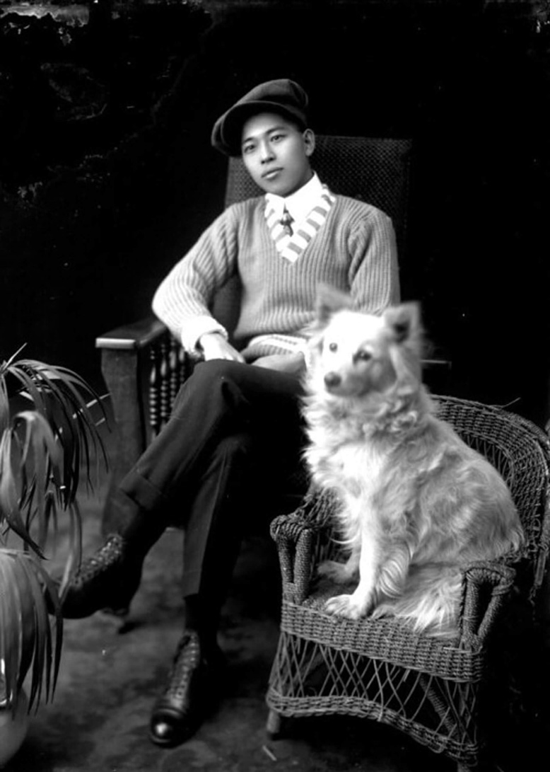
Learning Activity #1
Hayashi Studio, Kiyoshi Shirimoto and his dog, n.d. Based on Vancouver Island, Hayashi Studio was founded by Senjiro Hayashi (1880–1935) and produced an impressive body of portraits for immigrant clients.

Slide 19
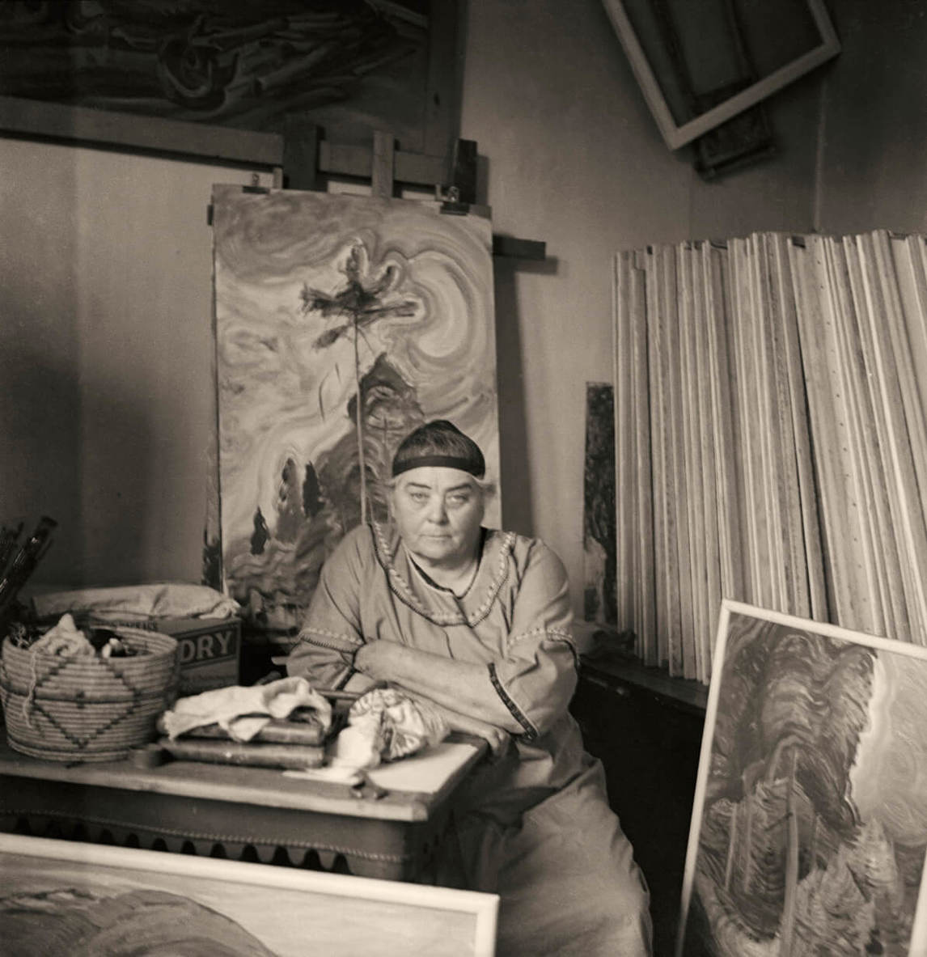
Learning Activity #1
Harold Mortimer-Lamb, Emily Carr in her Studio, c.1939. Mortimer-Lamb captures the characteristic intensity of B.C.-based painter Emily Carr (1871–1945) in this iconic portrait taken in her studio.

Slide 20
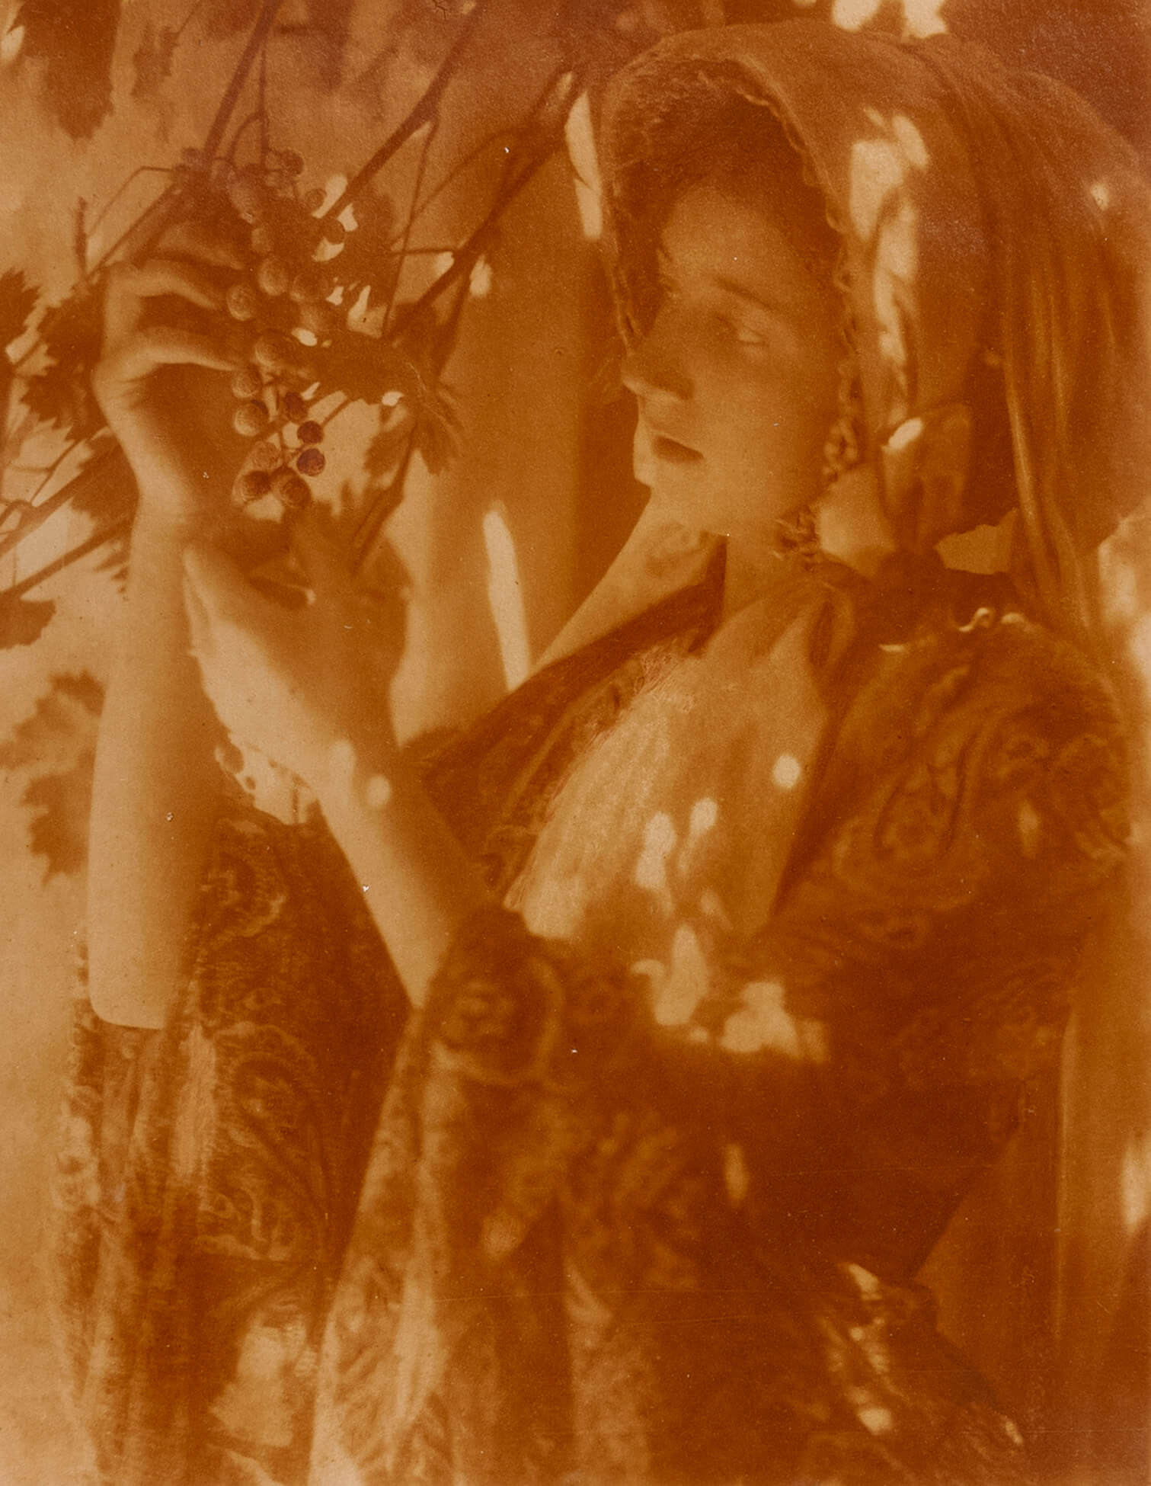
Learning Activity #1
Minna Keene, Untitled, c.1910.

Slide 21
Learning Activity #2
Peter Pitseolak, Aggeok Pitseolak wearing a beaded amauti, c.1940–60. Pitseolak’s wife, Aggeok (pictured here), helped him devise methods to develop film in the harsh Arctic climate.

Slide 22
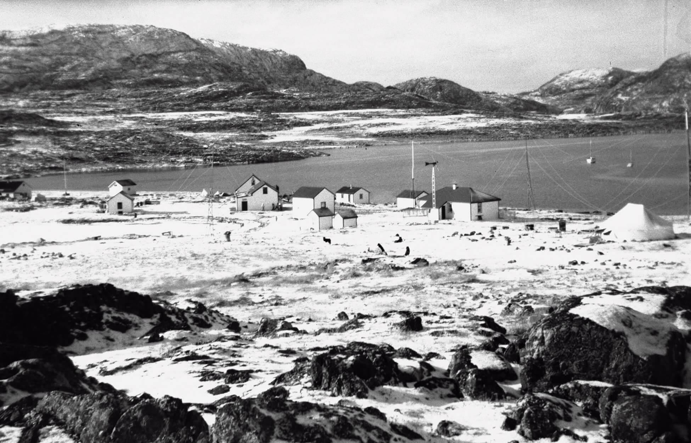
Learning Activity #2
Peter Pitseolak, Distant view of Cape Dorset, c.1942–43. Pitseolak took up photography to document how the implementation of permanent settlements, like this one at Cape Dorset, profoundly altered the nomadic lifestyles of Inuit.

Slide 23
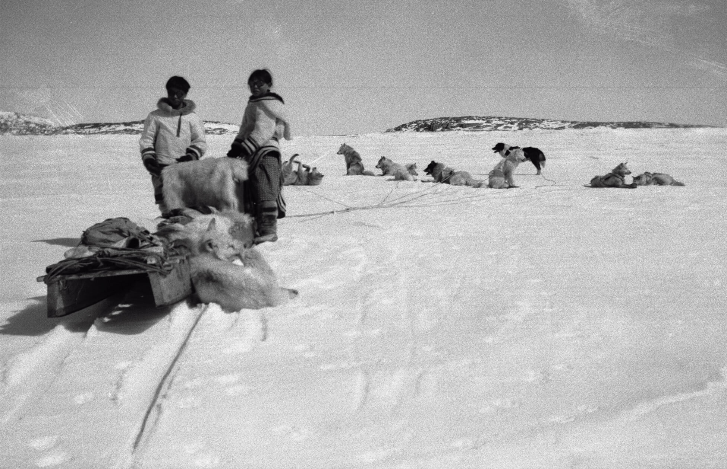
Learning Activity #2
Peter Pitseolak, Ashevak Ezekiel and Kooyoo Pitseolak leaving on the dog sled, c.1940–60. Pitseolak’s photographs of community activities, such as this one produced while on a hunting expedition, offer an insider’s perspective on life in the Arctic.

Slide 24
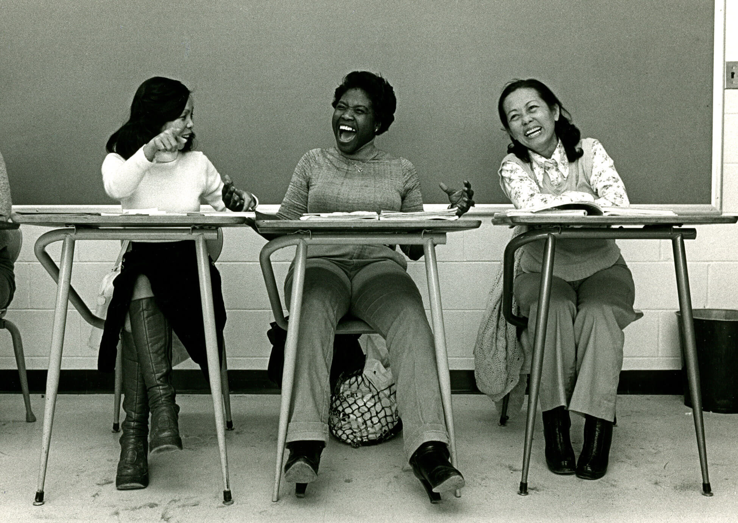
Learning Activity #2
Claire Beauregard-Champagne, Duyen, Thien’s mother, learns French at the COFI (Orientation and Training Center for Immigrants), 1980. Part of a larger project about Vietnamese immigration to Montreal, this image highlights the photographer’s focus on developing her work in dialogue with her subjects.

Slide 25
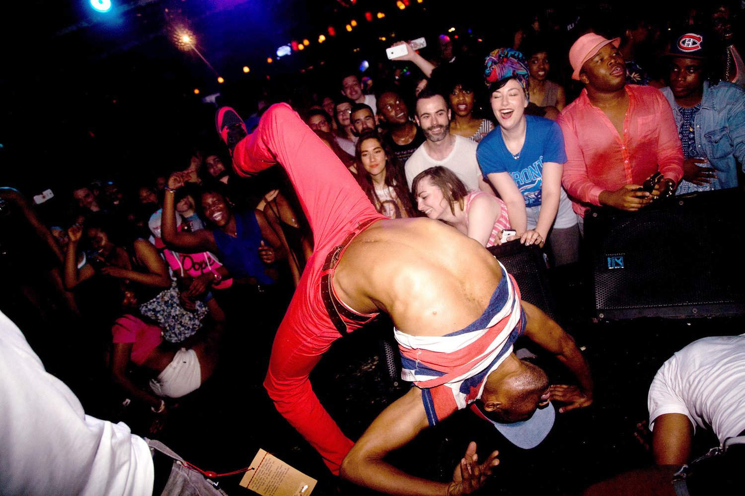
Learning Activity #2
Tayo Yannick Anton, Backway, 2013. This photograph captures the vivacity and energy of an event known as Yes Yes Y’all, a monthly hip-hop dance party celebrating the diversity of Toronto’s 2SLGBTQQIA+ community.

Slide 26
Culminating Task
Jeff Wall, A Sudden Gust of Wind (after Hokusai), 1993. Considered one of the artist’s most ambitious works, A Sudden Gust of Wind highlights Wall’s deep knowledge of art history and his interest in composing dynamic, thought-provoking images.

Slide 27
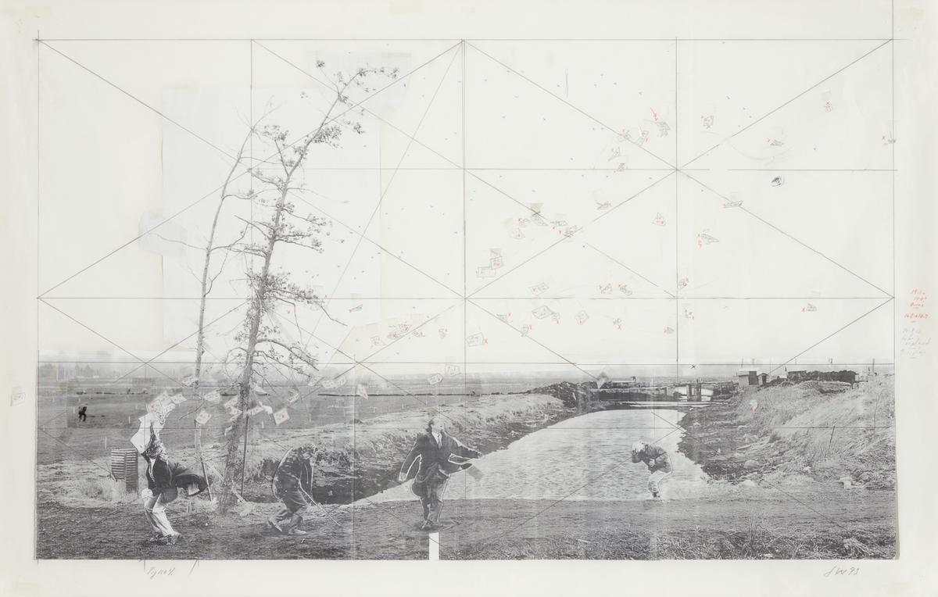
Culminating Task
Jeff Wall, Study for A Sudden Gust of Wind (After Hokusai), 1993. This preparatory document illustrates the careful process behind Wall’s final work, with the foreground figures superimposed over photographs of the landscape backdrop.

Slide 28
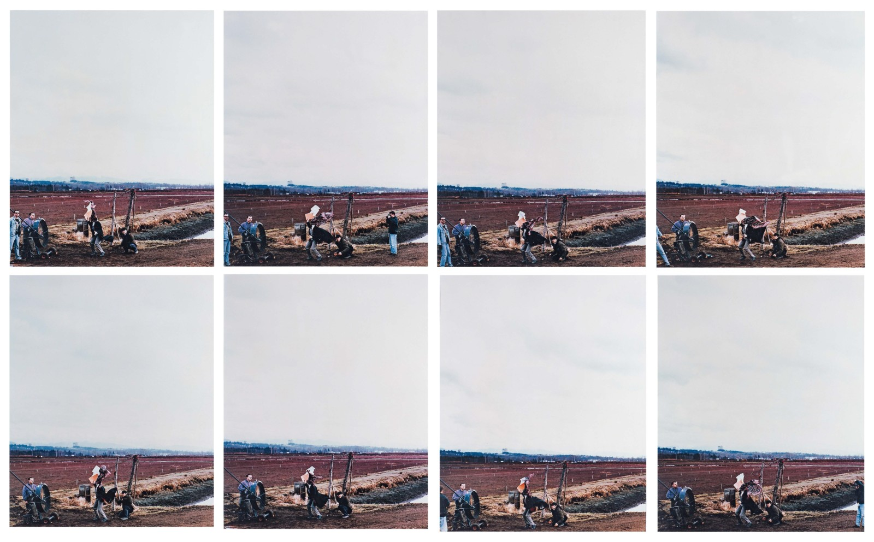
Culminating Task
Jeff Wall, Untitled production photos for A Sudden Gust of Wind, Richmond, B.C., 1993.

Slide 29
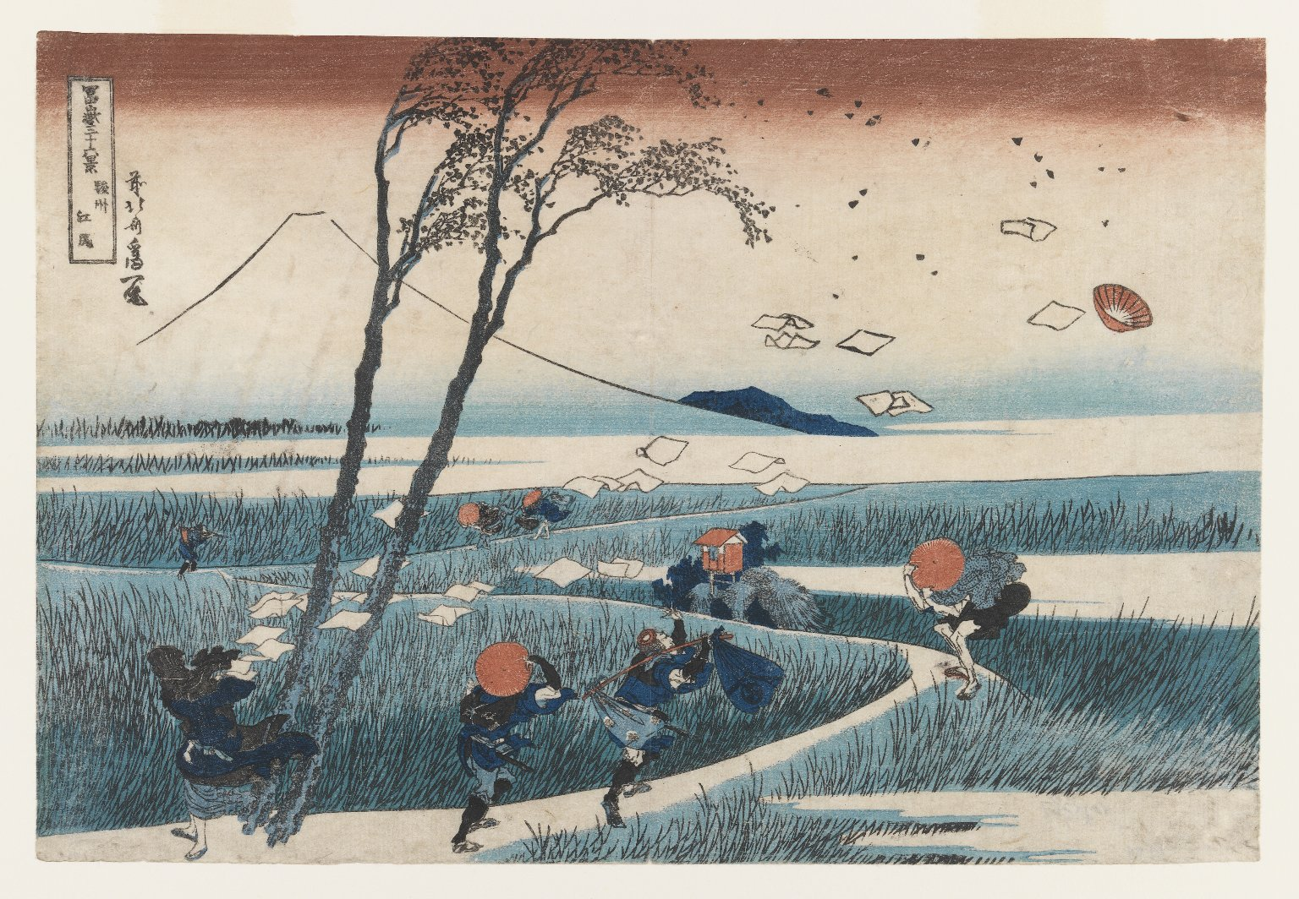
Culminating Task
Katsushika Hokusai, Yejiri Station, Province of Suruga, from the series “Thirty-Six views of Mount Fuji,” c.1830–31. Hokusai’s prints featuring different seasonal views of the iconic Mt. Fuji have long served as a source of inspiration for artists, both in Asia and the West.

Slide 30
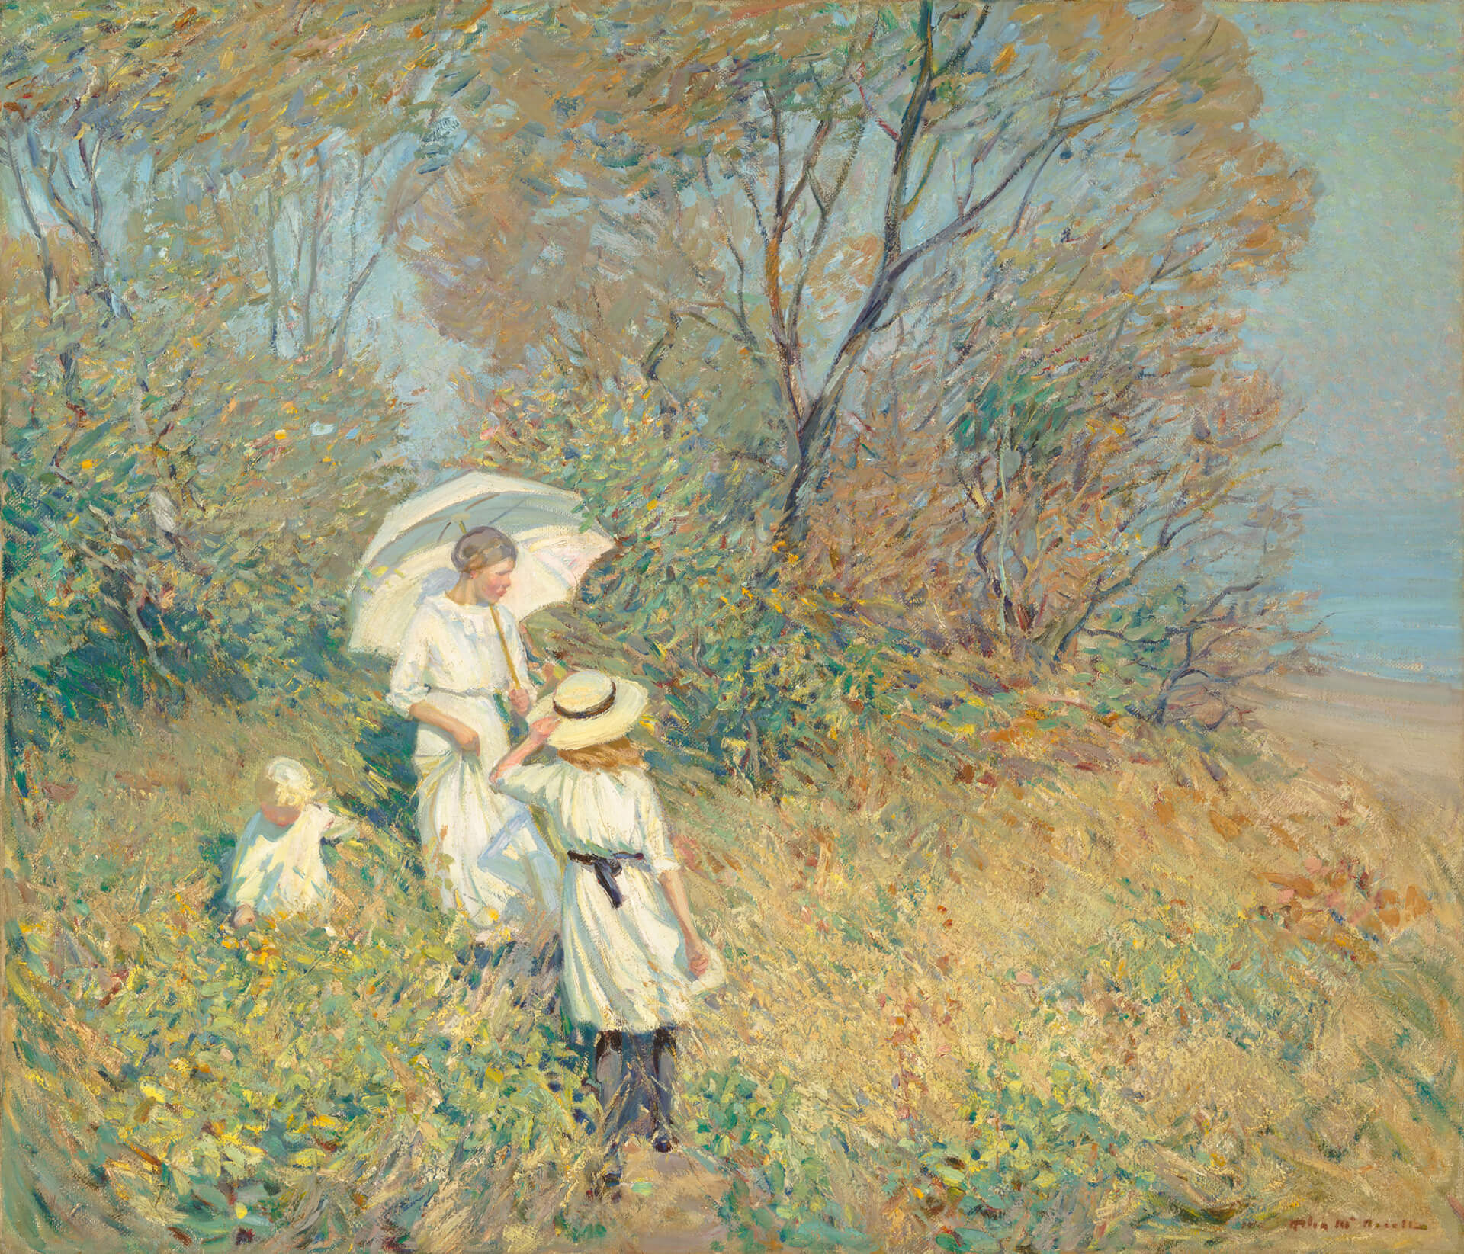
Culminating Task
Helen McNicoll, Sunny September, 1913.

Slide 31
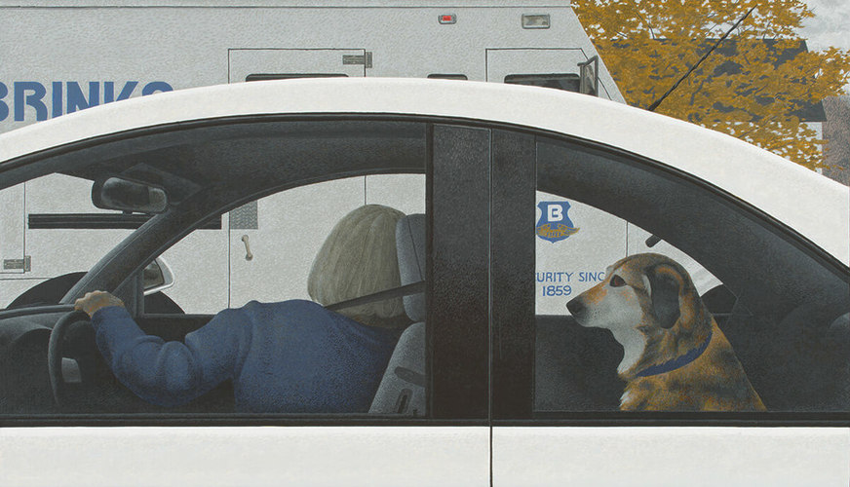
Culminating Task
Alex Colville, Dog in Car, 1999.

Slide 32
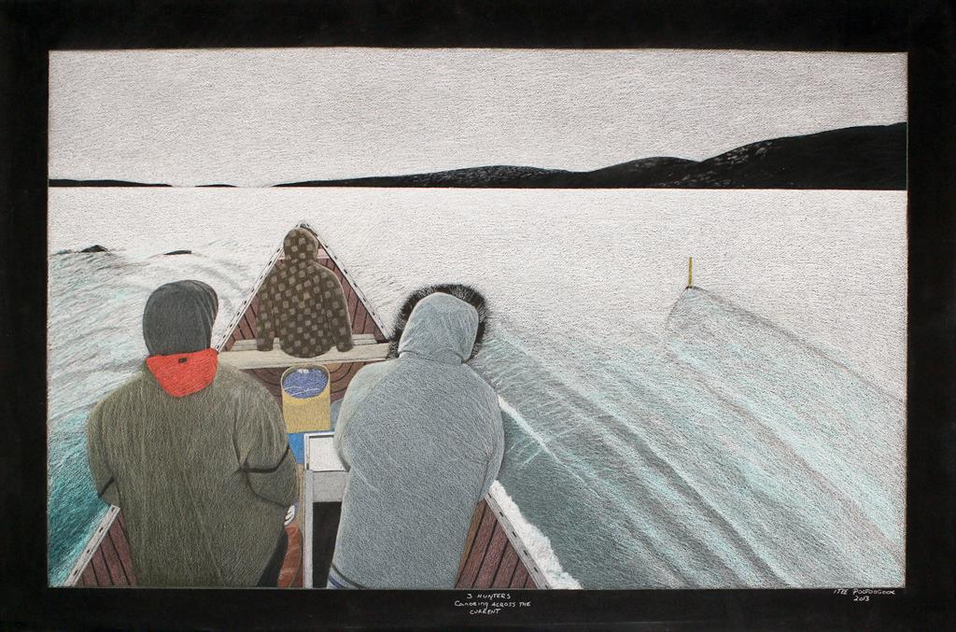
Culminating Task
Itee Pootoogook, Three Hunters Canoeing Across the Current, 2013.

Slide 33
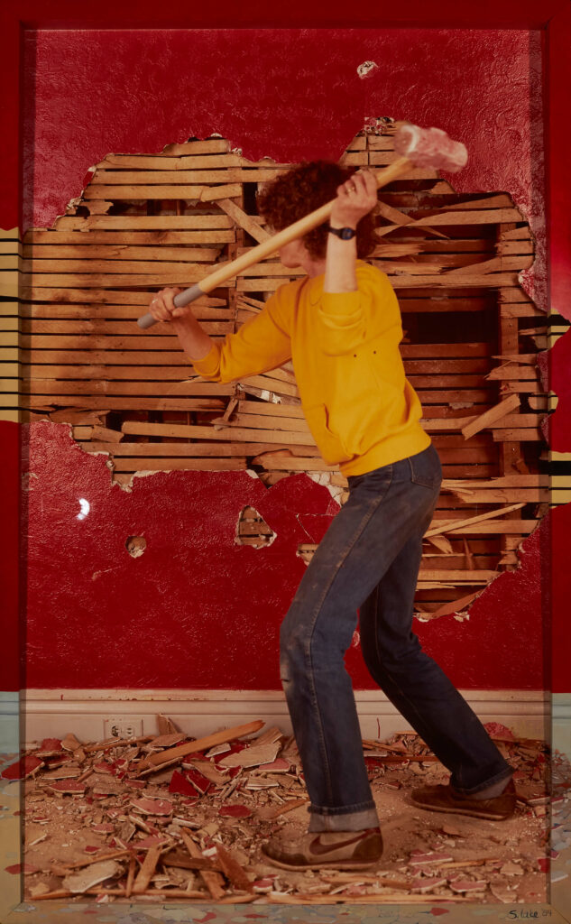
Suzy Lake, Pre-Resolution: Using the Ordinances at Hand #6, 1983–84. One of Canada’s most celebrated photographers, Lake’s works exploring issues related to gender and identity have helped advance photography’s evolution as a contemporary art medium.

Slide 34
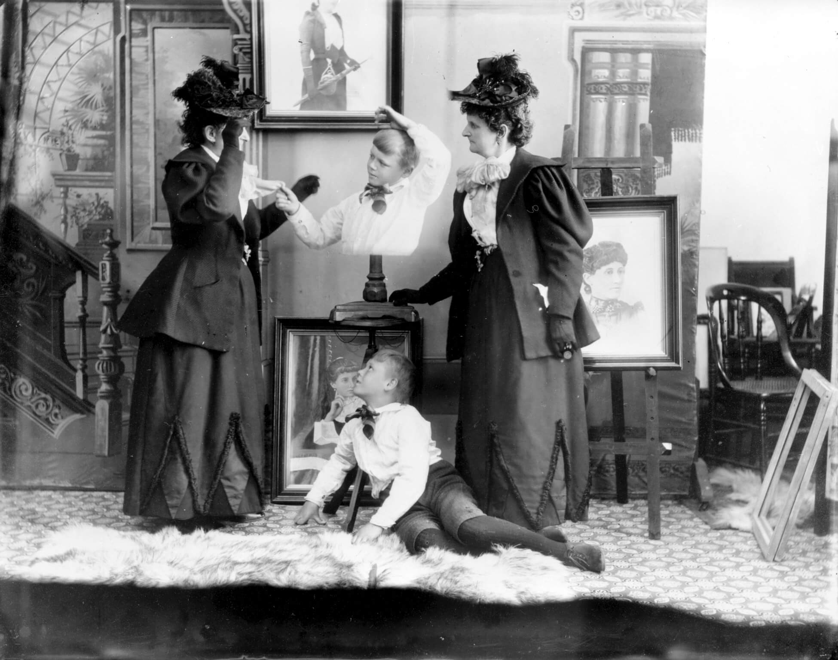
Hannah Maynard, Hannah Maynard and her grandson, Maynard McDonald, in a tableau vivant composite photo, c.1893. While Maynard operated successful portrait studio in Victoria, she is known for her experimental works using multiple exposures, such as in this staged portrait with her grandson.

