Slide 2
Takao Tanabe, Peace River 27/99, 1999. Since the 1980s, Takao Tanabe has been revered for his monumental paintings capturing British Columbia’s landscapes, including the province’s river systems.

Slide 3
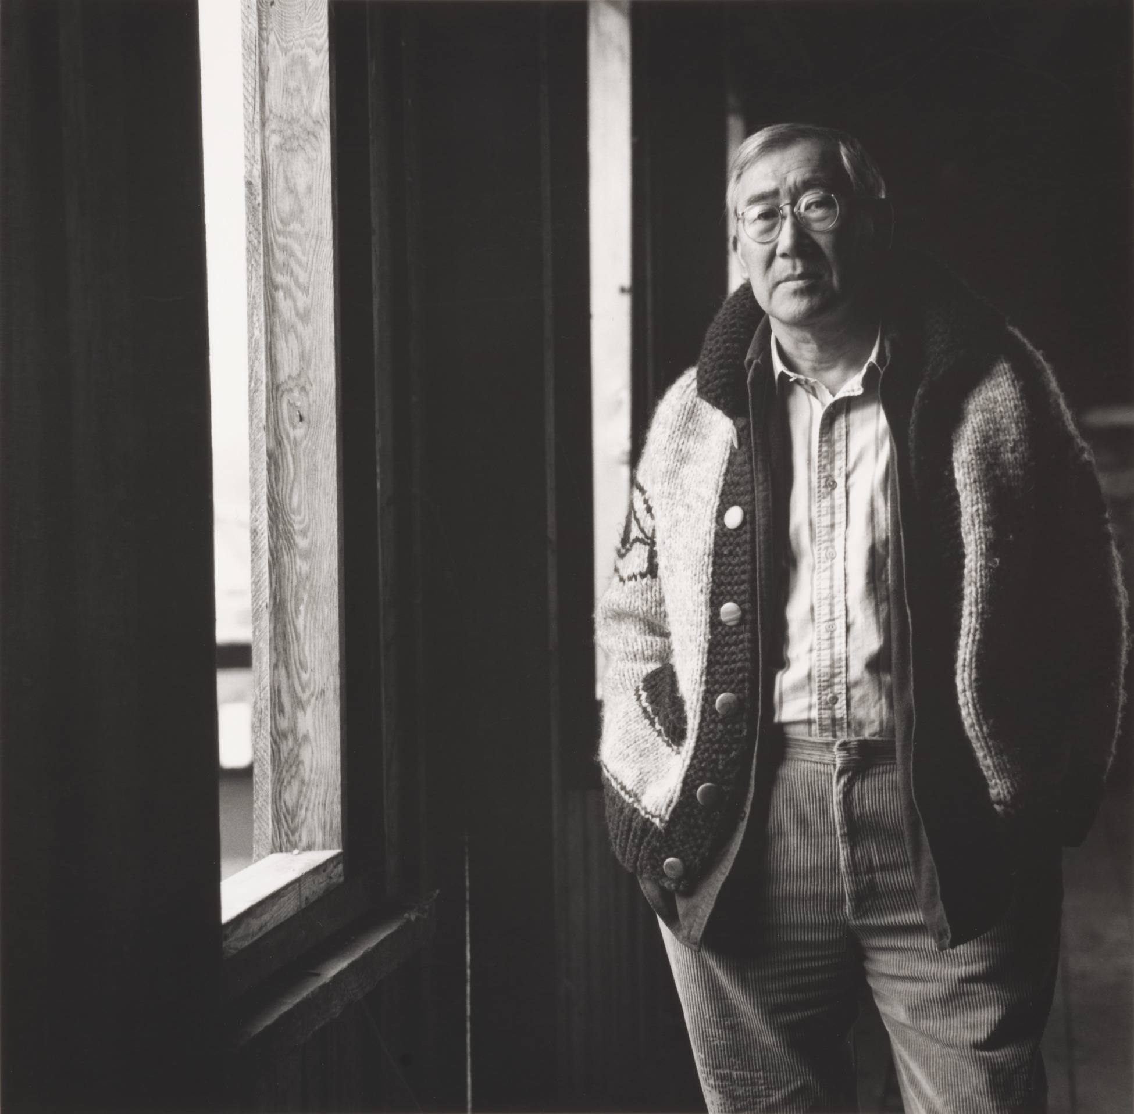
Takao Tanabe in his Vancouver Island studio, 1987.

Slide 4
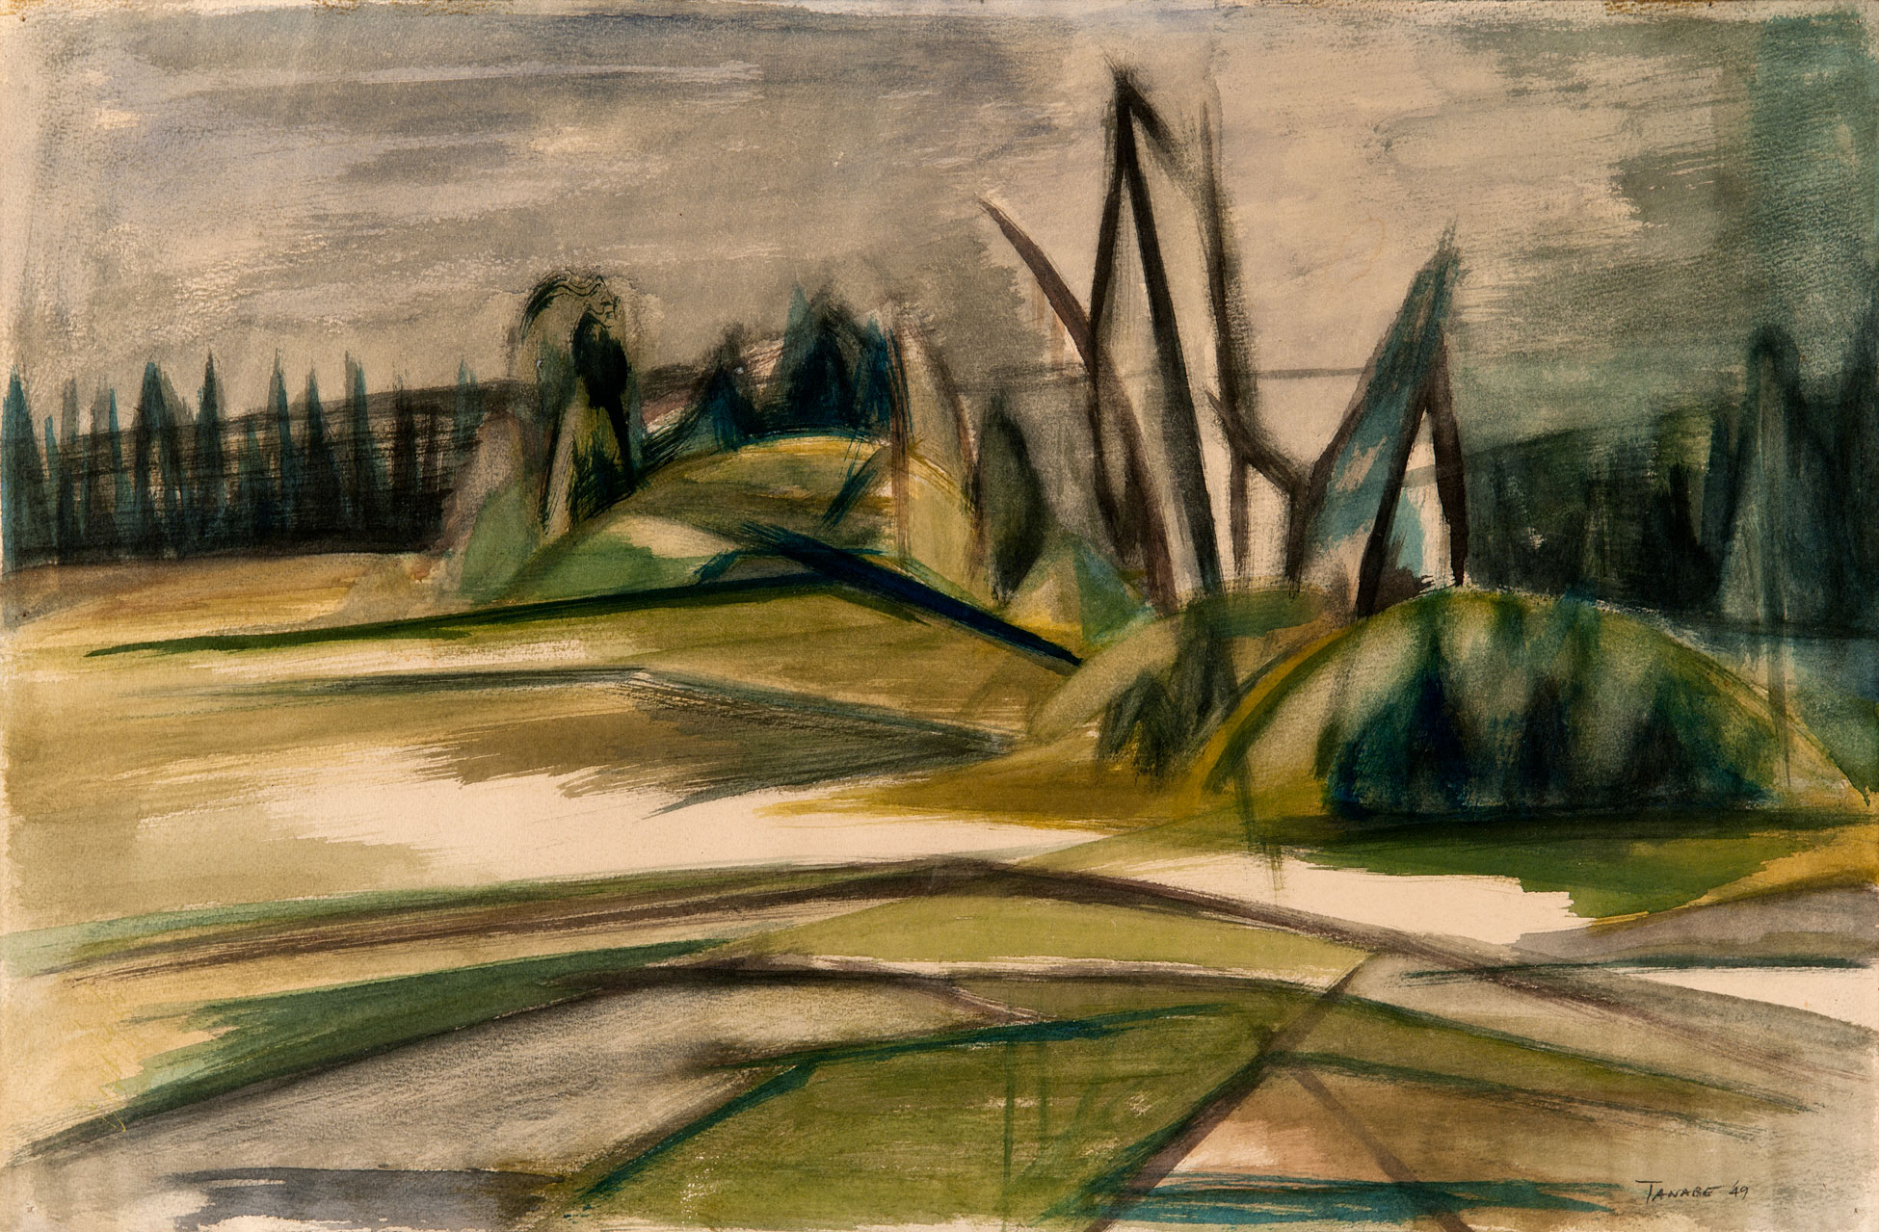
Takao Tanabe, West of Winnipeg, 1949. This watercolour painting showcases Tanabe’s early engagement with the landscape genre.

Slide 5
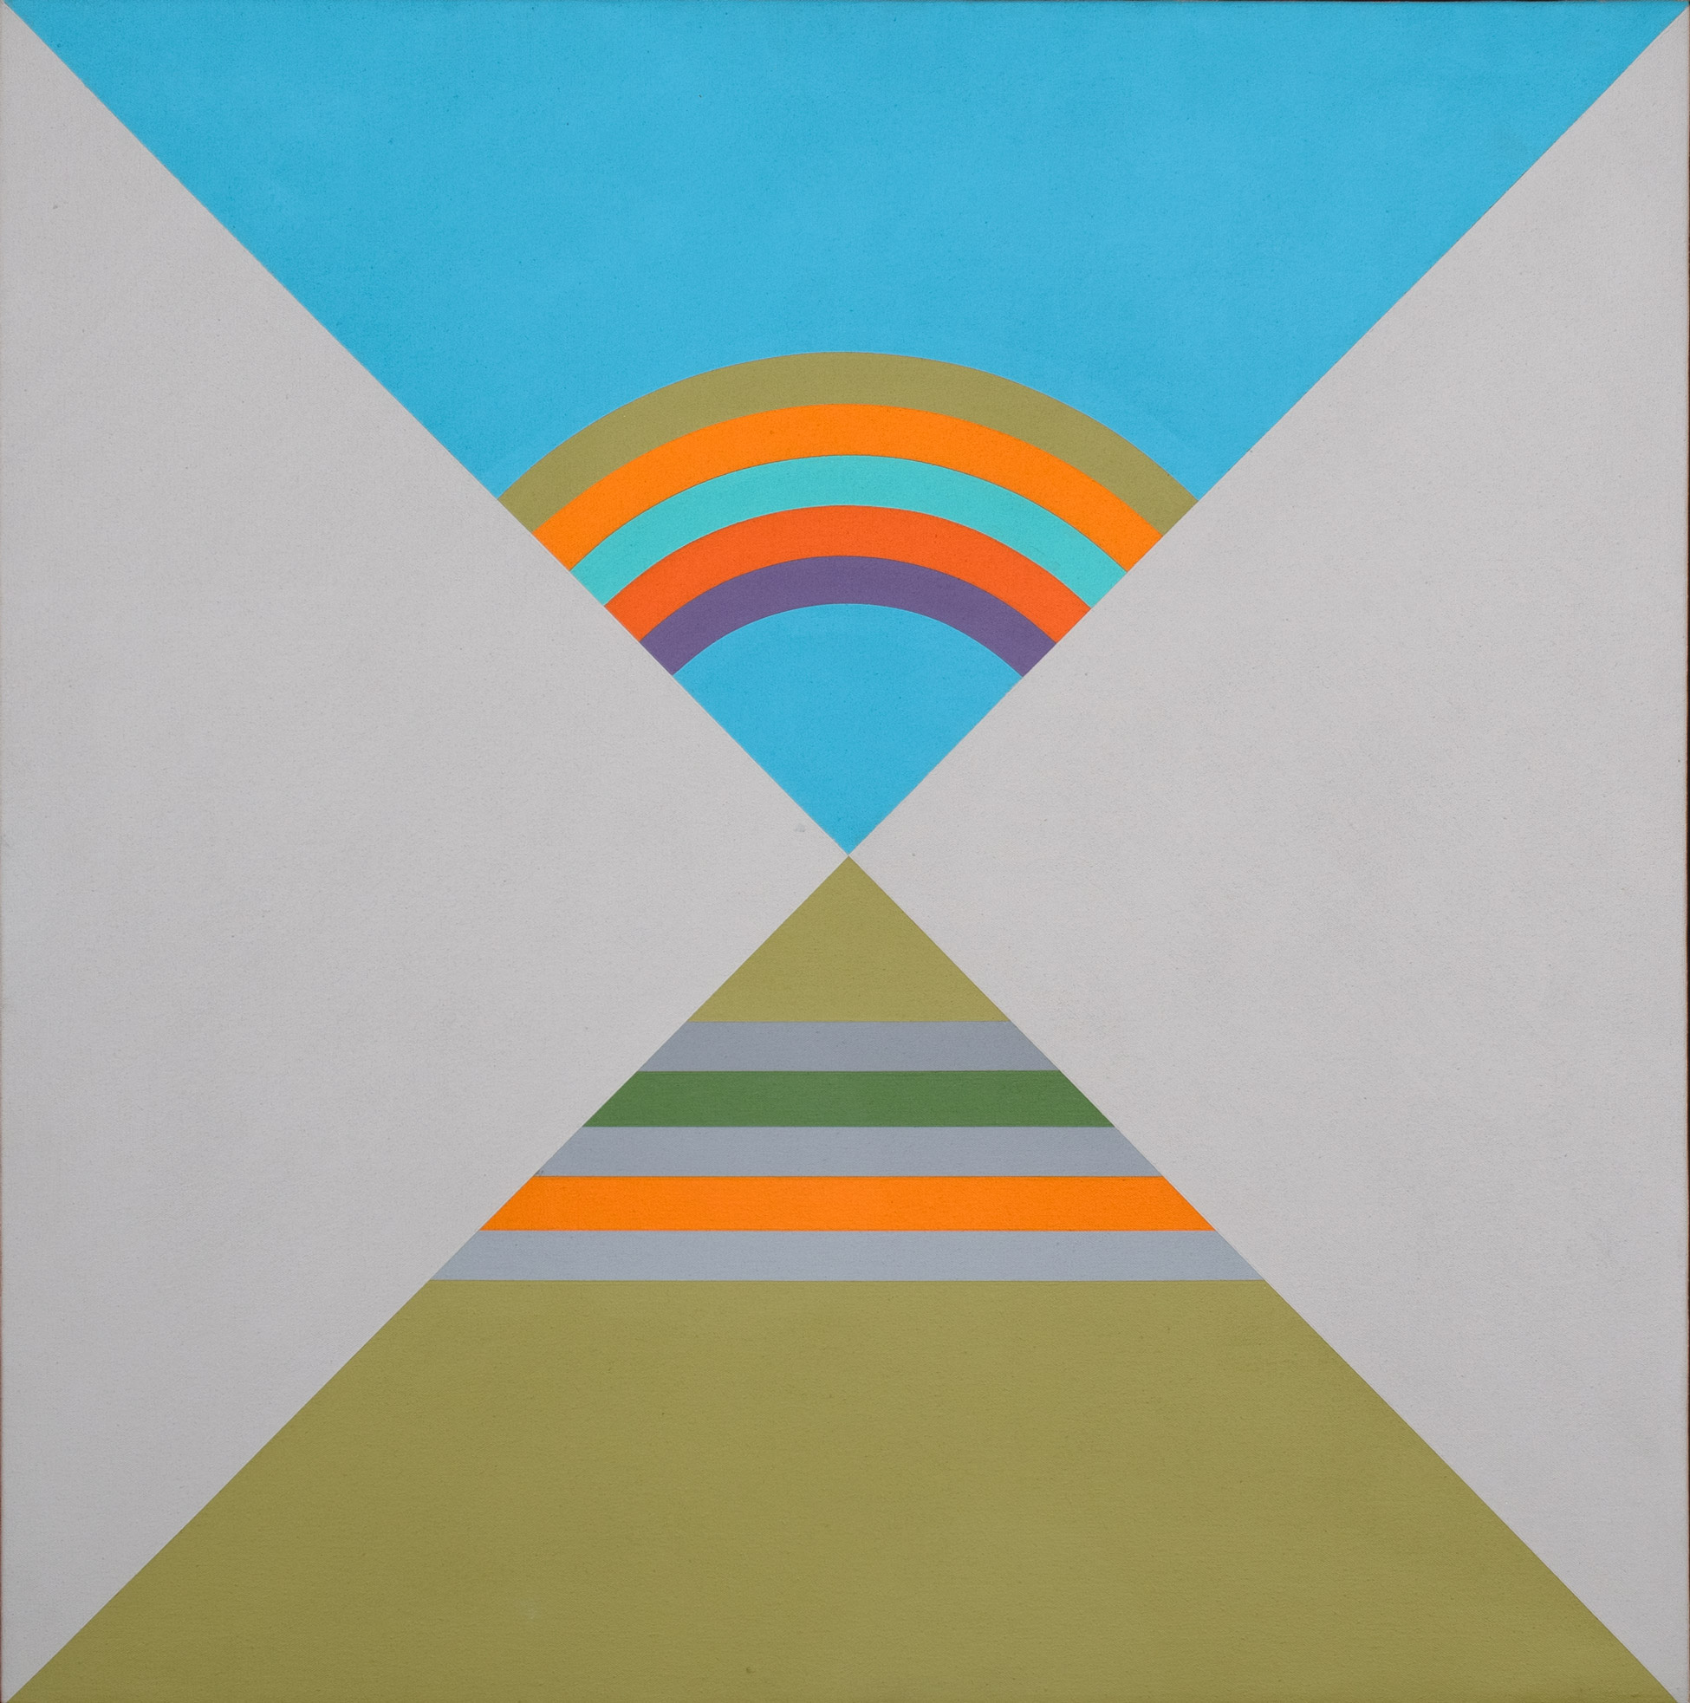
Takao Tanabe, Kitselas, 1970. By the 1970s, Tanabe emphasized a flattening of pictorial space achieved through strong lines and vibrant colour.

Slide 6
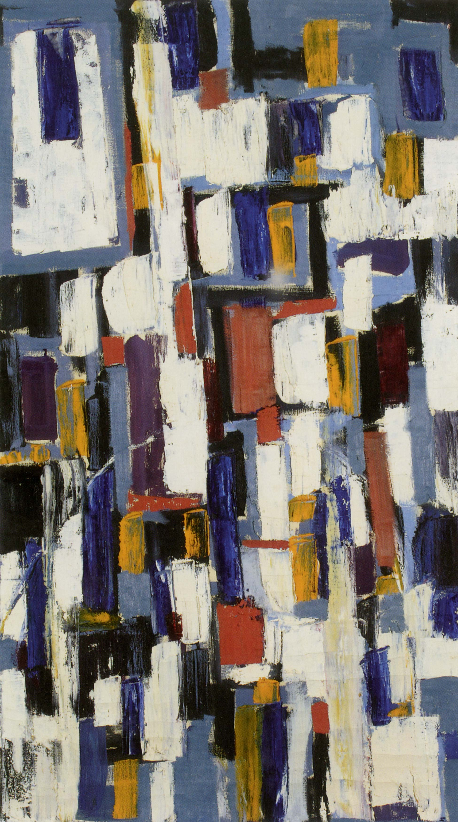
Takao Tanabe, Fragment 41, 1951. Produced during a trip to New York in 1951, this work illustrates emerging trends in abstraction.

Slide 7
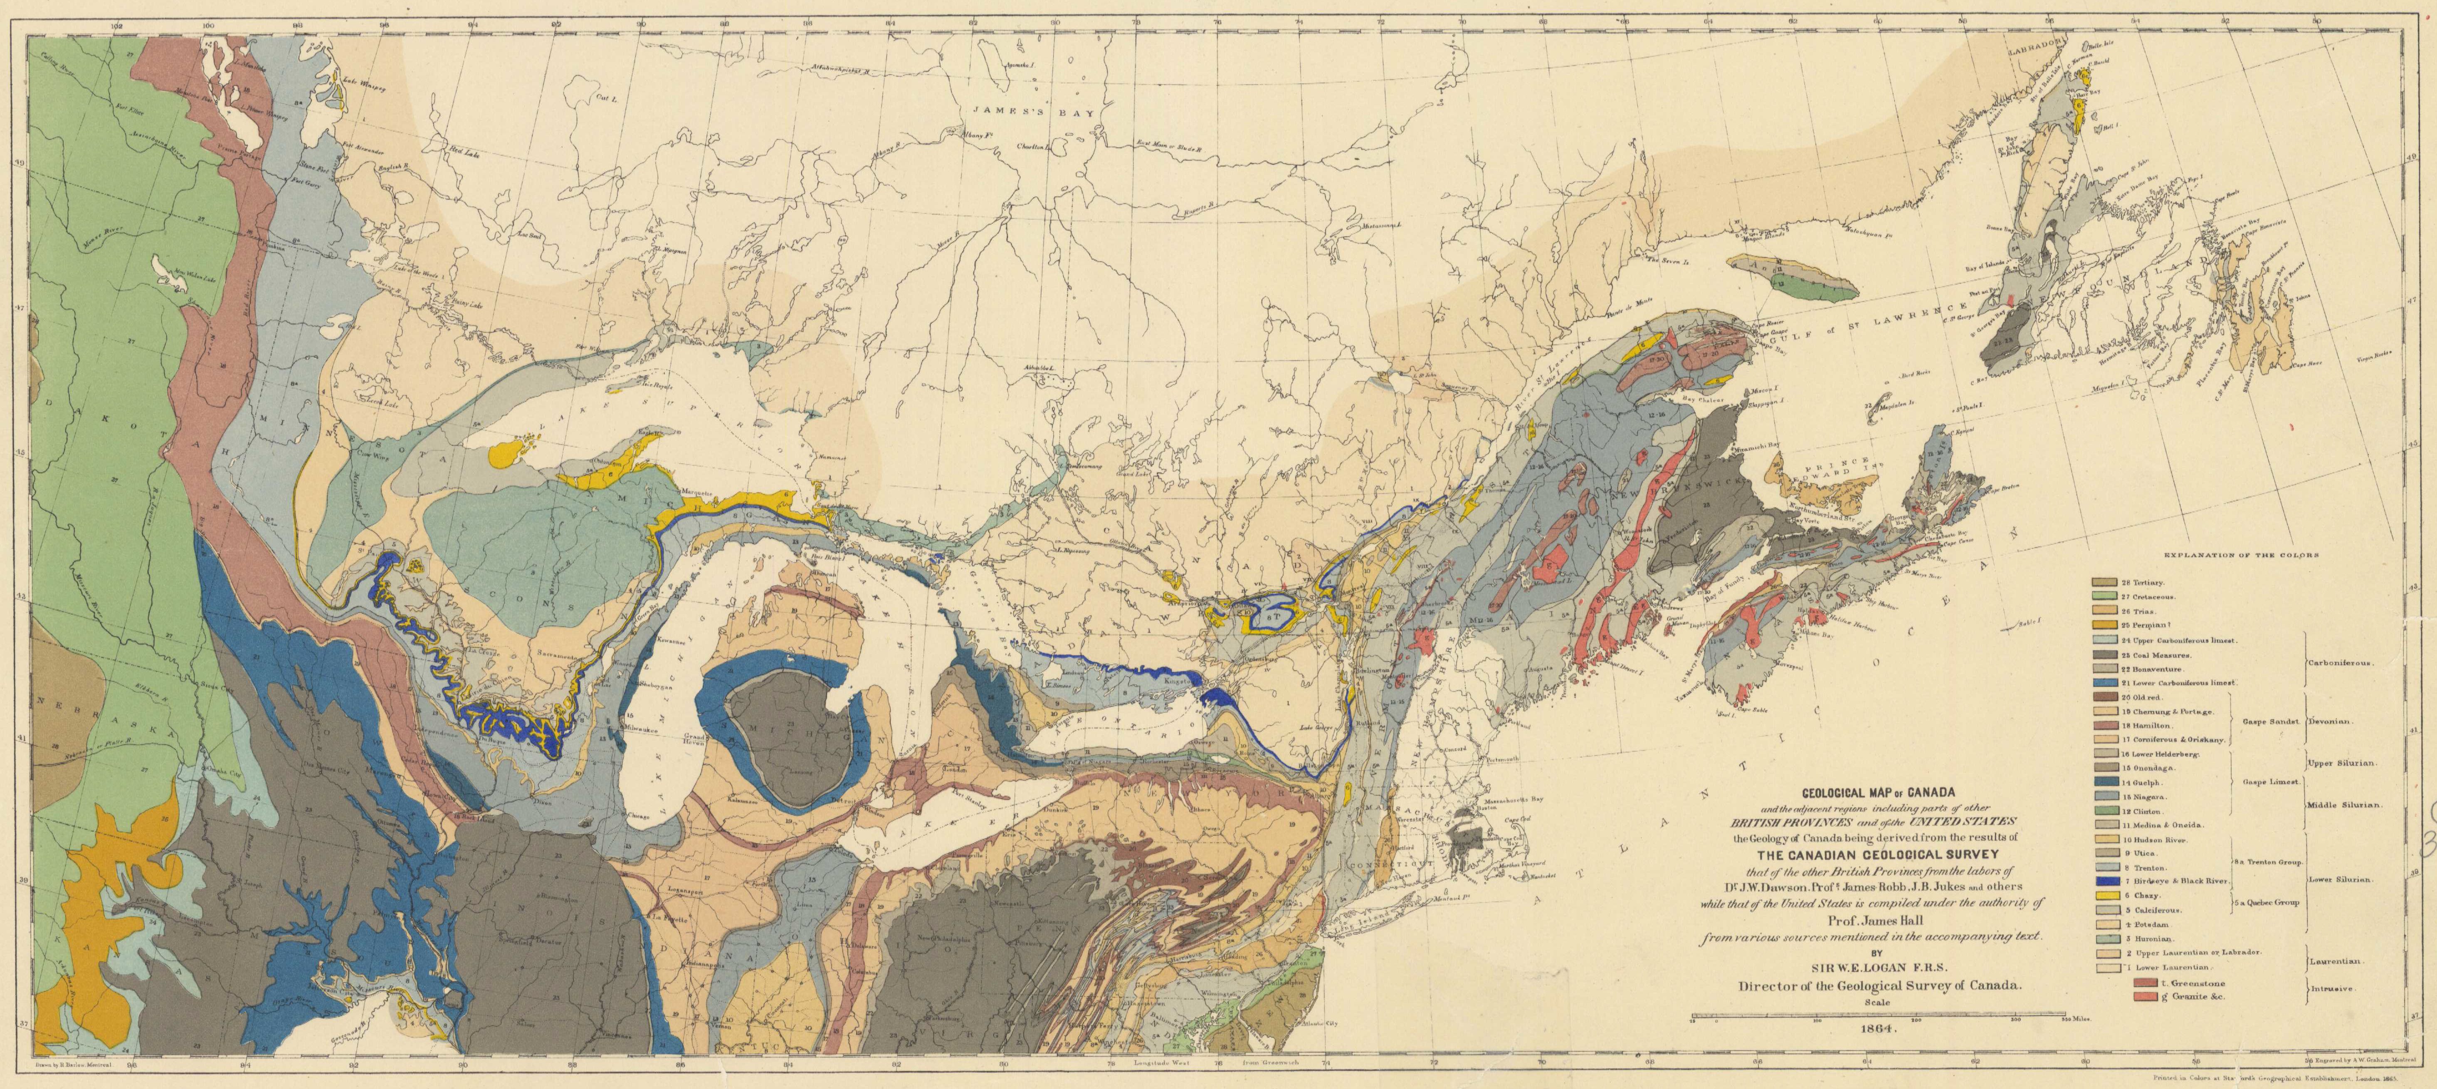
Geological map of Canada and adjacent regions, 1864.

Slide 8
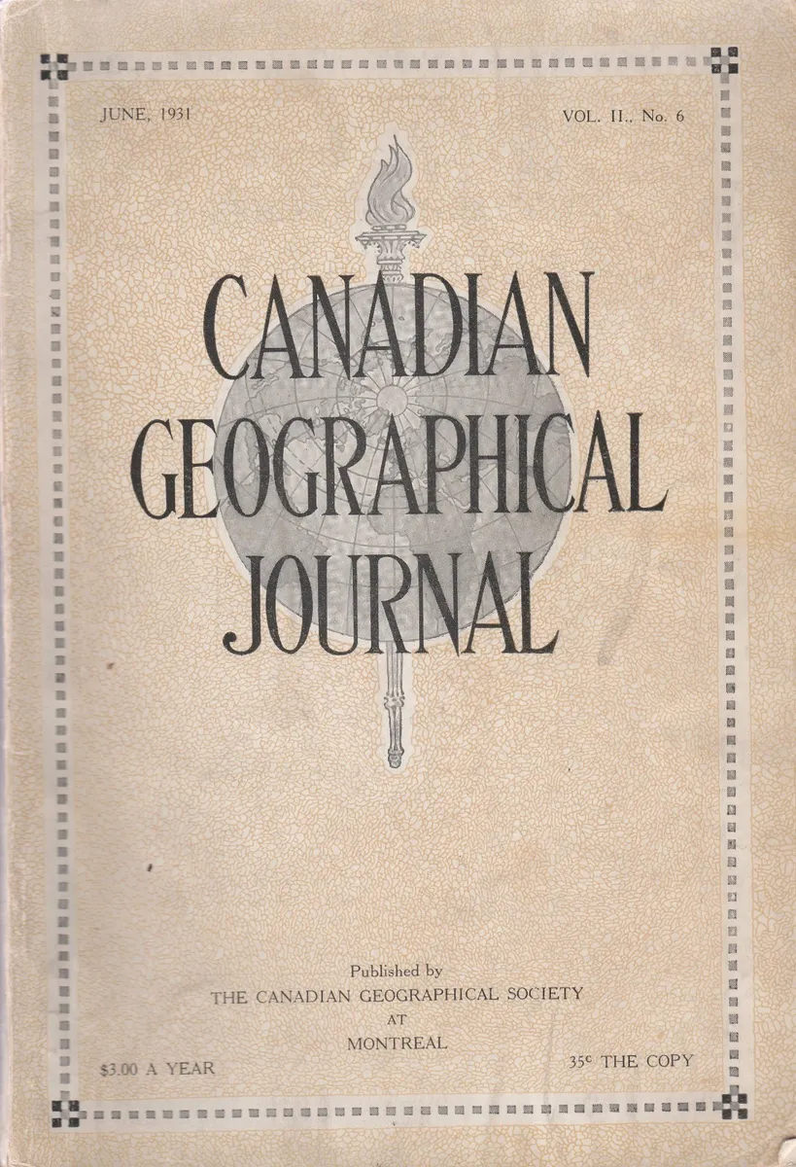
Cover of Canadian Geographical Journal, June 1931. In 1978, the journal was retitled Canadian Geographic.

Slide 9
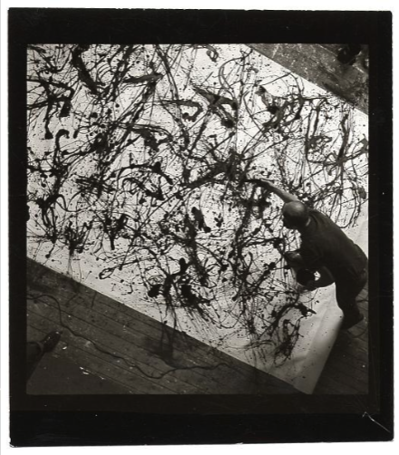
Jackson Pollock at work on a painting in his barn studio at Springs, NY, 1950.

Slide 10
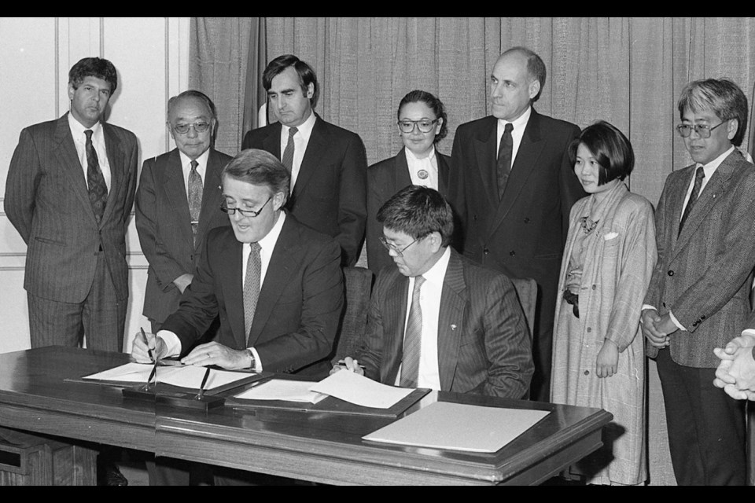
Prime Minister Brian Mulroney and Art Miki, the president of the National Association of Japanese Canadians, signing the agreement of redress in 1988.

Slide 11
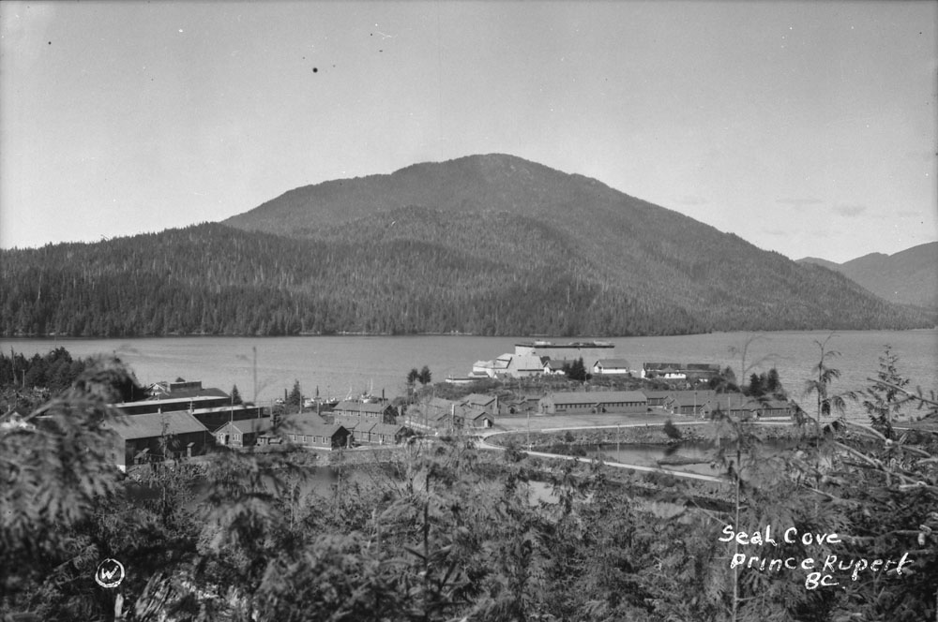
Seal Cove showing Canadian Fish & Cold Storage in Prince Rupert, B.C., c.1930.

Slide 12
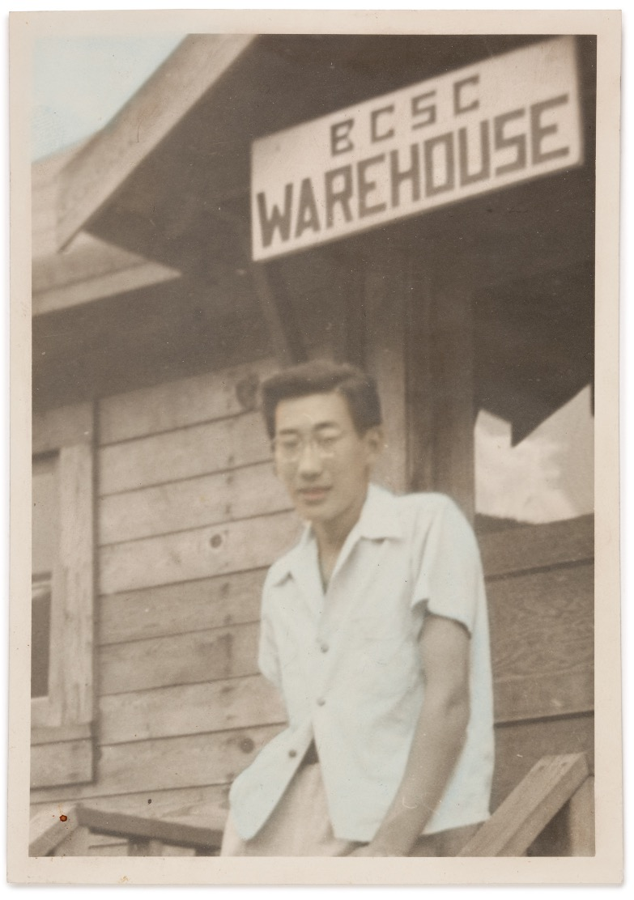
Takao Tanabe at Lemon Creek Japanese Internment Camp, B.C., 1943.

Slide 13
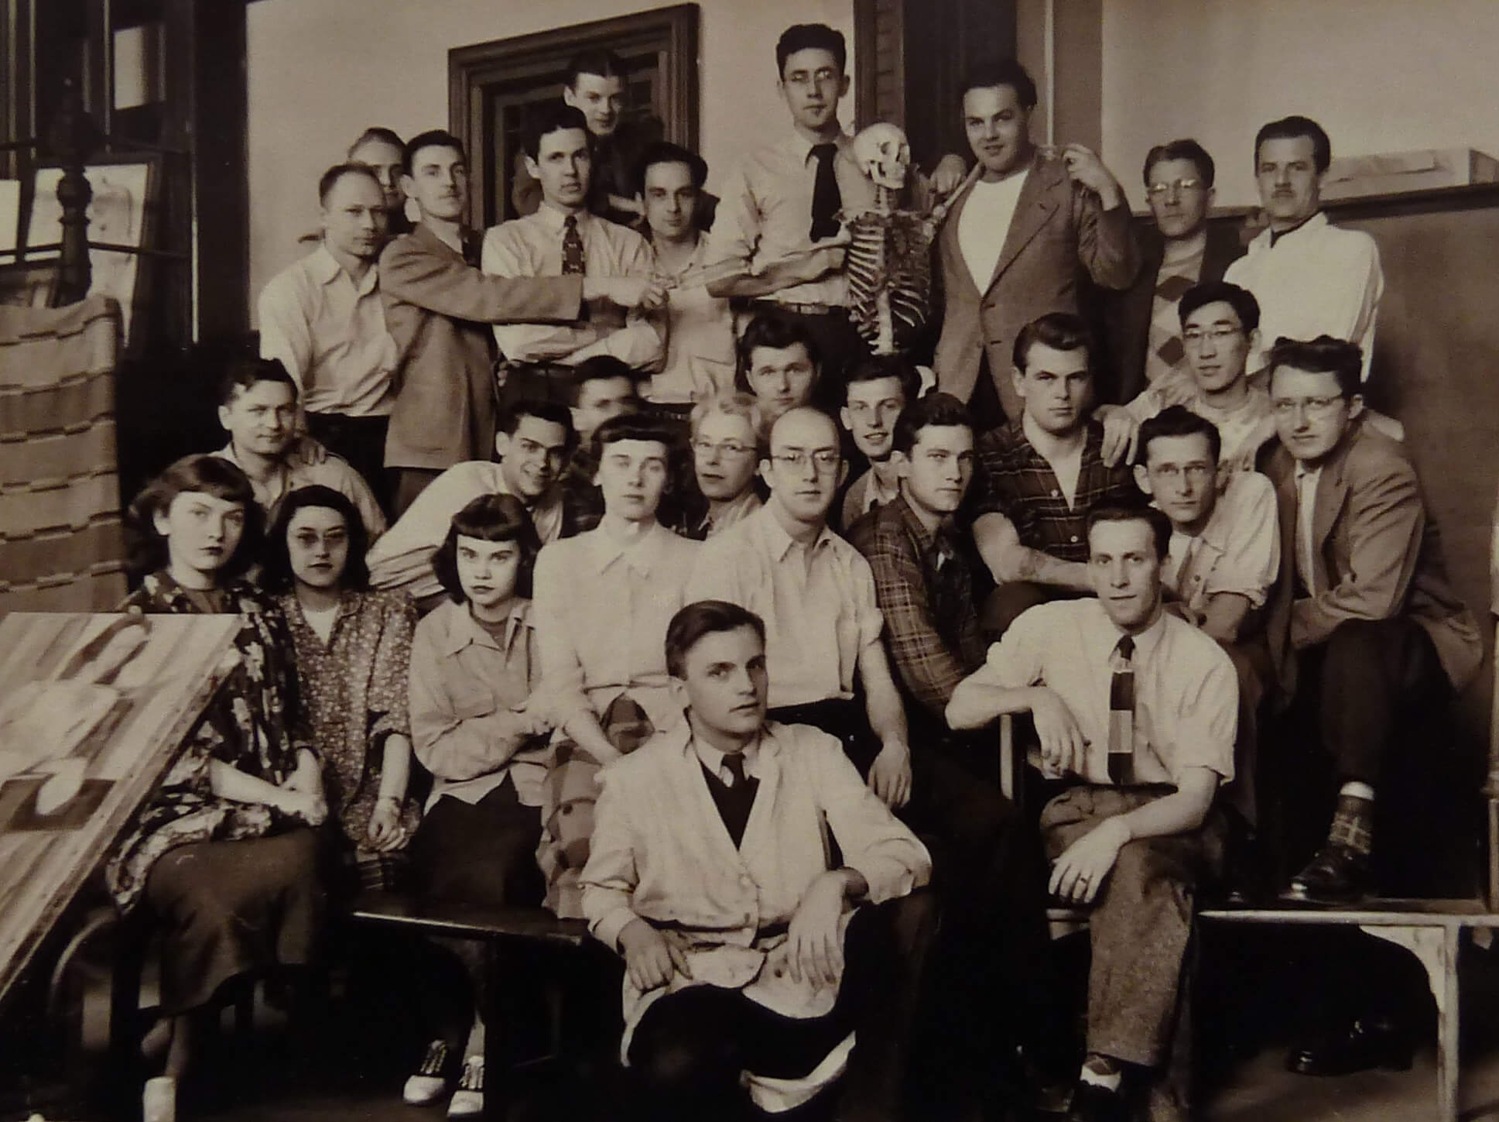
Takao Tanabe with his graduating class from the Winnipeg School of Art, 1949.

Slide 14
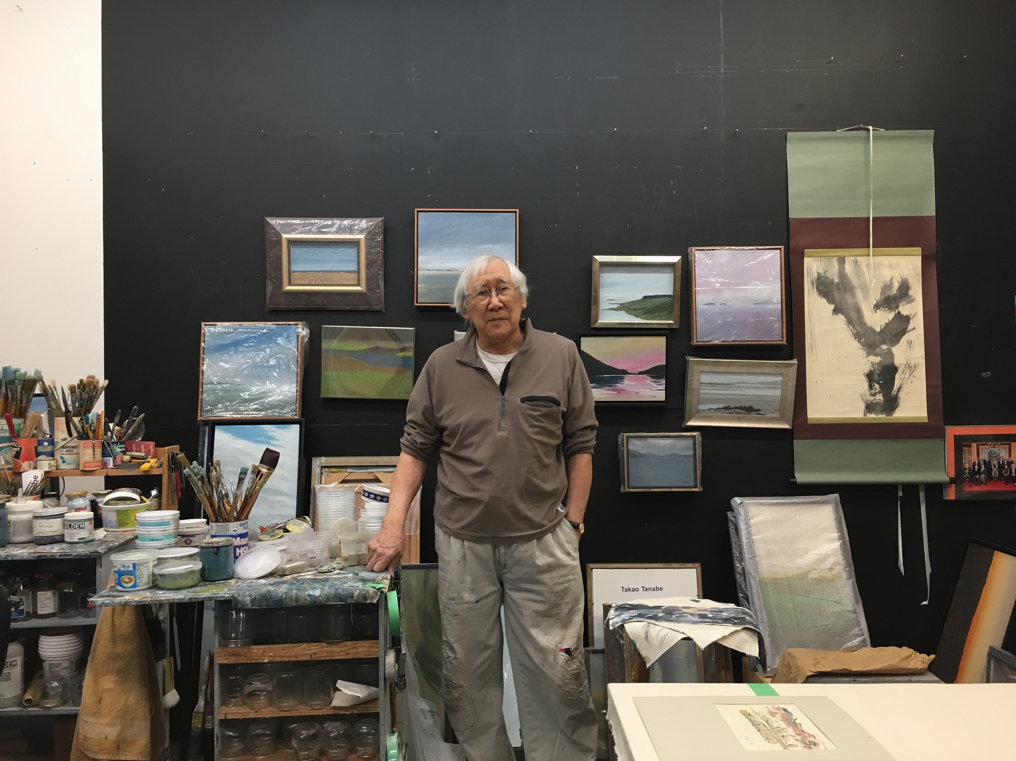
Takao Tanabe in his studio, n.d.

Slide 15
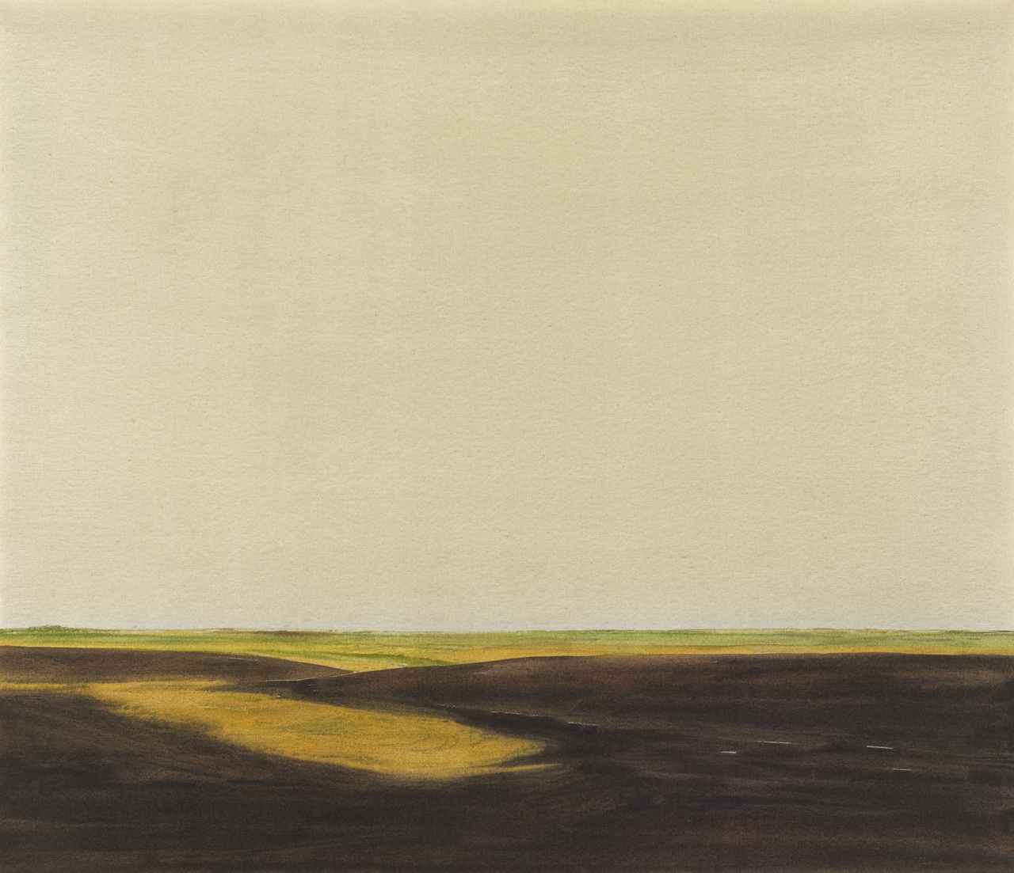
Learning Activity #1
Takao Tanabe, The Land 20, 1977. Despite their formal simplicity, Tanabe’s prairie landscapes are thoughtfully planned from reference photographs the artist shoots, crops, and compiles.

Slide 16
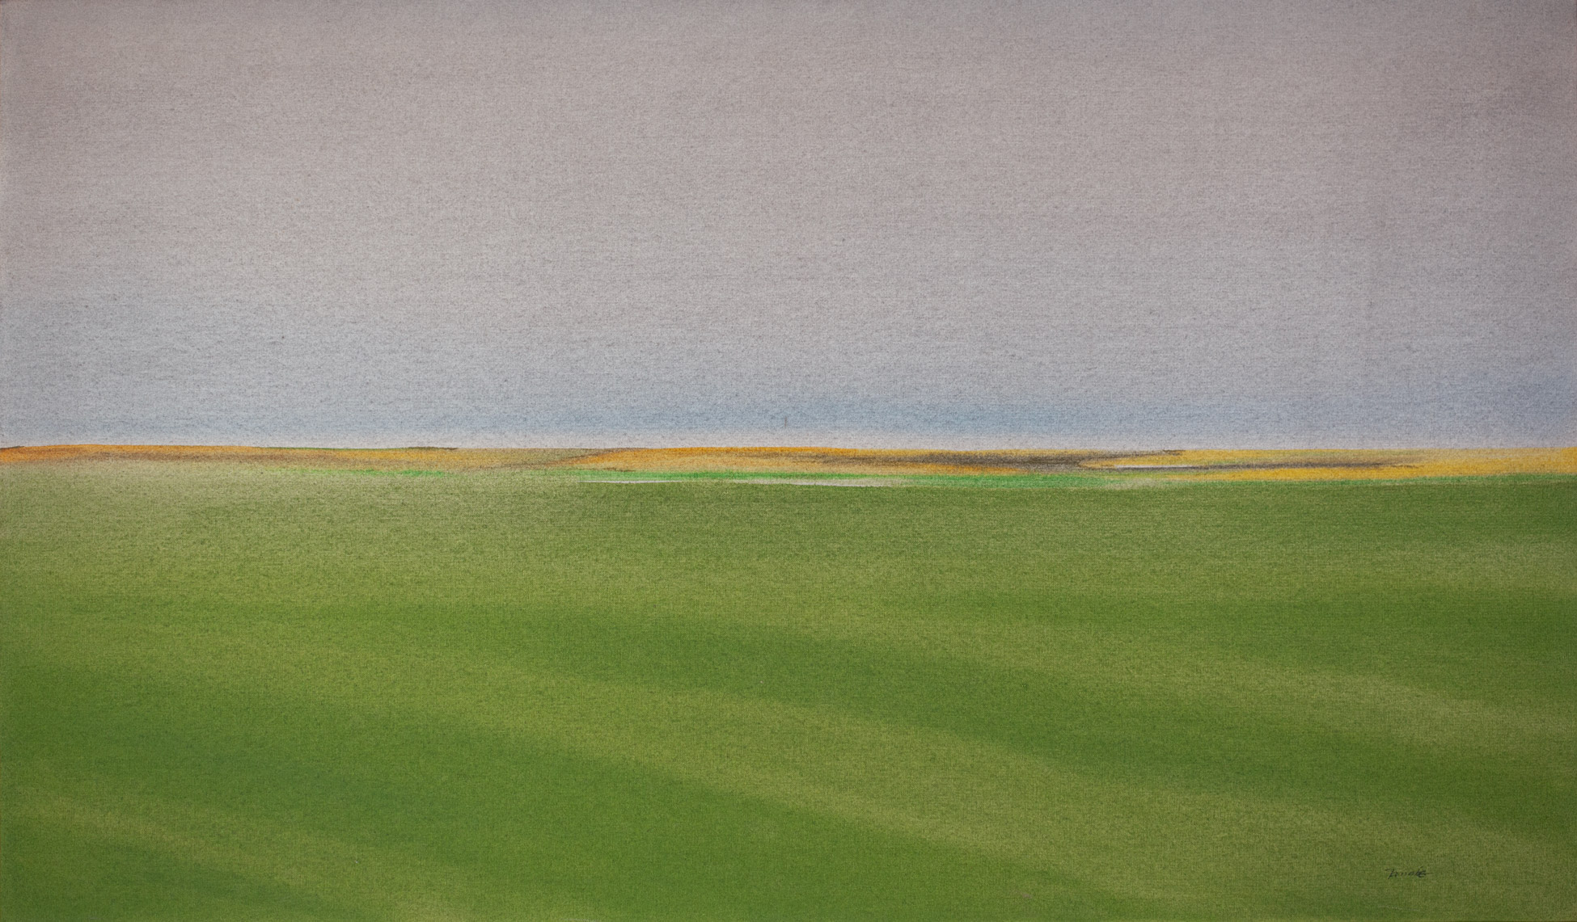
Learning Activity #1
Takao Tanabe, The Land 3/75, 1975. Most of Tanabe’s prairie landscapes were produced while the artist was living and teaching in Banff, Alberta.

Slide 17
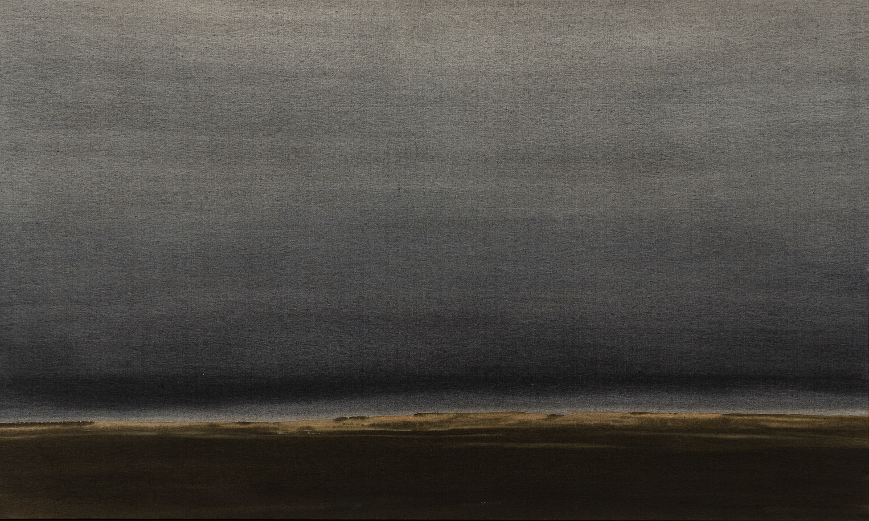
Learning Activity #1
Takao Tanabe, Prairie Hills 10/78, 1978. Here, Tanabe uses black wash, a technique he learned from his study of ink painting, to conjure the atmospheric effects of a prairie storm.

Slide 18
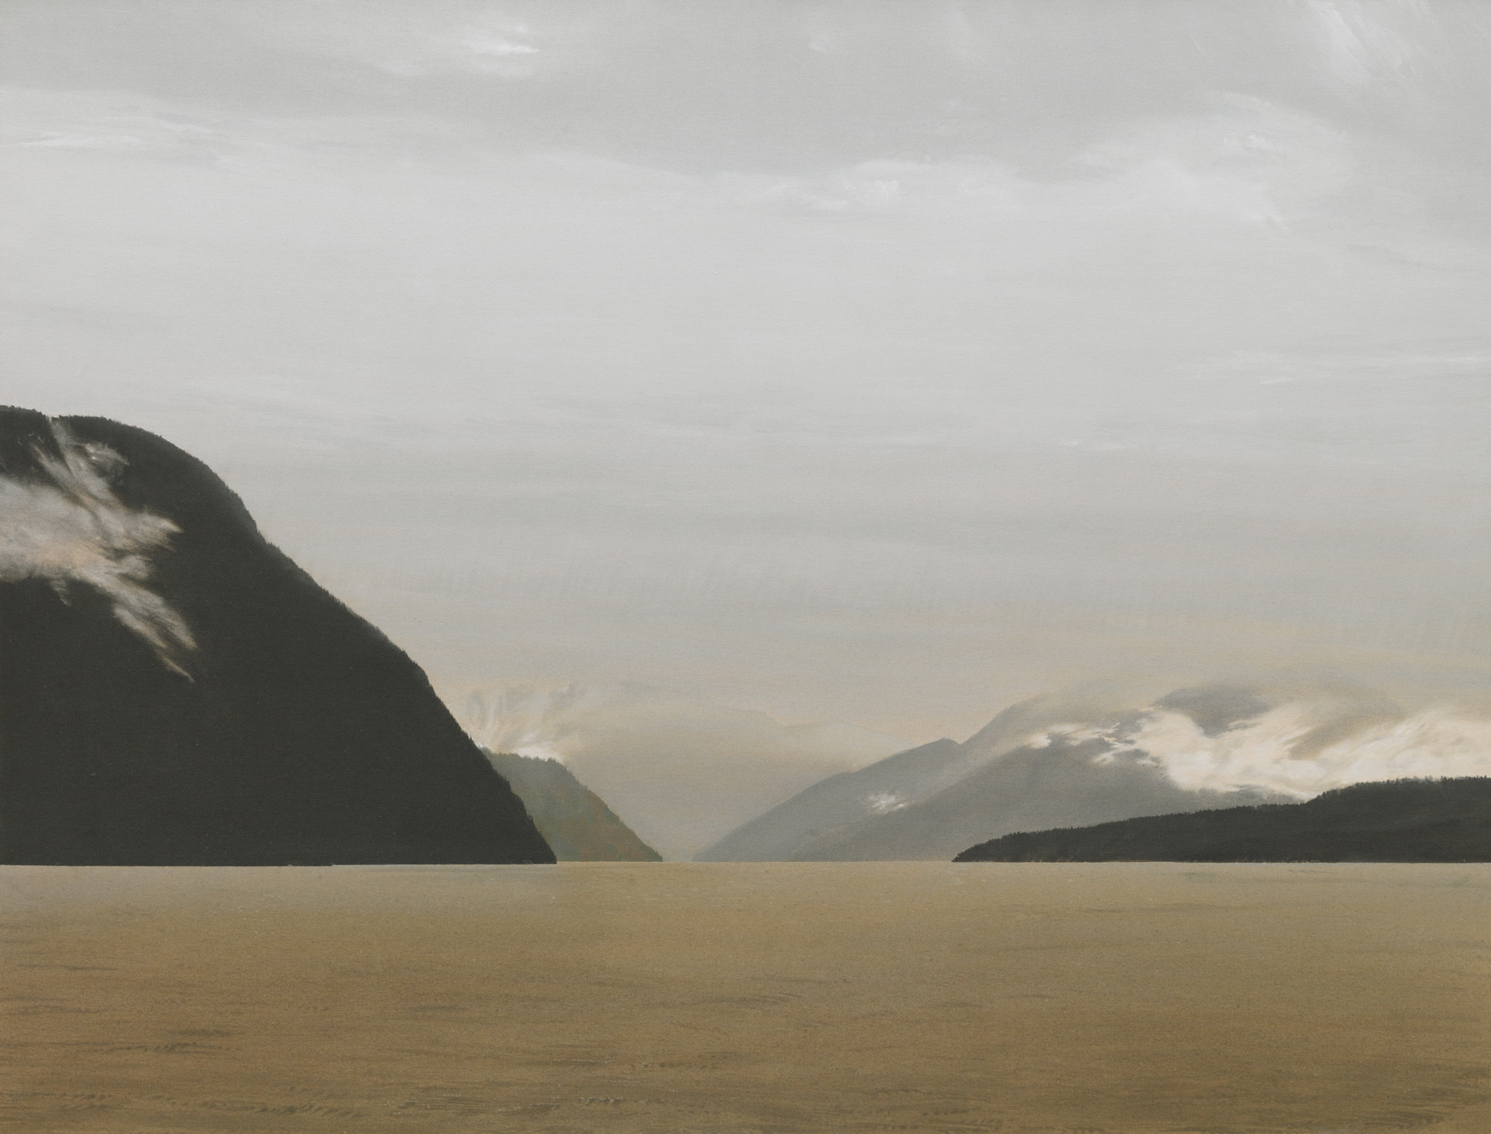
Learning Activity #1
Takao Tanabe, Strait of Georgia 1/90: Raza Pass, 1990. An image wreathed in mist, this painting depicts Raza Passage, a stretch of water located at the northern end of the Strait of Georgia.

Slide 19
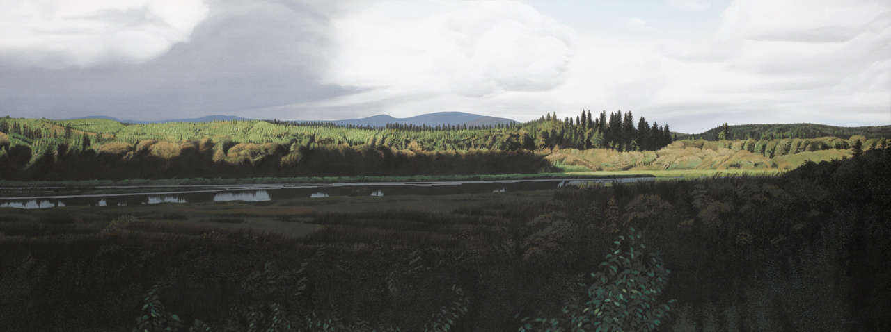
Learning Activity #1
Takao Tanabe, Rivers 2/00: Crooked River, 2000. This painting is part of a series of six paintings depicting the rivers of British Columbia that the artist produced from 2000 to 2001.

Slide 20
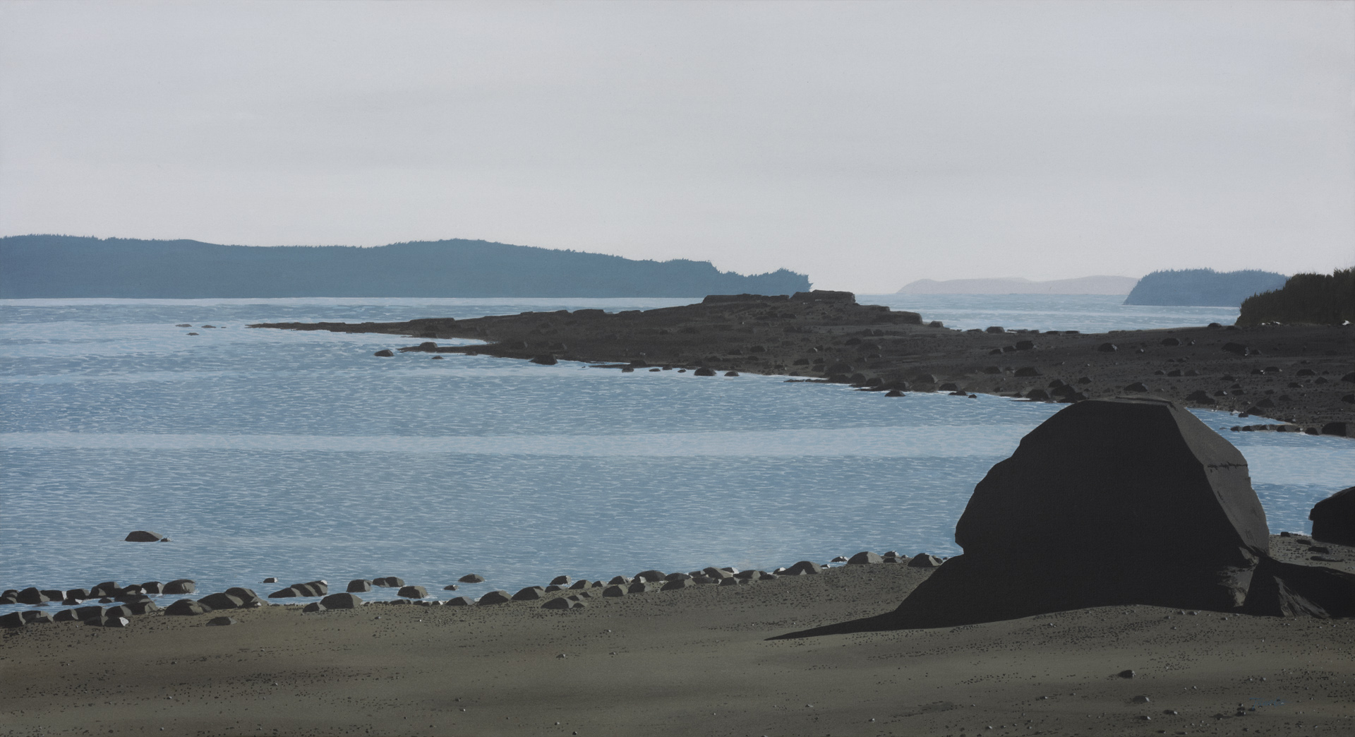
Learning Activity #1
Takao Tanabe, Cormorant Island, Looking South, 2015. This painting is a good illustration of Tanabe’s ability to capture the quality of light and its ability to permeate the foggy atmosphere of the West Coast.

Slide 21
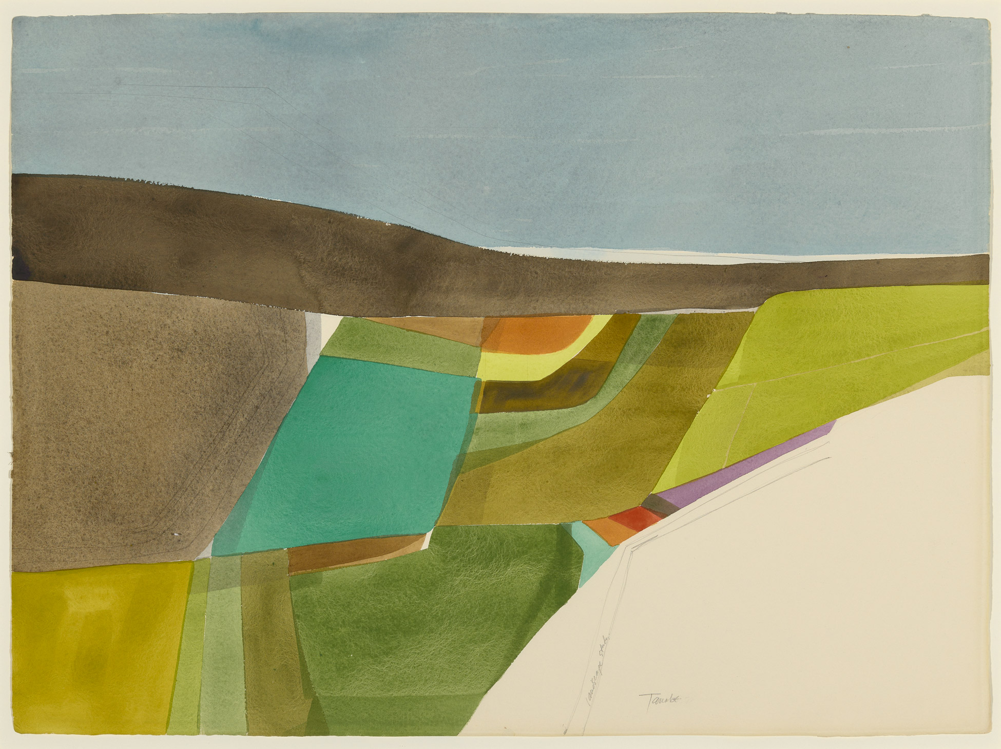
Learning Activity #2
Takao Tanabe, Landscape Study #4, 1972. Despite being rarely exhibited, Tanabe’s studies on paper reflect the innovative ways in which he was beginning to approach the landscape in the early 1970s.

Slide 22
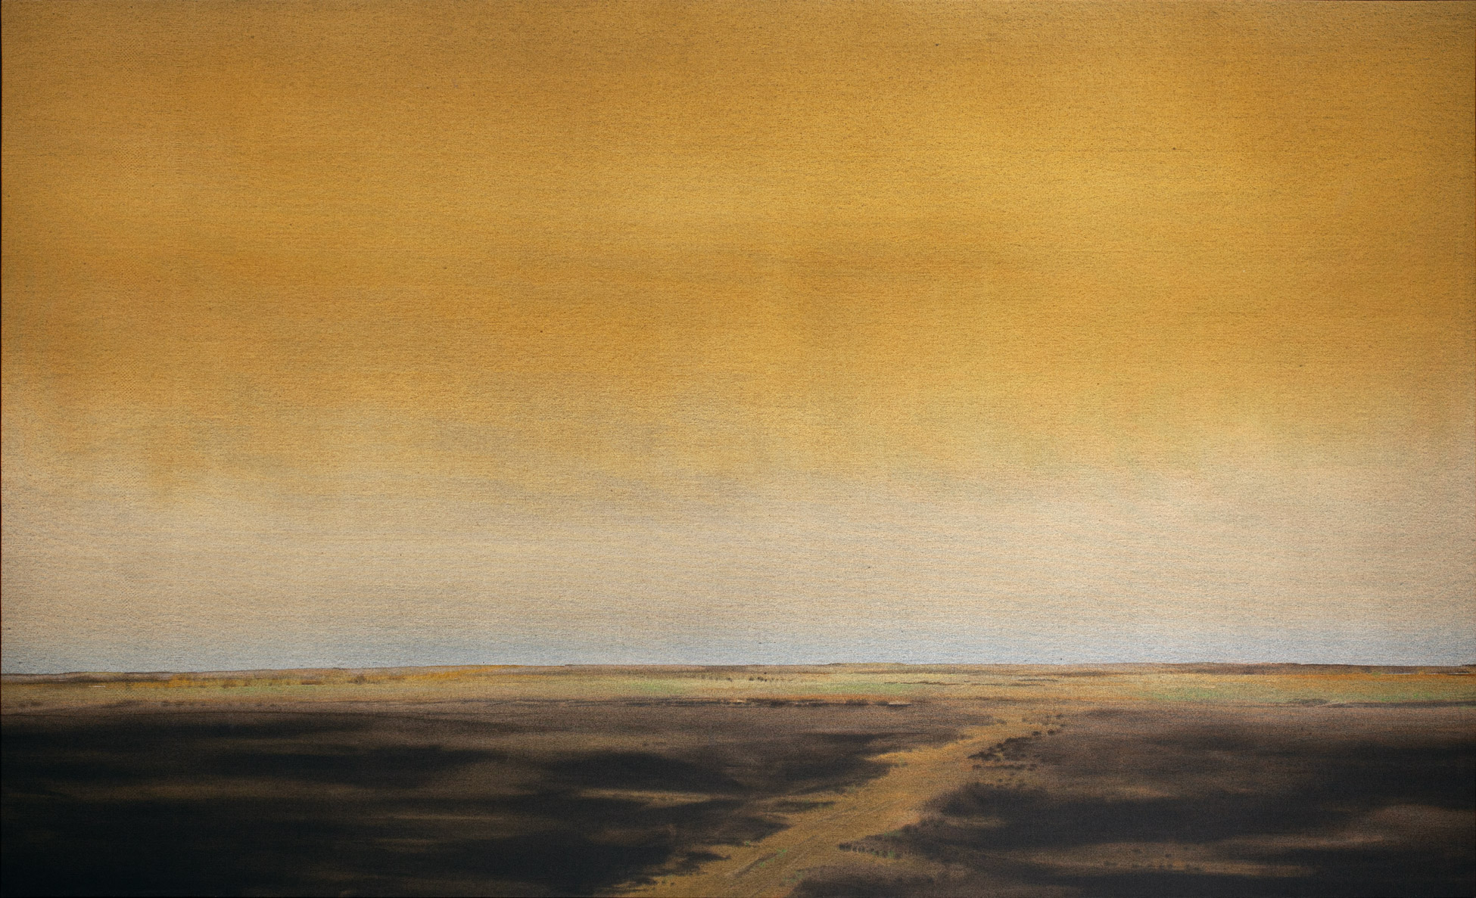
Learning Activity #2
Takao Tanabe, The Land 22/77, 1977. This work subtly communicates the feeling of vast space associated with the Canadian Prairies.

Slide 23
Learning Activity #2
Takao Tanabe, Foothills Looking West 3/83, 1983. This painting illustrates the foothills of Alberta—a series of forested and gently undulating slopes adjacent to the Rocky Mountains.

Slide 24
Learning Activity #2
Takao Tanabe, Westcoast 6/86: Late Afternoon, 1986. Tanabe’s paintings of the rain-soaked vistas of the West Coast necessitate many layers of painting that are applied methodically over time.

Slide 25
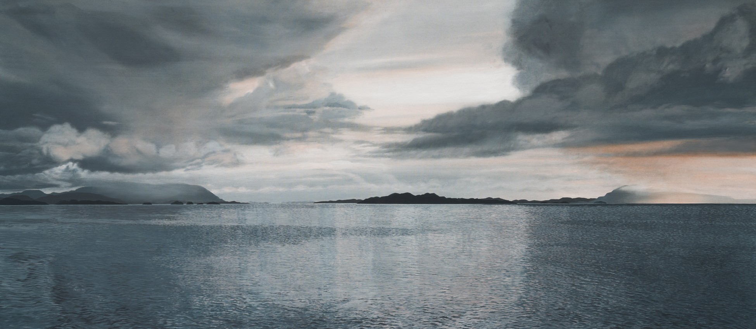
Learning Activity #2
Takao Tanabe, Inside Passage 1/04: Malacca Strait, 2004. In this painting, Tanabe has taken great care to render variegated ripples on the surface of the water.

Slide 26
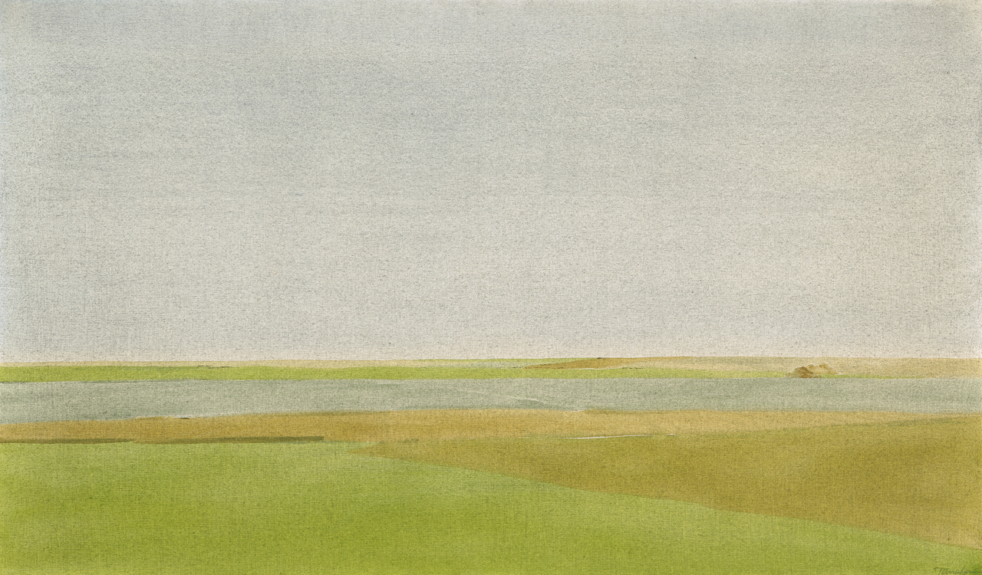
Culminating Task
Takao Tanabe, The Land #6, 1974. Between 1972 and 1984, Takao Tanabe produced more than two hundred paintings of the prairies, exploring the lines between abstraction and representation.

Slide 27
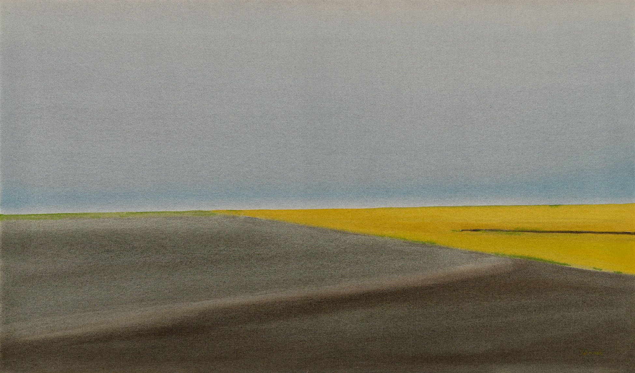
Culminating Task
Takao Tanabe, The Land 4/75 – East of Calgary, 1975. In this painting, Tanabe has removed virtually all traces of human intervention in the landscape, creating an image that expresses an essential quality of place.

Slide 28
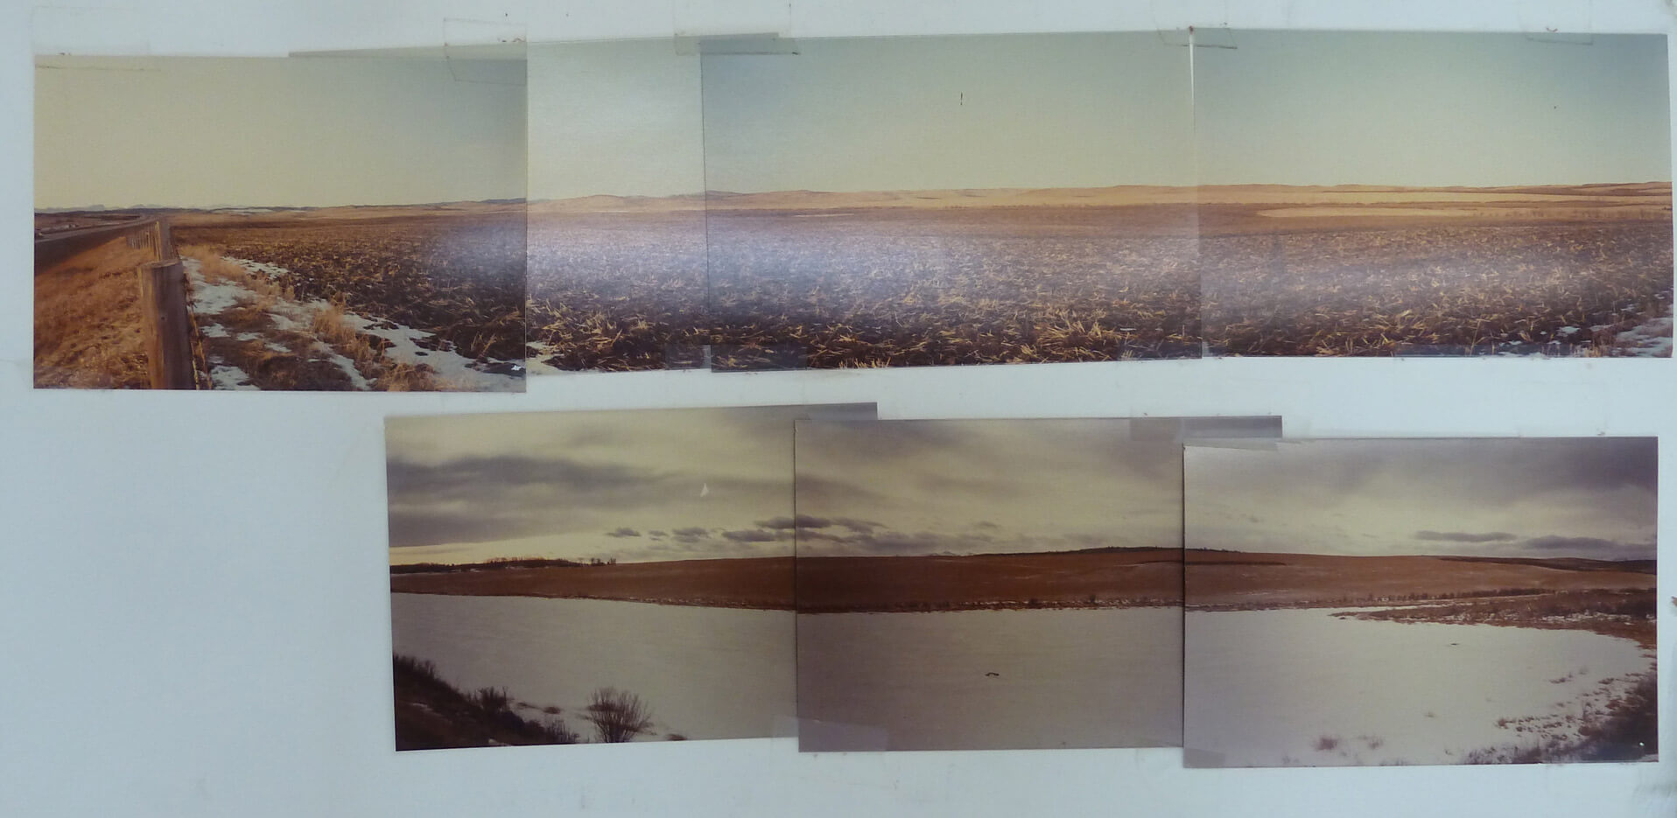
Culminating Task
Reference photographs of a prairie landscape enlarged and taped together, n.d., photographs by Takao Tanabe.

Slide 29
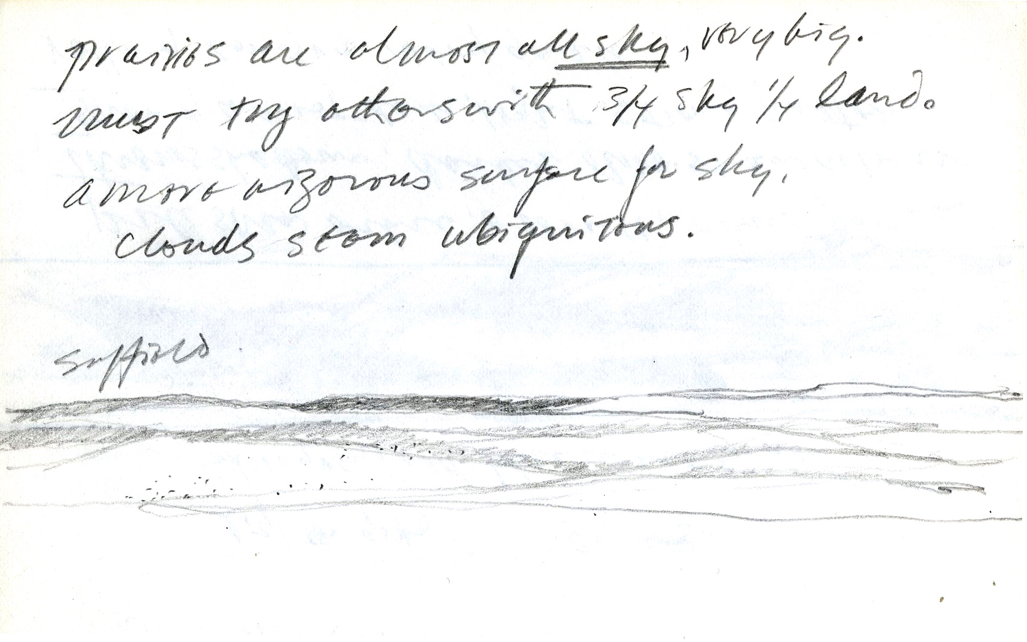
Culminating Task
Takao Tanabe, Landscape sketch in pencil, 1976. Tanabe has annotated this sketch, noting how prairies are “almost all sky” and that “clouds seem ubiquitous.”

Slide 30
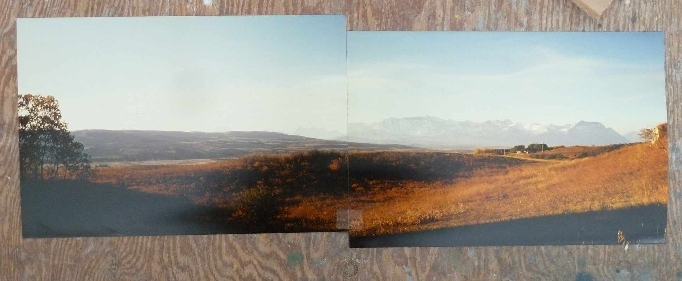
Culminating Task
Reference photographs of foothills in Alberta enlarged and taped together, n.d., photographs by Takao Tanabe.

Slide 31
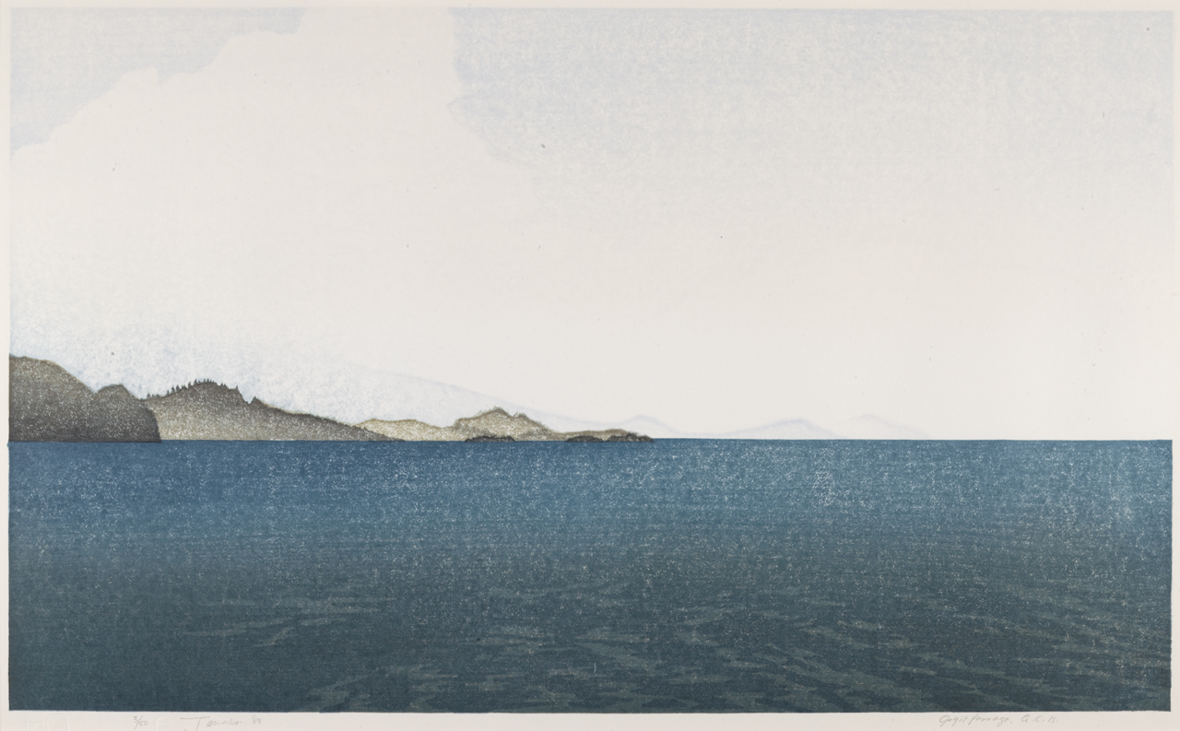
Takao Tanabe and Masato Arikushi (printer), Gogit Passage, Queen Charlotte Islands, 1988. This print is based on a series of paintings of Haida Gwaii, and was produced in collaboration with Masato Arikushi.

Slide 32
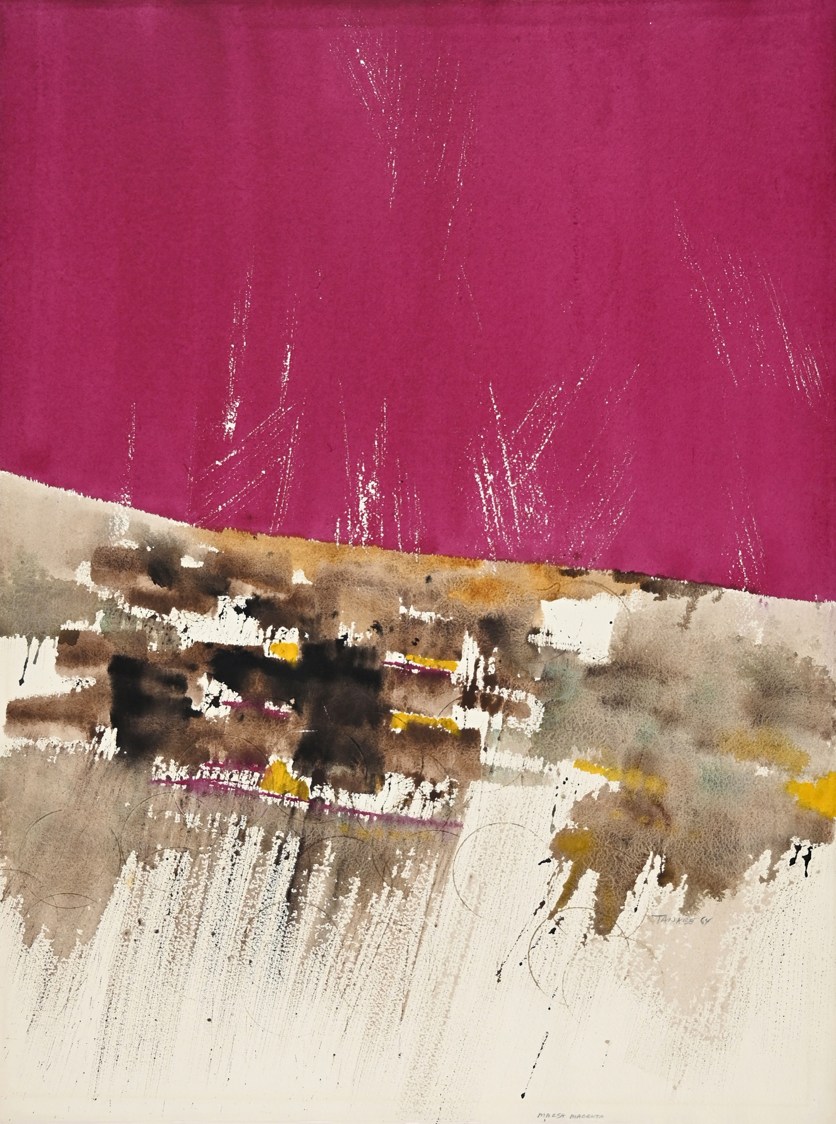
Takao Tanabe, Marsh, Magenta, 1964. This work on paper marks a transitional moment when Tanabe moved away from the influence of Abstract Expressionism.

Slide 33
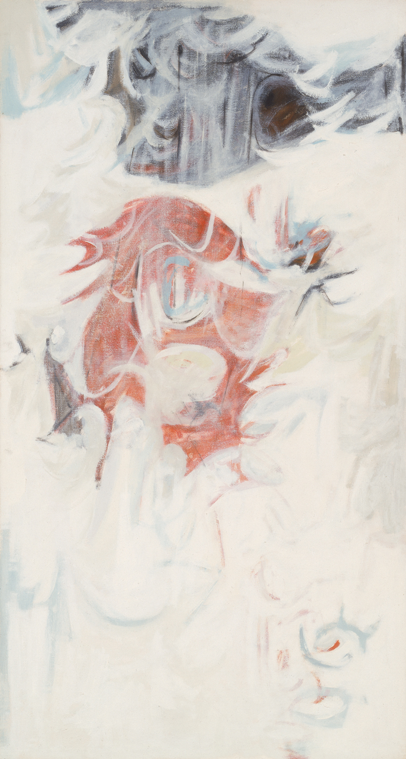
Takao Tanabe, A Region of Landlocked Lakes, 1958. An example of the artist’s painterly approach to abstraction, in this work Tanabe hints at forms that seem as though they could have been derived from nature.

Slide 34
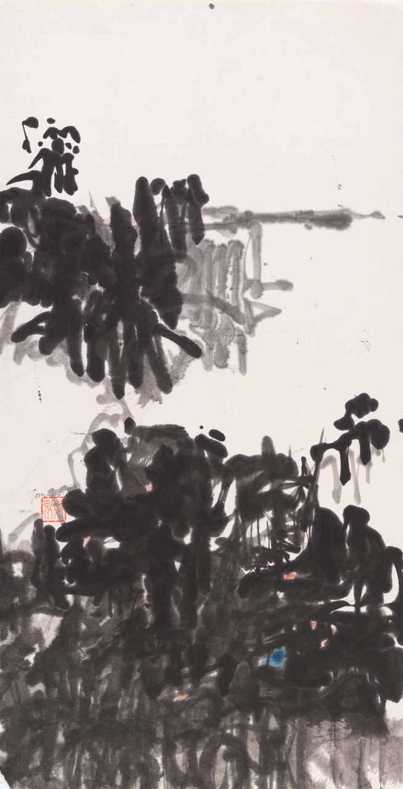
Takao Tanabe, Storm, 1960. This highly abstracted landscape was produced during Tanabe’s trip to Japan, during which he learned techniques associated with sumi-e.

Slide 35
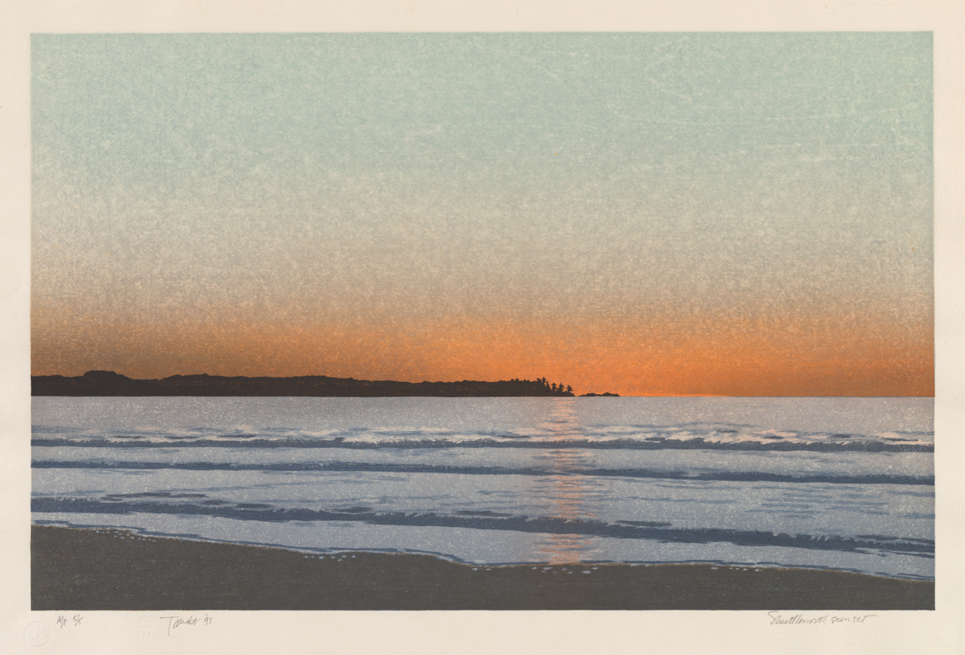
Takao Tanabe, Shuttleworth Sunset, 1993. This print depicts a sunset near Shuttleworth Bight, a remote beach located on the northern edge of Vancouver Island.

