Slide 2
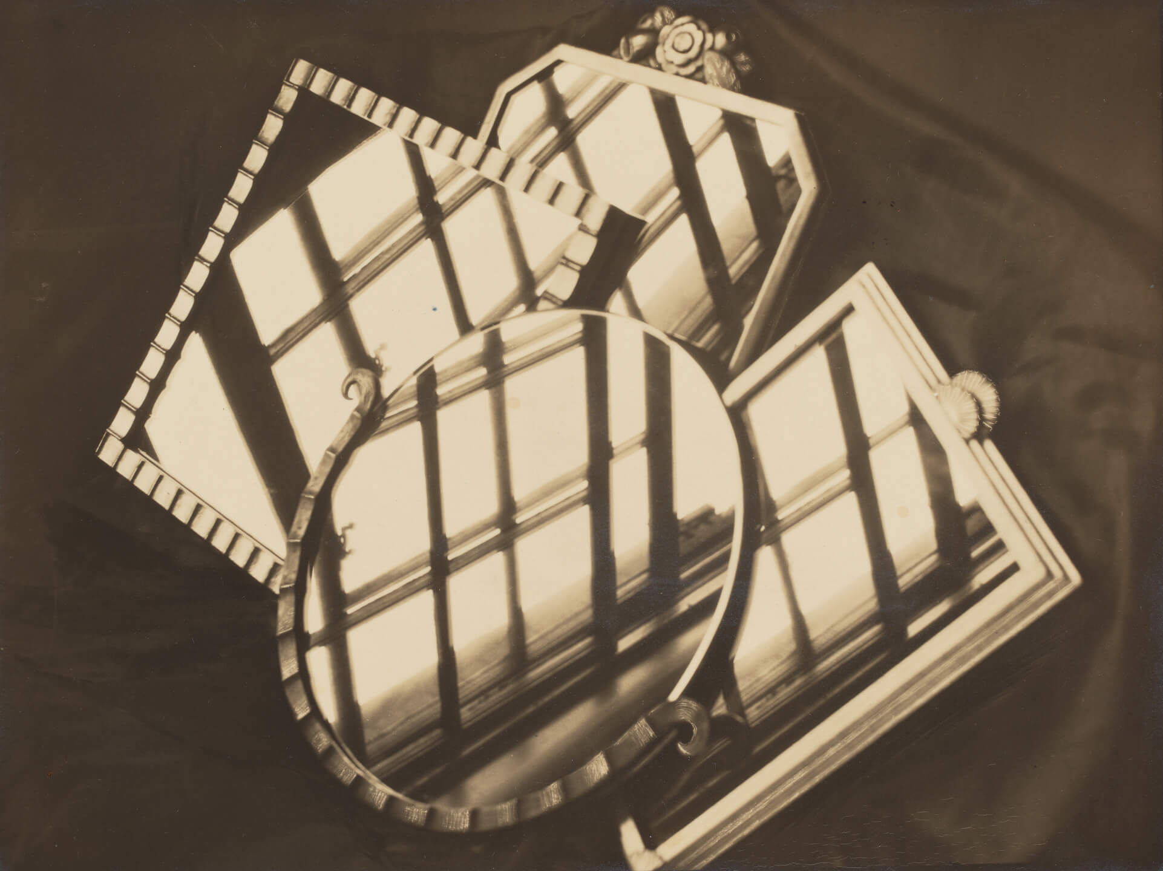
Margaret Watkins, Untitled [Still Life with Mirrors and Windows, NYC], 1927. Watkins experimented with angles and geometry in works like this one. ​

Slide 3
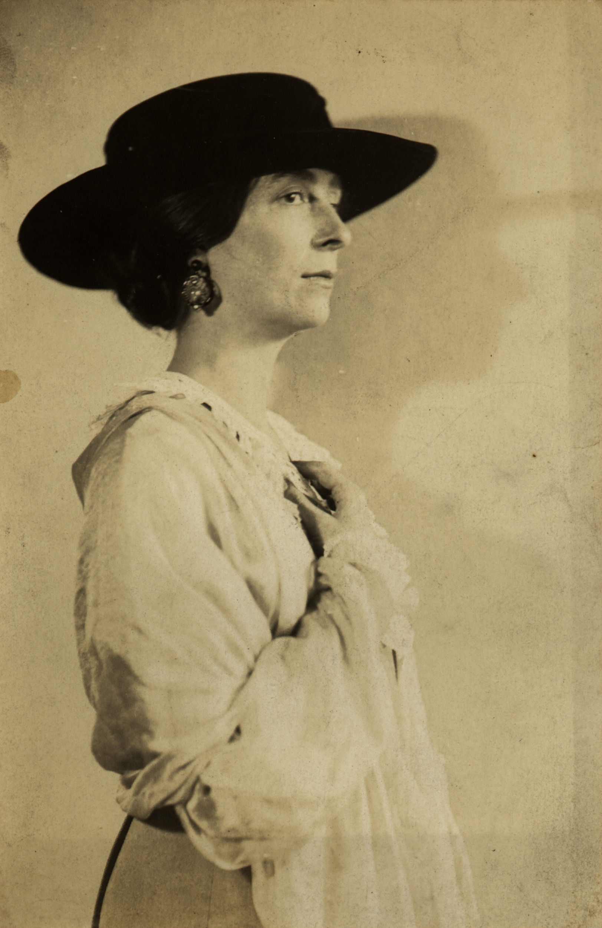
Portrait of Margaret Watkins by Alice Boughton, c.1919.

Slide 4
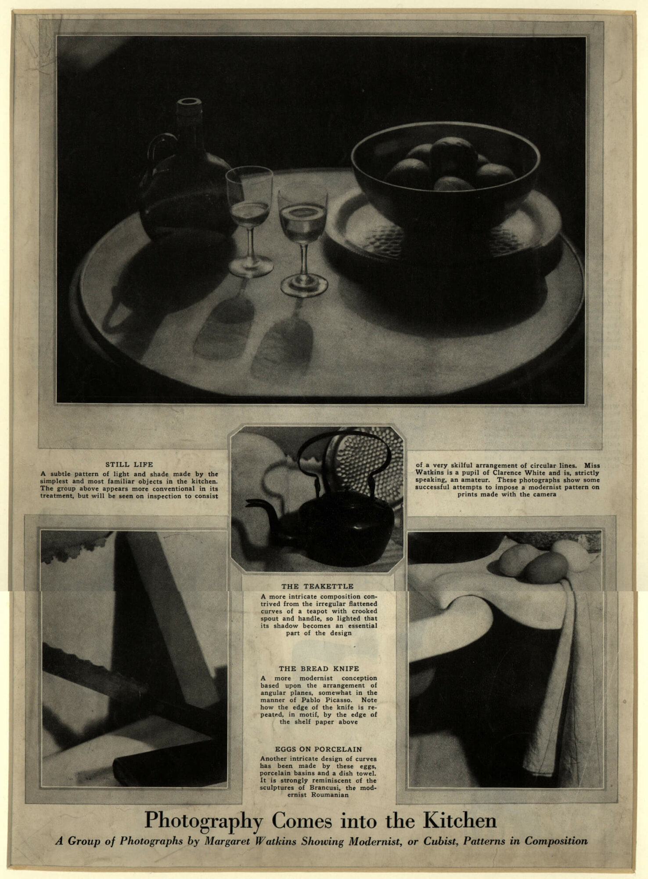
“Photography Comes into the Kitchen,” Vanity Fair 17, no. 2, October 1921. This magazine feature was a benchmark in public exposure for Watkins.

Slide 5
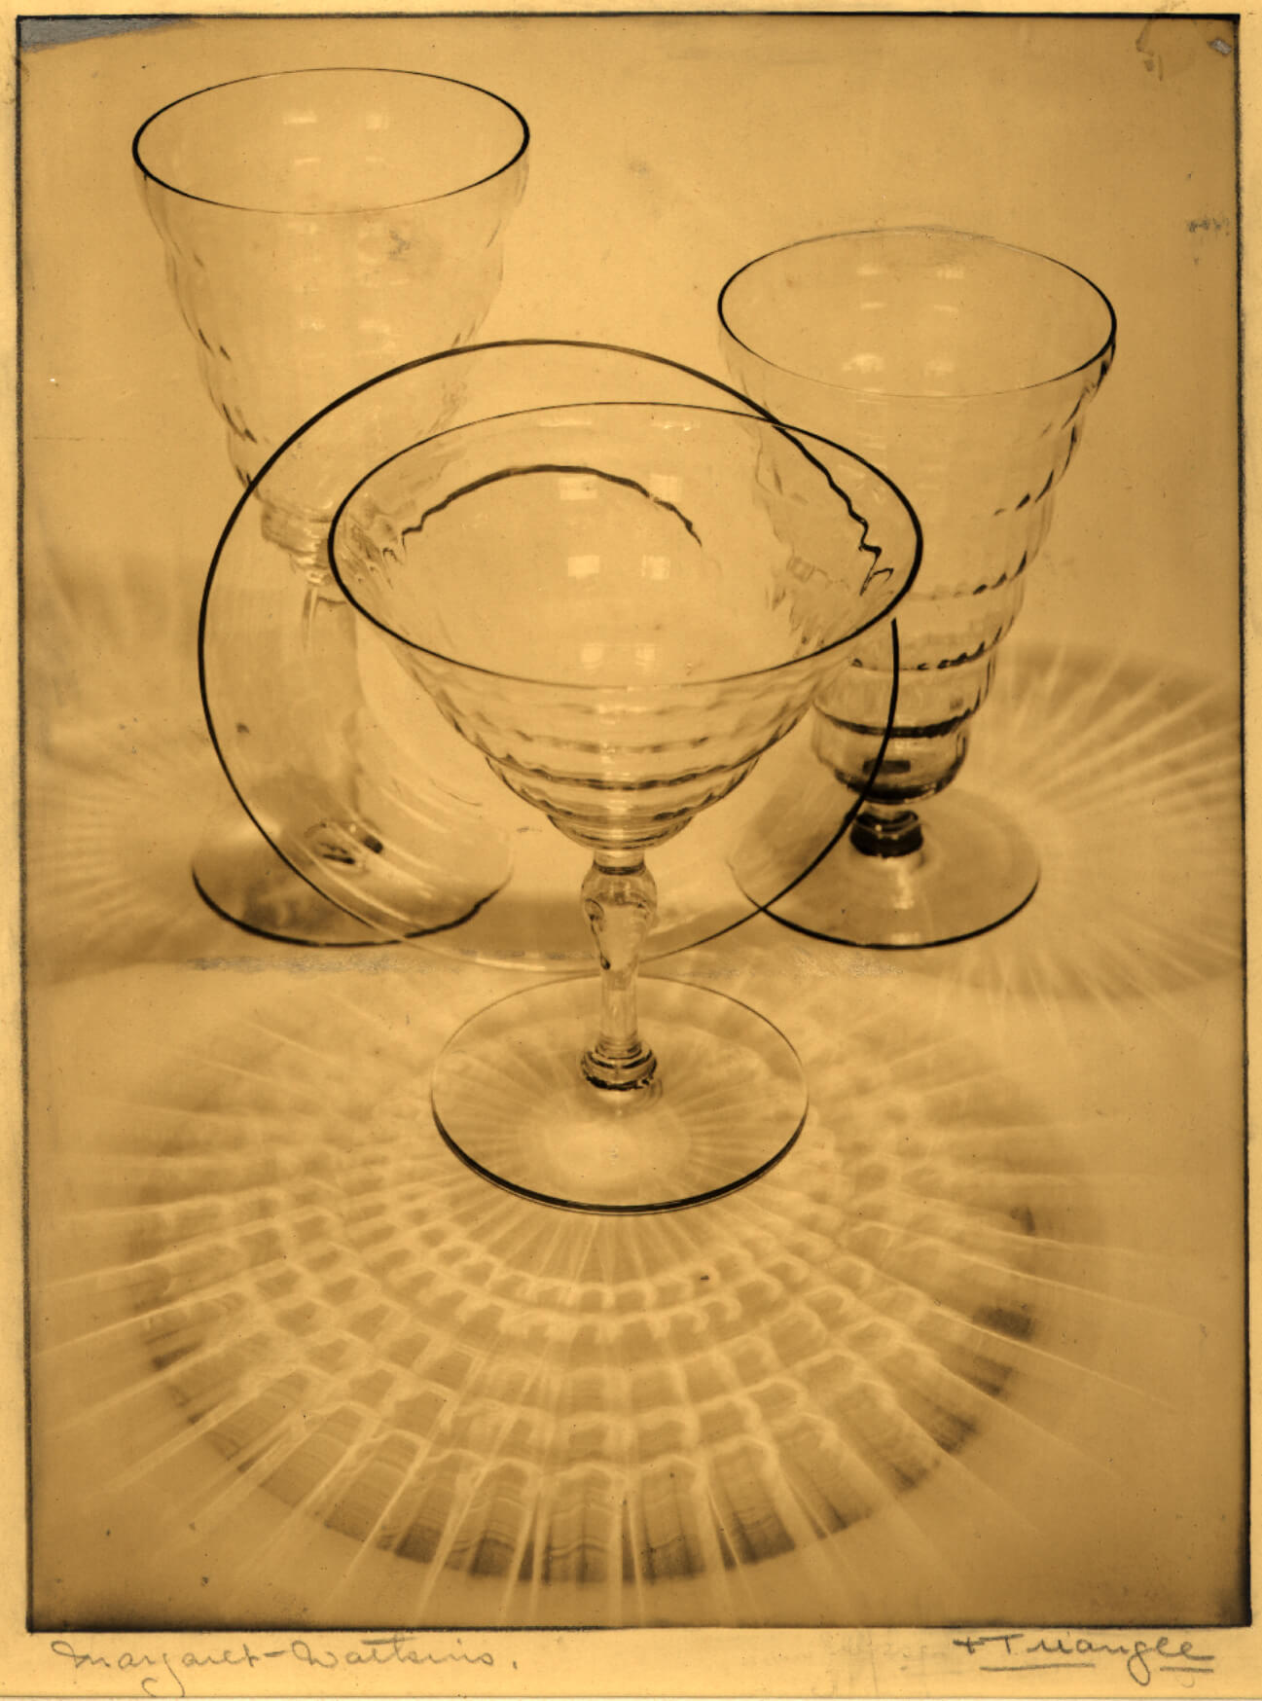
Margaret Watkins, Ellipse & Triangle, 1924–28. This image shows Watkins’s geometric patterns in a commercial context: a glassware advertisement for Macy’s department store.

Slide 6
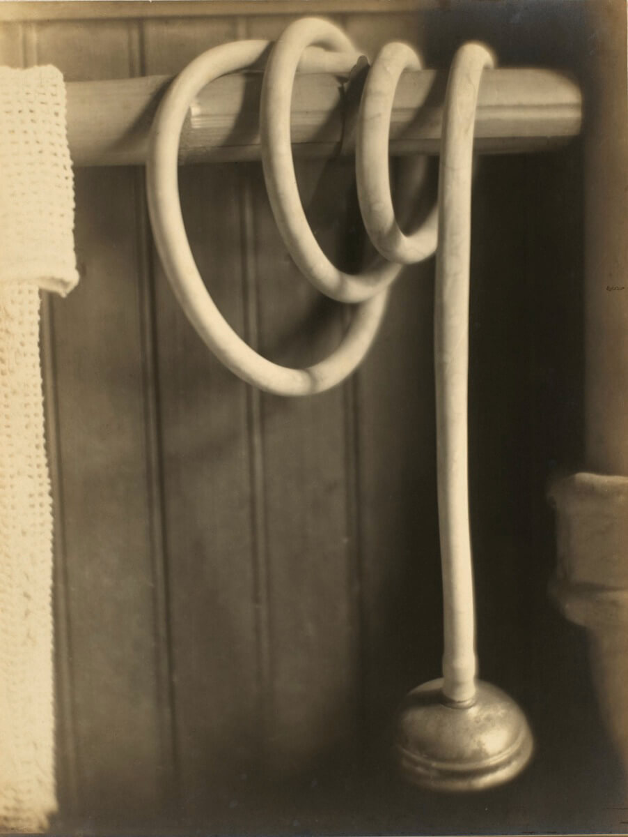
Margaret Watkins, Still Life – Shower Hose, 1919. Here, Watkins builds a hypnotic spiral composition out of an ordinary shower hose.

Slide 7
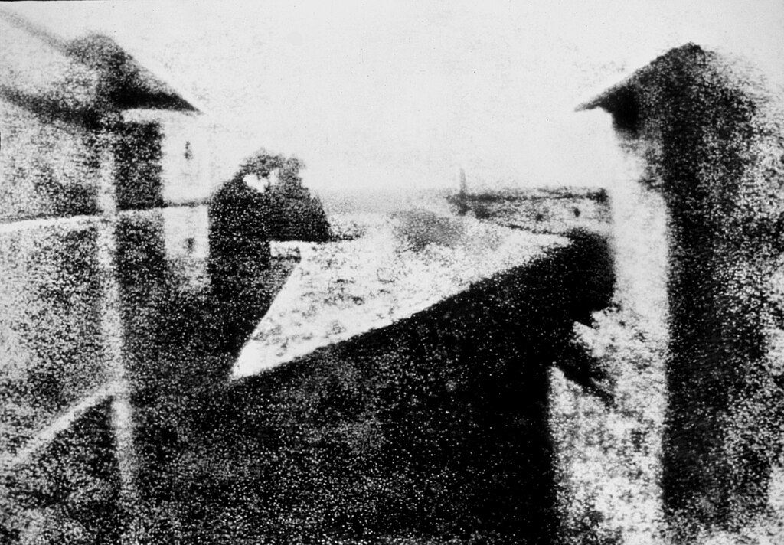
Joseph Nicéphore Niépce, View from the Window at Le Gras, 1827. This is considered to be the first permanent photographic image.

Slide 8
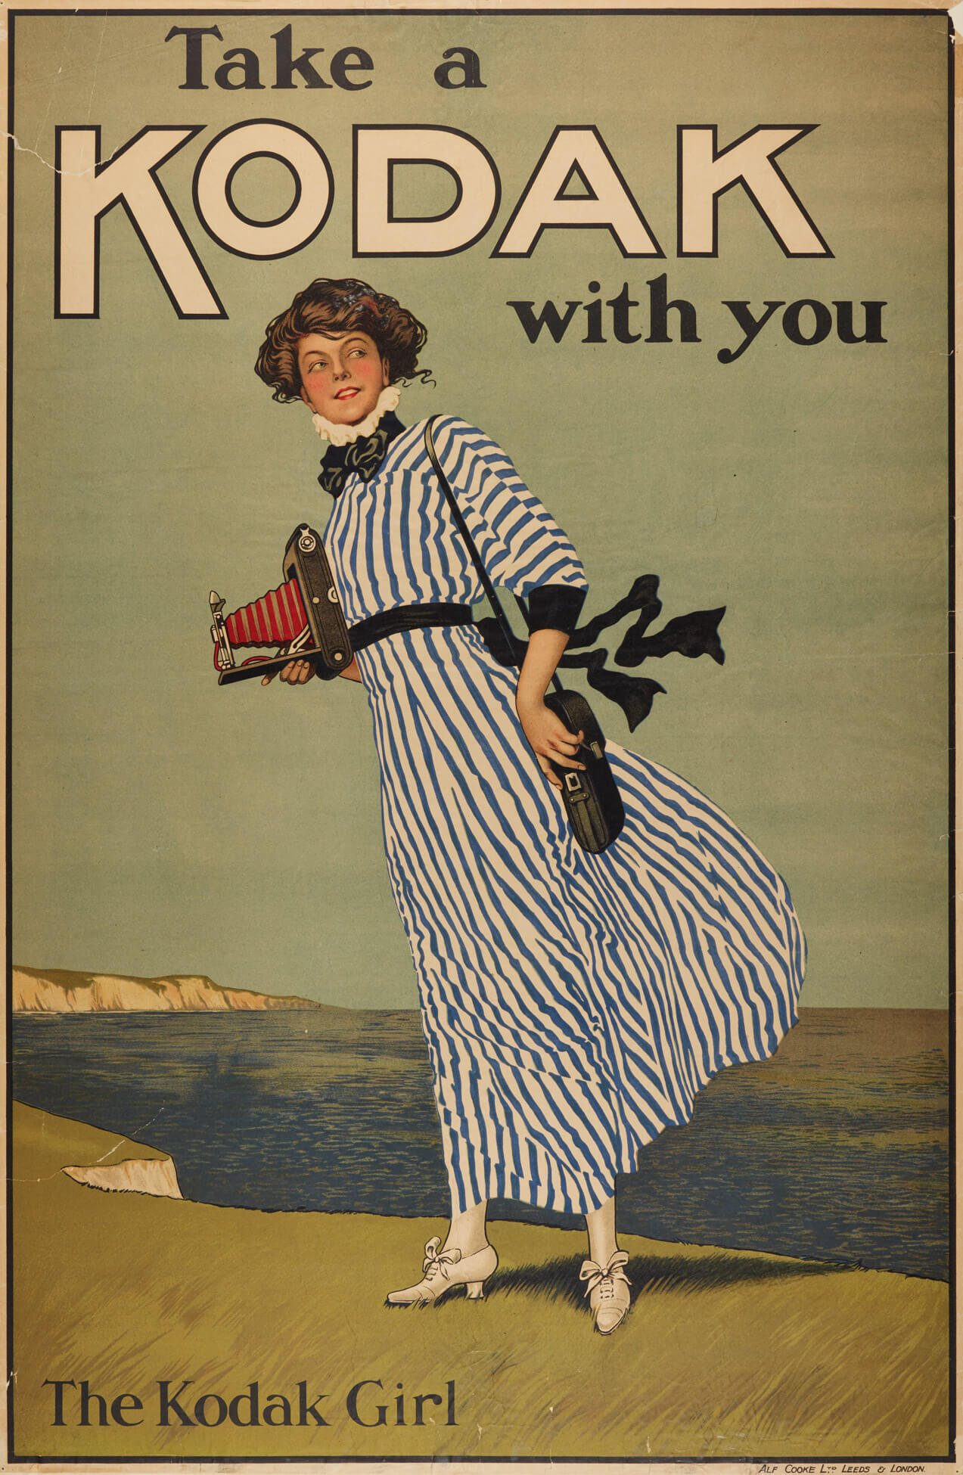
Eastman Kodak Company, “Take a Kodak with you,” date unknown. This style of illustrated advertisement was highly popular before the 1920s.

Slide 9
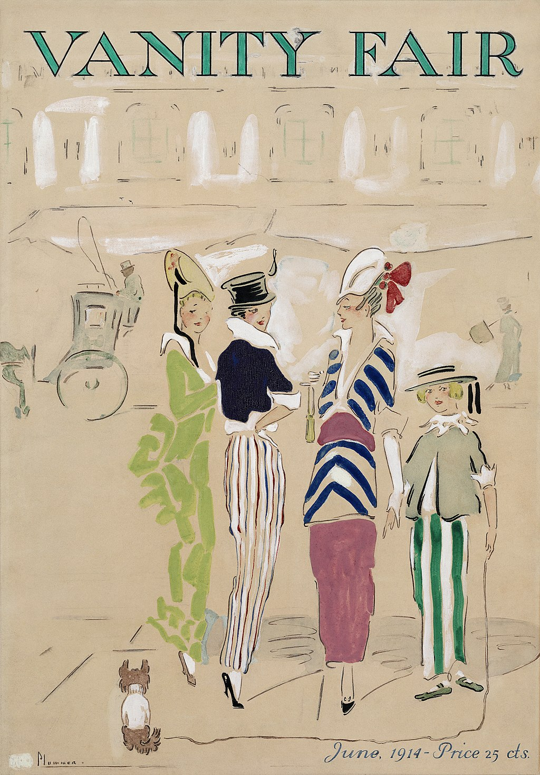
Ethel M’Clellan Plummer, Cover of Vanity Fair, June 1914. In its original run from 1913 to 1936, this magazine published literature and art criticism.

Slide 10
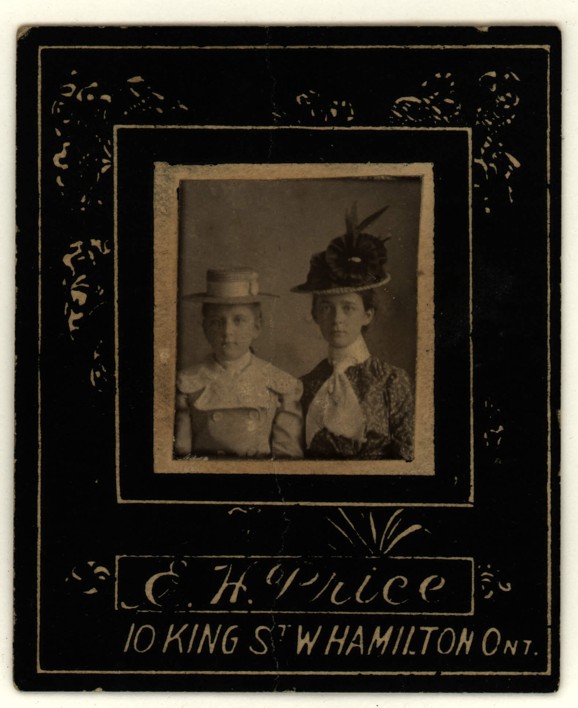
From left: Photograph of an unidentified person and Meta G. Watkins (Margaret Watkins).

Slide 11
Poster for the film
Archive Traces: Margaret Watkins Photographer, poster design by Sarah Dinnick, film directed by Mary O’Connor and Katherine Tweedie, 2022.

Slide 12
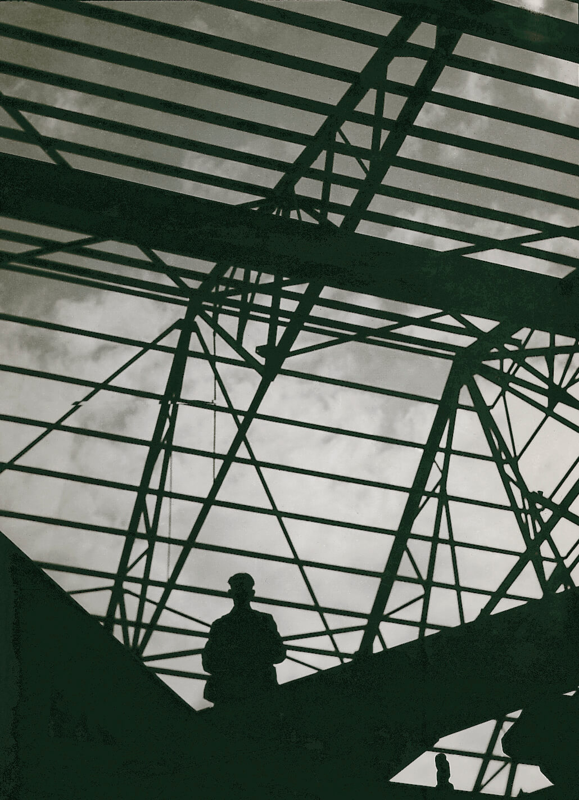
Margaret Watkins,
Untitled [Construction, Glasgow], 1928–38. Watkins used the beams and towers of Glasgow’s industrial buildings
as patterns in her photographs.

Slide 13
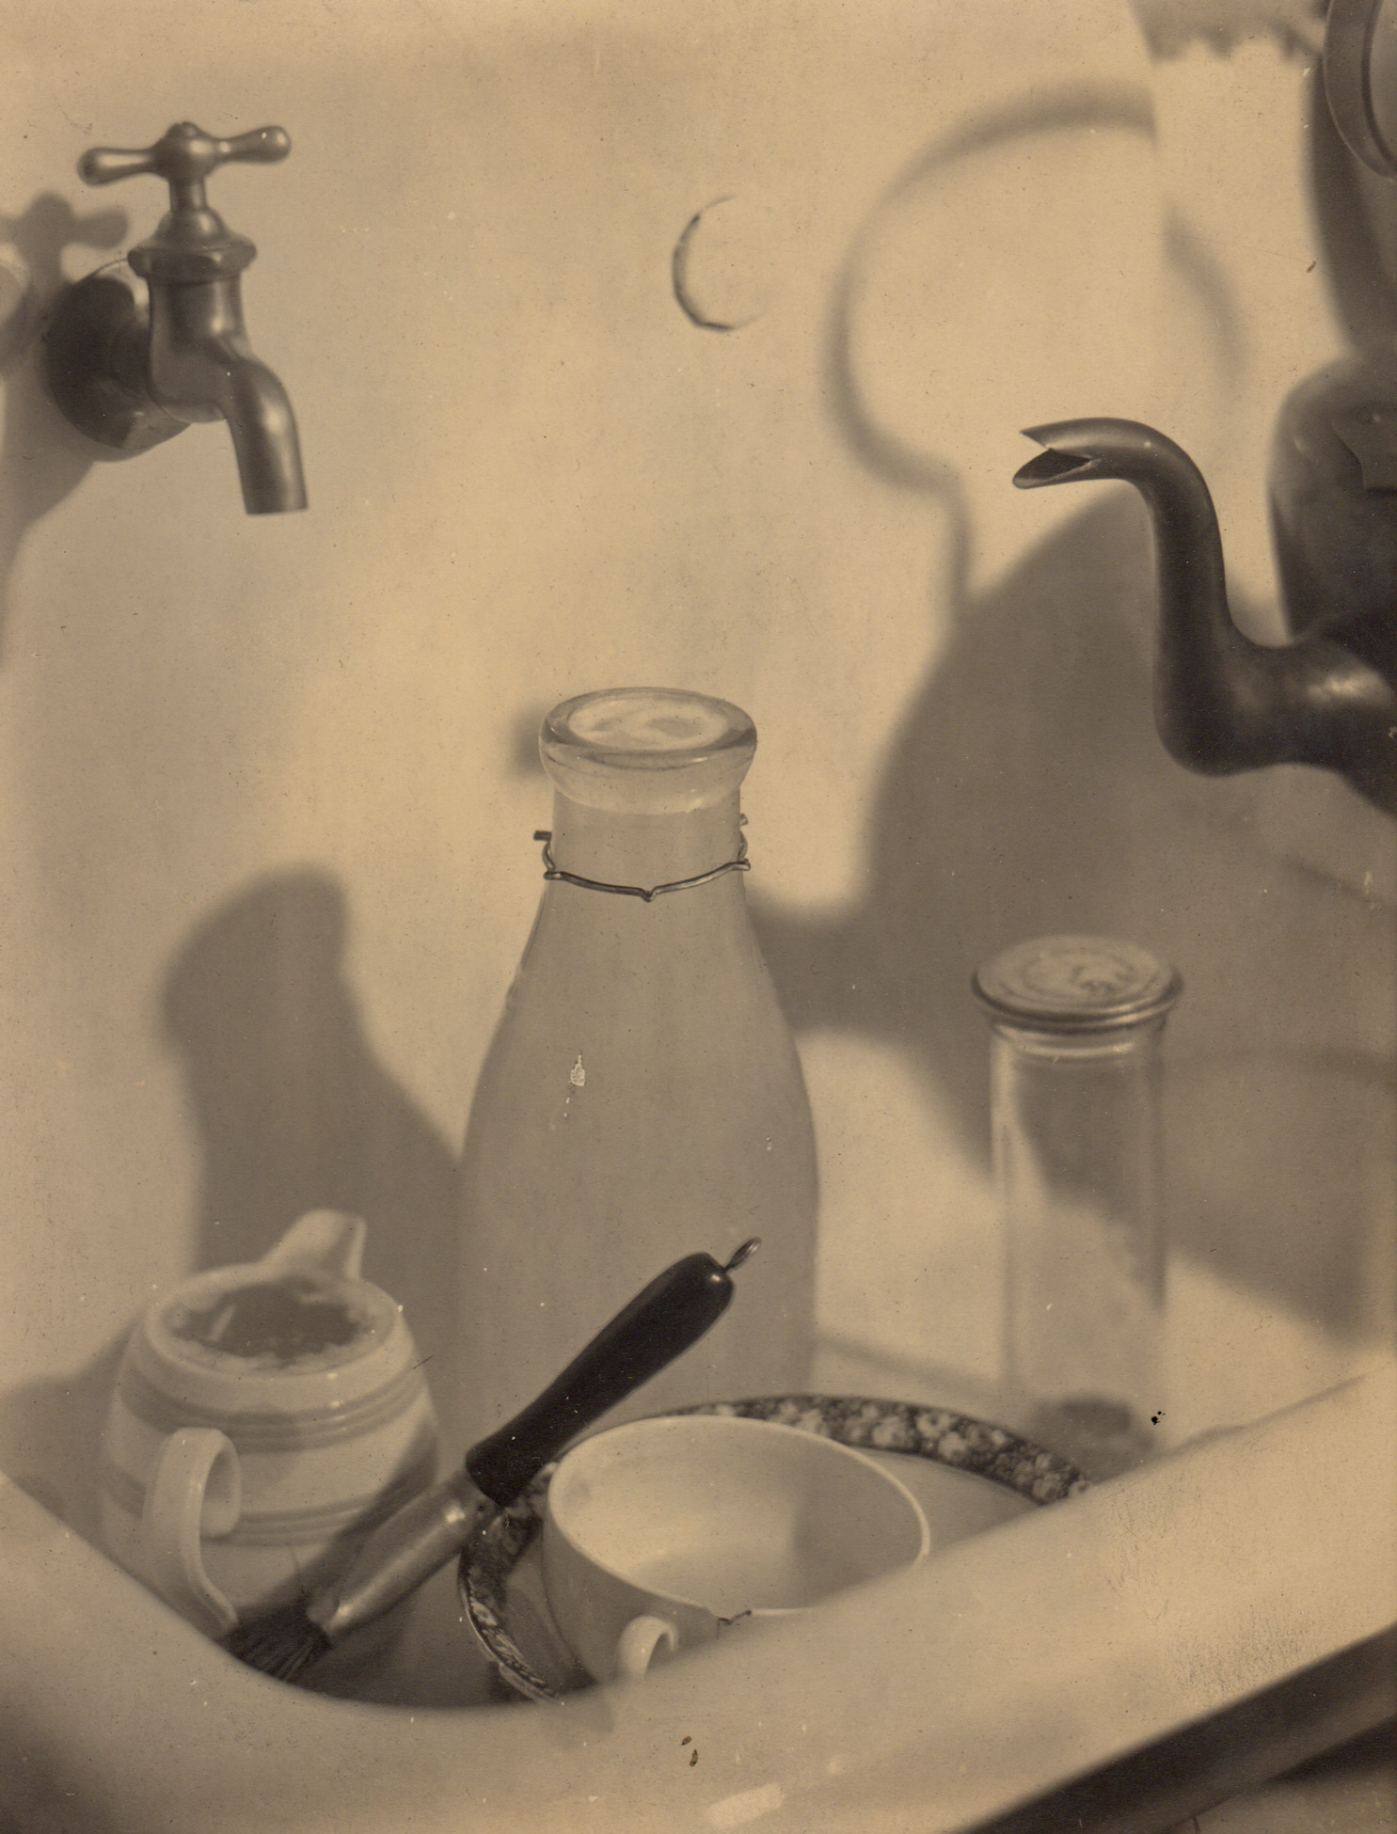
Learning Activity #1 ​
Margaret Watkins, The Kitchen Sink, 1919. One of Watkins’s most famous works, this photo of her own sink is framed around a milk bottle and chipped crockery.

Slide 14
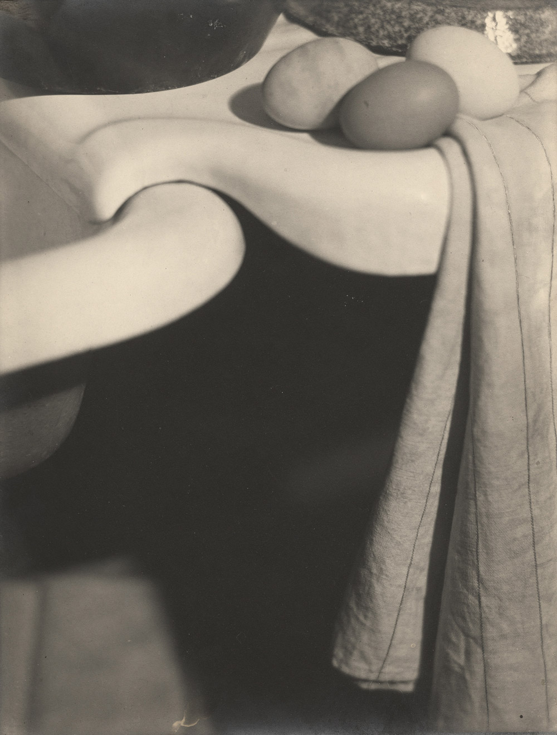
Learning Activity #1 ​
Margaret Watkins, Domestic Symphony, 1919. This photo balances curving patterns of eggs and a sink against a large patch of shadow, creating visual contrast.

Slide 15
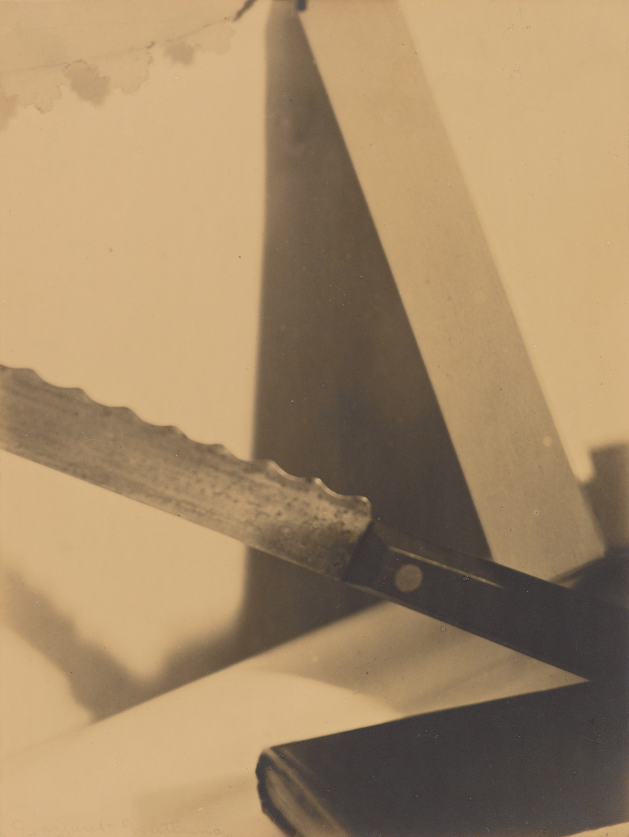
Learning Activity #1 ​
Margaret Watkins, Design – Angles, 1919. This photograph appeared in Vanity Fair’s 1921 feature on Watkins.

Slide 16
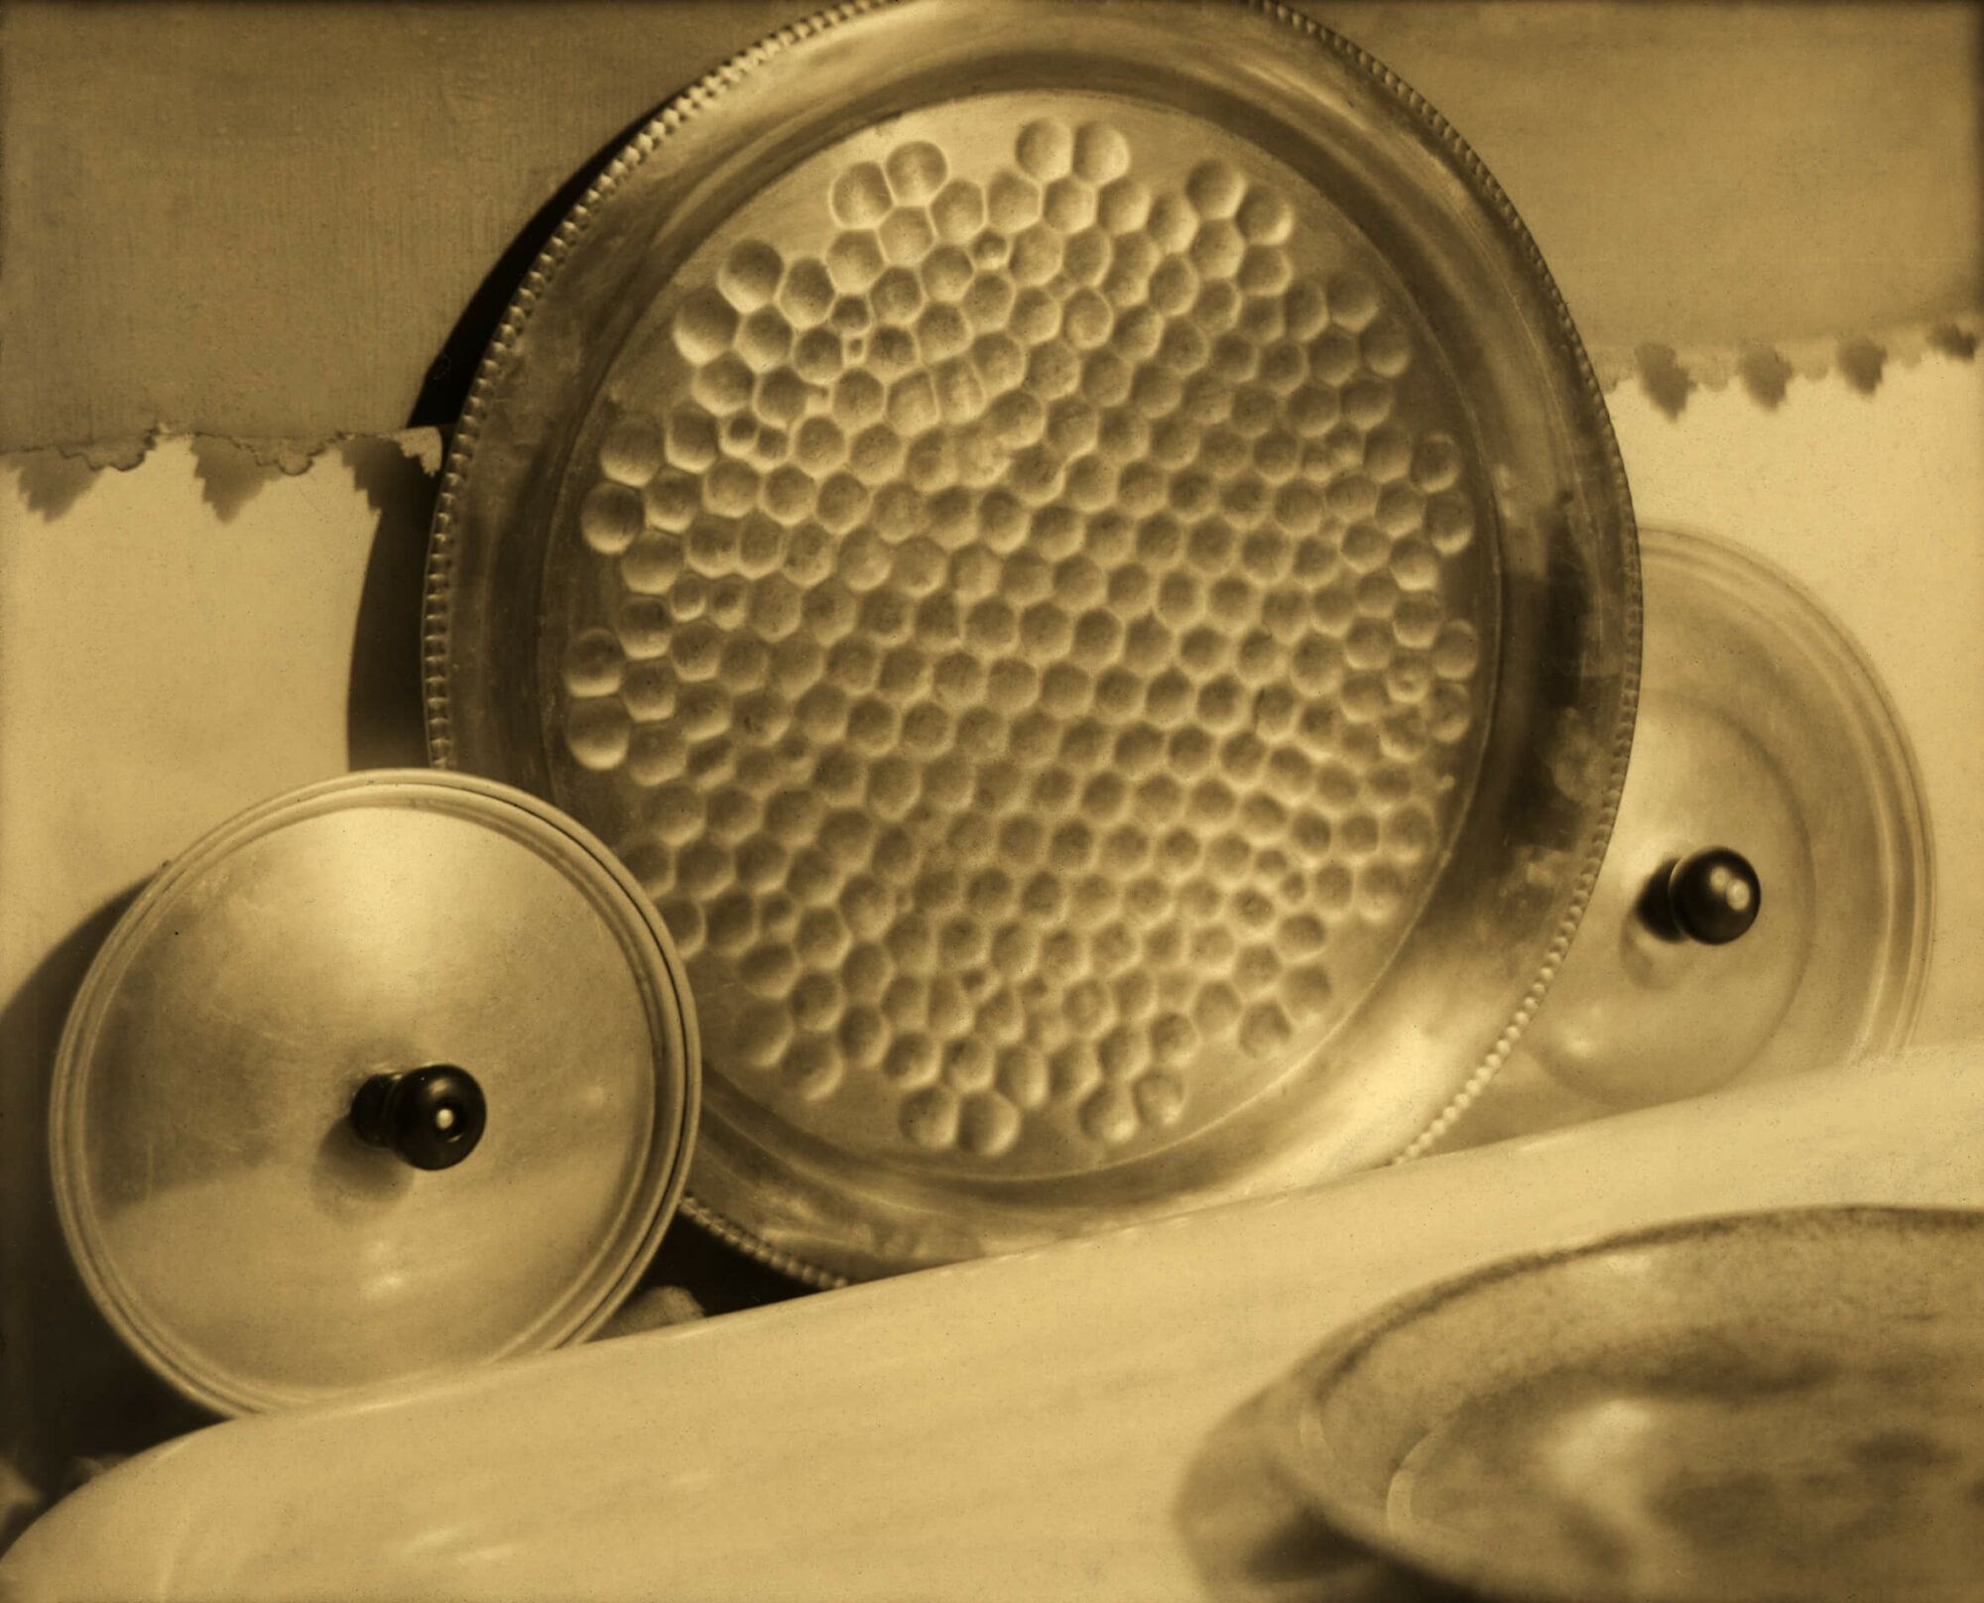
Learning Activity #1
Margaret Watkins, Still Life – Circles, 1919. Using ordinary kitchen dishes, this photo creates a composition of circles that resembles abstract painting.

Slide 17
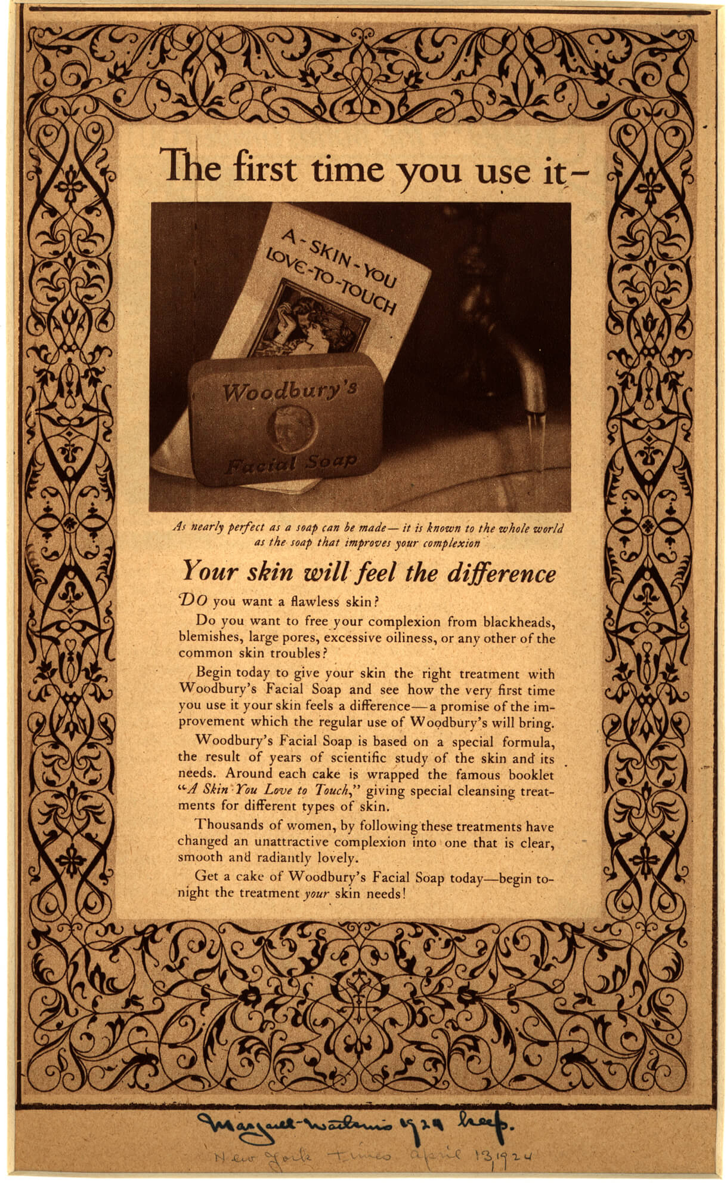
Learning Activity #2
Advertisement for Woodbury’s Soap, “the first time you use it,” in the New York Times, April 13, 1924. This advertisement features a photo by Watkins that emphasizes the soap’s visual appeal using contrasting shapes.

Slide 18
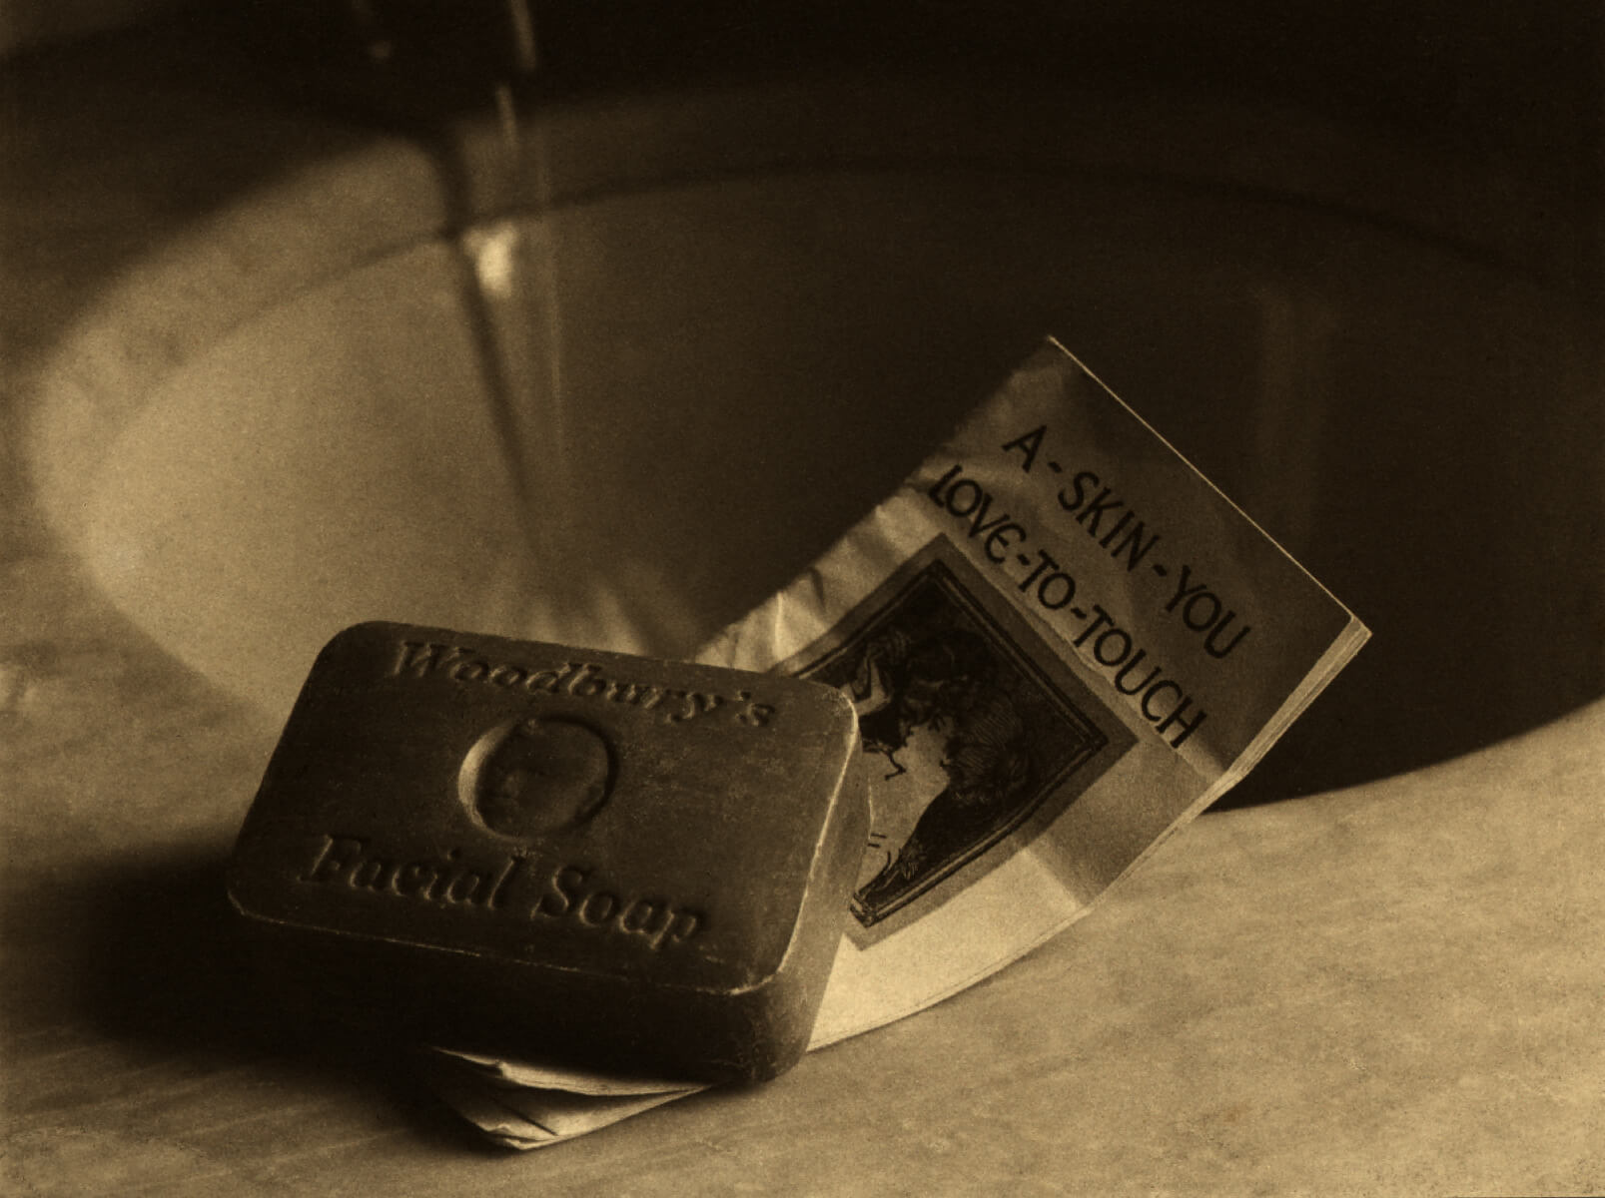
Learning Activity #2​
Margaret Watkins, Study for an ‘Ad’ [Woodbury’s Soap], 1924. Designed to be used in an advertisement, this photo nevertheless resembles Watkins’s domestic still life photos.

Slide 19
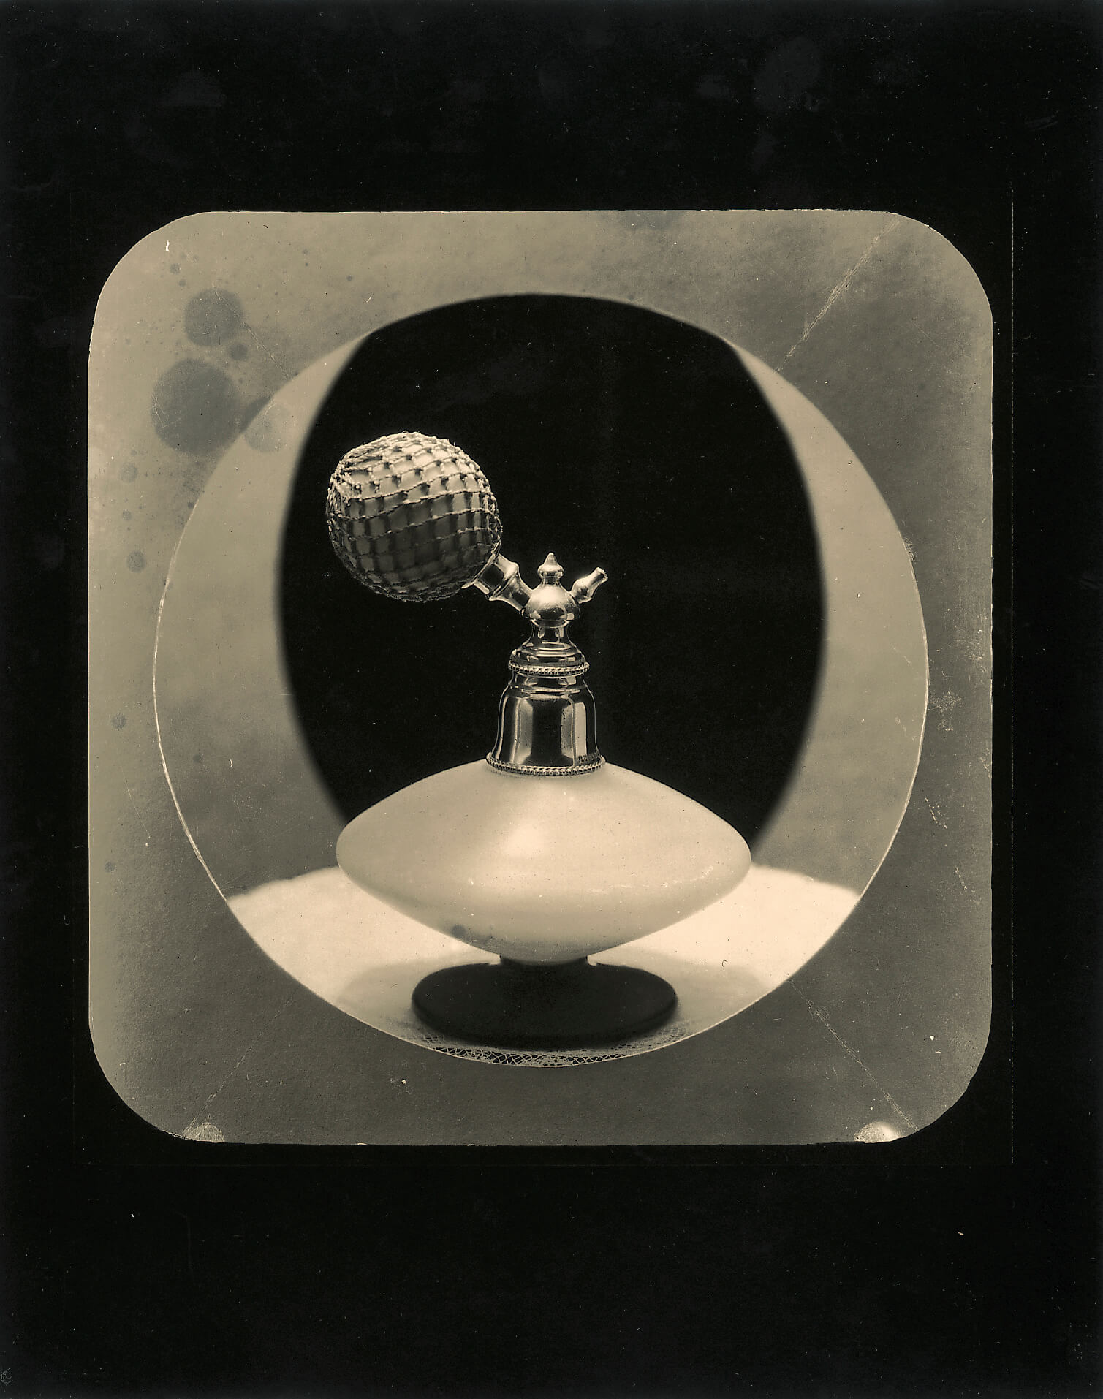
Learning Activity #2​
Margaret Watkins, Untitled [Perfume atomizer Advertisement], 1924–28. This image’s circular structure complements the off-kilter shape of the perfume bottle.

Slide 20
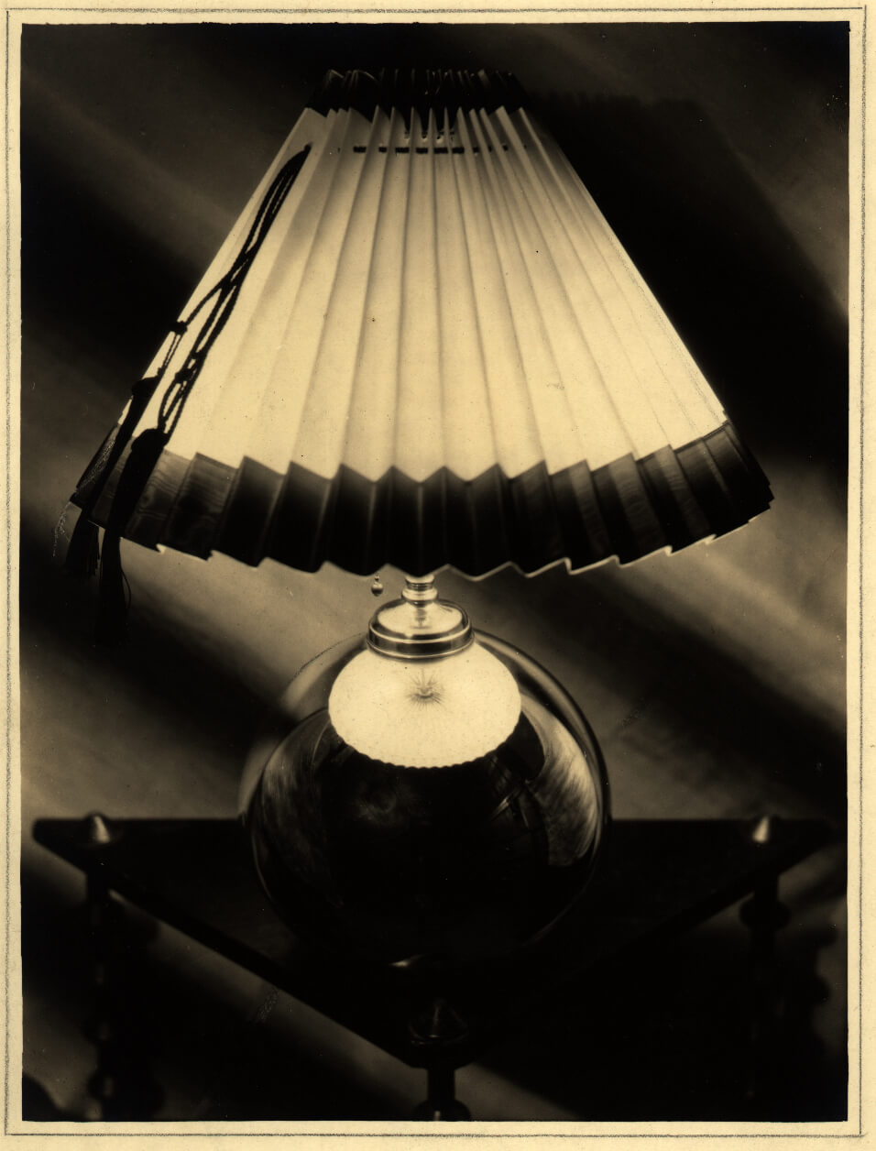
Learning Activity #2​
Margaret Watkins, Untitled [Lamp, study for Macy’s advertisement], 1925–27. The rays of light cutting across this photo play against the lampshade’s vertical folds.

Slide 21
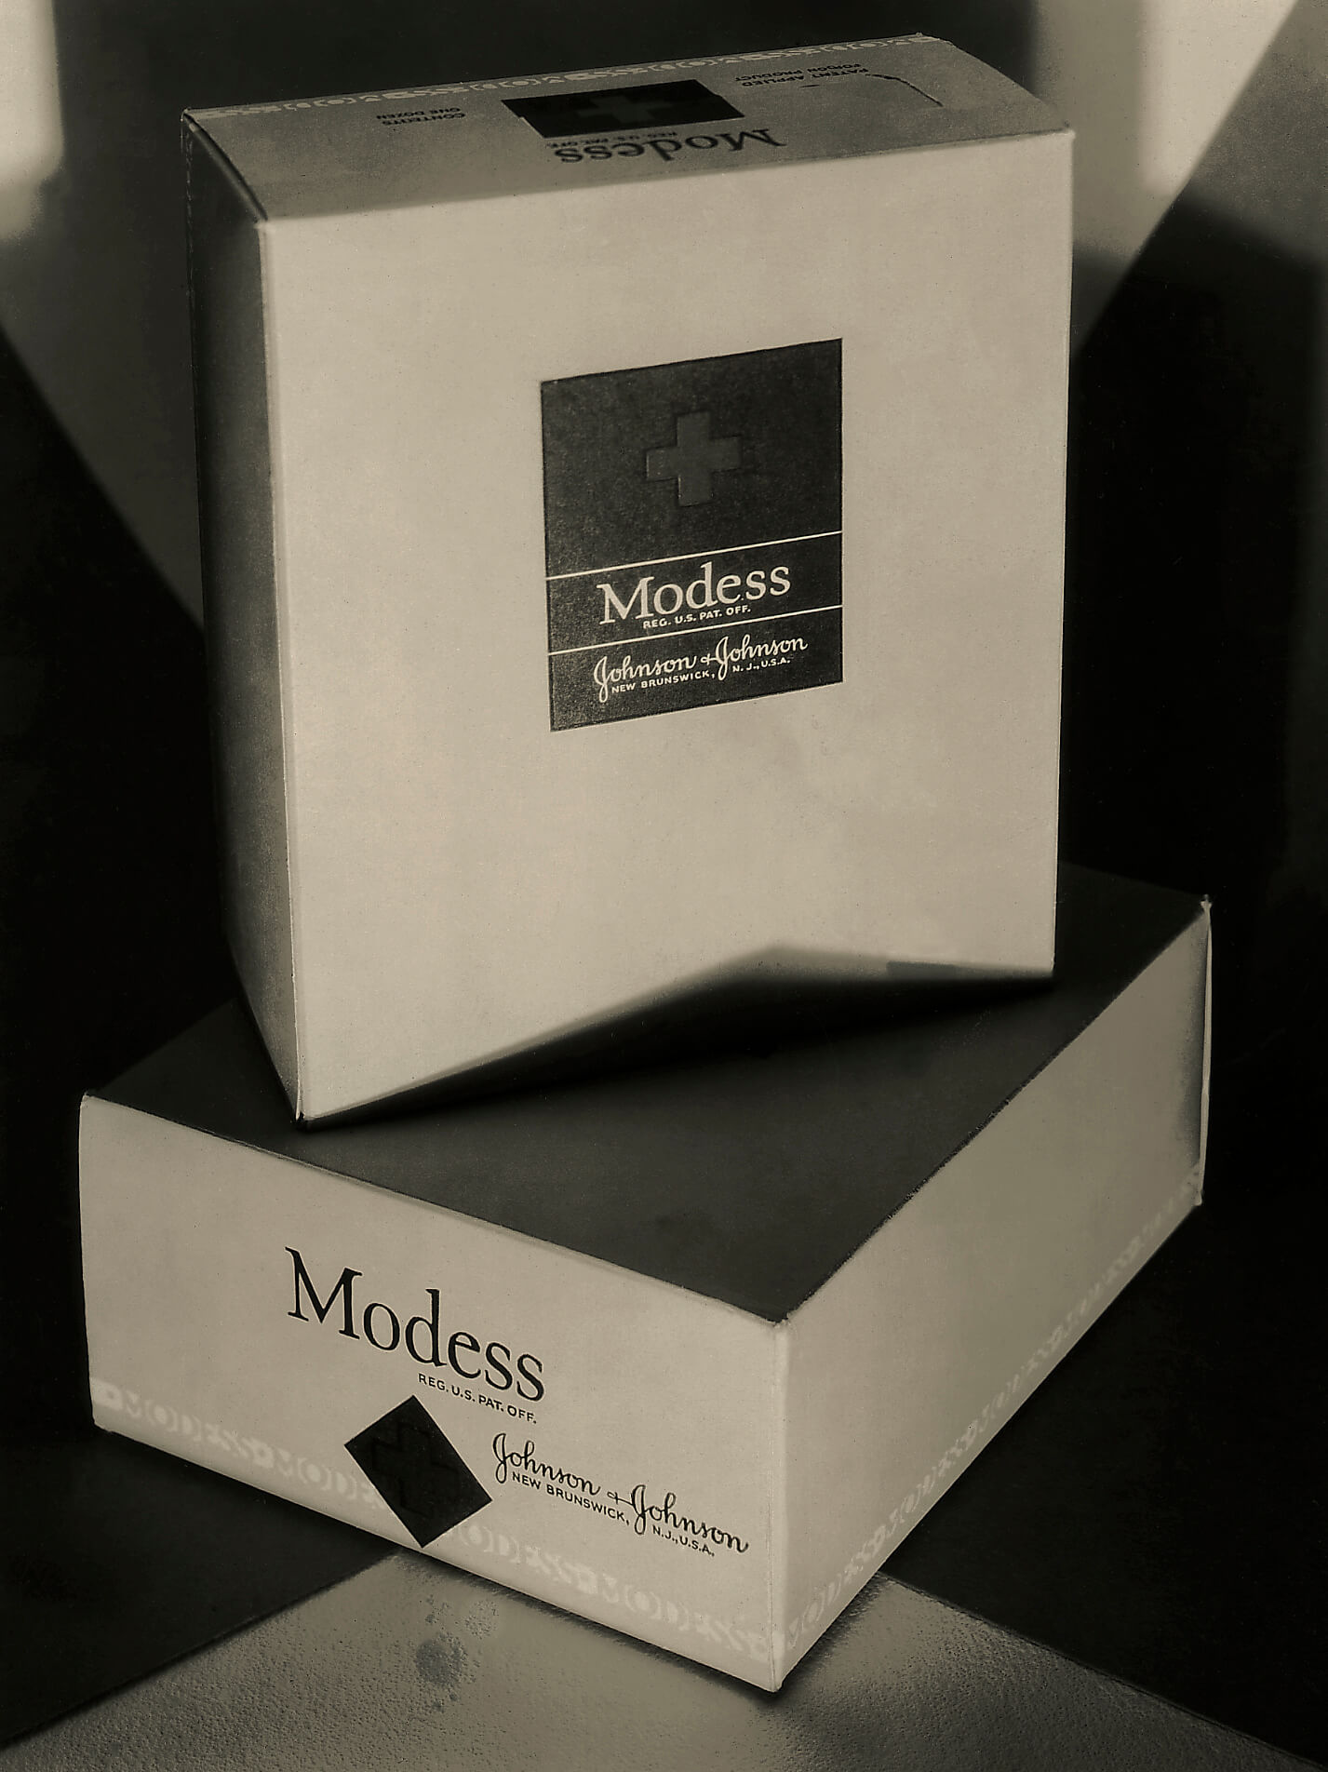
Learning Activity #2​
Margaret Watkins, Untitled [Johnson & Johnson Modess sanitary napkin ad], 1924–28. Here, Watkins entices using only the product’s box, as was customary for sanitary napkin ads of the era.

Slide 22
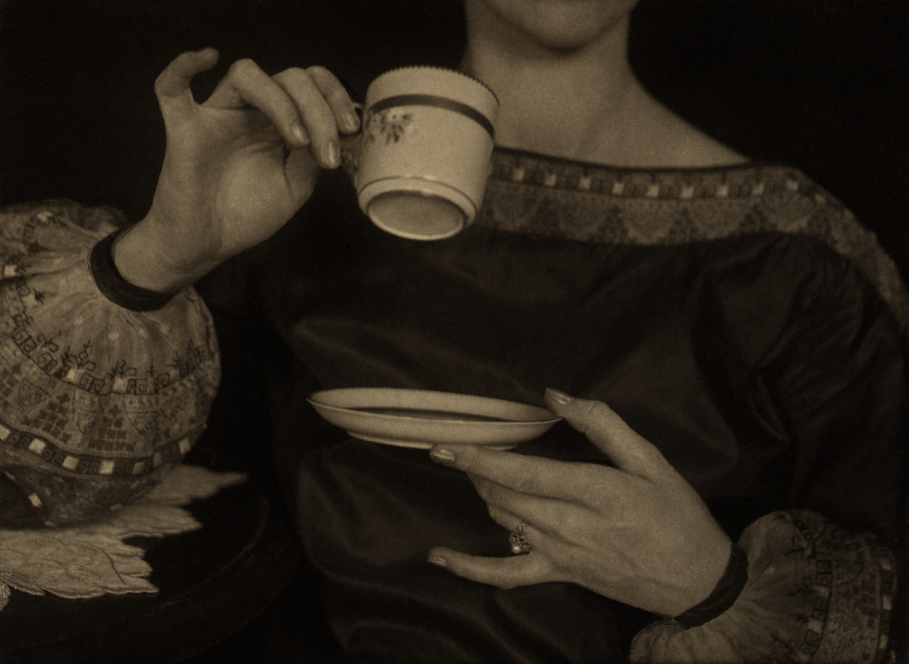
Learning Activity #2​
Margaret Watkins, The Tea Cup [advertisement for Cutex], 1924. This advertisement for nail treatment doesn’t feature the product at all, but rather subtly directs the eye towards the subject’s hands.

Slide 23
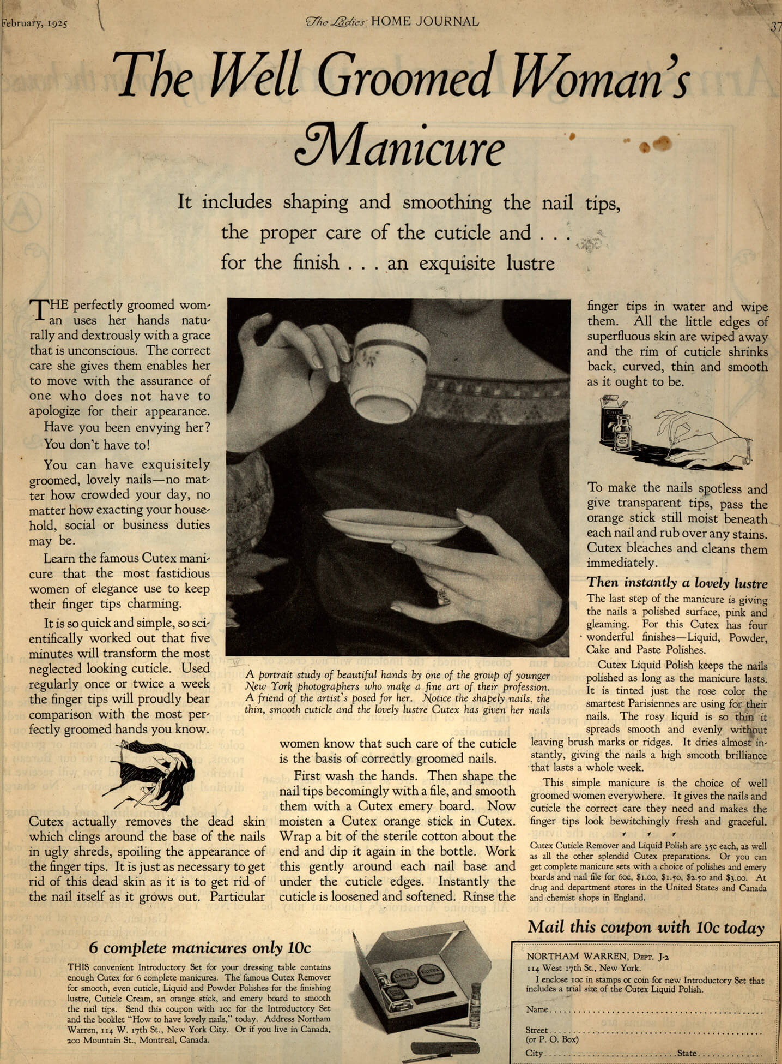
Learning Activity #2​
Cutex advertisement “The Well Groomed Woman’s Manicure,” in Ladies’ Home Journal 42, issue 2, February 1925. This advertisement featuring Watkins’s cropped photo was included in a popular women’s magazine.

Slide 24
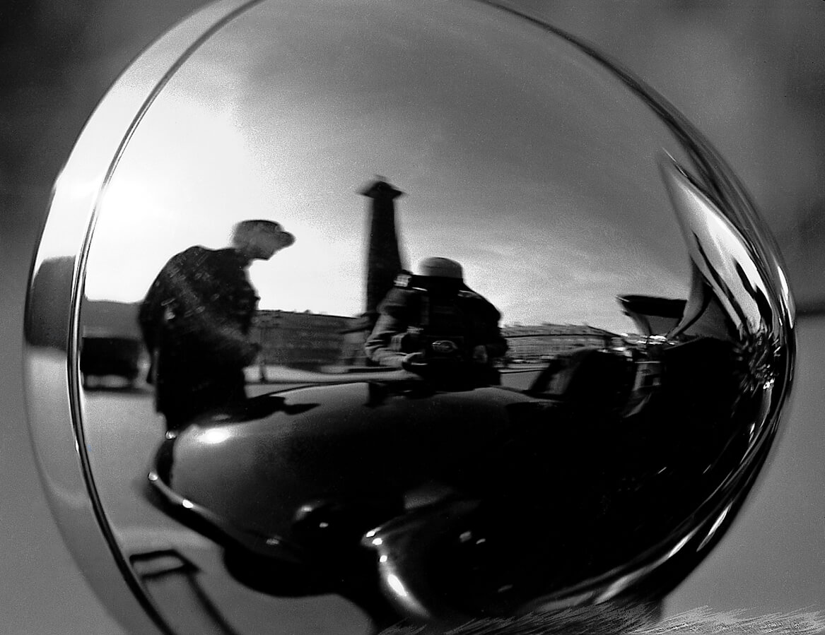
Culminating Task
Margaret Watkins, Untitled [Self-Portrait], 1931. This self-portrait, featuring a barely visible Watkins, was taken in Paris using a car lamp’s reflection.

Slide 25
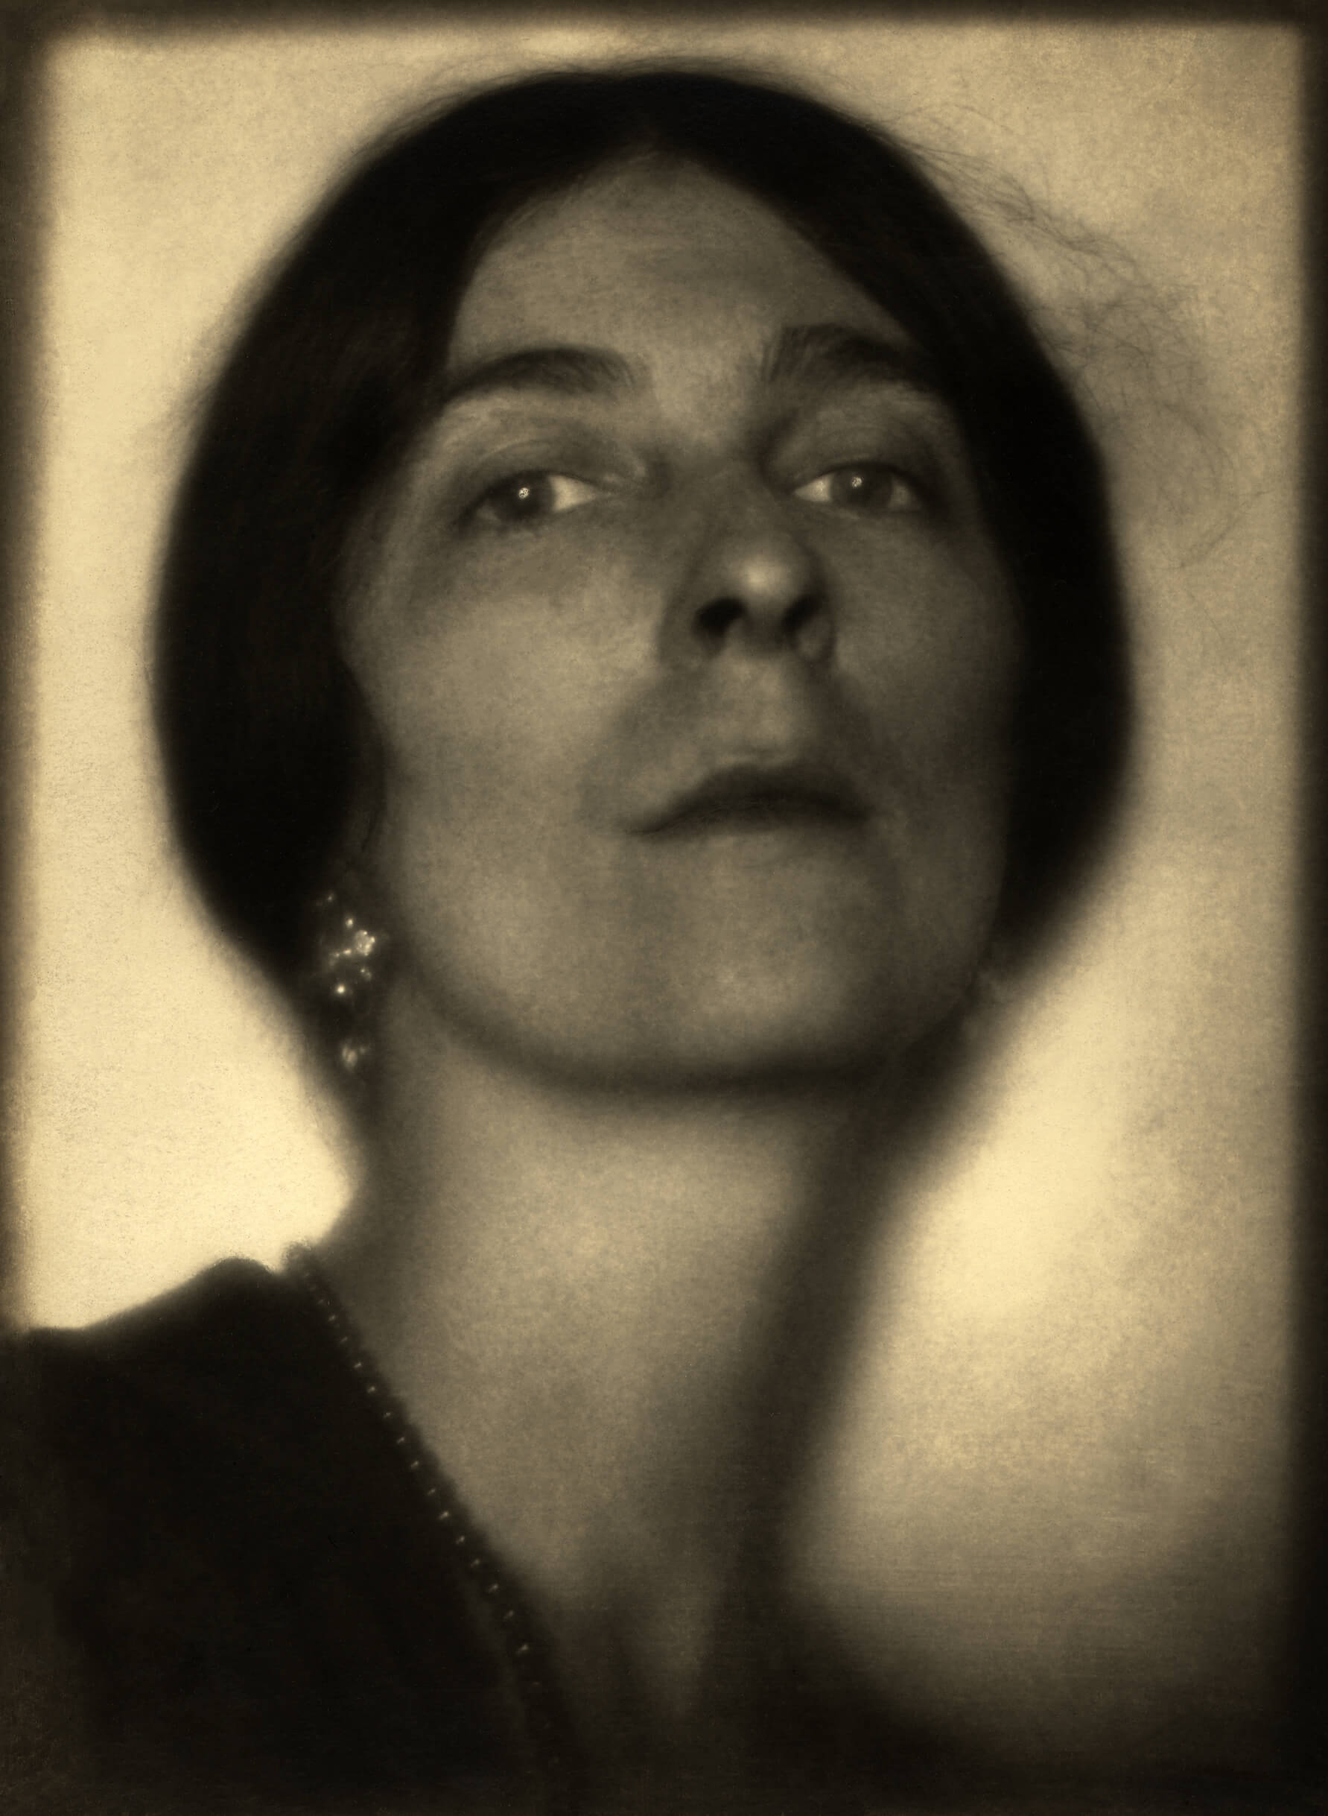
Culminating Task​
Margaret Watkins, Self-Portrait, 1923. Watkins offered this work to a newspaper to accompany an article on her work.

Slide 26
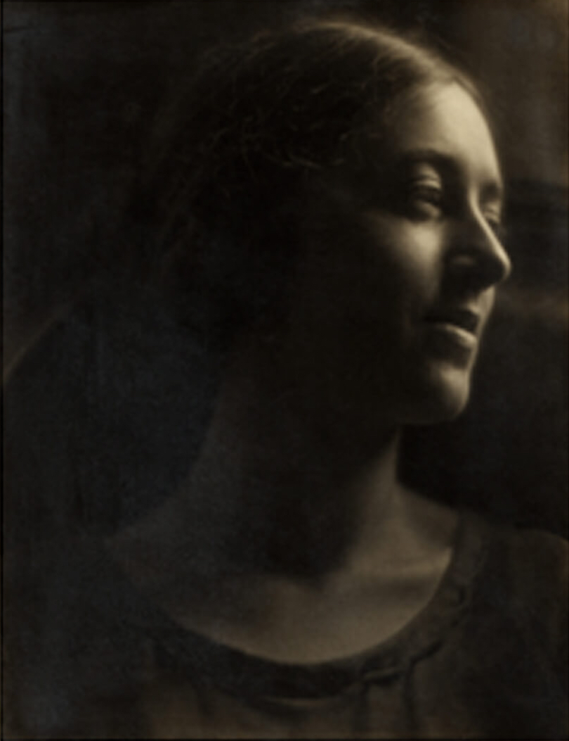
Culminating Task​
Margaret Watkins, Verna Skelton, 1923. This portrait playfully features a friend that Watkins had during her time in New York.

Slide 27
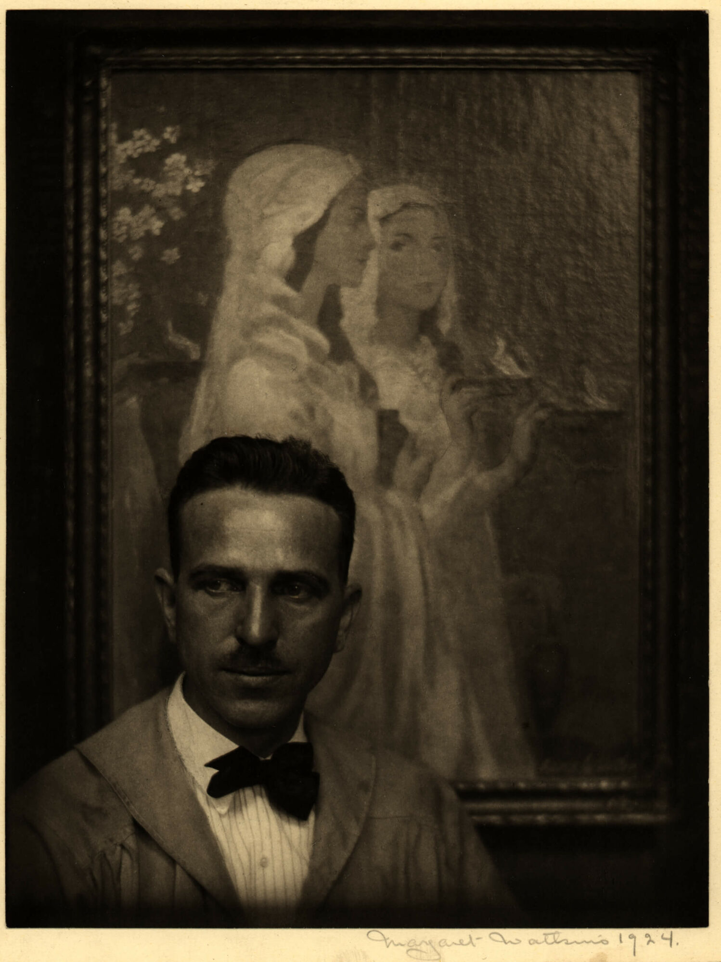
Culminating Task​
Margaret Watkins, Portrait of Ezra Winter, 1924. Watkins took this photo of the American muralist and painter in front of one of his works.

Slide 28
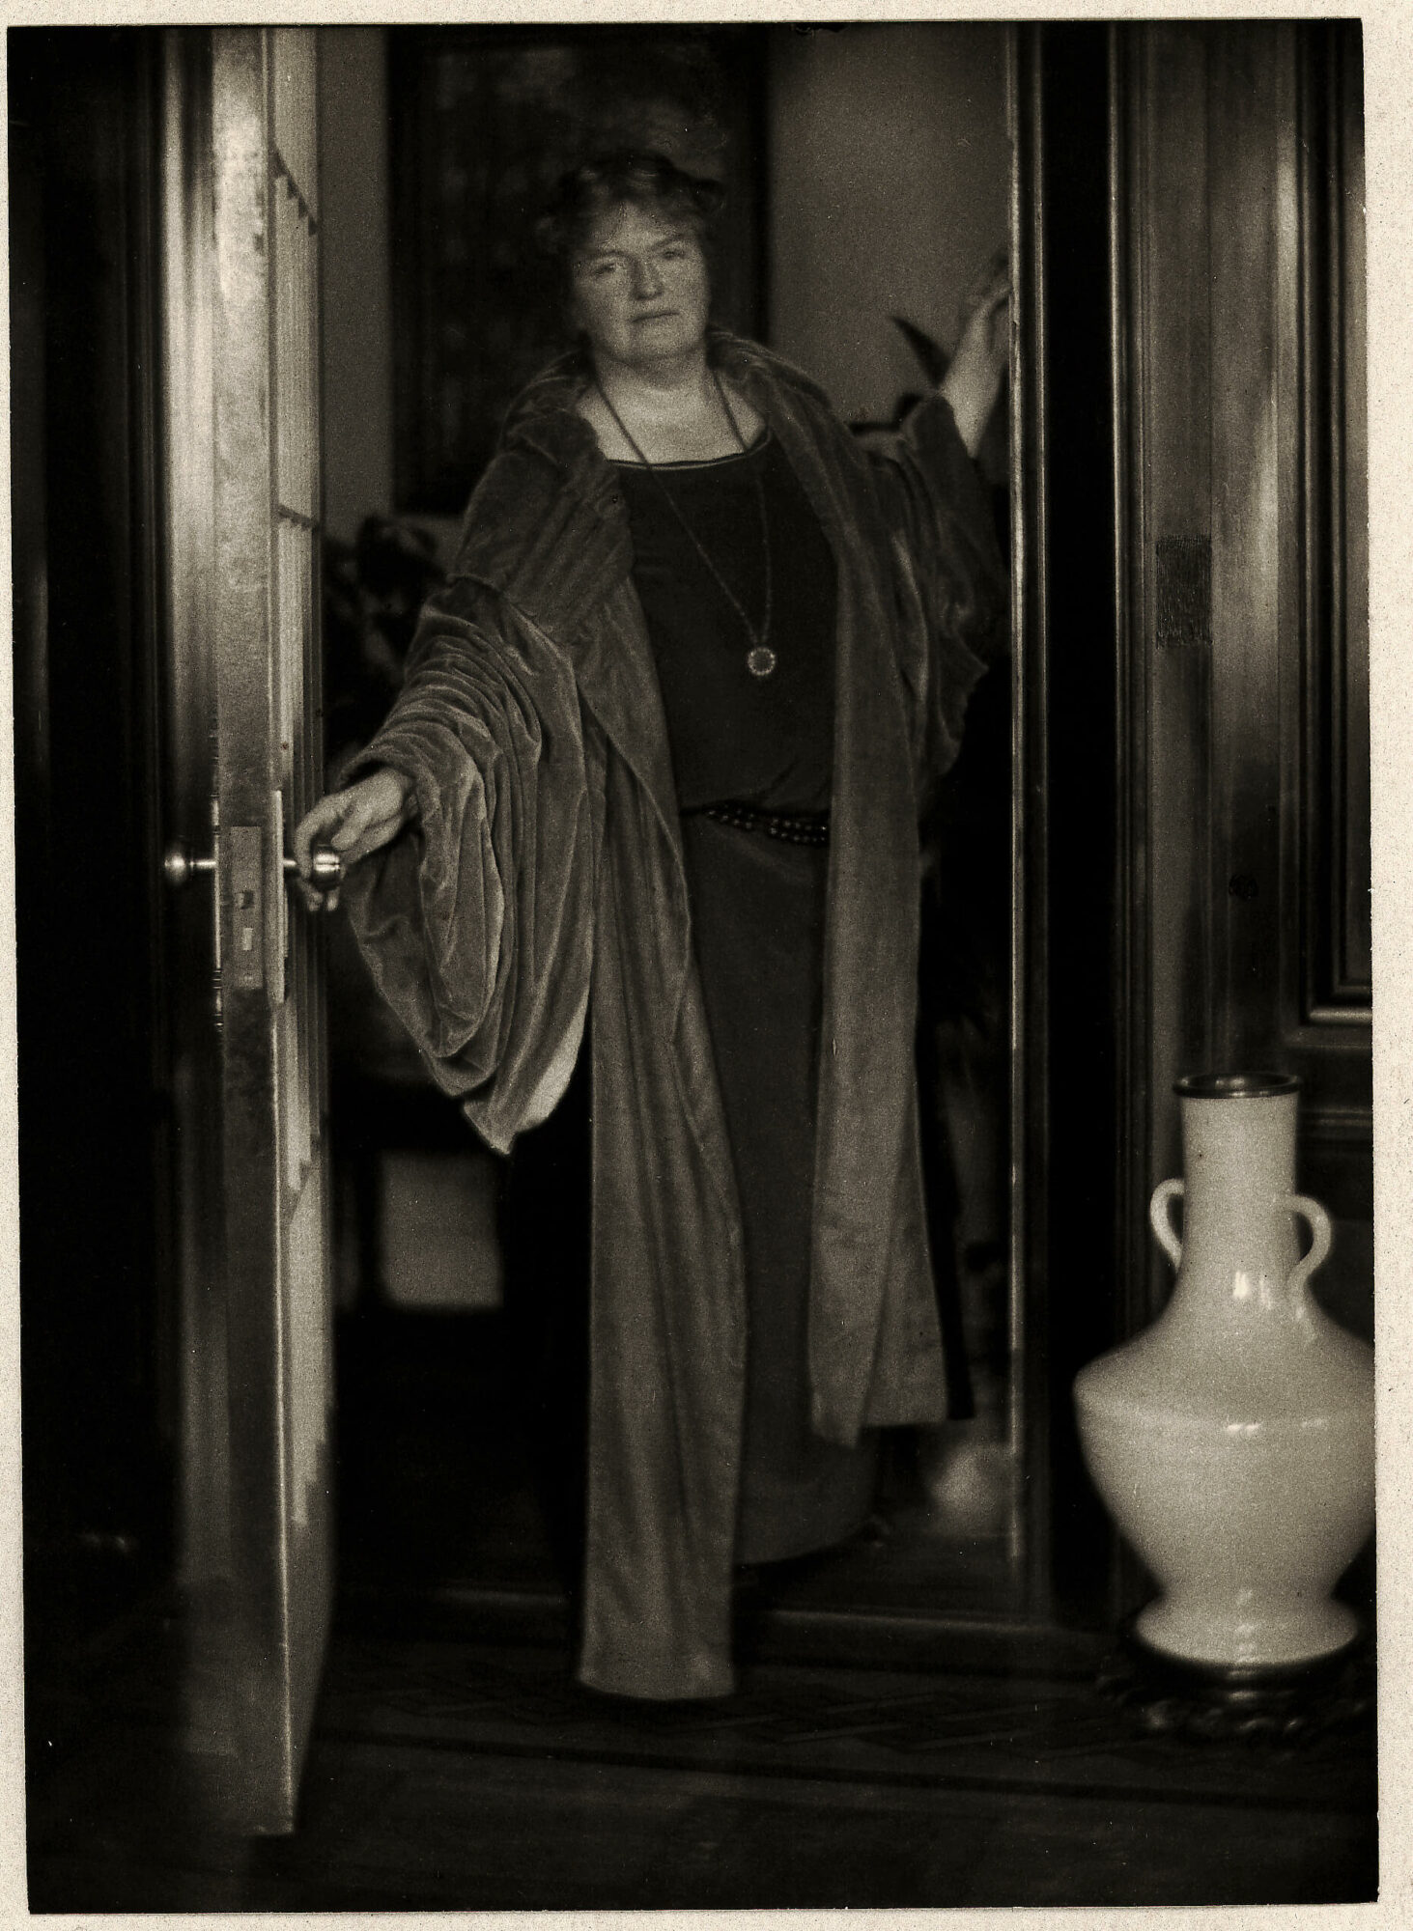
Culminating Task​
Margaret Watkins, Katherine at Home, c.1925. The subject of this portrai is Katherine Dreier, a suffragette, painter, and patron of the arts from New York.

Slide 29
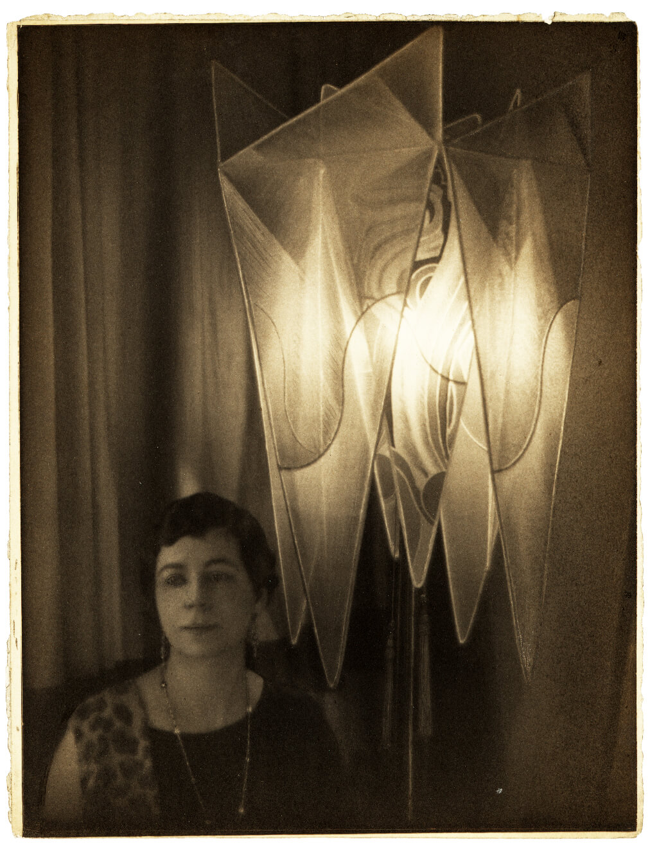
Culminating Task​
Margaret Watkins, Untitled [Portrait of Nina B. Price], 1925. Price was a publicist who Watkins met through the Zonta Club, a professional women’s networking group.

Slide 30
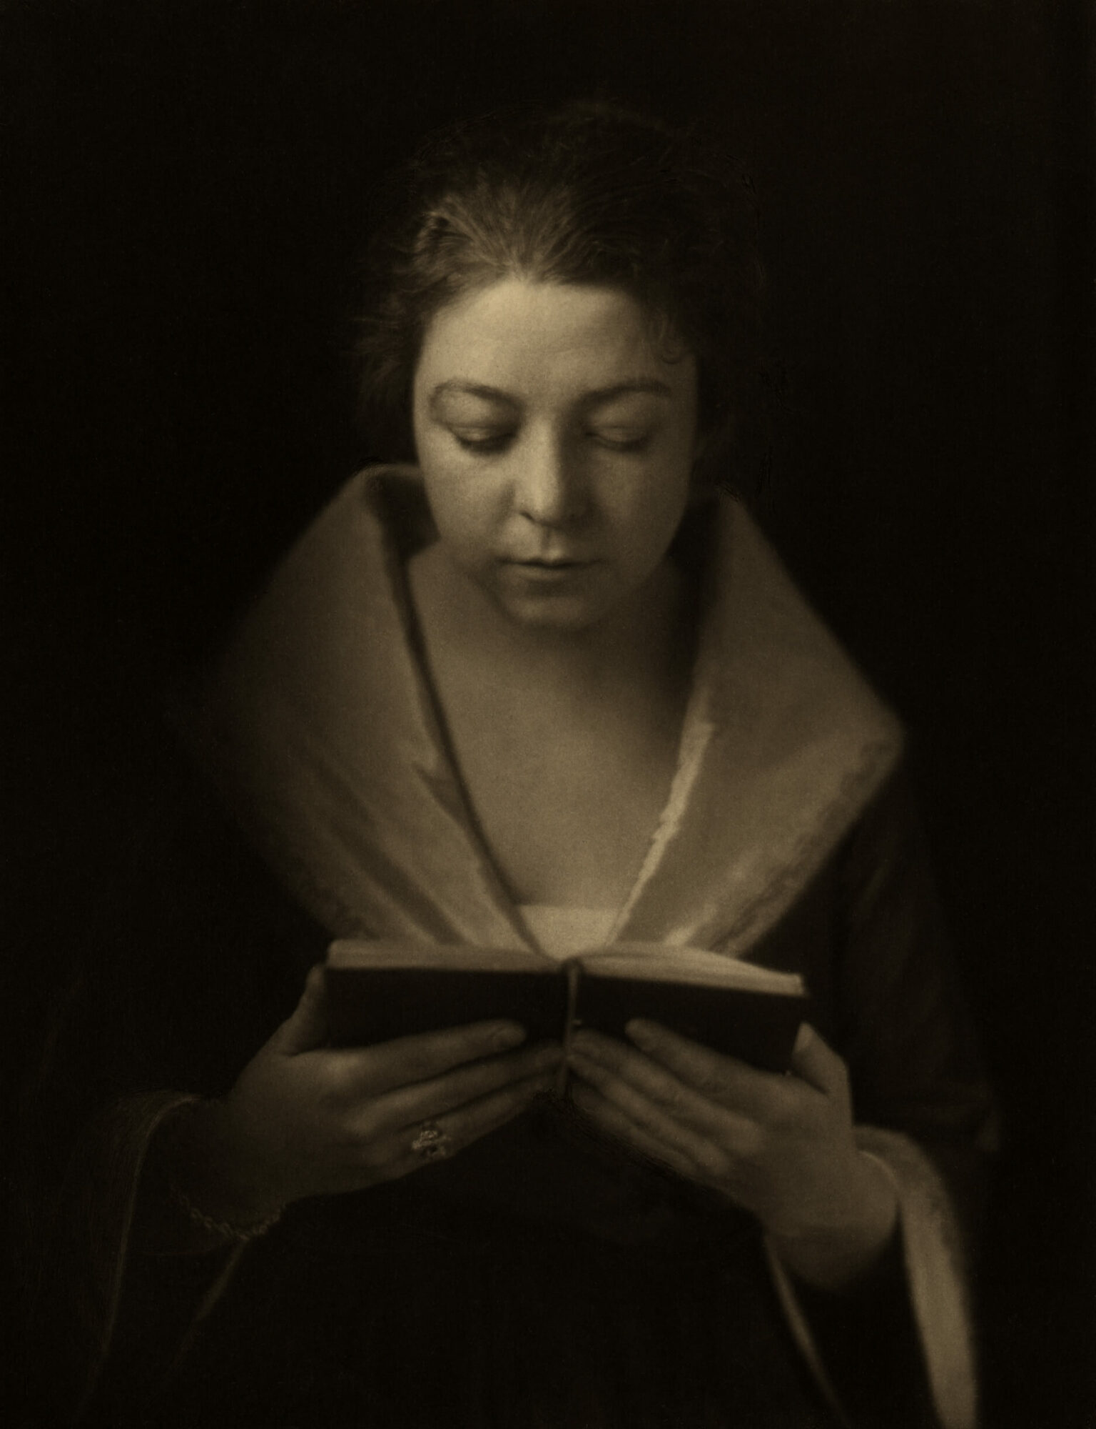
Margaret Watkins,
Dutch Girl Reading [Olivette Falls], 1918.

Slide 31
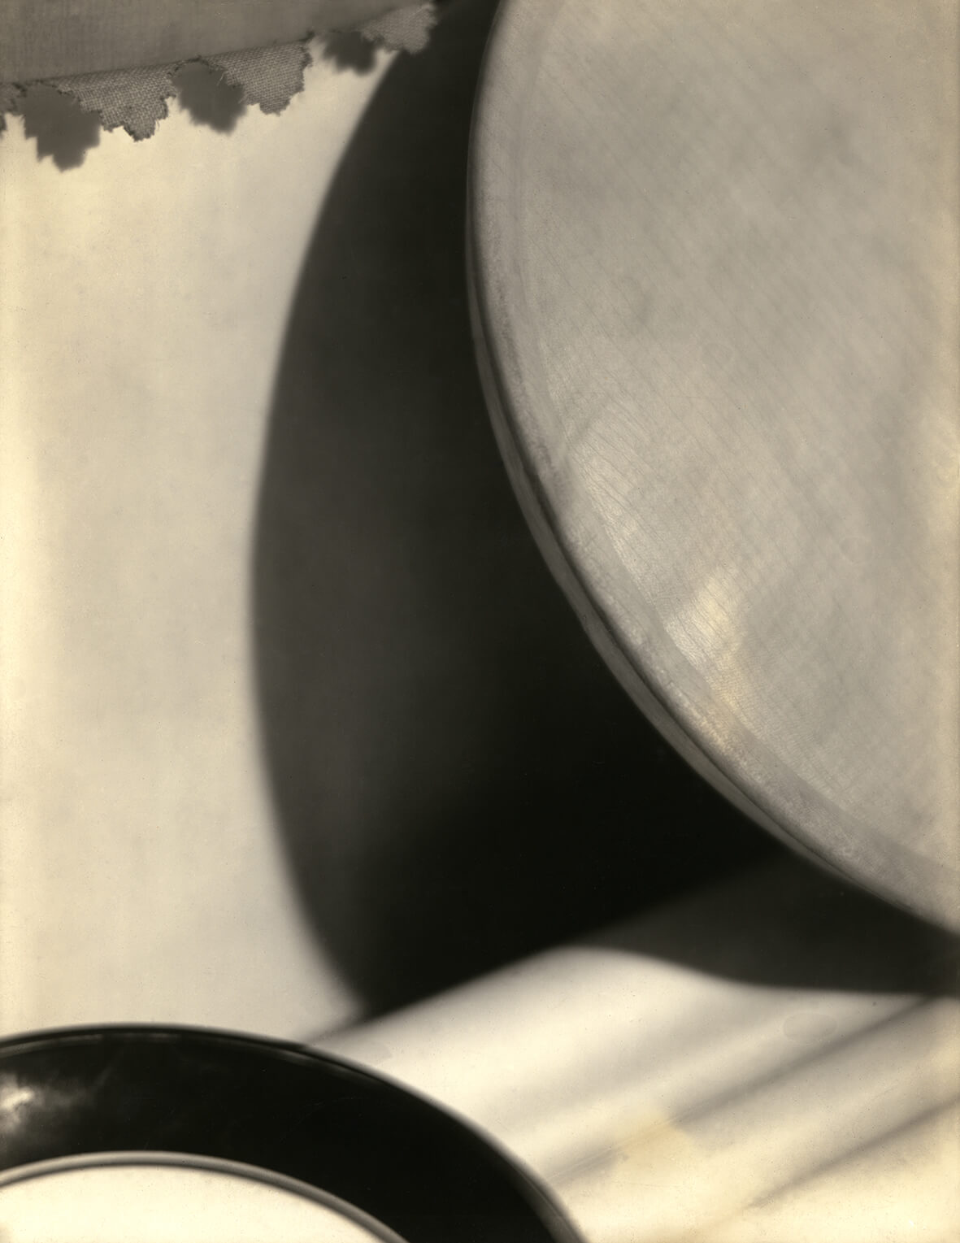
Margaret Watkins, Design – Curves, 1919.

Slide 32
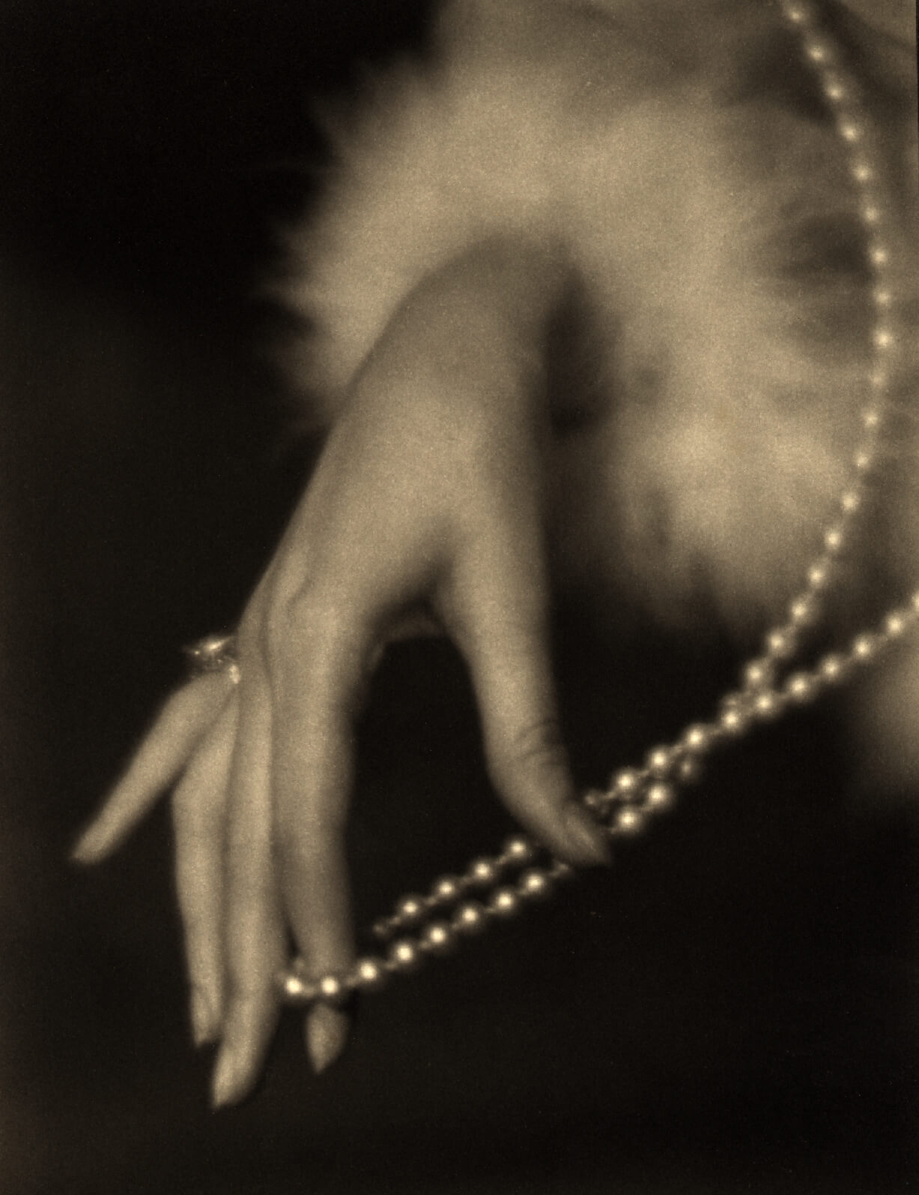
Margaret Watkins,
Untitled [Study for advertisement for Cutex nail polish], 1924.

Slide 33
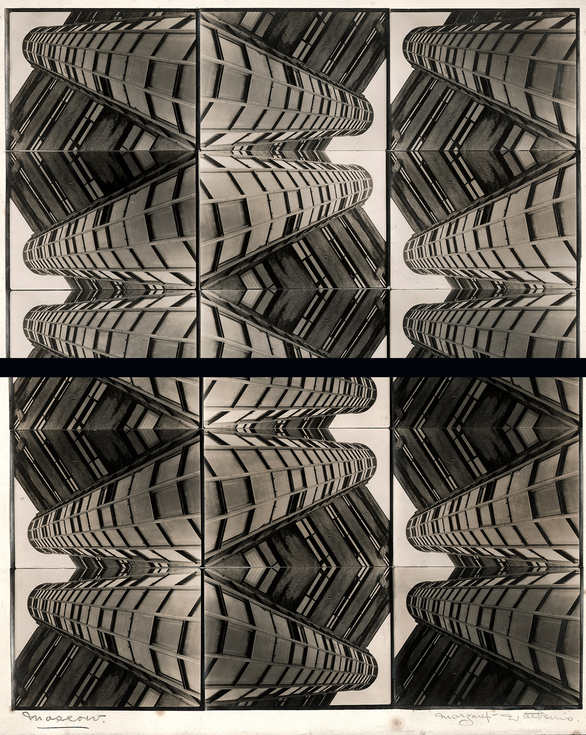
Margaret Watkins, Moscow, c.1935. This image of repeating and contrasting lines and circles is built from a single photo of a Moscow apartment building.

Slide 34
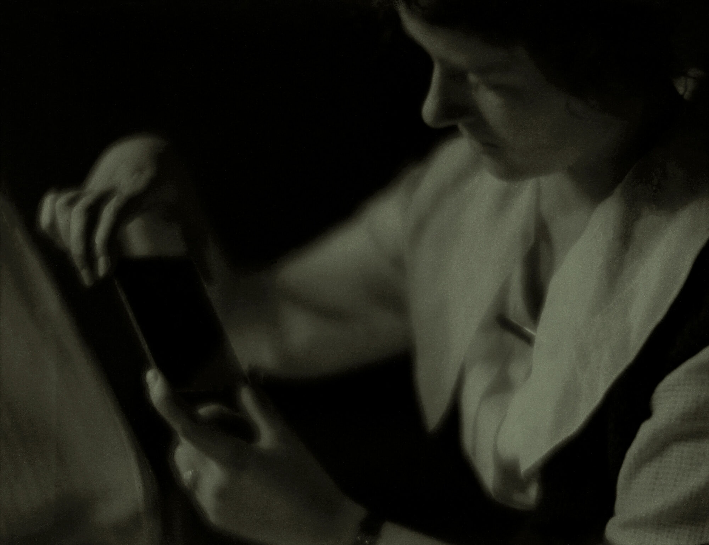
Margaret Watkins, The Negative, 1919. This image depicts a woman holding a photographic negative, which shows the light captured on film from a photo.

