Slide 2
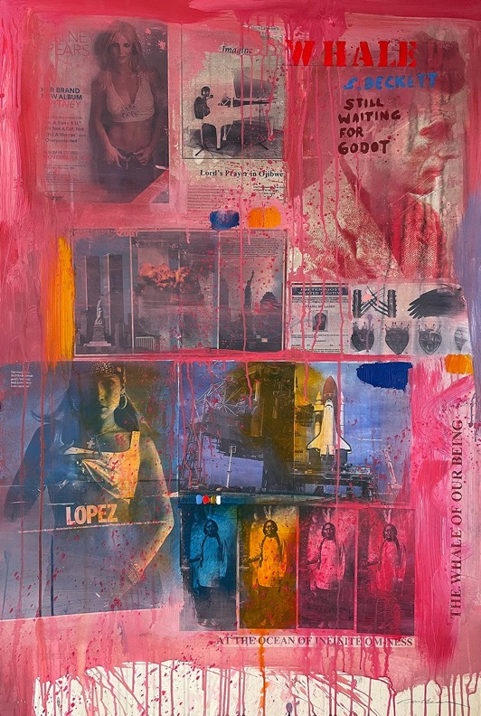
Carl Beam, The Whale of Our Being (Still Waiting for Godot), c.2003. Beam’s works often feature a combination of visual references, from historical to pop culture images.

Slide 3
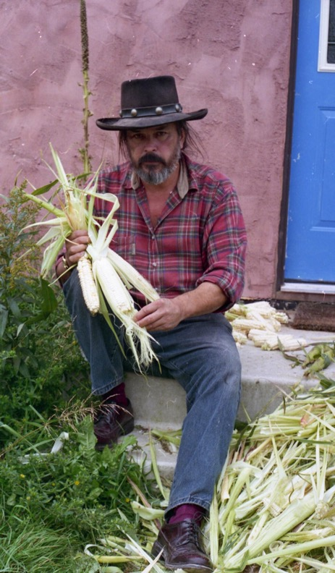
Carl Beam with his hominy corn harvest, n.d. Photographer unknown.

Slide 4
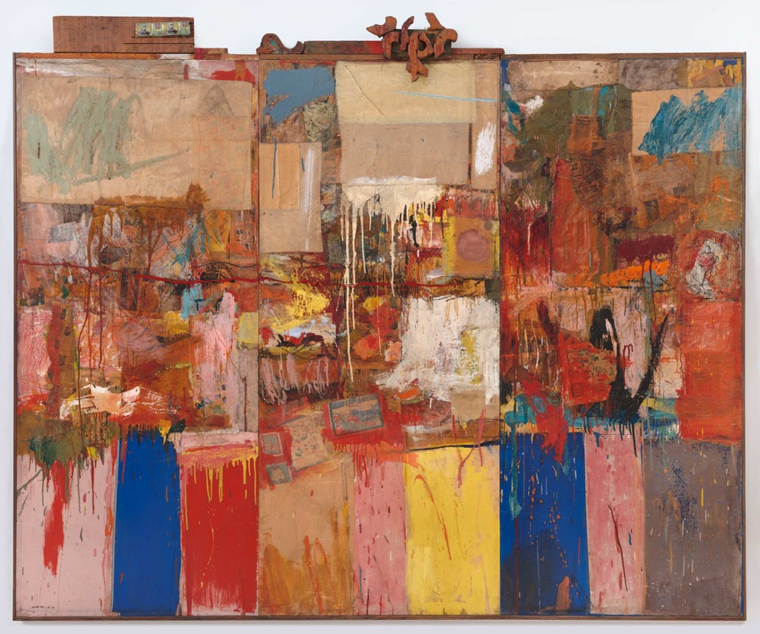
Robert Rauschenberg, Collection, 1954–55. Beam was influenced by American Pop artists like Robert Rauschenberg, famous for his “combine” paintings.

Slide 5
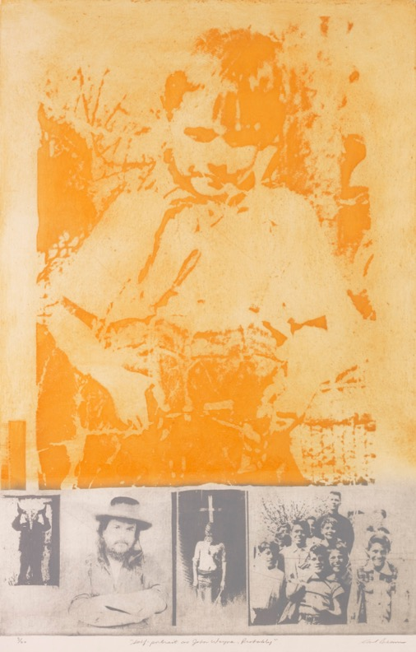
Carl Beam, Self-Portrait as John Wayne, Probably (from The Columbus Suite), 1990. Many of Beam's works were autobiographical, as in this etching featuring an image of him as a child.

Slide 6
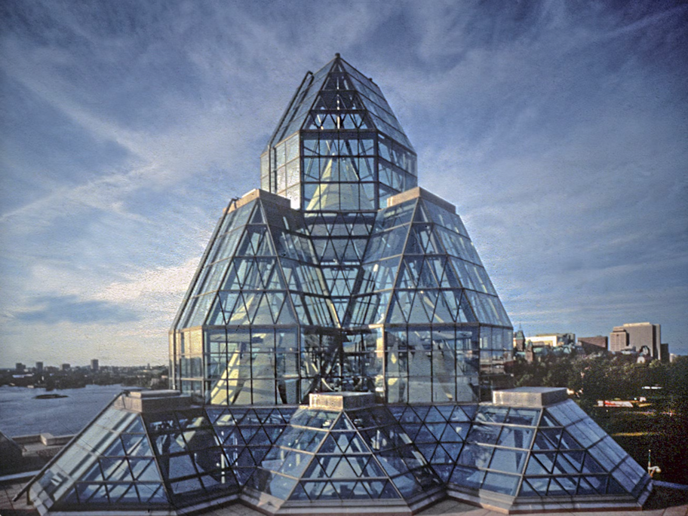
National Gallery of Canada, Ottawa, n.d. The current building that houses the country’s national collection was built in 1988 by Safdie Architects.

Slide 7
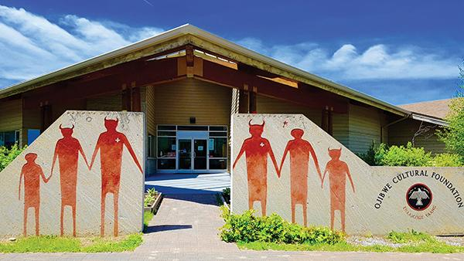
Ojibwe Cultural Foundation, M’Chigeeng First Nation, n.d. Along with its museum and gallery spaces, the foundation is home to the first Anishinaabe-language radio station.

Slide 8
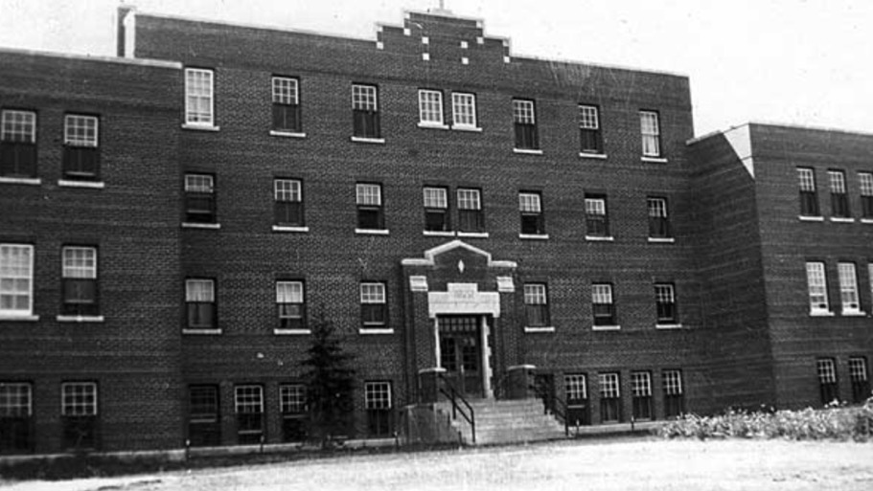
Gordon Reserve Indian Residential School, Punnichy, n.d. Students from Manitoba, Saskatchewan, and Alberta attended this institution.

Slide 9
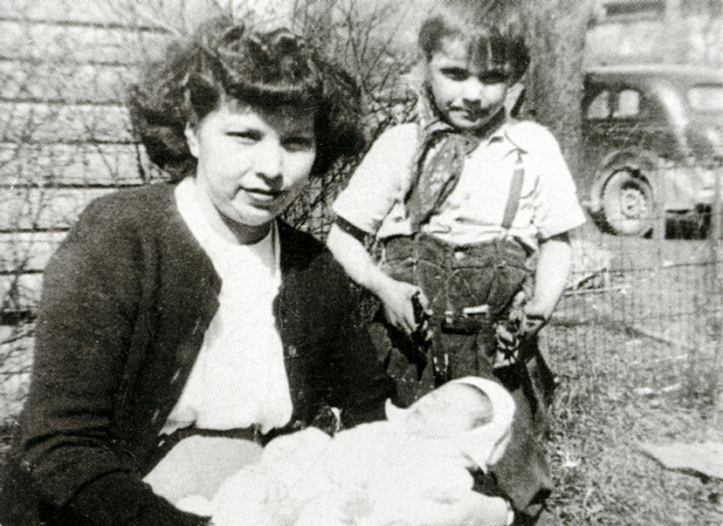
Carl Beam; his mother, Barbara Migwans; and his baby sister, Marjorie, on Manitoulin Island, 1946.

Slide 10
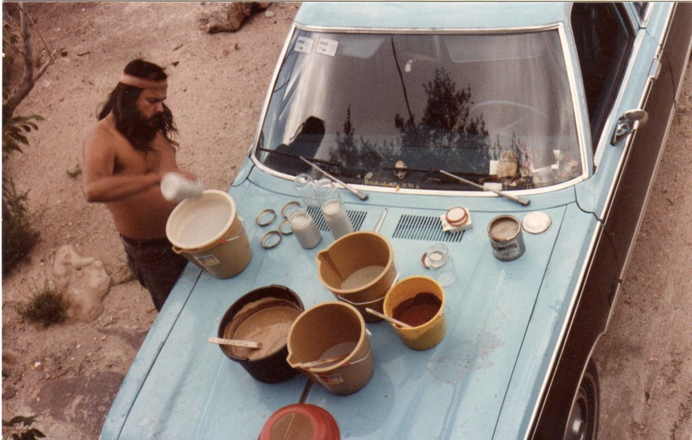
Carl Beam working on clay and slips on the hood of a blue station wagon, 1981. In the American Southwest, Beam created pottery and ceramic works.

Slide 11
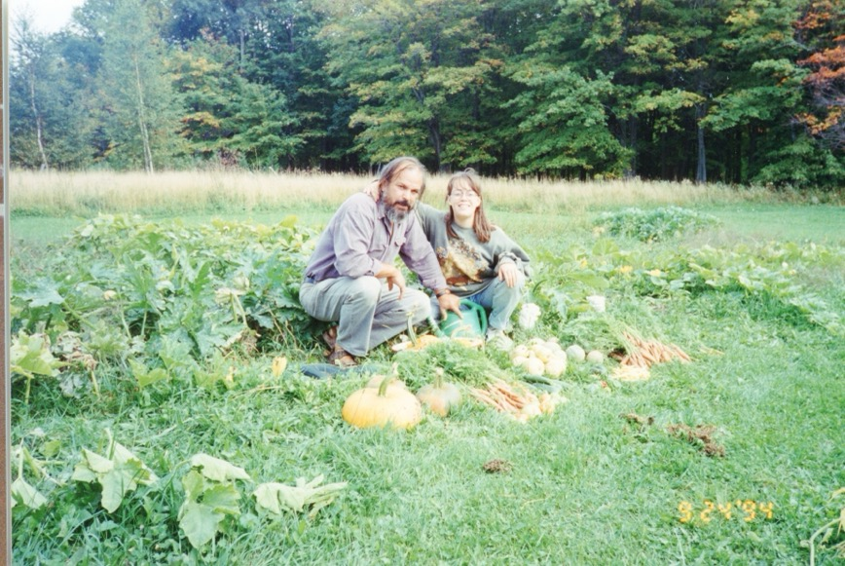
Carl and Anong Migwans Beam in the garden of the Adobe House in M’Chigeeng, Manitoulin Island, 1994.

Slide 12
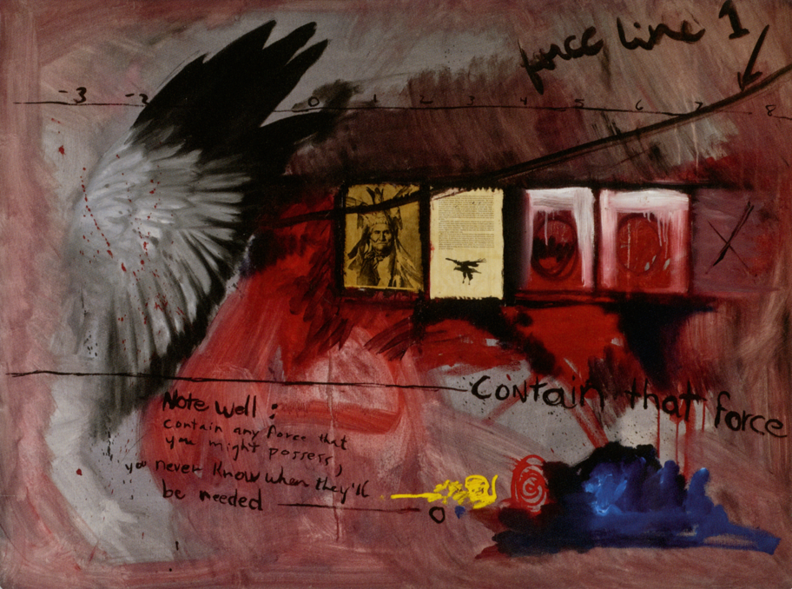
Carl Beam, Contain that Force, 1978. Starting in the late 1970s, Beam began to combine painting, poetry, photographic images, and found objects in his work.

Slide 13
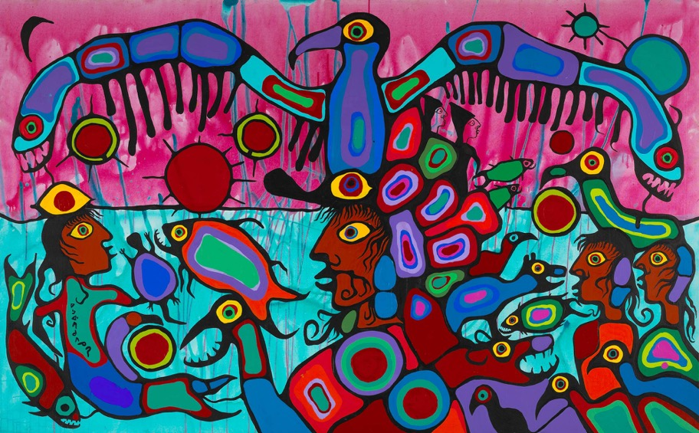
Norval Morrisseau, Artist and Shaman between Two Worlds, 1980. Morrisseau was a founding member of the Woodland School, a group of Ojibwe artists forging a new style of painting in the 1970s.

Slide 14
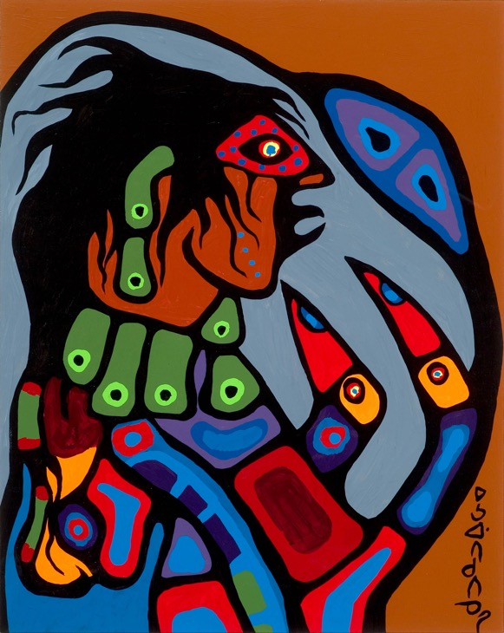
Norval Morrisseau, Ojibway Shaman Figure, 1975. Morrisseau was known for the use of bold, interconnected lines, vibrant colours, and themes connected to his cultural heritage.

Slide 15
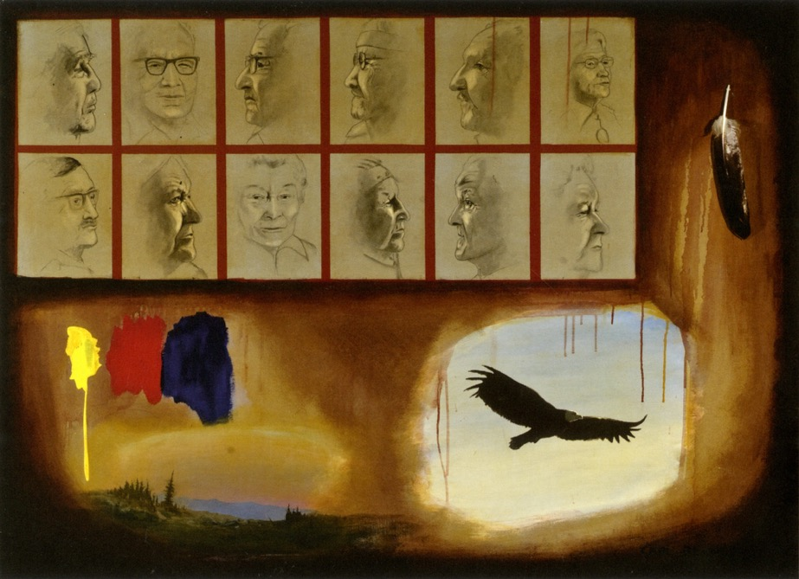
Carl Beam, The Elders, 1978. In this work commissioned by the Ojibwe Cultural Foundation, Beam worked from reference photographs.

Slide 16
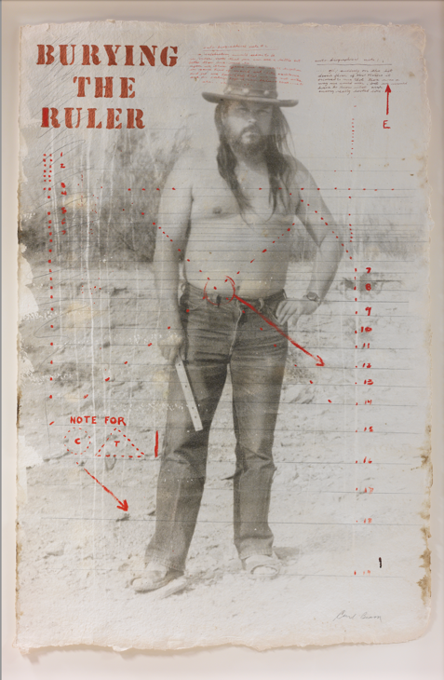
Carl Beam, Burying the Ruler, 1992. This work features a photograph of the artist, and is part of a larger project he created to question colonial domination.

Slide 17
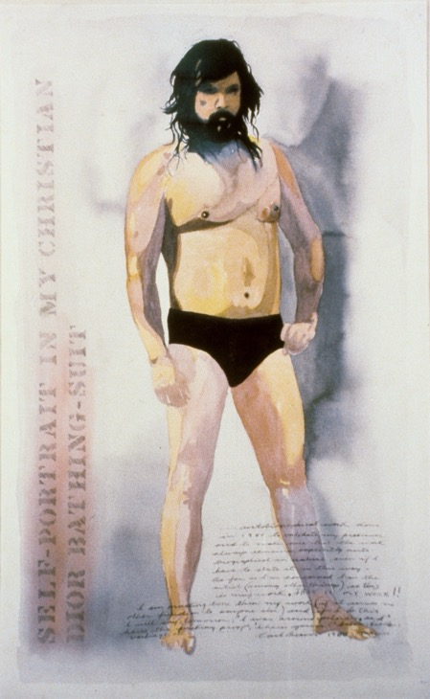
Carl Beam, Self-Portrait in My Christian Dior Bathing Suit, 1980. This is one of Beam’s most iconic self-portraits.

Slide 18
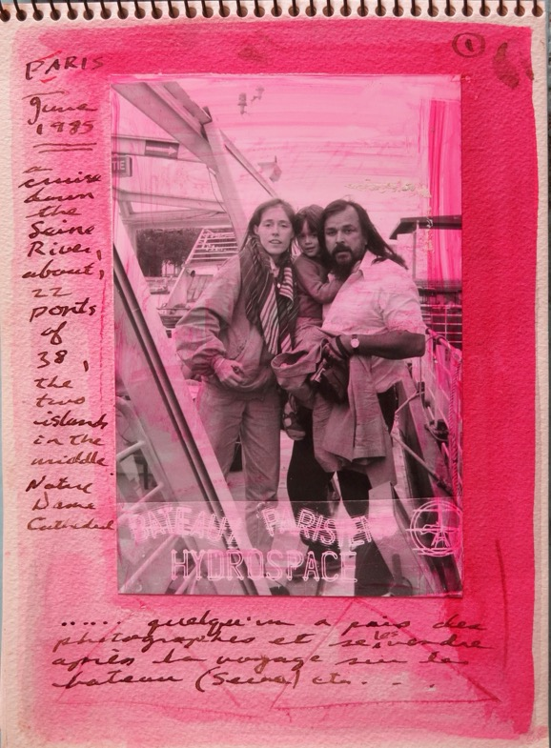
Page from Carl Beam’s Paris sketchbook, 1985. Beam used sketchbooks to record thoughts, archive photographs, and map out ideas for his works. This photograph pictures Beam with his wife Ann and daughter Anong.

Slide 19
Carl Beam, Self-Portrait as John Wayne, Probably (from The Columbus Suite), 1990. Many of Beam's works were autobiographical, as in this etching featuring an image of him as a child.

Slide 20
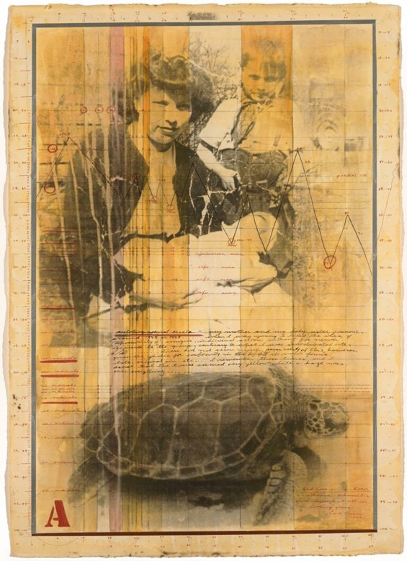
Carl Beam, Autobiographical Errata, 1997. This autobiographical work features a family photograph of the artist as a child with his mother Barbara Migwans and his sister Marjorie.

Slide 21
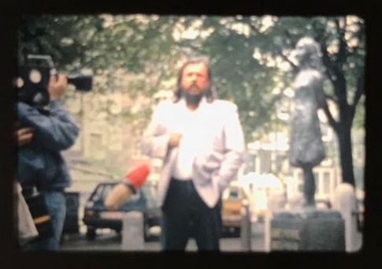
Carl Beam speaking about residential schools at the Anne Frank House in Amsterdam, Netherlands, 1985. Beam used his platform as an artist to advocate and raise awareness.

Slide 22
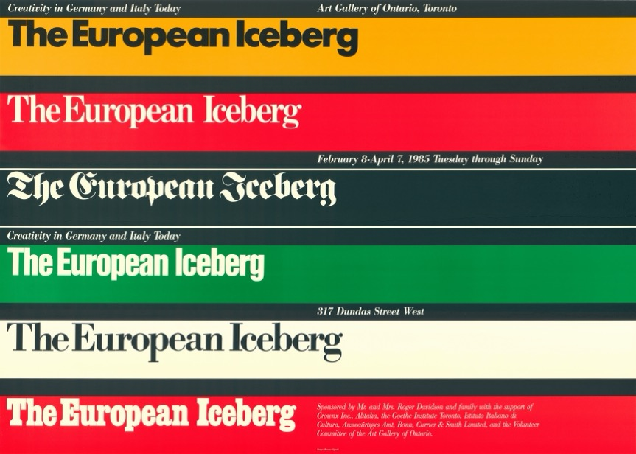
Poster for The European Iceberg: Creativity Today in Germany and Italy, an exhibition at the Art Gallery of Ontario, February 8–April 7, 1985. Beam’s The North American Iceberg was a response to this exhibition.

Slide 23
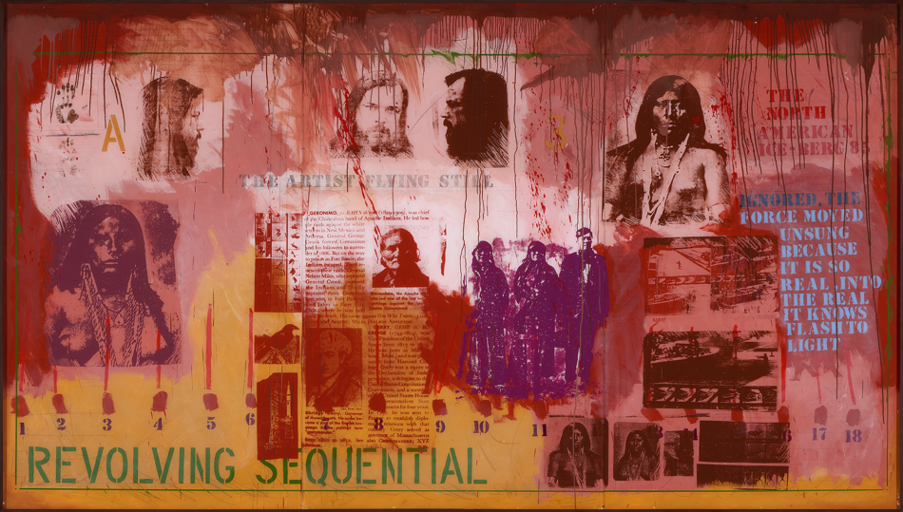
Carl Beam, The North American Iceberg, 1985. This is Beam’s best-known work, and was a landmark acquisition for the National Gallery of Canada.

Slide 24
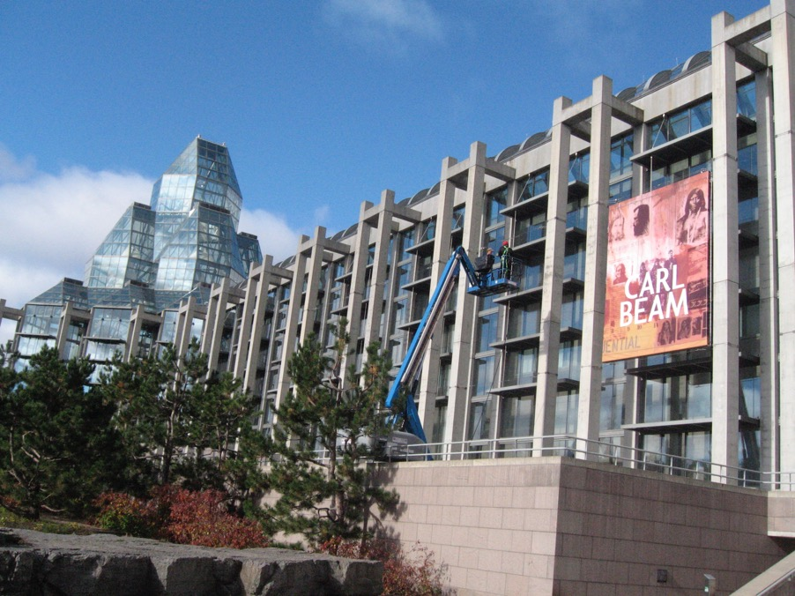
Exterior view of the Carl Beam retrospective at the National Gallery of Canada, 2010. The North American Iceberg was the first work of contemporary art by a self-identifying Indigenous artist purchased for the gallery’s contemporary collection.

Slide 25
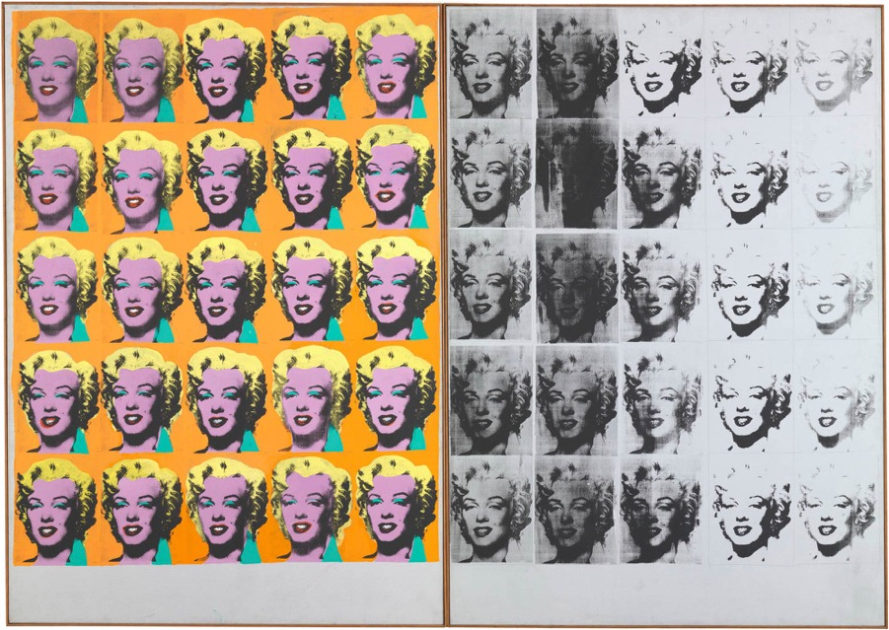
Andy Warhol, Marilyn Diptych, 1962. Warhol was an iconic figure from the American Pop Art movement.

Slide 26
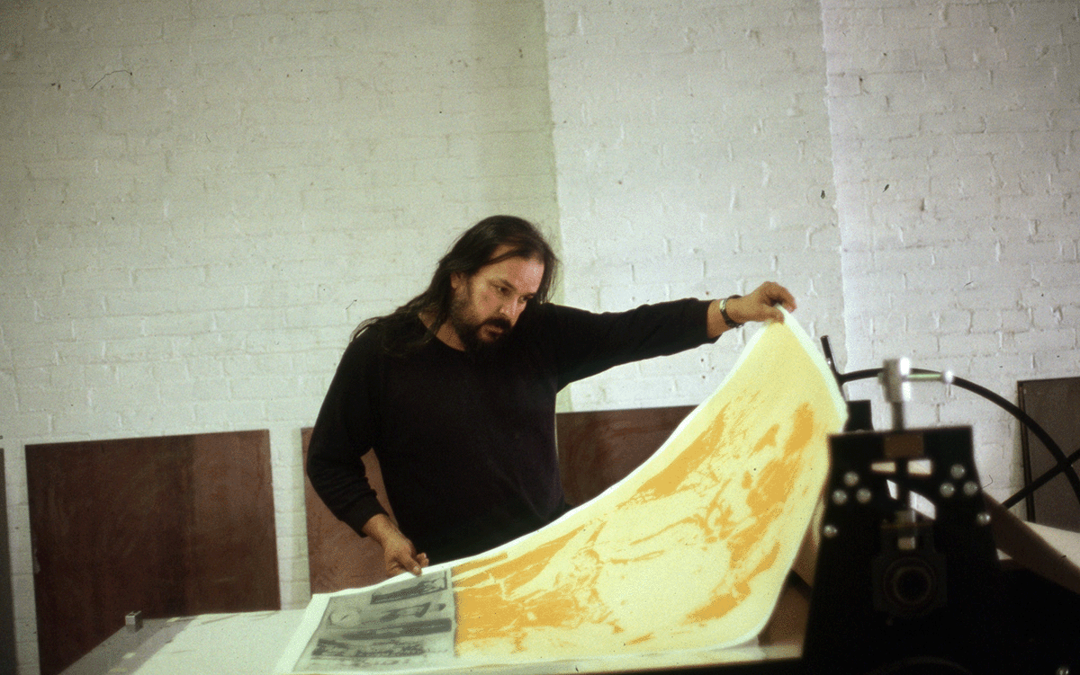
Carl Beam pulling proofs of The Columbus Suite from his Praga press, n.d. The Columbus Suite is one of Beam’s most ambitious series of prints.

Slide 27
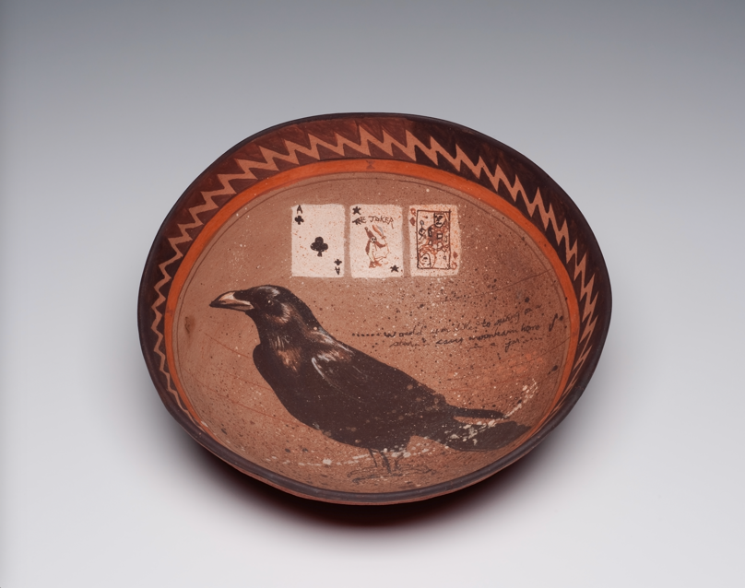
Carl Beam, Raven, 1983. Beam crafted this bowl using traditional materials and hand-built (not thrown or wheel-turned) methods.

Slide 28
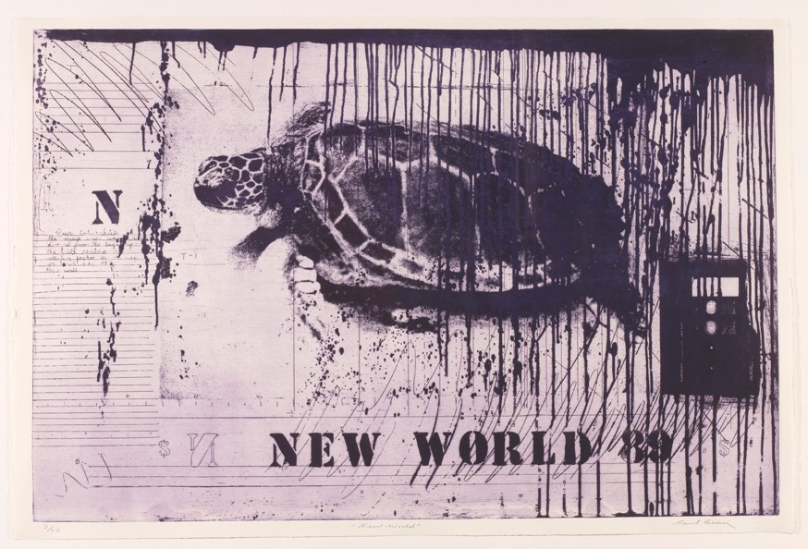
Carl Beam, New World (from The Columbus Suite), 1990. The turtle is a recurring motif in Beam’s work—a visual reference to Turtle Island, a term that comes from Indigenous creation stories.

Slide 29
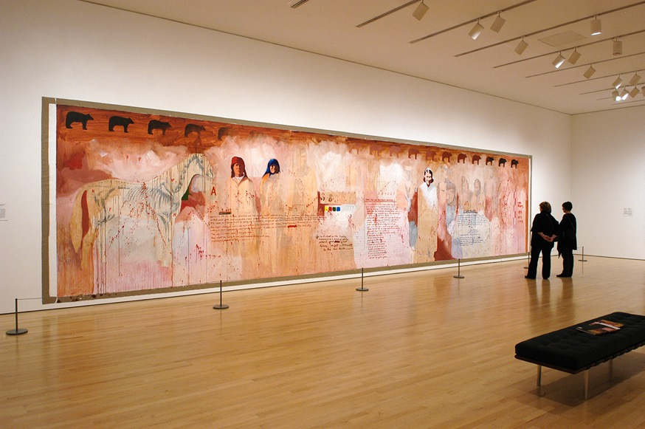
Installation view of Time Warp, 1984, in the exhibition Carl Beam at the National Gallery of Canada, Ottawa, from October 22, 2010 – January 16, 2011.

