Slide 1
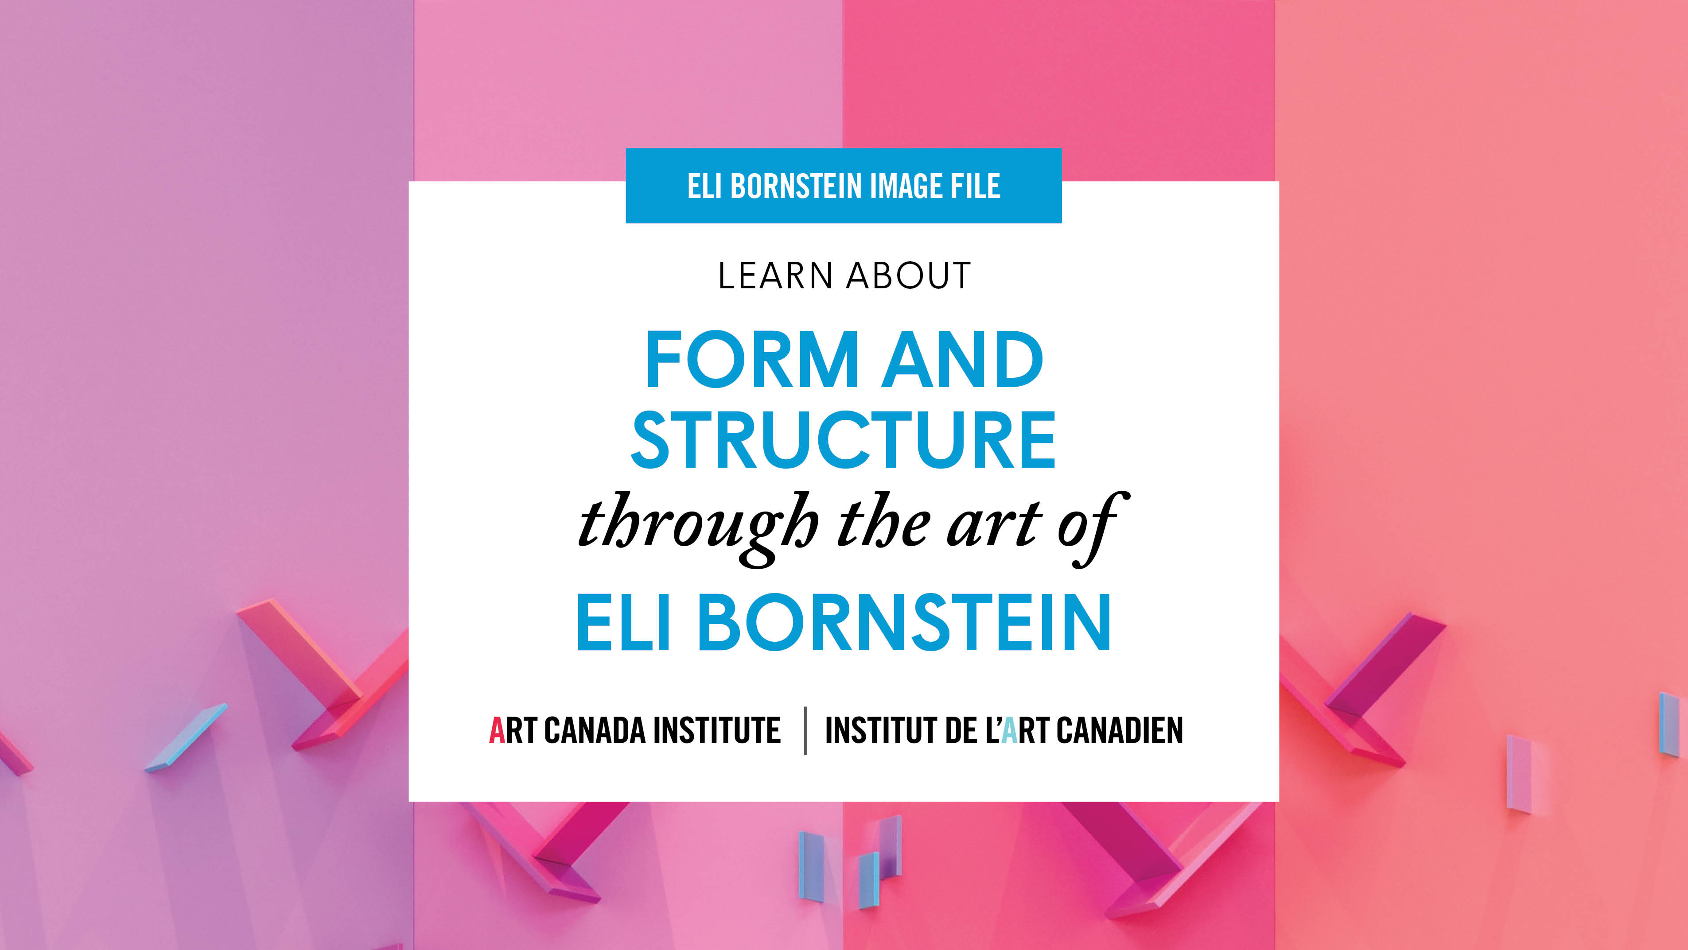

Slide 2
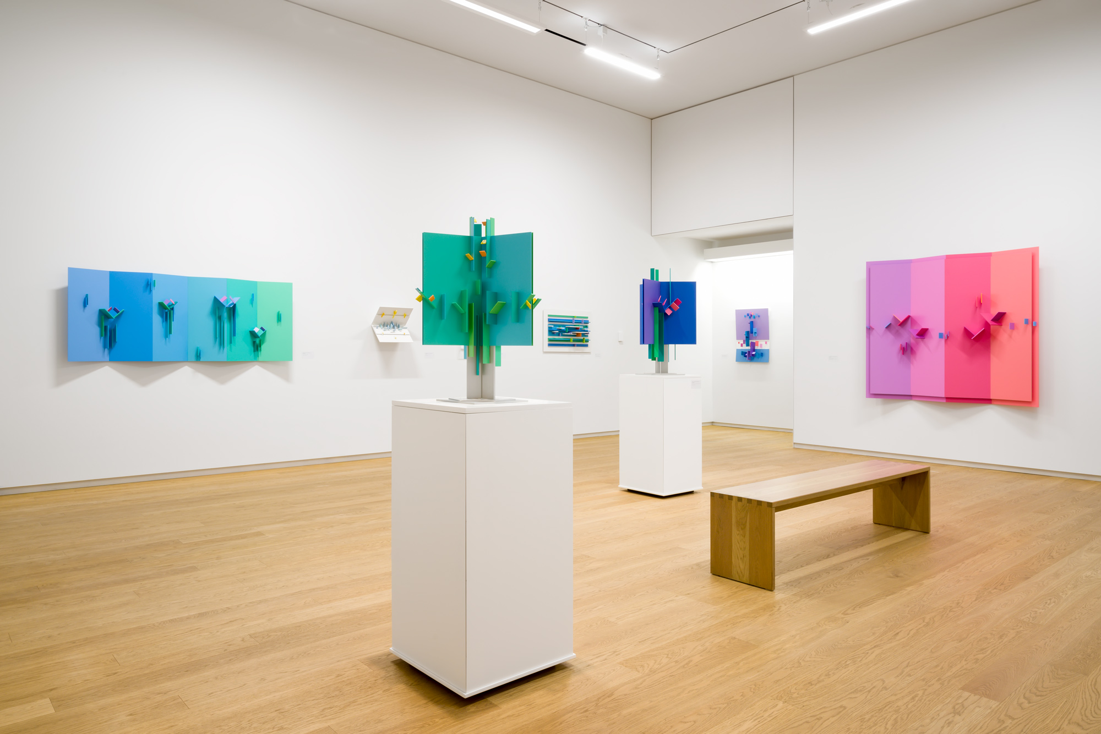
Installation view of Artist in Focus: Eli Bornstein at Remai Modern, Saskatoon, 2019.

Slide 3
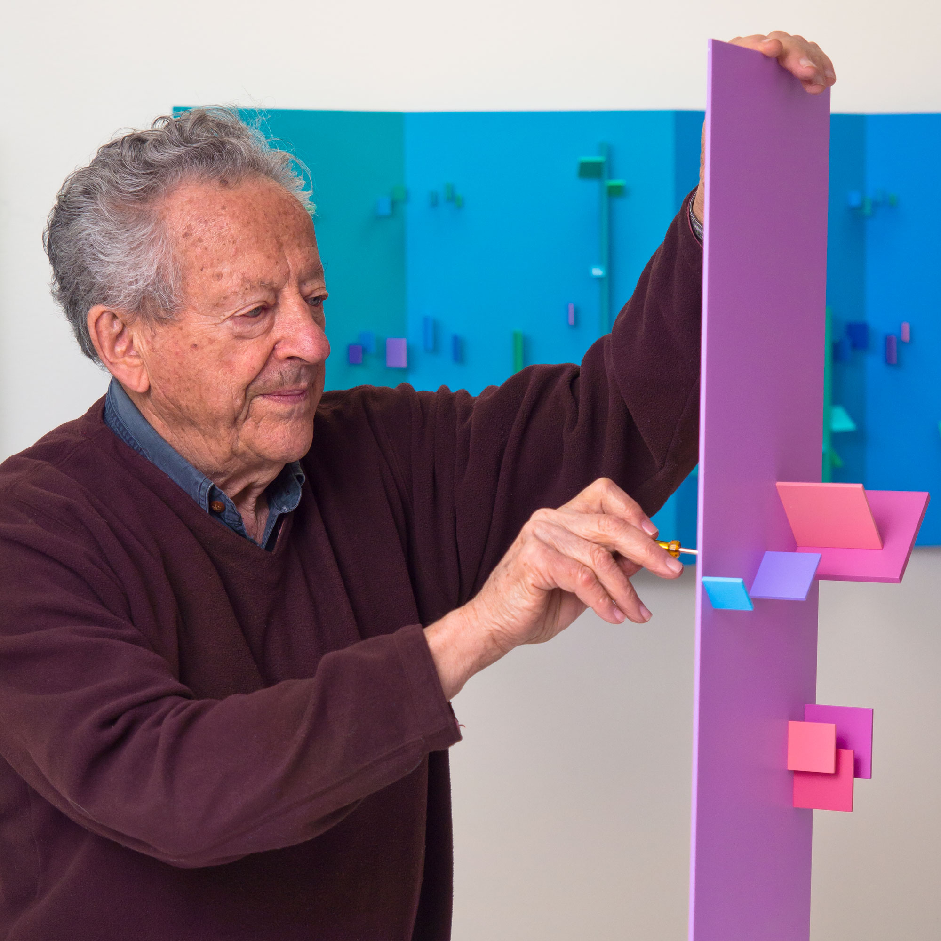
Eli Bornstein installing his work for Artist in Focus: Eli Bornstein at Remai Modern, Saskatoon, 2019.

Slide 4
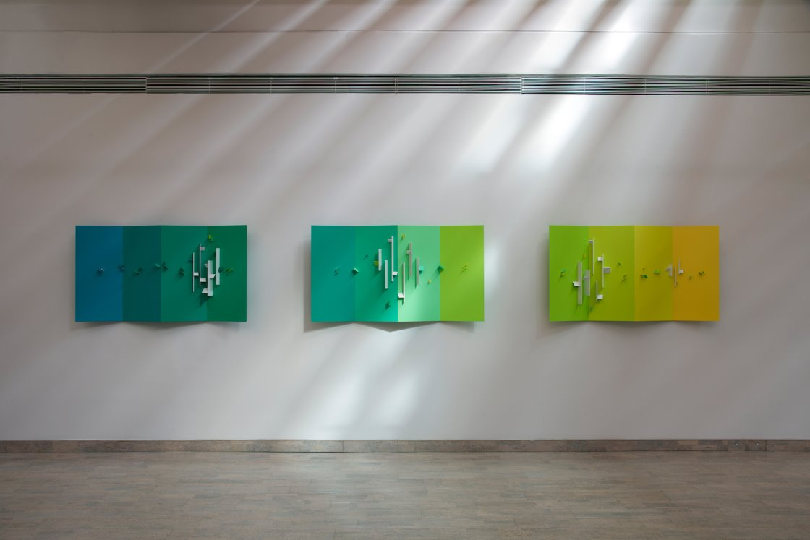
Installation view of Structurist Relief No. 6, 1999–2000, Structurist Relief No. 7, 2000–2001, and Structurist Relief No. 8, 2000–2002, by Eli Bornstein.

Slide 5
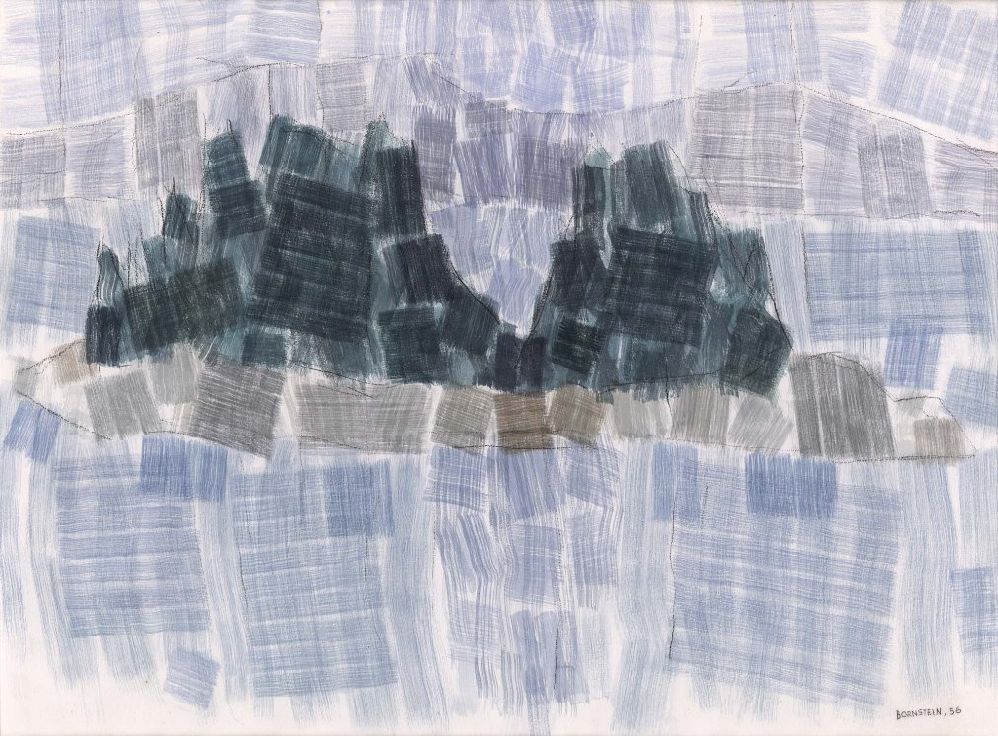
Eli Bornstein, The Island, 1956. This was the last representational painting Bornstein made before turning entirely to the construction of reliefs.

Slide 6
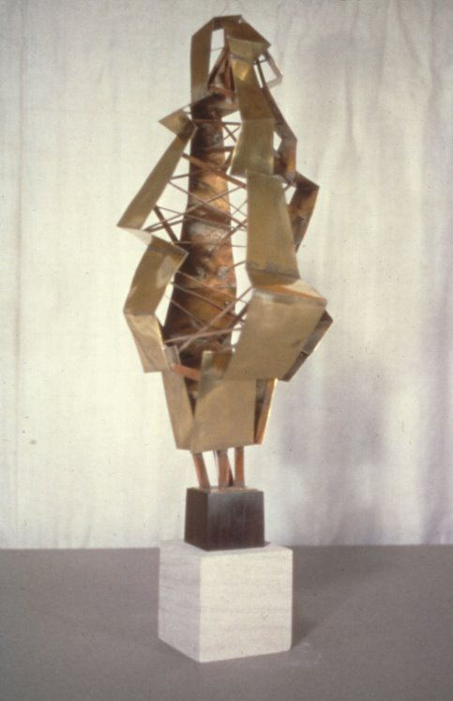
Eli Bornstein, Growth Motif No. 4, 1956. Bornstein’s early sculptures demonstrate his method of assembling, rather than carving, his three-dimensional works.

Slide 7
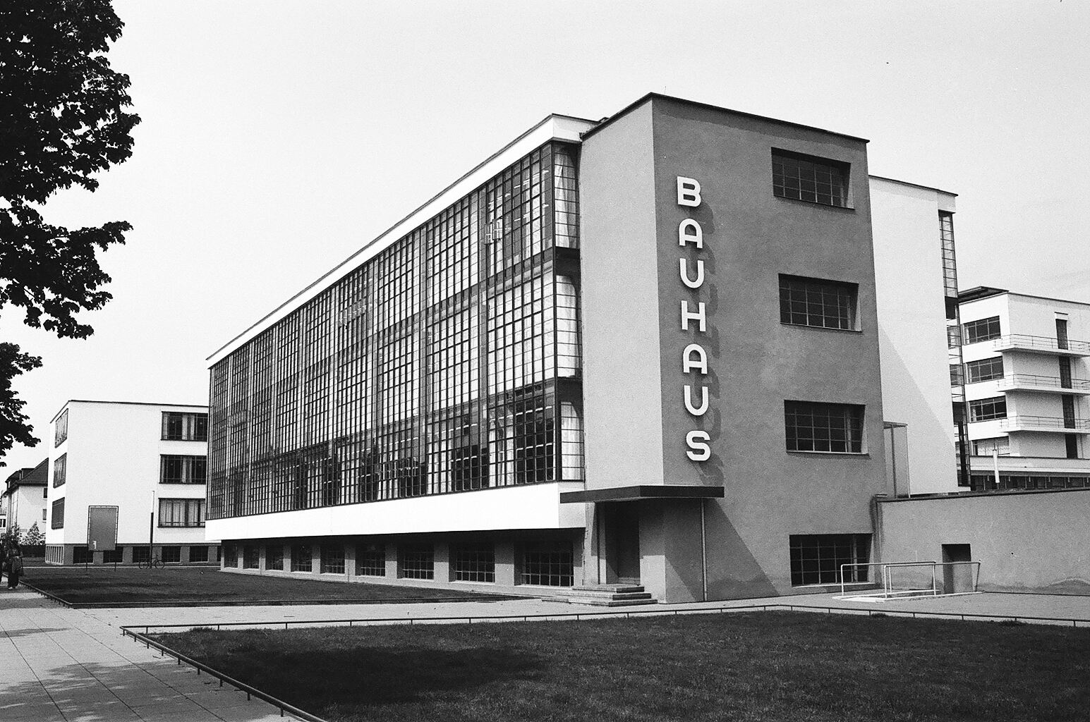
The Bauhaus located in Dessau, Germany, n.d. The Bauhaus became known for its curriculum integrating the fine arts with design and craft.

Slide 8
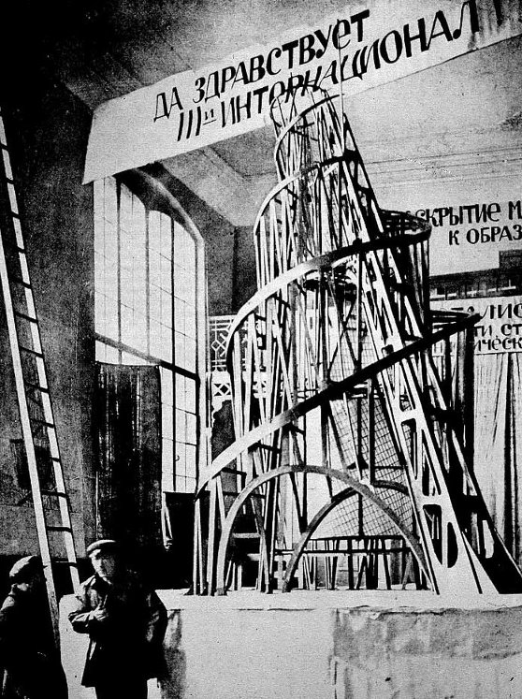
Vladimir Tatlin and an assistant in front of the model for the Third International, 1920.

Slide 9
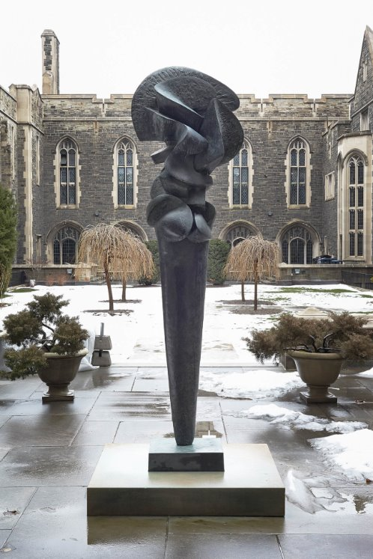
Sorel Etrog, Complexes of a Young Lady, 1962. Etrog was known for using organic shapes in his sculptural works.

Slide 10
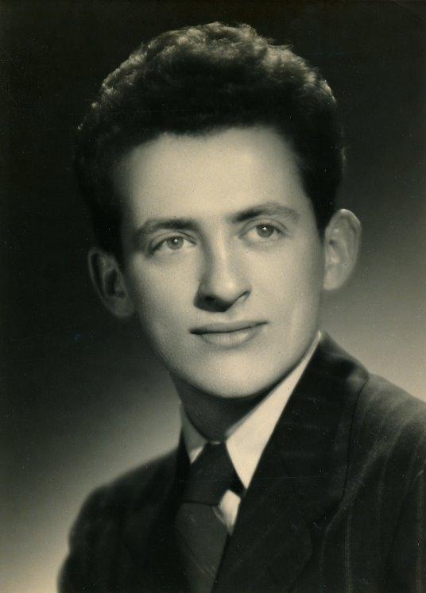
Eli Bornstein on the occasion of his graduation from the Milwaukee State Teachers College, 1945.

Slide 11
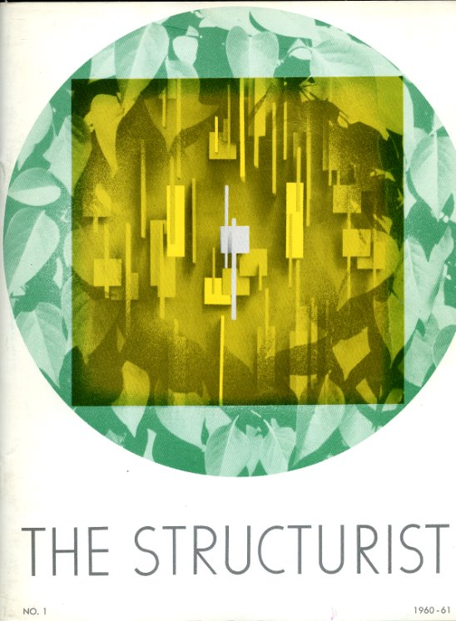
Cover of The Structurist, no. 1, “Structurist Origins/ Developments,” 1960, edited by Eli Bornstein.

Slide 12
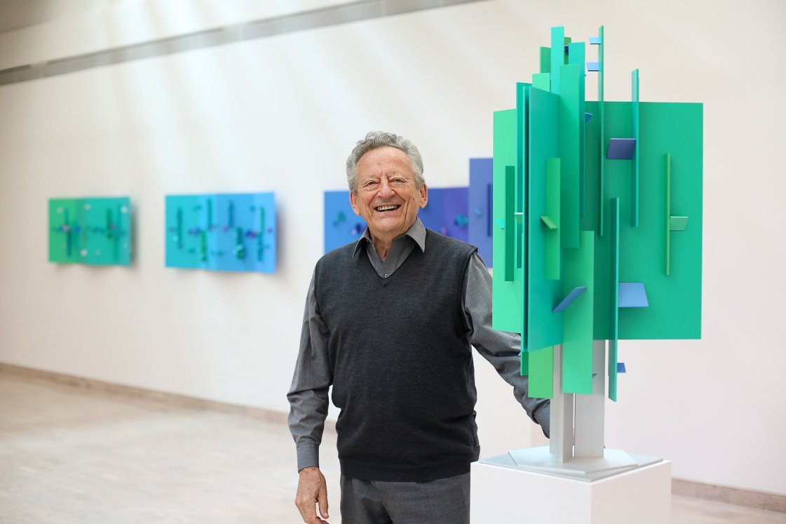
Eli Bornstein with one of his Structurist reliefs in An Art at the Mercy of Light: Recent Works by Eli Bornstein at the Mendel Art Gallery, Saskatoon, 2013.

Slide 13
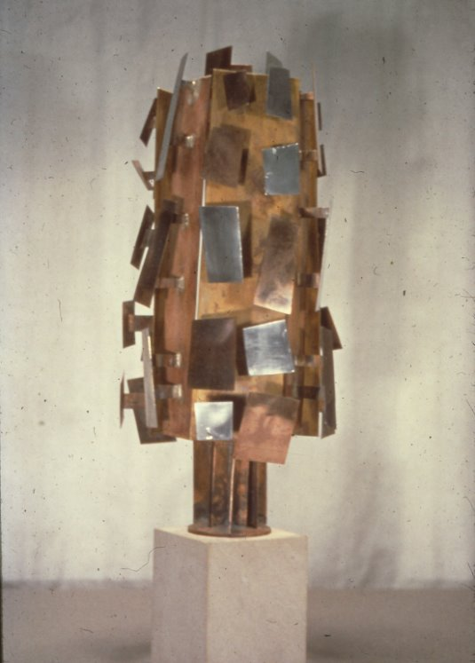
Eli Bornstein, Growth Motif Construction No. 3, 1956. This work exemplifies Bornstein’s transition to open work metallic constructing.

Slide 14
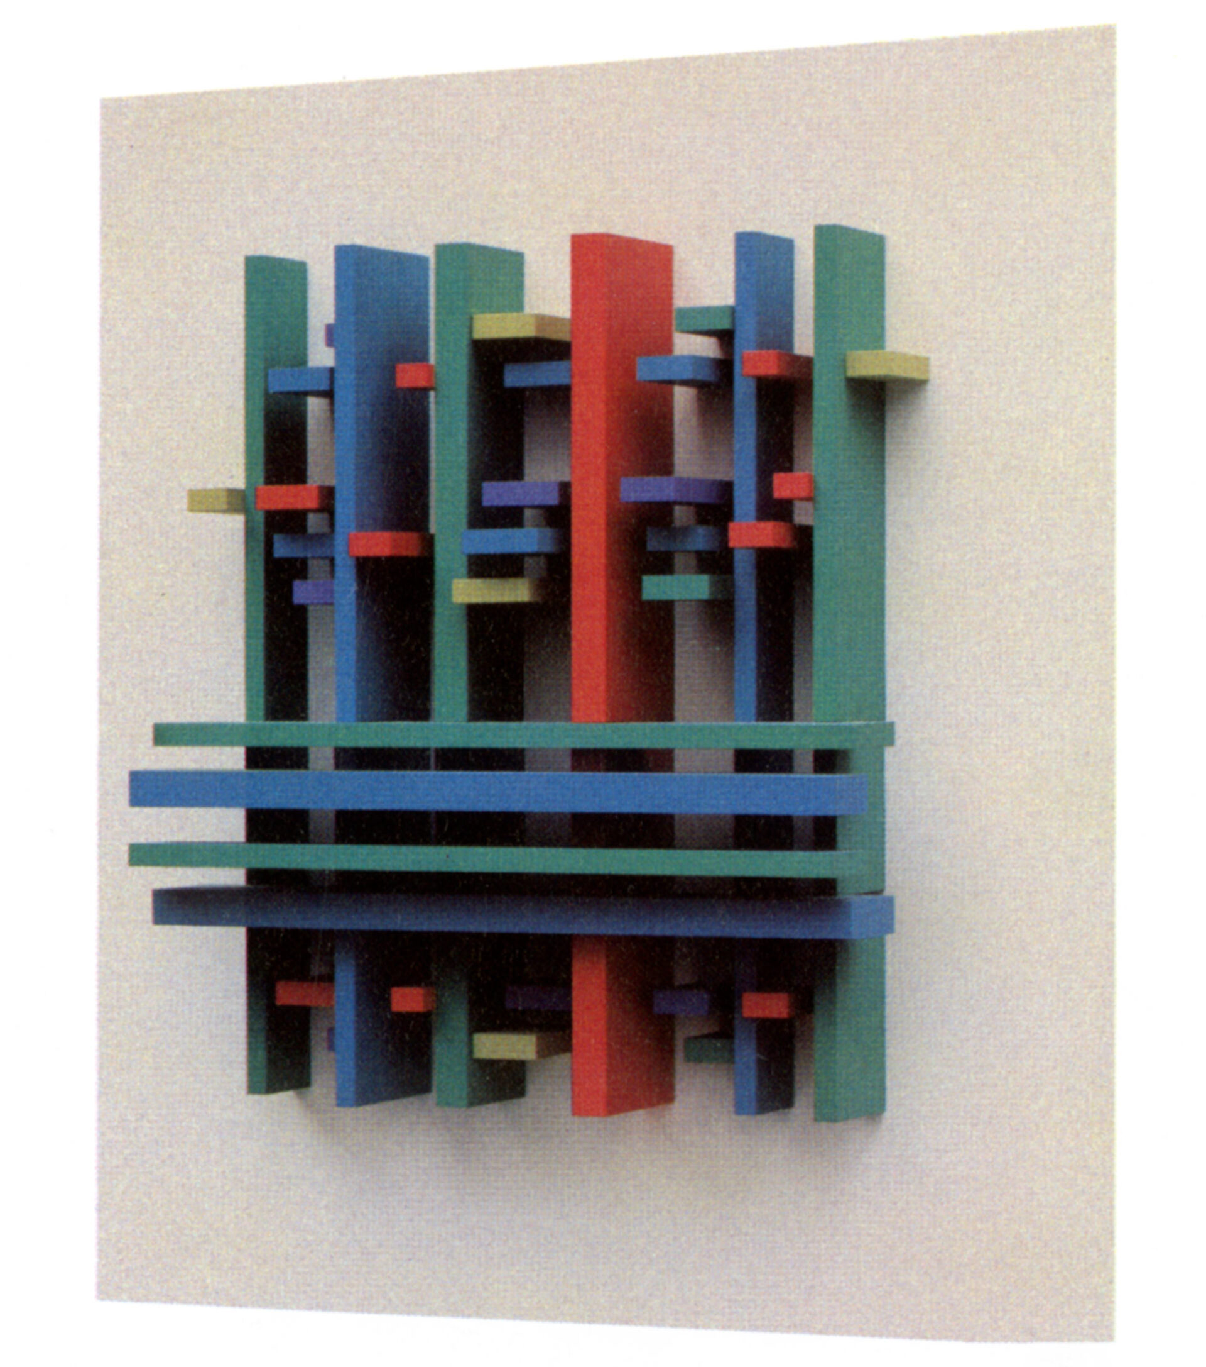
Eli Bornstein, Structurist Relief No. 3-1 (Canoe Lake Series), 1964. This work was produced during a summer trip to Algonquin Park in Ontario.

Slide 15
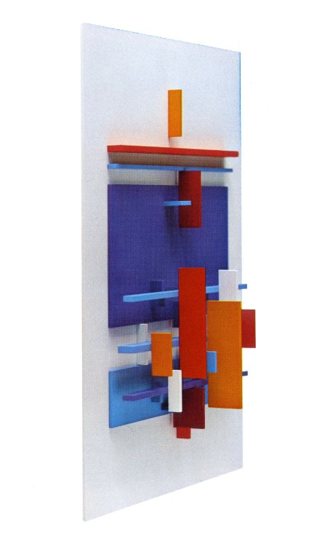
Eli Bornstein, Structurist Relief No. 2, 1966. The Structurist Relief is meant to be viewed at multiple angles.

Slide 16
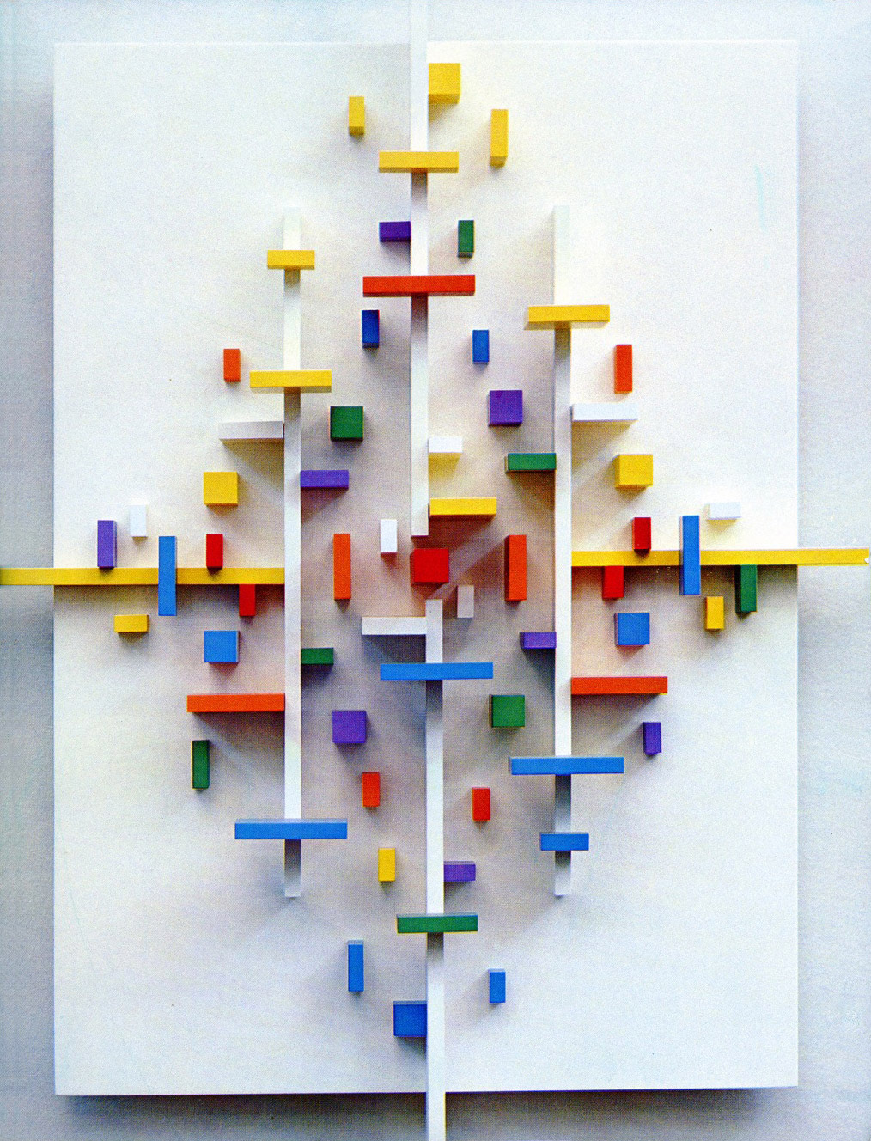
Eli Bornstein, Structurist Relief No. 1, 1965. In the mid-1960s, Bornstein began making reliefs with thinner and more differentiated elements.

Slide 17
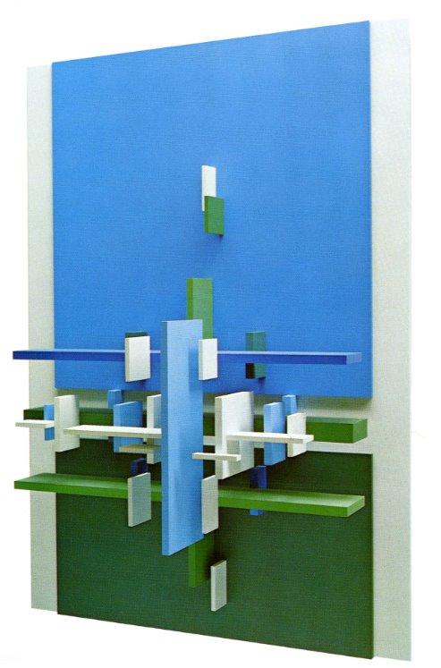
Eli Bornstein, Structurist Relief No. 3 (Sea Series), 1966–67. Bornstein’s Sea Series was produced during a year-long stay near Big Sur, California.

Slide 18
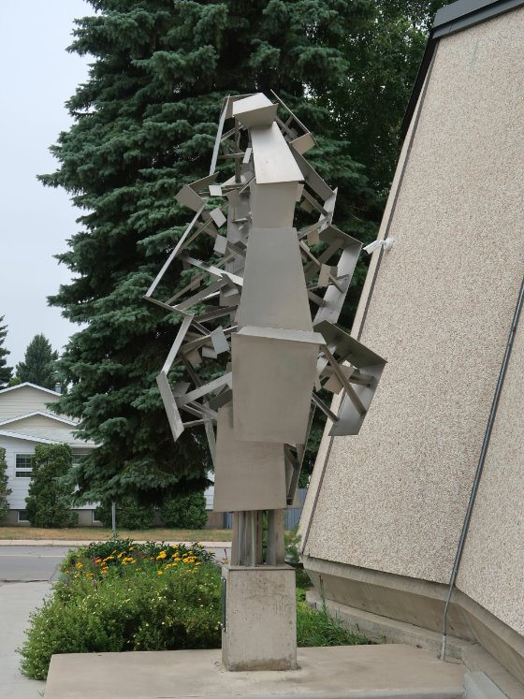
Eli Bornstein, Aluminum Construction (Tree of Knowledge), 1956. This sculpture received criticism when it was unveiled as the first abstract work of public art in Saskatoon.

Slide 19
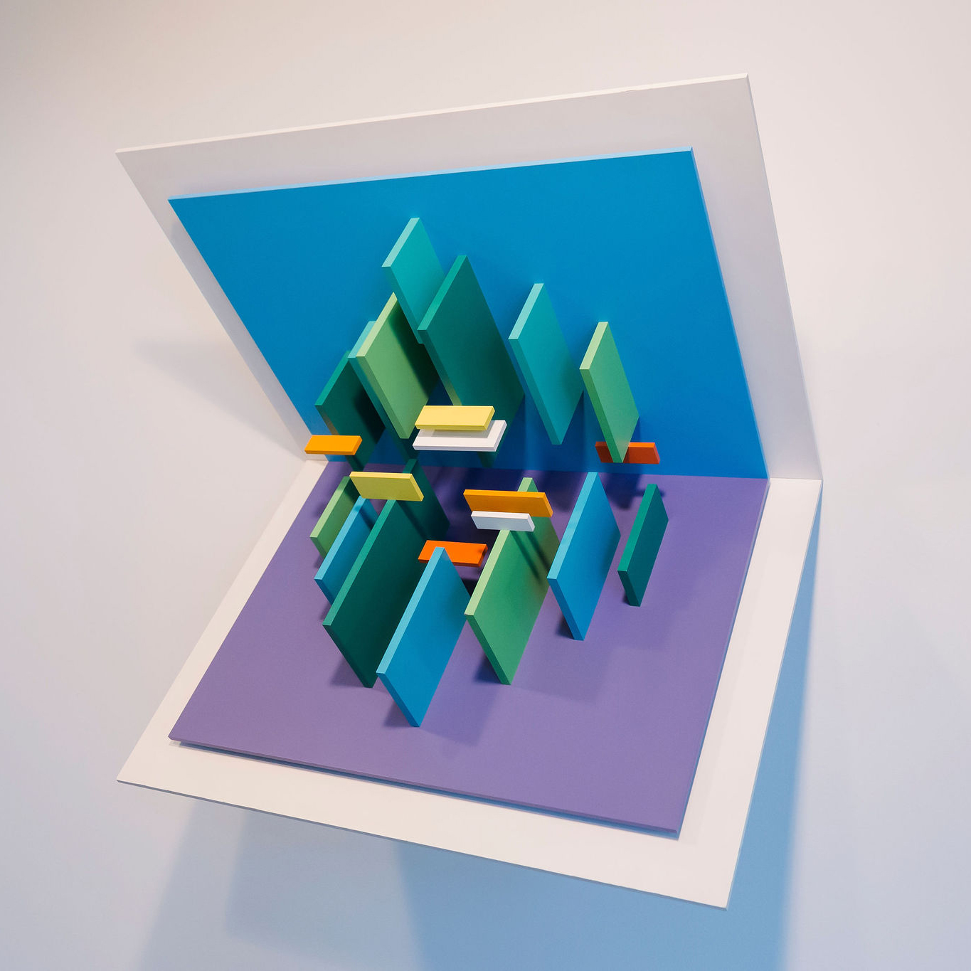
Eli Bornstein, Double Plane Structurist Relief No. 3, 1967–69. Here, Bornstein experimented by folding the work’s ground plane in half at a 90-degree angle.

Slide 20
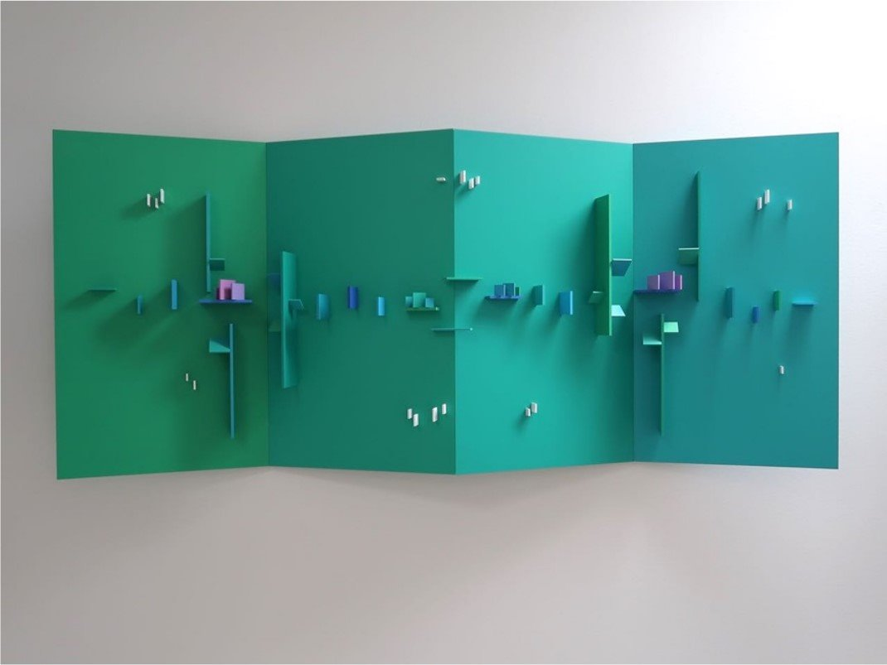
Eli Bornstein, Quadriplane Structurist Relief No. 1 (River-Screen Series), 1989–96. Bornstein often used vibrant colours to evoke phenomena seen in nature.

Slide 21
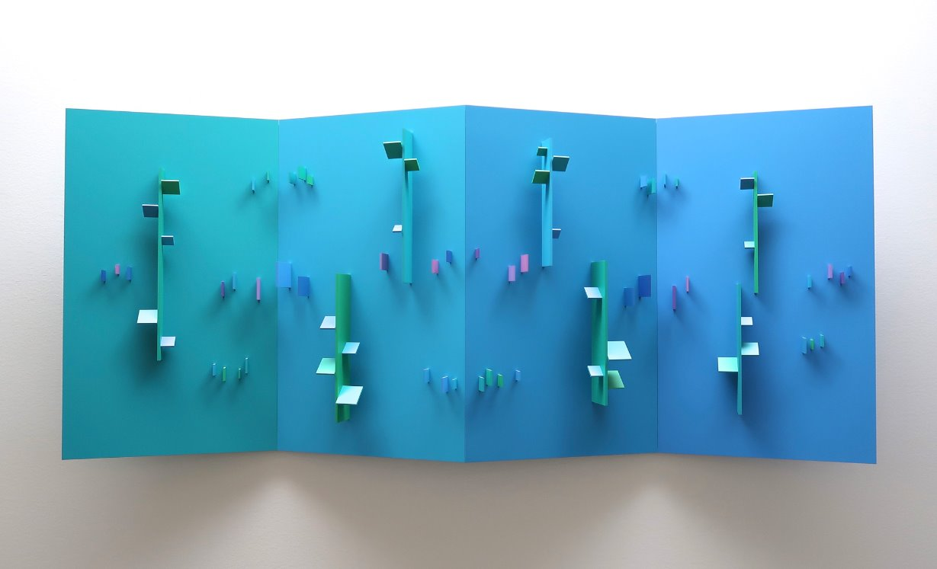
Eli Bornstein, Quadriplane Structurist Relief No. 2 (River-Screen Series), 1989–96. This series brilliantly captures the cycle from day to night using hues of blue and green.

Slide 22
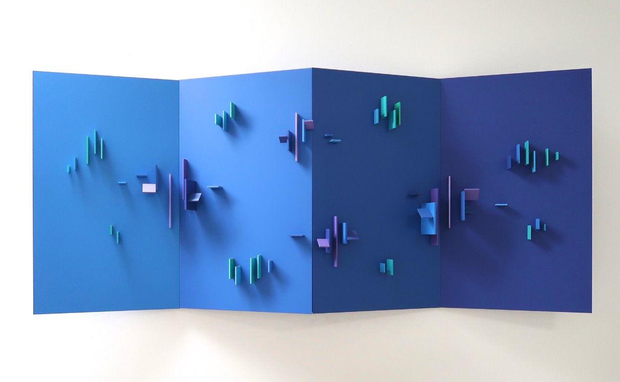
Eli Bornstein, Quadriplane Structurist Relief No. 3 (River-Screen Series), 1989–96. Bornstein took great care to light his works in specific ways, seeing lighting as part of the experience.

Slide 23
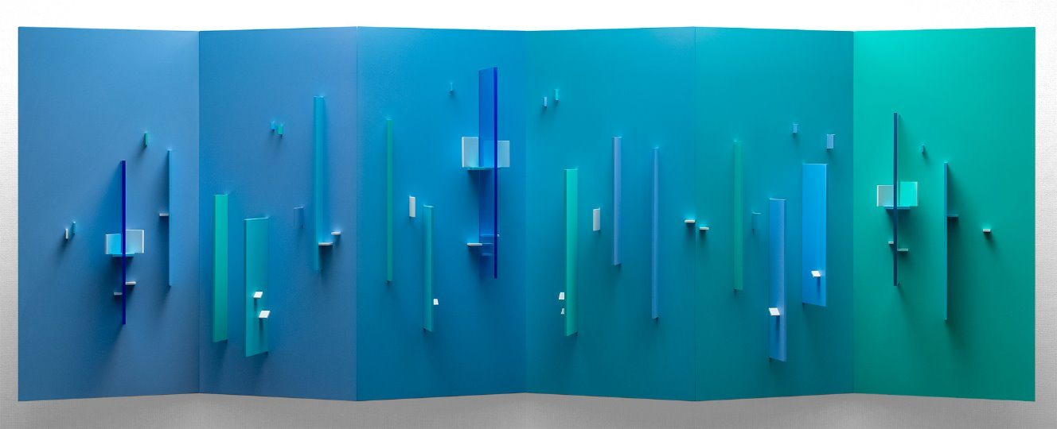
Eli Bornstein, Hexaplane Structurist Relief No. 2 (Arctic Series), 1995–98. The reliefs in Bornstein’s Arctic Series are some of the most sublime in his oeuvre.

Slide 24
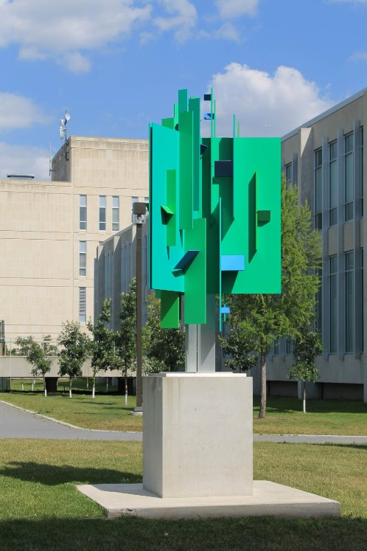
Eli Bornstein, Tripart Hexaplane Construction No. 2, 2002–6. In the early 2000s, Bornstein evolved his wall-mounted reliefs into a series of freestanding works.

Slide 25
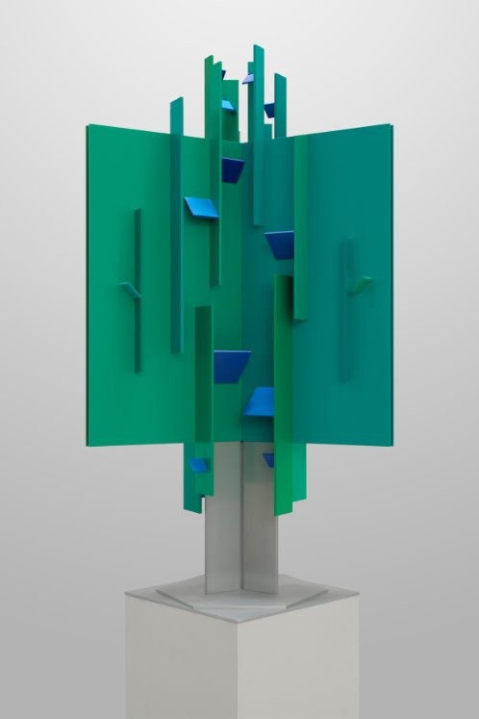
Eli Bornstein, Tripart Hexaplane Construction No. 2 (model), 2002–6. Throughout his career Bornstein used models to plan out his larger works.

Slide 26
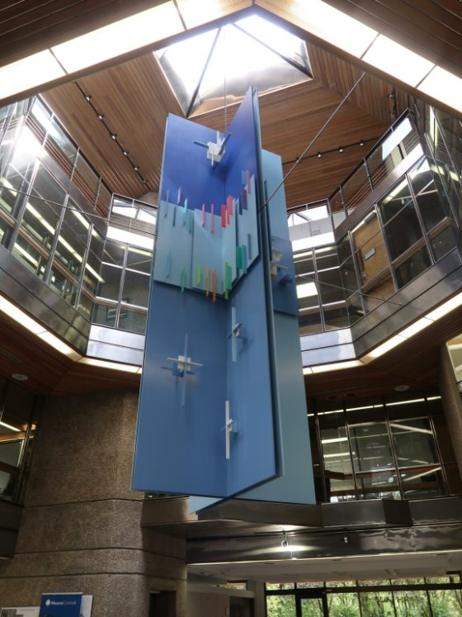
Eli Bornstein, Four Part Vertical Double Plane Structurist Relief (Winter Sky Series), 1980–83. This is the largest work Bornstein has produced to date.

Slide 27
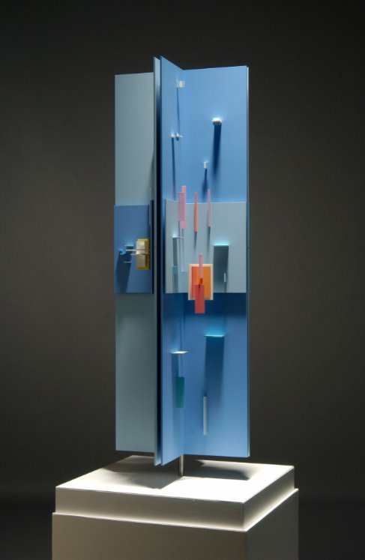
View A of Eli Bornstein, Four Part Vertical Double Plane Structurist Relief Nos. 14–17 (Winter Sky Series), 1980–83. As the title suggests, this work is an homage to winters on the Canadian Prairies

Slide 28
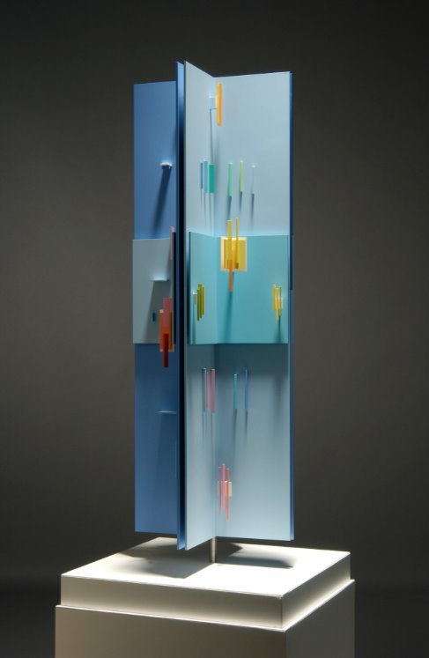
View B of Eli Bornstein, Four Part Vertical Double Plane Structurist Relief Nos. 14–17 (Winter Sky Series), 1980–83. Bornstein personally mixed many of the colours he used to paint his reliefs.

Slide 29
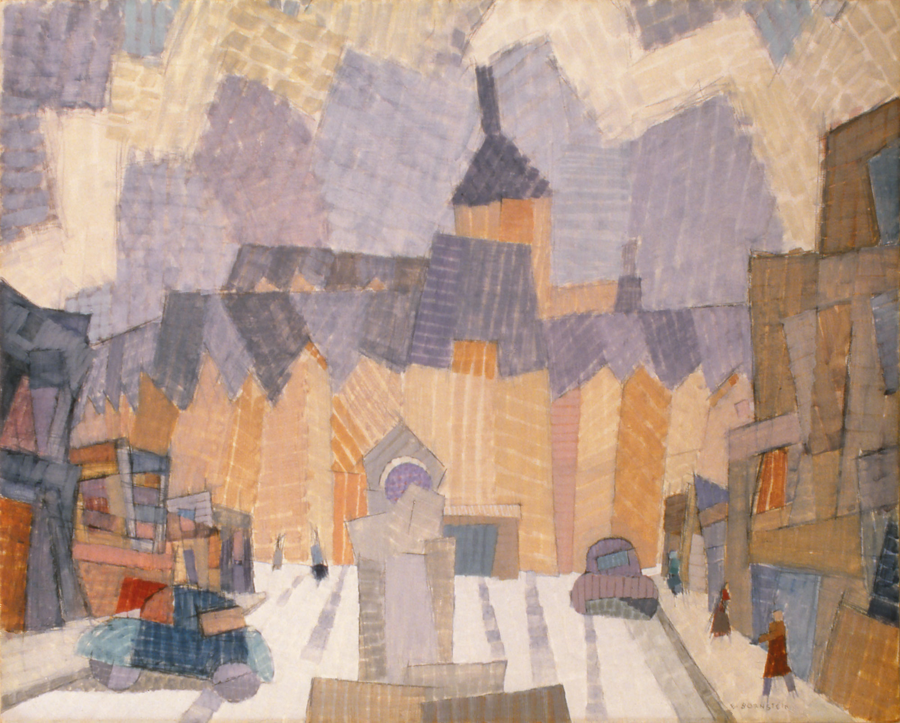
Eli Bornstein, Saskatoon, 1954. This semi-representational painting depicts the Bessborough, a grand hotel located in downtown Saskatoon.

Slide 30
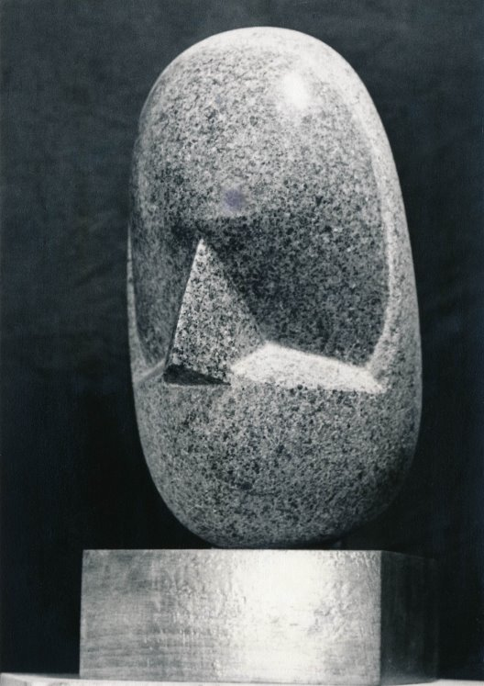
Eli Bornstein, Shelomo, 1949–56. When creating some of his earliest sculptures, Bornstein took inspiration from the work of Constantin Brânçusi.

Slide 31
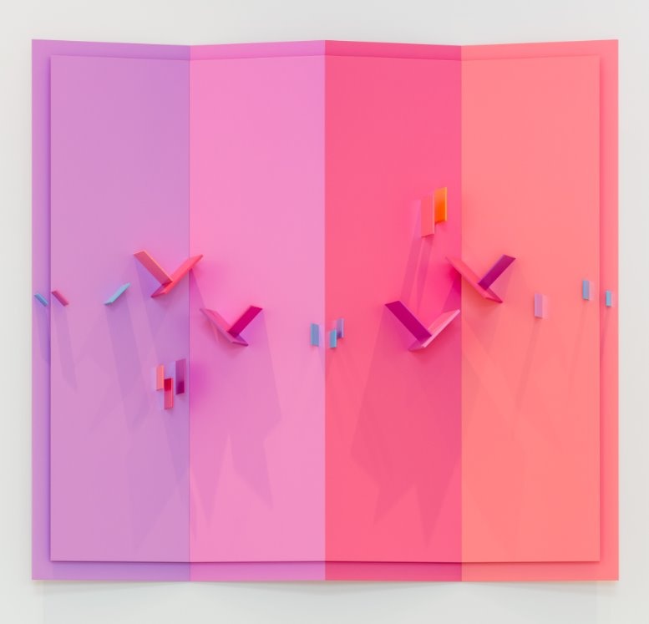
Eli Bornstein, Quadriplane Structurist Relief No. 15-II, 2016–17. The vibrant pinks and oranges used in this relief are reminiscent of a sunset.

Slide 32
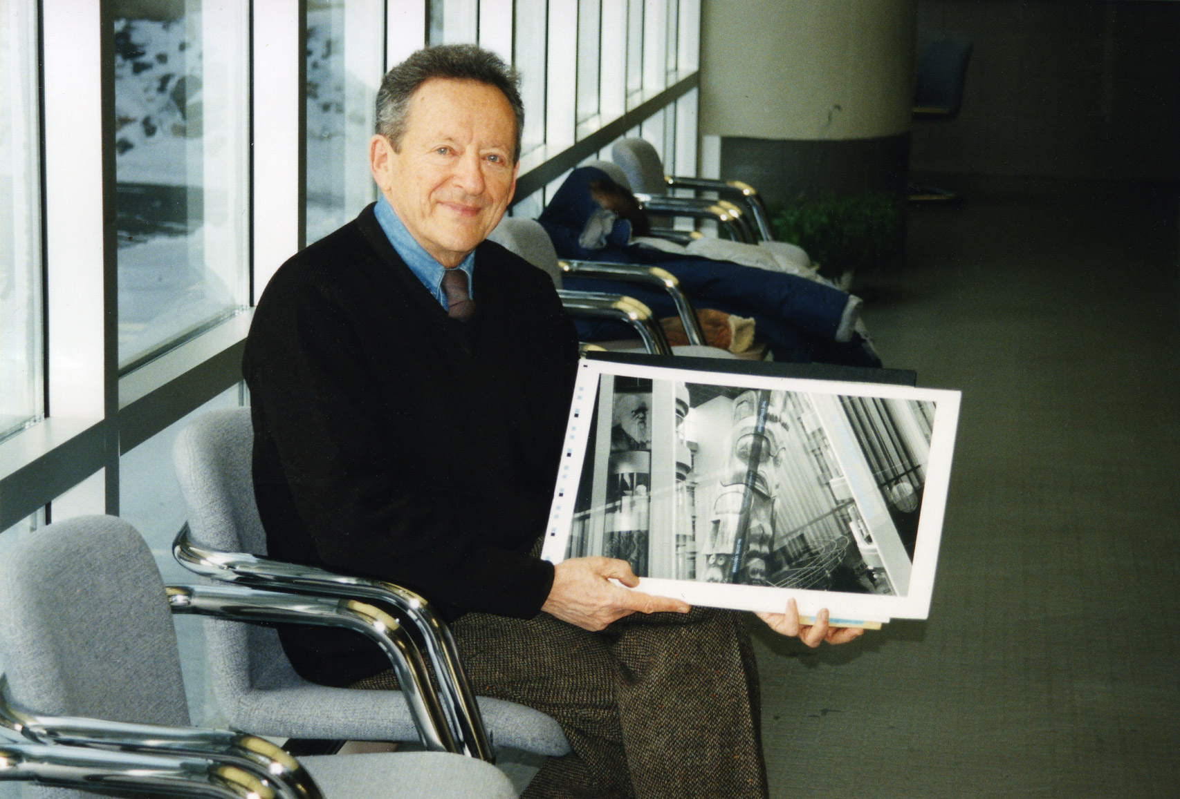
Eli Bornstein with the cover proof of the 1997–98 issue of The Structurist, the journal he founded in 1960.

Slide 33
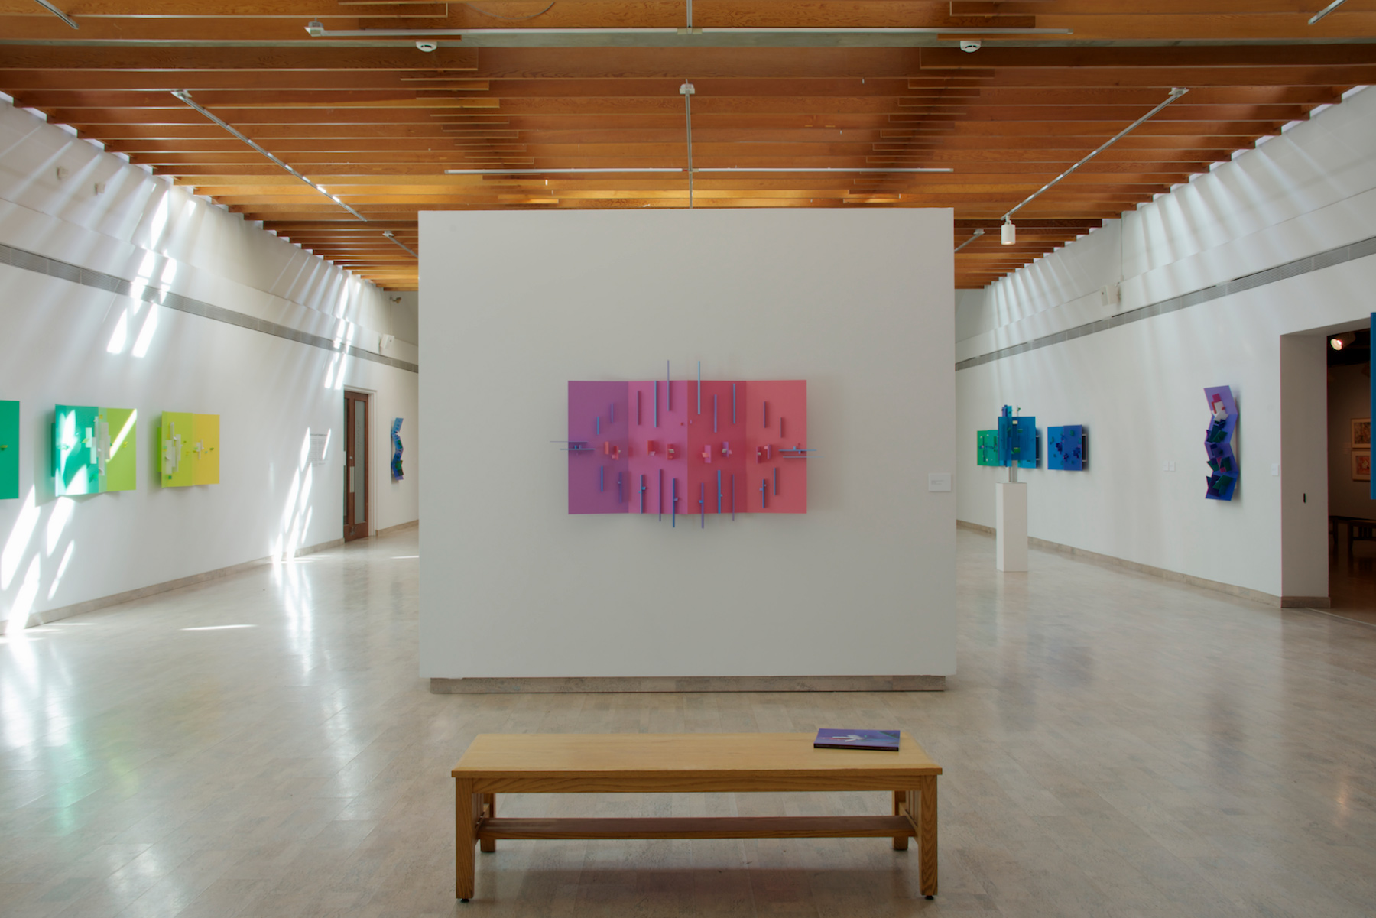
Installation view of An Art at the Mercy of Light: Recent Works by Eli Bornstein at the Mendel Art Gallery, Saskatoon, 2013.

