Slide 1
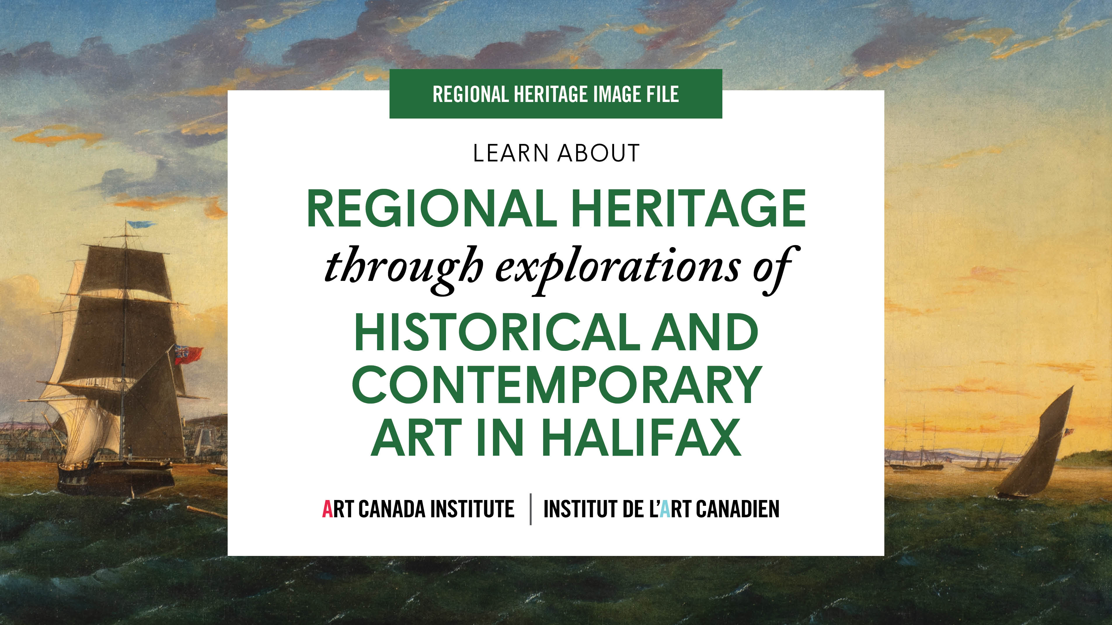

Slide 2
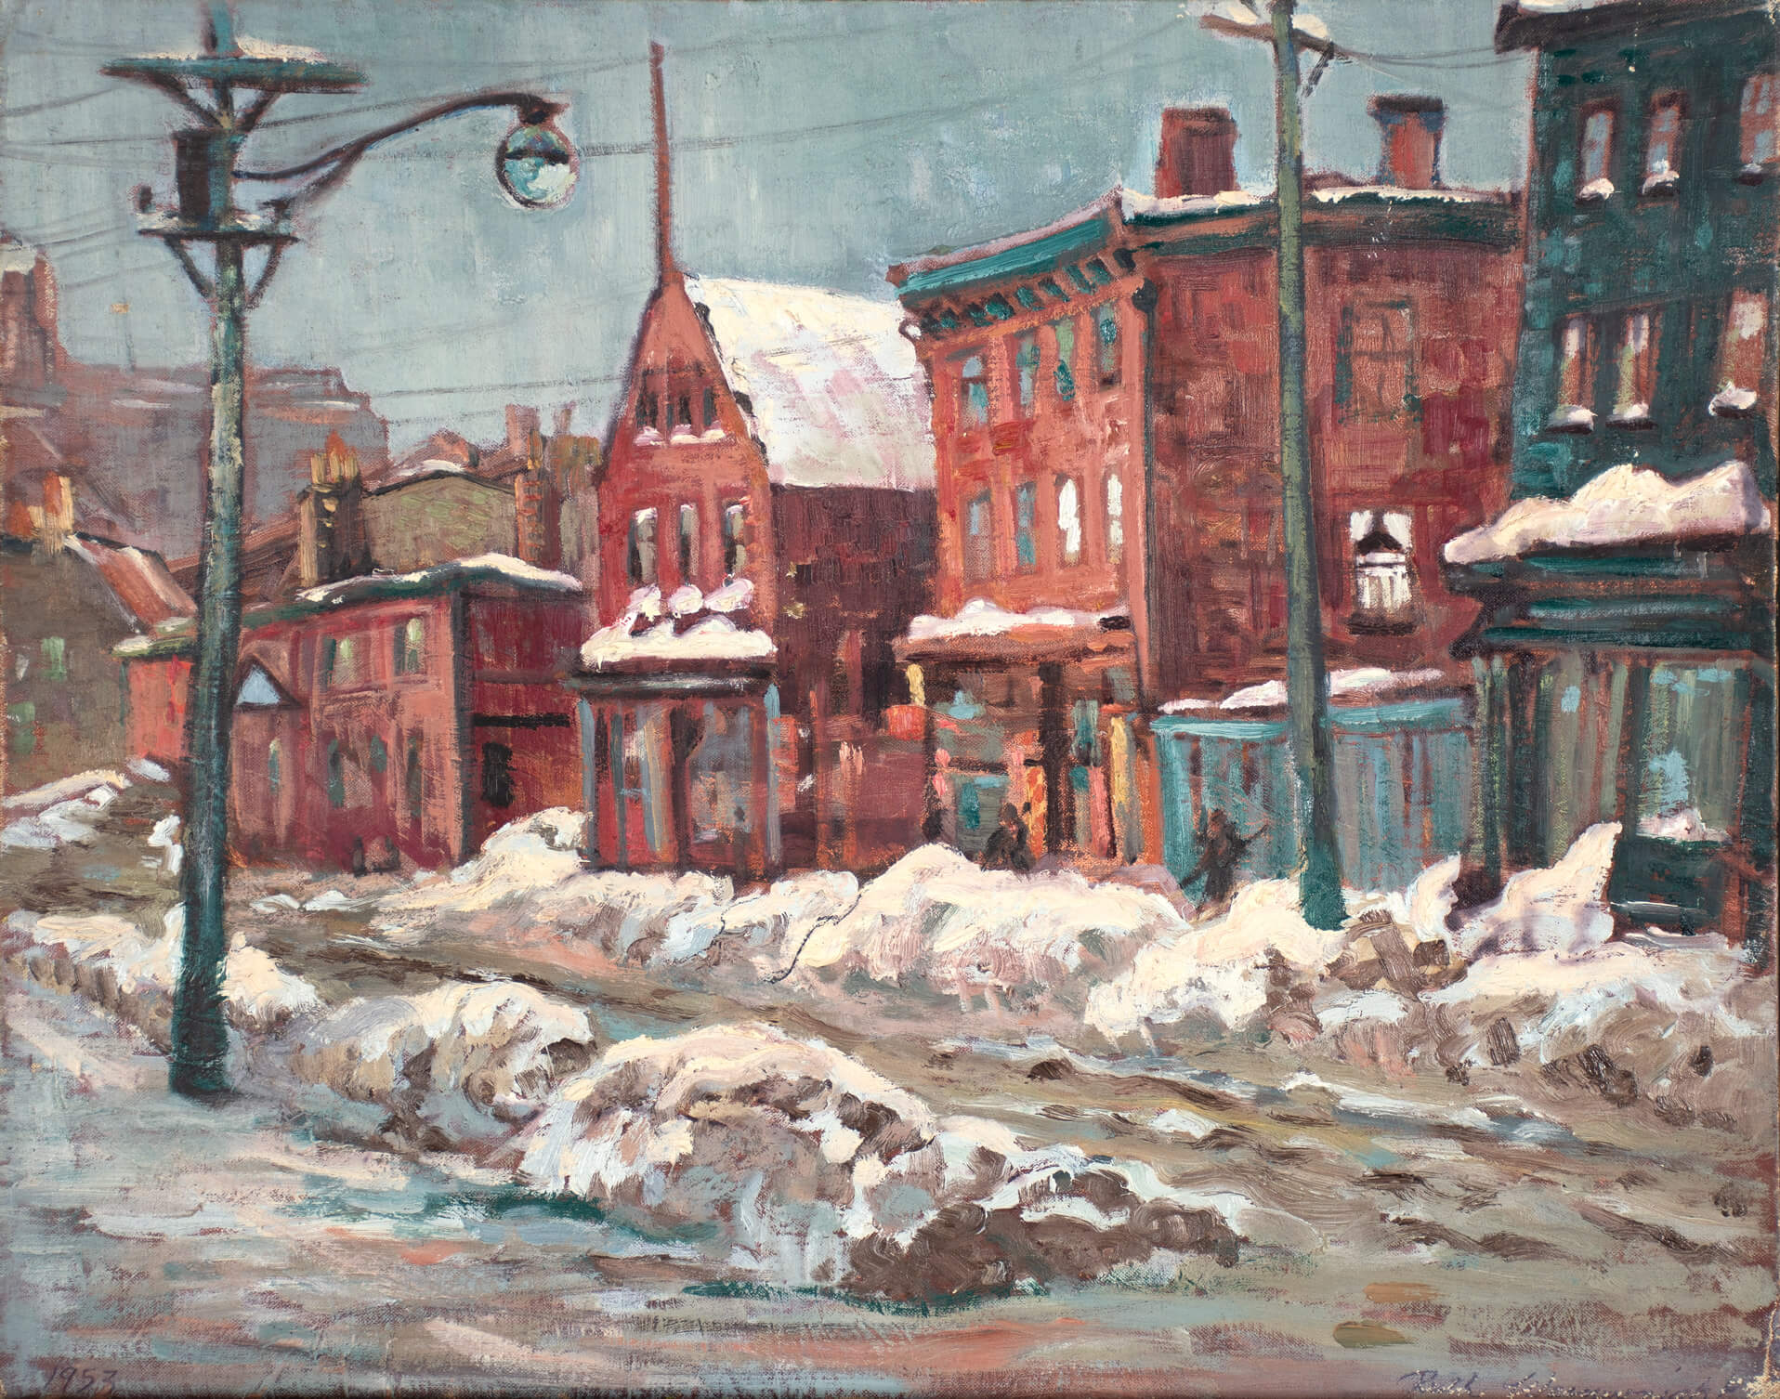
Ruth Salter Wainwright, Water Street, Halifax, 1953. Salter Wainwright exhibited widely throughout Halifax, and later, across Canada.

Slide 3
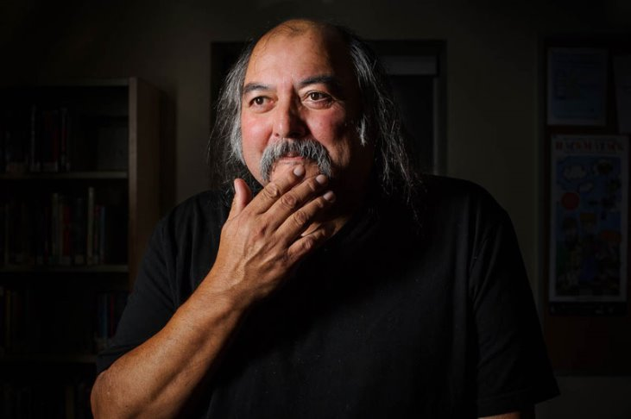
Alan Syliboy, date unknown.

Slide 4
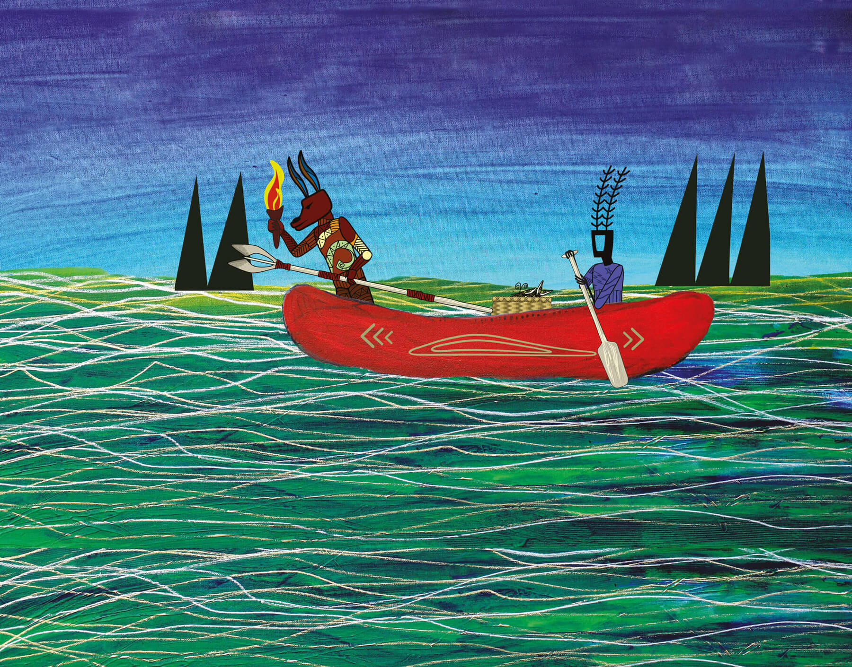
Alan Syliboy, Wolverine and Little Thunder, date unknown. This piece demonstrates Syliboy’s graphic style.

Slide 5
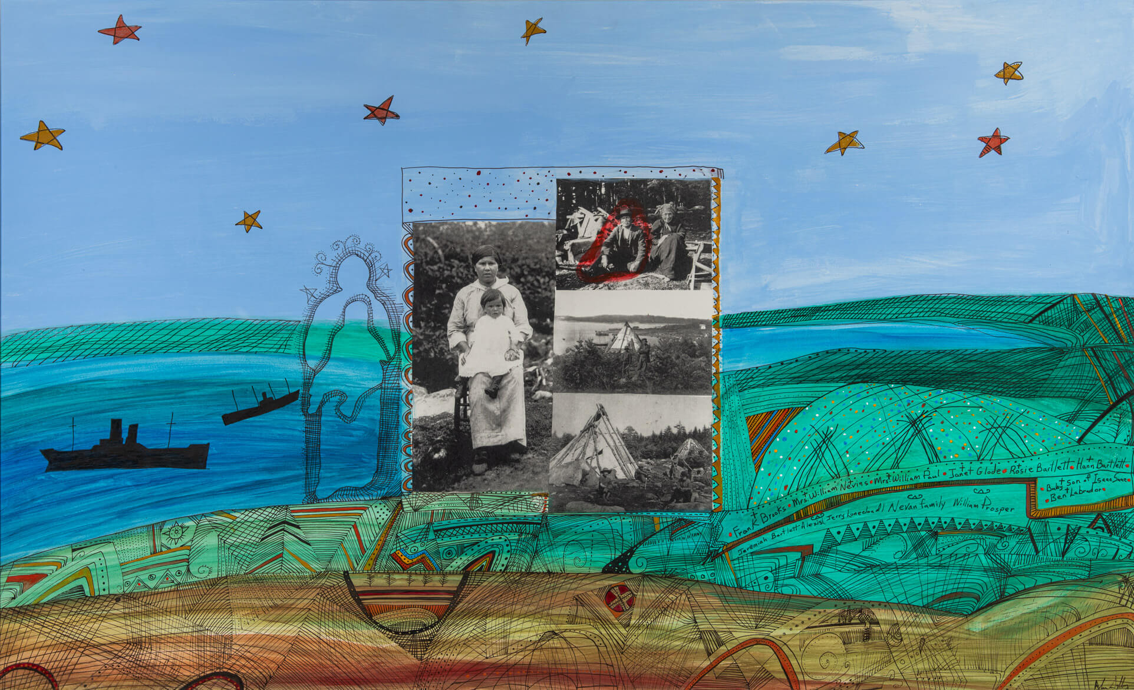
Alan Syliboy, Tuft’s Cove Survivor, 1999. Syliboy’s art practice became a means for reclaiming, understanding, and celebrating his culture.

Slide 6
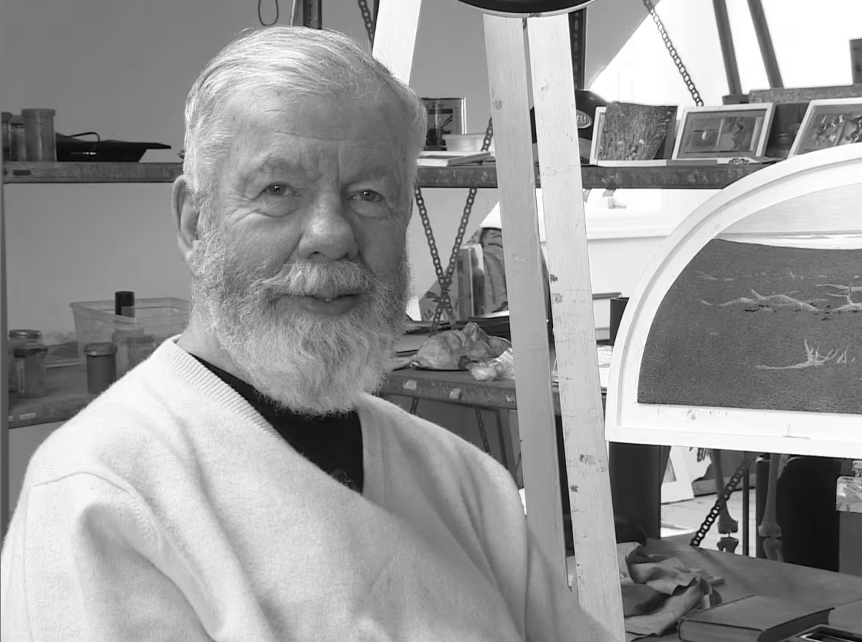
Tom Forrestall, date unknown.

Slide 7
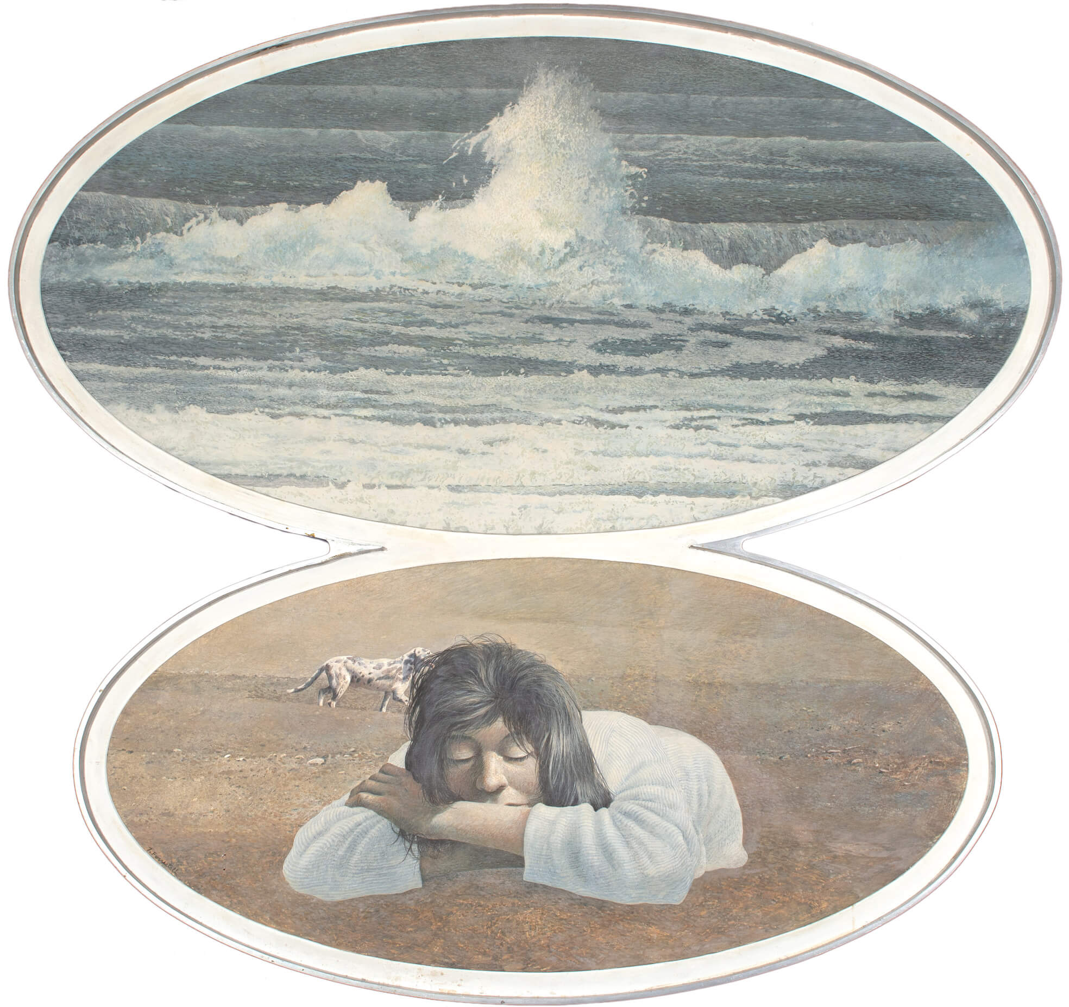
Tom Forrestall, Dog, Girl and Beach, 1979. This is an example of Forrestall’s meticulous attention to detail.

Slide 8
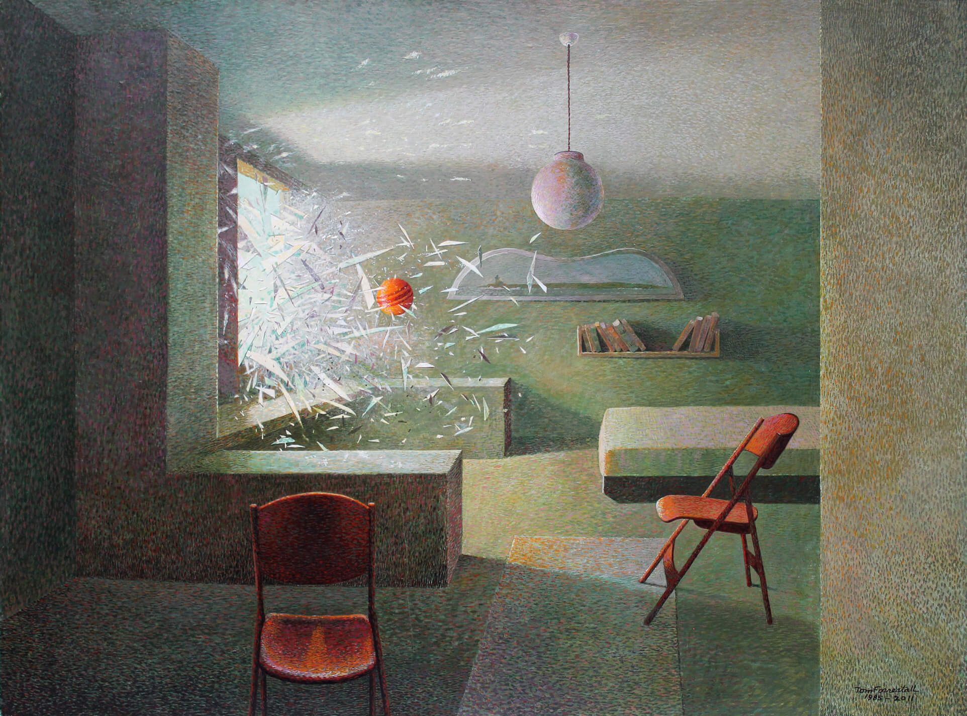
Tom Forrestall, The Dramatic Entrance, 1985–August 2011. This work is an example of Forrestall’s cinematic style of realism.

Slide 9
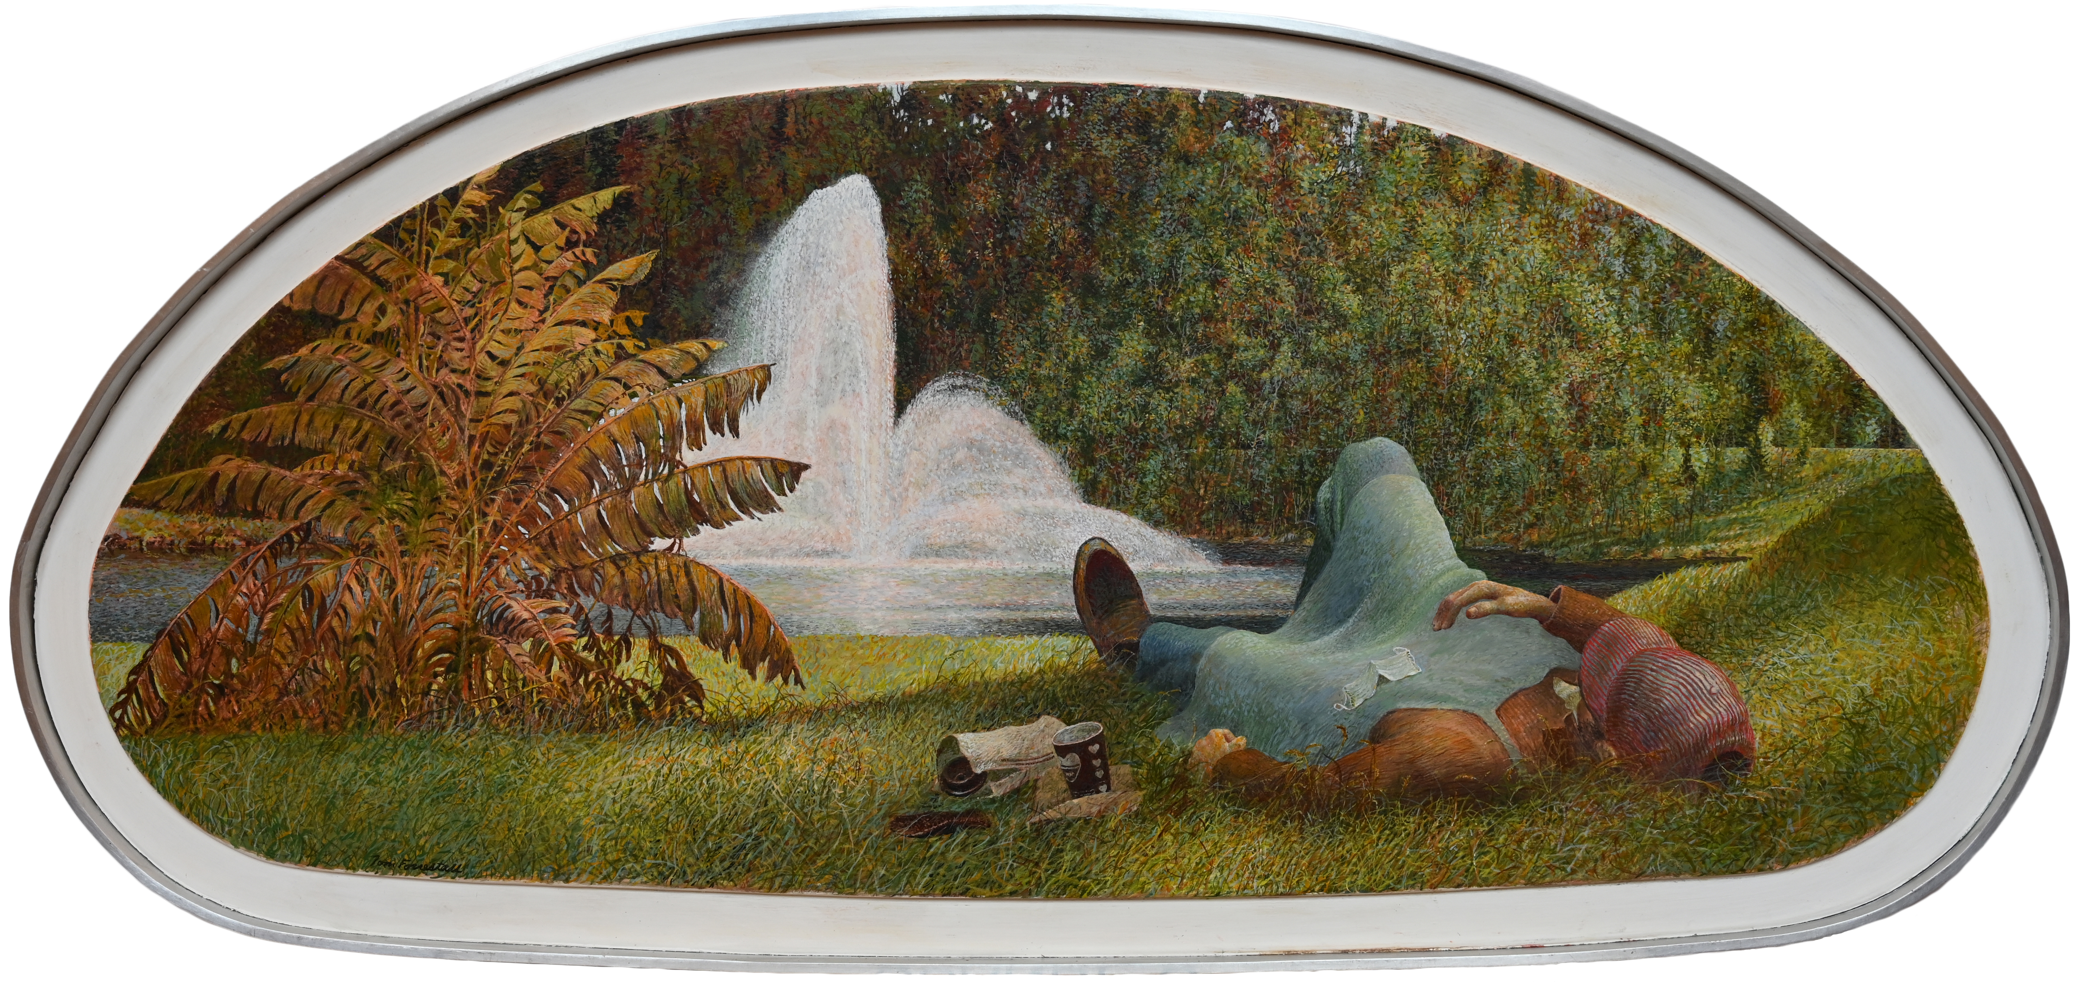
Tom Forrestall, Midday Nap, Near the Fountain, 2021–22. Forrestall’s paintings were often made on uniquely shaped boards.

Slide 10
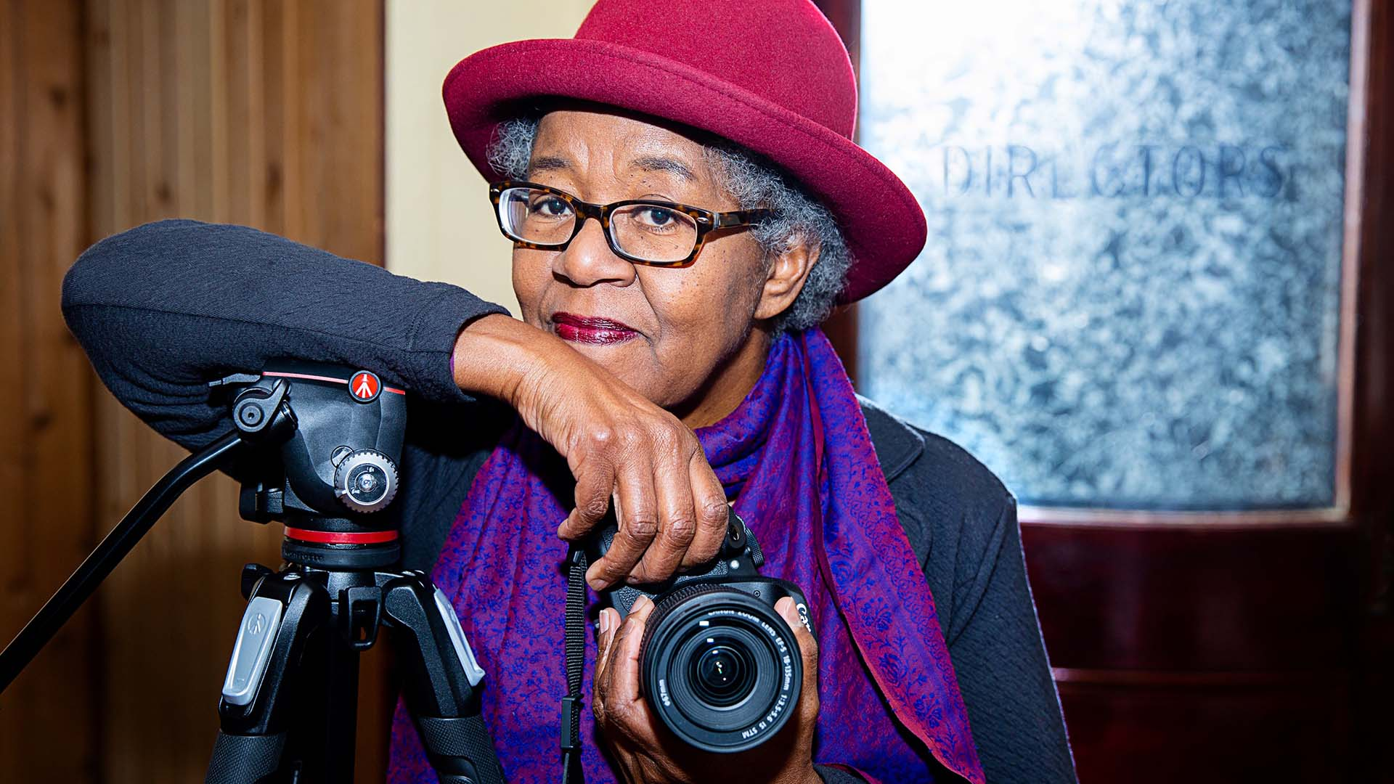
Sylvia D. Hamilton, date unknown.

Slide 11
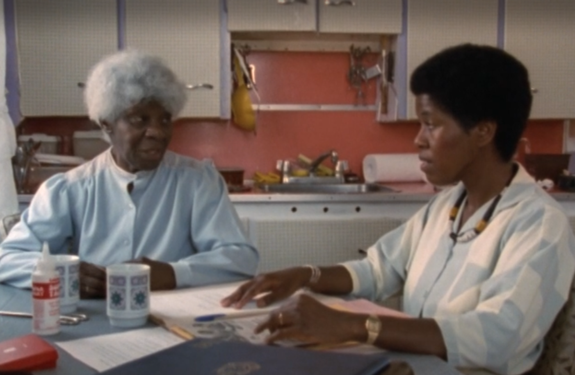
Sylvia D. Hamilton, still from Black Mother Black Daughter, 1989. Hamilton and her mother, Marie Waldron Hamilton, sit at the kitchen table discussing equality and empowerment.

Slide 12
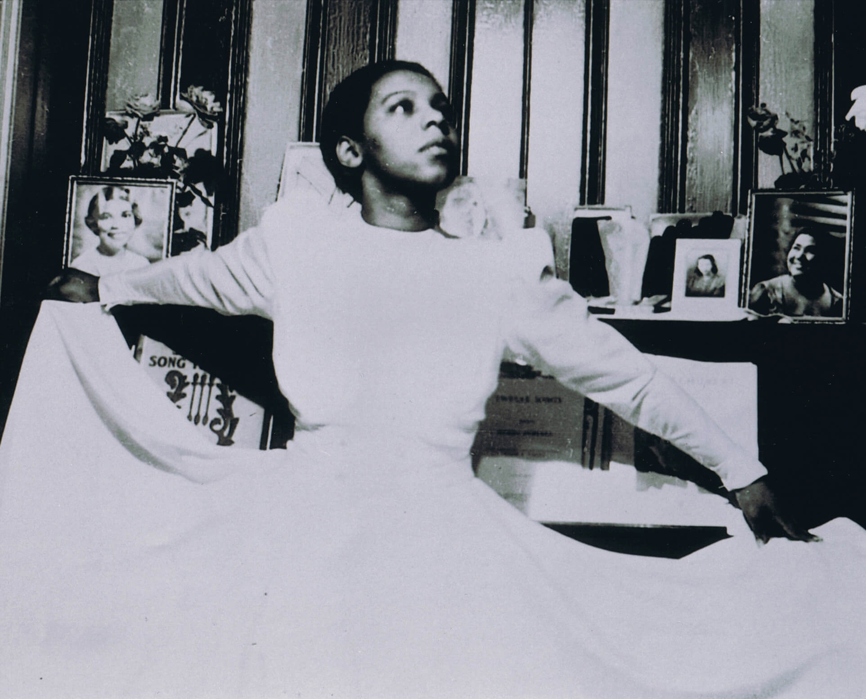
Sylvia D. Hamilton, still from Portia White: Think on Me, 2000. Hamilton creates films that feature a unique blend of tenderness, honesty, and activism.

Slide 13
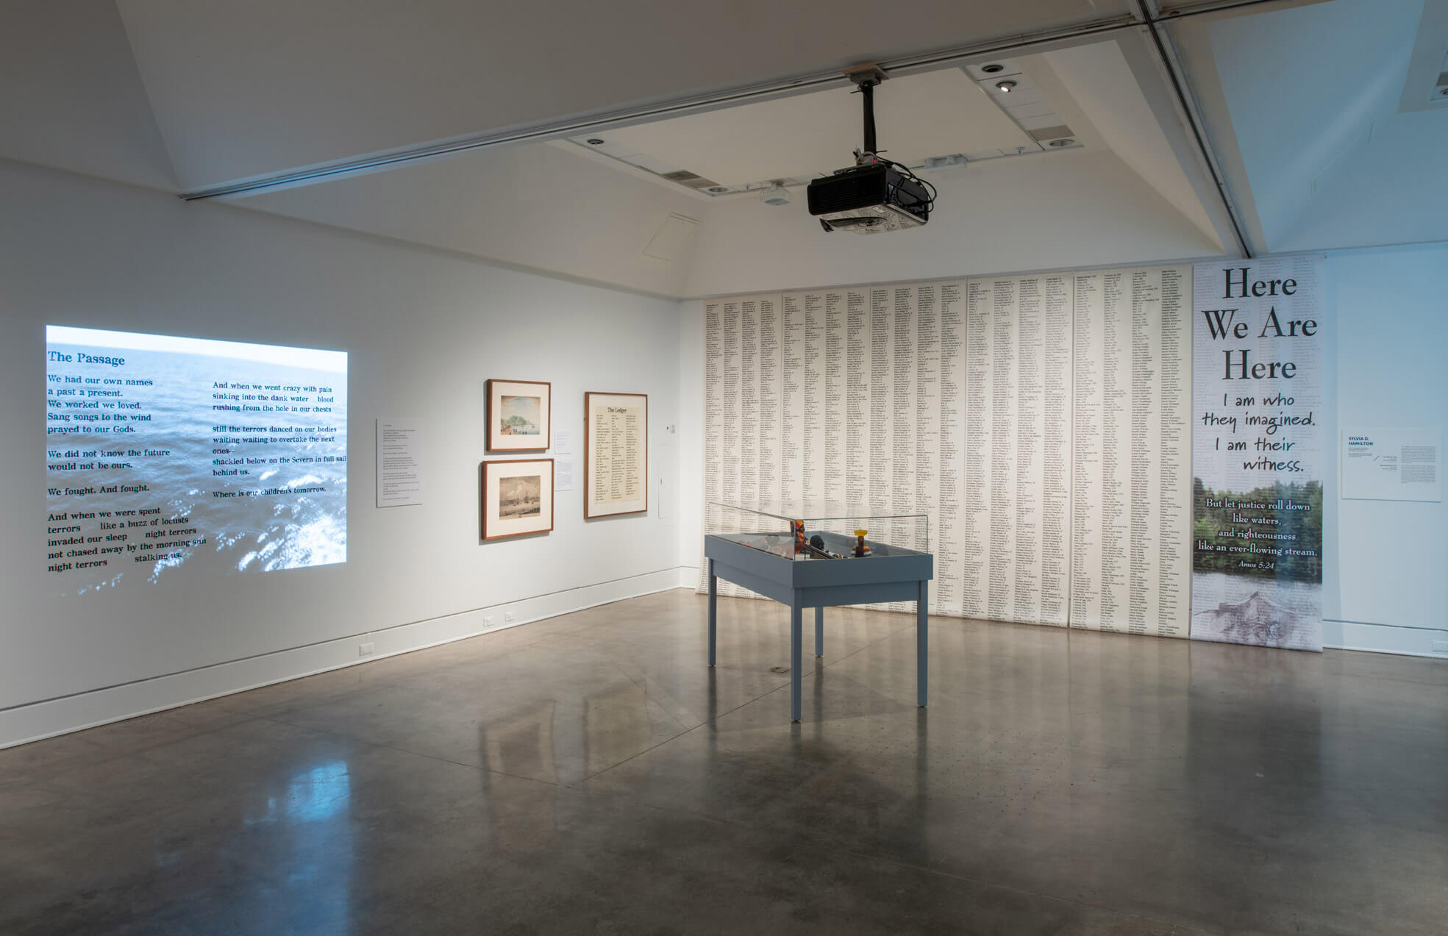
Installation view of Sylvia D. Hamilton, Here We Are Here, 2013–17. In her Excavations series, Hamilton uses text and objects to explore ideas of place, memory, and history.

Slide 14
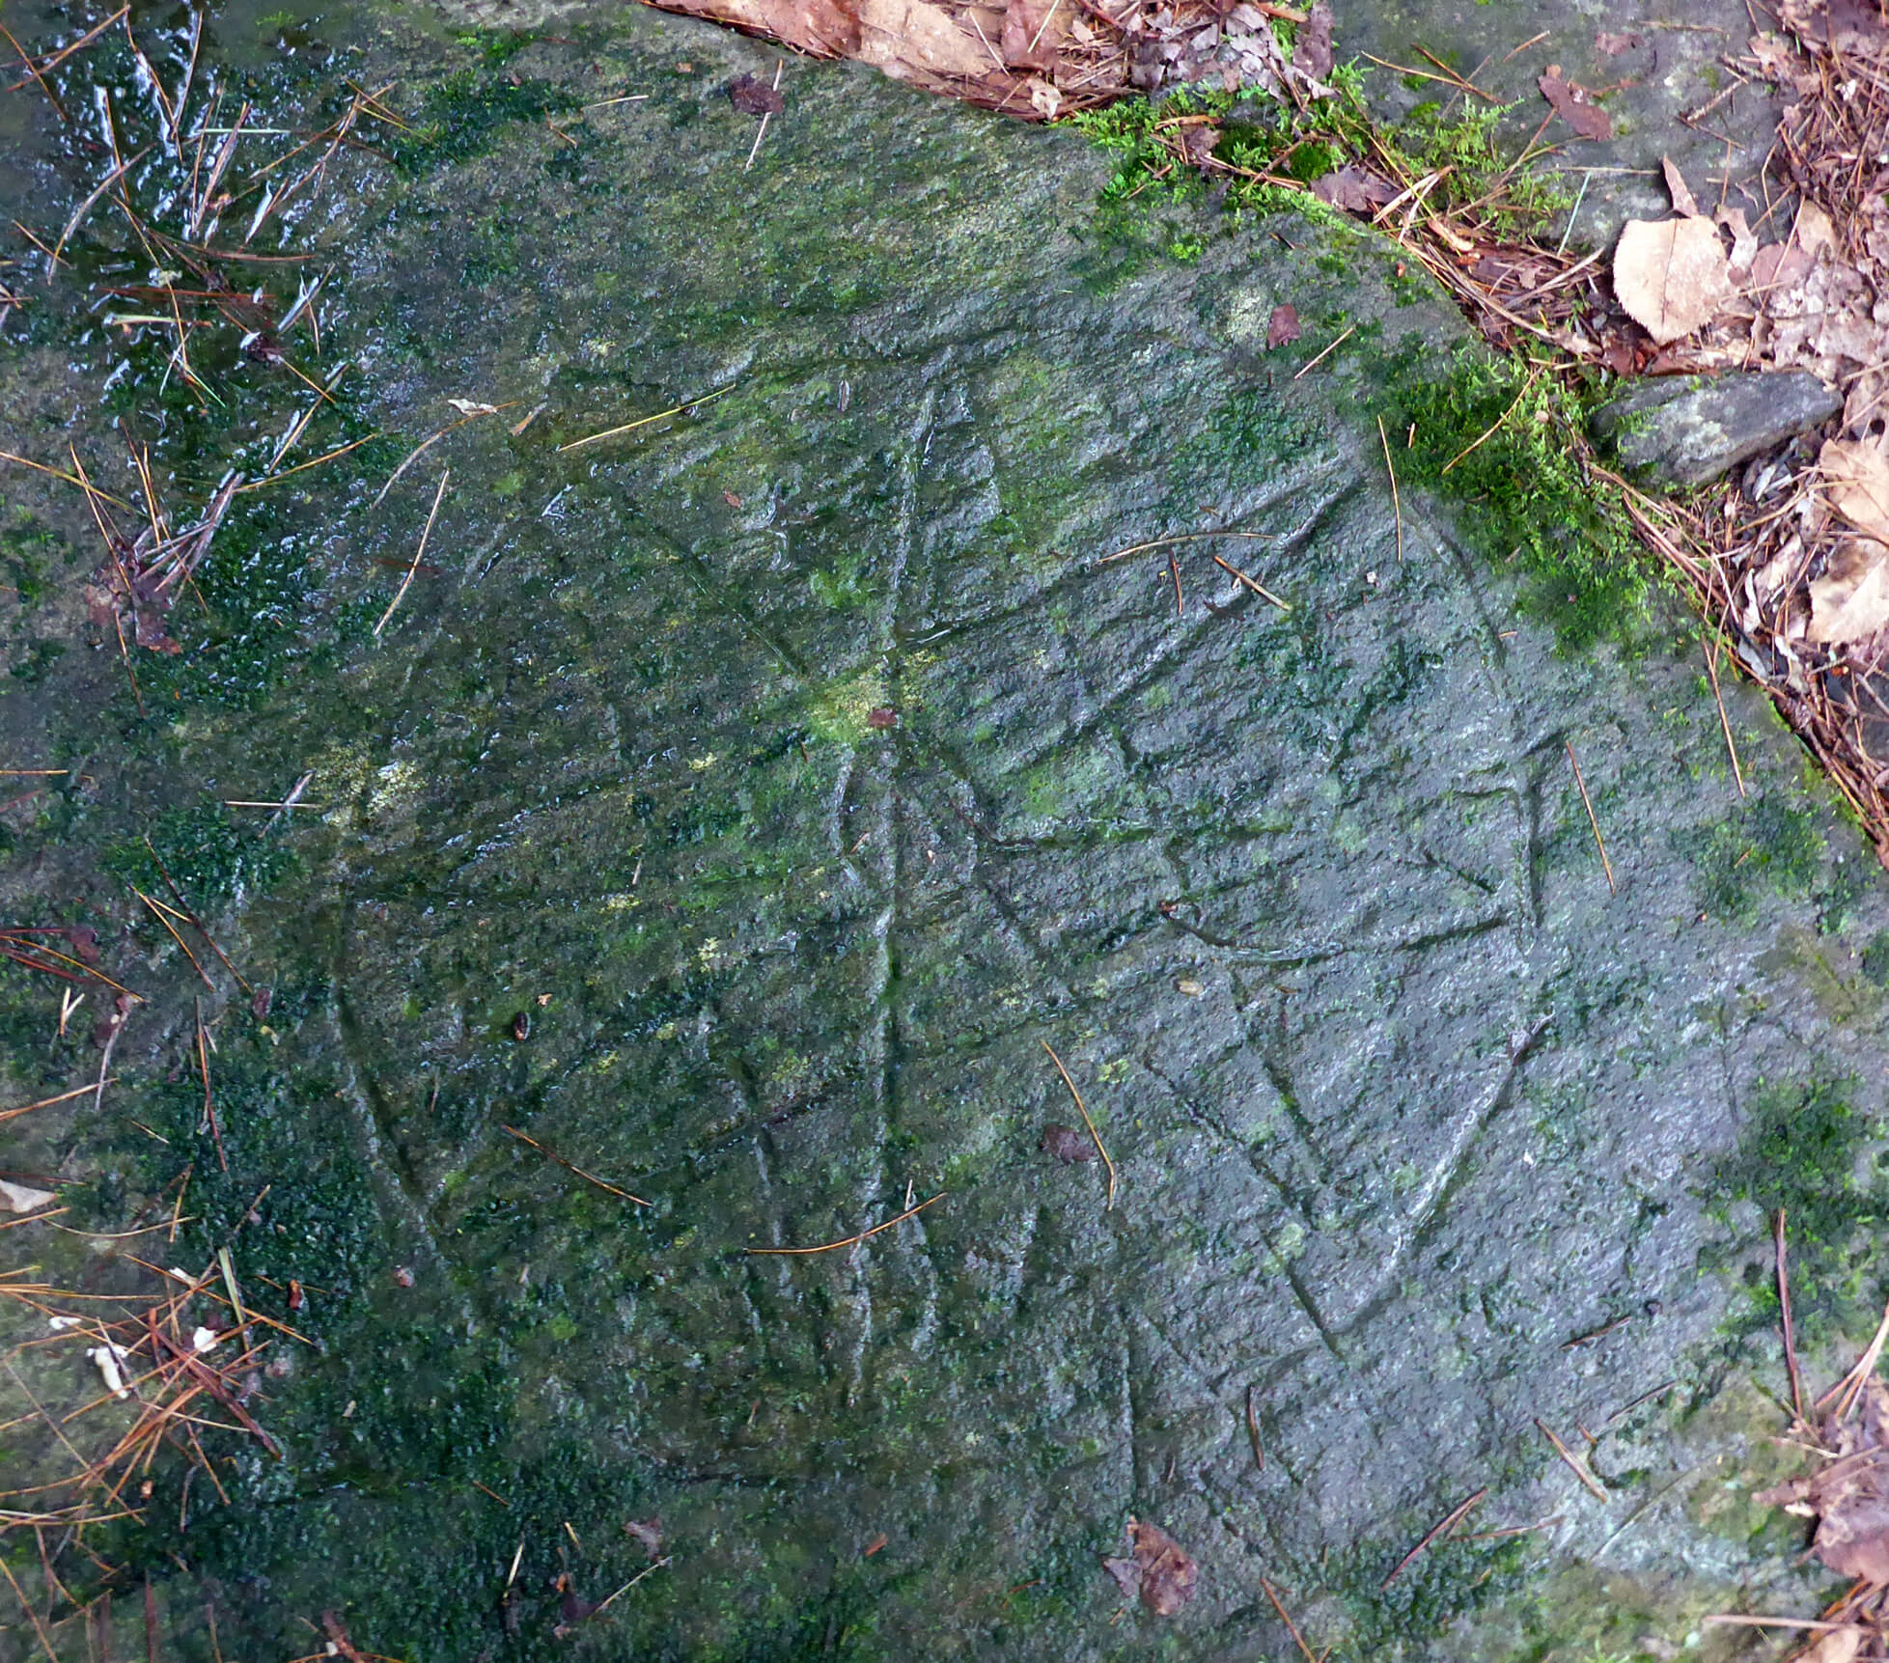
Once-Known Mi’kmaw Artist, Eight-Pointed Star, date unknown. This stone etching depicts the eight-pointed star, which represents the sun and the eight nations of Mi’kma’ki.

Slide 15
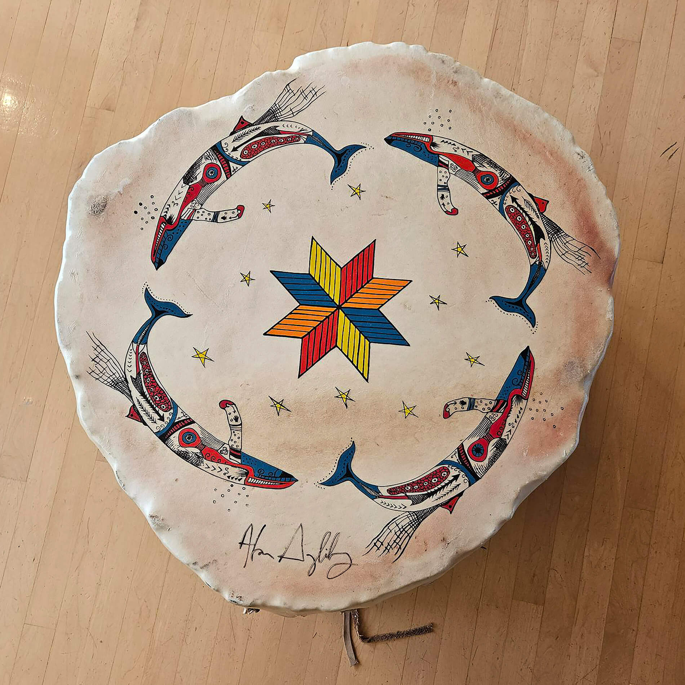
Jon Seca LaBillois and Alan Syliboy, Four Humpback Whale Drum, date unknown. Syliboy takes inspiration from Mi’kmaw petroglyphs.

Slide 16
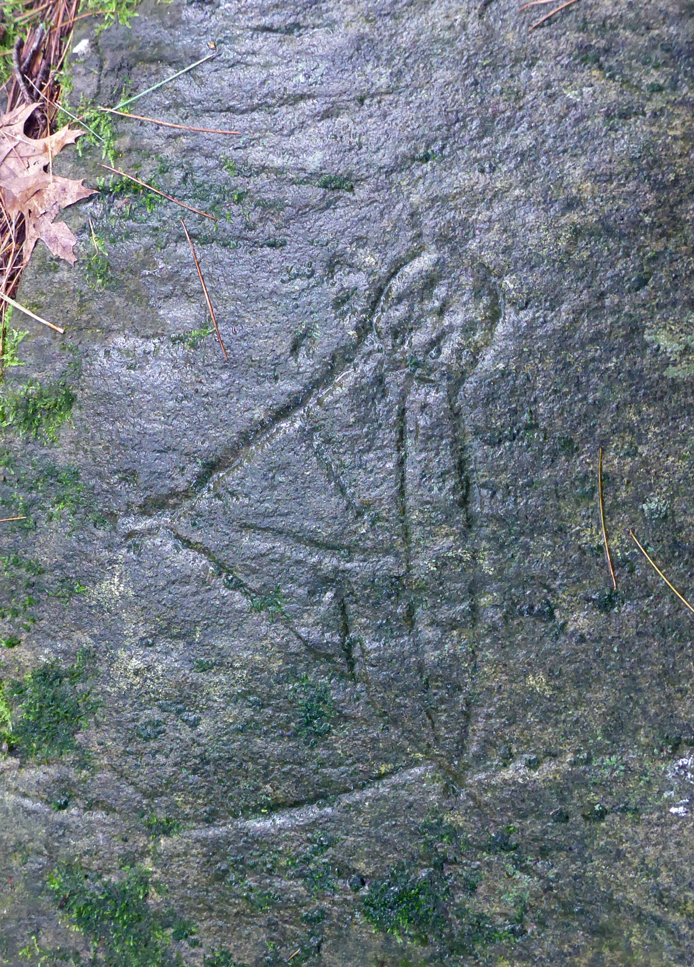
Once-Known Mi’kmaw Artist, Figure, date unknown. This petroglyph was made at least six hundred years ago.

Slide 17
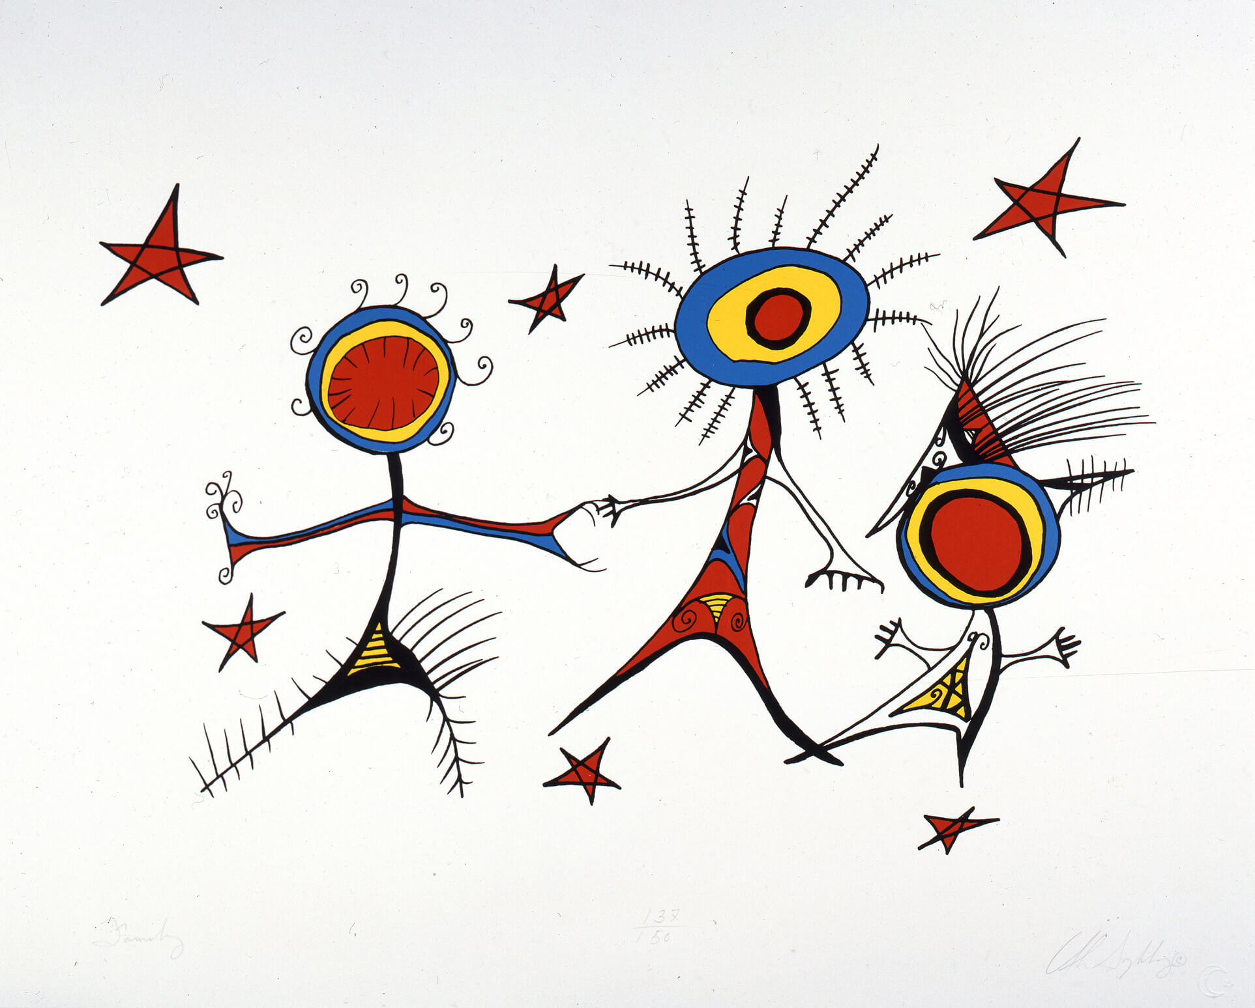
Alan Syliboy, All My Relations, Family, 1992. Syliboy combines shapes found in Mi’kmaw petroglyphs with bold colours in this contemporary composition.

Slide 18
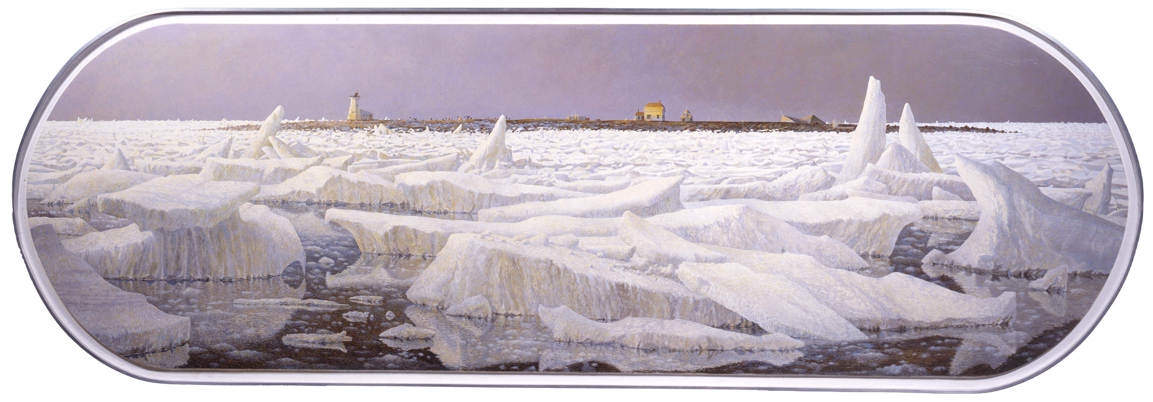
Tom Forrestall, Island in the Ice, 1987. This painting depicts a rare weather event that filled the Halifax harbour with pack ice for the first time in recorded history.

Slide 19
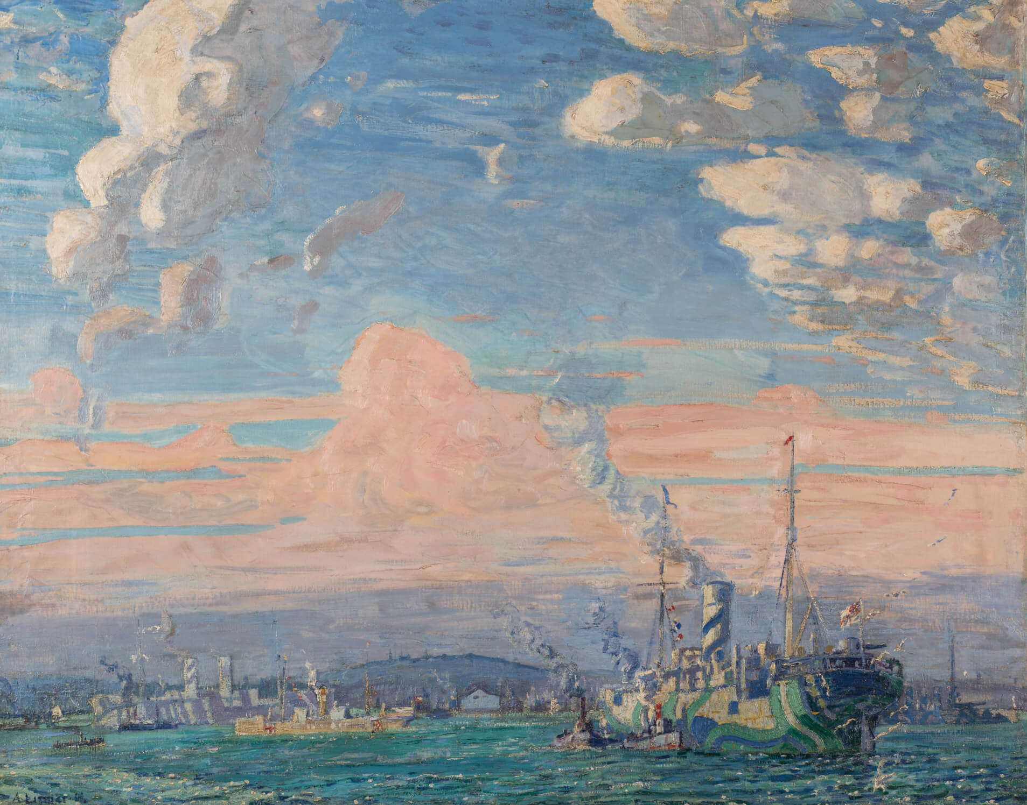
Arthur Lismer, Halifax Harbour, Time of War, c.1917. Lismer created this depiction of the Halifax harbour while serving as an official war artist.

Slide 20
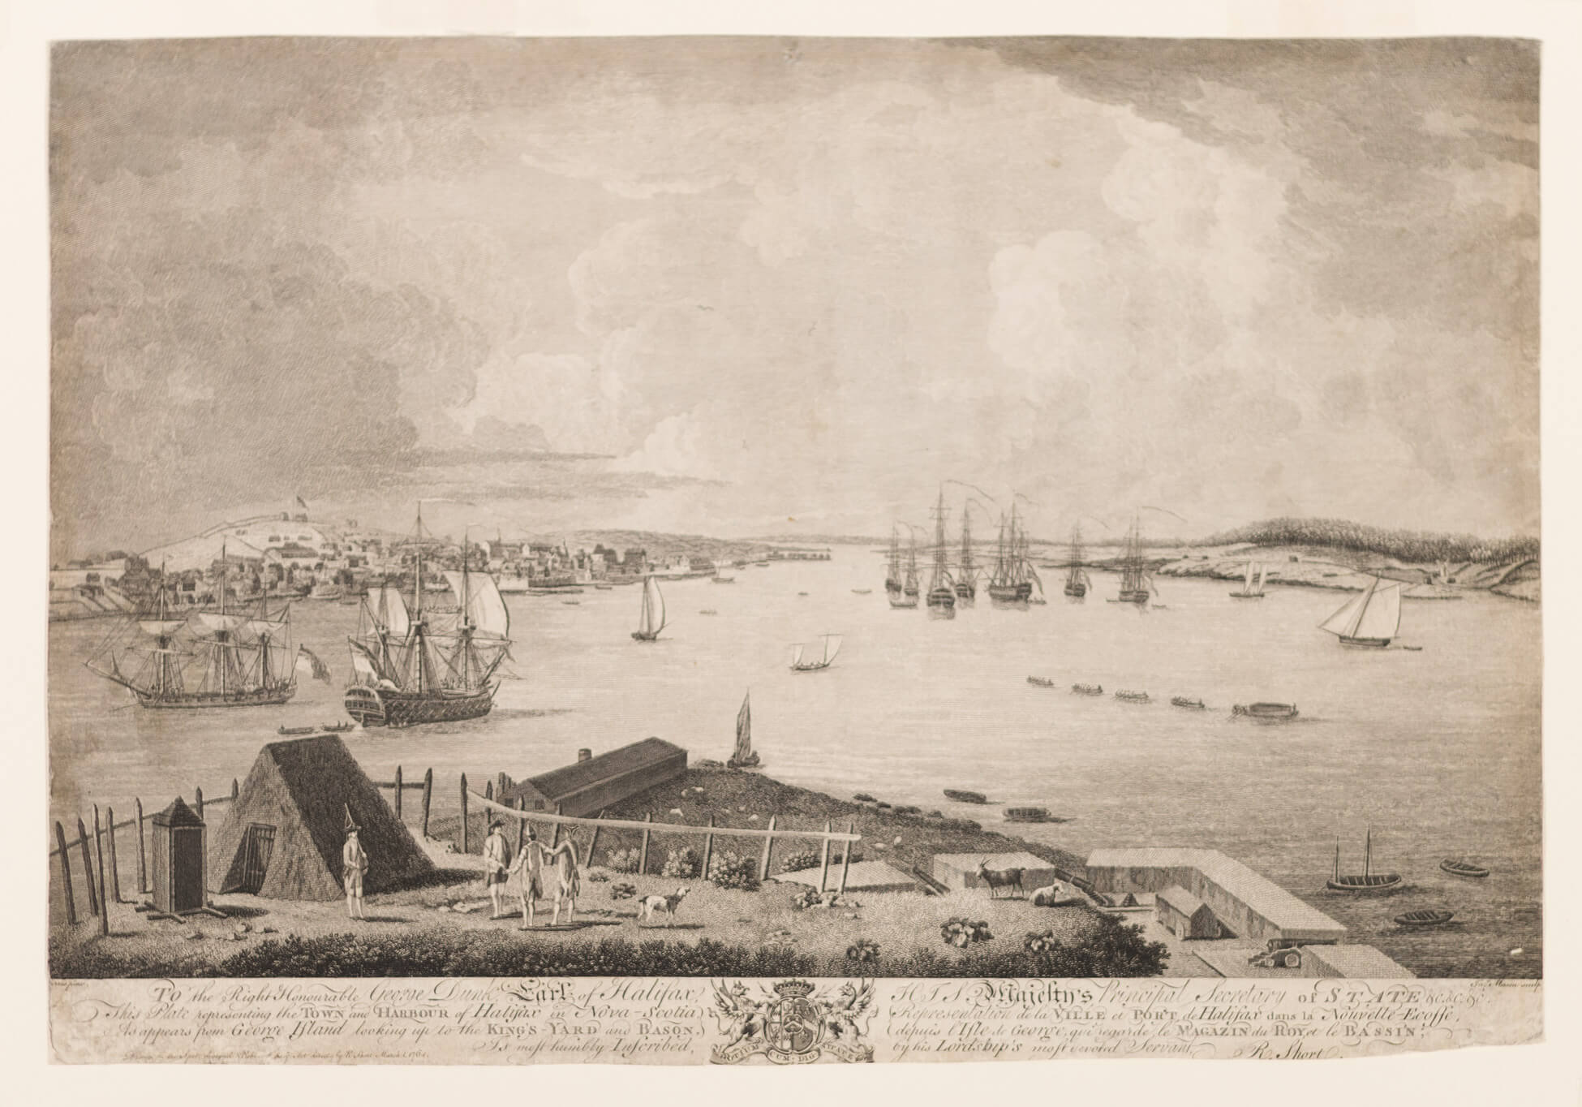
Richard Short, Dominic Serres, and James Mason, The Town and Harbour of Halifax in Nova Scotia, as appears from George Island, 1764. This engraving print is one of the earliest images of Halifax in existence.

Slide 21
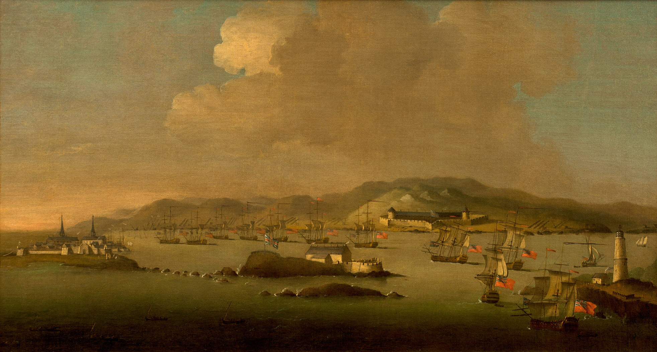
Peter Monamy, The Capture of Louisbourg, c.1745. Depictions of the Halifax harbour were some of the first settler images of the region.

Slide 22
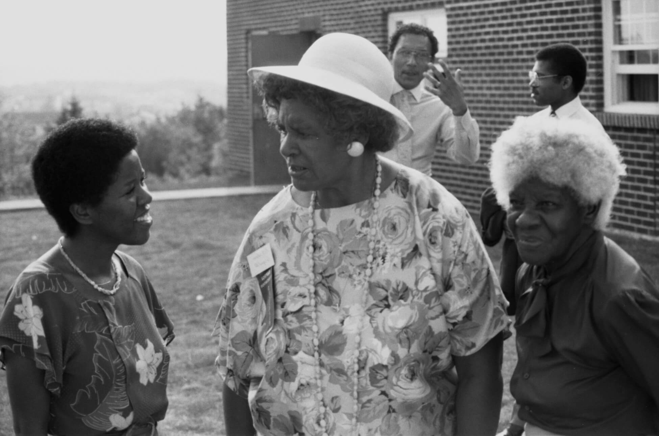
Sylvia D. Hamilton, still from Black Mother Black Daughter, 1989. In this film, Hamilton explores ideas of community, legacy, tradition, and empowerment.

Slide 23
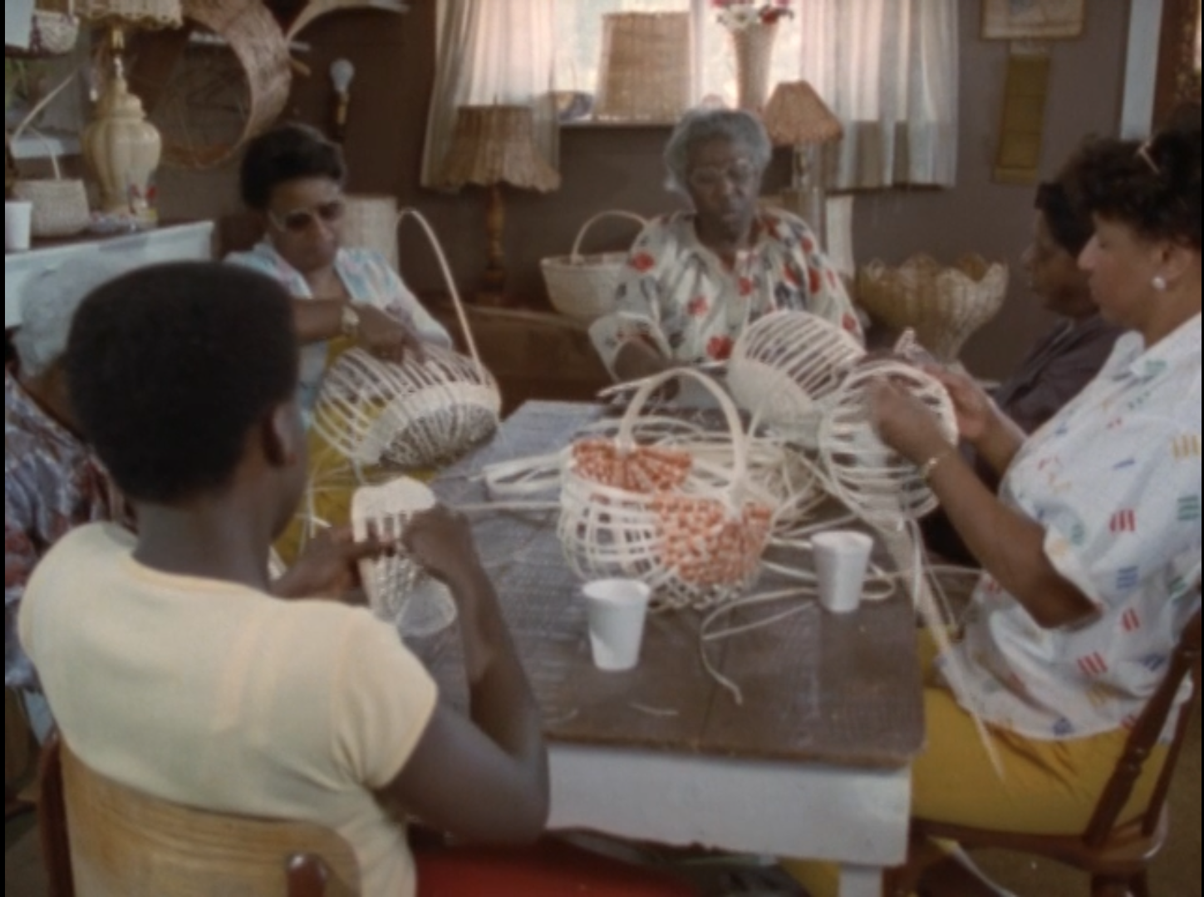
Sylvia D. Hamilton, still from Black Mother Black Daughter, 1989. In this scene, a group of Nova Scotia women share in the craft of basketweaving.

Slide 24
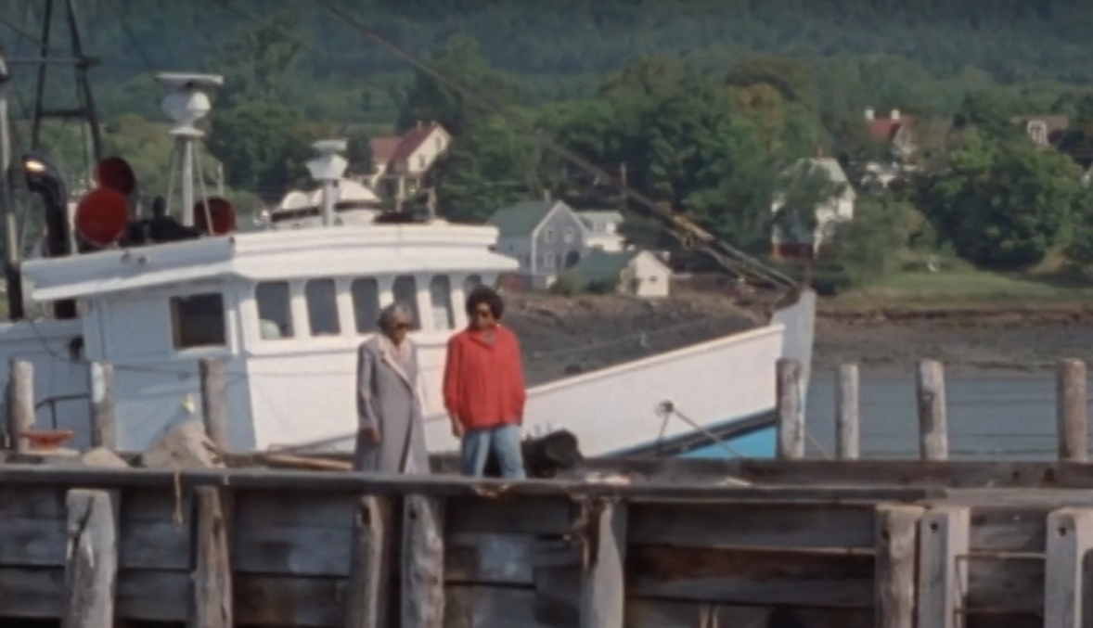
Sylvia D. Hamilton, still from Black Mother Black Daughter, 1989. This was Hamilton’s first documentary released by the National Film Board.

Slide 25
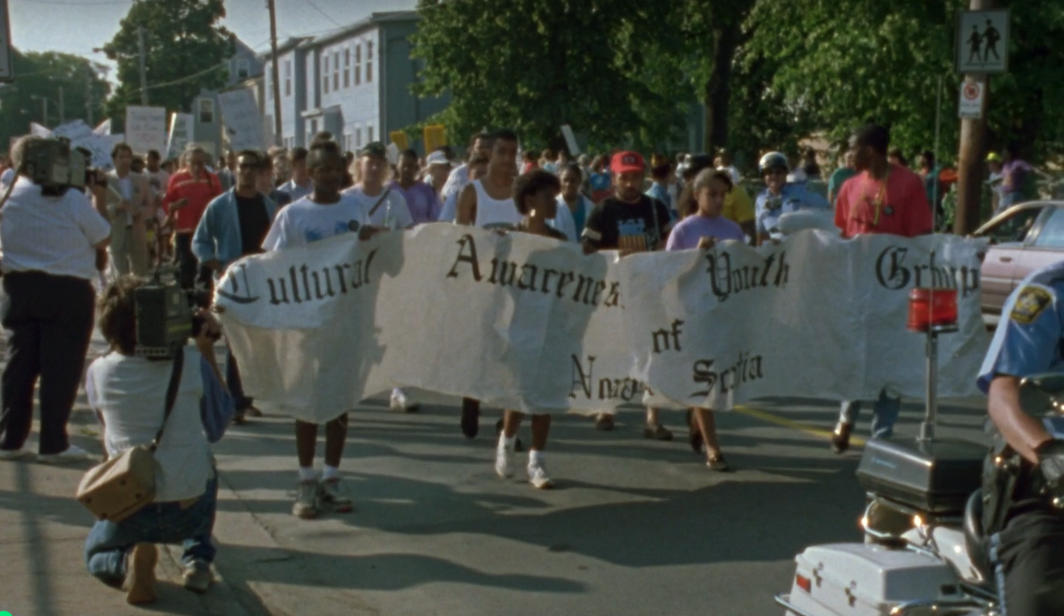
Sylvia D. Hamilton, still from Speak It! From the Heart of Black Nova Scotia, 1992. Students from the Cultural Awareness Youth Group lead a Peace and Justice Rally in Halifax, Nova Scotia.

Slide 26
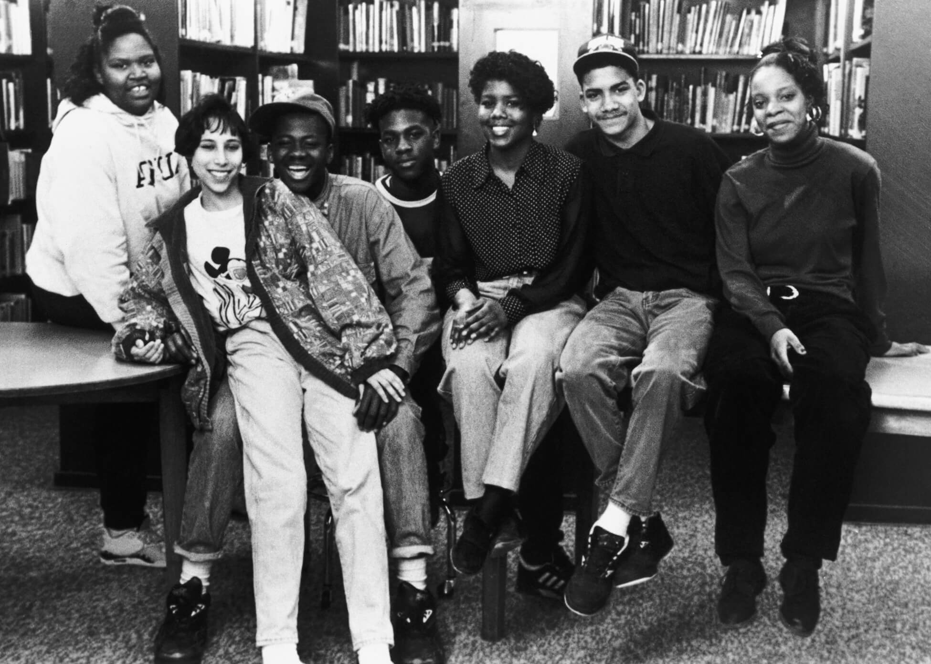
Sylvia D. Hamilton, still from Speak It! From the Heart of Black Nova Scotia, 1992. This film focuses on the experiences of a group of Black Halifax teenagers growing up in a predominantly White community.

Slide 27
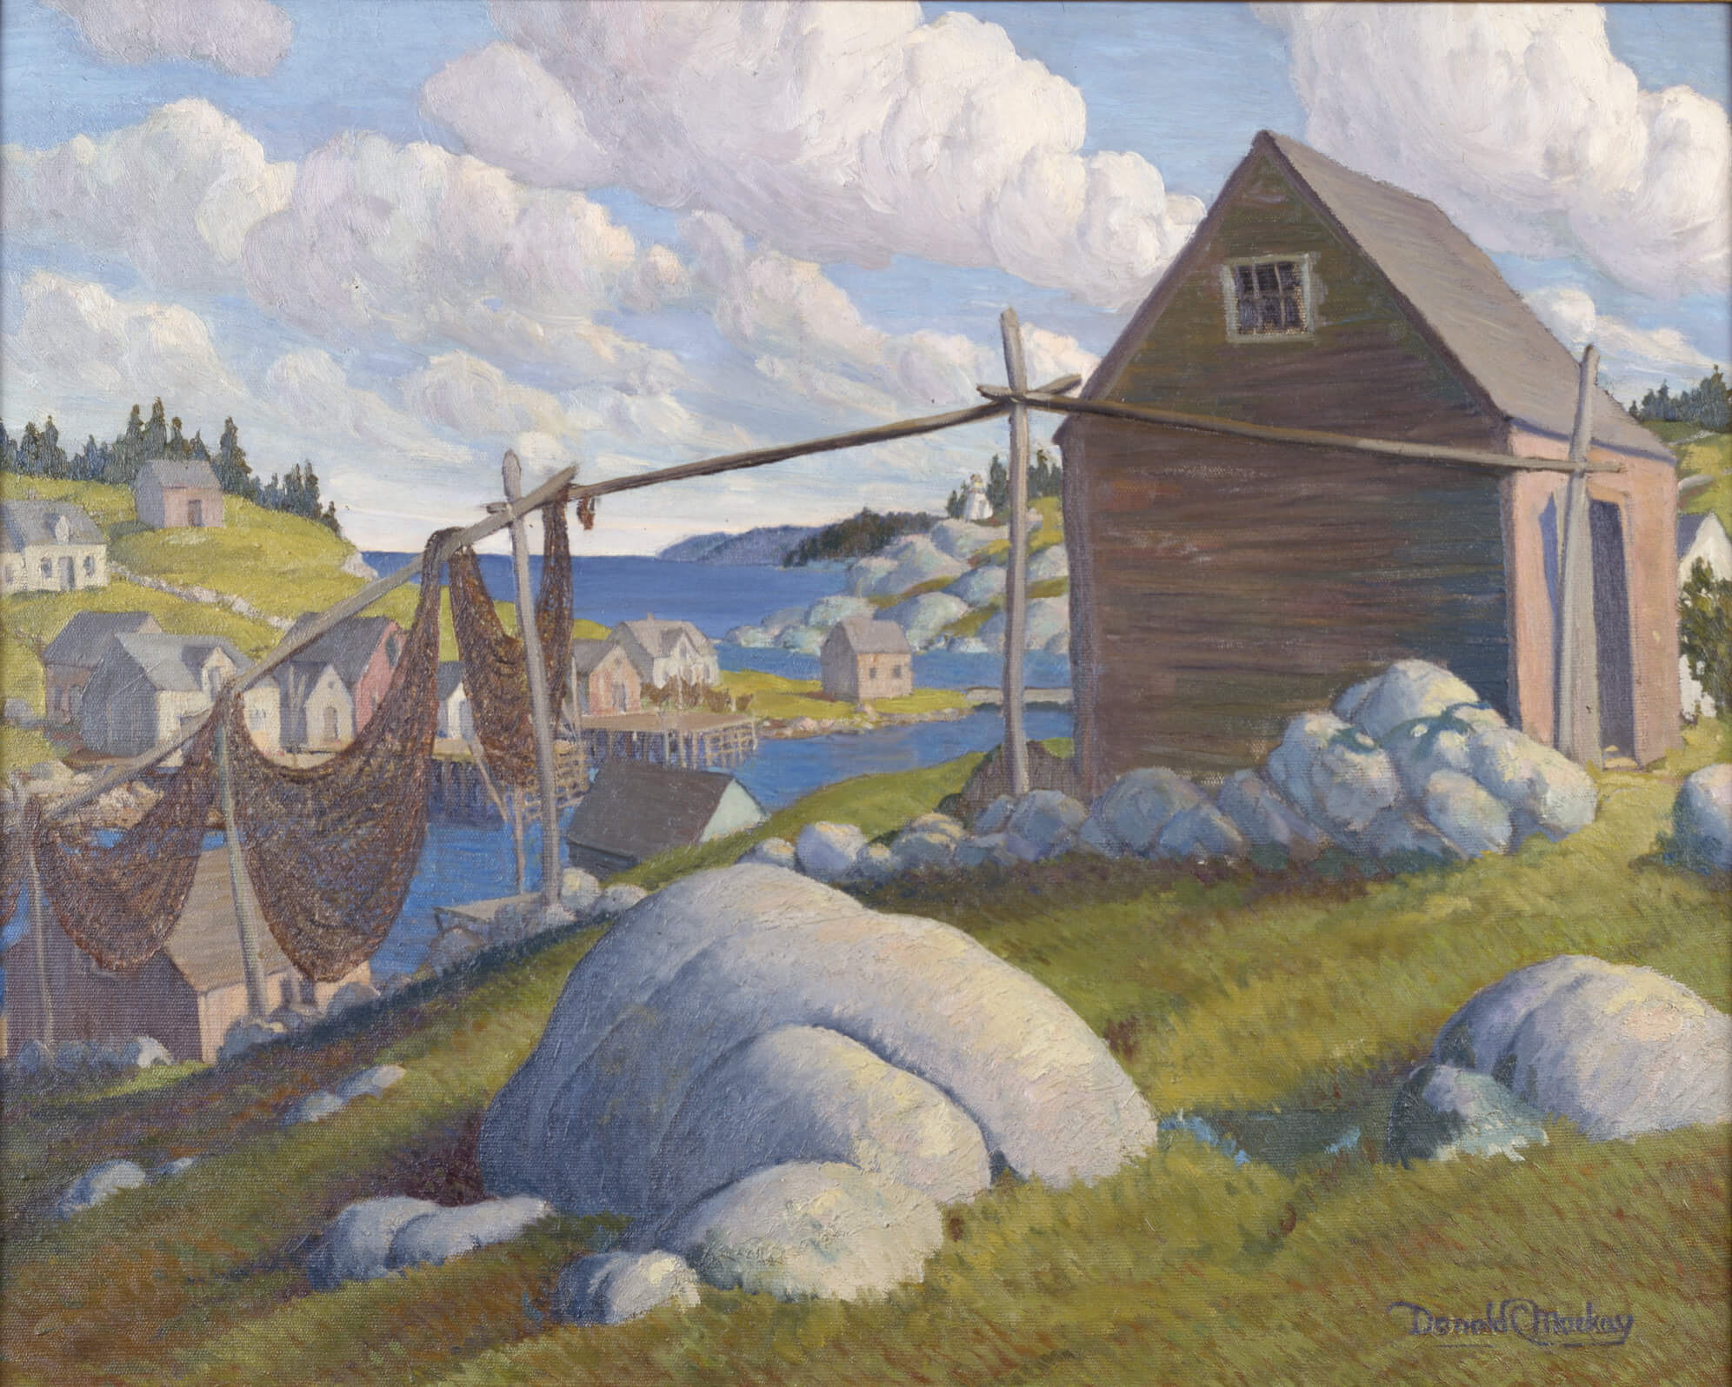
Donald Cameron Mackay, Landscape, Herring Cove, c.1950. This cheerful depiction of Herring Cove illustrates life in Nova Scotia during the mid-twentieth century.

Slide 28
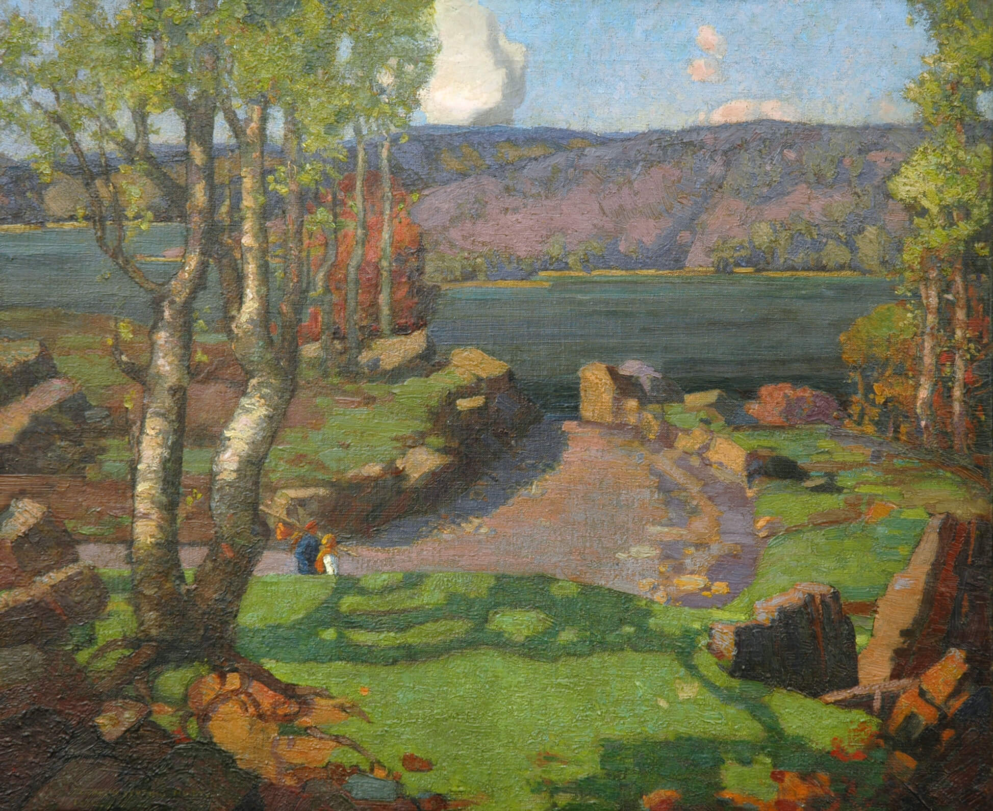
Elizabeth Styring Nutt, Autumn on the Northwest Arm, Halifax, Nova Scotia, 1930. Styring Nutt captures a serene moment on the Halifax coast.

Slide 29
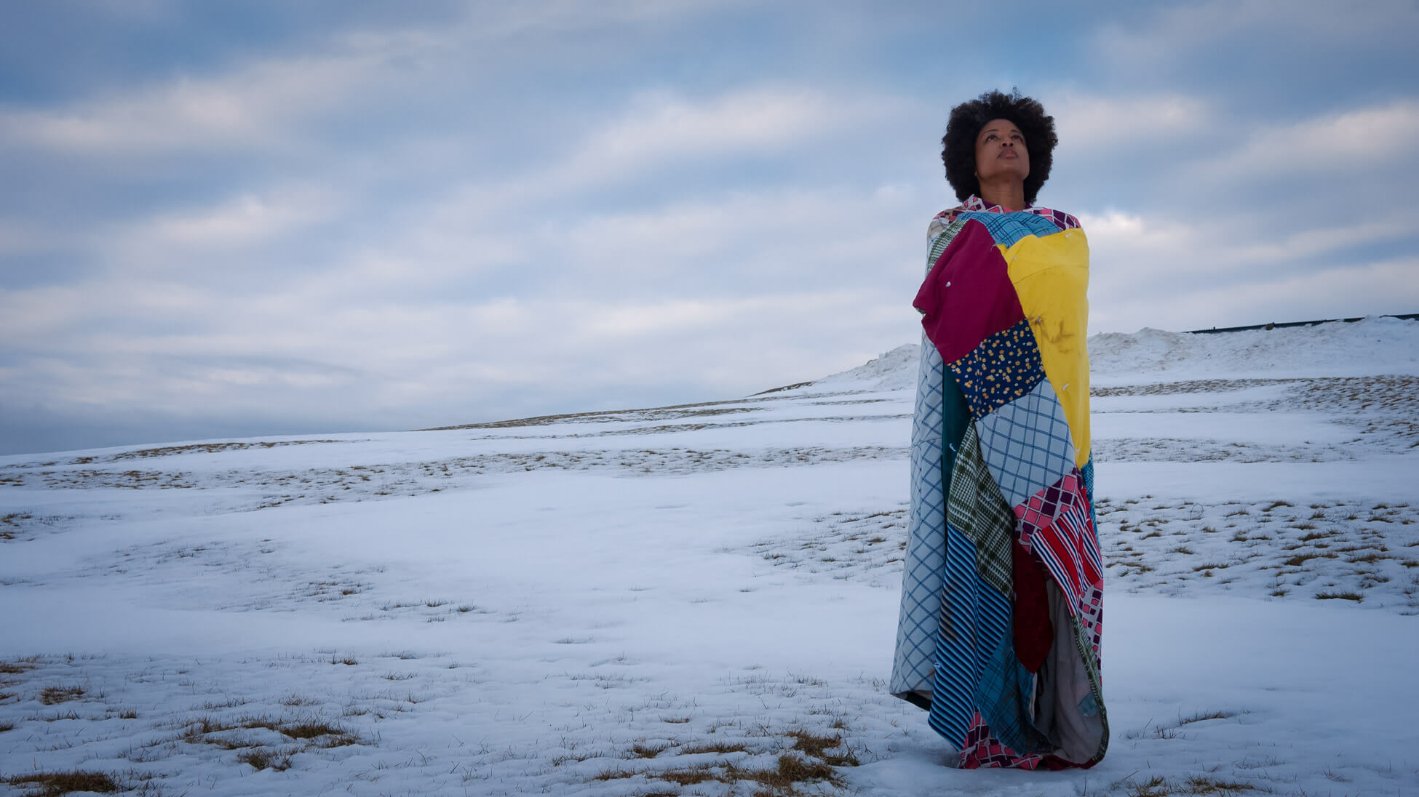
Shauntay Grant at Citadel Hill, Halifax, with Winter Quilt, c.1950, by her great-grandmother Annie Simmonds, 2013. Photograph by Shyronn Smardon.

