Slide 2
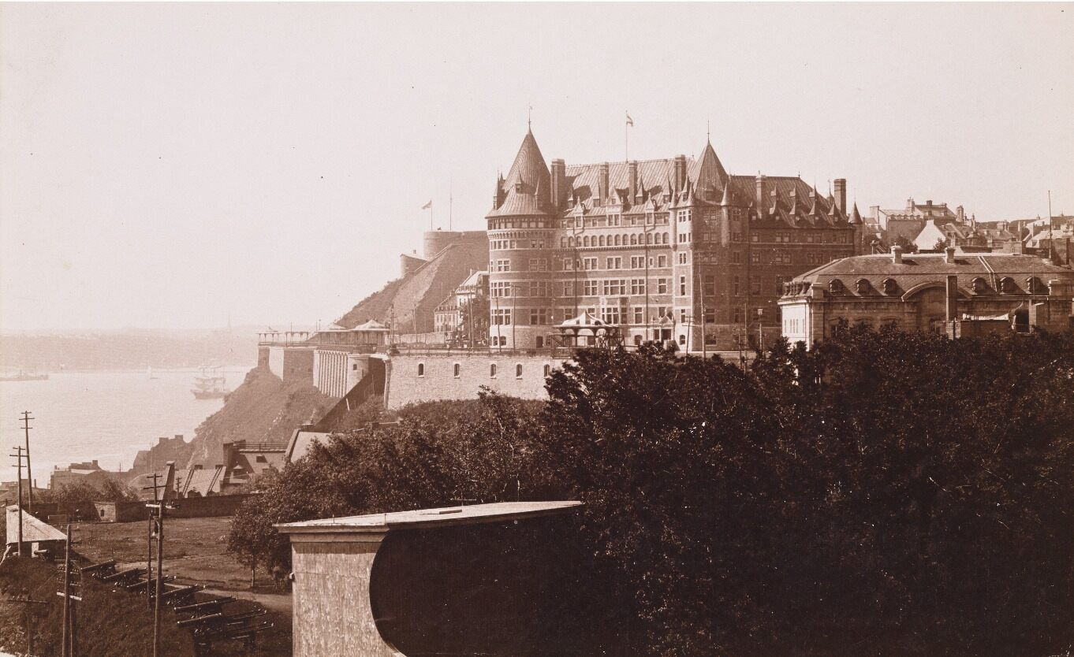
Jules-Ernest Livernois, Château Frontenac and Dufferin Terrace Viewed from Université Laval, Quebec City, c.1894.
Livernois captures the Château Frontenac, a landmark that has become embedded within Quebec City’s urban identity.

Slide 3
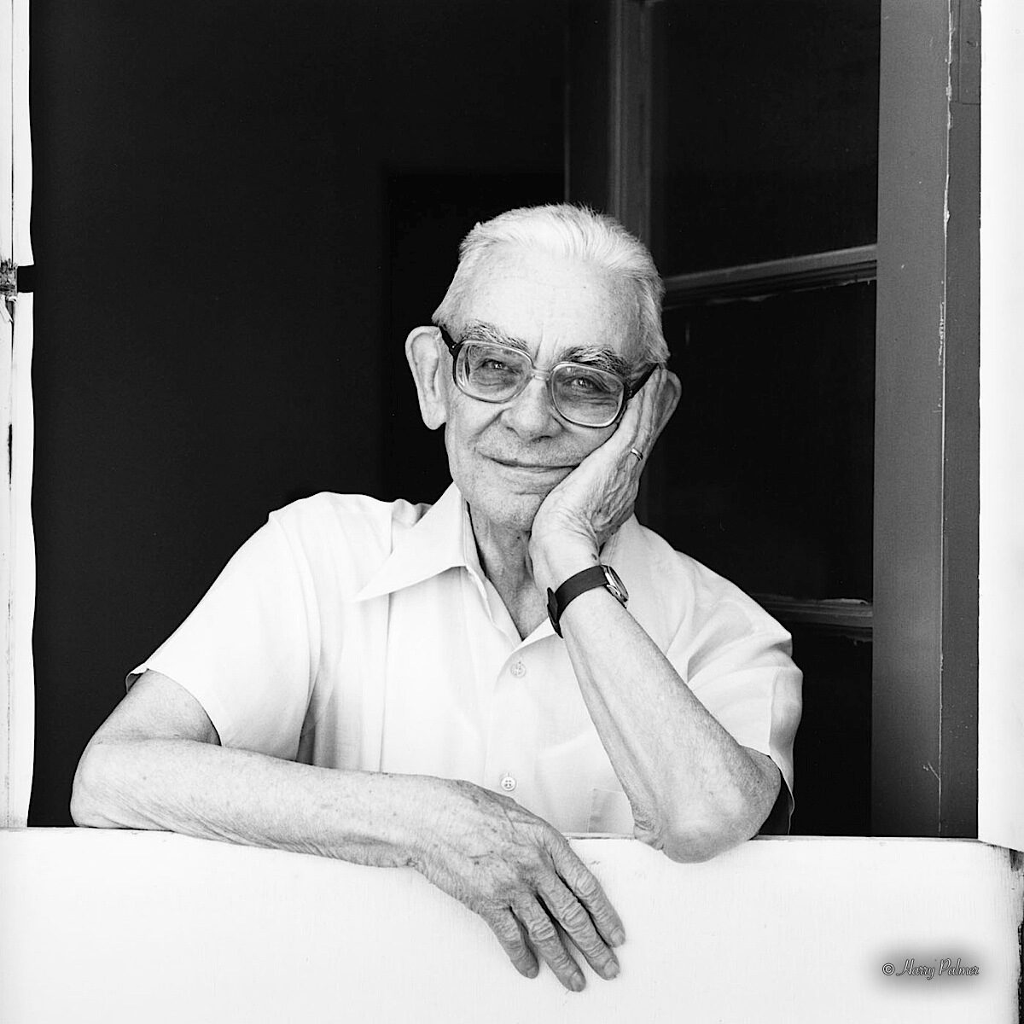
Jean Paul Lemieux, c.1987.

Slide 4
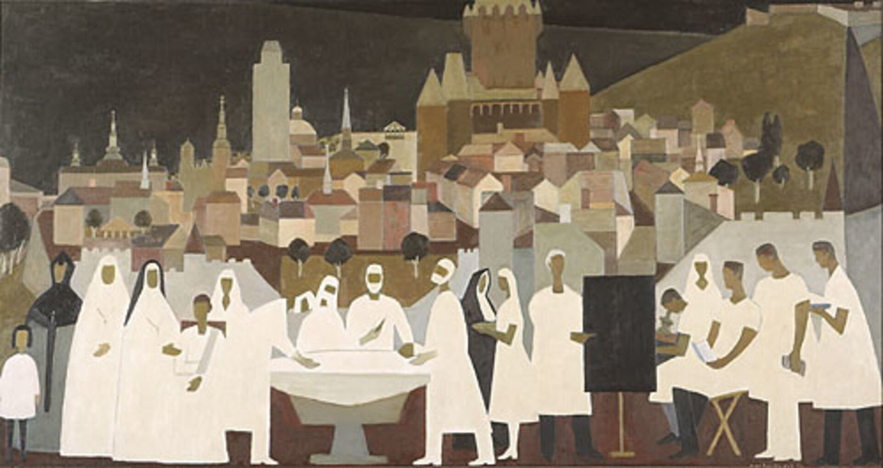
Jean Paul Lemieux, La médecine à Québec (Medicine in Quebec City), 1957.
This is an example of Lemieux’s interest in painting murals with simplified geometric figures and landscapes.

Slide 5
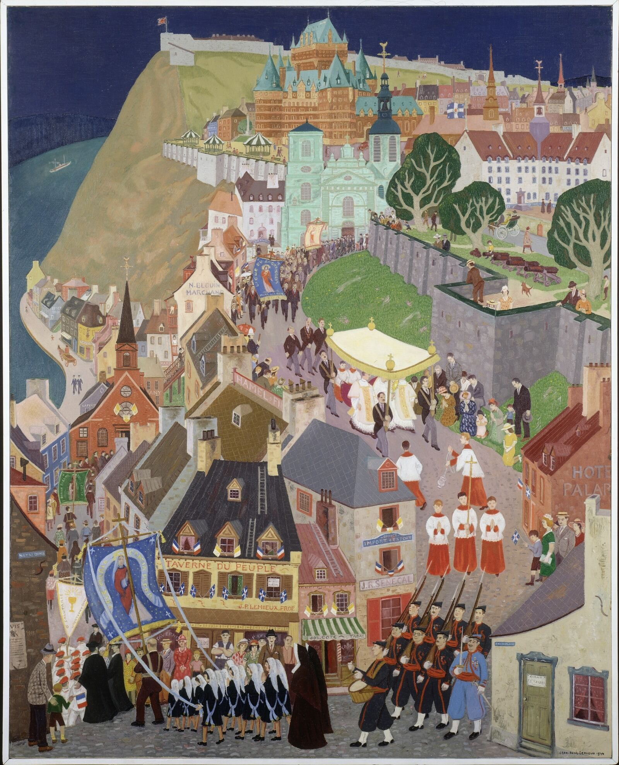
Jean Paul Lemieux, La Fête-Dieu à Québec (Corpus Christi, Quebec City), 1944.
Lemieux captures Quebec City’s architectural landscape during a religious festival.

Slide 6
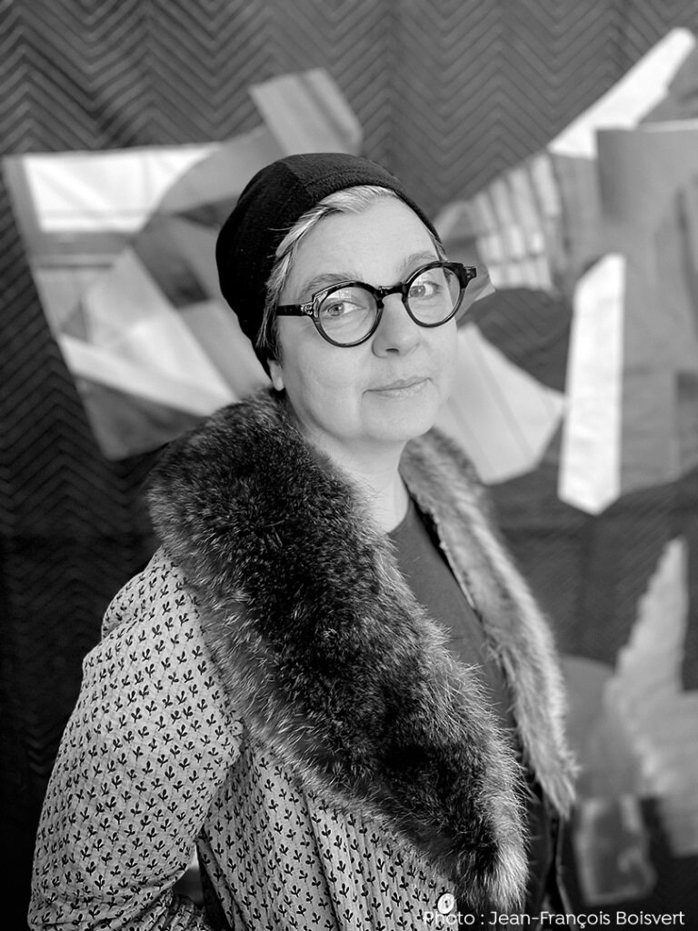
Giorgia Volpe, date unknown.

Slide 7
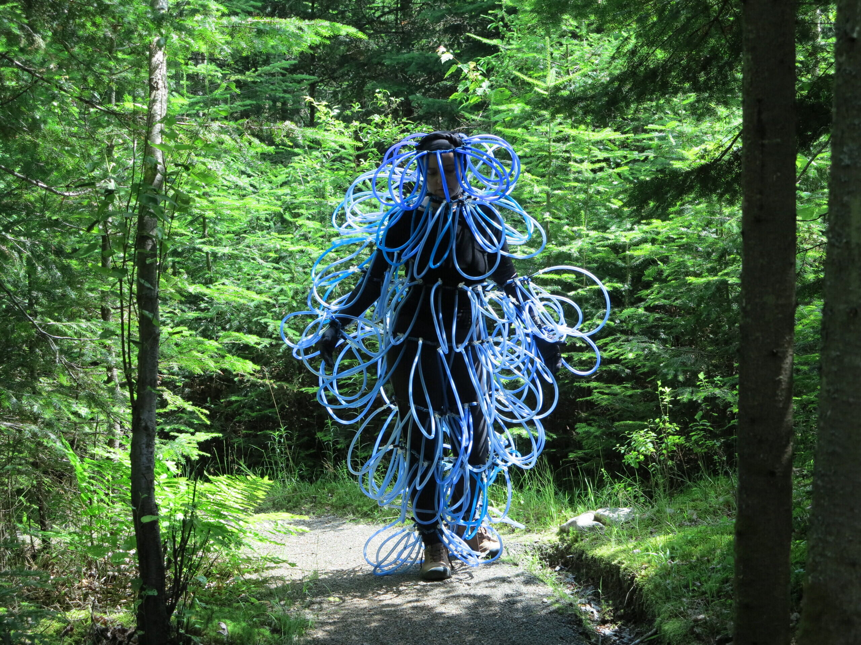
Giorgia Volpe, Se la couler douce (Taking It Easy), 2015–21.
This work exemplifies Volpe’s creative approach to topics such as humanity’s impact on the natural world.

Slide 8
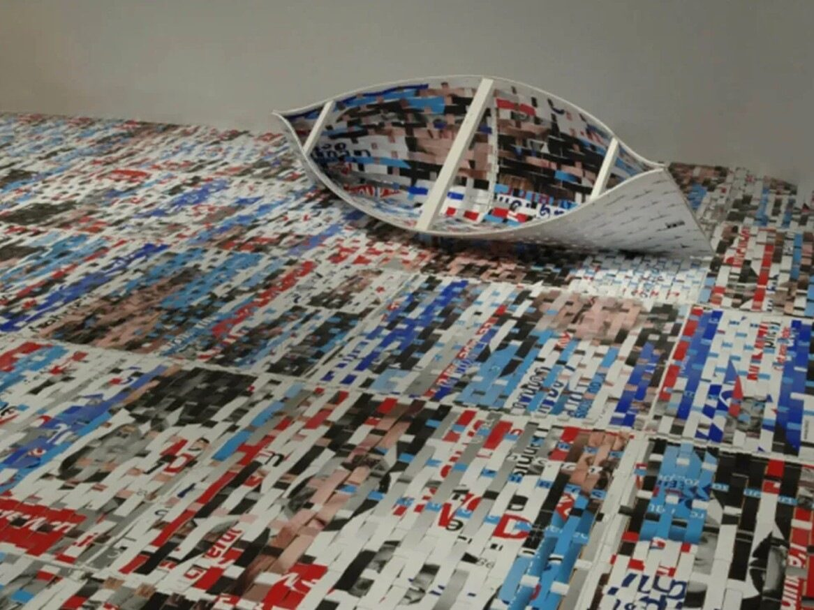
Giorgia Volpe, La dérive (Drift), 2008.
A common motif in Volpe’s work, this canoe was woven together using strips of discarded plastic.

Slide 9
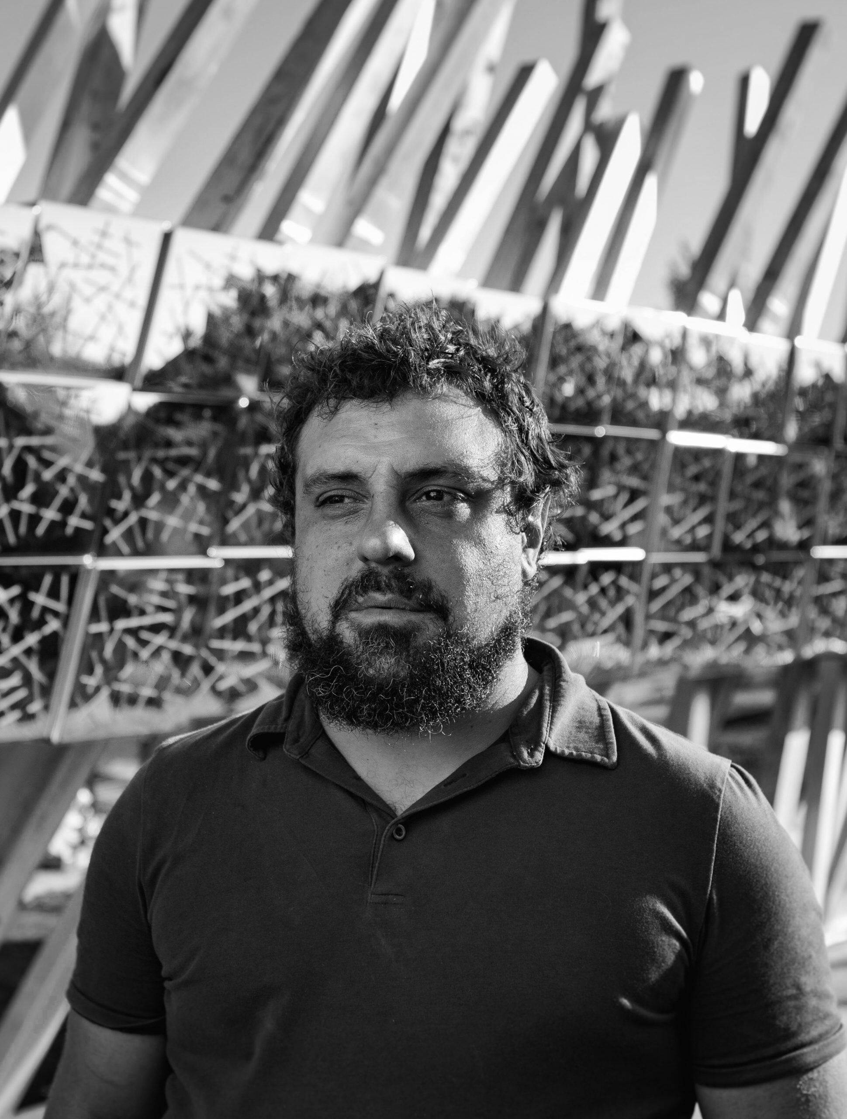
Ludovic Boney, date unknown.

Slide 10
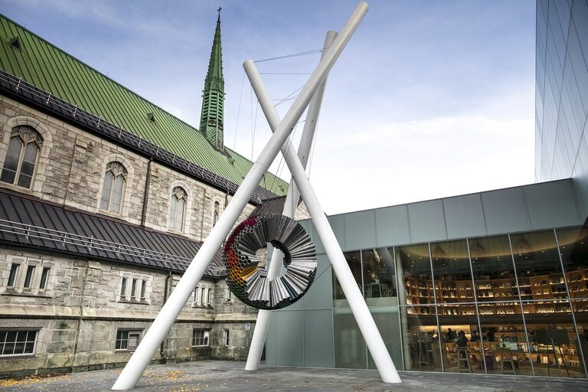
Ludovic Boney, Une cosmologie sans genèse (A Cosmology Without Genesis), 2015.
This public work was commissioned to encourage interactions between contemporary art and architecture.

Slide 11
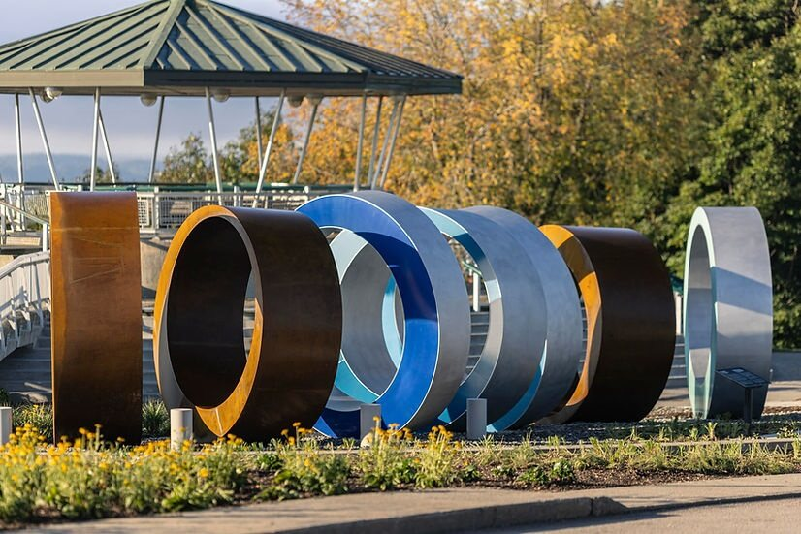
Ludovic Boney, Des perles en mémoire (Remembering Through Beads), 2024.
Boney often addresses themes of history, reconciliation, and public space in his large-scale installations.

Slide 12
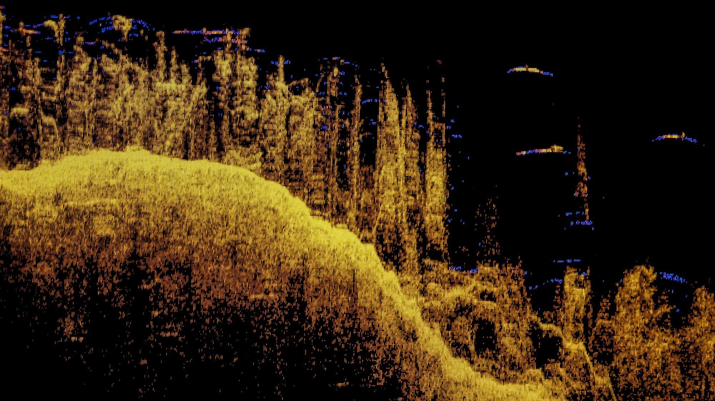
Ludovic Boney, Mémoires ennoyées 2 (Drowned Memories 2), 2021.
Boney captures underwater images of Innu First Nation territory, which was submerged by the creation of a dam.

Slide 13
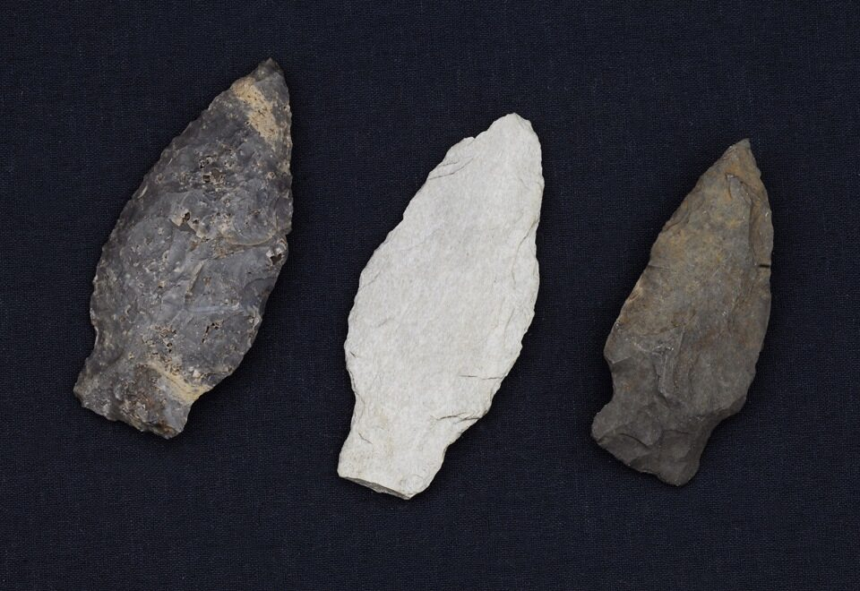
Once-known St. Lawrence Iroquoian creator, axe head, 1000–400 BCE.
This artifact is a design typical of the Iroquoian Peoples of the Centre-du-Québec region.

Slide 14
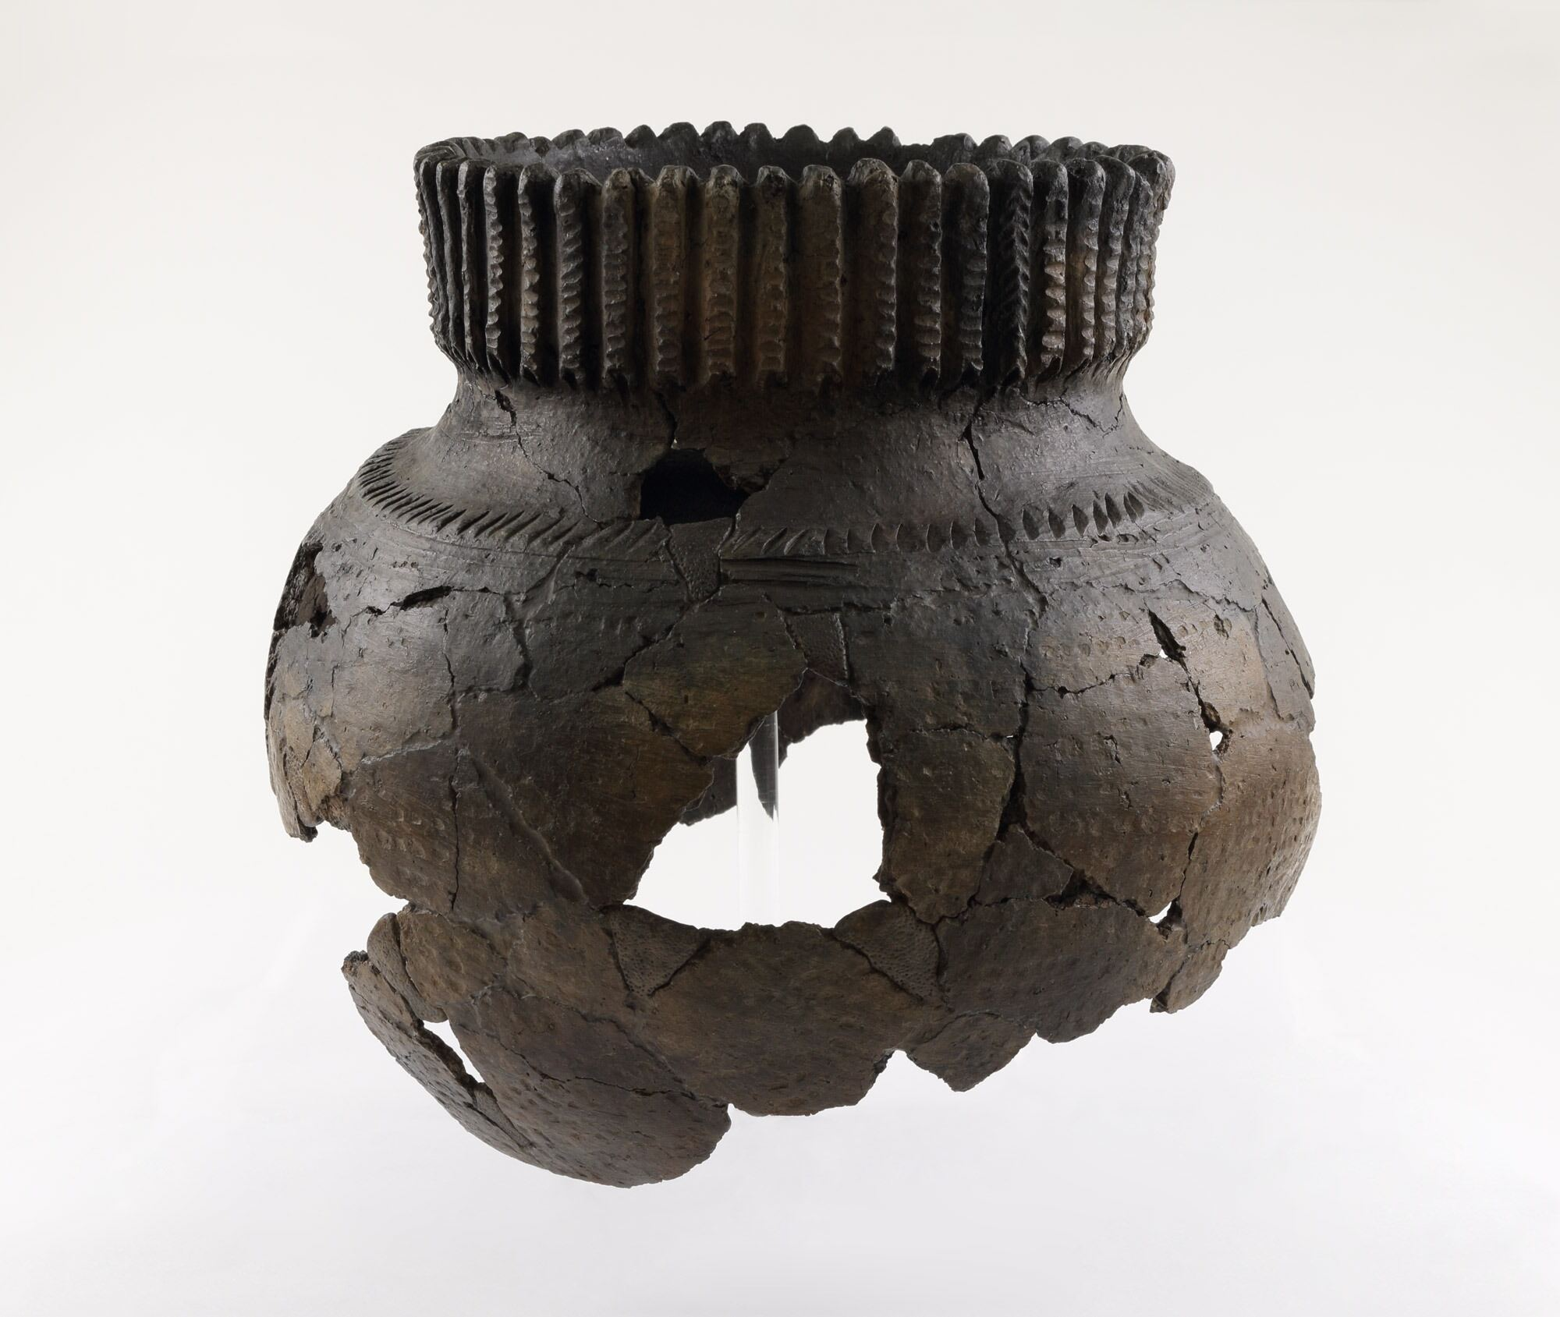
Once-known St. Lawrence Iroquoian creator, corn ear vessel, c.1350–c.1600.
This vessel features a corn ear motif around the opening—a hint at its use in food storage and preservation.

Slide 15
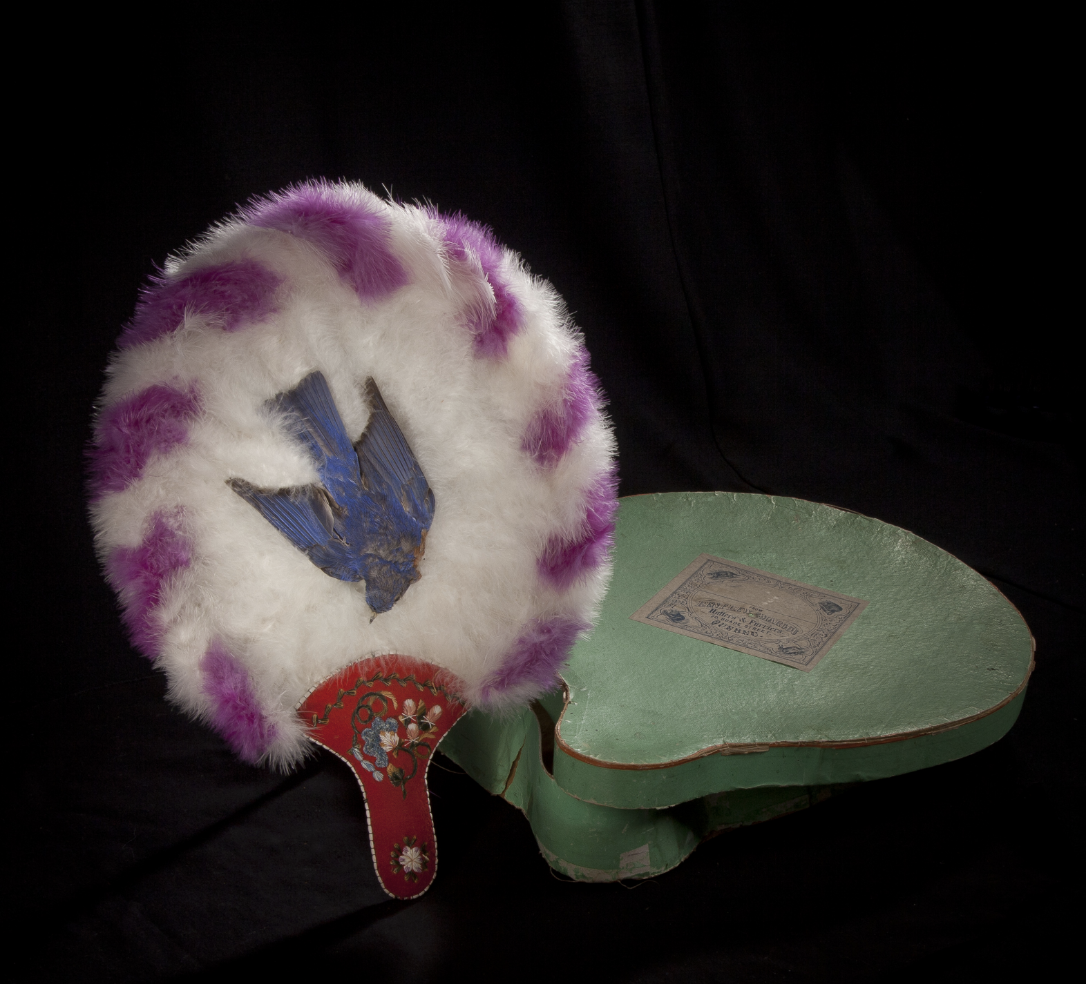
Once-known Huron-Wendat artist, fan, c.1860.
This unique fan is made using ostrich feathers and porcupine quills.

Slide 16
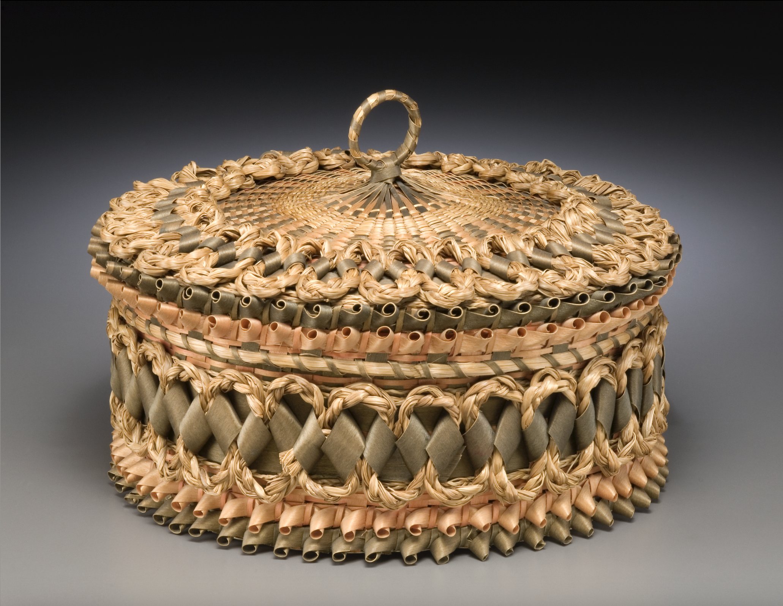
Mrs. Paul Thomas, basket, c.1911 or earlier.
The creativity of Huron-Wendat craftswomen is evident in works such as this intricately woven basket.

Slide 17
Once-known artist, wampum belt, 1678.
The Algonquin communities of this region wove wampum, or shell beads, into necklaces and clothing for ceremonial and diplomatic purposes.

Slide 18
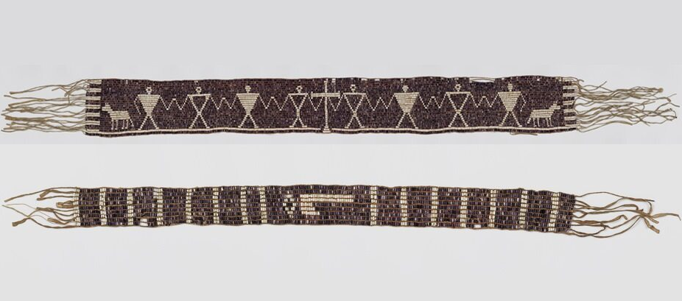
Once-known artist, The Two Dog Wampum, 1721–81.
Wampum, usually white and purple in colour, were woven into stylized scenes that told cultural, spiritual, or ceremonial stories.

Slide 19
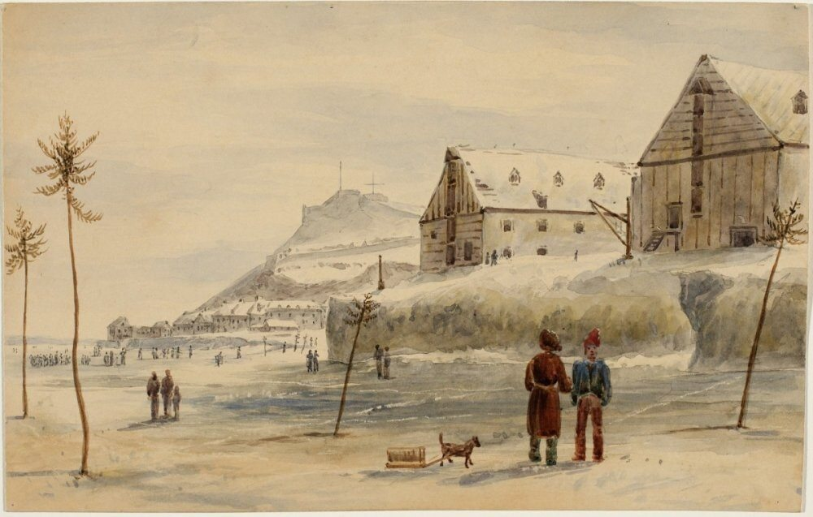
James Pattison Cockburn, The Citadel of Quebec from the Ice, 1831.
Cockburn was a prolific artist who created over one hundred depictions of Quebec City.

Slide 20
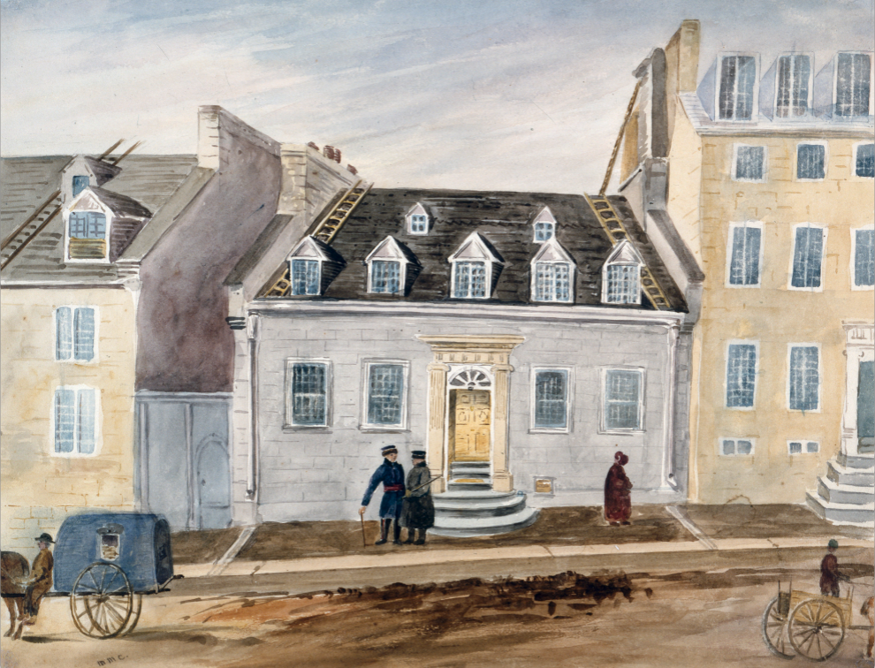
Millicent Mary Chaplin, Our House, Number 13 St. Ursula Street, Quebec, from July 1838 to September 1842, c.1838–40.
Chaplin spent four years in Quebec City creating approximately one hundred artworks depicting her surroundings.

Slide 21
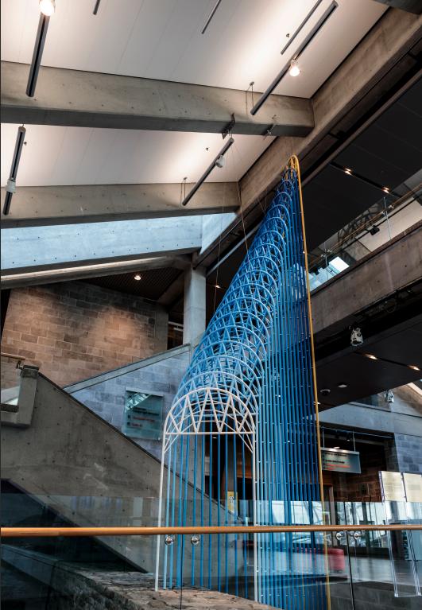
Ludovic Boney, Les Arches d’entente (The Arches of Understanding), 2020.
This public sculpture in the lobby of the Musée de la civilisation represents the city’s commitment to reconciliation.

Slide 22
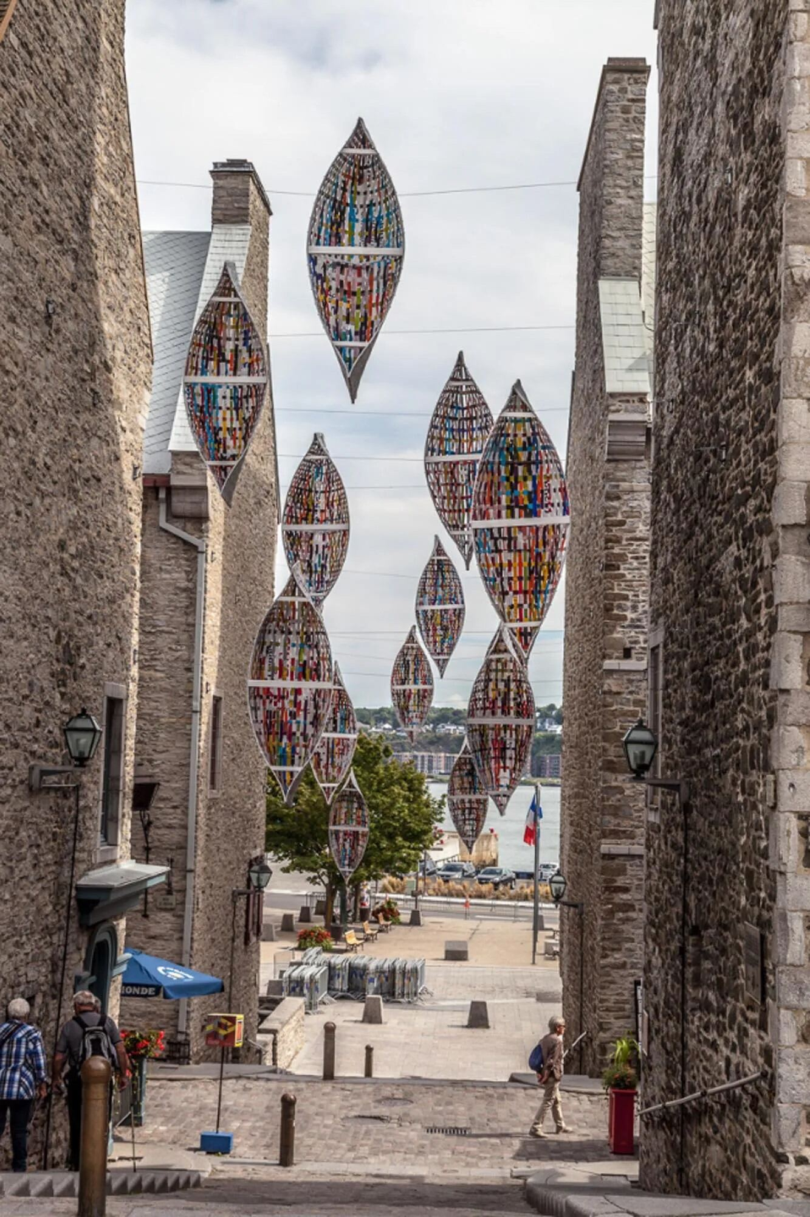
Giorgia Volpe, Passage migratoire I (Migratory Passage I), 2016.
This piece was installed in the city to encourage unexpected encounters between art and architecture.

Slide 23
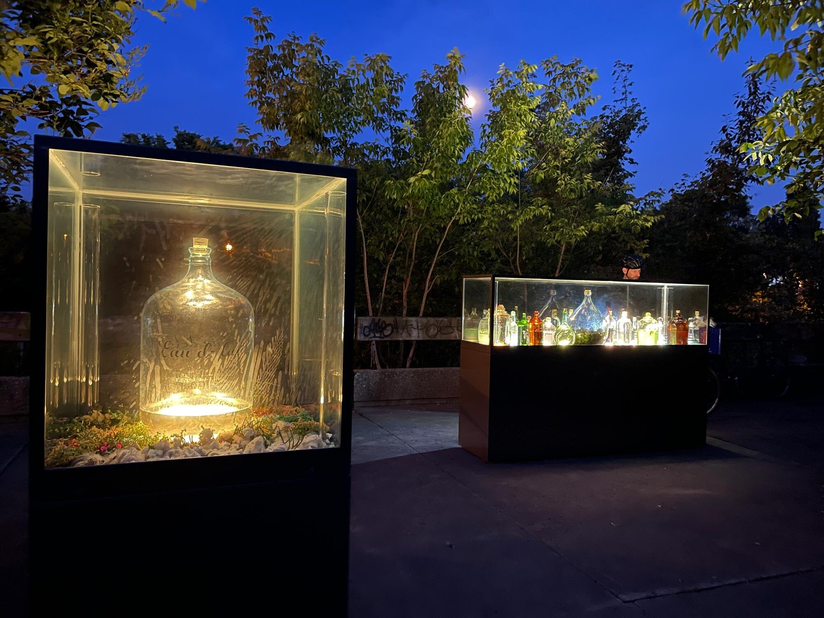
Giorgia Volpe, Le Musée de l’eau (The Water Museum), 2023–24.
The city commissioned this installation to raise awareness about the environmental impact of plastic bottles.

Slide 24
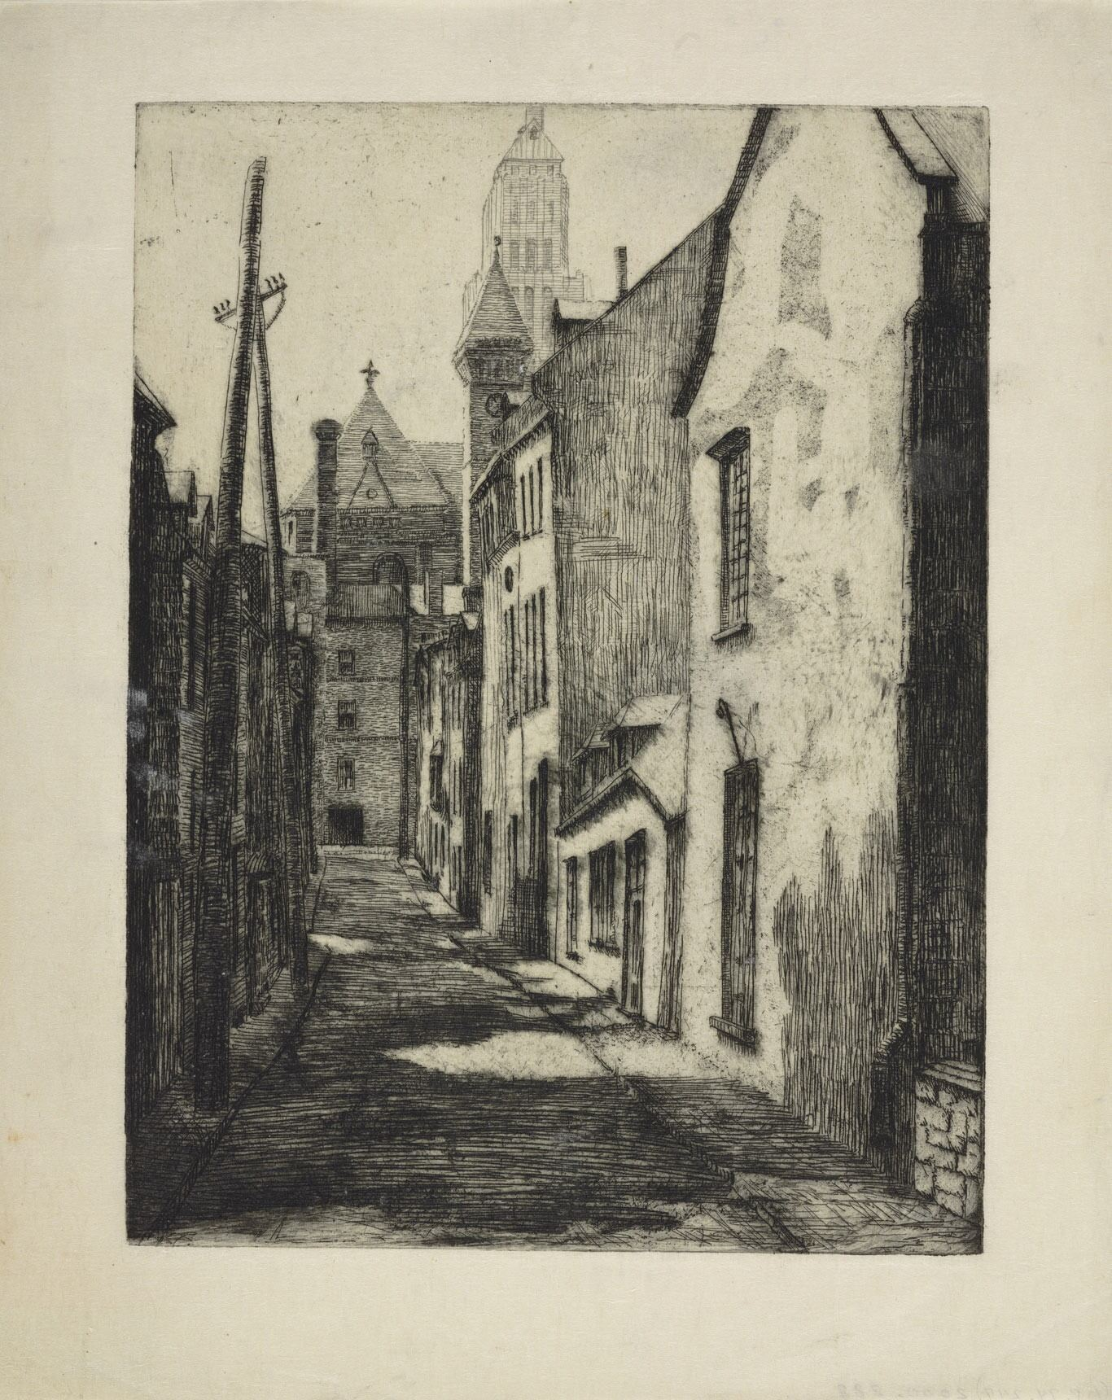
Simone Hudon, Rue Saint-Flavien à Québec (Saint-Flavien Street in Quebec City), c.1930–44.
Hudon was part of the revival of printmaking in Quebec City and continued her contributions to the discipline through her teaching.

Slide 25
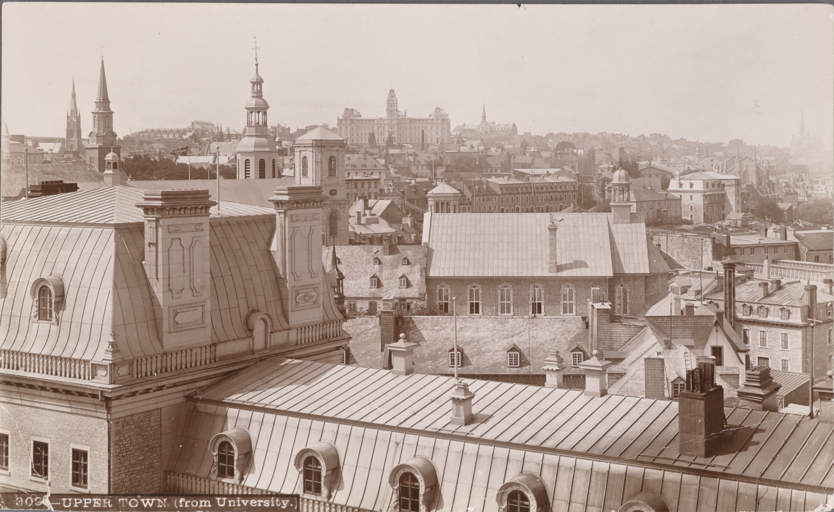
Jules-Ernest Livernois, La Haute-Ville et l’hôtel du Parlement vus de l’Université Laval, Québec (Upper Town and the Parliament Building Seen from Université Laval, Quebec City), c.1890.
Livernois dominated the field of photography in late nineteenth century Quebec City.

Slide 26
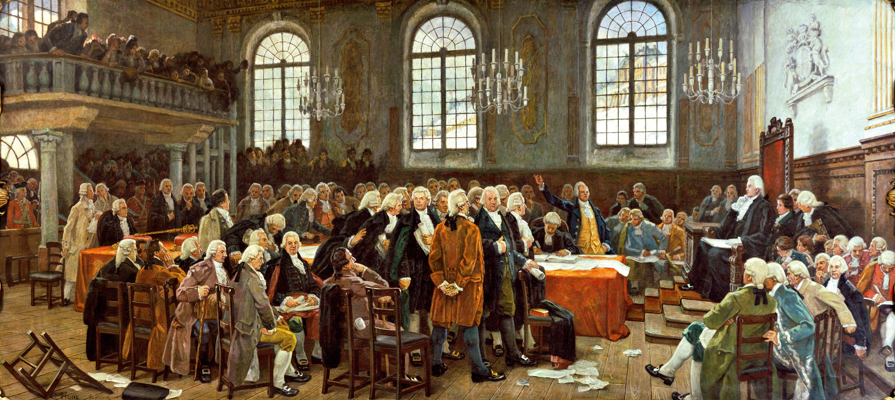
Charles Huot, Le débat sur les langues : séances de l’Assemblée législative du Bas-Canada le 21 janvier 1793 (The Language Debate: The Sitting of the Legislative Assembly of Lower Canada on 21 January 1793), 1910–13.
Huot studied French academic painting in Paris, bringing back the traditional style to his depictions of Canadian history.

Slide 27
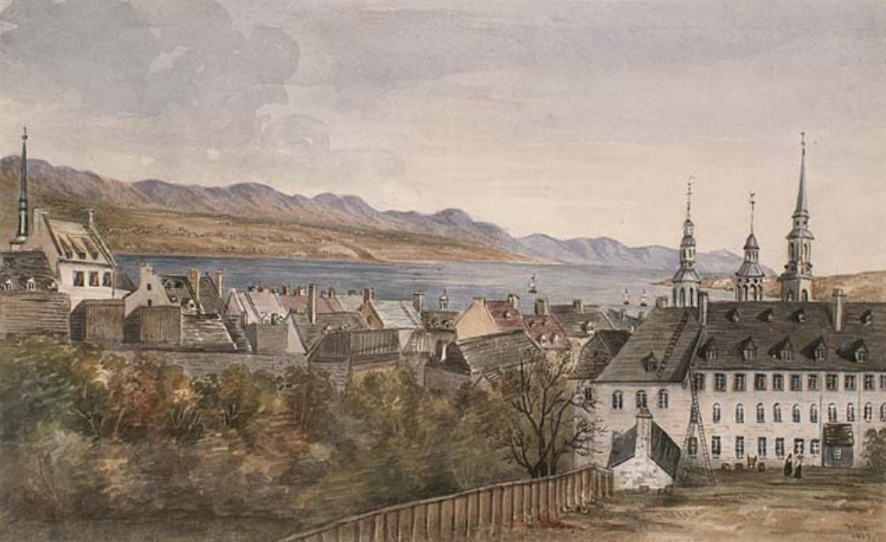
Millicent Mary Chaplin, View from Mrs. Chaplin’s Dressingroom Window, Quebec, 1839.
This delicately painted scene depicts Quebec City’s architecture and landscape, as seen from a window.

Slide 28
Jean Paul Lemieux, preparatory sketch for “Québec (projet de peinture murale)” (“Quebec [Mural Project]”), 1949.
Lemieux’s panoramic view of Quebec City was created as a submission for an arts competition.

Slide 29
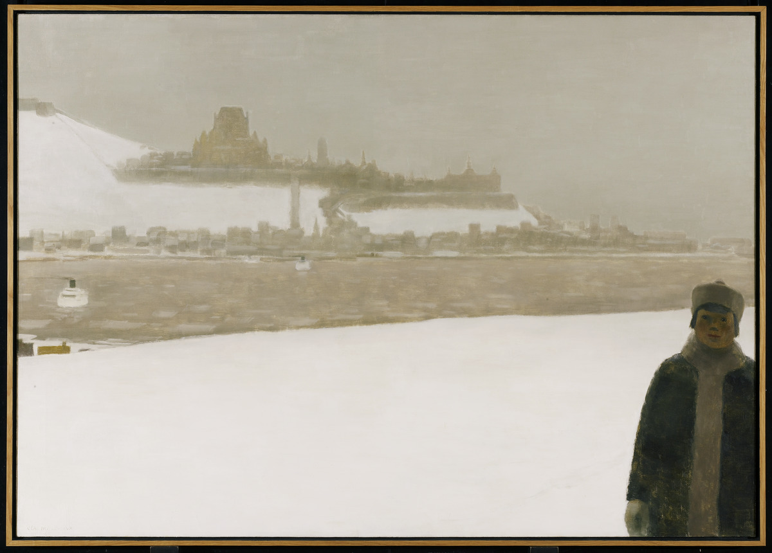
Jean Paul Lemieux, Janvier à Québec (January in Quebec City), 1965.
Quebec City's iconic landmarks loom in the background of this snowy painting.

Slide 30
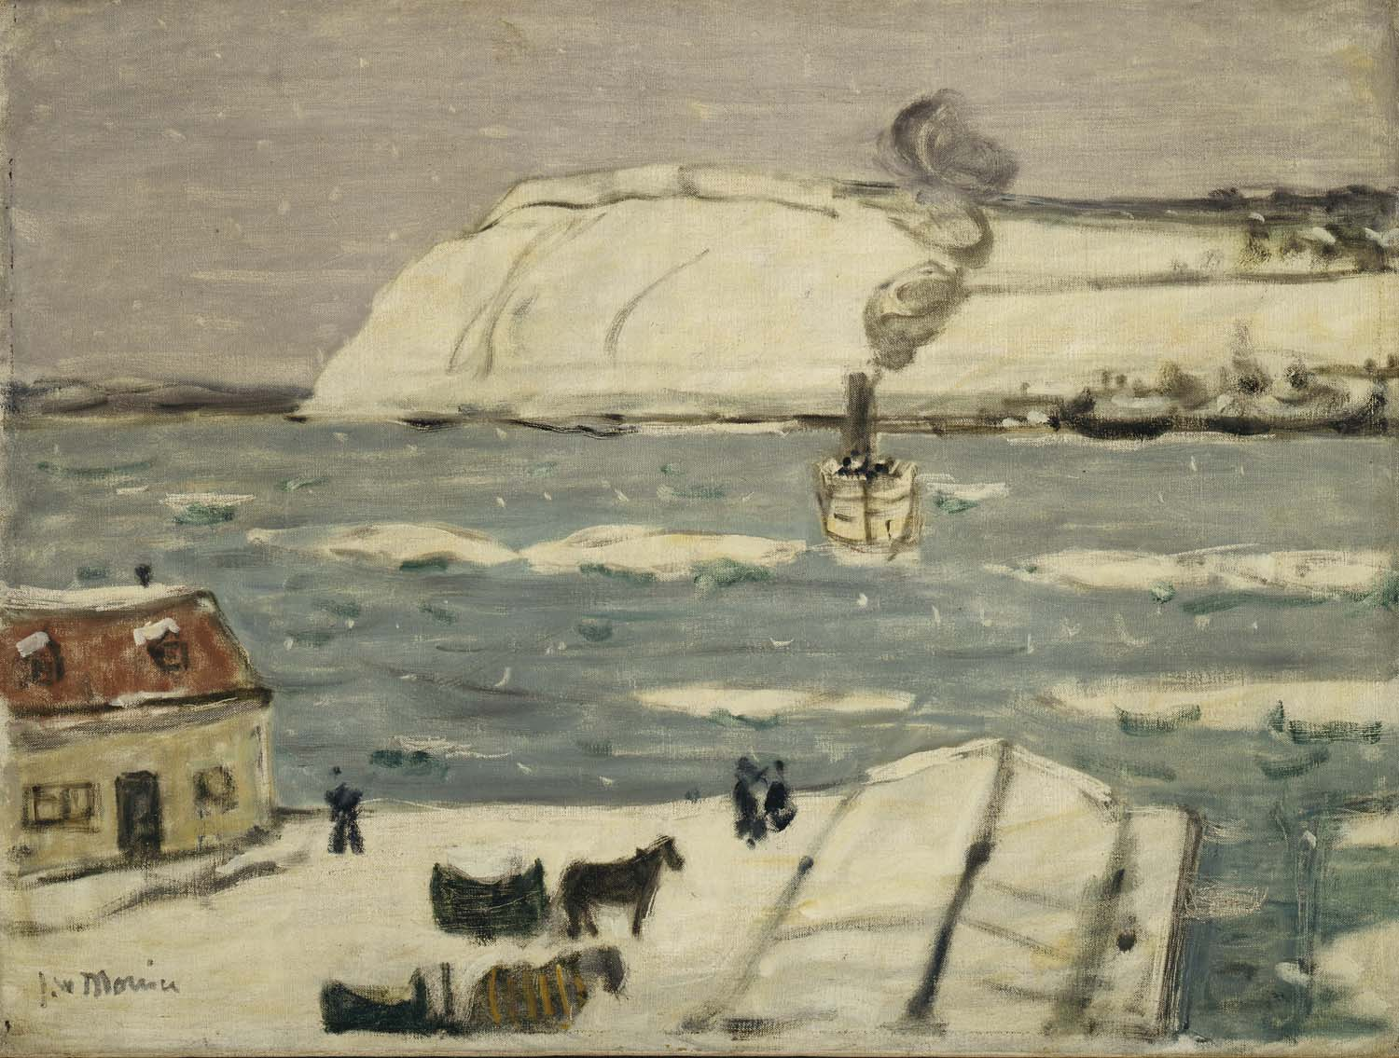
James Wilson Morrice, Le bac, Québec (The Ferry, Quebec), 1907.
In this example of Canadian Impressionism, Morrice uses simple shapes and muted colours to capture the winter landscape.

Slide 31
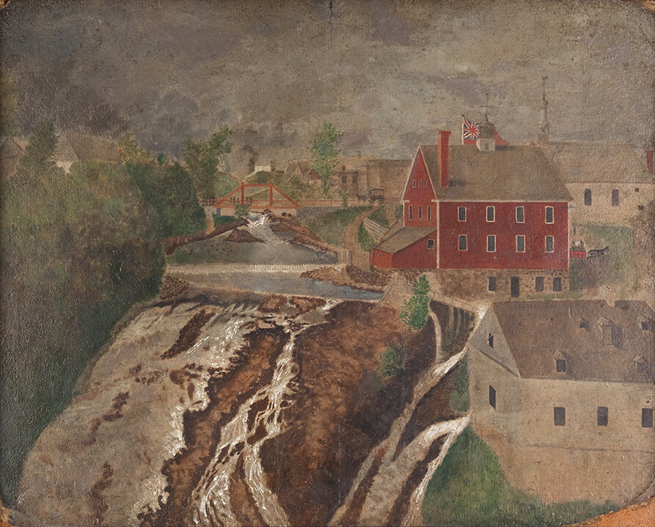
Zacharie Vincent Telari-o-lin, Les chutes de Lorette (Lorette Falls), c.1860.
The area surrounding Lorette Falls is captured here using multiple perspectives.

Slide 32
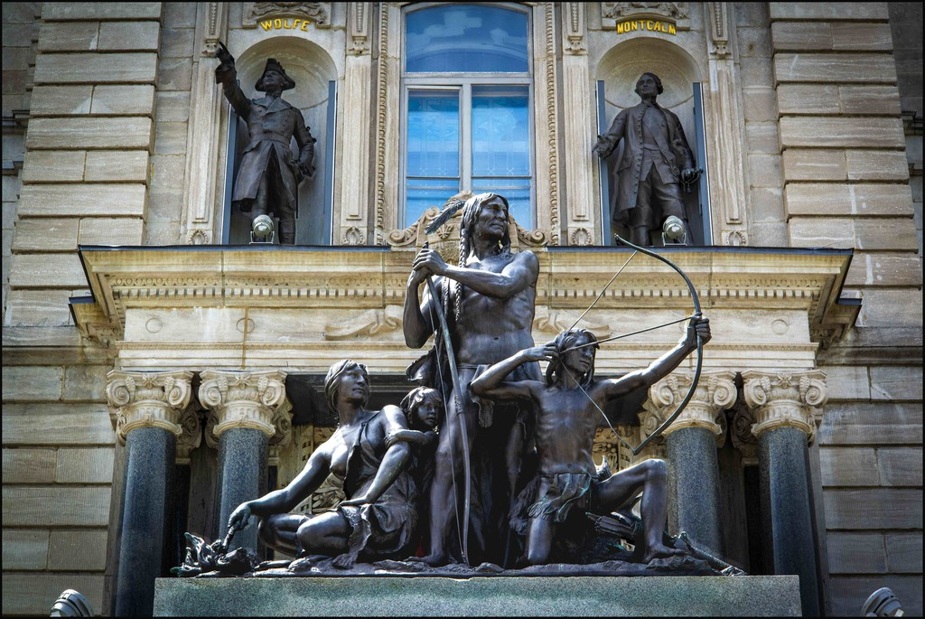
Louis-Philippe Hébert, Halte dans la forêt (A Halt in the Forest), 1889.
This monument depicts Indigenous hunting practices and can serve as an opportunity to discuss the impact of public sculpture.

Slide 33
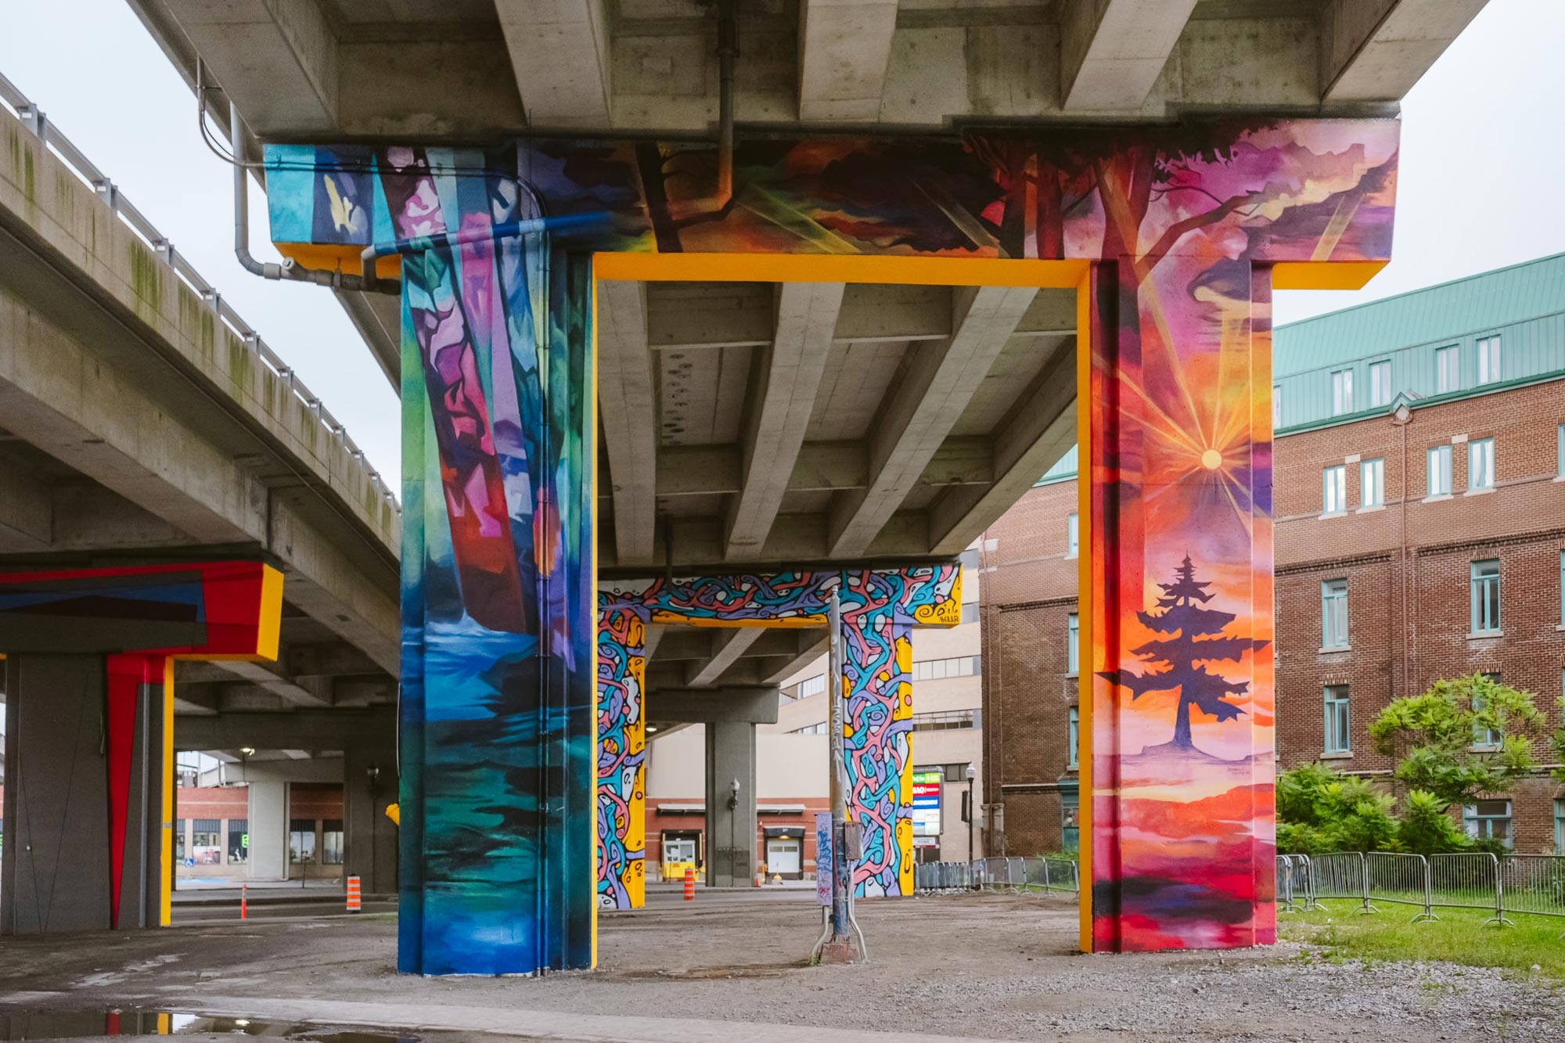
Murals on Dufferin-Montmorency viaduct pillars, presented as part of Passage mural (Mural Passage), Quebec City, 2023.
This mural is an example of the vibrant arts scene in Quebec City.

